Slide 1
Hantavirus
10/22/2026
Indian Health Service
LCDR Kerns

Slide 2
Biology
Hantavirus refers to a group of about 20 related RNA viruses in the Hantaviridae family
Infection usually occurs from contact with rodents, especially when exposed to their urine, droppings, or saliva
Three most common types to affect humans include
  Sin Nombre virus (North America)
  Andes virus (South America)
  Old World hantaviruses (Europe and Asia)

Slide 3

Clinical Signs
Hantaviruses can cause two syndromes
  Hantavirus pulmonary syndrome (HPS), found in the Western Hemisphere
  Hemorrhagic fever with renal syndrome (HFRS), found mostly in Europe and Asia
    Seoul virus is a type of virus worldwide that can cause HFRS

Slide 4
Clinical Signs
HPS
  Symptoms usually start to show 1-8 weeks after exposure
  Early symptoms include fever, fatigue, muscle aches
  About half of all patients experience headaches, dizziness, chills, and gastrointestinal problems
  Late symptoms, 4-10 days after the initial phase, include coughing and shortness of breath
  Can be fatal, ~38% of those who develop respiratory symptoms have died
HFRS
  Symptoms usually appear within 1-2 weeks after exposure
  Early symptoms include headaches, back and abdominal pain, fever/chills, nausea, blurred vision
  Later symptoms can include low blood pressure, acute shock, internal bleeding, or acute kidney failure
  Severity of disease depends on the virus
    Seoul virus found in North America is more moderate with less than 1% fatality
  Recovery can take several weeks to months

Slide 5
Diagnosis and Treatment
Early diagnosis can be difficult as symptoms are common with other febrile or respiratory illnesses such as influenza, COVID-19, viral pneumonia, etc.
Patient history of possible rodent exposure, work and environmental risks, travel history, or contact with known cases where hantaviruses are present is important
Laboratory diagnosis relies on serological testing for antibodies, along with molecular methods when viral RNA may be detectable in blood, and may need to be is repeated 72 hours after symptom onset
There is no specific treatment
  Patients should receive supportive care and symptom management to include rest, hydration, breathing support (HPS), or dialysis (HFRS) as needed

Slide 6
Prevention
Rodent control is the primary strategy for preventing Hantavirus
  Seal openings in buildings
  Store food securely
  Keep homes and workplaces clean
Avoid contact with rodent urine, droppings, saliva, and nesting materials
  When fresh urine, droppings, or nesting materials are disturbed, the virus can contaminate the air
  Spread can also occur when saliva, urine, or feces gets into cuts or in the eyes, nose, or mouth
If mice or rats are in or around the home, safe clean up is important
  PPE – gloves, respirator mask
  Avoid dry sweeping or vacuuming rodent droppings
  Dampen contaminated areas before cleaning
  Hand hygiene
You Can Prevent Hantavirus—How to Protect Yourself and Your Family from Hantavirus Pulmonary Syndrome in the United States

Slide 7
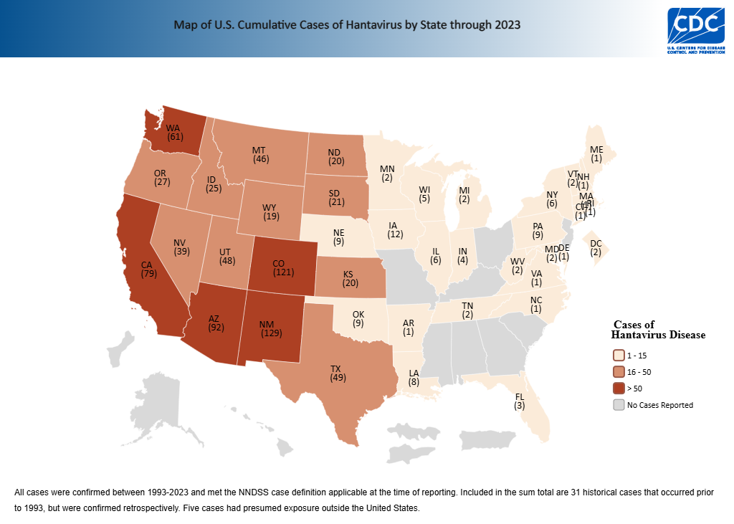

Slide 8
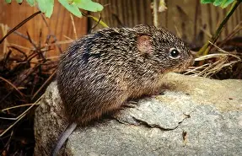
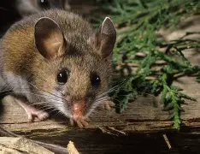
Epidemiology in the US
The primary carrier in the United States is the deer mouse
Other rodent hosts include the cotton rat, rice rat, and white footed mouse
Relatively rare
  Surveillance in the US began in 1993, and by 2023 there have been 890 total documented cases
The strain found in north America does NOT transmit from person to person
  Risks within households come from common exposure

Slide 9
Andes Virus
Type of hantavirus carried by rodents in South America
  These rodents have not been found in the US
Can cause HPS
The ONLY hantavirus type that is known to spread person-to-person
  Usually limited to people with close contact to an infected person
    Direct physical contact
    Exposure to bodily fluids
    Prolonged time in enclosed spaces
Recent outbreak on an Atlantic Ocean cruise ship
  No cases in the United States
  All involved have finished monitoring periods as of this time

Slide 10
El Nino Considerations
Correlation between El Nino and hantavirus infections
  Increased rainfall could provide rich food sources and conditions for rodent breeding
  Increased suitability of rodents in high altitude regions
  Increase in rodent-human interactions
1993 outbreak in the Four Corners region of the United States
  1992-1993 El Nino weather pattern
  20-fold increase in rodent population
    Increase in rodent-to-rodent and rodent-to-human contact and viral transmission
    Drought followed the increased rainfall likely increasing rodent stress
      Moving to new, potentially less stressful environments such as homes and nearby structures
  Similar pattern of increased rainfall followed by a drought was noted in an outbreak of HPS in Paraguay

Slide 11
Questions?

Slide 12
Resources
About Hantavirus | Hantavirus | CDC
Reported Cases of Hantavirus Disease | Hantavirus | CDC
Hantavirus Prevention | Hantavirus | CDC
Hantavirus (WHO)
Hantavirus: Types, Causes, Symptoms, Treatment & Prevention (Cleveland Clinic)
Hantavirus | Description, Infection, Hemorrhagic Fever, & Hantavirus Pulmonary Syndrome | Britannica
About Andes Virus | Hantavirus | CDC
Climatic and Environmental Patterns Associated with Hantavirus Pulmonary Syndrome, Four Corners Region, United States - Volume 5, Number 1—February 1999 - Emerging Infectious Diseases journal – CDC
phsa-elnino-regional-20262027-24june2026.pdf
Images
Deer Mice Habitat
Cotton rat | Characteristics & Facts | Britannica

