Slide 1
Hantavirus
October 22, 2026
Indian Health Service
Braiden Eilers, MD, MPH

Slide 2
History of Hantavirus
Traced back to Chinese writings dating approximately 960 CE
Outbreak of over 3000 cases of hemorrhagic fever with renal syndrome (HFRS) in United Nations troops from 1951-1953 during the Korean conflict
  The virus causing this was identified in 1978
First recognized case of hantavirus cardiopulmonary syndrome (HCPS) in North America 1993 in the Four Corners Region
Notes:
Uptodate

Slide 3
Four Corners Outbreak
May 1993, 19-year-old man from Crownpoint, NM was driving to Gallup, NM and became severely short of breath
Was a marathon runner and in good health
Few days before had fever and myalgias, seen and sent home
Presented to Gallup Indian Medical Center with florid pulmonary edema and died in the emergency department
Reported to NM Office of Medical Investigator and they noted similarity to another death of a young woman who had died from pulmonary edema at GIMC a few weeks earlier
Went to speak to the family to discuss possible autopsy and found out that their 21-year-old fiancée had recently died only a few days earlier
CDC was requested to come help and found more than 30 cases since the start of 1993 – initially thought it could be a new viral influenza, environmental toxin, or a previously unrecognized pathogen
They cross tested samples from 9 patients with viral stock samples and found antibody cross-reactivity with 3 different hantaviruses
Trapped over 1,700 rodents, most commonly the deer mouse and were able to identify “new” Sin Nombre Virus (SNV) in just 3 weeks
Why did it happen then? The deer mouse population was 10x greater than the year before due to El Nino winter, so there was an abundance of springtime vegetation providing shelter and food
Notes:
Uptodate

Slide 4
Epidemiology
  25,000 yearly cases associated with HFRS (Asia and Europe)
  Fewer than 1,000 cases of HCPS in the United States since 1993 (about 30 cases per year)
    94% of cases occur west of the Mississippi River
    19% of cases are American Indian/Alaska Native
  Case fatality rate around 35-50% with SNV
  Transmission – contact with urine, feces, or saliva of a rodent carrying the virus
    Breathe in air when cleaning up after rodents
    Touch contaminated objects, then touch their nose or mouth
    Bitten or scratched by an infected rodent
    Eat food contaminated with hantavirus

Slide 5
Phases of Illness
Cardiopulmonary phase
  Dry cough and onset of dyspnea often herald the abrupt transition from prodromal phase (order of hours)
  Capillary leak into the pulmonary bed, often reduced cardiac output
  Possible coagulation disorders and kidney involvement
  ~60-80% of hantavirus infections evolve to HCPS
  Lasts 48-72 hours
  Most deaths occur in first 24 hours
  This is when testing can occur
Convalescent phase
  Complete recovery can be slow
  Survivors report months of fatigue, dyspnea with slow recovery of motor skills
Incubation period
  No symptoms
  Typically, 2 to 3 weeks
Prodrome/febrile phase
  Fevers, chills, myalgias
  Sometimes nausea, vomiting, abdominal pain, diarrhea
  Headaches may be prominent
  Difficult to distinguish from other illnesses, however other features of upper respiratory tract infections are usually absent
  Chest x-rays usually normal
  Lasts 2 to 8 days

Slide 6
Testing
Serology (looking for antibodies) and/or PCR testing (looking for viral RNA)
Labs are send out
Antibodies not detectable during first 72 hours of symptoms
Need something else…

Slide 7
Rapid Screening Tool
Developed by University of New Mexico in 2001
Need CBC and peripheral blood smear
Hemoconcentration
  Hematocrit >50% for males and >48% for females
Thrombocytopenia
  Platelet count <150k
Left shift of myelocyte lineage
  Appearance of premature white blood cells including metamyelocytes, promyelocytes, and band neutrophils
Lack of toxic granulation
  Absence of moderate or severe toxic polymorphonuclear leukocytes
Presence of immunoblasts
  >10% of total lymphocyte count
4/5 criteria has 96% sensitivity and 99% specificity for HCPS
Only applicable to the cardiopulmonary phase

Slide 8
Real-Life Patient Pearls
Thank you to Dr. Carissa Solari of Gallup Indian Medical Center
Headache can be so severe patients end up getting a lumbar puncture
Can get pulmonary edema in the prodrome phase from IV fluids
  Improves with diuresis in this phase, but not once in true cardiopulmonary phase
In prodrome phase labs can look normal, but must look at trends
Abdominal pain with frequent vomiting with negative CT scans
Alcohol use can mask changes to platelet and hematocrit levels

Slide 9
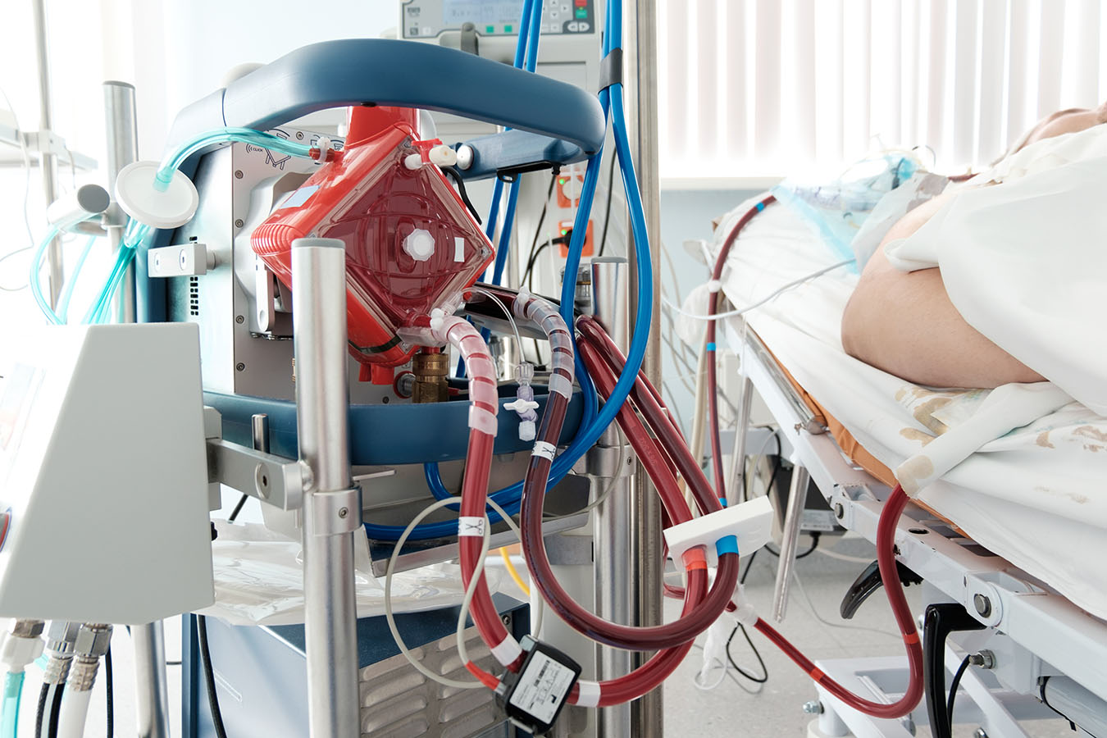
Treatment
Likelihood of survival greatly increases with early recognition, hospitalization, and adequate pulmonary and hemodynamic support
Must have hantavirus on the differential diagnosis
Fluid restriction in all suspected cases
Early use of vasopressors and inotropes
ICU monitoring and initiation of high-flow oxygen and/or mechanical ventilation (60% of patients will need)
Many need hemofiltration to avoid fluid overload
Early and immediate referral to higher level of care with extracorporeal membrane oxygenation (ECMO)

Slide 10
Thank you!

Slide 11
Resources
Hantaviruses - PMC
Hantavirus Pulmonary Syndrome—The 25th Anniversary of the Four Corners Outbreak - Volume 24, Number 11—November 2018 - Emerging Infectious Diseases journal – CDC
Hantavirus infections: Epidemiology, transmission, and prevention - UpToDate
Hantavirus Pulmonary Syndrome (HPS) 2015 Case Definition | CDC
Rapid Presumptive Diagnosis of Hantavirus Cardiopulmonary Syndrome by Peripheral Blood Smear Review | American Journal of Clinical Pathology | Oxford Academic
Hantavirus infections: Clinical features, diagnosis, and management of hantavirus cardiopulmonary syndrome – UpToDate
Reported Cases of Hantavirus Disease | Hantavirus | CDC

