Slide 1
Medications and Emerging Pharmacology in the Treatment of Dementia
Eric Metterhausen, PharmD, BCACP, BCPS, CPP, CPH
Clinical Dementia ECHO
Sept. 10th 2026

Slide 2
Learning Objectives
Identify risks and benefits of common medications that may improve memory
Recognize potentially disease-modifying therapy in dementia and Alzheimer’s Disease (AD)
Manage medications that may worsen memory impairment

Slide 3
What Medications May Help Memory in Alzheimer's Disease?
Removal of exacerbating medications
Cholinesterase inhibitors (donepezil, galantamine, rivastigmine)
NMDA receptor antagonist (memantine)
Recombinant monoclonal antibody against amyloid beta - discontinued
Lecanemab – anti-amyloid
Donanemab – anti-amyloid
Investigational medications
Vitamin E
Apoaequorin
Aspirin
Fish Oil
Others with limited data (selegiline, estrogen replacement, statins, NSAIDs, etc)
Notes:
Focus on Alzheimer’s for this review, however may apply to additional dementias.
Beers list first check for exacerbating medications
Non-pharm

Slide 4
Removal of Exacerbating Medications
Anticholinergic medications
  Anticholinergic burden score – several calculators available such as https://www.acbcalc.com/
    Score often increases with each hospital stay
  Side effects include impaired memory, impaired attention, and delirium
  Directly oppose a common dementia treatment of cholinesterase inhibitors
  Common drug classes include 1st generation antihistamines, Antimuscarinics (urinary incontinence), tricyclic antidepressants, muscle relaxants, antispasmodics, antiemetics, antipsychotics, and antidepressants.
Other medications that may cause confusion or drowsiness

Slide 5
Cholinesterase Inhibitors
Reduced cerebral cholinergic function in AD
Reversibly inhibit cholinesterase leading to increased cholinergic activity in synaptic cleft
Examples
  Donepezil 5-10mg (up to 23mg) oral daily
  Galantamine (IR and ER) titrated up from 8mg to 24mg oral daily
  Rivastigmine titrated up from 3mg up to 12mg/day (patch also available up to 13.3mg patch/24hrs)
FDA approved for mild to severe AD
Symptomatic treatment, not a cure

Slide 6
Cholinesterase Inhibitors Efficacy and Safety
Have shown statistically significant improvements but are these changes clinically significant
Donepezil x 2 years lead to 0.8 point improvement in MMSE (30pt scale), no improvement in institutionalization or disability at 3 years.
Other studies lead to similar cognitive/functional improvements of 2-4 points on a 70 pt scale.
Benefits are not shown to persist after discontinued
Common side effects – diarrhea, nausea, insomnia
Serious side effects – QTc prolongation, weight loss, anorexia
Avoid abrupt withdrawal (agitation, hallucinations) may also see cognitive decline
Are the benefits worth the risk?
  Modest but persistent cognitive benefits and reduced mortality possibly 23% reduction
  High discontinuation rate of up to 14%
Importance of baseline testing
Notes:
30 point scale

Slide 7
N-methyl-D-aspartate (NDMA) receptor antagonist
Limits glutamatergic excitation protecting cortical and hippocampal neurons
Memantine – 5mg oral daily titrated to 20mg/day (ER 7mg to 28mg)
FDA approved for moderate to severe AD
Symptomatic treatment, not a cure
Small statistically significant benefit, but generally more tolerable than cholinesterase inhibitors
Most common side effects: confusion, dizziness, headache
Can be combined with cholinesterase inhibitors for an additional small benefit which occurs irrespective of combined use

Slide 8
Monoclonal Antibodies Against Amyloid Beta
Amyloid beta accumulation thought to be the precursor to AD
  After enough build up it leads to failure of tau protein and neuroinflammation
  Neuron loss follows leading to progression of AD
Antibodies to amyloid beta lead to immune clearance of amyloid beta thereby protecting against neuron loss
Therapy to modify the pathology of the disease instead of treating the symptoms
Treatment in early disease
Amyloid-related imaging abnormalities (ARIA) side effect which may include microhemorrhage, brain edema, headache, confusion, dizziness
  Higher risk in those with APOE4 carriers, especially homozygous

Slide 9
Aducanumab – anti-amyloid
Reduces amyloid beta plaques
Aducanumab 1mg/kg IV every 4 weeks titrated up to 10mg/kg
FDA approved in June 2021 through Accelerated Approval based on reduction of amyloid beta plaques
Conflicting evidence on if there is a clinical benefit for cognition and if there is it is small
High risk (~40%) of ARIA
Manufacturer discontinued to “reprioritize in resources in AD” in 2024
Notes:
Accelerated Approval using surrogate markers

Slide 10
Lecanemab – Anti-amyloid
IgG antibody primarily targeting soluble anti-amyloid beta protofibrils
  25-100 times stronger binding to protofibrils than aducanamab
Received FDA Accelerated Approval in Jan. 2023. Full approval Jul. 2023 for mild AD
10mg/kg IV infusion over 1 hour every 2 weeks for 18 months or 500mg subcutaneously every week for 18 months for initial dosing
At 18 months, 26% decreased clinical deterioration on the CDR-SB
  0.45 difference on a 18 point scale
ARIA in 21.5% of lecanemab group and infusion reactions most common
Serial MRIs – baseline and at 1,2,3,6 months
Estimated annual price ~$19,500 - $26,500

Slide 11
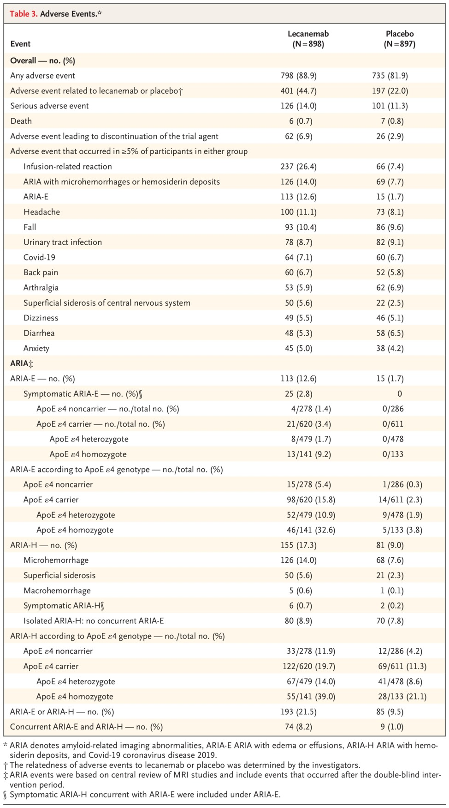
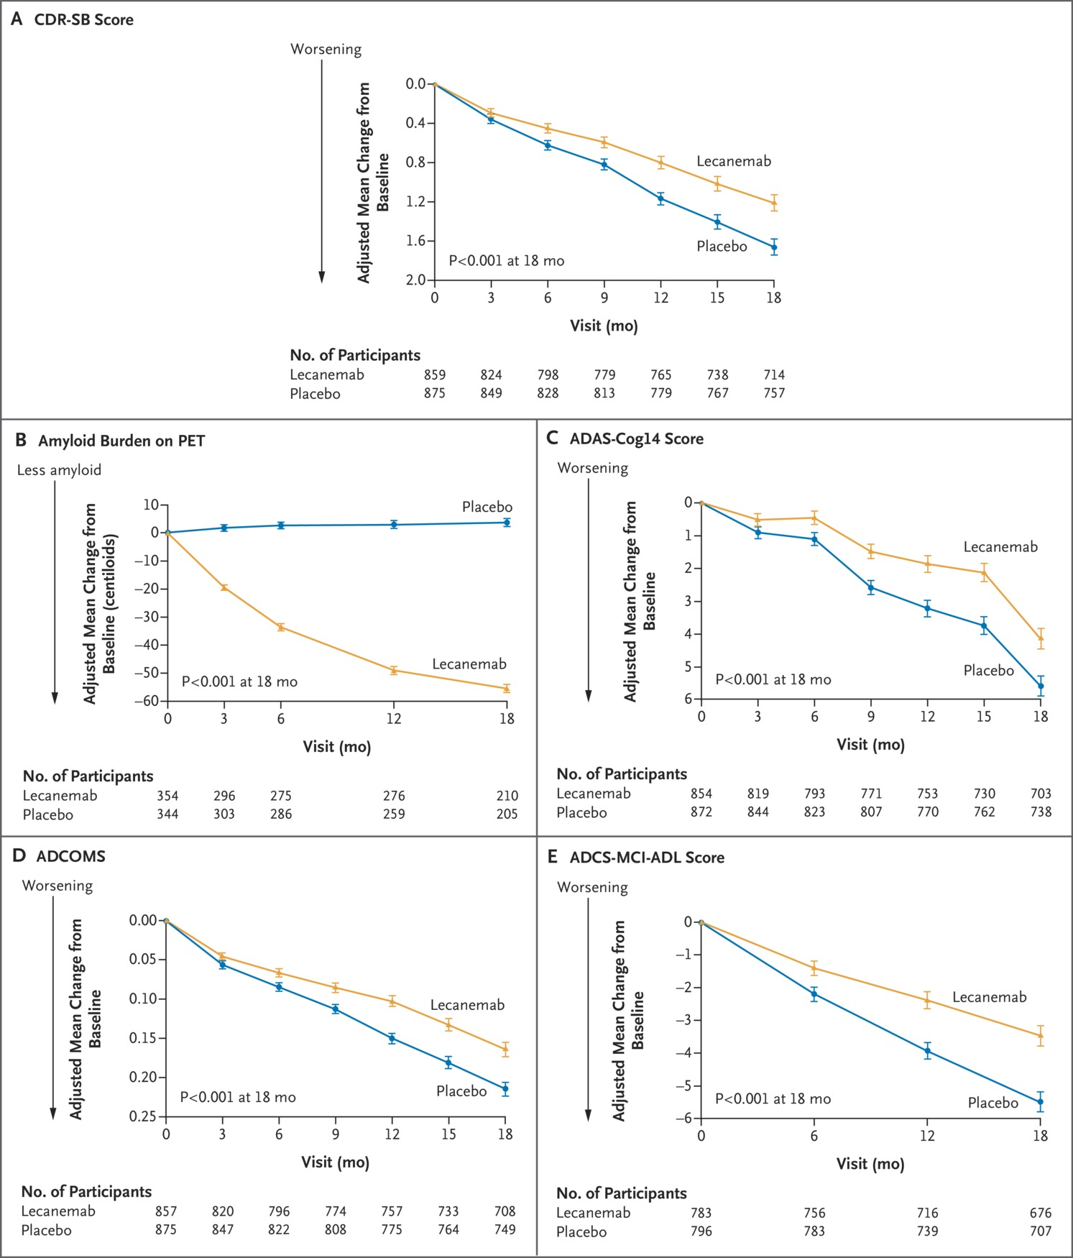

Slide 12
Donanemab – Anti-Amyloid – Trailblazer AD 2
FDA approved July 2024 – Mild AD
29% decreased clinical deterioration on the CDR-SB
  Up to 36% in low/medium tau populations
83.7% reduction in amyloid
Initial dosing 700mg IV infusion every 4 weeks x 3 doses then 1400mg every 4 weeks
Medication stopped if amyloid levels dropped low enough
36.8% ARIAs

Slide 13
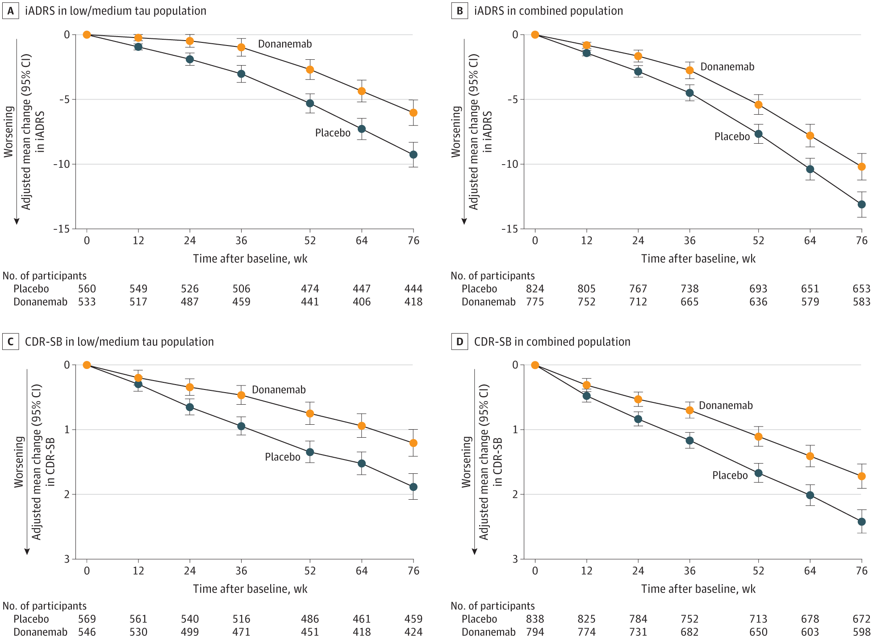
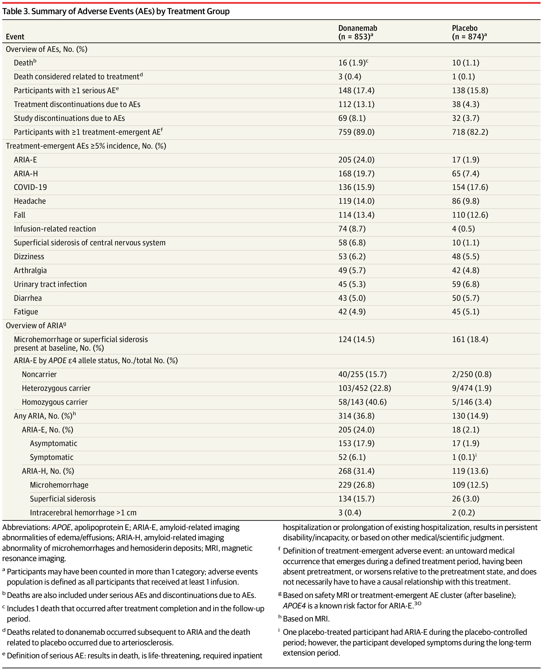

Slide 14
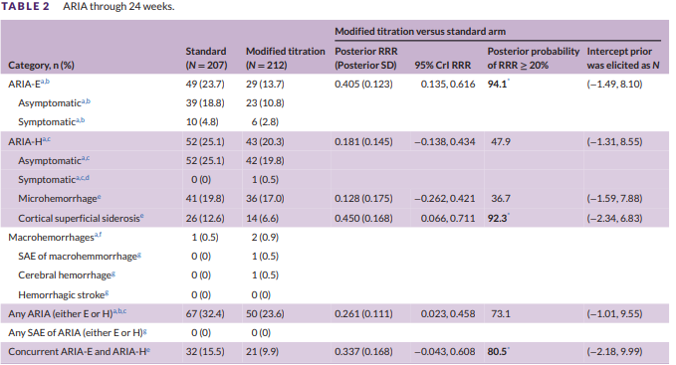
Donanemab – Anti-Amyloid – Trailblazer AD 6
Testing of a modified dosing strategy to decrease ARIA risk
Initial titration of 350mg, 700mg 4 weeks later, 1050mg 4 weeks later, then 1400mg IV every 4 weeks
Showed similar amyloid reduction with fewer ARIA incidents
~$32,000/year, but may be discontinued when amyloid plaques are minimal

Slide 15
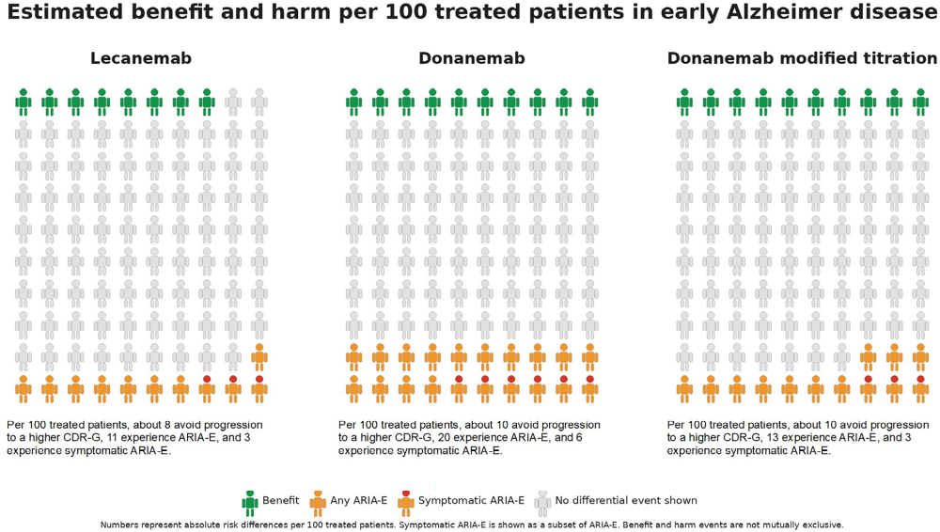

Slide 16
Investigational Medications
Anti-amyloid – trontinemab – increased brain penetration phase 1/2 trials – ARIA<5%. Previous brain penetration 0.1-0.2%.
Tau targeting
  Tau microtubule binding region (TMBR) – 4 different antibodies have not shown efficacy in phase 2 trials
Modulation of immune system
APOE targeting – valiltramiprosate phase 3 trials promising in MCI
Affecting lipid metabolism
  Maintaining an LDL<70 compared to >130 associated with a 26-28% risk reduction in AD.

Slide 17
Vitamin E
Neuroprotective
Vitamin E 2000 international units per day
May lead to a slower decline in functional status
Some controversy as to whether there may be worsening mortality with Vitamin E usage

Slide 18
Apoaequorin
Active ingredient in Prevagen
Binds to calcium potentially improving calcium dysregulation
Photogenic reaction in jellyfish
Preliminary research showed – manufacturer supported
  No improvement in verbal learning (except potentially for those who were cognitively normal at baseline)
  Modest improvement in delayed recall (Cognate International Shopping List)
Dizziness, headache, and nausea were the most common side effects
Very limited evidence that is not compelling

Slide 19
Aspirin
Low dose aspirin (<300mg/day)
No statistically significant delayed dementia onset or improved cognitive test scores
Up to 10 times as likely to have GI side effects
May still be on patient’s profile for other reasons

Slide 20
Omega-3 Fatty Acids
Limited data
Some evidence that omega-3 polyunsaturated fatty acids are associated with a decreased risk for MCI
No decreased association found for AD, dementia or the other fatty acids
GI complaints the most common side effects

Slide 21
Summary
Current treatments have limited benefits
If significant side effects occur, it is likely best to move away from that medication
Many medications in development

