Slide 1

Cirrhosis
Diagnosis and Preventing decompensation emergencies
Notes:
Introductions

Slide 2
Learning Objectives – Part 1
Review non-invasive cirrhosis work up (lab and imaging) with regard to sensitivity and/or specificity
Diagnose portal hypertension through noninvasive testing and describe the resultant highly fatal decompensation events
Recognize when to initiate and discontinue nonselective beta blockers
Notes:
Before we jump in, I want to note that we will have a wide range of backgrounds – a strength of our ECHO community! – and as such a wide range of questions. Please feel free to raise your electronic hand, put a question in the chat, or unmute to ask a question. There are no silly questions!

Slide 3
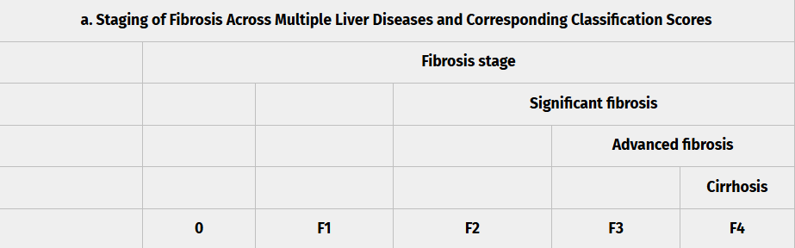
Chronicity of liver injury
based on fibrosis testing
liver biopsy (gold standard)
Sterling et al. 2025 Hep
Notes:
First recall, that all liver diseases cause some degree of inflammation or destruction to the cells of the liver, the hepatocytes. In order to diagnose “cirrhosis” we need to determine how far the fibrosis has progressed –stage 4 being cirrhosis. The common modalities are ….

Slide 4
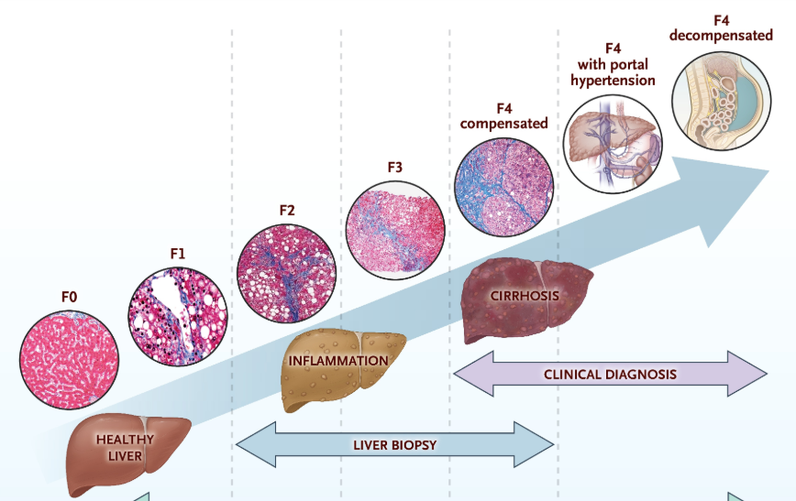
Chronicity of liver injury
based on fibrosis testing
liver biopsy (gold standard)
Castera et al. 2025 NEJM
Notes:
Diagnosis of cirrhosis has historically depended on invasive liver biopsy. Recall, that all liver diseases cause some degree of inflammation or destruction to the cells of the liver, the hepatocytes. In order to diagnose “cirrhosis” we need to determine how far the fibrosis has progressed –stage 4 being cirrhosis. The common modalities are ….
Noninvasive Assessment of Liver Fibrosis. N Engl J Med. October 29, 2025.

Slide 5
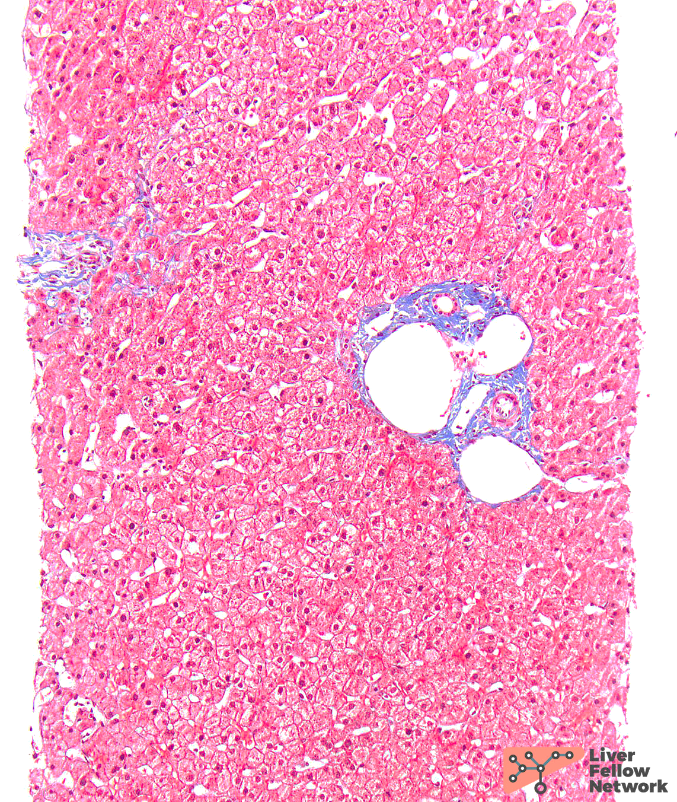
Biopsy
Sterling et al. 2025 Hep; Liver Fellow Network

Slide 6
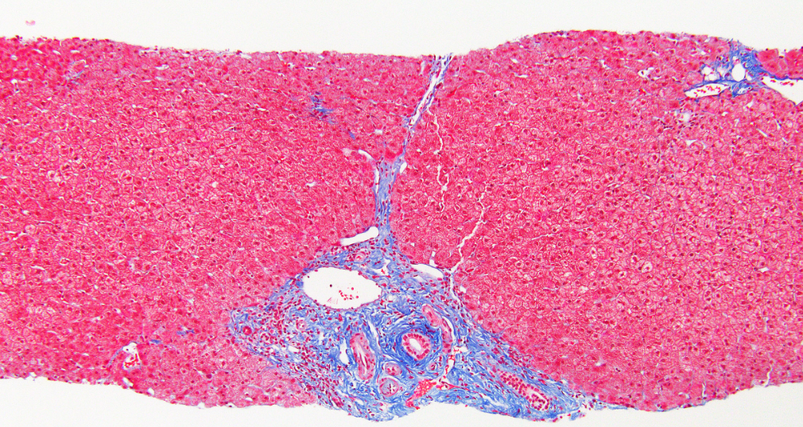
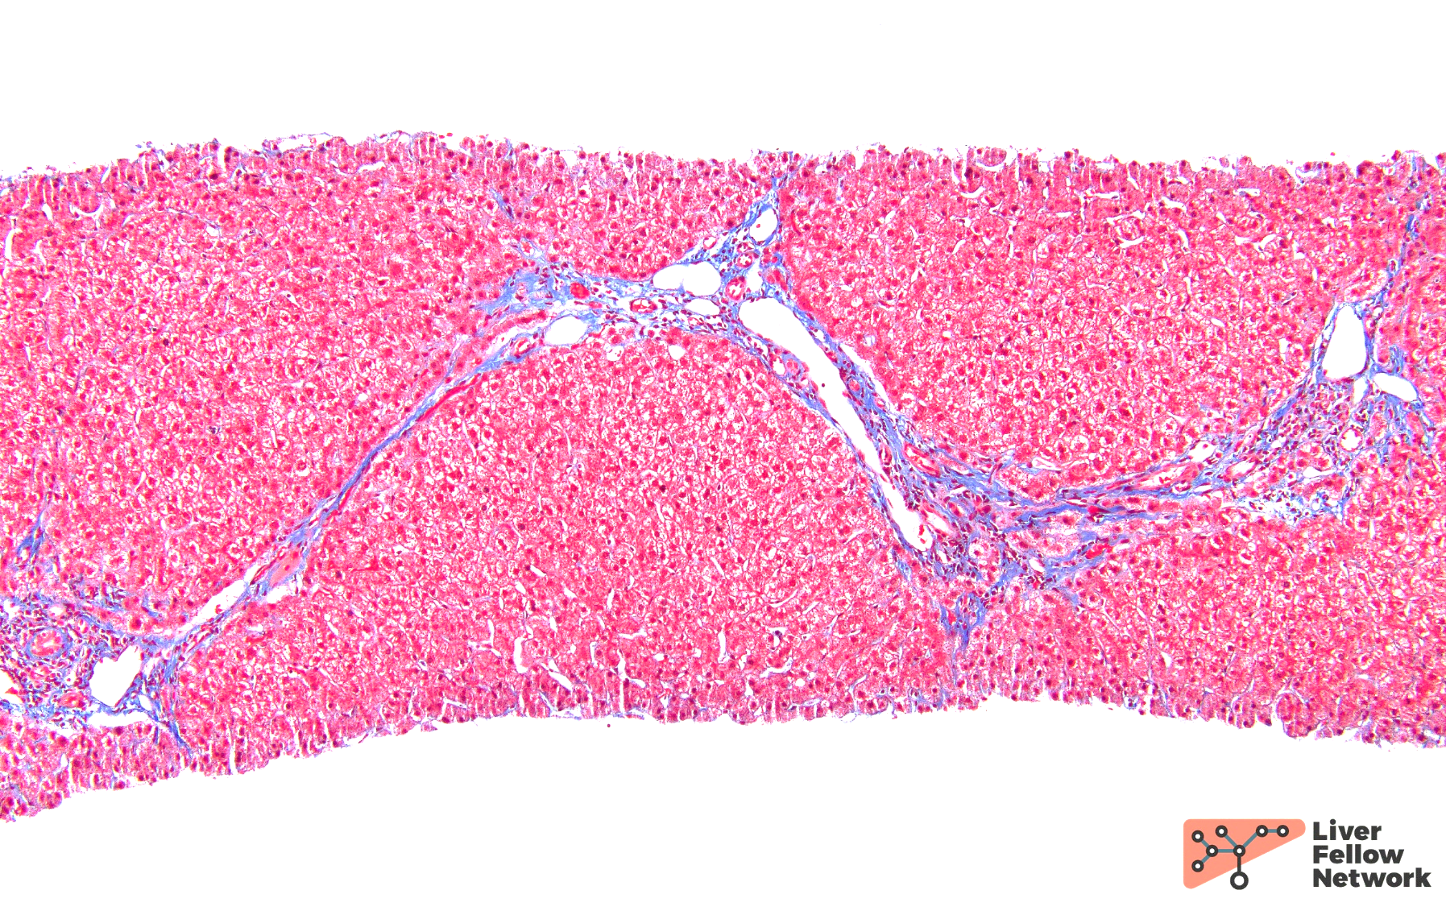
Biopsy
Sterling et al. 2025 Hep; Liver Fellow Network

Slide 7
Biopsy
Sterling et al. 2025 Hep; Liver Fellow Network

Slide 8
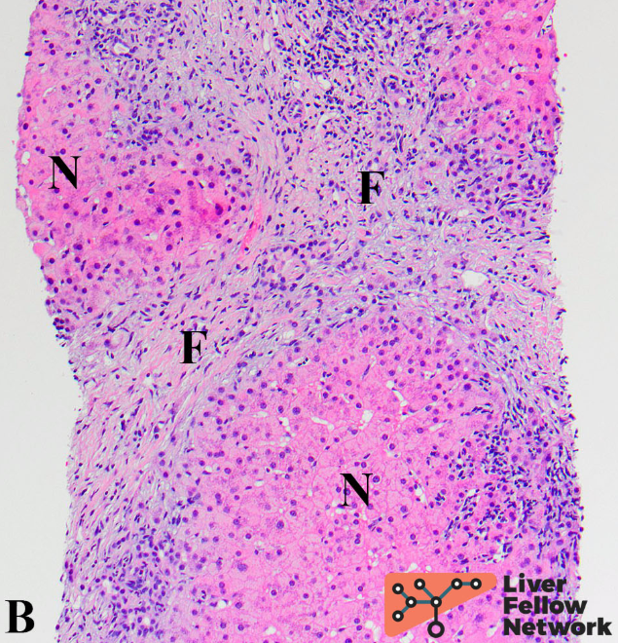
Biopsy
Sterling et al. 2025 Hep; Liver Fellow Network

Slide 9
Biopsy
Sterling et al. 2025 Hep; Liver Fellow Network

Slide 10
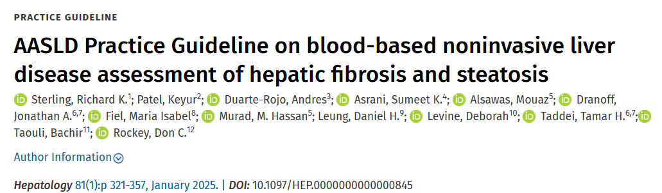
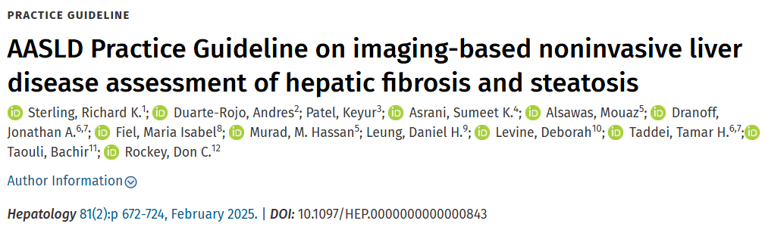
Notes:
So great, we have biopsy, but that’s not available in our clinics and sometimes not in town! Fortunately liver biopsy is not the only way to diagnose fibrosis and cirrhosis. We now have studied and endorsed non-invasive ways to diagnose fibrosis – both blood- and imaging-based modalities.

Slide 11
Notes:
We’ll start with blood lab-based diagnosis of fibrosis (which at stage 4-fibrosis is synonymous with cirrhosis in the most commonly referenced scale – the Metavir)

Slide 12
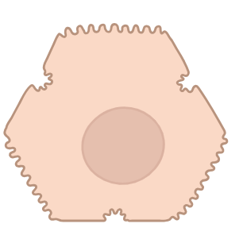
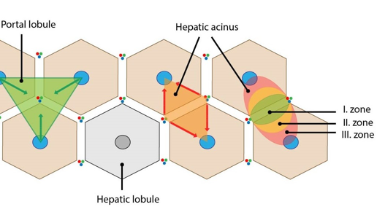
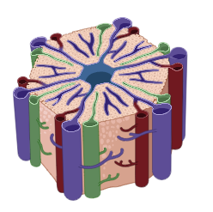
Liver Labs
        AST
        ALT
        AP
        TB
        Platelets
        Albumin
        INR
Hepatocyte
(Liver cell)
Modified from A. Brownlee; BioRender
Notes:
Remember from the LFT talk – these are the serum liver tests
Aspartate aminotransferase (AST) and Alanine aminotransferase (ALT) and these come from the hepatocytes where as the platelet is an indirect measure and when low can indicate a large spleen, and platelet sequestration.

Slide 13
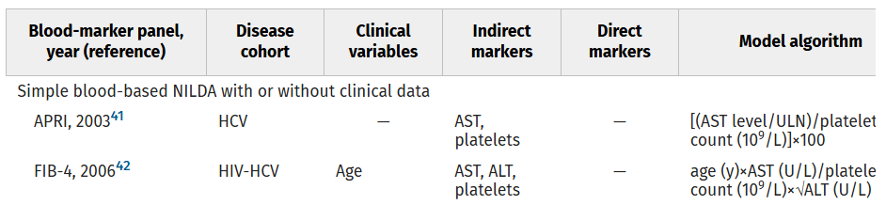
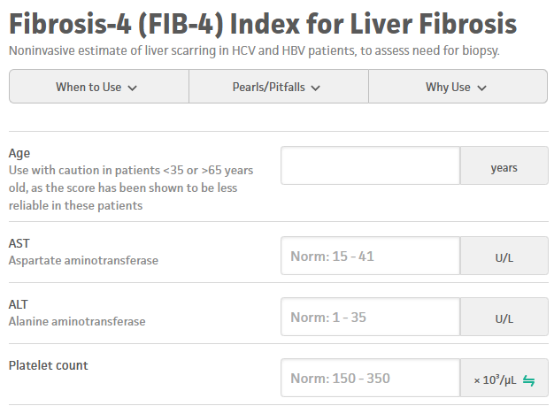
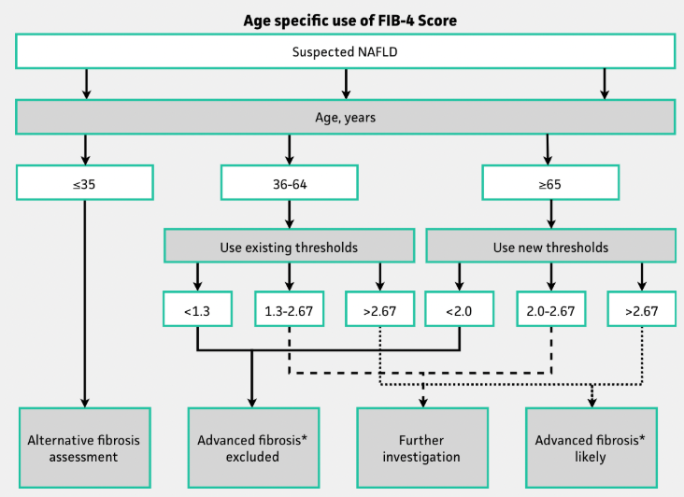
Fibrosis – 4
(FIB-4)
Sterling et al. 2006 Hep
Notes:
The first way we will discuss is a blood-based method to approximate fibrosis – the fibrosis-4 or FIB-4 score
FIB-4 is one of the best validated of the simple, cheap, and readily available nonproprietary blood-based tests, but known to be associated with “indeterminate” range scores and unreliable diagnostic performance in some scenarios
Revised FIB-4 thresholds of ≤1.30 and ≥2.67 have been proposed as having higher predictive values for F3-4 in the NASH CRN cohort
On the lower end, good rule-out power <1.3 In community-based and other low prevalence cohorts, blood-based NILDA are useful for excluding advanced fibrosis with high NPV but require additional noninvasive tests to improve their PPV. FIB-4 score at the prior low threshold<1.45 had a negative predictive value of 90% for advanced fibrosis
On the upper end, Robust studies determined FIB-4 ≥ 2.67 and ≥3.25 have excellent specificity at 0.96 to rule-in advanced fibrosis.

Slide 14
Fibrosis – 4
(FIB-4)
McPherson et al 2016 AJG; Sterling et al. 2006 Hep
Notes:
On the lower end, good rule-out power <1.3 In community-based and other low prevalence cohorts, blood-based NILDA are useful for excluding advanced fibrosis with high NPV but require additional noninvasive tests to improve their PPV. FIB-4 score at the prior low threshold<1.45 had a negative predictive value of 90% for advanced fibrosis
However, the specificity for advanced fi brosis using the FIB-4 declined with age, becoming unacceptably low in those aged ≥65 years (35% for FIB-4). New cutoffs were derived (and validated) for those aged ≥65 years, which improved specificity to 70% without adversely affecting sensitivity (FIB-4 2.0, sensitivity 77%)

Slide 15
Fibrosis – 4
(FIB-4)
Sterling et al. 2006 Hep
Notes:
FIB-4 is one of the best validated of the simple, cheap, and readily available nonproprietary blood-based tests, but known to be associated with “indeterminate” range scores and unreliable diagnostic performance in some scenarios
Revised FIB-4 thresholds of ≤1.30 and ≥2.67 have been proposed as having higher predictive values for F3-4 in the NASH CRN cohort
On the lower end, good rule-out power <1.3 In community-based and other low prevalence cohorts, blood-based NILDA are useful for excluding advanced fibrosis with high NPV but require additional noninvasive tests to improve their PPV. FIB-4 score at the prior low threshold<1.45 had a negative predictive value of 90% for advanced fibrosis
On the upper end, Robust studies determined FIB-4 ≥ 2.67 and ≥3.25 have excellent specificity at 0.96 to rule-in advanced fibrosis.

Slide 16
An example case – routine blood work with primary care
61
28
9
155
Which of these labs are abnormal?
Is there evidence of liver disease?
Notes:
We scroll back to routine blood work with her primary care doctor 3 months ago…. [READ]

Slide 17
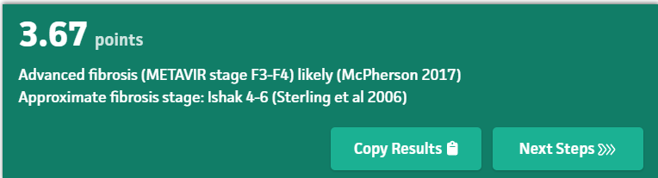
Cirrhosis!
Advanced fibrosis likely. Normal ≠ Normal!
ALT> 33 males
ALT> 25 females
Not EHR “normal”!
Sterling et al. 2006 Hep
Notes:
Does this surprise you?

Slide 18
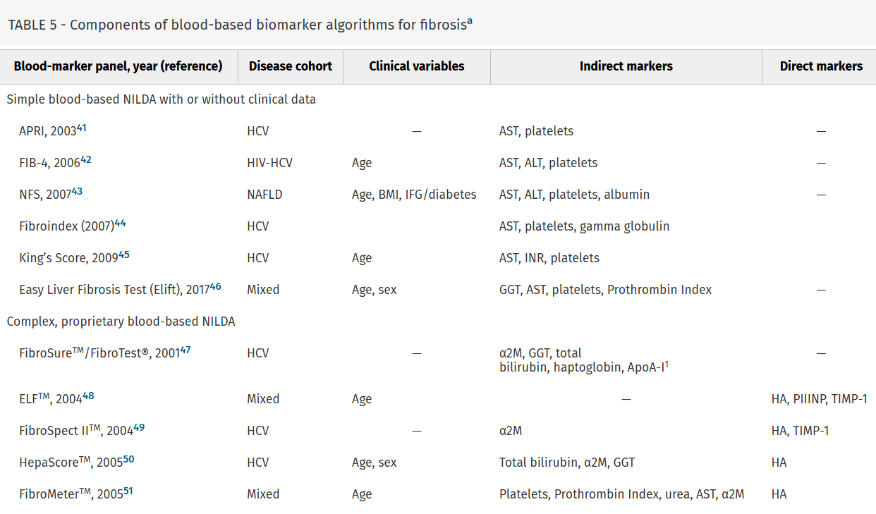
Sterling et al. 2025 Hep; Vali et al. 2020 J Hep
Notes:
QUICK - Just to show a few other blood tests – I specifically want to point out Enhanced Liver Fibrosis (ELF) as many community labs have this now
Other blood-based biomarker algorithms in the NILDA guidelines. I want to draw our eye a few – APRI Aspartate aminotransferase (AST)-to-platelet ratio index (APRI) and FIB-4 are the best validated of the simple, cheap, and readily available nonproprietary tests, but they are known to be associated with “indeterminate” range scores and unreliable diagnostic performance in some patients. APRI and FIB-4 are the most frequently used simple nonproprietary tests.
FibroTestTM (BioPredictive, Paris, France) or in the United States, FibroSURE® (LabCorp, Burlington, North Carolina) are the most validated blood-based biomarkers with a proprietary algorithm.
High specificity – good for use in 2 step or in ELF
Those who may have a moderate or high risk of advanced disease based on FIB-4 should undergo secondary risk assessment. In the primary care setting, vibration-controlled elastography (VCTE) or ultrasound-based methods such as acoustic radio force impulse (as available) are favored over magnetic resonance elastography (MRE), as initial secondary assessments due to cost considerations. The Enhanced Liver Fibrosis (ELF) test is approved for prognostication when advanced fibrosis is suspected, although it can be ordered for secondary risk assessment, particularly because the availability of elastography may be limited in some settings. If secondary risk assessment is still consistent with an intermediate or high risk of fibrosis, patients should be referred to specialty care for further evaluation and potential intervention.
A meta-analysis of 11 studies using ELF tests for F3-4 noted a high sensitivity (0.93) but limited specificity (0.34) at the lower recommended threshold of 7.7; higher thresholds and F3-4 prevalence of at least 30% were required for increasing ELF PPV to>0.8 for advanced fibrosis.¹⁰⁶

Slide 19
Notes:
That brings us to the other set of guidelines, so let’s transition over to the imaging-based non-invasive studies for fibrosis (which again is the precursor to cirrhosis).

Slide 20
Speaking of which….How sensitive is Ultrasound alone for cirrhosis?
nodularity
Yen et al 2019
Notes:
READ

Slide 21
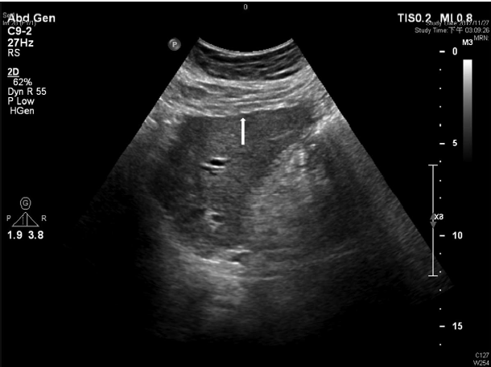
Ultrasound for cirrhosis? Not Sensitive!
In a cohort of 1738 patients with chronic HCV liver disease prior to HCV treatment, ultrasound diagnosis was compared to liver biopsy (gold standard).
Specificity was 97.1%
Sensitivity was 34.0%
Take home: if its present on ultrasound, you have your diagnosis, if it isn’t, the patient may still have cirrhosis! Confirmatory or “rule-in” only!
nodularity
Yen et al 2019
Notes:
In clinical practice, standard two-dimensional grayscale ultrasound (US), CT, and MRI are frequently used to identify features of cirrhosis; however, they are not sufficiently sensitive for compensated cirrhosis or precirrhotic stages.²⁹
Key imaging features that allow for diagnosis of cirrhosis or PHTN include a coarse or heterogenous nodular liver, dilated portal vein (>12 mm) or presence of collaterals, recanalization of the umbilical vein, ascites, and splenomegaly (most frequently defined as ≥13 cm but varies depending on patient sex, size, and morphology of the spleen).

Slide 22
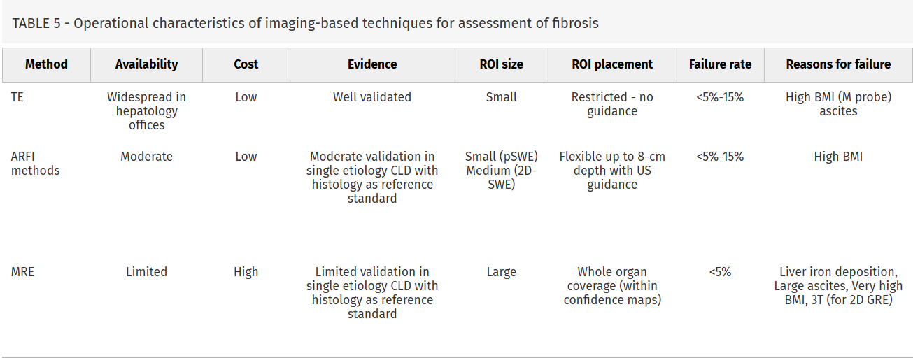
Fibrosis Imaging
Transient Elastography (TE)
Acoustic radiation force impulse (ARFI)
Magnetic resonance elastography
(MRE)
Sterling et al. 2025 Hep
Notes:
So not plain ultrasound – what imaging modality do we use?

Slide 23
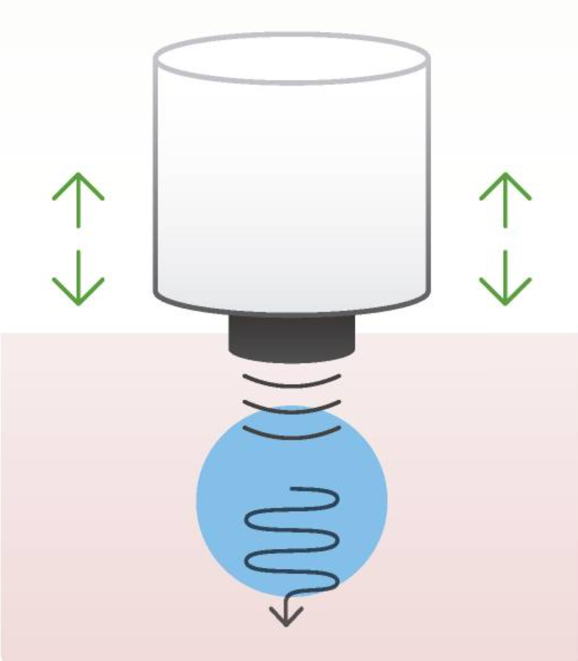
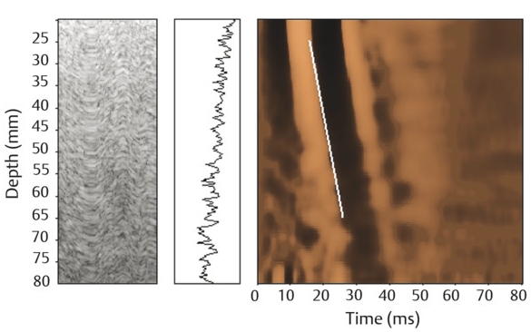
Vibration-controlled transient elastography (VCTE)
Liver Stiffness Measurement (LSM) in kilopascals (kPa)
Sigrist et al. 2017 Hep; Sterling et al. 2025 Hep; radiologykey.com/elastography
Notes:
Vibration-controlled transient elastography (VCTE) is an ultrasound transducer with additional vibration capabilities; the brand name that people in the United States have most often heard of is Fibroscan. The velocity of the vibration wave is directly related to tissue stiffness, which is read out as a Liver Stiffness Measurement in kilopascals (kPa). While there does exist liver disease-specific stiffness ranges, generally less than 8 kPA is reassuring against advanced fibrosis and greater than 15 kPA is very concerning for the presence of advanced fibrosis.
[Click] common pitfalls include…..
Liver congestion- Hepatic venous outflow tract obstruction, sinusoidal obstruction syndrome, hepatic congestion of cardiac/pulmonary vascular origin, Obstructive cholestasis, Hepatic infiltration (amyloid, tumor)

Slide 24
Vibration-controlled transient elastography (VCTE)
Liver Stiffness Measurement (LSM) in kilopascals (kPa)
Pitfalls
Body habitus (BMI ≥40, narrow intercostal space, ascites, steatosis) Acute hepatitis Liver Congestion
Sigrist et al. 2017 Hep; Sterling et al. 2025 Hep; radiologykey.com/elastography
Notes:
Common pitfalls include…..[READ]
Liver congestion- Hepatic venous outflow tract obstruction, sinusoidal obstruction syndrome, hepatic congestion of cardiac/pulmonary vascular origin, Obstructive cholestasis, Hepatic infiltration (amyloid, tumor) ESRD on HD

Slide 25
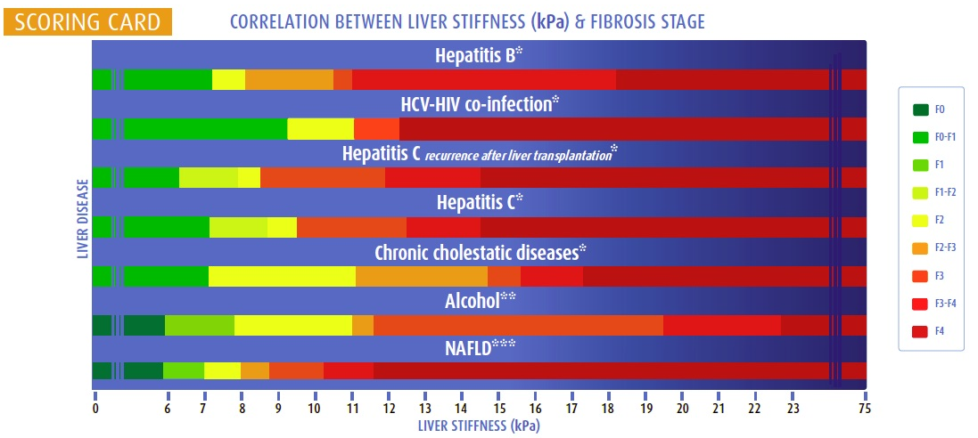
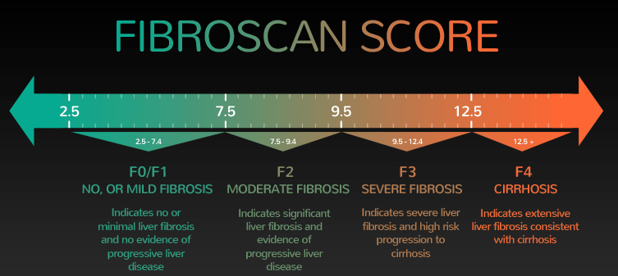
www.fibroscanlosangeles.com/index.php
Notes:
QUICK - We used to interpret liver stiffness by fibrosis-etiology specific kPa cutoffs – eg if we look at the last two bars here, Stage F4 also called cirrhosis didn’t start until 22 kpa whereas NAFLD, now called MASLD – the fatty liver or metabolic liver disease – is considered F4 at 12 kpa.

Slide 26
VCTE
www.fibroscanlosangeles.com/index.php
Notes:
Now VCTE, Fibroscan, uses a standard scale for all etiologies - <7.5 kpa is F0/F1, 7.5 – 9.5 is F2 moderate fibrosis, 9.5-12.5 is F3 severe fibrosis, and beyond 12.5 kpa is F4 which is synonymous with cirrhosis

Slide 27
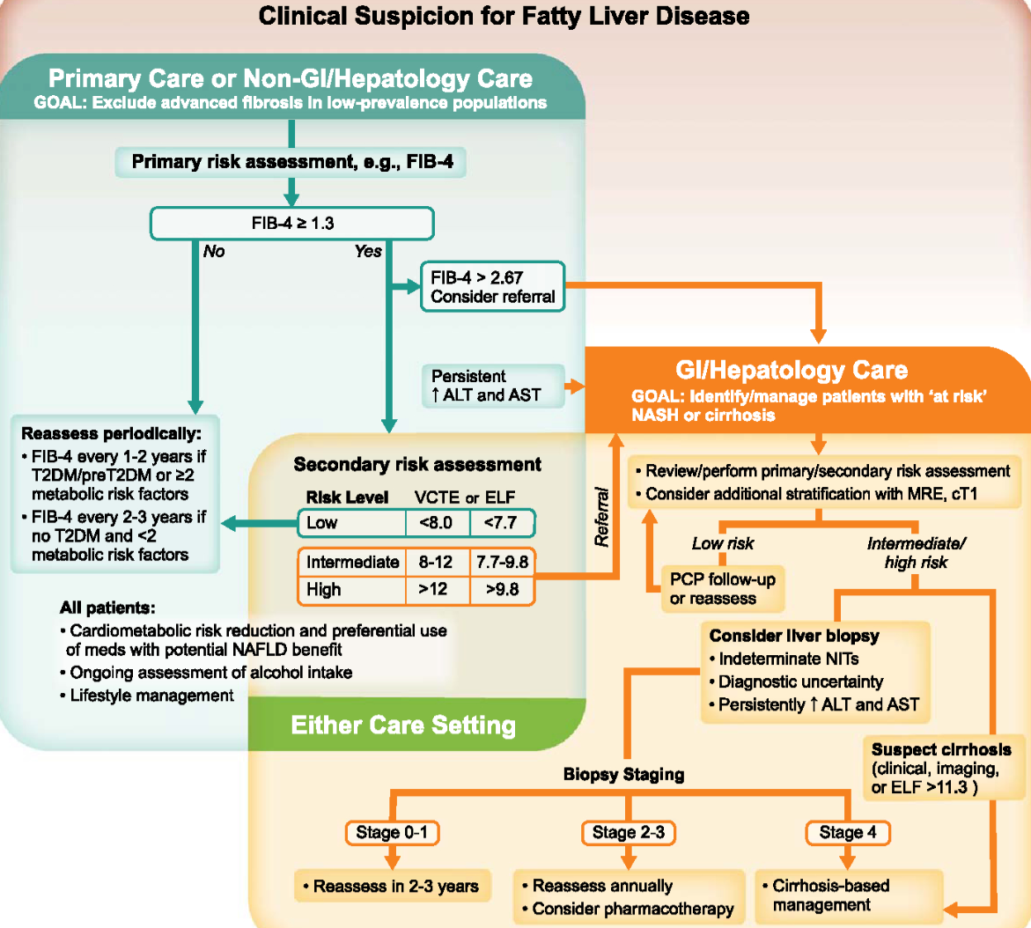
Rinella et al. 2023 Hep
Notes:
So how do we bring all these tools together to make a diagnosis of cirrhosis and decide next steps? Here is a possible work from the recent MASLD liver disease guideline update.

Slide 28
<Indeterminant>
Rescreen based on risk factors every 1-3 years
Rinella et al. 2023 Hep
Notes:
So how do we bring all these tools together to make a diagnosis of cirrhosis and decide next steps? Here is a possible work from the recent MASLD liver disease guideline update.
It’s not uncommon to have an indeterminant read, however! In these cases, further evaluation is needed to determine if advanced fibrosis is present.

Slide 29
Rescreen based on risk factors every 1-3 years
Rinella et al. 2023 Hep
Notes:
Then we conduct testing to move our “indeterminant” finding towards more clear low or high risk. We can refer especially when “consider liver biopsy”

Slide 30
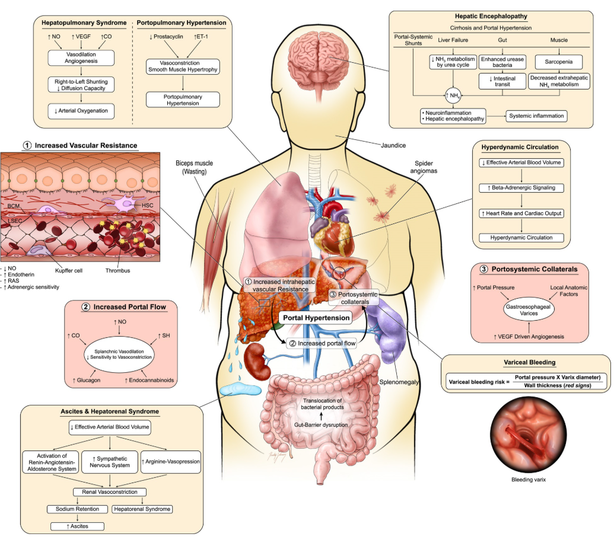
Clinically Significant Portal Hypertension (CSPH)
“Decompensation”
Ascites/SBP
Varices/Hemorrhage
Encephalopathy
Kumar et al. 2025 NEJM; Kaplan et al. 2024 Hep
Notes:
So why does it matter to diagnose cirrhosis? It is a precursor to the backpressure that is portal hypertension, or most recently named clinically significant portal hypertension.
Portal hypertension is the haemodynamic abnormality resulting from from a series of maladaptive responses to chronic liver injury and cirrhosis associated with the most severe complications of cirrhosis, referred to as decompensations which include ascites, hepatic encephalopathy and bleeding from gastroesophageal varices. Variceal bleeding is a medical emergency associated with considerable mortality
that, in spite of recent progress, is still in the order of 10–20% at 6 weeks. (Baveno VII)
Pathophysiology of portal hypertension and related complications. Portal hypertension results from a series of maladaptive responses to chronic liver injury and cirrhosis. Initially, structural mechanisms because of accumulation of fibrous tissue, regenerative nodules, microthrombi, parenchymal extinction, and collapse lead to an increase in intrahepatic vascular resistance (1). In addition to architectural distortion, dynamic sinusoidal vasoconstriction contributes to 30% of the total increase in vascular tone. These structural changes lead to an increased portal pressure gradient; when this reaches values of about 10 mm Hg, it gives rise to formation of portal-systemic collaterals and compensatory splanchnic vasodilation, which, in turn, increases portal blood flow and, consequently, portal pressure (2). One of the first consequences of portal hypertension is the development of portosystemic collaterals, for which vascular endothelial growth factor (VEGF)-driven angiogenesis plays an important role (3). Gastroesophageal varices represent the most clinically relevant collaterals because of their increased risk of bleeding. Bleeding is directly dependent on increased wall tension at the varices, determined by portal pressure, variceal diameter, and thin wall thickness. Vasodilation occurs also in the systemic circulation resulting in a hyperdynamic circulatory state, driven by decreased effective arterial blood volume leading to activation of neurohumoral and vasoconstrictive systems, sodium and water retention, and increased cardiac output. This process eventually results in the development of ascites and, at late stages, hepatorenal syndrome because of compensatory renal vasoconstriction. Hepatic encephalopathy represents a multifactorial complication of portal hypertension, resulting from portosystemic shunting, impaired synthetic liver function, increased bacterial translocation, and muscle wasting (sarcopenia). Finally, imbalances on vasoconstrictors and vasodilators in the pulmonary circulation results in hepatopulmonary syndrome (increased vasodilation) and portopulmonary hypertension (increased vasoconstriction). CO, carbon monoxide; H₂S, hydrogen sulfide; HVR, hepatic vascular resistance; NO, nitric oxide; ET, endothelin.
***Endoscopy
In patient with cACLD with CSPH for whom beta-blockers cannot be safely administered, endoscopic surveillance should be initiated with an intent to prevent first variceal hemorrhage (primary prophylaxis) through prophylactic endoscopic band ligation of high-risk varices. Performance of an endoscopy every 2 years is recommended; however, if cause of the liver disease is under control (alcohol abstinence, weight control, viral suppression or elimination, etc.), endoscopic surveillance may be done every 3 years.⁹⁴ In some cases, cessation of surveillance may be considered after negative serial endoscopic assessments in the setting of complete disease resolution (e.g., sustained sobriety, SVR after HCV direct-acting antiviral therapy with complete normalization of aspartate aminotransferase and alanine aminotransferase), LSM < 12 kPa, and platelet >150 K/mm³.¹¹⁸
If endoscopic variceal ligation (EVL) is selected for primary prophylaxis of high-risk varices, EVL should be repeated until all varices are eradicated. Intervals between endoscopies evaluated in clinical trials for primary and secondary prophylaxis have ranged from 1 to 8 weeks.^{119–124}

Slide 31
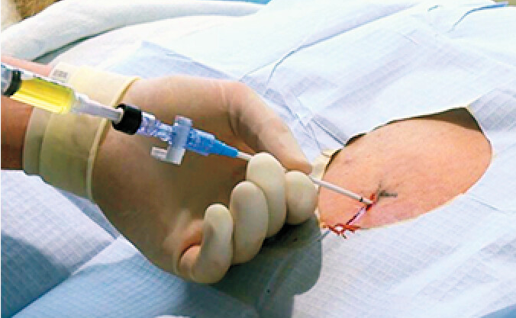
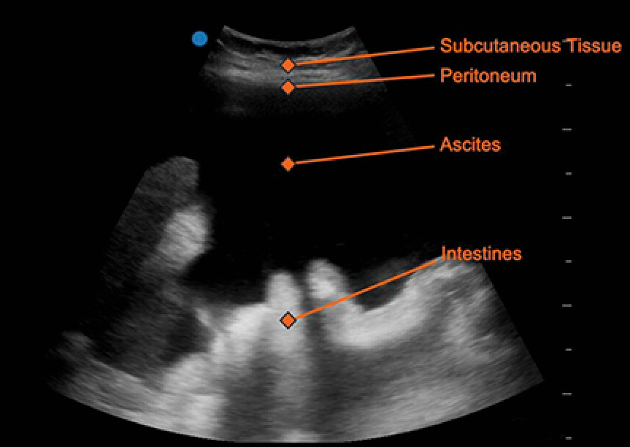
Clinically Significant Portal Hypertension (CSPH)
“Decompensation”
Ascites/SBP
Varices/Hemorrhage
Encephalopathy
Ascites
Kumar et al. 2025 NEJM; Kaplan et al. 2024 Hep
Notes:
Portal hypertension is the haemodynamic abnormality associated with the most severe complications of cirrhosis, including ascites, hepatic encephalopathy and bleeding from gastroesophageal varices. Variceal bleeding is a medical emergency associated with a mortality that, in spite of recent progress, is still in the order of 10–20% at 6 weeks. (Baveno VII)
Ascites – every patient should get a tap, every time they come to the hospital to check for SBP
Pathophysiology of portal hypertension and related complications. Portal hypertension results from a series of maladaptive responses to chronic liver injury and cirrhosis. Initially, structural mechanisms because of accumulation of fibrous tissue, regenerative nodules, microthrombi, parenchymal extinction, and collapse lead to an increase in intrahepatic vascular resistance (1). In addition to architectural distortion, dynamic sinusoidal vasoconstriction contributes to 30% of the total increase in vascular tone. These structural changes lead to an increased portal pressure gradient; when this reaches values of about 10 mm Hg, it gives rise to formation of portal-systemic collaterals and compensatory splanchnic vasodilation, which, in turn, increases portal blood flow and, consequently, portal pressure (2). One of the first consequences of portal hypertension is the development of portosystemic collaterals, for which vascular endothelial growth factor (VEGF)-driven angiogenesis plays an important role (3). Gastroesophageal varices represent the most clinically relevant collaterals because of their increased risk of bleeding. Bleeding is directly dependent on increased wall tension at the varices, determined by portal pressure, variceal diameter, and thin wall thickness. Vasodilation occurs also in the systemic circulation resulting in a hyperdynamic circulatory state, driven by decreased effective arterial blood volume leading to activation of neurohumoral and vasoconstrictive systems, sodium and water retention, and increased cardiac output. This process eventually results in the development of ascites and, at late stages, hepatorenal syndrome because of compensatory renal vasoconstriction. Hepatic encephalopathy represents a multifactorial complication of portal hypertension, resulting from portosystemic shunting, impaired synthetic liver function, increased bacterial translocation, and muscle wasting (sarcopenia). Finally, imbalances on vasoconstrictors and vasodilators in the pulmonary circulation results in hepatopulmonary syndrome (increased vasodilation) and portopulmonary hypertension (increased vasoconstriction). CO, carbon monoxide; H₂S, hydrogen sulfide; HVR, hepatic vascular resistance; NO, nitric oxide; ET, endothelin.
***Endoscopy
In patient with cACLD with CSPH for whom beta-blockers cannot be safely administered, endoscopic surveillance should be initiated with an intent to prevent first variceal hemorrhage (primary prophylaxis) through prophylactic endoscopic band ligation of high-risk varices. Performance of an endoscopy every 2 years is recommended; however, if cause of the liver disease is under control (alcohol abstinence, weight control, viral suppression or elimination, etc.), endoscopic surveillance may be done every 3 years.⁹⁴ In some cases, cessation of surveillance may be considered after negative serial endoscopic assessments in the setting of complete disease resolution (e.g., sustained sobriety, SVR after HCV direct-acting antiviral therapy with complete normalization of aspartate aminotransferase and alanine aminotransferase), LSM < 12 kPa, and platelet >150 K/mm³.¹¹⁸
If endoscopic variceal ligation (EVL) is selected for primary prophylaxis of high-risk varices, EVL should be repeated until all varices are eradicated. Intervals between endoscopies evaluated in clinical trials for primary and secondary prophylaxis have ranged from 1 to 8 weeks.^{119–124}

Slide 32
Clinically Significant Portal Hypertension (CSPH)
“Decompensation”
Ascites/SBP
Varices/Hemorrhage
Encephalopathy
Varices /
Hemorrhage
Ascites
Kumar et al. 2025 NEJM; Kaplan et al. 2024 Hep
Notes:
Portal hypertension is the haemodynamic abnormality associated with the most severe complications of cirrhosis, including ascites, hepatic encephalopathy and bleeding from gastroesophageal varices. Variceal bleeding is a medical emergency associated with a mortality that, in spite of recent progress, is still in the order of 10–20% at 6 weeks. (Baveno VII)
Pathophysiology of portal hypertension and related complications. Portal hypertension results from a series of maladaptive responses to chronic liver injury and cirrhosis. Initially, structural mechanisms because of accumulation of fibrous tissue, regenerative nodules, microthrombi, parenchymal extinction, and collapse lead to an increase in intrahepatic vascular resistance (1). In addition to architectural distortion, dynamic sinusoidal vasoconstriction contributes to 30% of the total increase in vascular tone. These structural changes lead to an increased portal pressure gradient; when this reaches values of about 10 mm Hg, it gives rise to formation of portal-systemic collaterals and compensatory splanchnic vasodilation, which, in turn, increases portal blood flow and, consequently, portal pressure (2). One of the first consequences of portal hypertension is the development of portosystemic collaterals, for which vascular endothelial growth factor (VEGF)-driven angiogenesis plays an important role (3). Gastroesophageal varices represent the most clinically relevant collaterals because of their increased risk of bleeding. Bleeding is directly dependent on increased wall tension at the varices, determined by portal pressure, variceal diameter, and thin wall thickness. Vasodilation occurs also in the systemic circulation resulting in a hyperdynamic circulatory state, driven by decreased effective arterial blood volume leading to activation of neurohumoral and vasoconstrictive systems, sodium and water retention, and increased cardiac output. This process eventually results in the development of ascites and, at late stages, hepatorenal syndrome because of compensatory renal vasoconstriction. Hepatic encephalopathy represents a multifactorial complication of portal hypertension, resulting from portosystemic shunting, impaired synthetic liver function, increased bacterial translocation, and muscle wasting (sarcopenia). Finally, imbalances on vasoconstrictors and vasodilators in the pulmonary circulation results in hepatopulmonary syndrome (increased vasodilation) and portopulmonary hypertension (increased vasoconstriction). CO, carbon monoxide; H₂S, hydrogen sulfide; HVR, hepatic vascular resistance; NO, nitric oxide; ET, endothelin.
***Endoscopy
In patient with cACLD with CSPH for whom beta-blockers cannot be safely administered, endoscopic surveillance should be initiated with an intent to prevent first variceal hemorrhage (primary prophylaxis) through prophylactic endoscopic band ligation of high-risk varices. Performance of an endoscopy every 2 years is recommended; however, if cause of the liver disease is under control (alcohol abstinence, weight control, viral suppression or elimination, etc.), endoscopic surveillance may be done every 3 years.⁹⁴ In some cases, cessation of surveillance may be considered after negative serial endoscopic assessments in the setting of complete disease resolution (e.g., sustained sobriety, SVR after HCV direct-acting antiviral therapy with complete normalization of aspartate aminotransferase and alanine aminotransferase), LSM < 12 kPa, and platelet >150 K/mm³.¹¹⁸
If endoscopic variceal ligation (EVL) is selected for primary prophylaxis of high-risk varices, EVL should be repeated until all varices are eradicated. Intervals between endoscopies evaluated in clinical trials for primary and secondary prophylaxis have ranged from 1 to 8 weeks.^{119–124}

Slide 33

Clinically Significant Portal Hypertension (CSPH)
“Decompensation”
Ascites/SBP
Varices/Hemorrhage
Encephalopathy
Encephalopathy
Varices /
Hemorrhage
Ascites
Kumar et al. 2025 NEJM; Kaplan et al. 2024 Hep; Kibble & Shawcross 2024 UEG
Notes:
The prevalence of Overt hepatic encephalopathy at the time of diagnosis of cirrhosis is 10%-14% in general,^{16,17,18} 16%-21% (1 in 5) in those with decompensated cirrhosis,^{7,19} and 10%-50% in patients with transjugular intrahepatic portosystemic shunt (TIPS). A previous bout of OHE were found to have a 40% cumulative risk of recurring OHE at 1 year,³³ and subjects with recurrent OHE have a 40% cumulative risk of another recurrence within 6 months, despite lactulose treatment
Pathophysiology of portal hypertension and related complications. Portal hypertension results from a series of maladaptive responses to chronic liver injury and cirrhosis. Initially, structural mechanisms because of accumulation of fibrous tissue, regenerative nodules, microthrombi, parenchymal extinction, and collapse lead to an increase in intrahepatic vascular resistance (1). In addition to architectural distortion, dynamic sinusoidal vasoconstriction contributes to 30% of the total increase in vascular tone. These structural changes lead to an increased portal pressure gradient; when this reaches values of about 10 mm Hg, it gives rise to formation of portal-systemic collaterals and compensatory splanchnic vasodilation, which, in turn, increases portal blood flow and, consequently, portal pressure (2). One of the first consequences of portal hypertension is the development of portosystemic collaterals, for which vascular endothelial growth factor (VEGF)-driven angiogenesis plays an important role (3). Gastroesophageal varices represent the most clinically relevant collaterals because of their increased risk of bleeding. Bleeding is directly dependent on increased wall tension at the varices, determined by portal pressure, variceal diameter, and thin wall thickness. Vasodilation occurs also in the systemic circulation resulting in a hyperdynamic circulatory state, driven by decreased effective arterial blood volume leading to activation of neurohumoral and vasoconstrictive systems, sodium and water retention, and increased cardiac output. This process eventually results in the development of ascites and, at late stages, hepatorenal syndrome because of compensatory renal vasoconstriction. Hepatic encephalopathy represents a multifactorial complication of portal hypertension, resulting from portosystemic shunting, impaired synthetic liver function, increased bacterial translocation, and muscle wasting (sarcopenia). Finally, imbalances on vasoconstrictors and vasodilators in the pulmonary circulation results in hepatopulmonary syndrome (increased vasodilation) and portopulmonary hypertension (increased vasoconstriction). CO, carbon monoxide; H₂S, hydrogen sulfide; HVR, hepatic vascular resistance; NO, nitric oxide; ET, endothelin.
***Endoscopy
In patient with cACLD with CSPH for whom beta-blockers cannot be safely administered, endoscopic surveillance should be initiated with an intent to prevent first variceal hemorrhage (primary prophylaxis) through prophylactic endoscopic band ligation of high-risk varices. Performance of an endoscopy every 2 years is recommended; however, if cause of the liver disease is under control (alcohol abstinence, weight control, viral suppression or elimination, etc.), endoscopic surveillance may be done every 3 years.⁹⁴ In some cases, cessation of surveillance may be considered after negative serial endoscopic assessments in the setting of complete disease resolution (e.g., sustained sobriety, SVR after HCV direct-acting antiviral therapy with complete normalization of aspartate aminotransferase and alanine aminotransferase), LSM < 12 kPa, and platelet >150 K/mm³.¹¹⁸
If endoscopic variceal ligation (EVL) is selected for primary prophylaxis of high-risk varices, EVL should be repeated until all varices are eradicated. Intervals between endoscopies evaluated in clinical trials for primary and secondary prophylaxis have ranged from 1 to 8 weeks.^{119–124}

Slide 34
Clinically Significant Portal Hypertension (CSPH)
“Decompensation”
Ascites/SBP
Varices/Hemorrhage
Encephalopathy
Encephalopathy
PPI
Varices /
Hemorrhage
Ascites
Kumar et al. 2025 NEJM; Kaplan et al. 2024 Hep; Kibble & Shawcross 2024 UEG
Notes:
Proton pump inhibitors should be discontinued in the absence of absolute indications because of increased risk of infection and encephalopathy.
Pathophysiology of portal hypertension and related complications. Portal hypertension results from a series of maladaptive responses to chronic liver injury and cirrhosis. Initially, structural mechanisms because of accumulation of fibrous tissue, regenerative nodules, microthrombi, parenchymal extinction, and collapse lead to an increase in intrahepatic vascular resistance (1). In addition to architectural distortion, dynamic sinusoidal vasoconstriction contributes to 30% of the total increase in vascular tone. These structural changes lead to an increased portal pressure gradient; when this reaches values of about 10 mm Hg, it gives rise to formation of portal-systemic collaterals and compensatory splanchnic vasodilation, which, in turn, increases portal blood flow and, consequently, portal pressure (2). One of the first consequences of portal hypertension is the development of portosystemic collaterals, for which vascular endothelial growth factor (VEGF)-driven angiogenesis plays an important role (3). Gastroesophageal varices represent the most clinically relevant collaterals because of their increased risk of bleeding. Bleeding is directly dependent on increased wall tension at the varices, determined by portal pressure, variceal diameter, and thin wall thickness. Vasodilation occurs also in the systemic circulation resulting in a hyperdynamic circulatory state, driven by decreased effective arterial blood volume leading to activation of neurohumoral and vasoconstrictive systems, sodium and water retention, and increased cardiac output. This process eventually results in the development of ascites and, at late stages, hepatorenal syndrome because of compensatory renal vasoconstriction. Hepatic encephalopathy represents a multifactorial complication of portal hypertension, resulting from portosystemic shunting, impaired synthetic liver function, increased bacterial translocation, and muscle wasting (sarcopenia). Finally, imbalances on vasoconstrictors and vasodilators in the pulmonary circulation results in hepatopulmonary syndrome (increased vasodilation) and portopulmonary hypertension (increased vasoconstriction). CO, carbon monoxide; H₂S, hydrogen sulfide; HVR, hepatic vascular resistance; NO, nitric oxide; ET, endothelin.
***Endoscopy
In patient with cACLD with CSPH for whom beta-blockers cannot be safely administered, endoscopic surveillance should be initiated with an intent to prevent first variceal hemorrhage (primary prophylaxis) through prophylactic endoscopic band ligation of high-risk varices. Performance of an endoscopy every 2 years is recommended; however, if cause of the liver disease is under control (alcohol abstinence, weight control, viral suppression or elimination, etc.), endoscopic surveillance may be done every 3 years.⁹⁴ In some cases, cessation of surveillance may be considered after negative serial endoscopic assessments in the setting of complete disease resolution (e.g., sustained sobriety, SVR after HCV direct-acting antiviral therapy with complete normalization of aspartate aminotransferase and alanine aminotransferase), LSM < 12 kPa, and platelet >150 K/mm³.¹¹⁸
If endoscopic variceal ligation (EVL) is selected for primary prophylaxis of high-risk varices, EVL should be repeated until all varices are eradicated. Intervals between endoscopies evaluated in clinical trials for primary and secondary prophylaxis have ranged from 1 to 8 weeks.^{119–124}

Slide 35
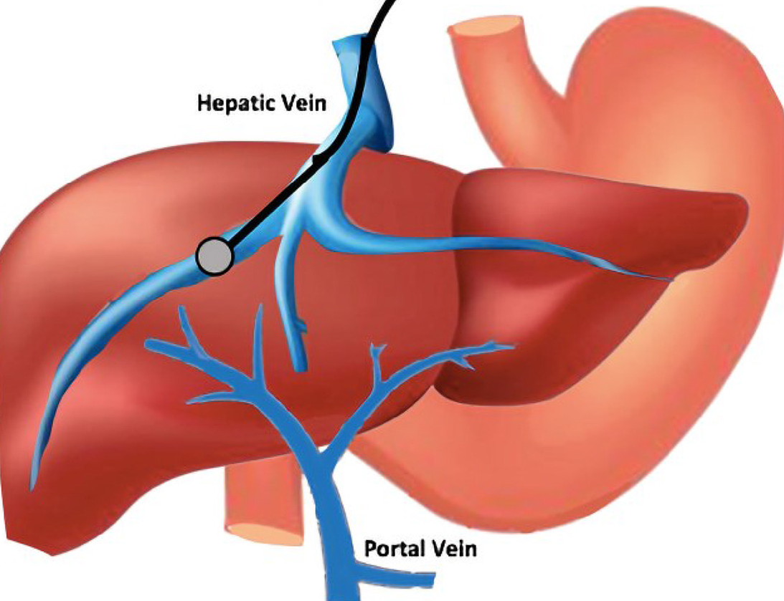
CSPH
CSPH = HVPG ≥10 mmHg
“Decompensation”
Ascites/SBP
Varices/Hemorrhage
Encephalopathy
Varices /
Hemorrhage
Ascites
Kumar et al. 2025 NEJM; Kaplan et al. 2024 Hep; Bazarbashi 2021 GIE
Notes:
How do we know a patient has clinically significant portal hypertension (CSPH) before they have a decompensation?
The hepatic venous pressure gradient or HVPG is calculated as the difference between free hepatic vein pressure (FHVP) and wedged hepatic vein pressure (WHVP), which is a surrogate for portal vein pressure in sinusoidal causes of portal hypertension. This is an invasive measurement done by IR through the central vein or other large peripheral vein access!
If the HVPG or the “gradient” ≥10 mmHg this is clinically significant portal hypertension, with the risk of developing varices, ascites, clinical decompensation, and HCC; risk of decompensation after liver resection for HCC
WHVP can be measured by a | a 'wedging' catheter or b | balloon occlusion. The balloon occlusion technique is preferred, as the volume of the liver circulation sensed by this technique is much larger than that assessed in the wedging catheter method, which increases the accuracy and stability of the results. c | A typical HVPG tracing. Please note the slow speed of the recorder (1 mm/s), the range of pressures, and that equilibration of WHVP requires over 25 s. HVPG is calculated as the difference between WHVP and FHVP. A valid measurement requires two consecutive determinations that differ by less than 1 mmHg, as illustrated. Abbreviations: HVPG, hepatic venous pressure gradient; FHVP, free hepatic venous pressure; WHVP, wedged hepatic venous pressure.

Slide 36
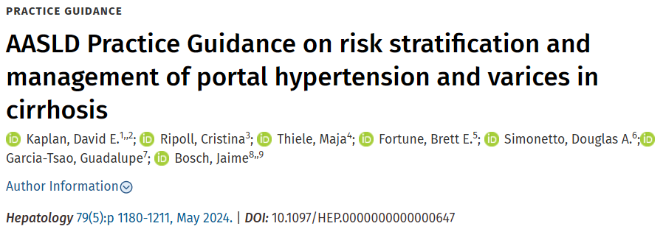
Notes:
So how do we do this without an invasive procedure like a HVPG with IR?

Slide 37
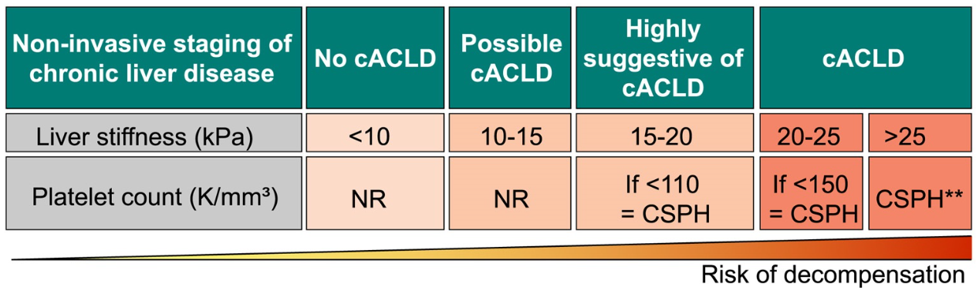
CSPH
VCTE
CBC
Ascites/SBP
Varices/Hemorrhage
Encephalopathy
cACLD: compensated advanced chronic liver disease
Kaplan et al. 2024 Hep
Notes:
What about NON-Invasively? The new guidelines used a consensus called the Baveno VII – an expert consensus from a meeting gathered and reiterated from northern Italy’s Baveno
To diagnose Clinically Significant Portal Hypertension (CSPH) we need the liver stiffness (from the VCTE) and the platelet count (from a CBC)
As the liver becomes stiffer and the platelets are fewer, there is greater risk of the first decompensation event.

Slide 38
Clinically Significant Portal Hypertension (CSPH)
Risk of death
cACLD: compensated advanced chronic liver disease
Kaplan et al. 2024 Hep
Notes:
And with the development of cirrhosis, first decompensation event, and further decompensation event, there is an increased risk of death.

Slide 39
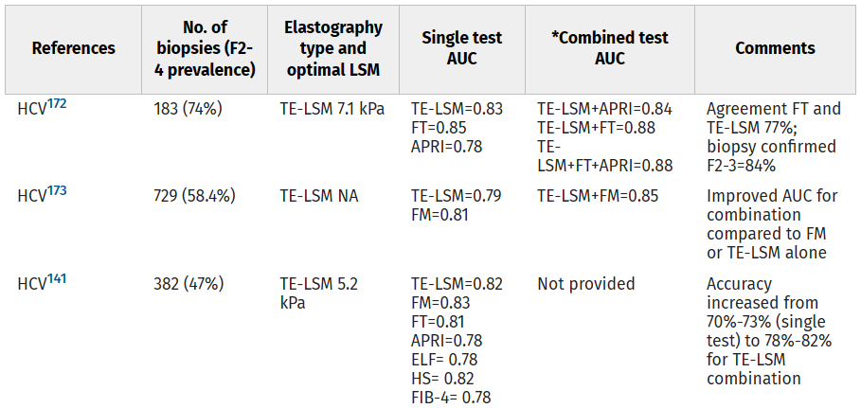
Sterling et al. 2025 Hep; Zarski & ANRS HCEP 23. 2012 J Hepatol

Slide 40
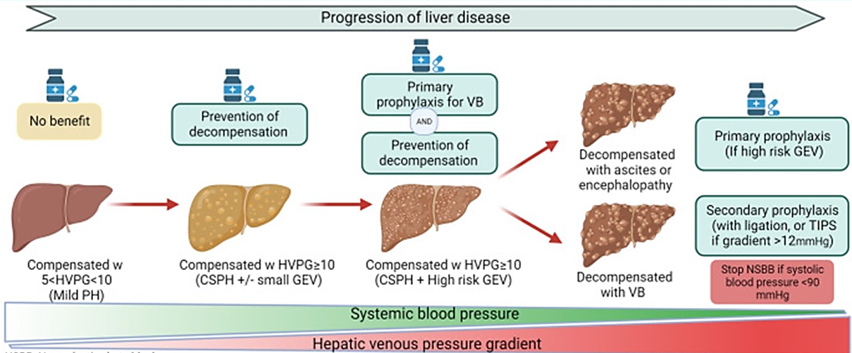
Treating CSPH – NSBB/Carvedilol
Starting dose: 6.25 mg daily x3 days, then 12.5 mg per day No Heart Rate Goal!
Kaplan et al. 2024 Hep; Rabiee & Rabiee CLD 2024
Notes:
Carvedilol allows for a significantly more pronounced decrease in HVPG than traditional NSBBs (such as propranolol and nadolol²⁷). 27 –
Based on its greater reduction of portal pressure in head-to-head comparisons with traditional NSBBs,^{29,30}
a trend for better tolerance, simpler administration, possibility of preventing ascites, and a potential survival advantage,^{31,32}
carvedilol is the preferred NSBB for management of PH.
Read: Starting dose….. Starting dose: 6.25 mg daily x3 days, then 12.5 mg per day No Heart Rate Goal!
Prevent first decompensation
Prevent first variceal hemorrhage
Prevent recurrent hemorrhage (secondary prophylaxis within 7 days, and EGD)
****Can Prevent first decompensation
Data from one prospective trial and a systematic meta-analysis^{4,109} provide support for initiation of NSBB to prevent decompensation in cACLD with CSPH. The PREDESCI study included 201 patients with compensated cirrhosis with CSPH without high-risk varices who were randomly assigned to a beta-blocker (propranolol or carvedilol, according to the acute hemodynamic response to propranolol) or placebo.⁴ NSBB were up-titrated to clinical tolerance as well as to maintain pulse ≥ 55 bpm and systolic blood pressure ≥ 90 mm Hg with planned upper limits of 160 mg and 25 mg for propranolol and carvedilol, respectively. However, the mean dosages of propranolol and carvedilol actually achieved post-titration were 95 mg/day and 19 mg/day, respectively. After 2 years of clinical follow-up, patients treated with NSBB manifested significantly lower risk of decompensation (HR, 0.51; 95% CI, 0.26–0.97), predominantly a lower risk of developing ascites, recently confirmed in a Bayesian reanalysis.¹¹⁰
((((Some caution should be made with applying these findings to all patients with compensated cirrhosis and CSPH because of the unique selection criteria of patients for this study; all patients had confirmed CSPH by HVPG and were not selected for inclusion by NILDA. Additionally, the majority of patients had untreated hepatitis C prior to availability of all-oral direct antiviral therapy, and the effect of ongoing alcohol use was not assessed. In subgroup analysis, patients with nonalcoholic liver disease and small varices appeared to have greater benefit from carvedilol.)))
****Can be a Primary prophylaxis to prevent variceal hemorrhage in dACLD
The administration of carvedilol in patients with high-risk varices and ascites has been associated to an improved survival in a prospective study (HR, 0.41; 95% CI, 0.19–0.96)¹³⁰
and a retrospective study (HR, 0.61; 95% CI, 0.46–0.81).¹³¹
A retrospective long-term follow-up of patients included in a previous RCT comparing carvedilol to EVL for primary prophylaxis, in which half of the patients had ascites and approximately two thirds of the patients were CTP class B and C at baseline, found a survival benefit related to randomization to carvedilol compared with EVL (median survival of 7.8 vs. 4.2 y).¹³²
This effect could be mediated by a decrease in the incidence of further decompensation among patients who receive NSBB.^{15,133–135}
****Can aid in Prevention of recurrent hemorrhage after initial bleeding
After an episode of first AVH, patients are at high risk of rebleeding (up to 60% at 1 y without prophylaxis).¹²⁷ Secondary prophylaxis to prevent rebleeding should be instituted immediately after control of the index bleed, within 7 days from admission (who do not undergo TIPS, NSBB should be initiated at discontinuation of vasoactive therapy), because the highest risk period for rebleeding is the first 6 weeks after presentation. Those without preemptive TIPS should receive secondary prophylaxis with NSBBs and endoscopic band ligation.^{193–195} When compared with EVL alone, the combination of EVL and NSBB reduced rebleeding in all categories of patients and improved survival in patients with CTP class B and C

Slide 41
Treating CSPH – NSBB/Carvedilol
Starting dose: 6.25 mg daily x3 days, then 12.5 mg per day No Heart Rate Goal!
Prevent first decompensation
Prevent first variceal hemorrhage
Prevent recurrent hemorrhage (secondary prophylaxis within 7 days, and EGD)
Kaplan et al. 2024 Hep
Notes:
Carvedilol allows for a significantly more pronounced decrease in HVPG than traditional NSBBs (such as propranolol and nadolol²⁷). 27 –
Based on its greater reduction of portal pressure in head-to-head comparisons with traditional NSBBs,^{29,30}
a trend for better tolerance, simpler administration, possibility of preventing ascites, and a potential survival advantage,^{31,32}
carvedilol is the preferred NSBB for management of PH.
Read: Starting dose…..
****Can Prevent first decompensation
Data from one prospective trial and a systematic meta-analysis^{4,109} provide support for initiation of NSBB to prevent decompensation in cACLD with CSPH. The PREDESCI study included 201 patients with compensated cirrhosis with CSPH without high-risk varices who were randomly assigned to a beta-blocker (propranolol or carvedilol, according to the acute hemodynamic response to propranolol) or placebo.⁴ NSBB were up-titrated to clinical tolerance as well as to maintain pulse ≥ 55 bpm and systolic blood pressure ≥ 90 mm Hg with planned upper limits of 160 mg and 25 mg for propranolol and carvedilol, respectively. However, the mean dosages of propranolol and carvedilol actually achieved post-titration were 95 mg/day and 19 mg/day, respectively. After 2 years of clinical follow-up, patients treated with NSBB manifested significantly lower risk of decompensation (HR, 0.51; 95% CI, 0.26–0.97), predominantly a lower risk of developing ascites, recently confirmed in a Bayesian reanalysis.¹¹⁰
((((Some caution should be made with applying these findings to all patients with compensated cirrhosis and CSPH because of the unique selection criteria of patients for this study; all patients had confirmed CSPH by HVPG and were not selected for inclusion by NILDA. Additionally, the majority of patients had untreated hepatitis C prior to availability of all-oral direct antiviral therapy, and the effect of ongoing alcohol use was not assessed. In subgroup analysis, patients with nonalcoholic liver disease and small varices appeared to have greater benefit from carvedilol.)))
****Can be a Primary prophylaxis to prevent variceal hemorrhage in dACLD
The administration of carvedilol in patients with high-risk varices and ascites has been associated to an improved survival in a prospective study (HR, 0.41; 95% CI, 0.19–0.96)¹³⁰
and a retrospective study (HR, 0.61; 95% CI, 0.46–0.81).¹³¹
A retrospective long-term follow-up of patients included in a previous RCT comparing carvedilol to EVL for primary prophylaxis, in which half of the patients had ascites and approximately two thirds of the patients were CTP class B and C at baseline, found a survival benefit related to randomization to carvedilol compared with EVL (median survival of 7.8 vs. 4.2 y).¹³²
This effect could be mediated by a decrease in the incidence of further decompensation among patients who receive NSBB.^{15,133–135}
****Can aid in Prevention of recurrent hemorrhage after initial bleeding
After an episode of first AVH, patients are at high risk of rebleeding (up to 60% at 1 y without prophylaxis).¹²⁷ Secondary prophylaxis to prevent rebleeding should be instituted immediately after control of the index bleed, within 7 days from admission (who do not undergo TIPS, NSBB should be initiated at discontinuation of vasoactive therapy), because the highest risk period for rebleeding is the first 6 weeks after presentation. Those without preemptive TIPS should receive secondary prophylaxis with NSBBs and endoscopic band ligation.^{193–195} When compared with EVL alone, the combination of EVL and NSBB reduced rebleeding in all categories of patients and improved survival in patients with CTP class B and C

Slide 42
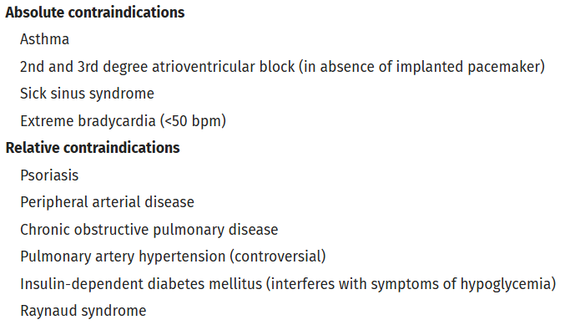
Treating CSPH – NSBB/Carvedilol
Sensitive to lower heart rate
Sensitive to β-blockade
Kaplan et al. 2024 Hep
Notes:
Carvedilol allows for a significantly more pronounced decrease in HVPG than traditional NSBBs (such as propranolol and nadolol²⁷). 27 –
Based on its greater reduction of portal pressure in head-to-head comparisons with traditional NSBBs,^{29,30}
a trend for better tolerance, simpler administration, possibility of preventing ascites, and a potential survival advantage,^{31,32}
carvedilol is the preferred NSBB for management of PH.
Data from one prospective trial and a systematic meta-analysis^{4,109} provide support for initiation of NSBB to prevent decompensation in cACLD with CSPH. The PREDESCI study included 201 patients with compensated cirrhosis with CSPH without high-risk varices who were randomly assigned to a beta-blocker (propranolol or carvedilol, according to the acute hemodynamic response to propranolol) or placebo.⁴ NSBB were up-titrated to clinical tolerance as well as to maintain pulse ≥ 55 bpm and systolic blood pressure ≥ 90 mm Hg with planned upper limits of 160 mg and 25 mg for propranolol and carvedilol, respectively. However, the mean dosages of propranolol and carvedilol actually achieved post-titration were 95 mg/day and 19 mg/day, respectively. After 2 years of clinical follow-up, patients treated with NSBB manifested significantly lower risk of decompensation (HR, 0.51; 95% CI, 0.26–0.97), predominantly a lower risk of developing ascites, recently confirmed in a Bayesian reanalysis.¹¹⁰
((((Some caution should be made with applying these findings to all patients with compensated cirrhosis and CSPH because of the unique selection criteria of patients for this study; all patients had confirmed CSPH by HVPG and were not selected for inclusion by NILDA. Additionally, the majority of patients had untreated hepatitis C prior to availability of all-oral direct antiviral therapy, and the effect of ongoing alcohol use was not assessed. In subgroup analysis, patients with nonalcoholic liver disease and small varices appeared to have greater benefit from carvedilol.)))
Primary prophylaxis to prevent variceal hemorrhage in dACLD
The administration of carvedilol in patients with high-risk varices and ascites has been associated to an improved survival in a prospective study (HR, 0.41; 95% CI, 0.19–0.96)¹³⁰
and a retrospective study (HR, 0.61; 95% CI, 0.46–0.81).¹³¹
A retrospective long-term follow-up of patients included in a previous RCT comparing carvedilol to EVL for primary prophylaxis, in which half of the patients had ascites and approximately two thirds of the patients were CTP class B and C at baseline, found a survival benefit related to randomization to carvedilol compared with EVL (median survival of 7.8 vs. 4.2 y).¹³²
This effect could be mediated by a decrease in the incidence of further decompensation among patients who receive NSBB.^{15,133–135}
After an episode of first AVH, patients are at high risk of rebleeding (up to 60% at 1 y without prophylaxis).¹²⁷ Secondary prophylaxis to prevent rebleeding should be instituted immediately after control of the index bleed, within 7 days from admission, because the highest risk period for rebleeding is the first 6 weeks after presentation.

Slide 43
Treating CSPH – NSBB/Carvedilol
NSBB discontinuation should prompt consideration of endoscopic evaluation for presence of high-risk varices requiring band ligation.
Sensitive to lower heart rate
Sensitive to β-blockade
Hold:
Hypotension < 90 mmHg
Uncontrolled infection
Hyponatremia < 130 mEq
Acute Kidney Injury (AKI)
Diuretic-resistant ascites
Rodrigues et al 2019 J Hep
Notes:
By extension of the contraindications, we hold the carvedilol in states that are sensitive to iatrogenic bradycardia or beta blockade. Such as states of hypotension, including precursors to sepsis such as infection….
And if we need to completely discontinue carvedilol, we should consider if the patient needs EVL.
Diuretic-resistant ascites (Furosemide 160mg, Spirono 400mg)

Slide 44
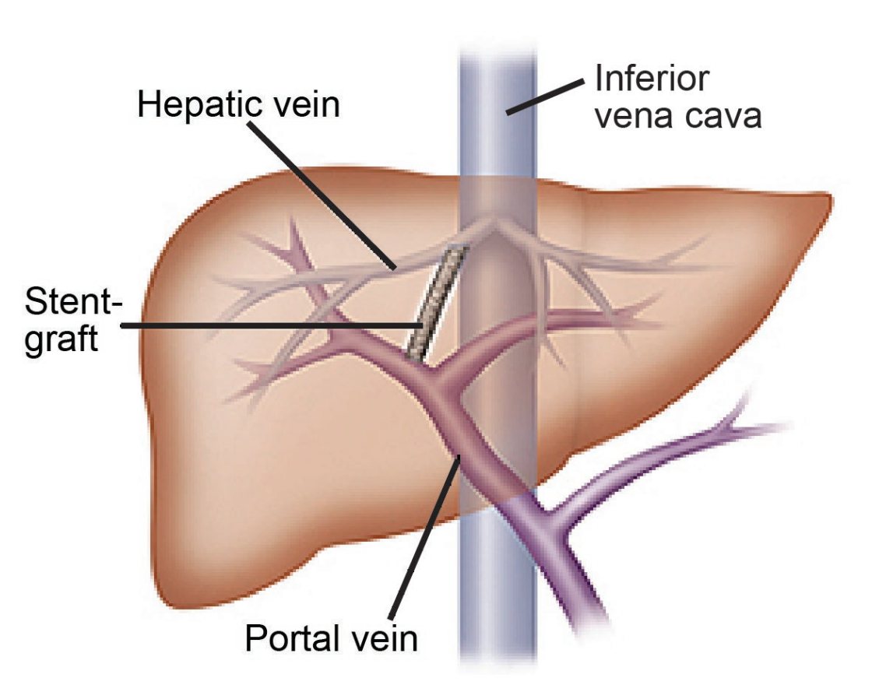
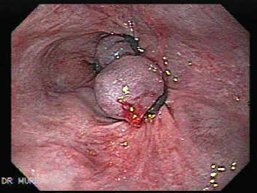
Treating CSPH – NSBB/Carvedilol
NSBB discontinuation should prompt consideration of endoscopic evaluation for presence of high-risk varices requiring band ligation.
Sensitive to lower heart rate
Sensitive to β-blockade
Hold:
Hypotension < 90 mmHg
Uncontrolled infection
Hyponatremia < 130 mEq
Acute Kidney Injury (AKI)
Diuretic-resistant ascites
Endoscopic Variceal Ligation (EVL) via EGD
Transjugular Intrahepatic Portosystemic Shunt (TIPS) via IR
Rodrigues et al 2019 J Hep; www.gastrointestinalatlas.com
Notes:
By extension of the contraindications, we hold the carvedilol in states that are sensitive to iatrogenic bradycardia or beta blockade. Such as states of hypotension, including precursors to sepsis such as infection….
And if we need to completely discontinue carvedilol, we should consider if the patient needs EVL.
Diuretic-resistant ascites (Furosemide 160mg, Spirono 400mg)

Slide 45
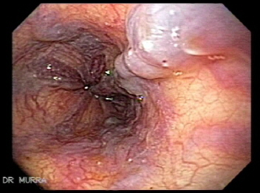
Endoscopic Variceal Ligation (EVL) via EGD
Who should receive EGD:
> Cannot tolerate carvedilol (initiate, then q2 or 3 years)
> Prevent first variceal hemorrhage (primary prophylaxis)
> Prevent recurrent variceal hemorrhage
(secondary, q4w then q6mo)
Contraindications:
> Inability to tolerate sedation
Important side effects:
> Banding ulceration
www.gastrointestinalatlas.com
Notes:
True failure of primary prophylaxis with NSBB (propranolol or nadolol) is associated with a persistently high risk of rebleeding and death despite addition of EVL¹⁹⁹ for secondary prophylaxis.
If endoscopic variceal ligation (EVL) is selected for primary prophylaxis of high-risk varices, EVL should be repeated until all varices are eradicated. Intervals between endoscopies evaluated in clinical trials for primary and secondary prophylaxis have ranged from 1 to 8 weeks.^{119–124} In a prospective randomized trial for secondary prophylaxis, no difference in overall obliteration rates after 3 endoscopy sessions was demonstrated in patients undergoing repeat endoscopy every 2 weeks (at week 2 and week 4) compared with those selected to undergo endoscopy every 8 weeks (at week 8 and week 16), with persistent banding ulcers only observed in the every 2 week arm, and higher rates for reintervention during long-term follow-up required in the every 2 week arm.¹²⁵ In a more recent study, repeat endoscopy after AVH every 1 week showed no superiority to repeat endoscopy every 2 weeks until eradication with regard to recurrent bleeding, safety, or mortality.¹²⁶ Based on limited data, a recommendation was made for an interval of 2–4 weeks, favoring 4 weeks to allow banding ulcers to heal. After eradication, periodic endoscopy should be repeated every 6–12 months.
***Endoscopy
In patient with cACLD with CSPH for whom beta-blockers cannot be safely administered, endoscopic surveillance should be initiated with an intent to prevent first variceal hemorrhage (primary prophylaxis) through prophylactic endoscopic band ligation of high-risk varices. Performance of an endoscopy every 2 years is recommended; however, if cause of the liver disease is under control (alcohol abstinence, weight control, viral suppression or elimination, etc.), endoscopic surveillance may be done every 3 years.⁹⁴ In some cases, cessation of surveillance may be considered after negative serial endoscopic assessments in the setting of complete disease resolution (e.g., sustained sobriety, SVR after HCV direct-acting antiviral therapy with complete normalization of aspartate aminotransferase and alanine aminotransferase), LSM < 12 kPa, and platelet >150 K/mm³.¹¹⁸
If endoscopic variceal ligation (EVL) is selected for primary prophylaxis of high-risk varices, EVL should be repeated until all varices are eradicated. Intervals between endoscopies evaluated in clinical trials for primary and secondary prophylaxis have ranged from 1 to 8 weeks.^{119–124}

Slide 46
TIPS
Who should be evaluated for TIPS:
  > Can’t tolerate NSBB
  > Recurrent variceal bleeding
  > Varices or shunts not amenable to ligation
  > Diuretic refractory ascites
Contraindications:
  > Severe liver failure
  > Reasons for procedural intolerance (sepsis)
  > Heart Failure, Pulmonary Hypertension
Important side effects:
> Worsened encephalopathy
Notes:
partial PVT – TIPS to keep the PV open for transplant possibility (restore hepatopedal flow)
TIPS when used as first-line therapy for secondary prophylaxis is associated with lower rebleeding rates compared with EVL + NSBB but has no impact on survival and is associated with higher rates of HE.^{201,202} Therefore, TIPS placement as first-line approach for secondary prophylaxis should be reserved for patients with other indications for TIPS, such as recurrent/refractory ascites, where it may improve survival.²⁰³ The use of TIPS as first option in secondary prophylaxis in other high-risk groups has not been adequately studied so far. TIPS is recommended for patients who rebleed despite adequate secondary prophylaxis, especially those with rebleeding within the first 6 weeks.²⁰⁴

Slide 47
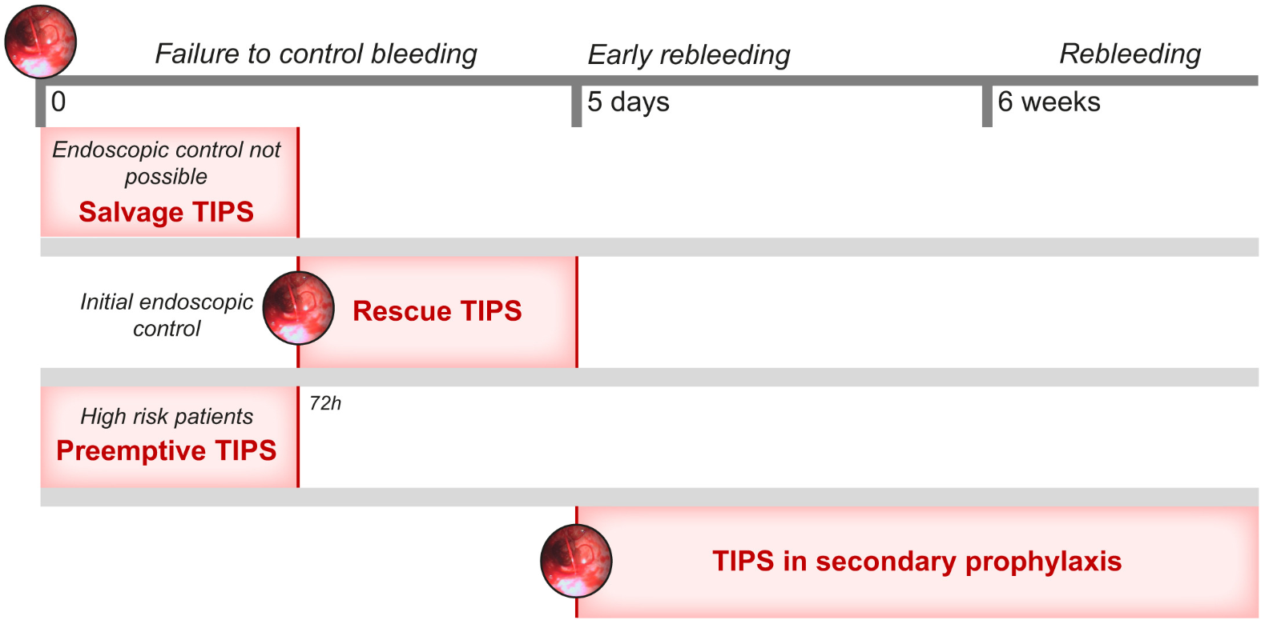
Can’t tolerate NSBB
Remote locations

Slide 48
Key Take-homes – Part 1
Ultrasound is not sufficient for cirrhosis evaluation
Blood-based AND imaging-based in combination give the best sensitivity and specificity (eg FIB4 + VCTE)
Stiff liver (LSM) and low platelets = CSPH
Manage CSPH with Carvedilol (need EGD if have bled!)
Clinically Significant Portal Hypertension (CSPH), ie portal hypertension

Slide 49
Cirrhosis – Part 2
Chronic disease care in the clinic
Notes:
Introductions

Slide 50
Learning Objectives – Part 2
Review post-hospitalization key items (NSBB, SBP ppx…)
Outline key health maintenance for people with cirrhosis
    infection management
    nutrition
Review the standard of surveillance of hepatocellular carcinoma
Notes:
Before we jump in, I want to note that we will have a wide range of backgrounds – a strength of our ECHO community! – and as such a wide range of questions. Please feel free to raise your electronic hand, put a question in the chat, or unmute to ask a question. There are no silly questions!

Slide 51
Post-hospitalization appointment
Review hospitalization for:
  cause of admission (esp if decompensation)
  procedures (endoscopy, paracentesis – might change management)
Review medication changes and consider restarting
  Carvedilol held? Next EGD due?
  Spontaneous bacterial peritonitis (SBP) prophylaxis needed?
  Hepatic encephalopathy controlled? Lactulose +/- rifaximin? Driving?
Preventative care!
  Vaccinations
  Movement and Nutrition
  Hepatocellular carcinoma surveillance
  Advanced directives / medical orders for scope of treatment (MOST)
Notes:
Cause for admission: HE, lactulose nonadherence ; no cause determined, but did not have a paracentesis?

Slide 52
Post-hospitalization appointment
Review hospitalization for:
  cause of admission (esp if decompensation)
  procedures (endoscopy, paracentesis – might change management)
Review medication changes and consider restarting
  Carvedilol held? Next EGD due?
  Spontaneous bacterial peritonitis (SBP) prophylaxis needed?
  Hepatic encephalopathy controlled? Lactulose +/- rifaximin? Driving?
Preventative care!
  Vaccinations
  Movement and Nutrition
  Hepatocellular carcinoma surveillance
  Advanced directives / medical orders for scope of treatment (MOST)
NSBB Contraindications:
Hyponatremia (<130)
AKI or difficulty with diuresis
SBP < 90 mmHg
Infection (esp SBP)
Notes:
Cause for admission: HE, lactulose nonadherence ; no cause determined, but did not have a paracentesis?

Slide 53
Post-hospitalization appointment
Review hospitalization for:
  cause of admission (esp if decompensation)
  procedures (endoscopy, paracentesis – might change management)
Review medication changes and consider restarting
  Carvedilol held? Next EGD due?
  Spontaneous bacterial peritonitis (SBP) prophylaxis needed?
  Hepatic encephalopathy controlled? Lactulose +/- rifaximin? Driving?
Preventative care!
  Vaccinations
  Movement and Nutrition
  Hepatocellular carcinoma surveillance
  Advanced directives / medical orders for scope of treatment (MOST)
NSBB Contraindications:
Hyponatremia (<130)
AKI or difficulty with diuresis
SBP < 90 mmHg
Infection (esp SBP)
Notes:
Cause for admission: HE, lactulose nonadherence ; no cause determined, but did not have a paracentesis?

Slide 54
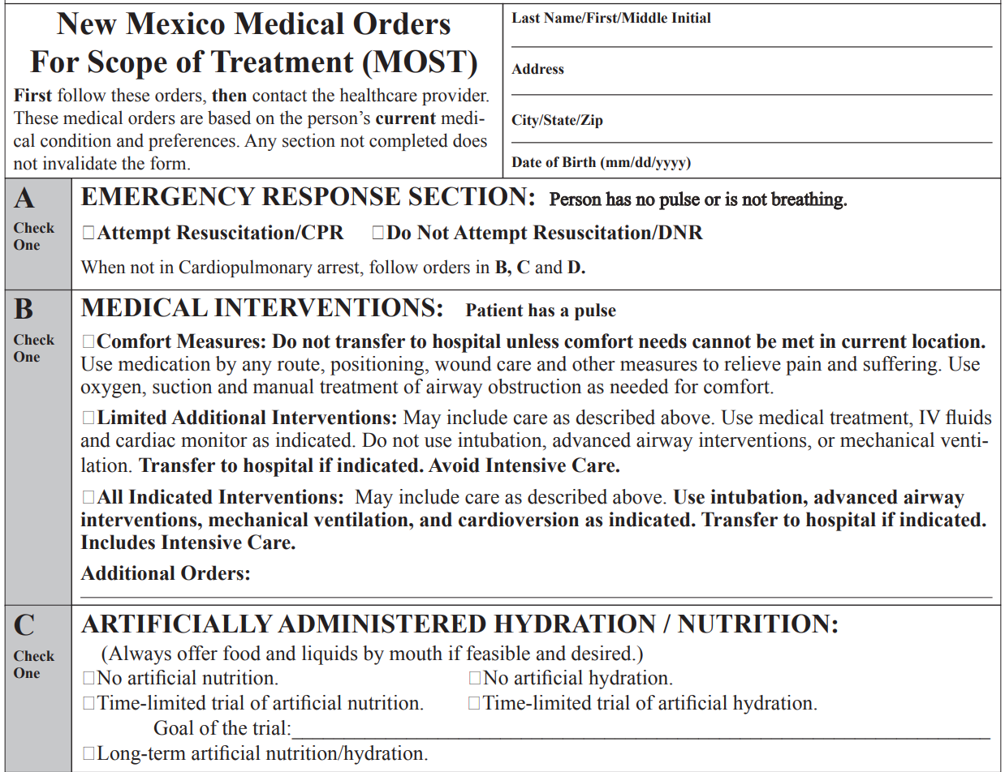
endoflifeoptionsnm.org

Slide 55
Infection management
Infection is a major cause of decompensation, hospitalization, and death
Pneumonia is the most common cause of infectious mortality in cirrhosis
Vaccinations
Core liver-specific vaccines:
  HAV, HBV (if nonimmune)
Respiratory protection:
  PCV20/PCV15+PPSV23 (PCV21)
  Respiratory syncytial virus (RSV, 50+)
  Annual influenza, COVID-19
Standard adult vaccines:
  Tdap/Td
  recombinant zoster (e.g. Shingrix 19+ if immunocompromised)
  MMR/Varicella (if nonimmune)
  HPV (age-based)
Atteberry et al. 2021 J Gastroenterol Hepatol
Notes:
Hepatitis A (HAV)
Why: Acute HAV can cause fulminant liver failure in cirrhosis.
Schedule: 2-dose series (0 and 6–12 months).
Check immunity first if prior exposure possible.
Hepatitis B (HBV)
Why: HBV superinfection dramatically worsens outcomes.
Schedule options:
Standard 3-dose series (0, 1, 6 months), or
High-dose or 2-dose recombinant (e.g., Heplisav-B) for better immunogenicity.
Check anti-HBs after series; boosters may be needed if poor response.
Influenza (Annual)
Why: Cirrhosis increases risk of complications from flu.
Recommendation: Annual inactivated influenza vaccine.
For immunocompromising conditions including chronic liver disease:
Use one of these pathways:
PCV20 once (preferred for simplicity)
OR
PCV15 followed by PPSV23 at least 1 year later.
(If a patient already had PPSV23 previously, recommendations adjust—usually give PCV20 or PCV15 depending on timing.)
COVID-19 Vaccination
Why: Cirrhosis increases risk of severe disease.
Recommendation: Stay up-to-date with current COVID vaccine schedules and boosters.
Tdap / Td
Why: Standard adult protection; cirrhosis itself doesn’t modify schedule.
Recommendation:
1 dose of Tdap in adulthood
Td or Tdap every 10 years thereafter.
Shingles (Herpes Zoster) – Recombinant zoster (Shingrix)
Recommendation:
Adults 50+ (2-dose series)
Also indicated at 19+ if immunocompromised (decompensated cirrhosis is often treated as such).
MMR and Varicella (IF nonimmune)
Only for immune-naïve, non-pregnant adults without contraindications.
Important: Live vaccines should not be given in patients with significant immunosuppression (e.g., some transplant candidates).
HPV (if age-eligible)
Routine through age 26, and shared decision-making 26–45.

Slide 56
Infection management
Infection is a major cause of decompensation, hospitalization, and death
Pneumonia is the most common cause of infectious mortality in cirrhosis
Vaccinations
Core liver-specific vaccines:
  HAV, HBV (if nonimmune)
Respiratory protection:
  PCV20/PCV15+PPSV23 (PCV21 – no sero4!)
  Respiratory syncytial virus (RSV, 50+)
  Annual influenza, COVID-19
Standard adult vaccines:
  Tdap/Td
  recombinant zoster (e.g. Shingrix 19+ if immunocompromised)
  MMR/Varicella (if nonimmune)
  HPV (age-based)
Atteberry et al. 2021 J Gastroenterol Hepatol
Notes:
Hepatitis A (HAV)
Why: Acute HAV can cause fulminant liver failure in cirrhosis.
Schedule: 2-dose series (0 and 6–12 months).
Check immunity first if prior exposure possible.
Hepatitis B (HBV)
Why: HBV superinfection dramatically worsens outcomes.
Schedule options:
Standard 3-dose series (0, 1, 6 months), or
High-dose or 2-dose recombinant (e.g., Heplisav-B) for better immunogenicity.
Check anti-HBs after series; boosters may be needed if poor response.
Influenza (Annual)
Why: Cirrhosis increases risk of complications from flu.
Recommendation: Annual inactivated influenza vaccine.
For immunocompromising conditions including chronic liver disease:
Use one of these pathways:
PCV20 once (preferred for simplicity)
OR
PCV15 followed by PPSV23 at least 1 year later.
(If a patient already had PPSV23 previously, recommendations adjust—usually give PCV20 or PCV15 depending on timing.)
COVID-19 Vaccination
Why: Cirrhosis increases risk of severe disease.
Recommendation: Stay up-to-date with current COVID vaccine schedules and boosters.
Tdap / Td
Why: Standard adult protection; cirrhosis itself doesn’t modify schedule.
Recommendation:
1 dose of Tdap in adulthood
Td or Tdap every 10 years thereafter.
Shingles (Herpes Zoster) – Recombinant zoster (Shingrix)
Recommendation:
Adults 50+ (2-dose series)
Also indicated at 19+ if immunocompromised (decompensated cirrhosis is often treated as such).
MMR and Varicella (IF nonimmune)
Only for immune-naïve, non-pregnant adults without contraindications.
Important: Live vaccines should not be given in patients with significant immunosuppression (e.g., some transplant candidates).
HPV (if age-eligible)
Routine through age 26, and shared decision-making 26–45.

Slide 57
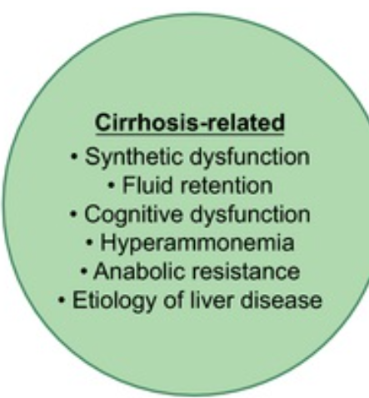
Nutrition
Malnutrition, frailty, and sarcopenia are common in patients with cirrhosis
Disease-specific: fat soluble vitamins (ADEK), healthy calorie displacement (MASLD/ALD)
Protein deficient
Frailty has been strongly associated with mortality
Lai et al 2021 Hep
Notes:
Malnutrition - A clinical syndrome that results from deficiencies or excesses of nutrient intake, imbalance of essential nutrients, or impaired nutrient use⁽⁴⁾
An imbalance (deficiency or excess) of nutrients that causes measurable adverse effects on tissue/body form (body shape, size, composition) or function and/or clinical outcome⁽¹⁾
Frailty - A clinical state of decreased physiologic reserve and increased vulnerability to health stressors⁽²
The phenotypic representation of impaired muscle contractile function
Sarcopenia - A progressive and generalized skeletal muscle disorder associated with an increased likelihood of adverse outcomes including falls, fractures, disability, and mortality⁽³⁾
The phenotypic representation of loss of muscle mass

Slide 58
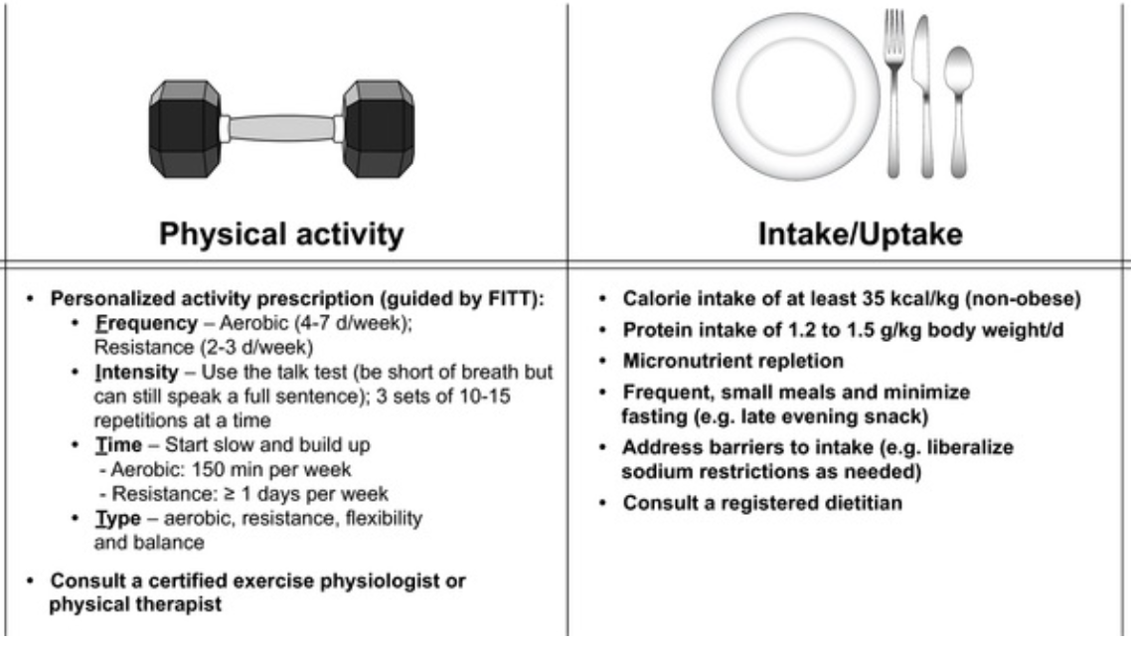
Notes:
90 kilo / 200# man =3150 calories
High protein does not cause encephalopathy
EVENING SNACK

Slide 59
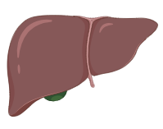
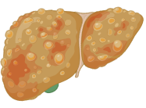
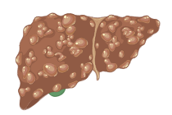
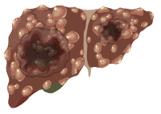
Hepatocellular carcinoma surveillance
Liver Ultrasound every 6 months, paired with serum AFP for best sensitivity
≥1.0% per year incidence: Sufficient to warrant surveillance, cost-effectiveness
Child-Pugh A–B cirrhosis, any etiology
Child-Pugh C cirrhosis, transplant candidate
Non-cirrhotic chronic hepatitis B (Special Populations)
Unclear: Stage 3 Fibrosis in HCV, Non-cirrhotic MASLD
Singal et al. 2023. Hepatology
Llovet et al. 2021. Nat Rev Dis Primer
BioRender
Notes:
Child-Pugh A–B cirrhosis, any etiology ≥1.0% per year
Hepatitis B
Hepatitis C (viremic or post-SVR)
Alcohol associated cirrhosis
Nonalcoholic steatohepatitis
Other etiologies
Child-Pugh C cirrhosis, transplant candidate
Non-cirrhotic chronic hepatitis B ≥0.2% per year
Man from endemic countryª age >40 y
Woman from endemic countryª age > 50 y
Person from Africa at earlier age^{b}
Family history of HCC
PAGE-B score ≥ 10^{c}
Hepatitis C and stage 3 fibrosis< 0.2% per year
Noncirrhotic NAFLD – as in non-cirrhotic MASLD, nearly 25% of MASLD-associated HCCs occur in the absence of cirrhosis
Liver Ultrasound every 6 months, paired with serum AFP for best sensitivity (cost effective to 70 years old)
ultrasound alone for early-stage HCC detection only has a sensitivity 53% (95% CI, 35%–70%) and specificity 91% (95% CI, 86%–94%)
ultrasound plus AFP achieves a sensitivity of 63% for early-stage HCC (95% CI, 48%–75%) with a small loss in specificity

Slide 60
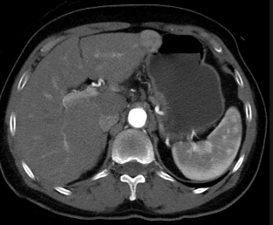
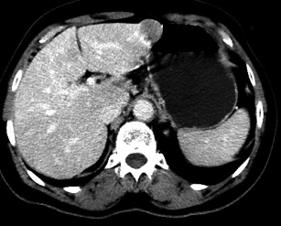
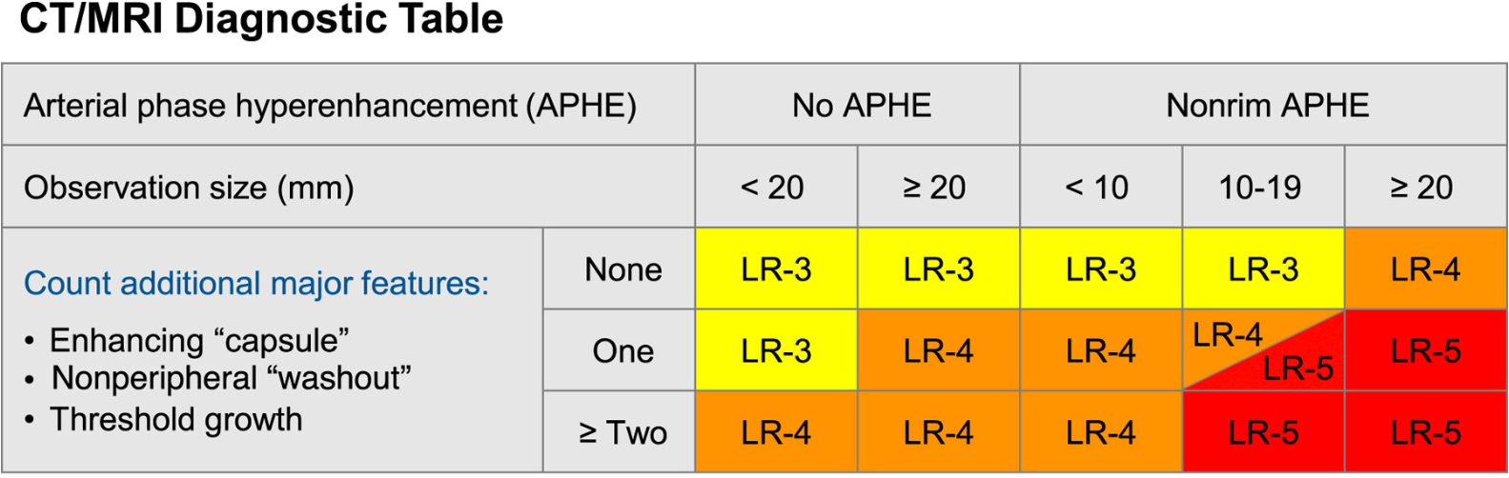
Arterial phase
Portal venous phase
Singal et al. 2023. Hepatology
radiopaedia.org/articles/hepatocellular-carcinoma
Llovet et al. 2021. Nat Rev Dis Primer
Notes:
Surveillance continues indefinitely or until other life-limiting illness would preclude HCC treatment
If Ultrasound detects <1 cm…. [READ]
HCC Diagnosis is unusual for cancer as there is not a dependence on tissue acquisition and most diagnoses are made radiologically. This is done through contrasted imaging Magnetic Resonance or Computed Tomography in order to exploit the pathobiology unique to HCC as compared to the normal hepatic parenchyma
+5-point score (Liver Imaging Reporting and Data System, LI-RADS) based on differences
- Arterial phase hyperenhancement (APHE): arises from that HCC receives most of its blood supply from branches of the hepatic artery, accounting for its characteristic enhancement pattern - the mass enhances vividly during late arterial (~35 seconds) and then washes out rapidly, becoming indistinct or hypoattenuating in the portal venous phase, compared to the rest of the liver which receives its primary blood supple from the PV
Lesion size
Major features: non-enhancing capsule, non peripheral wash out, and threshold growth
Higher LI-RADS score is associated with higher probability of HCC, where LI-RADS 4 is HCC with 60-70% probability and 5 is “definitely” and considered diagnostic at ~95% certainty.

Slide 61
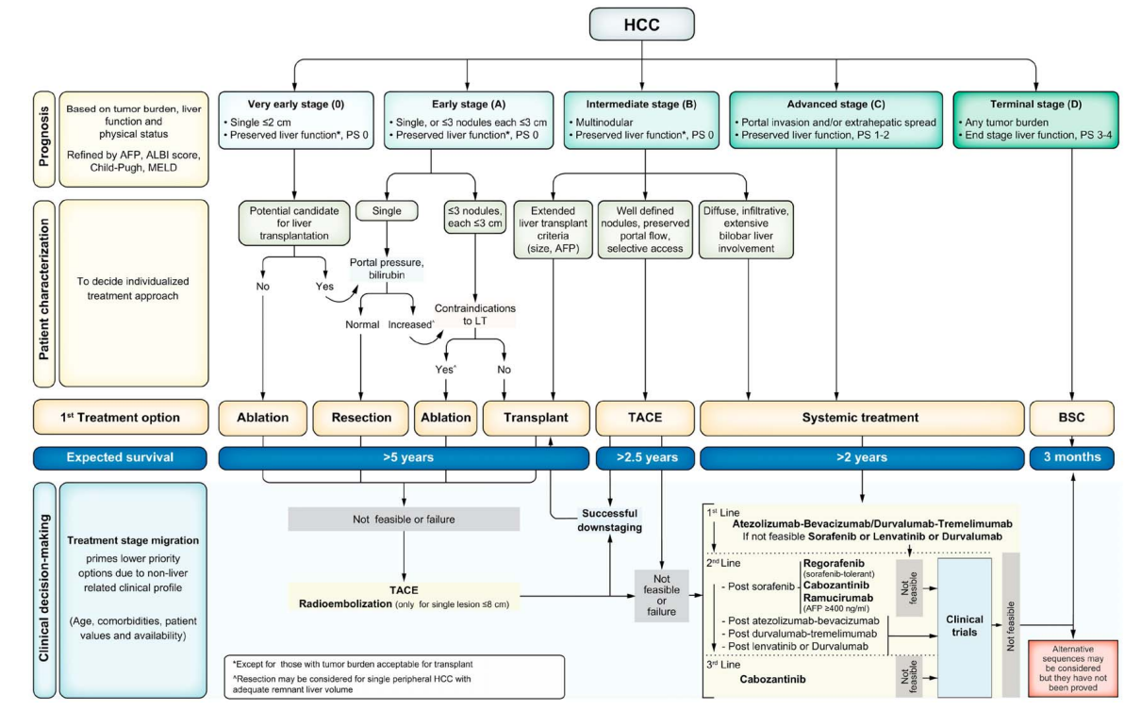
HCC, treatment
BCLC-0
(very early stage)
BCLC-A
(early stage)
BCLC-B
(intermediate stage)
BCLC-C
(advanced stage)
BCLC-D
(end stage)
BCLC Stage
Treatment strategies
Survival Prognosis
Singal et al. 2023. Hepatology
Reig et al. 2022. J Hepatol.
BioRender
Notes:
Barcelona Clinic Liver Cancer (BCLC) staging and treatment strategy from the update in 2022 is the framework most used in the United States to frame the characteristics of HCC for prognostic consideration and guide treatment selection.
Stages are based on tumor size and burden, liver function as estimated by decompensation events and Child-Pugh and MELD scores, as well as patient factors like functional status and transplant candidacy.
So next we’ll step through these stages, recommended treatments and survival estimates, as this is how we think about what treatments and survival we would expect ideally for patients who present at these different stages, regardless of Route to Diagnosis.
Stage BCLC-0 (very early stage):
Stage BCLC-A (early stage):
Stage BCLC-B (intermediate stage):
Stage BCLC-C (advanced stage):
Stage BCLC-D (end stage):

Slide 62
HCC, considerations
Singal et al. 2023. Hepatology
Reig et al. 2022. J Hepatol.
Notes:
ALBI score is Albumin-Bilirubin score in HCC that gives a liver function estimate

Slide 63
Key Take-homes – Part 2
Posthospital – think cause of decompensation, check new or held medications
Respiratory vaccines and calories/protein (especially evening snack!)
HCC screening every 6 mo with US and AFP
Multiphase MRI/CT with LIRADS read

Slide 64
References
Sterling RK, Lissen E, Clumeck N, Sola R, Correa MC, Montaner J, S Sulkowski M, Torriani FJ, Dieterich DT, Thomas DL, Messinger D, Nelson M; APRICOT Clinical Investigators. Development of a simple noninvasive index to predict significant fibrosis in patients with HIV/HCV coinfection. Hepatology. 2006 Jun;43(6):1317-25. doi: 10.1002/hep.21178. PMID: 16729309.
Sterling, Richard K.1; Patel, Keyur2; Duarte-Rojo, Andres3; Asrani, Sumeet K.4; Alsawas, Mouaz5; Dranoff, Jonathan A.6,7; Fiel, Maria Isabel8; Murad, M. Hassan5; Leung, Daniel H.9; Levine, Deborah10; Taddei, Tamar H.6,7; Taouli, Bachir11; Rockey, Don C.12. AASLD Practice Guideline on blood-based noninvasive liver disease assessment of hepatic fibrosis and steatosis. Hepatology 81(1):p 321-357, January 2025. | DOI: 10.1097/HEP.0000000000000845
Zarski JP, Sturm N, Guechot J, Paris A, Zafrani ES, Asselah T, Boisson RC, Bosson JL, Guyader D, Renversez JC, Bronowicki JP, Gelineau MC, Tran A, Trocme C, De Ledinghen V, Lasnier E, Poujol-Robert A, Ziegler F, Bourliere M, Voitot H, Larrey D, Rosenthal-Allieri MA, Fouchard Hubert I, Bailly F, Vaubourdolle M; ANRS HCEP 23 Fibrostar Group. Comparison of nine blood tests and transient elastography for liver fibrosis in chronic hepatitis C: the ANRS HCEP-23 study. J Hepatol. 2012 Jan;56(1):55-62. doi: 10.1016/j.jhep.2011.05.024. Epub 2011 Jul 23. PMID: 21781944.
Vali Y, Lee J, Boursier J, Spijker R, Löffler J, Verheij J, Brosnan MJ, Böcskei Z, Anstee QM, Bossuyt PM, Zafarmand MH; LITMUS systematic review team(†). Enhanced liver fibrosis test for the non-invasive diagnosis of fibrosis in patients with NAFLD: A systematic review and meta-analysis. J Hepatol. 2020 Aug;73(2):252-262. doi: 10.1016/j.jhep.2020.03.036. Epub 2020 Apr 8. PMID: 32275982.
Kumar A, Dancel R, Galen BT, Patel SA, Ma IWY, Cool JA. Ultrasound-Guided Paracentesis. N Engl J Med. 2025 Sep 4;393(9):e11. doi: 10.1056/NEJMvcm2119156. PMID: 40902164.
Kaplan, David E.1,,2; Ripoll, Cristina3; Thiele, Maja4; Fortune, Brett E.5; Simonetto, Douglas A.6; Garcia-Tsao, Guadalupe7; Bosch, Jaime8,,9. AASLD Practice Guidance on risk stratification and management of portal hypertension and varices in cirrhosis. Hepatology 79(5):p 1180-1211, May 2024. | DOI: 10.1097/HEP.0000000000000647
Hai Y, Chong W, Eisenbrey JR, Forsberg F. Network Meta-Analysis: Noninvasive Imaging Modalities for Identifying Clinically Significant Portal Hypertension. Dig Dis Sci. 2022 Jul;67(7):3313-3326. doi: 10.1007/s10620-021-07168-y. Epub 2021 Jul 17. PMID: 34275089; PMCID: PMC8761784.
Zarski JP, Sturm N, Guechot J, Paris A, Zafrani ES, Asselah T, Boisson RC, Bosson JL, Guyader D, Renversez JC, Bronowicki JP, Gelineau MC, Tran A, Trocme C, De Ledinghen V, Lasnier E, Poujol-Robert A, Ziegler F, Bourliere M, Voitot H, Larrey D, Rosenthal-Allieri MA, Fouchard Hubert I, Bailly F, Vaubourdolle M; ANRS HCEP 23 Fibrostar Group. Comparison of nine blood tests and transient elastography for liver fibrosis in chronic hepatitis C: the ANRS HCEP-23 study. J Hepatol. 2012 Jan;56(1):55-62. doi: 10.1016/j.jhep.2011.05.024. Epub 2011 Jul 23. PMID: 21781944.
de Franchis R, Bosch J, Garcia-Tsao G, Reiberger T, Ripoll C; Baveno VII Faculty. Baveno VII - Renewing consensus in portal hypertension. J Hepatol. 2022 Apr;76(4):959-974. doi: 10.1016/j.jhep.2021.12.022. Epub 2021 Dec 30. Erratum in: J Hepatol. 2022 Jul;77(1):271. doi: 10.1016/j.jhep.2022.03.024. PMID: 35120736; PMCID: PMC11090185.
Bazarbashi, Ahmad Najdat et al. Portal pressure measurement: Have we come full circle? 2021. Gastrointestinal Endoscopy, Volume 93, Issue 3, 573 – 576
Rabiee A, Rabiee A. Keep beta-blocking and carry on! Clin Liver Dis (Hoboken). 2024 Jan 31;23(1):e0114. doi: 10.1097/CLD.0000000000000114. PMID: 38304323; PMCID: PMC10833629.
Rodrigues SG, Mendoza YP, Bosch J. Beta-blockers in cirrhosis: Evidence-based indications and limitations. JHEP Rep. 2019 Dec 20;2(1):100063. doi: 10.1016/j.jhepr.2019.12.001. PMID: 32039404; PMCID: PMC7005550.

Slide 65
References
Atteberry P, Biederman B, Jesudian A, Lucero C, Brown RS Jr, Verna E, Sundaram V, Fortune B, Rosenblatt R. Mortality, sepsis, and organ failure in hospitalized patients with cirrhosis vary by type of infection. J Gastroenterol Hepatol. 2021 Dec;36(12):3363-3370. doi: 10.1111/jgh.15633. Epub 2021 Aug 2. PMID: 34293211.
https://endoflifeoptionsnm.org/wp-content/uploads/2021/07/nmmostform2014.pdf
Lai JC, Tandon P, Bernal W, Tapper EB, Ekong U, Dasarathy S, Carey EJ. Malnutrition, Frailty, and Sarcopenia in Patients With Cirrhosis: 2021 Practice Guidance by the American Association for the Study of Liver Diseases. Hepatology. 2021 Sep;74(3):1611-1644. doi: 10.1002/hep.32049. Erratum in: Hepatology. 2021 Dec;74(6):3563. doi: 10.1002/hep.32224. PMID: 34233031; PMCID: PMC9134787.
Singal, Amit G.1; Llovet, Josep M.2,3,4; Yarchoan, Mark5; Mehta, Neil6; Heimbach, Julie K.7; Dawson, Laura A.8; Jou, Janice H.9; Kulik, Laura M.10; Agopian, Vatche G.11; Marrero, Jorge A.12; Mendiratta-Lala, Mishal13; Brown, Daniel B.14; Rilling, William S.15; Goyal, Lipika16; Wei, Alice C.17; Taddei, Tamar H.18,19. AASLD Practice Guidance on prevention, diagnosis, and treatment of hepatocellular carcinoma. Hepatology 78(6):p 1922-1965, December 2023. | DOI: 10.1097/HEP.0000000000000466
Reig M, Forner A, Rimola J, Ferrer-Fàbrega J, Burrel M, Garcia-Criado Á, Kelley RK, Galle PR, Mazzaferro V, Salem R, Sangro B, Singal AG, Vogel A, Fuster J, Ayuso C, Bruix J. BCLC strategy for prognosis prediction and treatment recommendation: The 2022 update. J Hepatol. 2022 Mar;76(3):681-693. doi: 10.1016/j.jhep.2021.11.018. Epub 2021 Nov 19. PMID: 34801630; PMCID: PMC8866082.

