Slide 1
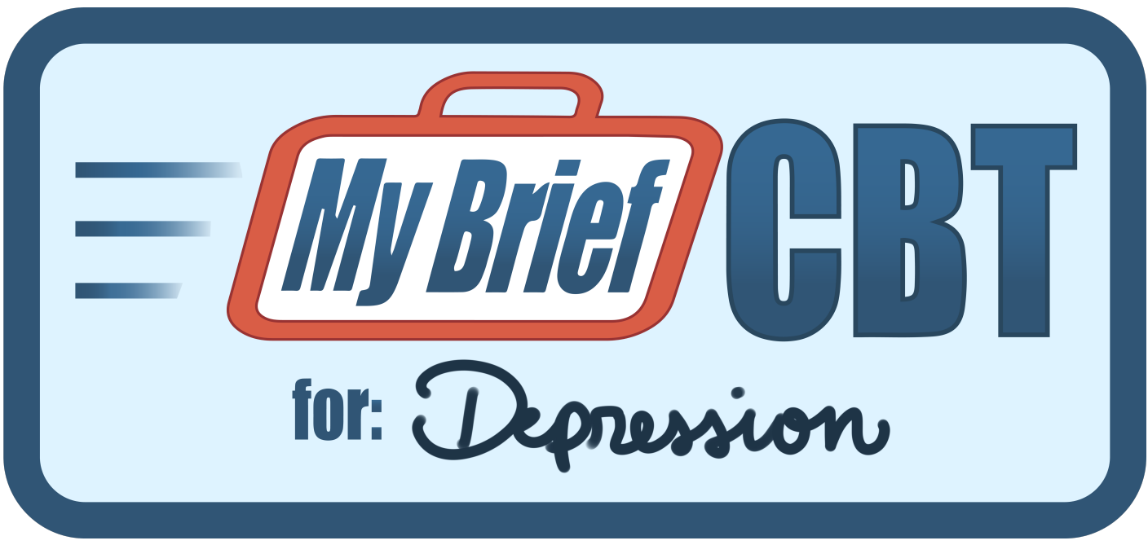


Improving Access to Evidence-Based Psychotherapies
MyBrief CBT for Depression Program
Jeff Cully, PhD
Clinical Psychologist, Houston VA Medical Center
Professor of Psychiatry, Baylor College of Medicine
Associate Director, South Central MIRECC
Indian Country SUD ECHO Presentation Series
September 3, 2026

Slide 2
Objectives
Learners will obtain clinical knowledge about the MyBrief CBT for Depression Program.
Learners will be able to describe how to obtain training to use the MyBrief CBT for Depression Program
Learners will obtain knowledge about the various MyBrief CBT for Depression program resources.

Slide 3
Psychotherapy for Depression
Full course EBPs for depression involve 12+ sessions and limit clinical utility (Mott, 2015)
Brief psychotherapies - 8 or fewer sessions - are efficacious and may increase access (Nieuwsma, 2012)
Brief treatments do not address other barriers
  Provider training and support
  Clinical competing demands
  Fit of treatment in clinical settings

Slide 4
Evidence for Brief Cognitive Behavioral Therapy
Full course CBT has a long and deep evidence-base (Butler, 2006)
Brief Psychotherapy for Depression-Primary Care (Nieuwsma, 2011)
  Methods
    15 RCTs on brief psychotherapy (6 CBT-specific; 8 problems solving therapy)
    Interventions 8 or fewer sessions
  Results
    Meta-analysis for brief CBT – Effect Size 0.42 (95% CI .10-.74)
  Conclusions
    6-8 sessions of brief CBT are more efficacious than usual care, but effects are modest.

Slide 5
MyBrief CBT: Development and Testing

Slide 6

MyBrief CBT Development and Testing
Developed in VA to improve care for Veterans
  Can be applied to non-Veteran populations*
Clinical Intervention Development
  Clinical procedures established in collaboration with
    Veterans
    VA providers
    National experts

Slide 7

MyBrief CBT Research Evidence
MyBrief CBT - 2 large VA trials
  - MyBrief CBT compared to Enhanced Usual Care
  - Outcomes: Depression, Anxiety, and Suicidal Ideation
  - Participants: Veterans recruited from VA Primary Care and Community Clinics
  - Providers: VA clinicians
  Trial #1: VA Primary Care
  (Cully et al., 2017)
  302 medically ill veterans; 19 providers
  Avg 3.9 sessions; 63% treatment completion
  Improved depression and anxiety
  Improvements maintained at 12 months.
  Reduced suicidal ideation. (Ecker, et al., 2019)
  Trial #2: VA Community Clinics
  (Cully et al., 2023)
  189 veterans; 17 providers
  Avg 3.7 sessions; 64% treatment completion
  Improved depression
  Improvements maintained at 12-months.

Slide 8
Overview of MyBrief CBT

Slide 9

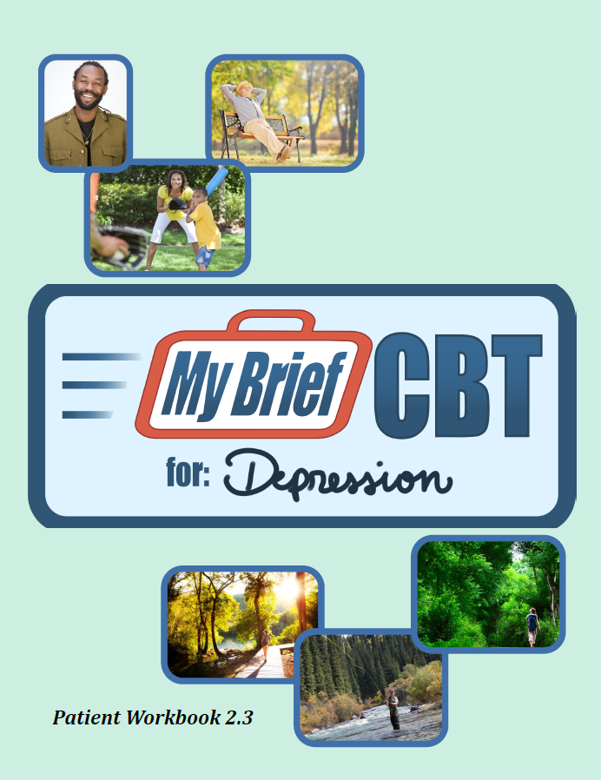
    Targeted Clinicians
    Developed for Psychotherapists
    Psychologists, Social Workers, Nurses, PAs, Counselors, etc.
    Treatment Structure
    * Flexible treatment duration (3-6 sessions)
    * Measurement-based care (PHQ-9)
    * Treatment delivery: weekly/biweekly (active treatment)
    * 30-minute sessions (flexible to 50 minutes)
    * Modular, skills-based intervention
    * Designed for individual therapy
      Group procedures available
    Resources
    Provider Manual
    Veteran Workbook
    Note Templates*
*Word templates available for Non-VA clinicians

Slide 10
Guiding Principles for MyBrief CBT
Patient-Centered
Providers as “Drivers”
Adapt to Patient Needs
Flexible Delivery
Should align with clinic
Skill Selection
Session Content
Duration of Treatment
Intervention Targets
Patients with PHQ-9 of 10+ *
3-4 sessions*
*based on patient need
Notes:
3-4 sessions of care appears ideal. More can be helpful but optional depending on Veteran needs.

Slide 11
MyBrief CBT - Patient Materials
Patient Workbook (mirrored with provider manual)
  Printable Online Version
  Fillable Online Version
  Modules and Extra Worksheet PDFs
Delivery and Use
  Facilitates telehealth encounters
  Provides Veterans with interactive experience
  “Dave” and “Danielle” vignettes
    Enhance patient skill development
  Integrates PHQ-9

Slide 12
MyBrief CBT Intervention Components

Slide 13
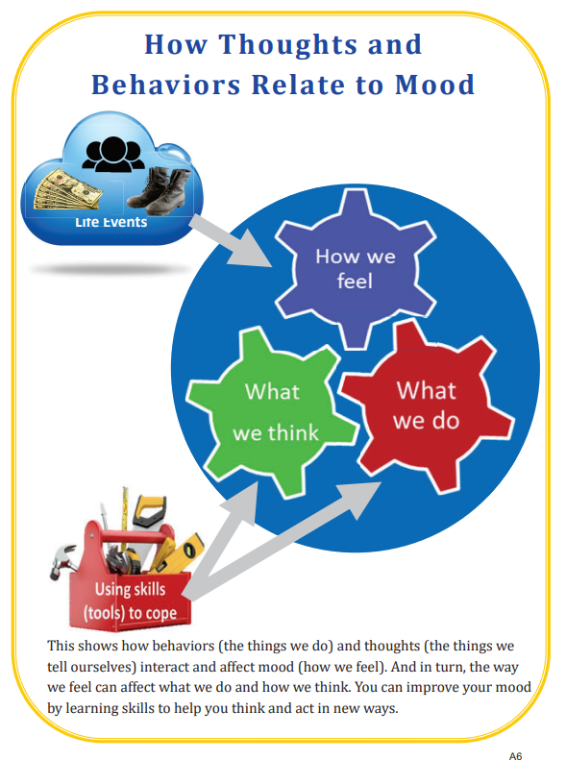

Slide 14




MyBrief CBT Skill Modules
Engaging in Activities to Improve Mood
This module focuses on increasing enjoyable or meaningful activities, as well as connecting with important people in your life. These exercises will help you to feel better about yourself by becoming more active.
Managing Unhelpful Thoughts
This module was designed to change the way you think about stressful situations. These exercises help you to challenge negative or pessimistic thinking and learn to use more practical and balanced thinking strategies.
Using Relaxation Skills to Manage Stress and Tension
This module teaches you to use skills such as deep breathing and imagery to relax yourself physically and mentally. These skills are particularly helpful for individuals who experience stress or tension.
Improving Health and Wellness
This module introduces skills to help improve areas such as physical activity, eating habits, sleep, and pain. Special attention will be given to when you should contact a medical provider.

Slide 15
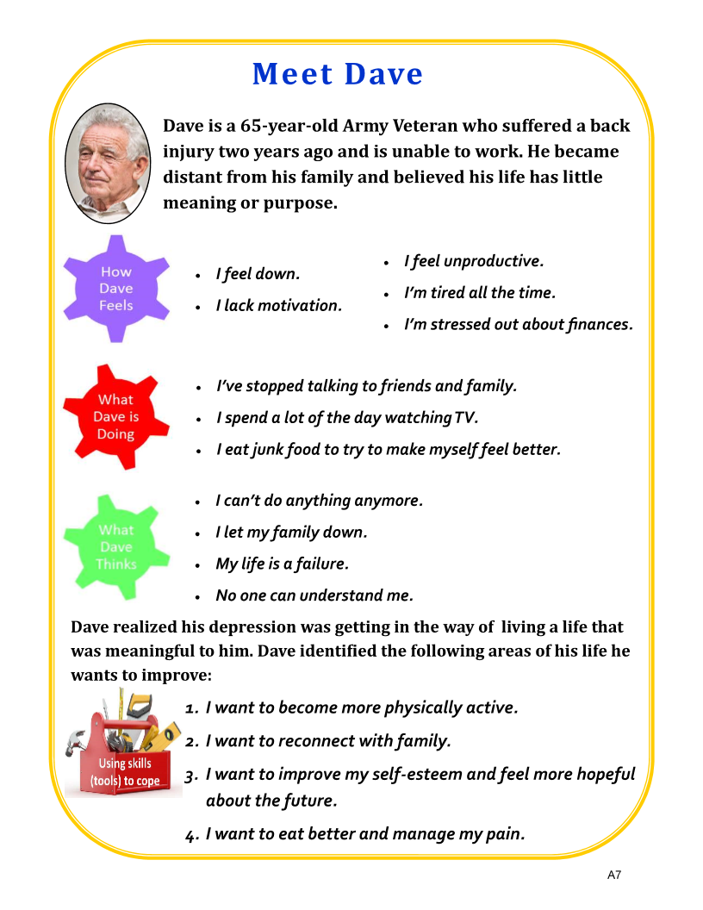

Slide 16
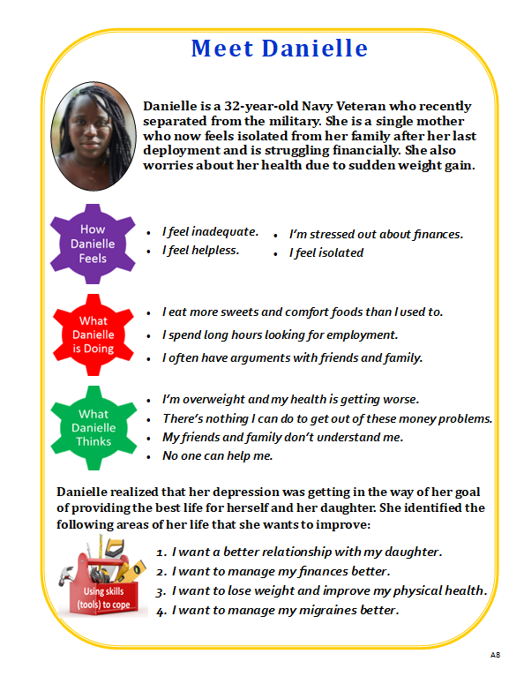

Slide 17
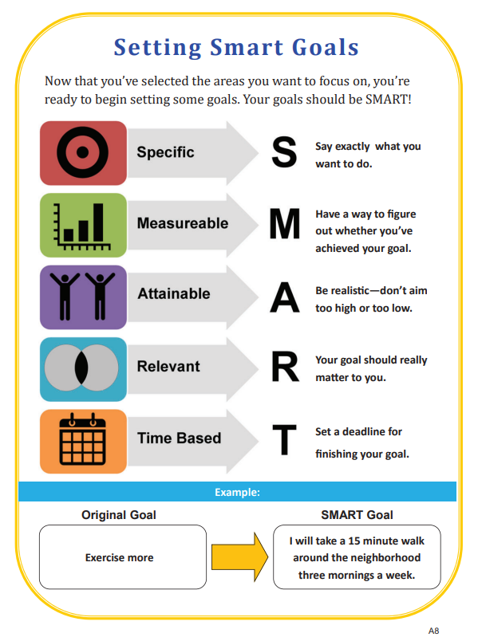
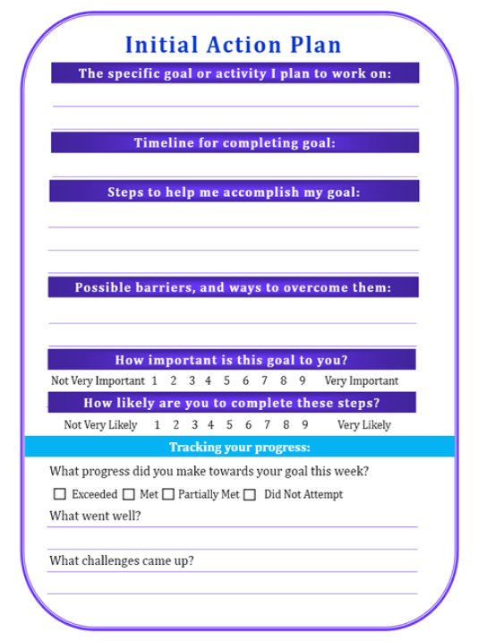

Slide 18
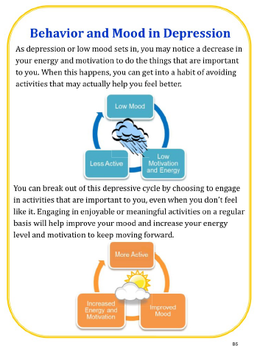
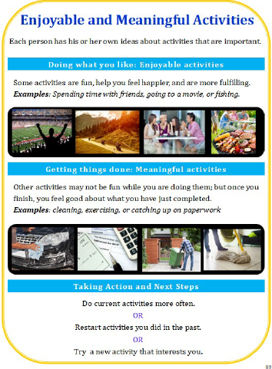

Slide 19

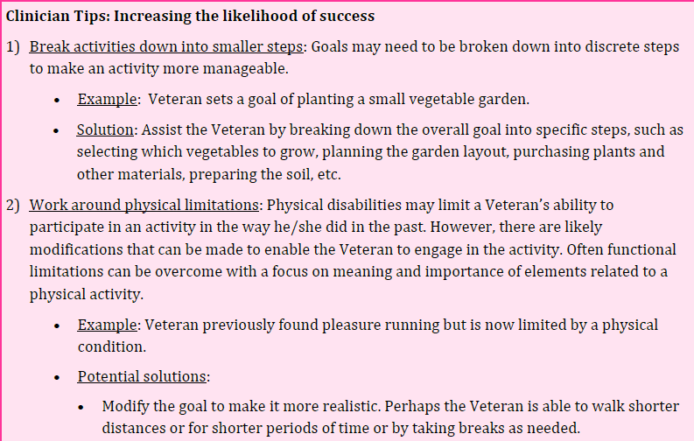

Slide 20
MyBrief CBT: Current use in VA

Slide 21
Clinical Demonstration Project
MyBrief CBT in VHA
(July 2026)
  Veterans Health Administration System Impact
    17 VISNs (regional networks)
    200+ VA Facilities (hospitals and clinics)
      Providers
    500 trained and using the program
    Veterans
      Over 5,500 Veterans served
      Over 19,000 sessions of care delivered

Slide 22
MyBrief CBT Delivery Data
  Session Duration
    30 minutes = 63%
    45-minutes = 16%
    60-minutes = 10%
  PHQ-9 Delivery
    ~80% of sessions
  Average of 3.5 sessions per Veteran
    1 session = 29% (cumulative %)
    2+ sessions = 44%
    3+ sessions = 56%
    4+ sessions = 66%
    5+ sessions = 76%
    6+ sessions = 98%
  Modality
    Video 52% of sessions
    F2F 38%
    Telephone 10%

Slide 23
MyBrief CBT Outcome Data
 | PHQ-9 Change
All Veterans | 2.8
PHQ-9 of 10+ | 4.2
Delivery (PHQ-9 10+) In Person VVC Telephone | 4.4 3.9 5.7
PHQ-9 Reference Data
Brief CBT RCT change = 3.5
Clinically Imp Difference = 5.0

Slide 24
MyBrief CBT Outcome Data
 | PHQ-9 Change Patients with 10+
Overall (2+ sessions) | 3.7
3+ sessions | 4.1
4+ sessions | 4.6
5+ sessions | 4.7
Gender Male (n= 847) Female (n=191) | 4.1 4.9
Race/Ethnicity White Black / African American Hispanic | 4.1 4.4 4.5
Rural/Highly Rural | 3.7
PHQ-9 Reference Data
Brief CBT RCT change = 3.5
Clinically Imp Difference = 5.0

Slide 25
MyBrief CBT Resources

Slide 26
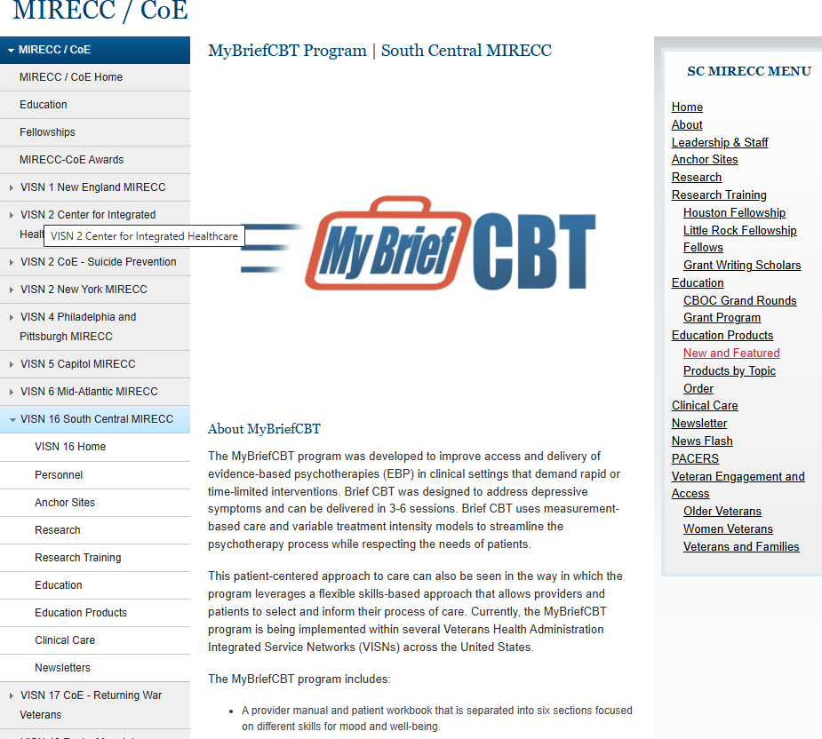
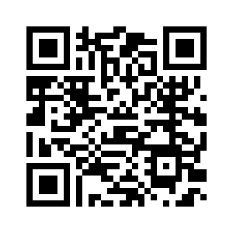
MyBrief CBT Materials
SC MIRECC Education Product
  Provider Full Manual
  Provider Abbreviated Manual
  Veteran/Patient Workbook
  Note Templates (available upon request)
https://www.mirecc.va.gov/visn16/mybriefcbt.asp

Slide 27
Training and Collaboration Opportunities

Slide 28
Clinician Training and Support
Program Goal: Help clinicians use MyBrief CBT in their daily practice.
  Leverages provider experience and independent practice status
  Does not include competency cases
Tailored online training = clinical intervention / procedural knowledge
Optional Consultation Support = to help providers deliver treatment
  Clinical assistance - how to use MyBrief CBT with patients
  Delivery assistance - addressing practice challenges (e.g., identifying patients, scheduling challenges, setting delivery goals and monitoring progress)

Slide 29
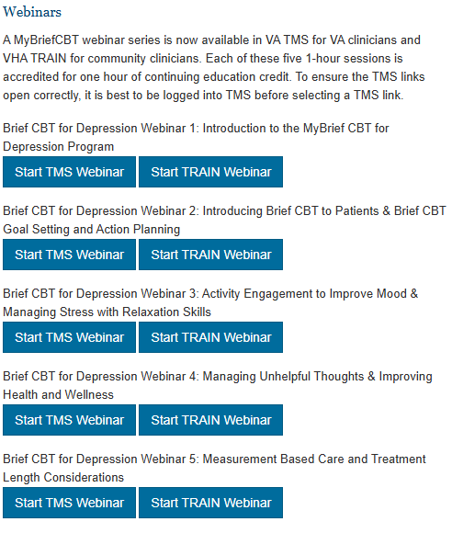

Online Training Program
TRAIN Webinars
  Five 1-hour training seminars available
https://www.mirecc.va.gov/visn16/mybriefcbt.asp

Slide 30

Consultation
Providers meet with MyBrief CBT consultants monthly (x4)
Consultants
  Address questions or challenges during the online training process
  Work with the provider after the online training program to:
    Address clinical questions
    Set delivery goals
    Address barriers to using Brief CBT
    Connect providers to resources
    Provide feedback, encouragement, recognition for progress

Slide 31
Delivering MyBrief CBT
Providers are encouraged to begin delivery of MyBrief CBT after the completion of the online training program.
  Consultants will encourage and support through first patients
  Goal is to engage at least 2 Veterans during consultation process
Providers to use MyBrief CBT with at least 1 patient per month.
  Most providers report using the program more frequently

Slide 32
MyBrief CBT Consultants
Providers can become consultants and local / regional champions
Work with the NRT to develop competencies and create site/regional plans.
Approach MyBrief CBT National Resource Team
  VHAHOUmybriefCBT_NRT@va.gov

Slide 33
Questions and Discussion about MyBrief CBT for Depression

Slide 34

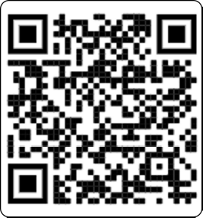

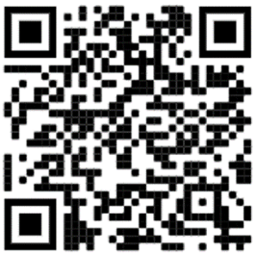
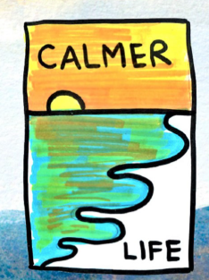
Related CBT Resources
 | Topic | Authors | Resources Available
 | “A Provider’s Guide to Brief Cognitive Behavioral Therapy” | Cully, Dawson, Hamer, Tharp 2021 | Provider Manual Patient Worksheets
 | “Living with Purpose: A Guide to Getting More Out of Each Day” | Hundt, Armento, Cully 2023 | Provider Manual
 | “Calmer Life” Guided-self help for older adults with anxiety. | Plasencia, Gonzalez, Donis, Lee, Cully 2024 | Provider Manuals Patient Workbook | https://www.mirecc.va.gov/MIRECC/VISN16/updated-calmer-life-program-cbt-anxiety.asp

Slide 35
Wrap Up and Discussion
  VHAHOUmybriefCBT_NRT@va.gov
https://www.mirecc.va.gov/visn16/mybriefcbt.asp
Jeffrey Cully, PhD
Jeffrey.cully@va.gov
jcully@bcm.edu

Slide 36
MyBrief CBT Primary References
Cully JA, Hundt NE, Fletcher T, Sansgiry S, Zeno D, Kauth MR, Kunik ME, Sorocco K. (2023). Brief cognitive-behavioral therapy for depression in community clinics: a hybrid effectiveness-implementation trial. Psychiatric Services, 75 (3), 237-245. doi: 10.1176/appi.ps202205982.
Ecker AH, Johnson A, Sansgiry S, Fletcher TL, Hundt N, Petersen NJ, Sweeney AC, Chaison AD, York-Ward KM, Kauth MR, Kunik ME, Cully JA (Jun 2019). Brief cognitive behavioral therapy reduces suicidal ideation in veterans with chronic illnesses. General Hospital Psychiatry, 58, 27-32.
Cully JA, Stanley MA, Petersen NJ, Hundt NE, Kauth MR, Naik AD, Sorocco K, Sansgiry S, Zeno D, Kunik ME. Brief cognitive behavioral therapy for medically ill patients in primary care: a randomized clinical trial. Journal of General Internal Medicine, 2017, 32 (9): 1014-1024.

