Slide 1
HIV PrEP and DoxyPEP
September 17, 2026
Leslie Stewart, MD
IHS Infectious Diseases Chief Clinical Consultant

Slide 2
Disclosure Statement
No potential conflicts of interest

Slide 3
Objectives
Describe current recommendations and clinical considerations for HIV PrEP and doxyPEP use.
Review the evidence supporting HIV PrEP and doxyPEP for sexually transmitted infection prevention.
Examine implementation considerations and future directions in STI prevention.

Slide 4


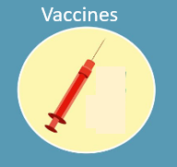


Prevention of STIs
Condoms
Vaccines
Dental Dams
HIV PrEP
U=U, HIV PEP
DoxyPEP

Slide 5
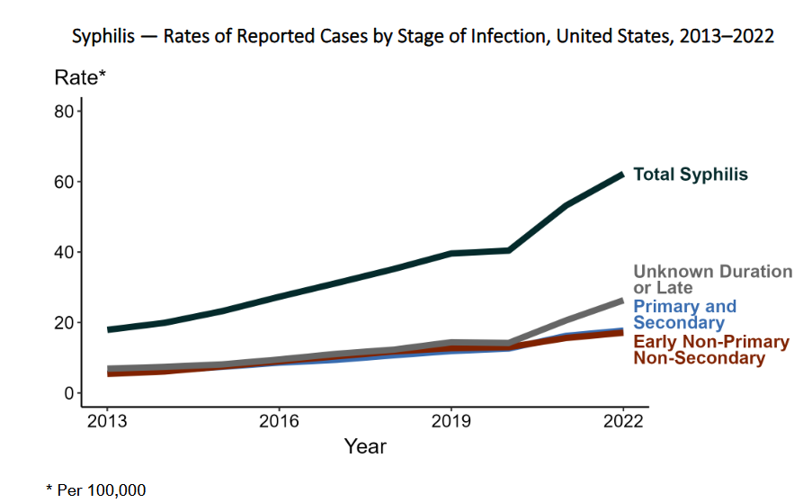
The importance of prevention
https://www.cdc.gov/sti-statistics/media/pdfs/2024/11/2022-STI-Surveillance-Report-PDF.pdf

Slide 6
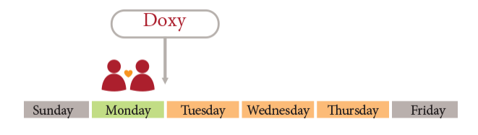

Doxycycline for STI prophylaxis (DoxyPEP)
Doxy: doxycycline
  Ideal candidate as there are no cases of resistance for chlamydia and syphilis to doxycycline, is taken long-term for other conditions
PEP: post-exposure prophylaxis
200mg of doxycycline within 72 hours of sex to prevent bacterial STIs
https://www.reddoorclinic.org/Doxy-PEP

Slide 7
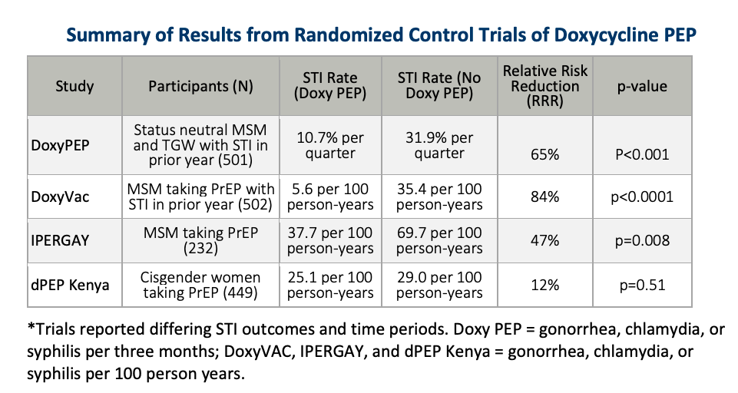
DoxyPEP Evidence
66%
https://www.health.state.mn.us/diseases/stds/hcp/doxypep.pdf

Slide 8
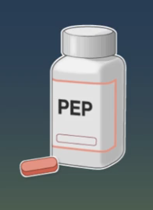
Why were dPEP results different?
Pharmacokinetic data does not support a biologic difference
Reported doxycycline use was high, but doxycycline detection in hair samples was low (29%)
  Barriers
    Side effects (nausea)
    Stigma and privacy concerns
    Pill burden
https://www.nejm.org/doi/full/10.1056/NEJMoa2304007
Kwach AIDS 2024 https://www.iasociety.org/sites/default/files/AIDS2024/abstract-book/AIDS-2024_Abstracts.pdf
https://pmc.ncbi.nlm.nih.gov/articles/PMC10910237/pdf/main.pdf

Slide 9
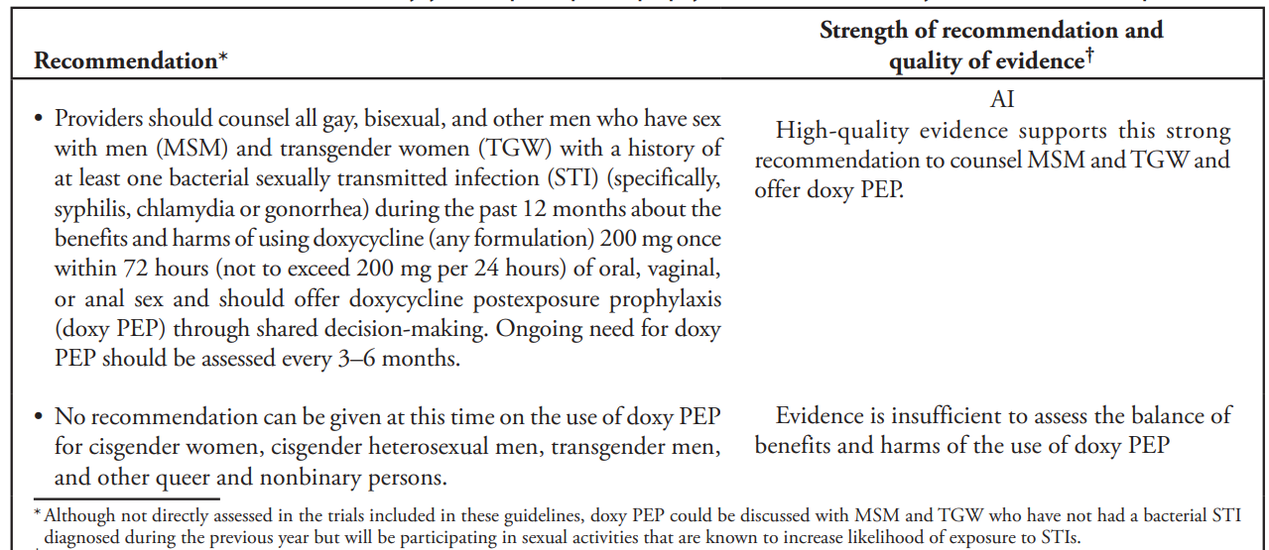
CDC recommendations June 2024

Slide 10
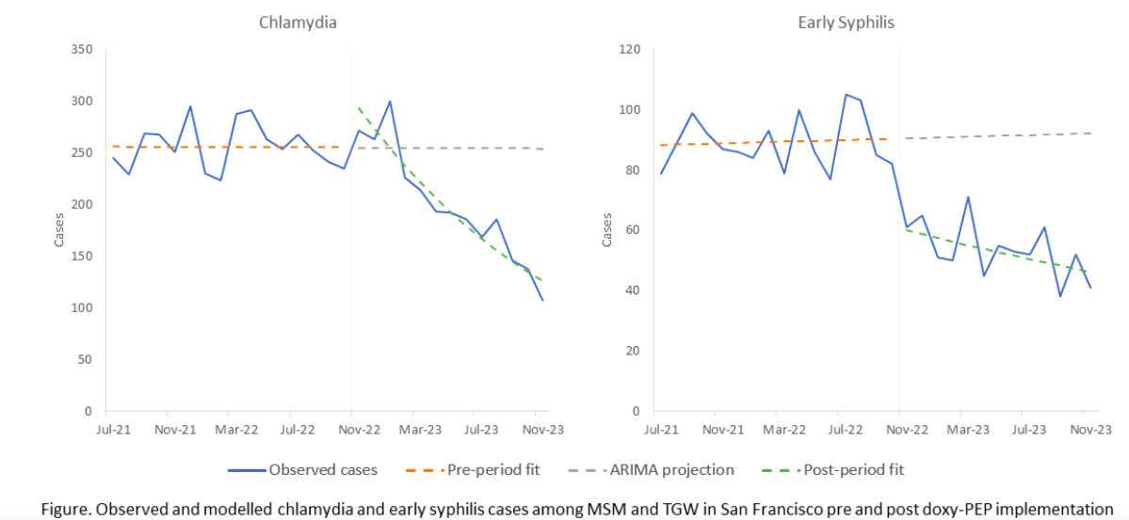
Citywide declines in STIs after SF guideline release
50% decrease in chlamydia cases compared to expected
51% decrease in early syphilis cases compared to expected
Sankaran M, et al. JAMA Int Med 2025

Slide 11
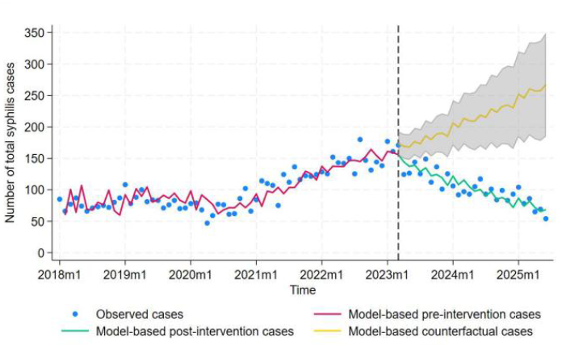
King County decrease in syphilis
52% total reduction in syphilis cases vs counterfactual model
Cases in cisgender women dropped 47%
  May reflect network effects
Syphilis in pregnant people or congenital syphilis was not affected through 2024
  In the first half of 2025, fewer than expected cases of CS
https://academic.oup.com/cid/advance-article/doi/10.1093/cid/ciag209/8541760

Slide 12
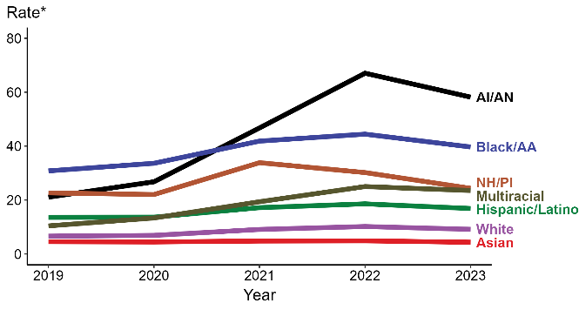




Population-level impacts (2023)?
Primary and Secondary Syphilis Rates
Syphilis increased by only 1% after years of double-digit increases
P & S syphilis declined for the first time in more than two decades, down 10% since 2022
P & S cases dropped 13% among MSM for the first time since the CDC began reporting national trends among this group in the mid-2000s
https://www.cdc.gov/sti-statistics/annual/slides.html

Slide 13
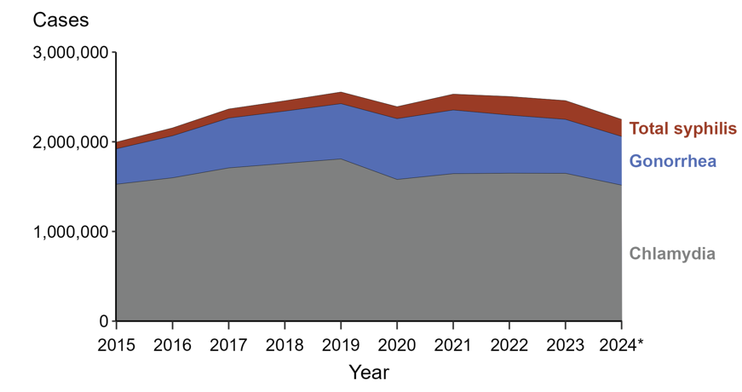
Population-level impacts (2024)?
Primary and secondary syphilis cases declined for the second year in a row, down 22% since 2023
Congenital syphilis increased for the 12th year in a row, with nearly 4,000 reported cases in 2024
Gonorrhea cases declined for the third year in a row, down 10% since 2023
Chlamydia cases declined for the second year in a row, down 8% since 2023
https://www.cdc.gov/sti-statistics/annual/slides.html

Slide 14
DoxyPEP: other considerations
Neisseria gonorrhoeae
  DoxyPEP users in studies have had higher tetracycline resistance in their gonorrhea isolates
    DoxyPEP may become less useful over time for gonorrhea
    Could this drive resistance to other antibiotic classes (select multi-class resistance)?
Staphylococcus aureus
  DoxyPEP decreases S. aureus colonization and slightly increases doxy resistance compared to baseline
But overall, do people have less exposure to antibiotics than if they were not on doxyPEP?
The impact of doxyPEP on individual and population-level bacterial resistance is an area of active study
https://journals.plos.org/plospathogens/article?id=10.1371%2Fjournal.ppat.1012575&utm_medium=email&utm_source=govdelivery https://academic.oup.com/jac/article/80/9/2484/8213549

Slide 15
DoxyPEP: other considerations
Safety for a fetus
  Recommendations to not use doxycycline in pregnancy are based on tetracycline data and we know that tetracycline binds calcium much more than doxycycline
  In dPEP study, doxyPEP was stopped when participant finished the first trimester
https://journals.plos.org/plospathogens/article?id=10.1371%2Fjournal.ppat.1012575&utm_medium=email&utm_source=govdelivery https://academic.oup.com/jac/article/80/9/2484/8213549

Slide 16
DoxyPEP: other considerations
Potential challenges with syphilis testing results
  May change serologic test performance (delayed or incomplete seroconversion, etc)
Seattle Sexual Health Clinic 2023-2024 (1,777 PrEP patients)
  Median RPR titer: 1:8 in DoxyPEP users vs 1:32 in non-users
  Early syphilis: 12% among users vs 88% among non-users
  Possible explanations
    Attenuated or delayed antibody response from recent doxycycline use
    Less symptomatic disease, delayed recognition
    Higher prevalence of past treated infections among DoxyPEP users
Cannon et al ISSDTR 2025

Slide 17

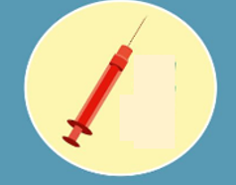

DoxyPEP implementation
Screen for STIs
  Do not need to wait for results before starting doxyPEP
  Test all anatomic sites exposed during sex for gonorrhea and chlamydia (e.g., triple site testing: urine, rectal, and pharyngeal)
Discuss the full spectrum of STI prevention strategies
  Condoms
  doxyPEP
  PrEP
  Vaccines (HepB, HPV, mpox)
Counsel
  Dosing
  Take with a full glass of water, can take with food
  Drug and food interactions
  Use for the intended purpose

Slide 18
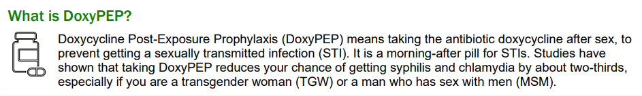
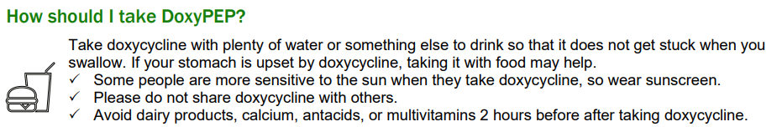
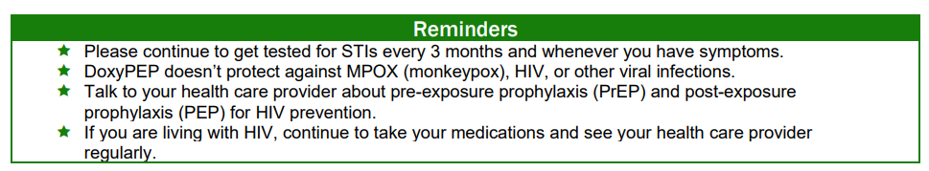
DoxyPEP Patient Guidance
http://publichealth.lacounty.gov/dhsp/HealthEducationLibrary.htm

Slide 19
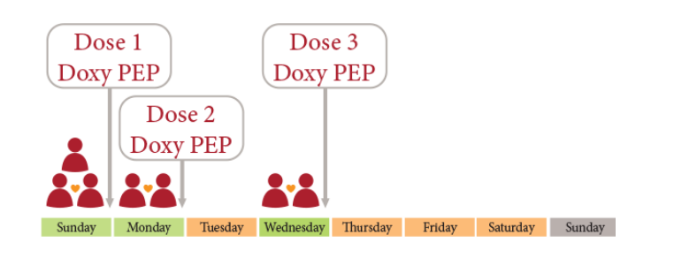
DoxyPEP Patient Guidance
Example of one sexual encounter
Example of sex on multiple days
https://www.reddoorclinic.org/Doxy-PEP

Slide 20
DoxyPEP implementation
Follow-up recommendations, every 3-6 months
  Repeat STI screening
  Assess for side effects
  Counsel
If patient has STI
  Treat as usual
If patient has exposure to STI
  Consider in-person exam and deferring empiric treatment for exposure to chlamydia and gonorrhea when doxyPEP taken correctly

Slide 21
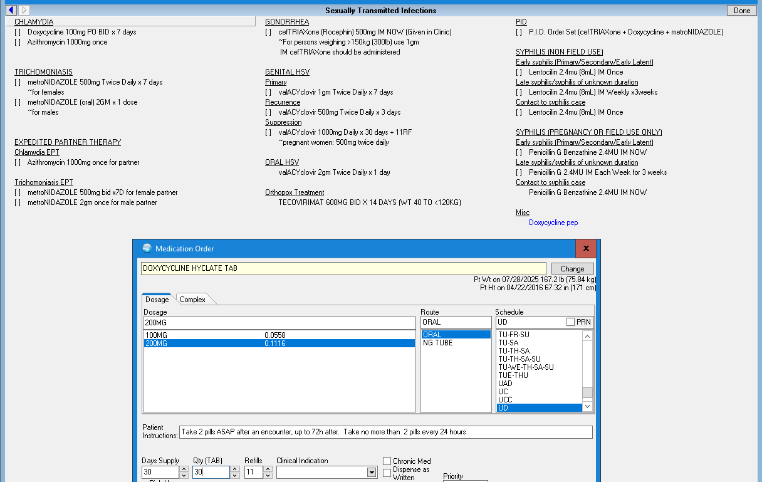
DoxyPEP implementation
Order sets
Templates
Patient handouts
Staff training

Slide 22
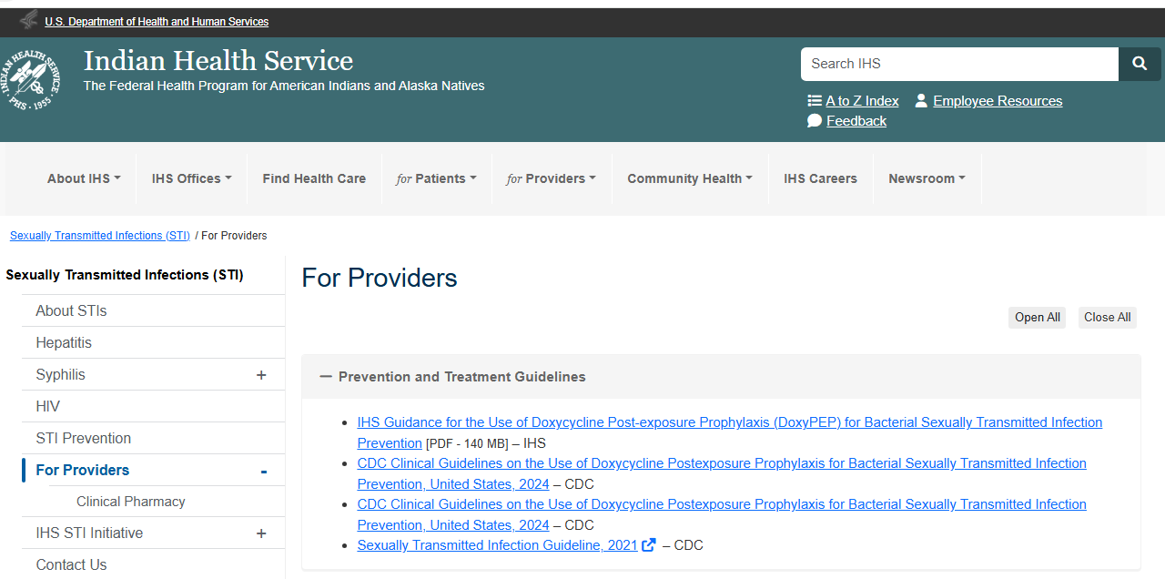
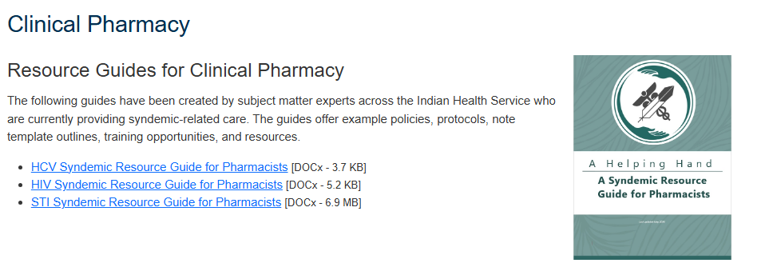
DoxyPEP implementation
Resources on I.H.S. site
https://www.ihs.gov/sti/forproviders/

Slide 23
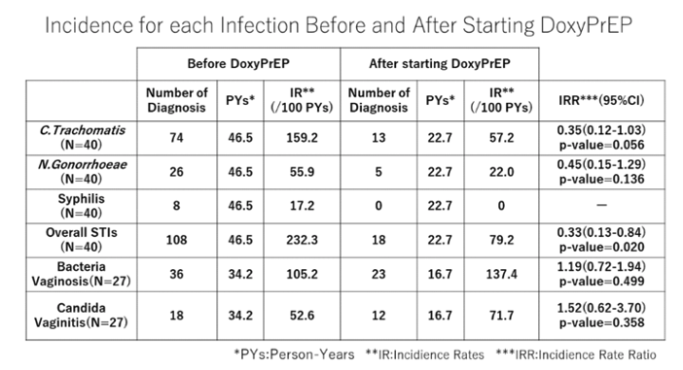
Doxy future directions
40 cisgender female sex workers
Daily 100mg doxycycline
Significant decrease in overall STI rate
No increase in BV or candidiasis
Abe et al, IAS, 2024 https://www.natap.org/2024/IAS/IAS_26.htm

Slide 24
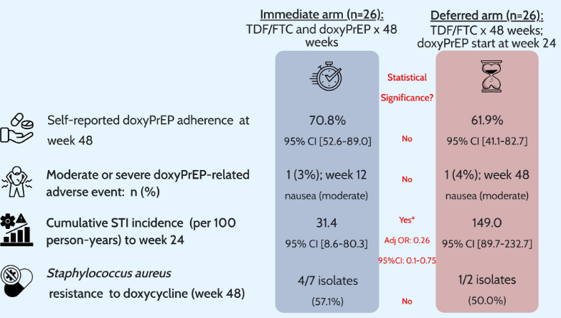
Doxy future directions
52 HIV-negative MSM and transgender women with a prior syphilis diagnosis, all on daily TDF/FTC for HIV PrEP
Randomized 1:1 to either immediate doxyPrEP (100 mg daily from baseline through week 48; n=26) or deferred doxyPrEP (100 mg daily starting at week 24 through week 48; n=26)
https://academic.oup.com/cid/article/82/6/1054/7990423

Slide 25
Doxy future directions
Doxy
(PrEP)
Doxy (PEP)
M
T
W
Th
F
S
S

Slide 26
Doxy future directions
Doxy
(PrEP)
Doxy (PEP)
DoxyDOT study
  60 cisgender women taking HIV PrEP
  Delivery of a weekly doxyPEP dose as DOT along with a snack
  Quarterly STI testing
  Findings to date: 91% adherence to weekly dosing, 61% reduction in chlamydia incidence
foXXy doxy study
  U.S. study 1:1:1 RCT of on-demand doxyPEP v weekly doxyPEP v SOC
  Enrolling 760 people aged 13-29 who were assigned female sex at birth, regardless of gender, who had an STI in the past year
  Quarterly STI testing
Stewart 2025, ISSTDR.
https://courses.nnptc.org/class_information.html?id=3954&utm_medium=email&utm_source=govdelivery

Slide 27
HIV PrEP

Slide 28
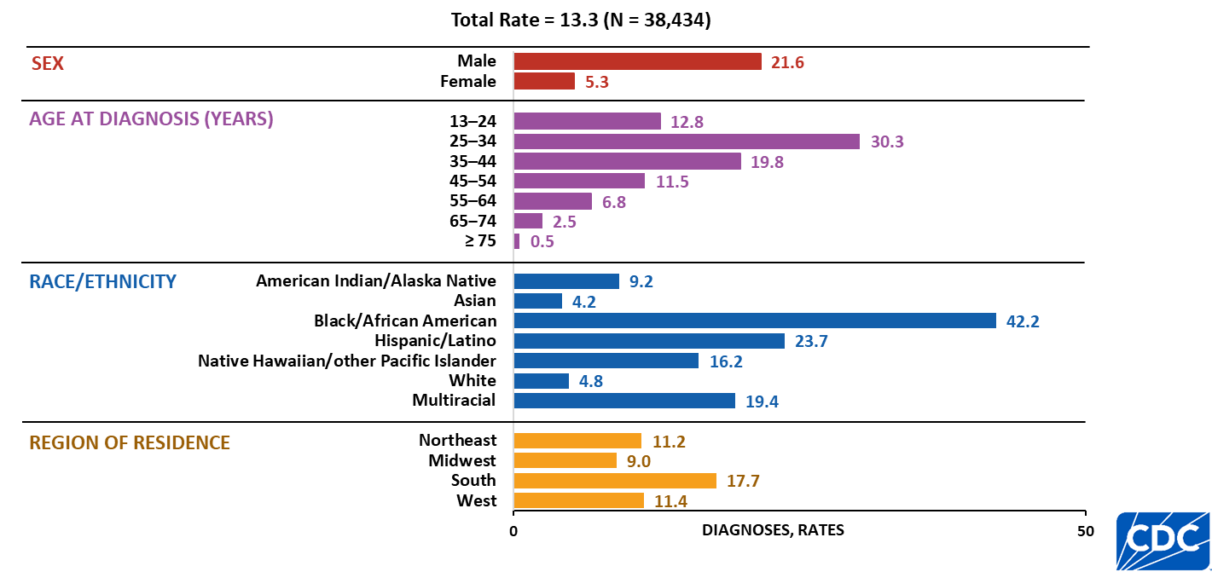
HIV diagnoses rates, by selected characteristics, 2024—United States
Note. Data are presented for persons aged ≥ 13 years at diagnosis. Rates are per 100,000. Persons who did not report Hispanic or Latino ethnicity were categorized by race. Hispanic/Latino persons can be of any race.

Slide 29
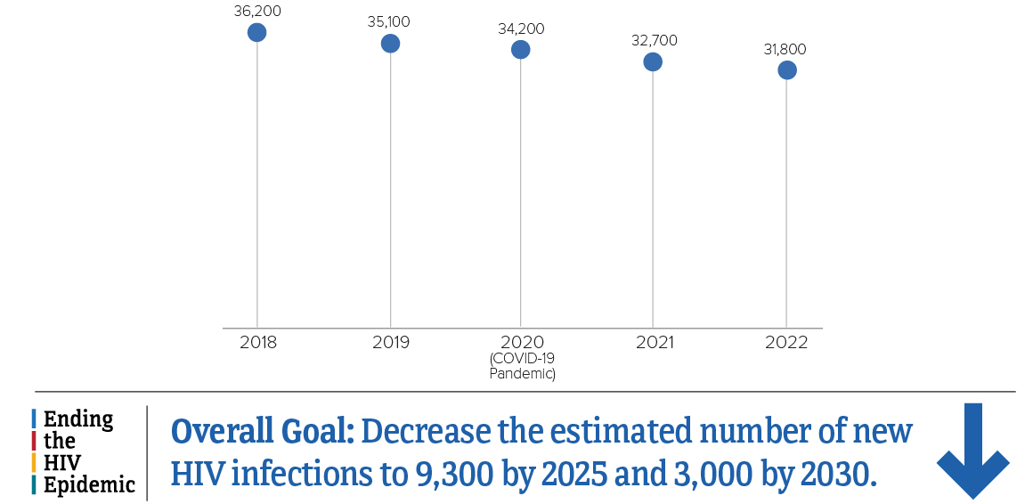
New HIV infections declined 12% from 2018-2022
https://www.cdc.gov/hiv-data/nhss/estimated-hiv-incidence-and-prevalence.html

Slide 30
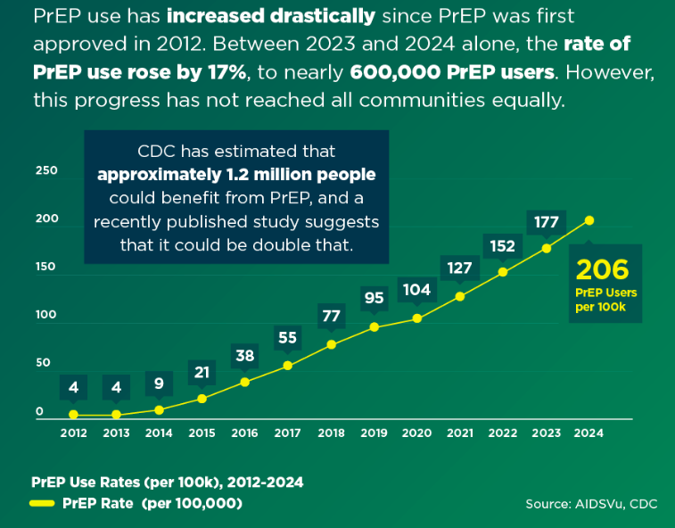
https://prepvu.org/resources/prep-use-in-2024/

Slide 31
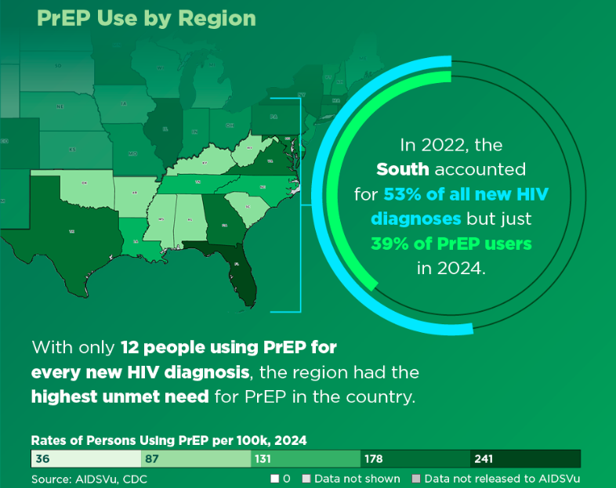
https://prepvu.org/resources/prep-use-in-2024/

Slide 32
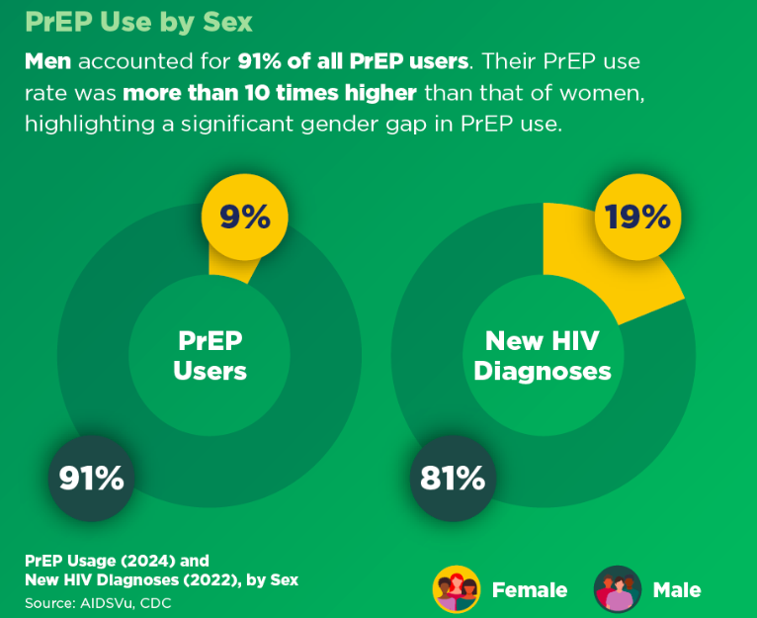
https://prepvu.org/resources/prep-use-in-2024/

Slide 33
HIV PrEP Works
Transmission Route | Effectiveness Estimate | Interpretation
Sexual | ~99% | Very high levels of adherence to PrEP provide maximum effectiveness
Injection drug use | at least 74% | This estimate is based on tenofovir alone and not necessarily when taken daily The effectiveness may be greater for other medications
¹ Centers for Disease Control and Prevention. Effectiveness of prevention strategies to reduce the risk of acquiring or transmitting HIV. Updated June 17, 2022. Accessed January 20, 2023. https://www.cdc.gov/hiv/risk/estimates/preventionstrategies.html
² Centers for Disease Control and Prevention, US Public Health Service. Preexposure prophylaxis for the prevention of HIV infection in the United States—2021 update—a clinical practice guideline. Published December 2021. Accessed January 20, 2023. https://www.cdc.gov/hiv/pdf/risk/prep/cdc-hiv-prep-guidelines-2021.pdf
Slide adapted from: https://www.cdc.gov/hiv/pdf/clinicians/materials/cdc-hiv-nexus-slideset-prescribing-prep.pdf

Slide 34

Talking about PrEP
Sometimes an easy way to start a conversation about PrEP is to say:
Did you know that there’s a daily pill or an injection every couple months that can protect people from HIV?
If yes, have they been on PrEP before? Have they thought about starting it?
If no, teach more about it
Picture from: https://www.cdc.gov/hivnexus/media/pdfs/2024/10/cdc-hiv-together-factsheet-PrEPadolescent-provider.pdf

Slide 35
Indications for PrEP
Sexually Active People
Behavior
Condomless sex with a partner of unknown HIV status
Sexual partner(s) living with HIV with a detectable or unknown viral load
Bacterial STI in past 6 months
People who Inject Drugs
Behavior
Injection drug use with sharing of needles/equipment
If someone requests it

Slide 36
Guidelines for Prescribing HIV PrEP

Slide 37
HIV PrEP Medications
 | Tenofovir disoproxil fumarate/emtricitabine (Truvada, F/TDF)
Dosing | 1 tab daily
Patients | All
Crcl | ≥ 60
HepB status | Important
Potential side effects
Medication interactions

Slide 38
HIV PrEP Medications
 | Tenofovir disoproxil fumarate/emtricitabine (Truvada, F/TDF)
Dosing | 1 tab daily
Patients | All
Crcl | ≥ 60
HepB status | Important
Potential side effects | More bone and renal considerations than TAF
Medication interactions
Start-Up Syndrome
<10% of patients
Nausea, headache, abdominal discomfort, diarrhea
Usually resolves within 1-3 weeks

Slide 39
HIV PrEP Medications
 | Tenofovir disoproxil fumarate/emtricitabine (Truvada, F/TDF) | Tenofovir alafenamide/ emtricitabine (Descovy, F/TAF)
Dosing | 1 tab daily | 1 tab daily
Patients | All | MSM, TGW IAS: alternative option if risk is receptive vaginal sex
Crcl | ≥ 60 | ≥30
HepB status | Important | Important
Potential side effects | More bone and renal considerations than TAF | More weight and lipid considerations than TDF
Medication interactions

Slide 40
HIV PrEP Medications
 | Tenofovir disoproxil fumarate/emtricitabine (Truvada, F/TDF) | Tenofovir alafenamide/ emtricitabine (Descovy, F/TAF) | Cabotegravir (Apretude)
Dosing | 1 tab daily | 1 tab daily | Injection every other month (can start with oral lead-in or monthly injection x2)
Patients | All | MSM, TGW IAS: alternative option if risk is receptive vaginal sex
Crcl | ≥ 60 | ≥30
HepB status | Important | Important
Potential side effects | More bone and renal considerations than TAF | More weight and lipid considerations than TDF
Medication interactions

Slide 41
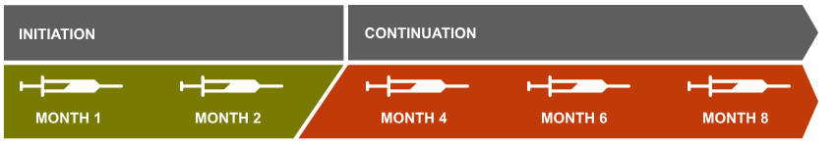
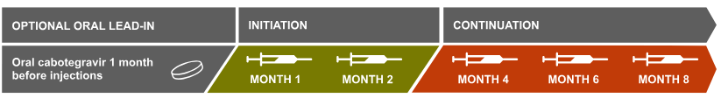
HIV PrEP Medications
OR
https://apretudehcp.com/

Slide 42
HIV PrEP Medications
 | Tenofovir disoproxil fumarate/emtricitabine (Truvada, F/TDF) | Tenofovir alafenamide/ emtricitabine (Descovy, F/TAF) | Cabotegravir (Apretude)
Dosing | 1 tab daily | 1 tab daily | Injection every other month (can start with oral lead-in or monthly injection x2)
Patients | All | MSM, TGW IAS: alternative option if risk is receptive vaginal sex | All
Crcl | ≥ 60 | ≥30 | N/A
HepB status | Important | Important | Not as relevant
Potential side effects | More bone and renal considerations than TAF | More weight and lipid considerations than TDF | Injection site reactions
Medication interactions |  |  | Carbamazepine, oxcarbazepine, phenobarbital, phenytoin, rifampin, and rifapentine

Slide 43
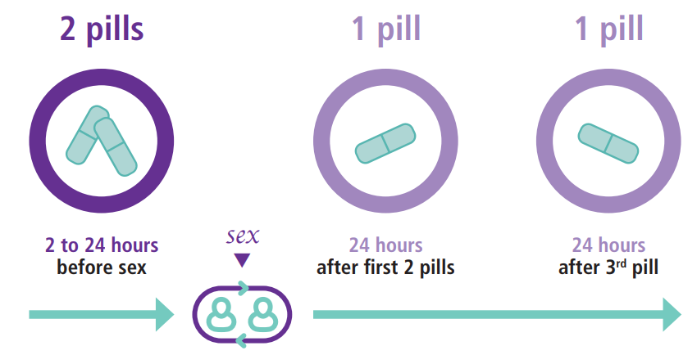
On-Demand/Event-Driven PrEP
Cisgender men and transgender women who have sex with men
https://brownmedpedsresidency.org/on-demand-prep/

Slide 44
HIV PrEP Medications
 | Tenofovir disoproxil fumarate/emtricitabine (Truvada, F/TDF) |  | Tenofovir alafenamide/ emtricitabine (Descovy, F/TAF) | Cabotegravir (Apretude)
Dosing | 1 tab daily | 2-1-1 On-demand, event-driven | 1 tab daily | Injection every other month (can start with oral lead-in or monthly injection x2)
Patients | All | Not if at risk from receptive vaginal sex or through IDU | MSM, TGW IAS: alternative option if risk is receptive vaginal sex | All
Crcl | ≥ 60 |  | ≥30 | N/A
HepB status | Important |  | Important | Not as relevant
Potential side effects | More bone and renal considerations than TAF |  | More weight and lipid considerations than TDF | Injection site reactions
Medication interactions |  |  |  | Carbamazepine, oxcarbazepine, phenobarbital, phenytoin, rifampin, and rifapentine

Slide 45


Slide 46
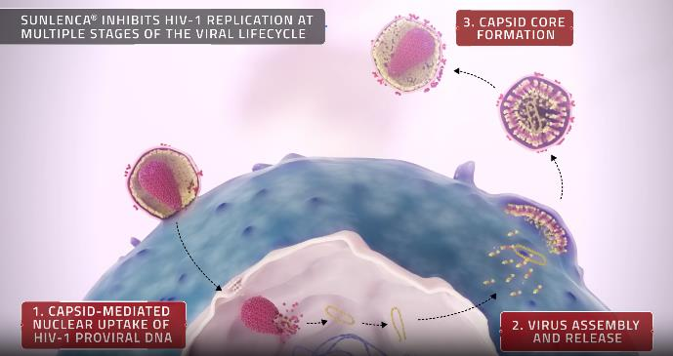
Lenacapavir (LEN) for PrEP
HIV-1 capsid inhibitor
Given 2 times a year subcutaneously
Approved as part of a treatment regimen for HIV in 2022
Approved for PrEP in June 2025
Picture from: https://www.sunlencahcp.com/how-sunlenca-works/first-in-class-moa/

Slide 47
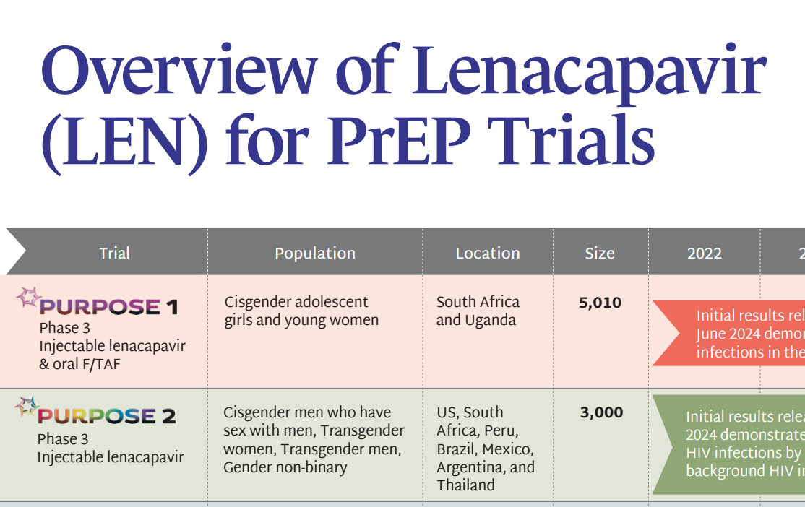
PURPOSE LEN Trials
https://avac.org/prevention-option/prep/

Slide 48
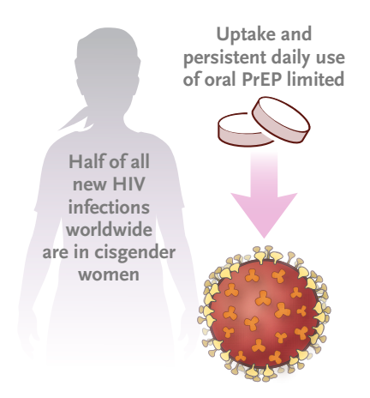
PURPOSE 1
Bekker L-G, Das M, Abdool Karim Q, et al. Twice-yearly lenacapavir or daily F/TAF for HIV prevention in cisgender women. N Engl J Med 2024;391:1179-92. DOI: 10.1056/NEJMoa2407001

Slide 49
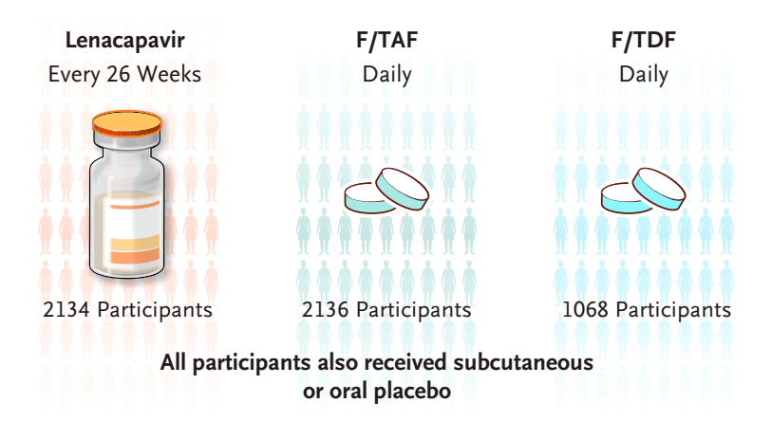
PURPOSE 1
5338 adolescent girls and young women in South Africa and Uganda (median age 21)
  Sexually active with male partners
  Not using PrEP
  Unknown HIV status and no HIV testing within the previous 3 months
Bekker L-G, Das M, Abdool Karim Q, et al. Twice-yearly lenacapavir or daily F/TAF for HIV prevention in cisgender women. N Engl J Med 2024;391:1179-92. DOI: 10.1056/NEJMoa2407001

Slide 50
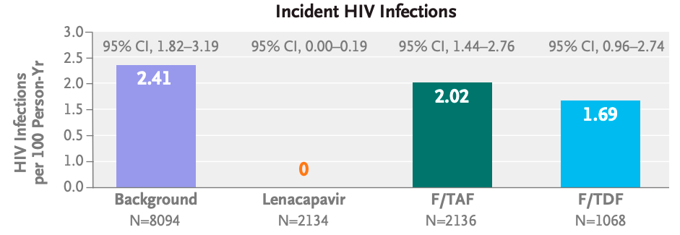
PURPOSE 1
39 infections
16 infections
F/TAF efficacy correlated to adherence
89% reduced odds of HIV infection with ≥2 doses a week compared to <2
Bekker L-G, Das M, Abdool Karim Q, et al. Twice-yearly lenacapavir or daily F/TAF for HIV prevention in cisgender women. N Engl J Med 2024;391:1179-92. DOI: 10.1056/NEJMoa2407001

Slide 51
PURPOSE 1
39 infections
16 infections
F/TAF efficacy correlated to adherence
89% reduced odds of HIV infection with ≥2 doses a week compared to <2
Bekker L-G, Das M, Abdool Karim Q, et al. Twice-yearly lenacapavir or daily F/TAF for HIV prevention in cisgender women. N Engl J Med 2024;391:1179-92. DOI: 10.1056/NEJMoa2407001

Slide 52
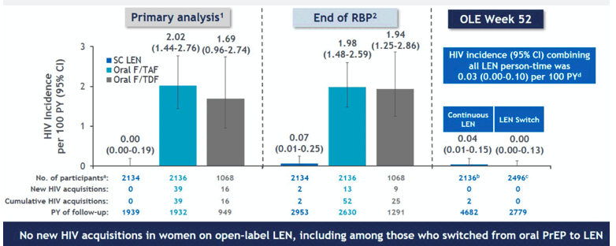
PURPOSE 1 Longer Term Follow-up
https://www.natap.org/2026/IAS/IAS_50.htm

Slide 53
PURPOSE LEN Trials
https://avac.org/prevention-option/prep/

Slide 54
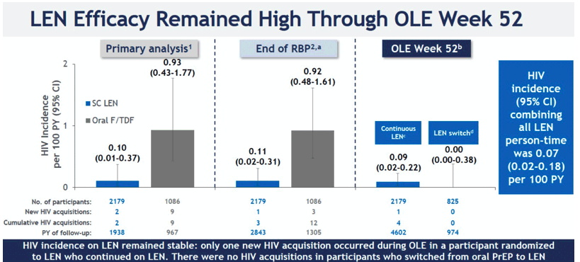
PURPOSE 2 Longer Term Follow-up
https://www.natap.org/2026/IAS/IAS_51.htm

Slide 55
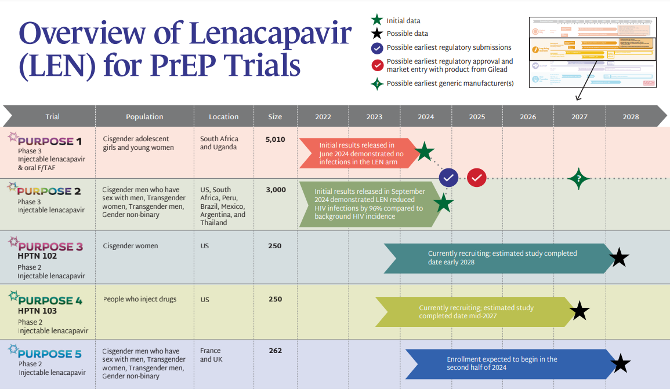
Lenacapavir (LEN) for PrEP
https://avac.org/prevention-option/prep/

Slide 56
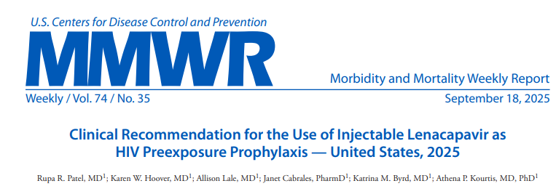

Slide 57
HIV PrEP Medications
 | Tenofovir disoproxil fumarate/emtricitabine (Truvada, F/TDF) |  | Tenofovir alafenamide/ emtricitabine (Descovy, F/TAF) | Cabotegravir (Apretude) | Lenacapavir (Yeztugo)
Dosing | 1 tab daily | 2-1-1/On-demand, event-driven | 1 tab daily | IM injection q other month (can start with oral lead-in or monthly injection x2) | Subq injections q 6 months (start with subQ and 2d of pills)
Patients | All | Not if at risk from receptive vaginal sex or through IDU | IAS: option after F/TDF even if risk is receptive vaginal sex | All | All
Crcl | ≥ 60 |  | ≥30 | N/A | N/A
HepB status | Important |  | Important | Not as relevant | Not as relevant
Potential side effects | More bone and renal considerations than TAF |  | More weight and lipid considerations than TDF | Injection site reactions | Injection site reactions
Medication interactions |  |  |  | Some antiseizure meds, rifamycins | Several, is moderate cytochrome P450 3A4 inhibitor

Slide 58
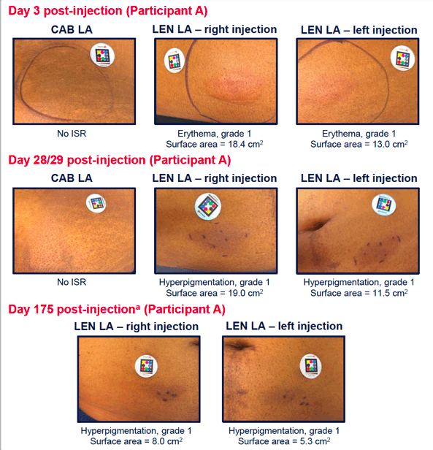
HIV PrEP Medications
 | Tenofovir disoproxil fumarate/emtricitabine (Truvada, F/TDF) |  | Tenofovir alafenamide/ emtricitabine (Descovy, F/TAF) | Cabotegravir (Apretude) | Lenacapavir (Yeztugo)
Dosing | 1 tab daily | 2-1-1/On-demand, event-driven | 1 tab daily | IM injection q other month (can start with oral lead-in or monthly injection x2) | Subq injections q 6 months (start with subQ and 2d of pills)
Patients | All | Not if at risk from receptive vaginal sex or through IDU | IAS: option after F/TDF even if risk is receptive vaginal sex | All | All
Crcl | ≥ 60 |  | ≥30 | N/A | N/A
HepB status | Important |  | Important | Not as relevant | Not as relevant
Potential side effects | More bone and renal considerations than TAF |  | More weight and lipid considerations than TDF | Injection site reactions | Injection site reactions
Medication interactions |  |  |  | Some antiseizure meds, rifamycins | Several, is moderate cytochrome P450 3A4 inhibitor
https://www.natap.org/2026/IAS/IAS_41.htm

Slide 59
HIV PrEP Medications
 | Tenofovir disoproxil fumarate/emtricitabine (Truvada, F/TDF) |  | Tenofovir alafenamide/ emtricitabine (Descovy, F/TAF) | Cabotegravir (Apretude) | Lenacapavir (Yeztugo)
Dosing | 1 tab daily | 2-1-1/On-demand, event-driven | 1 tab daily | IM injection q other month (can start with oral lead-in or monthly injection x2) | Subq injections q 6 months (start with subQ and 2d of pills)
Patients | All | Not if at risk from receptive vaginal sex or through IDU | IAS: option after F/TDF even if risk is receptive vaginal sex | All | All
Crcl | ≥ 60 |  | ≥30 | N/A | N/A
HepB status | Important |  | Important | Not as relevant | Not as relevant
Potential side effects | More bone and renal considerations than TAF |  | More weight and lipid considerations than TDF | Injection site reactions | Injection site reactions
Medication interactions |  |  |  | Some antiseizure meds, rifamycins | Several, is moderate cytochrome P450 3A4 inhibitor

Slide 60
Baseline Evaluation (same-day start ideal)
1. Any signs/symptoms of acute HIV in the past 4 weeks (flu-like symptoms, rash, swollen lymph nodes): if present, test for acute HIV, consider deferring HIV PrEP until test results back
2. Offer PEP if potential HIV exposure in past 72 hours, then can bridge to PrEP
3. Assess for history of renal or bone disease, weight ≥35kg
HIV test: antigen/antibody
(negative within 7d or pending)
and HIV viral load if recent PEP/PrEP use
Hepatitis B screening (especially for F/TDF and F/TAF) if not known to be immune to hep B
Lipid profile for F/TAF
Kidney Function for F/TDF and
F/TAF
STI tests for chlamydia, gonorrhea, syphilis, hepatitis C
Pregnancy test if applicable
F/TDF: emtricitabine/tenofovir disoproxil fumarate (Truvada), F/TAF: emtricitabine/tenofovir alafenamide (Descovy) CAB: cabotegravir (Apretude)
Centers for Disease Control and Prevention, US Public Health Service. Preexposure prophylaxis for the prevention of HIV infection in the United States—2021 update—a clinical practice guideline. Published December 2021. Accessed January 20, 2023. https://www.cdc.gov/hiv/pdf/risk/prep/cdc-hiv-prep-guidelines-2021.pdf

Slide 61
Baseline Evaluation
Explain use
Offer mpox vaccine
Discuss DoxyPEP
1. Any signs/symptoms of acute HIV in the past 4 weeks (flu-like symptoms, rash, swollen lymph nodes): if present, test for acute HIV, consider deferring HIV PrEP until test results back
2. Offer PEP if potential HIV exposure in past 72 hours, then can bridge to PrEP
3. Assess for history of renal or bone disease, weight ≥35kg
HIV test: antigen/antibody
(negative within 7d or pending)
and HIV viral load if recent PEP/PrEP use
Hepatitis B screening (especially for F/TDF and F/TAF) if not known to be immune to hep B
Lipid profile for F/TAF
Kidney Function for F/TDF and
F/TAF
STI tests for chlamydia, gonorrhea, syphilis, hepatitis C
Pregnancy test if applicable
F/TDF: emtricitabine/tenofovir disoproxil fumarate (Truvada), F/TAF: emtricitabine/tenofovir alafenamide (Descovy) CAB: cabotegravir (Apretude)
Centers for Disease Control and Prevention, US Public Health Service. Preexposure prophylaxis for the prevention of HIV infection in the United States—2021 update—a clinical practice guideline. Published December 2021. Accessed January 20, 2023. https://www.cdc.gov/hiv/pdf/risk/prep/cdc-hiv-prep-guidelines-2021.pdf

Slide 62
Monitoring on PrEP
 | Tenofovir disoproxil fumarate/emtricitabine (Truvada, F/TDF) | Tenofovir alafenamide/ emtricitabine (Descovy, F/TAF) | Cabotegravir (Apretude, CAB) | Lenacapavir (Yeztugo)
HIV testing | Every 3 months | Every 3 months | After first injection at 1 month, Every 2 months | Every 6 months
STI testing | Every 3-6 months | Every 3-6 months | Every ~4 months | Every 3-6 months
Crcl | Every 6 months if ≥50 years or had an CrCl <90, otherwise every 12 months | Every 6 months if ≥50 years or had an CrCl <90, otherwise every 12 months | N/A | N/A
Cholesterol panel, weight | N/A | Every 12 months | N/A | N/A
Ongoing: provide support, refill med

Slide 63
Discontinuing PrEP
Oral PrEP
Injectable PrEP
Protection from HIV will wane over 7-10 days
Assess ongoing HIV risk factors
Discuss other prevention methods if HIV exposure is anticipated (e.g., PEP)
CAB and LEN levels slowly wane over many months, known as the “tail phase”
Assess ongoing HIV risk and prescribe daily oral PrEP or other prevention methods if HIV exposure is anticipated
Continue follow-up visits quarterly for 12 months and conduct HIV testing
Let us know if you want to restart!
Slide adapted from: https://www.cdc.gov/hiv/pdf/clinicians/materials/cdc-hiv-nexus-slideset-prescribing-prep.pdf

Slide 64
Cost/Access
Cost without insurance/payment assistance, per year
  TDF/FTC $660
  TAF/FTC $26,400
  Cabotegravir $22,200
  Lenacapavir $28,000
Job aids exist
  Insurances, medicaid programs
  Patient assistance programs

Slide 65
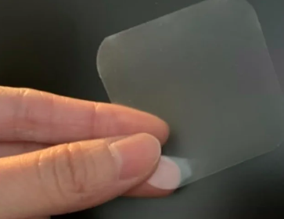
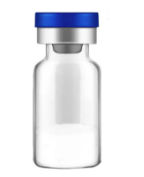

PrEP Pipeline
Extended dosing strategies (weekly, monthly, every 6 months. . . )
Different delivery systems
Multipurpose prevention technologies (MPTs)
Options!
Pictures from: https://popcouncil.org/project/the-three-month-dapivirine-vaginal-ring-for-hiv-prevention/ https://www.mountainside-medical.com/products/empty-sterile-glass-vial-10ml
https://www.eatg.org/hiv-news/researchers-launch-first-study-of-a-vaginal-film-that-dissolves-in-30-days-to-assess-its-acceptability-as-a-potential-hiv-prevention-method-for-women/

Slide 66
Summary
DoxyPEP has high efficacy against syphilis and chlamydia, moderate efficacy against gonorrhea for MSM and transgender women
Ongoing research about:
  Use in cisgender women and other populations
  Impact on bacterial resistance
HIV PrEP can be prescribed to any patient who requests it, even if they don’t report specific risk factors for HIV
When taken as prescribed, HIV PrEP is well-tolerated and is very effective
Four forms of HIV PrEP available in the U.S., but more options are coming soon

