Slide 1
Ethics and Artificial Intelligence in Telemedicine
Dr Jessica Whitfield, MD MPH
Sept 2026
Virtual Care I​mplementation ECHO

Slide 2
Disclosures
The planners and speakers have no relevant financial relationships to disclose.

Slide 3
Learning Objectives
Describe an overview of the use of AI in telemedicine
Identify at least two ethical concerns regarding AI in telemedicine
Name two parts of a framework to navigate these ethical concerns

Slide 4
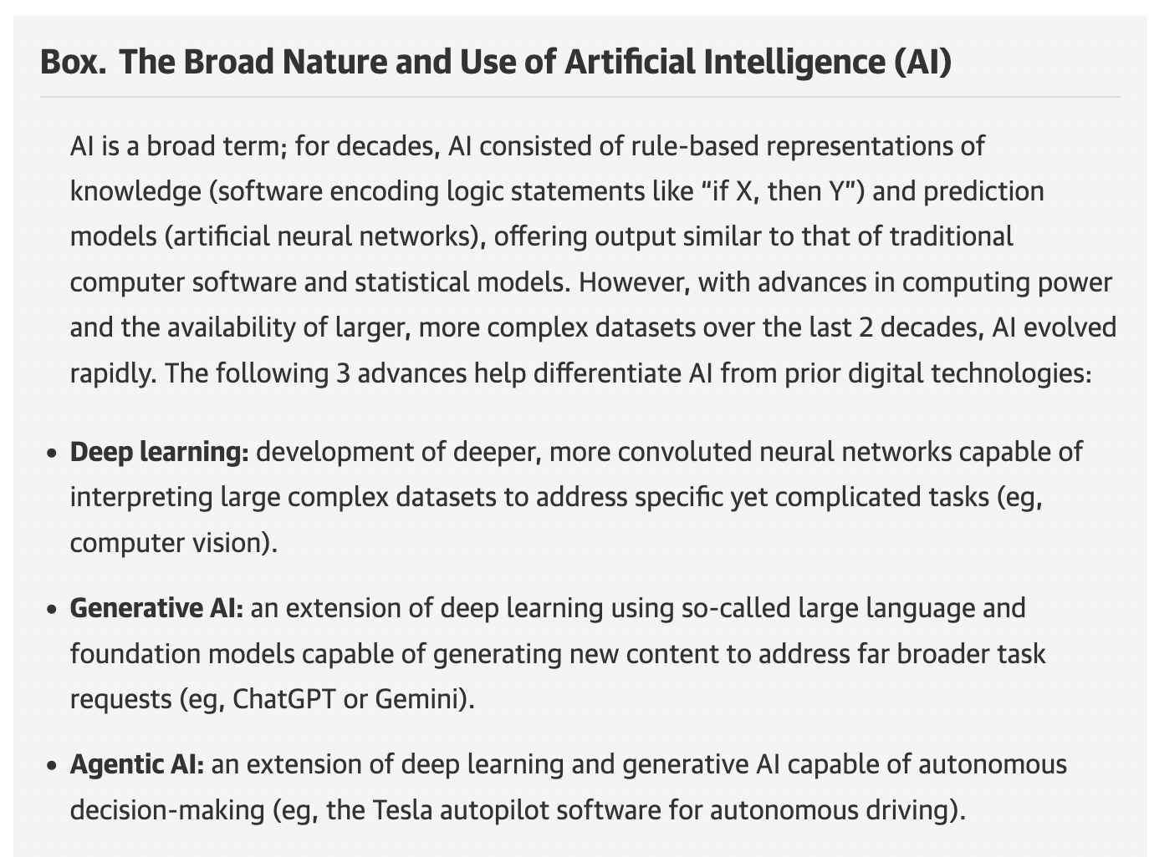
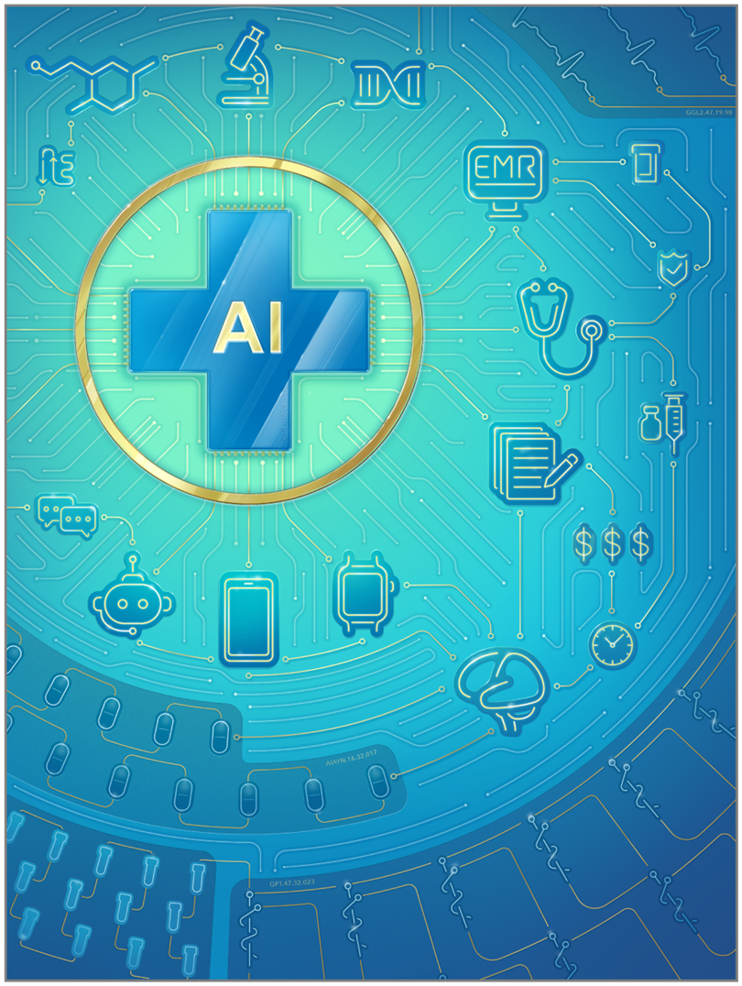
What is AI?
https://jamanetwork.com/journals/jama/fullarticle/2840175

Slide 5
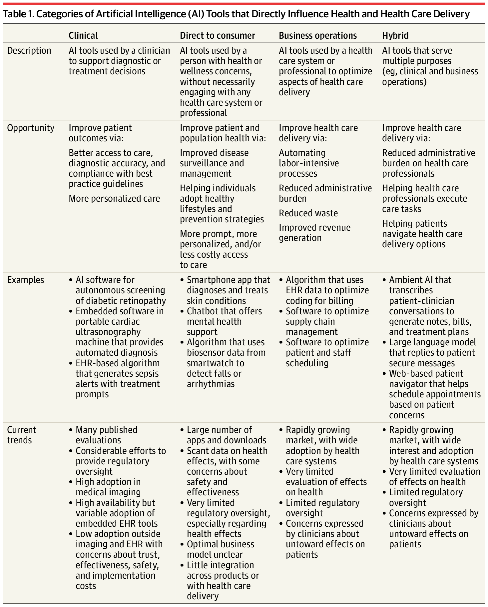
Why AI in Health Care?
American Medical Association calls it Augmented Intelligence to emphasize use as a tool
3 broad tool categories: Clinical, direct-to-consumer, Hybrid
https://jamanetwork.com/journals/jama/fullarticle/2840175

Slide 6
Why AI in Telehealth?
Limitation:
  Increased access, while good, also creates increases clinician workload and exacerbates shortages
  Asynchronous care in telemedicine affected by issues such as
    Delayed submission, incomplete or missing information
      Ex: drop in measurement based care completion in psychiatry clinic
    New workflows needed to monitor information coming in

Slide 7
WHY AI in Telehealth: Shifting Trends in Health Care
Increasing Telehealth Integration
Asynchronous
EHR messages or texting from patients
  Data reported from health devices, eg continuous glucose monitor or blood pressure monitors
  Validated measures sent through EHR
Synchronous
  Face to face in-person or tele-video visits
  Phone calls
  Procedures/surgeries
  Hospitalizations

Slide 8
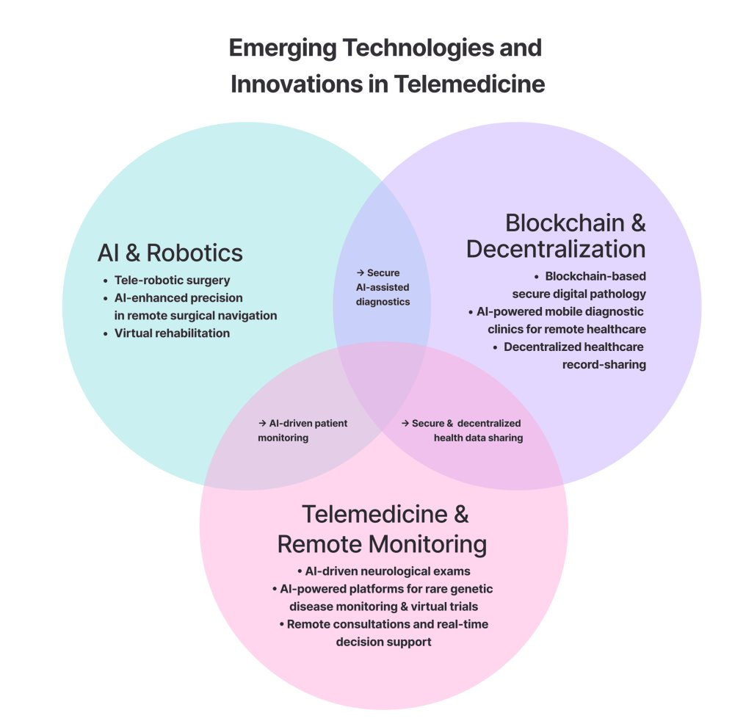
Why AI in Telehealth?
Solutions:
  Increased access is good and also creates increased clinician workload and exacerbates shortages
    Automation of medical information interpretation, predictive analytics and decision support systems can save time
    Digital scribes help with documentation
  Asynchronous care in telemedicine affected by issues such as
    Delayed submission, incomplete or missing information
      Ex: drop in measurement based care completion in psychiatry clinic
      Chatbots can prompt response
    New workflows needed to monitor information coming in
      AI can help with initial triage of information received remotely
https://assets.cureus.com/uploads/review_article/pdf/352455/20250922-127736-mqwfse.pdf; Pavuluri Suresh, et al. Balancing Act: The Complex Role of Artificial Intelligence in Addressing Burnout and Healthcare Workforce Dynamics. BMJ Health Care Informatics

Slide 9
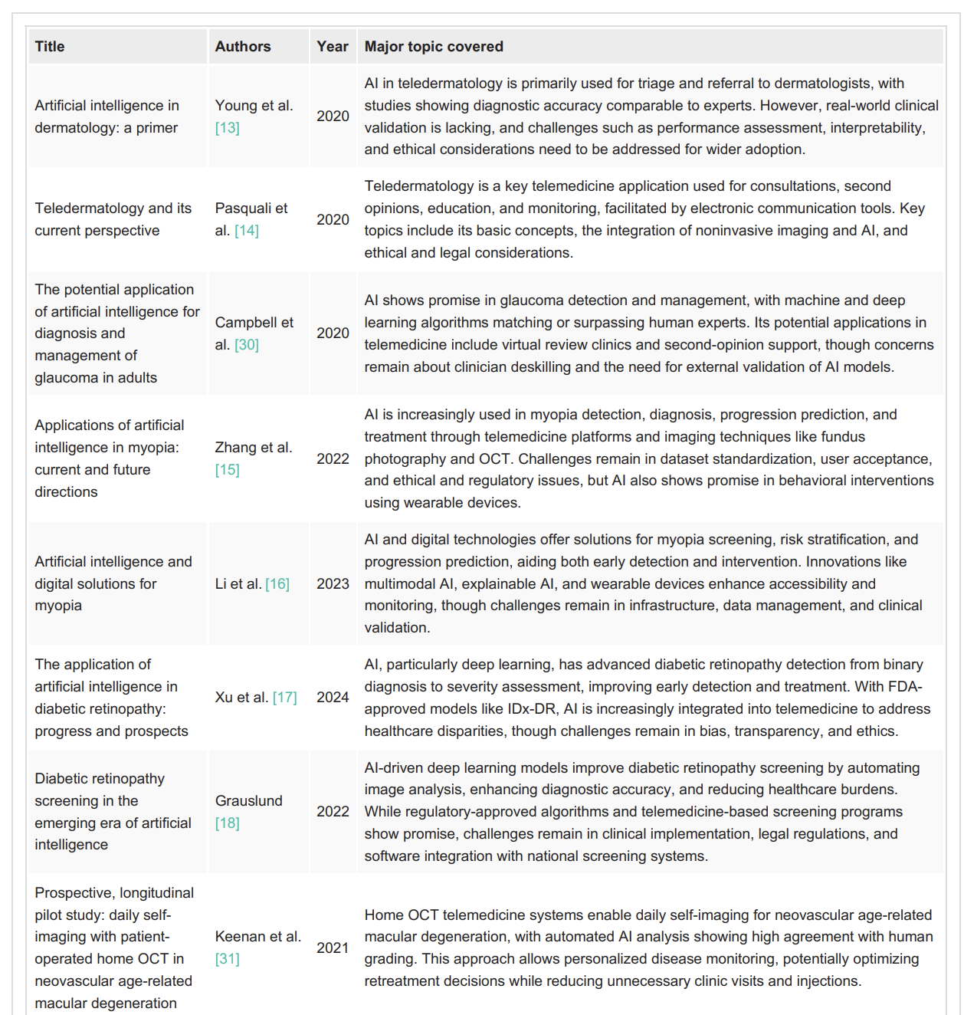
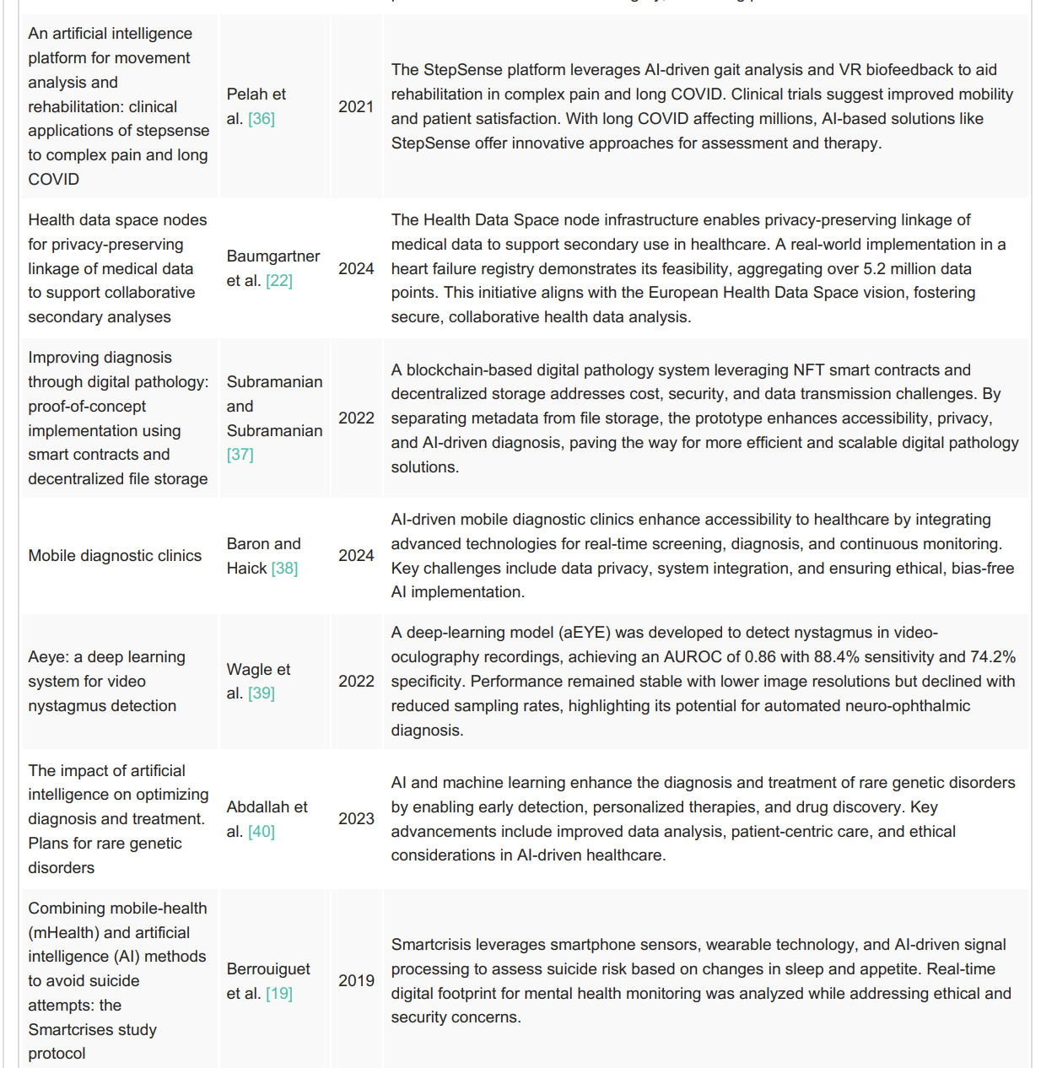
https://assets.cureus.com/uploads/review_article/pdf/352455/20250922-127736-mqwfse.pdf
Notes:
https://www.ama-assn.org/practice-management/digital-health/more-80-physicians-use-ai-professionally-ama-survey
80% of physicians use telemedicine

Slide 10
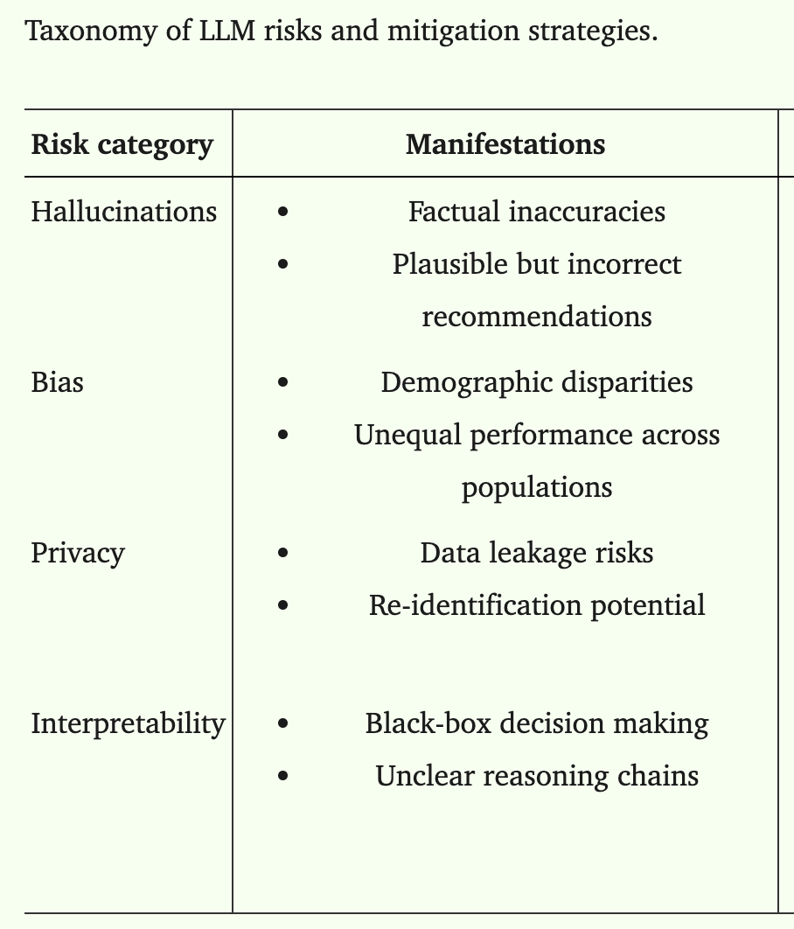
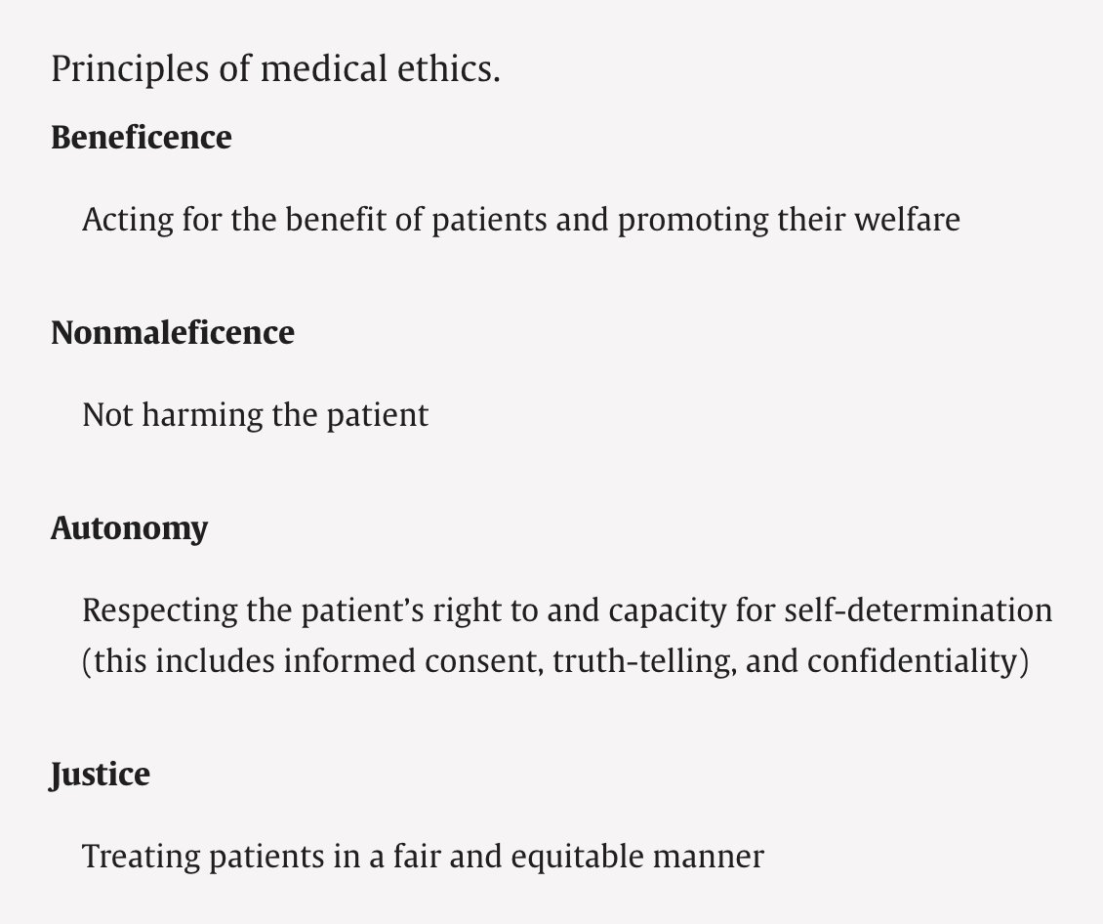
AI in Telemedicine:
Potential Harms and Ethical Concerns
https://www.sciencedirect.com/org/science/article/pii/S1438887123005629
Zendehbad SA, Ghasemi J, Khodadad FS. Trustworthy AI in Telehealth: Navigating Challenges, Ethical Considerations, and Future Opportunities for Equitable Healthcare Delivery. Healthc Technol Lett. 2025 Oct 1;12(1):e70020.;
https://indiancountryecho.npaihb.org/resources/the-evolving-role-of-ethics-committees-april-21st-2026/

Slide 11
AI Ethical Discussion Across Medicine
Arora T, Muhammad-Kamal H, Beam K. Preserving medical ethics in the era of artificial intelligence: Challenges and opportunities in neonatology. Semin Perinatol. 2025 Oct;49(6):152100. doi: 10.1016/j.semperi.2025.152100. Epub 2025 Jun 4. PMID: 40473508.
Khorsandi J, Ahmed AB, Mirharooni J, Kahen M, Ahdout J, Franzoni D, MacDavid J. Artificial Intelligence and Algorithmic Bias in Burn Care: A Literature Review of Ethical Challenges. J Burn Care Res. 2026 Sep 8;47(5):1380-1387. doi: 10.1093/jbcr/irag105. PMID: 42340329; PMCID: PMC13551613.--- Artificial Intelligence and Algorithmic Bias in Burn Care: A Literature Review of Ethical Challenges - PMC
Lee TK, Park EH, Lee MH. Medical Ethics and Artificial Intelligence in Neurosurgery-How Should We Prepare? World Neurosurg. 2024 Jul;187:e199-e209. doi: 10.1016/j.wneu.2024.04.067. Epub 2024 Apr 17. PMID: 38641244.
Narad C, Sharda K, Aasdhir SS. Ethical dimensions of artificial intelligence integration into dental practice. J Am Dent Assoc. 2026 Sep;157(9):999-1004. doi: 10.1016/j.adaj.2026.02.004. Epub 2026 Apr 30. PMID: 42059840.
Mazzolenis ME, Bulat E, Schatman ME, Gumb C, Gilligan CJ, Yong RJ. The Ethical Stewardship of Artificial Intelligence in Chronic Pain and Headache: A Narrative Review. Curr Pain Headache Rep. 2024 Aug;28(8):785-792. doi: 10.1007/s11916-024-01272-0. Epub 2024 May 29. PMID: 38809404.
Zarra F, Rolando M, Páramo Cardona R, Videtta W. Artificial intelligence in intensive care unit: Current ethical dilemmas. Med Leg J. 2025 Dec;93(4):195-197. doi: 10.1177/00258172251332485. Epub 2025 Aug 19. PMID: 40828634.
Chen M, Zhou AE, Jain N, Gronbeck C, Feng H, Grant-Kels JM. Ethics of artificial intelligence in dermatology. Clin Dermatol. 2024 May-Jun;42(3):313-316. doi: 10.1016/j.clindermatol.2024.02.003. Epub 2024 Feb 23. PMID: 38401700.
Morgan MB, Mates JL. Ethics of Artificial Intelligence in Breast Imaging. J Breast Imaging. 2023 Mar 20;5(2):195-200. doi: 10.1093/jbi/wbac076. PMID: 38416925.
Ethical considerations in telehealth and artificial intelligence for work related musculoskeletal disorders: A scoping review - PMC
Roles, Users, Benefits, and Limitations of Chatbots in Health Care: Rapid Review - PubMed
McCarthy M, Elster N. Artificial Intelligence and Ethics in Endodontics. Dent Clin North Am. 2025 Oct;69(4):555-562. doi: 10.1016/j.cden.2025.05.005. Epub 2025 Jul 2. PMID: 41106910.
Notes:
Ethics + artificial intelligence + teleheath returned 500+, without telehealth 5000

Slide 12
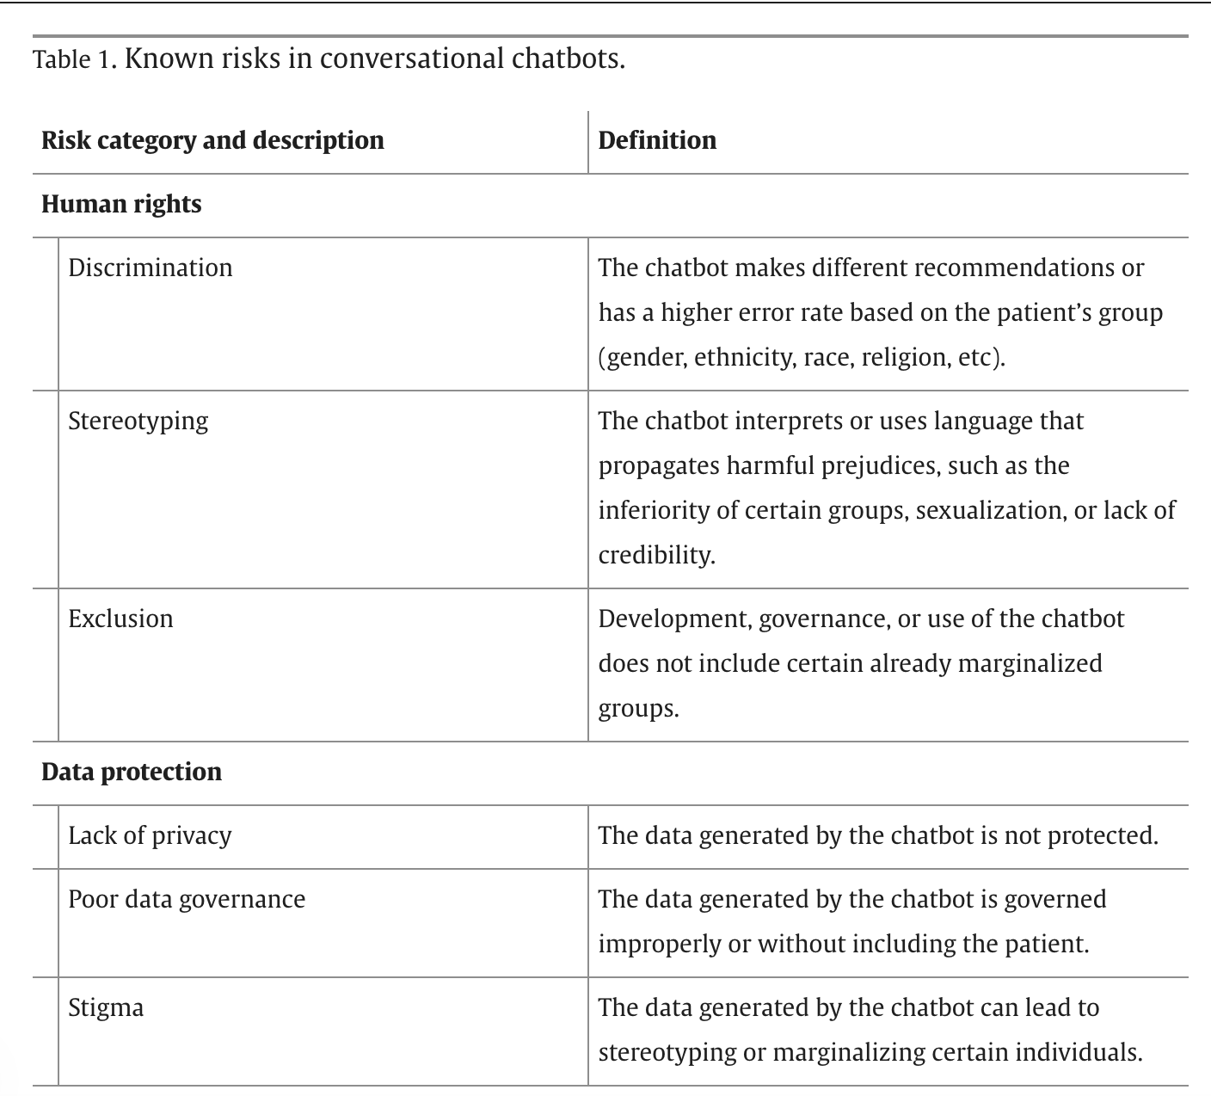
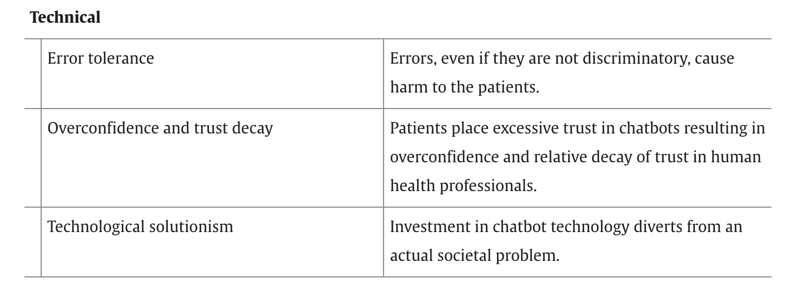
Medical Ethics
Framework for Chatbots
Chatbots use in medicine: public health alerts, therapy
  WHO utilized during COVID-19 as an information tool
  Published trials of chatbots used as CBT therapy replacement, adjunct to therapist, assisting remote measurement based care
https://www.sciencedirect.com/org/science/article/pii/S1438887123005629; Sedlakova J, Trachsel M. Conversational Artificial Intelligence in Psychotherapy: A New Therapeutic Tool or Agent? Am J Bioeth. 2023 May;23(5):4-13. doi: 10.1080/15265161.2022.2048739. Epub 2022 Apr 1. PMID: 35362368.

Slide 13
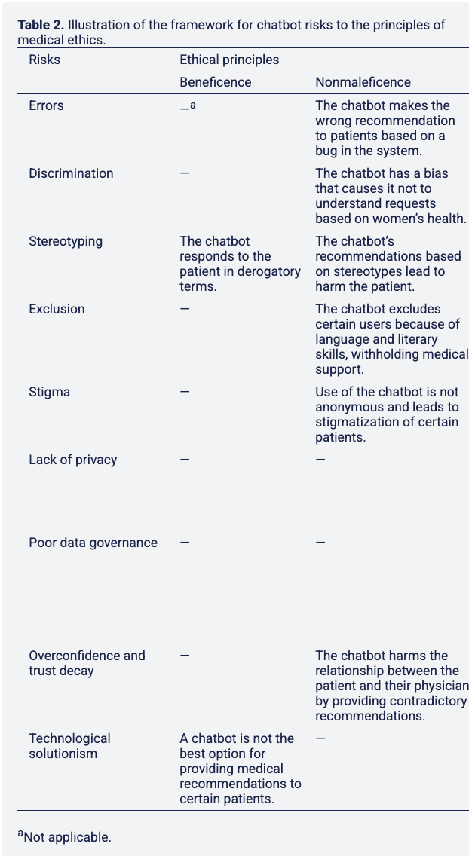
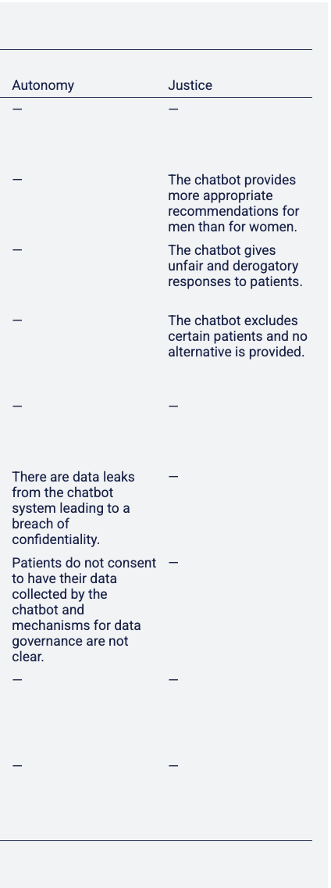
https://www.sciencedirect.com/org/science/article/pii/S1438887123005629
Notes:
This paper provides a simple yet comprehensive framework for the use of conversational chatbots in the health sector. It addresses the extraordinary developments of the last few years in AI conversations and increasing reliance on them due to COVID-19 as well as the likelihood that chatbots will increasingly be used to dialogue directly with people in medical and other health contexts.
In terms of applicability, this framework could be adapted based on locally appropriate norms in medical ethics to underpin an impact assessment process. The use of this process would then be required in assessing and monitoring the deployment of chatbot technology in any circumstance comparable to that of a patient-physician relationship. Concretely, to implement the framework, Table 2 would be used as a guide for practitioners seeking to implement a conversational chatbot, allowing them to reflect on each intersection of risk and principle to consider how this might apply to their tool. This would allow them to consider risks more thoroughly and find solutions to mitigate them before deployment.
As regulatory systems covering AI develop in sophistication to match or exceed what was proposed in the EU Draft AI Act, the results of these medical ethics assessments for chatbots could be required as one component of the reporting requirements for high-risk AI. It is also conceivable that similar medical ethics assessments may be required or beneficial for other deployments of AI in the health sector. However, it should also be emphasized that in other areas, such as when AI is a tool used with a health professional’s mediation, other ethical frameworks such as those of public health or professional responsibility may be more appropriate.

Slide 14
Ethics and AI Considerations: Tribal Communities
Treatment and research: History of violations of trust, lack of informed consent, active harms
AI and equity concerns
  Underrepresentation in datasets used to train AI, end users
  Balance with increase of access
Data sovereignty efforts prioritized (the right to govern the collection, ownership, and application of the Tribe’s data)
https://www.frontiersin.org/journals/artificial-intelligence/articles/10.3389/frai.2025.1568886/full

Slide 15
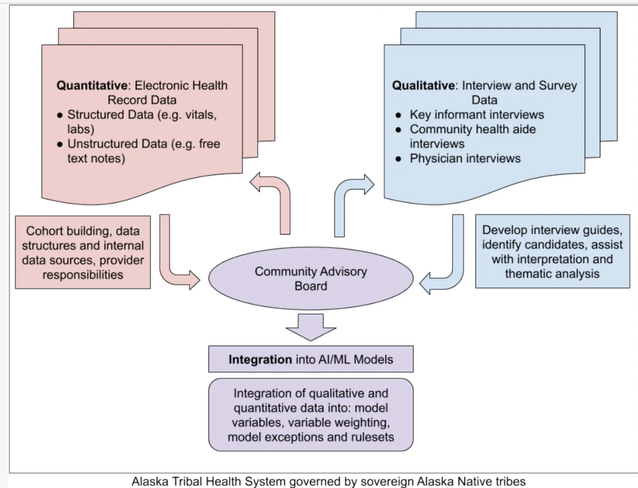
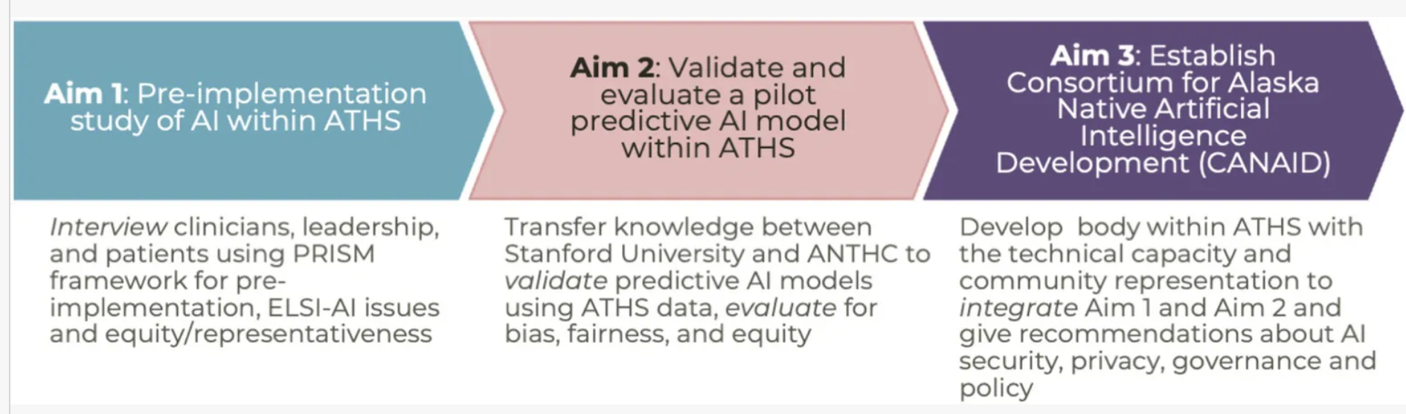
AI Development in AI/AN
Clinics Using CBPR
CBPR – community based participatory research
Researchers: Alaska Native Tribal Health Consortium, the Center for Alaska Native Health Research (Fairbanks), Stanford University, Southcentral Foundation, and Maniilaq Association
Using community-engaged AI/ML methods to address air medical ambulance (medevac) utilization in rural communities within the Alaska Tribal Health System (ATHS).
Ethical, Legal, and Social Implications of Research framework
https://www.frontiersin.org/journals/artificial-intelligence/articles/10.3389/frai.2025.1568886/full
Notes:
Medevac utilization provides an ideal pilot for “community-engaged AI” as it is: (a) a clear priority for patients and providers within the ATHS, (b) an issue unique to rural Alaska and thus requiring the use of data from rural Alaska, (c) an extraordinarily complex problem involving weighing many clinical (e.g., current and potential patient conditions, vital signs, patient complaints, provider exam) and non-clinical (e.g., provider training, resource availability, weather, aircraft availability) determinants, and (d) a health service that is Tribally managed.
AI/ML models represent a technical solution to deciphering this complex decision-making process. While AI/ML models are notorious for requiring a large amount of data, these needs can be adequately met despite the relatively small population in rural Alaska by using the comprehensive health records encompassing a patient’s lifespan and inclusion of medical, dental, and behavioral health services, that the ATHS has maintained for decades (Carroll et al., 2011). Furthermore, the ATHS is a closed system where final outcomes for every patient can be accounted for, greatly improving the quality of the overall data.

Slide 16
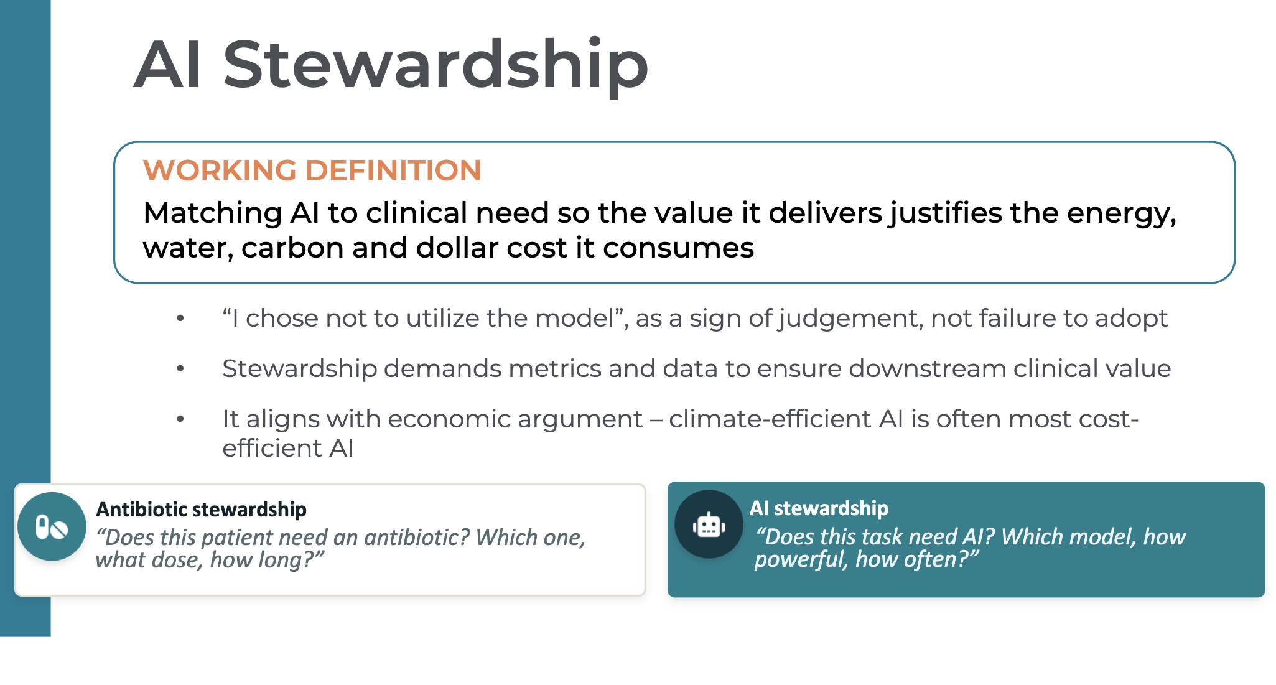
Other Ethical Considerations
Environmental: energy and water use
Involving communities in medical AI development
  Scoping review: only 0.2% of over 1,000 AI healthcare publications have community involvement
    Only a single study has been published with community involvement in application development
Teaching: Using AI as tool rather than replacement for skill and knowledge
Slide courtesy of Dr Jason Lau: https://indiancountryecho.npaihb.org/resources/ai-sustainability-healthcares-responsibility-on-environmental-impact-july-21-2026/
https://www.frontiersin.org/journals/artificial-intelligence/articles/10.3389/frai.2025.1568886/full
https://www.frontiersin.org/journals/artificial-intelligence/articles/10.3389/frai.2025.1568886/full; The Impact of Artificial Intelligence-Assisted Learning on Nursing Students' Ethical Decision-making and Clinical Reasoning in Pediatric Care: A Quasi-Experimental Study - PMC; Wynn M. The ethics of non-explainable artificial intelligence: an overview for clinical nurses. Br J Nurs. 2025 Mar 6;34(5):294-297. doi: 10.12968/bjon.2024.0394. PMID: 40063542.

Slide 17
Other Ethical Considerations
Accountability for adverse events
  Regulation, medical malpractice, and malpractice insurance facilitate remedies
  Unique challenges with AI
    Provider vs developer liability
    Black box reasoning can obscure decision making
  Regulation behind innovation
    Texas: Attorney General reached a settlement with AI healthcare technology company for misleading statements about product accuracy and safety
    California: a law addresses generative AI used by healthcare providers in care provided via written or verbal patient communications
    Utah: Artificial Intelligence Policy Act requires disclosures when interacting with AI systems in healthcare
    Colorado: https://leg.colorado.gov/bills/sb24-205
  Malpractice case law is early and developing
    Developer liability lawsuits for chatbot use outside healthcare
      American Psychological Association asked the Federal Trade Commission (FTC) to investigate chatbots acting as mental health professionals
    Healthcare organization liability caselaw:
      Digital scribe: Washington et al vs Sutter Health - April 2026
      AI tools used to process medical claims
        A company paid $145 million to settle allegations of unlawful kickbacks for clinical decision support alerts in its HER that ignored medical standards and increased drug prescriptions
    Research: Number of times case reviewed by radiologist impacted perceived medical malpractice liability related to AI
      Mock jurors 50% more likely to side with the plaintiff when the radiologist only reviewed the CT scan once after AI feedback vs when the radiologist read the scan twice, once before receiving the AI feedback and once after.
Chew K, Snyder K, Pert C. How Physicians Might Get in Trouble Using AI (or Not Using AI). Mo Med. 2025 May-Jun;122(3):169-172.
https://www.healthcaredive.com/news/why-ai-scribes-malpractice-risk/829541/
https://www.psu.edu/news/research/story/how-ai-integrated-clinical-workflow-lowers-medical-liability-perception
Bernstein, M.H., Sheppard, B., Bruno, M.A. et al. The radiologist–AI workflow and the risk of medical malpractice claims. Nat. Health 1, 386–389 (2026).
https://www.medicaleconomics.com/view/the-new-malpractice-frontier-who-s-liable-when-ai-gets-it-wrong-
Notes:
The lawsuit – Washington et al v. Sutter Health – was filed by plaintiffs Christina Washington, Dennis Gueretta, and Rebecca Matulic, who visited the defendants in the past six months and disclosed sensitive medical information in their visits. The plaintiffs allege that they had a reasonable expectation that their conversations with the clinicians would remain private and confidential. The plaintiffs allege that at the time of their visits, they were unaware that their conversations with clinicians were being recorded by an artificial intelligence platform and transmitted externally outside the clinical setting and processed by a third-party system.

Slide 18
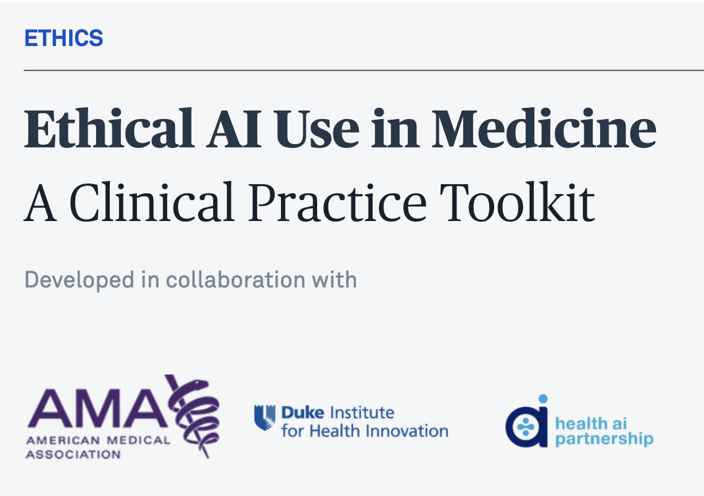
Ethical AI Use Toolkit: AMA
American Medical Association, published 2026
Highlights
  Utility: diagnostic accuracy, streamline workflows, and support personalized care
  Ethical concerns: reliability, bias, transparency, privacy, and patient trust
Types of AI: administrative, clinical decision-support, and medical intervention tools
https://edhub.ama-assn.org/code-of-medical-ethics/module/2843218?cmp=1

Slide 19
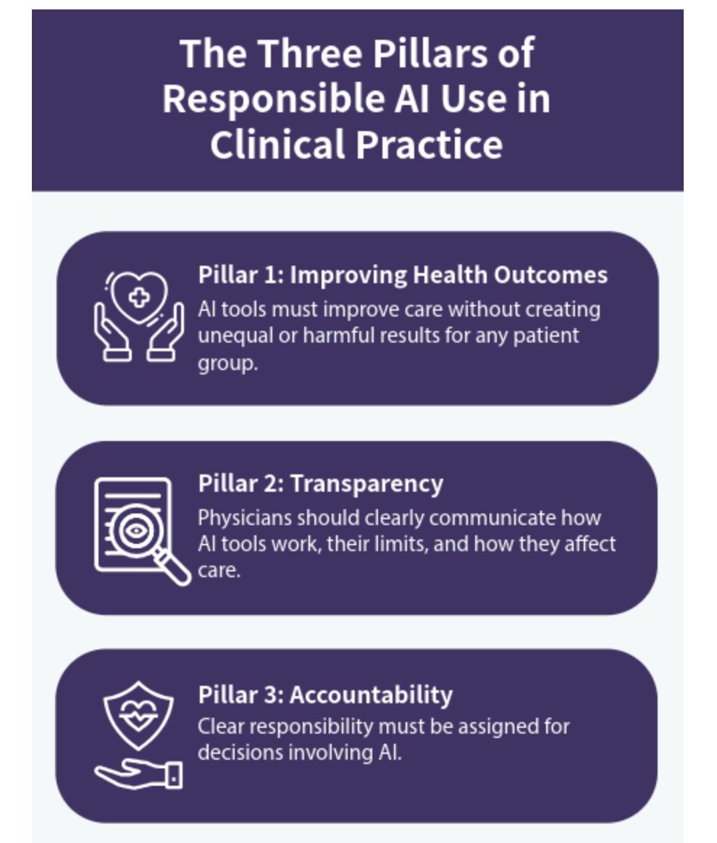
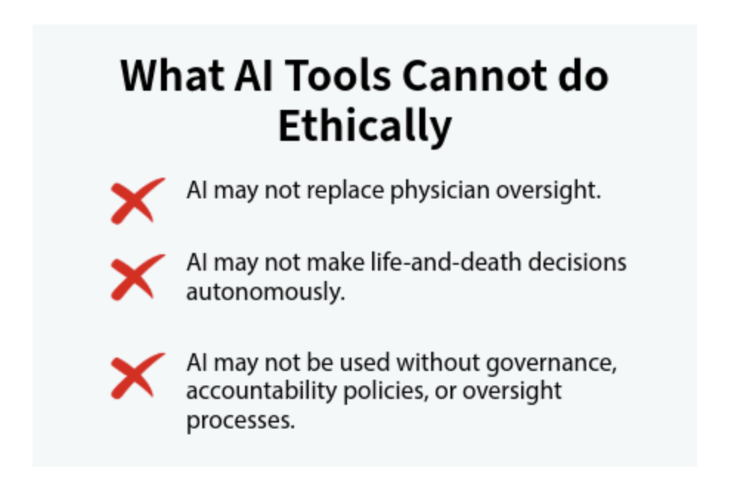
Clinical Oversight of AI Tools
https://edhub.ama-assn.org/code-of-medical-ethics/module/2843218?cmp=1

Slide 20
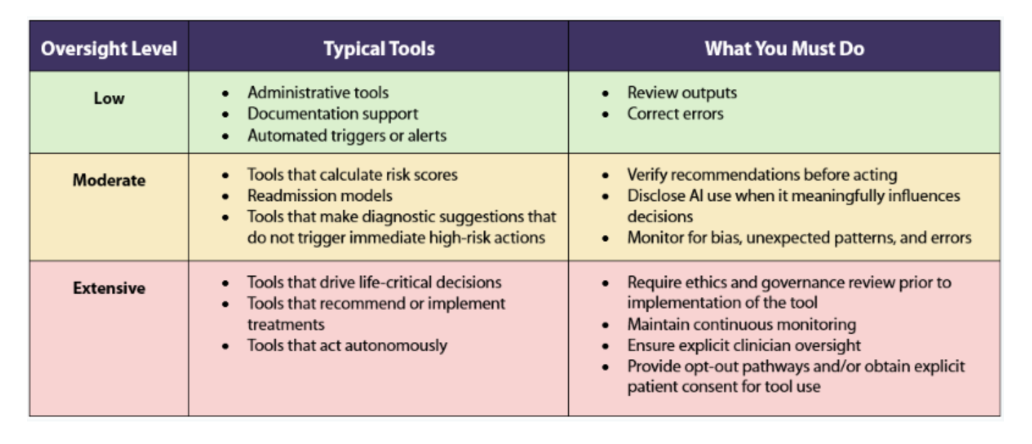
Clinical Oversight of AI Tools
https://edhub.ama-assn.org/code-of-medical-ethics/module/2843218?cmp=1

Slide 21
Six Steps for Introducing AI into Clinical Practice
Evaluate Tool Appropriateness
Is the tool validated, safe, and appropriate?
  Is there appropriate training in place for using the tool?
  Will this tool be used for its intended purpose?
  Do I understand the tool's function and limits?
  What is the oversight level of the tool?
2) Evaluate Health Outcome Impacts
Does the tool prioritize patient welfare, performs equitably, and supports safe, individualized care?
Do I understand when to accept, adapt, supplement, or override this tool's recommendations?
Am I using it to benefit the individual patient and not defaulting to population-level logic?
https://edhub.ama-assn.org/code-of-medical-ethics/module/2843218?cmp=1

Slide 22
Six Steps for Introducing AI into Clinical Practice
3) Evaluate Transparency: Disclosure
Disclosure: informing patients when AI impacts their diagnosis, prognosis, or treatment, or when its use raises questions about privacy, accuracy, or data handling.
Are there risks, limits, or uncertainties the patient should understand?
Would a reasonable patient want to know that AI contributed to their care?
4) Evaluate Transparency: Permission & Informed Consent
Does this tool influence diagnosis, prognosis, or treatment in a way the patient must understand and consent to?
Are there risks, uncertainties, or limitations that materially affect the patient's decision?
Admin tools: No, unless identifiable data used (such as digital scribes)
Clinical decision making tools: obtain consent when diagnostic tools impact clinical interpretation and when prognostic tools could impact treatment decisions
Medical intervention: Nearly always as impacts active treatment
https://edhub.ama-assn.org/code-of-medical-ethics/module/2843218?cmp=1
Notes:
Consent requires understanding and permission, not just awareness. Informed consent is required when the AI tool meaningfully influences diagnosis, prognosis, or treatment in ways that impact patient risk, autonomy, or decision-making, or when identifiable personal data is used in a way that requires explicit permission.

Slide 23
Six Steps for Introducing AI into Clinical Practice
5) Evaluate Accountability & Oversight: Who is Responsible?
Is there clear oversight for this tool (governance, monitoring, reporting)?
Am I maintaining human oversight, documenting, and addressing concerns, overrides, or unexpected outputs?
For example: institutional policies require checking work
6) Continuous Post-Implementation Evaluation: Ongoing Monitoring
Is the tool still accurate and safe in real-world use?
Are there signs of bias or subgroup performance inaccuracies?
Am I becoming overly reliant on the tool (de-skilling)?
Is the model's performance changing over time (model drift)?
https://edhub.ama-assn.org/code-of-medical-ethics/module/2843218?cmp=1
Notes:
Consent requires understanding and permission, not just awareness. Informed consent is required when the AI tool meaningfully influences diagnosis, prognosis, or treatment in ways that impact patient risk, autonomy, or decision-making, or when identifiable personal data is used in a way that requires explicit permission.

Slide 24
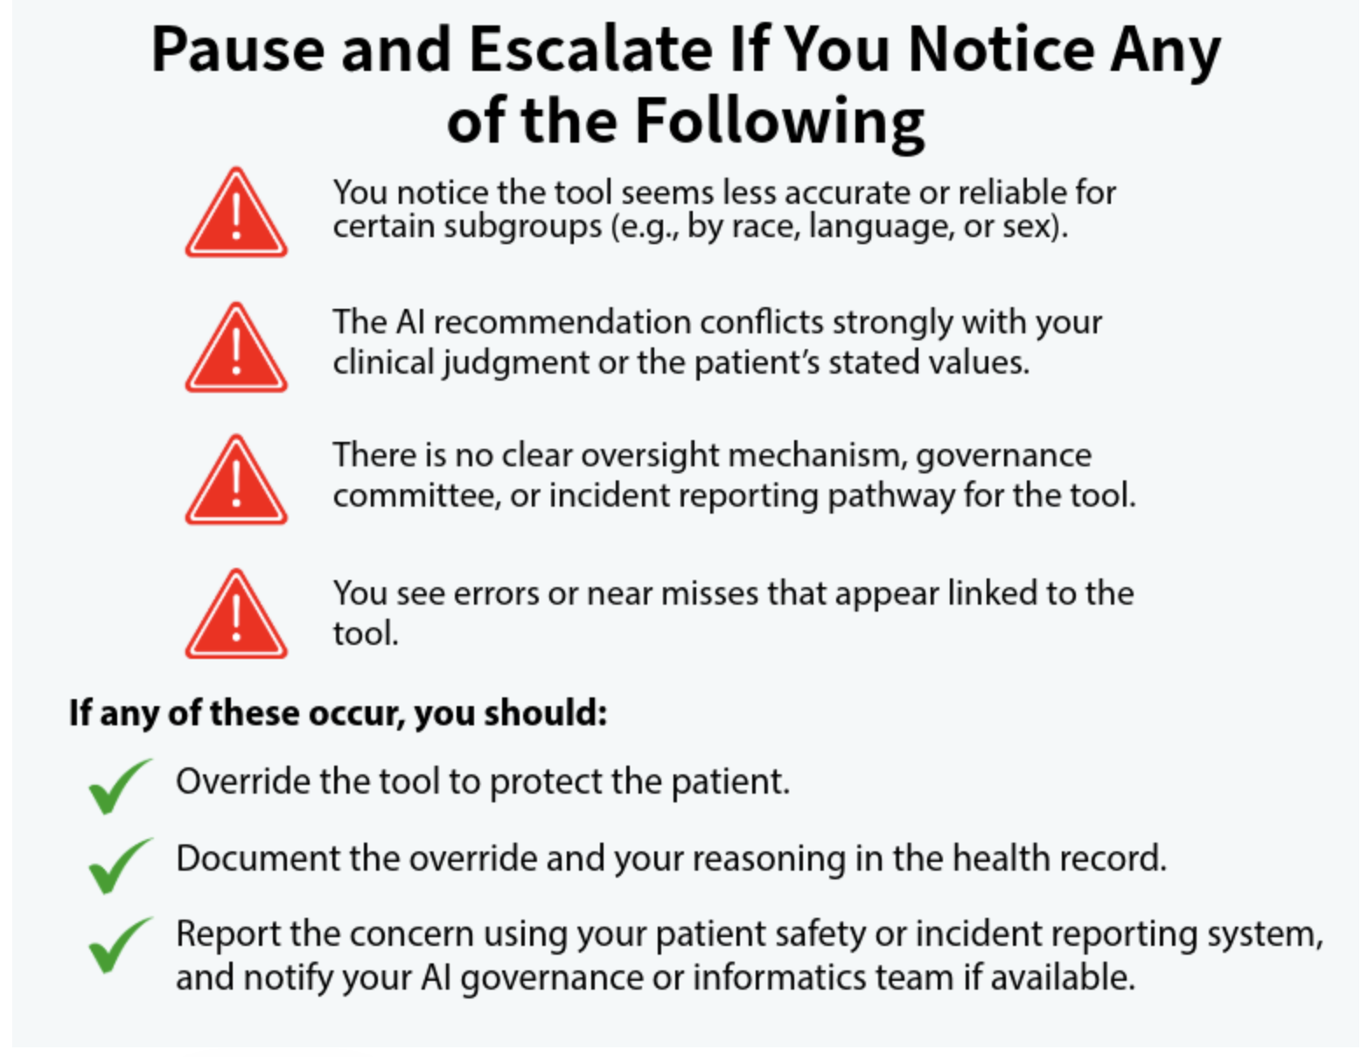
When to Pause
5) Evaluate Accountability & Oversight: Who is Responsible?
Is there clear oversight for this tool (governance, monitoring, reporting)?
Am I maintaining human oversight, documenting, and addressing concerns, overrides, or unexpected outputs?
For example: institutional policies require checking work
https://edhub.ama-assn.org/code-of-medical-ethics/module/2843218?cmp=1
Notes:
Consent requires understanding and permission, not just awareness. Informed consent is required when the AI tool meaningfully influences diagnosis, prognosis, or treatment in ways that impact patient risk, autonomy, or decision-making, or when identifiable personal data is used in a way that requires explicit permission.

Slide 25
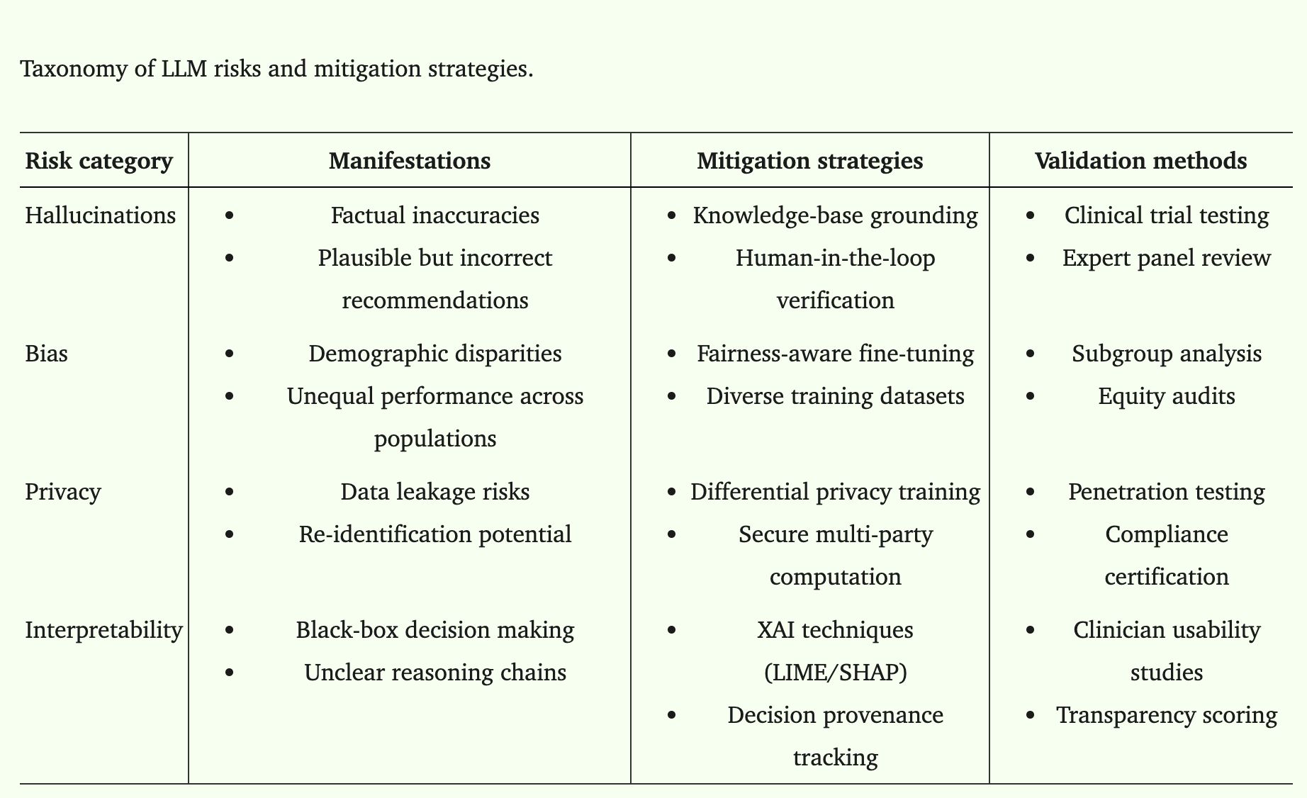
Trustworthy AI
TAI: "transparency‐based principles and combines reliability, ethical accountability, and fairness while maintaining transparency and seeking to maximize these aspects for high‐risk healthcare environments"
  User trust and ethical principles at the core of AI development and deployment
Zendehbad SA, Ghasemi J, Khodadad FS. Trustworthy AI in Telehealth: Navigating Challenges, Ethical Considerations, and Future Opportunities for Equitable Healthcare Delivery. Healthc Technol Lett. 2025 Oct 1;12(1):e70020.
Notes:
Consent requires understanding and permission, not just awareness. Informed consent is required when the AI tool meaningfully influences diagnosis, prognosis, or treatment in ways that impact patient risk, autonomy, or decision-making, or when identifiable personal data is used in a way that requires explicit permission.

Slide 26
References
Geny M, Andres E, Talha S, Geny B. Liability of Health Professionals Using Sensors, Telemedicine and Artificial Intelligence for Remote Healthcare. Sensors (Basel). 2024 May 28;24(11):3491. doi: 10.3390/s24113491. PMID: 38894282; PMCID: PMC11174849. --- Liability of Health Professionals Using Sensors, Telemedicine and Artificial Intelligence for Remote Healthcare - PMC
Hu S, Song D, Wan S, Zhang S, Luo C, Li N, Liu G, da Graça Espírito Santo Vasconcelos J, de Carvalho LLC, Neobísi E, da Costa MLB, Etchu Takounjou J, Neves KMD, Dos Ramos da Conceição L, da Costa Encarnação M, Zhao LY. Digital health: current applications, challenges, and future directions for enhancing healthcare quality and safety. Front Public Health. 2025 Sep 26;13:1646802. doi: 10.3389/fpubh.2025.1646802. PMID: 41089861; PMCID: PMC12516163. --- Digital health: current applications, challenges, and future directions for enhancing healthcare quality and safety - PMC
Canales Morales P. Ethics and Technology in Nursing Education: Rethinking Artificial Intelligence. Invest Educ Enferm. 2025 Sep;43(3):e14. doi: 10.17533/udea.iee.v43n3e14. PMID: 41289538; PMCID: PMC12674647. --- Ethics and Technology in Nursing Education: Rethinking Artificial Intelligence - PMC
Hey CY, Kulkarni S. Artificial intelligence in healthcare research: Research ethics perspective. Br J Clin Pharmacol. 2026 Mar;92(3):1003-1007. doi: 10.1002/bcp.70395. Epub 2025 Dec 7. PMID: 41355172.
El Arab RA, Al Moosa OA, Sagbakken M. Economic, ethical, and regulatory dimensions of artificial intelligence in healthcare: an integrative review. Front Public Health. 2025 Aug 29;13:1617138. doi: 10.3389/fpubh.2025.1617138. PMID: 40951387; PMCID: PMC12425912. --- Economic, ethical, and regulatory dimensions of artificial intelligence in healthcare: an integrative review - PMC
Sung J. Artificial intelligence in medicine: Ethical, social and legal perspectives. Ann Acad Med Singap. 2023 Dec 28;52(12):695-699. doi: 10.47102/annals-acadmedsg.2023103. PMID: 38920162

Slide 27
References
Shin H, De Gagne JC, Kim SS, Hong M. The Impact of Artificial Intelligence-Assisted Learning on Nursing Students' Ethical Decision-making and Clinical Reasoning in Pediatric Care: A Quasi-Experimental Study. Comput Inform Nurs. 2024 Oct 1;42(10):704-711. doi: 10.1097/CIN.0000000000001177. PMID: 39152099; PMCID: PMC11458082. ------ The Impact of Artificial Intelligence-Assisted Learning on Nursing Students' Ethical Decision-making and Clinical Reasoning in Pediatric Care: A Quasi-Experimental Study - PMC
Sedlakova J, Trachsel M. Conversational Artificial Intelligence in Psychotherapy: A New Therapeutic Tool or Agent? Am J Bioeth. 2023 May;23(5):4-13. doi: 10.1080/15265161.2022.2048739. Epub 2022 Apr 1. PMID: 35362368.
A Structured Decision Simulator for Using an Ambient AI Scribe: AI Ethics in Clinical Practice | Ethics | AMA Code of Medical Ethics | AMA Ed Hub
Pool J, Indulska M, Sadiq S. Large language models and generative AI in telehealth: a responsible use lens. J Am Med Inform Assoc. 2024 Sep 1;31(9):2125-2136. doi: 10.1093/jamia/ocae035. PMID: 38441296; PMCID: PMC11339524. --- Large language models and generative AI in telehealth: a responsible use lens - PMC
Fournier-Tombs E, McHardy J. A Medical Ethics Framework for Conversational Artificial Intelligence. J Med Internet Res. 2023 Jul 26;25:e43068. doi: 10.2196/43068. PMID: 37224277; PMCID: PMC10373921. --- A Medical Ethics Framework for Conversational Artificial Intelligence - PMC
Tiribelli S, Monnot A, Shah SFH, Arora A, Toong PJ, Kong S. Ethics Principles for Artificial Intelligence-Based Telemedicine for Public Health. Am J Public Health. 2023 May;113(5):577-584. doi: 10.2105/AJPH.2023.307225. Epub 2023 Mar 9. PMID: 36893365; PMCID: PMC10088937. ---- Ethics Principles for Artificial Intelligence–Based Telemedicine for Public Health - PMC
Marques M, Almeida A, Pereira H. The Medicine Revolution Through Artificial Intelligence: Ethical Challenges of Machine Learning Algorithms in Decision-Making. Cureus. 2024 Sep 14;16(9):e69405. doi: 10.7759/cureus.69405. PMID: 39411643; PMCID: PMC11473215. --- The Medicine Revolution Through Artificial Intelligence: Ethical Challenges of Machine Learning Algorithms in Decision-Making - PMC
Badawy W, Zinhom H, Shaban M. Navigating ethical considerations in the use of artificial intelligence for patient care: A systematic review. Int Nurs Rev. 2025 Sep;72(3):e13059. doi: 10.1111/inr.13059. Epub 2024 Nov 15. PMID: 39545614.

Slide 28
References
Adams J. Defending explicability as a principle for the ethics of artificial intelligence in medicine. Med Health Care Philos. 2023 Dec;26(4):615-623. doi: 10.1007/s11019-023-10175-7. Epub 2023 Aug 29. PMID: 37642834; PMCID: PMC10725847. --- Defending explicability as a principle for the ethics of artificial intelligence in medicine - PMC
De-Giorgio F, Benedetti B, Mancino M, Sala E, Pascali VL. The need for balancing 'black box' systems and explainable artificial intelligence: A necessary implementation in radiology. Eur J Radiol. 2025 Apr;185:112014. doi: 10.1016/j.ejrad.2025.112014. Epub 2025 Feb 26. PMID: 40031377.
Marshall DT, Naff DB. The Ethics of Using Artificial Intelligence in Qualitative Research. J Empir Res Hum Res Ethics. 2024 Jul;19(3):92-102. doi: 10.1177/15562646241262659. Epub 2024 Jun 17. PMID: 38881315.
Warrington DJ, Holm S. Healthcare ethics and artificial intelligence: a UK doctor survey. BMJ Open. 2024 Dec 20;14(12):e089090. doi: 10.1136/bmjopen-2024-089090. PMID: 39806591; PMCID: PMC11667393. ---- Healthcare ethics and artificial intelligence: a UK doctor survey - PMC
Wynn M. The ethics of non-explainable artificial intelligence: an overview for clinical nurses. Br J Nurs. 2025 Mar 6;34(5):294-297. doi: 10.12968/bjon.2024.0394. PMID: 40063542.
Doležal T, Doležal A. Artificial intelligence in healthcare: the duty to inform patients. Cas Lek Cesk. 2025;164(7-8):324-327. English. PMID: 41615791.
Astărăstoae V, Rogozea LM, Leaşu F, Ioan BG. Ethical Dilemmas of Using Artificial Intelligence in Medicine. Am J Ther. 2024 Jul-Aug 01;31(4):e388-e397. doi: 10.1097/MJT.0000000000001693. Epub 2024 Apr 25. PMID: 38662923.

