Slide 1
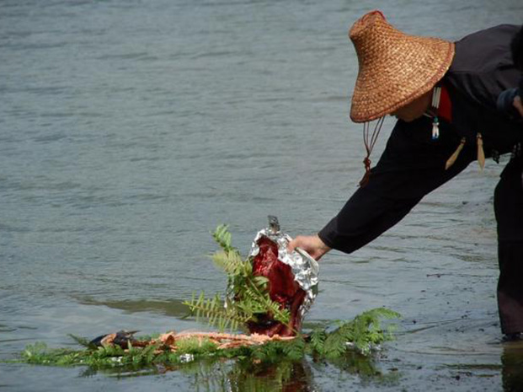
Cultural Considerations in Working with Native Communities
  Danica Love Brown, PhD, MSW, CACIII
  Choctaw Nation of Oklahoma
  White Crae Consultation, LLC
  danicabrown@whitecraneconsulting.com

Slide 2
Learning Objectives
Describe how historical and individual trauma contributes to psychological risk using the Indigenist Stress-Coping Model and identify at least two trauma-related effects on functioning.
Explain the role of Indigenous cultural connectedness and “culture as medicine,” citing three cultural buffers/practices.
Navigating the space in between in Indigenous psychological care.
Apply three strategies for incorporating Traditional Indigenous Knowledge into prevention/treatment: Original Instructions, Relational Restoration, Narrative Transformation, and produce one practical example for each.

Slide 3

Trauma is disconnection
Healing is Sacred Connection
Therefore think of the importance of acknowledgement
  Maestro Jerry Tello - traditional healer
  Image citation: https://www.travelsouthdakota.com/Tribes
Notes:
For tribal people in the Americas, current and past political and social events help shape the context of their lives in ways that many other Americans do not experience. The study of trauma, historical and present, has connected historical genocide, assimilation, oppression and disparate treatment to such symptoms as depression, suicidal thoughts, anger, anxiety, low self-esteem and difficulty in both recognizing and expressing emotions and impact substance misuse. A culturally responsive health system must recognize the broader social and political factors that underlie health issues for American Indian people. This presentation will focus on integrating traditional indigenous knowledge into treatment by utilizing the trickster as a metaphor for addressing substance misuse and provide examples of the integration of traditional indigenous knowledge into care.
Participants will gain an overview of trauma and its connection to health outcomes: This includes understanding the definition of trauma, its various types (acute, repetitive, complex, developmental, vicarious, and intergenerational), its effects on the brain and body, and how it manifests in thoughts and behaviors.
Participants will gain an overview of historical trauma and ancestral wisdom: This includes understanding the cumulative emotional and psychological wounding from massive group trauma across generations and an understanding of the epigenetic transfer of trauma and ancestral wisdom.
Participants will gain an overview of Indigenous wellness and healing: This includes learning about the importance of cultural connection, traditional practices, the relationship with medicine, and the concept of "Culture as Medicine" in promoting overall health and resilience within Tribal communities.

Slide 4
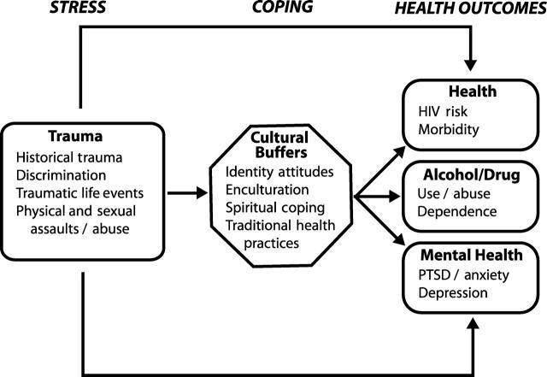
Indigenist Stress Coping Model
Walters, Karina L, Simoni, Jane M, & Evans-Campbell, Teresa. (2002). Substance Use Among American Indians and Alaska Natives: Incorporating Culture in an "Indigenist" Stress-Coping Paradigm. Public Health Reports (1974), 117(Suppl 1), S104–S117.
Notes:
Particularly powerful is the process by which colonization has become internalized among AI peoples and serves to shape health outcomes. Genocide against the indigenous people in the Americas is one of the most massive and longest lasting campaigns in human history.
Historical traumatic events have contributed to these disparities related to social and behavioral factors, such as, resulting in increased younger female headed households, significantly higher poverty rates, larger families, lower median income, lower education, etc., including substance misuse (CDC, 2013).
A significant body of robust research (Brave Heart Yellow Horse, 1998 and 2004; Brown, 2007; Duran, E., 2006; Duran and Duran, 1995; Evan-Campbell, 2008; Stites, 2001, Walters, 1999; Walters et al, 2002a) demonstrates the harmful impact of colonialism on indigenous cultures in the America’s and its continued impact on indigenous peoples across the planet, manifesting through cultural and historical trauma which has been shown to have a direct relationship to the internalized and lateral oppression seen in AI communities that impacts the quality of life for indigenous peoples and health outcomes in this generation.
These scholars have theorized that there is a connection between historically anchored traumatic events and current health inequities among American Indians”. This connection is relational as highlighted by the indigenous people’s relationship with the land, each other and spirit. Including substance misuse

Slide 5
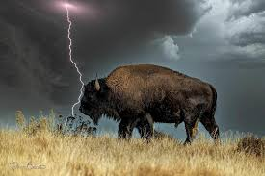
Overview of trauma
Trauma is “about loss of connection—to ourselves, our families, and the world around us.” Peter Levine
Is an inner injury, lasting rupture or spilt within the self due to difficult or hurtful events
  All trauma is preverbal
  Trauma is embodied (somatic)
  Trauma is a spectrum
  Levine, P. A. (2013). Transforming trauma : awakening the ordinary miracle of healing. Milton H. Erickson Foundation.
  Diagnostic and statistical manual of mental disorders : DSM-IV-TR. (4th ed., text revision.). (2000). American Psychiatric Association.
  Maté, G., & Maté, D. (2022). The myth of normal : trauma, illness, & healing in a toxic culture. Avery, an imprint of Penguin Random House
Notes:
Trauma refers to a person’s response or reaction to an event. The extent that a person has experiences trauma also influences how trauma is perceived and processed.
The psychic wounds we sustain are often inflicted on us before our brain is capable of formulating any kind of verbal narrative. Some wounds are imprinted on regions of our nervous system having nothing to do with language or concepts, in our brain and other parts of our body, known as “embodiment of trauma”.
Trauma pervades our culture, from personal functioning through relationships, parenting, education, popular culture, economics, and politics.
Trauma, until we work through it, constrains our inborn capacity and generates an enduring distortion of our view of the world, other people and ourselves.
It is important to acknowledge that the term “trauma” comes from a western medical context. Using trauma terminology implies that the individual is responsible for the response, that than the broader systemic force caused by the state’s abuse of power.

Slide 6
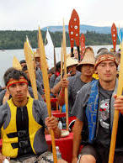
Types of trauma
Acute trauma
Repetitive trauma
Complex trauma
Developmental trauma
Vicarious trauma
Cultural, Historical and/or Intergenerational trauma
Notes:
Complex trauma describes both children’s exposure to multiple traumatic events—often of an invasive, interpersonal nature—and the wide-ranging, long-term effects of this exposure. These events are severe and pervasive, such as abuse or profound neglect. They usually occur early in life and can disrupt many aspects of the child’s development and the formation of a sense of self. Since these events often occur with a caregiver, they interfere with the child’s ability to form a secure attachment. Many aspects of a child’s healthy physical and mental development rely on this primary source of safety and stability.
Developmental Trauma is a term used in the literature to describe childhood trauma such as chronic abuse, neglect or other harsh adversity in their own homes.
Vicarious trauma is the emotional residue of exposure that counselors have from working with people as they are hearing their trauma stories and become witnesses to the pain, fear, and terror that trauma survivors have endured. It is important not to confuse vicarious trauma with “burnout”.

Slide 7
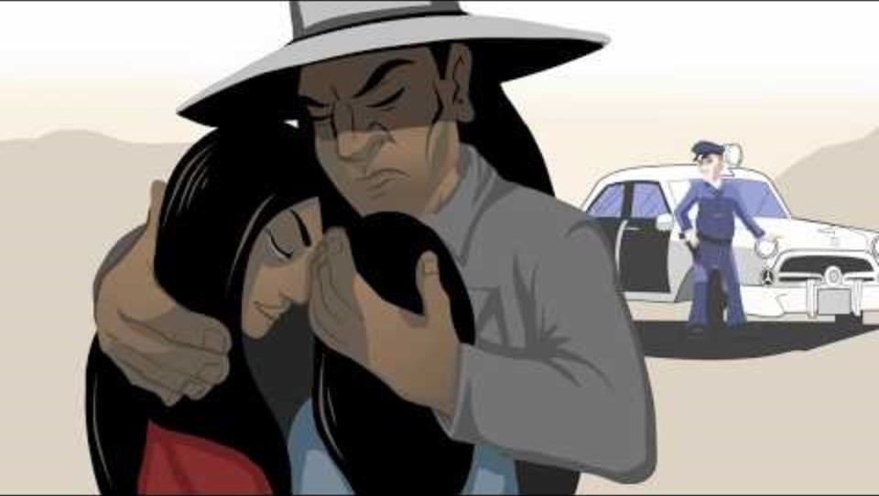
Source of the wound
Notes:
https://www.youtube.com

Slide 8
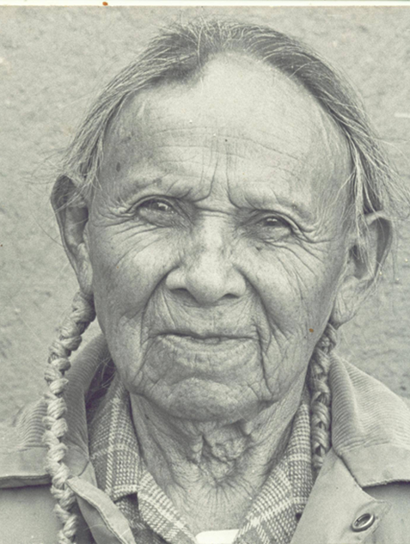
Ancestral Memory
“The memories of our ancestors are passed down on our blood”
Little Joe Gomez
Hamby, Sherry, Elm, Jessica H L, Howell, Kathryn H, & Merrick, Melissa T. (2021). Recognizing the cumulative burden of childhood adversities transforms science and practice for trauma and resilience. The American Psychologist, 76(2), 230–242. https://doi.org/10.1037/amp0000763
Notes:
There is some evidence of an epigenetic transfer of the trauma. Trauma can be passed down to offspring due to epigenetic changes in DNA. But positive experiences seem able to correct that. ... In recent years researchers have learned that trauma can be inherited—passed down due to changes in DNA, what's known as epigenetics.
Severe stress doesn’t just affect one generation: it is passed down, both socially — affecting parenting — and physiologically, by actually changing how children’s genes are read, which can alter both brain and body, a phenomenon known as epigenetics.

Slide 9

Impact of Historical Trauma
Disruption in our ability to fulfill our original instructions
Disruption in our relational ways of being
Disruption in how we narrate/story our lives

Slide 10
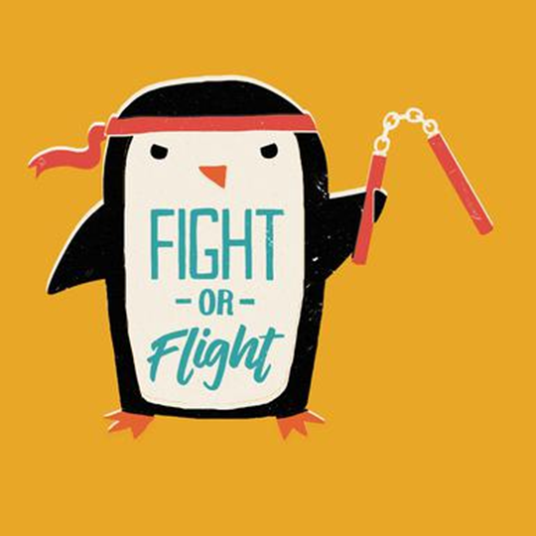
Our bodies are designed to remember danger
Notes:
Each of us begins to maintain a database of threats in the environment. This happened between the ages of 0-5 years old

Slide 11
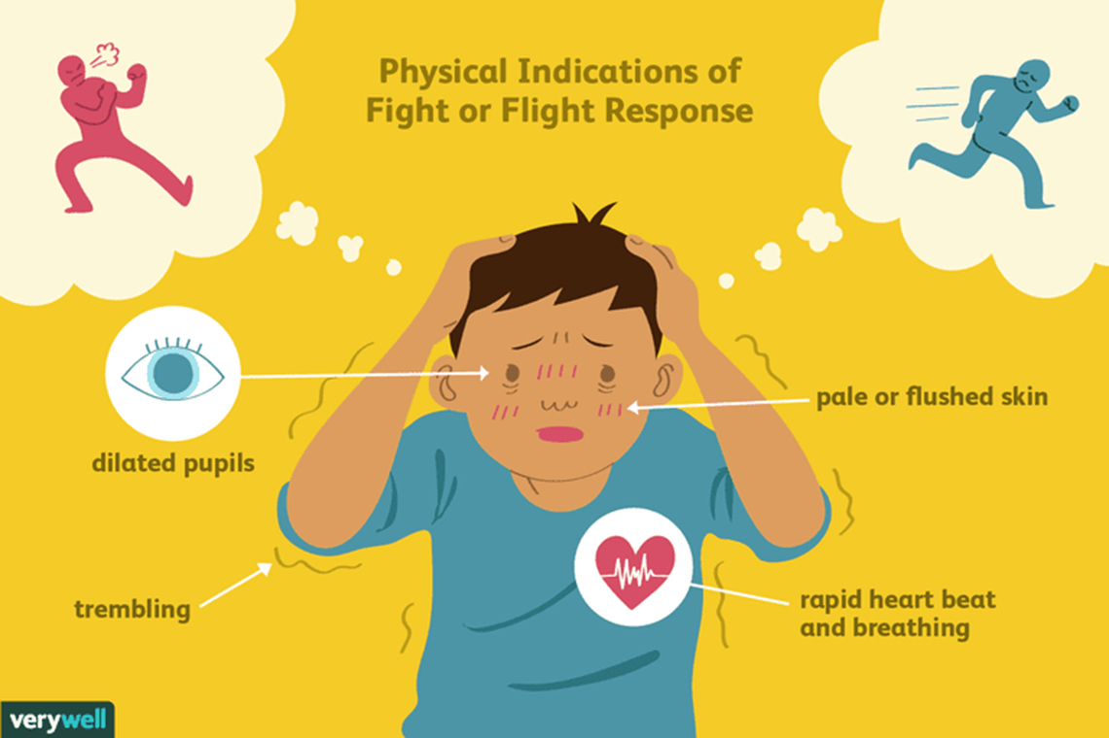
ANCIENT SURVIVAL RESPONSES
TO LIFE THREATENING CIRCUMSTANCES
Bracha, H. (2004). Freeze, flight, fight, fright, faint: Adaptationist perspectives on the acute stress response system. CNS Spectrums, 9(9), 679-685.
Stanton, S. (2016), "Intuition: A Silver Lining for Clinicians with Complex Trauma". Dissertations. https://surface.syr.edu/etd/615
Notes:
Fight- hyper vigilance on conscious and unconscious levels, prepared to attack; flooding of physiological changes related to aggression.
Flight- blood flows to the limbs preparing to run; flight is often thwarted, giving no relief or outlet to a primed nervous system. Avoidance, dissociation, hiding and other psychological“flight” behaviors can also become disruptive.
Freeze- response observed in animals, accompanied by slowed and shut down metabolism. Can also be a learned response as an attempt to remain safe and invisible; paralyze the victim ----actually making them more vulnerable and reinforcing helplessness in each new situation.
Fawn-In a nutshell, “fawning” is the use of people-pleasing to diffuse conflict, feel more secure in relationships, and earn the approval of others. It's a maladaptive way of creating safety in our connections with others by essentially mirroring the imagined expectations and desires of other people.

Slide 12
ACES Study
The Division of Violence Prevention at the Centers for Disease Control and Prevention (CDC), in partnership with Kaiser Permanente, conducted a landmark ACE study from 1995 to 1997 with more than 17,000 participants.
  28% of study participants reported physical abuse and 21% reported sexual abuse
  Almost 40% of the Kaiser sample reported two or more ACEs and 12.5% experienced four or more
Notes:
Many studies have examined the relationship between ACEs and a variety of known risk factors for disease, disability, and early mortality. The Division of Violence Prevention at the Centers for Disease Control and Prevention (CDC), in partnership with Kaiser Permanente, conducted a landmark ACE study from 1995 to 1997 with more than 17,000 participants. The study found:
ACEs are common. For example, 28% of study participants reported physical abuse and 21% reported sexual abuse. Many also reported experiencing a divorce or parental separation, or having a parent with a mental and/or substance use disorder.
ACEs cluster. Almost 40% of the Kaiser sample reported two or more ACEs and 12.5% experienced four or more. Because ACEs cluster, many subsequent studies now look at the cumulative effects of ACEs rather than the individual effects of each.
ACEs have a dose-response relationship with many health problems. As researchers followed participants over time, they discovered that a person’s cumulative ACEs score has a strong, graded relationship to numerous health, social, and behavioral problems throughout their lifespan, including substance use disorders. Furthermore, many problems related to ACEs tend to be comorbid or co-occurring.

Slide 13

Notes:
There is a reason why we crave cake and not celery, to be in a state of survival burns a huge amount of calories, and living in survival mode is exhausting

Slide 14
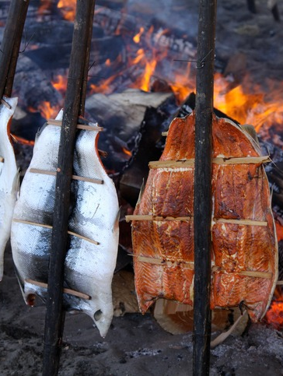
Effects of Trauma
Separates us from our bodies.
Splits is from our feelings
Limits response flexibility
Fosters a ‘shame’ based view of self
Distorts our view of the world
Alienates is from the present
Maté, G., & Maté, D. (2022). The myth of normal : trauma, illness, & healing in a toxic culture. Avery, an imprint of Penguin Random House.
Notes:
Trauma separates us from our bodies, it can manifest in variety of ways; high pain tolerance, over eating, hyper or hypo sexuality, etc.
Trauma splits is from our feelings, moves us from our cerebral cortex to the limbic system, fight flight freeze, fawn.
Trauma limits response flexibility. The ability to choose HOW we address life’s inevitable ups and downs, disappointments, triumphs and challenges. Response flexibility is a function of the midfrontal portion of the cerebral cortex, freedom to choose develops as the brain develops.
Fosters a ‘shame’ based view of self, us a awareness of ourselves as fundamentally deficient in some vital way as a human being. People develop a shame based view of themselves at the core, a negative self perception most are not even conscience of.
Trauma, especially complex trauma, imposes a worldview tinged with pain, fear, and suspicions: a lens that distorts and determines our view of how things are.
People are desperately seeking to escape from themselves. Trauma disconnects us from ourselves, and society is exploiting this and reinforces trauma, through work pressures, multi tasking, social media, drugs and alcohol, sex, shopping, meaningless conversations, etc. We are caught up in pursuits of all kinds that obliterate the present. So we can avoid the pain, trauma has left us.

Slide 15
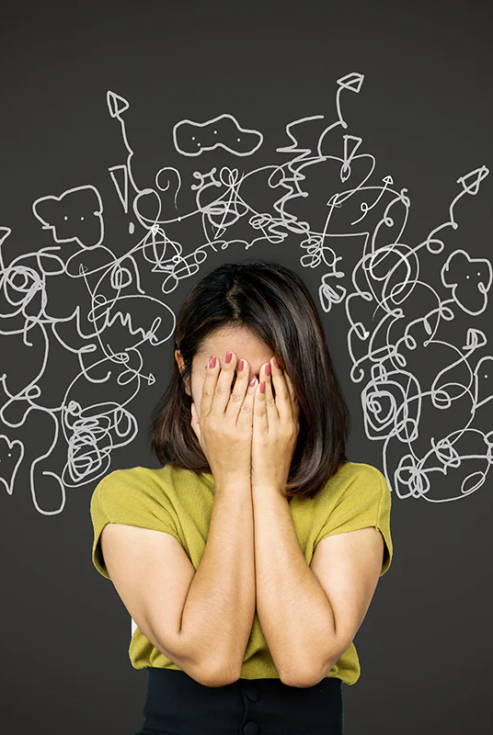
“Trauma is not what happens to you, but what happens inside you”
Gabor Mate’
Maté, G., & Maté, D. (2022). The myth of normal : trauma, illness, & healing in a toxic culture. Avery, an imprint of Penguin Random House.
Notes:
That is to say that its our response to a traumatic event, not who were are as a human being.
‘T’- Trauma- underlies much of what gets labeled as mental illness. Capital T trauma occurs when things happen to vulnerable people that should not have happened to us for example a child be abused, violence in the family, or loss of a parent…ie ACEs
‘t’ trauma is nearly universal in our culture,. This might include bullying by peers, the cause but repeated harsh comments of a well meaning parent, or even just lack of sufficient emotional connections with a caring adult. Trauma of this kind does not require overt distress or misfortune and can lead to the pain if disconnection from self, as a result of core needs not being satisfied.

Slide 16
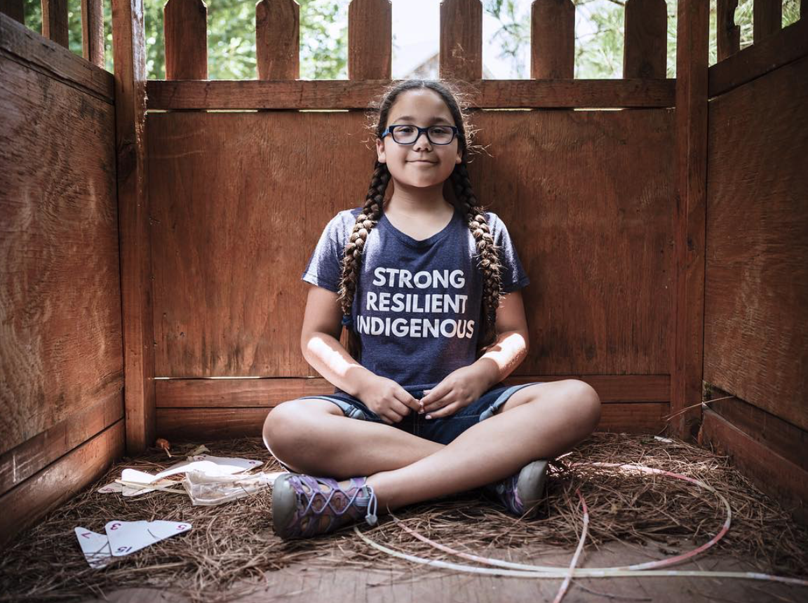
Notes:
And in fact, there is Hope. We know that trauma reactions may occur when there is a substantial perceived or actual threat. However, we also know that people often experience the same event and react very differently- where one may be traumatized, others are able to demonstrate greater resilience. In other words, it is not the traumatic event itself that causes humans distress, but rather the reactions to that traumatic event. (Denham, 2008; Duran, 2006; Brave Heart Yellow Horse, 1998 and 2004).

Slide 17
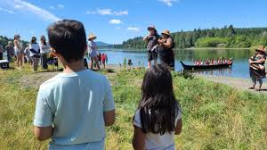
Resilient Responses to Trauma
Increased bonding with family and community.
Redefined or increased sense of purpose and meaning.
Increased commitment to a personal mission.
Revised priorities.
Increased charitable giving and volunteerism.
Center for Substance Abuse Treatment , issuing body, publisher. (2014). Trauma-Informed care in behavioral health services : A treatment improvement protocol. (Treatment improvement protocol (TIP) series ; 57). Rockville, MD: U.S. Department of Health and Human Services, Substance Abuse and Mental Health Services Administration, Center for Substance Abuse Treatment.
Notes:
Many people find healthy ways to cope with, respond to, and heal from trauma. Often, people automatically reevaluate their values and redefine what is important after a trauma. Such resilient responses include:

Slide 18
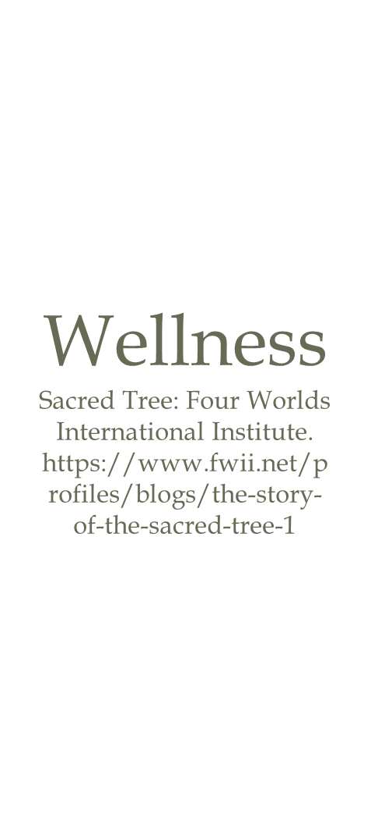

Notes:
Health and wellness from a traditional Indigenous perspective is centered in a holistic model, whereas western perspectives are based in illness/disease. This includes philosophies that equally consider the spiritual, emotional, mental, and physical aspects of the person. Linklater (2014) adds “the mind body-body split has influenced much of psychiatric thinking” (pg. 21). Jennings and Lowe (2013) sought to define health and wellness indicating that wellness involves multiple facets of life including the environment, space, and health of the earth. Lowe and Struthers (2001) further developed a conceptual framework for treating health among AI/AN groups including the dimensions of caring, traditions, respect, connection, holism, trust, and spirituality (p. 280). Moffitt and Vollman (2004) defined wellness as “aesthetic dimension to knowledge transmission, it may enhance the identity and visibility of past traditions” (Moffitt & Vollman, 2004, p. 195). Many AI/AN traditions look to the medicine wheel to define wellness, seeking balance in the physical, mental, emotional, and spiritual intersections of life.
Indigenous philosophies are holistic in nature, which consider equally the physical, mental, emotional and spiritual aspects of the human condition in relation to Mother Earth (land and resources) and Father Sky (natural law and ancestral wisdom). This is in contrast to western philosophies, which compartmentalize these aspects, and rarely address or consider the spiritual aspect of the human condition. Indigenous models are based in wellness, while western models are concerned about disease (Brown, 2016 and 2019; Linklater, 2014). The Diagnostic and Statistical Manual of Mental Health Disorders, 4th Edition (DSM-IV) (2000) defines mental health as “a state marked by the absence of illness”. Whereas, Indigenous philosophies understand mental health as a “broad spectrum, of challenges that [Indigenous] people face in the life walk” (Stevens & St. Germaine, 2003, pg. 160). AI/AN elders and developers of the 49 Days of Ceremony conceptual framework, Doug Modig and Amy Modig (2020) note that balance comes from “wakening the will” within one’s self, while restoring balance with our relationships with others, Mother Earth and Father Sky.
Wellness is related to our understanding of balance to one’s self, family, and community. Linklater (2014) identifies several themes in understanding AI/AN wellness, including balance and harmony, being in Creation, care and compassion, and challenges that AI/AN communities contend with in the pursuit of wellness. Specifically, Linklater (2014) states that the “core of the human experience is spiritual. The core of human wellness is Spirit and spiritual” (pg. 74, see also Hodge, Limb and Cross, 2009, pg. 213). Many AI/AN programs address issues related to balance and harmony. Acknowledging that human beings are in relationship with everything, including Mother Earth and Father Sky, that we are also a part of Creation. This is an ever-changing experience. Hart (2002) states “the reality that life is ever-changing requires all beings to readjust in the constant pursuit to regain a sense of balance” (pg. 41). This is a process which we need to learn to be flexible and adaptive to the world around us.
Linklater (2014) also discusses the concept of “Being in Creation” is relation to wellness. “Indigenous people often maintain a strong relationship with Creation”, and our ancestors past, present and future.. Linklater (2014) included “a connection with the Creator, as well as an understanding of one’s place and purpose within the universe” (pg. 75). This can be interpreted as “being enough” and “having enough”. Linklater adds, being able to know who you are, this is echoed by our Tribal elders, Doug Modig and Amy Modig. AI/AN people learn this from our Creation stories, which are Tribal interpretations of Father Sky, ancestral wisdom, natural law, and cultural expectations. Creation stories explain to AI/AN people what our responsibilities and expectations are for us in relationship to our communities. “In some senses, it may be understood that relations with the spiritual realm, including relationship with the Creator, encourage a person to see themselves as part of a larger network - the network of Creation” (Linklater, 2014, pg. 76). This can be a powerful experience of healing for many people.

Slide 19
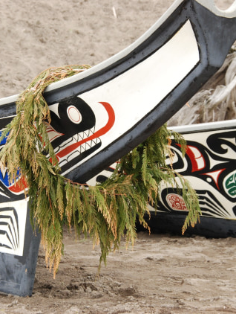
Do not despair!!!
Mate, G. (2009)
Our brains are resilient organs
Some important circuits continue to develop throughout our entire lives
They may do so even in the case of persistent and chronic substance dependency
Be patient with science, we are continuing to learn more about this complex human conduction and how to intervene
Notes:
Bring the limbic system back to health (story of devils club) communicating with the cerebral cortex

Slide 20
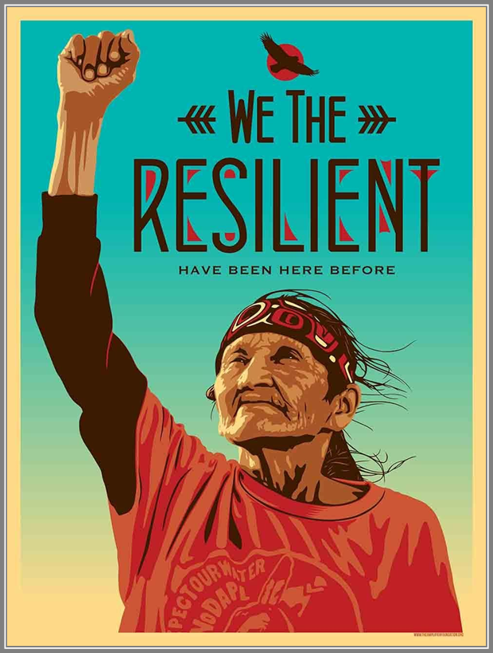
Notes:
If trauma impacts the epigenetic transfer of trauma, culture and connection can mitigate these affects. If we want to prevent substance misuse we need to focus more on stress, trauma, and poverty while providing intervention options that are grounded on Traditional Indigenous Knowledge. (Brown, 2020)
We can heal our communities through culture, connection, and developing interventions and policies that are grounded in traditional indigenous knowledge, tribal best practices, and evidence-based practice. This is not just true in the case of SUD, but in other conditions as well.

Slide 21
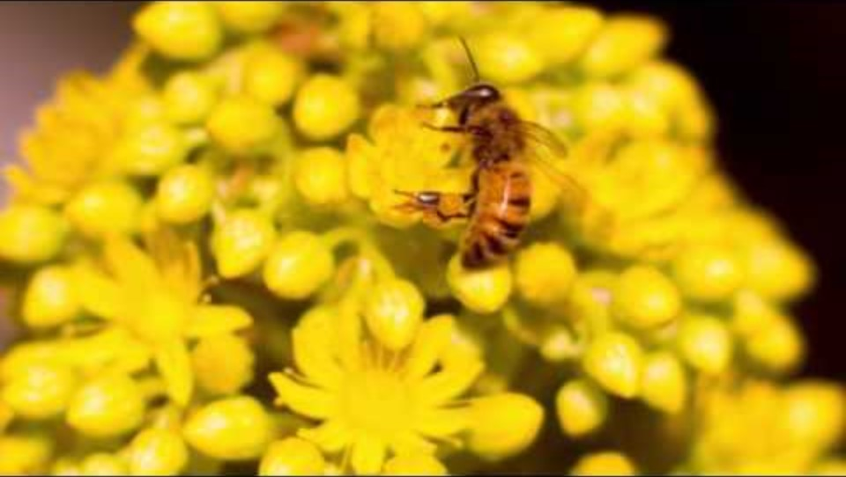
Here are some drunk bees

