Slide 2
Conflicts of Interest
No conflicts of interest to disclose
  I will be discussing off-label use of semaglutide, which is not currently FDA-approved to treat substance use disorders
  I will be discussing a semaglutide clinical trial that is named after a semaglutide brand name
Notes:
Disclosure slide option #1 for individual presenters. Select either option 1 or option 2, you don’t need to have both.
Please disclose all financial relationships that you've had with ineligible companies within the past 24 months regardless of them having ended. Ineligible companies are those whose primary business is producing, marketing, selling, re-selling, or distributing healthcare products used by or on patients. Please include the name of the ineligible company, your role (speaker's bureau, contracted research, employee, stockholder, etc), and if the relationship has ended

Slide 3
Learning Objectives
Describe the neurobiological rationale for using GLP-1 receptor agonists in the treatment of alcohol use disorder and other substance use disorders (SUDs).
Discuss current evidence from clinical trials and published literature on the efficacy and safety of GLP-1 receptor agonists in patients with SUDs.
Identify opportunities to integrate emerging metabolic treatments into comprehensive care plans for patients with SUDs.

Slide 4
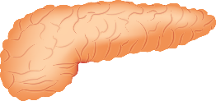
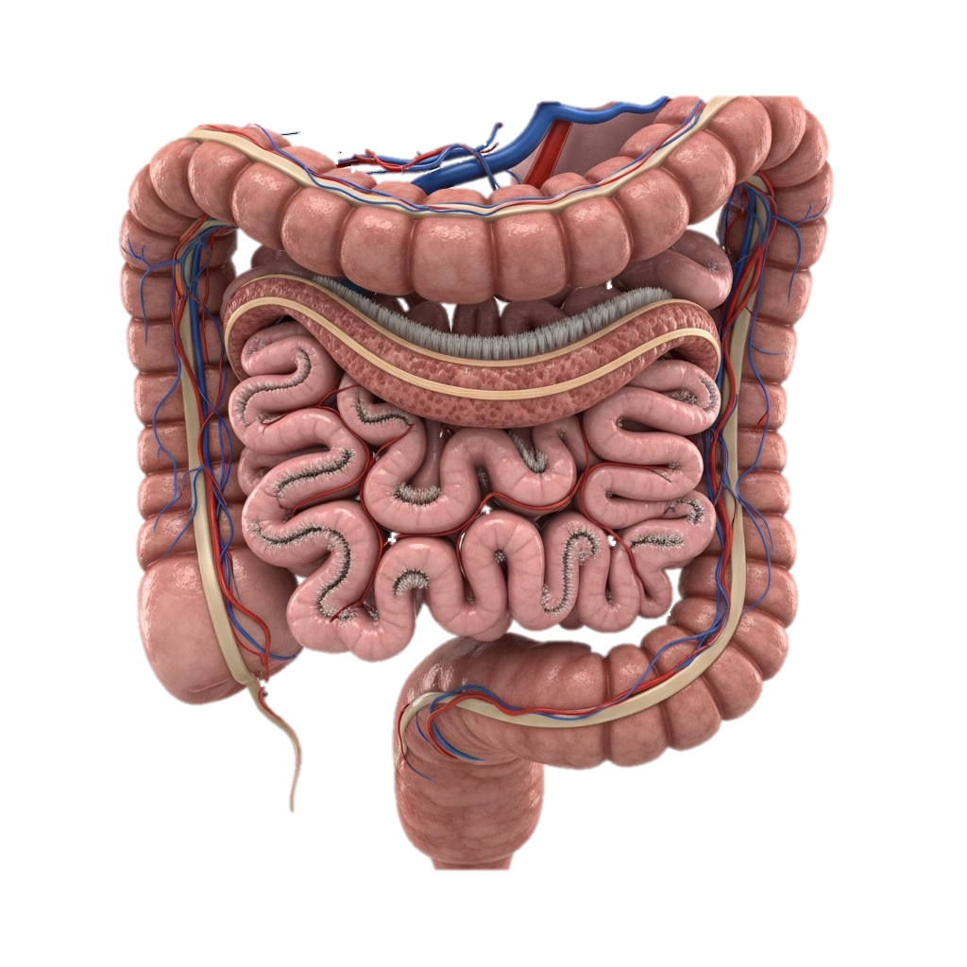
Glucagon-Like Peptide-1 (GLP-1)
Inhibit gastric emptying
↓ Blood glucose
↓ Glucagon secretion
↑ Insulin release
Short-acting peptide with 30 amino acids
Produced in the intestinal mucosa and pancreas
Regulates blood glucose and food intake
GLP-1
GLP-1 Release
Stomach
Pancreas
Gastrointestinal tract
Adapted from Cohen ND, et al. The Medical journal of Australia, 2013; 199(4), 246–249.
Illustration courtesy of: https://easy-peasy.ai/ai-image-generator/images/3d-human-small-intestine-white-background
Illustration courtesy of: https://www.needpix.com/photo/1195842/pancreas-organ-anatomy-free-pictures-free-photos-free-images-royalty-free-free-illustrations

Slide 5
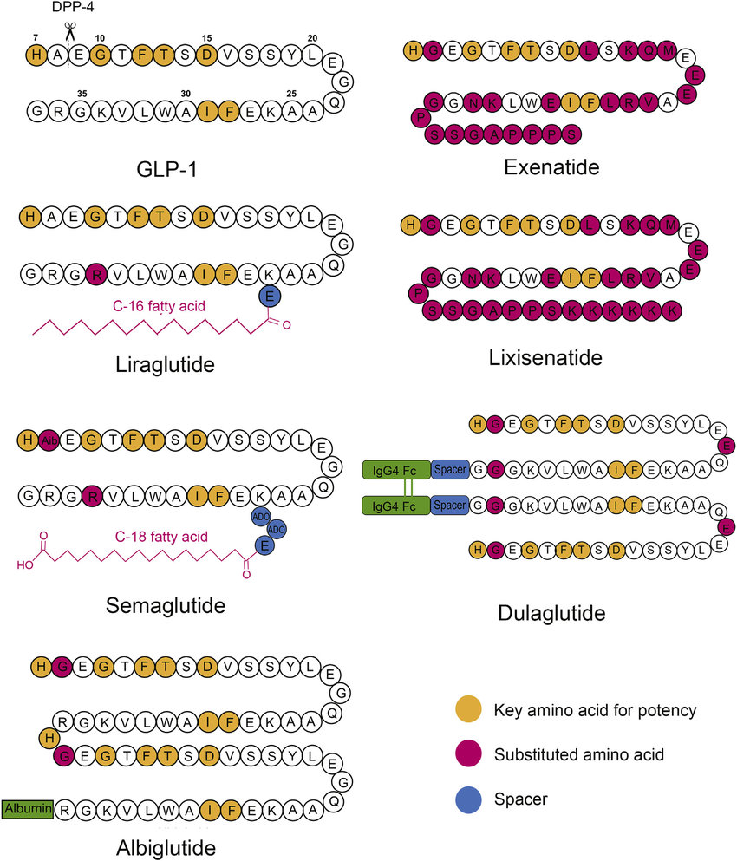
GLP-1 and GLP-1RAs
DPP-4 = Dipeptidyl Peptidase-4
Illustration courtesy of: https://commons.wikimedia.org/wiki/File:Glucagon_like_peptide_1_receptor_agonists.png
Adapted from Yu M, et al. Advanced Drug Delivery Reviews 2018;130:113-30
Notes:
Aib = aminoisobutyric acid

Slide 6
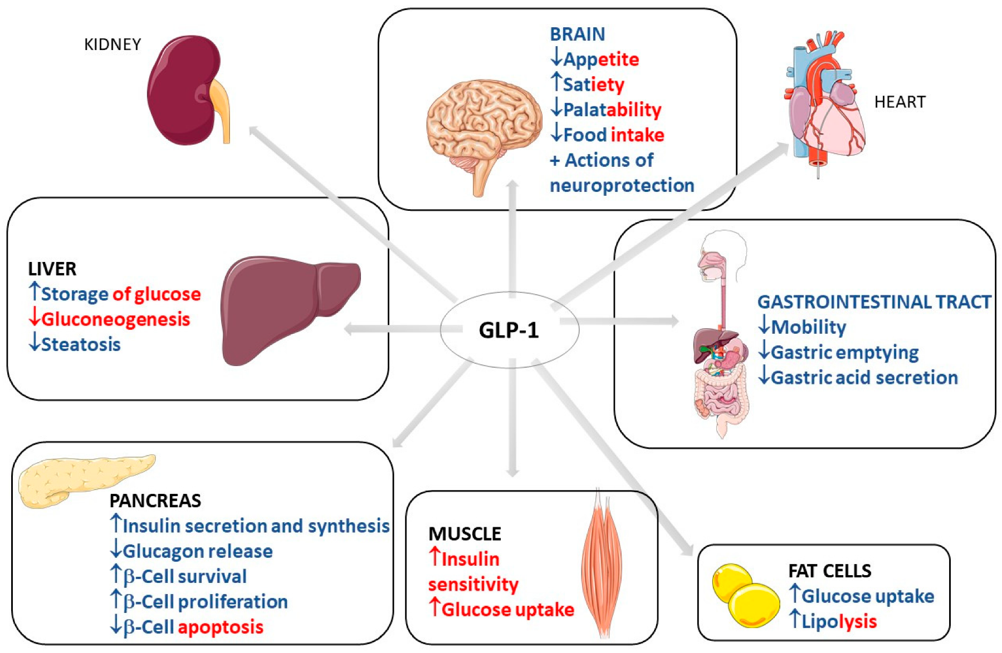
GLP1-RAs in Diabetes and Obesity
Reprinted with permission from: Laurindo LF, et al. Int Journal Mol Sci 2022; 23(2): 739.

Slide 7
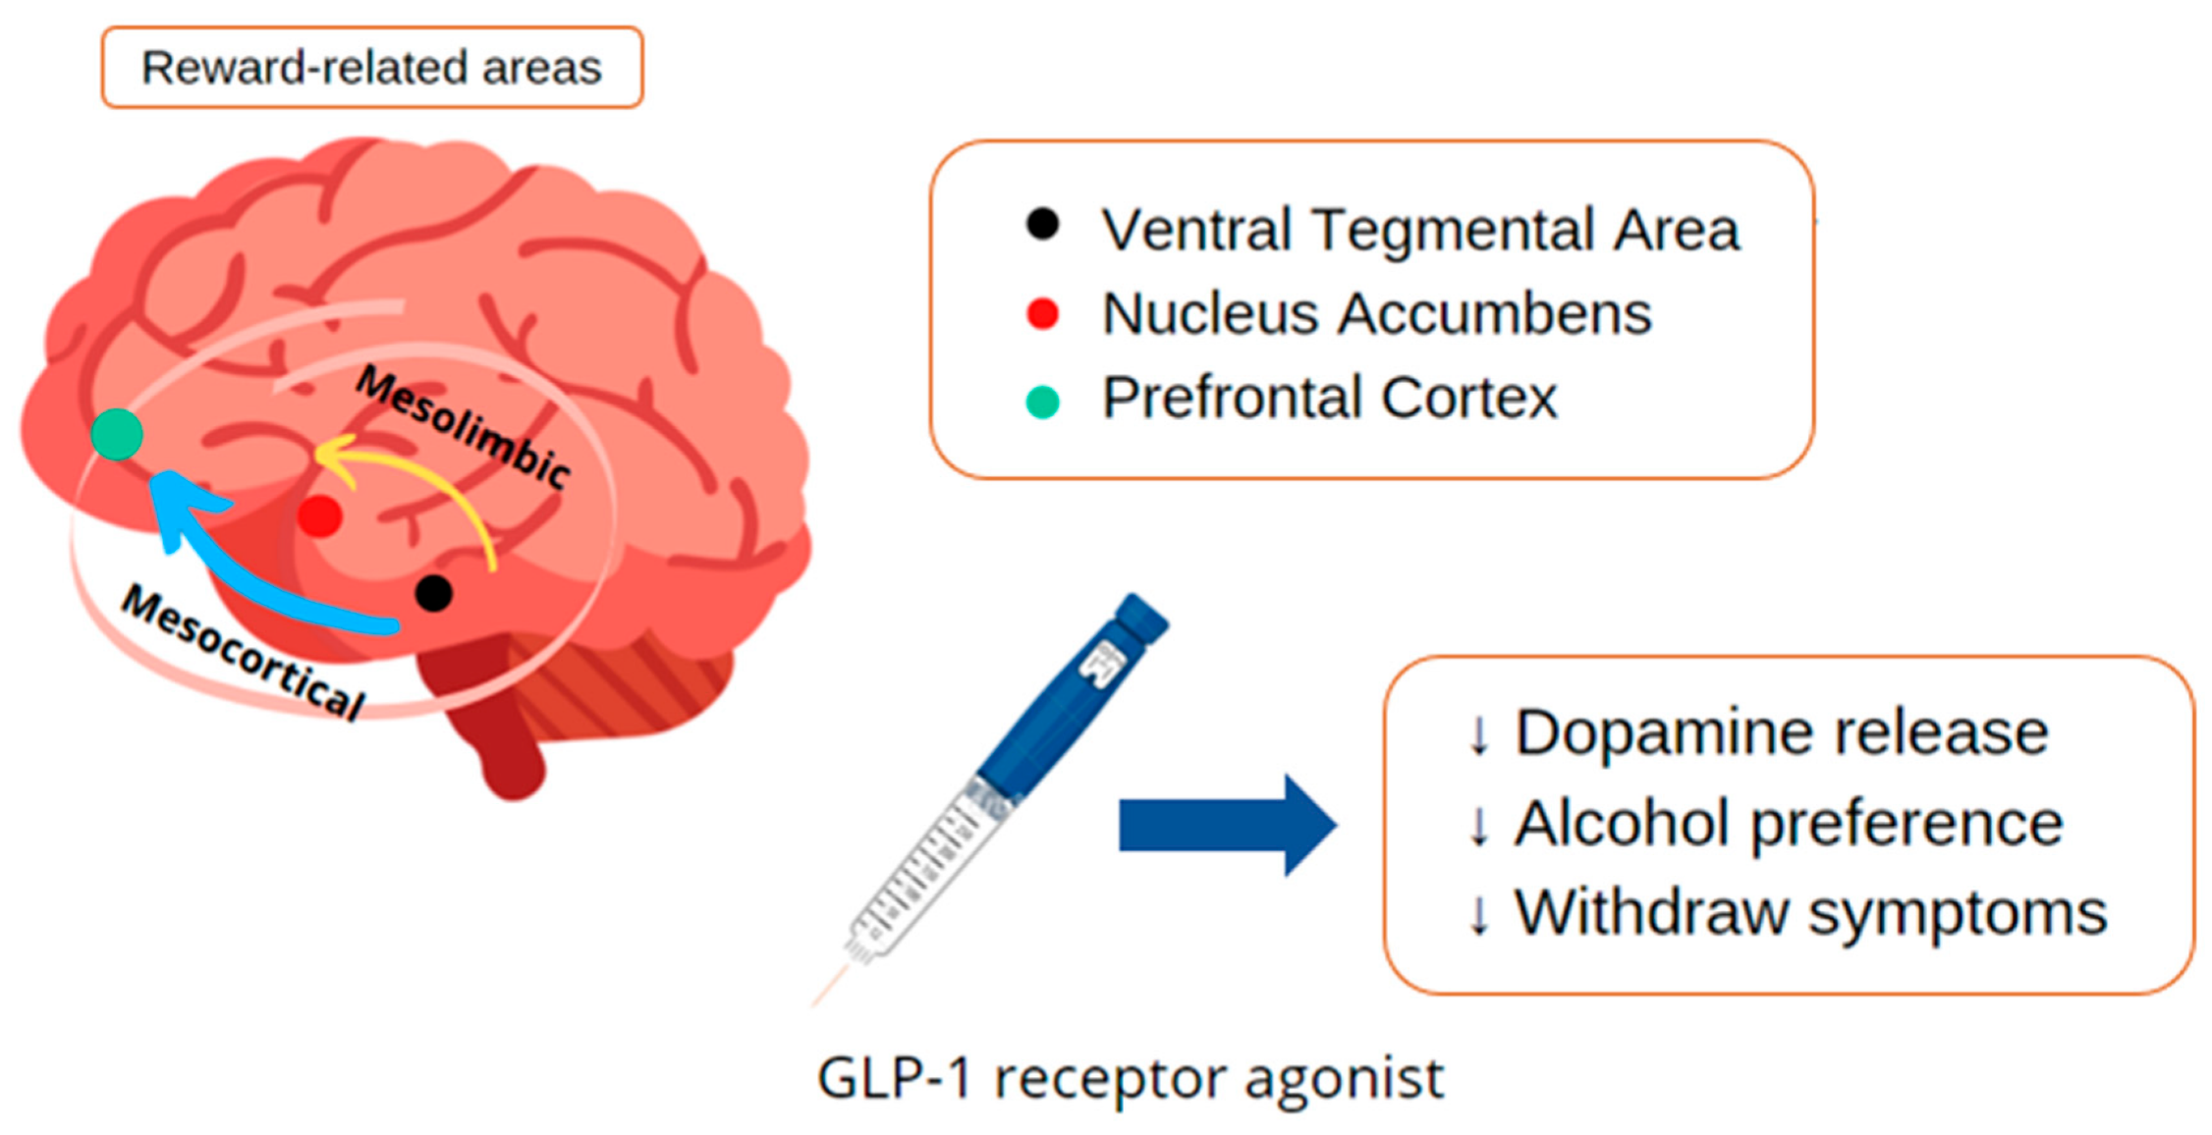
Possible Role of GLP-1RAs in SUDs
Reward-related areas
Ventral Tegmental Area
Nucleus Accumbens
Prefrontal Cortex
↓
Dopamine release
↓
Alcohol preference
↓
Abstinence symptoms
GLP-1 Receptor Agonist
Reprinted with permission from: Laurindo LF, et al. Int Journal Mol Sci 2022; 23(2): 739.

Slide 8
Over A Decade of Preclinical Evidence Supports a Role for GLP-1 in AUD
Study Reference | Findings
Egecioglu et al., Psychoneuroendocrinology (2013) 38: 1259 | Exendin 4 ↓ alcohol reward and intake in mice
Shirazi et al., PLOS ONE (2013) 8: e61965 | GLP-1 and Exendin 4 ↓ alcohol intake/reward in rats
*Suchankova et al., Transl. Psychiatry (2015) 5: e583 | AC3174 ↓ alcohol consumption in dependent mice
Vallöf et al., Addiction Biology (2016) 21: 422 | Liraglutide ↓ alcohol reward and intake in rats
Sørensen et al. Alcohol Clin Exp Res (2016) 40: 2247 | Exendin 4 ↓ self-administration of IV alcohol in mice
*Marty et al. Frontiers in Neuroscience (2020) 14: 599646 | Liraglutide and semaglutide ↓ alcohol intake in rats
Aranas et al. EBioMedicine (2023) 93: 104642 | Semaglutide ↓ alcohol intake and relapse in rats
*Chuong et al. JCI Insight (2023) 8: e170671 | Semaglutide ↓ binge drinking of alcohol in mice/rats
Administration of GLP-1 or GLP-1R agonists to rodents decreases drinking and attenuates the reinforcing properties of alcohol, suggesting that the GLP-1R is a potential target for treating AUD.

Slide 9
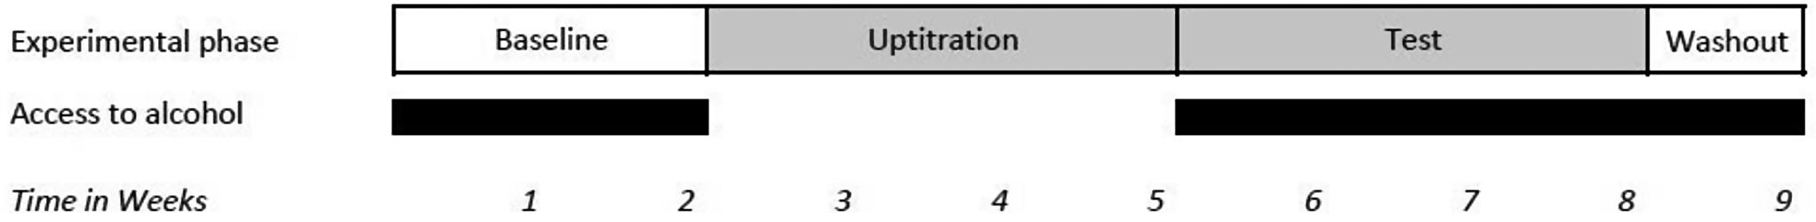
Semaglutide Administration Decreased Alcohol Drinking in Alcohol-Preferring Vervet Monkeys
Two weeks of alcohol self-administration to identify “alcohol-preferring” individuals
Three weeks dose up-titration (0.01 mg/kg => 0.03 mg/kg => 0.05 mg/kg dosed 2x/week)
Three weeks of semaglutide maximum tolerated dosing + EtOH
Reprinted with permission from: Fink-Jensen A., et al. Psychopharmacology 2025; 242: 63-70.
Notes:
Max dose was based on a pilot dose-finding study, and 2x/weekly dosing is because primates metabolize drugs faster than humans – the blood level of semaglutide was comparable to tx with the max dose in humans.

Slide 10
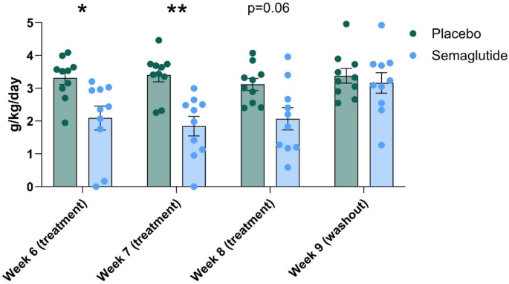
Semaglutide Administration Decreased Alcohol Drinking in Alcohol-Preferring Vervet Monkeys
No significant difference in drinking in the week after the drug was stopped.
Reprinted with permission from: Fink-Jensen A., et al. Psychopharmacology 2025; 242: 63-70.
Notes:
Not shown here, but no weight loss was seen either, interestingly (although the monkeys were not overweight/obese). There was no significant correlation between plasma semaglutide conc and drinking level.

Slide 11
Anecdotal/Correlational Human Evidence of GLP-1RA Efficacy for AUD
Study Reference | Findings
*Suchankova, Transl. Psychiatry (2015) 5: e583 | Variation in GLP1R ass’d w/ AUD (genetic association study)
Wium-Anderson, Basic & Clin. Pharm. & Tox. (2022) 131: 372-379 | GLP-1RA tx ass’d w/ lower risk of alcohol-related events (national registry cohort/case series)
*Farokhnia, Addict. Biol. (2022) 27: e13211 | ↑ GLP-1RA expression in AUD pts (post-mortem brain study) Alcohol administration ↓ blood [GLP-1] (experimental lab studies)
*Farokhnia, Scientific Reports (2022) 12: 13027 | GLP-1R gene variants ass’d w/ brain connectivity (imaging/genetic study)
Quoddos, Scientific Reports (2023) 13: 20998 | Semaglutide/tirzepatide improved AUD (social media post analysis)
Richards, J. of Clin. Psych. (2023) 85(1): 50515 | Semaglutide improved AUD (six-person case series)
Bremmer, J. Stud. on Alc. & Drugs (2024) 85: 5-10 | GLP-1RAs improve AUD (Reddit post pharmacovigilance)
Wang, Nature Communications (2024) 15: 4548 | Semaglutide ↓ AUD incidence/recurrence (retrospective EMR study)
These observational and large-data studies in humans are suggestive of GLP-1RA efficacy for treating AUD, and they provide additional support for testing these compounds as treatments for AUD, but they cannot substitute for rigorous human randomized controlled trials.

Slide 12
Alcohol Loading
Please wait…

Slide 13
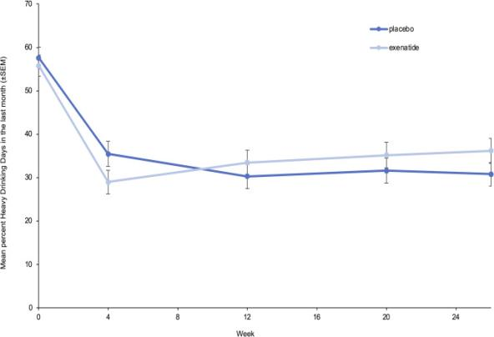
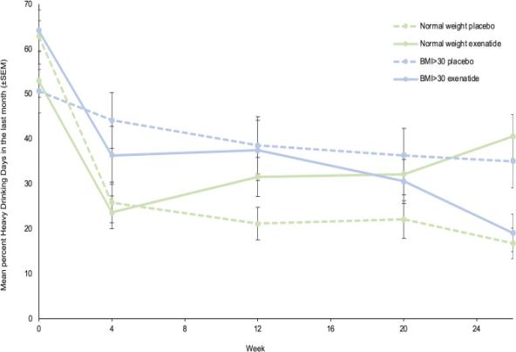
First Published Trial of a GLP-1RA in AUD
Exploratory Subgroup Analysis
Primary Outcome
After an initial decrease in heavy drinking days in both groups, there was no further significant difference
In patients with BMI>30 kg/m2, exenatide reduced heavy drinking days by 23.6% (CI -44.4—2.7, p=0.034)
Reprinted with permission from: Klausen MK, et al. JCI insight 2022; 7(19): e159863

Slide 14
FDA Approvals for Semaglutide
Injectable semaglutide
Treat obesity
Treat overweight + comorbidity
Injectable semaglutide
↓cardiovascular event risk in patients with diabetes + chronic kidney disease
Injectable semaglutide
Treat type 2 diabetes
↓cardiovascular event risk
2017
2019
2021
2024
2025
2025
Oral semaglutide
Treat type 2 diabetes
Injectable semaglutide
↓cardiovascular event risk in patients with obesity
Oral semaglutide
Treat obesity
The Medical Letter on Drugs and Therapeutics, Issue 1701, Apr. 2024
Perkovic V, et al. N Engl J Med 2024; 391: 109-121.

Slide 15
Summary of Semaglutide AUD Trials
Study Location | SAUD (UNC-NC) | SEMALCO (Denmark) | Rybelsus (CU-CO) | STAR-T (OSU-OK) | STAR-B (NIDA-MD)
Enrollment | 48 | 108 | 135 | 80 | 52
Drug Form | Injectable | Wegovy | Rybelsus | Injectable | Injectable
Max Dose | 1.0 mg | 2.4 mg | 7 mg | 1 mg | 2.4 mg
Dosing | 9 weeks | 26 weeks | 8 weeks | 12 weeks | 20 weeks
Primary Outcome | BrAC, alcohol consumed | TLFB (% heavy drinking days) | Craving (VAS score) | Standard drinks/week | AEs, standard drinks/week
Completion | 4/2024 | 8/2025 | 6/2025 | 12/2025 | 2/2027
Current Status | Completed, published 2/25 | Completed, published 5/26 | Completed, published 7/26 | Done enrolling (analysis) | Done enrolling (running)
Clinicaltrials.gov; Hendershot, C. et al. (2025) JAMA Psychiatry; Klausen, M.K. et al. (2026) The Lancet

Slide 16
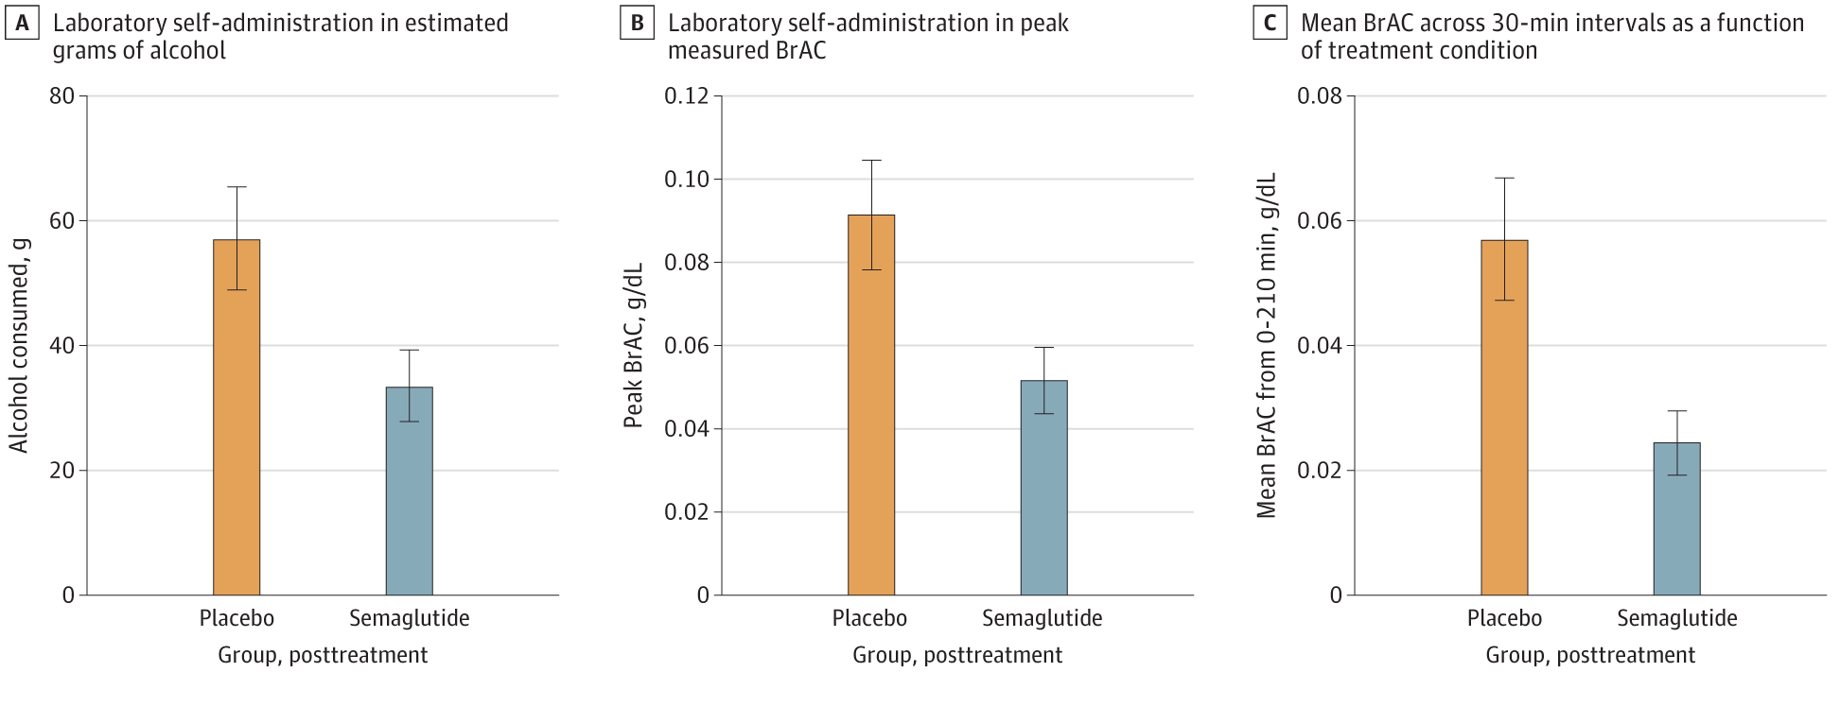
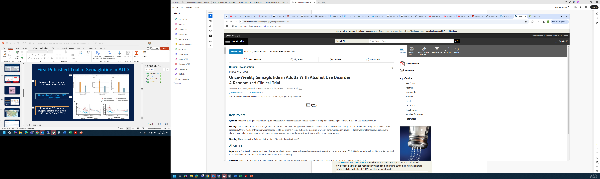
First Published Trial of Semaglutide in AUD
48 AUD patients, 9 weeks, tested low-dose semaglutide vs. placebo
Primary outcome: laboratory alcohol self-administration
Exploratory BMI endpoint suggests that the drug is more effective for *lower* BMIs
Reprinted with permission from: Hendershot C, et al. JAMA Psychiatry 2025; 82(4):395-405.

Slide 17
Reported Adverse Events (AEs) in UNC Trial of GLP-1RAs in AUD Patients
 | Semaglutide (N=24) |  |  | Placebo (N=24)
 | 0.25 mg | 0.50 mg | Total | “0.25 mg” | “0.50 mg” | Total
Total N (%) | 24 (100%) | 23 (95.8%) | 24 (100%) | 24 (100%) | 21 (87.5%) | 24 (100%)
Any AE | 19 (79.2%) | 19 (82.6%) | 22 (91.7%) | 16 (66.7%) | 12 (57.1%) | 18 (75.0%)
Serious AE | 0 | 0 | 0 | 0 | 0 | 0
Mild AE | 19 (79.2%) | 19 (82.6%) | 22 (91.7%) | 16 (66.7%) | 11 (52.4%) | 18 (75.0%)
Moderate AE | 4 (33.3%) | 5 (21.7%) | 8 (33.3%) | 2 (8.3%) | 2 (9.5%) | 4 (16.7%)
Severe AE | 0 | 2 (8.7%) | 2 (8.3%) | 0 | 1 (4.8%) | 1 (4.2%)
↓ Appetite | 15 (62.5%) | 16 (69.6%) | 18 (75.0%) | 9 (37.5%) | 5 (23.8%) | 10 (41.7%)
Nausea | 11 (45.8%) | 11 (47.8%) | 17 (70.8%) | 3 (12.5%) | 2 (9.5%) | 4 (16.7%)
Constipation | 8 (33.3%) | 9 (39.1%) | 12 (50.0%) | 1 (4.2%) | 1 (4.8%) | 2 (8.3%)
Diarrhea | 4 (16.7%) | 7 (30.4%) | 10 (41.7%) | 7 (29.2%) | 5 (23.8%) | 9 (37.5%)
Hendershot, C. et al. (2025) JAMA Psychiatry

Slide 18
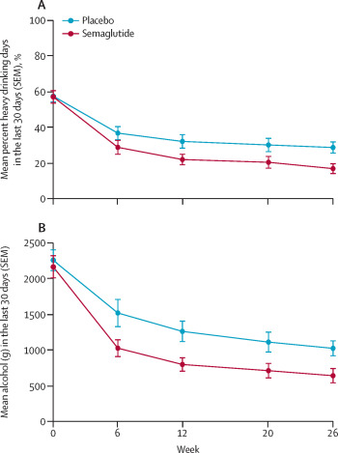
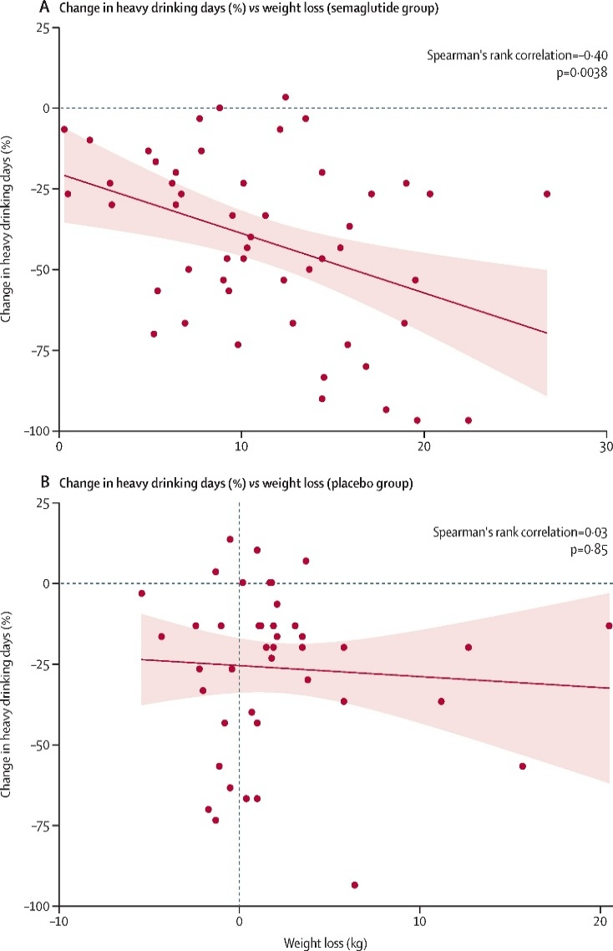
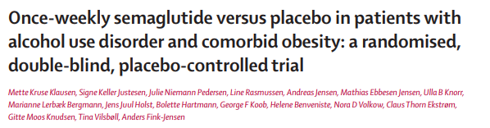
Second Published RCT of Semaglutide in AUD
108 treatment-seeking AUD patients, 26 weeks, tested high-dose semaglutide vs. placebo
Primary outcome
Post-hoc subgroup analysis: Δ heavy drinking days (%) vs. weight loss
A. Semaglutide group
Primary outcome: change in heavy drinking days per 30-day TLFB
(-41.1% semaglutide vs. -26.4% placebo)
Some secondary outcomes:
Mean alcohol grams in last 30 days
2-level ↓ in WHO risk drinking (NNT=4.3)
# drinks per drinking day….and more
Secondary outcome
B. Placebo group
-2.1 drinks/
drinking day
-3.5 drinks/drinking day
Notes:
Witkiewitz et al (JAMA Psych 2025 82(12): 1246 estimates the 2-level decrease in WHO risk drinking NNT is 7 for nalmafene, 8 for varenicline, 11 for naltrexone, 9-14.5 for topiramate, 30 for gabapentin. They did not assess acamprosate or disulfiram.

Slide 19
Reported Adverse Events (AEs) in SEMALCO Trial of GLP-1RAs in AUD Patients
 | Semaglutide (N=54) | Placebo (N=54)
 | 0.25 mg-2.4 mg | 0 mg
Serious AEs | 1 (1.8%: hospitalization w/ abd pain) | 3 (5.6%)
Nausea | 31 (57.4%) | 4 (7.4%)
↓ Appetite | 19 (35.2%) | 8 (14.8%)
Constipation | 19 (35.2%) | 9 (16.7%)
Fatigue | 17 (31.5%) | 10 (18.5%)
Elevated LFTs | 15 (27.8%) | 21 (38.9%)
Diarrhea | 15 (27.8%) | 11 (20.4%)
Reflux | 15 (27.8%) | 1 (1.8%)
Food Aversion | 13 (24.1%) | 1 (1.8%)
↑ Amylase | 4 (7.4%) | 0 (0%)
Klausen MK. et al. (2026) The Lancet
Notes:
The hospitalization w/ unspecified abd pain was at 0.25 mg and did not require study withdrawal.
For the placebo SAEs, these included hospitalization for EtOH withdrawal, posterior vitreous detachment, and hospitalization for r/o ACS (none withdrawn)

Slide 20
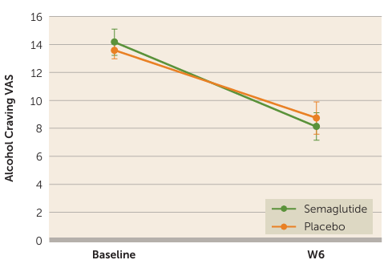
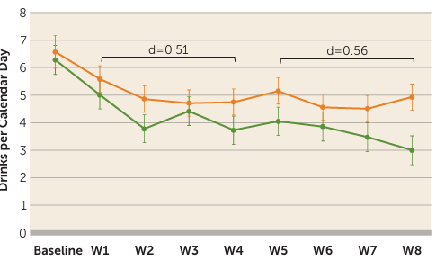
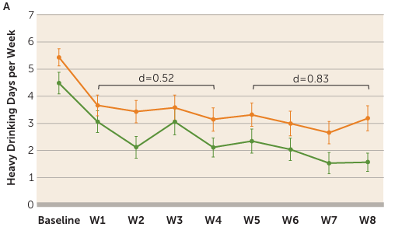
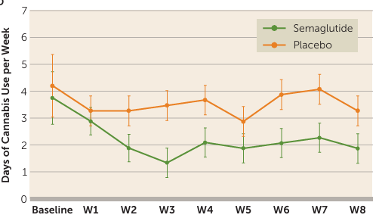
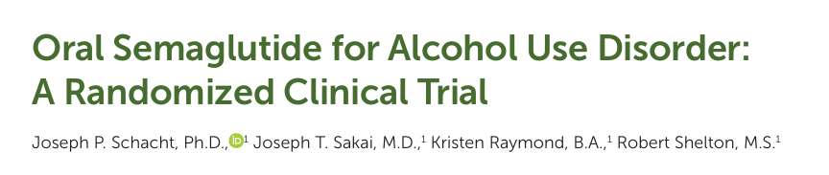

Third Published RCT of Semaglutide in AUD
50 treatment-seeking AUD patients, 8 weeks, tested oral semaglutide at 3 mg and 7 mg vs. placebo
Primary outcome
Primary outcome: 6 week change in lab alcohol cue-elicited craving
(no significant difference vs. placebo)
Secondary outcome
Some secondary outcomes:
Heavy drinking days/week
Drinks/day during the last four weeks
Cannabis use….and more
Secondary outcome
Cannabis use
Notes:
Witkiewitz et al (JAMA Psych 2025 82(12): 1246 estimates the 2-level decrease in WHO risk drinking NNT is 7 for nalmafene, 8 for varenicline, 11 for naltrexone, 9-14.5 for topiramate, 30 for gabapentin. They did not assess acamprosate or disulfiram.

Slide 21


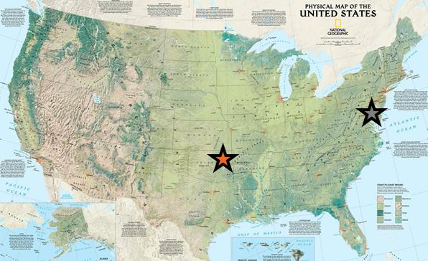
Semaglutide Therapy for Alcohol Reduction (STAR)
Two Harmonized RCTs
  Oklahoma State University
  NIDA IRP/TAMB
NCT05891587
PI: W. Kyle Simmons
NCT06015893
PI: Lorenzo Leggio

Slide 22
Schema for STAR-B
Screening under NIDA Screening Protocol
Eligibility
Study Design:
  Randomized
  Double-blinded
  Placebo-controlled
  Outpatient
  20 weeks!
Consent (52 completers, 80 accrual ceiling)
Randomization (stratified by BMI and baseline drinking)
Baseline Assessments
Treatment Phase (20 weeks)
Semaglutide + Take Control
Clinical and Research Assessments
Treatment Phase (20 Weeks)
Placebo + Take Control
Clinical and Research Assessments
Follow-Up (7 weeks)

Slide 23
Inclusion/Exclusion Criteria
Inclusion
Exclusion
Alcohol Use Disorder (DSM-5)
Age 18+
Heavy Drinking (28-Day TLFB)
  >7 (♀) or >14 (♂) drinks/week
  4+ days of the last 28 days with >3 (♀) or >4 (♂) drinks
CIWA<10
Metabolic
  BMI outside 23-50 kg/m²
  Medullary thyroid cancer hx
  Diabetic (HbA1c ≥6.5)
  Weight loss/diabetes/AUD medications or bariatric surgery
Unstable Medical Conditions
MRI or VR Contraindications

Slide 24

Study Interventions
Visit / Week # → | 1 | 2 | 3 | 4 | 5 | 6 | 7 | 8 | 9 | 10 | 11 | 12 | 13 | 14 | 15 | 16 | 17 | 18 | 19 | 20 | Follow up
Study Drug or Placebo (mg) | 0.25 | 0.25 | 0.25 | 0.25 | 0.5 | 0.5 | 0.5 | 0.5 | 1.0 | 1.0 | 1.0 | 1.0 | 1.7 | 1.7 | 1.7 | 1.7 | 2.4 | 2.4 | 2.4 | 2.4
Take Control | X |  |  | X |  |  | X |  |  | X |  |  | X |  |  | X |  |  | X
STARTING DOSE
DIABETES DOSE
OBESITY DOSES
Month 1
Weeks 1-4
0.25 mg/week
Month 2
Weeks 5-8
0.5 mg/week
Month 3
Weeks 9-12
1 mg/week
Month 4
Weeks 13-16
1.7 mg/week
Month 5
Weeks 17-20
2.4 mg/week
Start
Step up
Maintenance
Photo courtesy of: https://www.rethinkingdrinking.niaaa.nih.gov/
NB: the FDA approved a 7.2 mg injectable semaglutide dose for treating obesity in 3/2026.

Slide 25
Outcomes
Primary
Secondary
Safety and Tolerability
  Number/severity of Adverse Events (AEs)
  Number of people who reach target dose (2.4 mg)
Early Efficacy
  Change in self-reported drinks/week from baseline to end of study
    28-Day Timeline Followback (TLFB)
Other Drinking Outcomes
  Heavy drinking days
  WHO drinking risk levels
  Phosphatidylethanol (PEth) levels
Changes in Study Tasks
  Virtual Reality (Food Craving)
  Cue Reactivity (Alcohol Craving)
  Brain fMRI (resting, task-based)

Slide 26
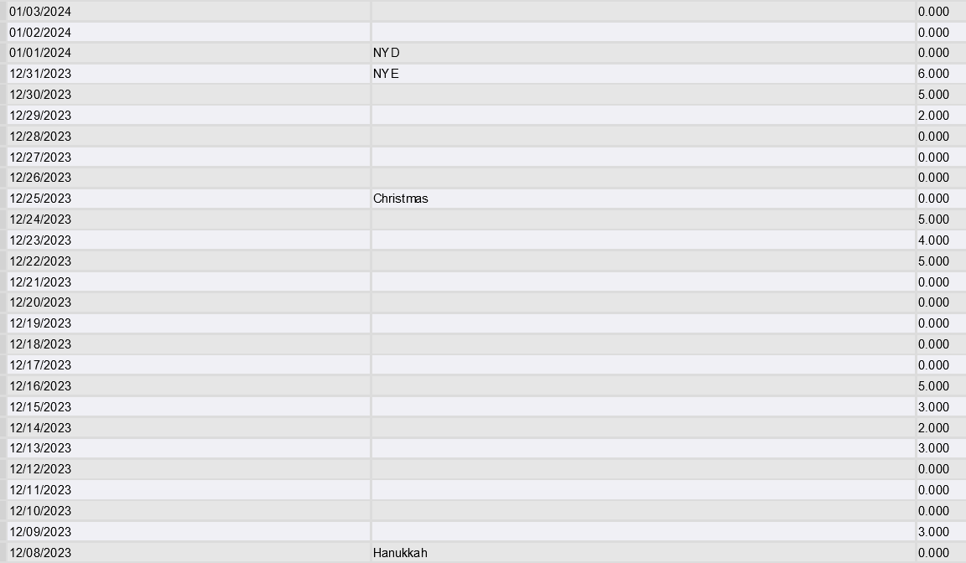
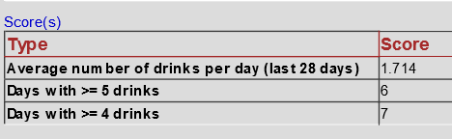
28 Day TLFB (Binge Drinking Pattern)

Slide 27

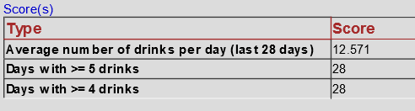
28 Day TLFB (Daily Drinking Pattern)

Slide 28


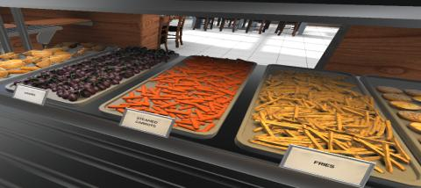
Virtual Reality Buffet

Slide 29
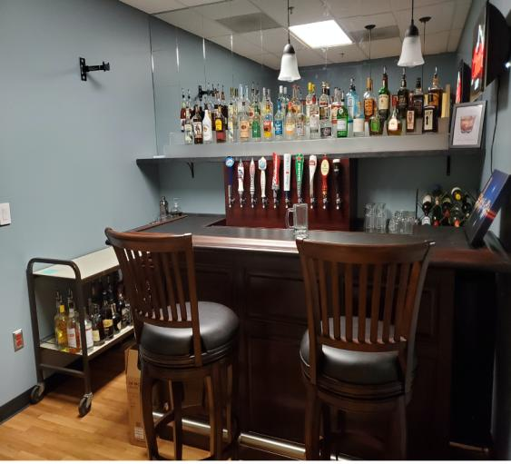
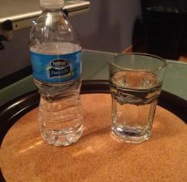
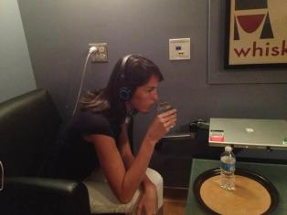
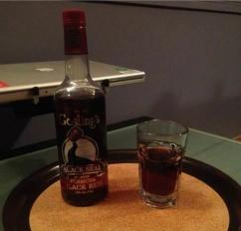
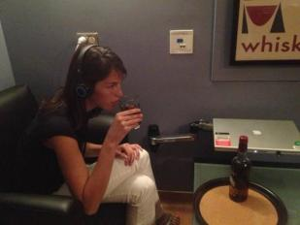
Cue Reactivity in the Mock Bar

Slide 30
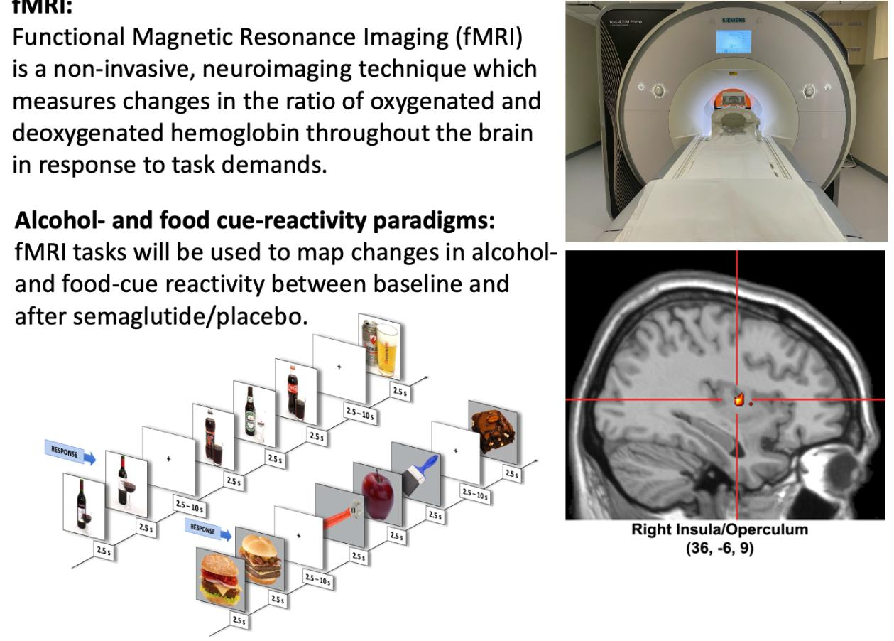
Brain Functional MRI
Cue Reactivity Task
Notes:
Resting-state
Cue reactivity task
Monetary incentive delay task
Emotion processing / Amygdala reactivity task
Stroop task

Slide 31
Demographics of Enrolled Patients 1
Characteristic | STAR-B (n=70) | Hendershot et al. (n=48)
Male Sex | 36 (51.4%) | 14 (29.1%)
Age <40 and ≥65 | 30 (42.9%), 6 (8.6%) | NR, 0 (0.0%)
Race/Ethnicity (Black, White) | 27B (38.6%), 35W (50.0%) | 7B (14.6%), 39W (81.2%)
Sexuality | 4 Gay/Les + 5 Bi (12.9%) | NR
*Body Mass Index Mean (range) | 31.6 (23.2-49.0) | 32.1 (min 23.0)
Comorbid Cannabis Use/Disorder | 32 (45.7%), 17 former | NR (allowed mild CUD)
Comorbid Tobacco Use Disorder | 24 (34.3%), 29 former | 13 (27.1%)
Comorbid Depress/Anxiety/OCD | 48 (68.6%) | NR but not exclusionary
Significant but Stable Medical Comorbidity (but not diabetes) | 47 (34 patients) 23 metALD, 9 MH, 7 Cardiac, 7 CKD, 1 cancer x2 | NR but not necessarily exclusionary
Notes:
High = >14 drinks/week for females, >21 drinks/week for males
US: heavy drinking = >4 drinks/day 56 g EtOH) in men or >3 drinks/day (42 g EtOH) in women – the Danes used 60 g and 48 g respectively

Slide 32
Demographics of Enrolled Patients 2
Characteristic | STAR-B (n=70) | Klausen et al. (n=108)
Male Sex | 36 (51.4%) | 55 (50.9%)
Age <40 and ≥65 | 30 (42.9%), 6 (8.6%) | 11 (10.2%), NR (max 70)
Race/Ethnicity (Black, White) | 27B (38.6%), 35W (50.0%) | 2B (1.8%), 102W (94.4%)
Sexuality | 4 Gay/Les + 5 Bi (12.9%) | NR
*Body Mass Index Mean (range) | 31.6 (23.2-49.0) | 34.4 (min 30.0)
Comorbid Cannabis Use/Disorder | 32 (45.7%), 17 former | 0 (excluded)
Comorbid Tobacco Use Disorder | 24 (34.3%), 29 former | 31 (28.7%)
Comorbid Depress/Anxiety/OCD | 48 (68.6%) | NR but not exclusionary
Significant but Stable Medical Comorbidity (but not diabetes) | 47 (34 patients) 23 metALD, 9 MH, 7 Cardiac, 7 CKD, 1 cancer x2 | NR but not necessarily exclusionary (T2 DM ok)
Notes:
High = >14 drinks/week for females, >21 drinks/week for males
US: heavy drinking = >4 drinks/day 56 g EtOH) in men or >3 drinks/day (42 g EtOH) in women – the Danes used 60 g and 48 g respectively

Slide 33
Demographics of Enrolled Patients
Characteristic | STAR-B (n=70) | Hendershot et al. (n=48) | Klausen et al. (n=108)
Severe AUD (6-11 DSM-5 criteria) | 37 (52.9%) | NR, but avg. 4.2 sx | 92 (85.1%)
Mean Drinks Per Day STAR: 28-Day TLFB UNC/Danish: 30-Day TLFB | 4.34 (30.4/week) | 2.9 (20.3/week) | 5.24 (36.7/week)
Mean Heavy Drinking Days US: >42g (♀) or >56g (♂) EtOH/day Danes: >48g (♀) or >60g (♂) EtOH/day | 13.1 | 9.1 | 17.2
*High Weekly Alcohol Drinking STAR: >14 (♀) or 21 (♂) drinks/week UNC: # drinks/drinking day Danes: 12+ heavy drinking days | 61 (87.1%) | NR | 76 (70.4%)
Notes:
High = >14 drinks/week for females, >21 drinks/week for males
US: heavy drinking = >4 drinks/day 56 g EtOH) in men or >3 drinks/day (42 g EtOH) in women – the Danes used 60 g and 48 g respectively

Slide 34
Current Status of STAR-B Trial (n=70)
Status | Number of Patients
Completed Trial (27 weeks): Target n=52 | 49 (46 @2.4 mg, 2 @1.7 mg, 1 @1 mg)
Status | Number of Patients
Completed Trial (27 weeks): Target n=52 | 49 (46 @2.4 mg, 2 @1.7 mg, 1 @1 mg)
Completed Dosing (20 weeks), in Follow-Up | 4 (all @ 2.4 mg)
Status | Number of Patients
Completed Trial (27 weeks): Target n=52 | 49 (46 @2.4 mg, 2 @1.7 mg, 1 @1 mg)
Completed Dosing (20 weeks), in Follow-Up | 4 (all @ 2.4 mg)
Medical Withdrawals | 4 (2 @ 0 mg, 1@ 1.0 mg, 1 @ 1.7 mg)
Patient Withdrawals | 4 (2 @ 0.5 mg, 1 @ 1.7 mg, 1 @ 2.4 mg)
Status | Number of Patients
Completed Trial (27 weeks): Target n=52 | 49 (46 @2.4 mg, 2 @1.7 mg, 1 @1 mg)
Completed Dosing (20 weeks), in Follow-Up | 4 (all @ 2.4 mg)
Medical Withdrawals | 4 (2 @ 0 mg, 1@ 1.0 mg, 1 @ 1.7 mg)
Patient Withdrawals | 4 (2 @ 0.5 mg, 1 @ 1.7 mg, 1 @ 2.4 mg)
Currently Dosing 2.4 mg (max obesity maintenance dose*) 1.7 mg (first obesity maintenance dose) 1.0 mg (DM dose, max STAR-T dose) 0.5 mg (max tested UNC trial dose) 0.25 mg | 9 (includes enrolled pts only) 1 3 2 1 2

Slide 35
Adverse Events (AEs) We Have Seen
Primarily GI, not generally severe, none serious
  GERD, belching, bloating, flatulence, nausea, vomiting, diarrhea, constipation, abdominal cramping
  Can usually be controlled with OTC meds and behavioral changes
Other reported AEs
  Const: fatigue, feeling less motivated to perform activities
  Injection Site: bruising, pain
  Psych: claustrophobia/panic attack in MRI, “vivid dreams”
  Neuro: headaches, dizziness/lightheadedness
Addiction-Specific Effects
  Craving during cue reactivity
  Decreased food, alcohol, and other drug consumption

Slide 36
Adverse Events (AEs) We Have Not Seen
Serious GI complications
  Acute pancreatitis (although we have seen asymptomatic bumps in liver tests and lipase)
  Gastroparesis, bowel obstruction, other surgical emergencies
Other addiction-specific effects or AEs of possible concern
  Const: weight loss to the point of malnutrition
  General: worsening of stable chronic conditions (cardiac, renal, liver)
  Psych: worsening depression, anxiety, SI/SA, but ? OCD
  Rebound increase in drinking during the post-dosing F/U phase

Slide 37
Some New Semaglutide AUD Trials
Study Location | Hopkins (Baltimore) | CRAVE (VA MCT) | HARP (HIV) (Atlanta VA) | SEMA (Yale – CT) | AUD/FLD (Switzerland)
Enrollment | 45 (RCT) | 622 (RCT) | 30 (open) | 10 (single-blind) | 64 (RCT)
Intervention | Semaglutide, naltrexone | Semaglutide (phase 3) | Semaglutide in HIV | Semaglutide s/p bariatric | Semaglutide for metALD
Drug Form | Oral (both) | Injectable | N.R. | Injectable | Injectable
Max Dose | 7 mg | 2.4 mg | N.R. | 1 mg | 2.4 mg
Dosing | 2 weeks | 28 weeks | 12 weeks | 12 weeks | 16+ weeks
Primary Outcome | Safety | TLFB (risky drinking days) | Safety, feasibility | TLFB (heavy drinking days) | Abstinence (PEth)
Current Status | Not yet recruiting | Recruiting | Recruiting | Recruiting | Not yet recruiting
Adapted from: Clinicaltrials.gov

Slide 38
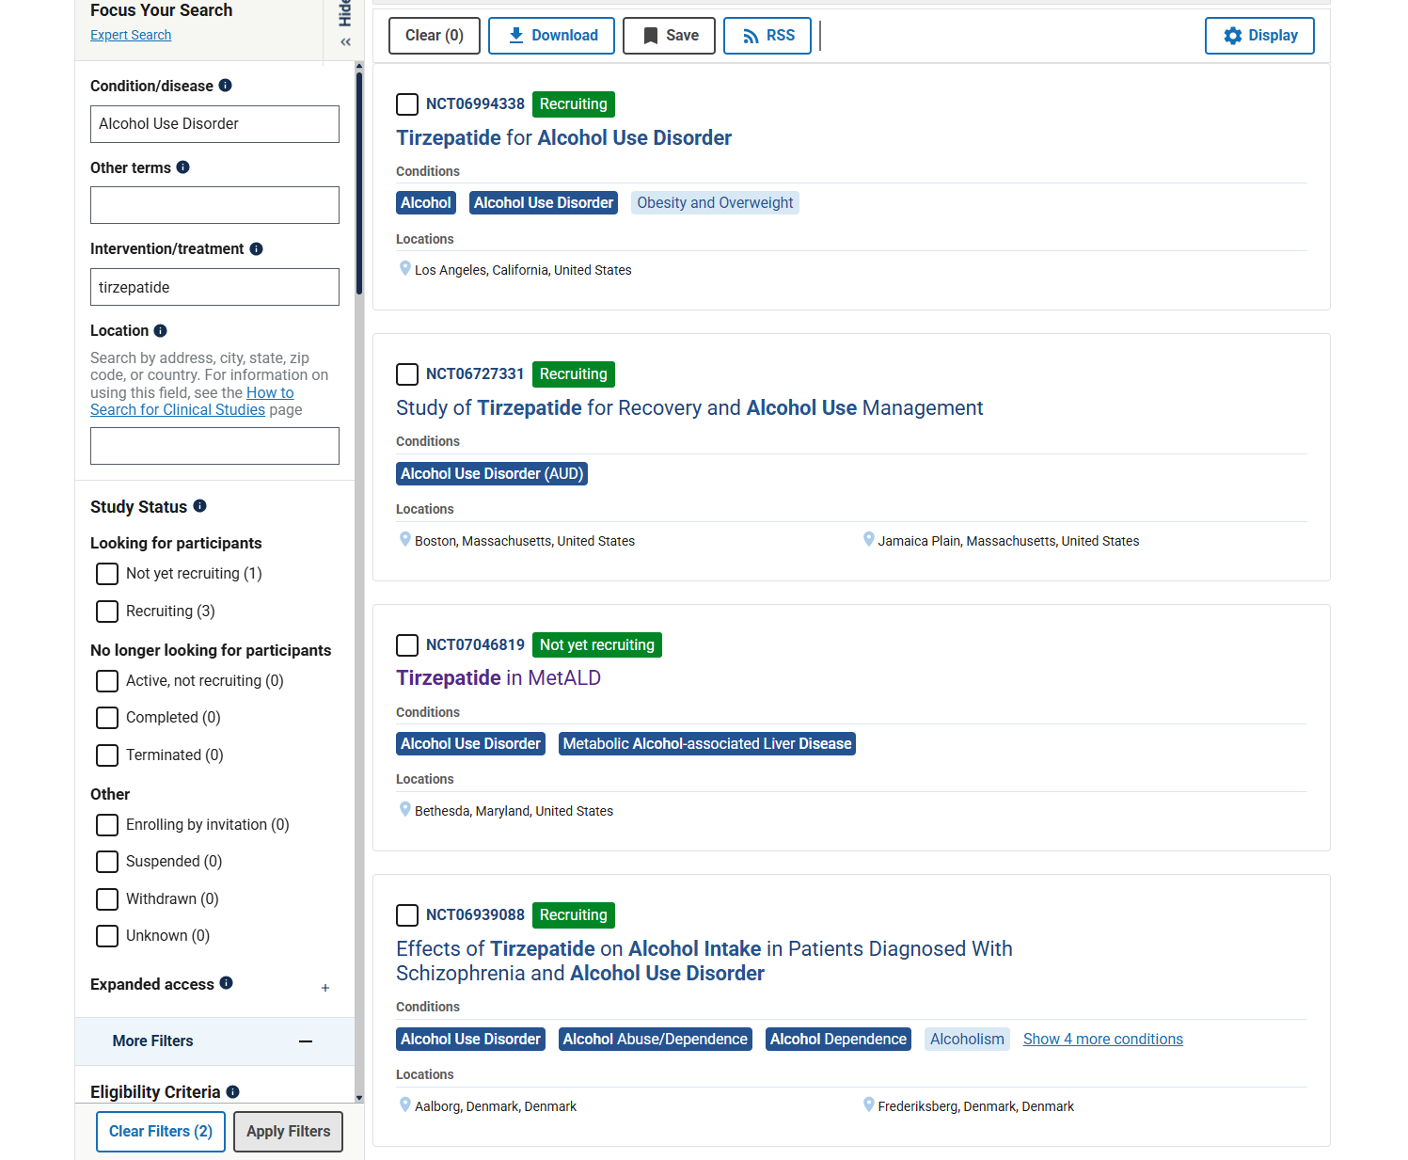
What About Tirzepatide?
Clinicaltrials.gov

Slide 39
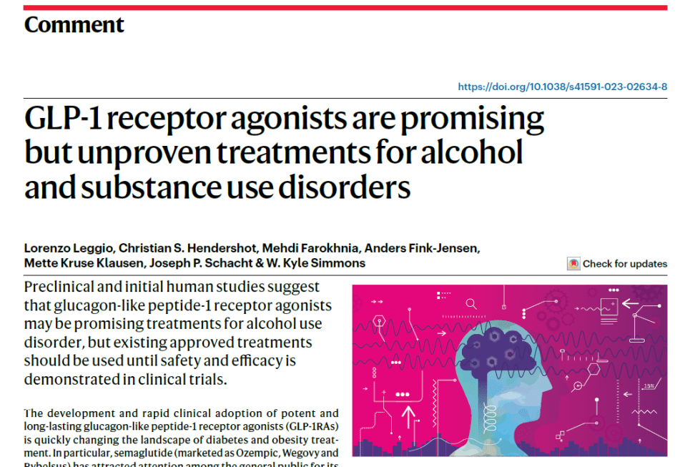
Leggio, L., et al. Nat Med 29, 2993–2995 (2023). https://doi.org/10.1038/s41591-023-02634-8

Slide 40
A Sample STAR Patient
37 y/o male w/ significant mental health history
  AUD w/ no prior treatment
    SCID: Severe (meets 8/11 DSM-5 criteria)
    TLFB: heavy drinking (avg. 3.1 drinks/day or 21.7 drinks/week, >4 drinks on 8/28 days)
  Cannabis use disorder (mild, in sustained remission x2 years)
  Depression, onset as a teenager, currently in full remission
  PTSD and panic attacks (last was 3 years ago)
He says, “I’m here because I really need to get my drinking under control.”
Notes:
Structured Clinical Interview for DSM-5 (SCID-5)
Metabolic dysfunction-associated and Alcohol-associated Liver Disease

Slide 41
Don’t Forget About the FDA-Approved AUD Therapies!
Oral disulfiram
ALDH inhibitor
Treat AUD
Oral naltrexone
Opioid antagonist
Treat AUD
Injectable naltrexone
Opioid antagonist
Treat AUD
1951
1984
1994
2004
2006
2010
Oral naltrexone
Opioid antagonist
Treat OUD
Oral acamprosate
NMDA antagonist
Treat AUD
Injectable naltrexone
Opioid antagonist
Treat OUD
Leggio L, et al. Nature Medicine 2023; 29:2993-2995.

Slide 42
A Sample STAR Patient
He provides some additional AUD history
  Prior blackouts from drinking (remote, in his 20s)
  Spends a lot of time recovering from drinking
  Has been arguing with his wife about his drinking and having issues at work
  Has never been treated for AUD and is unenthusiastic about treatment
Physical Exam and Labs:
  Severe obesity (BMI 47.3 – pt did not fit into the “mock” MRI)
  Several new diagnoses (he is currently on no meds)
    Hypertension (BP 166/97, 158/90 on repeat)
    MetALD w/ mild transaminitis (AST/ALT: 39/96)
    Hypertriglyceridemia (TGL: 258)
He is interested after hearing about semaglutide.
Notes:
Structured Clinical Interview for DSM-5 (SCID-5)
Metabolic dysfunction-associated and Alcohol-associated Liver Disease

Slide 43
A Sample STAR Patient
Medical Issue | Baseline | End of Study
Body Mass Index | 47.3 | 39.4 (total weight loss ~53 lb)
Blood Pressure | 166/97 and 158/90 | 129/83
Avg. Daily Alcohol Consumption | 3.1 drinks/day | 0 drinks/day
Liver Tests (AST/ALT/GGT) | 39/96/111 (all elevated) | 36/63/80 (still slightly elevated)
Triglycerides (TGL) | 258 | 85
HbA1c | 5.0 (normal) | 4.4 (still normal but even lower)
Patient is very reflective about how his life has changed
  He has enough energy to actively diet and exercise now
  He feels more fully present as a husband and father
  He is performing better at work
Notes:
Pt lost ~40 lb during dosing phase and another ~13 lb during post-dosing phase.

Slide 44
Final Takeaways/Summary
GLP-1 Receptor Agonists (GLP-1RAs) have a unique mechanism of action that may be effective in helping patients with SUDs decrease craving and control their alcohol or drug use.
“MAY be effective” does not mean “definitely WILL be effective!”
Along with awaiting the results of ongoing clinical trials of GLP-1RA safety and efficacy in patients with addictions, plans to provide equitable access to these drugs must be considered.
Notes:
Take this time at the end of your presentation to review key takeaways and information that audiences should remember in the future. If practical, apply this to clinical practice.

