Slide 1
ECHO Diabetes
Who Needs What When?
Practical Approach to Diabetic Foot Care
August 13,2026
Carol Greenlee MD MACP

Slide 2
Where Do You Stand on Foot Exams?
I do foot exams on my PWD and feel comfortable doing so
I do foot exams on my PWD but not sure I am doing it effectively
I prefer to refer my PWD to a podiatrist for annual foot exam
I am not sure what to look for on foot exam
I am not sure how to do the neurologic exam on the foot or how to interpret
I am not sure what to do if I find an abnormality on foot exam
It takes too long to get the PWD’s shoes and socks off and back on
Too many things to check on foot exam – overwhelming, time-consuming
Our team does foot exams & teaches foot care to our PWD

Slide 3
Why do foot exams in our people with diabetes?
To determine if foot is safe or at risk (risk assessment)
Hoping to help prevent foot ulcers and amputations in our PWD
Goal = to help our people with diabetes stay healthy –
Reduce complications & improve outcomes

Slide 4
Why are feet at risk for people with diabetes?
Neuropathy
  Loss of feeling (numbness) = Loss of Protective Sensation (LOPS) → injury prone
  Loss of temperature sensation or abnormal sensation (feet “feel” cold)
  Loss of skin oil (dryness) – cracking (impaired barrier to infection)
  Deformity prone - abnormal “rub” and pressure points
  Abnormal gait → abnormal pressure
Reduced blood flow
  Nutrition for tissues (O2 and nutrients)
  Ischemic changes / Gangrene
Impaired Immunity
  WBC can’t do their job when blood glucose is high

Slide 5
The Guidelines – ADA 2026 Standards of Care
Foot Care
Recommendations
12.23 Perform a comprehensive foot evaluation at least annually to identify risk factors for ulcers and amputations. A
  12.24 The examination should include inspection of the skin, assessment of foot deformities, neurological assessment (10-g monofilament testing or Ipswich touch test with at least one additional assessment: pinprick, temperature, or vibration), and vascular assessment, including pulses in the legs and feet. B
12.25 Individuals with evidence of sensory loss or prior ulceration or amputation should have their feet inspected at every visit. A
Notes:
12. Retinopathy, Neuropathy, and Foot Care: Standards of Care in Diabetes—2026 | Diabetes Care | American Diabetes Association

Slide 6
Comprehensive Foot Exam
ADA 2026 Standards of Care
The examination should include
  assessment of skin integrity
  assessment for LOPS using the 10-g monofilament or Ipswich touch test along with at least one other neurological assessment tool
  pulse examination of the dorsalis pedis and posterior tibial arteries
  assessment for foot deformities such as bunions, hammertoes, and prominent metatarsals, which increase plantar foot pressures and increase risk for ulcerations.
To detect if feet are “at-risk” or not
PWD with At-risk feet
  should have feet assessed at each visit (inspection)
  may be referred to foot care specialists for ongoing preventive care and surveillance
Notes:
12. Retinopathy, Neuropathy, and Foot Care: Standards of Care in Diabetes—2026 | Diabetes Care | American Diabetes Association

Slide 7
ADA 2026 Standards of Care
Recommends “assessment for LOPS using the 10-g monofilament or Ipswich touch test along with at least one other neurological assessment tool”
Absent monofilament (or Ipswich touch) sensation plus one other abnormal test confirm the presence of LOPS, while at least two normal tests (and no abnormal test) would rule out LOPS.
This is not testing for early diabetic peripheral neuropathy (DPN) – it is checking for LOSS of Protective Sensation or LOPS (insensate feet- loss of the “gift of pain”) – vulnerable to damage
  Patients with insensate feet are at greater risk of foot injury than those without neuropathy, and more than 80% of amputations follow a foot injury or ulcer
Reminder
  25–30% of people with diabetes will experience peripheral neuropathy pain (as a sign of early disease (small fiber damage) – exam often normal) – usually this pain
    is burning, lancinating, tingling, or shooting (electric shock–like)
    is typically worse at night
  ~50% of people with diabetic peripheral neuropathy do not have pain symptoms – requires exam to detect that they have neuropathy
  Just because they don’t have neuropathy pain doesn’t mean they don’t have neuropathy
Notes:
Hearing can be assessed with a 512-Hz tuning fork

Slide 8
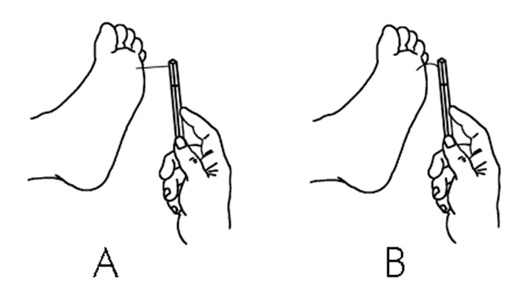
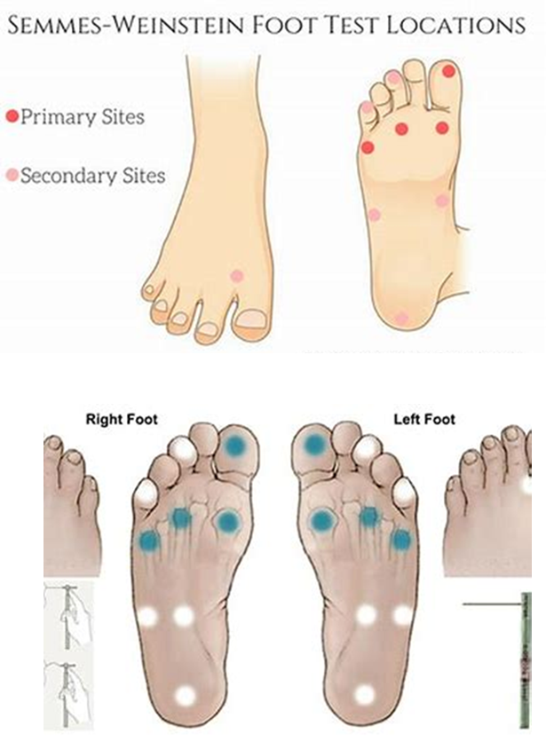
Monofilament (Pressure Sensation) Testing for LOPS
Place Monofilament (wire) on sole of foot, press until slight bend / curve
  Let PWD know it is very light pressure - show them on their hand or arm first, so they know how light it is
  Ask PWD to close their eyes
  Ask the PWD to tell you when they feel something and where they feel it – move randomly among spots
  Another suggestion: touch spot twice and ask “do you feel it now? Or now?”
Test on bottom of forefoot in 4 spots for each foot (at least 3-5 spots)
If abnormally thick skin or callouses – test other sites or use another test
Notes:
Patients want to do well when we “test” them – use word “check” – many people try to guess when they can’t feel for sure –by using methods to try to reduce guessing, we are not trying to trick them but trying to get accurate assessment

Slide 9
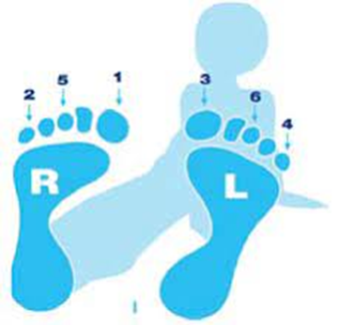
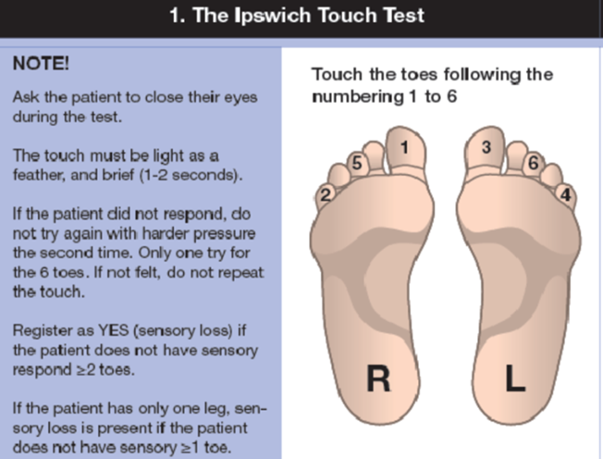
The Ipswich Touch Test
The IpTT involves lightly touching/resting the tip of the index finger for 1–2 s on the tips of the first, third, and fifth toes
Examiners should not push, prod, tap, or poke because this may elicit a sensation other than light touch.
With eyes closed, subjects are instructed to say yes whenever they feel the touch.
Scoring:
  6/6 = normal sensation
  <4/6 = suggests neuropathy and loss of protective sensation (LOPS)
  At-risk definition: ≥2 insensate areas (toes that do not respond)
Notes:
https://diabetesjournals.org/care/article/34/7/1517/38624/The-Ipswich-Touch-TestA-simple-and-novel-method-to
CARE / EDUCATION / NUTRITION / PSYCHOSOCIAL RESEARCH| JUNE 17 2011
The Ipswich Touch Test: A simple and novel method to identify inpatients with diabetes at risk of foot ulcerationhttps://diabetesjournals.org/care/article/34/7/1517/38624/The-Ipswich-Touch-TestA-simple-and-novel-method-to

Slide 10
At Least One Additional Assessment
Vibration (vibratory perception)
Pinprick (sharp vs dull discrimination)
Temperature perception
Position sensation (proprioception)
Ankle reflexes
Diabetic Peripheral Neuropathy – loss of feeling first in the toes and then moves up
Therefore, if toes have normal sensation, do not need to test posterior foot, ankles, knees etc.

Slide 11
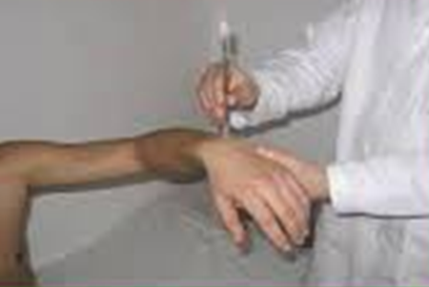
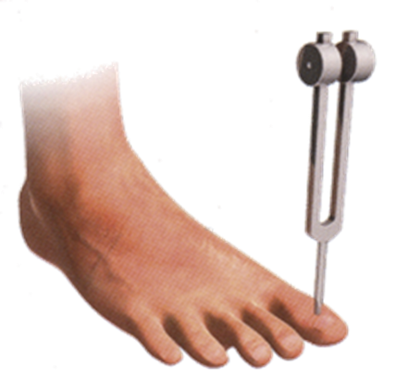
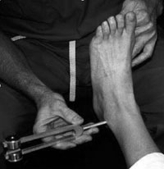
Checking Vibration (128 Hz)
Demonstrate on wrist or forearm bone so patient aware of vibration sensation vs just sensation
of touch
With patient’s eyes closed
Test on top of great toe.
If can feel at great toe – no
need to test other sites
Might have reduced (not totally absent)
vibration sensation
If vibration sensation is absent
at great toe, test at ankle. *
If absent at ankle move to
shin bone, then kneecap
Notes:
Be sure they tell you if they feel vibration, not just touch or temp – if they can’t feel vibration at all at the toe move to ankle bone - *if absent at toe & ankle, you know patient has a high-risk foot - recommend have clinician perform testing beyond the ankle// many patients will have impaired vibration sensation but not total loss – they stop feeling the vibration while you still feel it – this still indicates large fiber damage and is an abnormal test

Slide 12
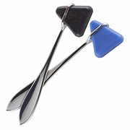

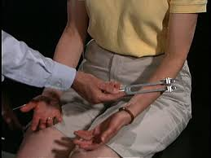
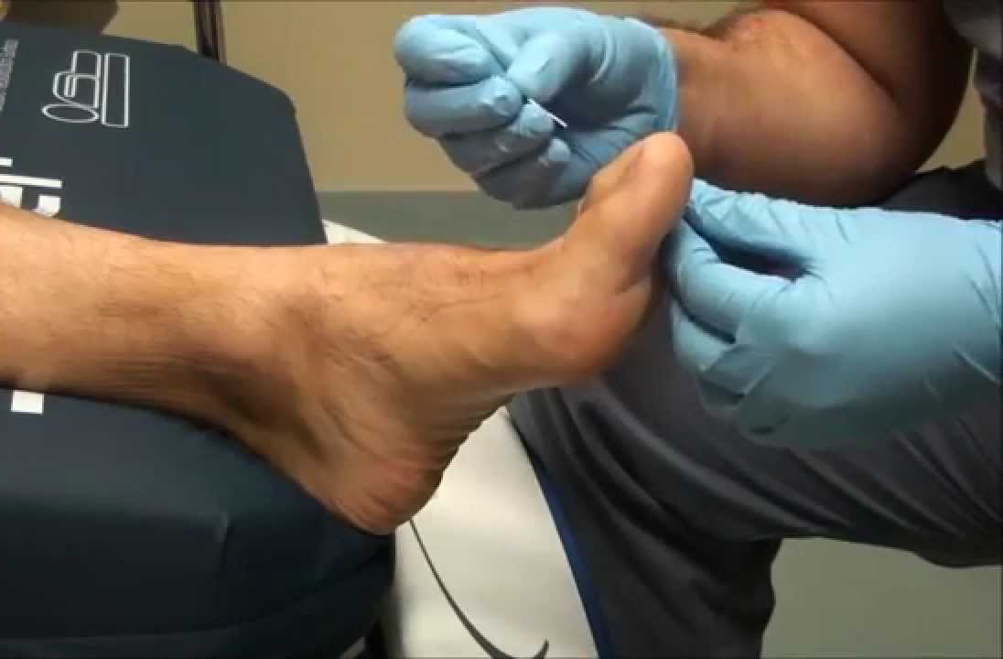
Checking Temperature or Pinprick Sensation
Can use
side of tuning fork
handle of reflex hammer
metal spoon
Test first on patient’s arm
so that they are familiar with the feeling –
then ask them to close their eyes & test their foot
Can use
disposable safety pin
disposable push pin
Light prick (no blood)
just below nail on
dorsum of toes
Start with top of big toe
Notes:
Neurologic Examination of the Foot: Pin Prick Testing – YouTube // pinprick and temp pick up earlier damage to smaller nerve fibers – can be part of annual check for DPN – see DPN recording

Slide 13
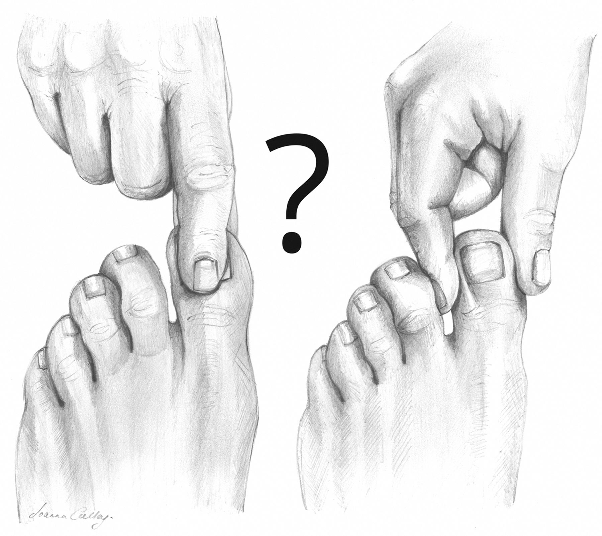
Testing Position Perception (Proprioception)
To perform the examination:
  Position the patient: Have the patient lie flat or sit comfortably with their eyes closed.
  Isolate the joint: Hold the sides of the patient’s great toe at the interphalangeal joint using your thumb and index finger. Pinching the top and bottom may give tactile clues.
  Stabilize the foot: Use your other hand to hold the adjacent toes and the foot steady to prevent the patient from feeling the overall ankle movement.
  Test the movement: Gently move the great toe upward (extension) or downward (flexion). Have the patient state whether the toe is pointing "up" or "down". (“towards your nose or towards me”)
  Vary the sequence: Perform the test multiple times, mixing up the "up" and "down" directions.
A person with intact proprioception should be able to identify even subtle, small-angle movements.
MSK you tube testing position sense during foot examination - Search

Slide 14
Loss of Protective Sensation
Absent monofilament (or Ipswich touch) sensation and one other abnormal test confirm the presence of LOPS
  at least two normal tests (and no abnormal test) would rule out LOPS.
Development of loss of protective sensation secondary to advanced symmetrical sensory neuropathy is the principal risk factor for diabetic foot ulceration which is subsequently the catalyst for foot infection and amputation.
  85% of all the lower extremity amputations in persons with diabetes are preceded by a foot ulcer.
  The mortality at 5 years for an individual with a diabetic foot ulcer is 2.5 times as high as the risk for an individual with diabetes who does not have a foot ulcer.
Notes:
https://pmc.ncbi.nlm.nih.gov/articles/PMC7919962/

Slide 15

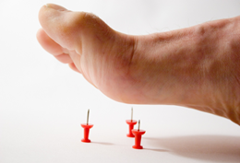
What Do You Do if Abnormal
LOPS indicates that the feet are “at risk”
  Instruct in daily foot inspections, foot care & hygiene
  Therapeutic shoes or inserts (reduce pressure points)
  Comprehensive foot exam every 6 months to annually
  Foot inspection every visit (shoes off)
  Consider referral to podiatrist
Further neurological testing, such as nerve conduction studies, electromyography, nerve biopsy, or intraepidermal nerve fiber density biopsies, are not routinely indicated
Notes:
ADA standards of care

Slide 16
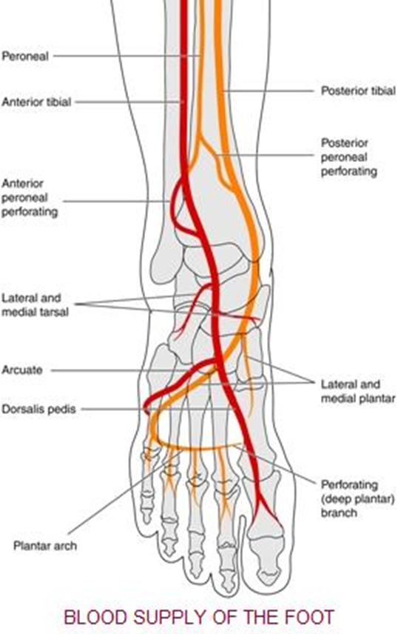
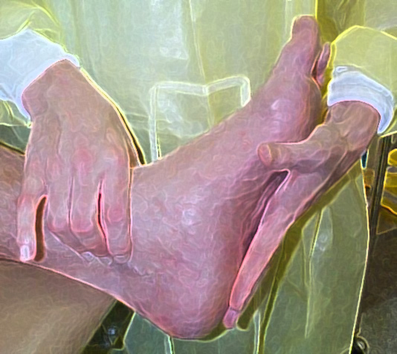
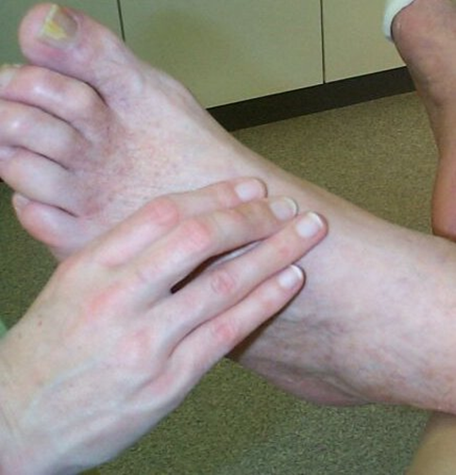
Pulse Examination the dorsalis pedis and posterior tibial arteries
top of foot next to extender
tendon from great toe
behind inside (medial) ankle bone

Slide 17
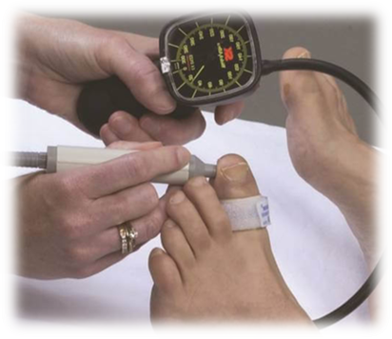
What Do You Do if Abnormal
Screen further for peripheral artery disease (PAD)
  History: c/o leg fatigue, claudication, and rest pain relieved with dependency
  Physical examination: in addition to LE pulses, assess temperature of the foot, capillary refill time (Nl < 2 sec), rubor on dependency/pallor on elevation, and venous filling time (>30 sec suggests PAD) – may have waxy or shiny skin (“atrophic”)
If symptoms or signs of PAD refer for noninvasive arterial studies in the form of Doppler ultrasound with pulse volume recordings.
  Ankle-brachial indices (ABI) should be interpreted carefully, as they are known to be inaccurate in people with diabetes due to noncompressible vessels.
  Toe systolic blood pressure tends to be more accurate. Toe systolic blood pressure <30 mmHg is suggestive of PAD and an inability to heal foot ulcerations.
If PAD plus LOPS &/or deformity refer to podiatrist
  High risk exam every 3-6 months / inspect feet every visit
If evidence of PAD with foot ulcers refer for formal vascular evaluation and angiography.
Notes:
Pale skin when foot elevated – “dependent rubor” (dusky) when foot down
2026 ADA SoC

Slide 18
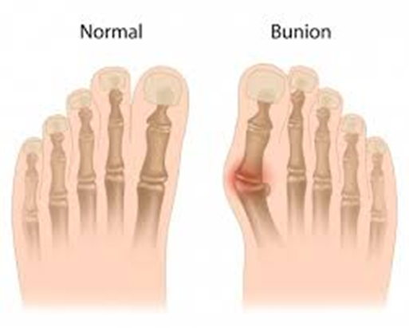
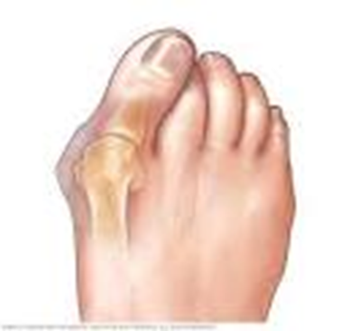
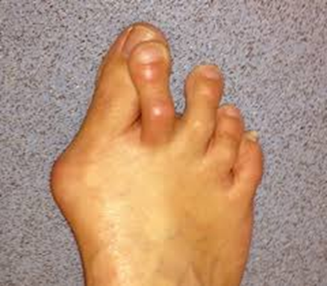
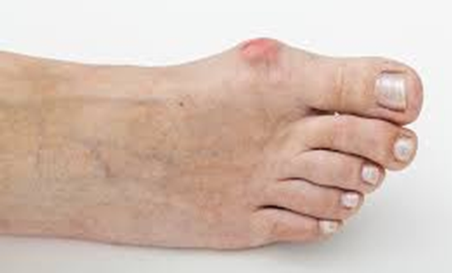
Assess for Foot Deformities
Increase foot pressures and increase risk for ulcerations
Bunion - usually caused by prolonged pressure compressing the foot (footwear/shoes)
Not caused by diabetes but if LOPS unable to feel rubbing & raw areas

Slide 19
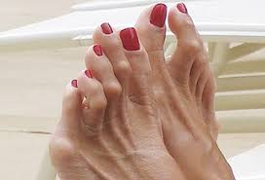
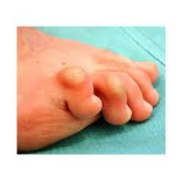
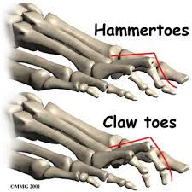
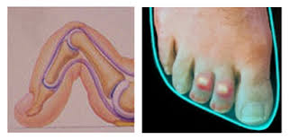
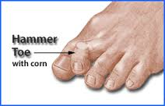
Hammer toes & Claw toes
Due to an imbalance in the muscles,
tendons or ligaments that normally
hold the toe straight
Worsened by foot cramped in shoe
Notes:
due to an imbalance in the muscles, tendons or ligaments that normally hold the toe straight (neuropathy can cause atrophy of small muscles in the foot)– can also be worsened by shoes that are too short and cramp the toes – with the deformity, the tops of toes can rub so need deeper shoe

Slide 20
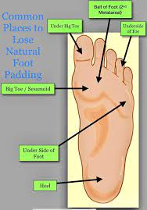
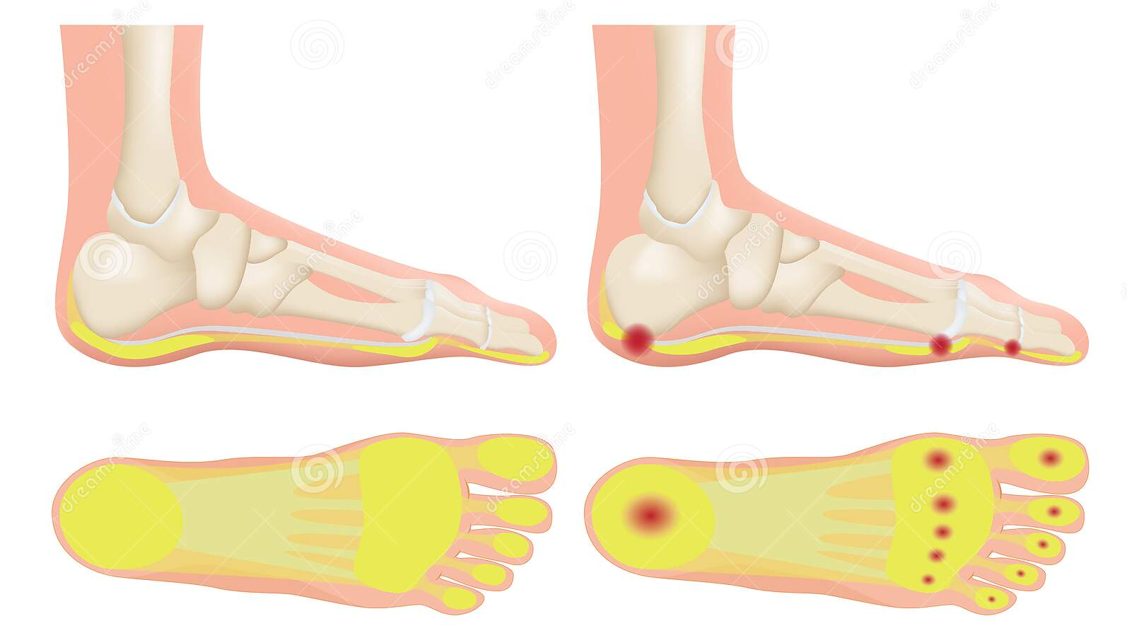
Fat Pad Atrophy
Due to age, abnormal pressure on foot,
improper or no footwear &
effects of neuropathy, deformity
Prominent Metatarsals
Fat Pad Atrophy can predispose patients to
ulcer at the metatarsal head or heel

Slide 21
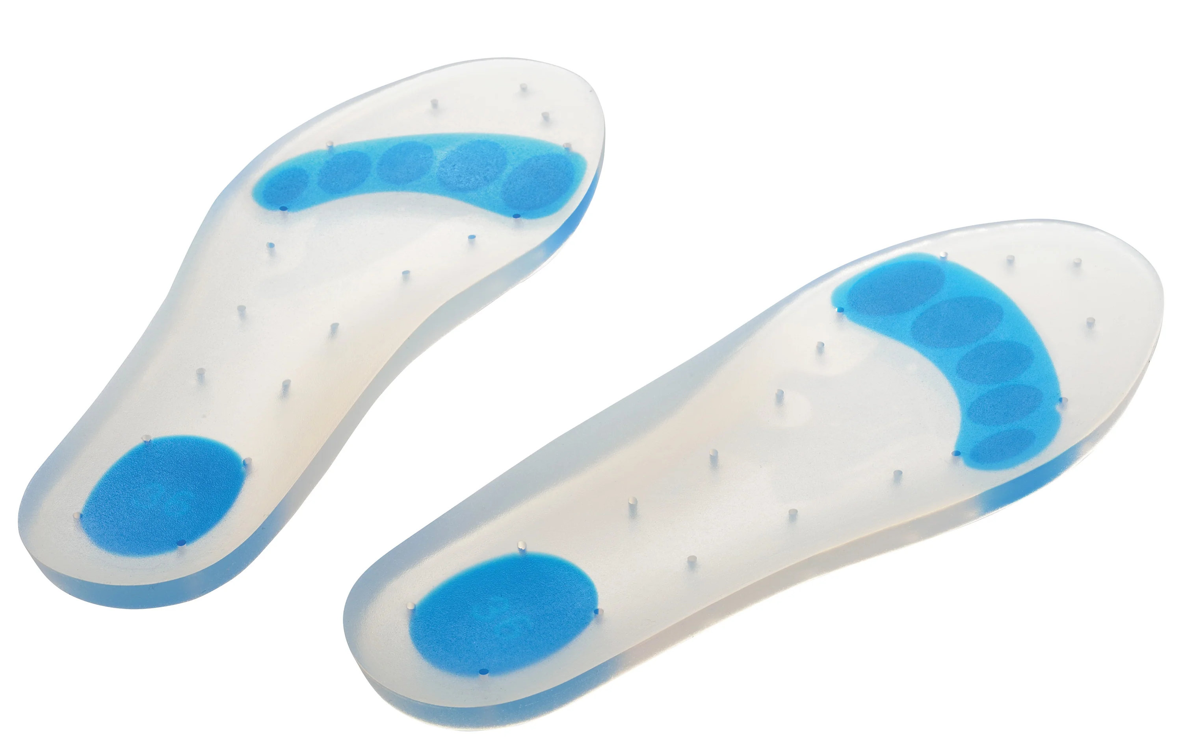
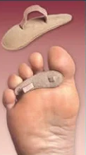
What Do You Do if Abnormal
Shoes with extra width &/or depth
for bunions & claw/hammer toes
Silicone insoles for fat pad atrophy
Hammer toe crest pads
Fat Pad Atrophy can predispose patients to
ulcer over metatarsal head or heel
Recommendations from podiatrist Dr Jennifer Ryder

Slide 22
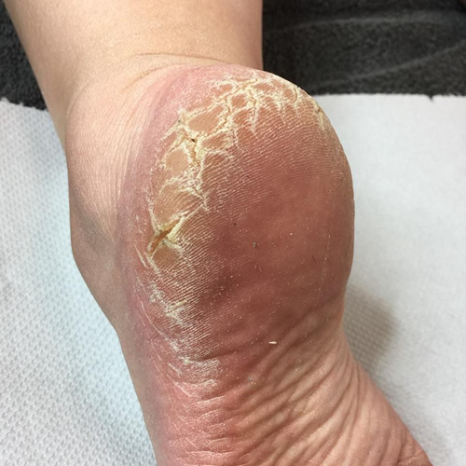
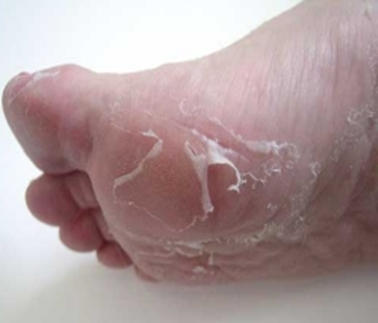
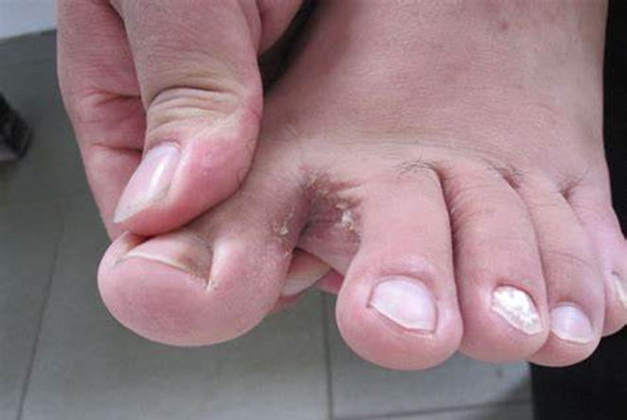
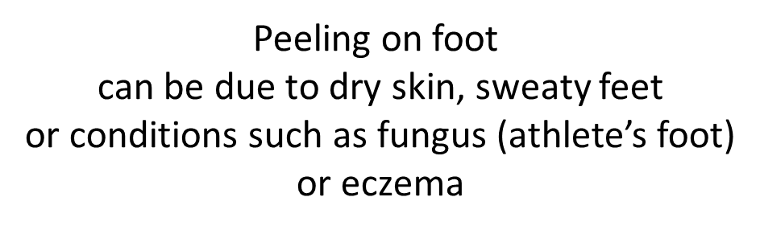
Assessment of Skin Integrity
Dry cracked Skin
Peeling
Peeling between toes
Can be due to maceration or fungus

Slide 23
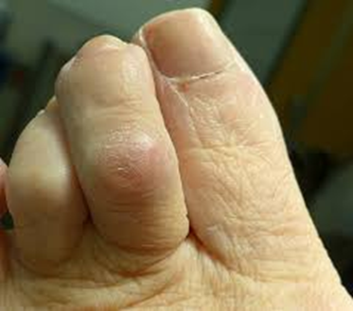
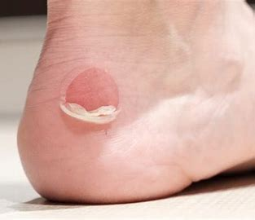
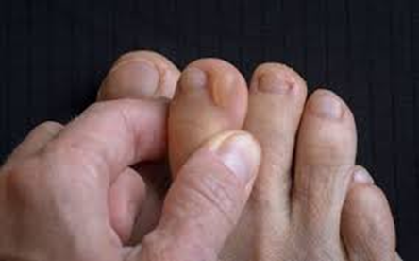
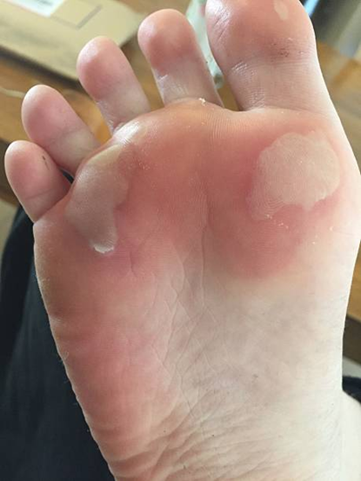
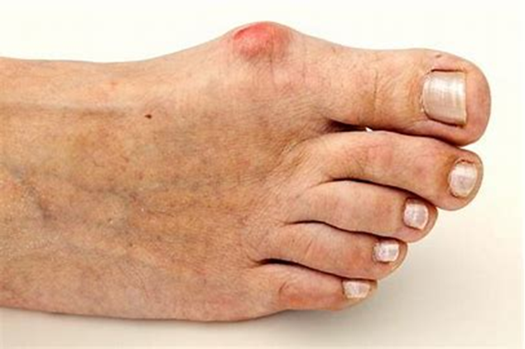
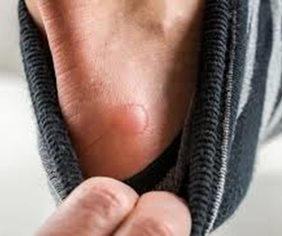
Red or Raw Spots & Blisters
Something is rubbing – check the socks & shoes…

Slide 24
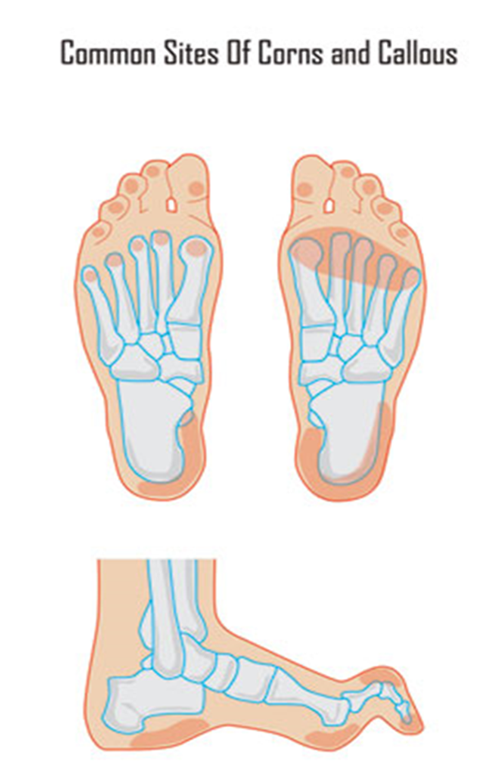
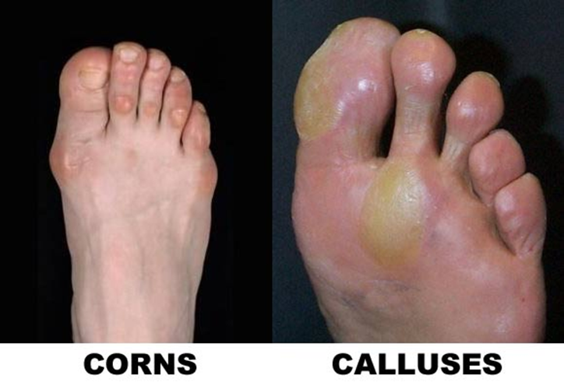
Corns & Calluses
hyperkeratosis from friction/rubbing

Slide 25
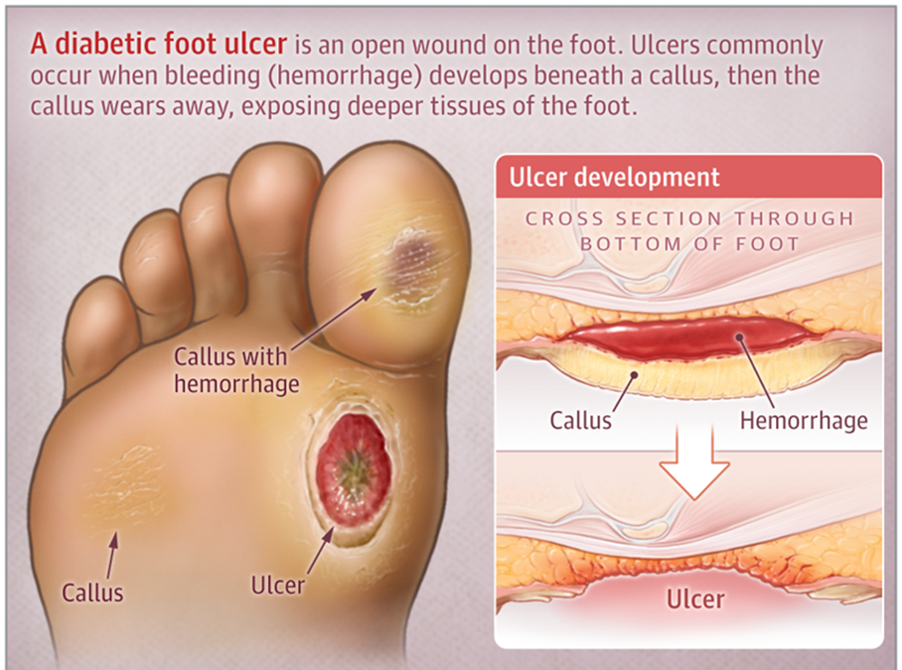
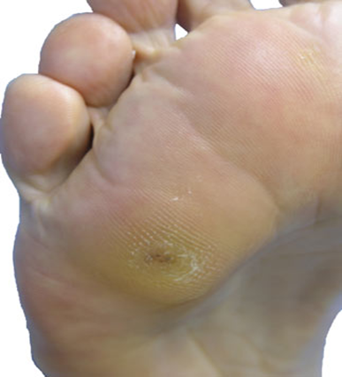
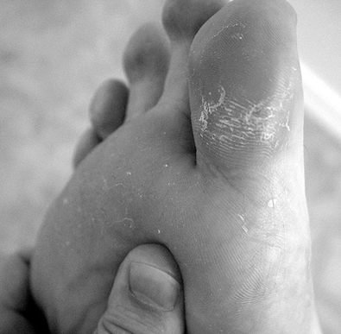
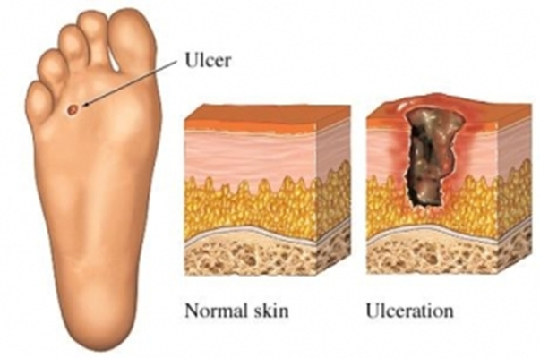
Calluses with Bleeding

Slide 26
What Do You Do if Abnormal
Dry skin: Frequent moisturize! Her favorites are Aveeno, Vaseline Intensive Care, Eucerin, Cera Ve, Lubriderm. (not between toes!)
Eczema: Moderate strength steroid cream like triamcinolone. If severely inflamed, consider fluorinated steroid.
Fungal infection (tinea pedis): Her favorite antifungal creams are ketoconazole (once daily for six weeks), Oxiconazole, Naftin, Luliconazole [ADA: “can usually be treated with over-the-counter topical antifungal products”]
Her go-to Powder is Nystatin. OTC options include Desenex and Lotrimin.
  Creams are used on the tops and bottoms of the feet. Powder goes between toes. (don’t use cream between toes, unless it’s Luliconazole)
It can sometimes be challenging to determine if tinea pedis vs dry skin vs eczema
  If you have a microscope – get skin shaving with KOH or PAS stain to look for hyphae
  Antifungal products will make eczema/dry skin worse.
Recommendations from podiatrist Dr Jennifer Ryder

Slide 27
What Do You Do if Abnormal
If maceration &/or tinea pedis (fungus likes dark, damp places!) -Reduce Moisture
Moisture wicking socks (not cotton), moisture-wicking synthetic fabrics (like polyester or nylon blends) or Merino wool
  Her recommendations: Balega, Bombas, Coolmax, Smart Wool and Drymax socks
Air out the shoes daily (change daily)
If maceration is severe enough, dry with hair dryer on COLD between toes
If fungal infection (tinea pedis)
  Wash and dry daily feet using an antibacterial soap ("Dial" is a good choice). It is especially important to pay close attention to the areas between the toes / apply antifungal cream/powder
  Don't wear shoes two days in a row. Allow shoes to "dry" for 24 hours between wearing
  Use an OTC foot powder such as Desenex, Lamisil or Tinactin on a daily basis
  Air out feet as much as possible
  Use Betadine to dry out toe webs especially if cracks are present between toes
  Use light-colored stockings or socks and avoid wearing hose
    Dark colors can bleed into damp skin causing irritation
    Light colors show bleeding, discharge, peeling
Recommendations from podiatrist Dr Jennifer Ryder

Slide 28
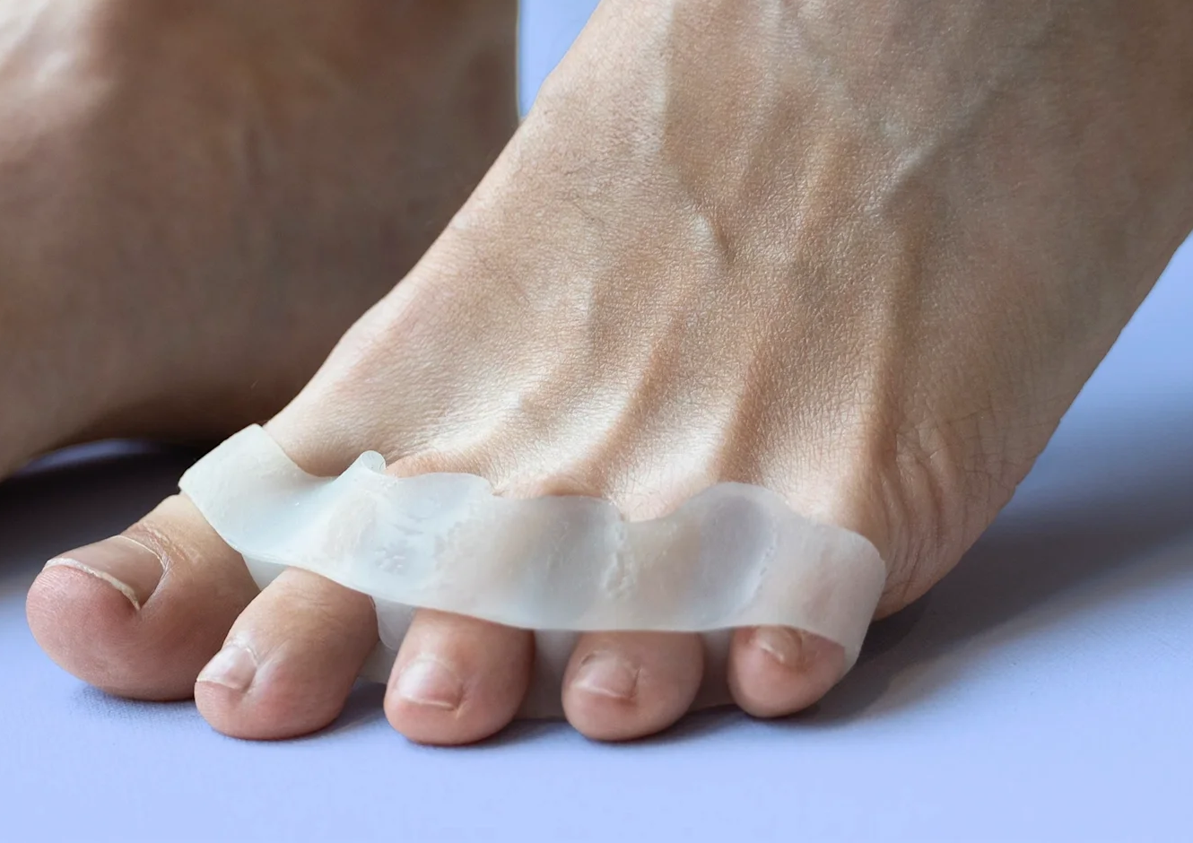
What Do You Do if Abnormal
Corns and Calluses (hyperkeratosis from friction/rubbing)
Debridement - 10 or 15 blade scalpel or tissue nipper
Application of urea-based keratolytic lotion to calluses such as ureacin (not to be used on regular skin) - supervised
Reduce pressures
  Shoes that fit well (usually wider or deeper toe box)
  Gel insole if fat pad atrophy
  Toe spacers (rubbing or overlapping toes, bunion)
  Hammer toe crest pads
  Off-loading felt pad
  Diabetic shoes /custom insoles
Callused areas can ulcerate! Refer to podiatry if pre-ulcerative or bleeding
Notes:
Dr JB Ryder, podiatry

Slide 29
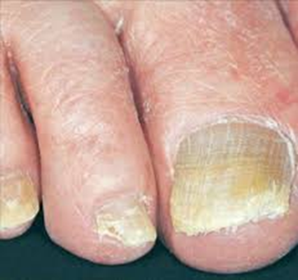
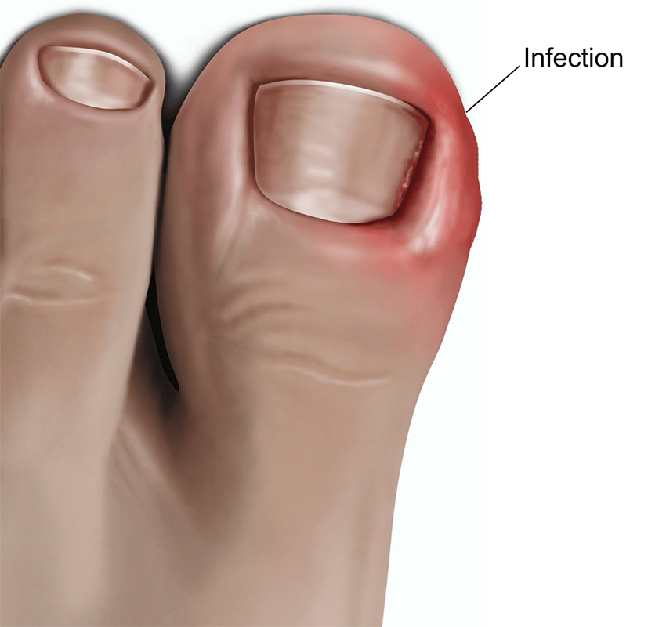
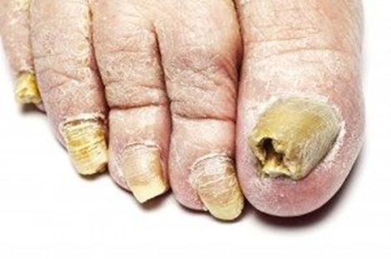
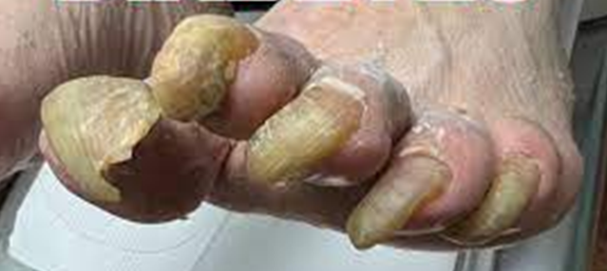
Toenail Changes/Abnormalities
Changes due to
  age
  neuropathy/trauma
  reduced blood flow
  increased susceptibility to fungal infections
https://blog.wcei.net/diabetic-toenails-watch-for-change

Slide 30
What to Do if Abnormal
Ingrown Nails
Onychomycosis- fungal infection of nail
Foot soaks and topical antibiotics.
Oral antibiotics (cephalexin or amoxicillin/clavulanic acid)
Digital block then partial or total nail avulsion
Matrixectomy if infection isn’t severe
Frequent debridement and the tinea pedis antifungal measures
Skin medications won’t work on nails
Can lead to overlying bacterial infection of nail or paronychia and cellulitis
Debridement every three months, if possible.
  Professional grade Miltex nipper– the more hinges the better
  Rotary burr on Dremel for thinning
If nail sample is PAS+
Topicals include efinazonazole (Jublia), ciclopirox (Penlac)
Oral medication includes Lamisil and Spronox.
  Liver function tests prior to therapy and at 25-28 days.
  Consider other meds potentially toxic to liver
https://blog.wcei.net/diabetic-toenails-top-tips-for-proper-trimming
Notes:
Recommendations from podiatrist Dr J B Ryder

Slide 31






Charcot Foot: Acute & Chronic
Off-load
Call Podiatry
(urgent eval)
& Refer
Acute Charcot Foot
Red
Swollen
Hot
Chronic Charcot Foot
Rocker – bottom foot
Notes:
Crutches or knee scooter or wheelchair until can get to podiatry

Slide 32
Patient Self Management: Foot Care Checklist
(Dos and Don’ts)
Wear shoes or slippers at all times (Don’t go barefoot)
  Wear comfortable shoes with socks (not tight; watch seams)
  Check inside shoe before putting it on
Look at feet daily
Keep skin soft, not dry & cracked; use lotion on top & bottom
  Keep feet dry (not wet), especially between toes, use powder
Keep feet clean
  do not soak feet – dry skin & peeling
Use only lukewarm water (Don’t use hot water – test with hand)
  Do NOT use heating pads or hot water bottles
Cut toenails straight across
  Do not use iodine, razors or medicines for corns

Slide 33


Slide 34



Look at feet every day

Slide 35


Who Needs Referral to Podiatrist?
ADA recommendations:
Individuals with foot ulcers and high-risk feet
e.g., people
  on dialysis
  with Charcot foot
  with a history of prior ulcers
  with a history of amputation
  with PAD
Individuals who smoke and have
  a history of prior lower-extremity complications
  loss of protective sensation (LOPS)
  structural abnormalities
  PAD

Slide 36

Who Needs Referral to Podiatrist?
PWD who:
Have LOPS with other risks such as deformities
Have PAD, especially if also have LOPS &/or deformities
Have suspected acute Charcot foot or chronic Charcot foot
Have pre-ulcerative callous / bleeding under callous
Need nail care
Need therapeutic shoes or insoles
Have refractory skin issues (tinea, eczema, etc.)
Have ESRD or on dialysis
Have history of prior foot ulcer or amputation

Slide 37
Who Needs Foot Exam by the PC Team ?
PWD who:
Are newly diagnosed (neuropathy can start in prediabetes, with obesity, metabolic syndrome, etc.)
Are new to your practice / clinic
Do not have any foot issues (annual foot exam – does not need referral to podiatry for foot exam)
Have minor foot issues without PAD
  dryness, mild tinea pedis, minor ingrown toenail, etc.
  deformities such as hammer toes, fat pad atrophy, minor bunion
Have LOPS without other risk factors (annual exam plus inspection of feet at each visit)
Still need to INSPECT feet at each visit for PWD & “at-risk” feet (even if under podiatry care)
Shoes Off policy – and just look at the feet (examples of burns, torn skin, raw areas, etc.)
  General foot hygiene (dirt, paper stuck to feet, etc.), inspect skin for red areas, etc.
  Remind regarding self-foot care at each visit (easily forgotten) - better if they know you are going to look
  If PWD who do not have “at-risk” feet take their shoes off – still look briefly, compliment on good moisturizing or mention need for moisturizing, ask if any problems, pain, etc., encourage self- foot care even if do not have LOPS

Slide 38
Foot Exam & Inspection as Team Care
Medical Assistants can help with Foot Exams & Inspections
  At the minimum instruct/remind PWD regarding shoe & sock removal; provide help as needed
  Can help with the exam & education - need written protocol for
    Comprehensive foot exam
      Inspect skin (including bottom of foot, heel & between toes)
      check pulses
      check for LOPS (at least 2 tests)
      check for deformities (including fat pad atrophy)
    Inspection of “at-risk” feet
      Look at feet – general foot hygiene (dirt, paper stuck to feet, etc.), inspect skin for red areas, etc. – hand-off to clinician
      Action needed regarding abnormalities to prevent more major problems
    Teaching self-foot care
  If any abnormalities, have PWD leave the shoes off & hand-off to the clinician
    For billing, leave shoes off for annual comprehensive exam on all PWD for confirmation of findings
Recommend training MAs, then have MA do the foot exam & hand-off & clinician repeat full foot exam to ensure similar findings – maybe 5-10 cases
Once satisfactory, MA can do the foot exam & hand-off, clinician checks on any abnormalities

Slide 39
Why do foot exams in our people with diabetes?
To help prevent foot ulcers and amputations in our PWD
  The lifetime risk of developing a diabetic foot ulcer is between 19% and 34%.
  Recurrence is common after initial healing:
    ~40% of patients have a recurrence within 1 year after ulcer healing
    ~ 60% within 3 years
    ~65% within 5 years
  Many/most of these are preventable with foot exams & foot care
    Examples:
      noticing a red/rubbed spot or callous, reducing pressure, trimming callous, gel insoles, felt padding, footwear
      self-foot care with appropriate moisturizing to prevent cracks in skin / infection
      noticing a cut on toe from patient attempting to trim thick nails
“The best way to reduce amputation is not with expensive tests, but by observing the feet every time you see the patient.”
Notes:
https://lermagazine.com/article/monofilament-testing-withstands-critiques

Slide 40
https://www.youtube.com/watch?v=Wa3TsUyiuo4&t=110s
The Diabetic Foot Exam - Diabetes Series

Slide 41
Extra Slides

Slide 42
FOOT EXAM:
Start with Inspection:
  Look from thighs or knees down, if possible →look between toes
  General foot hygiene (dirt, paper stuck to feet, etc.)
  Loss of hair
  Nails (thick, discolored, long, ingrown)
  Dry skin, cracks
  Deformities (previous amputation, bunions, hammertoes, etc.)
  Lesions (callouses, ulcers)
  Footwear (worn areas, fit, etc.)
  Gait (watch patient walk, can watch as the walk into room)
    Abnormal shoe wear/pressures
    Increased Fall Risk with diabetes…is the Patient safe as well as is their foot safe

Slide 43


The 10-g Semmes-Weinstein Mono­filament

Slide 44
Need for Reliable Monofilaments
A study published in Diabetes Care in 2000 reported that of 160 new 10-g nylon monofilaments, only those from a couple of manufacturers actually buckled within a gram of 10g. Worse, the devices—even the accurate ones—experienced material fatigue, bending too easily and giving false positives after testing about 10 patients. They had to be rested for 24 hours before regaining their firmness.
As Armstrong pointed out in an editorial in that issue of Diabetes Care, “Cycles of applied stress may make these devices inaccurate, rendering them potentially hypersensitive in identifying loss of protective sensation.” Clinics should, he suggested, have multiple monofilaments available so clinicians don’t overdiagnose as the day wears on. “We can no longer afford to look at any tool, even one as useful and important as the monofilament, as an infallible diagnostic divining rod,” he concluded.
Notes:
https://lermagazine.com/article/monofilament-testing-withstands-critiques

Slide 45
Practice Session : Testing Vibration Sensation
Place vibrating tuning fork on bone of hand or arm and ask patient if s/he can feel the vibration, then test at base of great toe , if can’t feel vibration at toe then test the ankle (ankle bone)
  (be sure they are feeling vibration & not just the touch of the tuning fork)
Various methods:
  All or nothing: ask if feel vibration, tell you when it stops
    if they stop feeling it before you do, then vibration sensation is impaired
  Allow tuning fork to vibrate until it stops; have patient tell you when s/he stops feeling the vibration: time <10 sec abnormal
Test on great toe/ankle: try different methods
If no 128 Hz tuning fork – try temperature or pin prick testing

Slide 46
Additional Self Care Instructions
Daily Visual Inspection: Because you cannot feel cuts, blisters, or pressure marks, you must use your eyes daily to check the tops, soles, and spaces between your toes. Use a mirror to see the bottoms of your feet.
Never Go Barefoot: Always wear supportive shoes and seamless socks, even when walking indoors, to protect against unseen objects or burns.
Professional Footwear: Use therapeutic, professionally fitted shoes and custom orthotics to evenly distribute weight and reduce high-pressure areas that trigger skin breakdown.
Avoid Self-Surgery: Never attempt to trim your own calluses or corns, and do not use over-the-counter chemical removers. Rely on a podiatrist for these and for trimming toenails.
Temperature Checks: Always test bathwater with your elbow or a thermometer—not your feet—to prevent accidental severe burns. [radiators, heating pads, hot pavement]

Slide 47
ADA 2026 Standards of Care
12.28 An interprofessional approach facilitated by a podiatrist in conjunction with other appropriate team members is recommended for individuals with foot ulcers and high-risk feet (e.g., those on dialysis, those with Charcot foot, those with a history of prior ulcers or amputation, and those with PAD). B
12.29 Refer individuals who smoke and have a history of prior lower-extremity complications, loss of protective sensation (LOPS), structural abnormalities, or PAD to foot care specialists for ongoing preventive care and lifelong surveillance. B These individuals should also be provided with information on the importance of smoking cessation and referred for counseling on smoking cessation. A
12.30 Provide general preventive foot self-care education to all people with diabetes, including those with LOPS, on appropriate ways to examine their feet (palpation or visual inspection with an unbreakable mirror) for daily surveillance of early foot problems. B
12.31 The use of specialized therapeutic footwear is recommended for people with diabetes at high risk for ulceration, including those with LOPS, foot deformities, ulcers, callous formation, poor peripheral circulation, or history of amputation. B

Slide 48

“The physical examination can stratify patients into different categories and determine the frequency of these visits”

Slide 49
References & Resources

Slide 50
Videos from Global Health Media
Choosing well-fitting shoes in the market
Choosing well-fitting shoes in the shoe store.
The diabetic foot exam
Taking care of your feet

Slide 51
ADA 2023 Standards of Care
12. Retinopathy, Neuropathy, and Foot Care: Standards of Care in Diabetes—2023
| Diabetes Care | American Diabetes Association (diabetesjournals.org)
Didactic on Diabetic Peripheral Neuropathy https://youtu.be/2RQyNLot8Ss
https://diabetesjournals.org/compendia/article/2022/1/1/147001/
Diagnosis-and-Treatment-of-Painful-Diabetic
Notes:
12. Retinopathy, Neuropathy, and Foot Care: Standards of Care in Diabetes—2023 | Diabetes Care | American Diabetes Association (diabetesjournals.org)
https://diabetesjournals.org/compendia/article/2022/1/1/147001/Diagnosis-and-Treatment-of-Painful-Diabetic

Slide 52

CHECKING THE DIABETIC FOOT
https://diabetesanddust.wordpress.com/checking-the-diabetic-foot/

Slide 53
Toenails & Dry Skin
https://blog.wcei.net/diabetic-toenails-watch-for-change
https://blog.wcei.net/diabetic-toenails-top-tips-for-proper-trimming
https://blog.wcei.net/dry-skin-alert-foot-xerosis-in-diabetic-patients

Slide 54
https://www.diabetesselfmanagement.com/managing-diabetes/complications-prevention/how-to-choose-footwear/

Slide 55
CDC (for patients) & Indian HS Resources
Diabetes and Your Feet - CDC
  https://www.cdc.gov › library › features › healthy-feet
  https://www.cdc.gov/diabetes/library/factsheets/diabetes-and-healthy-feet.html
https://www.ihs.gov/sdpi/sdpi-community-directed/diabetes-best-practices/foot-exam/

Slide 56
ADA & ACFAS resources (for patients)
http://main.diabetes.org/dorg/PDFs/foot_care_for_a_lifetime.pdf
https://diabetes.org/healthy-living/seniors/foot-care-tips
https://diabetes.org/diabetes/foot-complications
Poster(the PDF) https://diabetesjournals.org/clinical/article/39/2/225/40621/Taking-Care-of-Your-Feet
From American College of Foot and Ankle Surgeons https://www.foothealthfacts.org/conditions/diabetic-foot-care-guidelines

