Slide 1
Hypercalcemia in Malignancy
Trien Vu MD

Slide 2
Hypercalcemia is one of the very common metabolic problem in malignancy.
It occurs in 1% of the general population and can be seen in 2-3% of cancer patients.
90% of hypercalcemia cases are the result of hyperparathyroidism or malignancy.
Hypercalcemia carries a poor prognosis with a high 1 year mortality after diagnosis.
Treatment have shown statistical improvement but not by much.

Slide 3
Definition
Hypercalcemia is defined as the serum calcium above two standard deviation above the mean laboratory references.
Normal calcium range at MD Anderson: 8.4 – 10.2 mg/dL
Laboratory ionized calcium is 1.15-1.29 mmol/L

Slide 4
Classification of hypercalcemia
Mild hypercalcemia: <12 mg/dL ( 3 mmol/L)
Moderate hypercalcemia 12 to 14 mg/dl (3 to 3.5 mmol/L)
Severe hypercalcemia >14 mg/dL (>3.5 mmol/L)
40-45 % of total serum calcium binds to albumin and requires correction.
A popular approach to determine corrected measured serum calcium is:
Corrected calcium = measure calcium + 0.8 (normal albumin-measured albumin)

Slide 5
Physiology of Calcium metabolism
Key players in calcium metabolism are:
Serum calcium
Parathyroid gland
Kidney
Bones
Gastrointestinal tract
skin

Slide 6
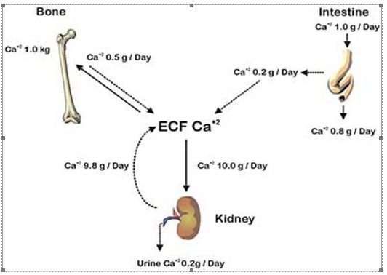

Slide 7
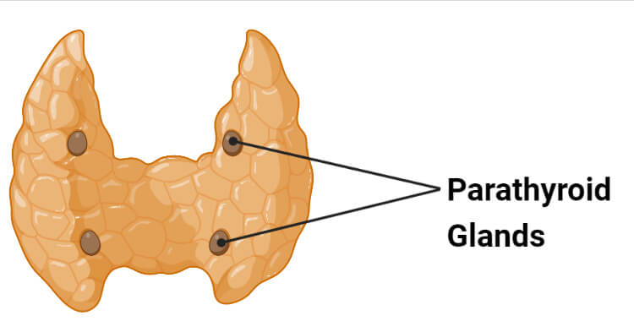
p
PARATHYROID
Calcium level will affect the production of parathyroid hormone (PTH)
PTH is released whene the calcium level reaches < 7.5 mmol/dL

Slide 8
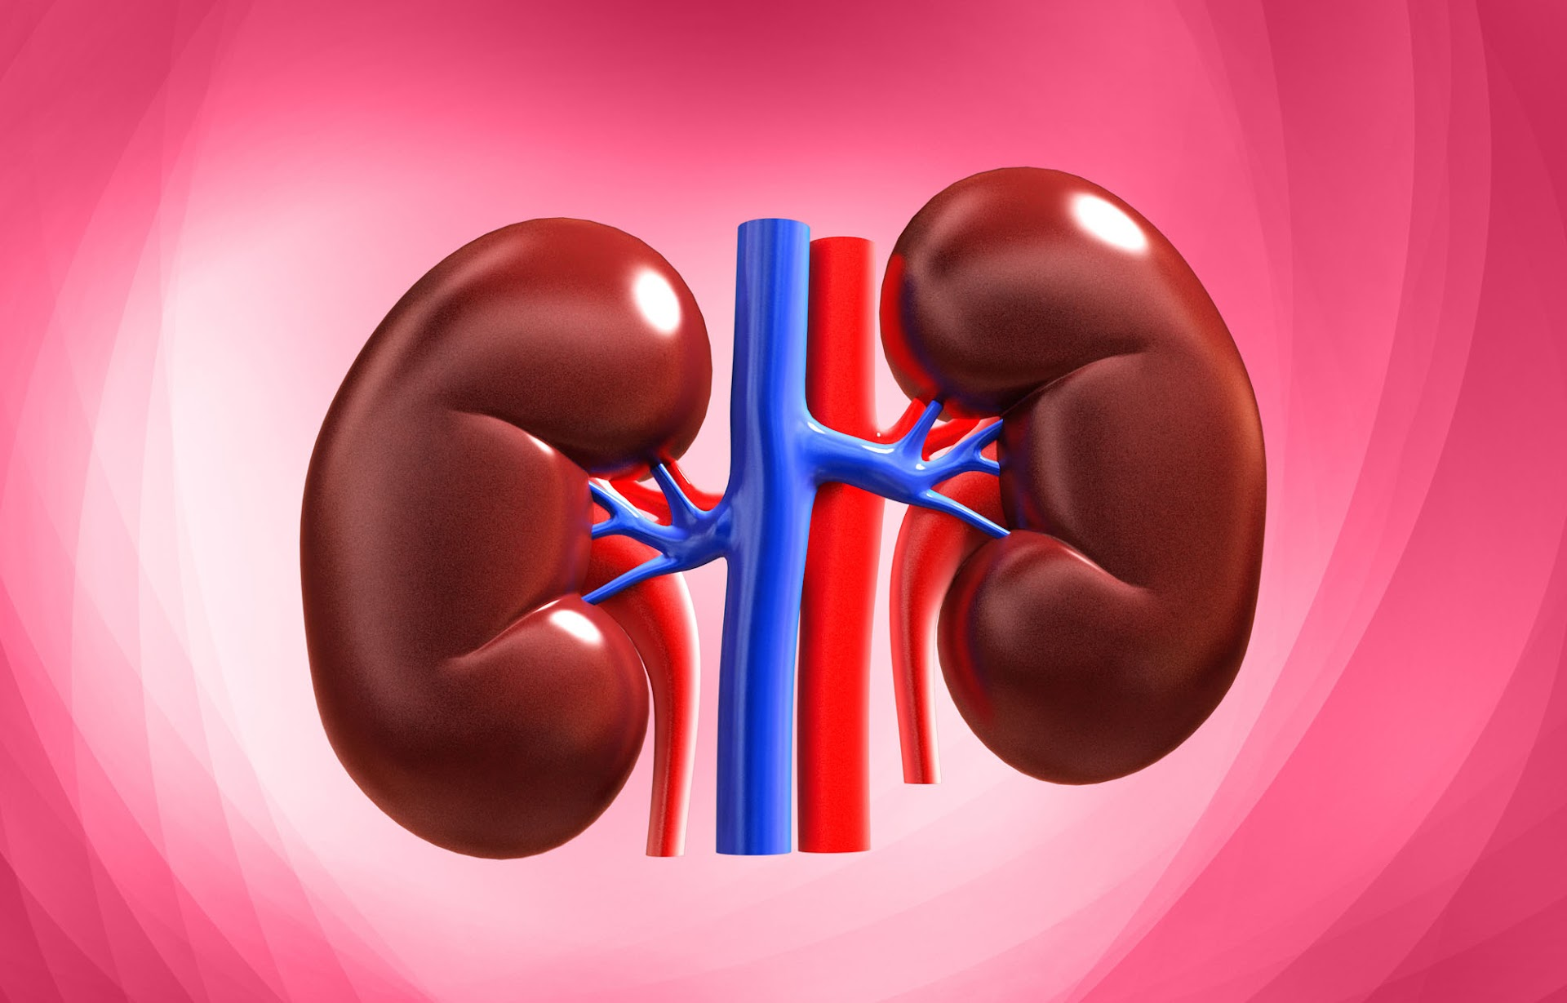
Kidney
PTH activate 1-alphhydroxylase enzyme in the renal proximal tubule converting 25-hydroxyvitamin D to 1,25-hydroxyvitamin D.
PTH increase renal calcium and magnesium reabsorption in the loop of Henle

Slide 9
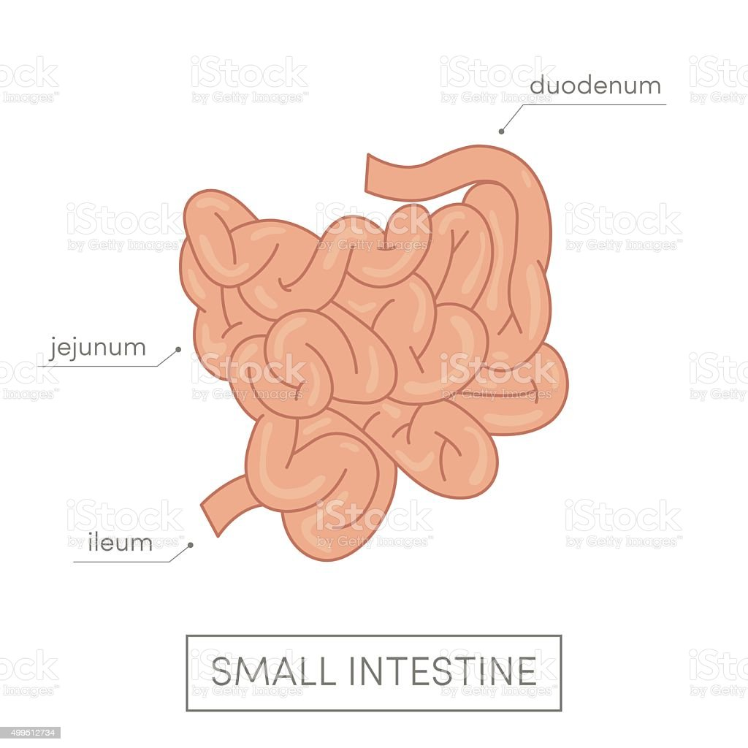
Gastrointestinal tract
1,25-hydroxyvitamin D can enhance calcium absorption by stimulating both the active and passive intestinal calcium transport.

Slide 10
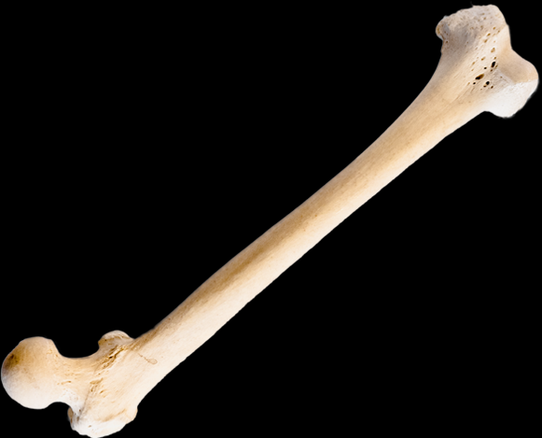
Bone
Both PTH and 1,25-hydroxyvitamin D can increase bone turnover by increasing through the osteoclast mediated bone reabsorption and cause release of calcium.

Slide 11
Mechanisms of cancer mediated hypercalcemia
Humoral hypercalcemia
Local osteolytic hypercalcemia
1,25-hydroxyvitamin D mediated hypercalcemia
Ectopic parathyroidism

Slide 12
Humoral hypercalcemia
Tumors produce and secrete the parathyroid hormone related protein (PTHrP) which mimic the function of PTH.
PTHrP exert their effect primarily on kidney and bone.
This is the most common cause of hypercalcemia in malignancy accounting for up to 80% of hypercalcemia in malignancy.
This finding in malignancy is usually when the tumor is advanced stages and signify poor prognosis.

Slide 13
Malignancy associated with humoral hypercalcemia
Squamous cell carcinoma
Renal carcinoma
Bladder carcinoma
Breast carcinoma
Lung cancer
Ovarian carcinoma
Prostate carcinoma
Colorectal carcinoma
Non-Hodgkin lymphoma
Chronic myeloid leukemia
Leukemia
lymphoma

Slide 14
Osteolytic metastases mediated hypercalcemia
Local metastatic of tumors to the bone can cause hypercalcemia and account for approximately up to 20% of the cases.
This mechanism is seen more commonly in solid tumors and myeloma but occasional seen in lymphoma and leukemia.
Breast cancer is the most common cause from this mechanism.

Slide 15
Tumor causes overproduction of calcitriol (1,25-dehydroxyvitamin D)
Most the cases is from Hodgkin lymphoma and to a lesser extent, non-Hodgkin lymphoma.
There are rare instances of solid tumor, ovarian dysgerminoma causing over secretion of calcitriol.
The primary organ affected is the gastrointestinal tract.
Glucocorticoid treatment reduces the absorption of calcium in the intestinal tract and can be an effective treatment for this pathway.

Slide 16
Ectopic PTH secretion
This pathway involves an elevated PTH in absence of an identifiable parathyroid adenoma. Some of the identifiable causes are:
ovarian carcinoma
Lung carcinomas
Neuroectodermal tumor
Thyroid papillary carcinoma
Rhabdomyosarcoma
Pancreatic carcinoma

Slide 17
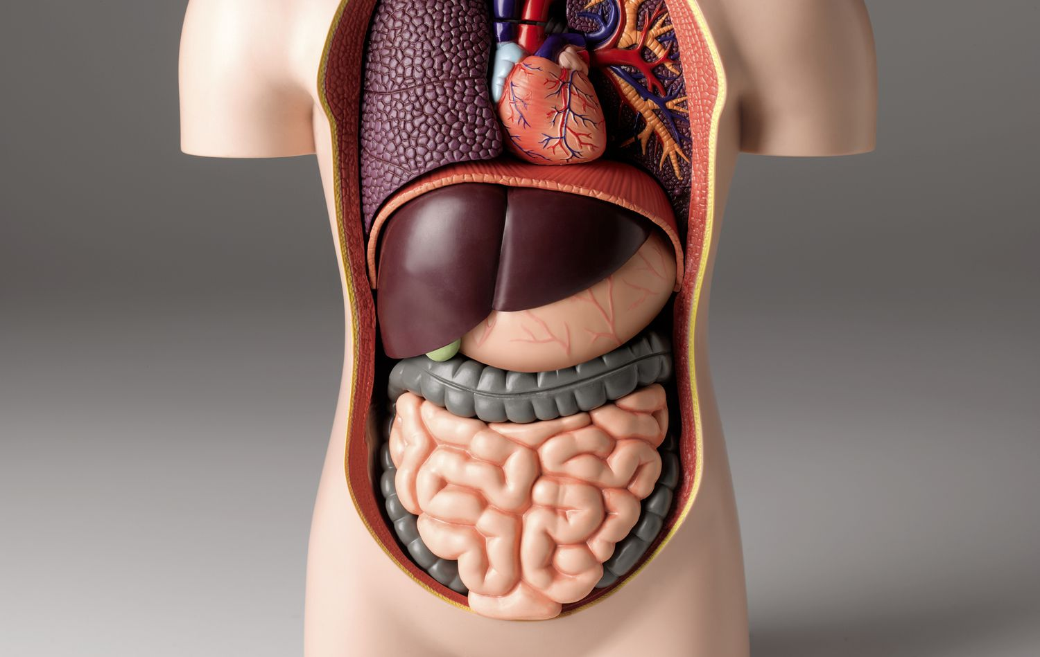
Clinical manifestations of hypercalcemia

Slide 18
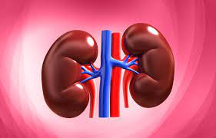
Renal manifestations
Polyuria and polydipsia
Nephrolithiasis
Nephrocalinosis
Distal renal tubular acidosis
Nephrogenic diabetes insipidus
Acute and chronic renal insufficiency

Slide 19
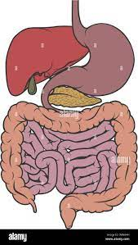
Gastrointestinal manifestations
Nausea and vomiting
Abdominal pain
Motility disorder and constipation
Pancreatitis
Peptic ulcer disease

Slide 20
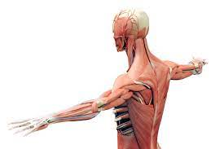
Musculoskeletal manifestion
Muscle weakness
Bone pain
Osteopenia and osteoporosis

Slide 21
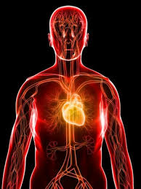
Cardiovascular manifestation
Bradycardia
Hypertension
Shortening of the QT interval
Widened QRS complex
Rarely, EKG mimic STEMI

Slide 22

Neurologic manifestation
Cognitive impairment
Confusion
Fatigue
Stupor, coma

Slide 23
Laboratory examination
Parathyroid hormone (PTH)
Parathyroid hormone related protein (PTHrP)
25-hydroxyvitamin D
1,25-hydroxyvitamin D
Serum and urine protein electrophoresis (myeloma)
TSH and vitamin A

Slide 24
Parathyroid hormone
Elevated PTH is highly suggestive of primary hyperparathyroidism.
Mid to upper normal PTH can still be suggestive of primary hyperparathyroidism within 20% of hypercalcemia cases.
Low to low-normal PTH is more likely to be non-PTH mediated hypercalcemia.

Slide 25
PTH-related protein
PTHrP level elevation is consistent with humoral hypercalcemia of malignancy especially when there is clinical evidence of malignancy.
Level of PTH and 1,25-hydroxyvitamin D are usually low.

Slide 26
Vitamin D metabolites
Consider checking levels in patients without elevated PTH and malignancy.
25-hydroxyvitamin D elevation may indicate vitamin D toxicities with level greater than 150 ng/mL.
1,25-hydroxyvitamin D elevation may be caused by lymphoma, granulomatous disease or direct ingestion.

Slide 27
Consideration for non-malignant causes of hypercalcemia
TSH for thyrotoxicosis
Vitamin A level for vitamin A toxicity
Urinary calcium excretion are low for conditions such as milk-alkali syndrome, medications induced such as thiazide diuretics, and Familial hypocalciuric hypercalcemia.

Slide 28
Patient with hypercalcemia
Confirm hypercalcemia with correction for albumin level or ionized calcium
Normal or elevated PTH
Low PTH
Primary hyperparathyroidism, consider familial hypocalciuric hypercalcemia in the proper setting
PTHrP
High 25-(OH) vit D
High 1,25-(OH) vit D
Humoral mediated malignancies
Medications, vit D excess
Lymphoma, granulomatous diseases
PRESENTATION TITLE
28

Slide 29
Treatment approach to hypercalcemia
Case presentation: A 53-years-old woman presents to the Acute Cancer Care Clinic with weakness, intermittent confusion, difficulty in talking progressively worsened over a 3 weeks span. She has metastatic breast cancer and is on active treatment of capecitabine (Xeloda). Her metastatic disease involves chest, abdomen, pelvis and spinal column. Her serum calcium is 15.3, potassium is 2.0, creatinine 1.69, phosphorus of 3.2 and an albumin of 2.4. Ct abdomen/pelvis shows widespread osseous disease of the chest, abdomen, pelvis and spinal column. How should this patient be treated?

Slide 30
Treatments
Isotonic saline hydration
Calcitonin
Biphosphonates
denosumab
glucocorticoids
Calcimmetics
dialysis

Slide 31
Isotonic saline hydration
In absent of comorbidities such as renal and cardiac conditions, the suggested treatment is 1-2 L bolus follow by a rate of infusion is 200-500 mL/hour with a urine output of 100-150 mL/hours.
In patients with volume overload, consider reducing rate to 100-150 mL/hours and monitor for volume overload, respiratory embarassment.

Slide 32
calcitonin
Naturally occurring hormone synthesized in the thyroid gland.
Dosing is 4-8mg/kg subcutaneous or intramuscular every 8-12 hours for 48-72 hours.
Inhibits osteoclast activity
Increase renal excretion.

Slide 33
Biphosphonates
Inhibits osteoclast activity
Pamidronate 60-90 mg is given over 2 hours with calcium reduction of serum calcium over 2-3 days.
Zoledronate 4mg is given over 15 minutes with calcium reduction of calcium over 2-3 days.
Pamidronate can worsen osteonecrosis of the jaw or causes pathological fractures in rare instances.
Biphosphonates are potential nephrotoxic agents and will need adjustment in renally impaired patients.

Slide 34
Denosumab
A human monoclonal antibody that binds to RANKL.
Inhibits osteoclast formation, differentiation and activities
Dosing is 120 mg subcutaneously.
It is not renally cleared and can be used in patients with chronic renal disease or renal impairment.

Slide 35
Calcimimetics
Class of medication that binds to calcium-sensing receptor on parathyroid cell and increase the sensitivity of the receptor to serum calcium. This increase the suppression of PTH secretion in the setting of hypercalcemia.
Cinacalcet is given initially as 30 mg orally every twelve hours.

Slide 36
Glucorticoids
Decrease 1,25-hydroxyvitamin D production
Decrease intestinal calcium absorption
Dosing is 20-40 mg daily

Slide 37
Dialysis
Consider for patients with severe refractory hypercalcemia, calcium level greater than 18 mg/dL with neurologic symptoms, and patients with decompensated heart failure or renal failure in volume overload.

Slide 38
Recent treatment guidelines
Eight scenarios for treatment of severe hypercalcemia:
Hypercalcemia treated with bisphosphonate or denosumab versus no treatment: RECOMMENDS treatment.
Hypercalcemia treated with bisphosphonate vs denosumab: RECOMMENDS denosumab.
Hypercalcemia treated with bisphosphonate or denosumab with calcitonin versus no calcitonin: RECOMMENDS with calcitonin.
Refractory hypercalcemia treated with bisphosphonate or desonumab versus combination therapy of bisphosphonate and desonumab: RECOMMENDS combination therapy.

Slide 39
Refractory hypercalcemia with high calcitriol on steroid therapy treated with bisphosphonate or denosumab versus no additional therapy: RECOMMENDS additional therapy with bisphosphonate or denosumab.
Hypercalcemia from parathyroid carcinoma treated with calcimimetics versus bisphosphonate or desonumab: RECOMMENDS surgery if feasible, treatment with any of the medication is acceptable but favors bisphosphonate or desonumab due to rapid onset of action and less adverse events.
Refractory hypercalcemia from parathyroid carcinoma on calcimimetics be treated with addition of bisphosphonate or desonumab or no addition: RECOMMENDS addition of bisphosphonate or desonumab.

Slide 40
Refractory hypercalcemia from parathyroid carcinoma on calcimimetics be treated with addition of bisphosphonate or desonumab or no addition: RECOMMENDS addition of bisphosphonate or desonumab.

Slide 41
Reducing risk factors
Dehydration
Excessive calcium intakes (>1000mg/day)
Prolong immobilization
Thiazide diurtetics
Vitamin D supplements

Slide 42
Preventing recurrence
In patients with hypercalcemia and metastatic bone disease, treatment with zoledronic acid or pamidronate every 3-4 weeks can be used for prevention of skeletal complication.

Slide 43
References
Hypercalcemia: A Review. Walker, Marcella Donovan ; Shane, Elizabeth. JAMA : the journal of the American Medical Association, 2022, Vol.328 (16), p.1624-1636
Cancer-Associated Hypercalcemia. Lipten, Samuel ; Guise, Theresa A. ; Wysolmerski, John J. The New England journal of medicine, 2022, Vol.386 (26), p.2540-2540
Pathophysiology of Hypercalcemia. Goltzman, David. Endocrinology and metabolism clinics of North America, 2021, Vol.50 (4), p.591-607
Hypercalcemia of malignancy: Mechanisms. Horwitz, Mara; Rosen, Clifford; Mulder, Jean. Up to date.

Slide 44
Clinical manifestations of hypercalcemia. Shane, Elizabeth; Rosen, Clifford; Mulder, Jean. Up to date.
Diagnostic approach to hypercalcemia. Shane, Elizabeth; Rosen, Clifford; Mulder, Jean. Up to date.
Treatment of hypercalcemia. Shane, Elizabeth; Berenson, James; Rosen, Clifford; Mulder, Jean. Up to date.
Electrocardiographic manifestations: Electrolyte abnormalities. Diercks, Deborah; Shumaik, George; Harrigan, Richard; Brady, William; Chan, Theodore. The Journal of Emergency Medicine. Vol. 27, No.2, pp. 153-160, 2004.
Denosumab versus intravenous bisphosphonate use for hypercalcemia in multiple myeloma. Lei, Matthew; Buzgo, Evan; Raje, Noopur; Yee, Andrew. Leukemia & Lymphoma, 63:13, 3249-3252.

Slide 45
Treatment of Hypercalcemia of Malignancy in Adults: An Endocrine Society Clinical Practice Guideline. Fuleihan, Ghad El-Hajj; Piggott, Thomas; Van Poznak, Catherine; Wu, Joy; Drake, Matthew. The Journal of Clinical Endocrinology & Metabolism, 2023, 108, pp. 507-528.

