Slide 1
Tick Distribution in the United States
23 July 2026
Indian Health Service
LCDR Michele Kerns
DVM, MPH, DACVPM
Emergency Management Specialist, IHS HQ

Slide 2
American Dog Tick – Dermacentor variabilis, D. similis
Asian longhorned tick – Haemaphysalis longicornis
Blacklegged tick – Ixodes scapularis
Brown dog tick – Rhipicephalus sanuineus
Gulf coast tick – Amblyomma maculatum
Lone star tick – Amblyomma americanum
Rocky Mountain wood tick – Dermacentor andersoni
Western blacklegged tick – Ixodes pacificus
Ticks of Human Concern

Slide 3
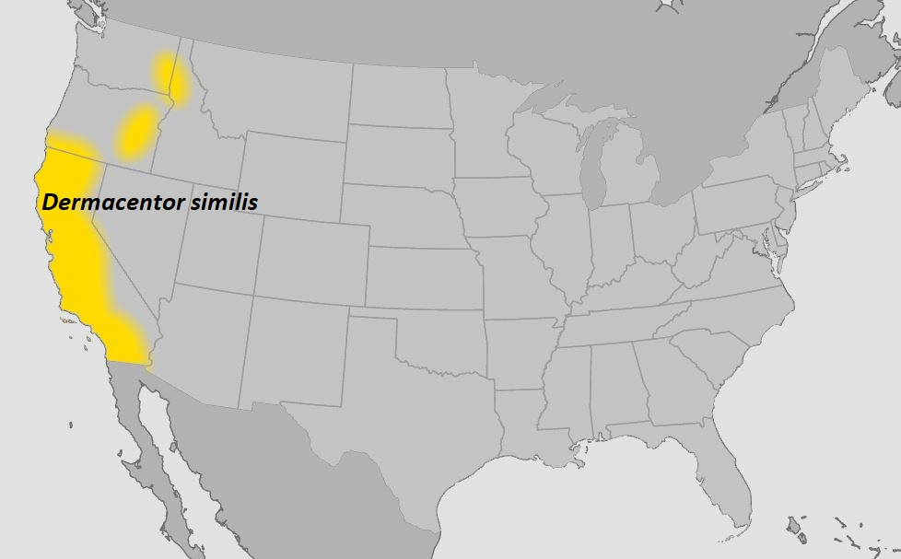
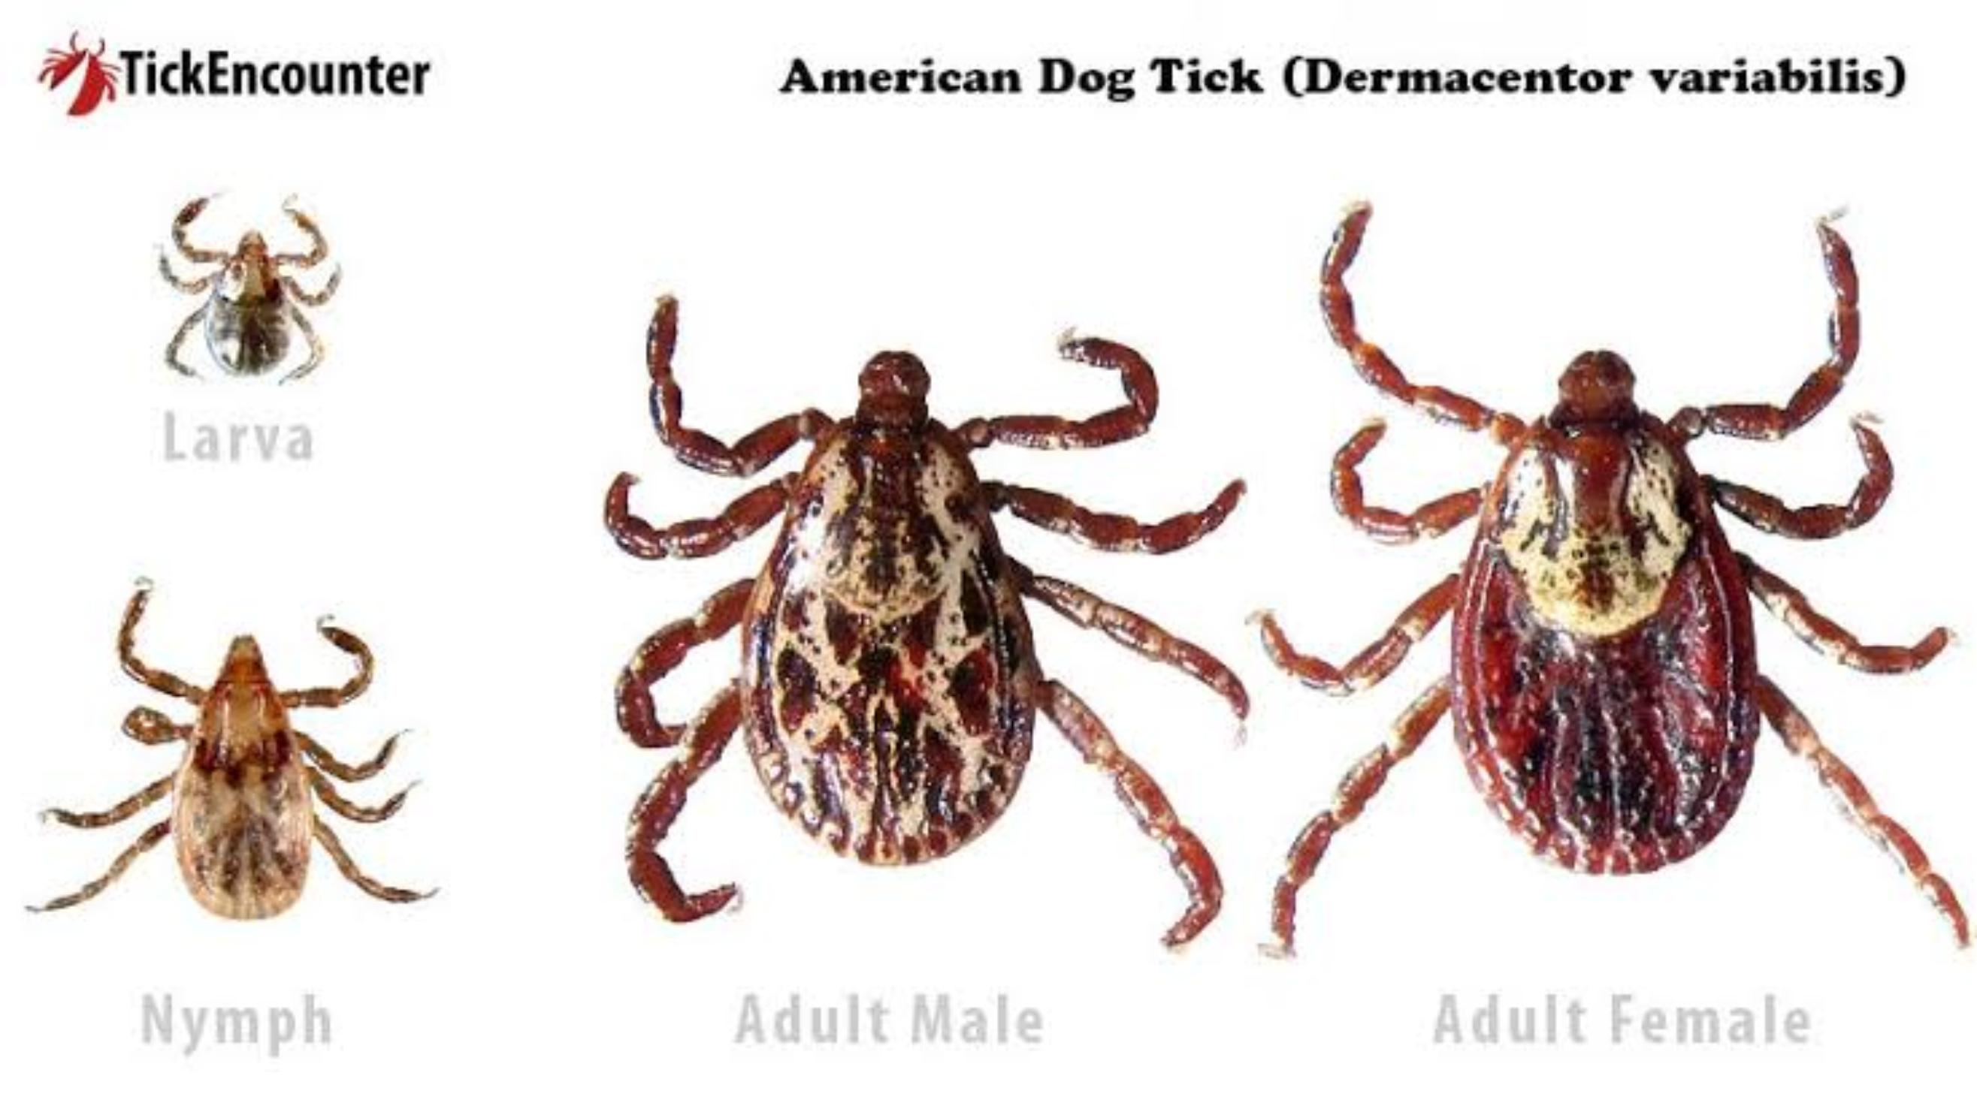
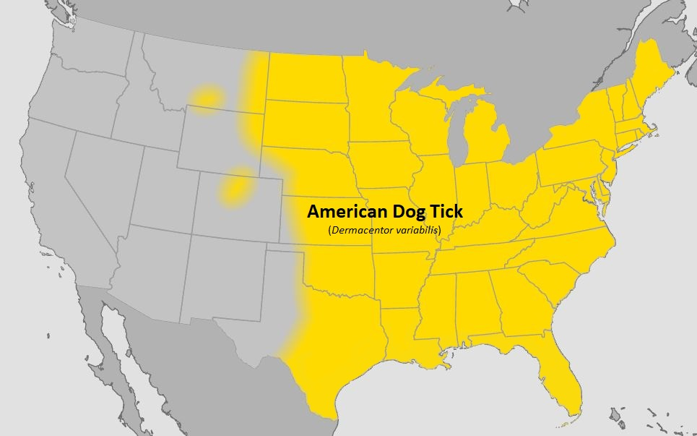
American Dog Tick
Widely distributed east of the Rocky Mountains
Transmits Tularemia and Rocky Mountain Spotted Fever
Adult females are more likely to bite humans with the highest risk occurring in spring and summer.

Slide 4
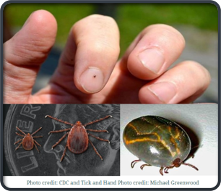
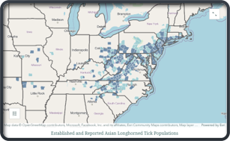
Asian Longhorned Tick
Invasive tick species – suspected to have arrived in the United States around 2010 but was confirmed by USDA in 2017
Males are rare, female ticks can reproduce without a male, laying 1000-2000 eggs at a time
Only takes a single tick to create a population in a new location
Individuals can host hundreds to thousands of ticks causing significant stress, reduced growth and production of livestock, and death from excessive blood loss

Slide 5
Asian Longhorned Tick Continued
  Compared to others on this list, the Asian longhorned tick appears to be less attracted to humans
  Experimental studies show this tick can carry Rocky Mountain spotted fever but the bacteria has not yet been found in these ticks in nature
  One experimental study showed this tick is NOT likely to contribute to the spread of Lyme disease bacteria
  We do not yet know if and how often these ticks are able to pass pathogens along here in the US; they have been shown to transmit other diseases in other countries.

Slide 6
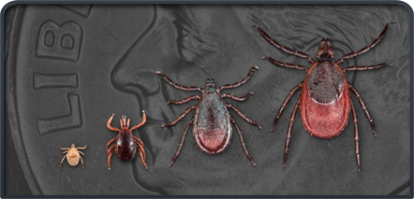
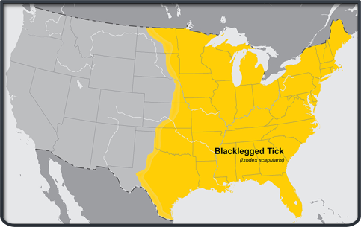
Blacklegged Tick (Deer Tick)
Transmits anaplasmosis, babesiosis, Lyme disease, ehrlichiosis, Powassan virus, and hard tick relapsing fever
Greatest risk is spring through fall, but adults may be searching for a host in the winter any time temperatures are above freezing

Slide 7
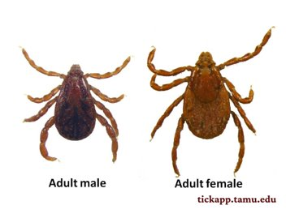
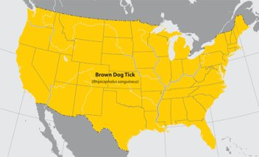
Brown Dog Tick
Transmits Rocky Mountain spotted fever (southwestern US and along US-Mexico border).
Dogs are the primary host in each life stage of the tick, but it may also bite humans or other mammals.

Slide 8
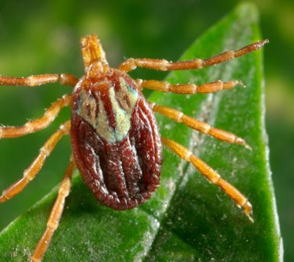
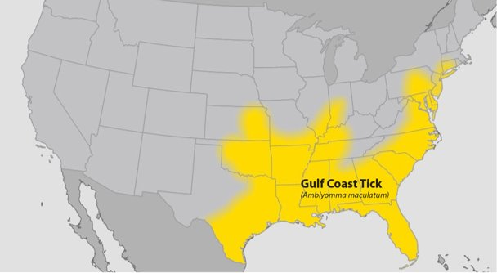
Gulf Coast Tick
Transmits Rickettsiosis

Slide 9
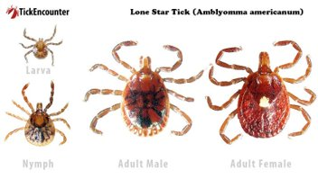
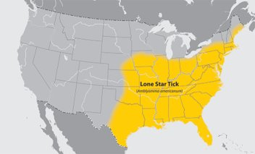
Lone Star Tick
Very aggressive
Transmits Bourbon virus, ehrlichiosis, Heartland virus, and tularemia
A circular rash (STARI) sometimes follows this tick bite
Alpha Gal syndrome, a red meat allergy, may be triggered by the bites of these ticks

Slide 10
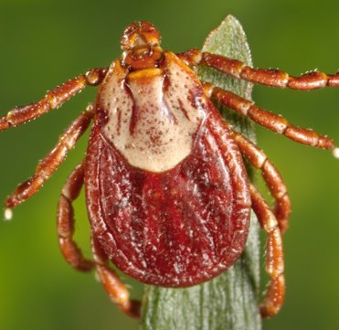
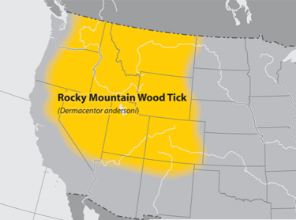
Rocky Mountain Wood Tick
Found in elevations of 4000-10500 feet
Transmits Rocky Mountain spotted fever, Colorado tick fever, and tularemia

Slide 11
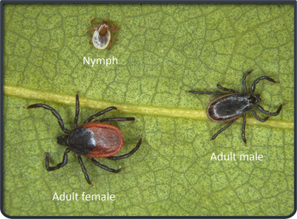
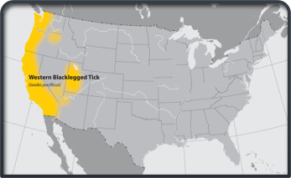
Western Blacklegged Tick
Transmits anaplasmosis, Lyme disease, babesiosis, and hard tick relapsing fever

Slide 12
Questions?

