Slide 1
Tick Borne Diseases
23 July 2026
Indian Health Service
LCDR Michele Kerns
DVM, MPH, DACVPM
Emergency Management Specialist, IHS HQ

Slide 2
Ticks of human concern in the US
American Dog Tick – Dermacentor variabilis, D. similis
Asian longhorned tick – Haemaphysalis longicornis
Blacklegged tick – Ixodes scapularis
Brown dog tick – Rhipicephalus sanguineus
Gulf coast tick – Amblyomma maculatum
Lone star tick – Amblyomma americanum
Rocky Mountain wood tick – Dermacentor andersoni
Western blacklegged tick – Ixodes pacificus

Slide 3
Diseases in the US
Anaplasmosis
Babesiosis
Bourbon virus
Colorado tick fever
Ehrlichiosis
Hard and soft tick relapsing fevers
Heartland virus
Lyme disease
Powassan virus
Rocky Mountain Spotted fever
Rickettsiosis
STARI (Southern Tick-Associated Rash Illness)
Tularemia
Tick paralysis
AlphaGal syndrome

Slide 4
Anaplasmosis
Caused by the bacteria Anaplasma phagocytophilum
Transmitted by Ixodes scapularis and Ixodes pacificus (blacklegged ticks)
Symptoms begin 1-2 weeks after the tick bite and can include:
  Early signs (1-5 days)
    Fever, chills
    Severe headache
    Muscle aches
    Nausea, vomiting, diarrhea, loss of appetite
  Late/severe illness if treatment is delayed or patient is immunocompromised
    Respiratory failure
    Bleeding complications
    Organ failure
    Death
Testing can take several weeks, if anaplasmosis is suspected antibiotic treatment should be started prior to confirmatory testing results are received

Slide 5
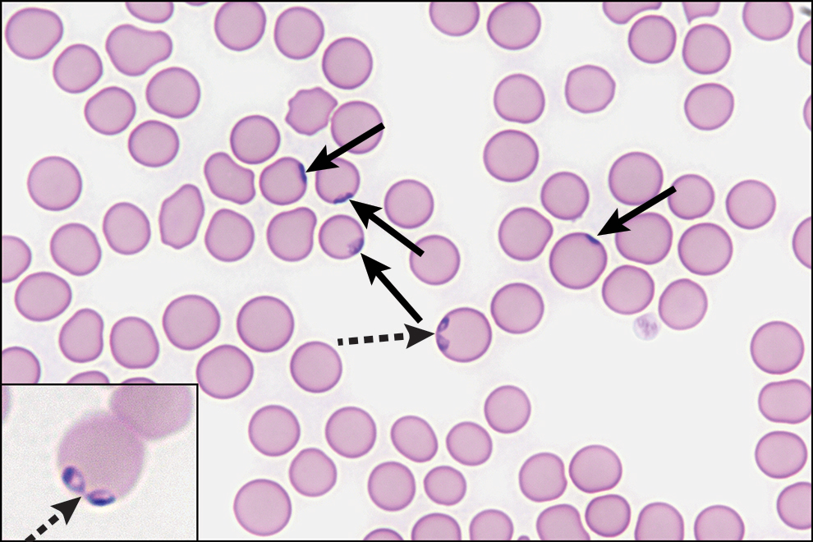
Babesiosis
Caused by Babesia parasites that infect red blood cells
Most infections are from Ixodes scapularis (blacklegged tick) bites
Many people are asymptomatic, though some may show flu like symptoms
  Fever, chills, sweats, body aches, headache, nausea, fatigue

Slide 6
Babesiosis
Hemolytic anemia can occur since the parasite attacks red blood cells
  this can be life threatening in some cases (immunocompromised, those without a spleen)
Diagnosis can be made by blood smear under a microscope
Treatment is available, though may not be necessary if there are no clinical symptoms

Slide 7
Ehrlichiosis
Bacterial diseases (E. chaffeensis, E. ewingii, or E. muris euclairensis)
Spread primarily through bites of Amblyomma americanum (lone star tick) and Ixodes scapularis (blacklegged tick)
Symptoms typically start 1-2 weeks after the tick bite
  Fever, chills, headache, muscle aches, nausea, and rash
    Rash is more common in children and can look like red splotches or pinpoint dots
  Severe illness can occur if treatment is delayed or if patient is immunocompromised
    Respiratory failure, meningitis, uncontrolled bleeding, organ failure, death
Treatment with doxycycline should be started while waiting for test results if ehrlichiosis is suspected

Slide 8
Relapsing Fevers
Hard tick relapsing fever (HTRF) is caused by Borrelia miyamotoi bacteria and is transmitted by Ixodes scapularis (blacklegged tick) and Ixodes pacificus (western blacklegged ticks)
Soft tick relapsing fever (STRF) is caused by Borrelia hermsii, B. turicatae, and other Borrelia bacteria transmitted by softy bodied ticks (Ornithordoros). In the US, most people become infected when they stay overnight in rodent-infested cabins. O. hermsi ticks emerge at night and feed while people are sleeping. Bites from soft ticks are brief, usually lasting less than half an hour, and the bites are painless.
  Less frequently, people become infected while exploring caves, usually involving O. turicata ticks

Slide 9
Relapsing Fevers
Most HTRF commonly involves a single episode of fever, however, relapsing fever has been documented in ~10% of cases. Symptoms usually appear around 2 weeks after a tick bite.
STRF typically relapse, with a recognizable pattern of ~3 days of fever followed by ~7 days without fever, followed by fever again. Antibiotic treatment is usually needed to break this cycle
  STRF can also have negative impacts on pregnancy including pregnancy loss, premature birth, and severe infections or death in infants

Slide 10
Lyme Disease
Bacterial infection caused by Borrelia burgdorferi occurring in the Northeast, mid-Atlantic, and upper-Midwest
Spread by Ixodes (blacklegged) ticks
  In most cases, a tick must be attached for more than 24 hours before the bacterium can be transmitted
Typical symptoms include fever, headache, body aches, fatigue, and a skin rash (erythema migrans)
  If left untreated, infections can spread to joints, the heart, and the nervous system causing facial paralysis, irregular heartbeat, severe headaches, and arthritis

Slide 11
Lyme Disease
Most diagnoses are made based on symptoms and possible tick exposure
  CDC recommends the use of FDA cleared antibody tests for laboratory diagnosis
Most cases can be treated successfully with a few weeks of antibiotics
Chronic, post infection symptoms of fatigue, body aches, or difficulty thinking have been associated with Lyme disease, referred to as Post-Treatment Lyme Disease Syndrome (PTLDS), through the cause of this is unknown. Post infectious symptoms have been reported following other types of infections, such as COVID-19
  Patients usually get better over time, but it can take many months to feel completely well

Slide 12
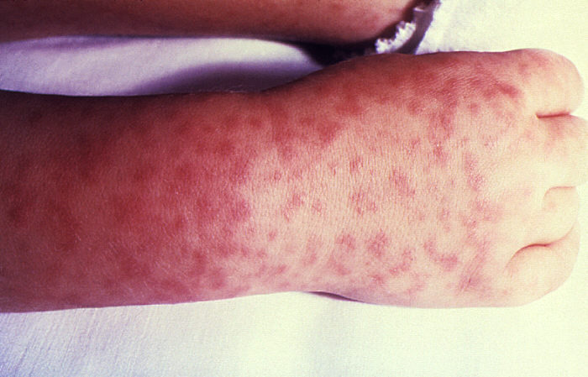
Rocky Mountain Spotted Fever
RMSF is caused by the bacterium Rickettsia rickettsii which is spread by several tick species including Dermacentor variabilis (American dog tick), Rhipicephalus sanguineus (brown dog tick), and Dermacentro andersoni (Rocky Mountain wood tick)
Early symptoms include fever, headache, rash, nausea or vomiting, muscle pain, reduced appetite, and stomach pain.
  The rash is a common sign of RMSF but doesn’t appear until ~2-4 days after the fever starts

Slide 13
Rocky Mountain Spotted Fever
Delayed treatment can lead to long term health problems and permanent damage such as blood vessel damage requiring amputation, hearing loss, or mental disability
Antibiotic treatment should be started right away before test results are available if RMSF is suspected

Slide 14

Tularemia (Rabbit Fever)
Caused by the bacterium Francisella tularensis
Can enter the body through skin, eyes, mouth, or lungs
  Symptoms vary based on route of infection, but all forms are usually accompanied by fever which can be as high as 104°F
Dermacentor variabilis (American dog tick), Dermacentor andersoni (Rocky Mountain wood tick), and Ambylomma americanum (lone star tick) have been shown to transmit tularemia along with deer fly bites
  infections from tick and deer fly bites usually take the form of ulceroglandular or glandular tularemia
    Symptoms include a skin ulcer at the site of the bite and swelling in the regional lymph nodes

Slide 15
Tularemia (Rabbit Fever)
F. tularensis can also be transmitted when handling infected animal tissues, particularly when hunting or skinning infected rabbits, muskrats, prairie dogs, or other rodents. Domestic cats are very susceptible to tularemia and have also shown to transmit the bacteria to humans
  Eating under-cooked contaminated meat (or contaminated water that has not been treated) can cause oropharyngeal tularemia
    Symptoms include sore throat, mouth ulcers, tonsillitis, and swelling of lymph nodes in the neck

Slide 16
Tularemia (Rabbit Fever)
Pneumonic tularemia can occur by inhaling dust or aerosols contaminated with the bacteria; this can occur most commonly during farming or landscaping activities, especially when machinery runs over infected animals or carcasses
  Symptoms include cough, chest pain, and difficulty breathing
    If other forms of tularemia are left untreated, the bacteria can spread through the bloodstream to the lungs causing pneumonic infection as well

Slide 17

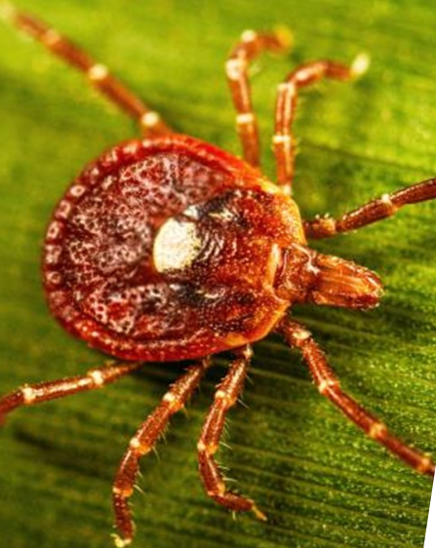
Alpha-Gal Syndrome (AGS)
Alpha-gal is a molecule (galactose-α-1,3-galactose) that is naturally produced in the bodies of most mammals, but not people, and can be found in the saliva of some ticks. In the US, the most common associated tick is Amblyomma americanum (lone star tick)
When the tick bites, it can transfer alpha-gal from its saliva into the bloodstream. The immune system may identify alpha-gal as a threat and develop an allergic response which is triggered when eating red meat or are exposed to other mammal-based products
It can take weeks to months for the allergy to develop after being bitten by a tick
Notes:
AGS is managed by avoiding red meat (such as beef, pork, lamb, venison, or rabbit), dairy products, or food cooked with mammal fat
Some people might not react to every product, and some people can experience different symptoms or reactions each time they are exposed
There is no cure, though some people eventually begin to tolerate alpha-gal containing products when additional tick bites are avoided

Slide 18
Alpha-Gal Syndrome (AGS)
Symptoms usually occur 2-6 hours after eating red meat or dairy products
  Hives; nausea or vomiting; severe stomach pain; difficulty breathing; coughing; drop in blood pressure; swelling of the lips, throat, tongue, or eyelids; dizziness; anaphylaxis
AGS is managed by avoiding red meat (such as beef, pork, lamb, venison, or rabbit), dairy products, or food cooked with mammal fat
Some people might not react to every product, and some people can experience different symptoms or reactions each time they are exposed
There is no cure, though some people eventually begin to tolerate alpha-gal containing products when additional tick bites are avoided

Slide 19
Questions?

