Slide 1
Who Needs What When?
An Update on Diabetes Standards of Care – Some Basics
July 9, 2026
Carol Greenlee MD MACP

Slide 2
Caring for your people with diabetes…
Who needs treatment with an ACEI/ARB?
& when?
Often referred to as Renin-Angiotensin System (RAS) Inhibitors or RASi
Who needs an SGLT2i for renal protection?
& when?

Slide 3
When should an ACEi/ARB be prescribed for PWD?
All PWD at time of diagnosis to prevent kidney damage
If they have elevated blood pressure (hypertension) but no CKD (normal eGFR and UACR)
If they have elevated BP (HTN) with elevated UACR and normal eGFR
If they have elevated BP (HTN) with elevated UACR and reduced eGFR
If they have elevated BP (HTN) with normal UACR and reduced eGFR
If they do not have elevated BP (no HTN) but have elevated UACR and reduced eGFR or normal eGFR
If they have reduced eGFR without elevated UACR & without elevated BP
Is your head spinning?

Slide 4
Diabetic Kidney Disease (CKD in Diabetes)
CKD attributed to diabetes (CKD in a Person with Diabetes / CKD in People with Diabetes [PWD], CKD in Diabetes)* occurs in 20–40% of people with diabetes.
Left untreated, CKD can lead to
  amplification of total cardiovascular risk
    atherosclerotic cardiovascular disease (ASCVD)
    heart failure([HF)
  kidney failure
    CKD in Diabetes is the leading cause of kidney failure in the U.S.
  premature mortality
Early detection and intervention are crucial for improving outcomes and preventing progression to end-stage kidney disease.
Effective management aims to
  reduce albuminuria
  reduce cardiovascular risk
  slow the decline in kidney function
*ADA: “It cannot be definitively stated that a person with diabetes and CKD
has CKD related to diabetes unless the person has a kidney biopsy,
as there may be another cause or multiple causes.
Hence, without a biopsy, it is recommended to state that the individual
has CKD in a person with diabetes or presumed diabetic nephropathy”

Slide 5
Detecting CKD in Diabetes (screening)
ADA 2026 Standards of Care
KDIGO 2026 draft Guidelines
11.1a Assess kidney function with random urine albumin-to-creatinine ratio (UACR) and estimated glomerular filtration rate (eGFR) at least annually
  in people with type 1 diabetes with duration of ≥5 years and
  in all people with type 2 diabetes regardless of treatment. B
CKD in people with diabetes (PWD)
  typically develops after a duration of 10 years in type 1 diabetes (most commonly 5–15 years after the diagnosis of type 1 diabetes)
  but may be present at diagnosis of type 2 diabetes.
1.3 Case-finding and diagnosis
Practice Point 1.3.1: Test all adults and children with diabetes for CKD using both urine albumin-to-creatinine ratio (UACR) and an estimation of glomerular filtration rate (eGFR)
  Practice Point 1.3.3: Begin testing people with T1D ≥5 years after diagnosis; test people with T2D from the time of diabetes diagnosis
  Practice Point 1.3.4: If eGFR ≥60 ml/min per 1.73 m2 and UACR <30 mg/g [3 mg/mmol] and there are no other markers of kidney damage, repeat annually

Slide 6
Diagnosis of CKD in PWD
CKD in PWD is usually a clinical diagnosis made based on the presence of albuminuria and/or reduced eGFR in the absence of signs or symptoms of other primary causes of kidney damage.
The typical presentation of CKD in people with diabetes is considered to include
  long-standing duration of diabetes,
  retinopathy,
  albuminuria without gross hematuria, and
  gradually progressive loss of eGFR.
However, signs of CKD may be present at diagnosis or without retinopathy in type 2 diabetes.
Reduced eGFR without albuminuria has been frequently reported in type 1 and type 2 diabetes and is becoming more common over time as the prevalence of diabetes increases in the U.S.

Slide 7
Diagnosis of CKD in Diabetes
ADA 2026 Standards of Care
KDIGO 2026 draft Guidelines
Chronic kidney disease is diagnosed by the
  persistent elevation of urinary albumin excretion (albuminuria), or
  estimated glomerular filtration rate (eGFR) <60 mL/min/1.73 m2, or
  other manifestations of kidney damage
because of high biological variability between measurements in urinary albumin excretion, two of three specimens of UACR collected within a 3- to 6-month period should be abnormal before considering an individual to have moderately or severely elevated albuminuria
Chronic kidney disease is diagnosed when
  the eGFR is less than 60 mL/min/1.73 m²,
  the urinary albumin-to-creatinine ratio is 30 mg/g or higher, or both
on at least 2 measurements taken more than 90 days apart
  This is crucial because determining chronicity distinguishes acute kidney injury (AKI) from chronic kidney disease.
Key point: Early changes in kidney function may be detected by increases in albuminuria before changes in eGFR - At any eGFR, the degree of albuminuria is associated with risk of cardiovascular disease (CVD), CKD progression, and mortality

Slide 8
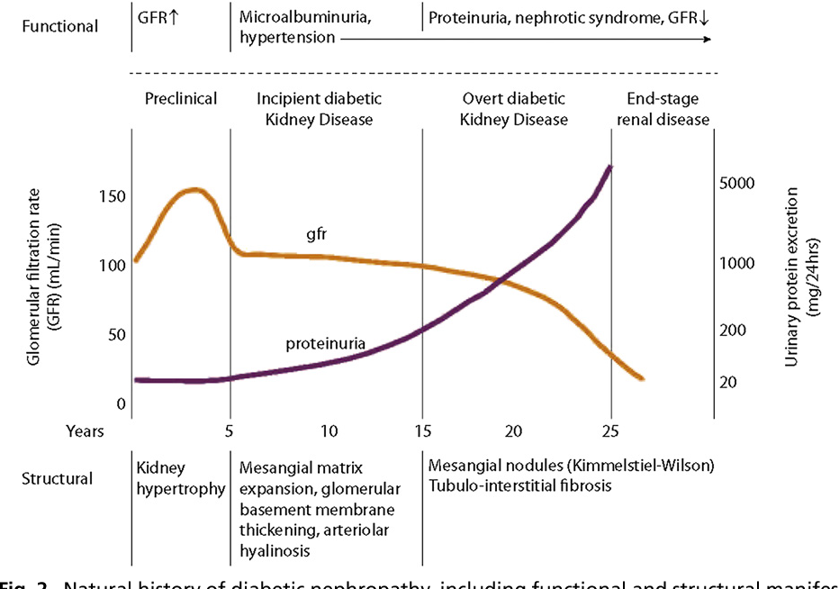
Natural history of diabetic nephropathy, including functional and structural manifestations
(course typical of type 1 diabetes).
Notes:
Natural history of diabetic nephropathy, including functional and structural manifestations (course typical of type 1 diabetes). (From Vora JP, Chattington PD, Ibrahin H. Clinical manifestations and natural history of diabetic nephropathy. In: Comprehensive clinical nephrology. Elsevier; 2000; with permission.

Slide 9
Stages of CKD in Diabetes
Key point: there is an additional subclassification by level of urine albumin
CKD is defined in stages by level of eGFR and albuminuria, with
  Stage G1 and stage G2 CKD defined by evidence of high albuminuria with eGFR ≥90 mL/min/1.73 m2and eGFR ≥60 but <90 mL/min/1.73 m2, respectively
  Stages G3-G5 CKD are defined by progressively lower ranges of eGFR
  Stage G5 is kidney failure
Both eGFR and albuminuria must be quantified to guide treatment decisions.
  Quantification of eGFR levels is essential for medication dosage modifications or restrictions of use (“renal dosing”); also, the prevalence of CKD complications (anemia, acidosis, bone, volume, etc.) correlates with eGFR (function)
  The degree of albuminuria should influence the choice of antihypertensive medications or glucose-lowering medications (damage)

Slide 10
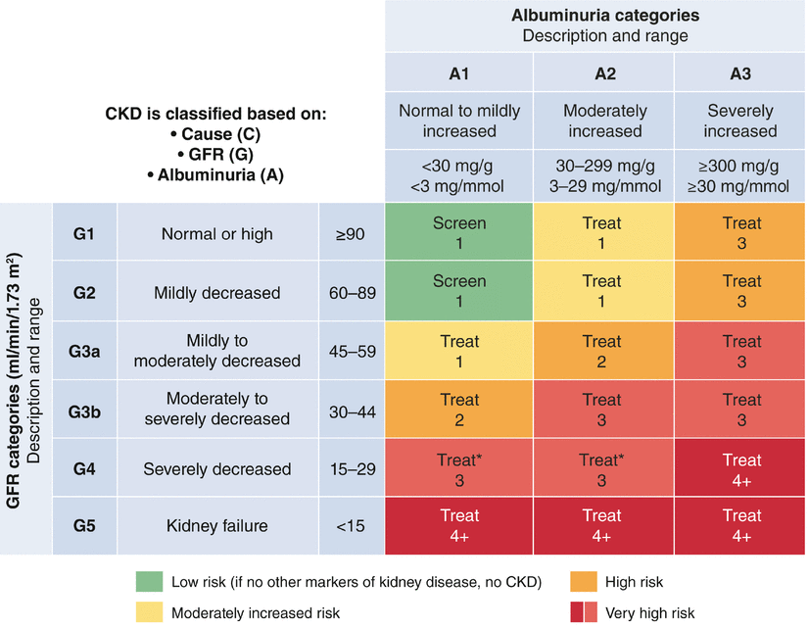
Risk of CKD progression,
cardiovascular disease risk,
and mortality
Notes:
Risk of CKD progression, cardiovascular disease risk, and mortality

Slide 11
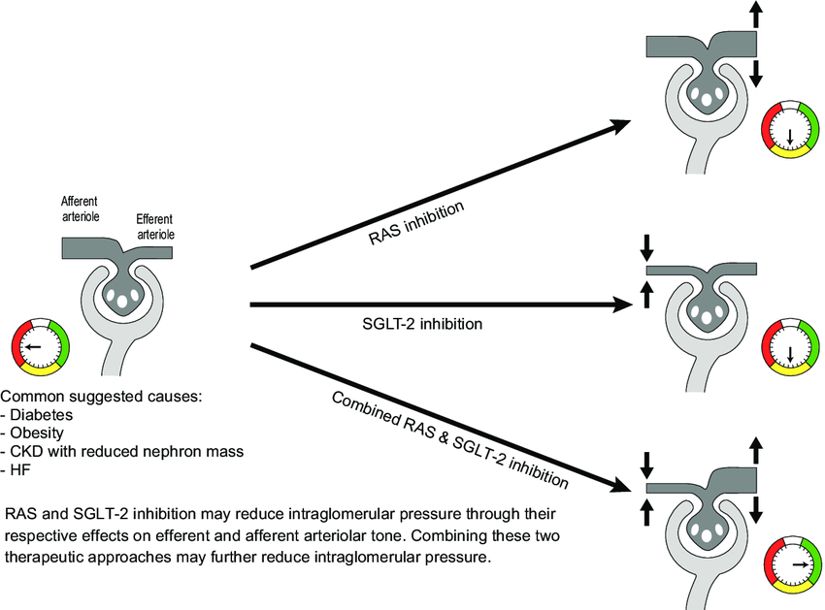
Mechanistic concept of the effects of RAS and SGLT-2 inhibition on intraglomerular pressure
High pressure in the glomerulus
Damage to basement membrane
& podocytes
Dilated
Constricted
Notes:
The potential for improving cardio-renal outcomes by sodium-glucose co-transporter-2 inhibition in people with chronic kidney disease: A rationale for the EMPA-KIDNEY study
December 2018CKJ: Clinical Kidney Journal 11(6):749-761

Slide 12
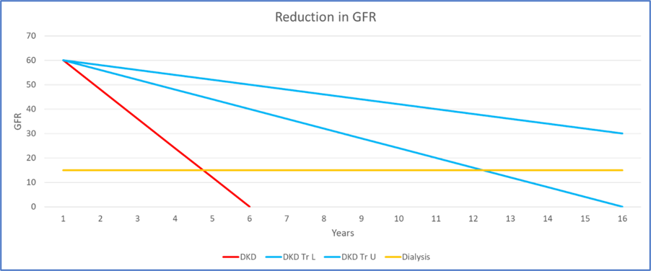
What does this mean for your patient?
Treatment of DKD can slow decline in GFR from average of 12 ml/min/year
to an average of 2-4 ml/min/year – thus delaying or avoiding ESRD (ESKD)
– and at same time help reduce CVD/HF risk
GFR declines with normal aging (>30) – average 0.75-0.8 ml/min/year (GFR 50-60 by age 80)

Slide 13
Preventing CKD
ADA 2026 Standards of Care
The only proven primary prevention interventions for CKD in people with diabetes are optimal management of
  blood glucose (A1C goal of 7%) and
  blood pressure (<130/80 mmHg)
“There is no evidence that RAS inhibitors or any other interventions prevent the development of CKD in the absence of hypertension or albuminuria.”
  In trials of people with T1D & T2D exhibiting neither albuminuria nor hypertension, ACEi or ARBs did not prevent the development of glomerulopathy assessed by kidney biopsy
Thus, the American Diabetes Association does not recommend routine use of these medications solely for the purpose of prevention of the development of CKD.
Recommendation 11.6c: An ACE inhibitor or an ARB is not recommended for the primary prevention of CKD in people with diabetes who have normal blood pressure, normal UACR (<30 mg/g creatinine), and normal eGFR. A
Notes:
11. Chronic Kidney Disease and Risk Management: Standards of Care in Diabetes—2026 | Diabetes Care | American Diabetes Association

Slide 14
Use of ACE Inhibitors and Angiotensin Receptor Blockers (RAS inhibitors)
Diabetes & Hypertension
  ADA: In the absence of kidney disease, ACE inhibitors or ARBs are useful to manage blood pressure but have not proven superior to alternative classes of antihypertensive therapy, including thiazide-like diuretics and dihydropyridine calcium channel blockers
  KDIGO: People with diabetes and hypertension are at low risk of CKD progression when urine albumin excretion is normal –
    Existing evidence does not demonstrate clear clinical benefit of RAS inhibition for CKD progression in this population.
    Cardiovascular risk reduction is the most important goal of BP management with normal urine albumin excretion, and multiple classes of antihypertensive agents (including RASi, diuretics, and dihydropyridine calcium channel blockers) are appropriate in this setting.

Slide 15
Use of ACE Inhibitors and Angiotensin Receptor Blockers (RAS inhibitors)
ADA 2026 Standards of Care
KDIGO 2026 draft Guidelines
11.6a In nonpregnant people with diabetes and hypertension, either an ACE inhibitor or an angiotensin receptor blocker (ARB)
  is recommended for those with moderately increased albuminuria (UACR 30–299 mg/g creatinine) B
  is strongly recommended for those with
    severely increased albuminuria (UACR ≥300 mg/g creatinine) and/or
    eGFR <60 mL/min/1.73 m2
  Titrate to maximally tolerated dose to prevent the progression of kidney disease and reduce cardiovascular events. A
  If one class is not tolerated, the other should be substituted. B
The combined use of ACE inhibitors and ARBs should be avoided.
  Clinical trials found no benefits on CVD or CKD, and the medication combination had higher adverse event rates (hyperkalemia and/or AKI)
Recommendation 4.2.1: We recommend that treatment with an angiotensin-converting enzyme inhibitor (ACEi) or an angiotensin II receptor blocker (ARB) be initiated in people with diabetes, hypertension, and albuminuria, and that these medications be titrated to the highest approved dose that is tolerated (1B).
  Practice Point 4.2.1: It may be reasonable to treat people with diabetes, hypertension, and no albuminuria with renin-angiotensin system inhibitors (RASi [i.e., ACEi or ARB]).
  Practice Point 4.2.2: For people with diabetes, albuminuria, and normal blood pressure, treatment with an ACEi or ARB may be considered
  Practice Point 4.2.5: Advise contraception in women who are receiving ACEi or ARB therapy and discontinue these agents in women who are considering pregnancy or who become pregnant.
  Practice Point 4.2.8: Combining an ACEi with an ARB or combining either an ACEi or an ARB with a direct renin inhibitor may be harmful

Slide 16
When should an ACEi/ARB be prescribed for PWD?
All PWD at time of diagnosis to prevent kidney damage – no benefit
If they have elevated blood pressure (hypertension) but no CKD (normal eGFR and UACR) – useful/reasonable (BP control & CVD risk)
If they have elevated BP (HTN) with elevated UACR and normal eGFR
If they have elevated BP (HTN) with elevated UACR and reduced eGFR
If they have elevated BP (HTN) with normal UACR and reduced eGFR
If they do not have elevated BP (no HTN) but have elevated UACR and reduced eGFR – consider (if tolerated)
If they have reduced eGFR without elevated UACR & without elevated BP – unclear recommendations re benefit if no HTN and no albuminuria – some recommend as tolerated – consider comorbidities such as HF
ACEi/ARB provides benefit in PWD with elevated UACR and/or HTN
Available data suggest that ACEi /ARB treatments are not beneficial for people with
neither albuminuria nor elevated BP

Slide 17
Reduction of Albuminuria Improves Outcomes
The presence of albuminuria is associated with an increased risk of progression of CKD and the development of kidney failure in PWD and CKD.
  It has also been demonstrated that the degree of albuminuria correlates with the risks
Both ACEi and ARBs are effective in the reduction of albuminuria
  The albuminuria-lowering effect is dose-related
  In clinical trials of ACE i/ARB therapy in PWD, reducing albuminuria to levels <300 mg/g creatinine or by >30% from baseline has been associated with improved kidney and cardiovascular outcomes
  Thus, the recommendation that the medications should be titrated to maximize reduction in UACR as residual risk persists with elevated UACR - but this has side effects as well
For maximal effect, start at a low dose and then uptitrate to the highest tolerated and recommended dose.
  Monitor for effectiveness & adverse effects/safety

Slide 18
Monitoring CKD in PWD
“Risk of CKD progression is directly related to residual albuminuria during treatment with kidney-protective therapies”
11.1b In people with chronic kidney disease (CKD), monitor urinary albumin (e.g., spot UACR) and eGFR 1–4 times per year depending on the stage of kidney disease. B
11.2 Aim to reduce urinary albumin by ≥30% in people with CKD and albuminuria ≥300 mg/g to slow CKD progression. B
  Real-world data demonstrate less benefit on cardiovascular and kidney outcomes at submaximal of RAS blockade
  The recommendation is that medications should be titrated to maximize reduction in UACR as residual risk persists with elevated UACR
Large biologic variability of UACR so watch the trend over time
Notes:
11. Chronic Kidney Disease and Risk Management: Standards of Care in Diabetes—2026 | Diabetes Care | American Diabetes Association

Slide 19
Monitoring & Management of Side Effects
ADA 2026 Standards of Care
KDIGO 2026 draft Guidelines
11.6b Monitor for drop in eGFR and increase in serum potassium levels at initiation and periodically as clinically appropriate when ACE inhibitors, ARBs, and mineralocorticoid receptor antagonists (MRAs) are used. B
11.6d Continue renin-angiotensin system blockade for mild to moderate increases in serum creatinine (≤30%) in individuals who have no signs of extracellular fluid volume depletion. A
  when increases in serum creatinine reach 30% without associated hyperkalemia, RAS blockade should be continued
In people with diabetes who have an eGFR <30 mL/min, studies demonstrate outcome benefits of continuing ACEi/ARBs on both mortality and slowed CKD progression
Practice Point 4.2.3: Monitor for changes in blood pressure, GFR, and serum potassium within 2–4 weeks of initiation or increase in the dose of an ACEi or ARB
Practice Point 4.2.4: Continue ACEi or ARB therapy unless GFR declines by more than 30% within 4 weeks following initiation of treatment or an increase in dose
Practice Point 4.2.6: Hyperkalemia associated with the use of an ACEi or ARB can often be managed by measures to reduce serum potassium levels rather than decreasing the dose or stopping the ACEi or ARB immediately
Practice Point 4.2.7: Reduce the dose or discontinue ACEi or ARB therapy in the setting of either symptomatic hypotension or uncontrolled hyperkalemia despite the medical treatment
In people with eGFR <30 mg/ml, close monitoring of serum potassium is required – withholding these drugs solely based on the level of kidney function will unnecessarily deprive many people of cardiovascular benefits

Slide 20
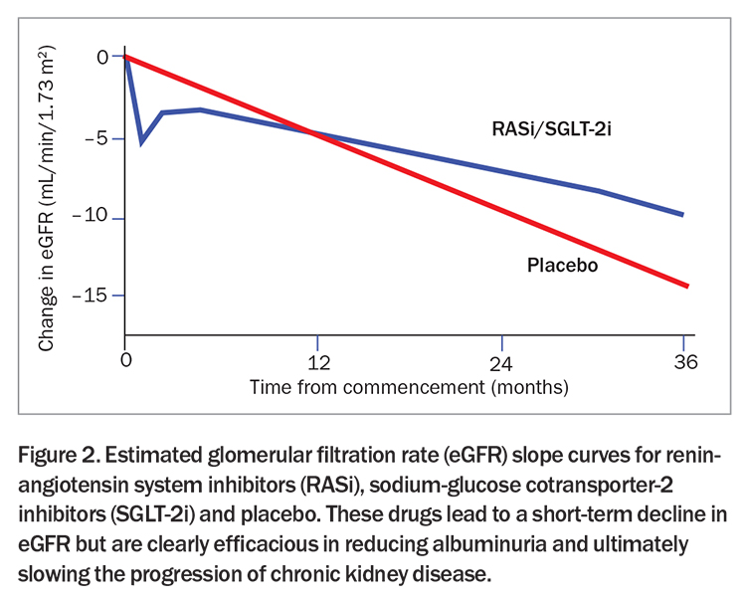
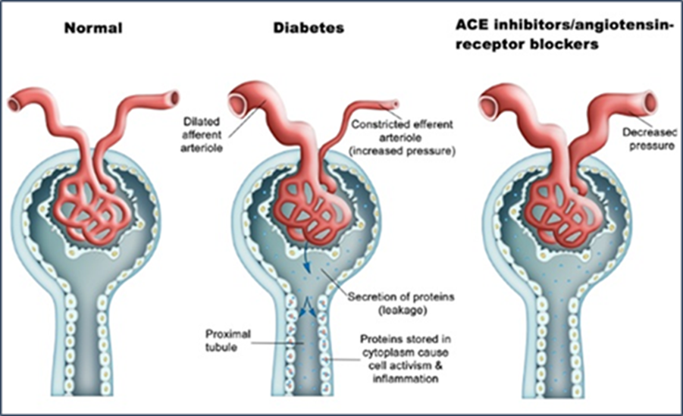
The decline in GFR should not prevent the use
of ACEi or ARB therapy in people with
Diabetes and CKD, including those with
Preexisting kidney disease.
  RCTs that evaluated kidney disease
among people with preexisting kidney disease
demonstrated a strong association between
acute declines in GFR of up to 30% from baseline
that stabilized within 2 months of ACEi therapy
initiation and long-term preservation of kidney
function.
Reduction in Intraglomerular Pressure
Hemodynamic changes vs Renal function (nephron) loss
Notes:
February 2024 Endocrinology Today 2024; 13(1): 14-21

Slide 21
Address an Excessive Drop in eGFR or BP (KDIGO)
In people with an acute excessive decline in GFR (>30%), the healthcare professionals should evaluate the potential contributing factors aiming to continue ACEi or ARB treatment after these risk factors have been managed
The most common cause of an excessive decline in GFR following the use of a RAS blockade agent results from
  a decreased effective arterial blood volume, such as occurs with
    volume depletion with aggressive diuretic use
    low cardiac output seen in HF
  the use of nonsteroidal anti-inflammatory drugs (NSAIDs) [constriction of afferent arterioles]
  bilateral renal artery stenosis (or stenosis of a single renal artery for people with a single functioning kidney)
    especially in people with extensive ASCVD or who are smokers
    may need imaging for bilateral renal artery stenosis.
In people who experience symptomatic hypotension, efforts should be made to discontinue other concurrent BP medication before attempting to reduce the ACEi or ARB dose.
Excessively low pressure into the glomerulus → Excessively reduced filtration rate (a type of AKI)

Slide 22
Measures to Reduce Serum Potassium Levels (KDIGO)
Moderate potassium intake, with specific counseling to avoid potassium-containing salt substitutes or food products containing the salt substitutes.
Review the patient’s current medication and avoid drugs that can impair kidney excretion of potassium.
  Use of over-the-counter nonsteroidal anti-inflammatory drugs, supplements, and herbal treatments should be pursued, and people should be counseled to discontinue these remedies if present.
General measures to avoid constipation should include sufficient fluid intake and exercise.
Initiate diuretics treatment to enhance the excretion of potassium in the kidneys.
  Diuretics can precipitate AKI and electrolyte abnormalities, and the hypokalemic response to diuretics is diminished with low eGFR and depends on the type of diuretic used.
  Diuretics are most compelling for hyperkalemia management when there is concomitant volume overload or hypertension.
Treatment with oral sodium bicarbonate is an effective strategy in minimizing the risk of hyperkalemia in people with CKD and metabolic acidosis.
  Concurrent use with diuretics will reduce the risk of fluid overload that can occur from sodium bicarbonate treatment.
If the above measures fail to control serum potassium levels: Treatment with potassium binders, such as patiromer or sodium zirconium cyclosilicate, where each has been used to treat hyperkalemia associated with RAS blockade therapy

Slide 23
Aim to/Goal is to Continue ACEi/ARB treatment
Stopping RAS blockers or reducing the RAS blocker dose has been associated with increased risk of cardiovascular events in observational studies (KDIGO)
The dose of an ACEi or ARB should be reduced or discontinued only as a last resort in people with hyperkalemia after other measures have failed to achieve a normal serum potassium level.
A study published in 2024 (Hattori et al)
  evaluated 6,065 participants between 2005 and 2021 (∼40% had diabetes) with eGFR ranging from 10 to 60 mL/min/1.73 m2 who had ACE inhibitors or ARBs stopped (usually due to hyperkalemia or AKI)
  found that those who restarted the ACE inhibitor or ARB had better long‐term kidney outcomes and lower mortality
Among individuals with diabetes and/or CKD receiving an ACE inhibitor or ARB therapy, SGLT2 inhibitor initiation was associated with a lower risk of
  hyperkalemia (HR 0.89 [95% CI 0.82–0.96])
  ACE i or ARB therapy discontinuation compared with nonusers (36% vs. 45%; P < 0.001)
Notes:
KDIGO-2026-Diabetes-and-CKD-Guideline-Update-Public-Review-Draft-March-2026.pdf
11. Chronic Kidney Disease and Risk Management: Standards of Care in Diabetes—2026 | Diabetes Care | American Diabetes Association
Hattori K, et al. Estimated effect of restarting renin-angiotensin system inhibitors after discontinuation on kidney outcomes and mortality. J Am Soc Nephrol 2024;35:1391–1401

Slide 24
When can an SGLT2 inhibitor be Prescribed for Renal Protection in PWD ?
Requires eGFR >45 mg/ml (45 or above)
Requires eGFR >30 mg/ml (30 or above)
Requires eGFR >20 mg/ml (20 or above)
Requires need for improvement in glycemia in addition to renal protection
Is beneficial for Cardio-renal protection regardless of glycemic benefit

Slide 25
Treatment with a SGLT2 Inhibitor
ADA 2026 Standards of Care
KDIGO 2026 draft Guidelines
11.7a For people with type 2 diabetes and CKD, use of a sodium–glucose cotransporter 2 (SGLT2) inhibitor with demonstrated benefit to reduce CKD progression and cardiovascular events is recommended.
SGLT2 inhibitors should be initiated in individuals with eGFR ≥20 mL/min/1.73 m² but can safely continue until kidney failure. A
Recommendation 4.3.1: We recommend treating adults with type 2 diabetes (T2D), CKD, and an eGFR ≥20 ml/min per 1.73 m2 with a sodium-glucose cotranporter-2 inhibitor (SGLT2i) (1A).
Practice Point 4.3.1: In people with T2D and CKD, SGLT2i should be used primarily for cardio-kidney protection as they significantly reduce mortality, HF hospitalizations, and kidney failure, even with modest glycemic effects.
Therefore, an SGLT2i should be added to existing glucose-lowering therapy specifically for its cardiovascular and kidney benefits.
Benefit seen across class, but strongest trial evidence with dapagliflozin and empagliflozin.

Slide 26
SGLT2i
The eGFR threshold for initiation of SGLT2i has changed over time with evidence demonstrating that initiating an SGLT2i in the eGFR range of 20–29 ml/min per 1.73 m2 is safe and beneficial.
  Across trials, benefits of SGLT2i were observed consistently in participants with CKD across a wide range of baseline eGFR and albuminuria categories, including those with moderate to-severe CKD (G4).
At the start of SGLT2 inhibitor treatment, the estimated glomerular filtration rate (GFR) should be ≥ 20 mL/minute/1.73 m², but once initiated, the treatment can continue until kidney failure.
In patients with estimated GFR of < 45 mL/minute/1.73 m², there is likely no glycemic benefit, but the cardio/kidney protection is still present.
  The cardiovascular and kidney benefits appear independent of glucose lowering, suggesting other mechanisms for organ protection

Slide 27
When can an SGLT2 inhibitor be Prescribed for Renal Protection in PWD ?
Requires eGFR >45 mg/ml (45 or above)
  Only if used for glycemia (glucose lowering) benefit
Requires eGFR >30 mg/ml (30 or above)
  The eGFR threshold for initiation of SGLT2i has changed over time with evidence demonstrating that initiating an SGLT2i in the eGFR range of 20–29 ml/min per 1.73 m2 is safe and beneficial.
Requires eGFR >20 mg/ml (20 or above)
  For initiation – can continue until kidney failure
Requires need for improvement in glycemia as well as renal protection
Is beneficial for Cardio-renal protection regardless of glycemic benefit

Slide 28
Key Points
ACEi/ARB therapy is Not recommended for prevention
ACEi/ARB therapy is recommended if PWD have HTN and CKD (elevated UACR and/or reduced eGFR) – can be tried in PWD with elevated UACR without HTN
Increased emphasis on albuminuria – associated risks, staging, management
  Goal is to reduce UACR as much as possible/ at least by 30% if UACR is >300 mg/g
  (also, evidence for benefit of reducing UACR in 30-300 mg/g range)
Emphasis on titrating to maximally tolerated, recommended dose of RASi
Emphasis on continuing RASi at highest tolerated dose for ongoing benefits
  Discontinue/ reduce dose as “last resort”
New cut offs for continuing RASi
  continue if eGFR <30 mg/ml with close monitoring of potassium
New eGFR recommendations & thresholds for starting SGLT2i
  if Diabetes & CKD (at any stage)
  Start SGLT2i as long as eGFR >20
  Continue until dialysis (once started, do not discontinue if eGFR drops < 20)
Note – Lifestyle interventions do make a difference (weight management, healthy eating, physical activity, tobacco, etc.)

Slide 29

Questions, Comments, Clarification
Are you routinely getting UACR results
for your patients with diabetes?
  Collecting specimen at time of
appointment might help improve rate
Are you prescribing ACEi/ARB based
on guidelines?
Are you monitoring response to ACEi/ARB
treatment with UACR?
Are you titrating to “maximally tolerated
dose”?

Slide 30
EXTRA SLIDES

Slide 31
UACR
A UACR of
  <30 mg/g [3 mg/mmol] is considered within the normal limits,
  >30–300 mg/g (3 - 30 mg/mmol) is moderately increased, and
  >300 mg/g (30 mg/mmol) is severely increased.
Due to intraindividual and day-to-day variability, KDIGO and the ADA Standards of Care recommends using 2 abnormal readings out of 3 specimens collected within 3–6 months to confirm whether a person has moderately or severely increased albuminuria.
“False Alarms” (UACR elevation independent of CKD)
  Fever / infection
  Marked elevation of BP or blood glucose
  Urinary tract infection
  Menstruation
  Heavy exercise within past 24 hours
  Dehydration
  Severe heart failure
Avoid testing UACR
when these conditions
are present (if aware)

Slide 32
Cardiovascular & Kidney Benefits of SGLT2i
SGLT2 inhibitors not only provide cardiovascular protection particularly for HF outcomes but also confer robust and clinically meaningful kidney protection, including reduction in progression to kidney failure.
  In a comprehensive meta-analysis of adults with T2D and CKD, SGLT2i therapy reduced
    all-cause mortality (RR: 0.87; 95% CI: 0.81–0.93),
    cardiovascular mortality (RR: 0.84; 95% CI: 0.77–0.92),
    major adverse cardiovascular events (MACE; RR: 0.85; 95% CI: 0.80–0.89), and
    hospitalization for HF (RR: 0.64; 95% CI: 0.58 0.71).
  In pooled analyses of adults with diabetes and CKD, SGLT2i also reduced
    the risk of kidney failure (HR: 0.69; 95% CI: 0.59–0.82) and
    composite kidney outcomes (HR: 0.62; 95% CI: 0.57–0.68)

Slide 33
Mechanism for Benefit from SGLT2i
SGLT2i reduce proximal tubular sodium and glucose reabsorption, leading to increased distal sodium delivery and restoration of tubule-glomerular feedback. This results in afferent arteriolar vasoconstriction, reduction in intraglomerular pressure, and attenuation of glomerular hyperfiltration, which together contribute to slowing of kidney disease progression.
Consistent with this mechanism, initiation of SGLT2i is associated with a modest, reversible reduction in eGFR, followed by long-term stabilization of kidney function. Across large kidney outcome trials (CREDENCE, DAPA-CKD, and EMPA-KIDNEY), SGLT2i markedly reduced the risk of sustained eGFR decline, kidney failure, and kidney-related death, supporting a hemodynamic mechanism that translates into durable structural protection.
Beyond hemodynamic effects, SGLT2i exert pleiotropic actions that may contribute to kidney and cardiovascular protection, including reductions in tubular workload and hypoxia, attenuation of kidney inflammation and fibrosis, and improvements in mitochondrial efficiency and cellular energetics.
Experimental and clinical biomarker studies demonstrate reductions in albuminuria that exceed what would be expected from glycemic or blood pressure (BP)-lowering alone, suggesting direct effects on the glomerular filtration barrier and tubular integrity.
Multiple lines of evidence indicate that the major benefits of SGLT2i on HF and CKD progression are not primarily mediated by improvements in glycemia, body weight, or BP. - their consistent benefits on kidney disease progression and HF outcomes, including in people without diabetes, support their use as foundational therapy for kidney and cardiovascular protection in people with CKD.

Slide 34
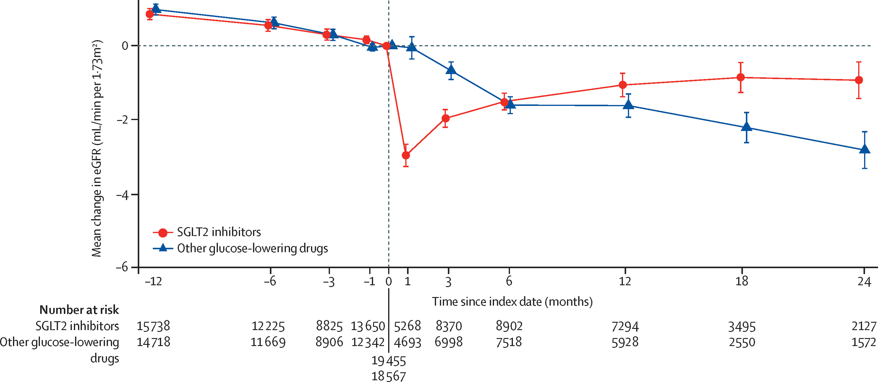
difference in slope for SGLT2 inhibitors vs other glucose-lowering drugs 1·53 mL/min per 1·73 m2 per year,
95% CI 1·34–1·72, p<0·0001).
Notes:
Lancet Volume 8, Issue 1p27-35January 2020

Slide 35
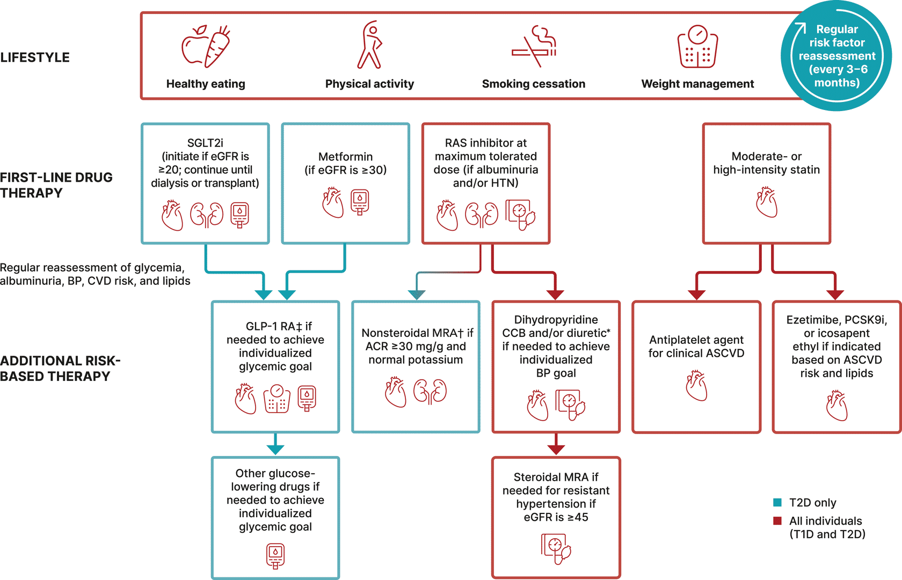
Notes:
American Diabetes Association Professional Practice Committee. 9. Pharmacologic Approaches to Glycemic Treatment: Standards of Care in Diabetes—2025. Diabetes Care. 2025;48(Suppl 1):S181–S206. doi:10.2337/dc25-S009

Slide 36
Managing chronic kidney disease according to KDIGO risk categories: A primer for primary care | Cleveland Clinic Journal of Medicine
Primary care clinicians play a critical role in early initiation of guideline-directed medical therapy.
Delays in starting evidence-based treatments heighten risks of irreversible complications.
Treatment should begin at diagnosis and be guided by ongoing risk assessment rather than specialist referral, though specialist referral is warranted in many cases.

Slide 37
CKM Lancet – maybe in future guidelines…
SGLT2 inhibitors reduced new-onset albuminuria and attenuated estimated glomerular filtration rate decline in participants without baseline CKD.

Slide 38
References
11. Chronic Kidney Disease and Risk Management: Standards of Care in Diabetes—2026 | Diabetes Care | American Diabetes Association
Managing chronic kidney disease according to KDIGO risk categories: A primer for primary care | Cleveland Clinic Journal of Medicine
KDIGO-2026-Diabetes-and-CKD-Guideline-Update-Public-Review-Draft-March-2026.pdf
Advances in the diagnosis and detection of chronic kidney disease - The Lancet
Managing chronic kidney disease according to KDIGO risk categories: A primer for primary care | Cleveland Clinic Journal of Medicine

