Slide 1
Hepatitis C Elimination in Tribal Health: Expanding Access, Improving Outcomes, and Advancing Population Health
LCDR SALEENA BROWNELL, PHARM.D, MPH, BCPS, CPP
July 2026

Slide 2
Brief Overview:
  This continuing education activity will review current evidence-based strategies for hepatitis C screening, evaluation, treatment, and elimination within a tribal healthcare system. Participants will examine innovative care models that expand access to treatment through multidisciplinary collaboration, discuss the pharmacist's role in hepatitis C management, and explore approaches to improving patient engagement, adherence, harm reduction, and sustained virologic response while supporting public health elimination goals.

Slide 3
Learning Objectives:
  1. Review current recommendations for hepatitis C screening, diagnosis, and monitoring based on national guidelines.
  2. Describe the role of the clinical pharmacist in hepatitis C treatment, including medication access, patient education, adherence monitoring, and care coordination.
  3. Identify strategies to expand hepatitis C treatment access and improve linkage to care through multidisciplinary and community-based approaches.
  4. Discuss interventions that reduce reinfection risk, promote harm reduction, and support hepatitis C elimination within underserved populations.

Slide 4
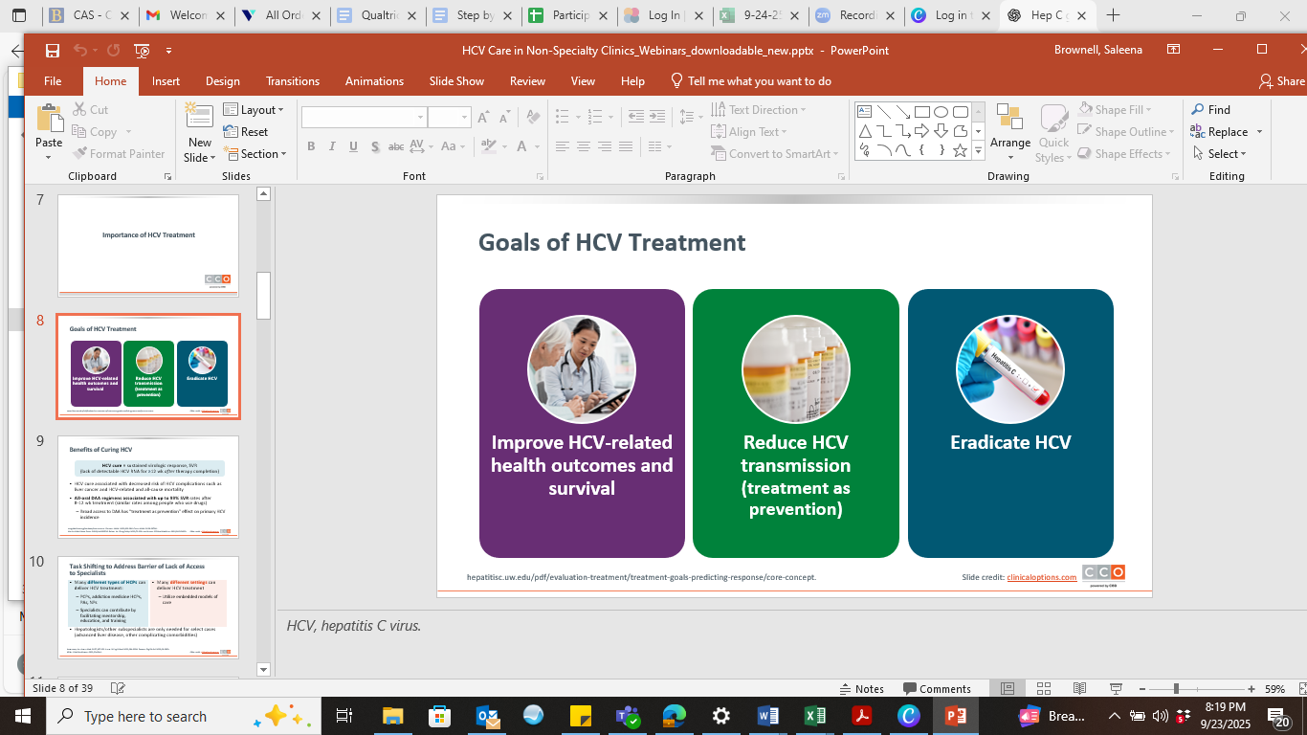
HEPATITISC.UW.EDU/PDF/EVALUATION-TREATMENT/TREATMENT-GOALS-PREDICTING-RESPONSE/CORE-C

Slide 5
  CDC recommends universal hepatitis C screening for all adults 18 and older and all pregnant women during each pregnancy.
  CDC recommends testing people in certain high-risk groups more frequently
HTTPS://WWW.CDC.GOV/HEPATITIS-C/HCP/DIAGNOSIS-TESTING/INDEX.HTML

Slide 6
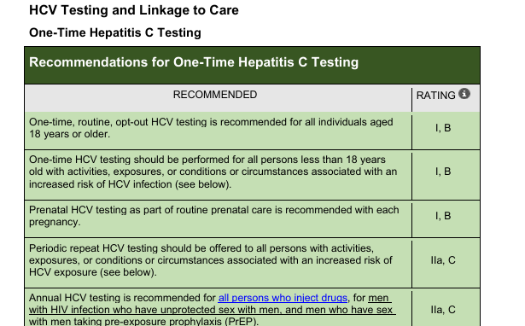
https://www.hcvguidelines.org/wp-content/uploads/2026/05/AASLD-IDSA_HCVGuidance_20260513_protected.pdf

Slide 7
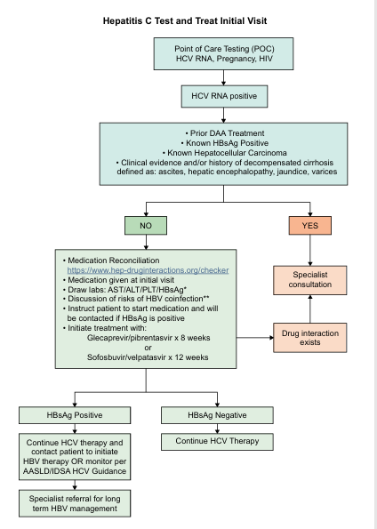
https://www.hcvguidelines.org/wp-content/uploads/2025/09/HCV-Test-and-Treat-Final-011725.pdf

Slide 8
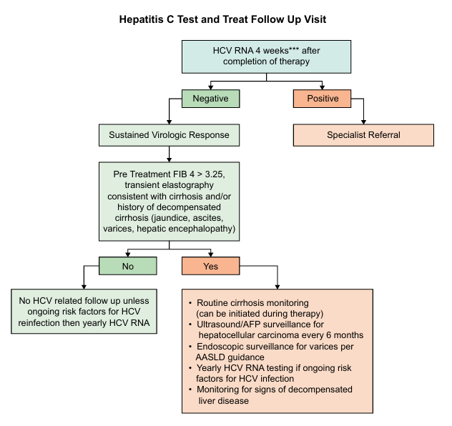
https://www.hcvguidelines.org/wp-content/uploads/2025/09/HCV-Test-and-Treat-Final-011725.pdf

Slide 9
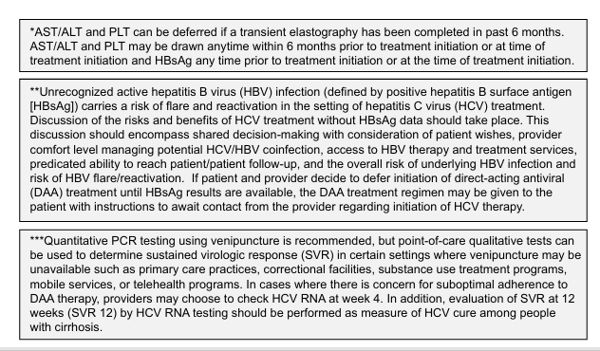
https://www.hcvguidelines.org/wp-content/uploads/2025/09/HCV-Test-and-Treat-Final-011725.pdf

Slide 10
Knowledge Check:
Which of the following is the most important predictor of hepatitis C cure (SVR) when using direct-acting antiviral therapy?
A. HCV genotype
B. Baseline viral load
C. Medication adherence
D. Patient age

Slide 11
Knowledge Check:
Which of the following is the most important predictor of hepatitis C cure (SVR) when using direct-acting antiviral therapy?
A. HCV genotype
B. Baseline viral load
C. Medication adherence
D. Patient age
Notes:
Modern direct-acting antivirals achieve cure rates exceeding 95%, but maintaining adherence is one of the strongest predictors of achieving sustained virologic response (SVR).

Slide 12
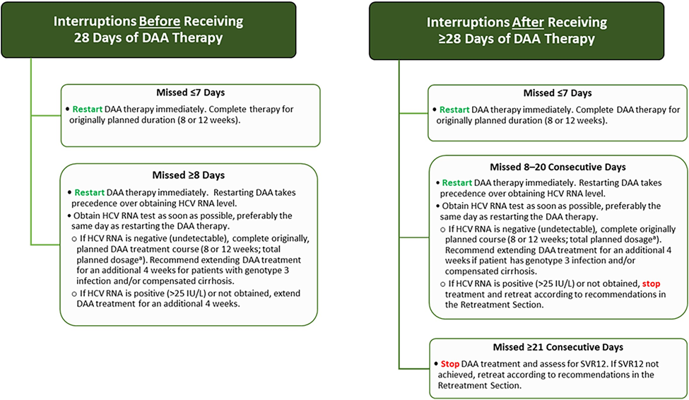
HTTPS://WWW.HCVGUIDELINES.ORG/EVALUATE/MONITORING#INCOMPLETE-ADHERENCE

Slide 13
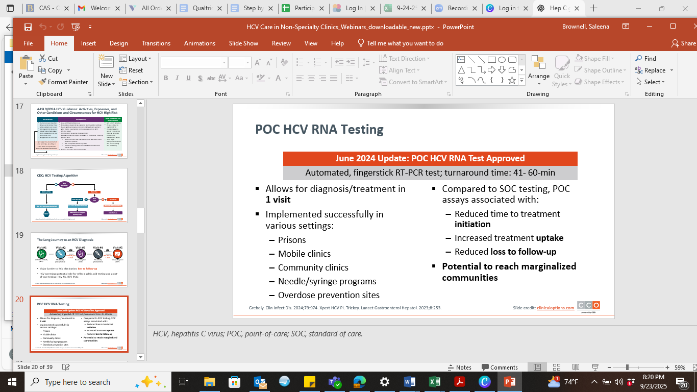
GREBELY. CLIN INFECT DIS. 2024;79:974. XPERT HCV PI. TRICKEY. LANCET GASTROENTEROL HEPATOL. 2023;8:253

Slide 14
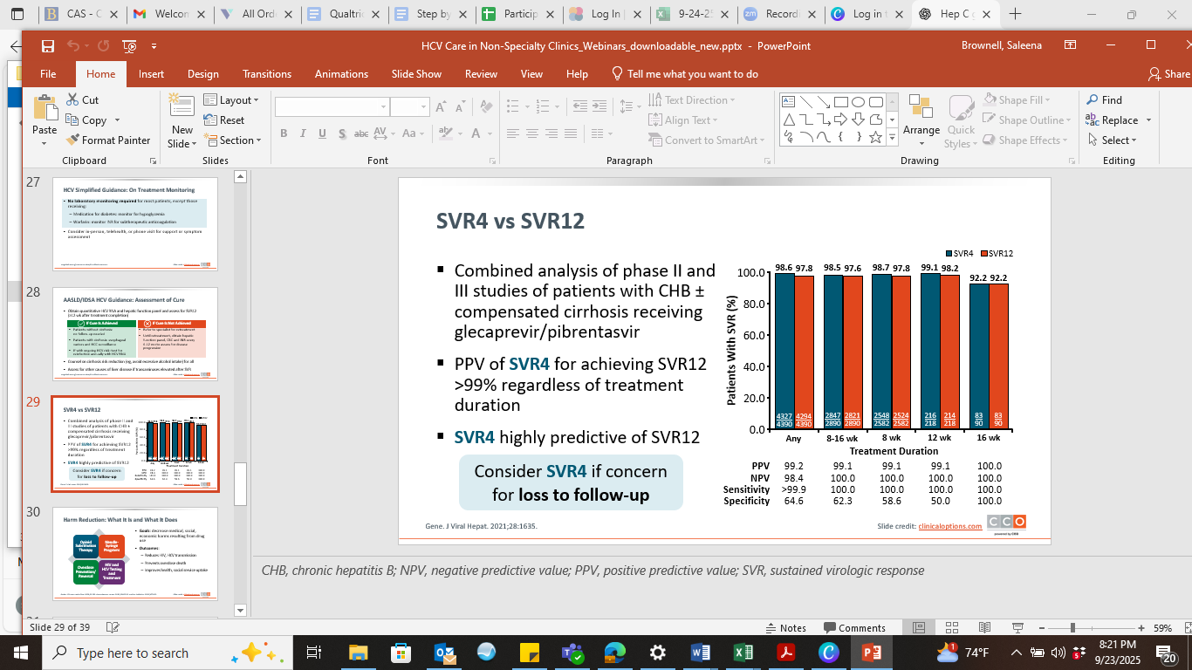
GENE. J VIRAL HEPAT. 2021;28:1635

Slide 15
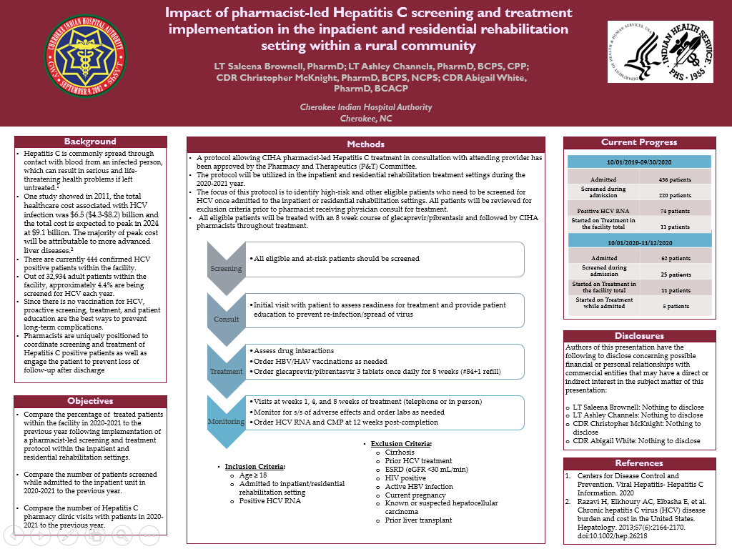

Slide 16
Expansion of Hepatitis C Treatment Approaches
  Emergency Room
  MAT
  Outpatient consults
  Detention Center
  Working with health department

Slide 17
Knowledge Check:
A 34-year-old patient with chronic hepatitis C is referred from the emergency department after testing positive for HCV RNA. The patient reports active injection drug use and is interested in treatment but has unstable housing. Liver fibrosis assessment shows no cirrhosis, and there are no contraindications to direct-acting antiviral therapy.
Which of the following is the BEST next step?
A. Delay treatment until the patient has been abstinent from drug use for at least 6 months.
B. Refer the patient back to primary care and repeat HCV RNA testing in one year.
C. Initiate hepatitis C treatment while providing harm reduction counseling, linkage to medication-assisted treatment (if interested), and close follow-up.
D. Decline treatment because unstable housing predicts treatment failure.

Slide 18
Knowledge Check:
A 34-year-old patient with chronic hepatitis C is referred from the emergency department after testing positive for HCV RNA. The patient reports active injection drug use and is interested in treatment but has unstable housing. Liver fibrosis assessment shows no cirrhosis, and there are no contraindications to direct-acting antiviral therapy.
Which of the following is the BEST next step?
A. Delay treatment until the patient has been abstinent from drug use for at least 6 months.
B. Refer the patient back to primary care and repeat HCV RNA testing in one year.
C. Initiate hepatitis C treatment while providing harm reduction counseling, linkage to medication-assisted treatment (if interested), and close follow-up.
D. Decline treatment because unstable housing predicts treatment failure.
Notes:
Current AASLD/IDSA guidance recommends treating people with ongoing substance use. Active drug use is not a contraindication to hepatitis C therapy. Multidisciplinary care—including harm reduction services, medication-assisted treatment, case management, and pharmacist follow-up—improves treatment completion and supports hepatitis C elimination efforts.

Slide 19
Roles
Case management
  Processing patient assistance applications
  Scheduling patient assistance deliveries
  Prior authorization paperwork and follow-up
  Follow-up with patients at 1, 4, 8 weeks of treatment
  Ensuring patients receive their 2nd box
  Scheduling lab draws for SVR-12 and CMP
Locating patients to inquire about interest to start treatment
Discussing treatment
Patient education and harm reduction

Slide 20
Daily hepatitis C surveillance
  iCare panels
    Emergency room
    Detention Center Clinic
    Inpatient/Behavioral Health Inpatient
  Screen for same day visits
  Monitor emergency room
  Telephone calls
Notes:
Current positivity rate YTD 10.30%. Started at 51.96% in 2020
Not a direct measure of true prevalence
Doesn’t capture people who aren’t tested.
Can be distorted by repeat testing
Can be misleading without knowing:
Who is being tested
Antibody vs RNA results
Repeat testing
Linkage to treatment

Slide 21

Notes:
Current positivity rate YTD 10.30%. Started at 51.96% in 2020
Not a direct measure of true prevalence
Doesn’t capture people who aren’t tested.
Can be distorted by repeat testing
Can be misleading without knowing:
Who is being tested
Antibody vs RNA results
Repeat testing
Linkage to treatment

Slide 22
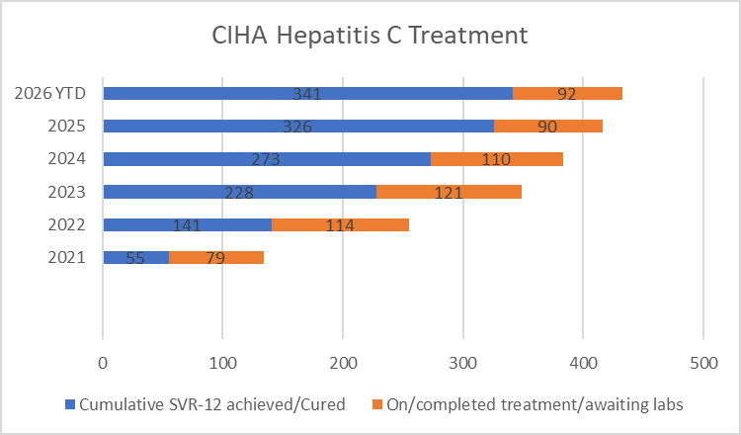

Slide 23


Slide 24
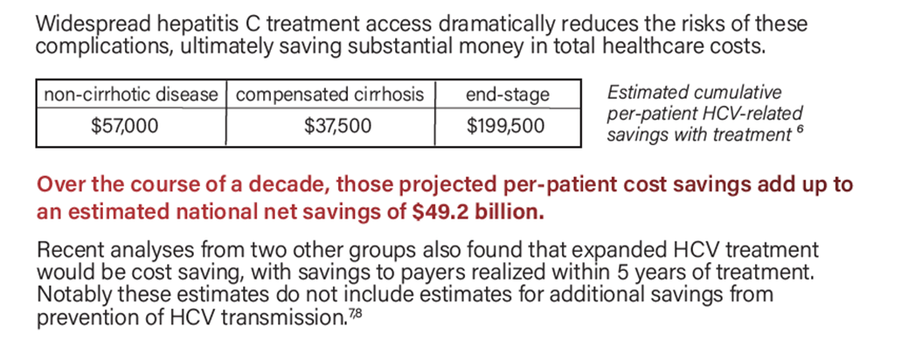

Center for Health Law and Policy Innovation at Harvard Law School, & National Viral Hepatitis Roundtable. (2023). The actual cost of HCV treatment: Hepatitis C: State of Medicaid access fact sheet. State of Hep C. https://stateofhepc.org/resources/

Slide 25
Impact
Patients have been more involved with their care
  Asking questions about MAT
  Attending MAT
  Following up with PCP
  Following Analenisgi
  Considering residential treatment
Patients feel like we, as a hospital, care more about their health
Prolonging the lives of tribal members
Educating on harm reduction
  Safe practices
  Preventing re-infection

Slide 26
  Goal is eradication- positivity rate <5%, preferably lower
  Education is key
    Compliance
    Reinfection prevention
    Harm reduction

