Slide 1

The “ideal” trauma call
Thinking about priorities

Slide 2
What are the differences between that call that goes so well and the one that feels clunky?
Priorities are the same
Care is expedited because the steps are smooth
Execute tasks efficiently and in the “right” place
Bandwidth to think about and accomplish the “extra” stuff
None of this happens on accident
Notes:
Think about this and a cardiac arrest. Its not like you just eeked by but that you really swung and hit. Nothing wrong with those calls where you squeek by; but how do we have more of those calls where we hit all the marks.

Slide 3
Our Assumptions today:
We are talking about the obviously sick trauma or the probably sick trauma
There are things outside of our control:
Our patient injuries
Our response time
Our scope of practice
The distance to the hospital
There are things decidedly within our control that can impact outcomes
And some things we could spend time on that likely don’t matter
So we probably shouldn’t do them
Notes:
Today we are talking specifically about trauma. And even more specifically about sick or potentially sick trauma.

Slide 4
My disclaimers
Our focus is on BLS (with a little touch on ILS) interventions
This talk is more about thinking- which is never limited by scope
You decide how to execute
I am not your medical director
I am not proposing you stop using any guidelines or protocols
I do hope that from today:
  You will have reinforced or modified your priorities on a trauma call
  You will decide and execute more “ideal” trauma calls
  You will continue asking- why do I do xxx? Where should it fall in priorities?
Notes:
You decide how to execute based off your protocols, geography, resources, and scope.

Slide 5


Slide 6
Why do trauma patients have bad outcomes?
Too much damage (especially to the head)
Blood loss
Secondary hits
Coagulopathy
Multiorgan failure
Ischemic brain injury
Sepsis
Notes:
When we look at this from one direction this is our question

Slide 7

What helps prehospital trauma patients the most?
Sometimes nothing
Limit blood loss
Prevent (as much as possible) secondary hits
Trauma surgeons/inpatient care
Occasionally, some procedure in the field or ED
Notes:
If we translate it to a positive question/an empowering question, We sometimes focus too much on these last two and forget about the others. Its not just about blood, certain meds, a needle decompression etc. Its about the top of the list AND the things we do beside drive fast/scoop and run to facilitate rapid transport.

Slide 8
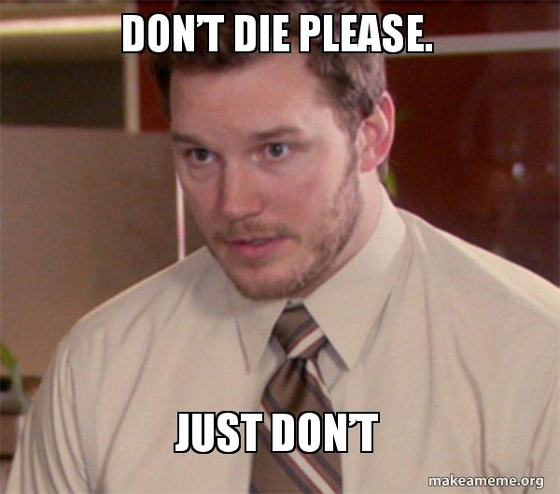
Goals of prehospital trauma care?
Treat immediate life threats
Mitigate “secondary hits” when we can
Rapid transport to the right place

Slide 9
Phases of Care
Dispatch to arrival
Arrival on scene until patient is loaded
Patient loaded to time of departure
Departure to arrival at the hospital (transport)
Arrival at the ED to transfer of care
Debrief
Notes:
As we move forward through this talk, think about different priorities are facilitated within these different phases. For example, rapid transport is probably facilitated the most through a prebrief prior to arrival and the things your partner is doing to prepare the ambulance while you are doing your initial assessment. Mitigating secondary hits doesn’t happen during transport when we are busy with lots of tasks unless we think about it in advance…

Slide 10
The Legend for our journey
If its well established. We are pretty sure it makes a difference
Intervention where the devil is in the details
Dogma that we should be aware of

Slide 11
Addressing Life Threats
A focus on hemorrhage control. Airway and breathing is also important
Notes:
Remember these might occur during different phases of care…

Slide 12
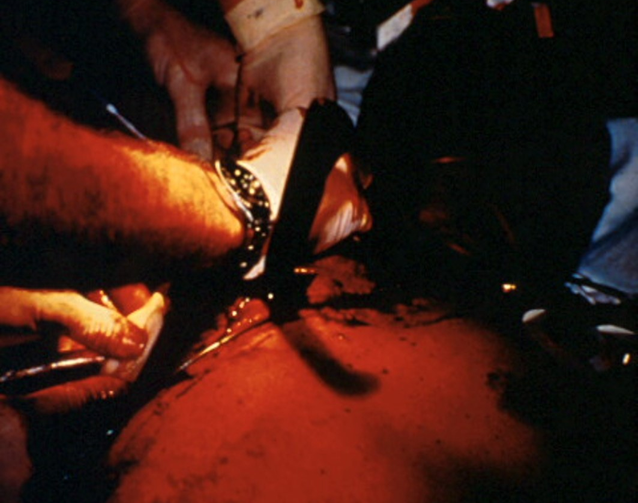
Hemorrhage control: Where have you learned patients can “bleed out”?
Pavement (lacerations etc)
Abdomen/Pelvis
Chest
Thigh?
Head. But definitely out the scalp or skull

Slide 13
What does this mean for hemorrhage control
Find
Find it
Expose your patient
Examine them with a thought toward where the bleeding might be
Think about
Think about what is intervenable (or not)
Anticipate
Anticipate what might get worse

Slide 14

Interventions
Tourniquets
  Life threatening bleeding
  Not oozing
Direct pressure/wound packing
  If this is the way to control hemorrhage it becomes somebody’s sole job
  Time/resource intensive
  Life saving
  It is not just wrapping more kerlix around

Slide 15

Example case: 37 yo male. Large scalp lac
Good decisions
Poor execution

Slide 16

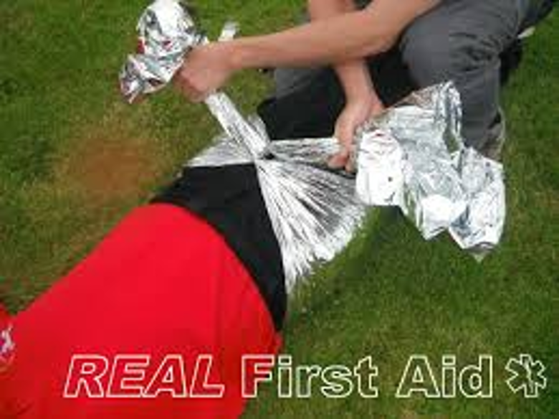
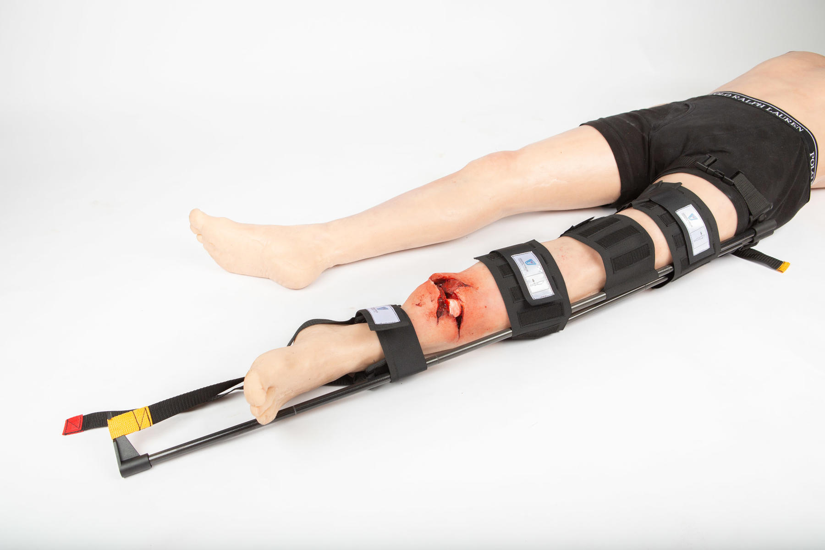
What other things might fall in “hemorrhage control”
Pelvic Binder?
Traction splint?

Slide 17
More thinking: Pelvic binders
What we know:
  May help (maybe decreased transfusion need?)
  May not help (no demonstrated change in mortality)
  Frequently applied incorrectly
  Our exam for pelvic stability is close to worthless
  If you do it, do it right

Slide 18
If it is helpful… Right patient
Assuming our exam is unreliable
Depending on the study our exam is accurate 7-69% of the time
And may cause harm? (case series only)
Other patient factors (most of these):
Significant mechanism
Complaining of pelvic pain
Signs of shock (hypotension, elderly “soft pressure”, SI >1)
Altered
Bruising
There is not currently an evidenced based mechanism to identify who benefits from a pelvic binder
Significant source of time and resources

Slide 19
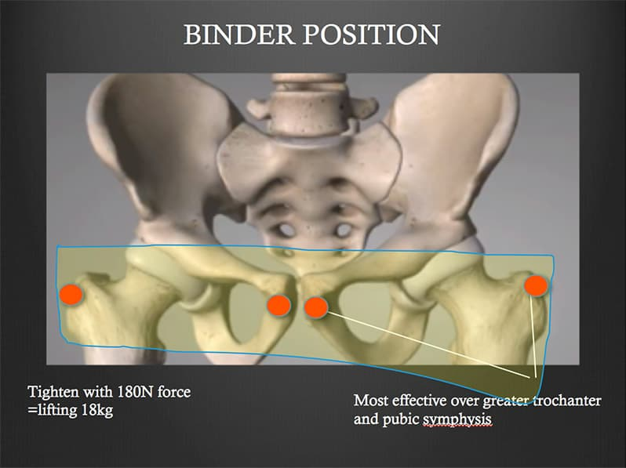
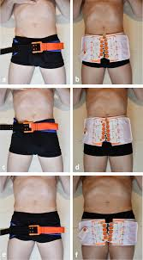
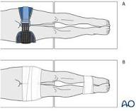
If it is helpful… Right way
If our suspicions are high
Right location
Internally rotate and secure the feet
No brand or mechanism is “better” than another

Slide 20
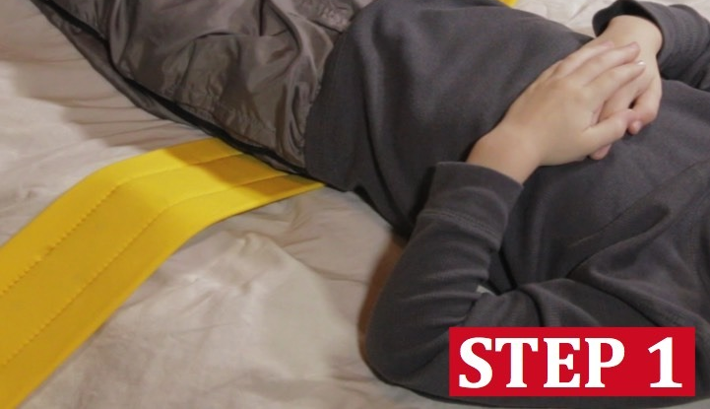
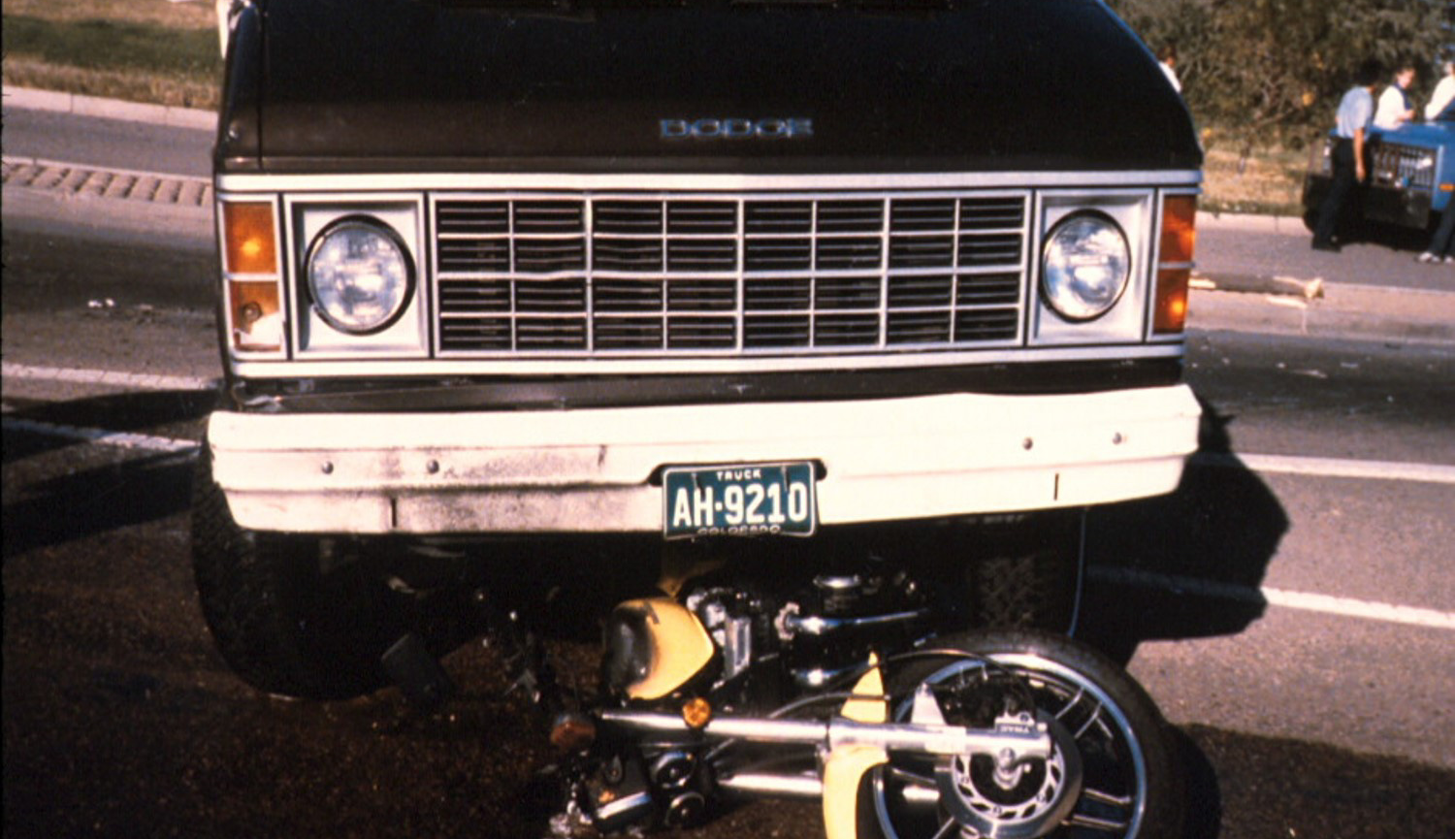
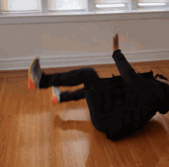
If its helpful… probably not as an after thought
Pictures always starts from here
You starts from here
The logistics of getting from the bottom to the top are dependent on deciding early that is your plan
If it interferes with the stuff we know matter, maybe not worth it.

Slide 21
Traction splint
Should never be a part of the XABCs
Take home:
  People probably don’t bleed out into their thigh
  Traction splints are complex
  There are contra-indications that can be hard to identify in the field
    Pelvic fractures
    Hip fractures
  Static splinting probably just fine.

Slide 22

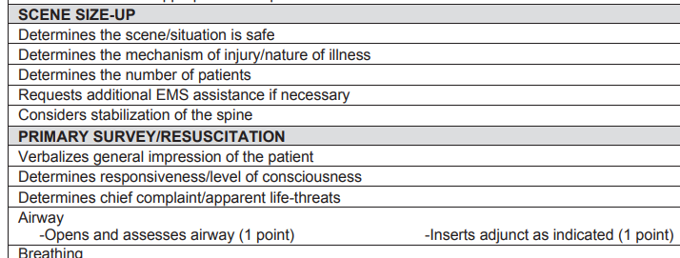

Bonus: placing a c-collar on a patient doesn’t really address a life threat
The emphasis of c spine stabilization before even a primary survey is bonkers (opinion)
C collars do not actually seem to limit motion, they might cause harm, they can impede our ability to accomplish tasks
They are still the standard of care upon arrival to the hospital for patients that don’t meet exclusion criteria.
Doesn’t mean flop the head around any which way on scene with no regard for the c spine…

Slide 23
Minimize “second hits”
Things we can do that might not address the injury itself help prevent further harm

Slide 24


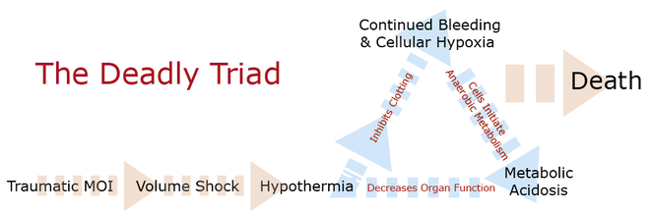
Keep ‘em Warm
Or at least don’t let them get cold
  Definition: Temp <35 C (95 F)
  Hypothermia ASSOCIATED with increased death
    In all comers- 5 times more likely to die if hypothermic
    In “sick” trauma patients: 43% mortality vs. 14%
What this means for us:
  Think about the external temperature
  Use your blankets
World J Surg (2020) 44:4106–4117
Injury 55 (2024) 110973
Notes:
"The odds of [death] happening to people who had [temp <35] are [5] times the odds of it happening to people who did not

Slide 25
Prevent hypoxia
Sometimes nothing we do helps
Prehospital hypoxia is consistently associated with worse outcomes
  2-4 times increased risk of mortality/death if hypoxic prehospital
  Improved survival to the hospital when oxygenation addressed
In stroke and STEMI we say too much oxygen is bad…
No current data suggesting similar in trauma
  TRAUMOX2 randomized trial
Of note: most of this research is from a focus on TBI patients
JAMA Netw Open 2025;8;(1):e2457506. doi:10.1001/jamanetworkopen.2024.57506

Slide 26

Ventilate at an appropriate rate
Address hypoxia! If you need to increase rate, volume etc. to get normoxic, do that first THEN reevaluate your rate + volume
Support respirations at patient rate
If you are bagging them:
EtCO2 goal 35-45
10-12 breaths per minute
Volume= 6 mL/kg= 500-600 mL for average adult

Slide 27
Prevent (prepare for) Hypotension:
Minimize blood loss
Large bore IV early (if possible)
Remember Hypotension is
Head injured: SBP 110 (ish)
Not Head injured: SBP 90 (ish)

Slide 28
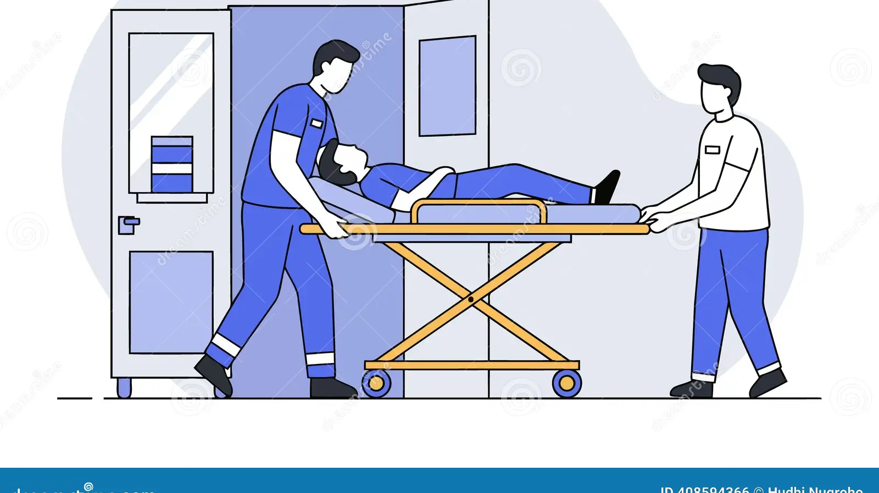
For Head Injury: Head of bed 25-30
Least good evidence here
Maybe decreases intracranial pressure
Has not been shown to change any outcomes

Slide 29
“Rapid Transport” to the right place
Anticipate the sick trauma patient. Streamline phases of care. Not about just driving faster

Slide 30
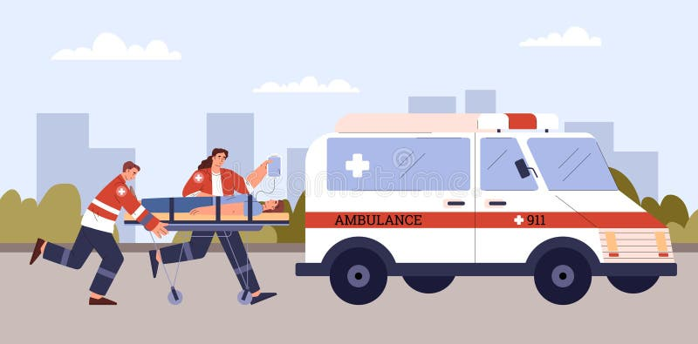
Notes:
For patients with hypotension, each increased 5 min of time out of the hospital does increase mortality

Slide 31
Anticipate the sick trauma patient
Obviously sick
Clues to probably going to get sicker?
  Agitation
  Single hypotensive blood pressure is associated with badness
    TAKE A MANUAL blood pressure
  Tachypnea
Consider the things we do the same way every time that can help us
The Journal of TRAUMA® Injury, Infection, and Critical Care • Volume 70, Number 5, May 2011
Notes:
Head to toe secondary exam, repeat vitals, early access in trauma patients. Efficiency

Slide 32
Reminder: Phases of Care. How can you use each one without delaying the phase?
Dispatch to arrival
Arrival on scene until patient is loaded
Patient loaded to time of departure
Departure to arrival at the hospital (transport)
Arrival at the ED to transfer of care
Debrief
Notes:
Lots of variables to the duration of and acceptable interventions in each but use each one

Slide 33
Streamline phases of care
If we are moving from chaos to order…
Things you can accomplish before you arrive
Things you can delegate upon arrival (who can you delegate to?)
What do you accomplish on scene vs. en route
Don’t skip the debrief

Slide 34
One last thing:
Facilitate transfer of care: hand off reports

Slide 35

Hand off report (radio report a version of this)
Patient approximate age
Mechanism of injury but brief- MVC, Stabbed, shot
Mental status (doesn’t have to be GCS)
Airway status
Clinical concerns (injuries identified, location of pain, agitation)
Last SBP, HR
Access
Any questions?

Slide 36
Summary:
If you only remember 3 things...

Slide 37
First three things
1. There are really important things that we do in the field that impact trauma patient outcomes
2. Thinking about phases of trauma care can help us organize our interventions in a shared framework.
3. Beware the things “we have always done”

Slide 38
Second 3 things?
Treat immediate life threats
Mitigate “secondary hits” when we can
Rapid transport to the right place

Slide 39

Questions?

