Slide 1
Hepatocellular Carcinoma in HCV: Screening and Surveillance
Paulina Deming, PharmD, PhC
Associate Professor of Pharmacy-College of Pharmacy
Director- Viral Hepatitis Programs, Project ECHO
University of New Mexico Health Sciences Center

Slide 2
For Patients with Cirrhosis
Baseline
Every 6 months
Baseline endoscopy of all patients with cirrhosis to screen for varices
Avoid NSAID use (risk of bleed)
Surveillance for hepatocellular carcinoma (HCC)
Ultrasound and AFP
Continued indefinitely… risk of liver cancer is 2-8% annually even after HCV cure

Slide 3
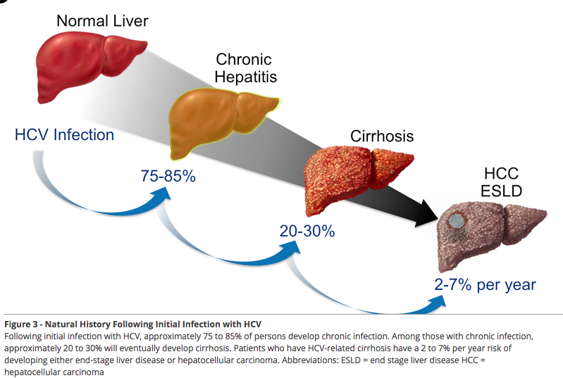
Liver Disease is a Progression of Increased Damage over Time
Cirrhosis is a spectrum of disease

Slide 4
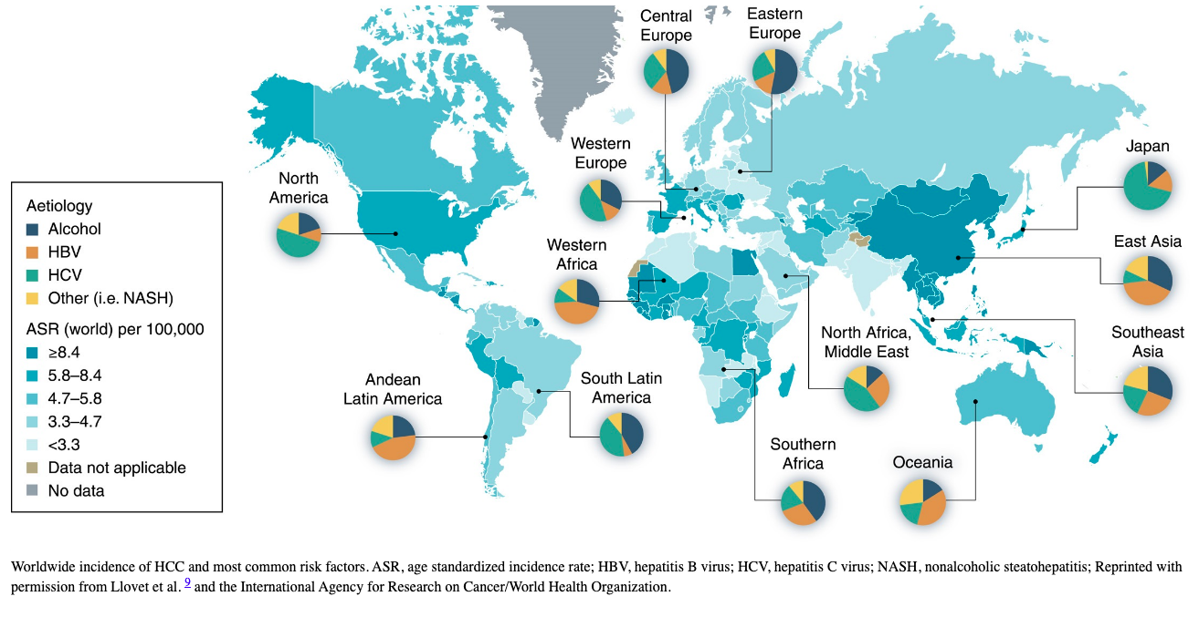
Hepatology 78(6):1922-1965, December 2023

Slide 5
HCC Prevention
Primary
Secondary
Hepatitis B vaccination
Antiviral therapy for hepatitis B virus (HBV)
Antiviral therapy for hepatitis C virus (HCV)
Under investigation:
  Coffee
  Aspirin
  Statins
  Metformin
Detecting disease early and interventions to reduce disease impact
Ultrasound and AFP for surveillance
Hepatology 78(6):1922-1965, December 2023

Slide 6
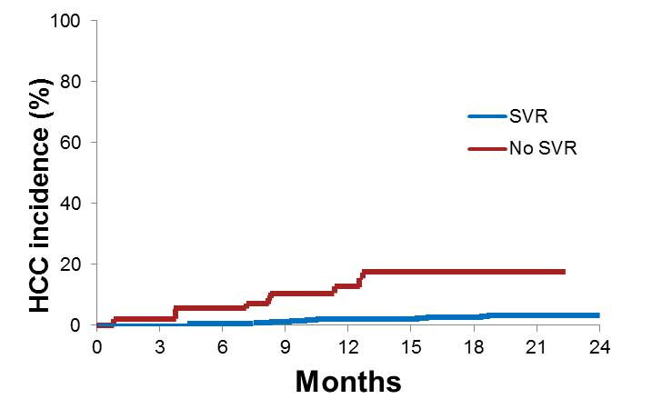
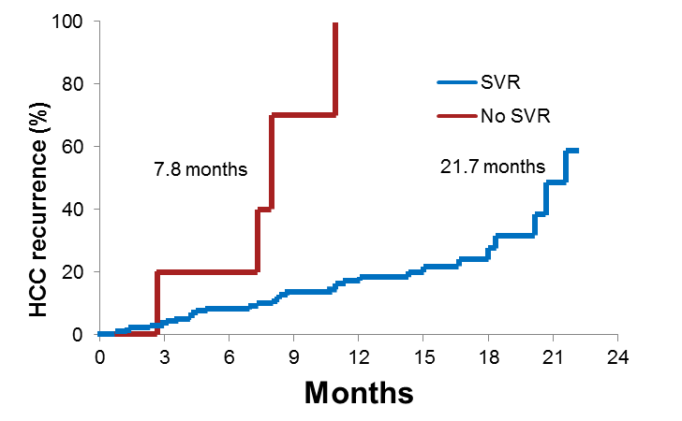
SVR as a Predictor of De Novo and Recurrent HCC in HCV Patients
Multicenter, prospective cohort of 1927 HCV-infected cirrhotic patients from Italy
De Novo HCC
HCC Recurrence
1766 patients no previous history of HCC;
50 patients developed HCC (50/1766 – 2.8%);
Average annual incidence of 2.4%
161 patients with previously treated
HCC; 38 patients developed HCC;
average annual incidence of 24.8%
p<0.0001
p<0.0001
HCC Recurrence (%)
HCC Incidence (%)
SVR with DAA regimens is associated with a significant reduction of incidence and recurrence of HCC
Notes:
6

Slide 7
Guidance Recommendations
Vaccination against HBV
Antiviral therapy for HBV and HCV
Counseling to maintain healthy weight, balanced diet, avoiding tobacco and alcohol, and achieving adequate control of comorbid conditions including components of metabolic syndrome
Consider recommending coffee
Hepatology 78(6):1922-1965, December 2023

Slide 8
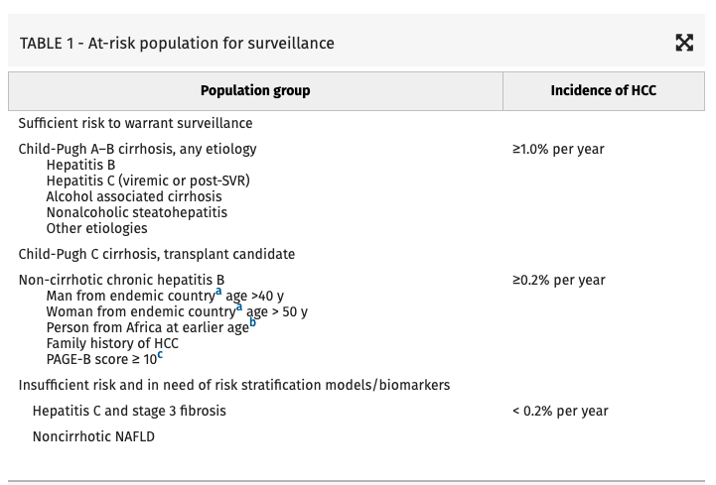
Who Needs HCC Surveillance?
Hepatology 78(6):1922-1965, December 2023

Slide 9
What is Recommended for HCC Surveillance?
US and AFP every 6 months
Diagnostic contrast enhanced multiphasic MRI or CT if
  Lesion on US 1 cm or greater OR
  AFP > 20 ng/mL OR
  AFP increasing (doubling of AFP on two consecutive tests)

Slide 10
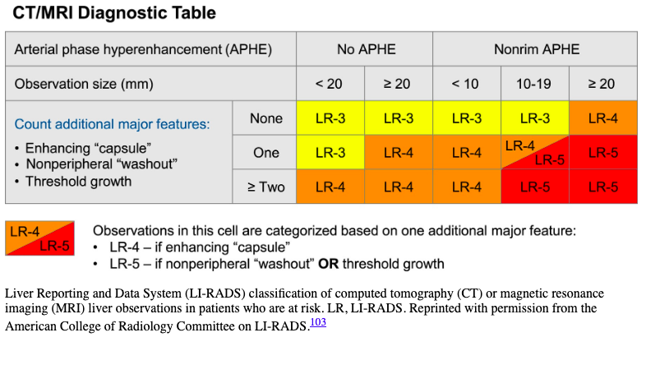
Interpreting Imaging Reports
Notes:
Score of 5 95-99% probability of hcc
Score of 4 75% probablility of hcc
Score of 3 30% probability

Slide 11
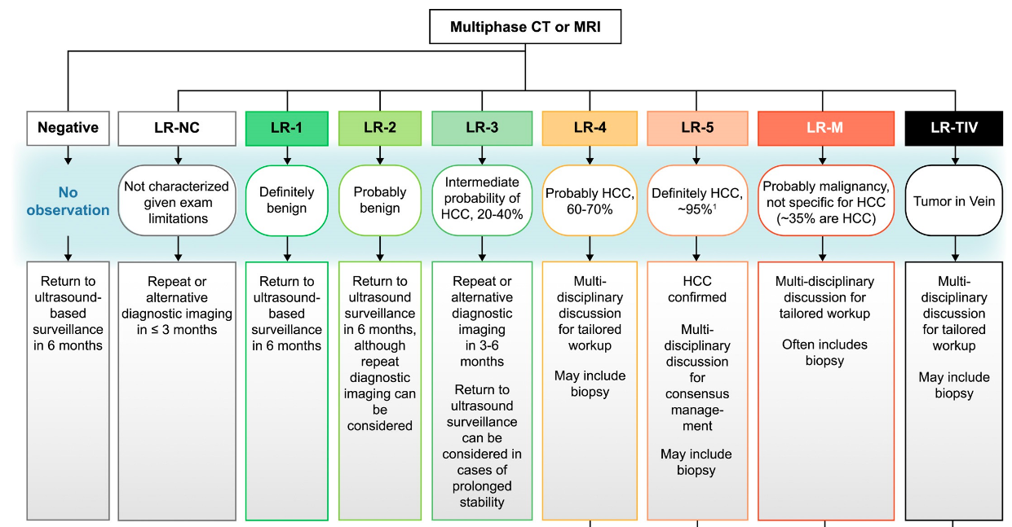
Notes:
Score of 5 95-99% probability of hcc
Score of 4 75% probablility of hcc
Score of 3 30% probability

Slide 12
What About AFP?
40% of HCCs have normal AFP
Elevated AFP can occur with other cancers- intrahepatic cholangiocarcinoma, gastric cancer, germ cell tumors
Use of AFP plus ultrasound improves sensitivity for HCC
Hepatology 78(6):1922-1965, December 2023

Slide 13
Common Questions
Why is HCC surveillance recommended every 6 months?
Why use ultrasound?
Associated with earlier tumor stage
Associated with improved survival
Quarterly surveillance not found to improve survival as compared to semiannual
Concerns for radiation and contrast exposure with use of CT as surveillance
Cost effectiveness, capacity, and patient acceptance concerns with MRI
Elastography not effective for surveillance
Hepatology 78(6):1922-1965, December 2023

Slide 14
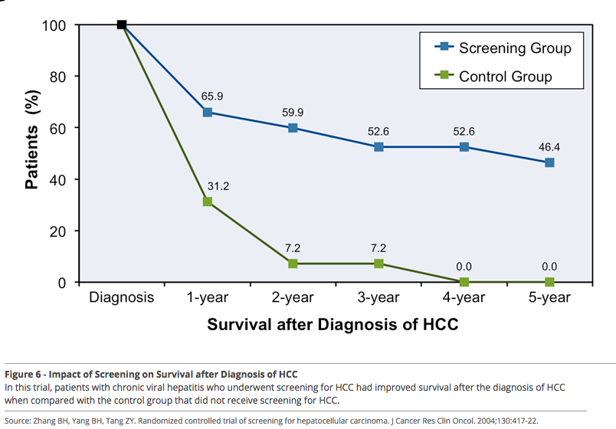
Why Continue HCC Surveillance?
Difference in Long-term Survival

