Slide 1
Diabetes ECHO
Case Discussion
June 11, 2026

Slide 2
Clinical Case Recap
Medications:
  Pioglitazone 30 mg daily
  Metformin XR 500 mg two twice daily (2g/d)
  Empagliflozin 25 mg daily
  Insulin glargine u300 insulin 74u twice daily
  Insulin aspart 30u three times daily
  Tirzepatide 5mg weekly since May 29
    Had 7.5 mg tirzepatide dc for abdominal pain in March 2026, now re-titrating
  Lisinopril 10 mg daily
  Atorvastatin 20 mg daily
  Fenofibrate 160 mg daily
  Fish oil 1000 mg TID with meals
238u/day

Slide 3
Recap - More Details
42-years-old – Dx T2D 2005
Single – lives at home – feels rude to not eat meals/food prepared by family
Employed as machinist with commercial insurance
Exercise bike/walking - 50-65 minutes - 3-4x/week
BMI 44.6 – weight increase from 301 to 340 over past year (370 at Dx 2005)
Bilat Retinopathy, abnormal foot exam (?neuropathy)
BP 118/72 – UACR 55.6 (1/2026) on lisinopril 10mg + Empagliflozin 25 mg daily + semaglutide 2 mg weekly
March 2026 lab results:
  A1c 8.5% with FBS 106
  LDLc 75, HDLc 22, TG 95, TC 116 – atorvastatin 20mg daily, fenofibrate 160 mg daily + fish oil 1000 mg TID
  Cr 1.1/eGFR 86
  ALT 36; FIB4 0.58
  TSH 1.09; HCV-negative
  Dexcom G7 data
    30 day: GMI 9.3% - 252 average glucose; TIR 10%; TAR: VH-49%, H- 41%; TBR-0%
    14 day: GMI 9.1% - 242 average glucose; TIR 15%; TAR: VH-42%, H-45%; TBR -0%
    7 day: GMI 8.9% - 234 average glucose; TIR 20%; TAR: VH – 34%, H- 46%; TBR-0%

Slide 4
Clinical Questions
What optimizations would you recommend?
Would you consider an A1c goal <8% for him?
If the patient cannot tolerate Mounjaro titration, what changes would you prioritize for his therapy?
Would you consider conversion from Toujeo (insulin glargine U300) to Tresiba (insulin degludec)?

Slide 5
Clinical Questions
Would you consider an A1c goal <8% for him?
The case patient’s recent A1c was 8.5%. What do you think his target/goal A1c should be?
Less than 6.5%
Less than 7.0%
Less than 8.0%
Use GMI & TIR (from his CGM) instead of A1c

Slide 6
ADA 2026 Standards of Care
11.4 Optimize glucose management to reduce the risk or slow the progression of CKD A
…lowering blood glucose itself helps prevent CKD and its progression
The presence of CKD affects the risks and benefits of intensive lowering of blood glucose and a number of specific glucose-lowering medications.
Adverse effects of intensive management of blood glucose levels (hypoglycemia and mortality) were increased among people with kidney disease at baseline.
Therefore, in some people with prevalent CKD and substantial comorbidity, treatment may be less intensive (i.e., A1C goals may be higher) to decrease the risk of hypoglycemia.
A1C levels are also less reliable at advanced CKD stages.
Notes:
https://diabetesjournals.org/care/article/49/Supplement_1/S246/163914/11-Chronic-Kidney-Disease-and-Risk-Management

Slide 7
Potential Glycemic Targets for People with Diabetes & CKD who use CGM – 2026 KDIGO draft
CKD stage G1-G3b
CKD stage G4-5
TIR > 70% of time between 70-180 mg/dl
TBR
  <4% of time <70 mg/dl
  <1% of time <54 mg/dl
TAR
  <25% of time >180 mg/dl
  <5% of time >250 mg/dl
TIR > 50% of time between 70- 180 mg/dl
TBR
  <1% of time < 70 mg/dl
TAR
  <35% of time > 180 mg/dl
  <14% of time > 250 mg/dl
[In most patients want to integrate CGM metrics to complement A1c]
Notes:
KDIGO-2026-Diabetes-and-CKD-Guideline-Update-Public-Review-Draft-March-2026.pdf

Slide 8
Glucose excursions & GMI-A1c Discordance
“several recent studies using large-scale real-time CGM datasets have shown that not only glycemic variability metrics but even CGM mean glucose and GMI themselves, can predict microvascular complications, cardiovascular outcomes, and mortality independently of A1c.”
The case patient’s GMI (30d) 9.3% vs A1c 8.5% in March 2026 (somewhat discordant) – likely reflects effect of dc semaglutide 2mg & starting tirzepatide at 2.5 mg weekly -
An interesting study in PWT1D found that elevated and prolonged fluctuations in blood sugar were consistently associated with discordance in glucose management indictor (GMI) measures and laboratory-measured A1c (GMI > A1c) – Diabetes Care May 4 2026
  “Historically, much of the discussion around GMI-A1c discordance focused on nonglycemic factors such as red blood cell lifespan, renal function, or glycation biology,”
  “In contrast, our findings showed that large and prolonged glucose excursions themselves appear to be an important determinant of the discordance.”
The current findings suggest that discordance between GMI and A1c should not always be interpreted simply as measurement error.
“In some patients, especially those with frequent prolonged postprandial hyperglycemia, elevated GMI relative to A1c may reflect a distinct glycemic phenotype characterized by substantial glucose excursions,”
Notes:
https://www.medscape.com/viewarticle/glucose-excursions-drive-cgm-a1c-discordance-monitoring-2026a1000ipa
https://diabetesjournals.org/care/article-abstract/doi/10.2337/dc25-2820/164782/High-Amplitude-and-Prolonged-Glucose-Excursions-as?redirectedFrom=fulltext

Slide 9

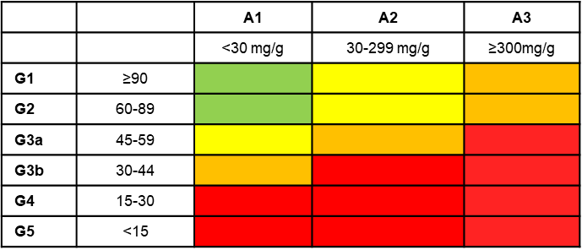

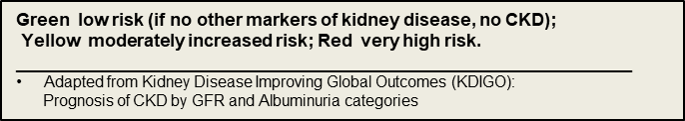

Slide 10
Clinical Questions
What optimizations would you recommend?
The case patient has CKD stage G2A2 – guidelines suggest an LDLc <70 – his LDLc is 75 on atorvastatin 20 mg daily +fenofibrate 160 mg daily + fish oil 1000 mg TID – what do you recommend?
Increase atorvastatin to 40 mg daily
See if he tolerates tirzepatide and repeat LDLc once on stable dose
Add ezetimibe 10 mg daily
Stop the fish oil supplements since they can elevated LDLc levels & his triglyceride level is now 95
Check Lp(a) as a risk modifier

Slide 11
KDIGO 2926 draft – Lipid Management
Practice Point 4.1.6: In people with diabetes and CKD, initiate statin-based regimens for atherosclerotic cardiovascular disease (ASCVD) risk reduction with more intensive low-density lipoprotein cholesterol (LDL-C) targets for people with diabetes and CKD at higher ASCVD risk.
Practice Point 4.1.7: Add non-statin, lipid-lowering therapy with proven cardiovascular benefit, alone or in combination, to people with diabetes and CKD who are unable to achieve their risk-based LDL-C targets with maximally tolerated statin alone.
Practice Point 4.1.8: Consider measuring lipoprotein (a) (Lp(a)) cholesterol levels at least once, as higher Lp(a) levels are associated with higher cardiovascular risk and help guide intensity of preventive therapies. Antiplatelet therapy D

Slide 12
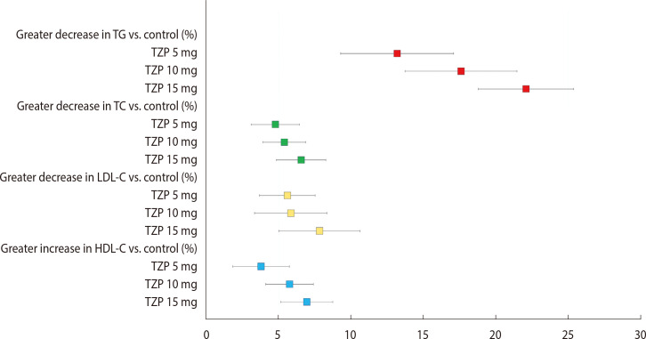
How Much does Tirzepatide Improve LDLc & Lipids?
Heterogeneity in responses
J Obes Metab Syndr. 2024 Dec 17;33(4):348–359
Notes:
https://pmc.ncbi.nlm.nih.gov/articles/PMC11704219/#sec14 - The Effects of Tirzepatide on Lipid Profile: A Systematic Review and Meta-Analysis of Randomized Controlled Trials. J Obes Metab Syndr. 2024 Dec 30;33(4):348-359.
https://pmc.ncbi.nlm.nih.gov/articles/PMC12365184/#sec2

Slide 13
Fish Oil Supplements
Heart disease:
  Research shows that people who eat dietary sources of fish oil (fatty fish) at least twice a week have a lower risk of dying of heart disease
  taking fish oil supplements seems to have little to no benefits to heart health
High triglycerides and cholesterol:
  There's strong evidence that omega-3 fatty acids can significantly reduce blood triglyceride levels
  There also appears to be a slight improvement in high-density lipoprotein (HDL) cholesterol
  An increase in levels of low-density lipoprotein (LDL) cholesterol also was observed.
Notes:
From Mayo Clinic - https://www.mayoclinic.org/drugs-supplements-fish-oil/art-20364810

Slide 14
Clinical Questions
What optimizations would you recommend?
The Diabetes guidelines and the Kidney guidelines recommend using the “maximally tolerated” dose of ACEI/ARB – the case patient has a BP of 118/72, but UACR is elevated at 55.6 despite lisinopril 10 mg daily + empagliflozin 25 mg daily – what do you recommend?
Increase lisinopril to 20 mg daily, if tolerated, to try to reduce UACR
Continue lisinopril 10 mg daily as his maximally tolerated dose due to his current BP
Continue lisinopril 10 mg daily for now and repeat UACR once on stable dose of tirzepatide
Other

Slide 15
KDIGO 2026 draft - RASi
Recommendation 4.2.1: We recommend that treatment with an angiotensin-converting enzyme inhibitor (ACEi) or an angiotensin II receptor blocker (ARB) be initiated in people with diabetes, hypertension, and albuminuria, and that these medications be titrated to the highest approved dose that is tolerated (1B).
Practice Point 4.2.6: Hyperkalemia associated with the use of an ACEi or ARB can often be managed by measures to reduce serum potassium levels rather than decreasing the dose or stopping the ACEi or ARB immediately (Figure 22).
Practice Point 4.2.7: Reduce the dose or discontinue ACEi or ARB therapy in the setting of either symptomatic hypotension or uncontrolled hyperkalemia despite the medical treatment outlined in Practice Point 4.2.6, or to reduce uremic symptoms while treating kidney failure (eGFR <15)

Slide 16
Clinical Questions
If the patient cannot tolerate Mounjaro titration, what changes would you prioritize for his therapy?
  A. Continue tirzepatide (Mounjaro) at the dose he can tolerate, even if low dose
  B. Return to treatment with semaglutide (Ozempic)
  C. Consider metabolic surgery

Slide 17
Clinical Questions
Would you consider conversion from Toujeo (insulin glargine U300) to Tresiba (insulin degludec)?
  A. Yes, since insulin degludec is reported to have less weight gain, requires lower dosage than glargine and could be dosed once per day as well as “more forgiving” of delayed or missed doses due to long half-life
  B. No, continue insulin glargine U300, it is more concentrated & there is no real benefit to switching
  C. No, would try to get patient using an AID insulin pump system
  D. No, would try U500 insulin to reduce number of injections daily

Slide 18
ADA 2026 Standards of Care
AID systems are the preferred insulin delivery system in individuals with type 1 diabetes and type 2 diabetes on multiple daily injections (MDI) and people with other forms of insulin-deficient diabetes.
They can be considered for use in people on basal insulin who are not reaching their targets.
Early initiation of AID therapy has been shown to be beneficial.
Recommendations
7.25a AID systems are the preferred insulin delivery method over MDI, CSII, and sensor-augmented pumps in
  people with type 1 diabetes, A
  adults with type 2 diabetes, A
  children and adolescents with type 2 diabetes, E
  those with other forms of insulin-deficient diabetes. B, C, D, E
  Choice of an AID system should be made based on the individual’s circumstances, preferences, and needs. E
7.25b Consider AID systems for select people with type 2 diabetes treated with basal insulin not achieving individualized glycemic goals. B
  Choice of an AID system should be made based on the individual’s circumstances, preferences, and needs. E

Slide 19
Consider AID Insulin Pump Therapy
I highly recommend consideration of AID insulin pump therapy
  But it may depend on his insurance coverage
Usually reduce TDD from MDI by 75-90% when start insulin pump therapy
  Starting TDD for pump for this patient would be 178u – 214 u
  Due to likely missed doses would start with lower estimate
  Sometimes (not always) see further reduction in insulin requirements
    Especially if able to remain on and/or increase tirzepatide or another GLP1 RA med
Medtronic MiniMed 780G
  Pros – 300u insulin capacity & meal coverage despite no meal announcement
  Cons – does not utilize CGM, has tubing, DME benefit
Omnipod 5
  patch pump, 200u insulin capacity, can use Dexcom/Freestyle Libre CGM, pharmacy benefit (easier access)
Will need to change reservoirs/pods more often

Slide 20
Issues with Large Insulin Requirements
Volume of insulin needed (units/day) vs reservoir capacity (200 -300 units)
  Need to change reservoir /pod more often if large insulin doses
    Often need less insulin with pump vs MDI but this varies
      For safety usually reduce TDI by 25% for initial start of AID system
      TDD insulin requirements often are reduced further as utilize the AID system
        E.g. In Omnipod trial with PWT2D -Total daily insulin requirements decreased from mean (SD) of 0.80 (0.46) U/kg/d at baseline to 0.57 (0.29) U/kg/d with AID (change, −0.23 U/kg/d)
  Add basal injection to CSII
  Use of concentrated insulin (Humalog U200, Humulin U500)
    AID systems not set for these/off label use
    Lispro (Humalog )U200 (only available in pens) – pharmacokinetics & pharmacodynamics identical to U100 lispro insulin : https://www.frontiersin.org/journals/endocrinology/articles/10.3389/fendo.2025.1692589/full
    U500 pharmacokinetic and pharmacodynamic profile differ significantly from U100 - U500 human insulin has an action time of 18.1-21.5 hours, the action time for U100 is 4–6 hours
      Case reports on use in AID systems

Slide 21
Diabetes Research & Clinical Practice. Volume 174108735April 2021
Improved glycemic control in 3,592 adults with type 2 diabetes mellitus initiating a tubeless insulin management system
Results
Change (mean ± SD) in HbA1c was
  −1.3 ± 1.7% overall
  −1.4 ± 1.7% for prior MDI users
  −0.9 ± 1.5% for prior CSII users
The percentage of patients with
  HbA1c ≥9% decreased (49% to 19%)
  HbA1c <7% increased (10% to 22%) (p<0.0001).
Reductions in
  TDD (overall, −33 ± 52U, p<0.0001)
  Hypoglycemic Events (HE) per week (overall, −0.5 ± 2.0, p<0.0001),
Conclusions: Omnipod System use was associated with statistically and clinically meaningful reductions in HbA1c, TDD, and HE compared to prior treatments in T2DM.

Slide 22
Utilization of Omnipod AID system in Pharmacy Diabetes Clinic – Robin John, RPh, CDCES
No endocrinology consult is needed to prescribe AID.
  I order it under a CPA with our providers and do all the management.
  The whole process to become a Certified Trainer takes about 2-3 months depending on how many patients you can schedule and see.
  The first training session for patients takes about 2 hours
  Patient needs to have an email.

Slide 23
Utilization of Omnipod AID system in Pharmacy Diabetes Clinic –
Robin John, RPh, CDCES
Contact Insulet rep and let them know you are interested in becoming a trainer.
  Contact Us for HCP | Omnipod HCP - the bottom of this page will have a “contact local representative” link
  Sign in or make an HCP (Health care Provider) account
  Start eTraining videos Healthcare provider | eLearning | Omnipod
  Complete the 4 modules
Add to formulary if needed – I have the data I presented to P&T if anyone would like to review/borrow
  Our focus group
    patients on basal/bolus and using a CGM
    patients on BID insulin and using a CGM
    patients on other pumps
  Carb counting is not necessary, being carb aware is helpful
    Automated Insulin Delivery in Adults With Type 2 Diabetes: A Nonrandomized Clinical Trial | Diabetes and Endocrinology | JAMA Network Open | JAMA Network
    Breakthrough Studies on Automated Insulin Delivery and CGM for Type 2 Diabetes Unveiled at ADA Scientific Sessions | American Diabetes Association

Slide 24
Utilization of Omnipod AID system in Pharmacy Diabetes Clinic –
Robin John, RPh, CDCES
The Process for Omnipod 5 at Yakima:
Once ordered, the rep will send a certified trainer or set up a video call to do the training. I watched 2-3 trainings in my office with the patient.
  This can take some coordination as you need to meet the schedule of all three: trainer, patient and trainee
I performed 2 trainings with the supervision from a certified trainer via video .
Pass the certification test with 80% or better. Certified Omnipod Trainer
We upload all our clinic providers into the system so when an order comes through for Omnipod, the patient is not called by the company. They know I will be taking care of the training and f/u.
Glooko is the platform you will use to monitor and assist your patients. This account will be provided to your clinic after training/certification.
  I believe there is a new platform available Omnipod Discover – (but I have not discovered it yet!)

Slide 25
Where would you start?

Slide 26
Where I would start…
Assess for diabetes distress – or at least for his sense of futility/hopelessness
  (no matter what I do – bad things are going to happen – so why deny food, take meds, etc.)
  DD associated with reduced motivation for self-management
  Prefer full assessment as you will learn more and help patient acknowledge and express concerns
  Remember – you don’t have to fix – just active listening & nonjudgemental curiosity & empathy – “the conversation is the intervention”
  Start with an assessment: https://diabetesdistress.org/

Slide 27
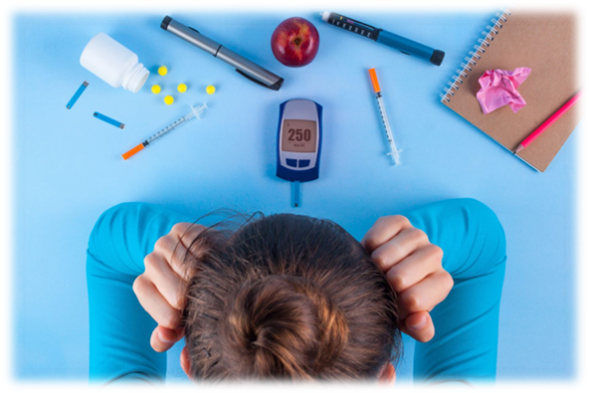
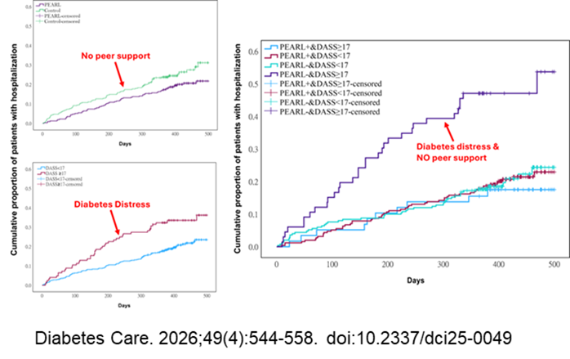
Diabetes Distress Impacts Motivation for Self-Management
Therefore, DD can result in
  problems with disease management
    lower self-efficacy
    less effective diabetes-related problem solving
  less optimal eating and exercise behaviors
  less consistent medication-taking
  elevated A1c
    but even those with lower A1c can have DD
  missed healthcare visits
  reduced health-related quality of life & well-being
  more complications
  more hospitalizations
  higher costs – human & financial

Slide 28

Why do anything about DD?
Addressing DD directly leads to better clinical outcomes.
If not addressed, DD doesn’t just go away
  It can get worse over time and/or wear the individual down
  It may lead to a person feeling emotionally exhausted and overwhelmed by the demands of their diabetes.
    They try to cope with this by giving up on taking care of their diabetes.
DD is a barrier to change
DD blocks responsiveness to education & management interventions
  Adjusting meds or referral to diabetes ed/nutrition counselling has minimal impact
Most PWD have not had DD addressed

Slide 29

Why do anything about DD?
Another reason to address DD is to avoid unnecessary polypharmacy
  Adding more meds for glycemia, BP, lipids when patient not consistently taking current medications
  CGM may seem like more judgement or futile effort unless DD addressed
Reminder – most non-adherence is intentional
  unless impaired cognition or very overloaded schedule /competing demands
  the patient has a “good reason” for not taking meds or doing an action
    It might not seem like a “good” reason to you, but they made a choice not to take/do
    Common excuse is “I forgot”
  Fear of side effects drives a lot of problems with medication taking (intentional missing)
    May need to directly ask about this as not well picked up in DD assessment
  Pill & injection burden –
    Missing insulin injections is very common, especially for MDI (Basal/Bolus insulin)

Slide 30

Addressing Diabetes Distress – Results of the DD Assessment
Start with a conversation – guided by the results of the DDAS
  I see here that you feel very hopeless regarding the diabetes and that you are concerned that no matter what you do, you are going to end up with bad complications – can you tell me more about that?
  This shows that overall, you are coping very well with the diabetes but there is a lot of concern/worry about hypoglycemia – can you give me more details about your concerns?
  F/u with open-ended questions – How, What, Why
Listen attentively (active listening – fully focused, listening to understand)
  Talk less
  Use body language to indicate understanding (e.g.; nodding, eye contact)
  Tolerate silence
Use the conversation to help the PWD label, express & evaluate the often unaddressed, hidden feelings & thoughts about diabetes (not to “fix” issues)
  Label feelings & beliefs - use “feeling” word(s)
    “It sounds like you are very frustrated/disappointed/angry/scared….about xxx”
    “It sounds like you feel it is your fault that you developed diabetes”
  Summarize & Reflect (without correcting factually incorrect perceptions)
    So, you are saying “people think having diabetes means you are somehow ‘bad’ or have done something bad” – do I have that correct?
    Let me see if I understand, “you feel as if nothing you do will change what happens to you because your father, uncle and grandfather all died at a young age from diabetes”
  Normalize & Accept (not trying to fix anything) – understand without judgement – helps them fix for themselves

Slide 31
JAMA Netw Open. 2024 Dec 10;7(12):e2448809. doi: 10.1001/jamanetworkopen.2024.48809
Glycemic Control With Layperson-Delivered Telephone Calls vs Usual Care for Patients With Diabetes
This study suggests that layperson-delivered, empathy-focused telephone engagement can improve glycemic control for patients with diabetes
  260 patients with uncontrolled diabetes at a federally qualified health center
Showed statistically significant improvements in hemoglobin A1c level of −0.7% for those who received empathy-oriented telephone calls for 6 months vs 0.02% for control patients who received usual care.
For the subgroup of PWD with baseline PHQ-9 >5
  A1c reductions were greater at −1.1% for the intervention arm vs 0.1% for controls
  Also showed evidence of improved diabetes-related emotional health, including self-perception of ability to manage diabetes, related behaviors, and distress
“Our exploratory results support the importance of addressing patients’ diabetes-related emotional distress to effectively improve glycemic control.”

Slide 32
Prevent & Reduce Diabetes Distress
Be on the same side as your people with diabetes (PWD)
  Understand, appreciate the workload/burden of diabetes & the impact of complications – EMPATHY
    Acknowledge the challenges (“If I were in your shoes, I would feel the same way”)
    Share that other PWD have similar struggles (Normalize)
First acknowledge the validity of emotions based on beliefs & expectations, even if “incorrect”
  Help clarify misperceptions
    Need to eat “no sugar” – “That does seem impossible, I can see why you feel discouraged – I have good news for you ….”
    Their fault when need additional meds – “It seems like you are blaming yourself for needing Insulin…” - Diabetes gets worse over time – more meds expected
    Insulin causes kidney failure/metformin causes cancer – “ I wouldn’t want to take it either if that was the case “ – Insulin made by the body – in diabetes don’t have enough insulin / metformin protects against some cancers, PWD who take metformin often have improved survival - there was a contaminate in metformin – recalled batches
  Provide “evidence-based” hope
    “not your father’s/grandmother’s diabetes” (we know more now, new meds, treatments, etc.)
    Do not need to be perfect
    Share results of studies showing improved outcomes
    Utilize CGM to help determine treatment efficacy – or lack of efficacy (not all meds work or work the same for everyone) [testing the medication, not the PWD]

Slide 33
Consider Connection to Culture & Community
Historical impacts - Epigenetic changes
  Both hopelessness & resilience
  Reverse negative epigenetic changes by restoring what was lost (reconnection)
  Identity & connection
Stress reduction
  Sage burning, sweat lodge, drumming, dancing, beading, gardening, foraging, music, song, language , etc.
    Reducing stress hormones improves blood glucose levels
    Reducing stress through cultural activities may also reduce apathy, hopelessness & sense of futility
  Diabetes programs are including cultural connection in their educational curriculum
    “Participation in cultural activities may provide a sense of belonging to something larger than the individual and also give a feeling of connectedness to those who participate.
    These factors may help explain the mechanism by which cultural participation seems to serve as a mediating factor in achieving better health outcomes among AI people.”

Slide 34
Optimization also includes “What can be
Reduced or Stopped”
Fish oil supplements
Fenofibrate?
Pioglitazone?
  Reduces insulin resistance (both PPAR gamma & alpha agonist)
  A1c reduction of 0.5 to 1.4%, dose dependent
  Benefits MASLD/ improves lipid profile
  Weight gain – dose dependent
  Increased risk of fluid retention & HF especially when combined with insulin
    Risk higher with pre-existing HF
    relative risk of CHF with TZDs was between 1.06 and 1.76 (between 1.10 and 1.44 if combined with insulin)
Want to continue empagliflozin beyond glycemic benefits
  CKD
  High risk of HF (HFpEF or HFrEF) – reduction in HHF even in PWD without Dx of HF
Notes:
Stat Pearls- https://www.ncbi.nlm.nih.gov/books/NBK544287/

Slide 35
Provide Frequent Reminders
Eating for GLP1 related meds
  Slow down (eat slowly)
  Avoid fatty/greasy foods, spicy foods and carbonation
  Eat less – STOP when full
  (he can blame modifications to his eating on the requirements of the medication)
Okay to slow the titration of GLP1 meds
Can stabilize at less than the “full” approved dosage

Slide 36
Extra Slides

Slide 37
Kudva YC, Raghinaru D, Lum JW, et al.; 2IQP Study Group. A randomized trial of automated insulin delivery in type 2 diabetes. N Engl J Med 2025;392:1801–1812
Abstract: In this 13-week, multicenter trial, adults with insulin-treated type 2 diabetes were randomly assigned in a 2:1 ratio to receive AID (Tandem t:slim X2) or to continue their pretrial insulin-delivery method (control group);
  Both groups received continuous glucose monitoring (CGM).
  The primary outcome was the glycated hemoglobin level at 13 weeks.
Results: A total of 319 patients underwent randomization. Glycated hemoglobin levels decreased by 0.9 percentage points (from 8.2±1.4% at baseline to 7.3±0.9% at week 13) in the AID group and by 0.3 percentage points (from 8.1±1.2% to 7.7±1.1%) in the control group (mean adjusted difference, -0.6 percentage points; 95% confidence interval.
The mean percentage of time that patients were in the target glucose range of 70 to 180 mg per deciliter increased from 48±24% to 64±16% in the AID group and from 51±21% to 52±21% in the control group (3.4 hours per day longer with AID than with CGM alone).
Conclusions: In this 13-week, randomized, controlled trial involving adults with insulin-treated type 2 diabetes, AID was associated with a greater reduction in glycated hemoglobin levels than CGM alone.

Slide 38
Kudva YC, Raghinaru D, Lum JW, et al.; 2IQP Study Group. A randomized trial of automated insulin delivery in type 2 diabetes. N Engl J Med 2025;392:1801–1812
The mean total insulin dose changed from
  95±47 units per day at baseline to 87±46 units per day at 13 weeks in the AID group
  102±50 units per day to 104±56 units per day, respectively, in the control group.
The mean change from baseline in weight was
  2.4±4.4 kg in the AID group
  0.9±3.3 kg in the control group
The use of the AID system led to no new safety signals unique to a population with type 2 diabetes.
  Device-related adverse events were mainly due to infusion-set failures.
The results of this trial suggest that previous experience with an insulin pump or in-depth training in carbohydrate-counting methods are not prerequisites to the successful and safe use of AID to improve glycemia in patients with type 2 diabetes.

Slide 39
Diabetes Distress
Diabetes Distress is not a co-morbidity or a diabetes complication
It is simply the emotional side of having & living with diabetes
  It is different than clinical depression
  It “reflects the broad range of feelings, beliefs and expectations that result from the emotional toll of living with diabetes”
Diabetes distress is emotional distress that captures
  the worries, concerns and fears among individuals struggling with the progressive and demanding chronic disease that is diabetes including:
    the emotional burden of self-management
    threats of complications and potential loss of functioning
Updated incidence
  Adults with T1D = 74%
  Adults with T2D = 62%
  88% have at least one elevated Source Scale (even higher for PWT1D)
It is a common and expected response to living with diabetes
  Diabetes is hard..

Slide 40

Why do anything about DD?
If it’s a normal part of living with diabetes …
  Hyperglycemia is a normal part of living with diabetes – but its harmful
  DD is also harmful – it has a significant impact on self-management behaviors and clinical outcomes
Motivation for self-management is critical for PWD
  “Self-management and team-based care are the greatest drivers of successful glycemic management.”
  Self-management choices are driven by feelings, beliefs, thoughts and expectations
    If you think that you are doomed (no matter what you do, you will end up with complications) … why bother?
    If you feel tired of being told you are not doing good enough – need to do better … why come to clinic?
    If you are skipping insulin to avoid having low BGs … why get an A1c level checked?
  DD impedes motivation for doing what is needed for self-management

Slide 41
Why do anything about DD?
Another reason to address DD is to avoid unnecessary polypharmacy
  DD can show up as a higher score on the PHQ9
    This is picking up something, but it is not always depression, often diabetes distress
    One study suggests ~70% of PWD with abnormal PHQ9 have DD not clinical depression
      When accounting for DD, the frequency of depression in PWD is about the same as in the general population (3-8%) vs the prior reports of depression being 2-3x higher in PWD
      Very different solutions - “This distress cannot be treated with depression medications because…it is not depression! Rather, it requires a greater focus on acknowledging and addressing the emotional and behavioral obstacles associated with diabetes.” W. Polonsky
    Often mis-addressed by adding meds for depression & when PHQ9 does not improve – add more and/or stronger meds adding to polypharmacy & negative metabolic impacts e.g.:
      SSRI meds: increased appetite & cravings; increased weight, lipids & glucose levels
      Second-generation antipsychotic meds – weight gain, increased IR, glucose & lipid levels
  Note: PWD can have both DD and MDD, Bipolar Disorder, etc. that benefit from Rx

