Slide 1
Asynchronous Measurement-Based Care in Psychiatry:
Remote Monitoring of depressive and manic symptoms
Dr Jessie Whitfield, MD MPH
June 2026 Virtual Care Implementation ECHO

Slide 2
Disclosures
The speaker does not have any conflicts of interest or relevant financial connections to disclose.

Slide 3
Objectives
By the end of this presentation, audience members should be able to:
  Identify the purpose and importance of measurement-based care in psychiatry
  Describe strategies for transitioning measurement-based care from synchronous to asynchronous collection
  Name at least two barriers to efficient implementation of asynchronous measurement-based care and common solutions to these challenges
Acknowledgements: University of Washington, Integrated Care Training Program (funded by WA legislature), John Fortney, PhD, Joe Cerimele MD MPH, Mindy Vredevoogd, MS, Gabriel Franta MD MPH

Slide 4
Shifting Trends in Health Care
Increasing Telehealth Integration
Asynchronous
EHR messages or texting from patients
  Data reported from health devices, eg continuous glucose monitor or blood pressure monitors
  Validated measures sent through EHR
Synchronous
  Face to face in-person or tele-video visits
  Phone calls
  Procedures/surgeries
  Hospitalizations

Slide 5

Background
Measurement Based Care - the systematic administration of symptom rating scales and utilization of the results to drive clinical decision making at the level of the individual patient
  Not intended to be a substitute for clinical judgment
  Used as a starting point in the clinical evaluation
  Maximize the likelihood that nonresponse to treatment is detected by the provider
  Mental health providers detect deterioration for only 21.4% of their patients who experience increased symptom severity¹
The failure to detect patients who are not responding to treatment contributes to clinical inertia
  Clinical Inertia - Not changing the treatment plan despite a lack of substantial improvement in symptom severity.
Slide courtesy of John Fortney, PhD, UW 2022
1. Hatfield D, et al. Clinical psychology & psychotherapy, 2010

Slide 6
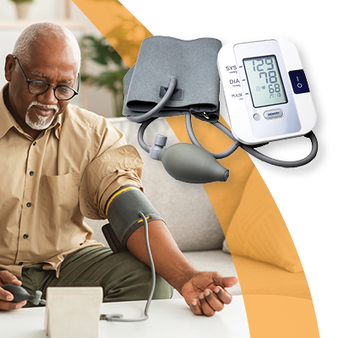


MBC = Mental Health Vital Signs

Slide 7
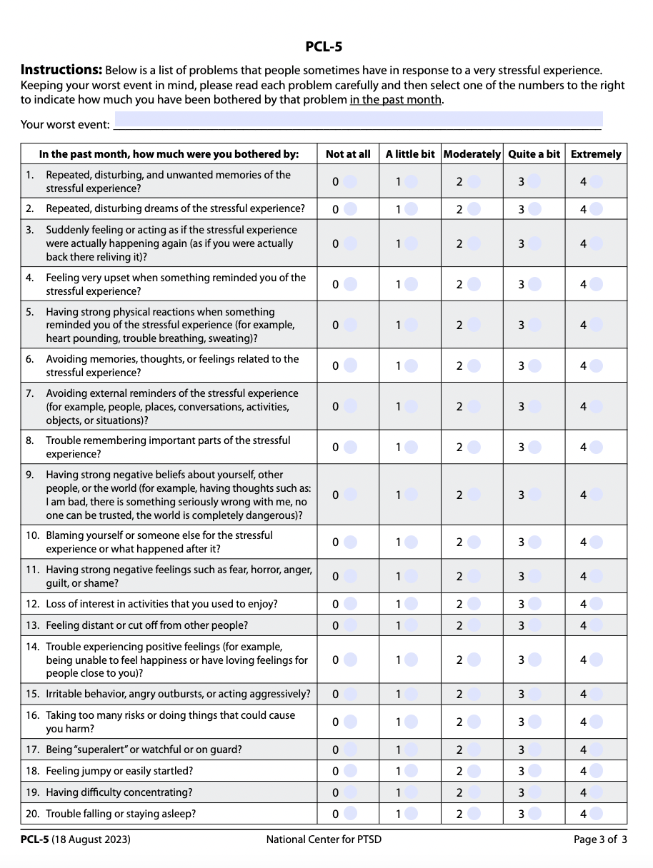
Common Questionnaires and Scales
Patient Health Questionnaire 9 (PHQ-9): Depression
Generalized Anxiety Disorder 7 (GAD-7): Anxiety
PTSD Checklist for DSM (PCL-5): PTSD
  Shorter form for primary care – PC-PTSD
AUDIT-C: Etoh Use disorder
Pediatrics: SCARED, PHQ-A, SMFQ
  https://site.chadis.com/questionnaires

Slide 8
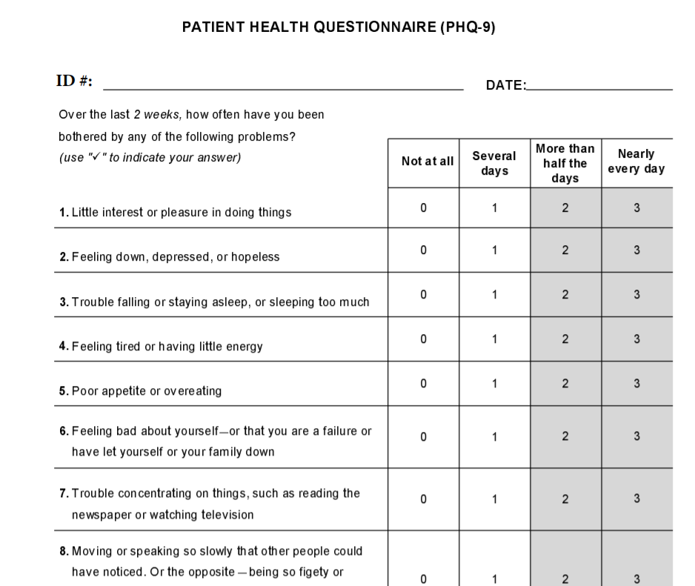

Slide 9
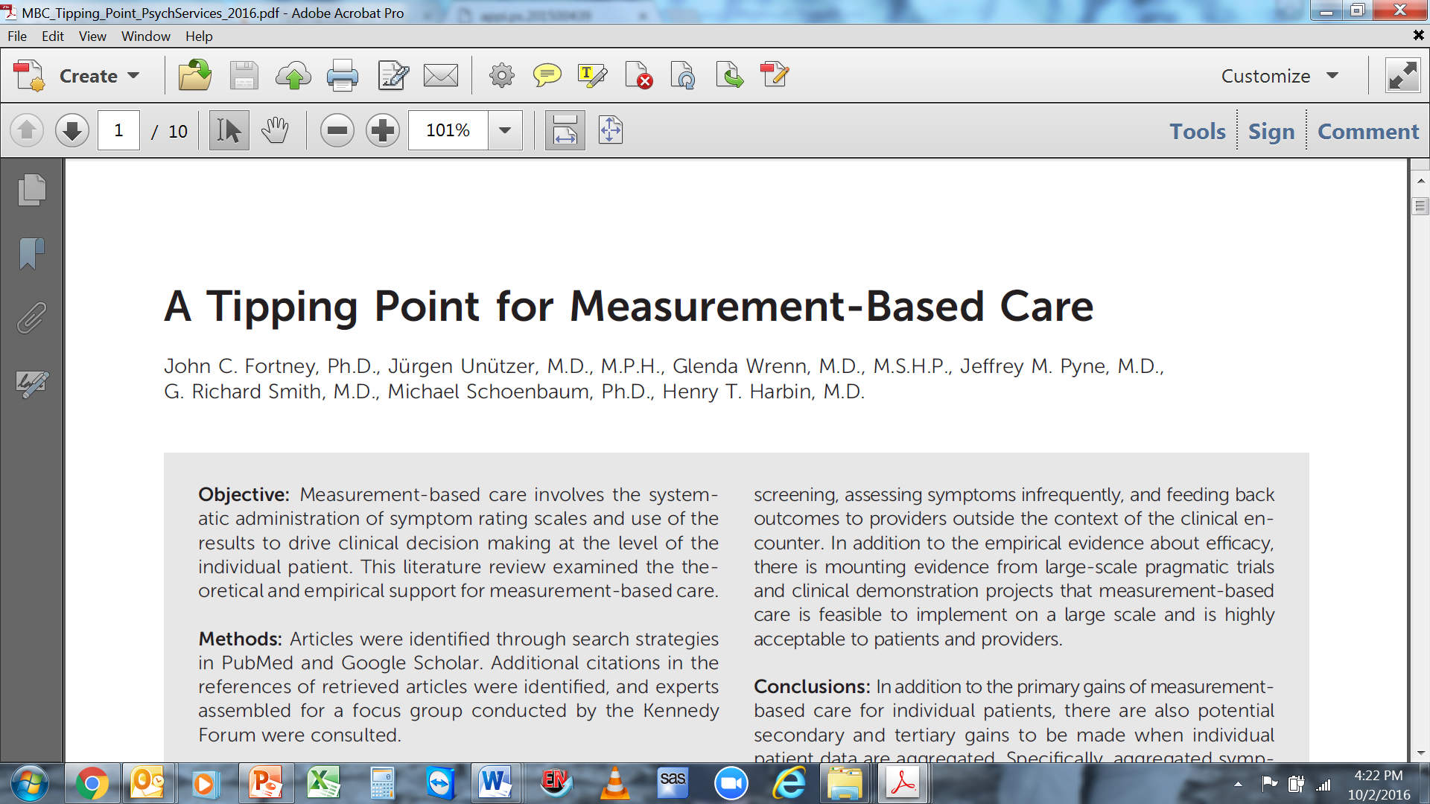
Fortney JC, Unützer J, Wrenn G, Pyne JM, Smith GR, Schoenbaum M, Harbin HT. A Tipping Point for Measurement-Based Care. Psychiatr Serv. 2017 Feb 1;68(2):179-188.
Slide courtesy of John Fortney, PhD, UW 2022

Slide 10
Studies of Measurement-Based Care
14 of 15 RCTs of MBC have demonstrated that it improves outcomes compared to UC
  Improves depression symptoms faster than usual care
  Helps patients who did not initially improve – change treatment plan sooner
These findings are robust and are consistent across
  Patient groups:
    Disorders
    Age
  Provider types
    Psychotherapists
    Psychiatrists
    Primary Care Providers
Consistently mentioned barrier: Adequate Support Staff
Slide courtesy of John Fortney, PhD, UW 2022; Modified with content by Dr Bud Vana, 2026

Slide 11
How much more effective is Measurement Based Care?
Review by Fortney and colleagues:
Deliverable in Primary Care Settings
Works – improves depression symptoms faster than usual care
Helps patients who did not initially improve – change treatment plan sooner
Better couples counseling outcomes
Bipolar has better outcomes (STEP-BD trial)
Moderators – immediacy of information (conducted in clinic and visit)
Secondary Benefits: easier quality improvement, outcomes measuring, values-based purchasing initiative
Consistently mentioned barrier: Adequate Support Staff
Psychiatric Services 2017; 68:179–188; doi: 10.1176/appi.ps.201500439

Slide 12
2025 Study of MBC
"Does measurement-based care (MBC) reduce time to response and time to remission compared with standard care for major depressive disorder (MDD) in a low- and middle-income country such as Pakistan?"
  154 adults with nonpsychotic MDD from psychiatric hospitals and primary care centers in 7 Pakistani cities
  September 2022 to January 2024, 24 weeks of follow-up.
    Pharmacotherapy: paroxetine or mirtazapine in both MBC or standard care groups
  Intervention group: Quick Inventory of Depressive Symptomatology–Self-Report (QIDS) and the Frequency, Intensity, and Burden of Side Effects Rating Scale at each visit (baseline and weeks 2, 4, 8, 12, and 24), scores informed medication adjustments
  Control group: received usual care and med adjustments based on clinician judgment, no scores
"The time to response and time to remission were half as long among those who received MBC compared with those who received standard care"

Slide 13
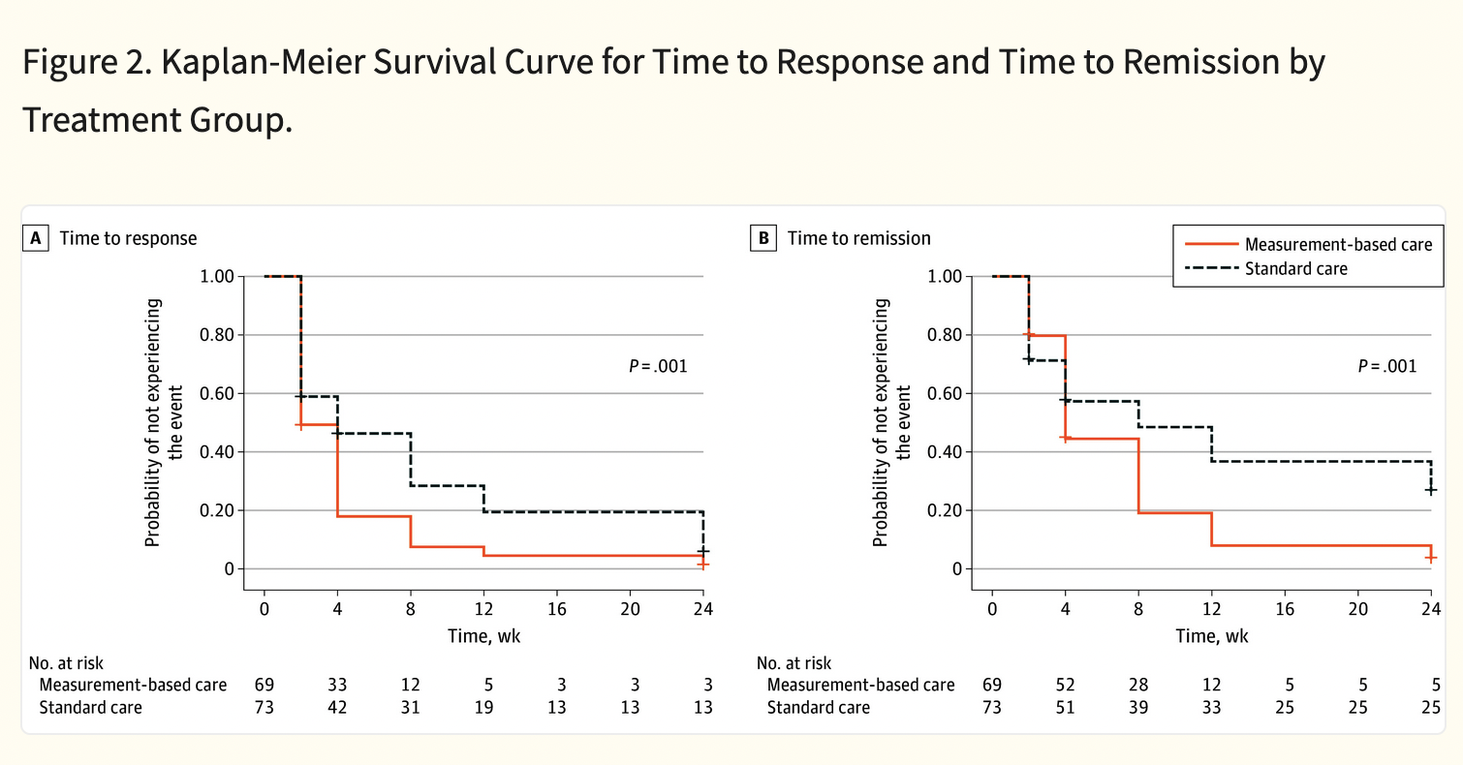

Slide 14
Why Does MBC Improve Outcomes?
- Provider Behavior
Helps overcome clinical inertia
  Triggers a change in the treatment plan
  Prompts for a consultation or referral
Facilitates the use of algorithms
  Symptom improvement can be quantified and operationalized into the decision points
Facilitates the detection of residual symptoms
  Prompts clinicians to intensify the treatment plan until the patient’s symptoms have completely remitted
  Treatment to target
Focuses collaboration and coordination across providers
Slide courtesy of John Fortney, PhD, UW 2022
Notes:
In the absence of biomarkers to inform clinicians as to which treatment will work best for an individual patient, initial treatment choices are often ineffective. Thus, without clear biological causal mechanisms to guide clinical decisions and given the current limitations with trial-and error– based clinical decision making, it is critical to closely monitor treatment response by using MBC.
MBC greatly facilitates the use of algorithms, because symptom improvement can be quantified
and operationalized into the decision points (23)

Slide 15
Why Does MBC Improve Outcomes?
- Patient Behavior
More knowledgeable about their disorders
  Leading to a more informed and activated patient, prepared to participate meaningfully in shared decision making
Attune to their symptoms
  Aware of symptom fluxuation over time, cognizant of the warning signs of relapse or reoccurrence
Recognize improvement early in the course of treatment
  Help patients feel more optimistic and hopeful, maintain better adherence to the treatment
Validates feelings
  Mitigates the self-blame that patients sometimes experience
Empowers patients
  Helps them communicate more effectively with their providers
  Enhanced therapeutic relationship
Slide courtesy of John Fortney, PhD, UW 2022

Slide 16
What is measurement-based Care?
Tracking sxs over time
Akin to sending patient home and having them check BP regularly or glucose monitoring, or checking lab work over time
Difference in psychiatry is not biomarkers, more subjective
Important to do however because easy to forget

Slide 17
Limitations of MBC and Cultural Sensitivity
Fit between scores and lived experience
  Ie, A number does not capture full story of a patient
  Fluctuations may be due to context that doesn't require or need to prompt medical intervention
  "Administering symptom scales without assessing social and cultural factors could produce disparities in diagnosis and treatment and could lead to malpractice claims, because legal authorities now adjudge standards for care on the basis of research, practice guidelines, and sources such as DSM-5-TR" (Aggarwal N, 2026)
Acknowledgement of social and structural factors is missing
re common measures adaptable across cultures?

Slide 18
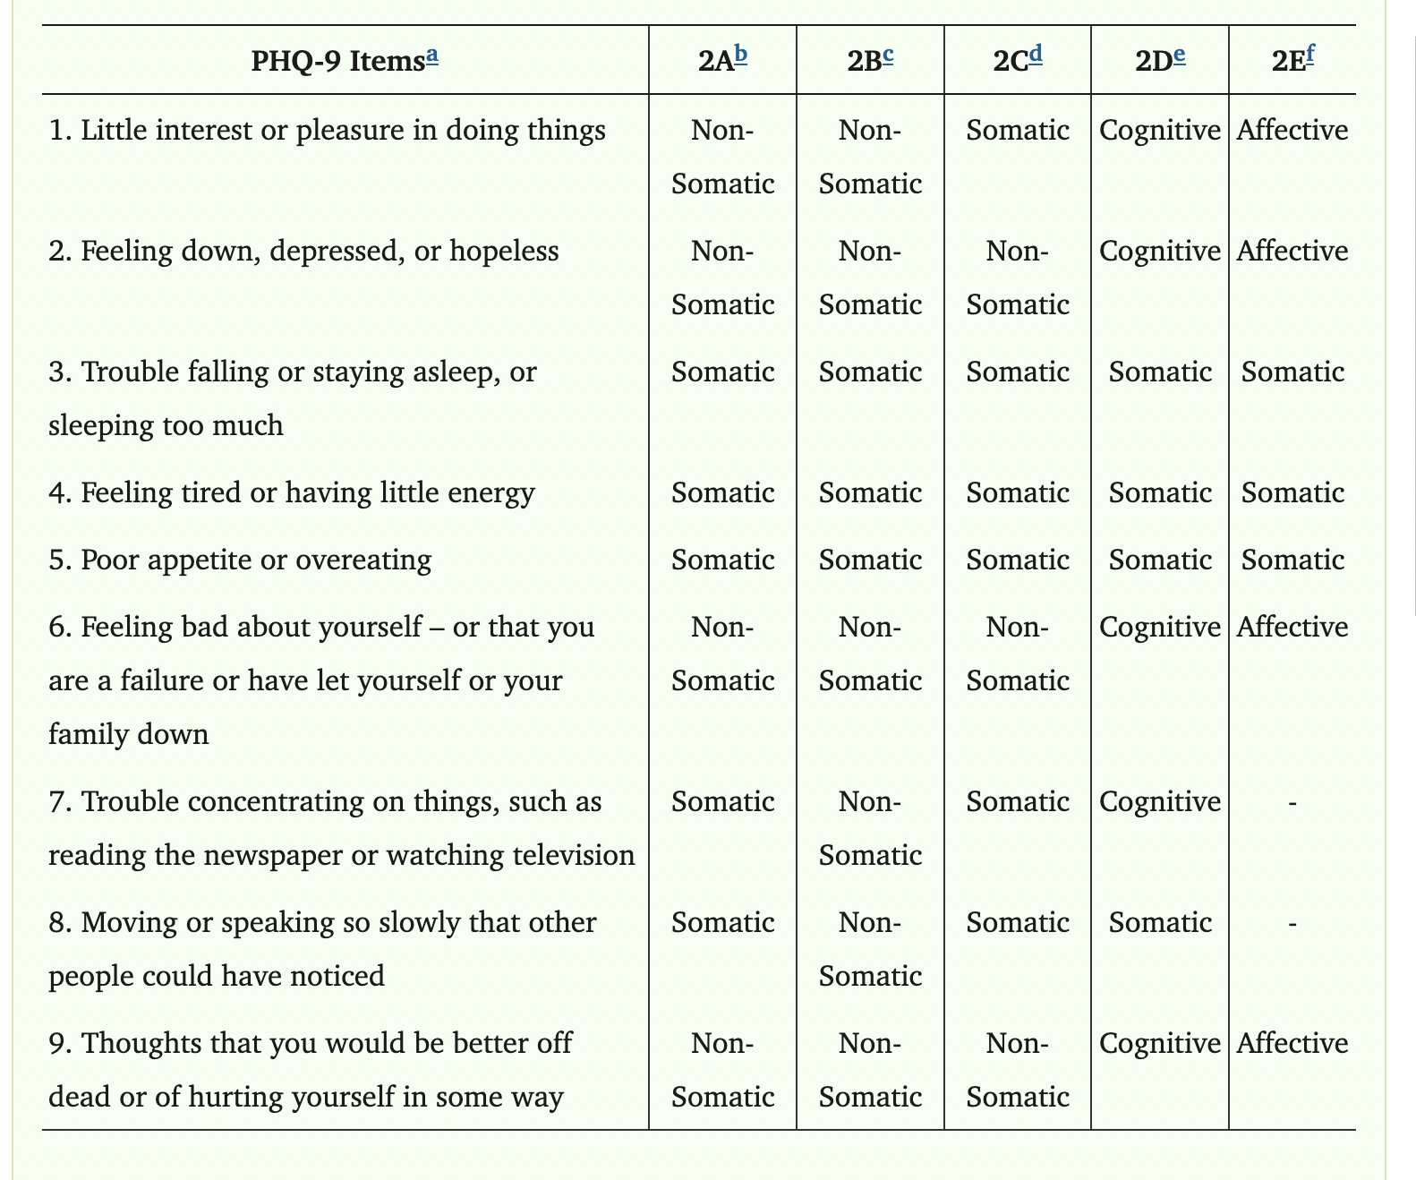
Limitations of MBC and Cross-Cultural Validation
Cultural fit of measures can impact validity
  Mixed results for the standard PHQ-9 model with a range of racial and ethnic groups in the United States
    A good fit for English and Spanish-speaking Latina women (Merz et al., 2011), and non-Hispanic White, non-Hispanic Black, non-Hispanic Asian, Mexican American, and Hispanic adults in a study by Patel et al. (2019),
    Breaking up into somatic and non-somatic questions was a better fit for a group of Hispanic, Asian American, Black, and non-Hispanic White college students (Keum et al., 2018) and generally improved fits over the standard PHQ9 racially and ethnically diverse U.S. groups
  Study by Harry and Waring appears to be the first regarding cross-cultural function of PHQ-9 with Indigenous North American groups.
    Important for indigenous groups, as PTSD and suicidal ideation can be higher in some tribes
    "Although there is a need for common measurement scales, finding that a scale works well with one tribal or AI/AN cultural group may not mean that the scale will work the same with another group of AI/AN people (Walls et al., 2017)"

Slide 19
Limitations of MBC and Cross-cultural validation
Cross-cultural validation of measures needs to be studied (Kiseley S, et al 2017)
Review examined validation studies of the Edinburgh Postnatal Depression Scale (EPDS) and the Patient Health Questionnaire-9 (PHQ-9) for postpartum depression (PPD) screening for AI/AN women in the U.S (Heck J 2018).
  good internal consistency, but discriminative validity for detecting PPD in women from non-Western cultures is low
Study by Harry et al 2021:
  Purpose: Evaluate the cross-cultural fit of PHQ-9 models between two geographically distant groups of non-Hispanic AI/AN people and other racially and ethnically diverse adults
    18 through 64 with at least one complete PHQ-9 in behavioral health or primary care
    Amental health or substance use disorder diagnosis from 1/1/2009 to 9/30/2017
    Pacific Northwest and Upper Midwest
    N= 34,979
Results:
  All PHQ-9 models tested were at least partially invariant across different AI/An groups tested
  Conclusions: "Before comparing mean scores, PHQ-9 models should be assessed for individual racial and ethnic group fit for adults with mental health or substance use disorders."

Slide 20
Evolution of MBC with telehealth
Traditionally filled out in waiting room as part of synchronous encounter
Since 2020, fewer patients appearing in waiting rooms with rise of telehealth, so trend towards electronic forms accompanying telehealth synchronous visits
Proliferation in this time as well as phone apps for monitoring
  Glucose, blood pressure, mental health, derm, etc
  See VCI ECHO from this year re: digital mental health apps, remote blood pressure and glucose monitoring
Benefits: captures in real time, can obtain more frequent measures to clarify trends
Drawbacks: filling them out not as consistent, technological challenges

Slide 21
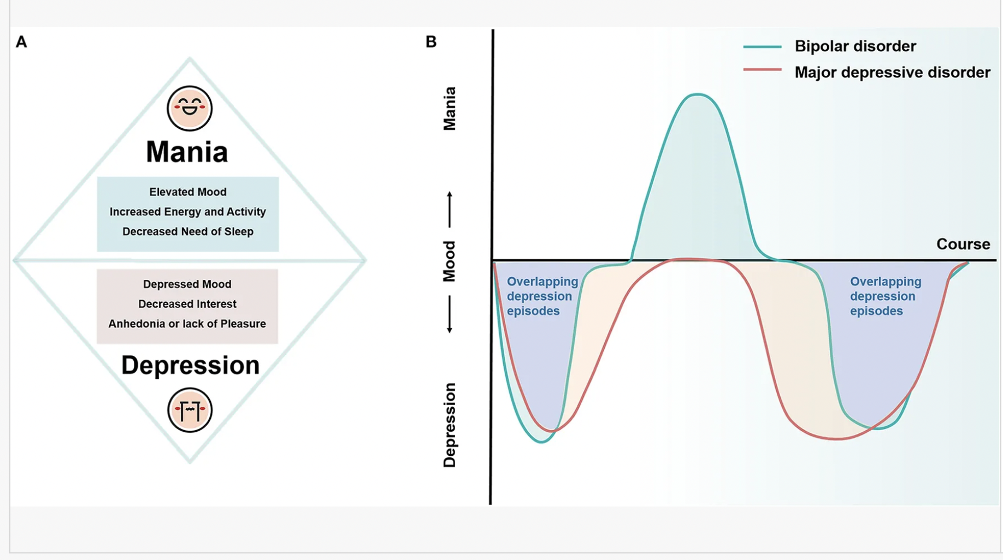
MBC Study at the University of washington 2024-2025
Problem:
  For many people with depressive symptoms (low mood, fatigue, loss of interest, suicidal ideation, appetite changes), takes approximately 5 years to obtain diagnostic clarity around mood disorder.
  For people with people with bipolar disorder (periods of depression as well as mania, including episodic increased energy/impulsivity/euphoria/irritability, grandiosity with decreased sleep), mean duration is 8 years
  If bipolar disorder is to manifest, most common in young adults (20s)

Slide 22
MBC Study at the University of washington 2024-2025
Objective: To pilot a novel clinical strategy of remote monitoring of depressive and manic symptoms in young adult patients with mood disorder symptoms.
  Capture both patient and provider perspectives via qualitative data as well
Setting, population, intervention:
  General mental health clinic.
  Schedules of psychiatrists reviewed for young adult patients (18-30 years)
  Demographics: women (37%), men (37%), trans-women (6%), non-binary (19%); Asian (13%), Black (6%), Native Hawaiian (6%), Multi-race (6%), White (69%); Hispanic (6%).
  Depressive symptoms
  Weekly symptom monitoring with the Patient Health Questionnaire-9 (PHQ-9) and the Patient Mania Questionnaire-9 (PMQ-9)
  12 weeks
  Measure results communicated to the patient’s psychiatrist at the next clinical appointment.
  Surveys of patients and providers - baseline and 24 weeks later

Slide 24
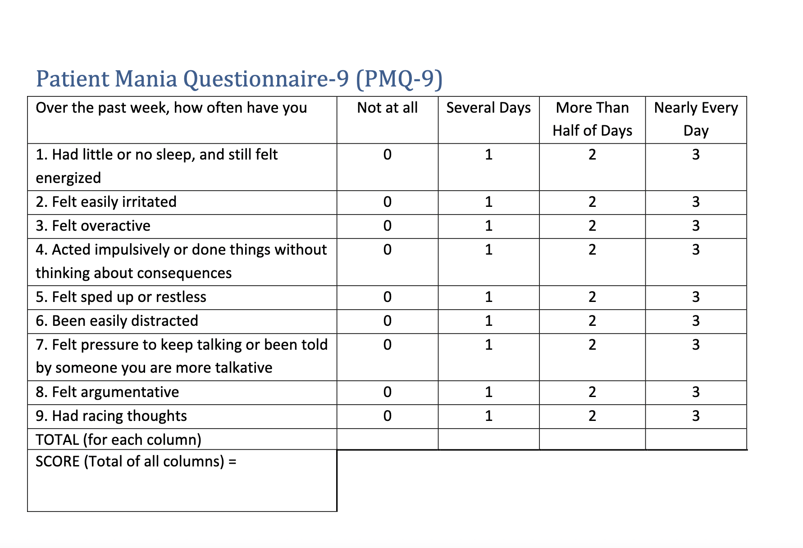

Slide 25
Quantitative Results
11 psychiatrists agreed to participate (none declined)
18 patients consented
216 occurrences of symptom measure delivery
  128 (59%) were completed by participants
  Participants completed symptom measures between 0-12 times, with a mean of 7.1 (SD 4.4).
Mean scores at time of first completion were 11.4 for PHQ-9 and 3.1 for PMQ-9.
Any marker of elevated risk for bipolar disorder occurred in 5 participants (28%)
57 clinical visits with participating psychiatrists occurred during the 24week study period with a range of 1-19 visits and modal number of visits of 4
Mood disorder diagnoses at enrollment and 24-week follow-up included major depressive disorder (n=10) and unspecified mood disorder (n=3).
14 patient participants had one or more medication treatment change of any kind, and two patients had one or more change in psychotherapy treatment.

Slide 26
Qualitative results – Patients (n=10)
Acceptability | Timing/Expectations | Influence on Care
Generally acceptable and contributed to increasing their own self-monitoring and reflection on symptoms | Over half (6) participants thought clinicians would see measures | Over half did not think would influence care (measures results did not vary often enough, clinicians might not see results)
Half of respondents did have times they forgot to complete them | Variability in when (e.g., ranging from immediately to at the end of treatment). | 5 noted that they felt that appropriate clinical decision making (no changes made, helped them in reporting sxs, or realizing more quickly that a med wasn’t working)
Four noted challenges, including not believing they are helpful, harder to complete frequently
Only one person commented concern with filling out PHQ Q9; the remaining respondents (9/10 reported) no concerns
No respondents reported any influence from crisis information they saw, with most commonly reported reason as not seeing the crisis information due to not answering positive on PHQ Q9
Main recommended changes were: focused on the measures themselves (using other measures to capture more disorders, or more varied response options within measures, more open-ended questions) or decreasing frequency
  One person that mentioned having response from care provider in reaction to measures would be helpful

Slide 27
Quotes - Helpful to track progress
“it was nice to be able to quantify my emotions, and how I'm feeling day to day, or week to week.... to track the progress of my mental health journey, basically, like when I'm anxious or depressed on certain days … to kind of reflect back on my days … on why I kind of felt those kind of emotions.”
“I thought it was kind of cool because I often have a hard time recalling over longer periods of time what symptoms are, or they tend to be more biased of what the shorter-term experience has been, so it was kind of interesting to check in more often... I think I had a better sense of my own symptoms, but I don't know if that necessarily changed how I was treated.”
“It kind of helped me keep track, like week to week just because sometimes with doing it for the appointment, I would sort of forget the previous few weeks, so that, I think, might have been a little helpful”
“It was interesting to see – I feel like whenever you take these quizzes, it’s like how things might change from week to week...You can see how it changes as the weeks go on – just kind of see goals... I would say that they were always pretty positive changes, so that was good to see .. Probably it helped me just to kind of see – went for myself, how I was doing. It was kind of a nice way to see where I’m at."

Slide 28
Quotes - Influencing care
“It might have made it a little bit quicker to do a medication switch, like to realize that I was on one that wasn't working very well.”
“I think I had a better sense of my own symptoms, but I don't know if that necessarily changed how I was treated.”
"I'm not sure, mostly just because there weren't any huge changes...I guess it would be good to see that things were level from week to week, but I don't think it did enough to change necessarily how my care was given. Though now that I'm saying that, I do remember there were a few weeks where I didn't have access to my ADHD medication, and so I think it was definitely reflected in the survey, so I suppose that was probably helpful for them.”

Slide 29
Quotes – Recommended Changes
“…Ask what kind of things in your life have influenced these …the responses that you have given, and maybe what kinds of things can help people cope with these depressive and anxious symptoms…”
"It just goes beyond numbers. Sometimes, just numbers doesn't really tell you the entire story about the patient or person feels."
“I think having more of a response from a care provider could have been helpful”

Slide 30
Qualitative results – Providers/Clinicians (n=5)
Acceptability/Workflow impact | Timing/Expectations | Influence on Care
3/5 generally positive and helpful 1/5 didn't find them impactful | 3/5 providers mentioned it was helpful to have closer to the day of the appointment or right before the appointment | Three providers described measures influencing care, with two noting acting on scores (either reaching out between visits or scheduling earlier appt)
3/5 had no concerns re impacts on workflows 2/5 wondered if impact would increase with scaling up |  | Two providers indicated sample size was too small to know if it influenced care.
Concerns:
Two providers saw no concern with remote reception in between visits (one found it reassuring to feel that treatment was on track), while two providers were not sure how their feelings about receiving scales between visits would change if score was unexpected or there was safety concern
Two providers had concern about frequency and repetition of screeners being an increased burden to patients
Recommend changes:
Two providers recommended having scales match pt concerns
Two mentioned needing better integration into normal workflows

Slide 31
Quotes – Acceptability and Benefits
Positives:
"Having the objective measures in a few cases helped me to really think a little bit more about interventions than – and be more prepared because I knew the patient was struggling more.”
“So I think that that influenced care in that they felt like they were maybe being seen more in between visits and hopefully having their experience of being heard and validated”
"There were a few times where knowing that this was going to be done gave me some reassurance that maybe I didn't have to see them as frequently."
"Made my appointments more efficient because the preparation I was able to do beforehand was more efficient and more targeted”

Slide 32
Quotes – Acceptability and Benefits
Negatives:
“I didn't perceive there to be a positive, but that also could have just been because I don't remember ever getting a score that caused me to do anything different.”
“I think I did have a worry that it could be bother my patients or be another burden on them especially the patients where it was hard to get them to do these screeners just before the appointments. I think I was worried that they'd be even less likely to do them for the appointments if they were getting more frequent screening requests”
“I guess I can theoretically see how it could be helpful. I guess in my specific examples I didn't find it helpful. That's not to say I don't think it would be helpful for everyone or for all clinicians or doctors, but yeah. I guess I specifically didn't find it very helpful and I would say it was a small net negative, but in the overall scheme of things with how many messages we get, it wasn't – I didn't find it to be a massive time suck or a huge drain on mental resources”

Slide 33
Quotes – Acceptability and Workflows
“I think if someone were scoring a three on Item 9 and I got that in advance of an appointment, my protocol would absolutely be to reach out to the patient. I'd probably call them and/or have one of our nurses call if I wasn't able to at that point."
“I guess one thing that theoretically could make it a little bit easier is if instead of the results going straight to the physician, if there was somebody who screened them and looked to see are they similar to the last appointment scores, are they within a realm of a certain standard deviation from where the patient has been at? And only maybe alert you if they're significantly different than that, specifically elevated, not decreased"
“There were a few times where knowing that this was going to be done gave me some reassurance that maybe I didn't have to see them as frequently”
“I can see where if you give somebody positive reinforcement for doing additional work, that would definitely be preferable to asking people to do unpaid work in their free time”

Slide 34
Limitations
12 week study period perhaps too short to capture fluctuations, especially manic episodes
  Majority of patients with bipolar disorder who present in primary care for help are in depressive episode
Small sample size
Academic center clinic in urban setting with majority White patients may not be generalizable

