Slide 1
Starting an Effective PHN/PCMH Model to End the Syndemic
CDR CASEY MARLIN, PHARMD, MHA, BCGP
MARLAINA RENNEY, PHARMD, PHARMACIST RESIDENT

Slide 2
Objectives
Summarize Steps Taken to Establish an Effective PHN/PCMH Clinic Model
Explain Team Member Roles and Workflow
Describe Current Clinic Status and Future Goals

Slide 3
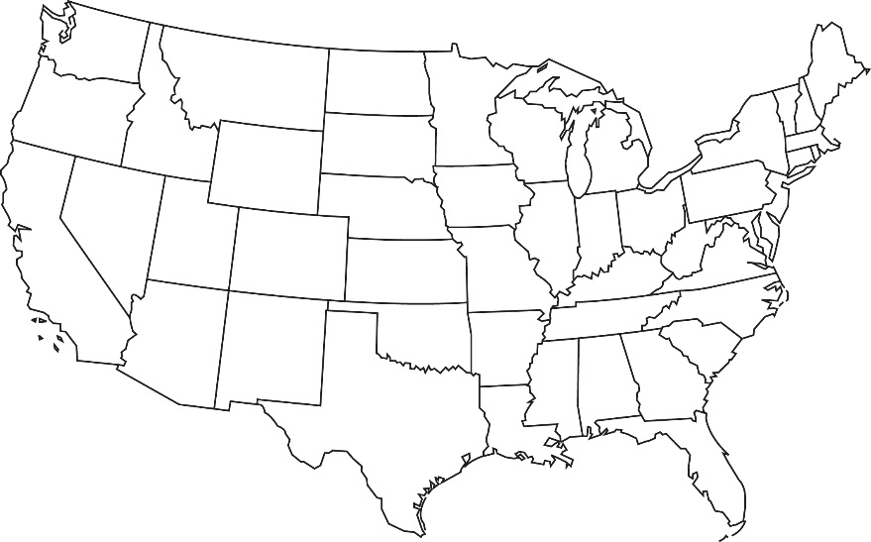
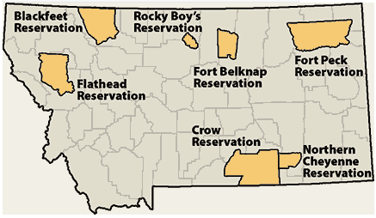
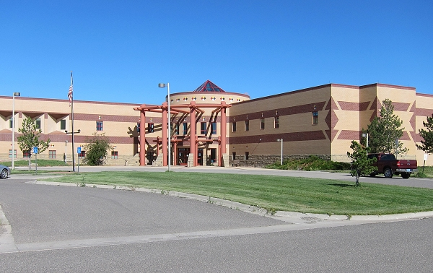
Our Facility
Located on the Crow Reservation
Main hospital in Crow Agency, MT
Two field clinics in Lodge Grass and Pryor, MT
Crow: ~11,200 enrolled
with ~7,000 living on reservation
Northern Cheyenne: ~11,266 enrolled and ~5,000 on reservation
Currently serving 15,254 active patients

Slide 4
Collaborative Impact Thus Far
Tracking 333 Hepatitis C consults
  82 documented cures
  7 pending SVR
  69 spontaneously cleared
Increased the amount of Narcan® (naloxone) in the community:
  60 doses dispensed in 2021
  98 doses dispensed in 2022
  181 doses dispensed in 2023
  220 doses dispensed in 2024
  182 doses dispensed in 2025
  68 doses dispensed through the clinic and 72+ during outreach events in 2026 at this point
Created/implemented STI standing order to increase timeliness to STI treatment:
  >400 patients received treatment under standing order since May 2022.
Notes:
A pilot project of staffing a pharmacist, on average, of once-weekly in PHN Department has generated the following impacts and data through tracking documentation of interventions:
64 patients cannot contact

Slide 5
STI Treatment Integration
In response to Syphilis outbreak that started end of 2021
Public Health Nursing department identified delayed initiation of treatment due to provider shortage as a barrier
Development of Sexually Transmitted Infection Treatment and Testing Standing Order to expedite treatment

Slide 6
STI Standing Order
Implemented May 2022
Applies to individuals ages 14+
Positive cases and known contacts of Gonorrhea, Chlamydia, Syphilis, and Trichomoniasis vaginalis
Patients identified and contact tracing completed by the PHN department
Pharmacy notified and appropriate treatment is prescribed and dispensed
Privileged and credentialed pharmacists may write in their own name
Non-privileged pharmacists will submit orders and cosign designated provider
PHN department will perform contact tracing

Slide 7
Condition | Medication
Chlamydia Trachomatis (CT) or known contact of CT | Doxycycline 100mg PO BID x7 days OR Azithromycin 1 gram PO x1 for allergies or concern for noncompliance
CT during pregnancy | Azithromycin 1gram PO x 1
Uncomplicated Gonorrhea (GC) or known contact to GC | Under 150 kg – 500 mg Ceftriaxone IM x1 150 kg and above – 1 gram Ceftriaxone IM x1
 | Expedited Partner Therapy – Cefixime 800 mg PO x1 (If IM injection cannot be given)
Uncomplicated GC with a cephalosporin allergy | Gentamycin 240mg IM AND Azithromycin 2 gram PO x1
If CT has not been excluded or co- infection of CT/GC | Under 150 kg – 500 mg Ceftriaxone IM x1 150 kg and above – 1 gram Ceftriaxone IM x1 Expedited Partner Therapy – Cefixime 800 mg PO x1 (If IM injection cannot be given) AND Doxycycline 100 mg PO BID x7 days OR Azithromycin 1gram PO x 1 for allergies or concern for noncompliance
Co-infection GC with CT during pregnancy | Under 150 kg – 500 mg Ceftriaxone IM x1 150 kg and above – 1 gram Ceftriaxone IM x1 AND Azithromycin 1 gram IM x1
Trichomoniasis Vaginalis | Metronidazole 500 mg PO BID x7 days (women) Metronidazole 2 gram PO x1 (men) OR Tinidazole 2 gram PO x1 (women & men)
Syphilis (Primary, Secondary, or Early Latent < 1 year) | Penicillin G 2.4 million units IM x1
Syphilis (Late Latent > 1-year, Latent syphilis of unknown duration) | Penicillin G 2.4 million units IM weekly x3 weeks
Syphilis treatment with Penicillin Allergy (Non- pregnant) | Doxycycline 100mg PO BID x14 days
Syphilis treatment with Penicillin Allergy (Pregnant) | Refer to PCP for penicillin desensitization
Notes:
Tinidazole sometimes chosen over metronidazole for Trich due to convenience of one-time dosing and same dose for both males and females.

Slide 8
Syphilis Statistically Speaking
(Nov 2021 through May 2026)
Notes:
352 confirmed cases Aug 2023-May 2026
809 confirmed cases Nov 2021-July 2
Several additional cases transferred to other jurisdictions
Many cases found were incarcerated
023

Slide 9
Syphilis Statistically Speaking
(Nov 2021 through May 2026)
Testing
6601 tests provided since Nov 2021
  207% increase from 2021 -2023
RPR with confirmatory Treponema
  2-3 weeks for results
Treponema Crow Lab:
  1 hr in-house results
Point of Care (POC) Treponema:
  10-15 minute results
Notes:
352 confirmed cases Aug 2023-May 2026
809 confirmed cases Nov 2021-July 2023

Slide 10
Community/Public Health Pharmacist

Slide 11
What does a Community Health Pharmacist do?
Screening and treatment for STIs, Hepatitis C, HIV and other communicable diseases
Substance Use Disorder management and treatment
Community engagement and outreach
Patient home visits (discharge medication reconciliation, medication management, patient/family education)
Vaccines for Children program management
Notes:
Have done outreach and engagement at local schools, college, health fairs in conjunction with the tribe and county health department.

Slide 12
Detention Center Visits
PHN staff make regular visits for STI and infectious disease screening and treatment
Provider visits/medical clearances for transfer
Pharmacists accompany as needed for patient education
Patients are educated on HCV status, transmission reduction, treatment options, vaccinations, etc.
Medications are delivered to the facility
Immunization Administration
Notes:
POC Syphilis and on the spot Pen G treatment
HCV treatment no longer initiated while incarcerated due to extremely low SVR follow-up upon release. Ensuring SVR follow-up is attested to by the provider and patient on the Medicaid NF request.

Slide 13
Over-the-Counter Medications
Pharmacists are able to place orders for OTC medications in their own name per policy for acute or chronic conditions.
Patients are seen on a walk in/as needed basis. No consult required.
Face-to-face encounters preferred; proxy visit or telephone encounters allowed at pharmacist discretion
  APAP, capsaicin cream, menthol/methyl salicylate cream, permethrin shampoo, seasonal allergy treatment, dry/itchy skin treatment, acne, sunscreen, vitamins, etc.
  Plan B
Assists patients in self-management of their symptoms
Frees up provider visits for more complex issues

Slide 14
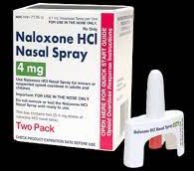
Naloxone
Provided to patients, family members, friends, or any other person who is in a position to assist a person at risk
Opioid overdose and naloxone training provided by dispensing pharmacist
  Naloxone annual training done in conjunction with Crow Tribe last completed in April 2026.

Slide 15
Harm Reduction
Safer Sex Kits
PrEP
Fentanyl & Xylazine test strips
Education!
Substance use disorder treatment info/education
Syringe disposal IN PROGRESS in partnership with Environmental Health Department.
Syringe exchange program remains a goal!

Slide 16
STI’s & PrEP
Provides initial and ongoing assessment of patients’ medical, physical, and psychosocial status including the following:
  Conduct comprehensive patient health and medication histories
  Perform focused physical examination
  Order, interpret, analyze, and monitor CLIA waived laboratory and other appropriate tests
  Formulate therapeutic treatment plans per CDC treatment guidelines
  Initiate and adjust medications as appropriate
  Provide care coordination for complex or chronic health problems requiring interdisciplinary management
  Refer patient for care beyond pharmacist scope of practice (i.e., PID, pregnancy, unstageable syphilis)

Slide 17
Community Health PGY-1
Residency Learning Experience
4-week residency rotation
Pharmacist working in PHN department full time
Home visits for INR monitoring
Home visits for medication reconciliation and counseling
On the spot patient education for walk-in PHN visits
Process improvement projects
2 more residents scheduled for this rotation in 26/27
Notes:
Tori- tobacco cessation note
Heather- opill note
Analeslie –HIV lab order set
Jess- HIV note
Marlaina – Latent TB order menu

Slide 18
Next Steps & Goals
Screen & educate 100% of incarcerated individuals at both the local detention center and county jail for HCV/HIV/STD/SUD
Integrate substance use disorder treatment and syringe service program
Provide mobile community screenings, education, and birth control in locations where high-risk individuals congregate
Provide HIV/HCV/STD/SUD education and resources to youth at local schools
Pharmacy led communicable disease treatment program
Telehealth (behavioral health) availability at detention center
Medicaid provision of care to incarcerated inmates
Birth control policy discussion

Slide 19
Questions?

