Slide 1
Lipoprotein (a)
You Have to Know About This Thing!!
Jerold Saef, MD FACC
Indian Country Diabetes ECHO Presentation
May 14, 2026

Slide 2
What I Will Tell You
What is Lp(a)?
What are important details about Lp(a) physiology?
What is different about patients with Lp(a) and what is the prevalence of Lp(a)?
What are the consequences to patients with Lp(a)?
What is the impact of current treatment?
What are the new treatments?

Slide 3
CASE
58-year-old previously healthy man presents to the ED
Severe abrupt onset epigastric and chest pain, diaphoresis and nausea.
ST elevation in the inferior leads and diffuse reciprocal ST depressions on initial ECG.
Coronary angiography - diffuse noncritical stenosis of the left anterior descending (LAD), high grade disease in the mid left circumflex (LCx) and acutely occluded right coronary artery (RCA) with staining thrombus in the proximal third of the vessel.
Successful PCI with drug eluting stents to the RCA and LCx.
He evolved a troponin I elevation to 17 ng/mL; left ventricular ejection (LVEF) 40% in acute phase with inferior-posterior dense hypokinesis.

Slide 4
Initial lab: total cholesterol (not on statin)132, HDL-C 44, non-HDL-C 88, LDL-C 73 and triglycerides 73 mg/dL. Fasting glucose was 110 mg/dL. BUN and creatinine were normal. Lipoprotein(a) was elevated, 292 nmol/L (normal value <75 nmol/L); hsCRP was <0.2 mg/L.
Family history: sister with coronary disease; coronary bypass surgery at age 60 without conventional risk factors.
Mother, age 87, alive and well; no cardiac episodes. Father died in his 50’s from myocardial infarction. Five adult children under the age of 30 who are alive and well.

Slide 5
Please note:
  Sudden event
  Moderate/severe disease
  Why did this event happen now?
  What is the actionable abnormality?
  These are individuals who have events but who, by rights, should not!
    High HDL
    Low LDL
    What is wrong here?

Slide 6
REMEMBER...
  AGE
  SMOKING
  DIABETES
  HYPERTENSION
  LIPIDS
  GENETICS/AUTOIMMUNE
  OBESITY
  INFLAMMATION
  ORAL/GINGIVAL BACTERIA...AND

Slide 7
LIPOPROTEIN (a)

Slide 8
It is BAD to have Lp(a)
It has been ignored
It is associated with MI/CVA/Aortic Stenosis

Slide 9
Genetic correlation of Lp(a) as causative for ASCVD
LP(a) IS THE MOST PREVALENT FORM OF INHERITED DYSLIPIDEMIA
THERE IS NO (approved) DIRECT TREATMENT FOR LP(a)….yet

Slide 10
Prevalence
>1.5 billion individuals worldwide have Lp(a) concentrations associated with increased ASCVD risk

Slide 11
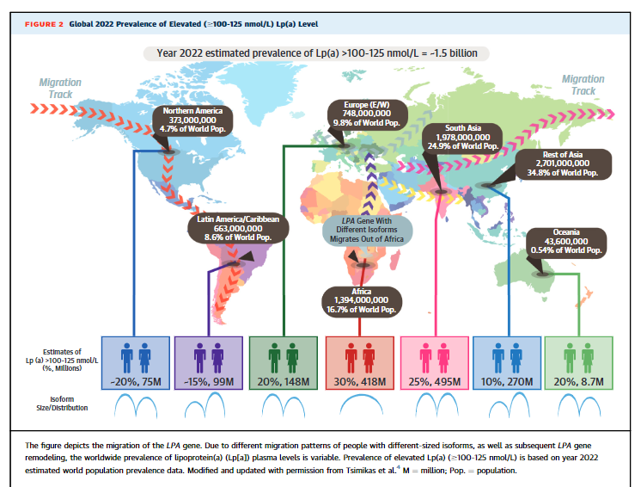
https://doi.org/10.1016/j.jacc.2022.06.019

Slide 12
Where Do Native Americans Fit In?

Slide 13
Overall, Lp(a) prevalence in the global Native American population is less than the general population but certain tribes are more likely to have Lp(a)

Slide 14
The Pima or Ojibwe are most significantly impacted
Data not well collected to date.
In practice, it’s crucial to assess individuals or specific tribal populations to get a clearer picture.

Slide 15
The Pima primarily live in southern Arizona, with the Gila River Indian Community and Salt River Pima-Maricopa Indian Community as notable areas.
The Ojibwe (also known as Chippewa) are spread across the northern United States and southern Canada, particularly in areas like Minnesota, Wisconsin, Michigan, and Ontario.

Slide 16
What is Lipoprotein (a)?
Lipoprotein(a) – or “Lp(a)” is an LDL-like core lipoprotein particle covalently bound to a large glycoprotein, apo(a), largely under genetic control by the LPA gene locus.
Serum levels little affected by statins, diet or exercise

Slide 17
What is it?
It contains Apolipoprotein B
This makes it a form of LDL
Has a carbohydrate-rich protein as well termed apo(a). This is NOT Apo A which marks HDL.
Apo(a) is covalently linked to apoB.
Apo (a) has marked size heterogeneity and there are over forty apo(a) isoforms.
Measured Lp(a) levels are inversely correlated to the size of apo (a).
Apo(a) size and Lp(a) concentration are determined by the LPA gene locus.
This encodes apo (a)
Notes:
Confusing that Lp(a) is called “a” but contains apo B. Clarify this for audience.

Slide 18
Large glycoprotein – apolipoprotein a is covalently bonded to apolipoprotein B by a disulfide bridge.
Apo a is homologous to the fibrin binding domain of plasminogen
Plasminogen, when activated to plasmin, dissolves blood clots.
The homology to plasmin works to effectively reduce plasmin potential by reducing the apparent concentration of plasmin in the circulation. Lp(a), like a beta blocker to adrenergic receptors, acts to reduce availability of plasmin binding sites on thrombus.

Slide 19
It is a MYSTERIOUS thing too
Presumed genetic “mistake.” An extra gene? Biological function not clearly known. Carries oxidized phospholipids which increases atherogenicity.

Slide 20
MORE CONFUSION
MEASUREMENT IS VERY OBSCURE.
  Size of the various isoforms
  Different assays
  Use of differing units – nmol/L, mg/dl - total mass vs number of particles.
  When measurement is unreliable, it’s not possible to draw conclusions as to correlation with disease, impact of therapy, etc. Whether a drug is reducing the presence of Lp(a) and whether it is impacting disease can produce uncertain conclusions.

Slide 21
Lack of Consensus on Measurement
Assays are variable as there are many isoform variations in Lp(a).
Preferred assays report the particle number in molar concentration units eg nmol/L.
Lp(a) molar concentration by ELISA (enzyme linked immunosorbent assay) is a better predictor of CV events.
LDL measurement can be inclusive of the Lp(a) because the cholesterol in this particle is detected by the LDL assay.
Generally can be measured just once unless a targeted treatment is being administered and impact of such is being observed.

Slide 22
Physiology – WHY is it bad?
Independent Risk Factor for ASCVD
IRF for cerebrovascular disease and aortic stenosis as well
The PCSK9 Inhibitor trials provided an exceptional database.
Patients with baseline Lp(a) in the highest quartile (>165 nmol/L) had a higher risk of coronary heart disease death, myocardial infarction, or urgent revascularization compared with those in the lowest quartile

Slide 23
A Base Cause Relationship with CAD and AS
Observational and genetic evidence strongly support the conclusion that high Lp(a) concentration is causal for ASCVD, aortic valve stenosis, and cardiovascular and all-cause mortality in men and women and across ethnic groups
What does it mean for something to be “causal?”
  LDL
  Gingival bacteria
  Smoking
  Lp(a)

Slide 24
The risk of ASCVD events increases linearly with Lp(a) concentrations. ASCVD risk increases are clinically relevant as Lp(a) concentrations exceed 30 to 50 mg/dL (125 nmol/L) and especially when they exceed 180 mg/dL (430 nmol/L).

Slide 25
Physiology
Remember – homologous with plasmin and reduces effectiveness of thrombolysis
Activated plaque therefore triggers a larger and more devastating episode of acute coronary syndrome in Lp(a) positive patients.
Apo (a) may interfere with fibrinolysis by competing with plasminogen binding sites.
  Lp(a) increases tissue factor mediated thrombosis and inhibition of clot fibrinolysis.
  Binds to macrophages and promotes foam cell formation and deposition of cholesterol in atherosclerotic plaque.
    Lp(a) is ubiquitous in human coronary atheroma. Especially in unstable plaque (analysis of plaque from patients with USA)
Corollary: aspirin is more important in patients with Lp(a)

Slide 26
The absolute concentration of Lp(a) particles, rather than apo(a) isoform size mediates the relationship between Lp(a) and ascvd risk.

Slide 27
Physiology
High Lp(a) may promote atherosclerosis as well as thrombosis.
Does this by affecting fibrinolysis, inflammation, endothelial function and oxidative stress.

Slide 28
Physiology
Binds to endothelium and interferes with endothelial function
Enhances expression of intercellular adhesion molecule-1
Oxidized phospholipids on Lp(a) trigger inflammation by toll-like receptor 2 mediated pathway, increasing arterial wall inflammation.

Slide 29
Guidelines? – Do they address Lp(a)?
AHA/ACC
National Lipid Association
European Atherosclerosis Society

Slide 30
UNTIL RECENTLY....
The National Lipid Association only stated that Lp(a) testing is reasonable to refine ASCVD risk in adults with:
First-degree relatives with premature ASCVD (<55 years of age in men; <65 years of age in women).
A personal history of premature ASCVD.
Primary severe hypercholesterolemia (low-density lipoprotein cholesterol [LDL-C] ≥190 mg/dL) or suspected FH.

Slide 31
Lp(a) should be measured at least once to identify those individuals at higher risk of ASCVD. It is considered as a risk-enhancing factor at levels ≥125 nmol/L (50 mg/dL), which is associated with about a 1.4-fold increased ASCVD risk, and values ≥250 nmol/L (100 mg/dL) are associated with ≥2-fold higher estimated risk. The presence of elevated Lp(a) should be an indication for more intensified LDL-C lowering and management of other risk factors.
https://www.jacc.org/doi/10.1016/j.jacc.2025.11.016

Slide 32
Lp(a) measurement (Top Take-Home Message 6) | No corresponding guideline recommendation | 1 | In all adults, measurement of Lp(a) concentration is recommended at least once for ASCVD risk assessment.

Slide 33
No corresponding guideline recommendations | 1 | In individuals with FH, premature ASCVD, or high Lp(a), cascade testing of first-degree family members for high Lp(a) concentration is recommended to identify those at increased ASCVD risk.
No corresponding guideline recommendation | 1 | In all individuals with elevated Lp(a) (≥125 nmol/L or ≥50 mg/dL), optimal early control of modifiable cardiovascular risk factors is recommended to reduce ASCVD risk.

Slide 34
In individuals with clinical ASCVD and elevated Lp(a) who have not achieved LDL-C and non–HDL-C treatment goals on maximally tolerated statin therapy, the addition of a PCSK9 mAb with proven cardiovascular benefit is recommended to achieve treatment goals and reduce ASCVD risk.

Slide 35
In patients with high Lp(a) (≥50 mg/dL or ≥125 nmol/L), more aggressive low-density lipoprotein cholesterol (LDL-C) targets than those recommended for the general population may be considered.
Excess residual cardiovascular disease risk associated with high Lp(a) level

Slide 36
Europe has been ahead of US entities until now.
EAS 2022 Consensus Statement – Lp(a) assessment should be included in global risk assessment

Slide 37
MANAGEMENT
LIFESTYLE INTERVENTIONS HAVE MINIMAL IMPACT ON LP(A) ITSELF, BUT......
Lifestyle intervention is still important. Especially in Native Americans, there is a significantly higher genetic propensity for Type II Diabetes.

Slide 38
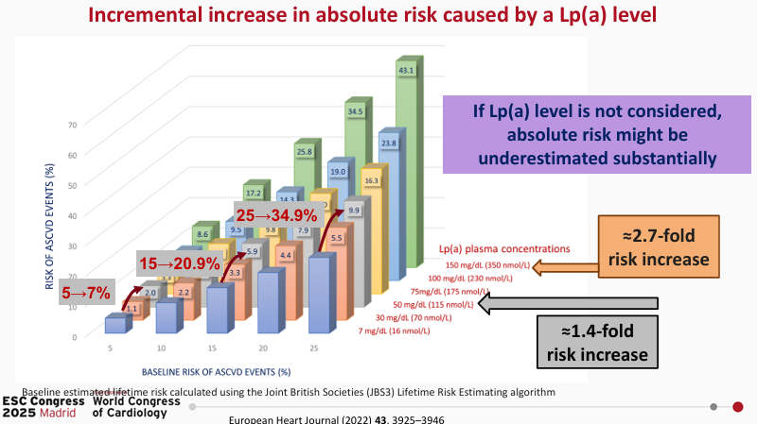

Slide 39
Existing
STATINS do not work – HMG Co-A Reductase inhibition may, in fact, increase Lp(a)

Slide 40
Other Existing
  Niacin
  Estrogen
  Lipoprotein apheresis
  PCSK9 Inhibitors – alirocumab, evolocumab, others
  siRNAs to PCSK9 – inclisiran/Leqvio
  siRNAs to Lp(a)
  Anti-Sense Oligonucleotides (ASOs) to Lp(a)
    Mipomersen – Kynamro inhibits apo b
    Pelacarsen inhibits apo(a)

Slide 41
Nicotinic acid (2 to 4 g/day) can lower Lp(a) levels by as much as 38 percent
Lowers LDL-C, apoB-100, small LDL, and triglycerides and raises high-density lipoprotein cholesterol (HDL-C) levels.
Many side effects, and no prospective studies have demonstrated the effects of Lp(a) lowering with niacin in patients with high Lp(a).
In subgroup analyses of trials designed to investigate the efficacy of niacin on increasing HDL-C, niacin-mediated reductions in Lp(a) were not accompanied by improved clinical outcomes

Slide 42
Estrogens do reduce Lp(a) – outcome benefits not clear.
Apheresis – 80% reduction but not clearly associated with change in outcomes.
“To take away” Separation and selective removal, exchange or modification of a blood component.

Slide 43
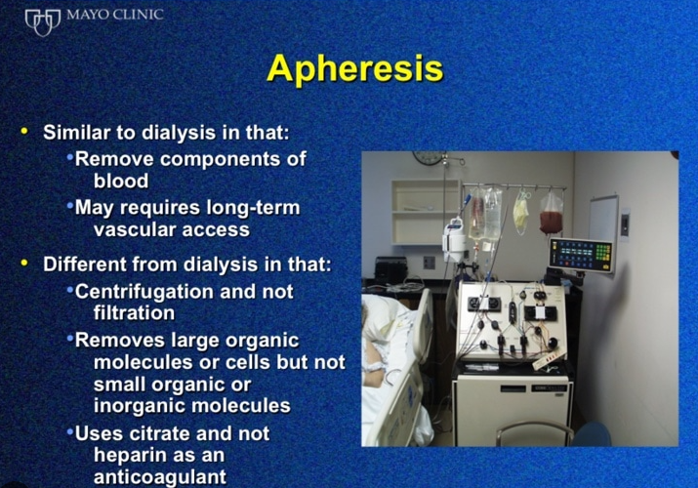
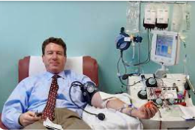

Slide 44
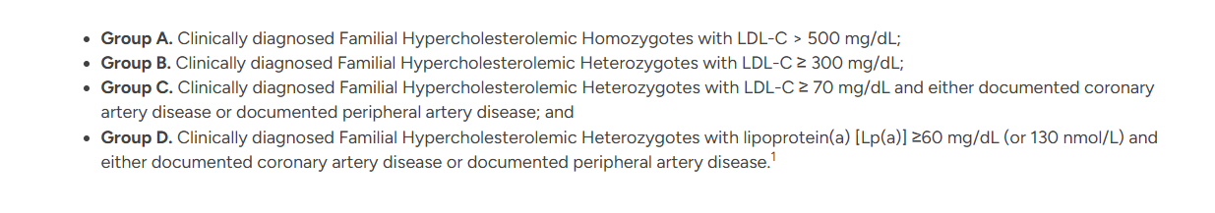

Slide 45
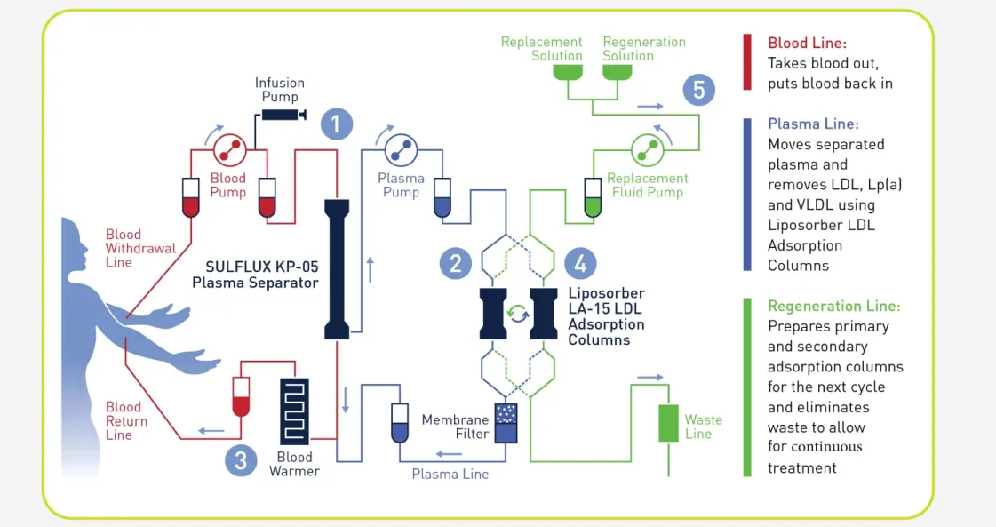

Slide 46
Newer Treatments

Slide 47
PCSK9 Inhibitors – The Fourier and Odyssey Trials
Meta-analysis of study-level data from 6566 patients in 12 randomized trials that compared treatment with PCSK9 antibody to no antibody, Lp(a) was lowered by approximately 26 percent.
FOURIER trial - randomly assigned statin-treated cardiovascular disease patients to evolocumab or placebo. Evolocumab reduced the risk of coronary heart disease death, myocardial infarction, or urgent coronary revascularization.
After adjustment for change in LDL-C, each 25 nmol/L reduction in Lp(a) from evolocumab led to a 15 percent relative risk reduction (95% CI 2.0-26.0 percent).
Evolocumab reduced the risk of coronary heart disease death, myocardial infarction, or urgent revascularization by 23 percent in patients with a baseline Lp(a) >median (37 nmol/L; hazard ratio 0.77, 95% CI 0.67-0.88) and in those with a baseline Lp(a) ≤median by 7 percent (hazard ratio 0.93, 95% CI 0.80-1.08; p interaction = 0.07).

Slide 48
PCSK9 Inhibitors
Some patients who cannot achieve an optimal LDL-C with statin plus ezetimibe are treated with a PCSK9 inhibitor.
FOURIER trial - Lp(a) reduction observed with PCSK9 inhibitor therapy was associated with ASCVD risk reduction independent of LDL-C lowering.
Very high-risk patients with high Lp(a) levels may benefit disproportionately from a lipid-lowering strategy that includes a PCSK9 inhibitor.
Also – ODYSSEY (alirocumab study) outcomes, participants with LDL-C levels between 55 mg/dL and <70 mg/dL with a Lp(a) level above the median of 13.6 mg/dL had fewer cardiovascular disease

Slide 49
PCSK9 Inhibitors
ODYSSEY Outcomes - trial of patients with an acute coronary syndrome.
Alirocumab reduced Lp(a) by 5 mg/dL and reduced the risk of major adverse cardiovascular events independent of its lowering of LDL-C.
ODYSSEY Outcomes also showed that a higher (>13.7 mg/dL) versus lower Lp(a) (<13.7 mg/dL) in patients a recent acute coronary syndrome was associated with a higher cardiovascular event rate regardless of whether the LDL-C levels were <70 mg/dL or >70 mg/dL.
There was a reduction in cardiovascular events with alirocumab in the LDL-C subgroup <70 mg/dL among patients with a higher Lp(a) level (>13.7 mg/dL).

Slide 50

Clustered Regularly Interspaced Short Palindromic Repeats
Jennifer Doudna and Emmanuelle Charpentier
Nobel Prize in Chemistry 2020

Slide 51


Slide 52
CPS 1 is an enzyme that converts ammonia into urea. Without it, hyperammonemia results with neurologic and liver damage.

Slide 53
New Stuff
How Drosha and Dicer work in RNA interference – YouTube
Gene Silencing by microRNA – YouTube
Treating Disease at the RNA Level with Oligonucleotides – YouTube
How CRISPR lets us edit our DNA | Jennifer Doudna – YouTube
Bloomberg Studio 1.0: CRISPR Co-Inventor Dr. Jennifer Doudna - YouTube

Slide 54

We Can Cure Disease by Editing a Person’s DNA. Why Aren’t We? https://www.nytimes.com/2022/12/09/opinion/crispr-gene-editing-cures.html

Slide 55
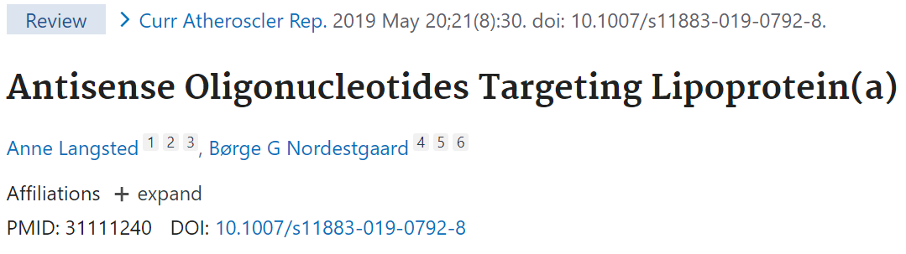
.

Slide 56
ASOs
Antisense oligonucleotide (aso). Synthetic oligonucleotide that can be used to inactivate a gene involved in disease processes.
2-4x/year as an infusion or injection
Mipomersen targets apolipoprotein B and reduces levels of ALL apolipoprotein B containing lipoprotein in the circulation. That means LDL and Lp(a). Lp(a) reduced by 20-50%
AKCEA-APO(a)-LRx (pelacarsen) – targets apo(a). 50-80% reduction in Lp(a)

Slide 57
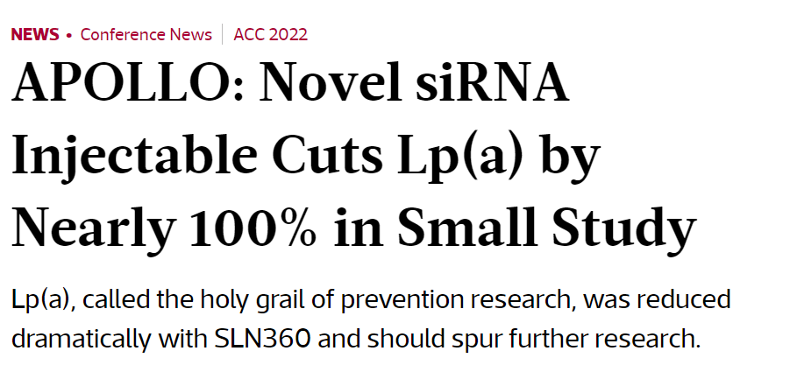

Slide 58
siRNAs
SLN360 – targets LPA – again, the gene that encodes Lp(a).
Degrades the mRNA of apo(a)
98% suppression of Lp(a)
Olpasiran - Amgen

Slide 59
What I Told You
What is Lp(a)?
What are important details about Lp(a) physiology?
What is different about patients with Lp(a) and what is the prevalence of Lp(a)?
What are the consequences to patients with Lp(a)??
What is the impact of current treatment?
What are the new treatments?

