Slide 1

Medication Treatment of Social Anxiety Disorder:
Beyond Serotonin Reuptake Inhibitors
Franklin Schneier, MD
Director, Anxiety Disorders Clinic
New York State Psychiatric Institute
Special Lecturer in Psychiatry
Columbia University Irving Medical Center

Slide 2
Disclosures
Dr. Schneier has been a consultant to Puretech and does not have any other relevant financial or other relationships with any ineligible companies or provider(s) of any commercial service(s) discussed in this CE activity.
This presentation will include discussion of off-label, experimental, and /or investigational use of drugs or devices: citalopram, escitalopram, fluoxetine, vortioxetine, vilazodone, clonazepam, alprazolam, mirtazapine, phenelzine, moclobemide, atenolol, propranolol, atenolol, gabapentin, pregabalin, olanzapine, aripiprazole, quetiapine, oxytocin, fasendiol, cannabidiol, JNJ-42165279, ayhuasca, alpha-7-nicotinic acetylcholine receptor agonists
Notes:
[STAFF] For conflicts: Name of company, nature of the relationship

Slide 3
Learning Objectives
Identify key features of social anxiety disorder (SAD)
Develop a treatment plan for SSRI/SNRI prescribing in SAD
Identify patients with SAD for whom off-label treatments should be considered
Describe off-label treatments for SAD supported by RCT evidence.

Slide 4
DSM-5 Social Anxiety Disorder (SAD)
Fear of scrutiny in social or performance situations
Fear that behavior/anxiety will → negative evaluation
e.g., rejection, embarrassment, offense to others
Exposure usually provokes anxiety
Avoids or endures with intense anxiety
Fear is excessive for situation and sociocultural context
Clinically significant distress or impairment
If secondary to medical condition, fear is excessive
Performance subtype: anxiety limited to performance situations (e.g. public speaking)
American Psychiatric Association. Diagnostic and Statistical Manual of Mental Disorders, Fifth Edition. Arlington, VA: American Psychiatric Association; 2013.

Slide 5
History of SAD Diagnosis
1960s–1970s
“Dissection” of phobias by Marks
1970s–1980s
Performance anxiety and β-blockers & Benzodiazepines
DSM-III introduces diagnosis of “Social Phobia”
1980s
“Neglected Anxiety Disorder”
Commonality with atypical depression → MAOI trials
DSM-III-R broadened dx (Generalized Type, “SAD”)
2010s
DSM-5: Subtype changed— “Generalized” dropped, “Performance Type” added
MAOI = monoamine oxidase inhibitor; SAD = social anxiety disorder.
Liebowitz, et al. Arch Gen Psychiatry. 1985;42:729-736.

Slide 6
Prevalence of Common Psychiatric Disorders
Adapted from Kessler, et al. Arch Gen Psychiatry. 1994;51:8-19 and Kessler, et al. Arch Gen Psychiatry. 1995;52:1048-1060.

Slide 7
Social Anxiety Disorder Features
Highly prevalent, 5-12%
Early onset typically in adolescence, and often chronic
Significant social and occupational disability
Risk factor for depression, alcohol abuse, suicide
Treatments efficacious, but underutilized
Schneier. Expert Rev Neurother 2024; 24:1127-30

Slide 8
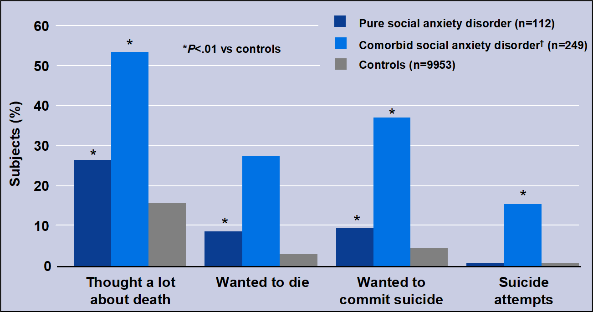
Potential for Suicidal Ideation in SAD
†With any DSM-III major disorder.
Based on the Epidemiologic Catchment Area study, which assessed rates and risks of psychiatric disorders in > 18,000 adults.
Adapted from Schneier, et al. Arch Gen Psychiatry. 1992;49(4):282-288.

Slide 9
Beyond DSM Criteria: Characterizing Clinical Features of SAD
Cognitive/Affective
Self consciousness, feelings of scrutiny
Fear of negative evaluation (“She won’t like me”)
Social inferiority (“I won’t measure up”)
High negative affect and low positive affect
Behavioral
Avoidance -- of situations, interaction, eye contact, self-disclosure
Physiological
Blushing, sweating, tremor/twitching
Panic attacks may occur (only social situations)

Slide 10
Symptoms in Relation to Feared Events
Anticipatory Anxiety (e.g., worry hours to weeks before a feared event)
Situational Anxiety – Physical and/or cognitive symptoms
Post-Event Processing
Self-critique of one’s social performance → depressed mood
Impaired processing of social reward
Adams, et al. Behav Res Ther. 2025; 191:104759

Slide 11
Differential Diagnosis
Panic Disorder
– unexpected panic attacks in public → embarrassment
Agoraphobia
– fear crowds due to fear of panic, not of evaluation
GAD
– social fears are only part of broader worries
Depression
– loss of interest in social activities
Psychosis
– social avoidance due to paranoid fear of harm
Autistic Spectrum Disorder
– impaired relatedness even with closest others
Heckelman & Schneier, in Heimberg et al. (eds.) Social Phobia 1995; 3-20.

Slide 12
Some Models of SAD
Genetic/Developmental: Heritability estimated at 30-40%; Behaviorally Inhibited Temperament
Evolutionary: Submissive behavior is one survival strategy across group-living species. In SAD submissive behavior is often experienced as automatic.
Neurobiological
Circuits
“Fear” circuitry: Amygdala reactivity/Prefrontal inhibition
Self-referential processing (posterior midline, default mode network)
Neurotransmitters: Dopamine, serotonin, GABA, glutamate
HPA axis; sympathetic activation in performance type
Cognitive-Behavioral
Fox & Kalin Am J Psychiatry 2014; 171:1162-73; Fouche, et al. Hum Psychopharmacol 2013; 28:102-5

Slide 13
Cognitive Behavioral Model of SAD
Anxiety/Fear in Social Situation
Avoidance/Escape Behavior
Reinforcement of Avoidance; Increased Anticipatory Anxiety
Temporary Relief of Anxiety
Rapee & Heimberg. Behav Res Ther 1997; 35:741-56

Slide 14
Efficacy of CBT in SAD
> 30 RCTs (including waitlist control studies) support efficacy
In RCT comparisons to medications, CBT was equivalent or better than SSRIs in 2 trials, somewhat less efficacious than phenelzine in 2 trials
CBT Advantages:
Persistence of benefit after treatment discontinuation
No risk of side effects and safe during pregnancy.
RCT = randomized controlled trial; SSRI = selective serotonin reuptake inhibitor.
Hofmann, et al. J Clin Psychiatry. 2008;69(4):621-632.

Slide 15
Psychopharmacology of SAD: RCTs
SSRI/SNRI (> 30 RCTs): Paroxetine, sertraline, venlafaxine, fluvoxamine, escitalopram*; desvenlaxine*, fluoxetine*, vilazodone*, vortioxetine*
Other antidepressants: Mirtazapine*, Phenelzine*
Benzodiazepines: Clonazepam*, alprazolam*
β-blockers: Atenolol*, propranolol*
Atypical Antipsychotics: Olanzapine*, quetiapine*
Gabapentin*, pregabalin*
Buspirone*
Ketamine*
*Off Label; blue = FDA approved for SAD
Williams, et al. Acta Neuropsychiatr 2020; 32:169-76

Slide 16
RCT Outcome Measures
Liebowitz Social Anxiety Scale (usually clinician-rated, but can be pt-rated)
Fear and Avoidance each scored (0-3) for 24 social or performance situations.
Range of Total Score is 0-144
Scores > 60 consistent with Generalized Type SAD
Scores > 30 consistent with diagnosis of SAD
Brief Social Phobia Scale (clinician-rated)
Social Phobia Inventory (self-rated)
Clinical Global Improvement
(clinician-rated, “much” or “very much improved” = responder)
Wong, et al. Curr Psychiatry Rep 2016; 18:38

Slide 17
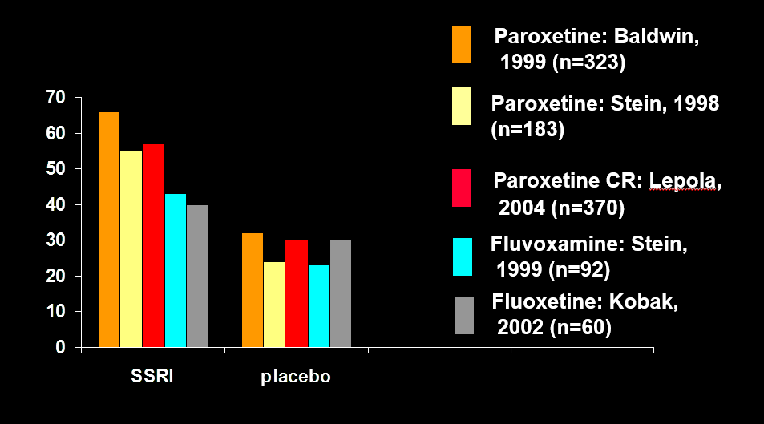
SSRI Response Rates (%) in pivotal trials
Baldwin D, et al. Br J Psychiatry. 1999;175:120-126. Stein MB, et al. JAMA. 1998;280(8):708-713. Lepola U, et al. J Clin Psychiatry. 2004;65(2):222-229. Stein MB, et al. Am J Psychiatry. 1999;156(5):756-760. Kobak KA, et al. J Clin Psychopharmacol. 2002;22(3):257-262.

Slide 18
SSRI/SNRI Treatment of SAD
The class overall is efficacious (SSRI treatment response risk ratio = 1.65)
Medical management should include encouraging self-exposure to feared situations
No evidence for efficacy in performance type SAD.
No clear evidence for superiority of one SSRI or SNRI over another, though switching non-responders to another SSRI/SNRI is sometime effetive.
SSRI non-remitters did not benefit from switch to venlafaxine in a RCT.
Williams, et al. Cochrane Database Syst Rev 2017; 10(10)CD001206; Pollack, et al. Am J Psychiatry 2014; 171:44-53

Slide 19
Audience Poll Question 1
After 4 weeks of sertraline treatment, including past 2 weeks at 100mg/day, there is no clear improvement and no persistent adverse effects. Next step is:
Continue to gradually escalate dose to 200mg/day and re-evaluate in 2 weeks.
Add a 2nd medication to augment effects.
Switch from sertraline to another medication.
Not sure.

Slide 20
Audience Poll Question 1
After 4 weeks of sertraline treatment, including past 2 weeks at 100mg/day, there is no clear improvement and no persistent adverse effects. Next step is:
Continue to gradually escalate dose to 200mg/day and re-evaluate in 2 weeks.
Add a 2nd medication to augment effects.
Switch from sertraline to another medication.
Not sure.

Slide 21
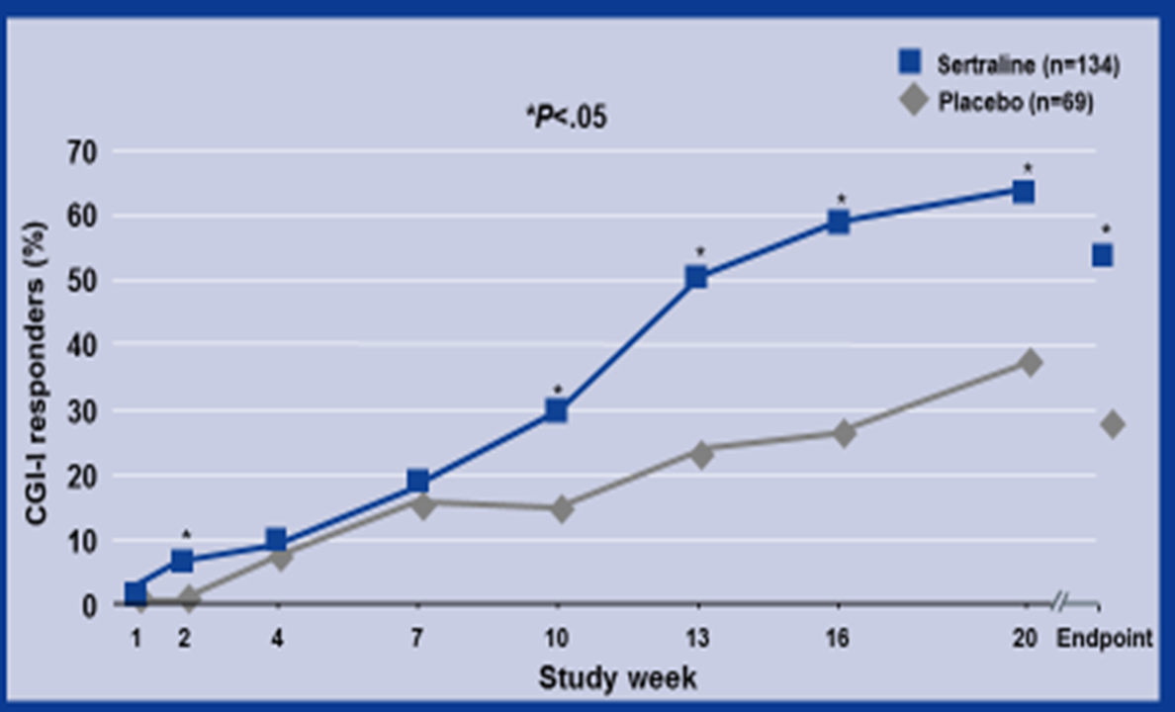
Sertraline: Significantly Greater Response Rate vs Placebo
Adapted from Van Ameringen, et al. Am J Psychiatry. 2001;158(2):275-281.

Slide 22
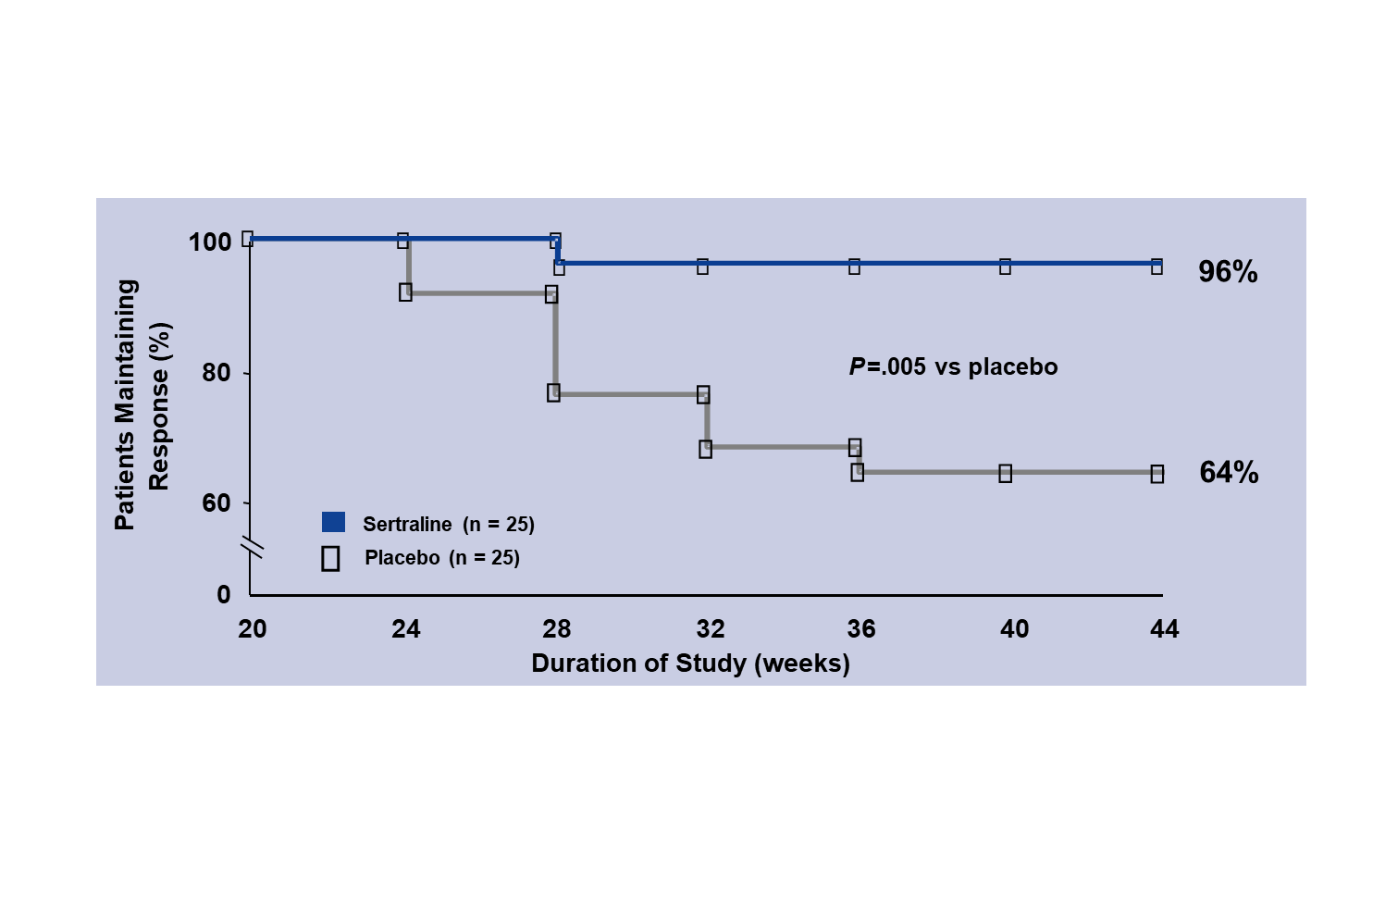
Sertraline: 96% Maintained Response in a Longer Term Continuation Trial
Adapted from Walker, et al. J Clin Psychopharmacol. 2000;20(6):636-644.

Slide 23
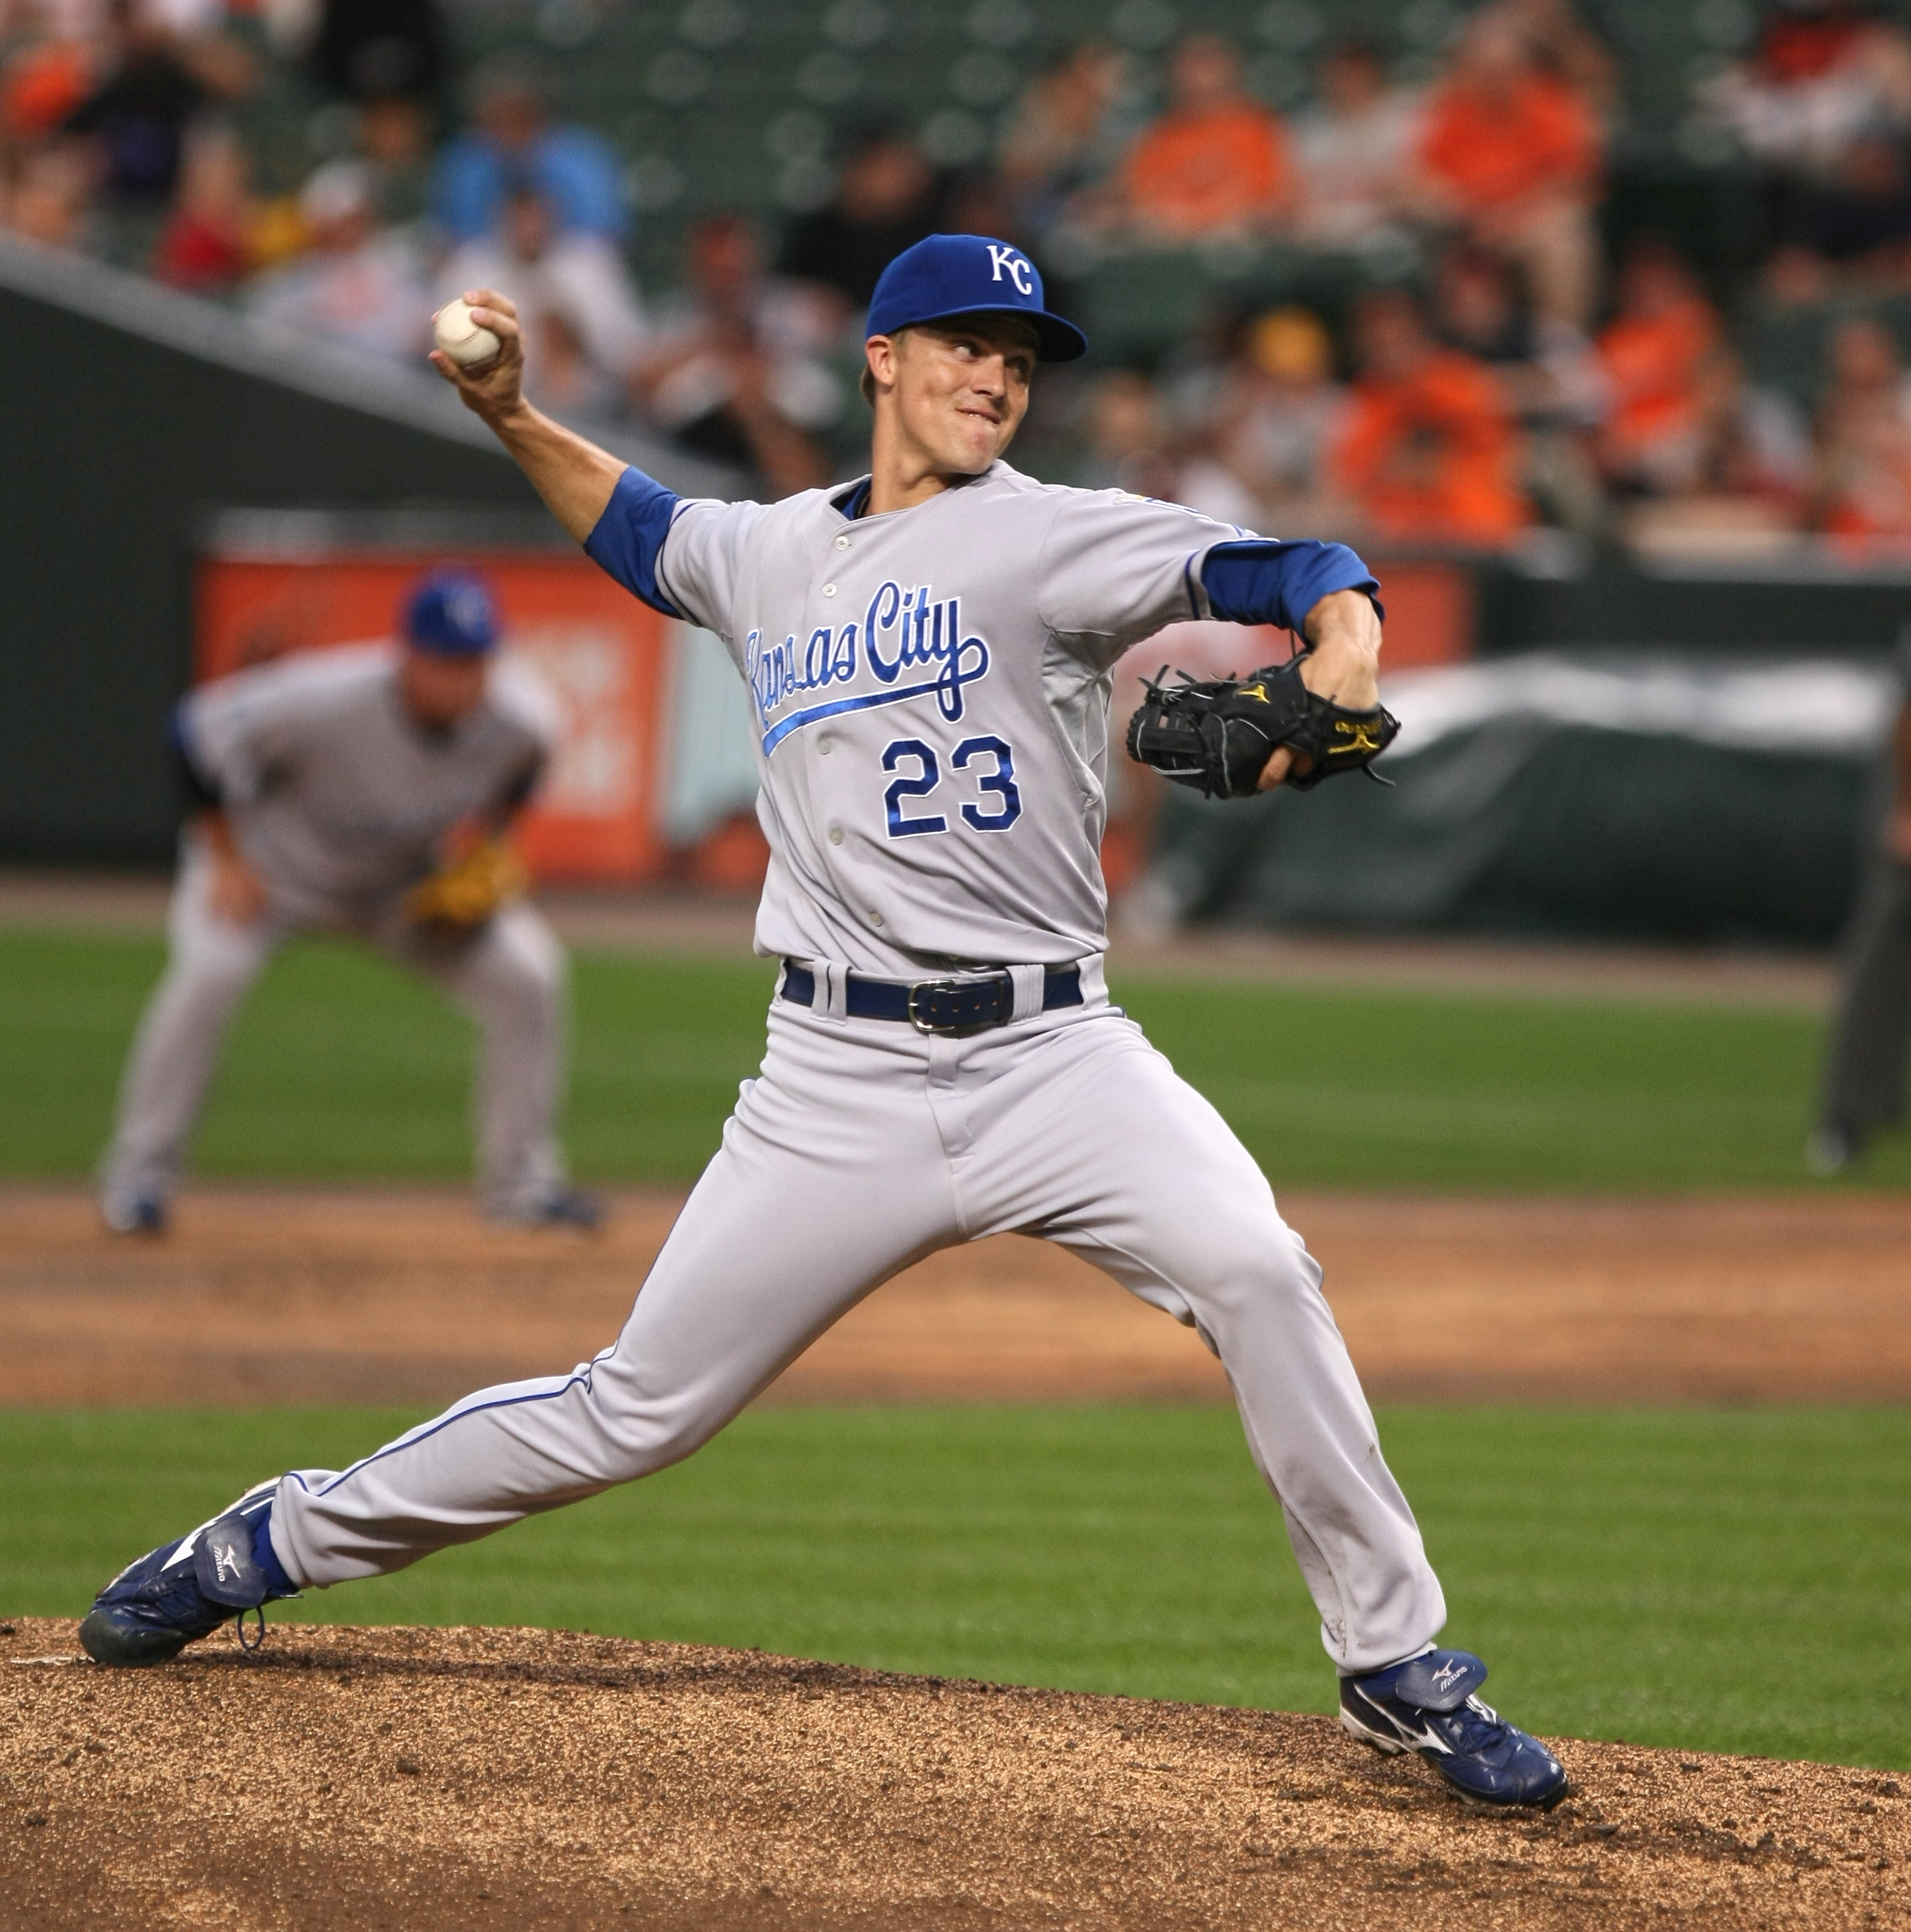
Case History: Zack Greinke
2006: Disabled by SAD “I was done playing,” and he reported receiving medication and therapy treatment.
2009: Best pitcher in American League
Recovery is common
2020: When there were no fans in the stands during COVID, he said that was enjoyable for him, “Cause there’s no one trying to talk to you”
Remission, not so much
New York Times 4/23/2009; CBS news 10/13/2020; Photo by Keith Allison, licensed under the Creative Commons Attribution-Share Alike 2.0 Generic license.

Slide 24
Audience Poll Question 2
Benzodiazepines…
Are the first-line medication treatment for SAD
Should be used for SAD only rarely due to risk of addiction.
Are a reasonable option for SSRI nonresponders who are not at elevated risk for abuse.
Cannot be safely combined with SSRIs

Slide 25
Audience Poll Question 2
Benzodiazepines…
Are the first-line medication treatment for SAD
Should be used for SAD only rarely due to risk of addiction.
Are a reasonable option for SSRI nonresponders who are not at elevated risk for abuse.
Cannot be safely combined with SSRIs

Slide 26
Benzodiazepine RCTs in SAD
 |  |  |  |  | Response rates (%)
 |  | Sample Size | Duration | Daily Dose | Drug | Placebo
Clonazepam | Davidson et al. (1993) | 75 | 10 weeks | 0.5–3.0mg | 78 | 20
Clonazepam | Munjack et al. (1990) | 23 | 8 weeks | 0.5–6.0mg | 90 | 10
Clonazepam (augmentation) | Seedat and Stein (2004) | 28 | 10 weeks | 1.0-2.0 mg | 79 | 43
Clonazepam | Ontiveros et al. (2008) | 27 | 16 weeks | 3.4 mg (mean dose) | 65 | 30
Bromazepam | Versiani et al. (1997) | 60 | 12 weeks | 3–27 mg | 83 | 20
Alprazolam | Gelernter et al. (1991) | 65 | 12 weeks | 2.1–6.3 mg | 38 | 23
Adapted from Weeks (Ed.) The Wiley Blackwell Handbook of Social Anxiety Disorder, 2014, pp 521-546

Slide 27
Evidence for Clonazepam in SAD
There is RCT evidence for Clonazepam, ̃2-3mg/day:
supporting efficacy in SAD as a monotherapy
combined with SSRI at outset, to have superiority over SSRI monotherapy
as an augmentation for SSRI non-remitters, to have superiority over SSRI continuation or switch to venlafaxine
Slow taper of clonazepam after 6 months treatment was well-tolerated in an RCT:
Placebo-controlled taper by 0.25 mg/2 weeks resulted in 0% relapse vs 21% in the group switched to placebo
Studies in analogue sample suggest benzodiazepines are also useful taken as needed for performance anxiety.
Risks include: abuse, sedation, falls (in elderly), withdrawal symptoms
Seedat S, Stein MB, J Clin Psychiatry 2004;65:244-8; Pollack et al. Am J Psychiatry. 2014;171(1):44-53; Connor et al. J Clin Psychopharmacology 1998; 18:373-378

Slide 28
Other meds
Gabapentin and Pregabalin
Modestly efficacious in 3 trials (response rates 30-43% vs 14-22%)
Mirtazapine
Mixed results in 2 trials (response rates 26% vs. 5%, and 13% vs. 13%, respectively)
Buspirone
Ineffective at low doses in 2 RCTs (up to 30mg/d)
Pande, et al., J Clin Psychopharmacol 2004; 24:141-9; Feltner, et al., Int Clin Psychopharacol 2011; 26:213-20; Muehlbacher, et al., J Clin Psychopharmacol 2005; 25:580-3; Van Vliet, et al., J Clin Psychiatry 1997; 58:164-8

Slide 29
Beta Adrenergic Blockers
Ineffective for generalized SAD in 2 RCTs of daily dosing of atenolol
Probably efficacious for performance type SAD
Based on several small RCTs of single doses in analogue samples.
Typical dosing is propranolol 20mg one hour before the performance situation.
Widely used off label for stage fright in anxious performers
Recently heavily promoted by online health care provider companies
Risks include hypotension, heart block, and exacerbating asthma or depression.
Liebowitz, et al. Arch Gen Psychiatry 1992 49: 290-300; Turner, et al. J Consult Clin Psychol 1994 62:350-8

Slide 30
Monoamine Oxidase Inhibitors
Among first meds studied for SAD, due to their known efficacy for interpersonal sensitivity in atypical depression
Phenelzine appeared efficacious in 5 RCTs.
Rarely prescribed in recent years to due to:
need for low-tyramine diet and risk of hypertensive reactions
risk of serotonin syndrome if combined with SSRIs.
The reversible MAOI moclobemide (marketed only outside the US) had mixed results in 5 RCTs.
Blanco et al. Int J Neuropsychopharmacol 2003 6: 427-42

Slide 31
Ketamine: Preliminary Findings
2 small crossover RCTs
One (n=12) showed some improvement in generalized anxiety lasting up to one week
One (n=18) found greater response rate over 2 week period after a single infusion (33% vs 0% for placebo)
Limitations:
Small studies
Blinding is difficult
No long term outcomes
Taylor JH, et al. Neuropsychopharmacology 2018;43:325-333; Glue, et al. J Psychopharmacol 2020; 34:267-272

Slide 32
Atypical Antipsychotic Trials in SAD
Rationale for study in SAD:
Quetiapine XR has shown efficacy for generalized anxiety disorder
Histamine receptor antagonism, and partial agonism at D2 and 5HT-1A receptors may be relevant for anxiety and anhedonia
Several atypicals have been found efficacious for augmentation in depression, and depressive symptoms often accompany SAD
Concerns: Side Effect Risks
Akathisia, Sedation, Metabolic, Cardiac, Tardive Dyskinesia
Garakani, et al. Acta Psychiatr Scand 2024; 149:295-312

Slide 33
RCTs of Antipsychotics for SAD
Quetiapine Monotherapy:
Placebo-controlled RCT of quetiapine (147 +/-105 mg/d) in SAD
N=15
No difference on clinician-rated instruments (Brief Social Phobia Scale or CGI)
Large effect on the self-rated Social Phobia Inventory
Placebo-controlled RCT of single dose quetiapine 25mg prior to public speaking in SAD
N=20
No effect on anxiety
Elevated HR and sleepiness
Vaishnavi, et al. Prog in Neuro-Psychopharmacol Biol Psychiatry 2007; 31: 1464-9; Donahue, et al., J Anx Disord 2009; 23:362-8

Slide 34
Olanzapine Monotherapy in SAD
Placebo-controlled RCT of olanzapine 20mg/d in 12 patients with SAD
Modified Intent-to-treat analysis (n=5 olanzapine and n=5 placebo):
Olanzapine reduced social anxiety more than placebo on 2 of 3 measures.
More drowsiness and dry mouth in olanzapine group
35 Barnett et al., 2002

Slide 35
Atypical Antipsychotics - Summary
Two small RCTs of monotherapy for SAD have had mixed results
One small RCT found low-dose quetiapine ineffective for public speaking anxiety
Other (uncontrolled) studies have suggested some benefit aripiprazole monotherapy and risperidone augmentation
Simon, et al. J Clin Psychiatry 2006; 67: 381-5

Slide 36
Audience Poll Question 3
Patient K is a 32 y.o. homemaker who unexpectedly has been asked to give a toast at a friend’s wedding in 2 weeks. K has always avoided public speaking and fears experiencing extreme anxiety. Which of the following orders of preference of medication treatment options is most reasonable:
Propranolol as needed; Lorazepam as needed; Sertraline daily plus propranolol as needed
Sertraline as needed, Paroxetine as needed, Propranolol as needed
Sertraline daily, Venlafaxine daily, Propranolol as needed
Propranolol as needed, Quetiapine as needed, Lorazepam as needed

Slide 37
Audience Poll Question 3
Patient K is a 32 y.o. homemaker who unexpectedly has been asked to give a toast at a friend’s wedding in 2 weeks. K has always avoided public speaking and fears experiencing extreme anxiety. Which of the following orders of preference of medication treatment options is most reasonable:
Propranolol as needed; Lorazepam as needed; Sertraline daily plus propranolol as needed
Sertraline as needed, Paroxetine as needed, Propranolol as needed
Sertraline daily, Venlafaxine daily, Propranolol as needed
Propranolol as needed, Quetiapine as needed, Lorazepam as needed

Slide 38
Audience Poll Question 4
Patient Z is a 30 y.o. data analyst who is impaired socially and in work by self-consciousness and anxiety in meetings, social gatherings of small groups of friends, dating, and eating in public. Z has a past history of alcohol use disorder that is in partial remission. After several months of CBT and 12 weeks of fluvoxamine, anxiety is moderately improved but Z remains distressed most of the time and remains impaired. Which of the following statements about a next option for medication treatment is most correct?
Benzodiazepine augmentation is relatively contraindicated due to alcohol abuse history.
Switching to an SNRI has been established as having benefit in SAD.
Antipsychotic augmentation is an established augmentation strategy in SAD.
Because SAD symptoms are predominant, they should be treated further before considering alcohol use disorder treatments.

Slide 39
Audience Poll Question 4
Patient Z is a 30 y.o. data analyst who is impaired socially and in work by self-consciousness and anxiety in meetings, social gatherings of small groups of friends, dating, and eating in public. Z has a past history of alcohol use disorder that is in partial remission. After several months of CBT and 12 weeks of fluvoxamine, anxiety is moderately improved but Z remains distressed most of the time and remains impaired. Which of the following statements about a next option for medication treatment is most correct?
Benzodiazepine augmentation is relatively contraindicated due to alcohol abuse history.
Switching to an SNRI has been established as having benefit in SAD.
Antipsychotic augmentation is an established augmentation strategy in SAD.
Because SAD symptoms are predominant, they should be treated further before considering alcohol use disorder treatments.

Slide 40
Reviews and Guidelines
Canadian guidelines recommend aripiprazole or risperidone 3rd line options for SAD. Katzman 2014
NICE (2013) and World Federation of Societies of Biological Psychaitry guidelines do not recommend Aps for SAD Gualana 2010
The evidence to date does not warrant the use of atypical antipsychotics as first-line monotherapy or as first- or second-line adjunctive therapy in the treatment of anxiety disorders.
Pies 2009
Not recommended Pignon 2017
we found that evidence for antipsychotic use in PD and SAD is not robust enough
Garakani 2024
.

Slide 41
Investigational Drugs
Fasendiol (PH94B) – a pheromone-like drug has shown promise in 2 RCTs
Cannabinoids
Cannabidiol
FAAH inhibitor
Ayhuasca
Oxytocin
Alpha-7-nicotinic acetylcholine receptor agonists
Liebowitz, et al. CNS Spectrums 2024; 29; 523-524.
Kwee, et al. European Neuropsychopharmacology 2022; 59; 58-67.
Schmidt, et al. Neuropsychopharmacology 2021; 46: 1004-1010.

Slide 42
Summary/Conclusions
There is no single approach that has been established as best for treatment of partial responders or nonresponders to SSRIs in SAD.

Slide 43
Questions?
Thank you for attending!
Notes:
This will be the final slide for all presentations.

