Slide 1




Managing Diabetes for Persons with Dementia
April 9th 2026
Robin Brown, MD| Assistant Professor, Geriatrics OHSU| browrobi@ohsu.edu
Notes:
4/9 11-12p
30-minute total, giving more time for intro and Q&A afterwards

Slide 2

Disclosures
This presentation is partially funded through a HRSA sponsored Geriatrics Workforce Enhancement Program (GWEP) and does not reflect the views of the US Government.

Slide 3
Objectives
Recognize the relationship between diabetes and dementia in older adults
Understand why persons with dementia (PWD) are at higher risk for hypoglycemia and how you can mitigate these risks
Demonstrate how to simplify or de-intensify diabetes medications
Understand how to approach diabetes care for patients at the end-of-life
Notes:
Focusing on type 2 diabetes

Slide 4



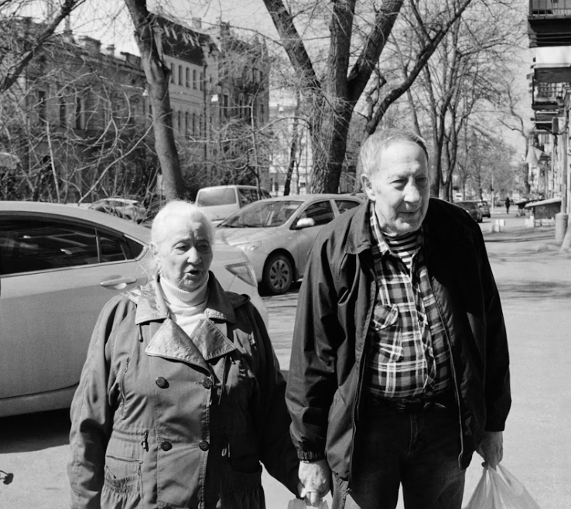


1 in 3 nursing home residents in the U.S. have diabetes
1 in 2 older adults in the U.S.
have prediabetes
1 in 3 older adults in the U.S.
have diabetes
Notes:
These numbers are all projected to increase as our populations ages
In this talk I am focusing on type 2 diabetes since that is the more common type to be managed in the primary care setting without specialist support, however there are increasing rates of older adults with type 1 as people with this disease live longer.

Slide 5




Prevalence of DM2 by race/ethnicity:
15.7% American Indian or Alaska Native
12.2% Black
11.8% Hispanic
9.7% Asian
7.1% White
ADA 2023: statistics about diabetes
Notes:
DM2 is a metabolic disease due to abnormalities in insulin secretion, insulin action, or both.
Adults from 2021-2023

Slide 6
Physiology of aging
as it relates to diabetes in older adults
Increased visceral fat and reduced muscle mass > insulin resistance
Reduction in insulin receptors and glucose transporters
Changes to taste and smell, reduced thirst
Changes in pharmacokinetics “what the body does to the drug” older adults may take longer to metabolize medications and be slower to eliminate them from the body
Changes in pharmacodynamics “what the drug does to the body” older adults may be more sensitive to lower doses of medication “start low and go slow”
Diseases more likely with aging:
Tremor, visual impairment, renal insufficiency, urinary incontinence

Slide 7


diabetes dementia
Persons with diabetes have higher incidence of dementia
The longer someone has diabetes the more likely they are to have dementia
Both hyper- and hypoglycemia are associated with a decline in cognitive function
Persons with dementia are more likely to develop diabetes
↔
*Screen older adults annually for cognitive impairment

Slide 8
What is dementia?
Impairment in ≥1 cognitive domain
Functional loss
Progression over time

Slide 9
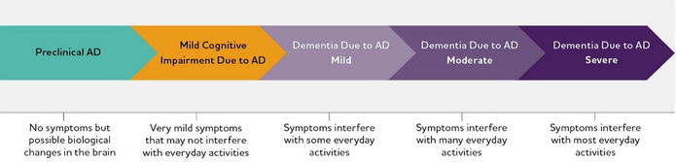
Stages of Dementia
Alzheimer's disease facts and figures. Alzheimers Dement. 2024;20(5):3708-3821

Slide 10
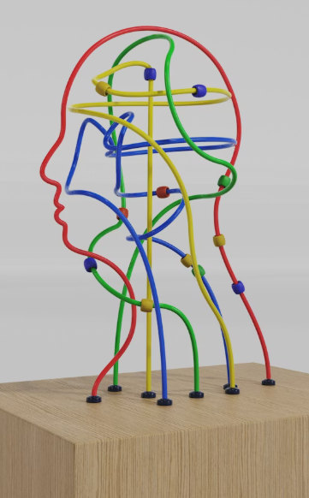
Functional decline from dementia will impact a patient’s ability to self-manage diabetes
Have trouble navigating medical appointments
Forget when or how to take medications
Have difficulty checking sugars, or using injectable medications
Miss signs or symptoms of hypo- or hyperglycemia
Skip meals, make unhealthy food choices, be prone to dehydration
Notes:
Older adults with DM2 are 1.5x more likely to need assistance in instrumental activities of daily living. GRS 12

Slide 11
Functional decline from dementia will impact a patient’s ability to self-manage diabetes
Have trouble navigating medical appointments
Forget when or how to take medications
Have difficulty checking sugars, or using injectable medications
Miss signs or symptoms of hypo- or hyperglycemia
Skip meals, make unhealthy food choices, be prone to dehydration
Self-management abilities need to be routinely assessed, especially when:
Treatment plans change
Clinical change or hospitalization
Functional decline
Notes:
Recommendation 13.1 - ADA; 13. Older Adults: Standards of Care in Diabetes—2026

Slide 12

Case - Hoku 78yow
CC: increasing anxiety
An established pt who was diagnosed with dementia four years ago. She lives with his daughter Sharyl, who joins the visit.
Hoku has type 2 diabetes and her current meds include:
Glargine 32u QHS
Aspart 6u TID AC
Glyburide 2.5 QAM
Metformin 1,000 ER BID
Sharyl shares that in the couple months her mother is regularly anxious in the early evenings. Her symptoms seem to subside after they have dinner. You wonder if she could be becoming hypoglycemic. You ask Sharyl to check her glucose on arriving home.
The next day she calls your clinic “wow it was low, her glucose was 58!”.

Slide 13
Quiz!
1 in 2 middle-aged patients correctly identified the symptoms of hypoglycemia, how many older adults correctly identified the symptoms of hypoglycemia? (put your answer in the chat)
1 in 3 older adults
1 in 5 older adults
1 in 13 older adults
1 in 22 older adults

Slide 14
Quiz!
1 in 2 middle-aged patients correctly identified the symptoms of hypoglycemia, how many older adults correctly identified the symptoms of hypoglycemia? (put your answer in the chat)
1 in 3 older adults
1 in 5 older adults
1 in 13 older adults
1 in 22 older adults
Notes:
Citation?

Slide 15
PWD and diabetes are at higher risk of hypoglycemia
Trouble with self- management
- Taking too little or too much medication
- Skipping meals, unhealthy food choices, dehydration
Trouble recognizing signs/symptoms of hypoglycemia
Comorbidities that increase risk of hypoglycemia
- Renal insufficiency
- Vision loss
- Tremor
- Hunger, anxiety, sweating, confusion
Notes:
Changes in taste
Renal insufficiency (lowers clearance of insulin), vision loss (may overtreat with meds)
Fasting for cultural or religious reasons
Acute illness, trauma, surgery increase risk

Slide 16
Case - Hoku 78yow
Sharyl realizes that while her mom can check her sugars when prompted, she forgets to check them when she’s on her own and no longer seems to recognize symptoms of low blood sugars.
Sharyl works 9-5 and Hoku is on her own in the day. Sharyl worries that her mom may be forgetting to eat lunch occasionally.
You schedule a follow-up to discuss medication changes, but in the meantime recommend Sharyl:
hold her mom’s glyburide
call her mom at lunch to remind her to check her BG and read them aloud to her
create a written lunch and afternoon snack plan

Slide 17
Caregivers
Older adults with diabetes often require more caregiver support than those without diabetes, especially true for PWD.
Identify caregivers
Involve them in all diabetes visits
Match treatment complexity with caregiver abilities
Number of medications, orals vs injectables
Assess need/frequency of fingersticks and injections
Discuss meal prep and healthy food choices
Consider if we can better support the caregiver
Involve the caregiver

Slide 18
Living situation
Needs to be considered when developing diabetes care plans for PWD > where are they living and do they have adequate support?
In the community
Independent living
Assisted living
Memory care
Notes:
Living situation and support needs must be considered as they greatly impact diabetes management. Patient living at an “assisted living facility” but in independent living may not have help with medications

Slide 19

Be cautious of quality metrics in frail older adults
Diabetes quality metrics almost always promote higher intensity treatments (= lower A1C), which does not consider treatment harms (ex. hypoglycemia) or patient heterogeneity
Notes:
Used extensively, and often tied to clinic reimbursements

Slide 20


Sarah – 81yo: DM2, moderate dementia, osteoporosis, recent hip fx
Mina – 82yo: DM2, HLD, GERD
Due to the heterogeneity of older adults, we both over- and undertreat those with diabetes
Notes:
Goals need to be individualized. Some pts may have had diabetes for years and is very skilled in self management. Or have had it for years and have significant complications. Or be recently diagnosed and are well controlled. Or be recently diagnosed and be very confused about how to manage sugars.
Patients also vary in their preferences for treatment intensity and medication options.

Slide 21
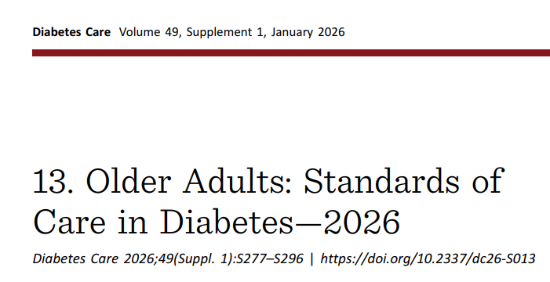
Link to 2026 guidelines: https://diabetesjournals.org/care/article/49/Supplement_1/S277/163921/13-Older-Adults-Standards-of-Care-in-Diabetes-2026
Notes:
Health status, life expectancy, patient priorities

Slide 22
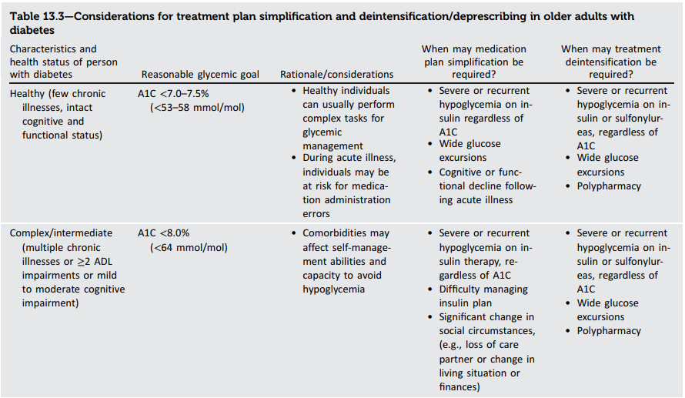























Table 13.3 from ADA; 13. Older Adults: Standards of Care in Diabetes—2026
Notes:
In all cases, patient preferences and quality of life must be considered.
Complex/intermediate group: These individuals may not only not derive benefit from intensive glucose lowering but are also more likely to experience serious adverse effects of treatment, such as hypoglycemia (73). However, significant hyperglycemia should also be avoided
Intensive treatment is associated with higher risk of hypoglycemia. Although these studies predominantly had insulin use (and not GLP1 agonists, or SGLT2 inhibitors) ADA guidelines.

Slide 23
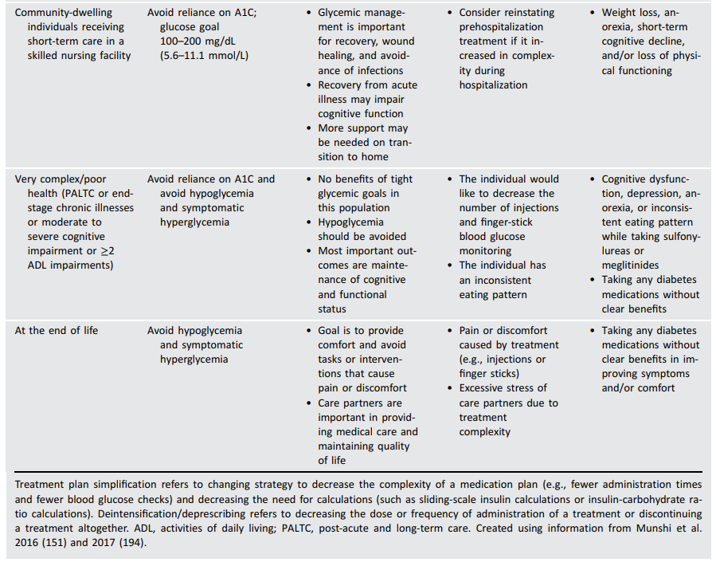




















Table 13.3 from ADA; 13. Older Adults: Standards of Care in Diabetes—2026

Slide 24
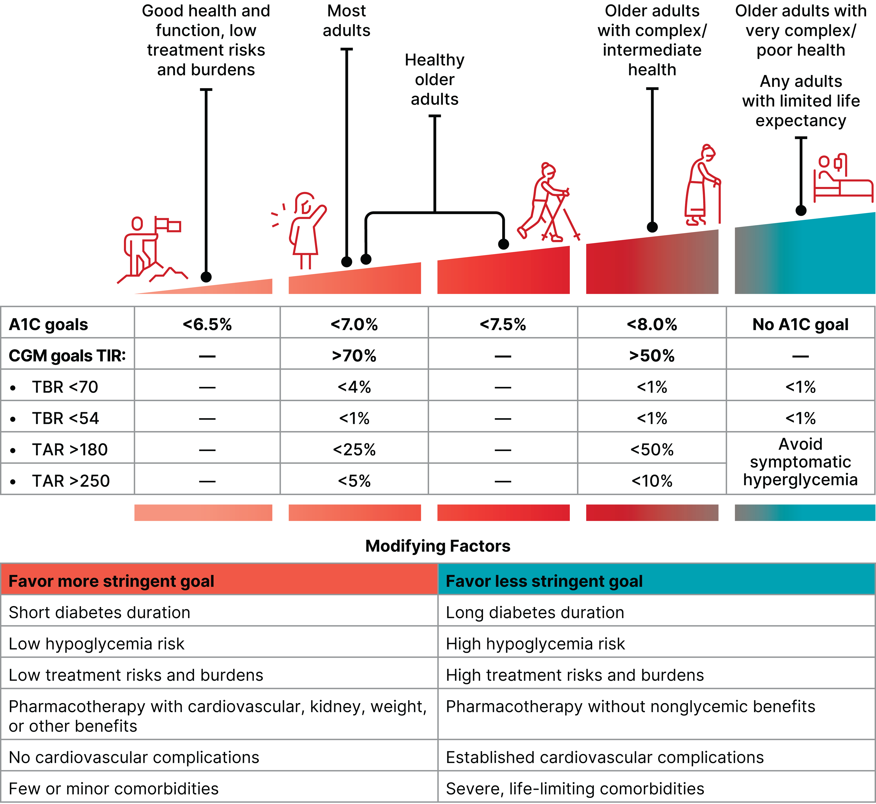
ADA 6. Glycemic Goals, Hypoglycemia, and Hyperglycemic Crises: Standards of Care in Diabetes—2026. Diabetes Care 1 January 2026; 49 (Supplement_1): S132–S149
Notes:
A1C can be impacted by conditions that affect red blood cell turnover. Conditions affecting red blood cell turnover that are common in older adults include kidney failure, recent significant blood loss, and erythropoietin therapy. In these instances, blood glucose monitoring and/or CGM should be used for glycemic goal setting
They give A1C targets, but if you read the article they also give time within range (TIR) and for CGM users

Slide 25
Case - Hoku 78yow
Problem list:
Early moderate Alzheimer’s dementia
Type 2 diabetes, previously difficult to control until the last year, recent A1C 6.6%
Hypertension
Hyperlipidemia
Gait instability with recurrent falls
IADLs:
She is no longer driving after becoming lost
She manages her own meds, but Sharyl wonders if she is doing it correctly
Sharyl took over the household finances
She joins Sharyl to the grocery store, but no longer creates the shopping list
She can put together simple meals but is frightened to use the stove
She picks up the phone when called but has trouble calling out

Slide 26












Case - Hoku 78yow
Pmhx:
Mild-moderate Alzheimer’s dementia
Type 2 diabetes, well controlled (last A1C 6.6%), recent hypoglycemia
Hypertension
Hyperlipidemia
Gait instability with recurrent falls
Functional status: ***

Slide 27
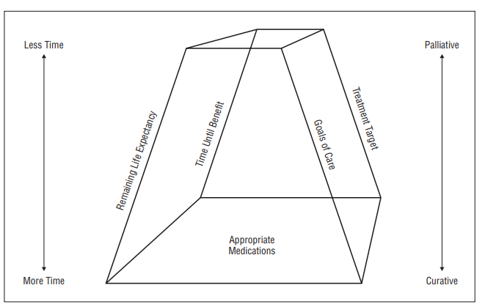
How to think about treatment goals?
Holmes HM et al. Reconsidering medication appropriateness for patients late in life. Arch Intern Med. 2006;166(6):605-609
Notes:
One of the really good things that has happened, at least through the ADA guidelines, in the last 5 years, is a shift in how to think about treatment goals for older adults. If they are healthly then yes maybe an a1c of <7% make sense, but if they have short life expectancy and/or multimorbidity, then it’s less beneficial to the patient to target a low A1C, and rather to focus on avoiding hyper- or hypoglycemia
Life expectancy calculator for older adults with diabetes, LEAD: https://pmc.ncbi.nlm.nih.gov/articles/PMC10228886/
Holmes HM, Hayley DC, Alexander GC, Sachs GA. Reconsidering medication appropriateness for patients late in life. Arch Intern Med. 2006;166(6):605-609

Slide 28
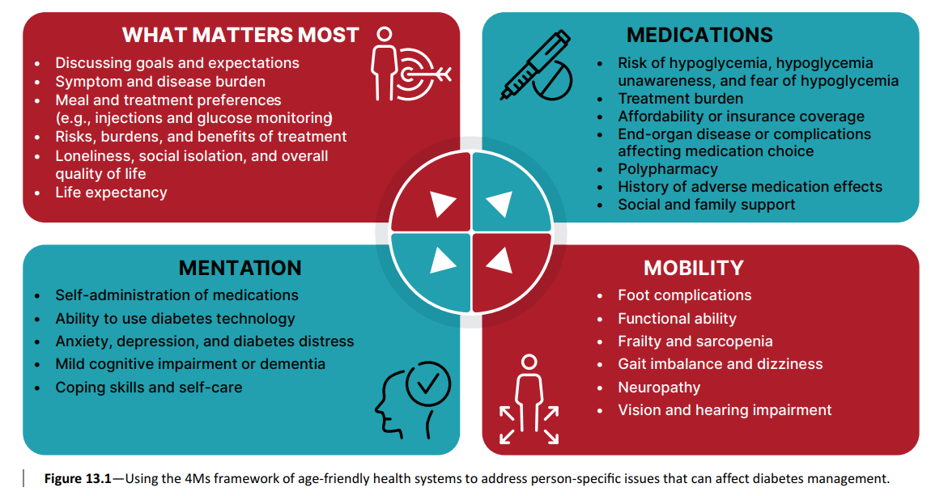
Using the 4Ms – diabetes care
Figure 13.1 from ADA; 13. Older Adults: Standards of Care in Diabetes—2026
Notes:
The 4Ms framework provides a helpful conceptual model to address person-specific issues that may be interrelated and affect diabetes management in older individuals (Fig. 13.1) and offers a framework to establish individualized treatment goals and approaches (13–15), including delivery of diabetes self-management education (particularly when complicating factors arise or when transitions in care occur) and whether the current plan is too complex for the individual’s self-management ability or for the care partners providing care (16). Particular attention should be paid to complications that can develop over short periods of time and/or would significantly impair functional status, such as visual and lower extremity complications

Slide 29
Using the 4Ms – Hoku
Frightened by “anxiety” of low sugars
Has had DM2 for a long time, reluctant to change meds for fear of high sugars
Wants to stay at home for as long as possible
Life expectancy 3-5 years
Does not recognize symptoms of hypoglycemia
Is on a complex medication regimen, with multiple meds that cause hypoglycemia
Does not have help in the day
Early moderate dementia
Unable to use diabetes technology
May be missing medications or meals
Uses a cane, has had frequent falls
Vision is worse, forgets to wear glasses

Slide 30

Screening for diabetes complications should be individualized and focused on preserving function and QOL
The largest benefit in limiting microvascular complications occurs when lowering very high A1C to moderate A1C (ex. 11% > 8%), there is less benefit in further reductions as the benefits are small and the risk of hypoglycemia is high.
Consider patient’s life expectancy vs. time-to-benefit from intervention. It takes 8 years of glycemic control will reduce microvascular complications.
ADA recommendation 13.8. Screening for diabetes complications should be individualized in older adults with diabetes. Prioritize screening for complications that would lead to impairment in functional status of quality of life. C
Geriatrics Review Syllabus. 12th Ed. 2025
ADA 6. Glycemic Goals, Hypoglycemia, and Hyperglycemic Crises: SOC 2026
Notes:
Retinopathy, resulting in diminished vision and blindness
Neuropathy, increasing risk of falls and lower extremity complications such as foot ulcers
Nephropathy, resulting in chronic kidney disease

Slide 31
As people get older, they are more likely to have multiple health problems, and consequently, they are more likely to be on more medications.

Slide 32

Polypharmacy
≥ 5 medications
More common in older age
More common in certain health problems (ex. heart failure, diabetes, cancer)

Slide 33






77yo with:
DM2
CAD
Chronic pain
Constipation
Current medications:
Acetaminophen 325 mg oral tablet | take 2 tablets my mouth every six hours, chronic pain
Aspirin chewable 81 mg oral tablet | chew and swallow 1 tablet once daily, prevention of heart attack
Duloxetine 30 mg oral capsule, delayed release | take 2 tablets by mouth once daily, chronic skeletal pain
Empagliflozin 25 mg oral tablet | take 1 tablet by mount once daily, diabetes
Evolocumab (Repatha) 140mg/ml subcutaneous injection | inject 1mL under the skin every 14 days
Ezetimibe 10mg oral tablet | take one tablet by mouth once daily, high cholesterol
Fluticasone propionate 50mcg/actuation nasal spray | instill 2 sprays into each nostril once daily, allergies
Insulin glargine (Lantus) 100u/mL subcutaneous injection | inject 10 units under the skin every evening, diabetes
Melatonin 1 mg oral tablet | take 1 tablet once daily at bedtime, sleep
Metformin 500 mg oral tablets | take 2 tablets two times daily, diabetes
Metoprolol succinate 100 mg oral tablet extended release, heart disease
Losartan 25 mg oral tablet | take 1 tablet two times daily, high blood pressure
Oxycodone 5 mg oral tablet | take one tablet three times daily as needed for severe pain, prescribed by pain clinic
Pregabalin 100 mg oral capsule | take 1 capsule twice daily, chronic pain, prescribed by pain clinic
Senna 8.6 mg oral tablet | take 1 tablet twice daily as needed, constipation
15 meds!
4 cardiac
3 diabetes
3 pain
5 OTC

Slide 34
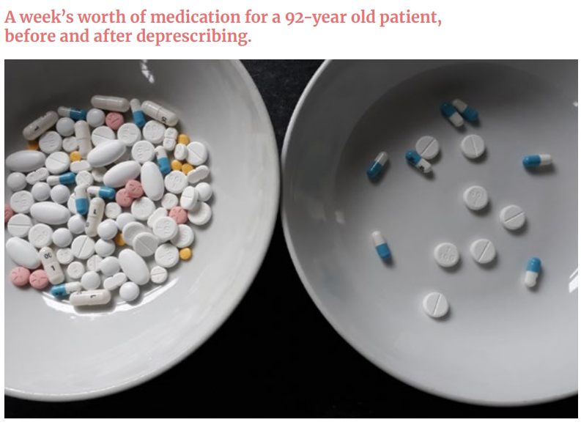
Medication Overload: America’s Other Drug Problem. How the drive to prescribe is harming older adults:
https://lowninstitute.org/wp-content/uploads/2019/08/medication-overload-lown-web.pdf
Notes:
Pill burden is something I think about often in my patients – from a quality-of-life standpoint.
This is a week’s worth of a 92 year old patient’s medications before and after deprescribing. This really speaks to that physical burden of taking many people.
This patient started out with 7 pills/day (went to 2 pills/day). Imagine my patient who had 15 pills/day!
https://lowninstitute.org/wp-content/uploads/2019/08/medication-overload-lown-web.pdf
*** do I want to add something about deprescribing

Slide 35
“what matters most”
Does care plan match caregiver management abilities?
Life expectancy versus time-to-benefit? Aim for function and quality of life.
Simplify / De-intensify / Deprescribe

Slide 36
What do patients want to hear?
(-) “Congratulations! You don’t need to have your A1C so low anymore… because you are not going to live long enough to benefit”
(+) “An A1C of 6.0% will not help you live longer”
Schoenborn NL et al. Older Adults’ Views and Communication Preferences About Cancer Screening Cessation. JAMA IM. 2017
Notes:
The most acceptable phrase to participants was, “This test will not help you live longer.” which is more about the ability of the test to help them, rather than whether they would benefit from the test in a given life expectancy.

Slide 37
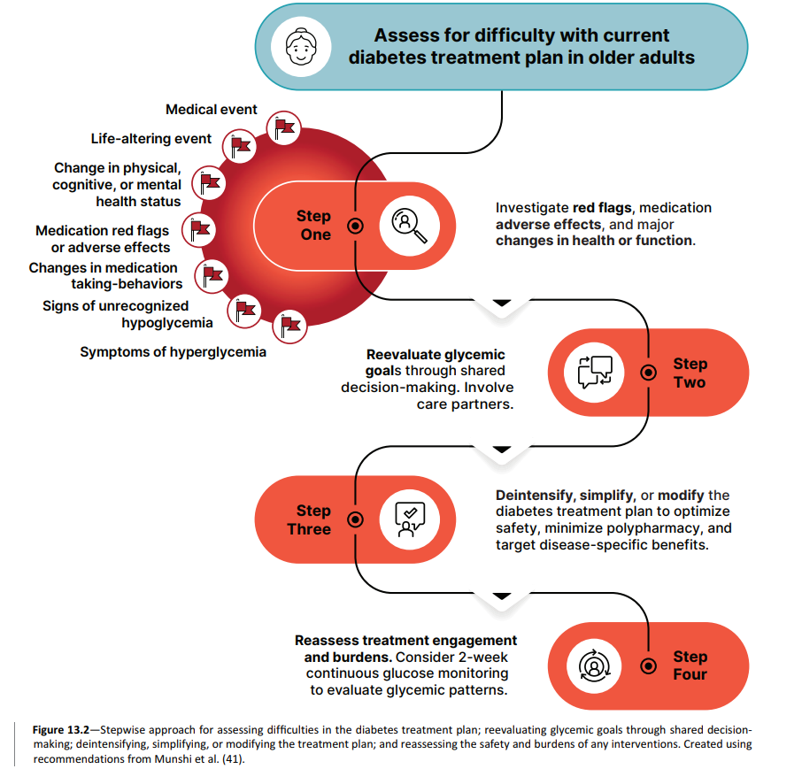
Figure 13.2 from ADA; 13. Older Adults: Standards of Care in Diabetes—2026

Slide 38
How to simplify medication use?
Meet with a pharmacist “brown bag med rec”
Prescribe 90-day refills
Use mail-in pharmacy
Provide medication lists
Recommend a pill-box
Avoid medical jargon (instead of “metformin BID” > “take one tablet in the morning and one tablet in the evening”)
Translate instructions into patient’s native language
Minimize multiple doses per day
Involve the caregiver
Notes:
If there are questions about what someone is taking?
You can have your patient do what is called a brown bag medication review – where they rbing all of the medicaionst hey are taking (prescribed or not) into the clinic
And you / them go through each bottle to make sure both the patient and the provider know what the patient is taking, how they are taking it, and why they are taking it.
This is the perfect opportunity to include your nurse or pharmacist if you have them available

Slide 39
Case - Hoku 78yow
New care plan:
A1C 6.6% → goal <8.0%
Recurrent hypoglycemia → avoid hypoglycemia and symptomatic hyperglycemia, focus on QOL and function
Alone during day → increase daughter involvement for meal planning/blood glucose checks/med supervision, refer to diabetic educator, consider home health for med management, explore other options of support
Med changes:
Glargine 32u QHS
Aspart 6u TID AC → lower or discontinue based on glucose logs
Glyburide 2.5 QAM → discontinue
Metformin 1,000 ER BID
“what matters most”
Does care plan match caregiver management abilities?
Life expectancy versus time-to-benefit? Aim for function and quality of life.

Slide 40
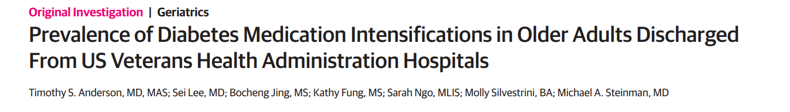
Transitions of Care (TOC)
FINDINGS: This cohort study of 16,178 older adults hospitalized in the VA, 1 in 10 patients were discharged with intensified diabetes medications. Nearly half of these patients had already reached outpatient blood glucose goals or had limited life expectancy
IMPORTANCE: Elevated blood glucose levels are common in hospitalized older adults and may lead clinicians to intensify outpatient diabetes medications at discharge, risking potential overtreatment when patients return home.
Notes:
Higher risk of hyperglycemia (and hypoglycemia) with acute illness, surgery, trauma
Move often represents a change in goals of care (given change in health status), changes in mobility, access to nutrition, monitoring of sugars. I often find when patients move into memory care diabetes treatment reduces given staff are now managing this. Need to include care partners.
Anderson TS, Lee S, Jing B, et al. Prevalence of Diabetes Medication Intensifications in Older Adults Discharged From US Veterans Health Administration Hospitals. JAMA Netw Open. 2020;3(3):e201511. Published 2020 Mar 2. doi:10.1001/jamanetworkopen.2020.1511

Slide 41
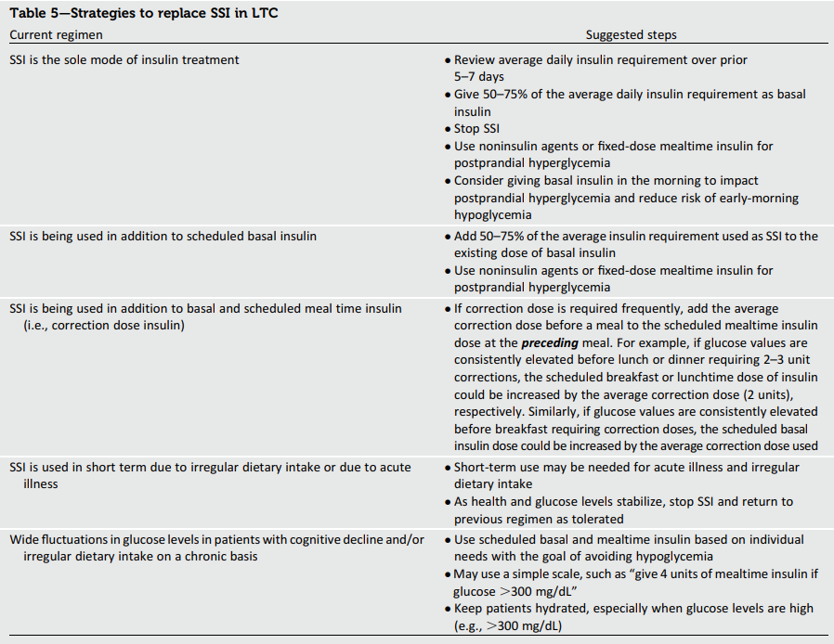




Management of Diabetes in LTC and SNF: a Position Statement from ADA. Diabetes Care 1 January 2016; 39(2):308-318
Notes:
Medha N. Munshi, Hermes Florez, Elbert S. Huang, Rita R. Kalyani, Maria Mupanomunda, Naushira Pandya, Carrie S. Swift, Tracey H. Taveira, Linda B. Haas; Management of Diabetes in Long-term Care and Skilled Nursing Facilities: A Position Statement of the American Diabetes Association. Diabetes Care 1 February 2016; 39 (2): 308–318.

Slide 42

Treatment considerations for persons with dementia and type 2 diabetes

Slide 43
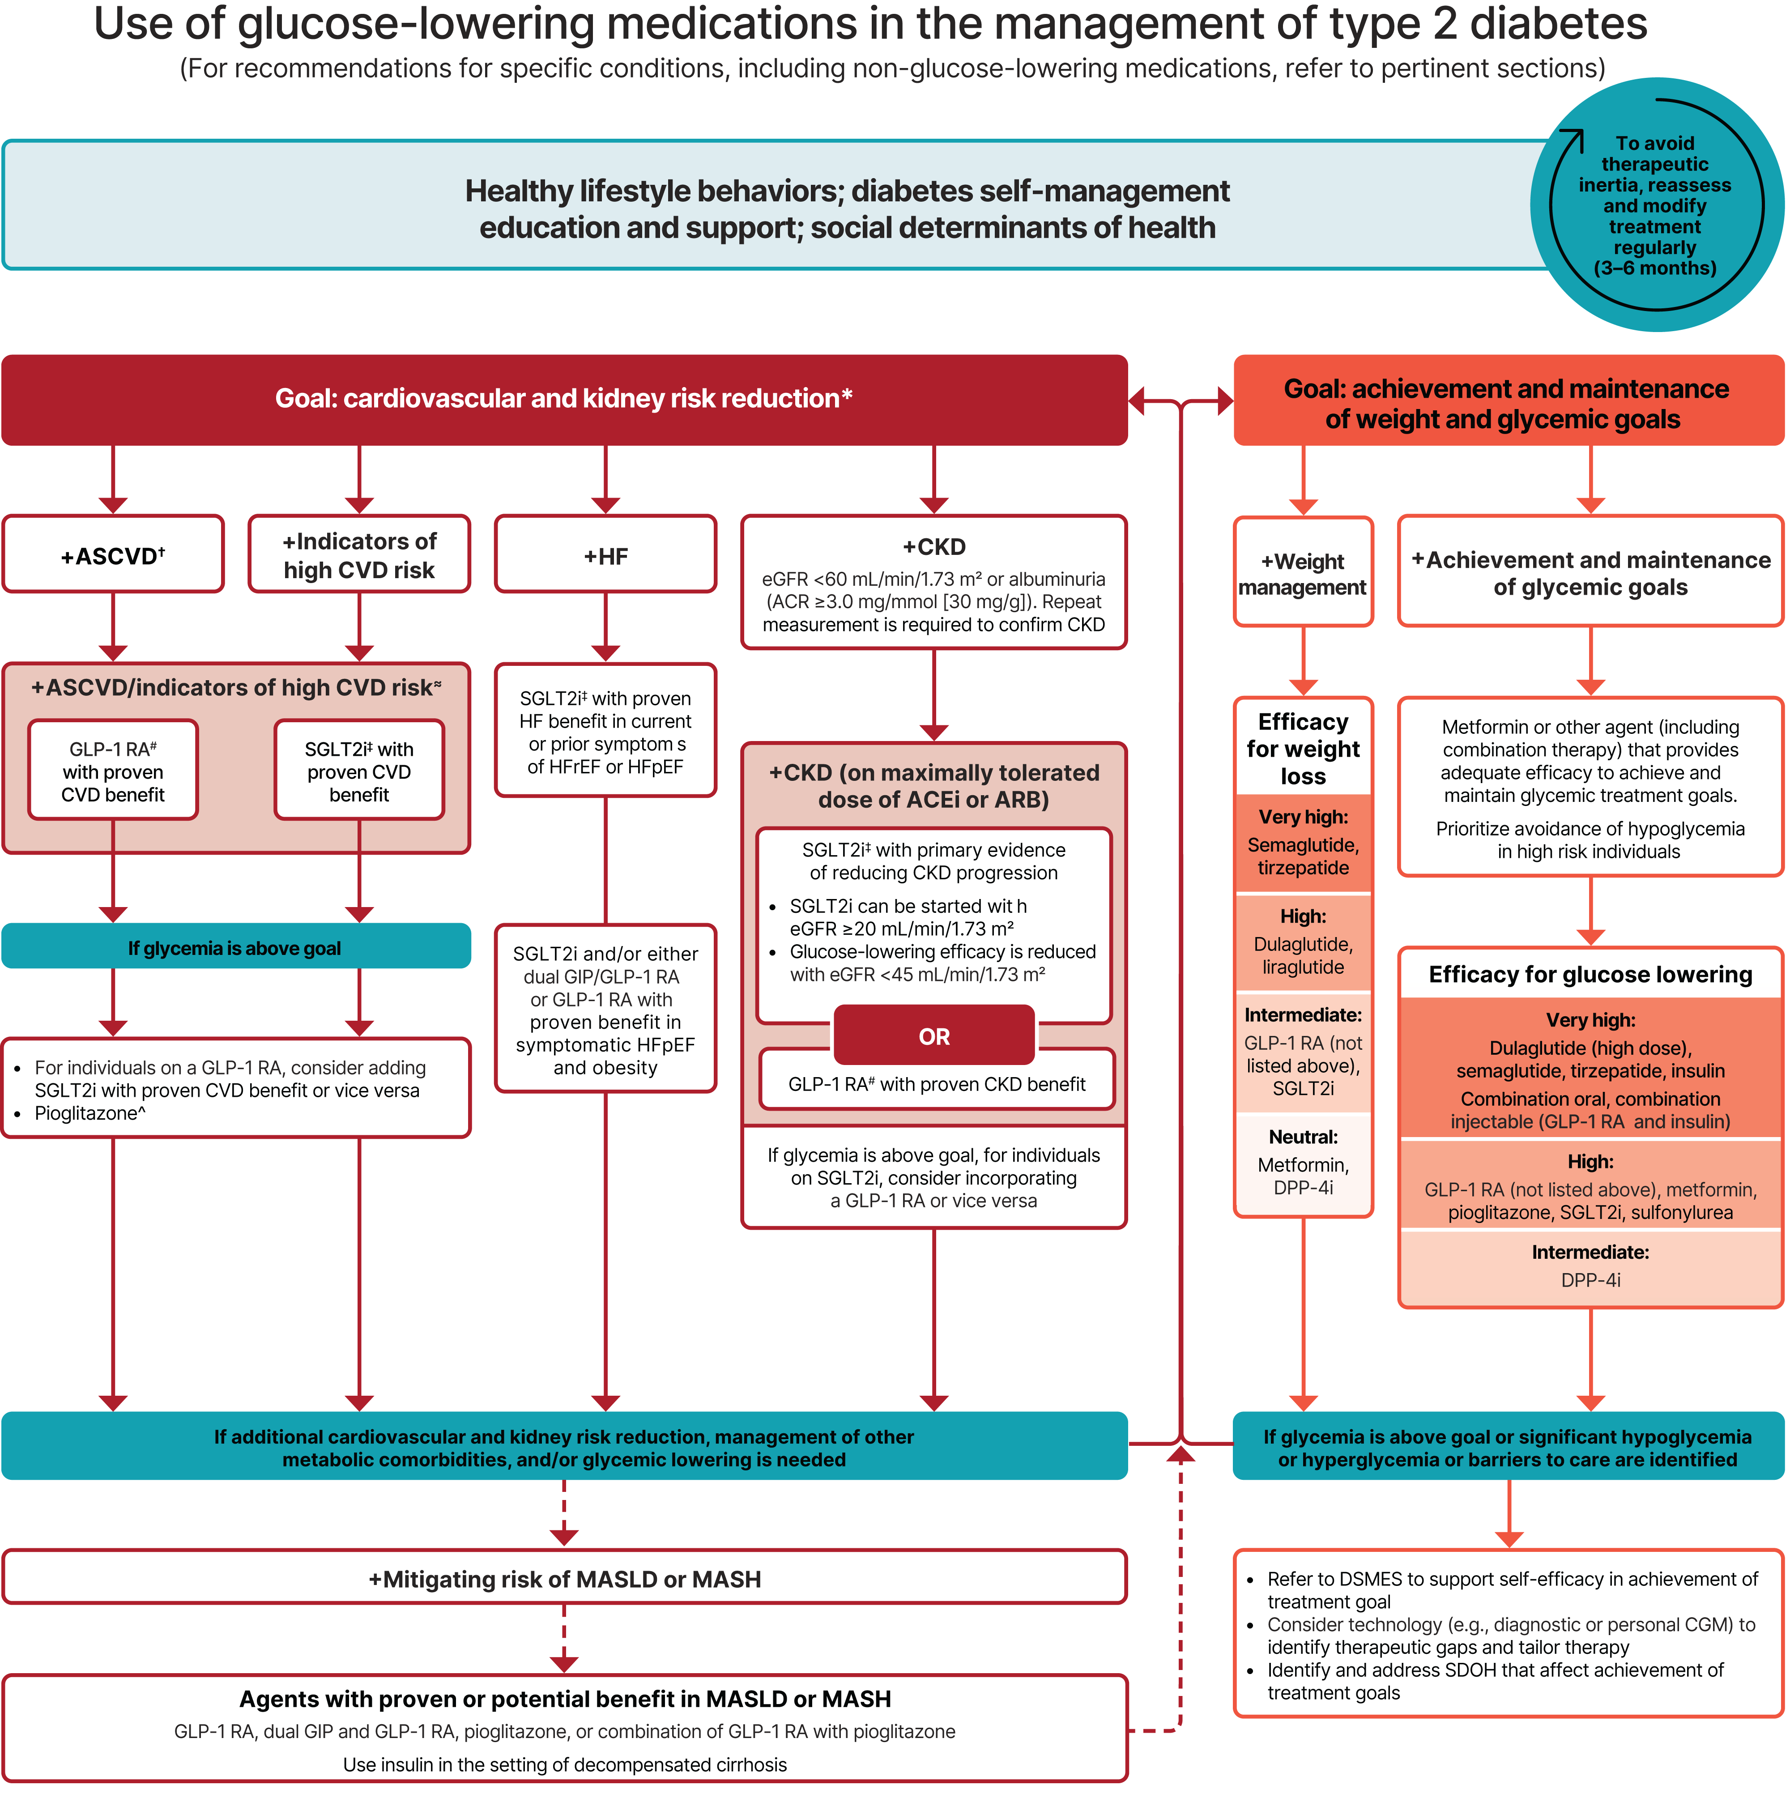
Figure 9.4 from ADA; 9. Pharmacologic Approaches to Glycemic Treatment SOC 2026
Notes:
American Diabetes Association Professional Practice Committee for Diabetes*; 9. Pharmacologic Approaches to Glycemic Treatment: Standards of Care in Diabetes—2026. Diabetes Care 1 January 2026; 49 (Supplement_1): S183–S215
Pioglitazone – low risk hypoglycemia, use cautiously in pts with HF, fluid retention, osteoporosis and macular edema.

Slide 44


Lifestyle management
5-10%
Healthy eating (Mediterranean, plant-based diet)
Adequate protein (0.8g/kg/day) reduces satiety, lessens sarcopenia, improves glycemic measures
Annual self management training “diabetes educator” is covered by Medicare B
Weight loss for non-frail older adults who are overweight or obese
Regular physical exercise (aerobic, weight-bearing, resistance)
Involve the caregiver
Notes:
It’s OK to not prescribe!
Frailty – state of increased vulnerability, lack of reserve. Weakness, slowing etc
Reduces a1c, blood pressure, waist circumference, increases HDL, functional decline

Slide 45








Protein ideas
Example: 150lb pt (68kg)
0.8g/kg/day = 54g/day
= 15-20g in each meal
1oz “handful” nuts = 6g
1oz “handful” beef jerky = 10g
1 cup cottage cheese = 25g
Involve the caregiver
3oz chicken breast= 25g
¼ cup hummus = 5g
3oz salmon = 20g
1 hard boiled egg = 6g
½ cup pinto beans = 8g
Notes:
Practicalities – helping caregivers have healthy meal options, create a list that you can draw from at the grocery store
Mix of protein in meals, and healthy snacks (veggies and hummus or handful of nuts)

Slide 46
How to help avoid hypoglycemia
Screen for hypoglycemia at each visit
- Teach how to identify hypoglycemia, always have glucometer on hand
- Teach how to treat hypoglycemia (carry glucose tabs, gel)
- Prescribe glucagon for high-risk patients
Risk factors to address
Safer approach
- Consider a CGM
- De-intensify treatment
- Change to medications that do not cause hypoglycemia (metformin, GLP1a, SGLT2i)
- Intensive treatment A1C < 6.0%
- Use of medications that cause hypoglycemia (sulfonylureas, short-acting insulin)
Involve the caregiver

Slide 47
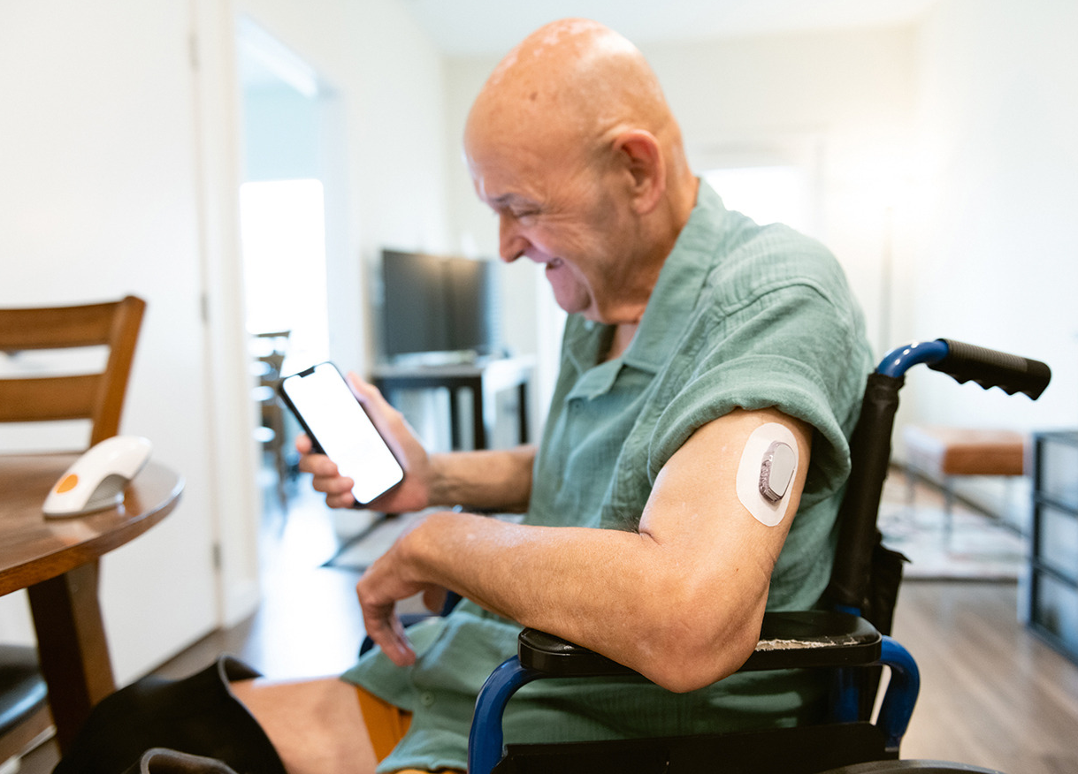
Continuous Glucose Monitor (CGM)
CGM have been shown to reduce hyper- and hypoglycemia in older adults with DM2, regardless of insulin use
ADA recommends all insulin treated older adults be recommended CGM to reduce burden of DM and mitigate hypoglycemia
Uptake of CGM in older adults is low (<10% in DM2)
Image: https://www.caringfortheages.com

Slide 48
Continuous Glucose Monitor (CGM)
Benefits:
CGM use reduces hypoglycemia and hyperglycemia
Reduces fingerstick checks (for patient and care staff!), alerts on highs/lows, personalized info for behavioral modification
Barriers:
Cost
Ability to learn and use new technology (set device alarms, read transmitter, respond to data), insert sensor, provider ability to interpret results
Image: https://www.caringfortheages.com
Notes:
Is it more intensive?

Slide 49
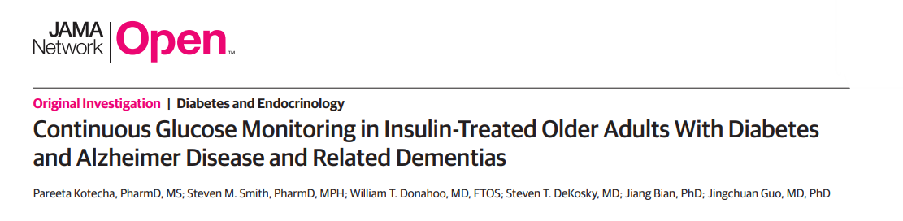
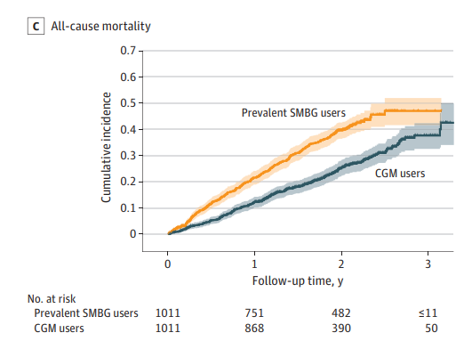
CGM use in older adults with dementia and diabetes
Medicare claim data from 2016-2020 (13,988 older adults)
Extensive list of covariates controlled for (ex frailty, socioeconomics)
Results comparing CGM users vs self-monitoring
Reduction in all-cause hospitalization (HR 0.86; 95% CI, 0.76-0.96)
Reduction in all-cause mortality
(HR, 0.57; 95% CI, 0.48-0.67)
Kotecha P, Smith SM, Donahoo WT, DeKosky ST, Bian J, Guo J. Continuous Glucose Monitoring in Insulin-Treated Older Adults With Diabetes and Alzheimer Disease and Related Dementias. JAMA Netw Open. 2025;8(12):e2541939

Slide 50
Insulin
High glucose lowering effect
Cost varies
Risk of hypoglycemia is higher with shorter-acting insulins (once daily basal insulin preferred over NPH)
Consider meal predictability when developing timing for short-acting insulin
Prefer insulin pens over syringes
Requires good vision, motor, and cognitive skills
Involve the caregiver
Notes:
insulin is not always the right medicine for type 2 diabetes but she use it in patients with signs of severe hyperglycemia such as weight loss and polyuria. Insulin is beneficial in those in whom insulin deficiency is very advanced or transient.

Slide 51
Metformin (is never out of fashion)
Safe to use for many older adults with DM2
Easy to administer
Low risk of hypoglycemia
Long acting (ER formulation) has lower GI side effects
Contraindicated in advanced renal disease (GFR <30)
Monitor B12 levels annually* for patients taking metformin long term (>4 years)
*and at baseline for pts with cognitive impairment if not already checked

Slide 52
Sulfonylureas
Avoid in older adults if able
Low cost
High risk of hypoglycemia (increases with age and frailty)
Increased fracture risk (attributed to hypoglycemia-induced falls)
Use short-acting (glipizide) over long-acting (glyburide) to lessen hypoglycemia risk
When using, routinely screen for hypoglycemia, hypoglycemia awareness and prevention strategies
Involve the caregiver
Notes:
Various rates of hypoglycemia are reported. On study showed that rate of hypoglycemia requiring hospitalization in UK Clinical Practice Reasearch Datalink was 4.1 per 1000 pt years with sulfonylureas vs 0.9 with metformin (HR 4.53)
High glucose lowering effect

Slide 53
Thiazolidinediones (ex. pioglitazone)
Low risk of hypoglycemia
Low cost
Avoid in patients with heart failure, fluid retention, weight gain, osteoporosis and macular edema.
Contraindicated in patients with bladder cancer
Considered cardioprotective in lowering risk of stroke and MI.
Notes:
High glucose lowering effect
Data about osteoporosis and fractures is conflicting
Pioglitazone = actos

Slide 54
DPP-4 inhibitors (ex. sitagliptin)
Low risk of hypoglycemia
High cost
Few side effects
Intermediate glucose lowering effect
Notes:
Do not have CV or renal benefits. Can be useful when pts have mild hyperglycemia or are high risk of hypoglycemia with other meds.
Sitagliptan = Januvia

Slide 55
SGLT2 inhibitors (ex. empagliflozin)
Intermediate glucose lowering effect
High cost
Oral formulation
Risk of hypovolemia (esp in frailty or orthostasis), genital mycotic infections (women>men, use wet wipes after peeing, dab penis don’t let drip), small risk UTI. Rare risk of euglycemic DKA.
To lessen risks, avoid starting when A1C >9%
Benefit for pts with elevated ASCVD, HF and CKD

Slide 56
GLP1 agonists (ex. semaglutide) and dual GIP (ex. tirzepatide)
High glucose lowering effect
Low risk of hypoglycemia
High cost
Mostly injectables
High risk of GI side effects (N,V,D,C). Avoid in pts with unexplained weight loss, gastroparesis, h/o pancreatitis. Risk of sarcopenia (mitigate with resistance exercise and protein supplementation).
Benefit in for patients with elevated ASCVD, HF, OSA, MASH and CKD. Reduces major adverse CV events, CV deaths, CVA, MI in older adults, TTB = 2-3yrs.

Slide 57
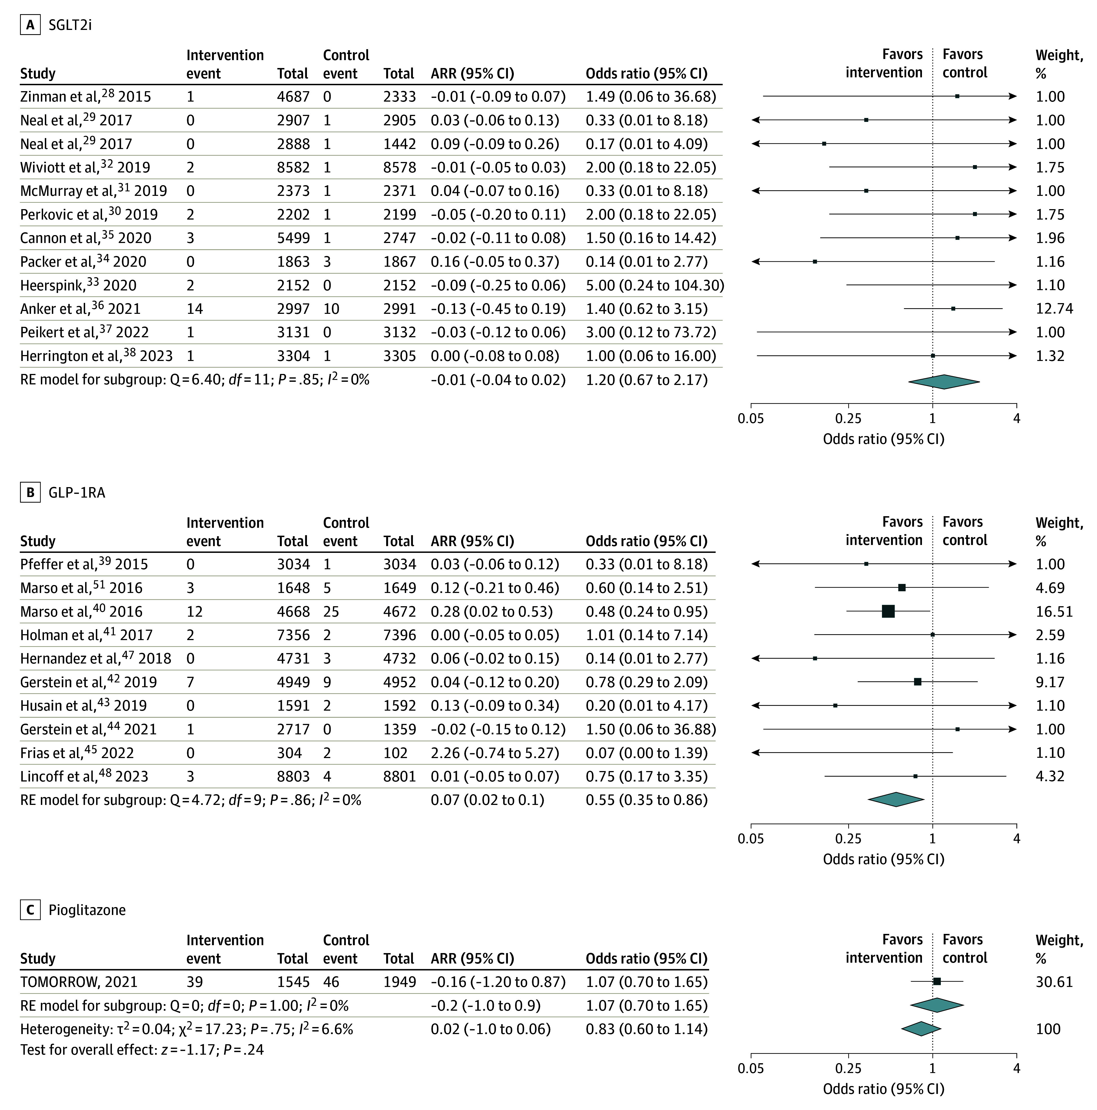

GLP1a use associated with lower all-cause dementia
Meta-analysis of RCTs found that glucose lowering with GLP1 agonists were associated with a statistically significant reduction in all-cause dementia
This was not found with other cardioprotective diabetes therapies (SGLT2i and pioglitazone)
Seminer A, Mulihano A, O'Brien C, et al. Cardioprotective Glucose-Lowering Agents and Dementia Risk: A Systematic Review and Meta-Analysis. JAMA Neurol. 2025;82(5):450-460

Slide 58

Cost Awareness
Most older adults live on fixed incomes
Consider medication cost and insurance coverage
Screen for food and housing insecurity
Ability to follow diabetic diet
Access to medication storage (ex refrigeration)

Slide 59
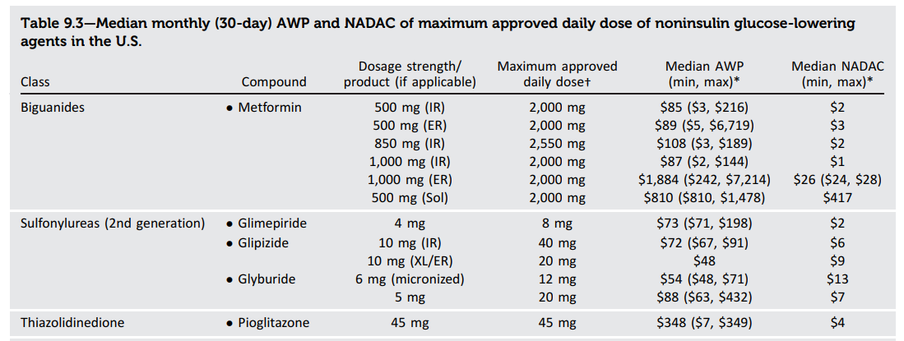






ADA Professional Practice Committee for Diabetes*; 9. Pharmacologic Approaches to Glycemic Treatment: Standards of Care in Diabetes—2026. Diabetes Care 1 January 2026; 49 (Supplement_1): S183–S215
Notes:
American Diabetes Association Professional Practice Committee for Diabetes*; 9. Pharmacologic Approaches to Glycemic Treatment: Standards of Care in Diabetes—2026. Diabetes Care 1 January 2026; 49 (Supplement_1): S183–S215. https://doi.org/10.2337/dc26-S009
Of note, prices listed are average wholesale prices (AWP) (222) and National Average Drug Acquisition Costs (NADAC) (223); these estimates allow for a comparison of drug prices but do not represent the actual costs to people with diabetes because they do not account for various discounts, rebates, and other price adjustments often involved in prescription sales that affect the actual cost incurred by the individual. Medication costs can be a major source of stress for people with diabetes and contribute to worse medication-taking behavior (224); cost-reducing strategies may improve medication-taking behavior in some cases (225).

Slide 60
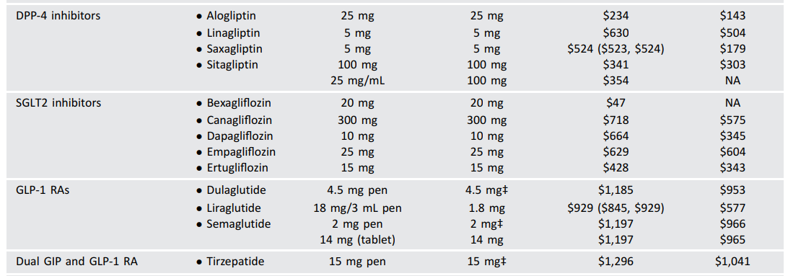
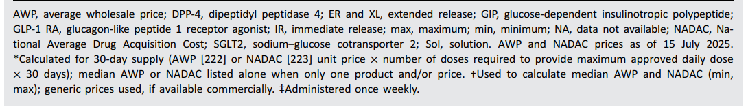








ADA Professional Practice Committee for Diabetes*; 9. Pharmacologic Approaches to Glycemic Treatment: Standards of Care in Diabetes—2026. Diabetes Care 1 January 2026; 49 (Supplement_1): S183–S215
Notes:
They also have charts for available insulins

Slide 61

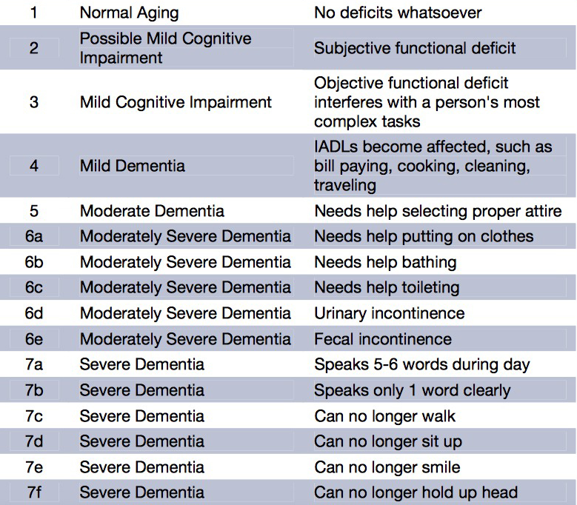
Stages of Dementia
FAST Scale for Dementia Staging
Hospice eligibility
Notes:
When is someone eligible for hospice due to their dementia?
You use the FAST scale for staging and they need to be a stage 7 or beyond
AND
One of the following problems, usually they have lost 10% of weight in last 6 months, but can be other reasons listed here

Slide 62
End-of-life
“He’s on hospice so they stopped all his insulin”
“I want to eat whatever I want”
“I don’t want to be poked anymore”

Slide 63
Prioritize comfort, quality of life, and dignity
Avoid hypoglycemia and symptomatic hyperglycemia
Reduce burden of diabetes care
End-of-Life

Slide 64
Prioritize comfort, quality of life, and dignity
Avoid hypoglycemia and symptomatic hyperglycemia
Reduce burden of diabetes care
End-of-Life
What was their prior self management plan?
Liberalize diet
Generally, continue orals (unless not eating)
Reduce insulin injections and complex regimens with preference to basal long-acting over short-acting insulin
What is their prognosis (hours, days, weeks, months)?
Limit fingersticks, no role for A1C checks
Aim for FBG <200, RBG <300
*Remember the heterogeneity of older adults, care needs to be individualized!

Slide 65
References
American Diabetes Association Professional Practice Committee for Diabetes; 13. Older Adults: Standards of Care in Diabetes—2026. Diabetes Care 1 January 2026; 49
American Diabetes Association Professional Practice Committee for Diabetes*; 6. Glycemic Goals, Hypoglycemia, and Hyperglycemic Crises: Standards of Care in Diabetes—2026. Diabetes Care 1 January 2026; 49 (Supplement_1): S132–S149
American Diabetes Association Professional Practice Committee for Diabetes*; 9. Pharmacologic Approaches to Glycemic Treatment: Standards of Care in Diabetes—2026. Diabetes Care 1 January 2026; 49 (Supplement_1): S183–S215
Anderson TS, Lee S, Jing B, et al. Prevalence of Diabetes Medication Intensifications in Older Adults Discharged From US Veterans Health Administration Hospitals. JAMA Netw Open. 2020;3(3):e201511.
Colburn JL., Westcott, AM, Potter JF, et al, eds. 2025. Geriatrics Review Syllabus: A Core Curriculum in Geriatric Medcine. 12th Ed. New York: American Geriatrics Society.
GeriPal Podcast, June 8th 2023, Diabetes in Late Life: Nadine Carter, Tamryn Gray, Alex Lee. https://geripal.org/diabetes-in-late-life-nadine-carter-tamryn-gray-alex-lee/
Hanyu H. Diabetes-Related Dementia. Adv Exp Med Biol. 2019;1128:147-160
Holmes HM, Hayley DC, Alexander GC, Sachs GA. Reconsidering medication appropriateness for patients late in life. Arch Intern Med. 2006;166(6):605-609

Slide 66
References
Idrees T, Toschi E. Continuous Glucose Monitoring in Older Adults With Diabetes and Alzheimer Disease and Related Dementias—Promise and Perspective. JAMA Netw Open. 2025;8(12):e2541947
Karter AJ, Warton EM, Lipska KJ, et al. Development and Validation of a Tool to Identify Patients With Type 2 Diabetes at High Risk of Hypoglycemia-Related Emergency Department or Hospital Use. JAMA Intern Med. 2017;177(10):1461–1470
Kotecha P, Smith SM, Donahoo WT, DeKosky ST, Bian J, Guo J. Continuous Glucose Monitoring in Insulin-Treated Older Adults With Diabetes and Alzheimer Disease and Related Dementias. JAMA Netw Open. 2025;8(12):e2541939
Schoenborn NL, Lee K, Pollack CE, et al. Older Adults’ Views and Communication Preferences About Cancer Screening Cessation. JAMA Intern Med. 2017;177(8):1121–1128
Seminer A, Mulihano A, O'Brien C, et al. Cardioprotective Glucose-Lowering Agents and Dementia Risk: A Systematic Review and Meta-Analysis. JAMA Neurol. 2025;82(5):450-460.
Images:
If not otherwise cited images are either my own, or from https://unsplash.com/

Slide 67

Thank you!
Visit: IndianCountryECHO.org
Robin S. Brown, MD
Assistant Professor, Geriatrics
Oregon Health & Science University
browrobi@ohsu.edu
Notes:
Please visit our website to sign-up to join one of our many ECHO sessions. Thank you!

