Slide 1



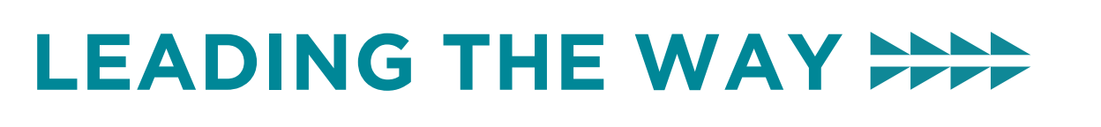
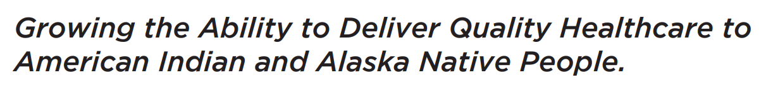
Understanding and Helping with Early Onset Alzheimer’s Dementia
March 12, 2026
Allison Lindauer, PhD, APRN, Oregon Health & Science University, Oregon Alzheimer’s Disease Research Center, lindauer@ohsu.edu
Sarah Foidel, PP-OTD, OTR/L, FAOTA
Pacific University, sfoidel@pacificu.edu

Slide 2
Objectives
Increase knowledge to understand early-onset Alzheimer’s disease (EOAD)
Identify treatment options for EOAD
Increase understanding of care planning considerations for EOAD
Apply information to case discussion to increase ability to

Slide 3
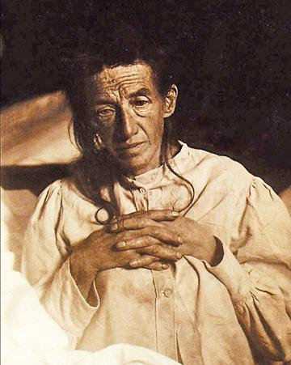
The first described patient with Alzheimer’s disease
August D. (1850-1906) of Frankfurt,
Germany
Patient of Dr. Alois Alzheimer, who treated her during her life and described the condition as the “Disease of Forgetfulness.”
Dr. Alzheimer examined her brain after death and described plaques and tangles for the first time.

Slide 4
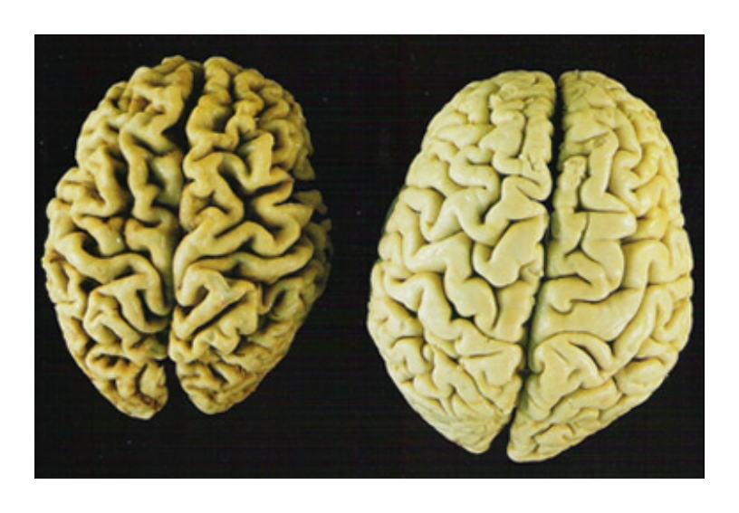
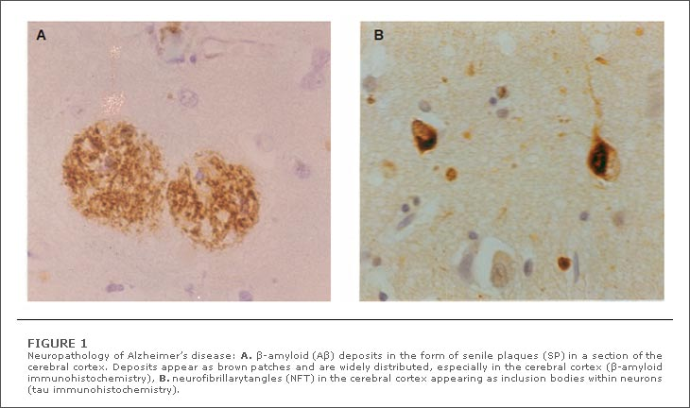
Hallmarks of Alzheimer’s Disease
With the naked eye: shrinkage of the brain (cerebral atrophy)
Under the microscope: amyloid plaques and neurofibrillary tangles
AD Normal
J. Optom, 2009
LaFerla and Oddo, Trends in Molecular Medicine, 2005

Slide 5
What is Alzheimer’s Disease?
For the next 70 years (1906-1968), ”Alzheimer’s disease” was considered an early-onset dementia*
This was distinct from “senile dementia” related to aging
In 1968 Blessed determined that the brains of patients with “senile dementia” had plaques and tangles qualitatively the same as early-onset Alzheimer’s disease
By 1984, “Alzheimer’s disease” and “senile dementia” were considered a single disease entity, with the range of onset spanning 40-90 years of age
Nevertheless, early-onset Alzheimer’s disease has distinct clinical features and treatment considerations
* “early-onset” = onset before 65 years of age

Slide 6
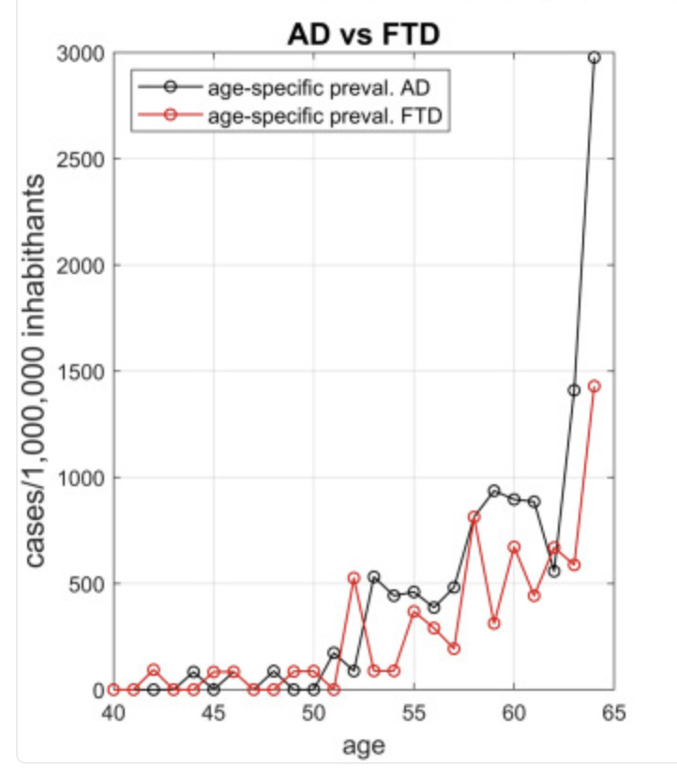
Early-onset Alzheimer’s Disease (EOAD)
Accounts for 5% of cases of Alzheimer’s disease overall
One of the most common causes of dementia with onset < 65 years
Similar prevalence to FTD < 65 years
Zamboni et al, J Neurol, 2024.

Slide 7
Causes of Early-Onset Alzheimer’s Disease
5% of cases of EOAD are autosomal dominant – associated with a mutation in presenilin 1, presenilin 2, or APP (amyloid precursor protein). These are genes involved in amyloid production.
Down syndrome is the most common form of genetically determined EOAD ~ 70% of people with Down syndrome will develop Alzheimer's disease dementia by age 55-60 and all will have amyloid plaques. APP gene is on chromosome 21.
Majority of cases of EOAD are considered “sporadic” – multifactorial related to risk factor genes (such as APOEe4), aging, environment, unknown factors
22% of patients with EOAD are APOE e4/e4 “homozygous” (compared to 11% of patients with LOAD).
Polsinelli et al, Alzheimer’s and Dementia, 2023

Slide 8
EOAD Diagnosis
Cognitive impairment which:
1. Interferes with the ability to function at work or at usual activities
2. Represent a decline from previous levels of functioning
3. Not explained by delirium or major psychiatric disorder
Impairment in a minimum of two of the following domains:
1. Ability to acquire and remember new information (working memory)
2. Reasoning and handling of complex tasks, poor judgment (executive)
3. Visuospatial abilities
4. Impaired language
5. Personality, behavior, or comportment
In persons under the age of 65=EOAD

Slide 9
Rate of progression and associated features
EOAD patients have a more rapid rate of dementia progression and shorter disease duration
Neuropsychiatric symptoms are more common and more severe in EOAD compared to LOAD (Late Onset Alzheimer's Disease), however one must adjust for base rates by age
More frequent in EOAD | More frequent in LOAD
Elation | Abnormal nighttime behaviors
Abnormal eating behaviors
Polsinelli et al, Alzheimer’s and Dementia, 2024

Slide 10
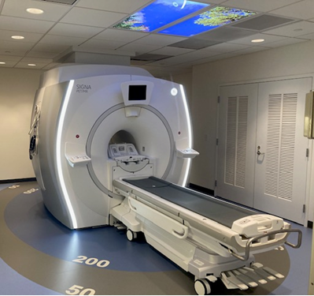
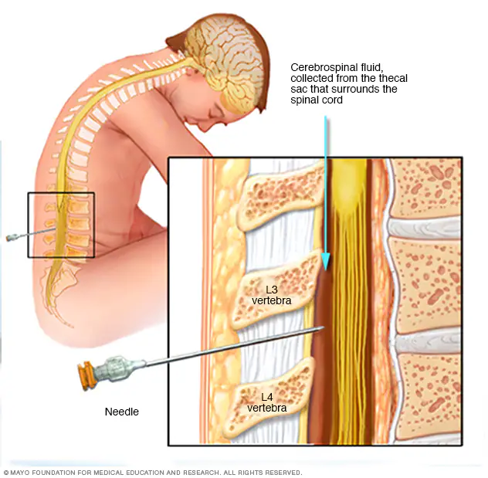
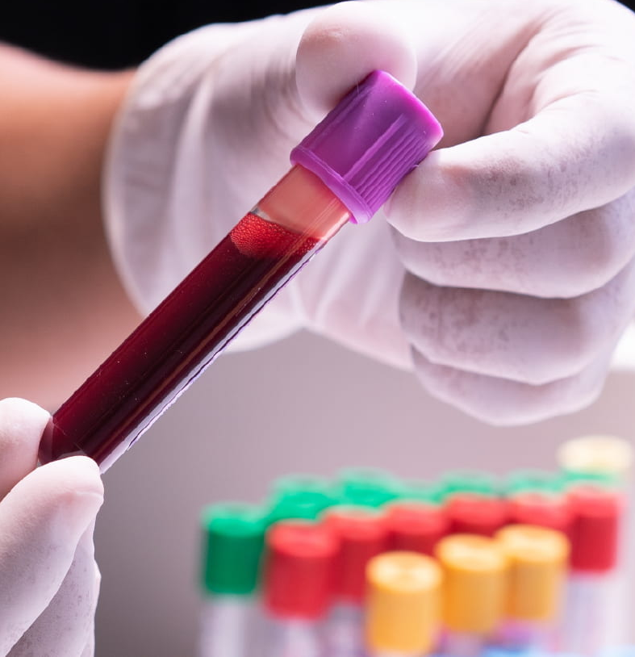
Alzheimer’s markers can now be seen in patients
Brain imaging – PET scans
Amyloid
Tau
Cerebrospinal fluid (CSF)
Amyloid
Tau
Blood
Amyloid
Tau

Slide 11
Management of AD
Acetylcholinesterase inhibitors (Donepezil)
Memantine: Memantine an NMDA antagonist that moderates the neurotoxic effects of AD
Anti-amyloid medications
Medications help, but do not cure. Care should focus on maximizes function and family health.

Slide 12
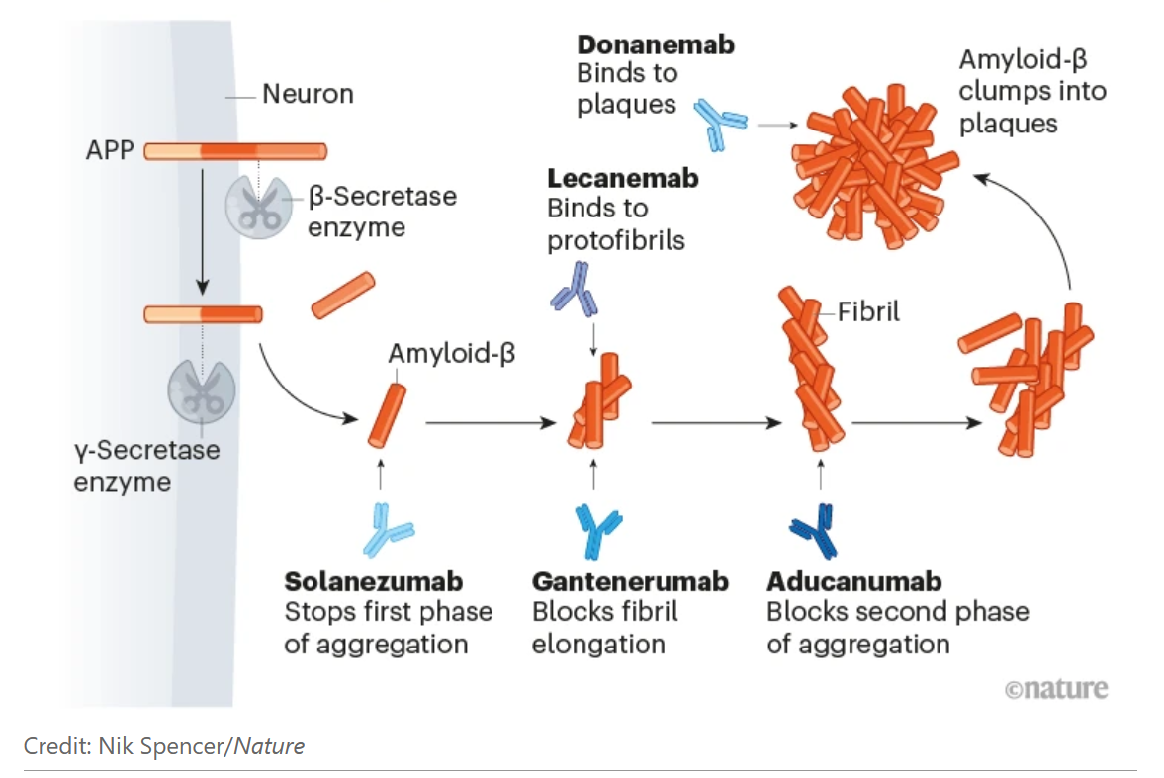
Anti-amyloid treatment
Many clinical trials targeting amyloid were negative, until…
FDA approval for anti-amyloid antibodies - aducanumab (2021), lecanemab (2023), donanemab (2024)
Every antibody is different – those which can reduce plaques have shown benefit on memory
Current trials selected participants more stringently and treat earlier and longer
Abbott, Nature 2022.

Slide 13
Interventions
Creating a care plan for
Early onset Alzheimer's disease

Slide 14

Age Friendly:
Mobility, Medications,
Mentation & What Matters
Focus care on maximizing physical function and mobility.
Address mentation and manage neuropsychiatric symptoms.
Care should always focus on what matters to the patient.
Medications must take into consideration function, efficacy, and purpose

Slide 15
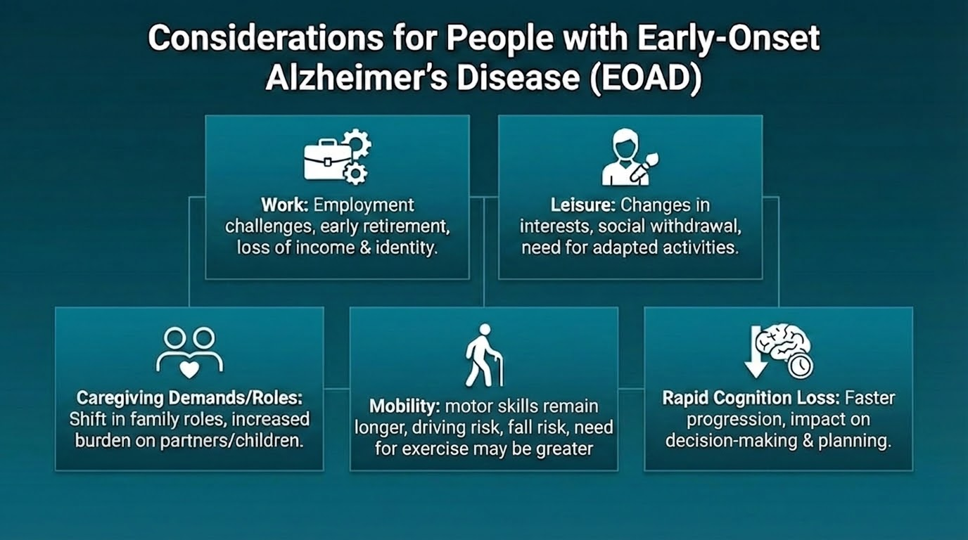

Slide 16
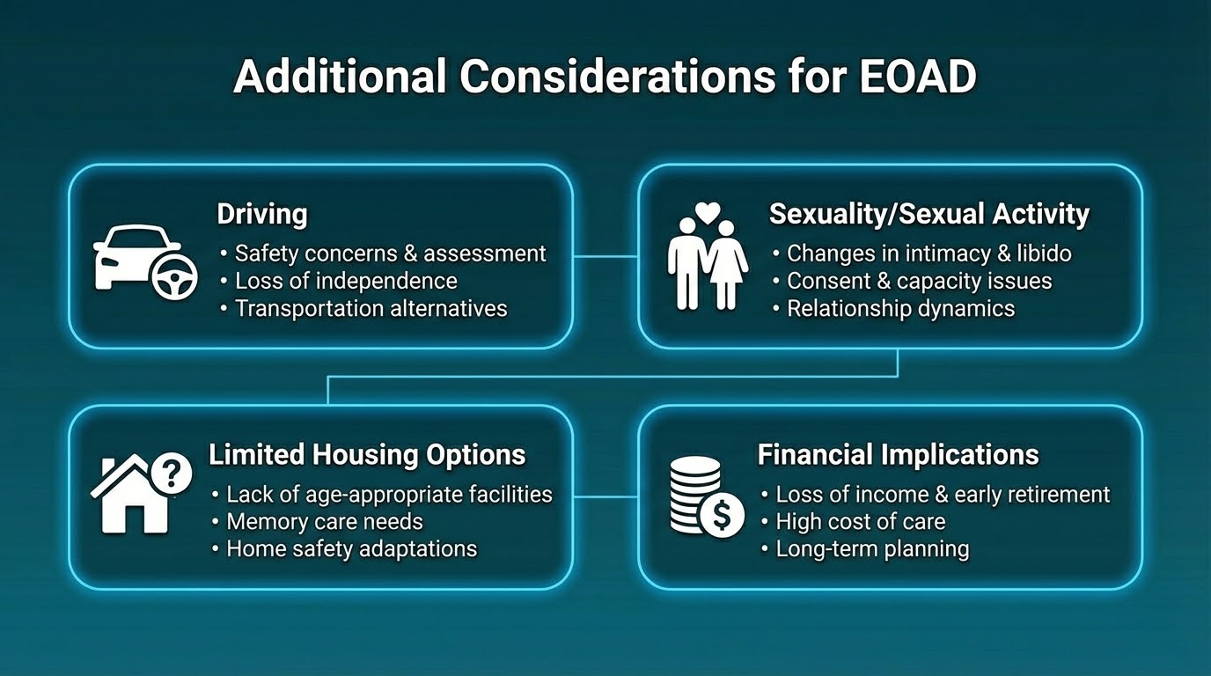

Slide 17
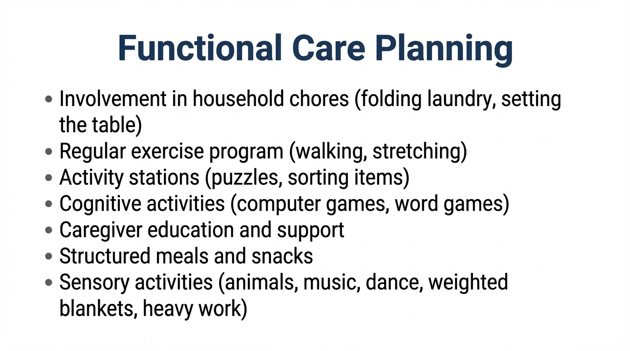

Slide 18
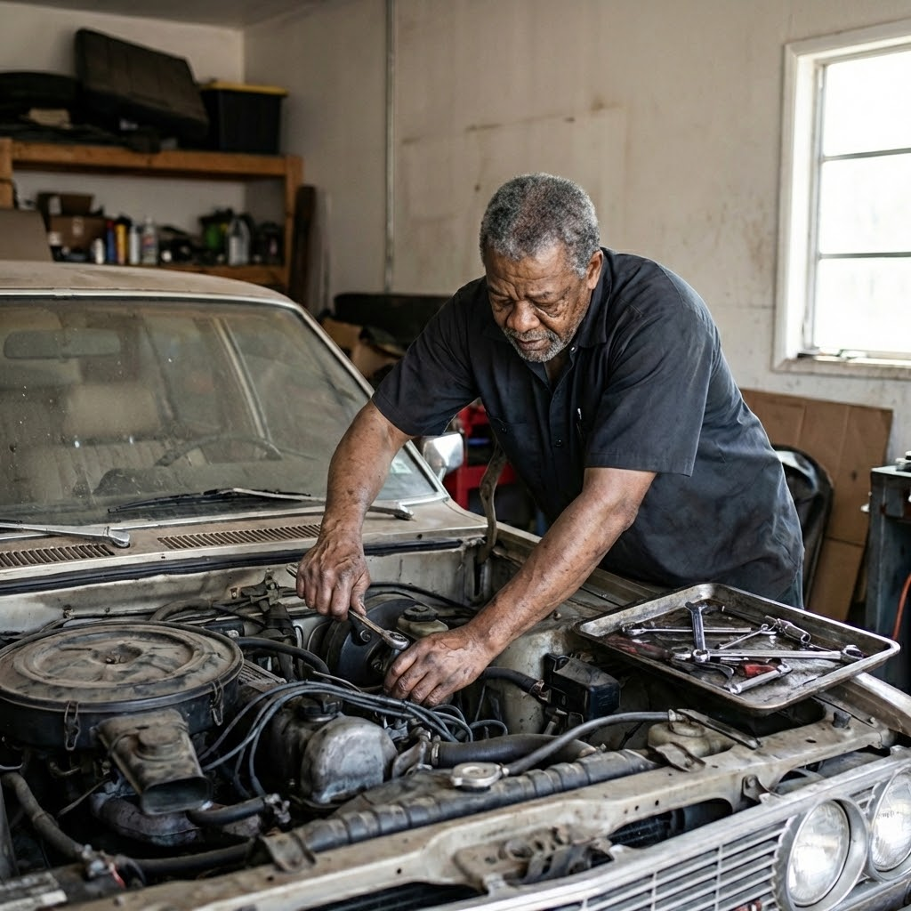
Case Discussion: Joe
Joe is 65 years old, and has Early Onset Alzheimer's
He works full time as a mechanic
He lives with his wife of 35 years and they are the primary caretakers for an 8 year granddaughter
Likes to refinish and build furniture
CONCERNS:
Inability to work (poor executive function, irritability), impulsive choices, pacing, and unsafe driving

Slide 19
Discussion of Care Planning and Interventions
What are the high priority considerations and concerns for Joe?
What resources and referrals could be implemented?
What are intervention ideas for Joe to improve function and quality of life?
What

Slide 20

Takeaways
Accurate diagnosis is key
Advocate for appropriate pharmacology and interventions
Focus on strengths and function
Support families and caregivers
Identify key differences between early and typical onset Alzheimer's dementia
Notes:
NC: Here's a few program areas that we're currently planning to launch.

Slide 21

Final Header
Visit: IndianCountryECHO.org
Allison Lindauer, PhD, APRN, Oregon Health & Science University, lindauer@ohsu.edu
Sarah Foidel, PP-OTD, OTR/L, FAOTA , Pacific University, sfoidel@pacificu.edu
Notes:
Please visit our website to sign-up to join one of our many ECHO sessions. Thank you!

