Slide 1

Hearing Loss and its Effects on the Brain: Pearls for Caregivers
Indian Country ECHO
Caregiver Dementia Support ECHO
April 23, 2026
Laura K. Byerly, MD
Oregon Geriatrics Workforce Enhancement Program

Slide 2
Disclosures
Dr. Byerly has no financial or commercial disclosures relevant to her presentation
She is the program director of a HRSA-funded Geriatrics Workforce Enhancement Program Award (U1Q53044)
The contents are those of the author and do not necessarily represent the official views of, nor an endorsement, by HRSA, HHS or the U.S. Government

Slide 3
Objectives
Goal
Today, my goal is to cover the following:
Describe
Describe how common hearing loss is within older adults
Describe
Describe how hearing loss can impact your loved ones’ quality of life, mood, and memory
Identify
Identify options that could help your hearing and improve your ability to communicate with people who have hearing loss
Empower
Empower you as a caregiver to advocate for your loved one’s hearing!

Slide 4
Quick check— does hearing loss impact your life or that of a person you care about?

Slide 5

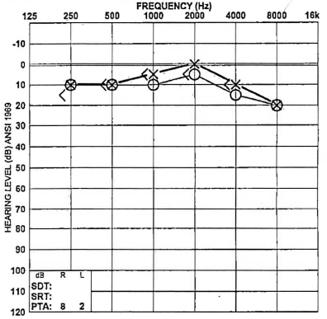

My audiogram
This Photo by Unknown Author is licensed under CC BY-NC-ND
Notes:
12/21/12
This is actually normal – but it was checked when I was 27 because I was experiencing 4 years of tinnitus due to sitting in front of brass and percussion instruments for most of my teen and young-adult life
I still remember that the ENT who saw me in Boston said something along the lines of, “well it’s fine right now, but you’ll probably start to lose your high pitch hearing over the next few years.
I’ll be honest that was 12 years ago and while I was told to get a follow up audiogram at the end of residency, I never did it.

Slide 6



Notes:
My life has been impacted by both hearing loss and dementia.

Slide 7
Hearing loss: A common problem for elders
65% of adults >70 years old
96% of adults >90 years old
Only about 30% of persons with hearing challenges use hearing aids
Only 1/3 of older adults recognize their impaired hearing
Notes:
Goman AM, Lin FR. Prevalence of Hearing Loss by Severity in the United States. Am J Public Health. 2016 Oct;106(10):1820-2
Reed NS, Garcia-Morales EE, Myers C, Huang AR, Ehrlich JR, Killeen OJ, Hoover-Fong JE, Lin FR, Arnold ML, Oh ES, Schrack JA, Deal JA. Prevalence of Hearing Loss and Hearing Aid Use Among US Medicare Beneficiaries Aged 71 Years and Older. JAMA Netw Open. 2023 Jul 3;6(7):e2326320. doi: 10.1001/jamanetworkopen.2023.26320. PMID: 37505496; PMCID: PMC10383002.
*Cited is more recent data

Slide 8
What to look (hear?) for with hearing loss
Crowds/Large group events
Volume adjustments
Repetition of questions
Difficulty tracking conversations
Silence…
Notes:
Is it just cranking up the volume?
There are more signs you can look for as a healthcare team member
My dad has unfortunately progressed to the latter two
In fact, we were at Blizzard Winery with my inlaws this past weekend, and my father in law at one point said “I haven’t been able to hear a word you’ve said the past 30 minutes.”

Slide 9
Risk factors for hearing loss
Noise
Music
Machinery
Military service
Trauma
Medications
Notes:
Starts in your youth—not just exposure as an older adult
Military: Artillery but also if you were a pilot with pressure changes
Trauma: Head trauma primarily
Medications: Some antibiotics, chemotherapy, solvents, heavy metals, malaria medications

Slide 10
How does hearing loss present?
Pitch
Clarity
“Cocktail party” challenges
Volume
Notes:
Pitch: Usually high pitched sound loss
Clarity: Feel like everyone is mumbling
Cocktail party: Complex listening situations—hard to zone in on one person’s words amongst the noise
Volume: Have to turn the TV or radio up

Slide 11

Hearing Loss Impacts on Life

Slide 12
Question time!
Hearing loss in older adults can increase the risk of which of the following conditions?
A: Dementia
B: Depression
C: Falls
D: Parkinson’s disease
E: All of the above

Slide 13
Hearing loss affects LIFE
Cognitive decline
Higher rates of depression
Quality of life changes
Reduced personal safety
Increased risk of falling
Figure courtesy of Michelle Hungerford, AuD
Notes:
Pitch: Usually high pitched sound loss
Clarity: Feel like everyone is mumbling
Cocktail party: Complex listening situations—hard to zone in on one person’s words amongst the noise
Volume: Have to turn the TV or radio up

Slide 14
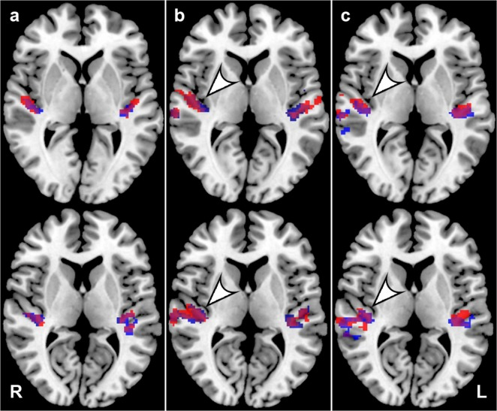
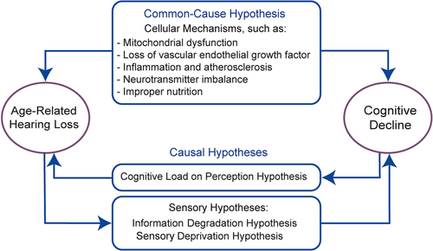
What does hearing loss do to the brain?
Notes:
Scientists are still working on how hearing loss and the brain are connected, but there are some studies that show that long-standing hearing loss can damage the brain
There are two main theories about the intersection of hearing and brain function
“Common Cause” hypothesis where the brain is being damaged in many different ways
Causal Hypothesis, which is starting to take more prominence. More stress on the brain from sensory degradation and deprivation leading to impaired memory and cognitive decline. Conversely, cognitive decline stresses the auditory cortex more to be able to hear.
We see changes in the brain itself that provide evidence.
Particularly, the “temporal lobe” of the brain, which contains the auditory cortex, is often smaller in persons with hearing loss. They have less gray matter in that part of their brain. Some people describe it as a lack of input from hearing loss leading to less use, which makes the cells die.
Another theory is that the brain has to work so much harder to hear and that this damages the cells or leads to fewer cells. We can see this in the picture on the left where the middle and right brain scans show more “activity” in the auditory cortex for people with hearing loss.
Think of it this way-- that part of the brain is working on overdrive to try and hear what people are saying but still can’t make out the words and phrases, and it’s getting stressed.

Slide 15
Hearing risk and memory
Association with mild cognitive impairment and dementia
More severe hearing loss = higher risk of dementia
Hearing loss taxes the brain
Lots of risk factors for dementia—but this one is changeable!

Slide 16
Hearing loss and Parkinson’s Disease
Association of severe hearing loss and Parkinson’s disease
Cell damage to brain affects hearing and movement
“Worse hearing confers more risk”
Hearing aids associated with reduced risk of Parkinson’s disease
Notes:
https://www.cambridge.org/core/journals/psychological-medicine/article/hearing-loss-and-psychiatric-disorders-a-review/6D28936E3701DBB4D59AFBDBF9FC8A0B
https://www.sciencedirect.com/science/article/pii/S0749069019301041?via%3Dihub

Slide 17
Hearing loss and mood
Higher risk of depression and anxiety
Contributions from social isolation/withdrawing from activities
Sudden hearing loss = highest risk
Notes:
https://www.cambridge.org/core/journals/psychological-medicine/article/hearing-loss-and-psychiatric-disorders-a-review/6D28936E3701DBB4D59AFBDBF9FC8A0B
https://www.sciencedirect.com/science/article/pii/S0749069019301041?via%3Dihub

Slide 18
Hearing loss and falls
Hearing loss associated with a 17% higher risk of falling
Sensory impairment changes how we walk/move
Hearing loss increases cognitive load and “distracts” from balance and stability
Potential common pathway with inner ear (hearing loss and balance loss)
Notes:
3 general theories:
Common pathological mechanism that causes cochlear and vestibular dysfunction in inner ear
Reduced auditory input makes it hard to read cues in our environment.
Increased cognitive load for central decoding and interpreting cues for postural control and navigation
Goman AM, Tan N, Pike JR, Bessen SY, Chen ZS, Huang AR, Arnold ML, Burgard S, Chisolm TH, Couper D, Deal JA, Glynn NW, Gmelin T, Gravens-Mueller L, Hayden KM, Martinez-Amezcua P, Mitchell CM, Pankow JS, Reed NS, Sanchez VA, Schrack JA, Sullivan KJ, Coresh J, Lin FR; ACHIEVE Collaborative Research Group. Effects of hearing intervention on falls in older adults: findings from a secondary analysis of the ACHIEVE randomised controlled trial. Lancet Public Health. 2025 Jun;10(6):e492-e502. doi: 10.1016/S2468-2667(25)00088-X. PMID: 40441816; PMCID: PMC12203021.

Slide 19
But is there any data for hearing aids and brain health?

Slide 20
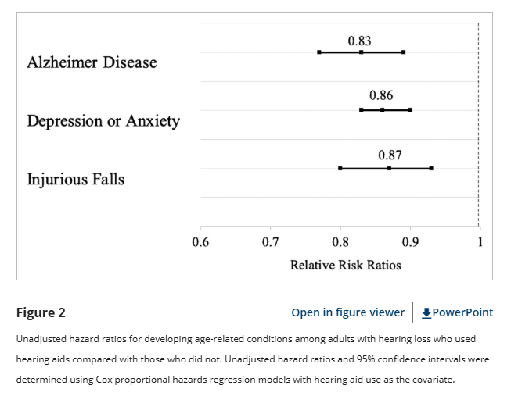
Promising data of hearing aid use
Retrospective study of people >66 years old with hearing loss
Association of hearing aids with delayed diagnoses of:
Dementia
Depression
Falls
Mahmoudi E et al. Can Hearing Aids Delay Time to Diagnosis of Dementia, Depression, or Falls in Older Adults? J Am Geriatr Soc. 2019
Notes:
Association does not equate to causation
Retrospective cohort study of people >66yo with hearing loss
Looked at those who were given HAs and their incidence of being diagnosed with the 3 outcomes
Their punchline was that HAs delayed diagnosis of the 3 outcomes

Slide 21
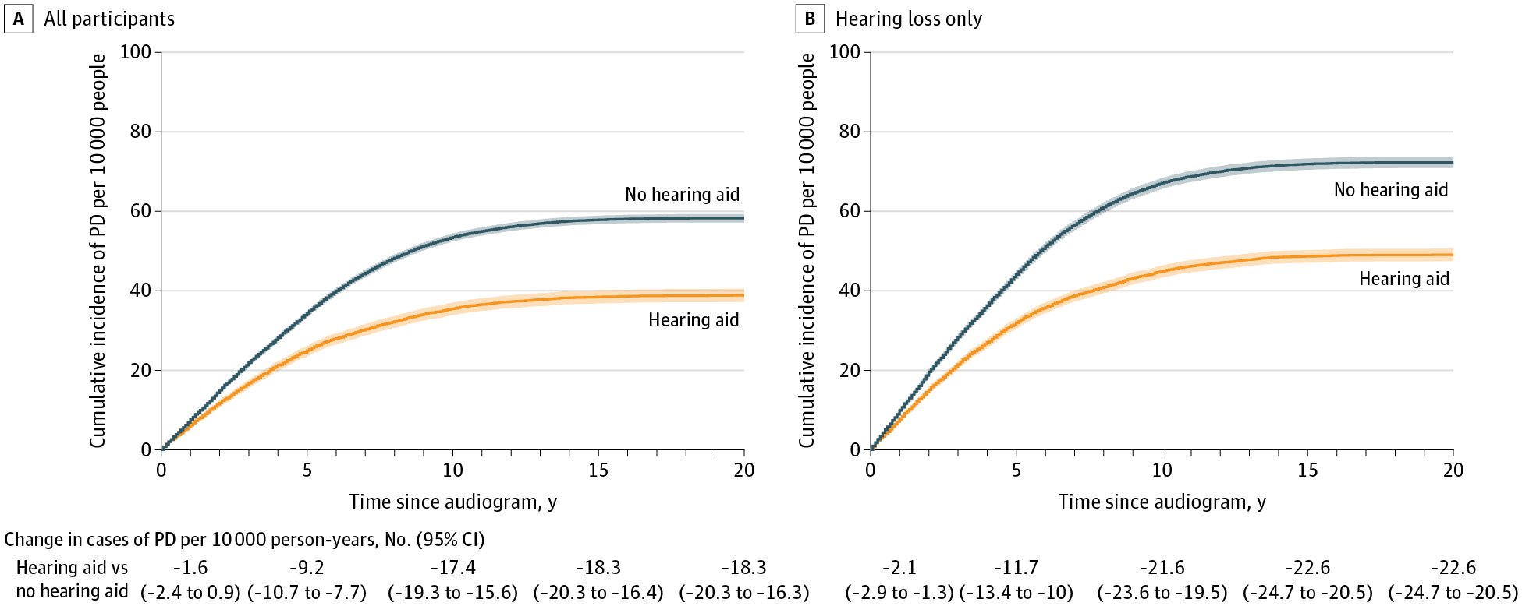
Hearing aids and Parkinson’s disease
Large group of Veterans over 10-year course
Receiving a hearing aid within 2 years of impaired hearing diagnosis reduced the risk of Parkinson’s disease
Neilson et al, Hearing Loss, Incident Parkinson Disease, and Treatment With Hearing Aids, JAMA Neurology, 2024
Notes:
Some research coming from Oregon!
Dr. Neilson’s team at the VA looked back at vets who had an abnormal audiogram
Looked 10 years down the road
Compared their rate of diagnosis of Parkinson’s disease

Slide 22
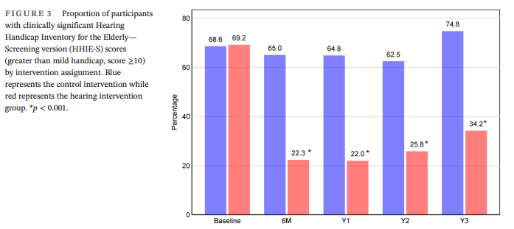
A look at communication and Hearing Aids
Adverse impact of hearing on Quality of Life at Year 3
Hearing intervention + support = 34% w/ impaired QOL
Education control = 75% w/ impaired QOL
NNT with hearing aids = 2.4 people!
Key point: Hearing interventions can significantly improve QOL
Sanchez et al, Effects of hearing intervention on communicative function, JAGS, 2024
Notes:
Sub-analysis of the ACHIECVE study
Looking primarily at ability to communicate with others with a hearing aid--using quality of life measures
“A hearing intervention that included provision of hearing aids and
extensive support led to a dramatic and sustained improvement in
communication function over 3 years
• Considerations
• Enrolled subjects predisposed to intervention
• Extensive support provided
• Suggests limits for OTC hearing solutions”

Slide 23
I think my loved one has a hearing problem…what next?

Slide 24
Question time!
Hearing tests are expensive
A: True
B: False
Notes:
False!
Hearing exams are covered by Medicare Part B if the exam is to diagnose a hearing problem, once every 12 months

Slide 25

Primary Care Provider
Say something! Your loved one may not recognize the problem!
Ear exam
Wax removal
Check for infection and inflammation
Review medications
Refer to specialists
Notes:
Talk to your healthcare provider about your concerns about hearing. And if someone else notices that you may not be hearing as well, even if you don’t agree, consider bringing it up with your provider. Sometimes the people around us notice we aren’t hearing so well before we notice ourselves.
Your provider can do an in office exam to check for ear wax, refer you to an audiologist, or an Ear Nose and Throat doctor if your hearing loss is severe.

Slide 26
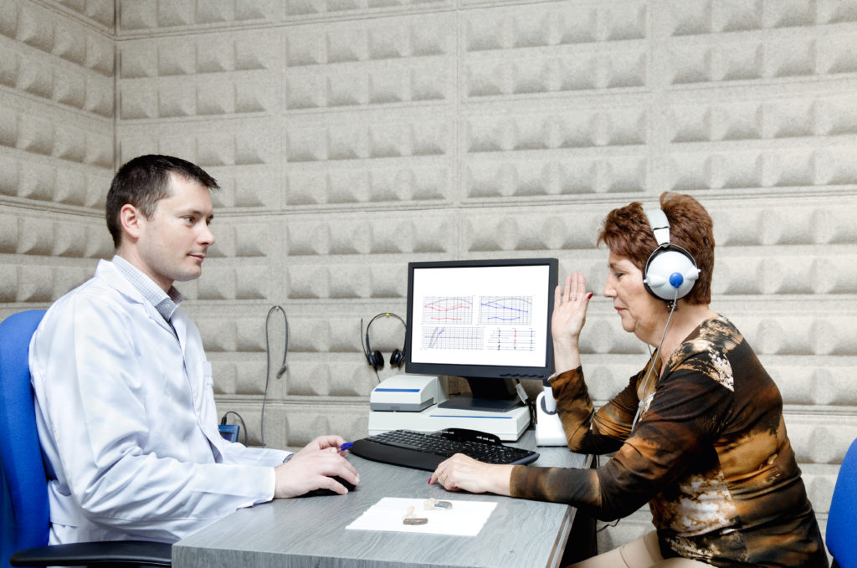
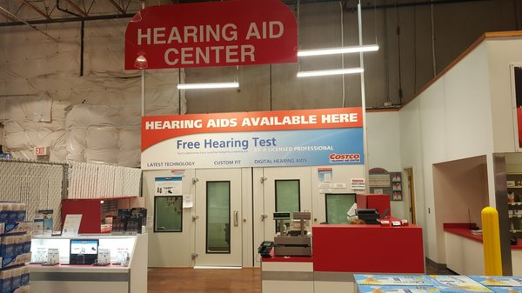
Audiologist
Audiogram/Audiometric testing
Soundproof room
Checks frequency loss to help localize loss
Word recognition
Notes:
Masters or Doctorate level provider who specializes in hearing testing and interventions
One option is Costco! They even have an online screening test. On-site testing is available to members and non-members.
An audiogram is a test of hearing, specifically of your ability to hear at certain volumes and certain pitches. It doesn’t hurt to have an audiogram and there isn’t any risk of radiation or other exposures.
Many private audiology clinics, and even some large store chains, will do audiograms even without a doctor’s referral.

Slide 27

Ear Nose and Throat (ENT) Doctor
Referral for medical concerns about hearing
Mass in ear canal
Pain associated with hearing loss
Asymmetric hearing loss
Perforated tympanic membrane
May recommend imaging
This Photo by Unknown Author is licensed under CC BY-ND

Slide 28
Helping Hearing Loss

Slide 29
Will a hearing aid help your memory?
Short answer: Probably! And it’s worth a shot!
So, let’s talk about hearing aids!
Notes:
Transition to hearing assistive devices on next slide

Slide 30
Question time!
Hearing aids are covered by Medicare Part B insurance
A: True
B: False
Notes:
False!

Slide 31
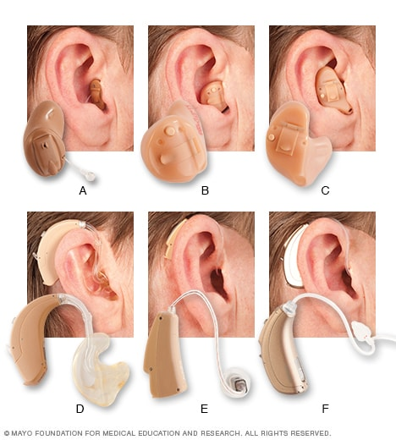
Prescription hearing aids
Benefits
Programmable and customizable
Can be used for all hearing loss types
Support and help through manufacturer and Audiology
Cool new tech to make life easier
Limitations
Expensive ($3000 per hearing aid)
Maintenance can be frustrating
Need hearing test
Notes:
Hearing exams are covered by Medicare Part B if the exam is to diagnose a hearing problem
Once every 12 months
Hearing aids are NOT covered under traditional Medicare
If you have a Medicare Advantage Plan—will cover additional tune-ups, part of the device costs
https://www.mayoclinic.org/diseases-conditions/hearing-loss/in-depth/hearing-aids/art-20044116
Many choices of hearing aid styles are available, including the following: completely in the canal (A), in the canal (B), in the ear (C), behind the ear (D), receiver in canal or receiver in the ear (E), and open fit (F).

Slide 32
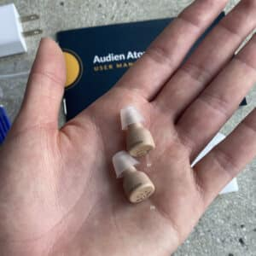
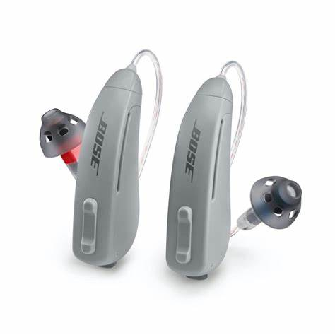
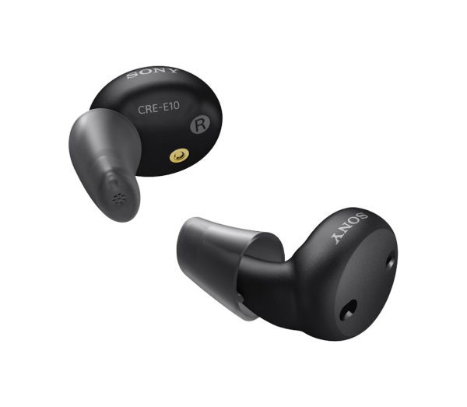
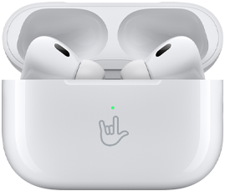
Over the counter hearing aids
Benefits
More affordable ($100-$3000)
No hearing exam needed
Good for mild hearing loss
Limitations
Less custom options
Not available for all hearing loss
No real customer support or programming help
Notes:
Sold directly via manufacturer and health-care websites and can be set up, tuned, and adjusted by the wearer (that is, no in-person doctor or audiologist visits required)
range in price from $99 per pair to more than $3,000 per pair
Apple now makes the AirPods Pro 2 for which you take a test online—about $250 for a pair and are clearly amplifiers with a few bells and whistles to modify
“The Over The Counter Hearing Aid Act (H.R. 1652) was approved in August 2022, allowing the FDA to create a new classification of hearing devices. The intent of this act is to improve access and affordability of hearing aids. In reality, direct to consumer hearing devices have been on the market for several years, but had not been regulated by the FDA for safety, reliability and consumer protection. These hearing amplifiers are designed for adults age 18 and older with “perceived” mild to moderate hearing loss and can be purchased over the counter (directly in stores or online). No hearing exam is required and there are no professional services included.” (OHSU website)

Slide 33
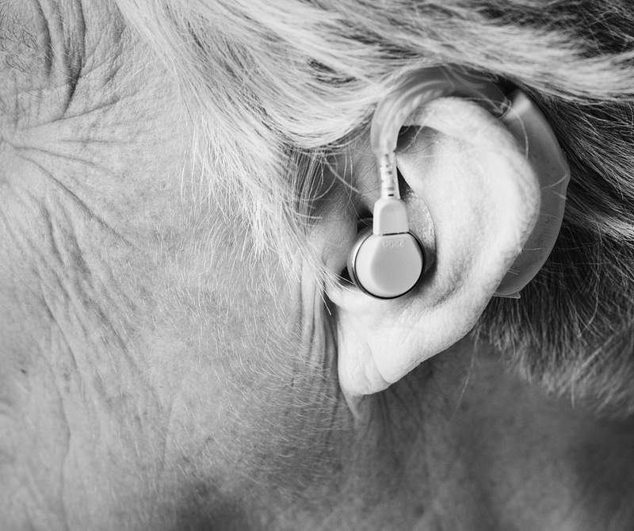
Important hearing aid pearls
Costs:
Not covered by Medicare Part A or B
Medicaid covers 75% of retail price
VA often covers through “sliding scale”
Expectations:
Amplifies volume and specific sounds → not “perfect”
Crowds still hard
Can’t improve “processing” speed
Notes:
https://secure.sos.state.or.us/oard/viewSingleRule.action?ruleVrsnRsn=308479

Slide 34
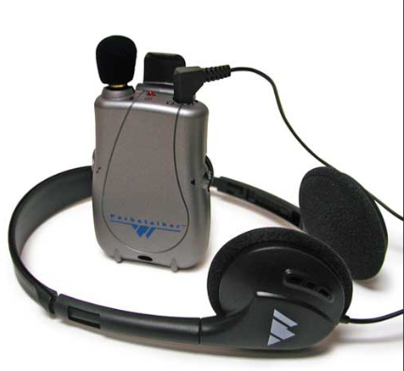
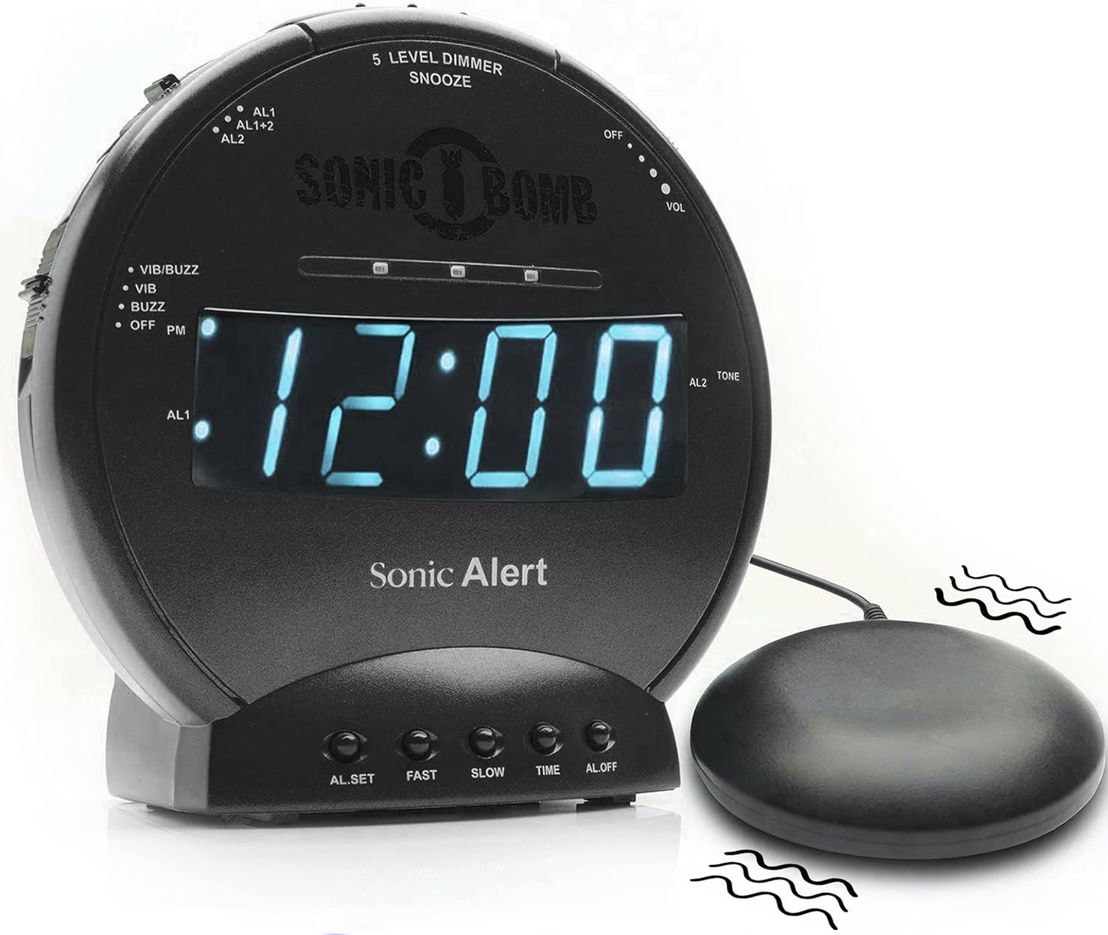
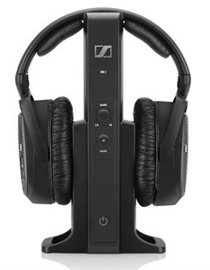
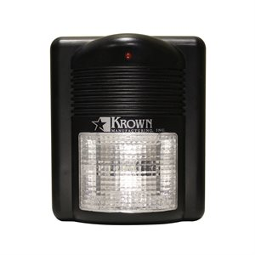
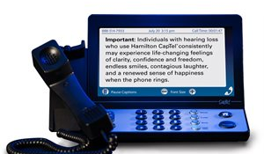
Assistive Listening Devices
Notes:
https://krownmfg.com/shop/door-knocker-125/
Door knocker that flashes when someone is at the door
Sonic “bed shaker” puts a vibrating device under the bed so that when the alarm goes off, the bed shakes

Slide 35
Healthy Hearing Pearls!
Healthy diet
Exercise
Tobacco use
Sleep
Notes:
Evidence that shows that Mediterranean Diet, low fat low cholesterol, and high protein diet improves hearing loss. Antioxidants good; high fat and carb bad.
Coffee is good!
Mice studies show that long-term exercise improves blood flow in the cochlea and slows degradation
Han et al, 2016
Tobacco: “Smoking is associated with increased risk of hearing loss, especially at the high frequency, in a dose–response manner. The excess risk of hearing loss associated with smoking disappears in a relatively short period after quitting”
https://academic.oup.com/ntr/article/21/4/481/4925604
Sleep: Need good quality sleep, 8 hours or less is fine. “Several studies have suggested an association between sleep-disordered breathing (SDB) and worse cardiovascular, cognitive, and functional outcomes. It has been hypothesized that sleep disturbances could impair hearing through disturbed energy metabolism and disrupted cochlear blood flow.”

Slide 36
Communication tips if you have hearing loss
Advocate for yourself! Let people know you have hearing loss!
Ask people to face you when they’re speaking
Remind them lower pitches are often easier to hear; consider a phrase such as, “Could you actually say that a little slower and lower?”
It’s okay to tell someone they don’t need to shout! Louder isn’t always helpful
Turn off TVs or radios and move away from other noises
Let the speaker know if you have a “better ear” they could speak towards
Ask for important points to be put in writing
Wear your hearing aid!

Slide 37
Communication tips when someone has hearing loss
Position yourself in front of the person and keep your mouth visible if possible
Use adequate lighting that shines on your face
Ensure the person is paying attention before you ask a questions
Speak at a normal volume—don’t shout!
Lower the pitch of your voice if possible
Rephrase instead of repeating your question or statement. Sometimes you need to use different words that are easier to understand.
Write down important information
Remind the to wear their hearing aid!
Notes:
KATIE—would you prefer to hack this slide for your section?

Slide 38
Final take-aways
Hearing loss is common
Hearing loss is important to memory, mood, and quality of life
We all can do something to help people with hearing challenges
Try a hearing amplifier—it might change your life

Slide 39

Thank you so much for letting me join you today!
Laura K. Byerly, MD
gwep@ohsu.edu

