Slide 1
Environmental Assessment and Action Plan for Reducing Asthma Triggers at Home
4/23/26
Indian Health Service
Shawn Blackshear

Slide 2
Enhancing Control of Childhood Asthma at Yakama IHS Clinic
A pharmacy-led, clinic-based childhood asthma education program that emphasizes self-management and coordination with home environment management has:
Increase patient knowledge of asthma;
Increase self-efficacy;
Increase proper use of controller and rescue medications;
Reduce exposures to home environment triggers;
Improve asthma-related quality of life (QoL); and
Reduce asthma-related medical care utilization.

Slide 3
A Public Health Response to Asthma: Environmental Interventions
Support the creation and maintenance of healthy home, school, and work environments through environmental interventions such as:
Assessments to identify asthma triggers
Education on how to address asthma triggers
Mitigation vs removing asthma triggers

Slide 4
Objectives
Identifying asthma triggers and conducting the environmental assessment.
Environmental health science and provide an example of walk-through forms​.
How to reduce and eliminate the asthma triggers and environmental hazards in the home.
Recommended actions and plans, and use of supplies and techniques for controlling triggers​.
Motivational Interviewing – Assess progress and identify weak points.
Notes:
What is asthma and asthma triggers in the home environment?

Slide 5
What is Asthma?
Chronic disease of the airways that may cause:
Wheezing
Breathlessness
Chest tightness
Nighttime or early morning coughing
Episodes involve variable, widespread airflow obstruction that is often reversible spontaneously or with treatment

Slide 6
Asthma Triggers
Learn the most common asthma triggers
Learn the principles of a healthy home environment
Understand how exposure to triggers and the environmental condition of the home can lead to “attacks” for people with asthma

Slide 7
Asthma Management
Asthma is controlled by…​
Taking medications correctly​
Reducing or eliminating triggers​

Slide 8
Environmental Health and Epidemiology of Asthma
Prenatal: Maternal smoking, poor diet/nutrition, stress, antibiotics, C-section​
Childhood: Allergic sensitization, tobacco smoke, animal exposure, limited breastfeeding, low infant lung function, family/socioeconomic factors, infections/antibiotics, sex/gender.
Adult: Occupational exposures
Notes:
Prenatal risk factors for asthma may include maternal smoking, diet and nutrition, stress, use of antibiotics and delivery by cesarean section.
Childhood risk factors may include allergic sensitization, environmental tobacco smoke, exposure to animals, breastfeeding, decreased lung function in infancy, family size and structure, socio-economic status, antibiotics and infections, and sex and gender.
Occupational exposures constitute a common risk factor for adult asthma.

Slide 9
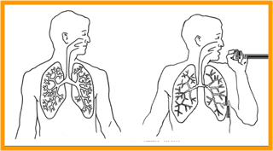
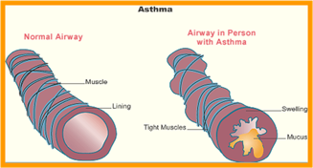
Exposure to Asthma Triggers: Indications of a Severe Attack
Breathless at rest
Hunched forward
Speaks in words rather than complete sentences
Agitated
Peak flow rate less than 60% of normal
Notes:
Notes: Asthma involves inflammation of the airways.

Slide 10
Remember
Asthma in Young Children (<5 Years)
Common symptoms: Persistent cough (night/early morning), wheezing, shortness of breath, rapid breathing, fatigue, difficulty eating/playing
Infants may show: Flaring nostrils, belly breathing, trouble feeding
Often triggered by: Colds or exercise
Watch for: Recurring or activity-related symptoms
Emergency signs: Blue lips/nails or severe breathing difficulty, seek immediate care
Notes:
Asthma in young children (under 5) often presents as a persistent cough (especially at night/early morning), wheezing, shortness of breath, rapid breathing, tiredness, and difficulty eating or playing, and often triggered by colds or exercise; with infants showing flared nostrils, belly movement, or trouble feeding. It can mimic other illnesses, so look for recurring symptoms or those worsening with activity or infection, and see a doctor if you notice blue lips/nails or severe struggling to breathe, which requires immediate intervention.

Slide 11
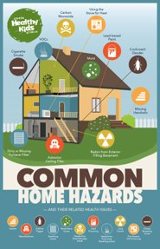
Environmental Health and Housing
8 Principles of a Healthy Home
Dry​
Safe​
Clean​
Pest-Free​
Contaminant-Free​
Well Ventilated​
Thermally Controlled​
Well Maintained​

Slide 12
Asthma Triggers in the Home
Some major asthma triggers found inside the home include:
Dust mites
Pests such as cockroaches, mice, and rats
Pets such as cats and dogs
Excess moisture and mold
Many consumer products with strong odors
Smoke

Slide 13
Asthma Triggers: Categories Indoor
Chemical Irritants​
Environmental tobacco smoke or wood smoke​
Chemicals found in air fresheners, cleaning products, and personal hygiene products​
Food preservatives
Biological Allergens​
Dust mite feces​
Pollen​
Pests​
Pet dander​
Mold​
Foods

Slide 14





Outside Asthma Triggers
Air Pollution​
​
Wildland fire​
Tree, grass, and ​weed pollen​
Ambient mold or​ fungi

Slide 15
Conducting the Environmental Assessment
Objectives
Identify asthma triggers​
Interviewing to go beyond visual observation and identification of triggers
​
Properly use and fill out the “Tribal Asthma Home Visit Form” to conduct the environmental assessment

Slide 16
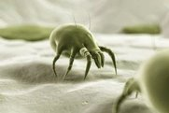
Dust Mites
Pillows
Mattresses
Upholstered furniture
Carpet
Book cases
Stuffed toys

Slide 17
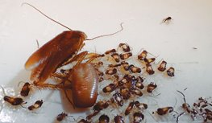
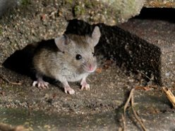
Pests
Cockroaches
Rodents, such as mice and rats
Where to look: water heaters, bathrooms, laundry areas, appliances, plumbing – usually only at night
Droppings look like black, greasy speckles
Look for holes and openings as small as a pencil​
Droppings are black or brown, and look like rice

Slide 18
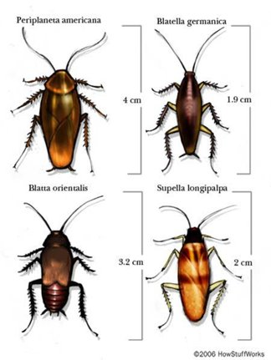
4,000 Cockroach Species
Four Major Pest Species​
American cockroach- Periplaneta americana​
German cockroach- Blatella germanica​
Oriental cockroach (waterbug)- Blatta orientalis​
Brown-banded cockroach- Supella longipalpa

Slide 19
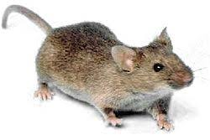
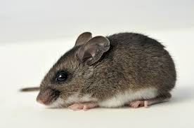
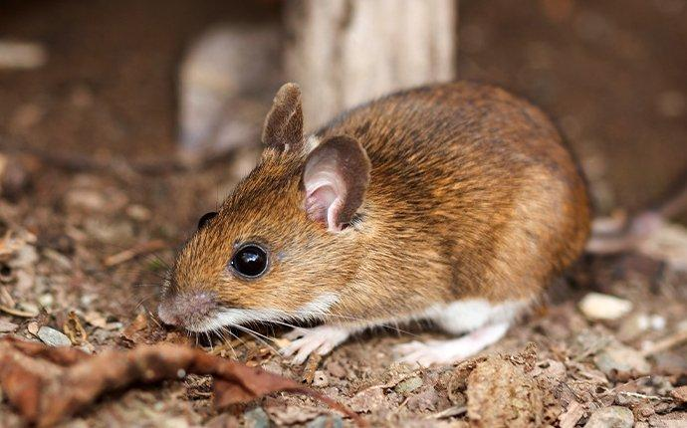
Mice
House mouse- known for its adaptability and uniform gray/brown color
Deer mouse- distinguished by its brown back, white belly, and bicolored tail, often found in rural settings (hantavirus)
White-footed mouse- similar to the deer mouse, also invades homes, particularly near wooded areas

Slide 20


Rats
Norway Rat (Brown Rat)- Large, stocky, brown/gray fur, short ears, blunt snout, tail shorter than body; prefer to make burrows.​
Roof Rat (Black Rat)- Smaller, slender, black fur, pointed nose, large ears, long tail (longer than head/body); prefer to make nests higher up.

Slide 21
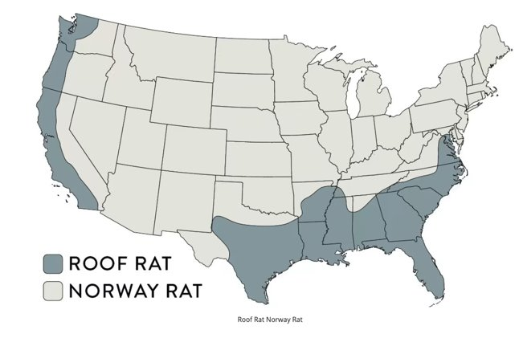

Slide 22
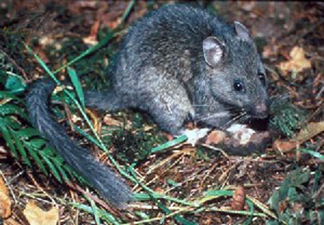
Woodrats aka Packrats
Woodrat (Packrat)- Furry tails (key difference!), varied appearance.
Western states, less common home invader than others. Its flat, hairy tail, long, full whiskers, large hairless ears, protruding eyes, and size make it easy to recognize.

Slide 23

Pets Asthma triggers and beloved pets
Allergens from pets come from skin flakes and dander, hair, saliva, and urine.​
​
Cat dander has microscopic protein allergen.
Notes:
Fel d 1, which clings to everything—hair, furniture, carpet, walls, even your clothes (months to years)—making it hard to remove and explaining why allergies persist even after a cat is gone.

Slide 24
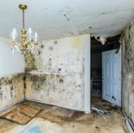

Moisture and Mold
Results from excess moisture​
Material that is damp for 24-48 hours can support mold growth.​
Dead hyphe, dry spores and particles can be health hazard.​
Not always visible; look for water damage, damp carpet, leaks in plumbing, standing water, and condensation on windows or inadequate venting.

Slide 25
Smoke
Secondhand or Environmental Tobacco Smoke
Harm with direct or proximal contact to smoke
Residue on clothing, furniture, or materials can be a trigger
Find out if anyone smokes inside and/or what the household rules are for smoking
Wood Smoke
Many tribal homes use wood burning stoves for whole house heat
Do not burn “junk” wood or any other products in the stove or fireplace – hazardous chemicals and particulate matter
Incomplete combustion can lead to CO

Slide 26
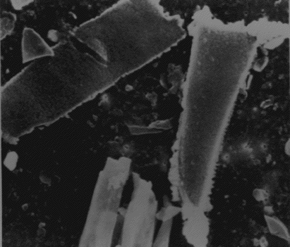
Wildfire Smoke
Dioxins- carcinogen, endocrine disrupter
Polychorinated biphenyls- carcinogen
Lead- heavy metal poison
Formaldehyde- poison, carcinogen
Polycyclic aromatic hydrocarbons- carcinogen
Cyanide- poison
Carbon monoxide- poison
Small particulates- 2.5pm inflammation
Arsenic- poison
Benzene- poison, possible carcinogen
Nitrogen Oxides- poison
Napthalenes- poison
Mold and Fungus spores- allergens
Toluene- neurotoxin
Methyl Chloride- toxin

Slide 27

Chemicals from Personal Products
Products that release odors or particulate matter can be triggers
Includes many cleaners such as household bleach
Personal hygiene body sprays or perfumes
Air fresheners, incense, or candles

Slide 28
Other Triggers
Air pollution and outdoor allergens can also trigger asthma.
As you drive to the home to conduct the assessment, take a look at any outdoor features or nearby activities that may be an asthma trigger or contribute to pollution, such as:
Heavy vehicular traffic
Agricultural activities, rural location
Industrial emissions
Land lots of trees or grass that may be an allergic trigger
Ask if asthma seems worse when traffic is bad or there are air alerts

Slide 29
Home Assessment
Methods of evaluating home environmental assessment findings
Use risk modeling for prioritizing needs and corrective actions
Effective methods and environmental controls for preventing and mitigating hazards
Identification of triggers and evaluation of the home environment to present findings and write the Home Action Plan for patients

Slide 30
Conducting the Home Environmental Assessment
Your goal is to find the allergens and irritants that can trigger asthma AND their sources
The home environmental assessment includes:
Inspection outside the home
First impressions upon entering
Review of the medical asthma action plan and patient history
Explain what you are looking for to clients
Have the homeowner/parent/caregiver accompany you
Patient’s bedroom is a good place to start

Slide 31
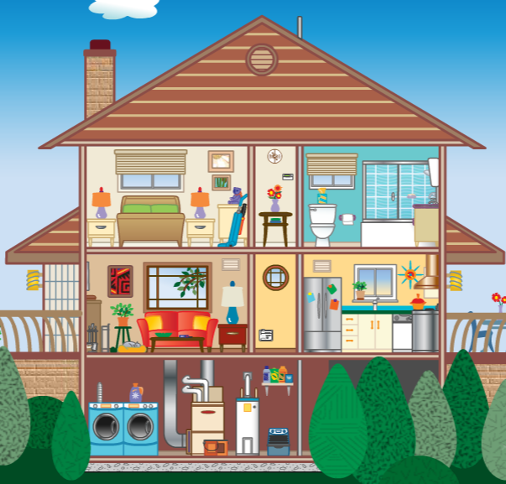
Homes are Systems
“Fire”- heat transfers drive air flow
“Air”- air movement creates pressure differences
“Water”- moves from wet to dry
“Earth”- dust infiltrates and circulates with air movement
Crawl space
From https://www.epa.gov/indoor-air-quality-iaq/

Slide 32

Tribal Home Environmental Assessment
Form for Asthma

Slide 33
Cultural, Safety, and Ethical Considerations for Conducting the Home Environmental Assessment
Cultural
Local, Tribal staff are key – each Tribe and community are unique
Take the time to listen and learn before and during your work
Ethical and Legal
Professional Association/Licensing Board (EHS, Nurses, Social Workers, CHES, AEC)
Public Health Code of Ethics or Employer Code
Mandatory reporting of abuse and neglect
Safety
Appropriate PPE when necessary
If the situation is unstable or perceived as unsafe, do not enter the home

Slide 34
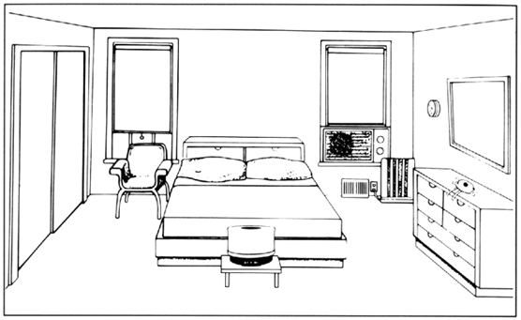
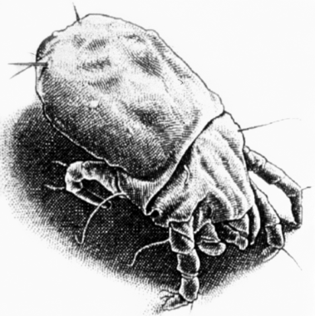
Reducing Exposure to Dust Mites
Use bedding encasements
Avoid down fillings
Vacuum weekly
Wash bed linens weekly in hot water (130*F)
Clear cluttered bookcases and areas which can get dusty
Limit stuffed animals to those that can be washed (can also freeze)
Reduce humidity level (between 30% and 50% relative humidity per EP-3)

Slide 35
Reducing Exposure to Pests
Practice Integrated Pest Management
Determine what pests are present and at what level (infestation, minimal,..)
Eliminate the pests sources of shelter, water, and food
Keep food in closed containers – including pet food
Immediately clean spills, crumbs
Wash dishes regularly
Dry items before putting away
Fix leaks
Keep trash in closed container and take out routinely
Clean, clean, clean
Prevent access to the home
Maintain wallpaper
Seal cracks and openings into the house

Slide 36
Reducing Exposure to Pets
People who are allergic to pets should not have them in the house
At a minimum, do not allow pets in the bedroom
Even with regular cleaning, it is difficult to remove all dander and pet allergens. Can last 6 months after pet is no longer inside.

Slide 37
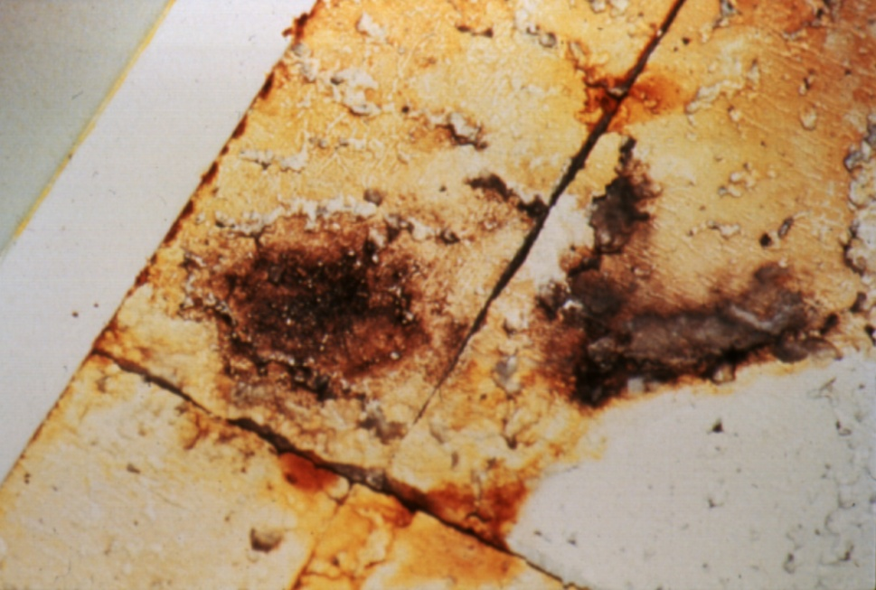
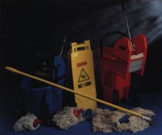
Reducing Exposure to Mold
Eliminating mold and the moist conditions that permit mold growth may help prevent asthma flare-ups.

Slide 38
Cleaning Mold
Discard all absorbent/soaked materials
Carpet and textiles
Sheet rock
Particle board
Ceiling tiles
Clean non-absorbent materials and surfaces
Hot water and non-ammonia soap
Stiff brush to remove visible mold and rinse with clean water
Dry thoroughly, don’t damage surface with the cleaning process
Use gloves and mask, and dispose of material in bags or closed container
Over 10 sq.ft. consider hiring contractor

Slide 39
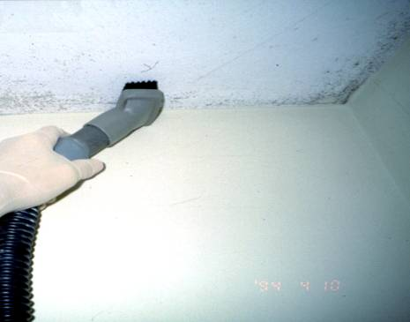
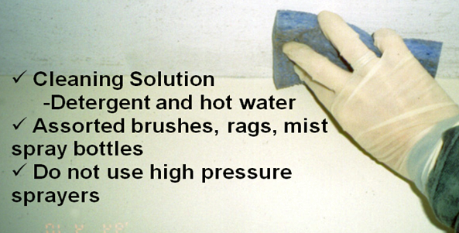
Cleaning Small Areas of Mold Growth
Clean surfaces starting with careful vacuuming
After vacuuming, small areas can be cleaned through a multi-step process summarized below
Provide clients with the EPA Booklet for guidance
Never use bleach- it is not necessary
Notes:
≤10 square feet

Slide 40

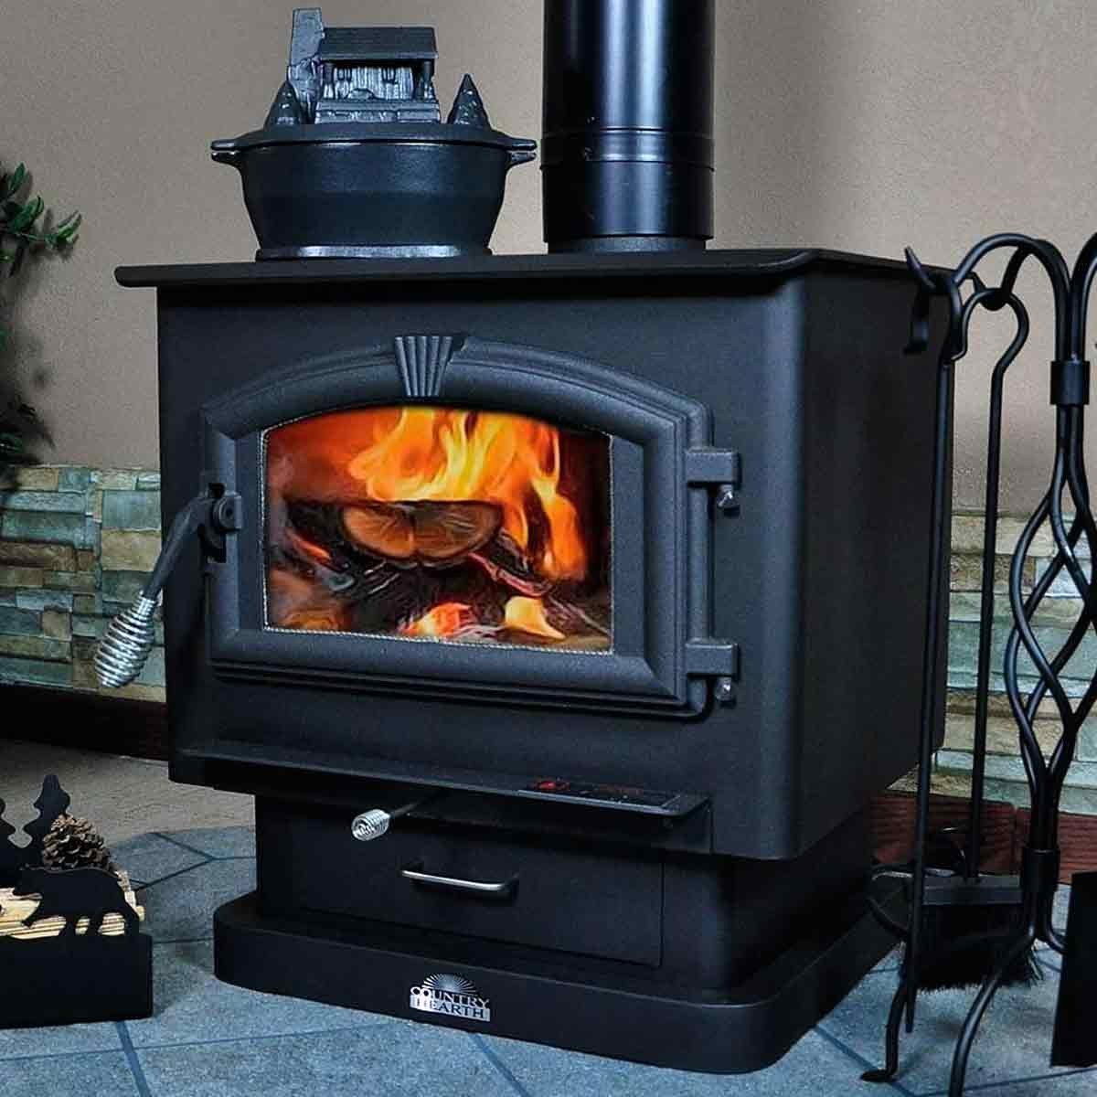
Reducing Exposure to Smoke
Environmental tobacco smoke is associated with asthma development in preschool children and worsened symptoms in older children and adults.

Slide 41
Limit Exposure to Chemicals in Personal Products
Avoid or limit uses of perfumes, fragrance sprays, candles, wax heaters, etc. that produce strong odors
Substitute with less toxic, non-scented, environmentally friendly/natural or organic products
Green Cleaners
When cleaning, pour the product into a cloth rather than spray it

Slide 42
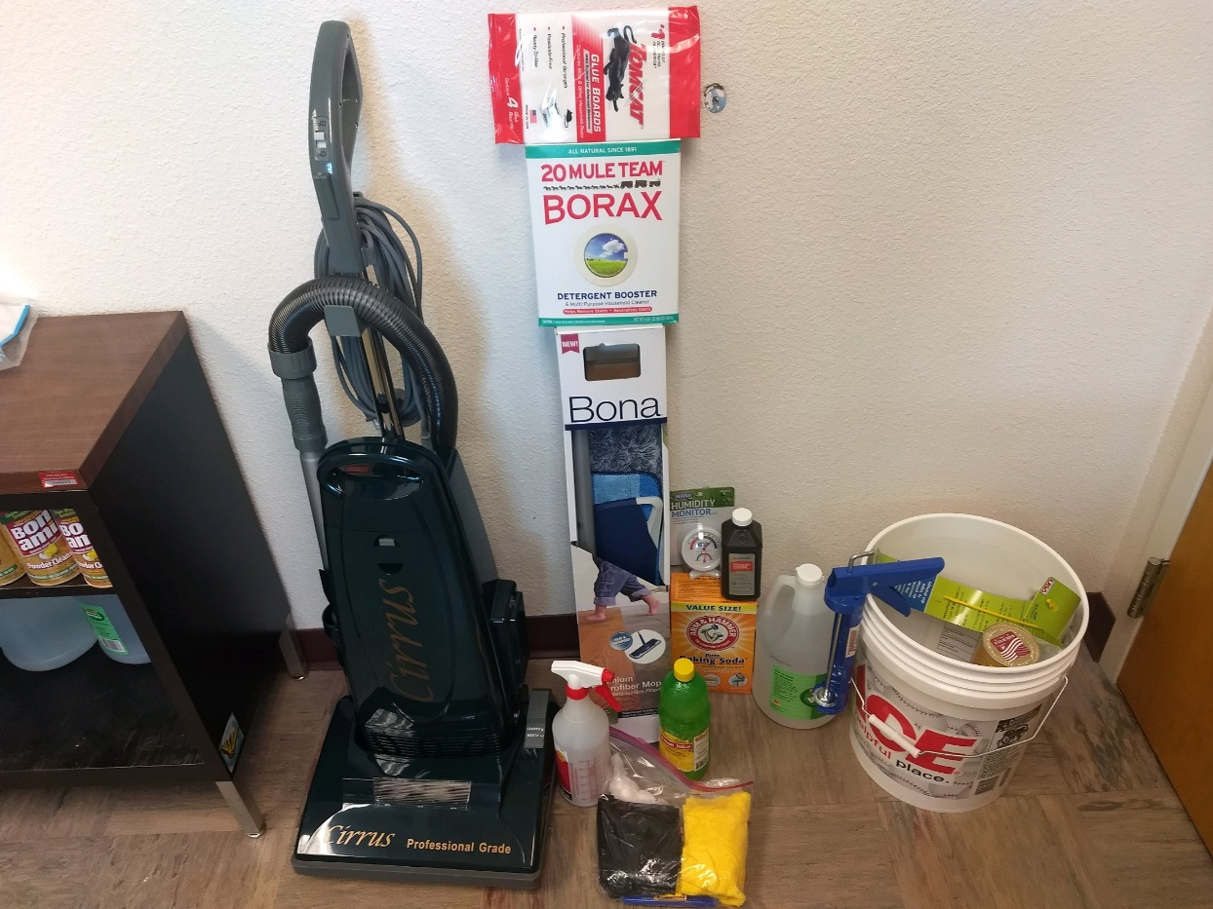
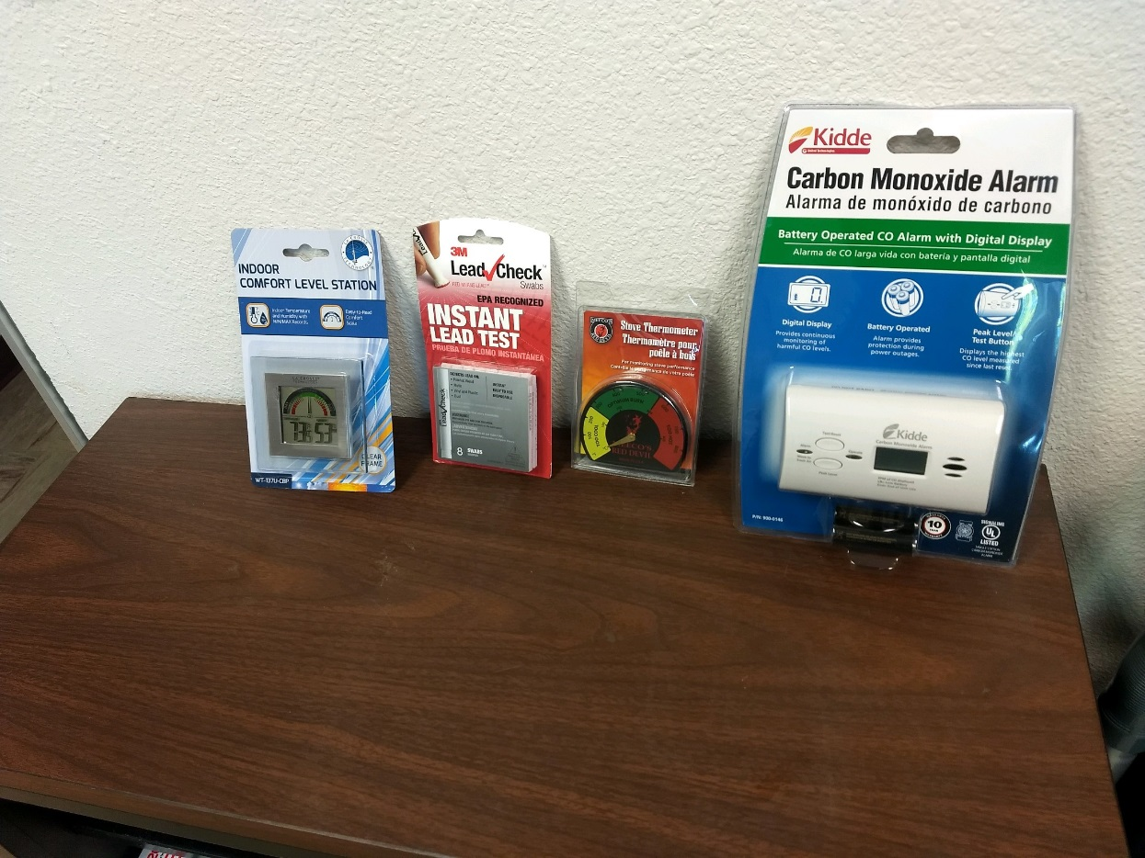
Equipment and Green Cleaning Supplies

Slide 43
Coordinate with social and housing support programs
Coordinate home visits with housing programs
Connect families to community support services
Identify grants/funding for home improvements and supplies
Integrate with primary care to support sustainable financing
Assess schools and workplaces for potential exposures
Notes:
Coordinate home visits with Housing Programs when possible
Connect the family with other community support programs as needed
See what grants/funding sources may be available to assist with improvements in the home and supplies
Integration with primary care can lead to health financing of the environmental health home visiting services for sustainability of the services
Consider if schools and work sites should be evaluated as potential exposure sources

Slide 44
Summary
Triggers include chemical irritants and biological allergens
Home environmental conditions directly impact asthma health
Exposure can cause airway narrowing, hospitalization, or death
Home assessments and Action Plans reduce/eliminate triggers
Demonstrate green cleaning and environmental control practices
Prioritize cultural, ethical, and safety considerations during visits
Coordinate across community systems to support families
Notes:
Asthma triggers include both chemical irritants and biological allergens.
The environmental conditions of the home (“environmental health of the home”) is important for the health of those who live there.
People who have asthma and are exposed to irritants or allergens can be “triggered” – airway closes and can lead to hospitalization or death.
The home environmental assessment and created Home Action Plan reduces or eliminates environmental hazards and triggers.
Demonstrating how to use green cleaners and other environmental controls (e.g. cleaning) can assist with intervention follow through.
Cultural, ethical, and safety considerations should be a primary focus for conducting effective home visits.
Coordinate across all community systems to ensure families receive the best support for achieving health.

Slide 45
Tribal Asthma Toolkit
Shake'n Bake
https://www.npaihb.org/wp-content/uploads/2024/04/asthma-toolkit.pdf

Slide 46
Healthy Homes Training
Indian Health Service Environmental Health Support Center
https://www.ihs.gov/ehsc/classes/

Slide 47
References and Resources
National Institutes of Health, National Institute of Allergy and Infectious Disease, https://www.niaid.nih.gov/diseases-conditions/asthma
National Institutes of Health, National Institute of Environmental Health Sciences, https://www.niehs.nih.gov/health/topics/conditions/asthma/index.cfm
National Heart, Lung, and Blood Institute – Guidelines for the Diagnosis and Management of Asthma, https://www.nhlbi.nih.gov/health-topics/guidelines-for-diagnosis-management-of-asthma
CDC Asthma | Asthma | CDC
Community Preventive Task Force – The Community Guide, https://www.thecommunityguide.org/topic/asthma

Slide 48
References and Resources
Department of Housing and Urban Development, Healthy Housing Program, https://www.hud.gov/program_offices/healthy_homes/hhi
Environmental Protection Agency, https://www.epa.gov/asthma
National Center for Healthy Housing, https://nchh.org/
Minnesota Department of Health – Asthma, https://www.health.state.mn.us/diseases/asthma/
Subbarao, P., Mandhane, P. J., & Sears, M. R. (2009). Asthma: epidemiology, etiology and risk factors. CMAJ : Canadian Medical Association journal = journal de l'Association medicale canadienne, 181(9), E181–E190. doi:10.1503/cmaj.080612

Slide 49
Questions?

