Slide 1
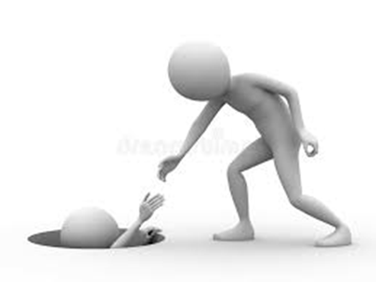
Diabetes Distress What YOU can do to Help
April 9, 2026
Carol Greenlee MD MACP

Slide 2
Learning Objects
Understand what diabetes distress is
Identify why it is important to address diabetes distress
Recognize how you can help people with diabetes (PWD) manage diabetes distress

Slide 3
Pre-Question – chose one best answer
What type of conversation is most helpful to PWD to assist them in dealing with diabetes distress?
Offering suggestions to help fix everything
Active listening with empathetic response
Encouraging the PWD to be stronger
Reassuring the PWD that it really isn’t that hard to manage diabetes

Slide 4
Diabetes Distress (DD)
Diabetes Distress is not a co-morbidity or a diabetes complication
It is simply the emotional side of having & living with diabetes
It is different than clinical depression
It “reflects the broad range of feelings, beliefs and expectations that result from the emotional toll of living with diabetes”
Updated incidence
Adults with T1D = 74%
Adults with T2D = 62%
88% have at least one elevated Source Scale (even higher for PWT1D)
It is a common and expected response to living with diabetes
Diabetes is hard..
Notes:
Fisher, L., Polonsky, W. H., & Hessler, D. (2019). Addressing diabetes distress in clinical care: A practical guide. Diabetic Medicine, 36(6), 803–812
Polonsky, W. H., Fisher, L., Hessler, D., Desai, U., King, S. B., & Perez-Nieves, M. (2022). Toward a more comprehensive understanding of the emotional side of type 2 diabetes: A re-envisioning of the assessment of diabetes distress. Journal of Diabetes and Its Complications, 36(1), 108103.

Slide 5
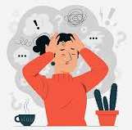
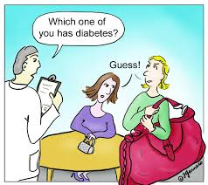

Diabetes is Hard
Management Demands
Self-management adds over 2 hours per day of an unasked-for “job” per day – every day
No pay, no vacation
Lots of numbers & math, lots of appointments, lots of instructions, lots of technology & often lots of big changes to lifestyle, lots of medications – lots of stuff to haul around
Few other people recognize how much work/burden this is
Perceptions & Judgements
Diabetes Stigma – society , medical personnel (blame & shame)
Diabetes “police” – “helpers”
“Control” - Goals & targets
Misperceptions
Self-expectations & self-judgement (“not doing a good job”, “failure”, “burden” “nothing works for me”)
Scary
Lots of needles, lots of meds
High and low blood glucose levels
Chronic complications – influenced by what you have seen in family/community
Vision loss, amputations, painful neuropathy, dialysis, heart failure, heart attack, stroke
May seem inevitable (“I am doomed”)

Slide 6
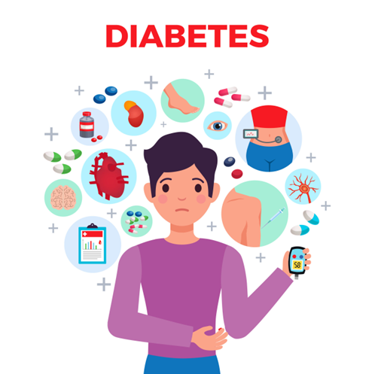
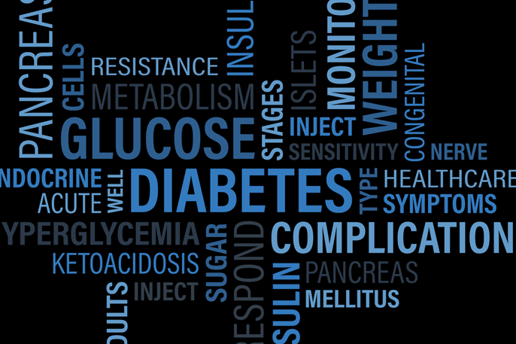
Defining Diabetes Distress (DD)
Diabetes distress is emotional distress that captures
the worries, concerns and fears among individuals struggling with the progressive and demanding chronic disease that is diabetes including:
the emotional burden of self-management
threats of complications and potential loss of functioning
Notes:
J Diabetes Complications
. May-Jun 2015;29(4):572-7.
doi: 10.1016/j.jdiacomp.2015.01.012. Epub 2015 Feb 7.
Understanding the sources of diabetes distress in adults with type 1 diabetes
Lawrence Fisher ¹, William H Polonsky ², Danielle M Hessler ³, Umesh Masharani ⁴, Ian Blumer ⁵, Anne L Peters ⁶, Lisa A Strycker ⁷, Vicky Bowyer ³
Affiliations expand
PMID: 25765489
PMCID: PMC4414881
DOI: 10.1016/j.jdiacomp.2015.01.012
Fisher, L., Gonzales, J.S., Polonsky, W.H. The confusing tale of depression and distress in patients with diabetes: A call for greater clarity and precision. Diabetic Medicine, 2014, 31, 764-772.
Diabet Med. Author manuscript; available in PMC 2015 Jul 1.
Diabet Med. Author manuscript; available in PMC 2015 Jul 1.
Published in final edited form as:
Diabet Med. 2014 Jul; 31(7): 764–772.
doi: 10.1111/dme.12428
PMCID: PMC4065190
NIHMSID: NIHMS573631
PMID: 24606397
The confusing tale of depression and distress in patients with diabetes: a call for greater clarity and precision
L. Fisher, J. S. Gonzalez, and W. H. Polonsky

Slide 7

Why do anything about DD?
If it’s a normal part of living with diabetes …
Hyperglycemia is a normal part of living with diabetes – but its harmful
DD is also harmful – it has a significant impact on self-management behaviors and clinical outcomes
Motivation for self-management is critical for PWD
“Self-management and team-based care are the greatest drivers of successful glycemic management.”
Self-management choices are driven by feelings, beliefs, thoughts and expectations
If you think that you are doomed (no matter what you do, you will end up with complications) … why bother?
If you feel tired of being told you are not doing good enough – need to do better … why come to clinic?
If you are skipping insulin to avoid having low BGs … why get an A1c level checked?
DD impedes motivation for doing what is needed for self-management

Slide 8
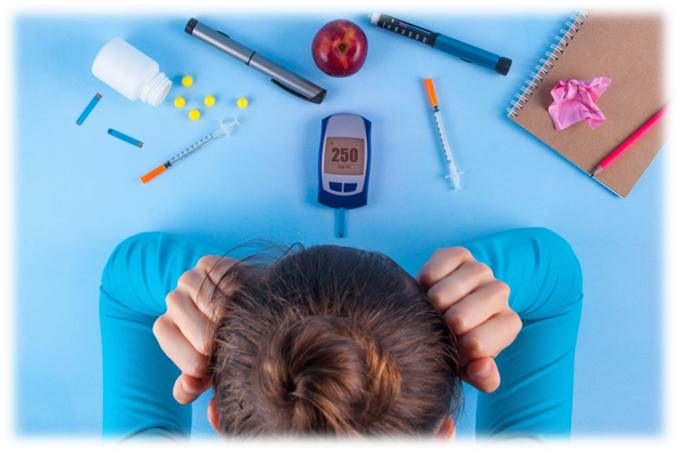
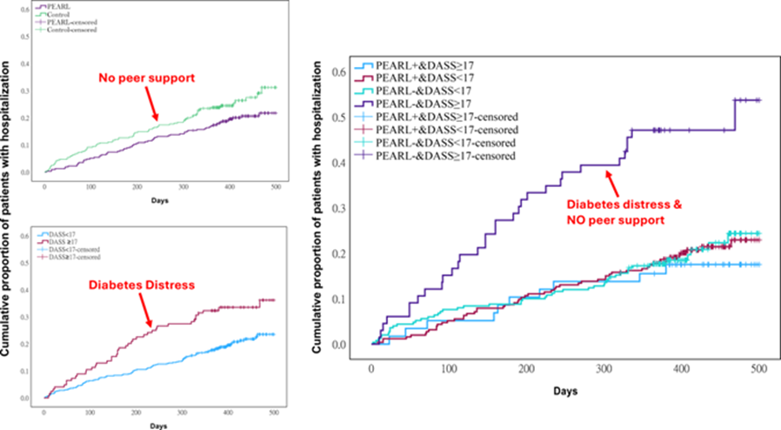
Impacts of Diabetes Distress
Therefore, DD can result in
problems with disease management
lower self-efficacy
less effective diabetes-related problem solving
less optimal eating and exercise behaviors
less consistent medication-taking
elevated A1c
but even those with lower A1c can have DD
missed healthcare visits
reduced health-related quality of life & well-being
more complications
more hospitalizations
higher costs – human & financial
Notes:
Polonsky, W. H., Strycker, L., Naranjo, D., Greenberg, K., & Fisher, L. (2025). Stability and impact of diabetes distress over time: The potential value and uses of the type 1 diabetes distress assessment system (T1-DDAS). Diabetic Medicine, 42(7), e70066.
Polonsky, W. H., Fisher, L., Hessler, D., Desai, U., King, S. B., & Perez-Nieves, M. (2022). Toward a more comprehensive understanding of the emotional side of type 2 diabetes: A re-envisioning of the assessment of diabetes distress. Journal of Diabetes and Its Complications, 36(1), 108103.
Redefining Diabetes and Creating Solutions—The Hong Kong Diabetes Register: Kelly West Award Lecture 2025 | Diabetes Care | American Diabetes Association

Slide 9
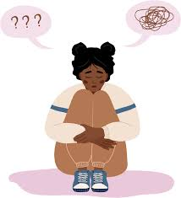
Why do anything about DD?
Addressing DD directly leads to better clinical outcomes.
If not addressed, DD doesn’t just go away
It can get worse over time and/or wear the individual down
It may lead to a person feeling emotionally exhausted and overwhelmed by the demands of their diabetes.
They try to cope with this by giving up on taking care of their diabetes.
DD is a barrier to change
DD blocks responsiveness to education & management interventions
Adjusting meds or referral to diabetes ed/nutrition counselling has minimal impact
Most PWD have not had DD addressed
Notes:
Diabet. Med. 36: 803–812 (2019)

Slide 10

Why do anything about DD?
Another reason to address DD is to avoid unnecessary polypharmacy
Adding more meds for glycemia, BP, lipids when patient not consistently taking current medications
CGM may seem like more judgement or futile effort unless DD addressed
DD can show up as a higher score on the PHQ9
This is picking up something, but it is not always depression, often diabetes distress
One study suggests ~70% of PWD with abnormal PHQ9 have DD not clinical depression
When accounting for DD, the frequency of depression in PWD is about the same as in the general population (3-8%) vs the prior reports of depression being 2-3x higher in PWD
Very different solutions - “This distress cannot be treated with depression medications because…it is not depression! Rather, it requires a greater focus on acknowledging and addressing the emotional and behavioral obstacles associated with diabetes.” W. Polonsky
Often mis-addressed by adding meds for depression & when PHQ9 does not improve – add more and/or stronger meds adding to polypharmacy & negative metabolic impacts e.g.:
SSRI meds: increased appetite & cravings; increased weight, lipids & glucose levels
Second-generation antipsychotic meds – weight gain, increased IR, glucose & lipid levels
Note: PWD can have both DD and MDD, Bipolar Disorder, etc. that benefit from Rx
Notes:
Fisher, Polonsky Fisher L, Gonzalez JS, Polonsky WH. The confusing tale of depression and distress in patients with diabetes: a call for greater clarity and precision. Diabet Med 2014;31:764–72.

Slide 11

What do you do? What can you do?
“For the most part, distress interventions typically do not require the expertise of a mental health professional, which can be costly and, in most cases, unavailable - they [the interventions] can be incorporated into regular diabetes care” Fisher & Polonsky
Where to start ?
ADA 2026 Standards of Care Recommendation
5.45 Screen for diabetes distress at least annually in people with diabetes, caregivers, and family members, and
repeat screening when treatment goals are not met, at transitional times, and/or in the presence of diabetes complications.
Based on research, broad screening measures are superior to brief screens
Preferable to screen everyone on a regular basis
Notes:
Diabet. Med. 36: 803–812 (2019)
Diabetes Care 2026;49(Supplement_1):S61–S88

Slide 12
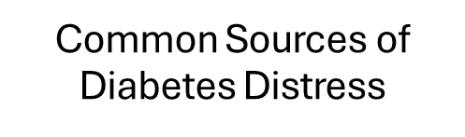
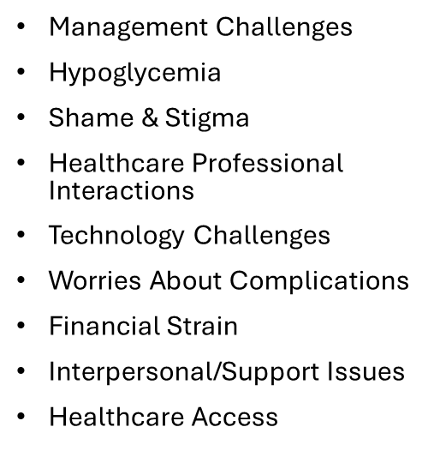
Diabetes Distress is not “One Thing”
Different PWD have different issues that result in diabetes distress
Not always detected by overall distress
Sometimes driven by individual sources of distress
Total or averaged scores often miss critical issues
Recommended validated assessment tool:
T2-Diabetes Distress Assessment System (T2-DDAS)
T1-Diabetes Distress Assessment System (T1-DDAS)
BDI*: https://diabetesdistress.org/
Provides scoring
Provides subscales (sources of distress)
Can download or print results
* Behavioral Diabetes Institute

Slide 13
BDI: Assessment of Diabetes Distress in Type 2 Diabetes:
For adults with type 2 diabetes (regardless of medication regimen) - the T2-Diabetes Distress Assessment System (T2-DDAS)
Consists of 29 items and yields two sets of scores:
an 8-item CORE DISTRESS SCORE, reflecting overall diabetes-related emotional distress
a 21-item set of seven SOURCE SCORES, reflecting different potential sources of distress
For type 1 diabetes – a 30 item T1-DDAS
How to use the T2-DDAS on the Website (Diabetes Distress Assessment & Resource Center -https://diabetesdistress.org/)
Preferable to ask patients to complete the T2-DDAS online (use of a tablet)
Online administration will automatically compute scores providing a single CORE score, 7 SOURCES scores, and all item scores
All scores will then be summarized in an accompanying report, available for download or printing.
You can also print a copy of the T2-DDAS along with scoring instructions.
Notes:
Diabetes Distress Assessment & Resource Center

Slide 14
Instructions for Patients
DIRECTIONS: Living with diabetes can be tough. Listed below are many of the stresses and worries that people with diabetes often experience.
These are issues that can often be tough to acknowledge and to talk about, but please be as open and honest as you can.
Thinking back over the past month, please indicate how much each of the following items were a problem for you by marking the appropriate column. For example:
If an item was not a problem for you over the past month, place a mark in the first column: "Not a Problem" (1).
If it was a very tough problem for you, place a mark in the last column: "A Very Serious Problem" (5).

Slide 15
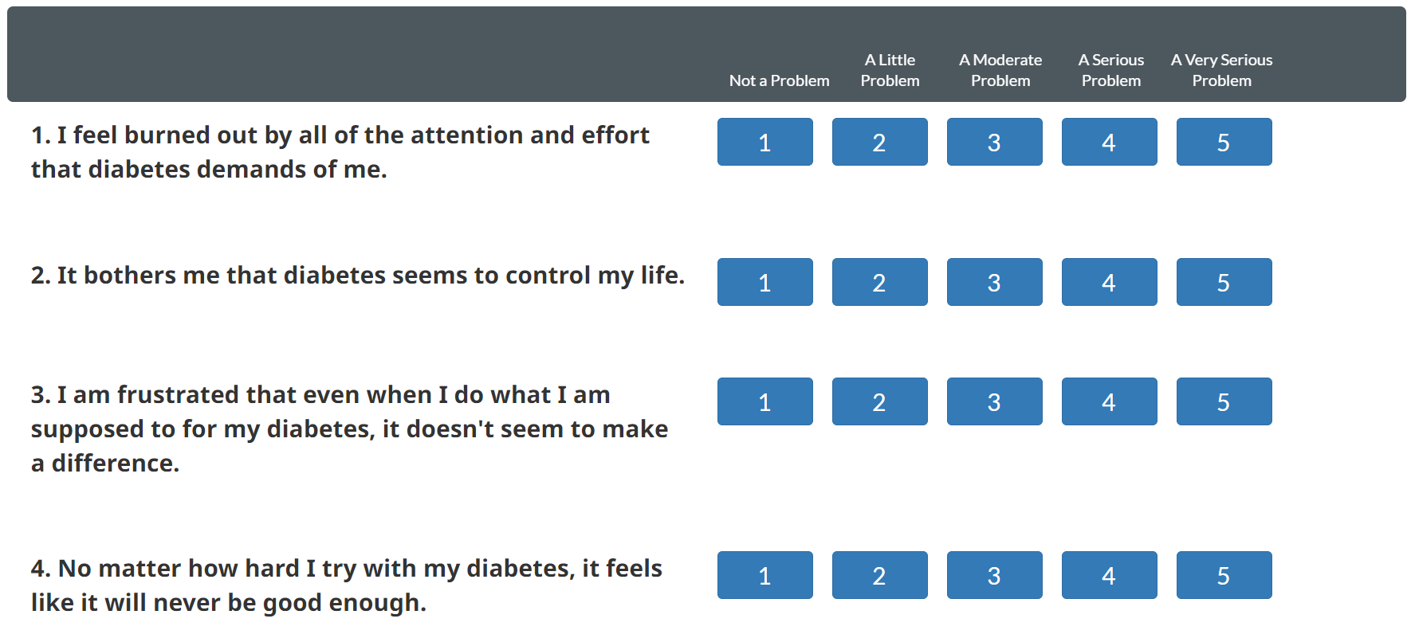
The Online Screening Tool

Slide 16
Interpreting & Using the Screening Scores
Mean Scores
Mean score < 2.0 indicate little or no distress.
Mean score between 2.0 and 2.9 indicate moderate distress.
Mean score =/> 3.0 indicate high distress
Any subscale (source) score =/> 2.0 is considered clinically significant
How to Use the T2-DDAS
Use the T2-DDAS to identify three levels of specificity of diabetes distress information for use in clinical care:
Use the CORE score to begin a conversation about a patient's overall level of diabetes distress and current general feelings about living with diabetes.
Review each of the 7 SOURCE scores to identify the highest reported source or cause of distress.
Use this subscale to begin a conversation about more focused areas of concern
Identify the highest rated of the 29 T2-DDAS items.
Use these specific items to begin a conversation about particular sources of diabetes distress.

Slide 17
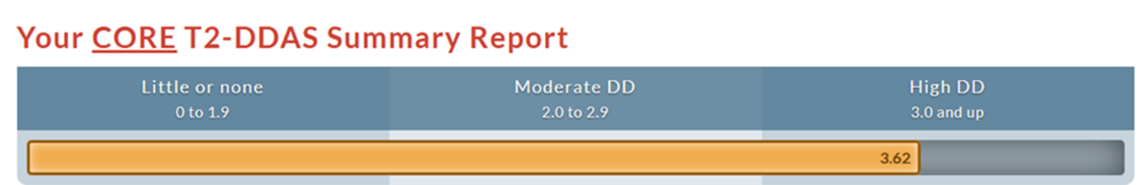
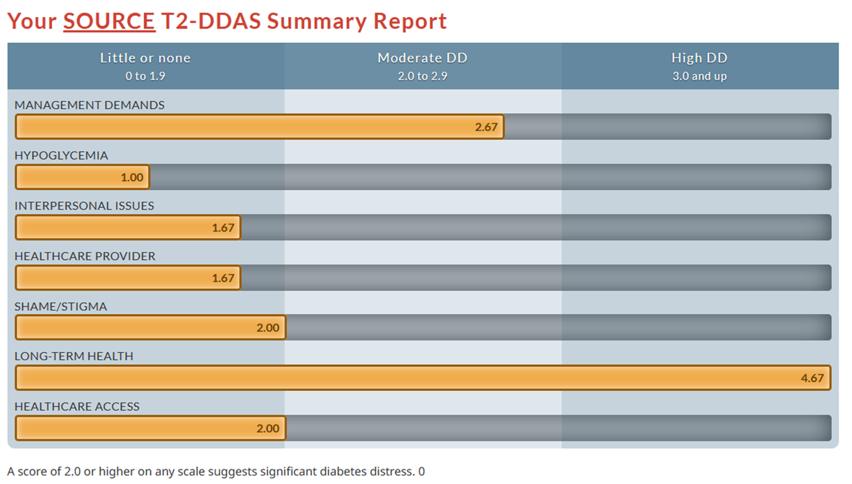
Example of a Scored Assessment – Summary Reports

Slide 18
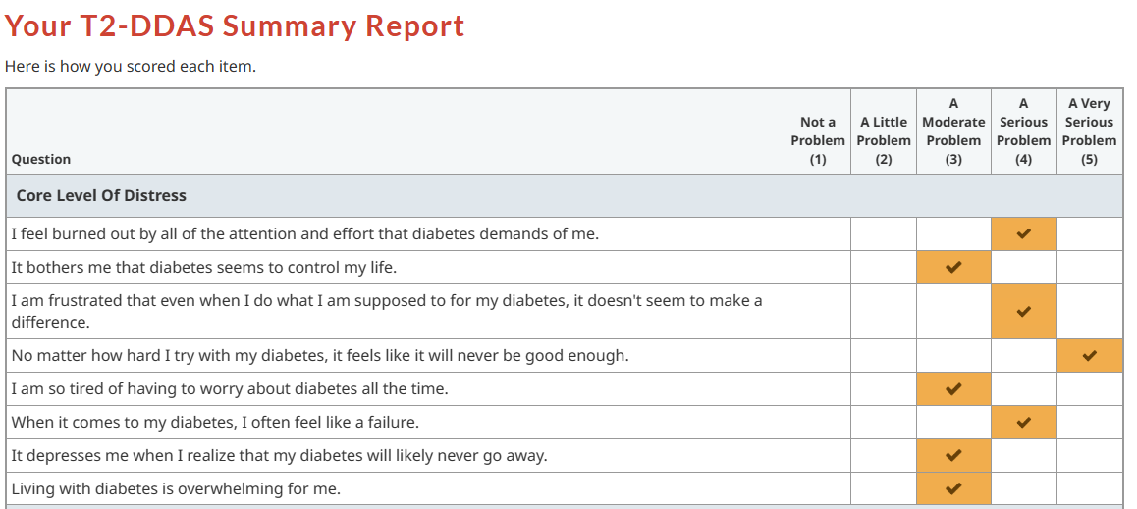
More Detailed Look – at Core Issues
Main message = sense of futility, hopelessness –
No matter what I do, bad things are going to happen
What I do doesn’t make a difference, I am ‘doomed’
I am doing a lot of stuff for nothing (no benefit)

Slide 19
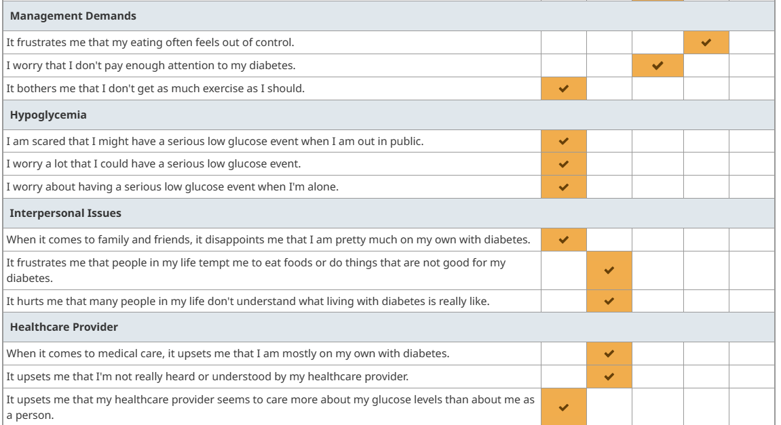
More Details- Sources of Distress
Eating Distress
Maybe some ambivalence
(distress over how much time
diabetes requires & that it
doesn’t make a difference AND
Guilt/distress over not doing more)
Some sense of
“in it all alone”

Slide 20
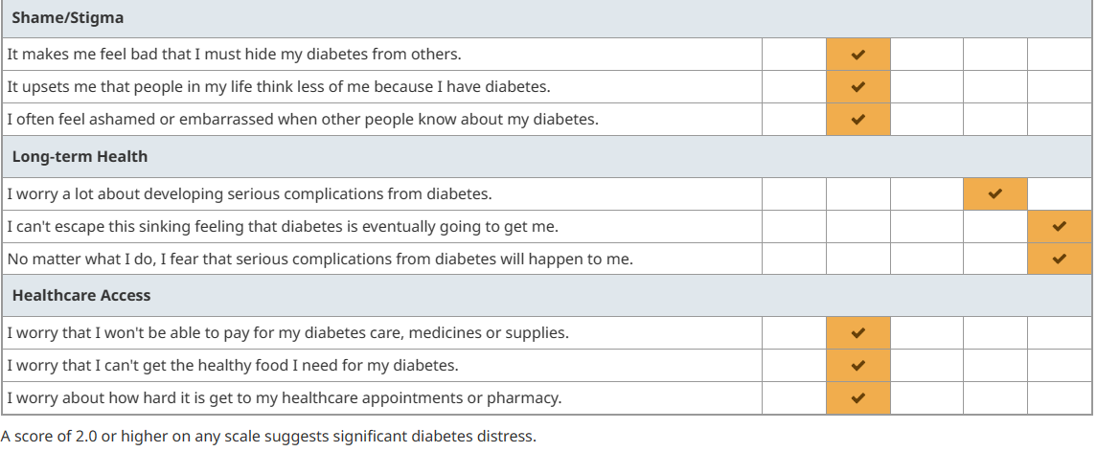

More Details- Sources of Distress
Mild/Moderate
Shame & stigma
The Big One
Futility and
hopelessness
Mild/Moderate
Access Distress

Slide 21
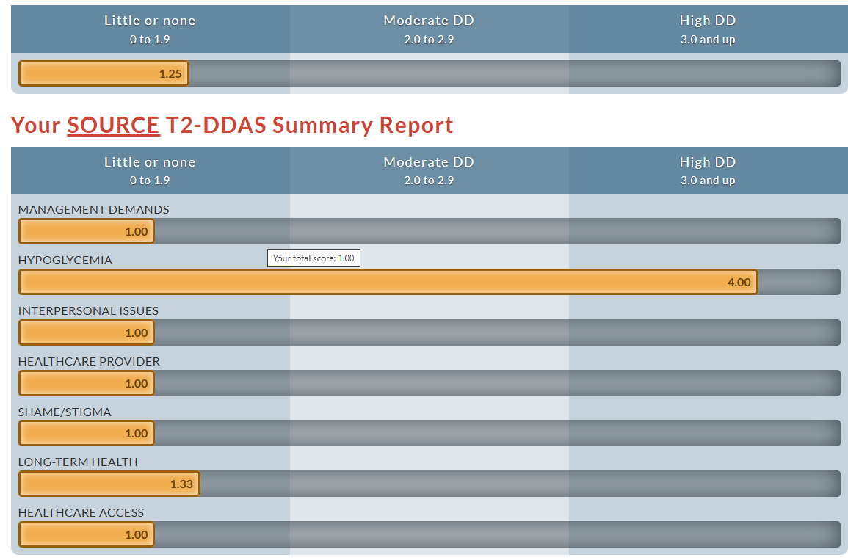
An example of another experience of DD

Slide 22

Now What?
Do not want to screen and do nothing with the results!!
Start with a conversation – guided by the results of the DDAS
I see here that you feel very hopeless regarding the diabetes and that you are concerned that no matter what you do, you are going to end up with bad complications – can you tell me more about that?
This shows that overall, you are coping very well with the diabetes but there is a lot of concern/worry about hypoglycemia – can you give me more details about your concerns?
f/u with open-ended questions – How, What, Why

Slide 23

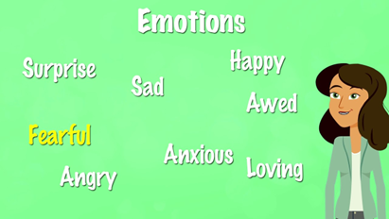

Next Steps
Listen attentively (active listening – fully focused, listening to understand)
Talk less
Use body language to indicate understanding (e.g.; nodding, eye contact)
Tolerate silence
Have a conversation to help the PWD label, express & evaluate the often unaddressed, hidden feelings & thoughts about diabetes (not to “fix” issues)
Label feelings & beliefs - use “feeling” word(s)
“It sounds like you are very frustrated/disappointed/angry/scared….about xxx”
“It sounds like you feel it is your fault that you developed diabetes”
Summarize & Reflect (without correcting factually incorrect perceptions)
So, you are saying “people think having diabetes means you are somehow ‘bad’ or have done something bad” – do I have that correct?
Let me see if I understand, “you feel as if nothing you do will change what happens to you because your father, uncle and grandfather all died at a young age from diabetes”
Normalize & Accept (not trying to fix anything)
You understand without judgement - provides an objective perspective for them
Helps the PWD evaluate & consider – sort things out – often “fix” for themselves
Notes:
Bringing the assessment and treatment of diabetes distress into the real world of clinical care: Time for a shift in perspective - Fisher - 2024 - Diabetic Medicine - Wiley Online Library

Slide 24

The Conversation is The Intervention
Empathy
Listen - PWD directed commentary
Acknowledge the emotional impact of all the demands & fears/concerns
Validate & Normalize
You don’t need to fix anything
Notes:
Bringing the assessment and treatment of diabetes distress into the real world of clinical care: Time for a shift in perspective - Fisher - 2024 - Diabetic Medicine - Wiley Online Library

Slide 25
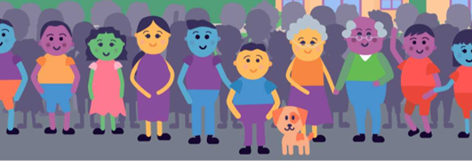
Who can Help with DD?
“It takes a village” – everyone can and should play a role
Provider/Clinician – pressure to reach targets, etc. – perceive not enough time
Ironic that attention to DD can help improve self-management & improve outcomes
Even acknowledging diabetes is hard & the results of the DDAS or asking, “how are you dealing with everything?” or “What is driving you crazy about diabetes?”– beneficial
CDCES, RN, RD – often pressure regarding agenda & need to cover material
Ironic as attention to DD would increase receptiveness to education & making changes
Benefit of acknowledging the “work” & “fears” & other emotions of living with diabetes
Pharmacists – offer frequent touchpoints with adherence as entry point
Built-in counseling role with trusted, accessible support – opportunity to address DD
BH professionals – do not always have training re diabetes –limited supply
Can consider & help with DD when caring for PWD & be available for challenging situations
CHR/CHW – opportunity to provide social support & education (vs focus on tasks)
Studies show reductions in emotional distress related to diabetes combined w/ changes in lifestyle
Peer leader or trained layperson – potential benefit for DD
Frequent check-ins & offer listening, empathy and support

Slide 26
JAMA Netw Open. 2024 Dec 10;7(12):e2448809. doi: 10.1001/jamanetworkopen.2024.48809 Glycemic Control With Layperson-Delivered Telephone Calls vs Usual Care for Patients With Diabetes
This study suggests that layperson-delivered, empathy-focused telephone engagement can improve glycemic control for patients with diabetes
260 patients with uncontrolled diabetes at a federally qualified health center
Showed statistically significant improvements in hemoglobin A1c level of −0.7% for those who received empathy-oriented telephone calls for 6 months vs 0.02% for control patients who received usual care.
For the subgroup of PWD with baseline PHQ-9 >5
A1c reductions were greater at −1.1% for the intervention arm vs 0.1% for controls
Also showed evidence of improved diabetes-related emotional health, including self-perception of ability to manage diabetes, related behaviors, and distress
“Our exploratory results support the importance of addressing patients’ diabetes-related emotional distress to effectively improve glycemic control.”

Slide 27
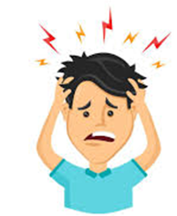
Additional Considerations
Don’t forget the distress of a new diagnosis of diabetes
Strong negative emotions and reactions
Unable to process information (“stunned”) – need time to process
Also need
Simple handouts on diabetes & on what to eat
Reassurance/not judgement - “Diabetes is not your fault” (not a bad person)
Reassurance & Hope – “T2D is a manageable condition and not a death sentence”
Perhaps start by asking patients what they know about diabetes and if they have any relatives with diabetes and what that has meant for them - “This isn’t your grandmother’s diabetes” (we know more now – there are more tools)
Engagement & Support – Collaboration
Engaged in such a way that they are psychologically prepared to be actively involved in managing the condition (self-management)
Emphasize that the individual will be the primary manager of their condition, with the support of their health care team (partnership) (on the same side as the PWD)
Explain role of care team members (e.g., RD, CDCES, PharmD, etc.)
A few more considerations …

Slide 28

Prevent & Reduce Diabetes Distress
Reduce diabetes stigma (Diabetes is a metabolic condition not a moral condition )
Check your & co-workers’ mental model of diabetes (judgement, blame & shame)
Consider word choice “test” vs “check, measure”; “control” vs “manage, outcomes, target”
Avoid labels→ use person- first language (PFL) & strength-based language
A person with diabetes vs “a diabetic”
“..was able to remember meds about 4 days each week” vs “Non-compliant/non-adherent”
Avoid directives
“You should…”, “You need to…” vs “an option would be …”
Avoid scare tactics & use gain-framing vs loss-framing
“If you don’t do better, you could go blind and lose your feet” → fear & hopelessness
Provide hope & a strategy
“There are things we can do together to help protect your feet” → teach home foot care
“Early diagnosis & treatment can prevent 98% of severe vision loss”→ annual eye exam
Notes:
Messages in North American and Australasian Diabetes-Specific Media (from American Diabetes Association, Canadian Diabetes Association, etc.)
Linda J. Beeney and Elizabeth J. Fynes-Clinton – Clinical Diabetes 2018

Slide 29

Prevent & Reduce Diabetes Distress
Be on the same side as your people with diabetes (PWD)
Understand, appreciate the workload/burden of diabetes & the impact of complications
How would you work in all the demands? – EMPATHY
Acknowledge the challenges (“If I were in your shoes, I would feel the same way”)
Share that other PWD have similar struggles
First acknowledge the validity of emotions based on beliefs & expectations, even if “incorrect”
Help clarify misperceptions
Need to eat “no sugar” – “That does seem impossible, I can see why you feel discouraged – I have good news for you ….”
Their fault when need additional meds – “It seems like you are blaming yourself for needing Insulin…” - Diabetes gets worse over time – more meds expected
Insulin causes kidney failure/metformin causes cancer – “ I wouldn’t want to take it either if that was the case “ – Insulin made by the body – in diabetes don’t have enough insulin / metformin protects against some cancers, PWD who take metformin often have improved survival - there was a contaminate in metformin – recalled batches
Provide “evidence-based” hope
“not your father’s/grandmother’s diabetes” (we know more now, new meds, treatments, etc.)
Do not need to be perfect
Share results of studies showing improved outcomes
Utilize CGM to help determine treatment efficacy – or lack of efficacy (not all meds work or work the same for everyone) [testing the medication, not the PWD]

Slide 30
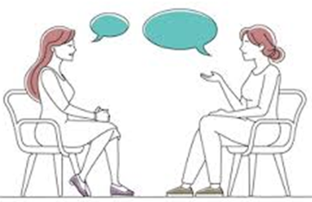
During the Encounter
Ask open ended questions about the impact of diabetes on daily life & well-being:
“What is driving you crazy about diabetes?”
“Diabetes can be a lot to deal with, how are you doing with everything?”
“What is the hardest thing for you in dealing with diabetes?”
“What is the most difficult part of living with diabetes for you?”
“How is your diabetes getting in the way of other things in your life right now?”
“Why do you think you are having trouble lowering your glucose levels?”
Good to at least briefly check on DD during almost every encounter
Reinforces that you understand the challenges of diabetes
Reinforces that you are on the same side as the PWD
Helpful with management issues – uncover barriers

Slide 31
Consider Connection to Culture & Community
Historical impacts - Epigenetic changes
Both hopelessness & resilience
Reverse negative epigenetic changes by restoring what was lost (reconnection)
Identity & connection
Stress reduction
Sage burning, sweat lodge, drumming, dancing, beading, gardening, foraging, music, song, language , etc.
Reducing stress hormones improves blood glucose levels
Reducing stress through cultural activities may also reduce apathy, hopelessness & sense of futility
Diabetes programs are including in their educational curriculum
“Participation in cultural activities may provide a sense of belonging to something larger than the individual and also give a feeling of connectedness to those who participate.
These factors may help explain the mechanism by which cultural participation seems to serve as a mediating factor in achieving better health outcomes among AI people.”
Notes:
Culture, Social Support, and Diabetes Empowerment Among
American Indian Adults Living With Type 2 Diabetes
Miigis B. Gonzalez, Kaley A. Herman, and Melissa L. Walls

Slide 32
Summary – Key Points
Diabetes is not easy – Diabetes Distress (DD) is common
DD is distinct from clinical depression – it is the emotional side of diabetes
DD reduces motivation for self-management & worsens outcomes for PWD
Blocks receptiveness to & effectiveness of education & management interventions
DD does not just go away – it persists/worsens over time, can lead to giving up
Addressing DD can improve outcomes & likely reduce unnecessary polypharmacy
Improved lifestyle changes, A1c, PHQ9 & DD scores: reduced hospitalizations
All PWD should be assessed for DD on a regular basis with a broad screening measures so not to miss specific sources of distress
DD does not respond to treatment with antidepressant medication but is very responsive to acknowledgement & support – the Conversation is the Intervention
Anyone & everyone can provide acknowledgement & support - empathy
Ask open-ended questions, listen, help label & validate emotions, reflect & normalize

Slide 33
Post-Question – chose one best answer
What type of conversation is most helpful to PWD to assist them in dealing with diabetes distress?
Offering suggestions to help fix everything
Active listening with empathetic response
Encouraging the PWD to be stronger
Reassuring the PWD that it really isn’t that hard to manage diabetes

Slide 34

Questions, Comments, Clarifications, etc.
“It is simply about initiating
normal conversation,
listening to and showing an understanding and awareness of the psychosocial and emotional issues embedded in diabetes,
which often go unnoticed and grow.”
Do you think you are willing to
have a conversation about DD?
“Instruction does much, but encouragement everything.”
Johann Wolfgang von Goethe
Notes:
Berry E, et al. Postgrad Med J 2015;91:278–283. doi:10.1136/postgradmedj-2014-133017

Slide 35
References & Resources

Slide 36
Risk Factors, Mortality, and Cardiovascular Outcomes in Patients with Type 2 Diabetes Swedish National Diabetes Register n engl j med 379;7 August 16, 2018
The following five risk factors were considered:
the glycated hemoglobin level (cutoff value, ≥7.0%)
systolic and diastolic blood pressure (cutoff value, ≥140 mm Hg for systolic blood pressure or ≥80 for diastolic blood pressure)
albuminuria (the presence of microalbuminuria or macroalbuminuria)
Smoking (being a current smoker at study entry)
the LDL cholesterol level (cutoff value, 97 mg per deciliter]).
Message: “not your grandparents’ diabetes” “What you do does make a difference”
“don’t need to be perfect to see benefits” “not futile, not hopeless”

Slide 37
References
Lawrence Fisher, William H Polonsky , Danielle M Hessler, Umesh Masharani, Ian Blumer 5, Anne L Peters, Lisa A Strycker, Vicky Bowyer. Understanding the sources of diabetes distress in adults with type 1 diabetes. J Diabetes Complication. May-Jun 2015;29(4):572-7
Fisher, L., Gonzales, J.S., Polonsky, W.H. The confusing tale of depression and distress in patients with diabetes: A call for greater clarity and precision. Diabetic Medicine, 2014, 31, 764-772.
Risk Factors, Mortality, and Cardiovascular Outcomes in Patients with Type 2 Diabetes Swedish National Diabetes Register n engl j med 379;7 August 16, 2018
William Polonsky , Cory Gamble, Neeraj Iyer, Mona Martin, Carol Hamersky. Exploring Why People With Type 2 Diabetes Do or Do Not Persist With Glucagon-Like Peptide-1 Receptor Agonist Therapy: A Qualitative Study. Diabetes Spectr. 2021 May;34(2):175-183.
https://diabetesjournals.org/care/article/47/Supplement_1/S77/153949/5-Facilitating-Positive-Health-Behaviors-and-Well
Diabetes Distress: Why It’s Common and What We Can Do About It! (diatribe.org)
Diabetesdistress.com
Diabet. Med. 36: 803–812 (2019)

Slide 38
References
Hessler, D., Strycker, L., & Fisher, L. (2021). Reductions in management distress following a randomized distress intervention are associated with improved diabetes behavioral and glycemic outcomes over time. Diabetes Care, 44(6), 1472–1479. https://doi.org/10.2337/dc20-2724
Fisher, L., Hessler, D., Polonsky, W., Strycker, L., Masharani, U., & Peters, A. (2016). Diabetes distress in adults with type 1 diabetes: Prevalence, incidence and change over time. Journal of Diabetes and Its Complications, 30(6), 1123–1128
Fisher, L., Polonsky, W. H., & Hessler, D. (2019). Addressing diabetes distress in clinical care: A practical guide. Diabetic Medicine, 36(6), 803–812
Polonsky, W. H., Fisher, L., Hessler, D., Desai, U., King, S. B., & Perez-Nieves, M. (2022). Toward a more comprehensive understanding of the emotional side of type 2 diabetes: A re-envisioning of the assessment of diabetes distress. Journal of Diabetes and Its Complications, 36(1), 108103.
Hessler, D. M., Polonsky, W. H., Strycker, L., Naranjo, D., Greenberg, K., & Fisher, L. (2025). Stability and impact of diabetes distress over time: The potential value and uses of the type 1 diabetes distress assessment system (T1-DDAS). Diabetic Medicine, 42(7), e70066.
Fisher, L., Polonsky, W. H., Perez-Nieves, M., Desai, U., Strycker, L., & Hessler, D. (2022). A new perspective on diabetes distress using the type 2 diabetes distress assessment system (T2-DDAS): Prevalence and change over time. Journal of Diabetes and Its Complications, 36(8), 108256.
Polonsky, W. H., Strycker, L., Naranjo, D., Greenberg, K., & Fisher, L. (2025). Stability and impact of diabetes distress over time: The potential value and uses of the type 1 diabetes distress assessment system (T1-DDAS). Diabetic Medicine, 42(7), e70066.

Slide 39
References
Emotional Distress Predicts Reduced Type 2 Diabetes Treatment Adherence in the Glycemia Reduction Approaches in Diabetes: A Comparative Effectiveness Study (GRADE). Claire J. Hoogendoorn et al. Diabetes Care 2024;47(4):629–637
Gonzalez JS, Bebu I, Krause-Steinrauf H, et al. Differential Effects of Type 2 Diabetes Treatment Regimens on Diabetes Distress and Depressive Symptoms in the Glycemia Reduction Approaches in Diabetes: A Comparative Effectiveness Study (GRADE). Diabetes Care. 2024;47(4):610619.
T. C. Skinner, L. Joensen and T. Parkin. PSAD Special Issue Paper: Twenty-five years of diabetes distress research. Diabet. Med. 37, 393–400 (2020)
L. Fisher, W. H. Polonsky and D. Hessler. Invited Review: Addressing diabetes distress in clinical care: a practical guide. Diabet. Med. 36: 803–812 (2019)
Marisa Kostiuk et al. Addressing Diabetes Distress in Primary Care: Where Are We Now, and Where Do We Need to Go?. Current Diabetes Reports 25:17 (2025)

Slide 40
References
Pharmacists & DD
https://accpjournals.onlinelibrary.wiley.com/doi/10.1002/jac5.70015
https://journals.sagepub.com/doi/10.1177/2635010624126841
CHR/CHW & DD
https://pmc.ncbi.nlm.nih.gov/articles/PMC7256181/
https://diabetesjournals.org/care/article-abstract/41/7/1414/36448/Outcomes-at-18-Months-From-a-Community-Health?redirectedFrom=fulltext
Trained Laypeople & DD
https://pmc.ncbi.nlm.nih.gov/articles/PMC11632544/#H1-4-ZOI241369
https://www.youtube.com/watch?v=WwtUBPEV6fY
Culture, Social Support, and Diabetes Empowerment Among American Indian Adults Living With Type 2 Diabetes Miigis B. Gonzalez, Kaley A. Herman, and Melissa L. Walls

Slide 41
Diabetes distress: understanding the hidden struggles of living with diabetes and exploring intervention strategies Berry E, et al. Postgrad Med J 2015;91:278–283.
…the importance of prompting discussion during appointments to present people with an opportunity to talk about which aspects of diabetes care are the most difficult.
This does not require psychological expertise and does not require providing solutions there and then; indeed, the MIND Study suggests that simply monitoring diabetes distress can have beneficial effects.
It is simply about initiating normal conversation, listening to and showing an understanding and awareness of the psychosocial and emotional issues embedded in diabetes, which often go unnoticed and grow.
Practitioners should encourage patients to acknowledge their emotional difficulties and remind them that they are part of the process of adapting to living with diabetes.
Notes:
Berry E, et al. Postgrad Med J 2015;91:278–283. doi:10.1136/postgradmedj-2014-133017

Slide 42
It is important to distinguish diabetes distress from clinical depression or major depressive disorder Diabet. Med. 36: 803–812 (2019)
Most people with diabetes labelled as clinically depressed using common self-report inventories (e.g. Patient Health Questionnaire-9; PHQ-9) do not meet standard psychiatric criteria for major depressive disorder. When well-structured psychiatric interviews are undertaken with most samples of adults with diabetes, however, the prevalence of major depressive disorder distress falls to between 3.8% and 6%, which is similar to rates in the general community (note variation in this rate based on clinical setting and an individual’s characteristics).
Still, individuals with diabetes typically score higher on depression symptom measures than people who do not have diabetes, and although these higher scores may not be indicative of a depressive disorder, they do reflect the experience of significant emotional distress. In recent studies, depressive symptom scores, using the PHQ-9, have been found to correlate quite highly with diabetes distress scores (e.g. r as high as 0.60), pointing to a significant overlap between these two constructs.
Furthermore, in one study, initial analyses indicated significant associations between depressive symptoms with management and HbA1c; but when diabetes distress scores were entered into the same analysis, depressive symptom scores were no longer significantly associated with these outcomes, whereas diabetes distress scores were.
We suggest, therefore, that clinicians should not immediately assume that elevated depression symptom scores obtained from self-report inventories are indicative of a depressive disorder. Instead, it is likely that such scores reflect the emotional distress associated with diabetes. This is not to say that major depressive disorder does not exist in diabetes populations. When it is carefully documented and diagnosed, it needs to be treated accordingly.
Notes:
Diabet. Med. 36: 803–812 (2019)

Slide 43
Diabetes Technol Ther. 2024 Mar 25. doi: 10.1089/dia.2023.0612. The Potential Impact of CGM Use on Diabetes-Related Attitudes and Behaviors in Adults with T2D: A Qualitative Investigation of the Patient Experience Taylor Clark, William Polonsky, Emily Soriano
Conclusions: Participants reported a far-reaching impact of CGM on their daily lives, with many stating that CGM fostered a greater understanding of diabetes and prompted positive behavior changes. The observed attitudinal and behavioral shifts likely contributed synergistically to the significant glycemic benefits observed over the study period.
This study highlights the technology's potential to bring about meaningful attitudinal and behavioral changes. Six primary themes emerged:
1) Making the Invisible Visible, highlighting the newfound awareness of T2D in daily life;
2) Effective Decision Making, emphasizing the use of real-time glucose data for immediate and long-term choices;
3) Enhanced Self-Efficacy, describing a renewed sense of control and motivation;
4) Diabetes-Related Diet Modifications;
5) Changes in Physical Activity; and
6) Changes in Medication Taking.
Notes:
Diabetes Technol Ther. 2024 Mar 25. doi: 10.1089/dia.2023.0612. Online ahead of print.
The Potential Impact of CGM Use on Diabetes-Related Attitudes and Behaviors in Adults with T2D: A Qualitative Investigation of the Patient Experience
Taylor Clark 1, William Polonsky 2 3, Emily Soriano 4

Slide 44
Resources
Behavioral Diabetes Institute (BDI) https://behavioraldiabetes.org/
https://behavioraldiabetes.org/resources/health-care-professionals/professional-education-brief-video-series/
DIABETES DISTRESS (From Behavioral Diabetes Institute (BDI) & https://diabetesdistress.org/ )
ADA https://diabetesjournals.org/care/article/47/Supplement_1/S77/153949/5-Facilitating-Positive-Health-Behaviors-and-Well
https://professional.diabetes.org/professional-development/behavioral-mental-health/behavioral-health-toolkit
How to make the diagnosis of type 2 diabetes less difficult (youtube.com)
https://www.youtube.com/watch?v=6qtuO7Hq9WE (evidence-based hope in diabetes)
Bing Videos (diabetes distress vs depression)

Slide 45
ADA - Diabetes Distress in Diabetes
https://www.youtube.com/watch?v=8MTKa4PSp1c
ada_mental_health_toolkit_questionnaires.pdf (diabetes.org)
ada_mental_health_toolkit_handouts_r3.pdf (diabetes.org)
ada_mental_health_toolkit_7as_r2.pdf (diabetes.org)
ADA https://diabetesjournals.org/care/article/47/Supplement_1/S77/153949/5-Facilitating-Positive-Health-Behaviors-and-Well
https://professional.diabetes.org/professional-development/behavioral-mental-health/behavioral-health-toolkit

Slide 46
https://www.youtube.com/watch?v=BLVqr0_3AVo

Slide 47
Diabetes Stigma
Resources – dStigmatize
‘I'm not a druggie, I'm just a diabetic’: a qualitative study of stigma from the perspective of adults with type 1 diabetes | BMJ Open
https://www.youtube.com/watch?v=6qtuO7Hq9WE

Slide 48
Diabetes Stigma
Resources – dStigmatize
‘I'm not a druggie, I'm just a diabetic’: a qualitative study of stigma from the perspective of adults with type 1 diabetes | BMJ Open
https://www.youtube.com/watch?v=6qtuO7Hq9WE

Slide 49
Sources of Distress -T2D
Management Demands:
Disappointment with your self-care efforts (for example, "It frustrates me that my eating often feels out of control").
Hypoglycemia:
Concerns about severe hypoglycemic events (for example, "I worry a lot that I could have a serious low glucose event").
Interpersonal Issues:
Disappointment that you are not getting the right type of support and help from family and friends about diabetes (for example, "When it comes to family and friends, it disappoints me that I am pretty much on my own with diabetes").
Healthcare Provider:
Disappointment with your current health care professionals (for example, "It upsets me that I'm not really heard or understood by my healthcare provider").
Shame/Stigma:
Concerns about the negative judgments of others (for example, "It upsets me that people in my life think less of me because I have diabetes").
Long-Term Health:
Concerns about the potential harm that diabetes may cause over time (for example, "No matter what I do, I fear that serious complications from diabetes will happen to me"). [hopelessness]
Healthcare Access:
Concerns that obtaining the medical care you need for your diabetes are, or will be, too difficult (for example, "I worry that I won't be able to pay for my diabetes care, medicines, or supplies").

Slide 50
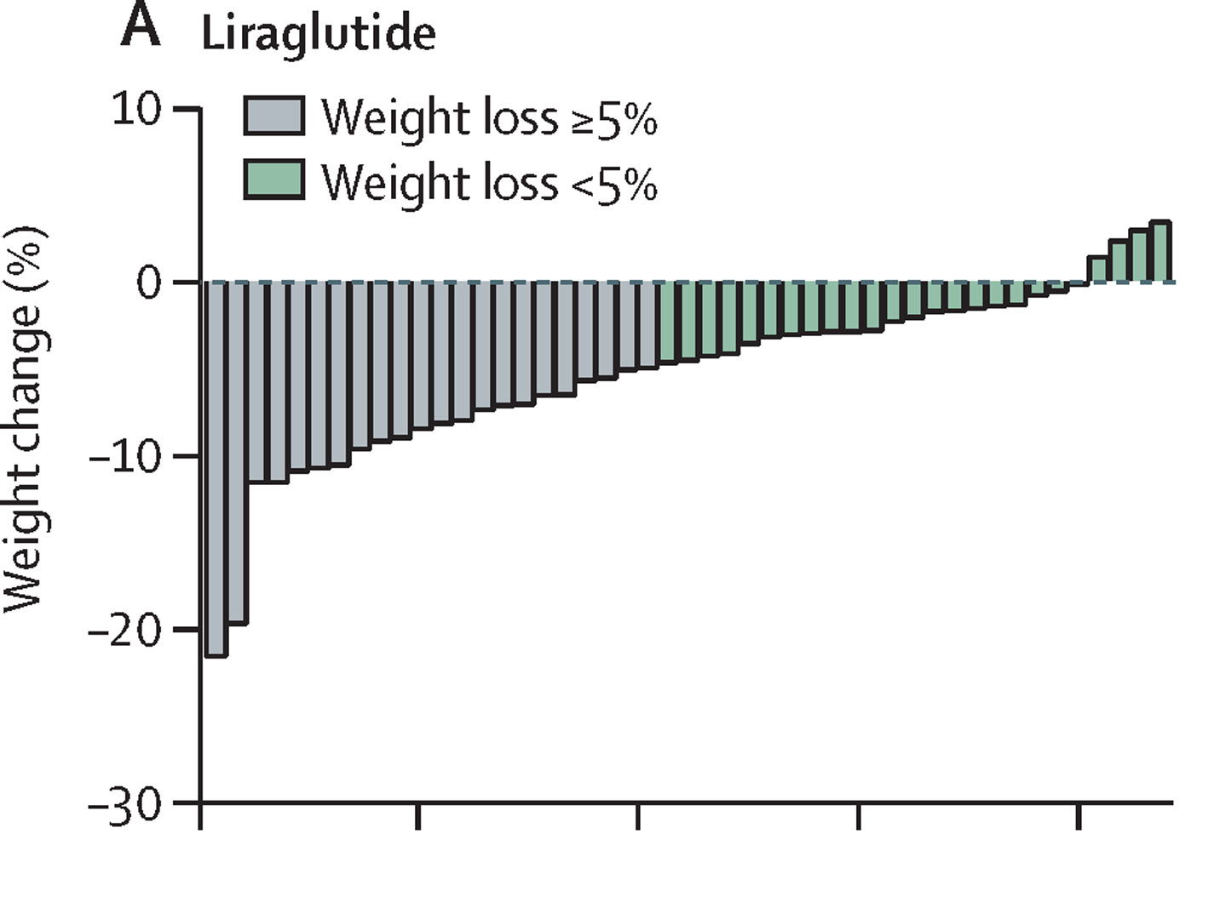
Therapeutic Heterogeneity (not everyone responds the same)
Based on our individual make-up, some things work better or not as well for some of us- this includes:
Type of foods/meal plan (low fat, low carb, low glycemic index, intermittent fasting, etc.)
Glucose lowering
Weight loss
Exercise (aerobic, strength training)
Glucose lowering
Weight loss
Fitness
Medications
for example, the research reports the average A1c lowering or weight loss with a medication but in the study group of patients, some had a greater than average response and some had less than average or worsening
E.g., ~10-15% non-responders to weight loss for semaglutide & tirzepatide
Notes:
Skeletal Muscle Gene Expression Signatures of Obese High and Low Responders to Endurance Exercise Training | The Journal of Clinical Endocrinology & Metabolism | Oxford Academic (oup.com)

Slide 51
Diabetes Distress – the Patient Experience
Futility
BLAME
SHAME
Misperceptions
GUILT
A1c
FEAR
Hopelessness
Foot exams
Hypoglycemia
UACR
Pills
My life/My story
Eye Exams
Ketones
lipids
eGFR
CGM
Injections
Blood Pressure
Meters
Sleep
Apnea
BMI
Test Strips
Lancets
MASH

