Slide 1

The Month in
Virology
Jorge Mera, MD
Tara Perti, MD, MPH
March 18, 2026

Slide 2
Conflict of Interests Disclosure
In the past 36 months Dr. Mera as received grant funding from Gilead Sciences and AbbVie, nonfinancial support from AbbVie, Cepheid and Abbott and is member of the Speaker Bureau for AbbVie (not active) and Cepheid.

Slide 3
Outline
Update on respiratory infections
Polio
Viral respiratory infections in patients with hematologic malignancies
Impact of RSV vaccines in cardioembolic events
Conference on Retrovirus and Opportunistic Infections (CROI) 2026 Updates

Slide 4


Portland Area IHS
Respiratory Virus Surveillance Update
Tara Perti, MD, MPH
MEDICAL EPIDEMIOLOGIST
IHS, Portland Area OFFICE
March 18, 2026
,

Slide 5
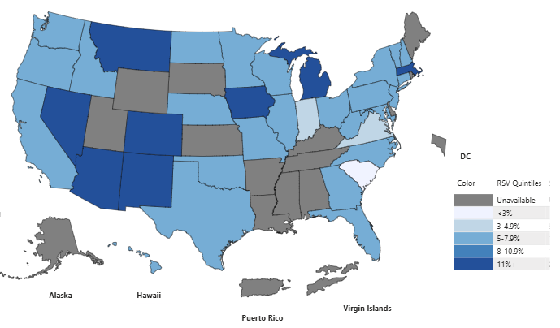
Percent of Tests Positive for RSV — United States, 2025-26
(week ending 3/7/26*)
*Centered 3 week moving average for week ending 3/7/26.
National Respiratory and Enteric Virus Surveillance System Dashboard. Available at: https://www.cdc.gov/nrevss/php/dashboard/index.html

Slide 6
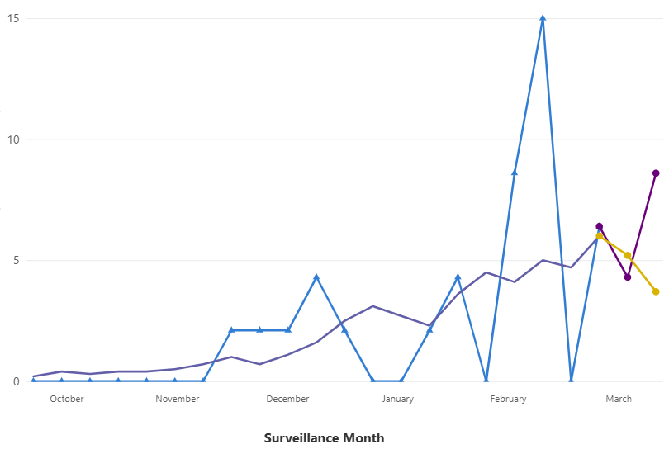
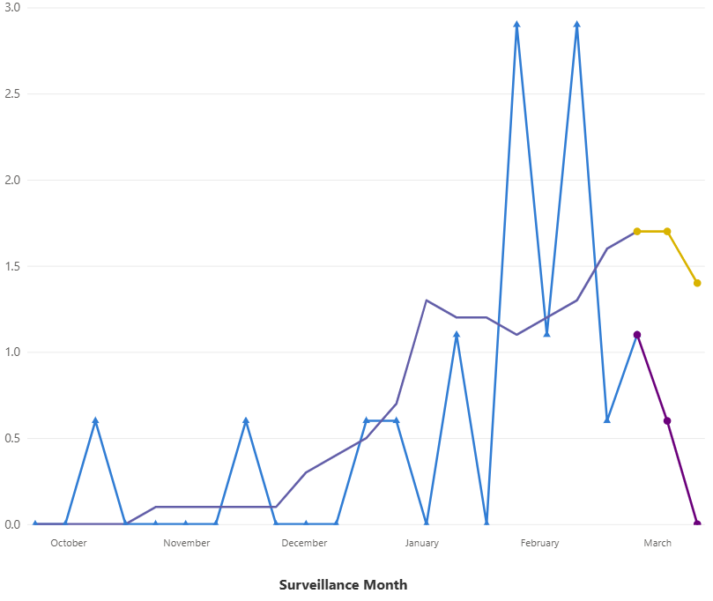


RSV-Associated Hospitalization Rate by Age, non-Hispanic AI/AN vs. non-Hispanic White — United States, 2025-26 (through 3/7/26)
Children (0-17 years)
Adults (≥ 18 years)
8.6
1.4
3.7
0
RSV-NET. Available at: https://www.cdc.gov/rsv/php/surveillance/rsv-net.html?CDC_AA_refVal=https%3A%2F%2Fwww.cdc.gov%2Frsv%2Fphp%2Fsurveillance%2Findex.html

Slide 7
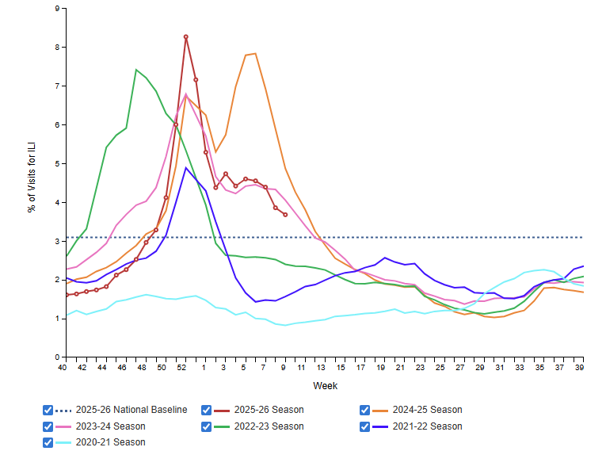
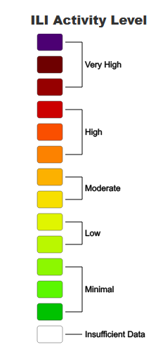
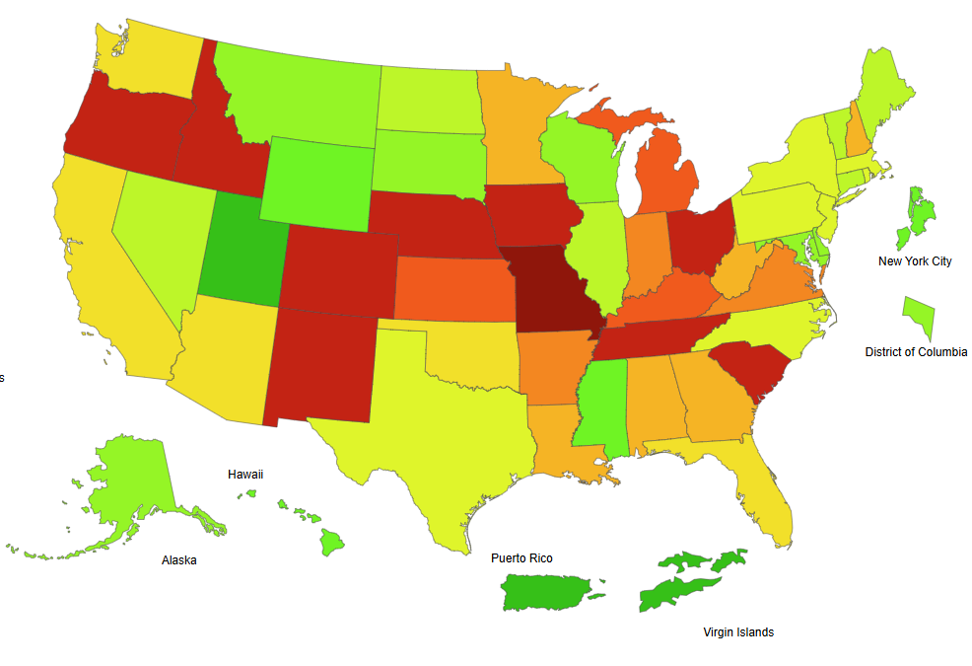
Influenza-like Illness (ILI) Activity — United States,
2025-26 (through 3/7/26)
Percentage of Outpatients Visits for ILI
ILI Activity (week ending 3/7/26)
8.3%
3.7%
CDC. FluView. Weekly US Influenza Surveillance Report. Available at: https://www.cdc.gov/fluview/surveillance

Slide 8
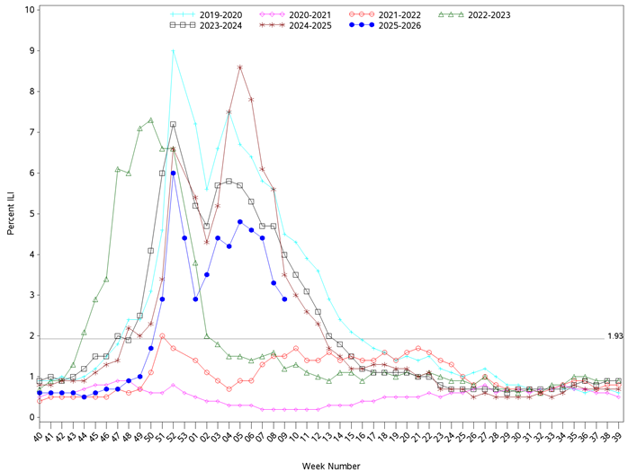
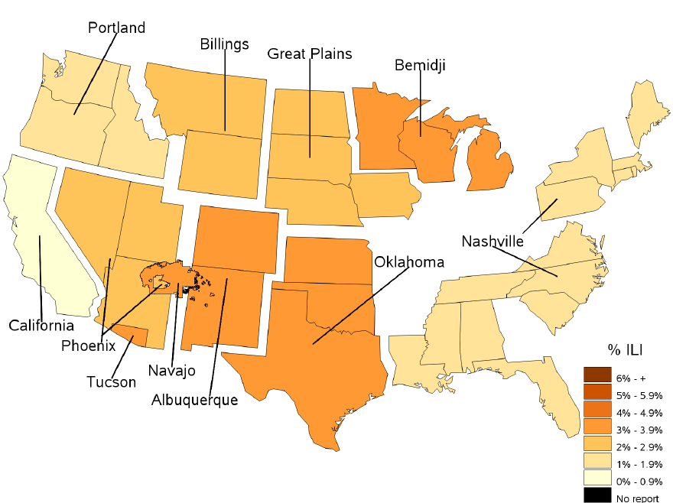
Percentage of Weekly Outpatient Visits for Influenza-Like Illness (ILI) —
IHS (I/T/U facilities), 2025-26 (through 3/7/26)
2.9%
IHS Division of Epidemiology and Disease Prevention. Influenza-like Illness Surveillance Report (IHS Influenza Awareness System)

Slide 9
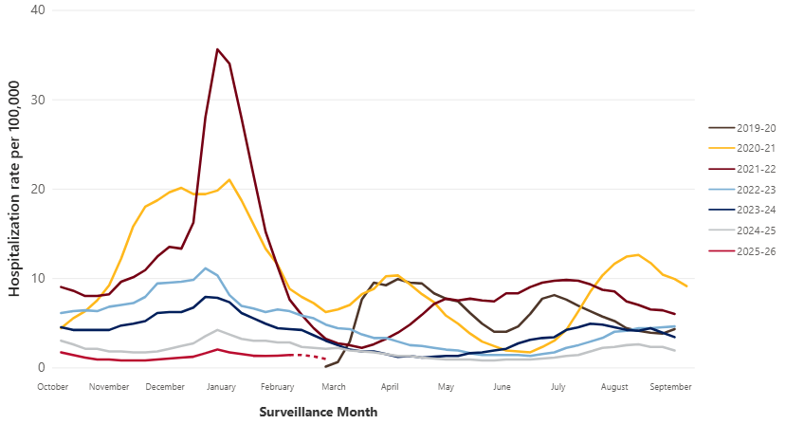
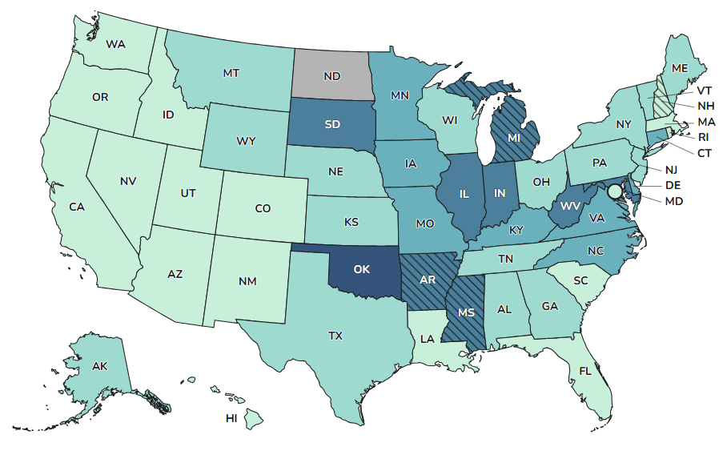
COVID-19 Associated Hospitalization Rate — United States,
2025-26 vs. Prior Six Seasons (through 3/7/26) and Wastewater Surveillance
SARS-CoV-2 RNA Wastewater Activity (week ending 3/7/26)
2025-26
COVID-NET. Available at: https://www.cdc.gov/covid/php/covid-net/index.html
COVID-19 National Wastewater Data. Available at: https://www.cdc.gov/nwss/rv/COVID19-national-data.html

Slide 10
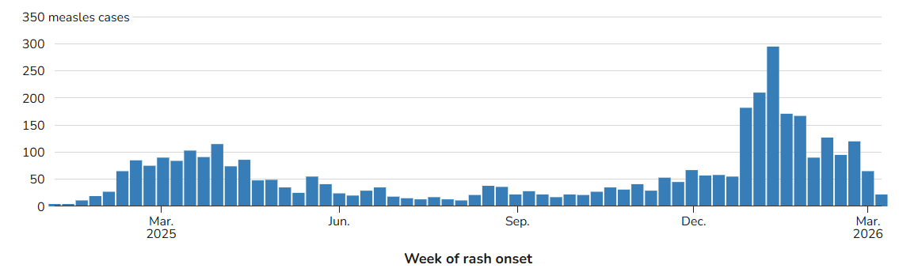
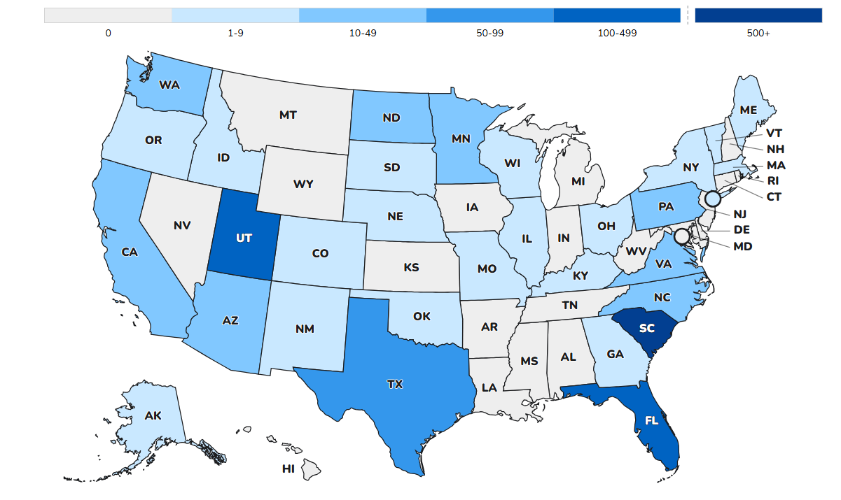
Measles — United States, 2026
Weekly Measles Cases — United States, 2025-26
1,362 confirmed cases among 30 states during 2026 as of 3/12 (2,284 cases during 2025).
94% of cases are outbreak-associated (≥3 related cases).
Age: 22% <5 years-old, 54% 5-19 years-old, 23% ≥ 20 years-old.
5% hospitalized overall (during 2025, 11% hospitalized, with 18% of those <5 years-old hospitalized).
0 deaths (during 2025, 3 deaths among unvaccinated individuals, including 2 healthy school-aged children).
92% unvaccinated or with unknown vaccination status, 4% one MMR dose, 4% two MMR doses.
Measles Cases Among U.S. Residents, 2026
Centers for Disease Control and Prevention. Measles Cases and Outbreaks. Available at: https://www.cdc.gov/measles/data-research/index.html
HHS: All individuals are encouraged to consult with their health care providers to understand their options regarding vaccinations.

Slide 11
Notes:
Oregon Adult Immunizations | Tableau Public

Slide 12
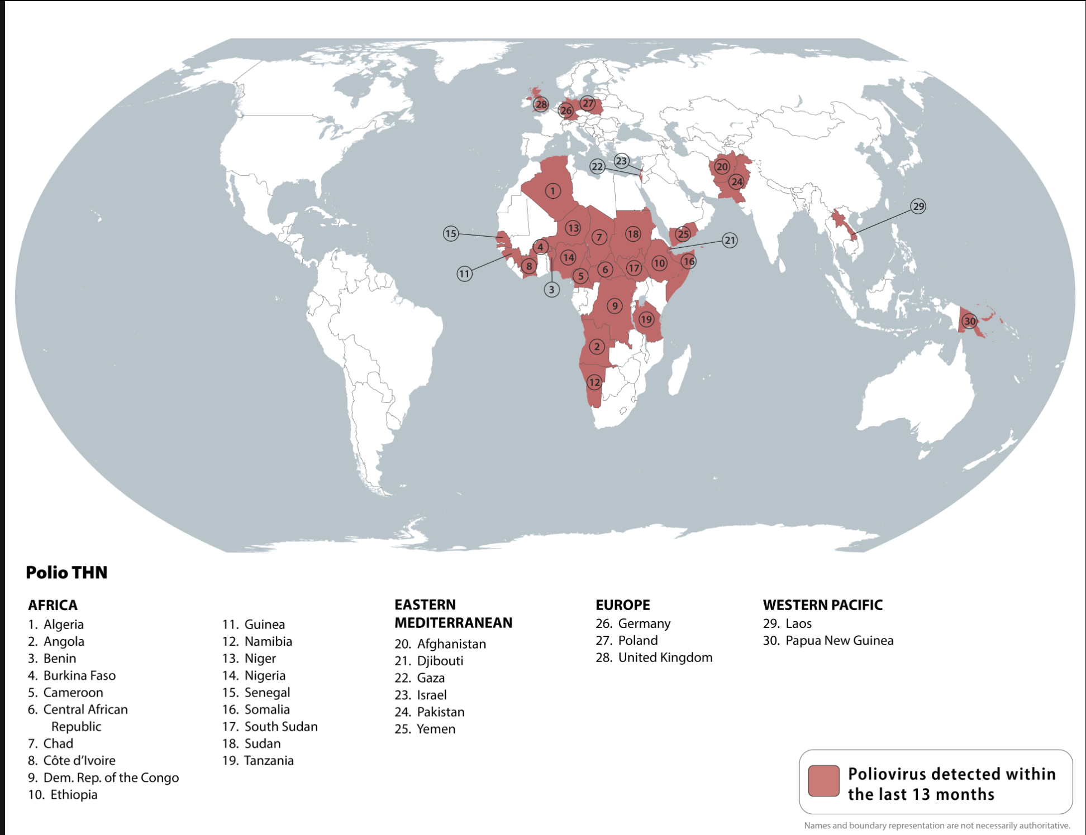
Polio
Some international destinations have circulating poliovirus
This list includes countries that have detected poliovirus in humans or environmental samples in the past 13 months
Before travel to any of these destinations, adults who previously completed the full, routine polio vaccine series may receive a single, lifetime booster dose of polio vaccine.
https://wwwnc.cdc.gov/travel/notices/level2/global-polio

Slide 13
Polling Question # 1
1,650 Adults in the US were surveyed with the following Question: “How Confident, if at all, are you that ……………is providing the public with trustworthy information about matters concerning public health”
Which Option do you think had the highest confidence score?
CDC
American Heart Association
American Academy of Pediatrics
Primary Care Provider
NIH
FDA
Dr. Oz, CMS administrator
RFK junior at HHS

Slide 14
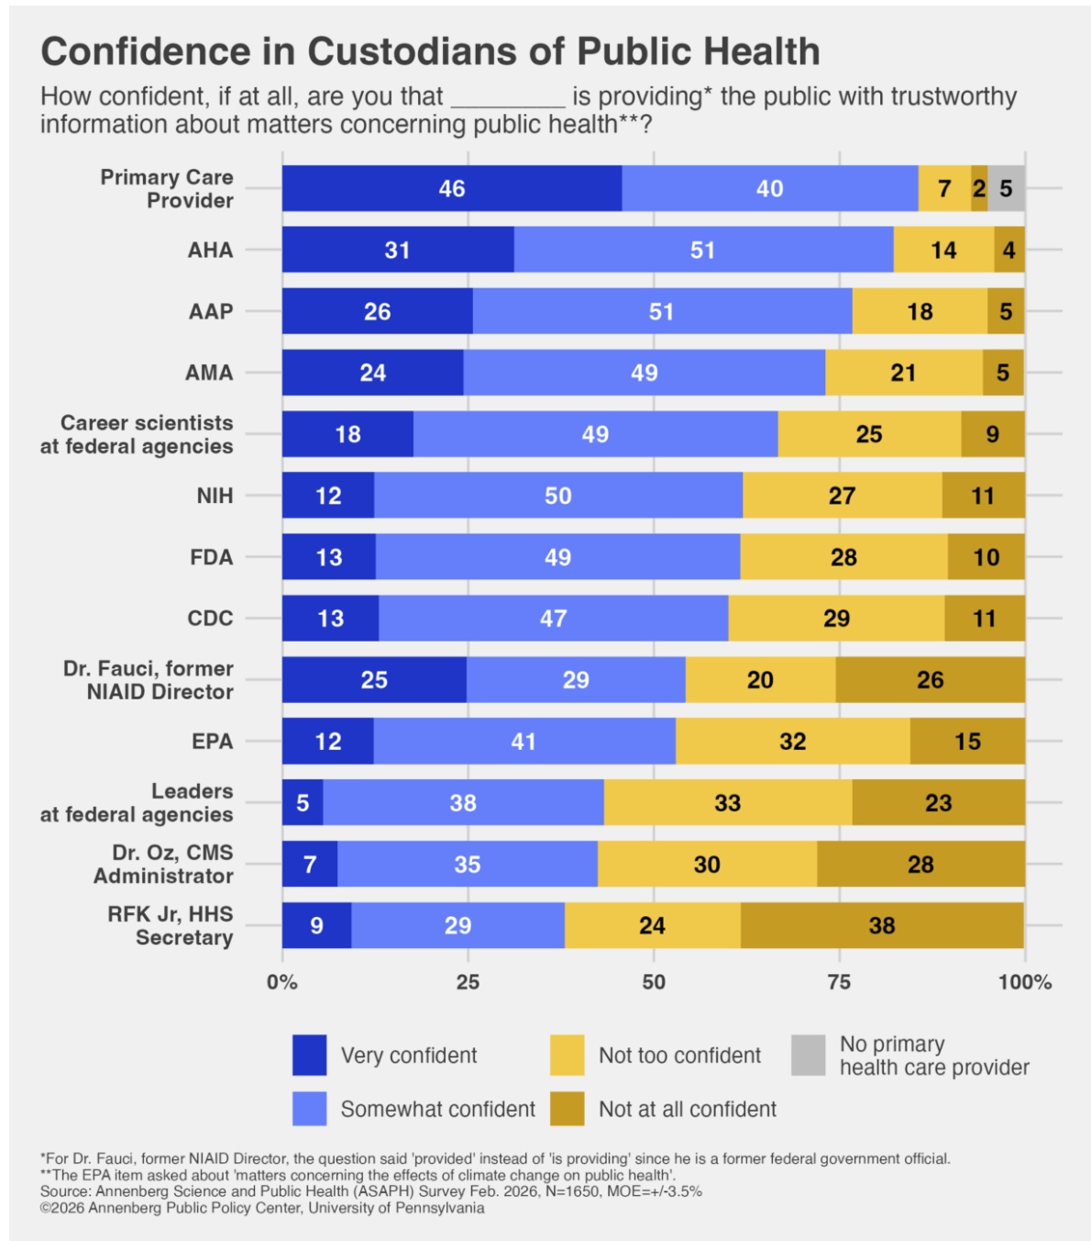
Who Do People Trust?
The survey, conducted Feb. 3-17, 2026, among a nationally representative sample of 1,650 U.S. adults
These studies were conducted for the Annenberg Public Policy Center of the University of Pennsylvania via web and telephone by SSRS, an independent research company.
Interviews were conducted among a nationally representative probability sample drawn from SSRS’s Opinion panel.
Data were weighted to represent the target U.S. adult population.
https://www.annenbergpublicpolicycenter.org/stark-divide-americans-more-confident-in-career-scientists-at-u-s-health-agencies-than-leaders/

Slide 15
Polling Question # 2
Which statement is true regarding Outcomes of Patients With Hematologic Malignancies Hospitalized With Respiratory Viral Infections:
Mortality is highest with SARS-CoV-2, followed by Influenza
Mortality is highest with Influenza followed by SARS-CoV-2
Mortality is the same regardless of the virus causing the respiratory infection (RSV, Influenza, SARS-CoV-2, rhinovirus/enterovirus, others)

Slide 16
Characteristics and Outcomes of Patients With Hematologic Malignancies Hospitalized With Respiratory Viral Infections
Background
Respiratory viral infections (RVIs)in patients with hematologic malignancies and HCTs are associated with increased morbidity and mortality.
Hospital presentations and courses of these infections remain under-described.
Methods
Multicenter retrospective cohort study (2 Centers, 2019 -2023)
Patients with acute RVIs with defined severity parameters were included
Clinical presentations, care, and patient outcomes across pathogens were compared
The primary outcome was the composite of hospital death or discharge to hospice.
HCTs: hematopoietic stem cell transplants (HCTs)
Zulfiqar A Lokhandwala, Brenna Park-Egan, Ravneet Waraich, et al, Open Forum Infectious Diseases, Volume 13, Issue 1, January 2026, ofaf779, https://doi.org/10.1093/ofid/ofaf779

Slide 17
RESULTS
385 hospitalizations were evaluated
42% were for SARS-CoV-2 infection, followed by RSV, rhino/enterovirus, influenza and others
Death or
discharge to hospice
Did not differ across pathogens (P = .4).
Clinical presentation
Use of Corticosteroids
Higher Rx lung edema scores in SARS-CoV-2 ( P < .001).
Occurred in 14% encounters
Was similar regardless of the pathogen
Use of Antibiotics
SARS-CoV-2 60%, RSV 61%, rhino/enterovirus 65%, influenza 67%, others 80%, (P = .034)
SARS-CoV-2 61%, RSV 36%, rhino/enterovirus 33%,
influenza 27%, and others 43%, (P < .001).
Zulfiqar A Lokhandwala, Brenna Park-Egan, Ravneet Waraich, et al, Open Forum Infectious Diseases, Volume 13, Issue 1, January 2026, ofaf779, https://doi.org/10.1093/ofid/ofaf779

Slide 18
Characteristics and Outcomes of Patients With Hematologic Malignancies Hospitalized With Respiratory Viral Infections: Interpretation
Among hospitalized patients with hematologic malignancies or HCTs, acute VRIs display similar initial physiology and outcomes regardless of pathogen.
These findings may have implications for clinical practice.
Zulfiqar A Lokhandwala, Brenna Park-Egan, Ravneet Waraich, et al, Open Forum Infectious Diseases, Volume 13, Issue 1, January 2026, ofaf779, https://doi.org/10.1093/ofid/ofaf779

Slide 19
Polling Question # 3
Which of the following viruses has evidence suggesting a possible laboratory-associated origin?
Ebola
Marburg
Mpox
Influenza A
SARS-CoV
SARS-CoV-2.

Slide 20
Dynamics of natural selection preceding human viral epidemics and pandemics
Using phylogenetic analysis, the following zoonotic viruses were studied:
Ebola, Marburg, mpox, influenza A, SARS-CoV, SARS-CoV-2.
Most viruses, did not show evidence of increased evolutionary pressure (selection) before spreading in humans
Meaning they were already capable of transmission without major prior adaptation.
An exception was SARS-CoV
Which showed evidence of adaptation in an intermediate animal host.
In contrast, the 1977 H1N1 influenza reemergence showed unusual evolutionary patterns
Consistent with a possible laboratory-associated origin.
https://doi.org/10.1016/j.cell.2026.02.006

Slide 21
Dynamics of natural selection preceding human viral epidemics and pandemics
Extensive pre-adaptation in animals is not required for a virus to achieve human-to-human transmission.
Overall, these evolutionary methods can help identify whether a virus emerged via natural host switching or other processes (e.g., lab passage).
Clinical / epidemiologic implication:
  Emerging zoonotic threats may already be capable of human transmission at the time of spillover
  Highlighting the importance of early detection and surveillance, rather than assuming a period of gradual adaptation is required.
https://doi.org/10.1016/j.cell.2026.02.006

Slide 22
Polling Question # 4
Which of the following statements best describes the effectiveness of RSV vaccines against RSV-associated thromboembolic events?
A. Vaccine effectiveness was approximately 50% and significantly lower in immunocompromised individuals
B. Vaccine effectiveness was ~79%, with similar protection in immunocompromised and immunocompetent individuals
C. Vaccine effectiveness was higher in adults 65–74 years compared to those >75 years
D. There were major differences in effectiveness between Arexvy and Abrysvo vaccines

Slide 23
Effectiveness of RSV Vaccines against RSV-Associated Thromboembolic Events
Respiratory virus infections, including RSV infections, have been associated with:
Increased risk for myocardial infarction
Ischemic stroke
Venous thromboembolism
In 1 US-based surveillance network:
≈22% of adults >50 years of age who were hospitalized with RSV experienced an acute cardiac event
Wiegand RE, Sung H, Zhang Y, et al. Emerging Infectious Diseases. 2026;32(2):246-249. doi:10.3201/eid3202.251520.

Slide 24
Effectiveness of RSV Vaccines against RSV-Associated Thromboembolic Events
Study:
  Effectiveness of RSV vaccines against RSV-associated thromboembolic events (TEE) among 15,558,386 Medicare beneficiaries >65 years of age
  Enrolled during October 1, 2023–March 30, 2024.
Results: Vaccine Effectiveness (VE)
  Against RSV-associated TEE (VE 79% in the same season)
  VE estimates did not differ substantially between immunocompromised and immunocompetent beneficiaries
  Estimated VE was 75% among 65–74 years of age, and 80% in >75 years of age
  Product-specific VE estimates did not differ substantially (Arexvy:76%; Abrysvo: 85%
Wiegand RE, Sung H, Zhang Y, et al. Emerging Infectious Diseases. 2026;32(2):246-249. doi:10.3201/eid3202.251520.

Slide 25
Conference on Retrovirus and Opportunistic Infections (CROI) 2026 Updates

Slide 26
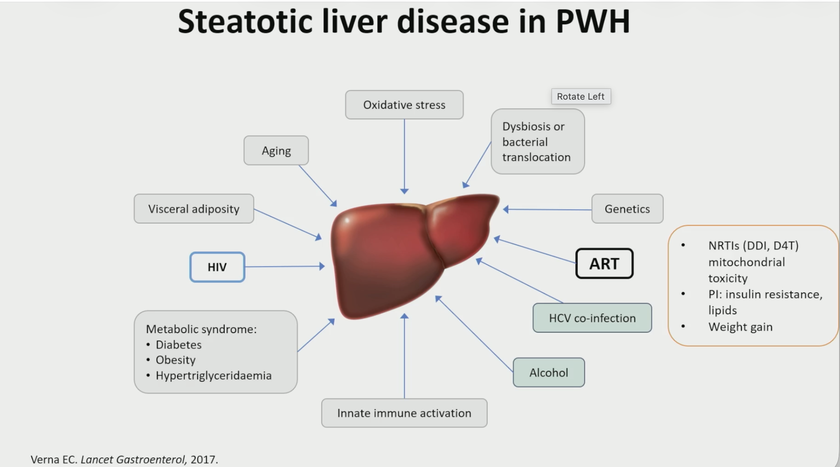
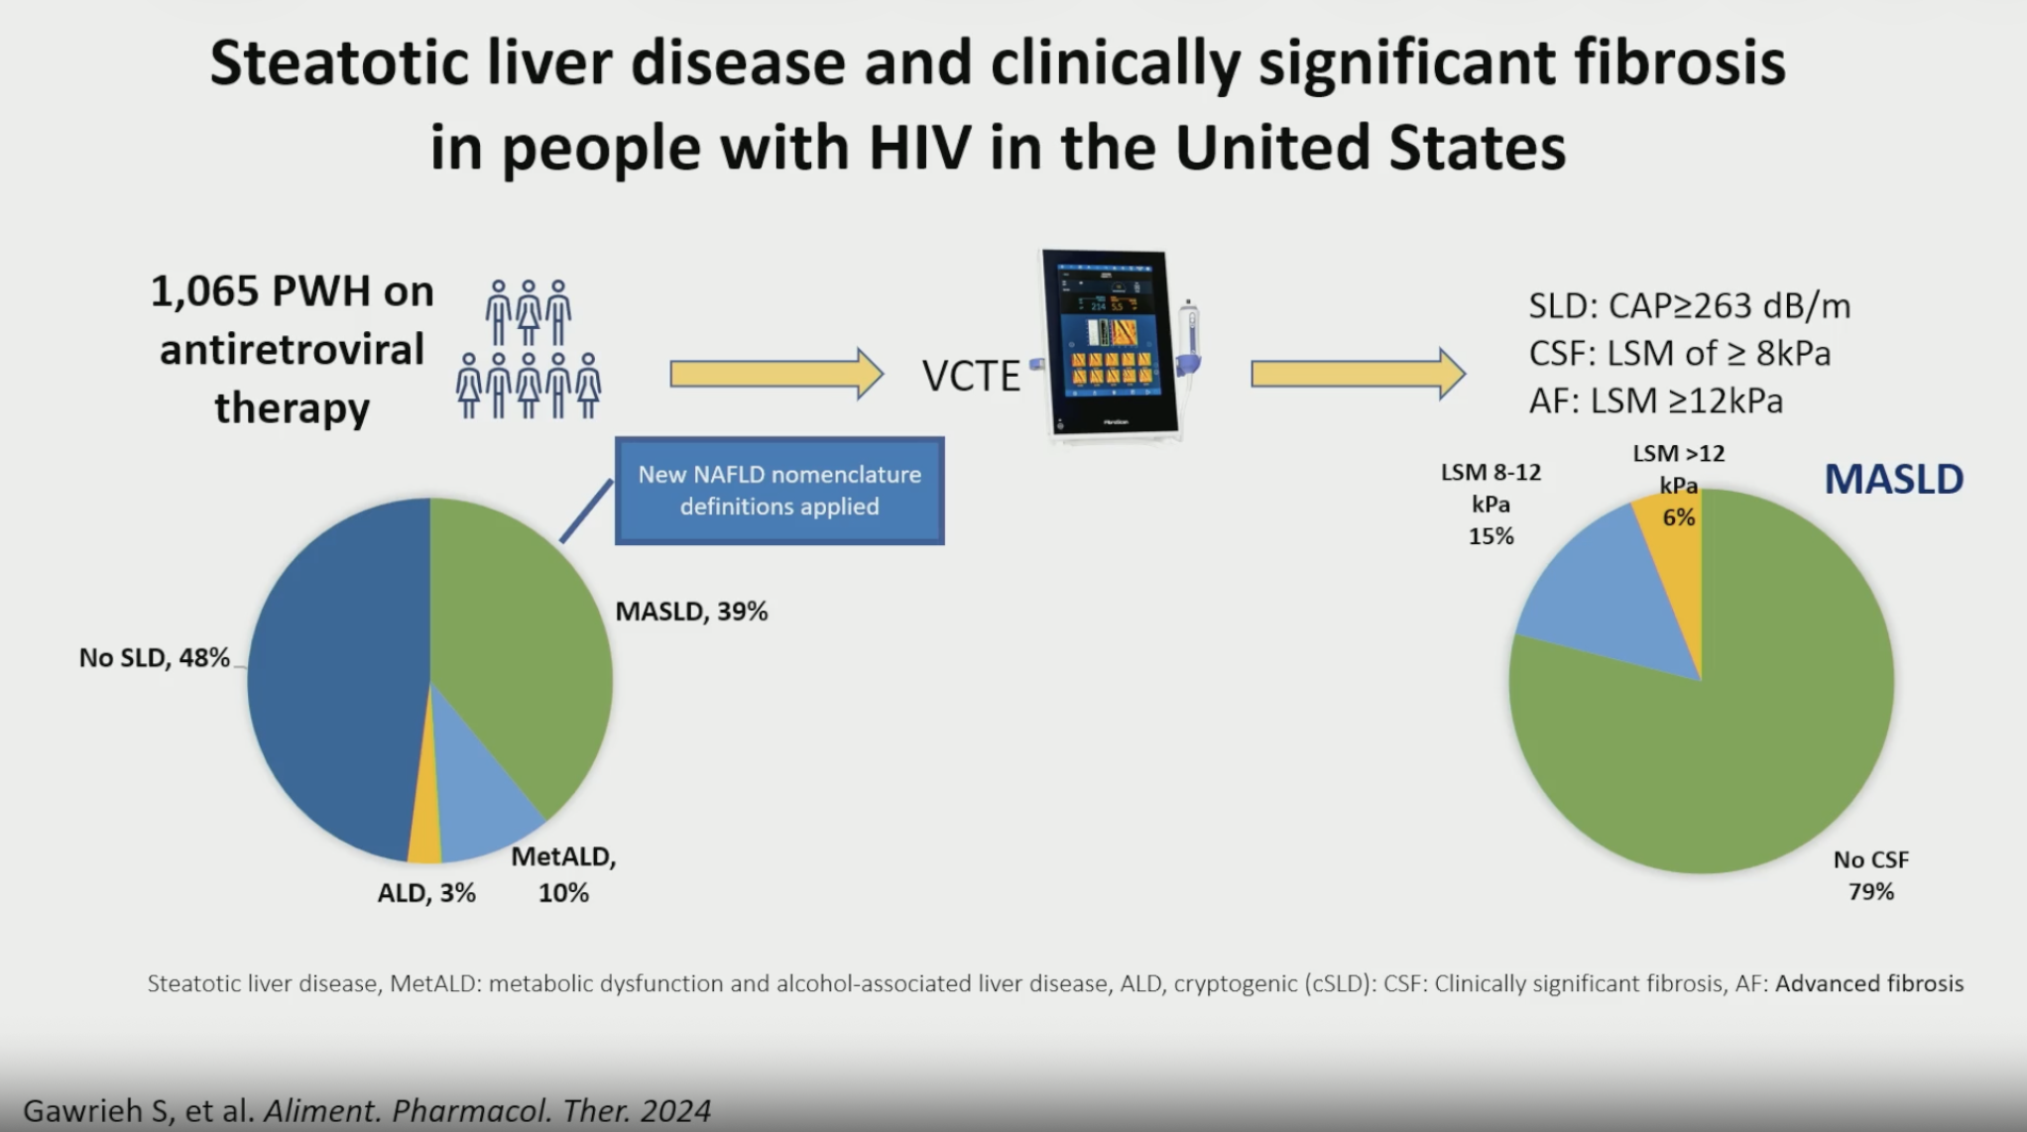
Steatotic Liver Disease in PWH

Slide 27
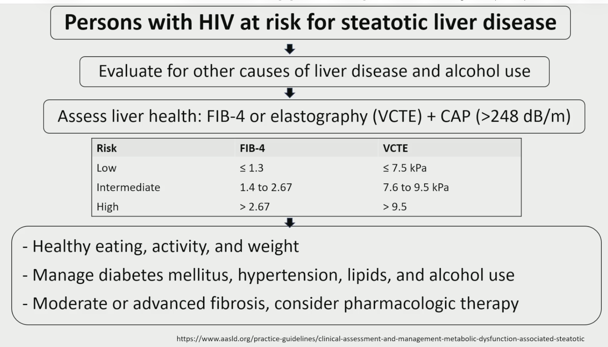
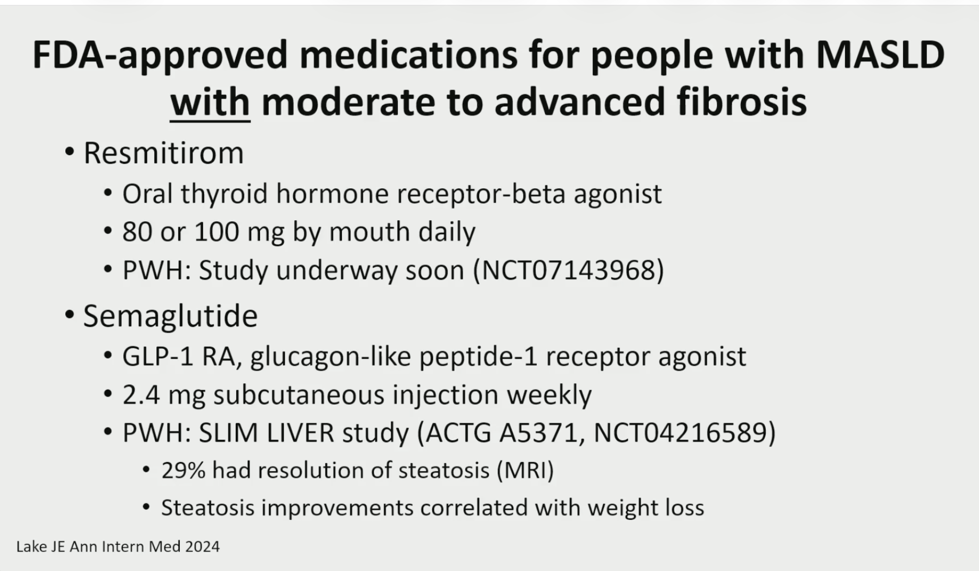
Evaluation and Treatment of
Steatotic Liver Disease in PWH

Slide 28
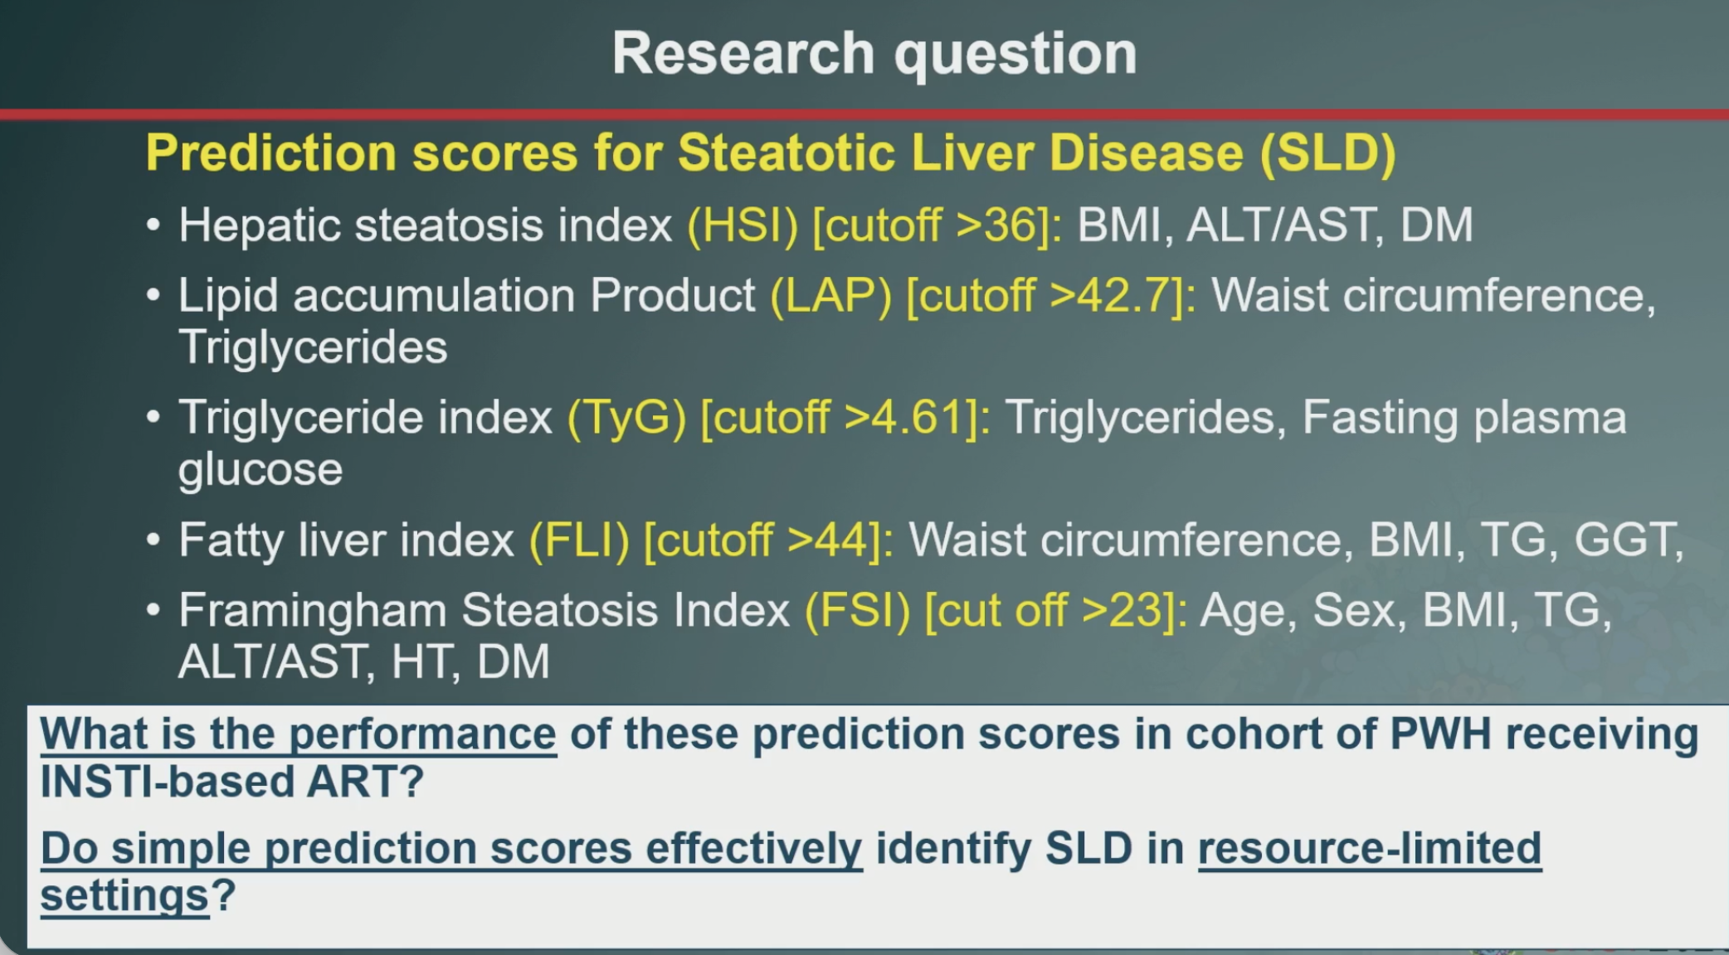
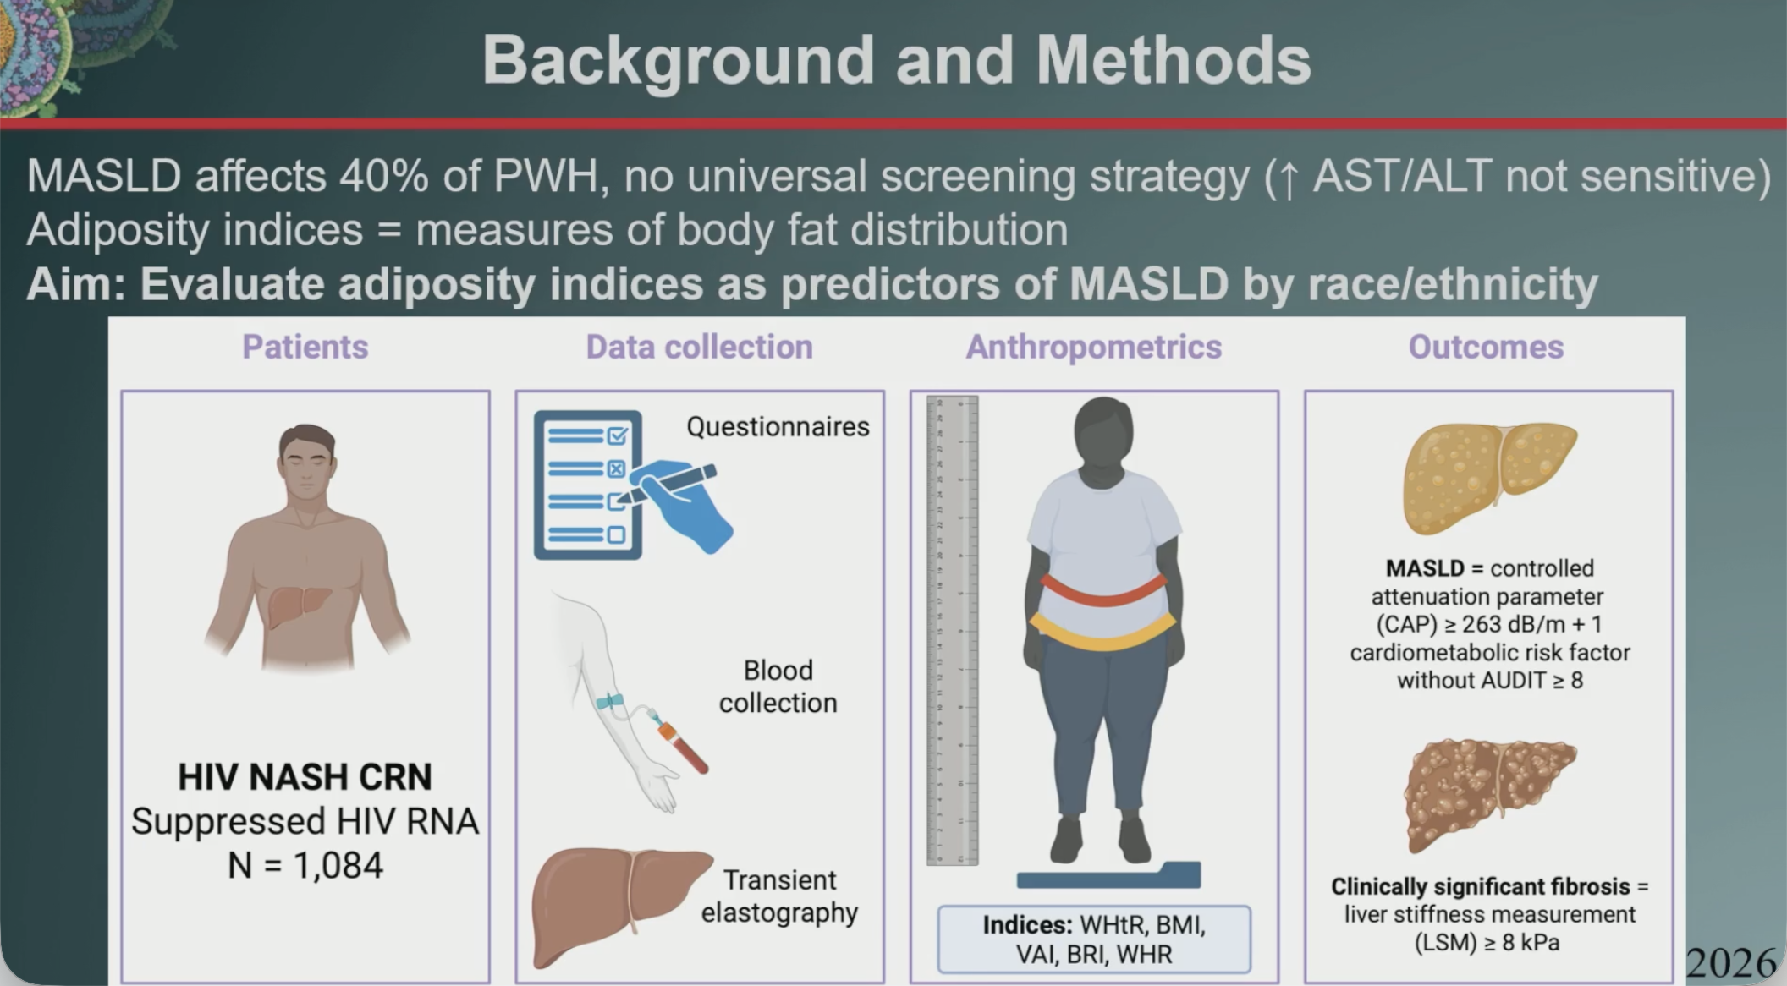
Prediction Scores for
Steatotic Liver Disease (SLD)

Slide 29
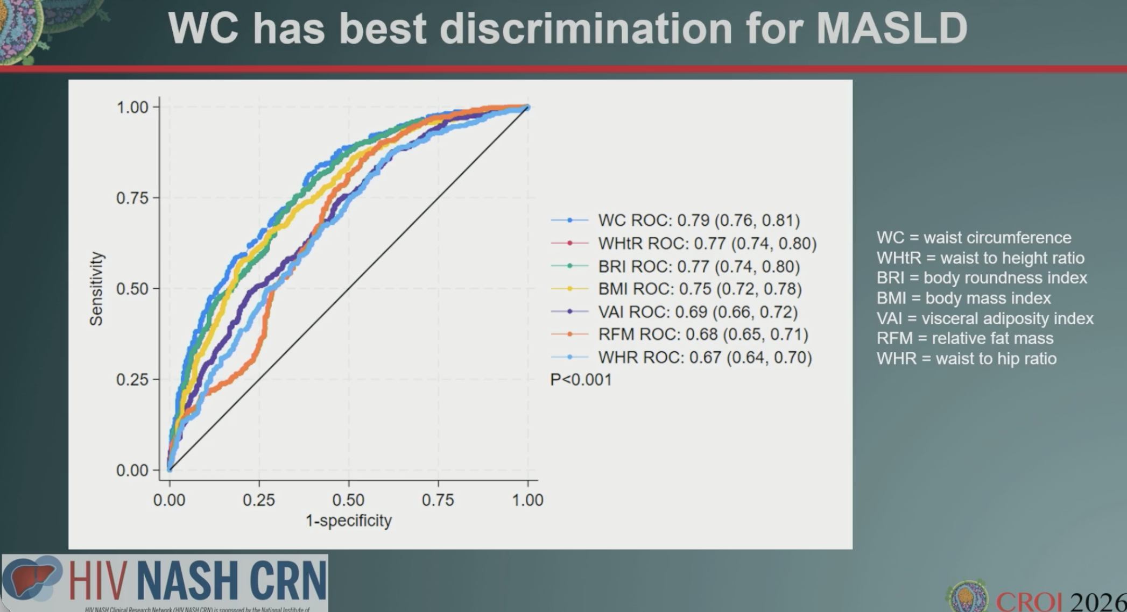
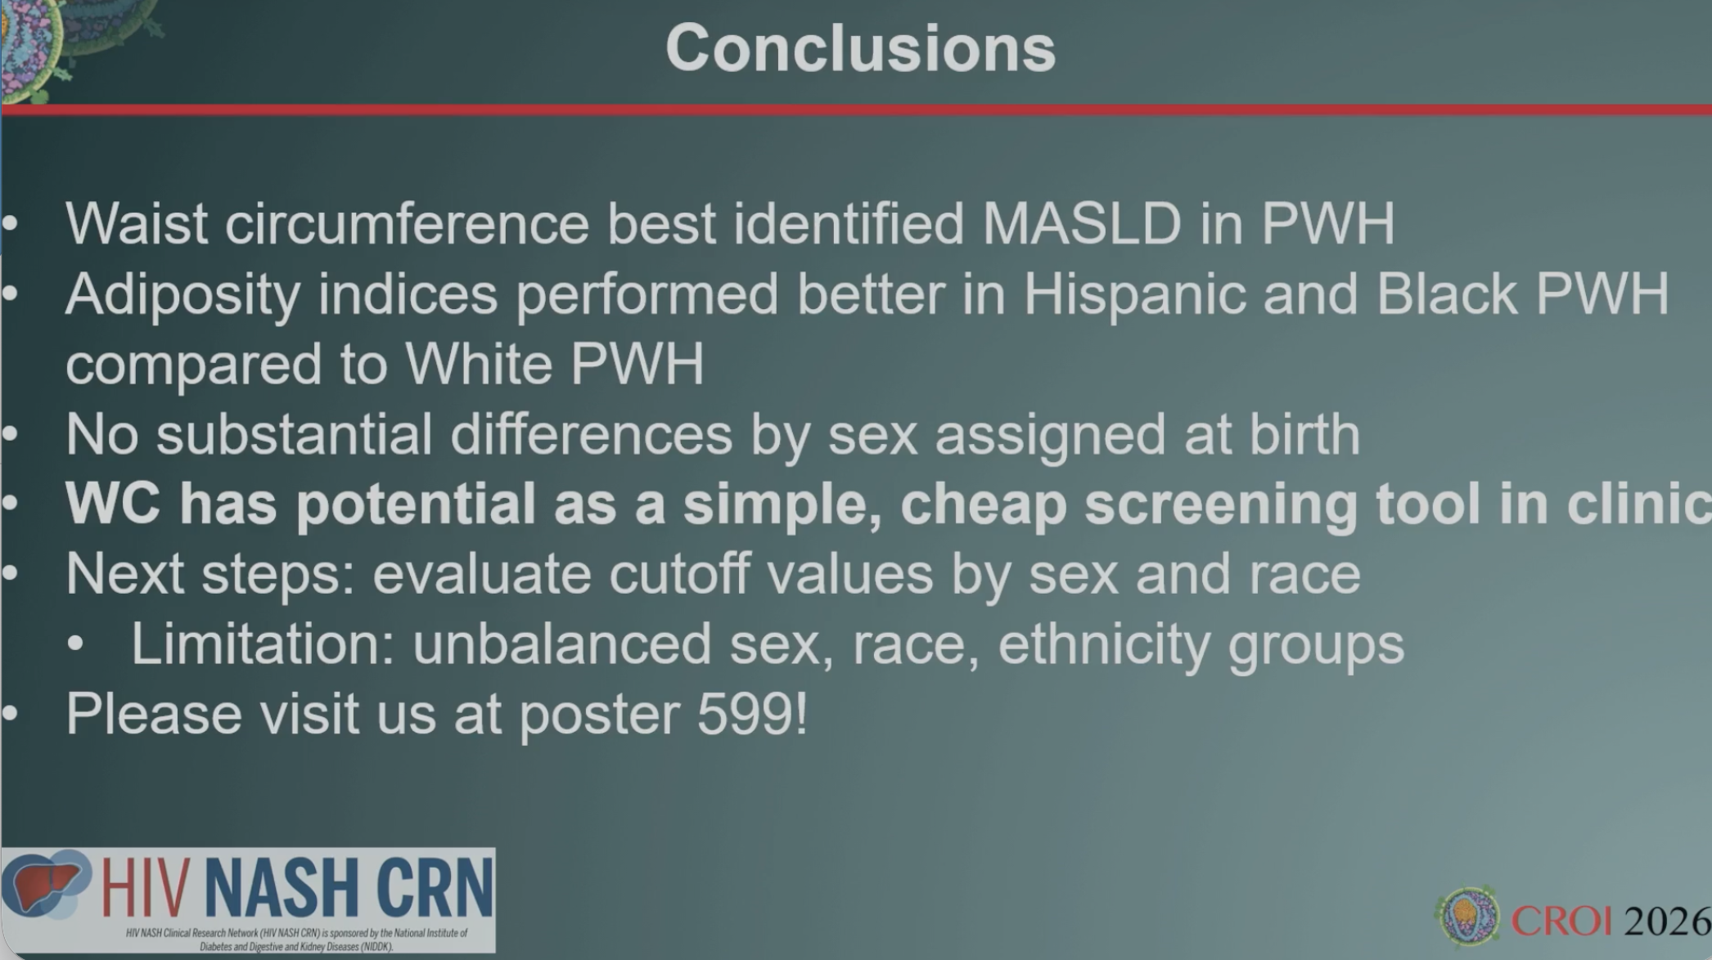
Waist Circumference Best Identified MASLD in PWH

Slide 30
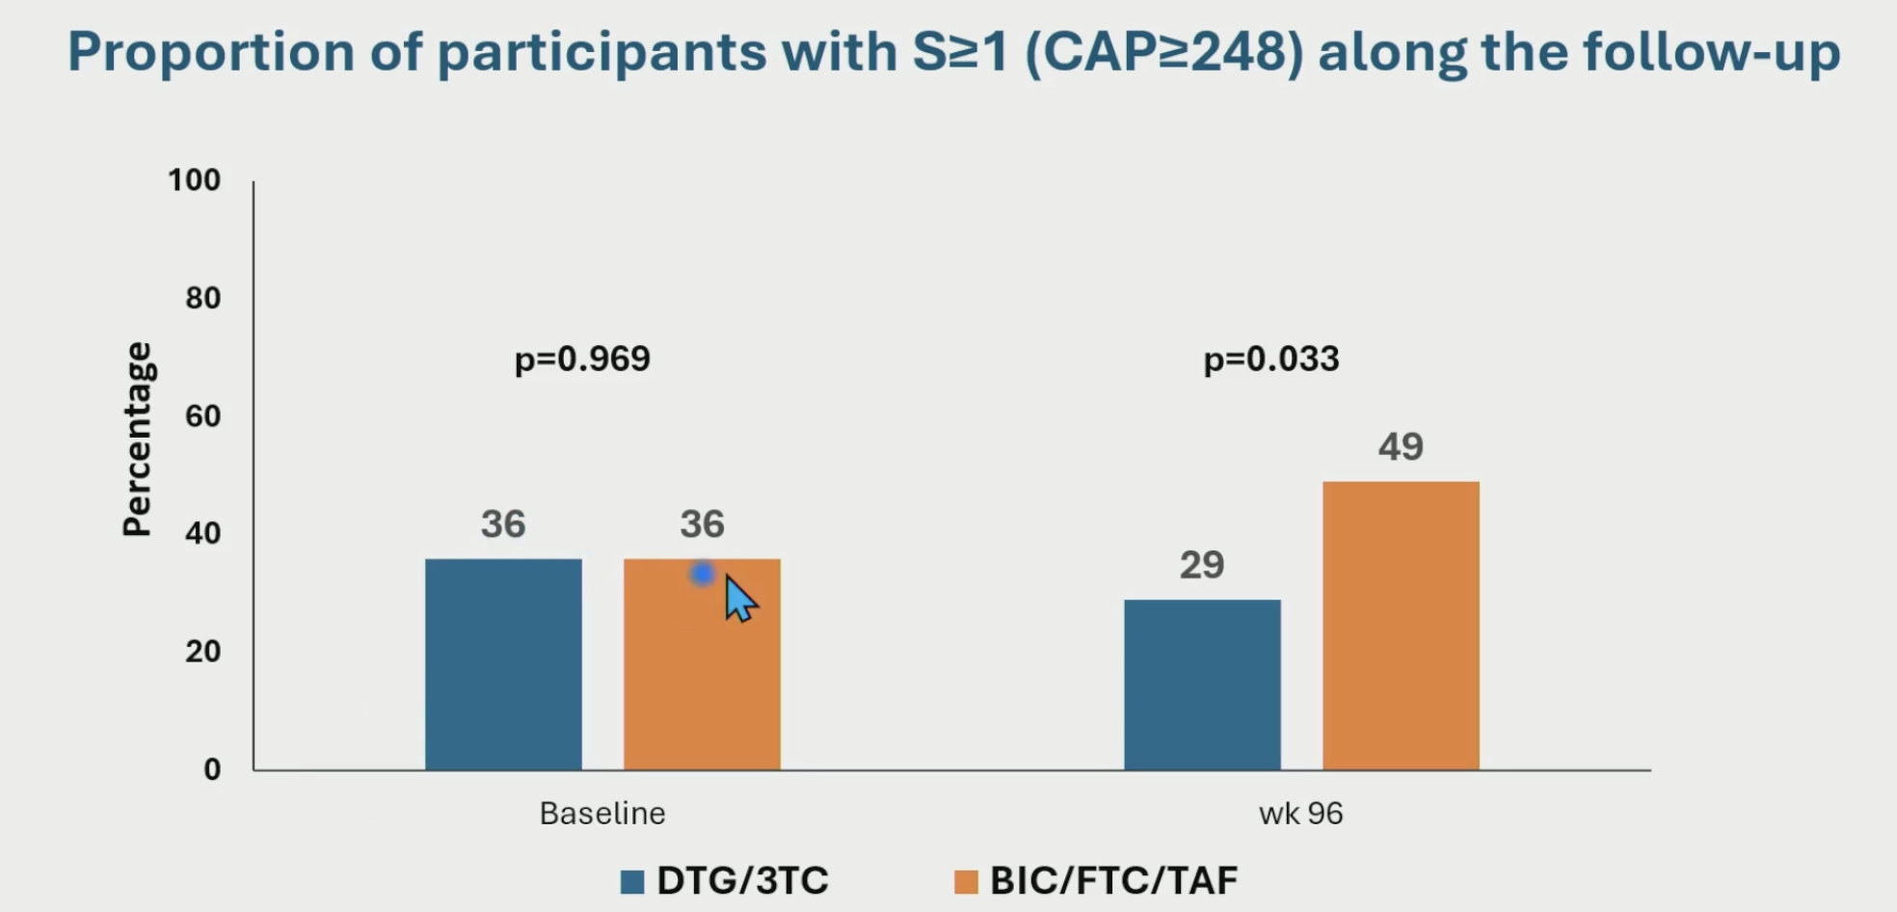
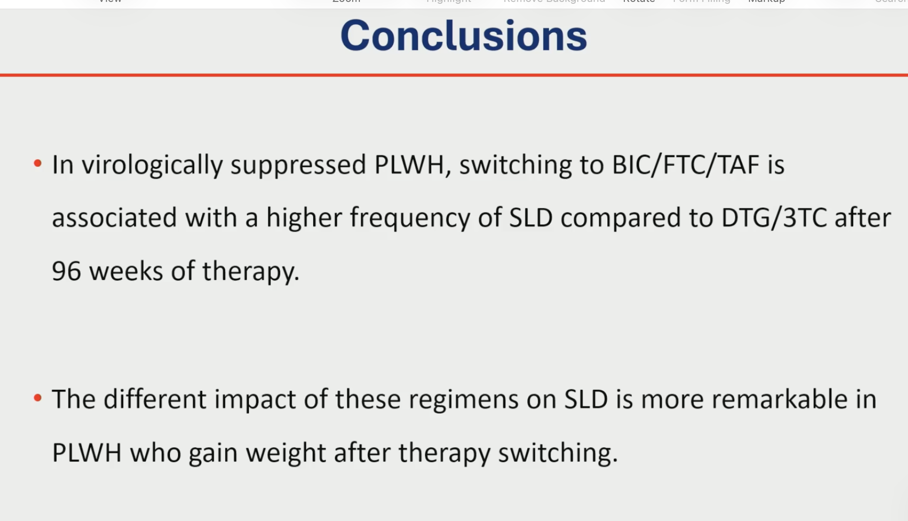
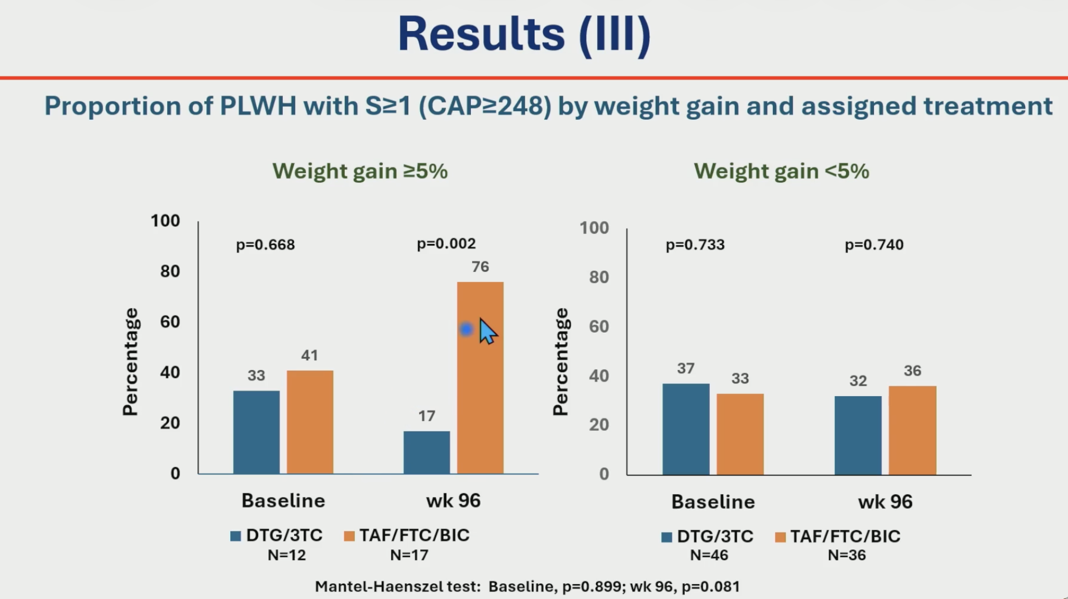
Effect of ART and Weight Gain on SLD

Slide 31
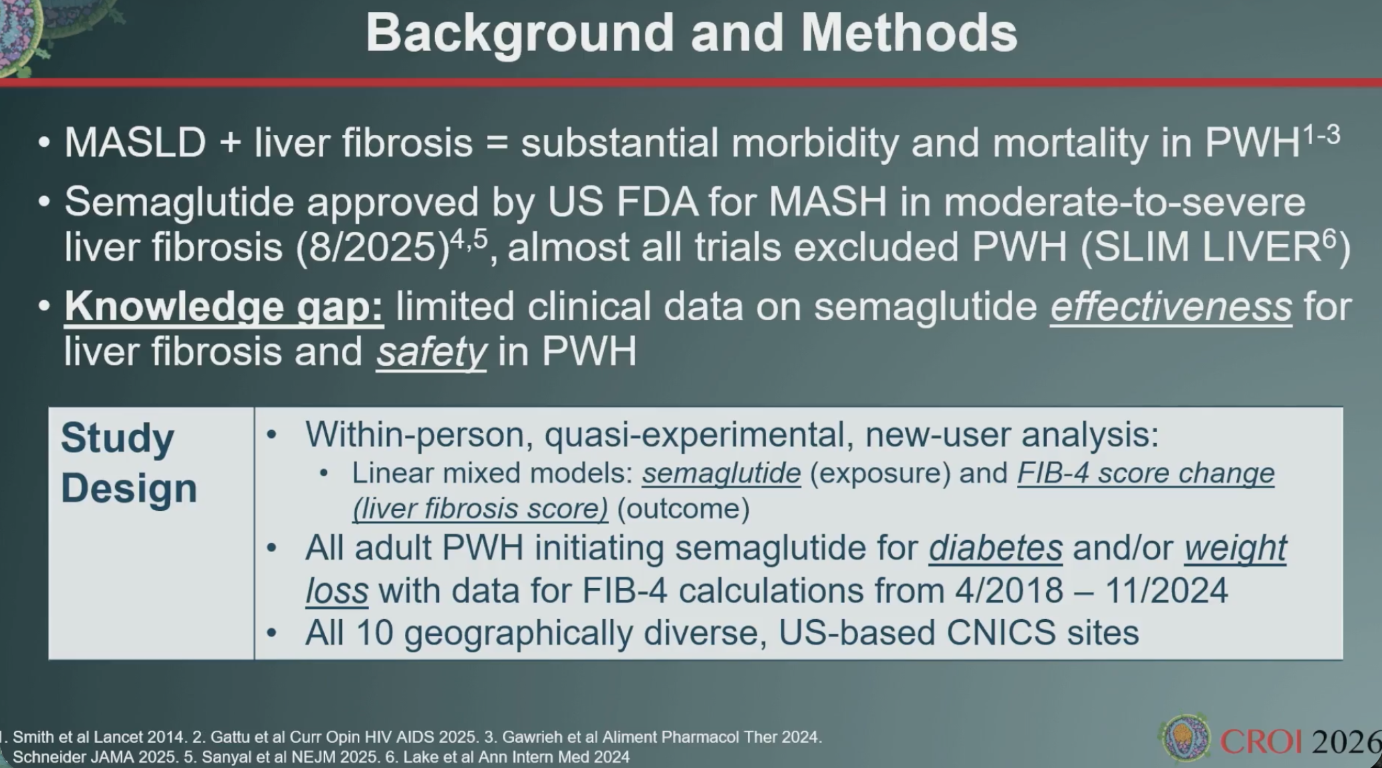
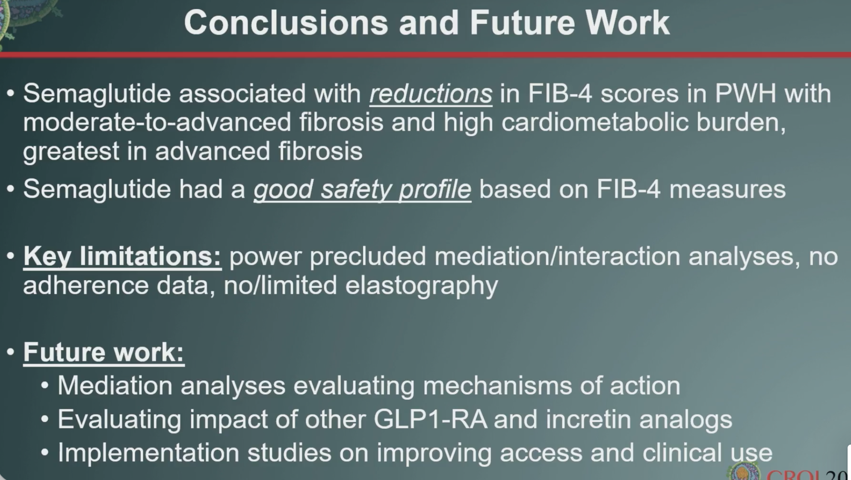
Semaglutide Effectiveness for Liver Fibrosis and Safety in PWH

Slide 32
Adolescents with Early Syphilis and HIV Early syphilis cases sent to CDC through NNDSS. (U.S., 2014–2023)
Study population: 28,965 adolescents aged 15–19 years diagnosed with early syphilis
HIV status:
9% HIV positive
65% HIV negative
27% unknown HIV status
Higher HIV prevalence among adolescents with:
Secondary (10%) and early latent syphilis (9%) vs primary (5%)
MSM (17%) vs MSW (3%) and women (1%)
Black/African American adolescents (12%) vs Hispanic (7%) and White (3%)
Southern U.S. (10%) vs West (5%)
Diagnosis Settings
79% diagnosed in non-STI clinics
21% diagnosed in STI clinics
NNDSS: National Notifiable Diseases Surveillance System
Presented by Daniel Gore, MD at CROI 2026

Slide 33
Adolescents with Early Syphilis and HIV Early syphilis cases sent to CDC through NNDSS. (U.S., 2014–2023)
Trends
HIV coinfection among adolescents with early syphilis declined from 11% (2014) to 6% (2023)
≈1 in 12 adolescents with early syphilis had HIV
Key Takeaways
HIV–syphilis coinfection is concentrated in MSM, Black adolescents, and the U.S. South
Most coinfections are identified outside STI clinics, highlighting opportunities for expanded HIV testing and prevention in general healthcare settings.
NNDSS: National Notifiable Diseases Surveillance System
Presented by Daniel Gore, MD at CROI 2026

Slide 34
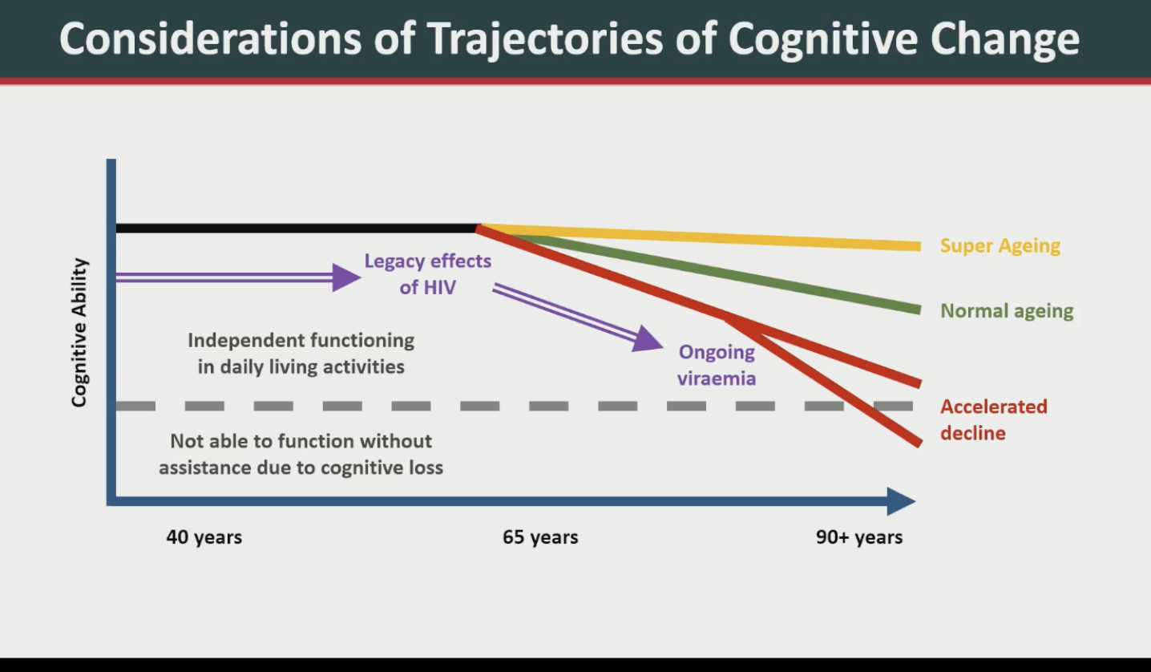

Slide 35
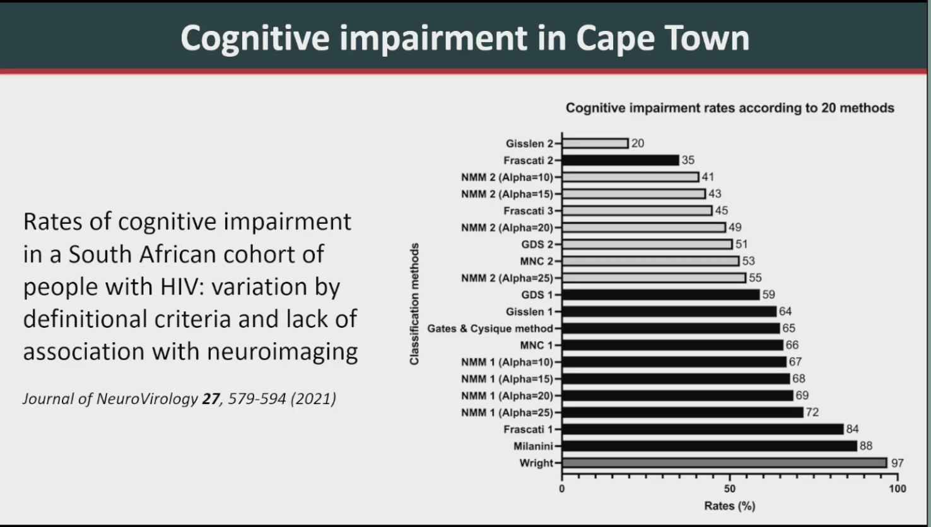
Cognitive Dysfunction in
People with HIV
Does HIV still effect the brain, and can it lead to early dementia?
Does the brain age differently in people with HIV from people without HIV?
Neurodegeneration and Dementia Risk in Older Adults with HIV
Alan Winston, MD. Presented at CROI 2026

Slide 36
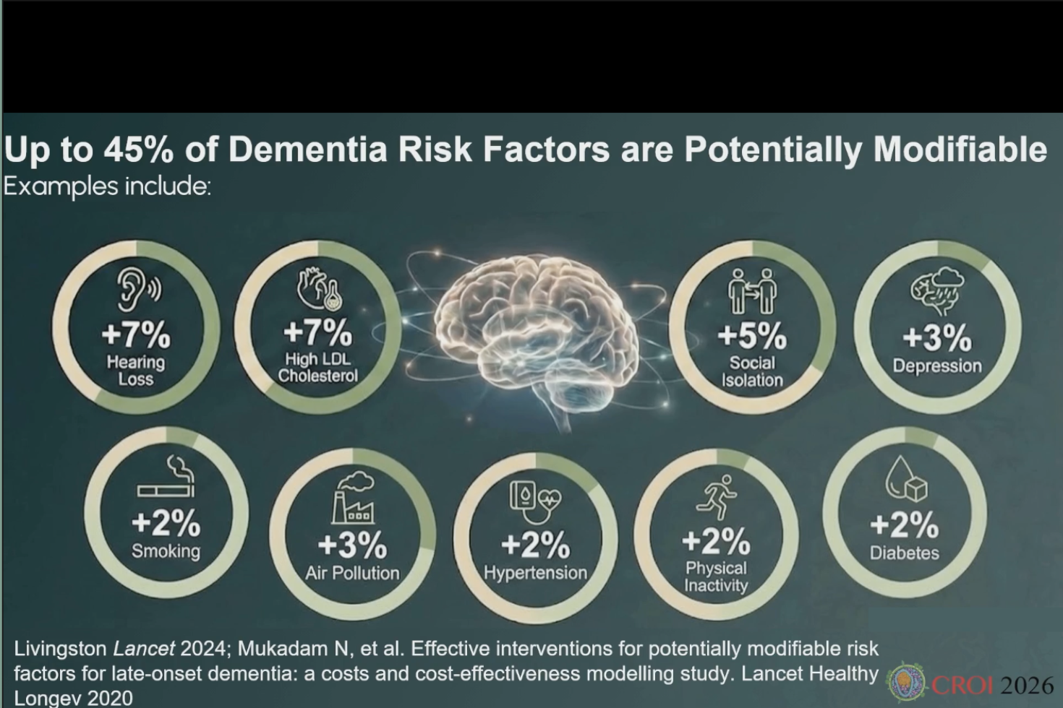
Cognitive Aging in HIV, Clinical Assessment and Management
Shibani S Mukerji, MD
Presented at CROIn2026

Slide 37
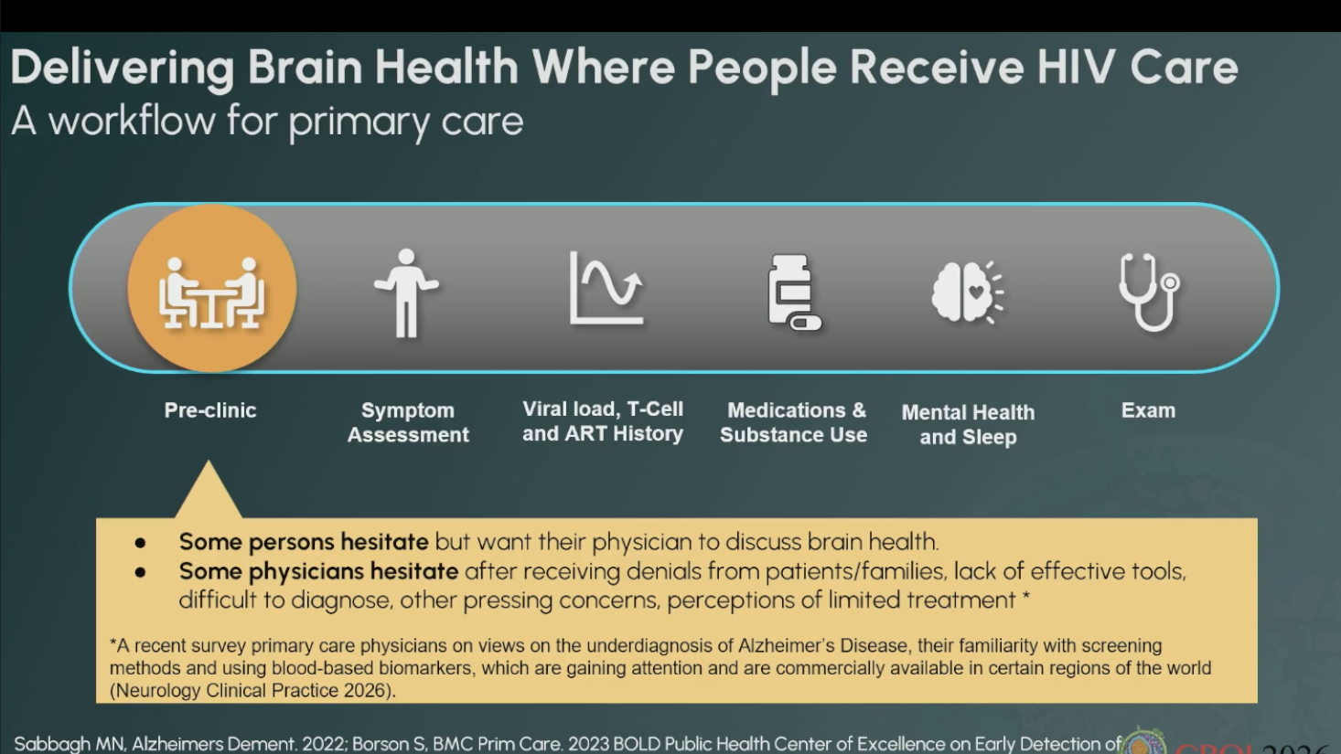
Cognitive Aging in HIV, Clinical Assessment and Management
Shibani S Mukerji, MD. Presented at CROI 2026

Slide 38
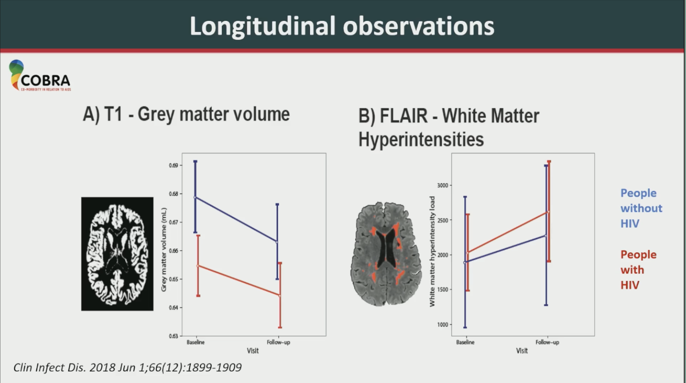
Neurodegeneration and Dementia Risk in Older Adults with HIV
Alan Winston, MD. Presented at CROI 2026

Slide 39
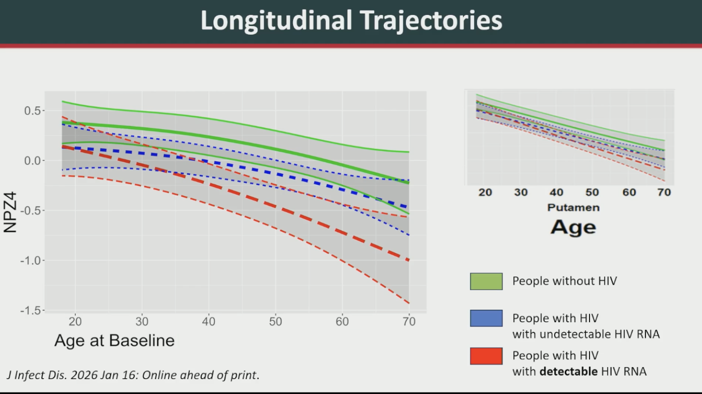
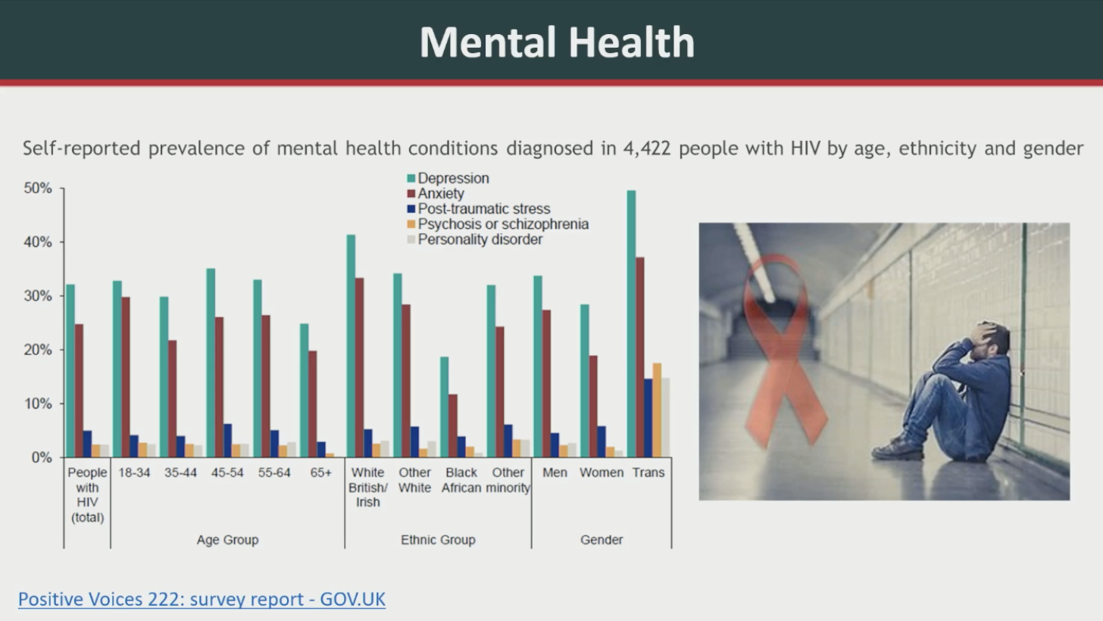
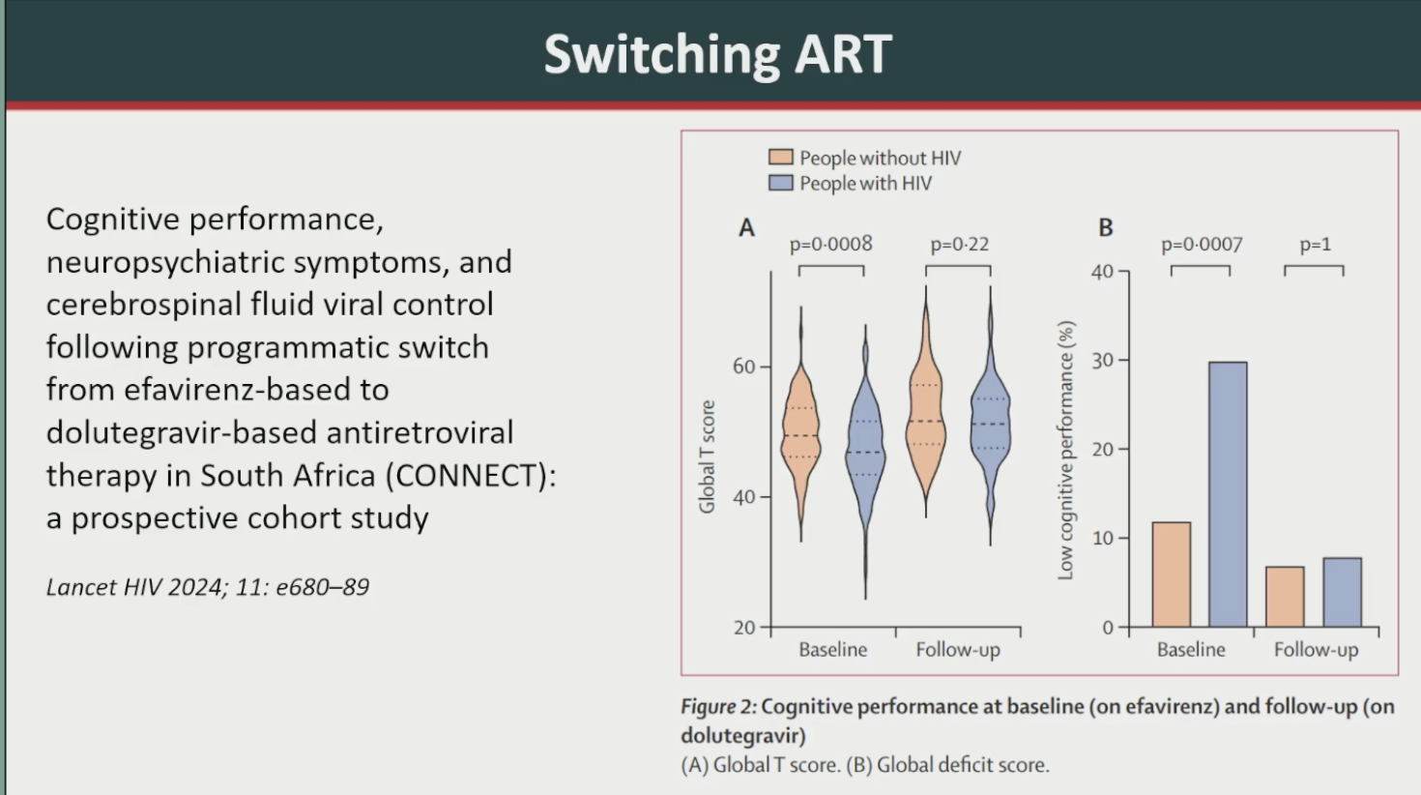
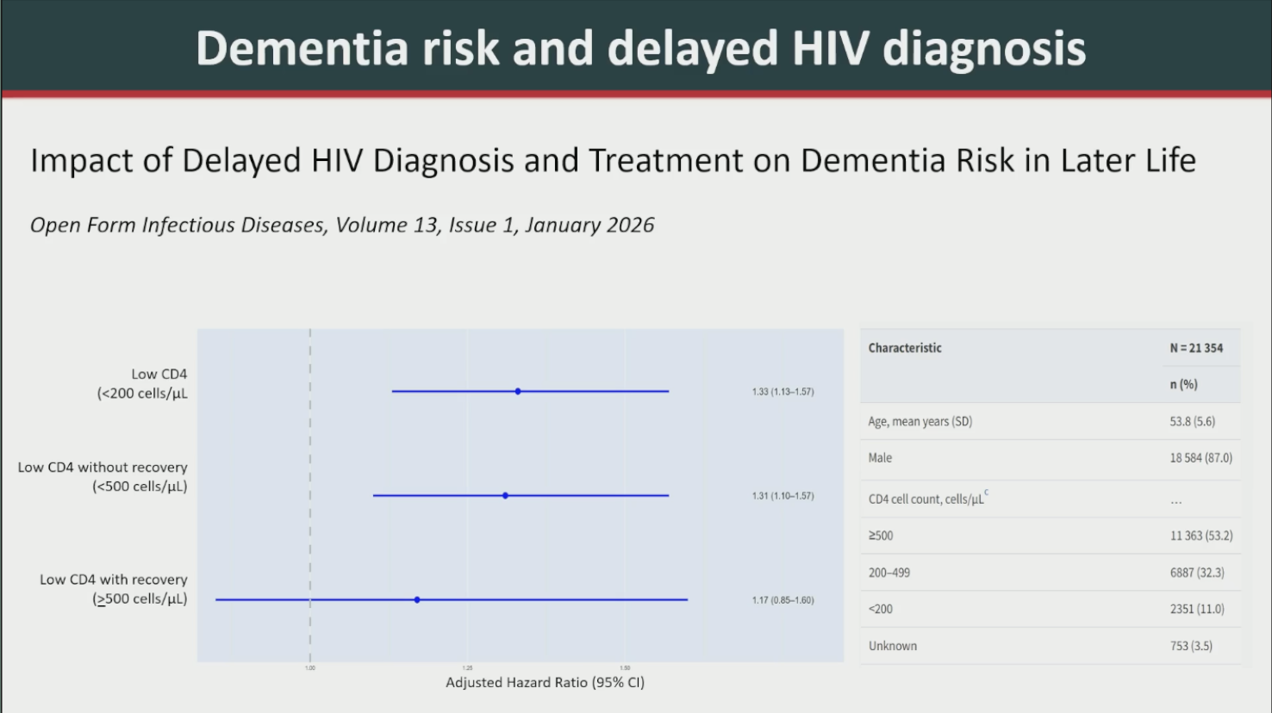
Cognitive Decline:
Risk Factors in PWH

Slide 40
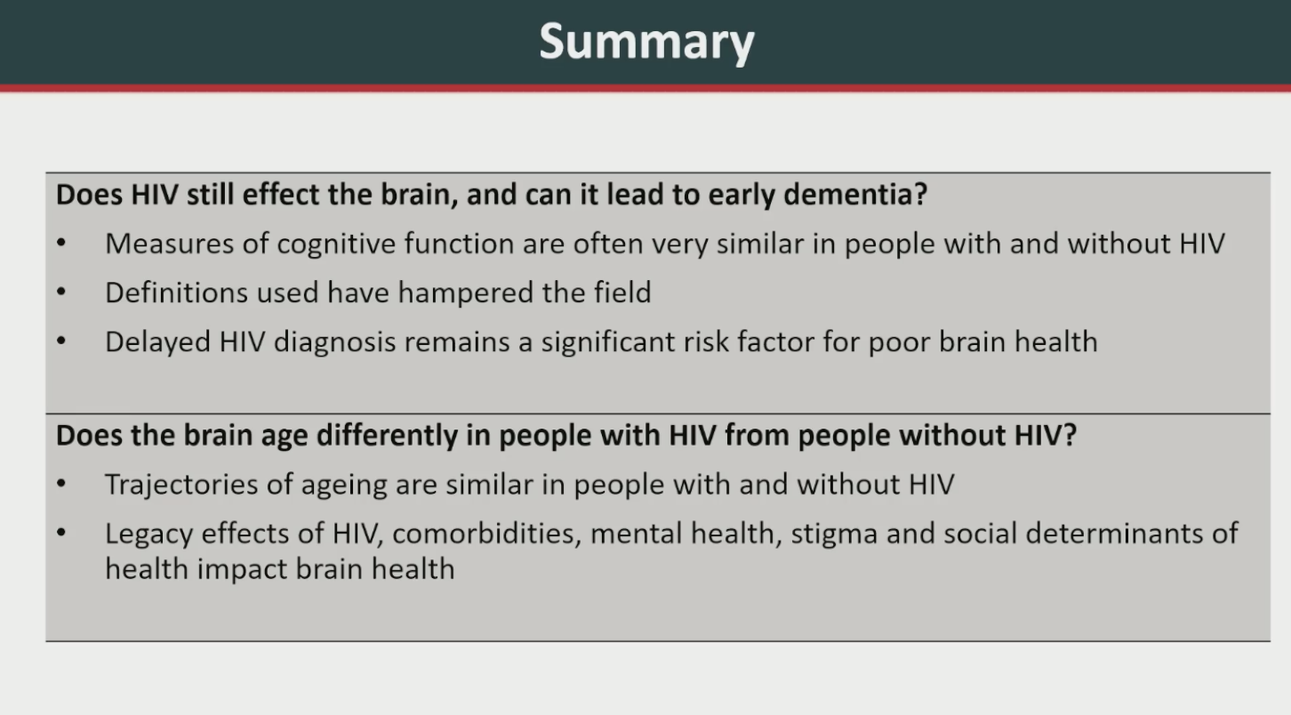

Slide 41
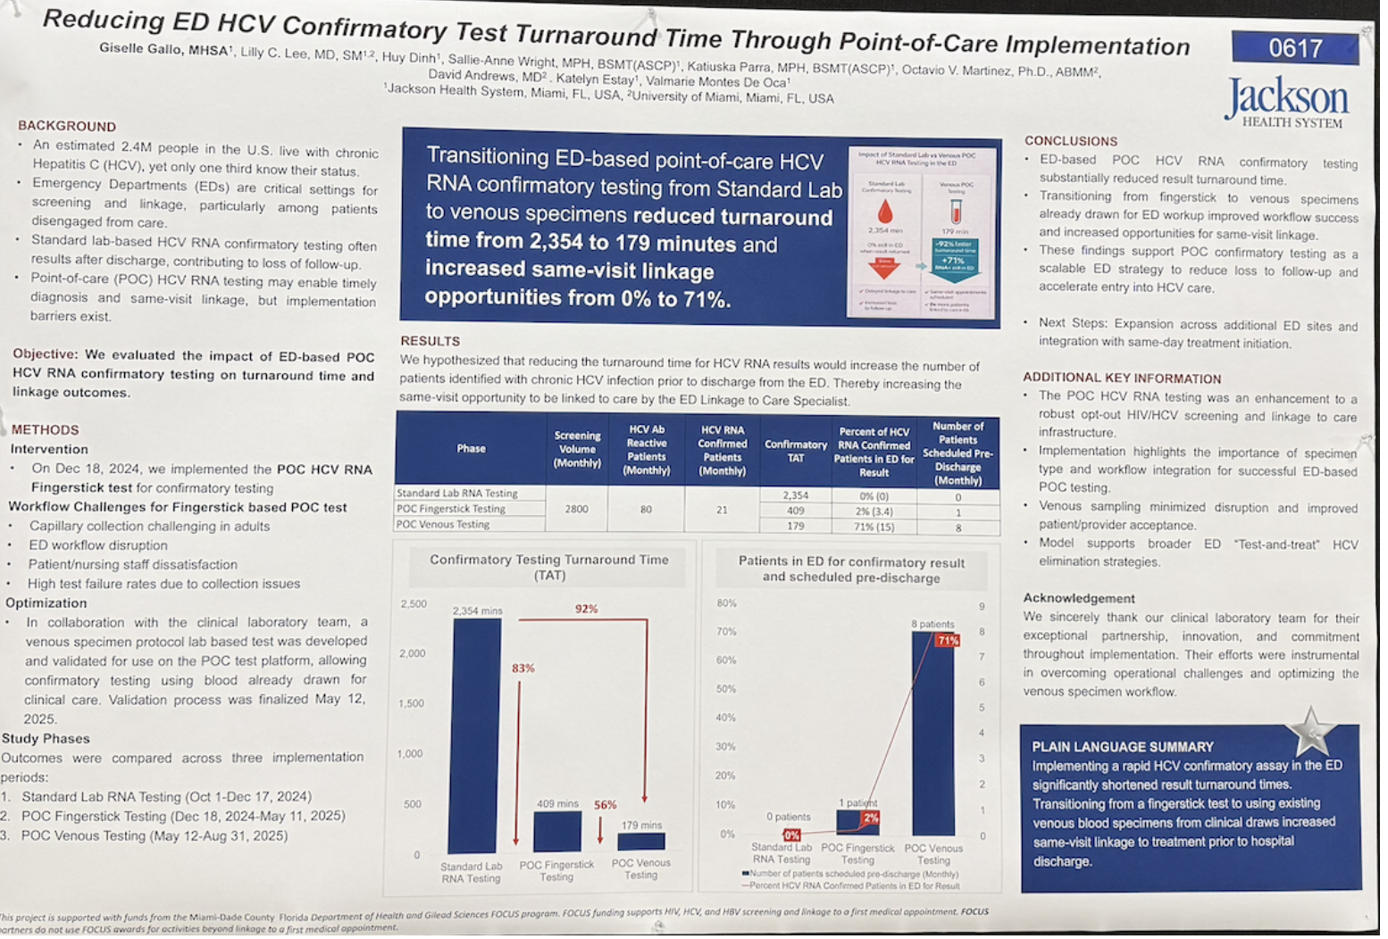

Slide 42
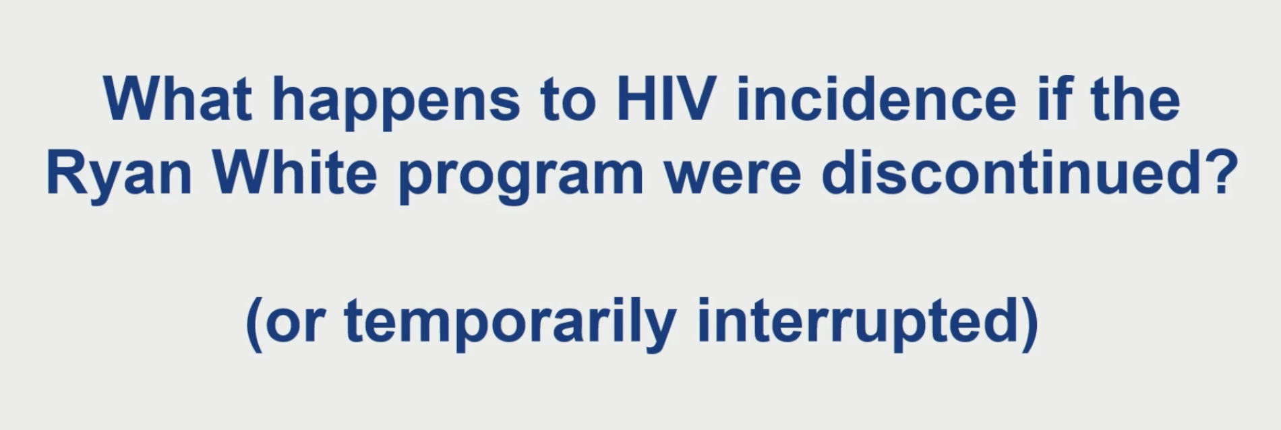
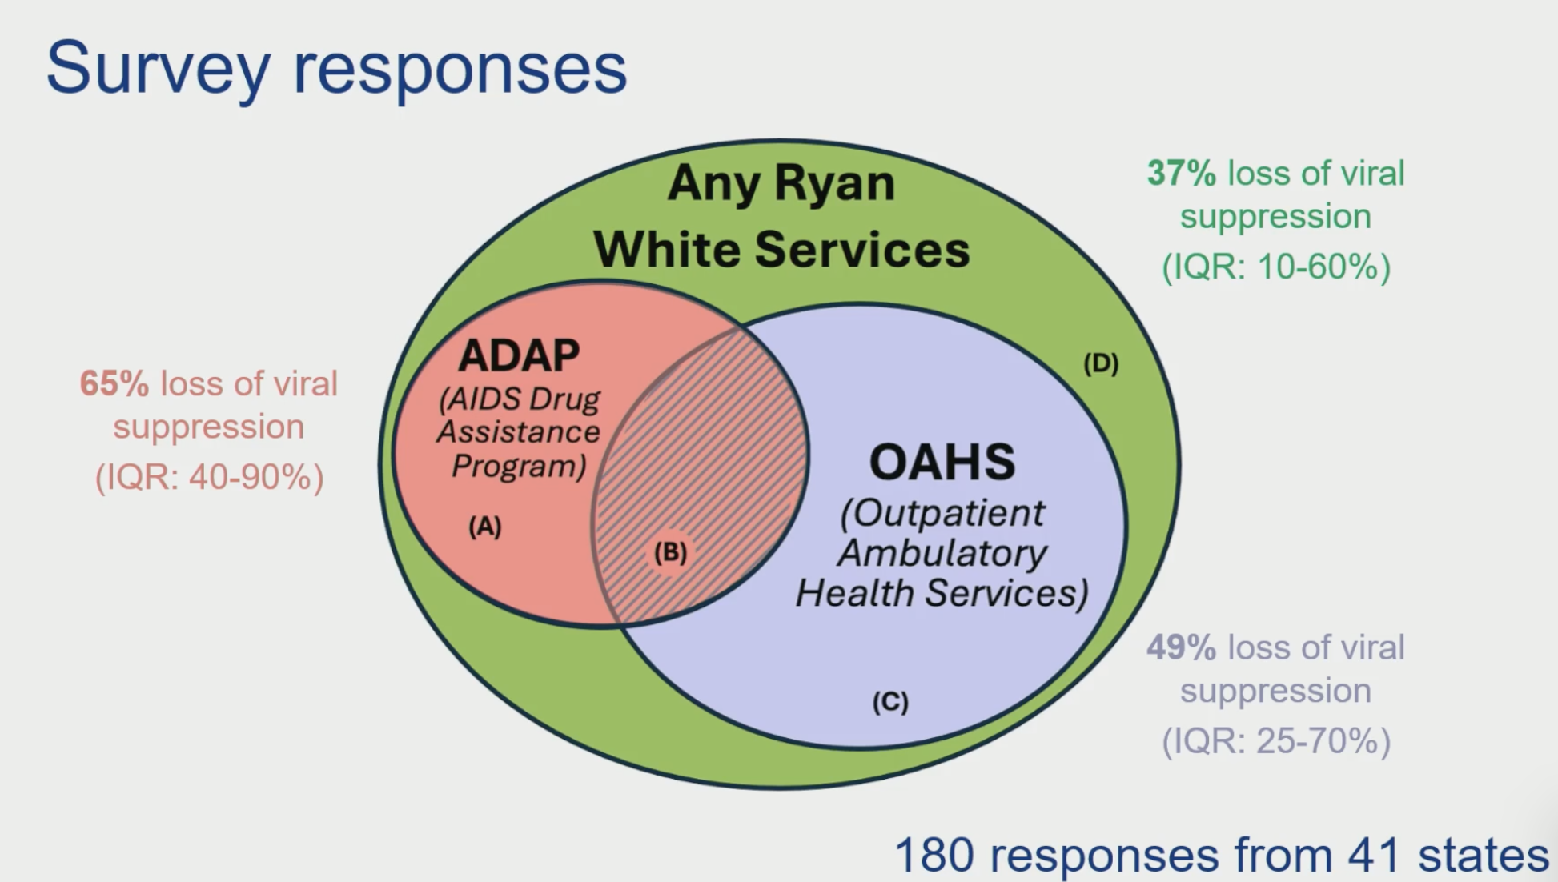
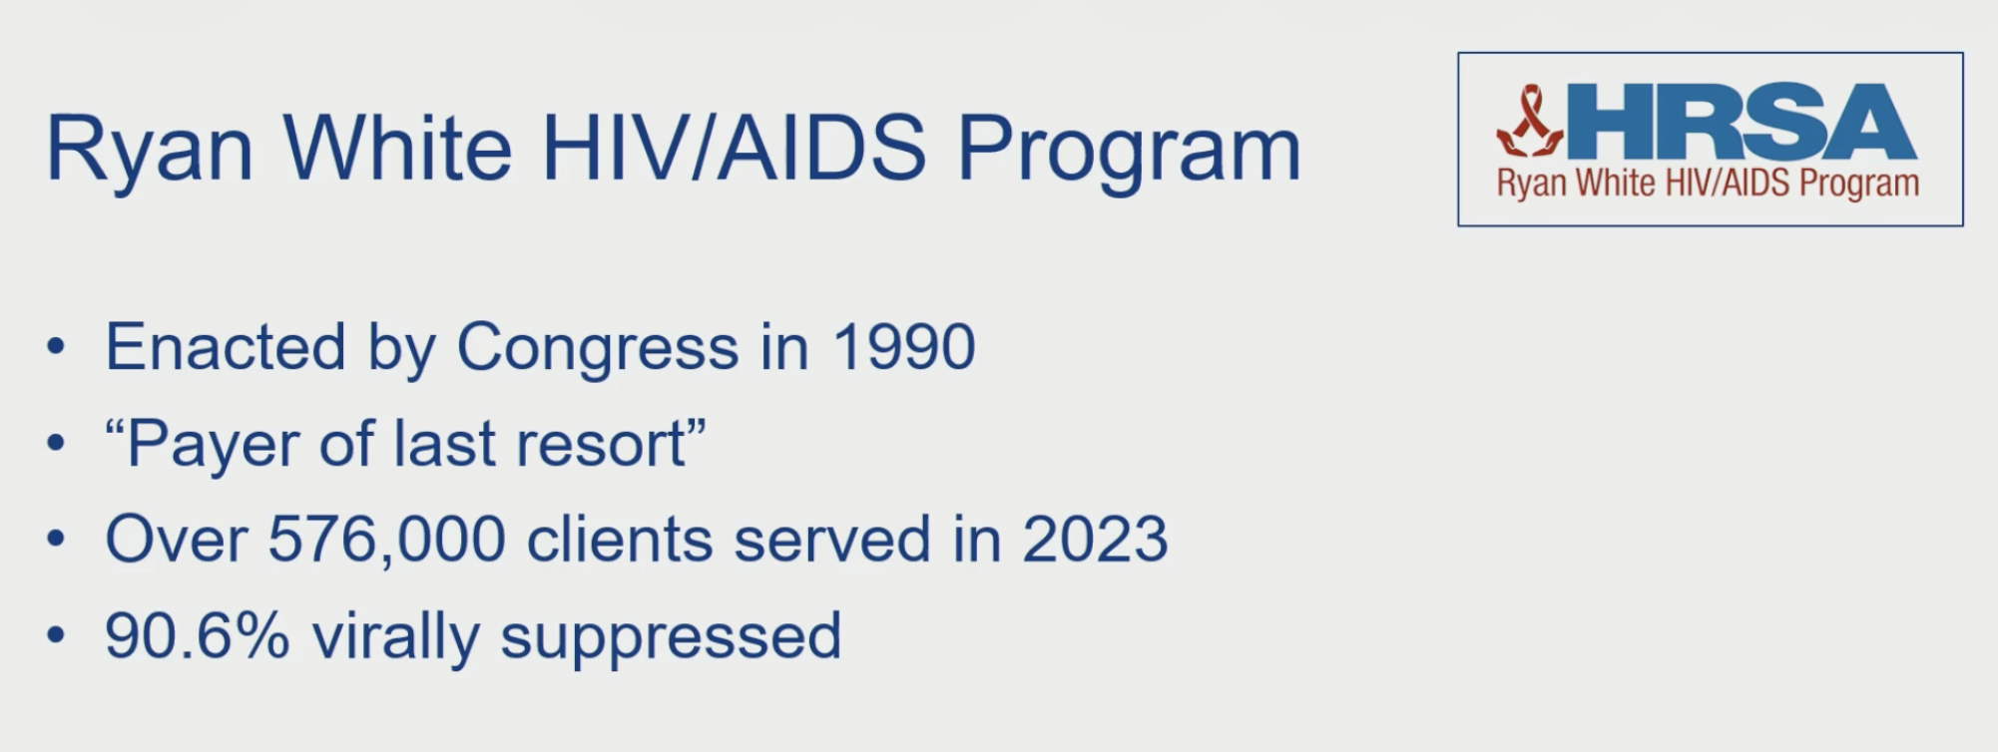
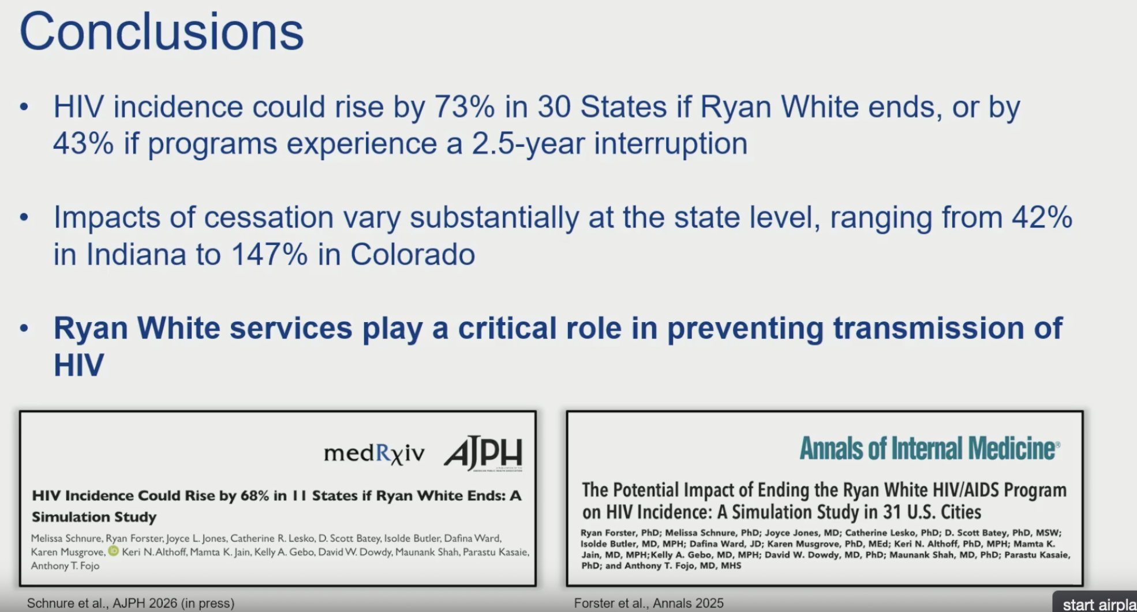
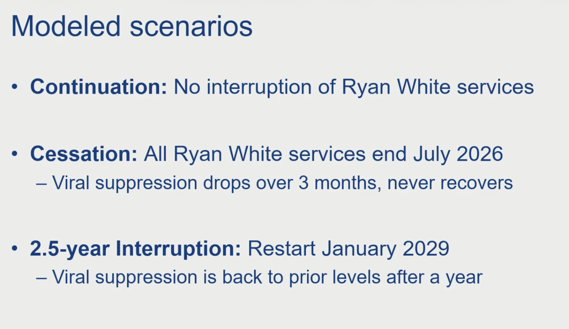

Slide 43

Questions?

