Slide 1
Maternal-Child Syphilis
March 19, 2026
Indian Health Service James McAuley MD MPH

Slide 2
This material is the result of work supported with resources and the use of facilities at the Whiteriver Indian Hospital, located in the Phoenix Area of the Indian Health Service.
Dr. McAuley is a federal employee and serves as the Chief Medical Officer of the Whiteriver Service Unit in Whiteriver, Arizona
The contents do not represent the views of the Indian Health Service or the United States Government
Clinical vignettes are fictionalized cases

Slide 3
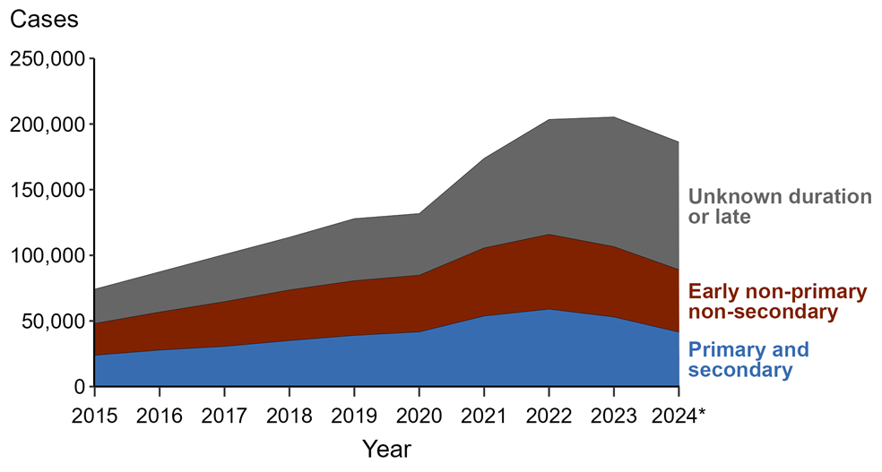
Syphilis – Reported Cases by Stage and Year, United States, 2015-2024
https://www.cdc.gov/sti-statistics/annual/index.html

Slide 4


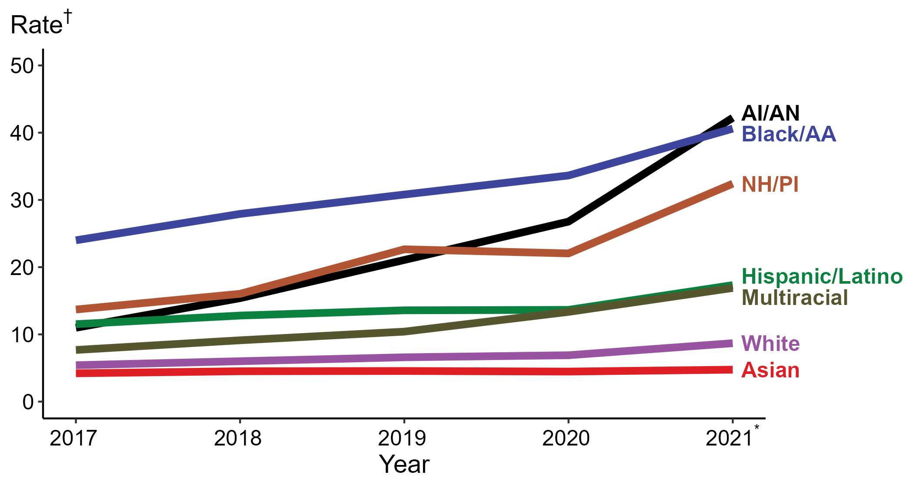
Primary and Secondary Syphilis — Rates of Reported Cases by Race/Hispanic Ethnicity, United States, 2017–2021*
* Reported 2021 data are preliminary as of July 7, 2022
† Per 100,000
ACRONYMS: AI/AN = American Indian/Alaska Native; Black/AA = Black or African American; NH/PI = Native Hawaiian/Pacific Islander
Notes:
The 2021 data are preliminary and reflect cases reported through National Notifiable Diseases Surveillance System (NNDSS) as of July 7, 2022.
In 2021, the highest rate of reported cases of primary and secondary syphilis was among non-Hispanic American Indian or Alaska Native persons (42.2 cases per 100,000; 57.5% increase from 2020), followed by non-Hispanic Black or African American persons (40.6 cases per 100,000; 20.8% increase from 2020), non-Hispanic Native Hawaiian or other Pacific Islander persons (32.4 cases per 100,000; 47.3% increase from 2020), Hispanic or Latino persons of any race (17.3 cases per 100,000; 27.2% increase from 2020), non-Hispanic persons of multiple races (16.9 cases per 100,000; 27.1% increase from 2020), non-Hispanic White persons (8.7 cases per 100,000; 26.1% increase from 2020), and non-Hispanic Asian persons (4.7 cases per 100,000; 4.4% increase from 2020). Non-Hispanic American Indian or Alaska Native persons had the greatest 5-year increase in rates of reported cases of primary and secondary syphilis (11.0 to 42.2 per 100,000; 283.6% increase from 2017).
For this figure, race/Hispanic ethnicity is categorized first by reported Hispanic ethnicity, then by reported race. Therefore, cases categorized as Hispanic/Latino can be of any race; cases categorized into a race group include both non-Hispanic persons and persons of unknown Hispanic ethnicity. Not all US jurisdictions reported cases in Office of Management and Budget compliant race categories during 2017 to 2021. This may minimally under- or overestimate rates for Asian, Native Hawaiian or other Pacific Islander, or multiracial individuals. No population data exist for unknown or other race; therefore, rates are not calculated. For completeness, data in this figure include cases reported from all jurisdictions.
The COVID-19 pandemic has introduced uncertainty and difficulty in interpreting STD data collected during 2020 and 2021. See Impact of COVID-19 on STDs (https://www.cdc.gov/std/statistics/2020/impact.htm) for more information.
See Technical Notes (https://www.cdc.gov/std/statistics/2021/) for information on STD case reporting and reporting race/ethnicity for STD cases.
Data points are available at: https://www.cdc.gov/std/statistics/2021/PreliminaryData.zip

Slide 5

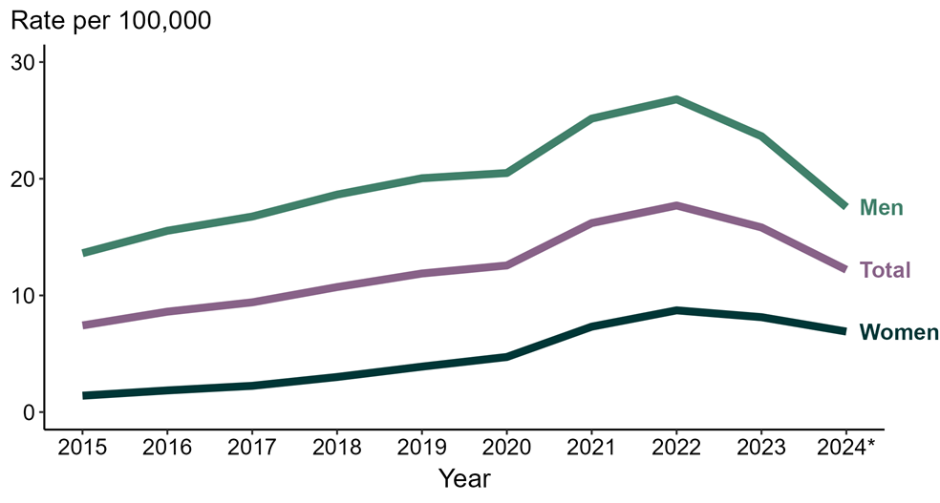
Primary and Secondary Syphilis – Rates of Reported Cases by Sex and Year, United States, 2015-2024
https://www.cdc.gov/sti-statistics/annual/index.html
Notes:
In 2024, 120,567 cases of syphilis (all stages) among men were reported in the United States.
Percentage of 2024 syphilis cases by stage among men:
47.8% - Unknown duration or late
27.7% - Early non-primary non-secondary (ENPNS)
24.5% - Primary and secondary (P&S)
Comparing 2023 to 2024 syphilis cases by stage among men:
Unknown duration or late syphilis decreased 5.2% (60,718 to 57,591)
ENPNS syphilis decreased 17.5% (40,486 to 33,401)
P&S syphilis decreased 24.5% (39,188 to 29,575)
Syphilis (all stages) decreased 14.1% (140,392 to 120,567)
Syphilis (all stages) excludes cases of congenital syphilis. Case definitions are periodically revised using the Council of State and Territorial Epidemiologist’s (CSTE’s) Position Statements and provide uniform criteria of nationally notifiable conditions for reporting purposes. Prior to 2018, syphilis cases identified as “early non-primary non-secondary syphilis” were classified as “early latent syphilis.” Prior to 2018, cases in the “unknown duration or late syphilis” category included cases classified as “late latent syphilis,” “latent syphilis of unknown duration,” “late syphilis with clinical manifestations,” and “neurosyphilis.” Please see the National Notifiable Diseases Surveillance System (NNDSS) website (https://ndc.services.cdc.gov/) for historical and current case definitions.
This report includes data from years that coincide with the COVID-19 pandemic, which introduced uncertainty and difficulty in interpreting STI surveillance data. See Impact of COVID-19 on STIs (https://www.cdc.gov/sti-statistics/about/impact-of-covid-19.html) for more information.
See the final slide of this slide deck for more information about the 2024 provisional data displayed in this report. Please see the Technical Notes from the 2023 STI Surveillance Report (https://www.cdc.gov/sti-statistics/media/pdfs/2025/09/2023_STI_Surveillance_Report_FINAL_508.pdf) for additional information on STI case reporting formats and practices.
Data for all figures are available at https://www.cdc.gov/sti-statistics/media/files/2025/09/STI-Surveillance-Report-2024-Provisional_data-files.zip. The file “Syphilis — Cases Men by Stage and Year (US 2015-2024).xlsx” contains the data for the figure presented on this slide.

Slide 6
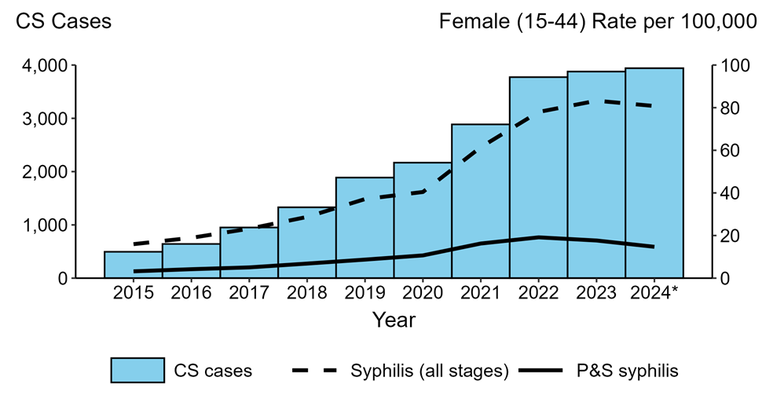
Congenital Syphilis –Cases by Year of Birth and Rates of Primary and Secondary Syphilis and Syphilis (All Stages) Among Women Aged 15-44 Years, United States, 2015-2024
https://www.cdc.gov/sti-statistics/annual/index.html
Notes:
Congenital syphilis (CS)
In 2024, 3,941 cases of congenital syphilis (CS) were reported in the United States (rate of 109.6 cases per 100,000 live births).
Comparing CS case counts:
1 year (2023 to 2024) - CS cases increased 1.6% (3,878 to 3,941)
5 years (2020 to 2024) - CS cases increased 81.8% (2,168 to 3,941)
10 years (2015 to 2024) - CS cases increased 696.2% (495 to 3,941)
Among women aged 15 to 44 years:
In 2024, 54,447 cases of syphilis (all stages) (rate of 80.8 per 100,000)
In 2024, 9,921 cases of primary and secondary (P&S) syphilis (rate of 14.7 per 100,000)
Comparing rates of syphilis (all stages):
1 year (2023 to 2024) - rates decreased 3.0% (83.3 to 80.8 per 100,000)
5 years (2020 to 2024) - rates increased 100.0% (40.4 to 80.8 per 100,000)
10 years (2015 to 2024) - rates increased 405.0% (16.0 to 80.8 per 100,000)
Comparing rates of P&S syphilis:
1 year (2023 to 2024) - rates decreased 16.9% (17.7 to 14.7 per 100,000)
5 years (2020 to 2024) - rates increased 37.4% (10.7 to 14.7 per 100,000)
10 years (2015 to 2024) - rates increased 359.4% (3.2 to 14.7 per 100,000)
This report includes data from years that coincide with the COVID-19 pandemic, which introduced uncertainty and difficulty in interpreting STI surveillance data. See Impact of COVID-19 on STIs (https://www.cdc.gov/sti-statistics/about/impact-of-covid-19.html) for more information.
See the final slide of this slide deck for more information about the 2024 provisional data displayed in this report. Please see the Technical Notes from the 2023 STI Surveillance Report (https://www.cdc.gov/sti-statistics/media/pdfs/2025/09/2023_STI_Surveillance_Report_FINAL_508.pdf) for additional information on STI case reporting formats and practices.
Data for all figures are available at https://www.cdc.gov/sti-statistics/media/files/2025/09/STI-Surveillance-Report-2024-Provisional_data-files.zip. The file “CS - Cases by Year of Birth and Syphilis Rates Women 15-44 (US 2015-2024).xlsx” contains the data for the figure presented on this slide.

Slide 7
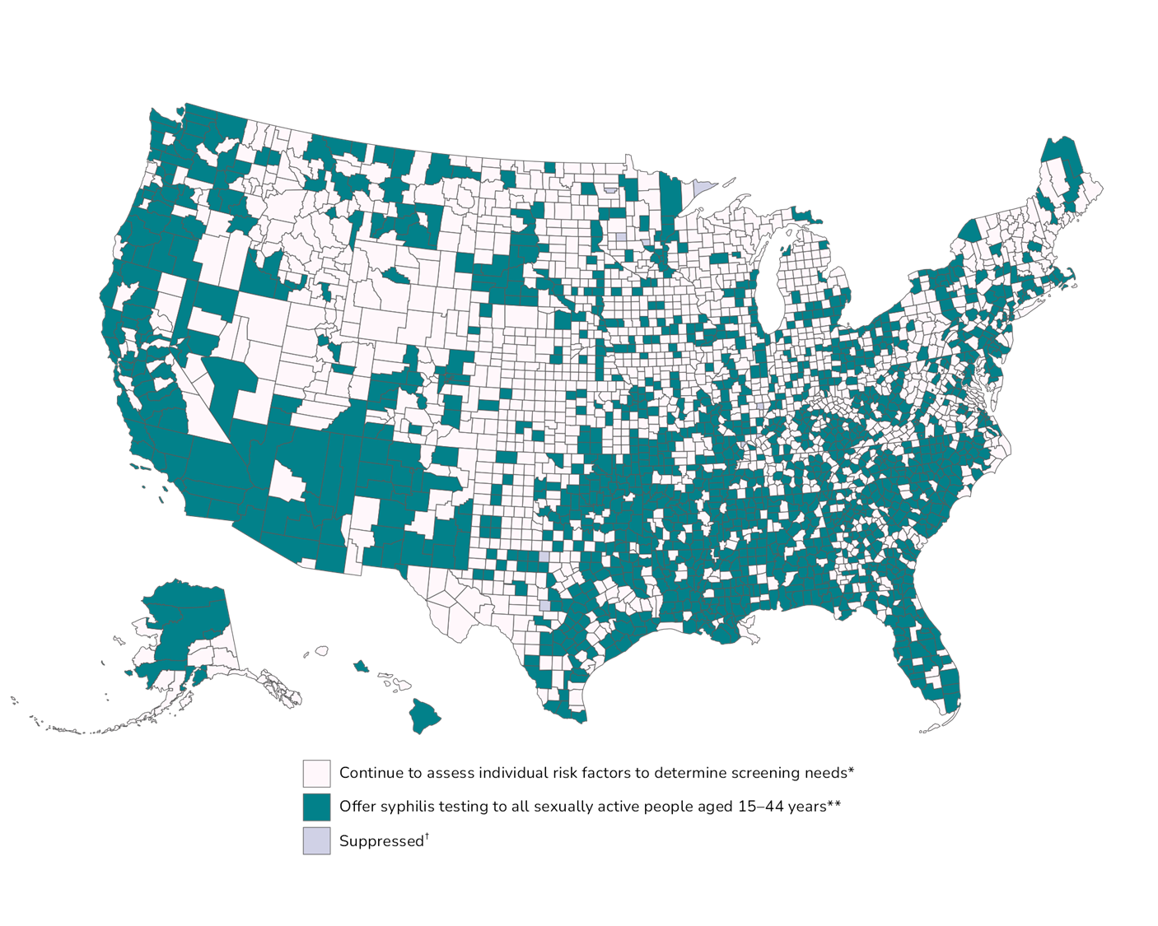
Primary and Secondary Syphilis — Rates of Reported Cases by County Among Women, United States, 2023
https://www.cdc.gov/sti-statistics/annual/index.html
Notes:
In 2020, 58% of all counties and county equivalents in the United States reported at least one case of primary and secondary syphilis. Out of 3,143 counties and county equivalents, 50 (2%) reported over half of all cases of primary and secondary syphilis.
The COVID-19 pandemic has introduced uncertainty and difficulty in interpreting 2020 case data. See Impact of COVID-19 on STDs (https://www.cdc.gov/std/statistics/2020/impact.htm) for more information.
See Technical Notes (https://www.cdc.gov/std/statistics/2020/technical-notes.htm) for information on syphilis case reporting.
Data points are available at: https://www.cdc.gov/std/statistics/2020/data.zip

Slide 8
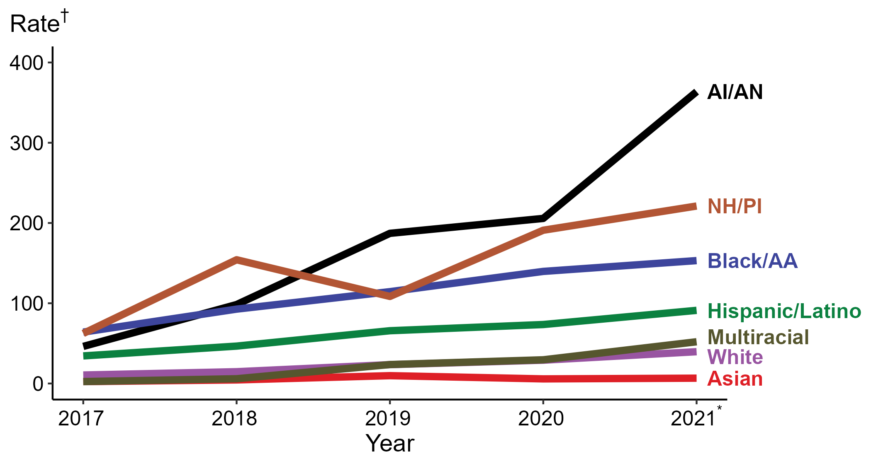
Congenital Syphilis — Rates of Reported Cases by Year of Birth, Race/Hispanic Ethnicity of Mother, United States, 2017–2021*
* Reported 2021 data are preliminary as of July 7, 2022
† Per 100,000 live births
ACRONYMS: AI/AN = American Indian/Alaska Native; Black/AA = Black or African American; NH/PI = Native Hawaiian/Pacific Islander
No recent updates available on CDC website as data removed during reported data system updates
Notes:
The 2021 data are preliminary and reflect cases reported through National Notifiable Diseases Surveillance System (NNDSS) as of July 7, 2022.
In 2021, the highest rate of reported cases of congenital syphilis was among mothers who were non-Hispanic American Indian or Alaska Native (363.7 cases per 100,000 live births; 76.8% increase from 2020), followed by mothers who were non-Hispanic Native Hawaiian or other Pacific Islander (221.1 cases per 100,000 live births; 15.8% increase from 2020), mothers who were non-Hispanic Black or African American (153.1 cases per 100,000 live births; 9.6% increase from 2020), mothers who were Hispanic or Latino and of any race (91.1 cases per 100,000 live births; 23.9% increase from 2020), mothers who were non-Hispanic and of multiple races (52.0 cases per 100,000 live births; 75.7% increase from 2020), mothers who were non-Hispanic White (39.6 cases per 100,000 live births; 36.1% increase from 2020), and mothers who were non-Hispanic Asian (6.7 cases per 100,000 live births; 15.5% increase from 2020). Mothers who were non-Hispanic and of multiple races had the greatest 5-year increase in rates of reported cases of congenital syphilis (2.4 to 52.0 per 100,000 live births; 2,066.7% increase from 2017).
For this figure, race/Hispanic ethnicity is categorized first by reported Hispanic ethnicity, then by reported race. Therefore, cases categorized as Hispanic/Latino can be of any race; cases categorized into a race group include both non-Hispanic persons and persons of unknown Hispanic ethnicity. Not all US jurisdictions reported cases in Office of Management and Budget compliant race categories during 2017 to 2021. This may minimally under- or overestimate rates for Asian, Native Hawaiian or other Pacific Islander, or multiracial individuals. No population data exist for unknown or other race; therefore, rates are not calculated. For completeness, data in this figure include cases reported from all jurisdictions.
The COVID-19 pandemic has introduced uncertainty and difficulty in interpreting STD data collected during 2020 and 2021. See Impact of COVID-19 on STDs (https://www.cdc.gov/std/statistics/2020/impact.htm) for more information.
See Technical Notes (https://www.cdc.gov/std/statistics/2021/) for information on STD case reporting and reporting race/ethnicity for STD cases.
Data points are available at: https://www.cdc.gov/std/statistics/2021/PreliminaryData.zip

Slide 9
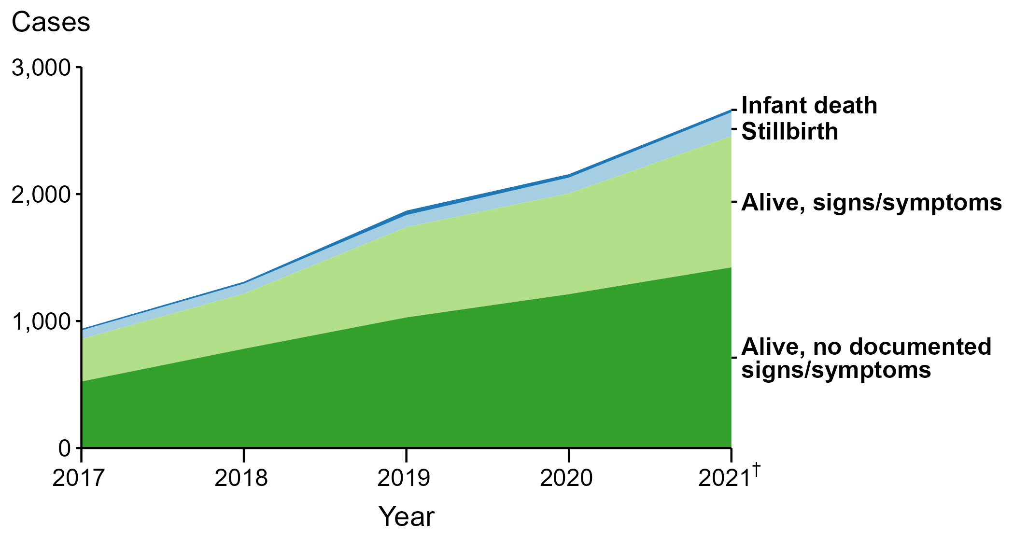
Congenital Syphilis — Reported Cases by Vital Status and Clinical Signs and Symptoms* of Infection, United States, 2017–2021†
* Infants with signs/symptoms of congenital syphilis have documentation of at least one of the following: long bone changes consistent with congenital syphilis, snuffles, condyloma lata, syphilitic skin rash, pseudoparalysis, hepatosplenomegaly, edema, jaundice due to syphilitic hepatitis, reactive CSF-VDRL, elevated CSF WBC or protein, or evidence of direct detection of T. Pallidum.
† Reported 2021 data are preliminary as of July 7, 2022; formerly available at https://www.cdc.gov/std/statistics/2021/default.htm
NOTE: Of the 8,974 congenital syphilis cases reported during 2017 to 2021, 30 (0.3%) did not have sufficient information to be categorized.
Notes:
The 2021 data are preliminary and reflect cases reported through National Notifiable Diseases Surveillance System (NNDSS) as of July 7, 2022.
In 2021, among the 2,677 infants reported with congenital syphilis, 188 (7.0%) were reported as stillbirth and 23 (0.9%) as an infant death. Combined, the 211 congenital syphilis-related deaths were an increase of 39.7% from 2020 (151 in 2020 to 211 in 2021) and an increase of 163.8% from 2017 (80 in 2017 to 211 in 2021).
The number of infants reported with congenital syphilis who had congenital syphilis-related signs and/or symptoms and were born alive increased 30.2% from 2020 to 2021 (794 in 2020 to 1,034 in 2021) and increased 208.7% from 2017 to 2021 (335 in 2017 to 1,034 in 2021).
The COVID-19 pandemic has introduced uncertainty and difficulty in interpreting STD data collected during 2020 and 2021. See Impact of COVID-19 on STDs (https://www.cdc.gov/std/statistics/2020/impact.htm) for more information.
See Technical Notes (https://www.cdc.gov/std/statistics/2021/) for information on STD case reporting.
Data points are available at: https://www.cdc.gov/std/statistics/2021/PreliminaryData.zip

Slide 10
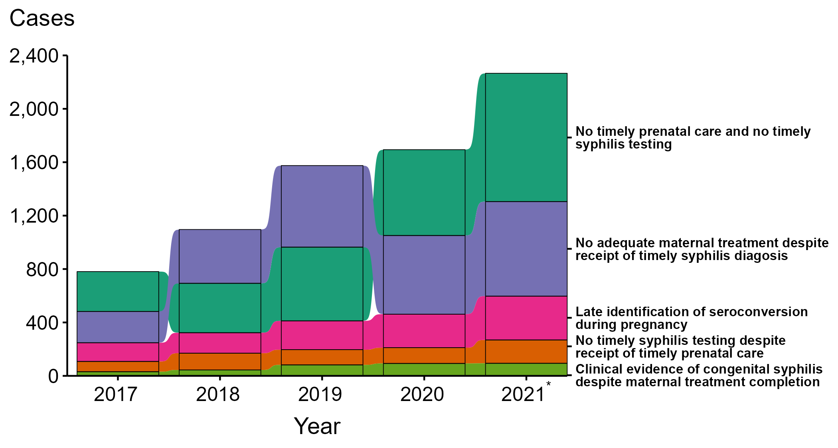
Congenital Syphilis — Missed Prevention Opportunities among Mothers Delivering Infants with Congenital Syphilis, United States, 2017–2021*
* Reported 2021 data are preliminary as of July 7, 2022
NOTE: Of the 8,974 congenital syphilis cases reported during 2017 to 2021, 1,562 (17.4%) were not able to have the primary missed prevention opportunity identified due to insufficient information provided to CDC related to maternal prenatal care, testing, or treatment. Formerly available at https://www.cdc.gov/std/statistics/2021/default.htm
Notes:
The 2021 data are preliminary and reflect cases reported through National Notifiable Diseases Surveillance System (NNDSS) as of July 7, 2022.
During 2017 to 2021, the majority of missed prevention opportunities among mothers delivering infants with congenital syphilis were those with no timely prenatal care or syphilis testing (n = 2,825; 38%) and timely syphilis testing but no adequate maternal treatment (n = 2,545; 34%). In 2021, the most common missed congenital syphilis prevention opportunity was mothers who had no timely prenatal care or syphilis testing (n = 961; 42%), followed by those who had timely syphilis testing but no adequate maternal treatment (n = 708; 31%).
The COVID-19 pandemic has introduced uncertainty and difficulty in interpreting STD data collected during 2020 and 2021. See Impact of COVID-19 on STDs (https://www.cdc.gov/std/statistics/2020/impact.htm) for more information.
See Technical Notes (https://www.cdc.gov/std/statistics/2021/) for information on STD case reporting.
Data points are available at: https://www.cdc.gov/std/statistics/2021/PreliminaryData.zip

Slide 11
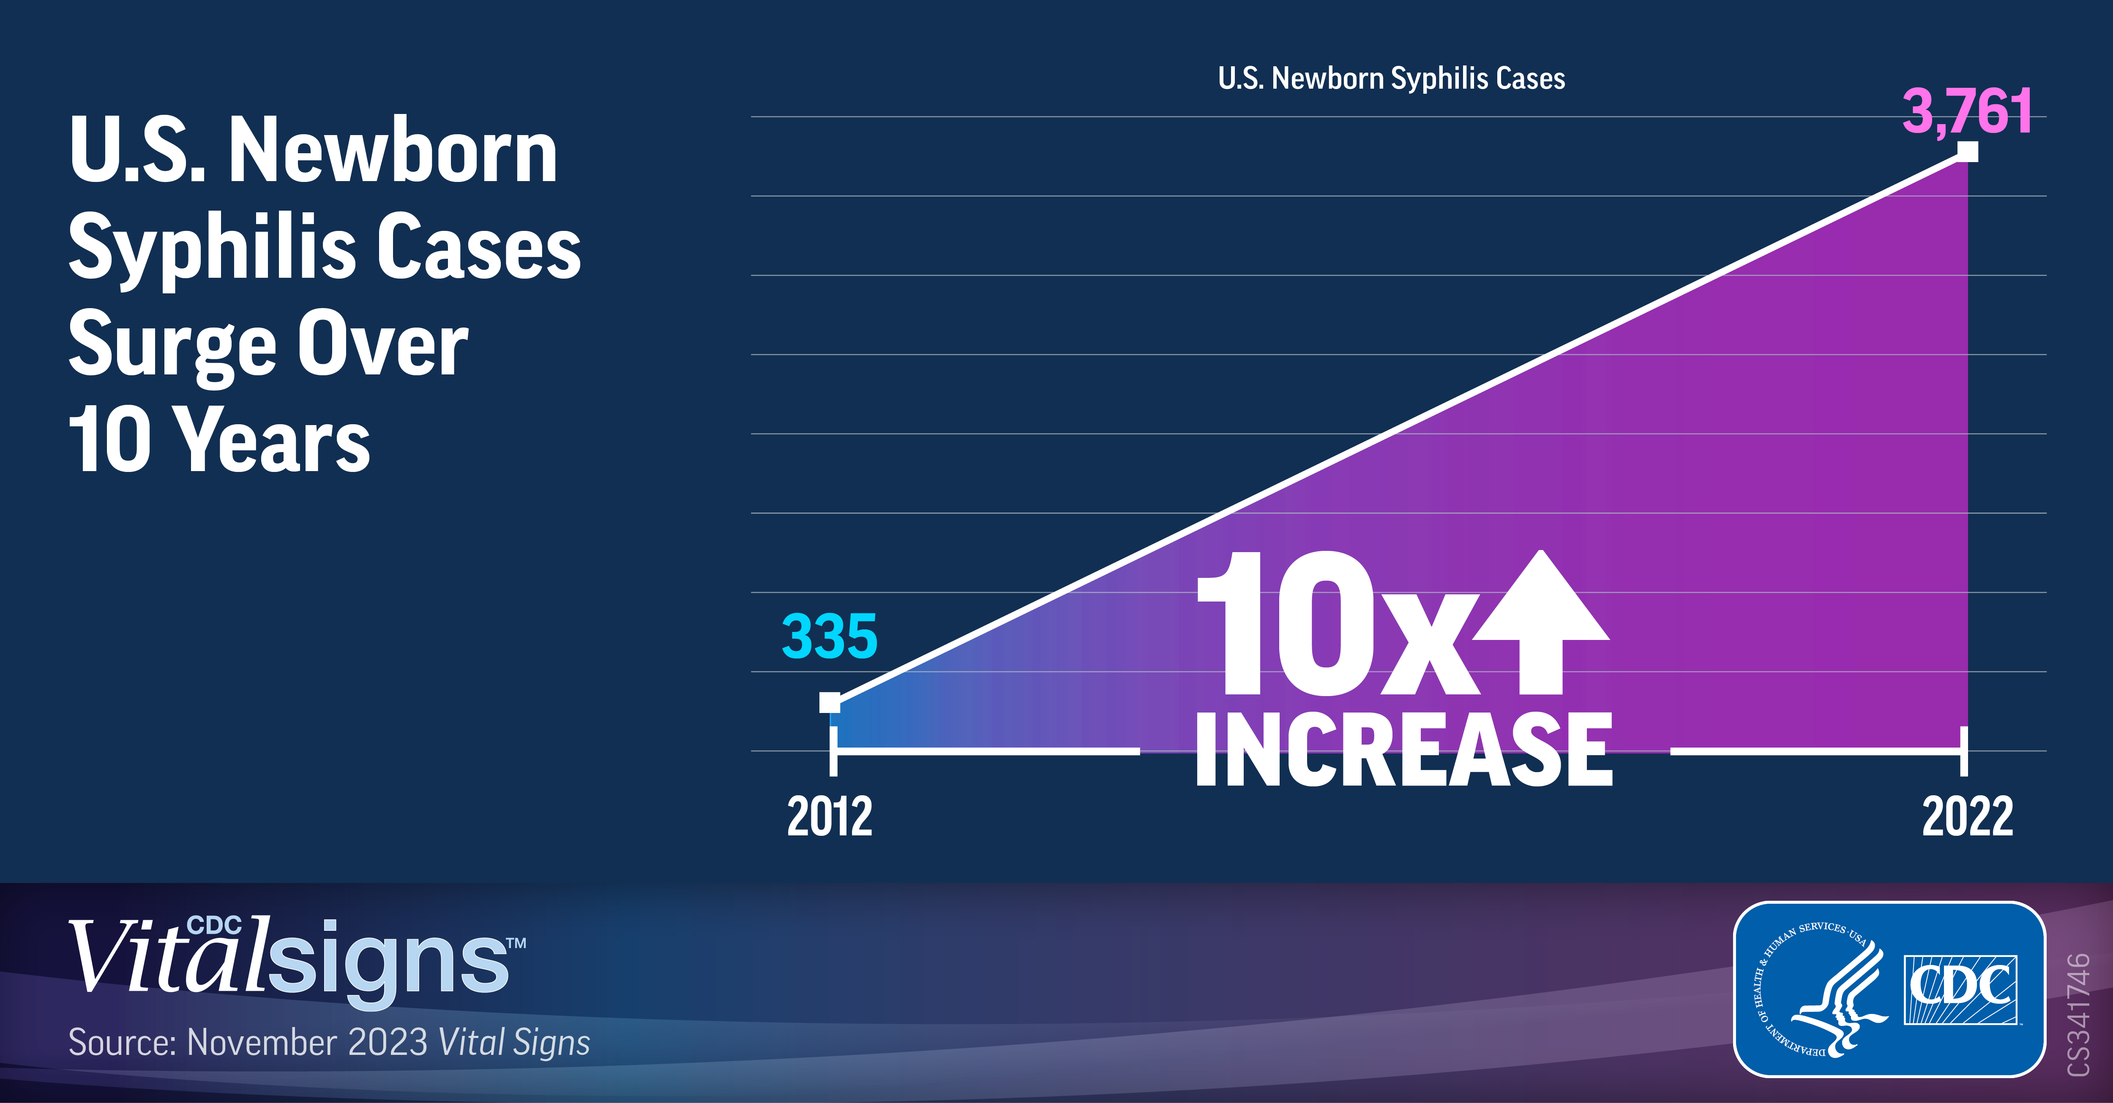

Slide 12
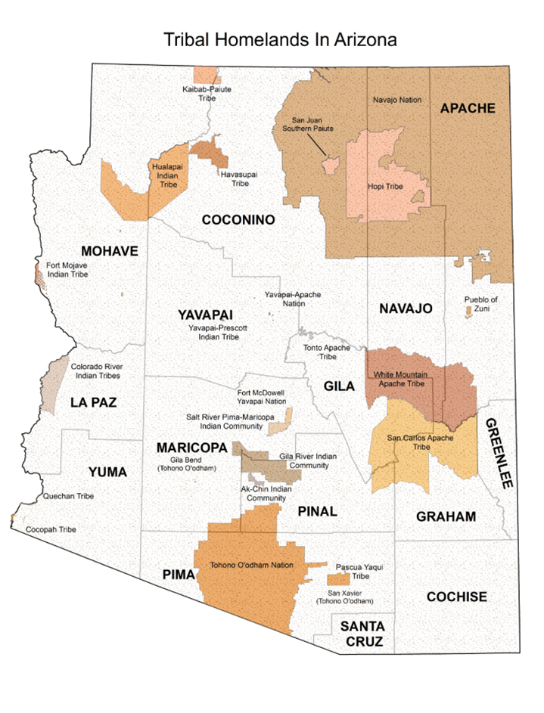
Arizona – STI Annual Report 2022, published 2024

Slide 13
Arizona – STI Annual Report 2022, published 2024
Syphilis increased 8% in 2022
Congenital syphilis increased 20% 2021 to 2022
Arizona had the 3rd highest rate of congenital
syphilis in the US in 2022 (281/100,000 live births
with US rate of 106/100,000)
32 deaths and 41 symptomatic of the 219 congenital
cases
Total Cases
Cases Among Women
Congenital Cases

Slide 14
Congenital Syphilis Case Counts, New Mexico, 2000 - 2024
100
90
80
70
60
50
40
30
20
 |  |  |  |  | 92
 |  |  |  | 76 | 74
 |  | 43 | 44
 | 26
10 10
² ₀ 1 ₀ 1 ² 1 1
Counts of Congenital Syphilis cases
10
5
6
7
5
4 4
3 3 3
0
2000 2001 2002 2003 2004 2005 2006 2007 2008 2009 2010 2011 2012 2013 2014 2015 2016 2017 2018 2019 2020 2021 2022 2023 2024
Year
After 7 years of increases in the number of CS cases, there was a 19.6% decrease from
2023 to 2024.
In 2023, New Mexico ranked 2nd in the nation for congenital syphilis rate.

Slide 15
Primary, Secondary, and Early Latent Syphilis Rates by Race/Ethnicity, NM, 2023 – 2024
2023
2024
140
123.9
120
100
80
Cases per 100,000 Population
65.6
61.3
60
50.1
45.9
40.9
40
27.6
20
12.0
16.0
17.2
0
American Indian/Alaska
Native
Asian or Pacific Islander
Black/African American
Hispanic
White, non-Hispanic

Slide 16
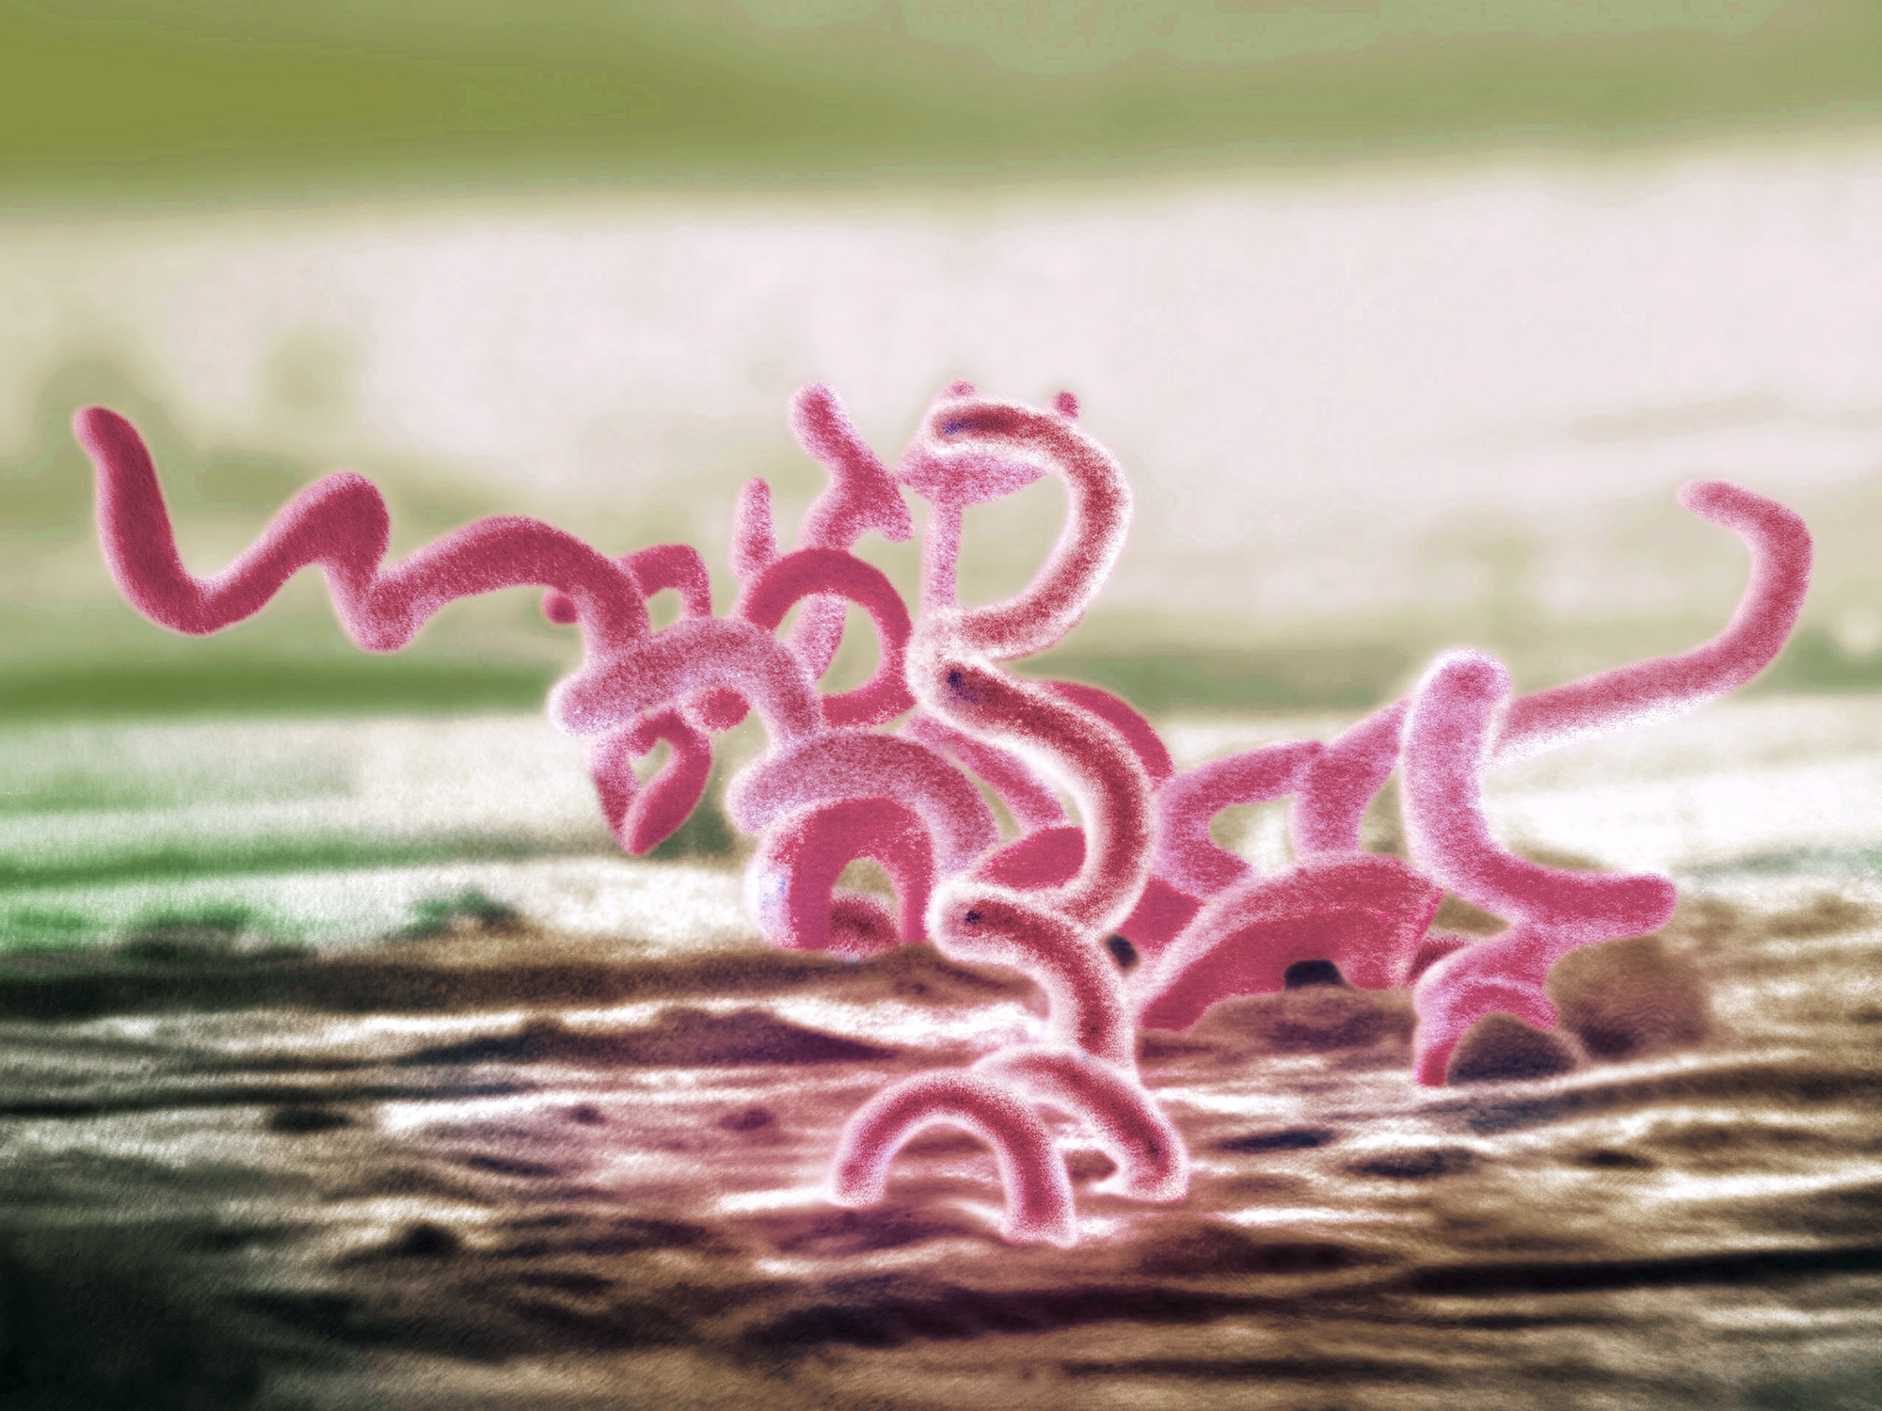
Syphilis
Treponema pallidum
Sexual, vertical, and horizontal transmission
Curable with penicillin
4 stages
Primary
Secondary
Early (non-primary, non-secondary)
Unknown duration or late
Notes:
Horizontal transmission is rare but can occur from blood transfusion or organ transplantation “Prior to the standard practice of using gloves by healthcare providers, there were reports of extragenital syphilitic lesions on the fingers and in the nose of physicians.^{12,39} In addition, the transmission of syphilis via human bite in both sexual and non-sexual circumstances has been reported,^{13–15} as well as transmission via mouth-to-mouth feeding of infants with pre-chewed food from infected relatives”
Stoltey JE, Cohen SE. Syphilis transmission: a review of the current evidence. Sex Health. 2015;12(2):103-109. doi:10.1071/SH14174
Tertiary syphilis is no longer consider a stage of syphilis rather the clinical signs are called “late”

Slide 17
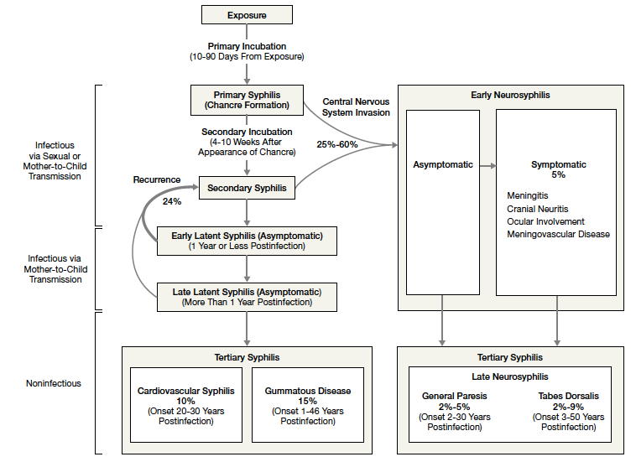
Natural History of Untreated Syphilis
Golden, MR et al JAMA 2003; 290(11) 1510-1514

Slide 18
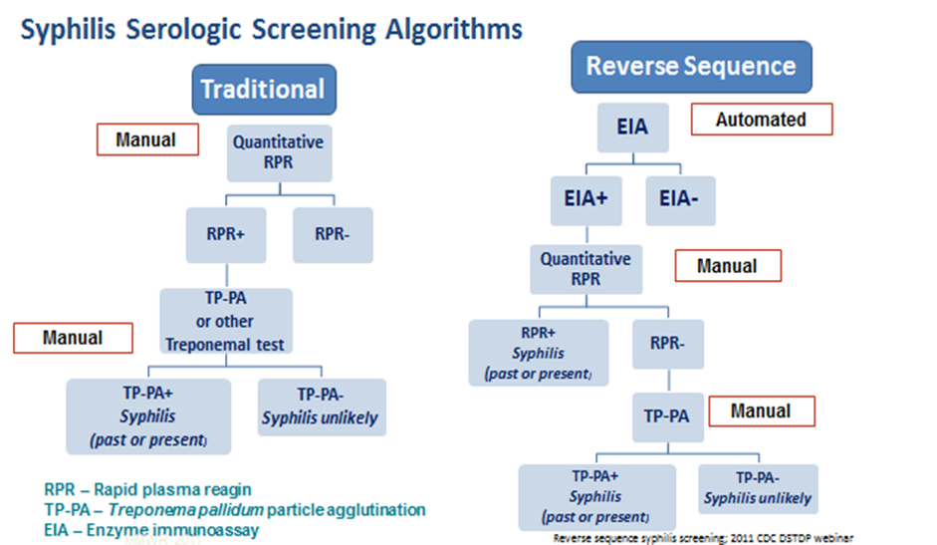
Serologic Diagnosis of Syphilis
ASI/AIX/BioPlex
Automated
190 test/hour
ASI/AIX/BioPLex
Automated
flocculation reader
190 test/hour
Chembio POC combination HIV 1/2 and TPPA FDA approved (2023). Syphilis Health Check POC TPPA previously FDA cleared.
ASI – Arlington Scientific Instrument, AIX – Gold Standard Diagnostics, BioPLex – Bio-Rad – all fast, low cost per test

Slide 19
Congenital Syphilis
Transmission follows placental infection with hematogenous spread to the fetus, or the baby can be infected by exposure to an active lesion during delivery.
The majority of congenital syphilis is asymptomatic.
It is rare for a fetus to show evidence of infected before 20 weeks gestation.
Infection can be transmitted during any stage of maternal disease but 60-100% of primary and secondary untreated cases result in transmission, while only 10-15% of late latent cases result in transmission.
Notes:
Horizontal transmission is rare but can occur from blood transfusion or organ transplantation “Prior to the standard practice of using gloves by healthcare providers, there were reports of extragenital syphilitic lesions on the fingers and in the nose of physicians.^{12,39} In addition, the transmission of syphilis via human bite in both sexual and non-sexual circumstances has been reported,^{13–15} as well as transmission via mouth-to-mouth feeding of infants with pre-chewed food from infected relatives”
Stoltey JE, Cohen SE. Syphilis transmission: a review of the current evidence. Sex Health. 2015;12(2):103-109. doi:10.1071/SH14174
Tertiary syphilis is no longer consider a stage of syphilis rather the clinical signs are called “late”

Slide 20
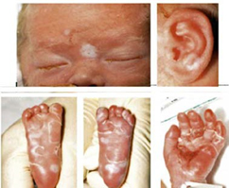
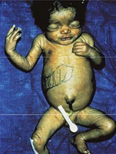
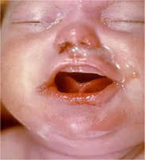
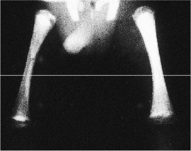
Clinical Manifestations of Congenital Syphilis (CS)

Slide 21
Syphilitic Stillbirth
Clinical case definition
A fetal death that occurs after a 20-week gestation OR in which the fetus weighs >500g AND the mother had untreated or inadequately treated* syphilis at delivery.
* Adequate treatment is defined as completion of a penicillin-based regimen, in accordance with CDC treatment guidelines, appropriate for stage of infection, initiated 30 or more days before delivery.
Comments: For reporting purposes, congenital syphilis includes:
cases of congenitally acquired syphilis among infants and children
syphilitic stillbirths

Slide 22
Scenario 1: Confirmed, proven or highly probable congenital syphilis | Scenario 2: Possible congenital syphilis | Scenario 3: Congenital syphilis less likely | Scenario 4: Congenital syphilis unlikely
Neonate with: a physical exam consistent with CS serum quantitative nontreponemal serology 4-fold greater than mother’s or a positive darkfield or PCR test of placenta, body fluids or positive silver stain of placenta or cord | Neonate with a normal physical exam and a serum quantitative nontreponemal serologic titer equal to or < 4-fold of the maternal titer at delivery and one of the following: • The mother was not treated, was inadequately treated, or has no documentation of treatment. • The mother was treated with erythromycin or a regimen not recommended in these guidelines • The mother received recommended regimen but treatment was initiated <30 days before delivery. | Neonate with a normal physical examination and a serum quantitative nontreponemal serologic titer equal or <4-fold of the maternal titer at delivery and both of the following are true: • The mother was treated during pregnancy, treatment was appropriate for the infection stage, and the treatment regimen was initiated ≥30 days before delivery. • The mother has no evidence of reinfection or relapse | Neonate with: a normal physical exam serum quantitative nontreponemal serology equal to or less than 4-fold mother’s at delivery and Mother’s treatment was adequate before pregnancy Mother’s nontreponemal titer remained low and stable before and during pregnancy and at delivery
Evaluation: CSF with VDRL, cell ct, protein, CBC/diff, long bone radiographs, neurologic eval (eye, auditory, imaging) | CSF analysis for VDRL, cell count, and protein** CBC, differential, long-bone radiographs | No evaluation is recommended | No evaluation is recommended
Treatment: Aqueous crystalline penicillin G 100,000–150,000 units/kg/body wt./day, administered as 50,000 units/kg body wt./dose IV q 12 hours during the first 7 days of life and q 8 hours thereafter for a total of 10 days OR Procaine penicillin G 50,000 units/kg body weight/dose IM in a single daily dose for 10 days | Treatment: Aqueous crystalline penicillin G 100,000–150,000 units/kg/body wt./day, administered as 50,000 units/kg body wt./dose IV q 12 hours during the first 7 days of life and q 8 hours thereafter for a total of 10 days OR Procaine penicillin G 50,000 units/kg body weight/dose IM in a single daily dose for 10 days (unavailable) OR Benzathine penicillin 50,000 units/kg body wt. single IM injection | Treatment: Benzathine penicillin G 50,000 units/kg body weight/dose IM in a single dose * Another approach involves not treating the newborn if follow-up is certain but providing close serologic follow-up every 2–3 months for 6 months for infants whose mothers’ nontreponemal titers decreased at least fourfold after therapy for early syphilis or remained stable for low titer, latent syphilis (VDRL <1:2 or RPR <1:4). | No treatment recommended Benzathine penicillin 50,000 units/kg body weight as a single IM injection might be considered, if follow-up is uncertain and the neonate has a reactive nontreponemal test. Neonates should be followed serologically to ensure the nontreponemal test returns to negative
https://www.cdc.gov/std/treatment-guidelines/default.htm

Slide 23
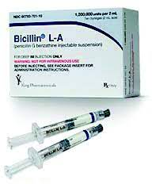
Treatment of syphilis: Overview
Stage
Primary | Secondary | Early non-primary, non secondary | Late Latent/ or Unknown Duration | Neurosyphilis, ocular syphilis and otosyphilis
Benzathine penicillin 2.4 million units IM in a single dose | Benzathine penicillin 2.4 million units IM in a single dose | Benzathine penicillin 2.4 million units IM in a single dose | Benzathine penicillin 2.4 million units total administered as 3 doses of 2.4 million units IM each at 1-week intervals | Aqueous crystalline penicillin G 18-24 million units per day, administered as 3-4 million units by IV every 4 hours or continuous infusion for 10-14 days Alternative: procaine penicillin G 2.4 million units IM 1x/day PLUS probenecid 500 mg orally 4x/day, both for 10-14 days
https://www.cdc.gov/std/treatment-guidelines/default.htm

Slide 24
Who should be screened for syphilis? US Preventive Services Task Force Grade A Recommendations
“The USPSTF recommends early screening for syphilis infection in all pregnant women”.
All pregnant women are at risk. All pregnant women should be tested for syphilis as early as possible when they first present to care. If a woman has not received prenatal care prior to delivery, she should be tested at the time she presents for delivery.
“The USPSTF continues to recommend screening for syphilis in nonpregnant persons who are at increased risk for infection”.
Population: Asymptomatic, nonpregnant adolescents and adults who are at increased risk for syphilis infection
JAMA 2025;333;(22):2006-2012. doi:10.1001/jama.2025.5009

Slide 25
Syphilis Screening Recommendation by the IHS Chief Medical Officer in 2022, reiterated in 2024
Recommends three-point screening in pregnancy – first prenatal visit, start of third trimester, at delivery
Annual syphilis testing for sexually active persons over the age of
An annual EHR reminder should be turned on at all sites to facilitate testing until incidence rates decrease locally to baseline
Adoption of an STI/HIV/Viral hepatitis testing bundle at all sites to screen broadly:
Syphilis screening test with reflex RPR and TPPA
Pregnancy test
Adoption of “Express Testing": On-demand, no-provider/no nurse, lab visits for testing, including the above bundle
Enhance screening rates by screening outside the hospital/clinic in the community
Field treatments for syphilis by PHNs with Benzathine Penicillin

Slide 26
Clinical Case
A pregnant woman in her mid-20s with no prenatal care presented at 40+ weeks gestation and gave birth to a 3200 gm baby, Apgar's 8/9. RPR two years prior was negative. Maternal RPR at delivery 1:16.
The baby had a normal physical exam, and RPR of 1:4. He was discharged with no further treatment.

Slide 27
How would you classify this child’s congenital syphilis status?
Confirmed congenital syphilis
Possible congenital syphilis
Congenital syphilis less likely
Congenital syphilis unlikely

Slide 28
How would you classify this child’s congenital syphilis status?
Confirmed congenital syphilis
Possible congenital syphilis
Congenital syphilis less likely
Congenital syphilis unlikely

Slide 29
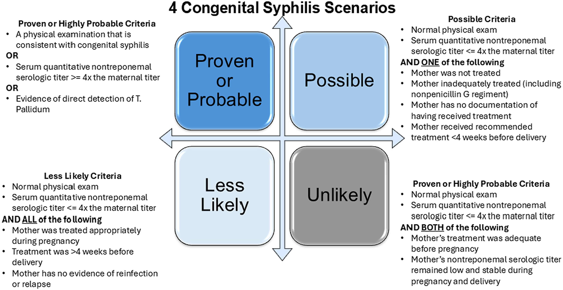
Clin Infect Dis, Volume 81, Issue 6, 15 December 2025, Pages 1023–1035, https://doi.org/10.1093/cid/ciaf504

Slide 30
How would you manage this child if you were the treating provider at the time of delivery?
No further evaluation is needed
Complete a laboratory evaluation which includes CBC with differential, long bone x-rays, CSF evaluation (VDRL, cells, protein)
Complete a laboratory evaluation which includes CBC with differential, long bone x-rays, CSF evaluation (VDRL, cells, protein) plus liver enzymes
Complete a laboratory evaluation which includes CBC with differential, long bone x-rays, CSF evaluation (VDRL, cells, protein) plus neurological evaluation (imaging, audiology, eye exam)

Slide 31
How would you manage this child if your were the treating provider at the time of delivery?
No further evaluation is needed
Complete a laboratory evaluation which includes CBC with differential, long bone x-rays, CSF evaluation (VDRL, cells, protein)
Complete a laboratory evaluation which includes CBC with differential, long bone x-rays, CSF evaluation (VDRL, cells, protein) plus liver enzymes
Complete a laboratory evaluation which includes CBC with differential, long bone x-rays, CSF evaluation (VDRL, cells, protein) plus neurological evaluation (imaging, audiology, eye exam)

Slide 32
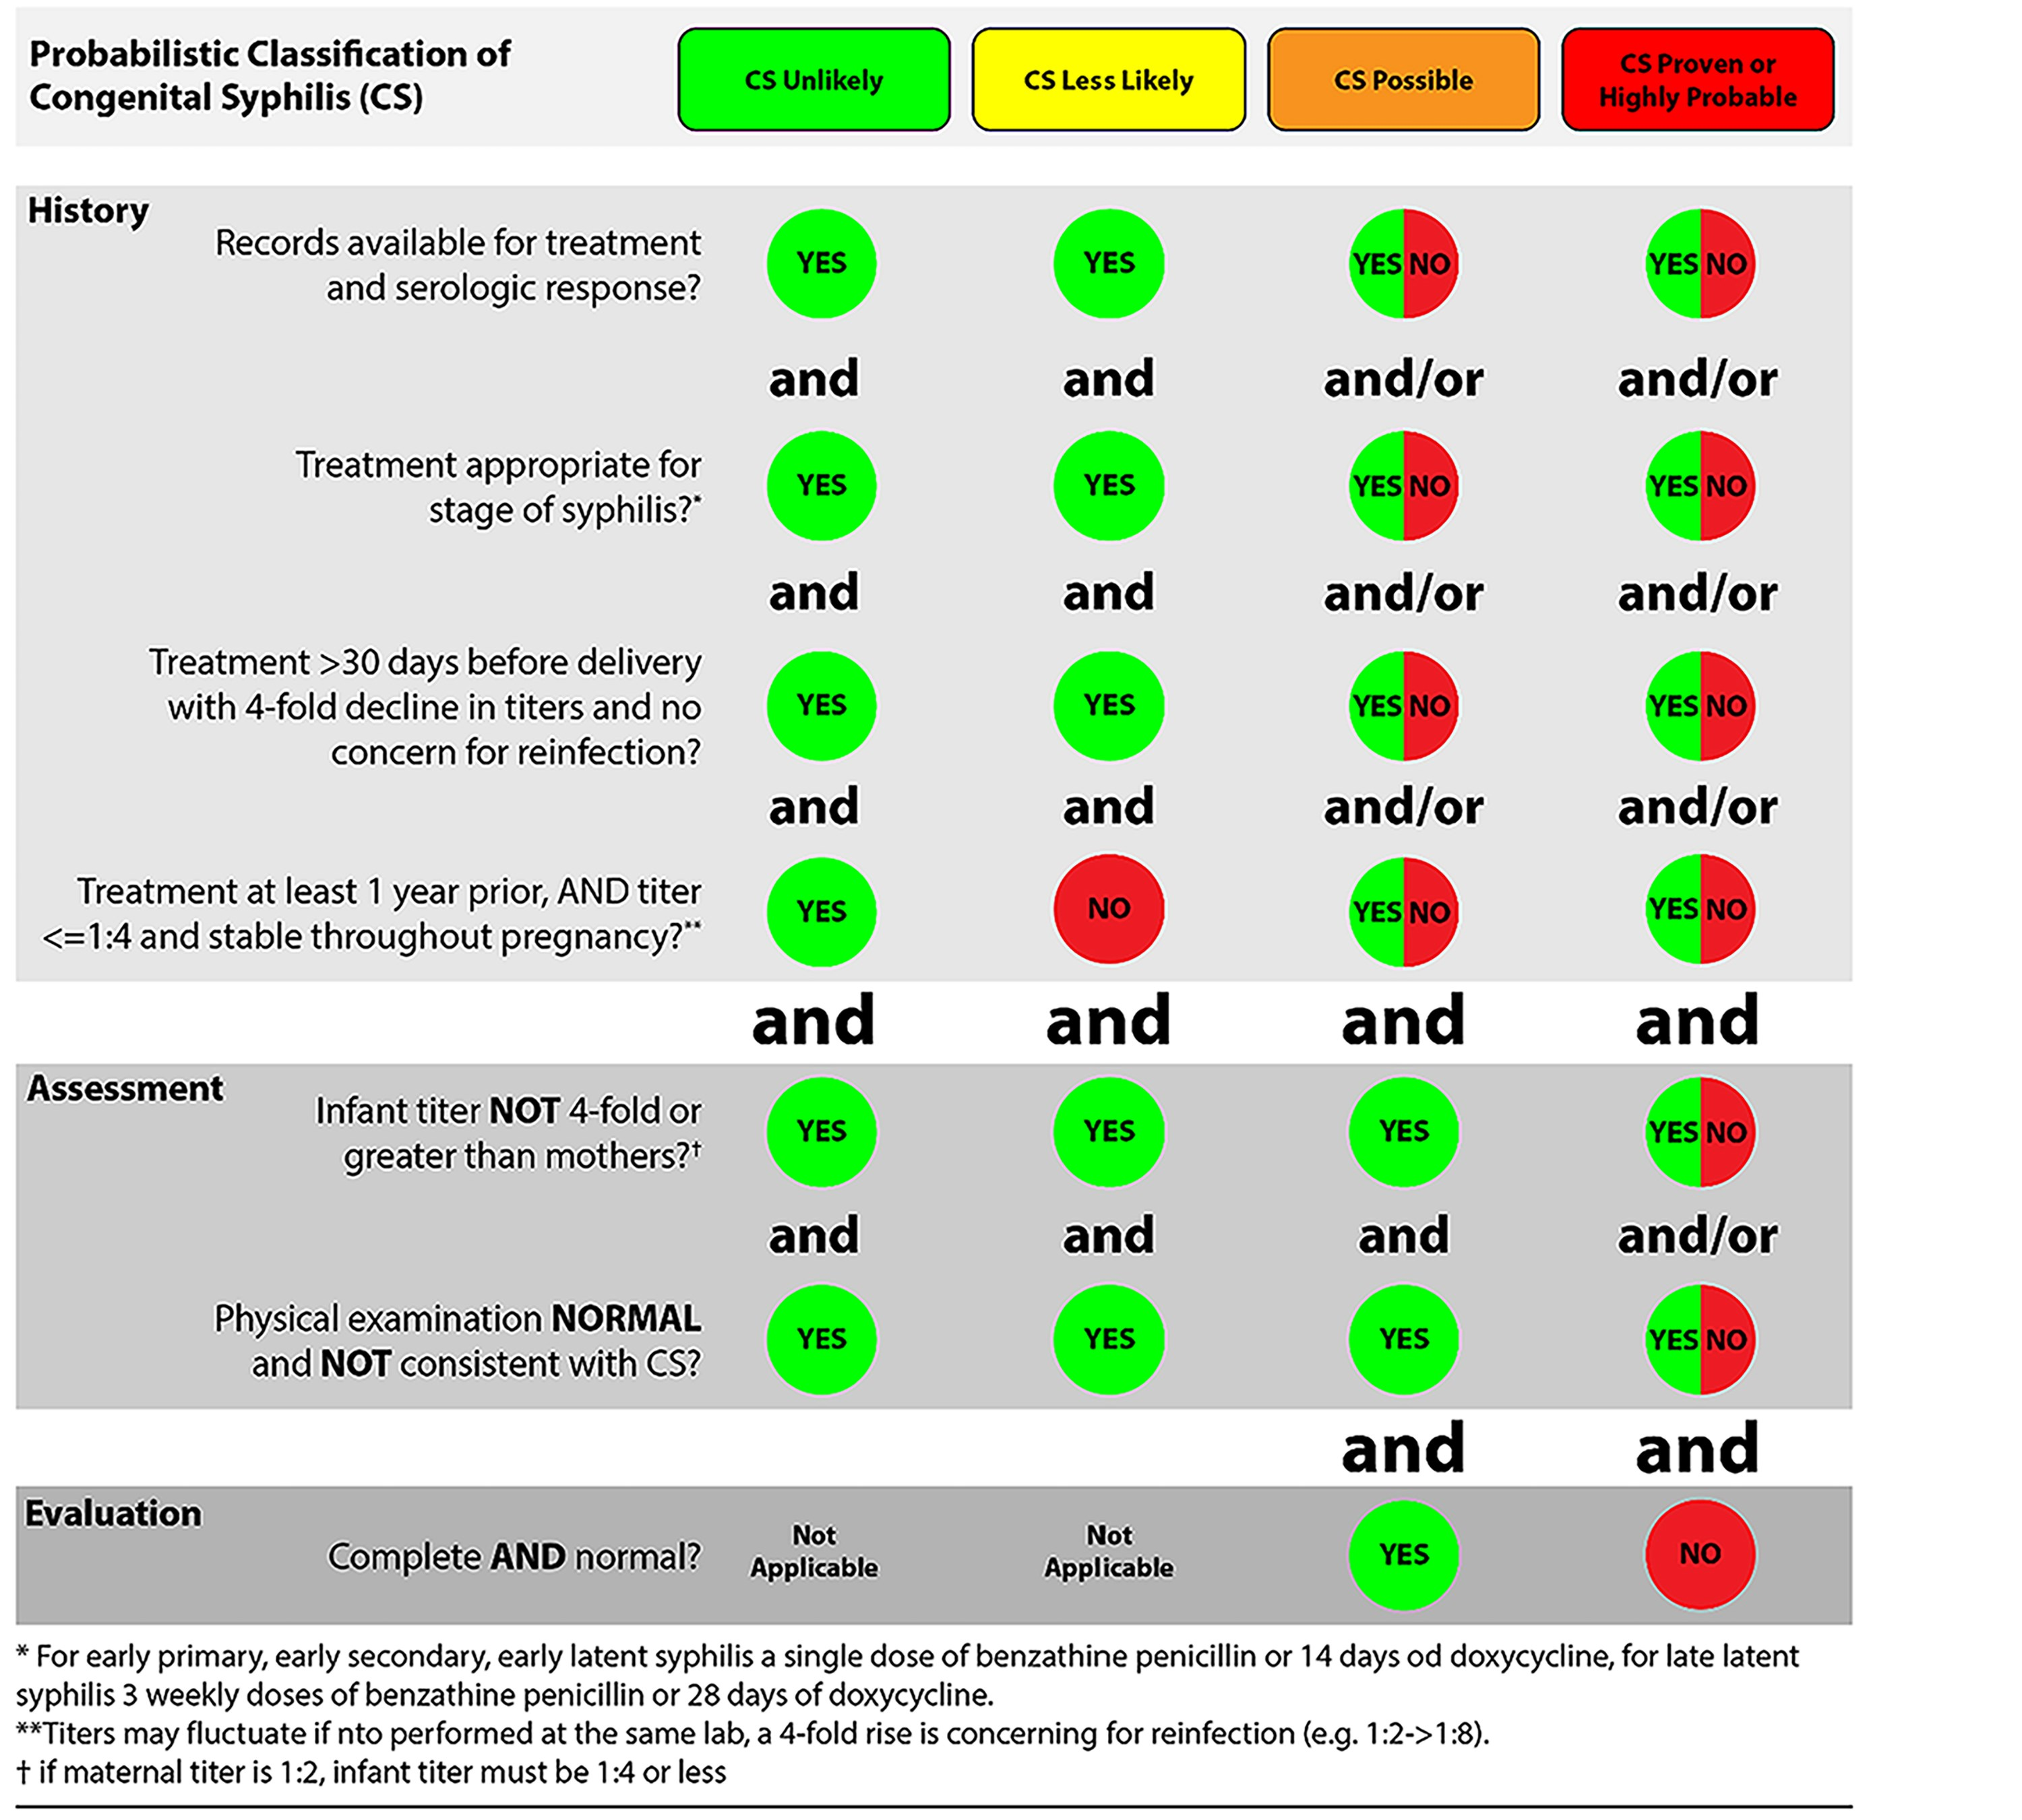
Clin Infect Dis, Volume 81, Issue 6, 15
December 2025, Pages 1023–1035,
https://doi.org/10.1093/cid/ciaf504

Slide 33
Assuming your completed newborn evaluation is normal, how would you treat the child?
With a normal evaluation no treatment is necessary
Aqueous crystalline penicillin G 100,000–150,000 units/kg/body wt./day, administered as 50,000 units/kg body wt./dose IV q 12 hours during the first 7 days of life and q 8 hours thereafter for a total of 10 days
Procaine penicillin G 50,000 units/kg body weight/dose IM in a single daily dose for 10 days
Benzathine penicillin 50,000 units/kg body wt. single IM injection

Slide 34
Assuming your completed newborn evaluation is normal, how would you treat the child?
With a normal evaluation no treatment is necessary
Aqueous crystalline penicillin G 100,000–150,000 units/kg/body wt./day, administered as 50,000 units/kg body wt./dose IV q 12 hours during the first 7 days of life and q 8 hours thereafter for a total of 10 days or
Procaine penicillin G 50,000 units/kg body weight/dose IM in a single daily dose for 10 days or
Benzathine penicillin 50,000 units/kg body wt. single IM injection

Slide 35
Outcome of Case
Date Age RPR Intervention
2/20 Birth 1:4 (Mat 1:16) Home without further work-up or treatment
3/5 2 weeks 1:4 Neg W/U (CBC, LFTs, Long bone x-ray, CSF); 170,000 U Benzathine PCN IM
3/30 5 weeks - Presents to ER fussy with desquamating rash. PCN 50,000 U/kg q 8hr x 10 days,
CSF VDRL NR
4/20 8 weeks 1:128 Post treatment RPR elevated but baby normal exam
6/25 16 weeks 1:8
2/10 1 year 1:1 Recommend re-evaluation and retreatment but tertiary center declined
Was this congenital syphilis? Yes
Was a single dose of IM benzathine penicillin appropriate at 2 weeks? Probably not
Why is the RPR still elevated at one year? Either a seropersistor of inadequately treated
Is it a treatment failure? Possibly

Slide 36
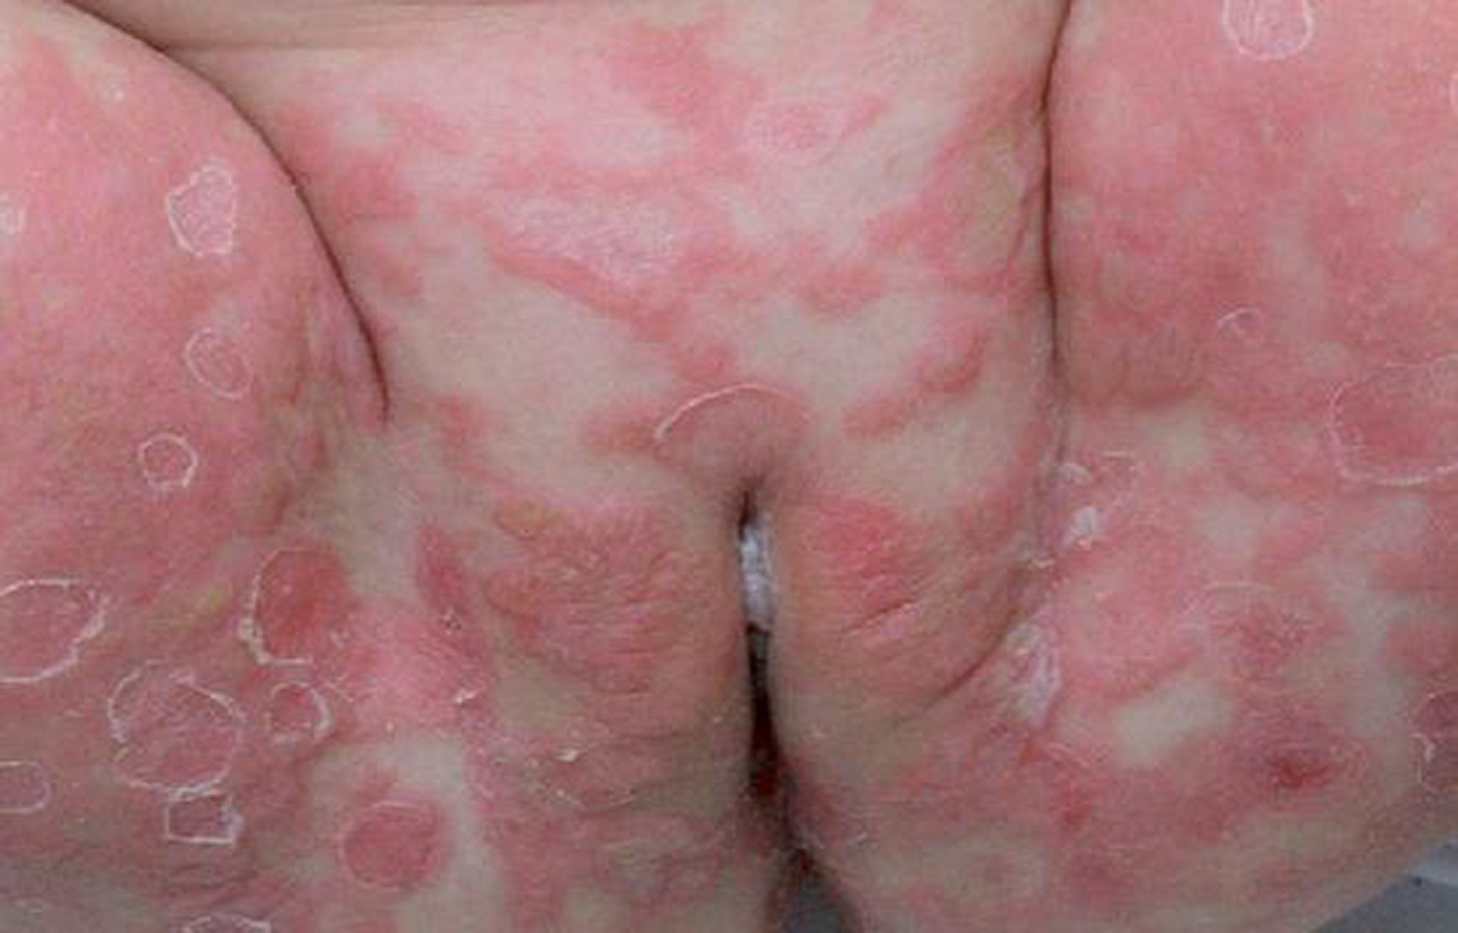

This is a picture of a perineal region of an infant with erythematous patches and superficial bullae and desquamation typical of congenital syphilis
Notes:
Figure 1. This is a picture of a perineal region of an infant with erythematous patches and superficial bullae and desquamations on the inguinal area. This was seen right after birth in an infant with symptomatic congenital syphilis [7].
Unless provided in the caption above, the following copyright applies to the content of this slide: © The Author(s) 2026. Published by Oxford University Press on behalf of Infectious Diseases Society of America. All rights reserved. For commercial re-use, please contact reprints@oup.com for reprints and translation rights for reprints. All other permissions can be obtained through our RightsLink service via the Permissions link on the article page on our site—for further information please contact journals.permissions@oup.com.This article is published and distributed under the terms of the Oxford University Press, Standard Journals Publication Model (https://academic.oup.com/pages/standard-publication-reuse-rights)

Slide 37
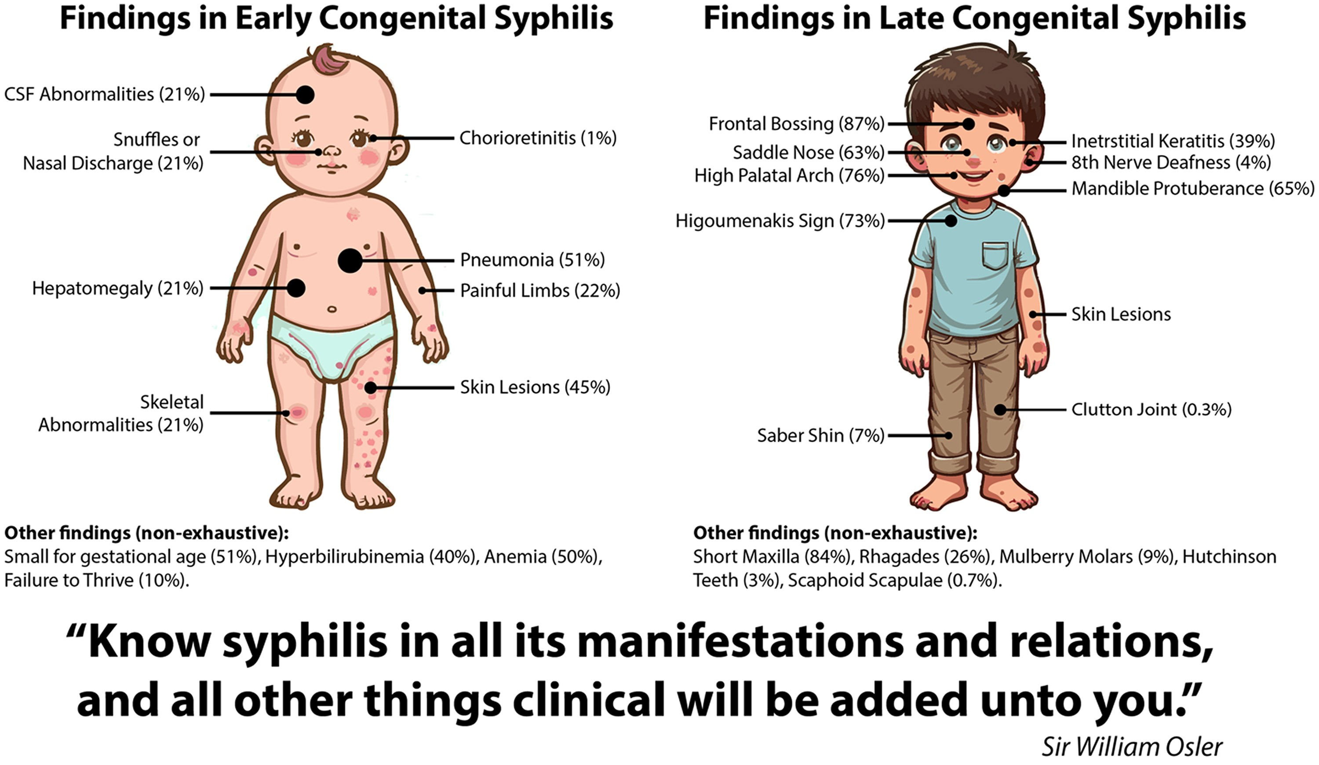
Clin Infect Dis, Volume 81, Issue 6, 15 December 2025, Pages 1023–1035, https://doi.org/10.1093/cid/ciaf504

Slide 38
Outcome of Case
Approximately 5% (8/147) of appropriately treated infants with congenital syphilis had persistent RPR beyond 6 months of age
Persistence beyond one year is considered uncommon
Persistence beyond 18 months warrants re-evaluation and probably re-treatment
Higher titers at time of diagnosis and treatment after age one month were associated with prolonged detection of RPR
Serologic Follow-up of Infants Exposed to Maternal Syphilis During Pregnancy. 2026.
https://pubmed.ncbi.nlm.nih.gov/41165318/

Slide 39
Clinical Case
23 yo pregnant female (G1P0) presents for her first prenatal visit. She denies symptoms other than morning sickness. Her EGA is 10 weeks
She has no other medical conditions. She is allergic to penicillin which causes throat swelling.
Her prenatal labs reveal a positive syphilis EIA and an RPR of 1:512. She denies recent symptoms of syphilis and she is no longer in contact with her sexual partner. Her last sexual encounter was 3 weeks ago.
She lives 40 miles away and used medical transport to get to clinic today.

Slide 40
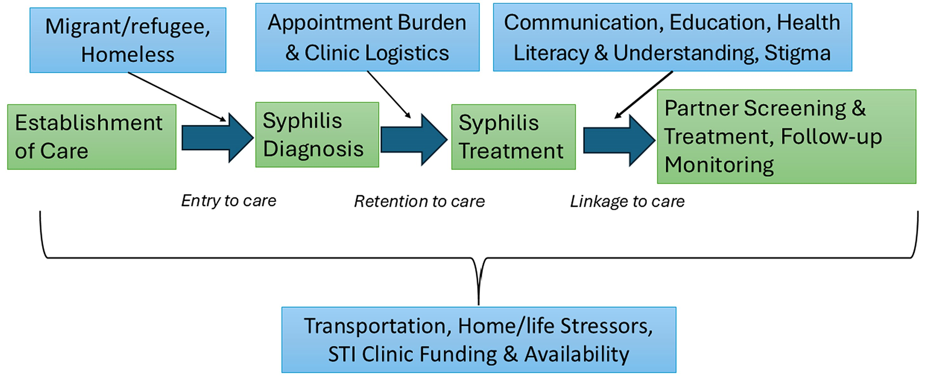
Green boxes refer to the steps along the CS care cascade [30–32]. The italicized text refers to the transitions phases – often areas where continuity breaks down
Notes:
Figure 2. Green boxes refer to the steps along the CS care cascade [30–32]. The italicized text refers to the transition phases along the CS care cascade. The top row and bottom row of boxes refer to various barriers to care along the CS care cascade (the middle row of boxes) that have been identified in previous research studies. Abbreviation: STI, sexually transmitted infections.
Unless provided in the caption above, the following copyright applies to the content of this slide: © The Author(s) 2026. Published by Oxford University Press on behalf of Infectious Diseases Society of America. All rights reserved. For commercial re-use, please contact reprints@oup.com for reprints and translation rights for reprints. All other permissions can be obtained through our RightsLink service via the Permissions link on the article page on our site—for further information please contact journals.permissions@oup.com.This article is published and distributed under the terms of the Oxford University Press, Standard Journals Publication Model (https://academic.oup.com/pages/standard-publication-reuse-rights)

Slide 41
What is the ideal clinical management for this patient with syphilis?
Administer benzathine penicillin 2.4 MU now as she is unlikely to be truly allergic to penicillin
Begin treatment with doxycycline 100 mg BID as an alternative regimen for treatment of syphilis since she is allergic to penicillin
Ask her to return to clinic at her convenience for penicillin desensitization and treatment
Admit her to the hospital for penicillin desensitization followed by the first injection of benzathine penicillin 2.4 MU of a 3 weekly dose series
Retest her for syphilis as test results may be false positive since she is pregnant

Slide 42
What is the ideal clinical management for this patient with syphilis?
Administer benzathine penicillin 2.4 MU now as she is unlikely to be truly allergic to penicillin
Begin treatment with doxycycline 100 mg BID as an alternative regimen for treatment of syphilis since she is allergic to penicillin
Ask her to return to clinic at her convenience for penicillin desensitization and treatment
Admit her to the hospital for penicillin desensitization followed by the first injection of benzathine penicillin 2.4 MU of a 3 weekly dose series
Retest her for syphilis as test results may be false positive since she is pregnant

Slide 43
Penicillin Allergy
Patients often are incorrectly labeled as allergic to penicillin
Evaluate what symptoms were experienced by patients with reported penicillin allergy
Penicillin allergy causing anaphylaxis is rare
In studies that have incorporated penicillin skin testing and graded oral challenge among persons with reported penicillin allergy, the true rates of allergy are low, ranging from 1.5% to 6.1%.
Allergies wane over time:
Approximately 80% of patients with a true IgE-mediated allergic reaction to penicillin have lost the sensitivity after 10 years
Desensitization is recommended for pregnant women diagnosed with syphilis followed by treatment with penicillin.
https://www.cdc.gov/std/treatment-guidelines/STI-Guidelines-2021.pdf . Page

Slide 44
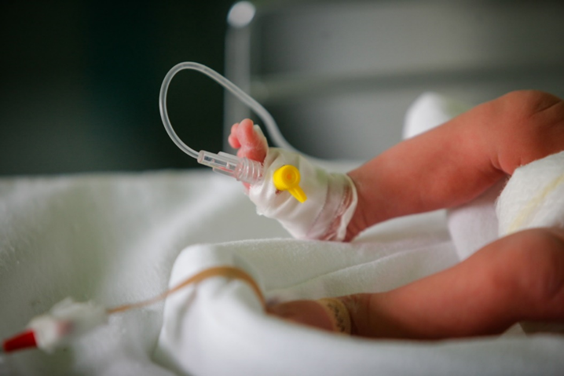
Maternal Screening for Syphilis
All pregnant women should be tested for syphilis early in pregnancy at the first prenatal visit or at the time of pregnancy confirmation
In high prevalence areas or who are at high individual risk*, retesting at 28 weeks and delivery is recommended. High-risk* pregnant women should be screened at delivery
No mother or baby should be discharged from the hospital without documentation of maternal syphilis testing (during pregnancy and/or delivery)
Women who experience a fetal death at ≥20 weeks should be tested for syphilis
*Examples of high risk: multiple prior STIs, recent incarceration, substance misuse, homelessness, transactional sex

Slide 45
Clinical Considerations for Syphilis Outbreak Response
Expand syphilis case finding
Expand syphilis screening to populations at risk
Health facility- Emergency departments, OB/GYN, primary care, behavioral health
**(Consider Test-only Visits)
Community-based – schools, community events, corrections, work/school physicals
Implement screening reminders in E H Rs, automated order sets, and customized treatment orders for syphilis and other STIs
Ensure 3-time point syphilis screening during pregnancy/delivery in high-prevalence settings or among high-risk populations
Test women with syphilis for pregnancy
Notes:
Consider corrections and school screening

Slide 46
Public Health Considerations for Syphilis Outbreak Response
Provide prompt, stage-based treatment of cases and sexual partners
Link providers and case managers to public health investigative staff for effective disease intervention and community prevention (case investigation with identification and treatment of sexual partners)
Provide presumptive treatment of (1) symptomatic persons and (2) sexual partners of cases
Ensure access to prompt treatment (either health facility or field-based) using designated case management pathways
Endeavor to identify patients with early syphilis which requires only one injection of benzathine penicillin
Repeat day of treatment RPR if most recent test is >6 days old
Clinical consultative “rounds” to share and discuss case staging and treatment

Slide 47
Southern Arizona Syphilis Outbreak, 2007-2009
Johnson M, et al. Syphilis Outbreak Among American Indians --- Arizona, 2007–2009. MMWR Morb Mortal Wkly Rep. 2010 February 19; 59(6): 158–161

Slide 48

Southern Arizona Syphilis Response
Identification of syphilis, HIV, chlamydia, and gonorrhea screening program on the reservation to include:
Clinic- and hospital-based screening of all persons aged 12–55 years receiving health care (including pregnant women),
Screening of all incarcerated adults and juvenile detainees,
Screening of students at seven high schools and of youths at six social events,
Screening of workers at two worksites, and door-to-door screening in seven of the reservation’s 11 districts.
Case investigation and clinical management of sexual partners
Community awareness campaign
Johnson M, et al. Syphilis Outbreak Among American Indians --- Arizona, 2007–2009. MMWR Morb Mortal Wkly Rep. 2010 February 19; 59(6): 158–161

Slide 49
Whiteriver Service Unit
Educational sessions for clinical staff
Updated EHR reminders for all patients over 13 years of age (age stratified)
Initiated POC TPPA testing – Field, pharmacy, community events
Automated RPR implemented with ordering of RPR for all ER and Inpatients (opt-out) who had a blood draw (age appropriate and based upon time since last RPR). ~8,800 persons screened to date (approximately 500 RPRs per month)
Door-to-door campaign (POC TPPA) with the White Mountain Apache Tribe
PHN field delivery of IM PCN
Updated PCN allergy desensitization protocol
Updated standing orders and initiated ‘golden ticket testing’

Slide 50
Whiteriver Service Unit
Changed to reverse algorithm,
leading to an increase in identified
persons with remote infections

Slide 51
16 Countries/Territories validated by WHO for the Elimination of Mother-to-Child Transmission of HIV and/or syphilis
2015
Cuba
2016
Thailand
Belarus
Moldova (Syphilis only)
Armenia
(HIV only)
2017
Anguilla
Antigua & Barbuda
Bermuda
Cayman Islands
Monserrat
St Kitts & Nevis
2018
2019
2020
Malaysia
Maldives
Sri Lanka
2021
Oman
Dominica
Global guidance on criteria and processes for validation: elimination of mother-to-child transmission of HIV, syphilis and hepatitis B virus (who.int)
https://www.who.int/initiatives/triple-elimination-initiative-of-mother-to-child-transmission-of-hiv-syphilis-and-hepatitis-b/validation
Notes:
Here are the countries that have achieved validation. Cuba was the first. Thailand was the only country with a generalized epidemic to be validated. 2018, Malaysia became the first WPRO country to be validated. To date, 15 countries have been validated for having maintained criteria for EMTCT of HIV and/or syphilis. Many countries in the pipeline for validation of EMTCT or on Path to Elimination including countries in the AFRO region.

Slide 52
Provider Education Resources
CDC STI Treatment Guidelines: https://www.cdc.gov/std/treatment-guidelines/default.htm
Indian Country Infectious Disease ECHO: www.IndianCountryECHO.org
CDC STI Prevention Training: https://www.cdc.gov/sti/php/training/index.html
University of Washington STI CME sessions: https://www.std.uw.edu/
California Prevention Training Center Online: https://www.stdhivtraining.org/online_courses.html
Johns Hopkins STI Prevention Training: https://www.stdpreventiontraining.com/
New York City STI/HIV Prevention Training Center: https://www.nycptc.org/
CDC STI Surveillance: https://www.cdc.gov/sti-statistics/annual/index.html
CDC STI Hotline: https://www.cdc.gov/sti/index.html

Slide 53
Some thoughts on the future
Two very large retrospective cohort
reviews (n=18,027 and n=761) suggest
one dose of Benzathine PCN may
be sufficient for all stages of syphilis.
Doxycycline (n=3017) seemed to work
as well as 3 dose of BPG.

Slide 54

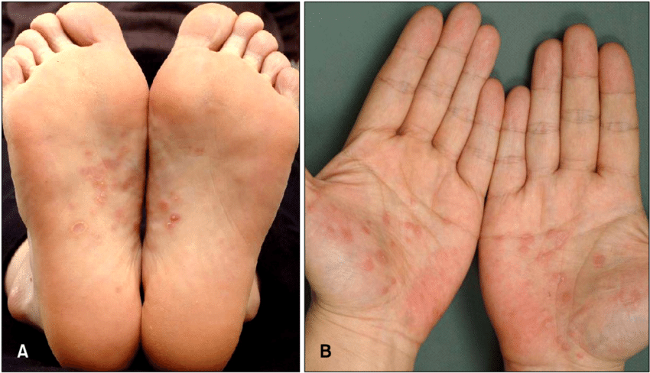
.
Where is the wisdom we have lost in knowledge? Where is the knowledge we have lost in information?
- T.S. Eliot The Rock
Notes:
With high turnover of staff, some Indian Health Facilities may need to ensure that new staff are trained on local epidemiology, STI diagnosis and management of syphilis and other STIs.

