Slide 1


Self-Care: Avoiding Secondary Trauma and Burnout - Part 2: A Deeper Dive How to use the 8 Dimensions of wellness through a cultural lens
Presenters:
Anna Winters, CPRC, RCPF
Tracy Madden, CPRC, CPRM, RCPF

Slide 2

Mino Bimaadziwin
To Live In A Good Way

Slide 3
Land acknowledgement
We honor and pay our respects to the land on which we live and work, which was violently stolen through colonialism, genocide, and forced removal of its traditional stewards. These stewards are the Anishinaabek, the Council of the Three Fires which include the Odawa, Ojibwe, and Bodewadmi, also known as Ottawa, Chippewa, and Potawatomi Tribes.

Slide 4
Labor acknowledgement
We also acknowledge the people of African descent who were forcibly removed from their land and separated from their families through kidnapping and enslavement and pay reverence and respect to them for building this country's infrastructure and economy with no compensation or reparations to date.

Slide 5
Objectives
Reinforce Key Concepts of Secondary Trauma and Burnout: Review these concepts and reflect on how they continue to impact your life journey and professional service delivery.
Apply the 8 Dimensions of Wellness Through a Cultural Lens: Explore how the 8 Dimensions of Wellness align with the 7 Grandfather Teachings and how these teachings guide balanced self-care in daily life and professional practice.
Strengthen Personal Self-Care Practices: Review/refine your self-care approach and recommit to sustainable strategies that prevent secondary trauma and burnout and promote long-term well-being.

Slide 6
Acknowledgements
Mid State Health Network
Michigan Department of Health and Human Services
Indian Country ECHO

Slide 7
Large Group Discussion
Why is self care a critical concern for
Prevention, Recovery, and other Health Care service providers?
Why have a presentation focused on self care?

Slide 8
Recap: Secondary Trauma Definition/Symptoms
Secondary trauma, also called vicarious trauma or compassion fatigue, happens when people are indirectly affected by hearing about or working with those who have experienced trauma. This can impact professionals like counselors, therapists, social workers, recovery coaches, pharmacists, healthcare providers, and others who support trauma survivors.
Signs of secondary trauma might include:
Feeling Drained: You’re emotionally exhausted after sessions, overwhelmed by traumatic stories.
Intrusive Thoughts: You can’t stop thinking about the person’s trauma, even during off hours.
Sleep Issues: Struggling to sleep because you're worried about the situations the people are presenting to you.
Anxiety: Feeling constantly anxious about a person’s well-being or upcoming sessions.
Irritability: Becoming easily frustrated, especially when dealing with a person’s problems.
Numbness: Feeling emotionally detached and finding it hard to empathize.
Avoidance: Avoiding certain people or situations because the emotional burden is too much.
Physical Symptoms: Experiencing stress-related physical issues like headaches or stomach problems.

Slide 9
Recap: Burnout Definition/Symptoms
In any helping field burnout happens when a provider becomes extremely tired and overwhelmed from the emotional demands of their work. This exhaustion can lead to a drop in motivation and effectiveness, making it harder for the provider to help the people they serve. It’s important for the provider to recognize and address burnout to stay effective and take care of their own well-being.
Signs of burnout might include:
Feeling Drained: Constantly tired and having little energy left after sessions.
Loss of Empathy: Struggling to connect with recoverees or feeling indifferent to their progress.
Negative Attitude: Becoming cynical or feeling like your efforts don’t matter.
Difficulty Focusing: Making more mistakes or feeling less effective in your work.
Physical Issues: Experiencing headaches, stomach problems, or ongoing fatigue.
Irritability: Getting easily frustrated with participants or colleagues.
Isolation: Withdrawing from others and feeling alone in your work.
Losing Passion: No longer feeling the same joy or purpose in helping others.

Slide 10
Self Caring for Prevention, Recovery, & Health Care Providers RECAP: Why Prioritize self care?
Energy
Focus
Availability
Compassion capacity
Role modeling
Capability
Credibility
Hope
Avoid return to active illness

Slide 11
Self Caring for Prevention, Recovery, & Health Care Providers 8 Dimensions of Wellness
Physical Wellness - Exercise, nutrition, sleep
Environmental Wellness - Safe and healthy environment
Spiritual Wellness - Purpose, values, beliefs
Emotional Wellness - Stress management, emotional expression
Intellectual Wellness - Learning, problem-solving
Occupational Wellness - Job satisfaction, work-life balance
Social Wellness - Relationships, social support
Financial Wellness - Budgeting, financial stability

Slide 12
Self Caring for Prevention, Recovery, & Health Care Providers 7 Grandfather Teachings
The Seven Grandfather Teachings are core Anishinaabe (Ojibwe) guiding principles for living a balanced "good life" (mino-bimaadiziwin).
They are:
Wisdom (Nibwaakaawin)
Love (Zaagi'idiwin)
Respect (Manaaji'idiwin)
Bravery (Aakde'ewin)
Honesty (Gwekwaadziwin)
Humility (Dbaadendizwin)
Truth (Debwewin)
These, often represented by animals, must be applied together to live ethically.
When we care for ourselves in balanced ways, we actively practice Love, Respect, Bravery, Truth, Honesty, Humility, and Wisdom, not just toward others, but toward ourselves.

Slide 13
Self Caring for Prevention, Recovery, & Health Care Providers 7 Grandfather Teachings as it applies to 8 dimensions of wellness
1. Physical Wellness Caring for your body through movement, rest, nourishment, and medical care • Love - Feeding and resting your body is an act of love toward the spirit that lives within it. • Respect - You honor your ancestors by caring for the body they passed down. • Wisdom - Listening when your body says “slow down.” • Bravery - Seeking medical or mental health support when needed. Neglecting your body is not strength. Caring for it is. 2. Emotional Wellness Understanding and regulating your feelings • Honesty - Naming what you truly feel instead of suppressing it. • Truth - Acknowledging when you are overwhelmed or hurting. • Bravery - Setting boundaries even when it feels uncomfortable. • Love - Offering yourself compassion instead of criticism. Emotional awareness is a form of courage.

Slide 14
Self Caring for Prevention, Recovery, & Health Care Providers 7 Grandfather Teachings as it applies to 8 dimensions of wellness
3. Social Wellness Nurturing healthy relationships and community • Respect - Choosing relationships that are mutual and safe. • Humility - Accepting help when you need it. • Love - Showing up authentically in community. • Wisdom - Knowing when to step back from harmful dynamics. Healthy connection reflects balanced living. 4. Spiritual Wellness Living with purpose, values, and connection to Creator • Truth - Walking in alignment with your values. • Humility - Recognizing you are part of something greater than yourself. • Wisdom - Seeking guidance through prayer, ceremony, or reflection. • Love - Honoring the sacredness of your life. Spiritual wellness keeps the other dimensions aligned.

Slide 15
Self Caring for Prevention, Recovery, & Health Care Providers 7 Grandfather Teachings as it applies to 8 dimensions of wellness
5. Intellectual Wellness Engaging in growth and lifelong learning • Wisdom - Seeking knowledge with discernment. • Humility - Understanding you do not know everything. • Bravery - Challenging your own assumptions. • Truth - Being open to learning what is uncomfortable. Growth is a responsibility. 6. Occupational Wellness Finding purpose and balance in your work • Respect - Setting boundaries around your labor. • Honesty - Admitting when you are burned out. • Bravery - Advocating for sustainable workload or fair treatment. • Love - Serving others without abandoning yourself. Work should not cost you your wellbeing.

Slide 16
Self Caring for Prevention, Recovery, & Health Care Providers 7 Grandfather Teachings as it applies to 8 dimensions of wellness
7. Environmental Wellness Creating safe, healthy surroundings • Respect - Caring for the land and your physical space. • Humility - Recognizing the land sustains you. • Wisdom - Placing yourself in environments that support your nervous system. • Love - Creating beauty and calm where you live and work. Environment shapes spirit. 8. Financial Wellness Managing resources responsibly • Wisdom - Planning for the future. • Honesty - Being truthful about your financial reality. • Bravery - Seeking guidance or making changes when needed. • Respect - Treating resources as sacred, not disposable. Financial balance supports generational stability.

Slide 17
Self Caring for Prevention, Recovery, & Health Care Providers 7 Grandfather Teachings as it applies to 8 dimensions of wellness
The Deeper Connection Practicing self-care across these eight dimensions is not self-indulgence - it is living the teachings daily. When you: • Rest, you practice Love. • Set boundaries, you practice Respect. • Seek help, you practice Humility. • Speak your needs, you practice Truth. • Admit your limits, you practice Honesty. • Take hard steps toward healing, you practice Bravery. • Learn and grow, you practice Wisdom. Balanced wellness is walking the teachings in action.

Slide 18

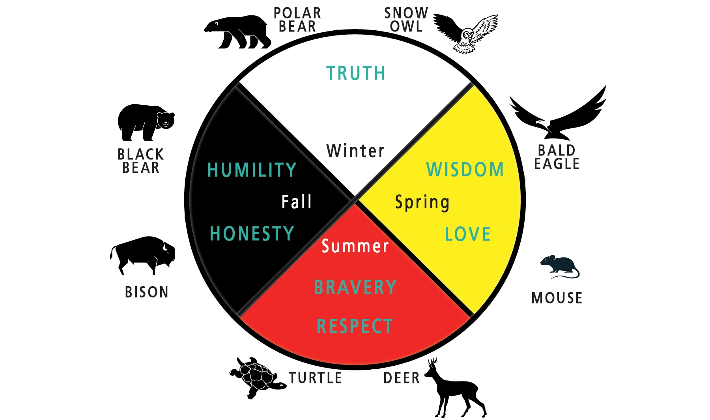

The 7 Grandfather Teachings
_________
The Medicine Wheel

Slide 19

Recap: Holistic
Start Anywhere – The Medicine Wheel
MENTAL
PHYSICAL
SPIRITUAL
EMOTIONAL

Slide 20
Recap: Creating a Self-Care Plan
A self-care plan is a simple, personalized guide to help you take care of yourself. It includes activities that keep you healthy, happy, and balanced. It can help you manage stress and stay well by regularly doing things that make you feel good and feel good about yourself.
Identify Stress Points: Think about what stresses you out or drains your energy.
Set Basic Goals: Pick a few simple goals, like exercising, getting enough sleep, or setting work hours.
Build a Routine: Add a few activities to your daily routine, like short breaks, morning meditation, or evening relaxation.
Focus on Wellness: Exercise regularly, eat well, and stay connected with friends.
Set Boundaries: Decide on clear work hours and make sure to have personal time.
Find Support: Talk to a mentor or connect with peers for advice and support.
Check In Weekly: Once a week, review how your plan is going and adjust if needed.

Slide 21
RECAP: Self Care Accountability Partner
A Self-Care Accountability Partner:
Offers support through regular check-ins
Gives encouragement during challenges
Participates in goal-related activities
Your Self-Care Accountability Partner:
Doesn’t have to be in the workplace
Can be a family member or close friend
Encourage partnership with other Providers

Slide 22
Other Self Care Ideas
Quiet Meditation/Reflecting
Yoga
Exercise
Ceremonies (ie., Smudging, Talking Circles, Drumming)
Laughter Yoga (google it!)
Spending time with family/friends
Getting haircut/hair done or nails done
Massage
Music
Reading a good book
Forest Bathing (Shinrin-Yoku)

Slide 23
Closing Thought
This, I believe, is incontrovertible. Our primary ethical imperative may be to care for others, but this imperative is meaningless, empty, if divorced from the imperative to care for oneself.
I must care for :
My hands, if I am to lift the fallen;
My heart, if I am to love the lonely;
My mind, if I am to cure the ill;
My eyes, if I am to find the lost;
And my soul, if I am to guide them home.
No matter how it is conceived – philosophically, theologically, psychologically – the imperative to care for others is always already an imperative to care for myself.
-Craig Irvine

Slide 24
Q & A
What other questions, comments, thoughts do you have?

Slide 25
Summary and Close
Strengthen Personal Self-Care Practices: Review and reflect on your personal self-care—intentional actions that support physical, emotional, and mental well-being—to identify and refine strategies that prevent burnout and secondary trauma in both personal and professional life.
Let’s Review!
Reinforce Key Concepts of Secondary Trauma and Burnout: Review these concepts and reflect on how they continue to impact your life journey and professional service delivery.
Apply the 8 Dimensions of Wellness Through a Cultural Lens: Explore how the 8 Dimensions of Wellness align with the 7 Grandfather Teachings and how these teachings guide balanced self-care in daily life and professional practice.
Strengthen Personal Self-Care Practices: Review/refine your self-care approach and recommit to sustainable strategies that prevent burnout and promote long-term well-being.

Slide 26
Peer 360 Recovery Alliance
For more information about Peer 360 Recovery Alliance
Visit our website:
www.peer360recovery.org

