Slide 1
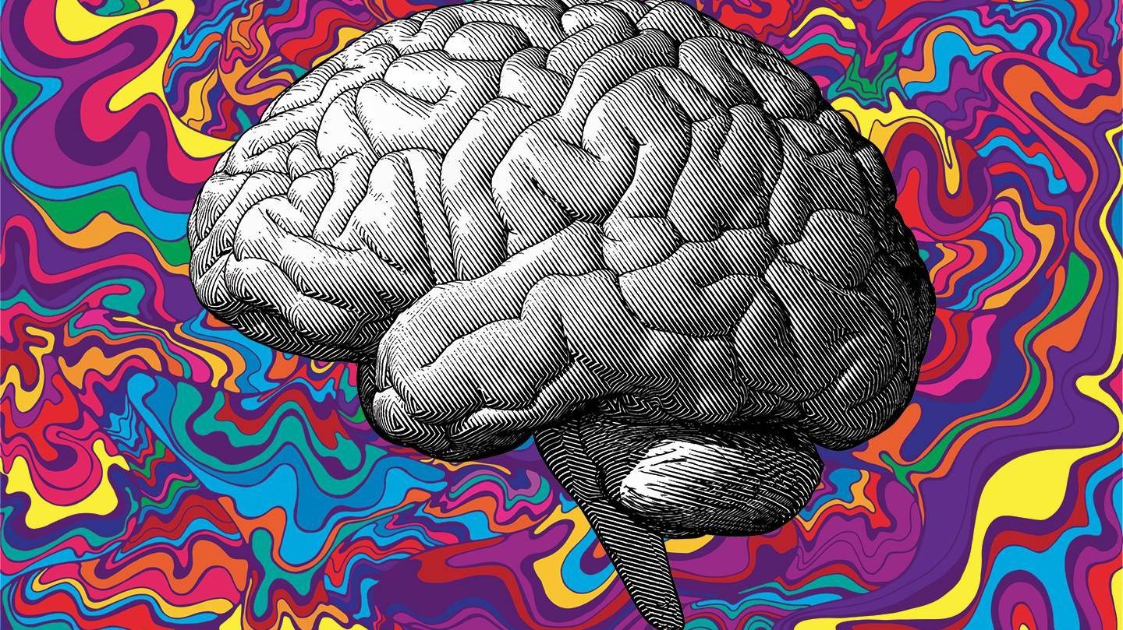
Psychedelics for Addiction and
Mental Health Treatment
© Kathleen Schachman, PhD, PMHNP-BC
Fellow, International Academy of Addictions Nursing

Slide 2
Disclaimers
The drugs mentioned in this presentation are not FDA-approved for the treatment of psychiatric disorders. Exception:
  Intranasal esketamine (Spravato) for treatment-resistant depression in conjunction with other antidepressants. (2019)
Many of the drugs mentioned in this presentation are controlled substances and highly regulated by the DEA
Many of the drugs mentioned in this presentation are illegal to manufacture/grow, buy, sell, possess and use

Slide 3
Objectives
Trace how the use of psychedelics to treat addiction and mental health conditions has evolved over time.
Describe brain changes that occur in individuals with addiction and mental health conditions, and how those changes are impacted by psychedelics.
Identify research that is currently underway to examine the safety and efficacy of psychedelic-assisted psychotherapy for the treatment of addiction and mental health conditions.
Explore legal and ethical issues surrounding the use of psychedelic-assisted psychotherapy for the treatment of addiction and mental health conditions.

Slide 4

Why Learn About Psychedelics?
Your patients may already be taking psychedelics
Emerging therapy that has the potential to improve mental health conditions and addictions
  Current pharmaceutical approaches are less than ideal– poor efficacy, intolerable side effects
  Development pipeline for MH pharmaceuticals quiescent since 1990’s

Slide 5

What are Psychedelics?
Psychedelics are psychoactive substances that can alter perception, mood, and cognitive processes.
Classic hallucinogens: LSD, psilocybin, mescaline, DMT
Dissociative agents: Ketamine
Plant: Psilocybin, ayahuasca, DMT, and mescaline
Synthetic: LSD, Ketamine
Animal: Bufo toad, (5-MeO-DMT)
Serotonin: LSD, psilocybin, MDMA, mescaline, DMT
NMDA: Ketamine
DRUG CLASSIFICATION
SOURCE
RECEPTOR

Slide 6
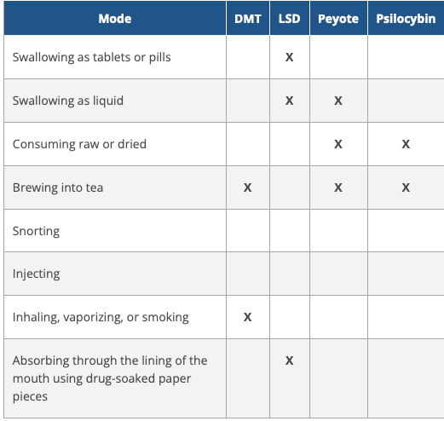


How Are Psychedelics Consumed?

Slide 7

Q: What happens in the brain with psychedelics?
A: Decreased activity in Default Mode Network (DMN)
Default mode = “brain at rest”
Daydreaming, self-reflection, thinking about past or future
Create autobiographical self
Overactivity associated with depression, anxiety, addiction: impaired self-awareness, negative ruminations, pre-occupation with drug use
Other things that ↓DMN activity: acupuncture, meditation, hypnosis

Slide 8
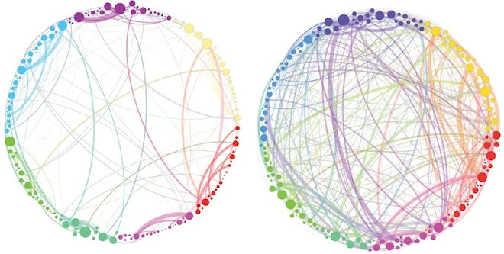
Q: What happens when DMN activity is suppressed?
A: Lots of “cross-talk” (new connections) in the brain!
Usual lines of communication w/in brain radically reorganized
Novel connections →new ideas, fresh perspectives, creative insights, or the ascribing of new meanings to familiar things
Enduring structural changes (?)
  ↑ number of neuronal connections
  ↑ neuronal density (neurons are larger)
de Vos, C. et al. (2021). Psychedelics and neuroplasticity: A systematic review unraveling the biological underpinnings of psychedelics. Frontiers in Psychiatry, 12, 724606.
“Normal Waking Consciousness”
PSILOCYBIN
Carhart-Harris, R. et al. (2017). Psilocybin for treatment-resistant depression: fMRI-measured brain mechanisms. Science Reports, 7, 13187.

Slide 9

Shaking the Snow Globe
Negative thought patterns are disrupted → greater flexibility and interconnectedness within the brain → opportunities to craft new narratives and develop new insights!

Slide 10


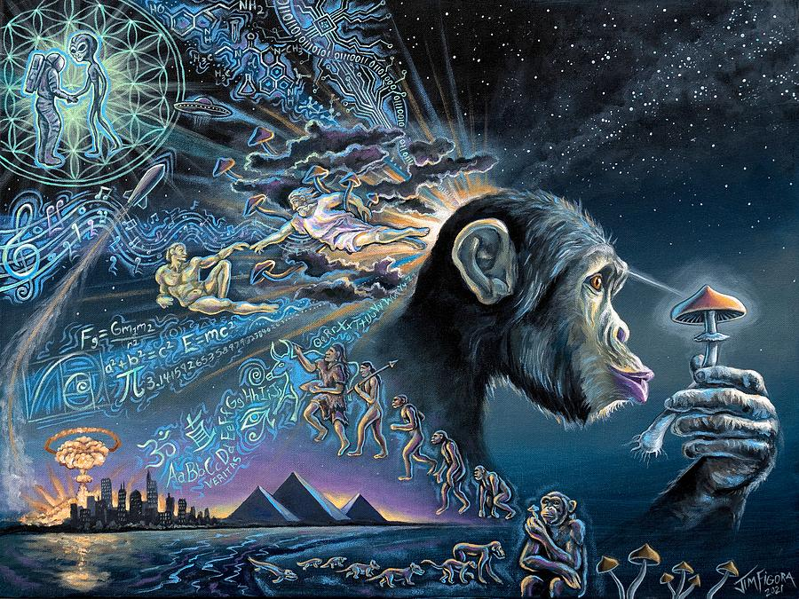

Psychedelic History: Pre-Historic Times
”Stoned Ape Theory” (T. McKenna)

Slide 11

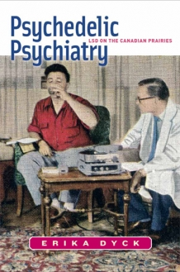
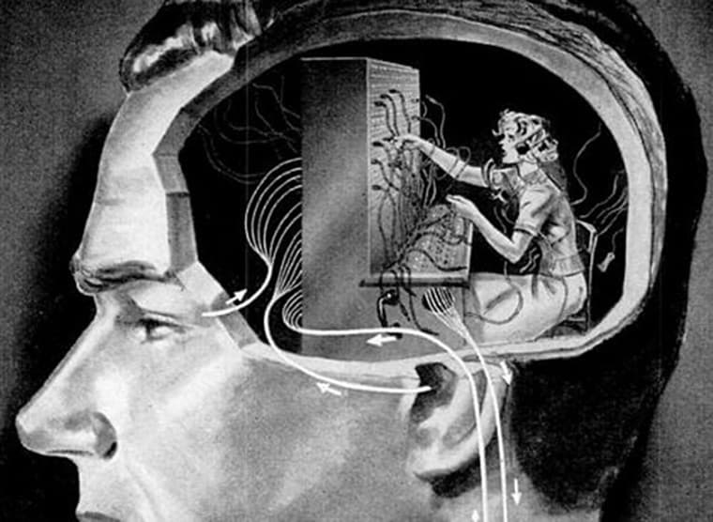

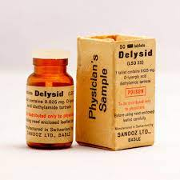
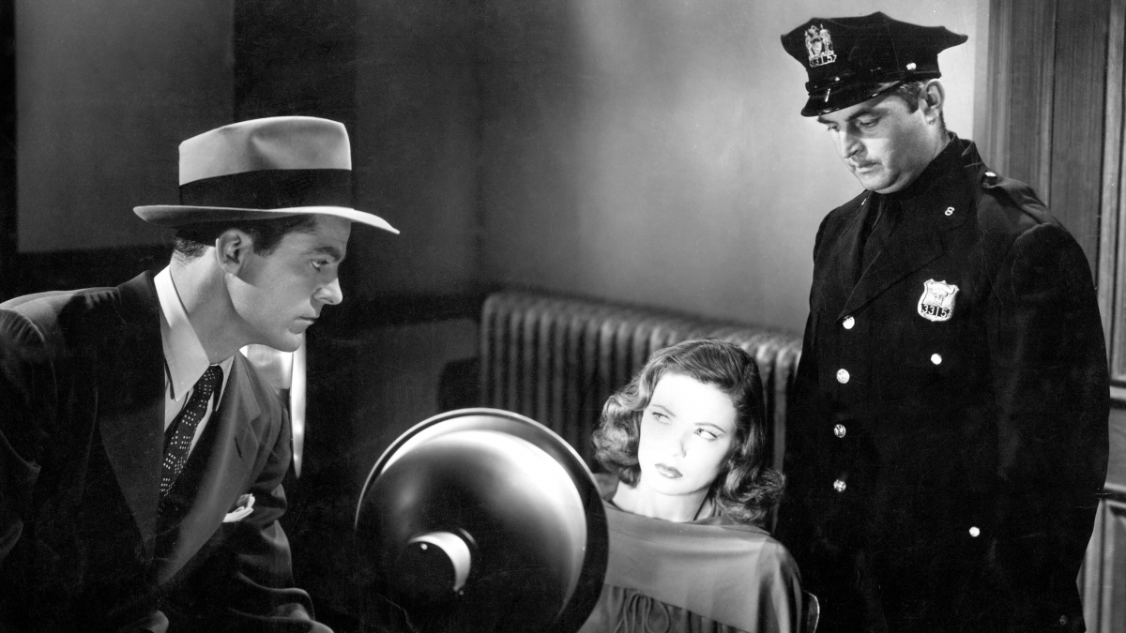
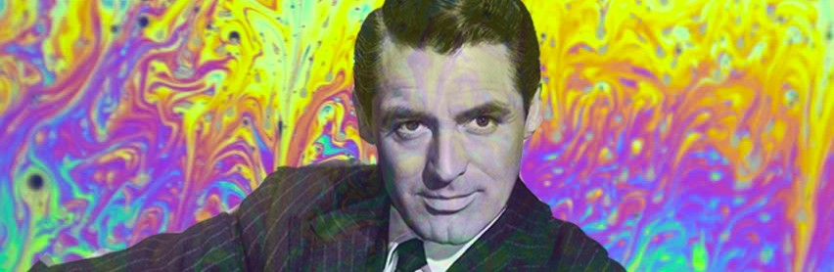
Psychedelic History
1945-1965

Slide 12

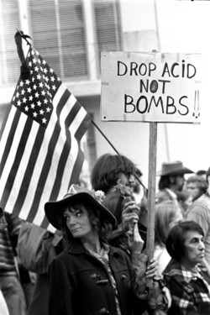
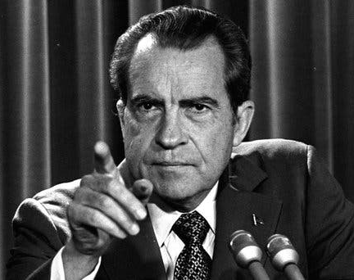

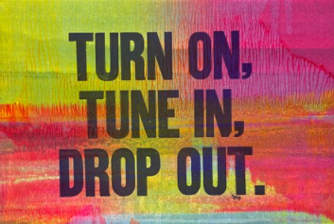


Psychedelic History
1965-1975
Controlled Substance Act of 1971

Slide 13
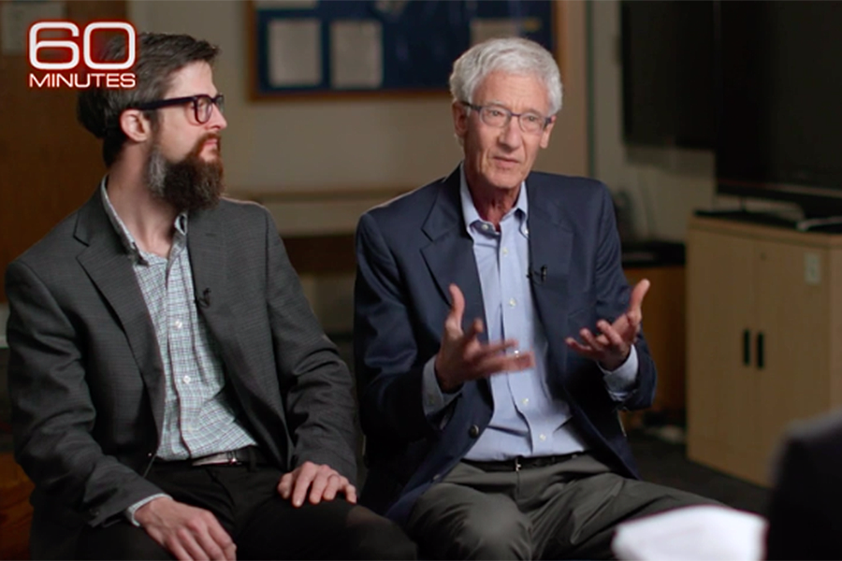

Psychedelic History: Present Day
Research re-emerges in early 2000s
Growing mainstream acceptance
2019: FDA approval of intranasal esketamine (Spravato)
MDMA & psilocybin: late-stage trials
  MDMA: FDA declined approval (2024)
  Psilocybin: Breakthrough Therapy designation

Slide 14
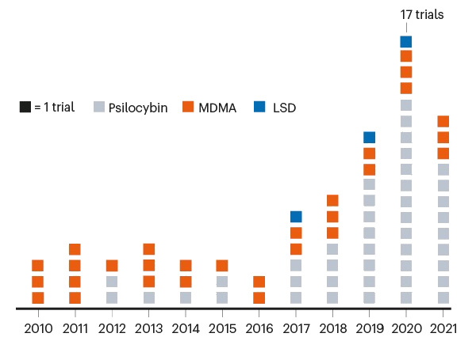
Which Psychedelics Are Being Studied?
Notes:
https://www.nature.com/articles/d41586-021-00187-9

Slide 15
Brief Overview of Recent Scientific Studies
Mystical experiences in healthy individuals on psilocybin
Treating PTSD with MDMA-assisted therapy
Effects of psilocybin on end-of-Life depression and anxiety
Enduring effects of psilocybin on treatment-resistant depression
Smoking cessation abstinence rates on psilocybin
As of 2026, the body of high-quality evidence on psychedelic therapy remains relatively small and more, larger studies are needed to reliably show the effectiveness and safety of psychedelic therapy's various forms and applications.

Slide 16
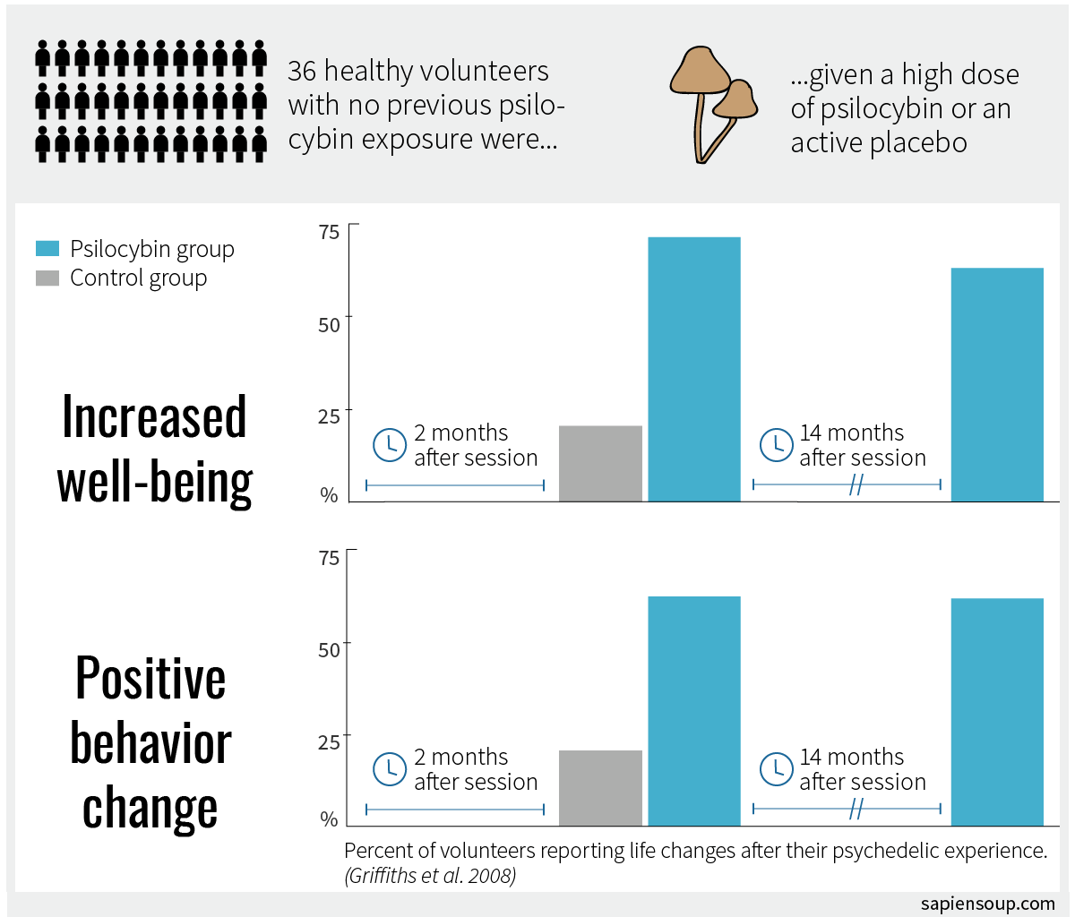
Griffiths, R., et al. (2008). Mystical-type experiences occasioned by psilocybin mediate the attribution of personal meaning and spiritual significance 14 months later. Journal of Psychopharmacology, 22(6):621-632.
Notes:
Griffiths RR, Richards WA, Johnson MW, et al. Mystical-type experiences occasioned by psilocybin mediate the attribution of personal meaning and spiritual significance 14 months later. Journal of psychopharmacology (Oxford, England). 2008;22(6):621-632.

Slide 17
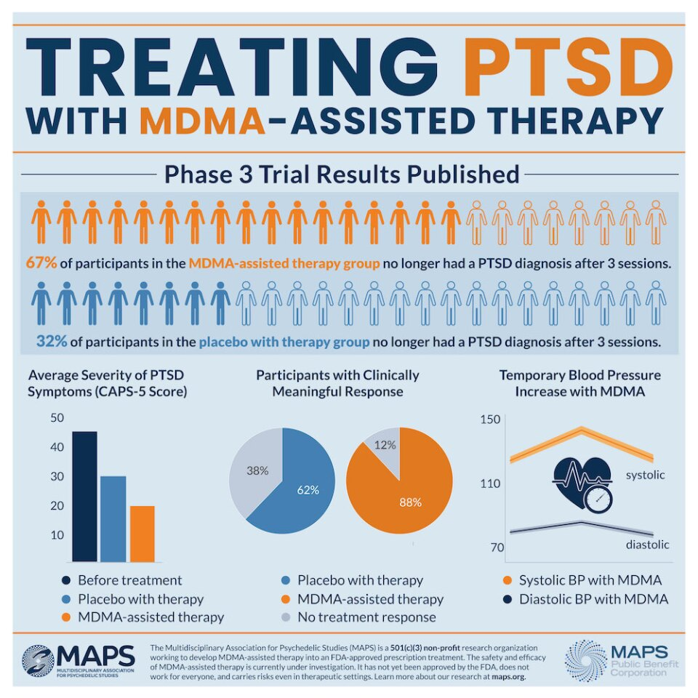

Mitchell, J.M., Bogenschutz, M., Lilienstein, A. et al. (2021). MDMA-assisted therapy for severe PTSD: a randomized, double-blind, placebo-controlled phase 3 study. Nature Medicine, 27, 1025–1033.
Notes:
Mitchell, J.M., Bogenschutz, M., Lilienstein, A. et al. (2021). MDMA-assisted therapy for severe PTSD: a randomized, double-blind, placebo-controlled phase 3 study. Nature Medicine, 27, 1025–1033.

Slide 18
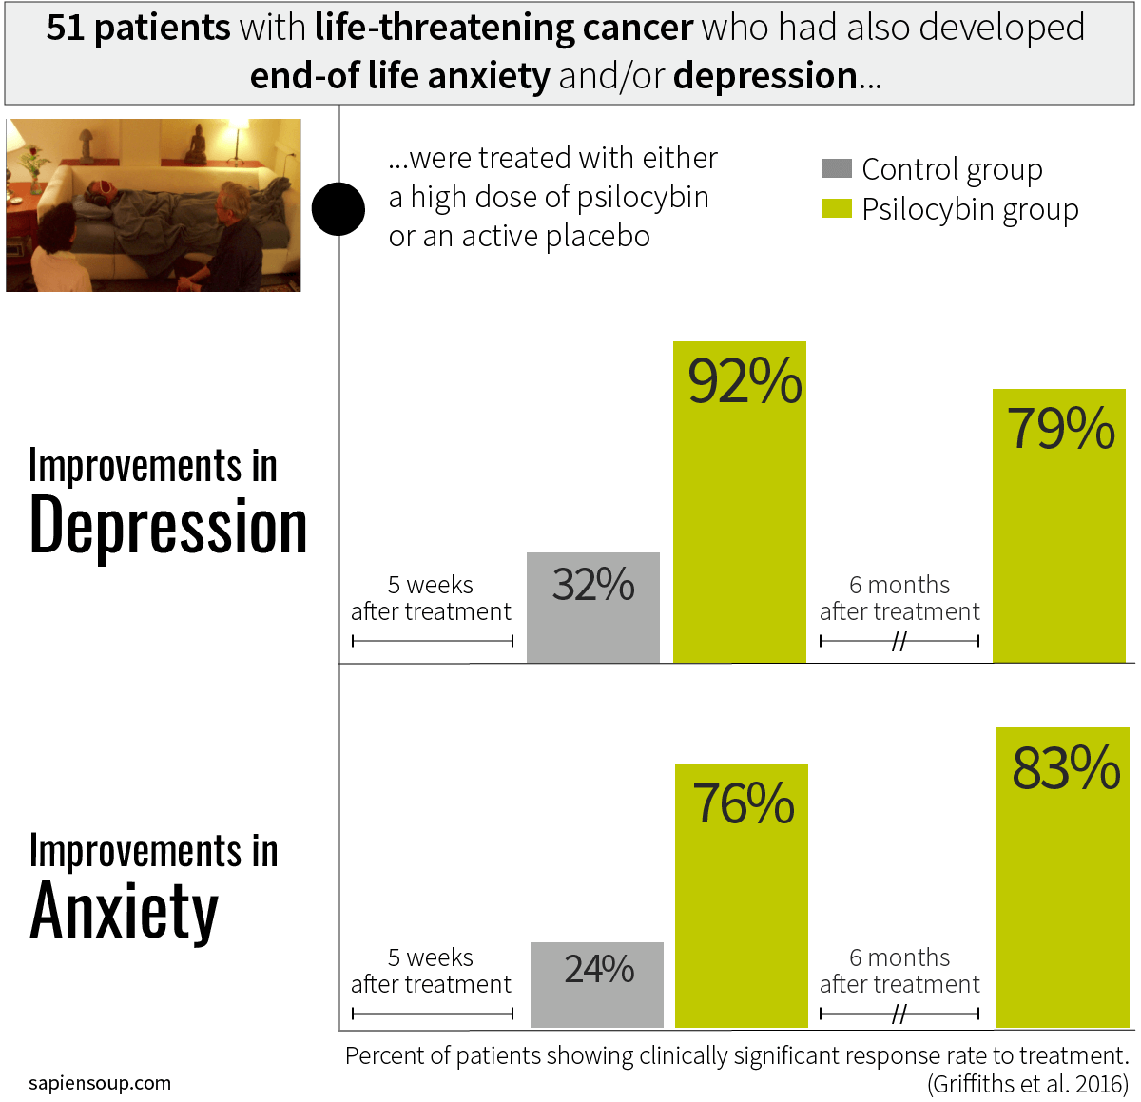

Griffiths, R., Johnson, M., & Carducci, M. (2016). Psilocybin produces substantial and sustained decreases in depression and anxiety in patients with life-threatening cancer: A randomized double-blind trial. Journal of Psychopharmacology, 30(12):1181-1197.
Notes:
------------
Griffiths RR, Johnson MW, Carducci MA. Psilocybin produces substantial and sustained decreases in depression and anxiety in patients with life-threatening cancer: A randomized double-blind trial. J Psychopharmacol. 2016 Dec;30(12):1181-1197.

Slide 19
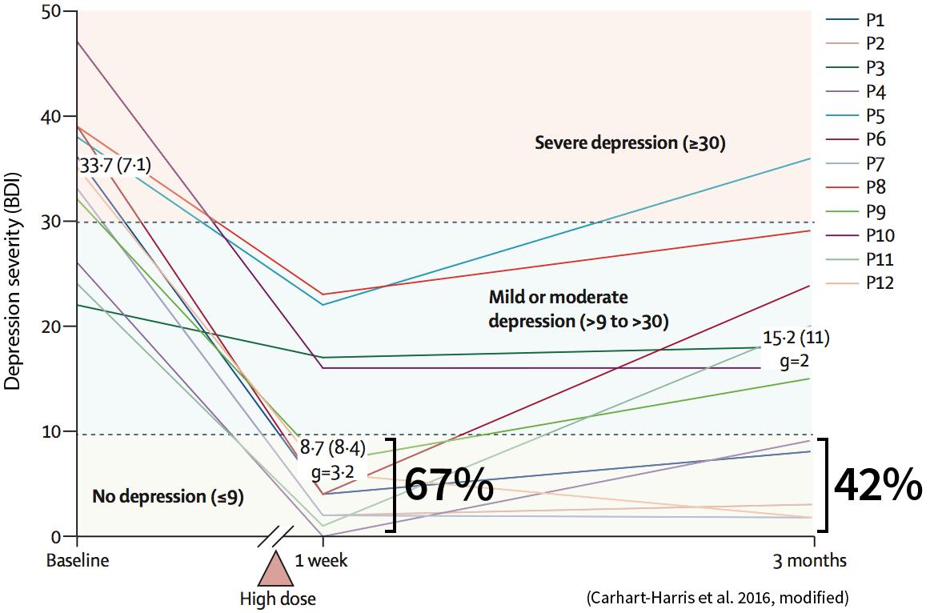
Carhart-Harris, R., et al. (2024). Psilocybin with psychological support for treatment-resistant depression: an open-label feasibility study. Lancet Psychiatry, 3(7), 619-627.
Notes:
Johnson MW, Garcia-Romeu A, Cosimano MP, Griffiths RR. Pilot study of the 5-HT2AR agonist psilocybin in the treatment of tobacco addiction. J Psychopharmacol 2014; 28: 983–92.

Slide 20
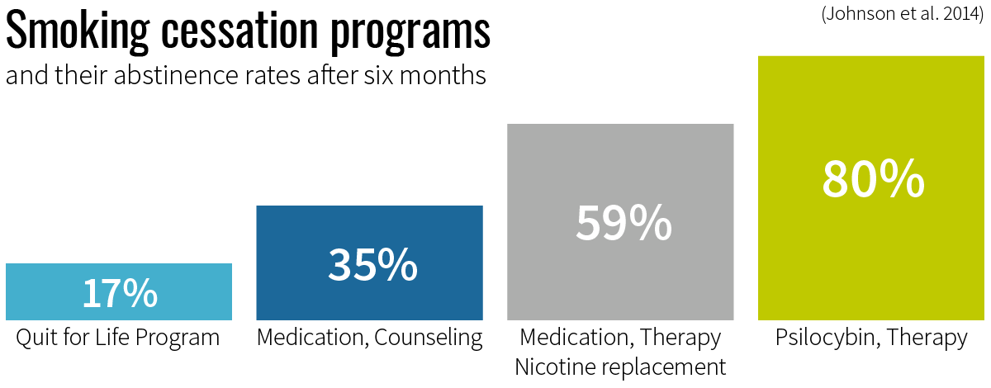
Johnson, M., et al. (2014). Pilot study of the 5-HT2AR agonist psilocybin in the treatment of tobacco addiction. Journal of Psychopharmacology, 28, 983–92.
Notes:
Johnson MW, Garcia-Romeu A, Cosimano MP, Griffiths RR. Pilot study of the 5-HT2AR agonist psilocybin in the treatment of tobacco addiction. J Psychopharmacol 2014; 28: 983–92.

Slide 21
The Upside of Psychedelics
Potential for durable symptom improvement (limited but growing evidence)
Few treatment sessions, not daily dosing
Tolerance may develop; low evidence of physiologic dependence
Relatively safe in supervised settings; serious harms usually indirect

Slide 22
The Downside of Psychedelics
Short-Term/Immediate Effects
Long-Term Effects
Stimulant effects : ↑ BP and HR (esp. Ibogaine)
Vomiting/nausea (esp. Ayahuasca & Peyote)
Client may be vulnerable/safety concerns
“Bad trip”
Intoxication → calm reassurance
Flashbacks OR--Hallucinogen Persisting Perception Disorder
Persistent Psychosis

Slide 23
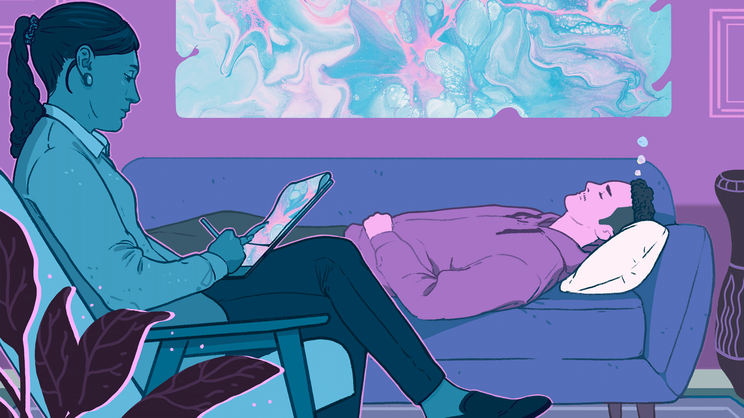
When utilized under supervision in a carefully controlled setting, research shows that some psychedelic substances can produce lasting and significant psychological and behavioral changes.

Slide 24
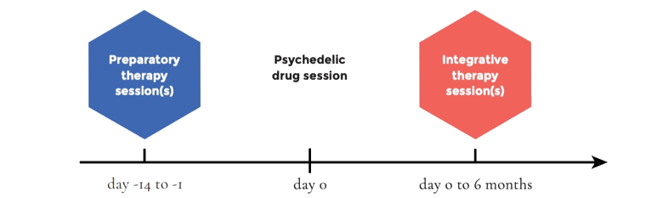
Psychedelic-Assisted Psychotherapy
A technique that involves the use of psychedelic substances to aid the therapeutic process.
Specific pharmacological actions of the psychedelic drug → temporally induce modifications in brain functioning and conscious experience.
When appropriately mediated, these can be deeply meaningful experiences that elicit the emotional, cognitive and behavioral changes.

Slide 25
Preparatory Therapy Session(s)
Clinical evaluation and screening for contraindications
Orientation to the treatment process
Establishing therapeutic alliance
Exploring symptoms and broader life context
Intention setting for the dosing session
Preparing for potentially challenging experiences

Slide 26


The Active Drug Session(s)
SET: The participant’s emotional/cognitive/and behavioral mindset and expectations
SETTING: The physical environment in which the exposure occurs
Set is optimized through the preparatory sessions
  Openness, acceptance, surrender
  Set expectations
  Manage challenging emotions
Setting is optimized by creating a comfortable, safe, and distraction-free space

Slide 27







Factors That Influence A Psychedelic Experience
PREPARATION
TYPE OF PSYCHEDELIC
DOSE
ROUTE OF ADMINISTRATION
MINDSET
SETTING
INTEGRATION

Slide 28

Integration Therapy Session(s)
“the process of exploring and sharing challenges and insights that arise during psychedelic experiences”
Helps participants’ process the events that occur during psychedelic sessions, learn valuable lessons from them, and incorporate key lessons into their daily life
Increases the potential for personal transformation that psychedelics offer

Slide 29
Psychedelics: Into the Future!
Psychedelic research is now blossoming globally
There are realistic prospects of regulatory approval
There is potential for widespread application within public health models
Pharmaceutical companies, academic institutions, health insurance industry are invested and informed

Slide 30
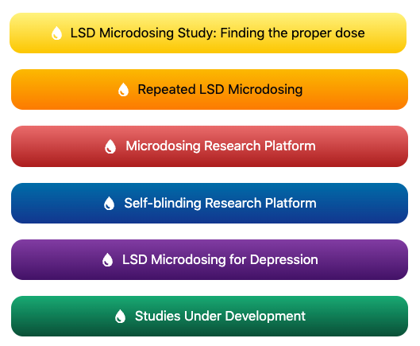
In Case You Are Wondering About Microdosing…..
Microdosing = ingesting sub-hallucinogenic amounts of a psychedelic substance (usually LSD or psilocybin) -- about 1/10th to 1/20th of “full dose”
Often done on a schedule of every 3-4 days
Purported benefits
  Increased physical energy and productivity
  Enhanced creativity and problem-solving
  Improved performance and stamina
  Emotional balance
  Treatment for MH condition
Risks
  Illegal
  Unregulated
  Inaccurate microdose → unexpected full-blown experience
  Tolerance & cross-tolerance with other psychedelics
https://www.beckleyfoundation.org/microdosing/

Slide 31
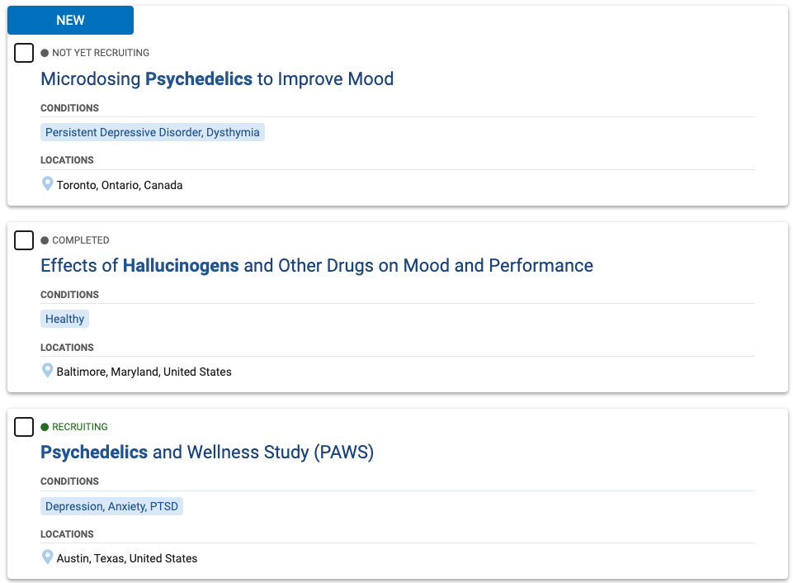
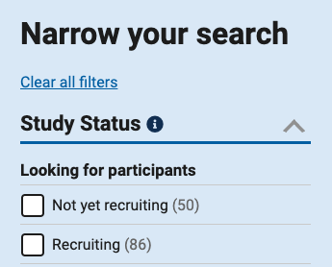
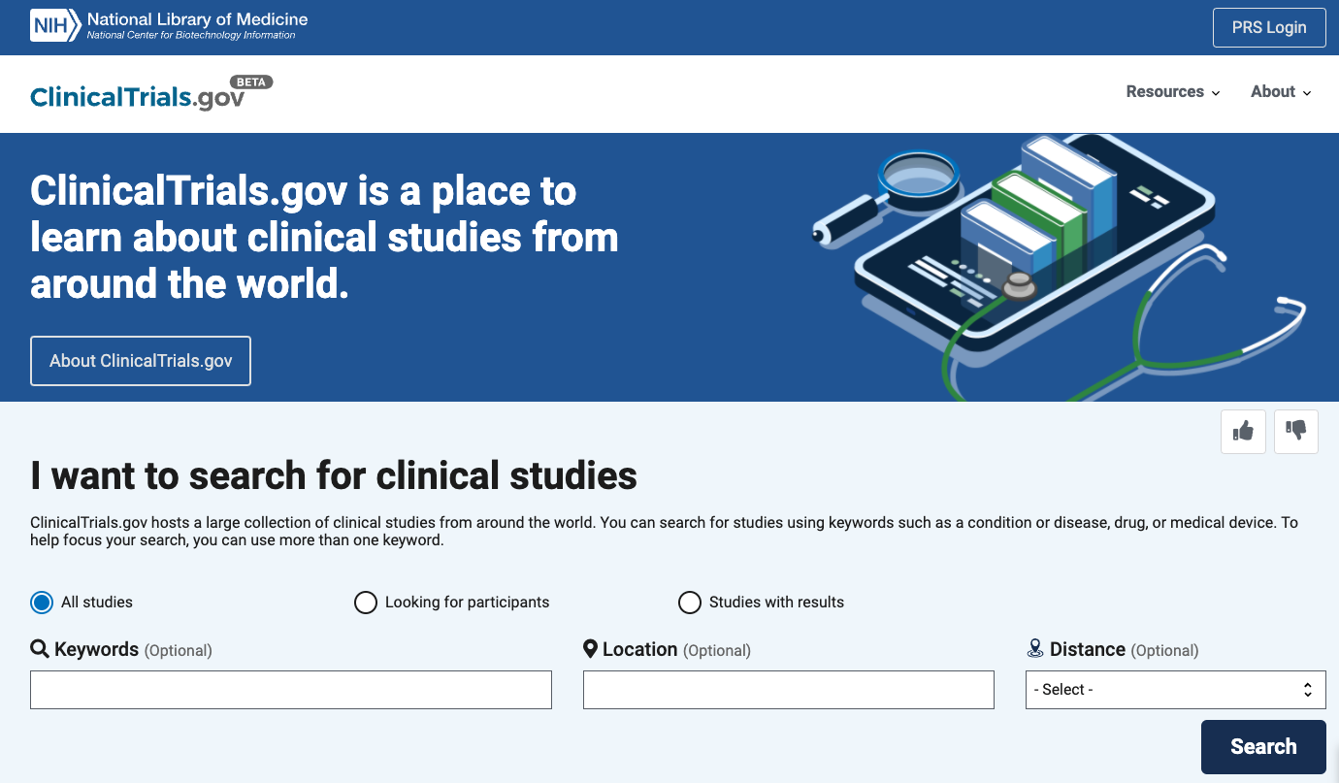
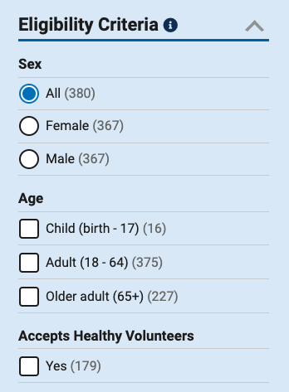
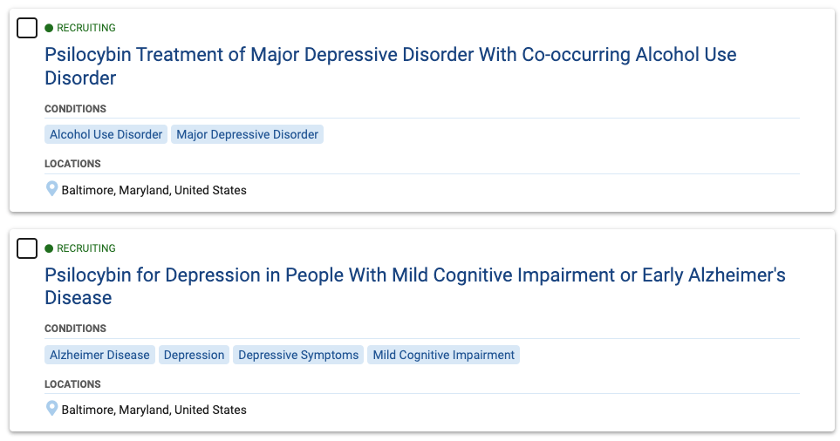
Looking to Participate or Learn Results of a Study?
https://beta.clinicaltrials.gov/
PSYCHEDELIC

Slide 32
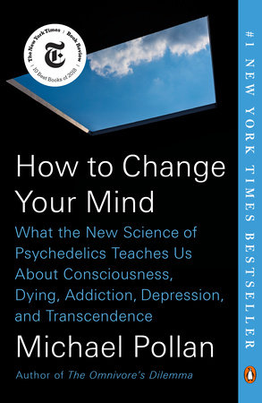
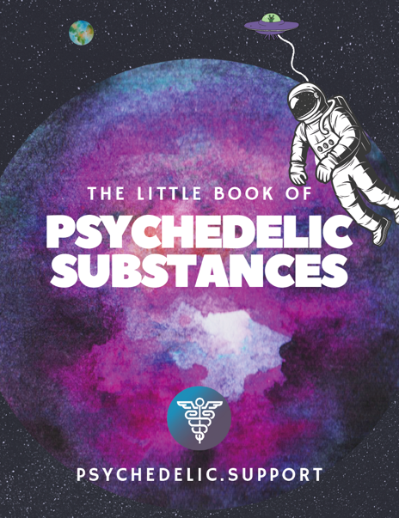
Learn More About the Psychedelic Experience
Audiobook = 13 hours, 35 min
Download FREE at https://psychedelic.support/education/free-courses/

Slide 33
References
Bonomo Y, Norman A, Biondo S, et al. The Australian drug harms ranking study. Journal of Psychopharmacology. 2019;33(7):759-768.
Canady, Valerie A. Psychedelic-assisted therapy considered ‘breakthrough’ treatment for PTSD. 2021, Mental Health Weekly, pages 1-3, volume 31, 19.
Carhart-Harris, R., et al. (2016). Psilocybin with psychological support for treatment-resistant depression: an open-label feasibility study. Lancet Psychiatry, 3(7), 619-627.
Carhart-Harris, R. et al. (2017). Psilocybin for treatment-resistant depression: fMRI-measured brain mechanisms. Science Reports, 7, 13187.
Davis, A., Agin-Liebes, A. et al. (2021) Attitudes and Beliefs about the Therapeutic Use of Psychedelic Drugs among Psychologists in the United States. Journal of Psychoactive Drugs.
Gorman, I, Nielson E., et al. (2021). Psychedelic Harm Reduction and Integration: A Transtheoretical Model for Clinical Practice, Frontiers in Psychology, Volume 12, 710.
Griffiths, R., et al. (2008). Mystical-type experiences occasioned by psilocybin mediate the attribution of personal meaning and spiritual significance 14 months later. Journal of Psychopharmacology, 22(6):621-632.
Griffiths. R., Johnson, M., & Carducci, M. (2016). Psilocybin produces substantial and sustained decreases in depression and anxiety in patients with life-threatening cancer: A randomized double-blind trial. Journal of Psychopharmacology, 30(12):1181-1197.
Johnson, M., et al. (2014). Pilot study of the 5-HT2AR agonist psilocybin in the treatment of tobacco addiction. Journal of Psychopharmacology, 28, 983–92.

Slide 34
References
Mitchell, J.M., Bogenschutz, M., Lilienstein, A. et al. (2021). MDMA-assisted therapy for severe PTSD: a randomized, double-blind, placebo-controlled phase 3 study. Nature Medicine, 27, 1025–1033
Muthukumaraswamy, S. et al. (2013). Broadband cortical desynchronization underlies the human psychedelic state. The Journal of Neuroscience, 33,15171-15183.
Penn AD, Phelps J, Rosa WE, Watson J. (2021). Psychedelic-Assisted Psychotherapy Practices and Human Caring Science: Toward a Care-Informed Model of Treatment. Journal of Humanistic Psychology.
Perkins D, Sarris J, Rossell S, et al. (2021). Medicinal psychedelics for mental health and addiction: Advancing research of an emerging paradigm. Australian & New Zealand Journal of Psychiatry.
Pollan, M. (2019). How to change your mind: What the new science of psychedelics teaches us about consciousness, dying, addiction, depression, and transcendence. Penguin Books.
Stone, R. (2021). Psychedelics and addiction. The Conservative Drug Policy Reform Group. Retrieved April 10, 2022, from https://www.cdprg.co.uk/blog/2021/4/9/discover-psychedelics-and-the-treatment-of-addiction.
Watts, R. & Luoma, J. (2020). The use of the psychological flexibility model to support psychedelic assisted therapy. Journal of Contextual Behavioral Science, 15, 92-102.
Yaden, D. et al. (2021). Classic psychedelics in the treatment of substance use disorder: Potential synergies with twelve-step programs, International Journal of Drug Policy, Volume 98, 2021,103380

