Slide 1


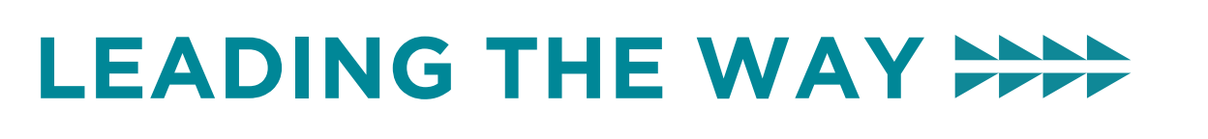

Accelerated Aging in our Communities
February 12, 2026
Laura Byerly, MD (she/her/hers)
| Associate Professor of Medicine | Oregon Health & Science University and Oregon GWEP| byerlyla@ohsu.edu

Slide 2
Disclosures
Laura Byerly has no financial conflicts to disclose related to this talk’s content
Her time is partially funded through the HRSA Geriatrics Workforce Enhancement Program
Her presentation doesn’t reflect or represent the perspectives of the US government
All images are used under a creative commons license unless otherwise indicated
Notes:
LAURA

Slide 3
Session Objectives
By the end of this session, you will be able to:
Describe the term “accelerated aging”
Identify adults who are at higher risk of experiencing accelerated aging.
Describe accelerated aging pathways to higher incidence of dementia.
Identify opportunities for community intervention to improve the well-being of those experiencing accelerated aging.
Notes:
LAURA

Slide 4
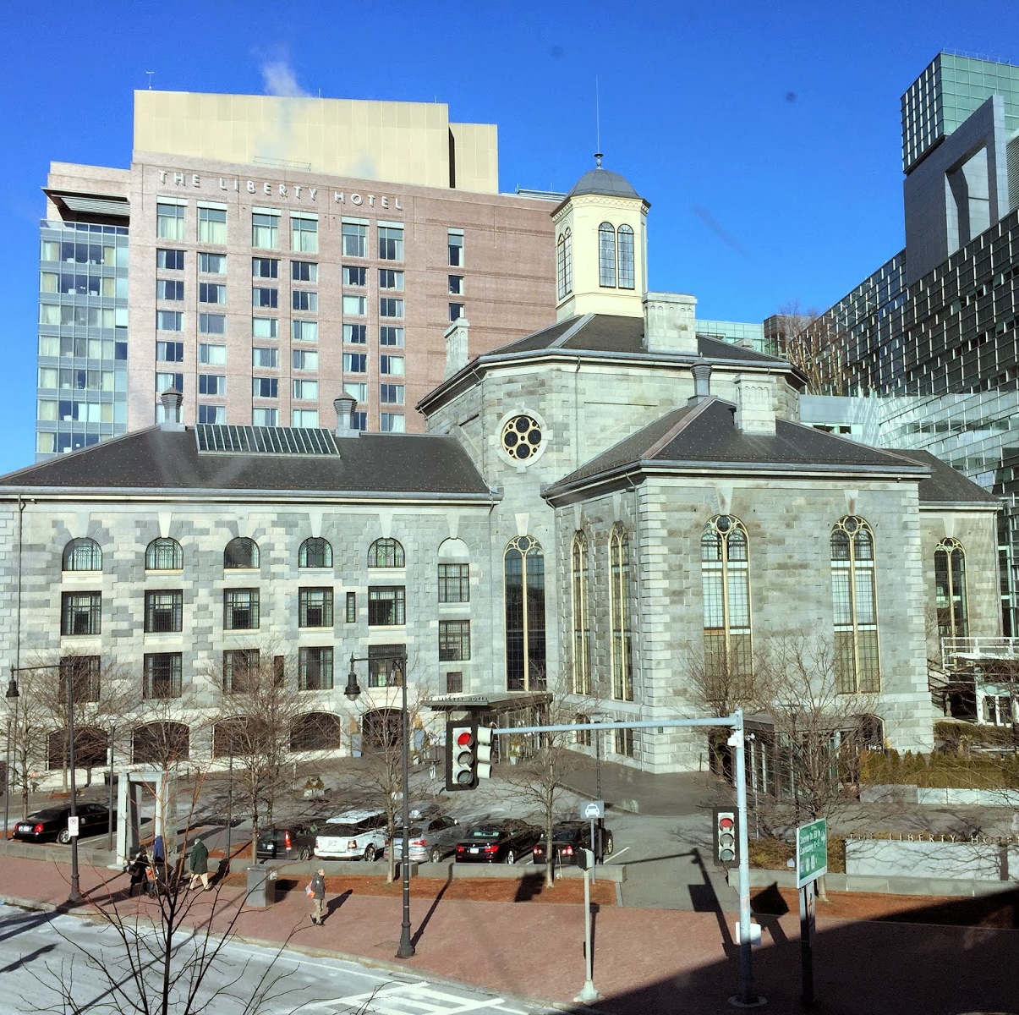
https://bostonbostonphotos.blogspot.com/2015/01/charles-street-jail-liberty-hotel-boston.html
My “why”
I teach to encourage others to do better than I did
Notes:
Joe
64yo vet when I met him
Intermittently housed in an SRO
No family
Military was his family due to trauma in childhood
Active smoker, active oxygen tank user
I met him because he was admitted to MGH so many times during my intern year that I got to personally admit him at least 3 times – and then I adopted him
Joe had osteoporosis, he fell, he used a 4WW, he had MCI, he had bladder incontinence
And if you’d looked at his chart, just based on age, you wouldn’t have thought he’d need a geriatrician (but he got me)
He never missed an appointment
I occasionally would run into him on my way from my apartment to the Charles MGH T-stop, sitting on his walker, right here, outside the Liberty hotel.
Never too far away from the ER.
He always said hello to me. I introduced him to my now husband before I introduced him to a large number of my friends.
And I think back now about how I hadn’t really seen the constellation of “old age” syndromes in someone who had only just passed Medicare’s definition of “old”
And how hard it was on him in Boston’s scene to manage all of his syndromes
And how purely based on his age, he likely missed out on a lot of resources and screening that I didn’t even think to consider because of his age.
And I have consistently since then strove to do better.

Slide 5
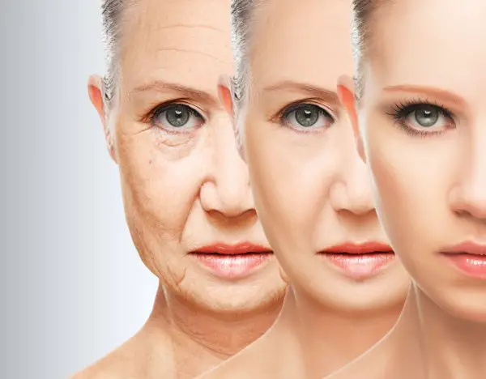
Accelerated Aging: Definitions and big picture
Development of biological markers of aging and chronic disease at a rate faster than expected for chronological age
Increased chronic illness and functional decline at a younger age
“50 is the new 65”
Notes:
About a 15 year advanced age
Ask the audience off the cuff if they have ever thought about geriatric syndromes in a 52yo
The goal of this hour is to help you identify individuals who might be experiencing accelerated aging in your communities, in your healthcare environments, and in your primary care practices
Because if we don’t recognize, we will never screen, and we will never treat

Slide 6

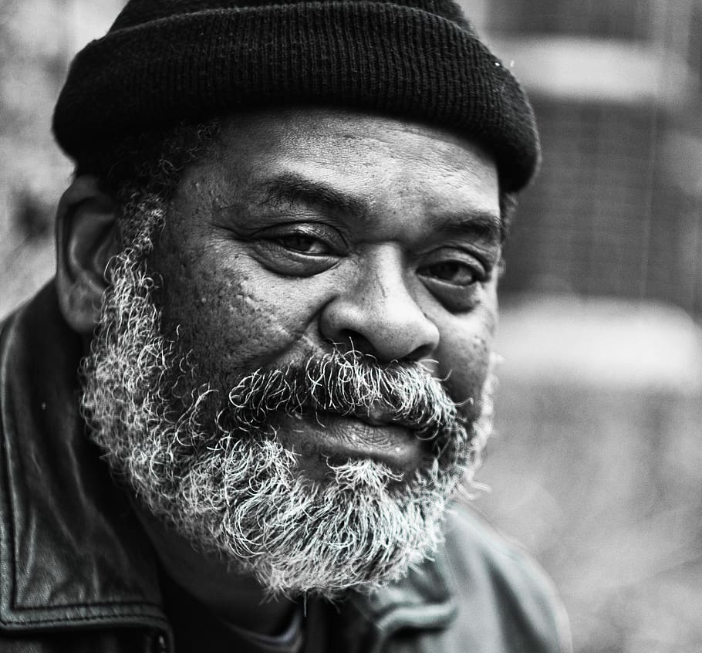
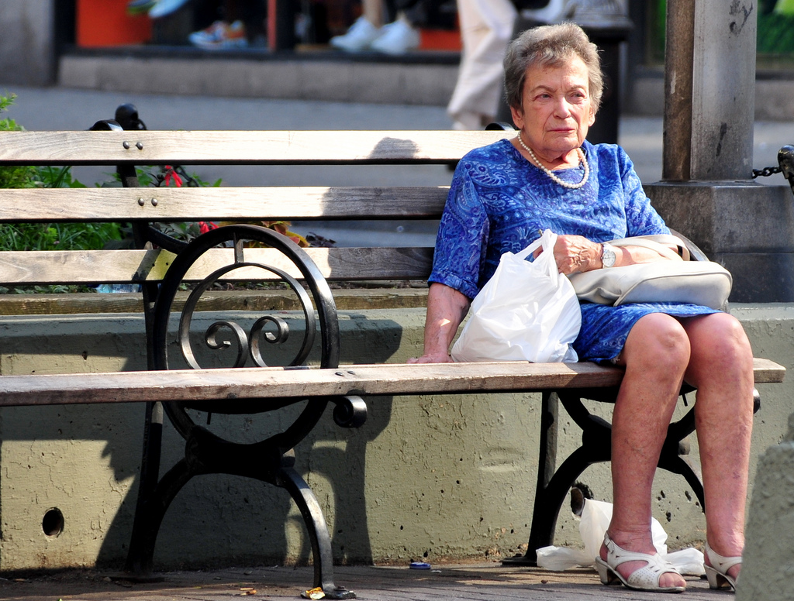

Recognizing accelerated aging
Who is experiencing it?
How would you be able to tell?
This Photo by Unknown Author is licensed under CC BY
Notes:
Upper left is from https://ncoagallery.org/link/agingwellforall2021 (Joe Hunter credit)

Slide 7

Some “Scary Thoughts”
Environmental and societal factors impact the rate at which we age
Scary, right?
Let’s dive into the “why” before the “who”
Notes:
This isn’t new information
We’ve seen all the way into childhood how people age at different “Rates” depending on their community, family, and trauma
We call them “Adverse Childhood Experiences”
But why is it that our environment and social structure can affect our biology?

Slide 8
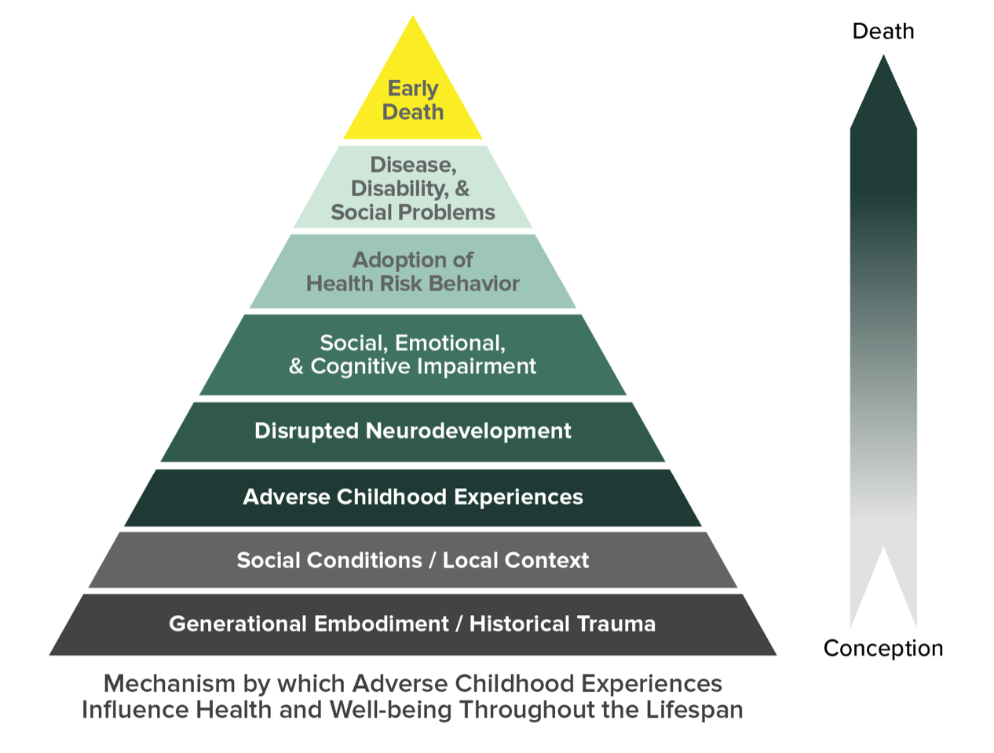
Kaiser ACE Study
https://www.cdc.gov/violenceprevention/aces/about.html
Notes:
Has any one heard of the Kaiser ACE Study before?
The Kaiser study ran from 1995-1997
Looked at abuse, neglect, changes in family structure, household challenges,
ACE study has uncovered how ACEs are strongly related to development of risk factors for disease, and well-being throughout the life course
More ACEs led to increased rates of depression, suicide, PTSD, diabetes, fetal death when the individual became pregnant, STIs, and substance use
It’s not just about “this person was raised in this place so they thus have these comorbidities”
There is an actual physiological mechanism driving some of this – stress leads to brain development changes which leads to riskier health behaviors which leads to disease

Slide 9
Wear and Tear
Immune system decline
Stress
HPA Axis Activation
Inflammation
Cognitive Decline
Cardiovascular Disease
“Allostatic Load”
Notes:
Let’s think beyond childhood though to our patients throughout their lifespan
People under stress have higher risks of negative health effects at the cellular level
HPA activation by stress
High cortisol levels CONSTANTLY leads to decreased appropriate body response
“with exposure to chronic stress and repeated activation of the stress response systems, these stress responses become inefficient”
“continued SNS activation with chronic stress coupled with HPA dysfunction in the form of the loss of cortisol's anti-inflammatory effects would result in an increase in inflammation and oxidative stress. In turn, inflammatory processes result in increased risk of cardiovascular, immune, and metabolic dysfunction (Khansari et al. 2009). Through such mechanisms, allostatic load may then take a toll throughout the body and contribute to the development or progression of a broad range of clinical and preclinical pathological processes, including cardiovascular disease, obesity, diabetes, susceptibility to infection, carcinogenesis, and accelerated aging.”
Allostatic Load = wear and tear on the body
Like a car engine that gets repeatedly revved up
https://www.ncbi.nlm.nih.gov/pmc/articles/PMC2861506/

Slide 10



Quick Biology Refresher!
Notes:
Let’s be clear—I’m not a biology major. I studied American History.
This is the non-biologist’s refresher.
Telomere length decreases
“Caps on shoelaces”
DNA can’t replicate
Cells stop replicating and die
Klopack et al, PNAS, 2022
Decreased number of T-cells
T-cells are part of our immune system—they “kill” pathogens
“Stressful life events, high lifetime discrimination, and chronic stress were associated with a higher percentage of terminally differentiated CD8⁺ cells. High lifetime discrimination and chronic stress were related to a lower CD4⁺:CD8⁺ ratio.”
Fewer T-cells and decreased T-cell diversity that can respond to new antigens—lots of “memory” t-cells but a lack of diversity of T-cells
You need T_cell diversity to respond to new pathogens
Decreased “T-regulatory cells” leading to unchecked inflammation
DNA methylation
Methylation is a chemical modification of DNA and other molecules that may be retained as cells divide to make more cells. When found in DNA, methylation can alter gene expression. In this process, chemical tags called methyl groups attach to a particular location within DNA where they turn a gene on or off, thereby regulating the production of proteins that the gene encodes.
Global loss of methylation as we age; in general hypomethylation is more concerning but some areas that we don’t’ want methylated become more methylated
Methylation changes based on ENVIRONMENT
DNA methylation provides us with a “epigenetic clock” within our cells to tell estimated age of tissues—can measure the degree that certain genes are methylated (either too much or too little)
“Some have argued that cellular aging is caused by epigenetic signalers—which repair damaged DNA—becoming overtaxed from cellular insults, including those present in the external environment” (Sinclair 2019:47–49)

Slide 11
“Inflamm-aging” & medical conditions
COPD
Cardiovascular disease
Diabetes
Infections
Cancer
Notes:
COPD
https://pubmed.ncbi.nlm.nih.gov/27373322/
Cyclical inflammation causing more damage to lungs causing worsening of COPD
Diabetes:
https://pubmed.ncbi.nlm.nih.gov/18672179/
Bidirectional relationship
Insulin resistance and hyperglycemia leads to connective tissue damage, oxidative damage, DNA unwinding
Causes frailty
Infections:
https://pubmed.ncbi.nlm.nih.gov/35696572/
Psychosocial stress associated with reduced CD4 naïve cells
Fewer T-cells an B-cells, increased risk of viral and bacterial infections
Cardiovascular disease:
Looked at 7 biomarkers of aging (total cholesterol, HDL, glucose, BMI, CRP, FEV1/h², MAP)
Black participants more likely to experience acc aging
Stroke and Cardiovascular disease associated with impaired social determinants of health and accelerated aging
Particularly related to SES and discrimination
Cancer:
https://pubmed.ncbi.nlm.nih.gov/30794318/
Advanced “biological clock” leading to increased risk of breast cancer

Slide 12
Pathways to geriatric syndromes…at non-geriatric “ages”
Osteoporosis
Falls
*Dementia
Functional Impairment
Urinary Incontinence
Sensory Impairment
Notes:
Geriatric syndromes lead to a higher risk of needing higher levels of care, more frequent hospitalizations, higher healthcare costs, higher out of pocket costs, and death
Often times, when we DON’T consider geriatric syndromes as the cause of a potential problem, we “blame the patient” for not either doing what we tell them to do or for being noncompliant.
We have to consider the 58yo man with HIV who has experienced trauma and lack of social supports and is now becoming “non-adherent” with his medications to be at risk for DEMENTIA and not just “refusing to adhere” to his medications.
We have to consider that the 60yo black veteran with no family supports and who previously experienced houselessness in his 40s and doesn’t seem to be following though with scheduling follow ups and getting testing done to be at risk for hearing and vision loss that is causing the lack of follow through and not “noncompliance.”
We can’t just brush off the “accidents” that the 62yo woman who was previously abused by their family and then their partner, who never got to complete high school and has been living out of her car for the past 6 months as being a UTI.
Osteoporosis
https://pubmed.ncbi.nlm.nih.gov/30522407/
Poverty in mid-life as proxy for social determinants leads to lower BMD

Slide 13
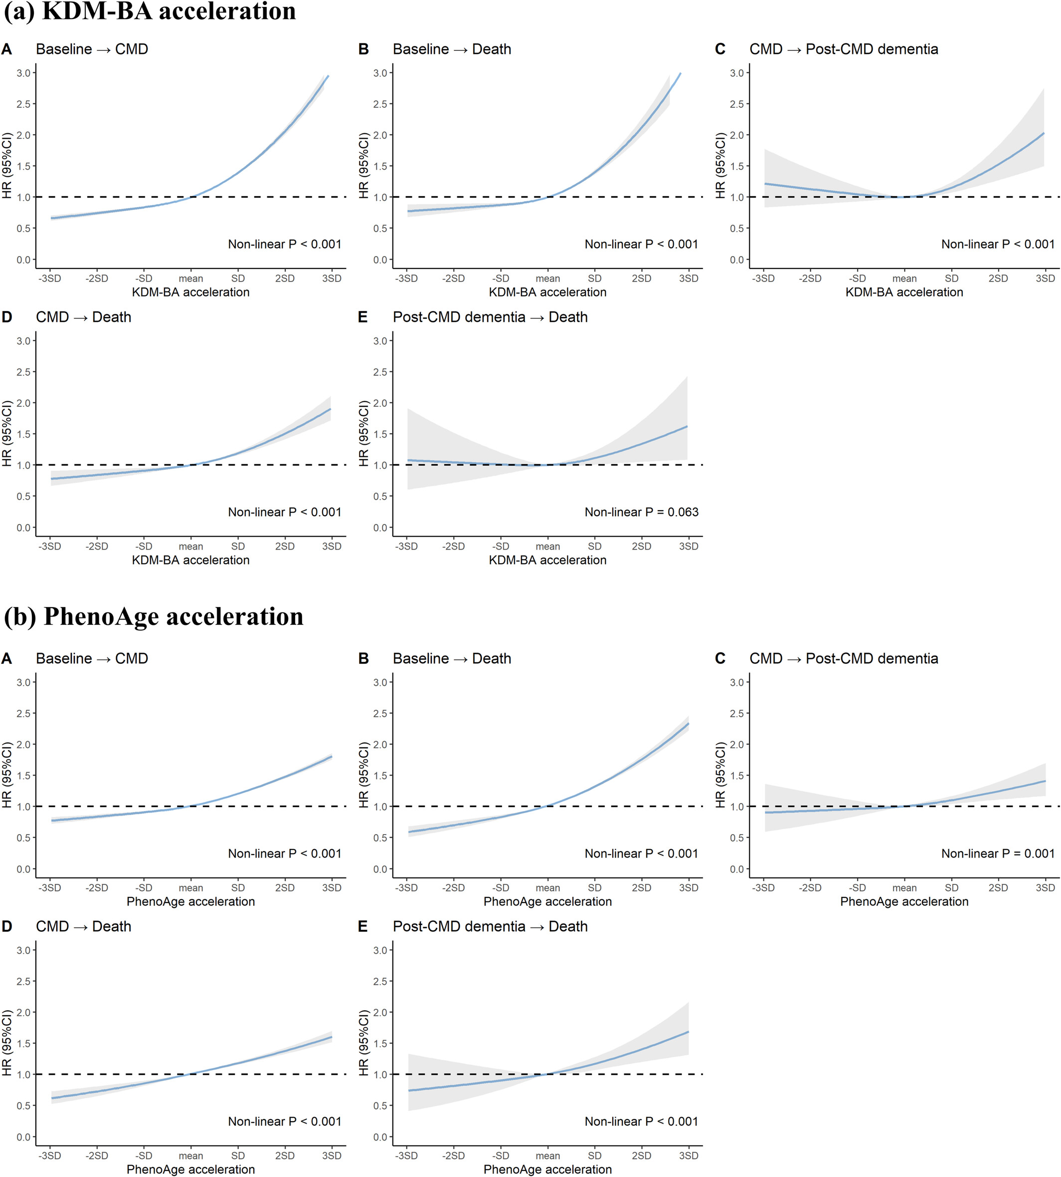
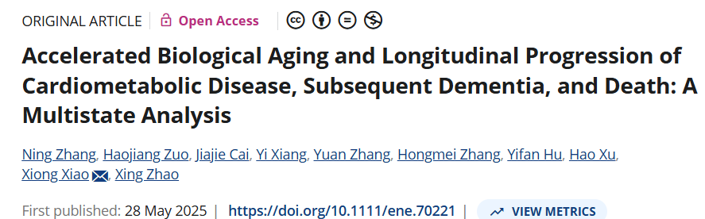
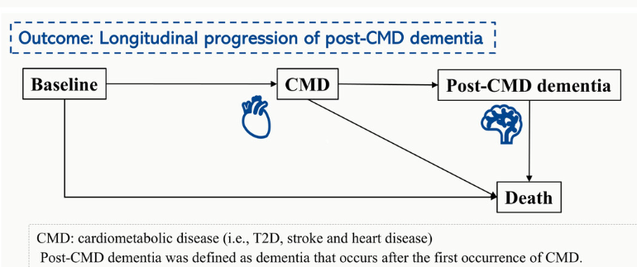
Accelerated aging, cardio-metabolic disease, and dementia
Dose–response curves of the accelerated biological aging with the dynamic progression of CMD, post-CMD dementia, and death (N = 284,723). Solid lines: point estimates; shadows: 95% confidence interval.
Notes:
From the European Journal of Neurology in 2025
“For the transition from baseline to CMD, adjusted HRs (95% CI) were 1.34 (1.32, 1.35) for each SD increase in KDM-BA acceleration and 1.19 (1.18, 1.20) for PhenoAge acceleration. For the transition from CMD to post-CMD dementia, HRs were 1.12 (1.04, 1.20) for KDM-BA acceleration and 1.10 (1.04, 1.17) for PhenoAge acceleration. Both BA accelerations were more strongly associated with the transition from CMD to post-CMD VaD than with the transition to post-CMD AD.”
Basically, accelerated aging markers were associated with higher risks of cardio-metabolic disease (CAD, diabetes, stroke) AND subsequent development of dementia (VD > AD)

Slide 14
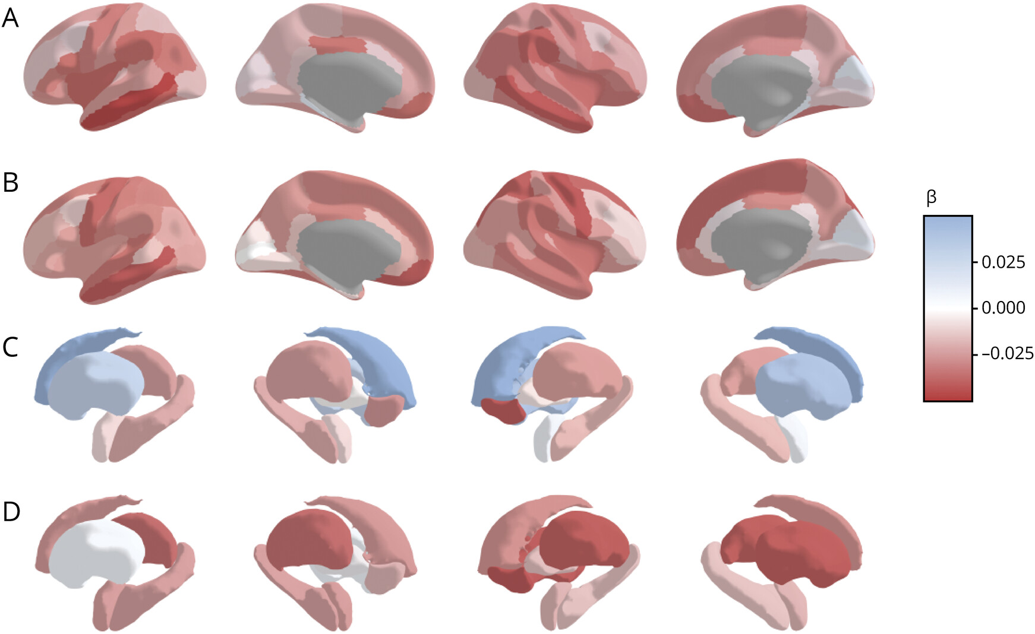
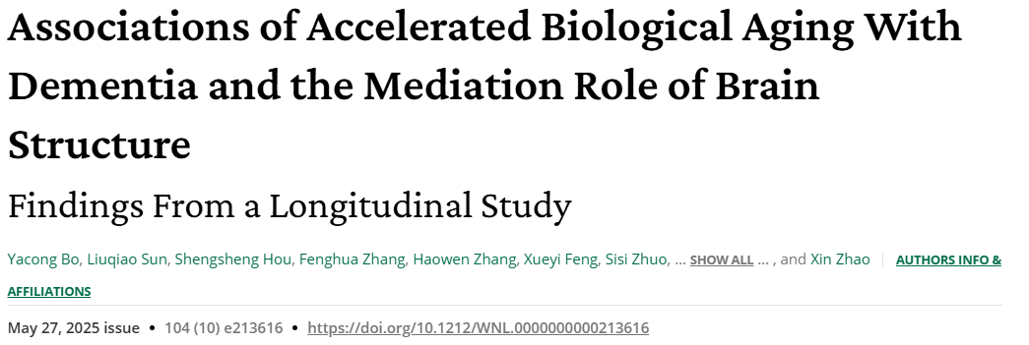
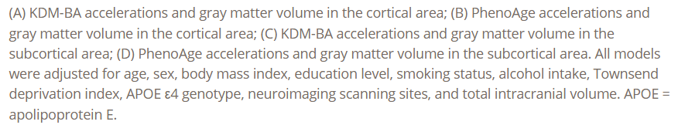
Advanced Biological Age Association with Gray Matter Loss
Notes:
In this longitudinal of patients in the UK, biological age composite scores (PhenoAge and KDM-BA) were followed a;long with incidence of dementia and gray matter volume
Accelerated BA (KDM-BA and PhenoAge) was associated with decreased GMV in 52 and 65 out of 82 brain regions, respectively

Slide 15
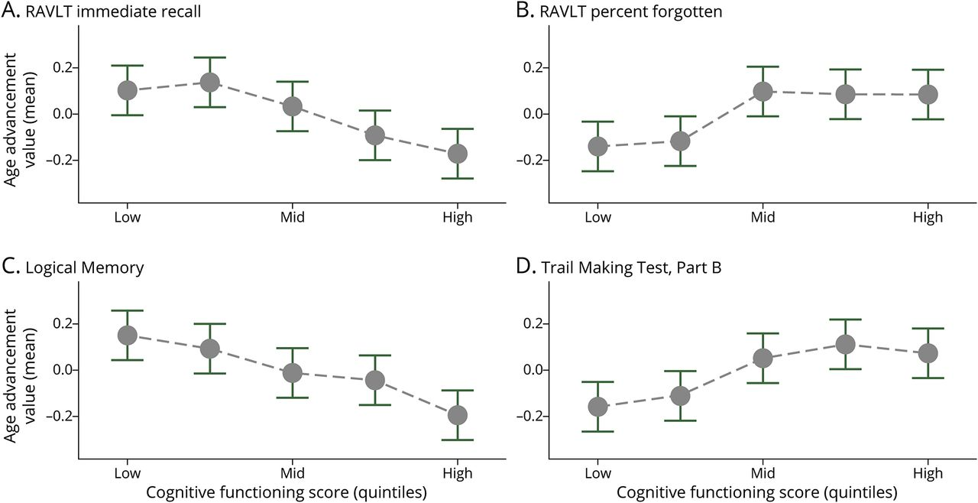
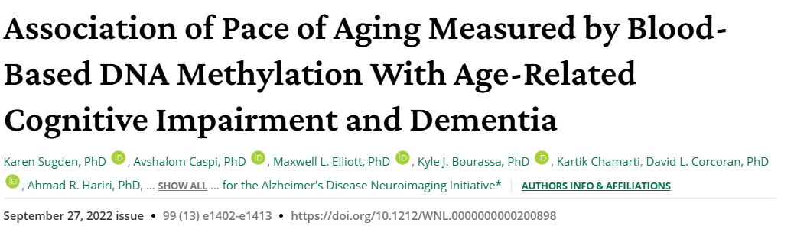
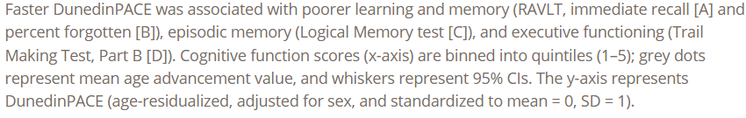
DNA Methylation and Cognitive Performance
Notes:
FHS cohort looking at multiple blood based DNA methylation measures of Acc Aging associated with cognitive testing and dementia
3rd generation DNA clock (DunedinPACE) was most sensitive
Associated with clinical diagnosis, poorer scores on screening tests, and cognitive test batteries

Slide 16
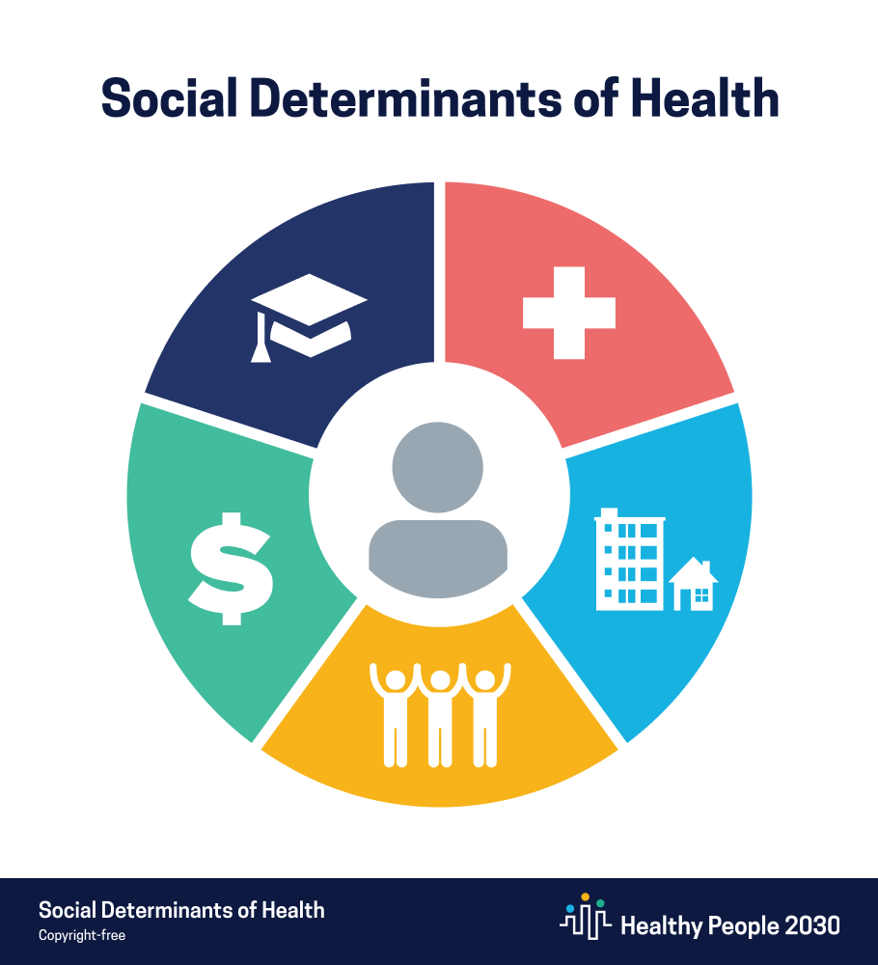
So…
Now let’s think about the “who”

Slide 17
Social Drivers of Health
Courtesy of Stepha Dragoon
Economic Stability
Education Access & Quality
Social & Community Context
Neighborhood & Built Environment
Health Care Access & Quality
Food Access & Quality
Employment Opportunities
Income Stability & Poverty
Expenses
Debt
Medical Bills
Safety Net
Economic Discrimination
School Quality
Language Barriers
Early Childhood Education
Opportunities for Advancement
Higher Education
Technology Access
Support Systems
Community
Engagement
Stress
Exposure to Violence, ACEs
Policing & Justice Policy
Systemic
Discrimination
Housing Stability & Living Conditions
Transportation, Mobility & ADA Accessibility
Parks, Playgrounds & Walkability
Rural Vs. Urban Disparities
Environmental Discrimination
Health Coverage
Provider & Pharmacy Availability
Equitable Access to Care (Language, Culture, Location, etc.)
Quality of Care
Food Security
Food Deserts
Access to Healthy Options
Food Education
Systemic Racism
Toxic Stress
Morbidities
Population Health Outcomes
https://health.gov/healthypeople/objectives-and-data/social-determinants-health ; https://www.kff.org/coronavirus-covid-19/issue-brief/tracking-social-determinants-of-health-during-the-covid-19-pandemic/
Notes:
SDoH contribute to allostatic load, to that chronic stress response
I have shamelessly stolen this from Stepha Dragoon

Slide 18
Big picture
“When people are struggling with housing instability, food insecurity, and/or unemployment, they likely do not have the necessary emotional and material resources to devote adequate attention to their health and treatment regimen.”
Marcee E. Wilder, Impact of Social Determinants of Health on Medication Adherence, JGIM, 2021

Slide 19

Specific Health Impacts of Social Drivers
Medication adherence (food insecurity, housing instability)
Family caregiver health (education, financial satisfaction)
Dementia (race/ethnicity*, economically disadvantaged neighborhoods, education)
Delirium (new framework being proposed!)
Wilder et al, Impact of Social Determinants of Health on Medication Adherence, JGIM, 2021
Roosa-Maria et al, Social and Environmental Determinants of Health Among Family Caregivers of Older adults, Nurs Res, 2022
Quinones et al, An Agenda for Addressing Multimorbidity and Racial and Ethnic Disparities in ADRD, Am J AD, 2020
Notes:
Med adherence: Not able to meet basic needs. Survival over health. Short term vs long term gains (long-term requires med adherence). Additional considerations: side effects when don’t have adequate food—meds make you feel bad!
FCs: Finnish study looking at aging caregivers showed FCs with lower baseline education and lower stability and subjective financial satisfaction were more likely to have heart disease, inflammatory arthritis
Dementia (OHSU driven!): black and American Indian/Alaska Native populations are high risk, also Hispanic immigrants. Delayed diagnosis overall. But remember—it’s not “being Black” that makes risk of dementia higher—it’s the cumulative social determinant impact on life.

Slide 20
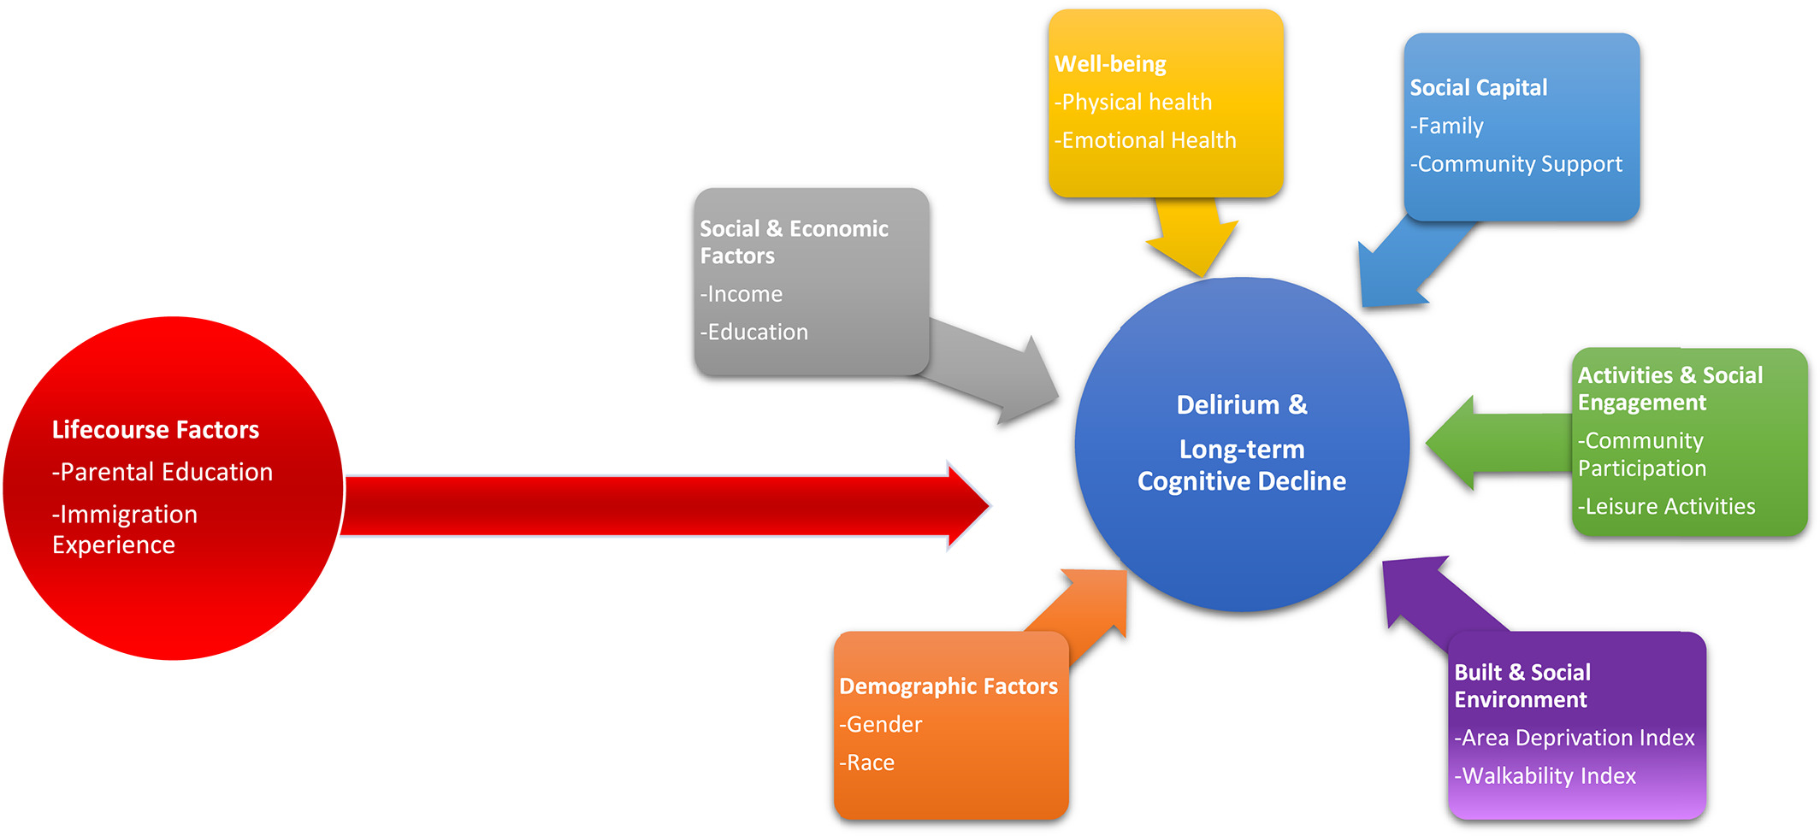
“…environmental and social factors may increase risk for delirium by increasing brain vulnerability across the lifecourse—that is, over many years or decades of exposure”
Arias et al, A framework of social determinants of health for delirium tailored to older adults, JAGS, 2021.
Notes:
Hypothesis: “environmental and social factors may increase risk for delirium by increasing brain vulnerability across the lifecourse—that is, over many years or decades of exposure”
Consider that the experiences of your childhood increasing your risk of delirium 50 years later
If any of you also practice inpatient or post-acute care medicine you may have seen this in the patients you’ve cared for who have suffered polytrauma
Life course factors include:
Prior to the age of 16 years old:
Family’s financial status
Number of siblings
Parental level of education
Parental occupation and job responsibilities
Social Capital: Importance of family members and informal caregivers in reducing incident delirium

Slide 21
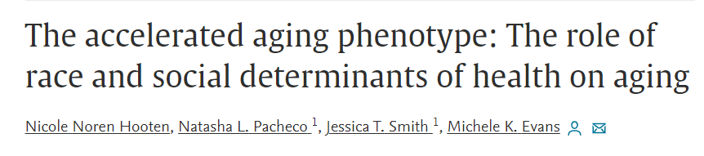
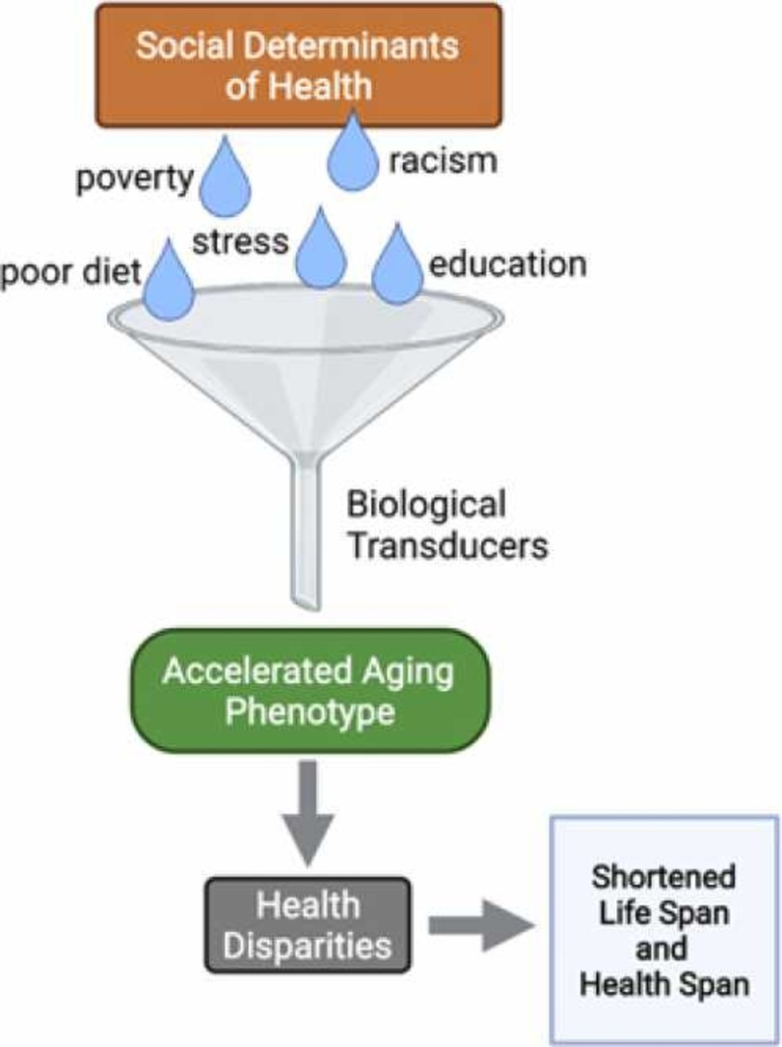
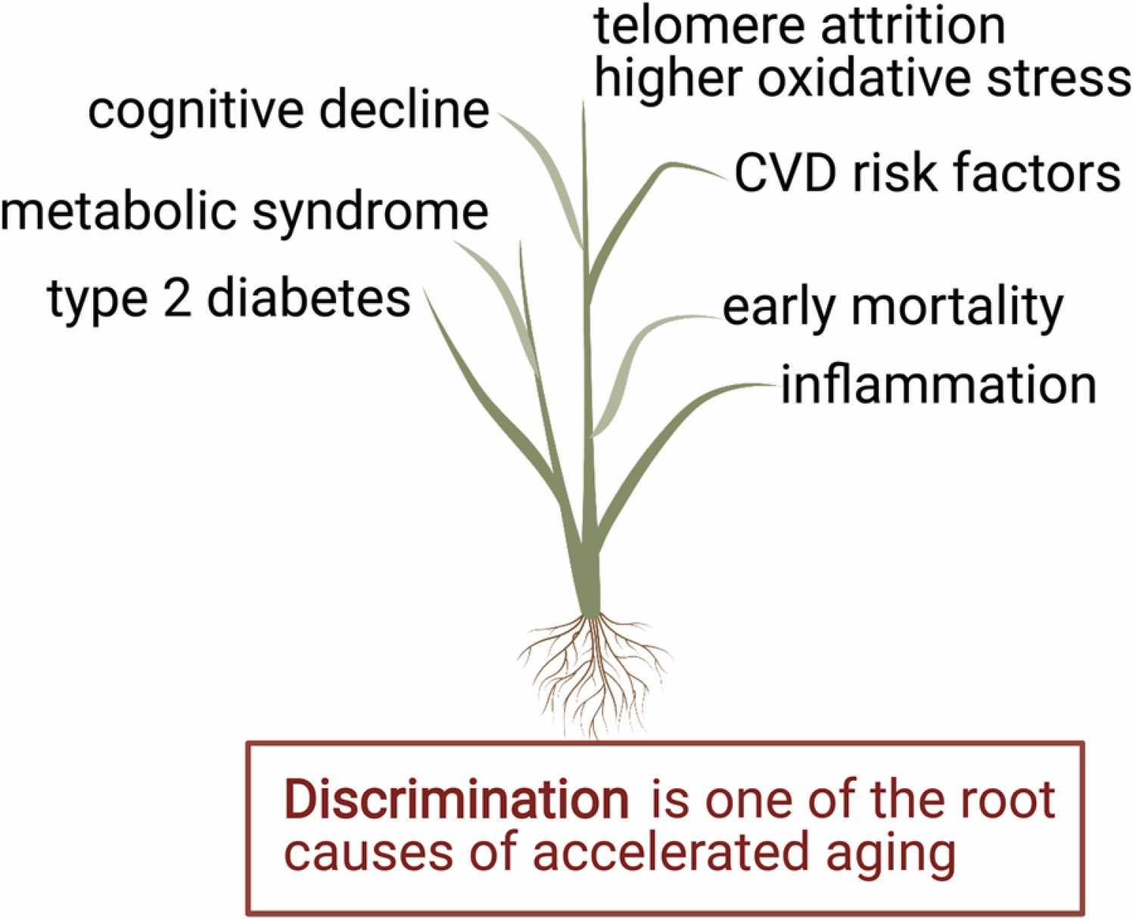
Summary: Communities of color facing discrimination and impacted social drivers are associated with biological markers of aging, development of chronic comorbidity, and shortened life span
Notes:
https://pubmed.ncbi.nlm.nih.gov/34883202/
2022 article
Very long but extremely insightful
From the National Institute on Aging

Slide 22
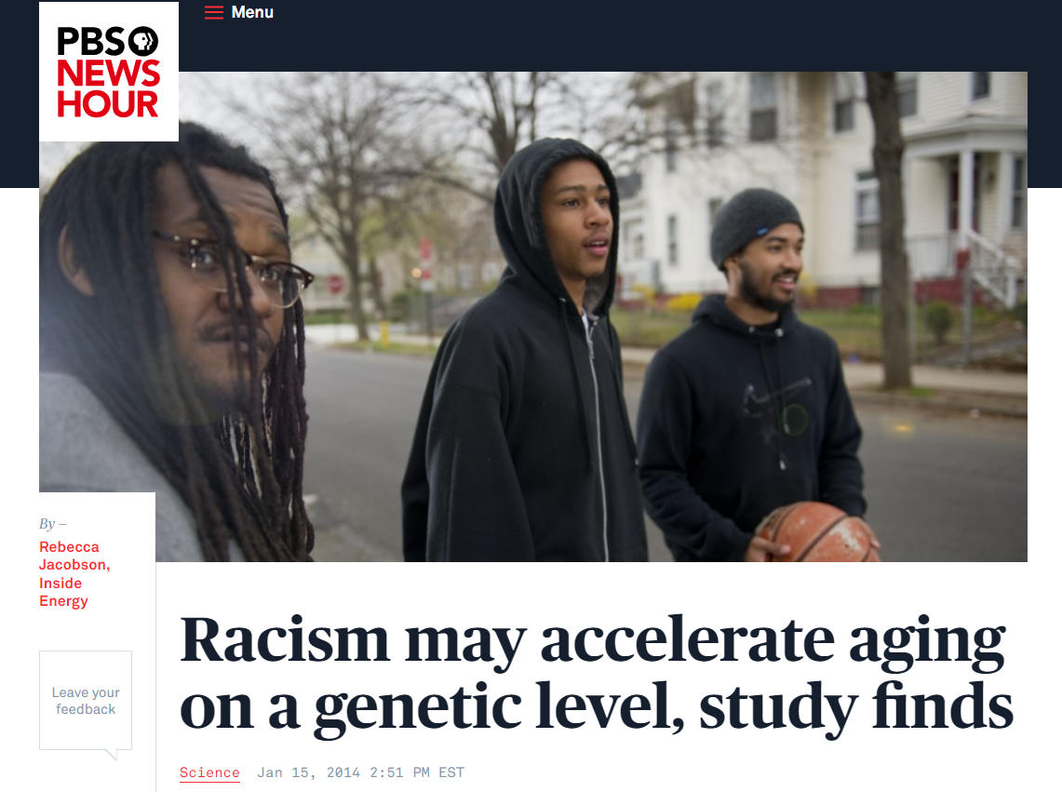
“There’s a cascade of biochemical reactions. Your heart rate rises, your muscles clench.” Dealing with prejudice — and all its effects on your life — is inherently stressful, he said, and that may lead to accelerated aging.”
- David Chae (University of Maryland)
Notes:
https://www.pbs.org/newshour/science/racism-makes-you-age-faster-on-a-genetic-level-study-finds
According the Centers for Disease Control, black men die six to seven years earlier than white men

Slide 23

Accelerated Aging Deep Dive

Slide 24
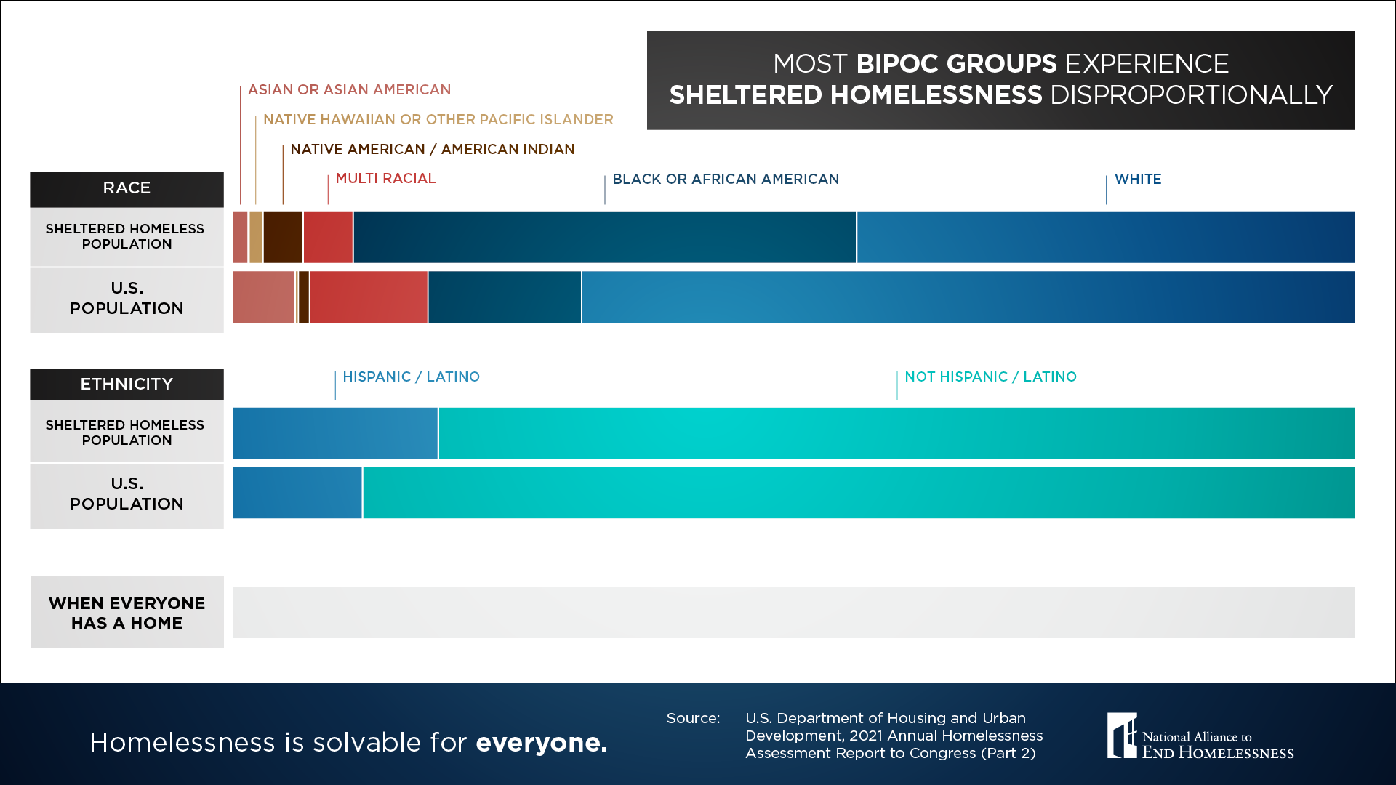
Accelerated aging deep dive: Houselessness
https://endhomelessness.org/wp-content/uploads/2024/10/2023-Sheltered-Racial-Disparities-Data-Snapshot-1.png
Notes:
2023 HUD Report on Homelessness highlighted that there is a disproportionate increase in homeless AI/AN people, particularly veterans
Increased by 18% between 2022 and 2023.
https://ncuih.org/2024/03/08/new-report-shows-increase-in-homelessness-disproportionately-affects-american-indian-and-alaska-native-people/
In Portland:
21% of houseless adults are >55 yo
Of the 256,000 unhoused AND unsheltered, roughly 1 in 4 were >55 yo
Rate of homelessness is expected to triple in older adults by year 2030³

Slide 25
Accelerated aging deep dive: Houselessness
Adults experiencing houselessness in their 50s experience chronic illnesses and geriatric syndromes at rates similar to those of housed adults 15–20 years older
Accelerated aging
Mental health conditions
Lack of health insurance
Lack of access to medications and care
Substance use disorder
Chronic Health Conditions
Notes:
From an accelerated aging perspective, experiencing houselessness is one of the single most studied risk factors related to accelerated aging.
Particularly when a person is developing geriatric syndromes AND is houseless
Over the past 2 decades, the proportion of the homeless population aged 50 years and older has increased substantially. In 1990, only 11% of single homeless adults were aged 50 years and older, but this percentage increased to 32% by 20031 and is nearly 50% today

Slide 26
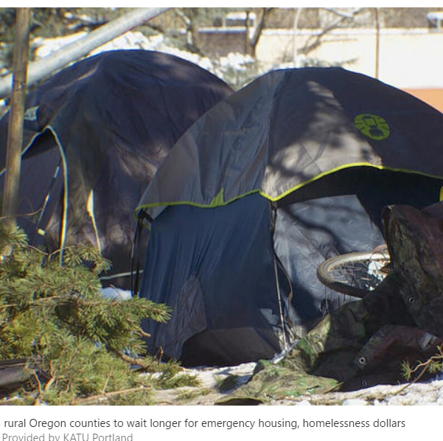
Accelerated aging deep dive: Houselessness
50% of adults >50yo have ≥ 2 chronic medical conditions
  COPD, Hypertension, Arthritis, Depression
Geriatric syndrome rates = 80yo peers
  ADL impairment (1/3)
  IADL impairment (60%)
  Falls (50%) and Mobility impairment (40%)
  Cognitive impairment (25%)
  Hearing impairment (>1/3)
  Vision impairment (20%)
  Urinary incontinence (50%)
Notes:
Most of these studies were done based on self-report so numbers might actually be higher

Slide 27
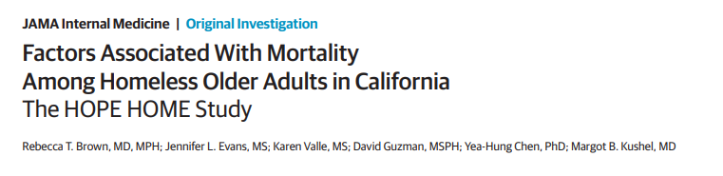
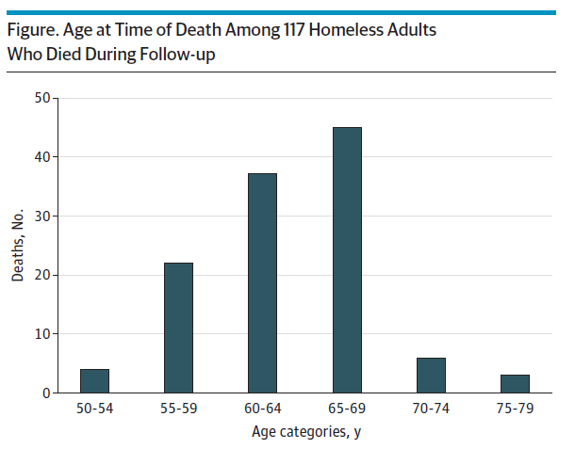
Houselessness and Premature Mortality Risks
Mortality rate 3.5-fold higher than the general population
Heart disease, cancer, drug overdose
Higher risk if newly houseless >50yo
“Health shock”
Notes:
New this year! Pivotal study done in the Bay Area that followed 450 patients longitudinally for up to 7 years (median of around 4.5 years)
Compared to Oakland matched peers
Die much younger

Slide 28
Case discussion
Mr. Thompson is a 61-year-old veteran experiencing houselessness with hx of COPD, diabetes, arthritis, PTSD, and alcohol use disorder in remission, whom you see in your local free clinic.
He reports that he has had increasing difficulty with walking for about 5 years because of worsening arthritis and numbness in his feet. He started having falls in the past year or so. His most recent fall was yesterday when he slipped in a puddle on the sidewalk outside the local shelter where he is staying. He is fearful of falling. His last walker was stolen 6 months ago.
He is foggy on some details of his health history. Your team notices that his refill report shows lapses in medication fills.

Slide 29
Case discussion
What are you most worried about for Mr. Thompson?
What resources would you want to mobilize for Mr. Thompson?
How would you address his mentation?

Slide 30
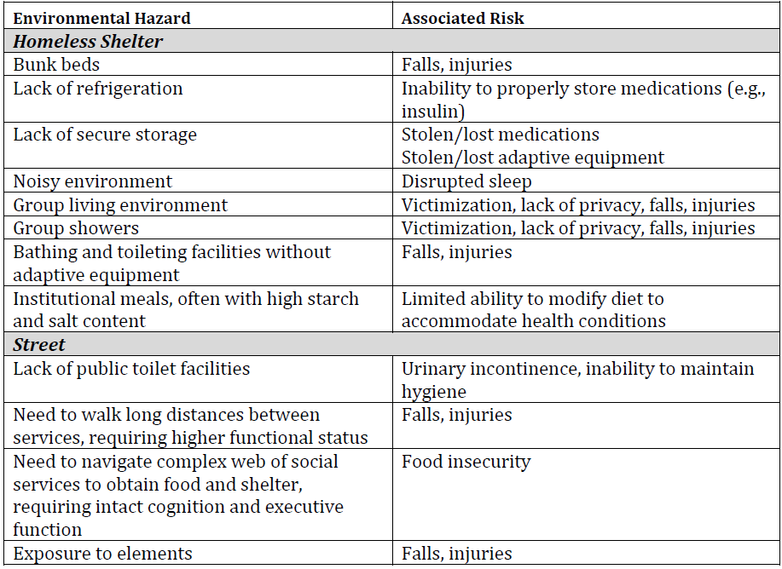
Brown R, Kushel, M. Understanding the Effects of Homelessness and Housing Instability on Older Adults. In: Williams BA, Chang A, Ahalt C, Chen H, Conant R, Landefeld C, Ritchie C, Yukawa M. eds. Current Diagnosis & Treatment: Geriatrics, Second Edition New York, NY: McGraw-Hill; 2014.
Notes:
Older adults who live in stable housing may be able to modify their environment to adapt to geriatric impairments—those experiencing unstable housing cannot adapt their environment to meet their needs.

Slide 31




Providing care for houseless older adults
Screen for ADL/IADL impairments
  Brief Instrumental Functioning Scale (BIFS) validated for houseless adults
Screen for falls at age 50
  Documentation requesting lower bunk
  Physical Therapy—don’t assume it can’t happen
Screen for cognitive impairment
  Use usual metrics (MOCA, SLUMS)
  Early referral to social work to determine resources
Medication management
  Storage options and refrigeration
  Weekly dispenses to minimize lost/stolen medications
Notes:
BIFS asks 6 questions related to life tasks and whether they can perform six activities entirely by themselves: take medications as prescribed by a physician, fill out an application for benefits such as food stamps, keep track of or budget their money, use city buses to get where they want to go,
Respondents answer that they can do the activity by them-selves, that they need help, or that they do not know whether they can do the activity by themselves. The BIFS is scored by assigning one point for each activity that respondents re-port being able to do by themselves. Items checked “don’t know” are considered to be activities with which the respondent would need help
https://ps.psychiatryonline.org/doi/epdf/10.1176/appi.ps.52.8.1097

Slide 32

It’s not JUST housing that’s needed
“Housing alone may not be sufficient to end and prevent homelessness for older adults and other at-risk subgroups, such as chronically homeless persons with an undue burden of co-occurring medical, psychiatric, and substance use disorders.”
– Dr. James O’Connell, Boston Health Care for the Homeless Program
O’Connell JJ. Zones of Excess Mortality for Homeless Adults in the US—A Half Century Later. JAMA Intern Med. 2022

Slide 33
Takeaways
Chronic stress, trauma, and social/healthcare disparities cause the body to age at a faster rate than expected
Accelerated aging leads to the development of geriatric syndromes 10-15 years ahead of chronological age--this means higher rate of comorbidities, risk of falls, cognitive impairment in a "younger" patient
Screening for social determinants of health within primary care settings could improve the ability to detect accelerated aging
There is no magic “solution”—but identifying geriatric syndromes in individuals with accelerated aging lets you intervene and improve quality of life

Slide 34


Thank you!
Visit: IndianCountryECHO.org
Laura Byerly, MD
Associate Professor of Medicine
Oregon Health & Science University
Oregon GWEP Program Director
byerlyla@ohsu.edu
gwep@ohsu.edu
Notes:
Please visit our website to sign-up to join one of our many ECHO sessions. Thank you!

