Slide 1
ECHO Diabetes Pancreatic Diabetes part 2
February 12, 2026
Carol Greenlee MD MACP

Slide 2
Pre-question: Which one answer is correct?
New onset diabetes caused by pancreatic cancer
Is primarily due to destruction of beta-cells by the cancer cells
Is associated with markedly increased insulin resistance
Is associated with rapid weight gain
Appears to be due to a paraneoplastic suppression of beta-cell function
Paraneoplastic – signs and symptoms that occur due to the production of chemical signaling molecules by tumor cells (not due to cancer destroying tissue)
Tumor-induced diabetes – tumor cells secrete substances that cause insulin resistance or interfere with insulin production

Slide 3
Pancreatic Diabetes or Diabetes in the Context of Disease of the Exocrine Pancreas
A type of diabetes that develops because of diseases of the exocrine pancreas or damage to the pancreas
Also referred to as Pancreatogenic or Type 3c Diabetes
Difficult to determine prevalence but likely up to 9-10% of diabetes cases
Some analyzes indicate Pancreatic Diabetes is more common than T1D
Often misdiagnosed as T2D, occasionally as T1D
Traditionally attributed to a variety of exocrine pancreatic diseases with various causes of hyperglycemia - most commonly:
Acute or Chronic pancreatitis (inflammation of the pancreas) - ~80%
Pancreatic cancer (pancreatic ductal adenocarcinoma) - ~ 8%
Pancreatic surgery
Trauma
Hemochromatosis
Cystic fibrosis ~4%
Notes:
https://pubmed.ncbi.nlm.nih.gov/33460395/
https://diabetesjournals.org/care/article/40/11/1486/36928/Incidence-Demographics-and-Clinical
https://pmc.ncbi.nlm.nih.gov/articles/PMC5495015/

Slide 4
Table 1 Classification of diabetes of the exocrine pancreas.
General inclusions
Post-pancreatitis diabetes mellitus (PPDM)
Post-acute pancreatitis diabetes mellitus (PPDM-A)
Post-chronic pancreatitis diabetes mellitus (PPDM-C)
Pancreatic cancer-related diabetes (PCRD)
Cystic fibrosis-related diabetes (CFRD)
General exclusions
Stress hyperglycemia
Autoimmune diabetes with first recognition after an attack
of pancreatitis
Diabetes with first recognition during pregnancy after an
attack of pancreatitis
Maturity-onset diabetes of the young
Drug-induced diabetes
Diabetes after pancreatic surgery
Diabetes after blunt pancreatic (abdominal) trauma
Diabetes secondary to pancreatic agenesis/hypoplasia
Diabetes secondary to hereditary hemochromatosis
Special entities
Antecedent diabetes mellitus in pancreatitis (ADMP)
New-onset diabetes in pre-symptomatic pancreatic ductal
adenocarcinoma (NOD-PDAC)
Recently proposed renaming & classification
For Diabetes of the Exocrine Pancreas (DEP)
Eur J Endocrinol. 2021 Apr;184(4):R151-R163. DIAGNOSIS OF ENDOCRINE DISEASE: Diagnosing and classifying diabetes in diseases of the exocrine pancreas
Notes:
Eur J Endocrinol
. 2021 Apr;184(4):R151-R163. doi: 10.1530/EJE-20-0974.
DIAGNOSIS OF ENDOCRINE DISEASE: Diagnosing and classifying diabetes in diseases of the exocrine pancreas

Slide 5
Table 1 Classification of diabetes of the exocrine pancreas.
General inclusions
Post-pancreatitis diabetes mellitus (PPDM)
Post-acute pancreatitis diabetes mellitus (PPDM-A)
Post-chronic pancreatitis diabetes mellitus (PPDM-C)
Pancreatic cancer-related diabetes (PCRD)
Cystic fibrosis-related diabetes (CFRD)
General exclusions
Stress hyperglycemia
Autoimmune diabetes with first recognition after an attack
of pancreatitis
Diabetes with first recognition during pregnancy after an
attack of pancreatitis
Maturity-onset diabetes of the young
Drug-induced diabetes
Diabetes after pancreatic surgery
Diabetes after blunt pancreatic (abdominal) trauma
Diabetes secondary to pancreatic agenesis/hypoplasia
Diabetes secondary to hereditary hemochromatosis
Special entities
Antecedent diabetes mellitus in pancreatitis (ADMP)
New-onset diabetes in pre-symptomatic pancreatic ductal
adenocarcinoma (NOD-PDAC)
Recently proposed renaming & classification
For Diabetes of the Exocrine Pancreas (DEP)
Eur J Endocrinol. 2021 Apr;184(4):R151-R163. DIAGNOSIS OF ENDOCRINE DISEASE: Diagnosing and classifying diabetes in diseases of the exocrine pancreas
Notes:
Eur J Endocrinol
. 2021 Apr;184(4):R151-R163. doi: 10.1530/EJE-20-0974.
DIAGNOSIS OF ENDOCRINE DISEASE: Diagnosing and classifying diabetes in diseases of the exocrine pancreas

Slide 6
Recap of Post-Pancreatitis Diabetes Mellitus (PPDM)
Chronic Pancreatitis – highest risk for PPDM (>70%)
Inflammation & other processes lead to fibrosis and tissue damage → loss of the functional tissue of the pancreas
Patients with chronic pancreatitis may develop the clinical triad of
abdominal pain (which occurs in 85%-97% of patients with chronic pancreatitis)
exocrine pancreatic insufficiency – loss of acinar cell function & digestive enzymes
Maldigestion/malabsorption (need for Pancreatic enzyme replacement therapy (PERT))
Impaired nutrient availability & incretin secretion
pancreatic endocrine insufficiency – loss of islet cell function (alpha, beta and pancreatic polypeptide cells)
Loss of glucagon → more hypoglycemia & erratic glycemia (“brittle” diabetes)
Loss of insulin → hyperglycemia (early need for insulin therapy)
Loss of PPP → hepatic insulin resistance → increased hepatic glucose production
Early on – metformin; then MDI – insulin pump with AID recommended

Slide 7
Recap of Post-Pancreatitis Diabetes Mellitus (PPDM)
Acute Pancreatitis – One of the most common GI disorders
Because AP is so common, in many analyzes AP is the most common cause of Post-pancreatitis DM (DEP/type 3 diabetes)
Risk higher with
alcohol-induced AP, recurrent AP &/or more severe AP
co-existing risk factors for type 2 diabetes (obesity, metabolic sn, +family hx)
AP reduces beta-cell reserve →
earlier age onset /diagnosis
earlier time to insulin therapy
More difficult to manage
higher risk of hypoglycemia & increased glucose variability
1.7 x more likely to have A1c >7% (less well controlled)
Loss of all types of islet cells (glucagon & PP as well as insulin)
Unrecognized early (within 5 years of diagnosis) need for insulin therapy

Slide 8
Table 1 Classification of diabetes of the exocrine pancreas.
General inclusions
Post-pancreatitis diabetes mellitus (PPDM)
Post-acute pancreatitis diabetes mellitus (PPDM-A)
Post-chronic pancreatitis diabetes mellitus (PPDM-C)
Pancreatic cancer-related diabetes (PCRD)
Cystic fibrosis-related diabetes (CFRD)
General exclusions
Stress hyperglycemia
Autoimmune diabetes with first recognition after an attack
of pancreatitis
Diabetes with first recognition during pregnancy after an
attack of pancreatitis
Maturity-onset diabetes of the young
Drug-induced diabetes
Diabetes after pancreatic surgery
Diabetes after blunt pancreatic (abdominal) trauma
Diabetes secondary to pancreatic agenesis/hypoplasia
Diabetes secondary to hereditary hemochromatosis
Special entities
Antecedent diabetes mellitus in pancreatitis (ADMP)
New-onset diabetes in pre-symptomatic pancreatic ductal
adenocarcinoma (NOD-PDAC)
Recently proposed renaming & classification
For Diabetes of the Exocrine Pancreas (DEP)
Eur J Endocrinol. 2021 Apr;184(4):R151-R163. DIAGNOSIS OF ENDOCRINE DISEASE: Diagnosing and classifying diabetes in diseases of the exocrine pancreas
Notes:
Eur J Endocrinol
. 2021 Apr;184(4):R151-R163. doi: 10.1530/EJE-20-0974.
DIAGNOSIS OF ENDOCRINE DISEASE: Diagnosing and classifying diabetes in diseases of the exocrine pancreas

Slide 9

Cystic Fibrosis
Cystic fibrosis is one of the most common genetic disorders, with about 1,000 new cases diagnosed each year.
Autosomal recessive disorder due to a defect in the chloride transport channel
Loss of function of the Cystic Fibrosis Transmembrane Conductance Transmitter (CFTR) gene →impacts CFTR protein
CFTR primarily located in lungs, intestines and pancreas
Nonfunctioning CFTR protein results in thick & sticky (viscous) mucous
Increased fluid viscosity & impaired mucociliary clearance in the airways → sinopulmonary disease
Viscous secretions in pancreatic ducts → plugging of ducts → fibrofatty replacement of the acinar tissues → pancreatic insufficiency
Cystic Fibrosis Related Diabetes (CFRD) is rare in childhood but develops in ~20% of adolescents & ~50% of adults with CF
Notes:
https://onlinelibrary.wiley.com/doi/10.1002/ppul.26209
Detection of disease-causing CFTR variants in state newborn screening programs
https://www.ucsf.edu/news/2022/10/424096/non-white-newborns-cystic-fibrosis-more-likely-be-missed-screening#:~:text=In%20most%20states%2C%20a%20newborn,potentially%20diagnosed%2C%2095%25%20properly%20diagnosed

Slide 10
Cystic fibrosis-related diabetes (CFRD)
Fat infiltration & inflammation from the plugged acinar ducts → loss of islet cells, but not complete loss – preserved islands of cells
Often enough Beta cells to provide insulin for basal needs / patients do not develop ketosis
Reduced Alpha cells - Adequate fasting glucagon (regulates hepatic glucose production) but impaired response to hypoglycemia
Hyperglycemia with food/nutrients
Recommendation is to do 2h OGGT annually beginning at age 10 years
~50% of cases of CFRD missed if use FBS or A1c for screening
Development of CFRD associated with worse pulmonary function, poorer nutritional status & higher mortality
Catabolic state & higher BGs increase risk for pulmonary infection
Prandial insulin therapy
Oral repaglinide may provide equivalent outcomes to short-acting meal-time insulin
Although the majority of CFRD patients have isolated post-prandial hyperglycemia, clinicians should be aware that those who develop fasting hyperglycemia are at risk of microvascular complications
Notes:
https://www.nhlbi.nih.gov/health/cystic-fibrosis/causes#:~:text=Cystic%20fibrosis%20is%20an%20inherited%20disease%20caused,each%20biological%20parent)%20will%20have%20cystic%20fibrosis.

Slide 11
Risk Factors for Cystic fibrosis-related diabetes (CFRD)
Risk factors for CFRD include:
more severe mutations
pancreatic insufficiency
a family history of T2DM
corticosteroid use
poor pulmonary function (less with early & optimal care)
undernutrition
liver dysfunction
Notes:
Cystic fibrosis-related diabetes: Prevalence, screening, and diagnosis - ScienceDirect

Slide 12
Cystic Fibrosis in AI/AN
Cystic fibrosis (CF) is significantly less common in American Indian and Alaska Native (AI/AN) patients compared to White populations, but it is more common than in Asian Americans.
The carrier frequency among AI/AN individuals is approximately 1 in 84 (vs 1 in 25 for White Americans; 1in 90 in Asian Americans; 1 in 46 in Hispanic Americans)
The incidence rate in AI/AN newborns is estimated to be around 1 in 36,000 live births (vs 1 in 2,500 – 3,500 in people of Northern European ancestry)
Genetic Variations: The specific CFTR gene mutations differ by ethnicity.
The most common mutation in AI/AN patients is often the 3849+10kbC>T variant (vs the F508del mutation) in White populations.
The 3849+10kbC>T variant is associated with a milder course of cystic fibrosis disease.
Diagnosis Disparities: AI/AN newborns and children are more likely to have delayed diagnoses or false-negative results
due to the lower prevalence and different common mutations (standard newborn screening panels are designed for the mutations prevalent in White populations)
This can lead to delays in treatment and worse health outcomes.
Clinical Presentation: In AI/AN patients, CF often presents with milder symptoms and is diagnosed at an older age, with incidental bronchiectasis and failure to thrive being common presentations
CFRD diagnosis complicated by high risk of T2D
Notes:
https://www.ucsf.edu/news/2022/10/424096/non-white-newborns-cystic-fibrosis-more-likely-be-missed-screening#:~:text=In%20most%20states%2C%20a%20newborn,potentially%20diagnosed%2C%2095%25%20properly%20diagnosed

Slide 13
Pancreatic Adenocarcinoma (Pancreatic Cancer)
Pancreatic adenocarcinoma is a malignant tumor of the pancreas that accounts for approximately 90% of all pancreatic carcinomas – called “Pancreatic Cancer”
Most tumors (about 60%-70%) occur in the head of the pancreas.
The peak incidence is in individuals aged 60-80 years, with > 90% of cases reported in adults > 55 years old.
The highest incidence is in Northern America
Male adults are slightly more affected in the United States and worldwide.
Pancreatic cancer is the 10th most common cancer for male persons and the eighth most common cancer for female persons in the United States.
African Americans are more commonly affected than persons of other races and ethnicities in the United States.
Native American and Alaskan Native (AI/AN) populations have
higher incidence of PDAC than US Whites
the worst survival outcomes for PDAC among all major US racial/ethnic groups
Notes:
Dynamed Plus
(PDF) Disparities in pancreatic cancer care and research in Native Americans: Righting a history of wrongs

Slide 14
Major Risk Factors for Pancreatic Cancer
Major risk factors include:
Tobacco use
Genetic predisposition and family history
~10% of pancreatic cancers are inherited, caused by inherited gene mutations (like BRCA1/2, PALB2, ATM)
Obesity/central adiposity
Chronic pancreatitis
Diabetes
Heavy alcohol use (> 3 drinks (30-45 g of ethanol) /day)
Other risk factors include:
Low physical activity
Dietary factors - Consumption of red meat (especially processed meat), foods high in sugars, foods containing saturated fatty acids
Insulin resistance
Sulfonylureas (suggestive) https://pubmed.ncbi.nlm.nih.gov/23399556/
Notes:
Dynamed Plus

Slide 15
Major Risk Factors for Pancreatic Cancer
Major risk factors include:
Tobacco use
Genetic predisposition and family history
~10% of pancreatic cancers are inherited, caused by inherited gene mutations (like BRCA1/2, PALB2, ATM)
Obesity/central adiposity
Chronic pancreatitis
Diabetes
Heavy alcohol use (> 3 drinks (30-45 g of ethanol) /day)
Other risk factors include:
Low physical activity
Dietary factors - Consumption of red meat (especially processed meat), foods high in sugars, foods containing saturated fatty acids
Insulin resistance
Sulfonylureas (suggestive) https://pubmed.ncbi.nlm.nih.gov/23399556/
Postpancreatitis DM > DM-Pancreatitis > Pancreatitis > T2DM
Notes:
Dynamed Plus

Slide 16
Bidirectional Relationship between Diabetes & Pancreatic Cancer
Diabetes is both a risk factor and a complication of pancreatic cancer.
Long-term type 2 diabetes (≥ 2 years) is associated with (predisposes to) an increased risk of pancreatic cancer, with risk ratios ranging from 1.5 to 2.0.
New-onset diabetes (NOD) may be caused by early-stage pancreatic cancer as a paraneoplastic syndrome with a poorly understood pathophysiology (Pancreatic ductal adenocarcinoma-related diabetes mellitus (PDAC-DM)) or PCRD
Up to 85% of patients with pancreatic cancer have diabetes or hyperglycemia, which frequently manifests as early as 2-3 years before a diagnosis of pancreatic cancer.
Glucose control worsens in patients with PDAC-DM in the face of ongoing, often profound, weight loss.
Diabetes & weight loss are paraneoplastic phenomena induced by pancreatic cancer.
These pancreatic cancer-induced metabolic alterations are likely mechanisms to promote the survival and growth of pancreatic cancer
Pancreatic cancer-induced Paraneoplastic Diabetes gets better/resolves with partial pancreatectomy resection of the cancer vs Type 2 diabetes usually gets worse (fewer Beta-cells- less insulin)
Notes:
New insights into pancreatic cancer-induced paraneoplastic diabetes – PMC
Diabetes and pancreatic cancer: a complex and confounding interplay | Gut

Slide 17
PDAC-DM/PCRD - potential clues to earlier diagnosis?
Pancreatic cancer is one of the deadliest cancers
due to aggressive invasion & spread and late diagnosis (7 to 9% 5-year survival)
~75% of people with PDAC die from their disease within 1 year of diagnosis
Earlier diagnosis is the key for improved survival
Localized (stage 1-2) allows resection (40 to 50+% 5-year survival)
No reliable screening tests for early detection
The metabolic dysregulation caused by invasive pancreatic cancer leads to new-onset glycemic abnormalities (NOGA) in the months to years preceding pancreatic cancer diagnosis
These metabolic changes could enable early diagnosis of pancreatic cancer, if they can be distinguished from the ones that occur in patients with type 2 diabetes (NOD due to pancreatic cancer vs T2D, etc.)
Adrenomedullin is a potential mediator of β-cell dysfunction (inhibits insulin secretion) in pancreatic cancer-induced diabetes & promotes invasive tumor behavior
Notes:
New insights into pancreatic cancer-induced paraneoplastic diabetes – PMC

Slide 18
Probability of Pancreatic Cancer in NOD
For patients with new-onset diabetes (NOD) – the clinical risk for PDAC shows a substantially increased probability within two years if combination of
age 50 years or older
unintentional weight loss
rapid glycemic deterioration/rapid A1c rise/early insulin requirements
PDAC-DM/PCRD is often clinically confused with type 2 diabetes (most cases of NOD), resulting in delayed cancer detection
UK guidelines recommend urgent imaging to assess for pancreatic cancer in people aged over 60 years with weight loss and new-onset diabetes
Imaging can include CT, MRI and endoscopic US
Notes:
Pancreatic Cancer and Diabetes: Insights, Hypotheses, and Next Steps

Slide 19
Metabolic Defects in PDAC-DM vs other forms of Diabetes
PDAC-DM and type 2 diabetes are metabolically distinct, with different defects responsible for hyperglycemia:
PDAC-DM is characterized predominantly by insulin deficiency and displays higher insulin sensitivity (less insulin resistance) than type 2 diabetes.
Compared with type 2 diabetes, individuals with PDAC-DM showed ~2.5-fold greater insulin sensitivity, ~81% lower insulin secretion and ~40% lower beta cell function
There are also differences in alpha cell regulation and insulin clearance compared with type 2 diabetes.
Glucagon and GLP-1 levels increased after a meal in both groups, but levels were higher in the PDAC-DM group. GIP levels were similar between groups.
Chronic pancreatitis type 3c (PPDM-c) often shows α-cell deficiency (decreased glucagon levels) and a high hypoglycemia risk whereas PDAC-DM has been shown to exhibit α-cell disinhibition (increased glucagon levels)
These findings identify biological characteristics that may have implications for individualized treatment of PDAC-DM and guide diagnostic biomarker discovery for early PDAC diagnosis – focus of ongoing research
Notes:
Pancreatic cancer-related diabetes and type 2 diabetes differ in multiple aspects of glucose homeostasis | DiabetologiaPancreatic Cancer and Diabetes: Insights, Hypotheses, and Next Steps

Slide 20
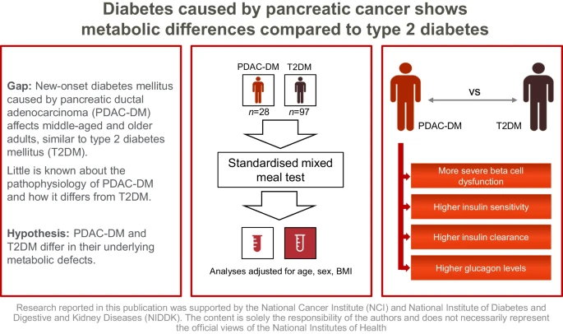
Notes:
Pancreatic cancer-related diabetes and type 2 diabetes differ in multiple aspects of glucose homeostasis | Diabetologia

Slide 21
Summary - Key Points
Cystic Fibrosis Related Diabetes (CFRD) usually develops with increasing age/duration of CF and/or with more severe mutation variants, co-existing stress, pancreatic insufficiency, corticosteroids.
The most common CF gene variant in AI/AN people results in a milder/less severe form
CFDR primary results in post-prandial hyperglycemia treated with mealtime insulin therapy
Pancreatic cancer-related diabetes (PCRD) [Pancreatic Ductal Adenocarcinoma Diabetes (PDAC-DM)] is considered a paraneoplastic phenomena induced by the PDAC
In a subset of people, new-onset hyperglycemia/diabetes (NOD) is due to PDAC – most often in people over age 50, with associated weight loss & rapid deterioration in glycemia/ rise in A1c or early requirement for insulin therapy
Currently no reliable screening test – potential for biomarker with further research on PCRD
AI/AN people have high risk for PDAC and worse prognosis (survival) (late diagnosis)
Think about PCRD in people with NOD, especially if weight loss, rapid worsening glycemia

Slide 22
Post-question: Which one answer is correct?
New onset diabetes caused by pancreatic cancer
Is primarily due to destruction of beta-cells by the cancer cells
Is associated with markedly increased insulin resistance
Is associated with rapid weight gain
Appears to be due to a paraneoplastic suppression of beta-cell function

Slide 23
Extra Slides

Slide 24
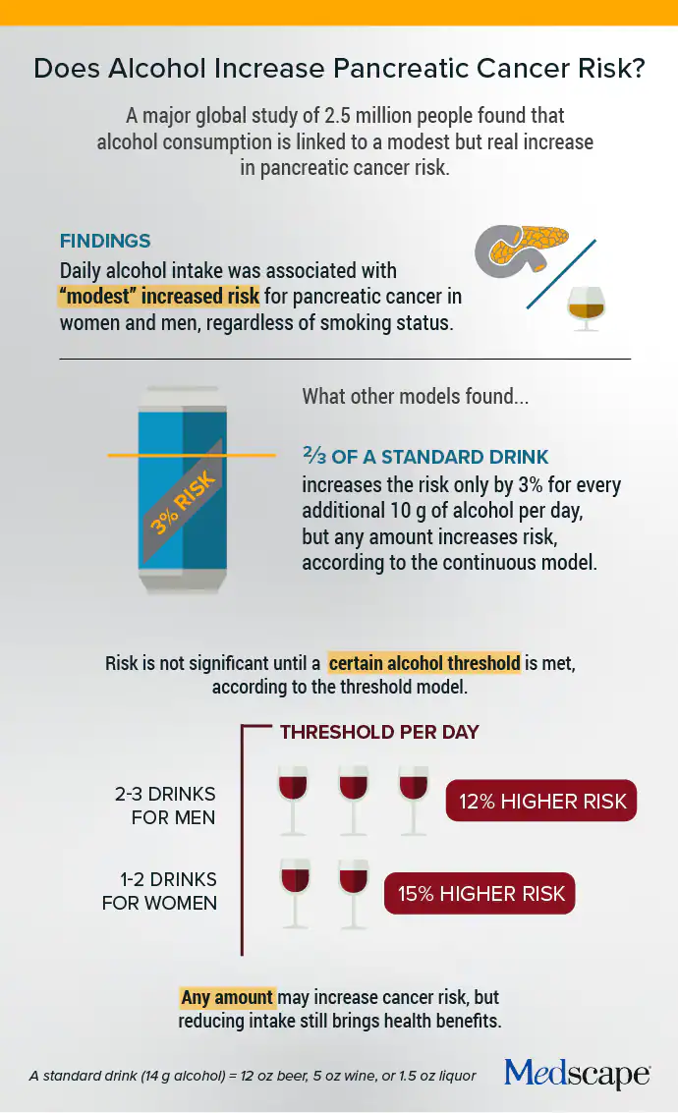

Slide 25
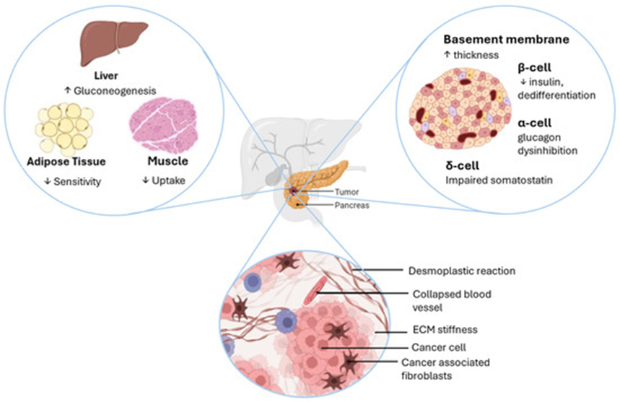
Pancreatic Cancer and Diabetes: Insights, Hypotheses, and Next Steps
Figure 2. Proposed mechanisms of PDAC-DM. Illustration of a proposed framework whereby PDAC perturbs systemic and islet glucose regulation. Changes in muscle, adipose, and liver, together with loss of islet hormonal balance, may result in progressive dysglycaemia and diabetes. Tumour-derived mediators promote hepatic gluconeogenesis, impair skeletal muscle glucose uptake, and reduce adipose insulin sensitivity.
Within islets, β cells exhibit reduced insulin secretion and dedifferentiation, α cells show glucagon disinhibition, and δ cells have impaired somatostatin signalling. Stromal alterations including basement membrane thickening, desmoplasia, extracellular matrix stiffening, vascular compression, and cancer-associated fibroblasts may further contribute to dysglycaemia. Arrows indicate directional increase or decrease in PDAC-DM.
Notes:
Pancreatic Cancer and Diabetes: Insights, Hypotheses, and Next Steps

Slide 26
Paraneoplastic Syndrome
The term paraneoplastic refers to conditions that are caused by or resulting from the presence of cancer in the body, but not due to the physical presence of cancerous tissue in the affected organ. Specifically, paraneoplastic syndromes are a set of signs and symptoms that occur due to the production of chemical signaling molecules by tumor cells or an immune response against the tumor. These symptoms can disrupt the normal function of surrounding cells and tissues. [Merriam Webster]
Tumor-induced diabetes mellitus occurs when tumors, particularly pancreatic tumors, secrete substances that cause insulin resistance or interfere with insulin production. This condition can precede the cancer diagnosis, sometimes resolves after tumor removal, and is often associated with weight loss rather than the weight gain typical of type 2 diabetes.
A paraneoplastic syndrome is a syndrome (a set of signs and symptoms) that is the consequence of a tumor in the body (usually a cancerous one).[1] It is specifically due to the production of chemical signaling molecules (such as hormones or cytokines) by tumor cells or by an immune response against the tumor.[2] Unlike a mass effect, it is not due to the local presence of cancer cells.[Wikipedia]

Slide 27
Risk Factors -DynaMedex
Tobacco smoking is a major risk factor in the development of pancreatic cancer.
The effect of smoking appears to be dose dependent in terms of smoking duration and intensity and decreases with smoking cessation.
Maternal smoking during pregnancy and childhood may also increase the risk of pancreatic cancer for the offspring.
Obesity (high body mass index [BMI], abdominal girth, weight gain, and fat distribution) and low-level physical activity are major risk factors for pancreatic cancer.
Low physical activity may be associated with increased risk of pancreatic cancer
Heavy alcohol use is associated with increased risk of pancreatic cancer. Consumption of > 3 drinks (30-45 g of ethanol) per day may be associated with increased risk of pancreatic cancer
Consumption of red meat (especially processed meat), foods high in sugars, foods containing saturated fatty acids, and excess vitamin D may increase risk of developing pancreatic cancer.
Dietary factors associated with increased risk of pancreatic cancer may include consumption of:
Red meat from beef, pork, lamb, and goat (WCRF/AICR Suggestive - limited evidence)
Processed meat, including meat preserved by smoking, curing, salting, or chemical preservatives (WCRF/AICR Suggestive - limited evidence)
Foods and beverages containing fructose, both naturally occurring and added (WCRF/AICR Suggestive - limited evidence)
Foods containing saturated fatty acids (WCRF/AICR Suggestive - limited evidence)
Reference - World Cancer Research Fund/American Institute for Cancer Research (WCRF/AICR) 2018PDF
Notes:
Dynamed Plus

Slide 28
Risk Factors/references - DynaMedex
Pancreatitis
Both alcoholic and nonalcoholic forms of chronic pancreatitis are reported to be associated with increased risk of pancreatic cancer.
Asian Pac J Cancer Prev 2014;15(12):5029.acute or chronic pancreatitis associated with increased risk for pancreatic cancer
Diabetes
Diabetes is both a risk factor and a complication of pancreatic cancer.
Long-term diabetes is reported to be associated with increased risk of pancreatic cancer.
Early-stage pancreatic cancer is reported to cause new-onset diabetes, but the pathogenesis is unclear.
PLoS One 2015;10(7):e0134321. long-term diabetes (≥ 2 years) associated with increased risk of pancreatic cancer
BMJ 2015 Jan 2;350:g7371. increased fasting blood glucose may be associated with increased risk of pancreatic cancer

Slide 29
Hart PA, Chari ST. Diabetes mellitus and pancreatic cancer: why the association matters? Pancreas. 2013 Nov;42(8):1207-9. doi: 10.1097/MPA.0b013e3182a7c963. PMID: 24152945; PMCID: PMC3826564.
New-onset diabetes mellitus frequently resolves following pancreatic cancer resection
Pancreatic resection in diabetic subjects would be expected to worsen DM as it is associated with loss of a third or more of pancreatic parenchyma. On the other hand, there is, on average, an 8% loss of body weight following pancreaticoduodenectomy, which should improve glucose tolerance.
While PaC patients with long-standing DM have persistent DM following pancreatic resection, patients with PaC and new-onset DM often experience resolution of diabetes in the postoperative setting,

Slide 30
Lancet Gastroenterol Hepatol. 2016 Oct 12;1(3):226–237. doi: 10.1016/S2468-1253(16)30106-6 Type 3c (pancreatogenic) diabetes mellitus secondary to chronic pancreatitis and pancreatic cancer
The markedly increased risk of pancreatic ductal adenocarcinoma in new-onset diabetes appears to be due to reverse causality—ie, pancreatic ductal adenocarcinoma causes hyperglycaemia. This notion is supported by a large body of clinical, epidemiological, and experimental evidence.
First, there is an exceedingly high prevalence of diabetes in the setting of pancreatic ductal adenocarcinoma, irrespective of the method of diagnosis.
Approximately 80% of patients with pancreatic ductal adenocarcinoma have abnormal fasting glucose or glucose intolerance regardless of tumour size or stage.
When formally tested with oral glucose tolerance tests, nearly two-thirds of patients with pancreatic ductal adenocarcinoma have diabetes.
When screened for diabetes with fasting glucose, the prevalence is about 45%.
Second, the onset of diabetes is often temporally related to the diagnosis of pancreatic ductal adenocarcinoma.
Most patients (75–88%) reported that diabetes was new onset—ie, diagnosed less than 24–36 months before diagnosis of pancreatic ductal adenocarcinoma.
Third, effective treatment of pancreatic ductal adenocarcinoma often leads to improvement in hyperglycaemia for those with new-onset diabetes secondary to pancreatic cancer.
Resection of the tumour improves or resolves diabetes in many patients with new-onset diabetes, although there is no improvement in those with long-standing diabetes.
Similarly, the metabolic defects are improved in those who have a treatment response to chemotherapy.82 Lastly, pancreatic tumours might indirectly induce hyperglycaemia.
Notes:
https://pmc.ncbi.nlm.nih.gov/articles/PMC5495015/#S2

Slide 31
Lancet Gastroenterol Hepatol. 2016 Oct 12;1(3):226–237. doi: 10.1016/S2468-1253(16)30106-6 Type 3c (pancreatogenic) diabetes mellitus secondary to chronic pancreatitis and pancreatic cancer
A population-based study from Rochester, MN, USA, found that approximately 1% of participants with new-onset diabetes at age 50 years or older have diabetes secondary to pancreatic cancer.
In other studies, subsets of participants with recently diagnosed diabetes have been found to have an even higher prevalence of pancreatic ductal adenocarcinoma (5.2–13.6%).
Thus, although long-standing diabetes modestly increases the risk of pancreatic ductal adenocarcinoma, new-onset diabetes appears to be a marker of underlying pancreatic ductal adenocarcinoma in an important subset.
--there is insufficient evidence to support the hypothesis that diabetes secondary to pancreatic cancer is due to local effects of tumour infiltration, ductal obstruction, and consequently glandular destruction.
Notes:
https://pmc.ncbi.nlm.nih.gov/articles/PMC5495015/#S2

