Slide 1
Medication Management of Depression
Jasen Christensen, DO
Professor Psychiatry and Behavioral Sciences
UNM School of Medicine

Slide 2
Disclosures
Nothing to Disclose

Slide 3
Learning Objectives
Be able to discuss reasons to choose and reasons to avoid certain antidepressants.
Be able to discuss the importance of antidepressant treatment duration.

Slide 4
Which Antidepressants Do We Have?
Fluoxetine (Prozac)
Paroxetine (Paxil)
Escitalopram (Lexapro)
Citalopram (Celexa)
Sertraline (Zoloft)
Amitriptyline (Elavil)
Nortriptyline (Pamelor)
Doxepin
Tricyclic
Antidepressants
TCA
SSRI
Mirtazapine (Remeron)
Bupropion (Wellbutrin XL)
Trazodone
Vilazodone (Viibryd)
Vortioxetine (Trintellix)
Venlafaxine (Effexor XR)
Duloxetine (Cymbalta)
Other
SNRI

Slide 5
Key Principles
If a medication can help a person with more than one problem, some patients will be more likely to try it
Encourage taking the medication daily, and at the same time daily
Set the expectation that these medications can take 6 weeks or more to help
Generally recommend taking antidepressants with some food to reduce chance of nausea (possible side effect during initiation)
Alcohol interacts with antidepressants by decreasing their effectiveness, but in nearly all cases there is no dangerous drug interaction with alcohol
Medications are most effective when combined with other interventions such as Psychotherapy or Behavioral Activation
Most antidepressants are also helpful for anxiety

Slide 6

Screening for Bipolar: why does it matter?
SSRI treatment associated with mania-like responses in as many as 8% of patients diagnosed as MDD ¹
Bipolar patients treated with antidepressant + mood stabilizer had no increased risk of mania over 3 months.
------------------------------
Bipolar patients treated with antidepressant monotherapy had increased risk for mania (HR=2.83%) ²
1. Baldessarini RJ, et.al. Journal of Affective Disorders 2013 May 15; 148(1): 129-35
2. Victorin A, et,al. American J of Psychiatry 2014; 171:1067-1073

Slide 7
Medical Consequences of Bipolar Disorder
Increase in medical comorbidity with longer duration of untreated bipolar disorder
Guiseppe M, et.al. Psychosomatics Sept/Oct 2013; 54(5): 437-42.

Slide 8
A clinician-administered screen for
Bipolar Disorder
CIDI-3
(WHO Composite International Diagnostic Interview)
https://fdocuments.us/document/stable-resource-toolkit-home-samhsa-hrsa-
mood-chart-61-the-stable-resource.html

Slide 9
Using the CIDI-3 (make a smartphrase or .phrase)
1. “Some people have periods lasting several days when they feel much more excited and full of energy than usual. Their minds go too fast. They talk a lot. They are very restless or unable to sit still and they sometimes do things that are unusual for them, such as driving too fast or spending too much money. Have you ever had a period like this lasting several days or longer?”
2. “Have you ever had a period lasting several days or longer when most of the time you were so irritable or grouchy that you either started arguments, shouted at people or hit people?”
“No” answer to these 2 questions is a negative screen for Bipolar Disorder

Slide 10
Stats for the CIDI-3
  For Bipolar I PPV= 0.79
          NPV= 0.99
For Bipolar II PPV = 0.85
        NPV= 0.99
So if you have 100 patients screen negative,
99 of them would not have bipolar disorder.
Kessler RC, et al. J Affective Disorders 2006 Dec; 96(3); 259-69

Slide 11
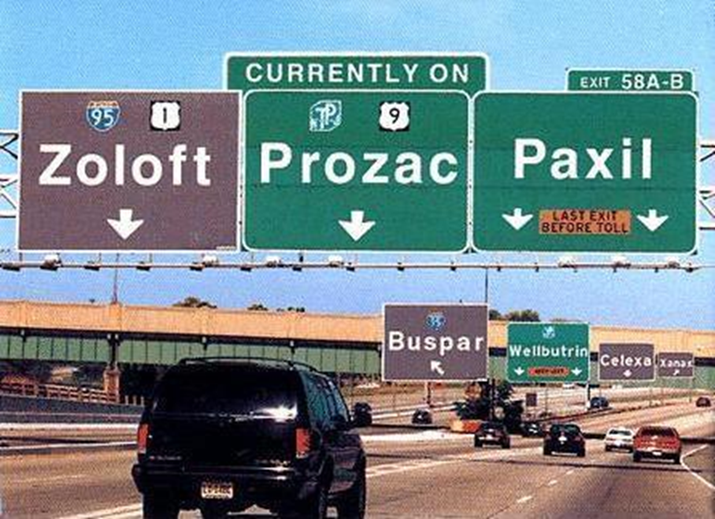

Slide 12
When to Consider Particular Medications
The following medication characteristics may help
Fluoxetine
Paroxetine
Escitalopram
Sertraline
Longest duration of action, so most forgiving when some doses are missed
Among the most helpful for anxiety / FDA approval for PTSD / Some evidence for earlier onset of benefit
Among the most helpful for anxiety / Generally very well tolerated
FDA approval for PTSD / Considered Safest Antidepressant in Pregnancy and During Lactation
SSRI
Venlafaxine
Duloxetine
Among the most helpful for anxiety / Helpful for ADD/ADHD
Among the most helpful for anxiety / Helpful for Chronic Musculoskeletal, Neuropathic and Myofascial Pain
SNRI
Amitriptyline
Nortriptyline
Helpful for Insomnia, Migraine Prophylaxis, Neuropathic Pain, Myofascial Pain
Helpful for Migraine Prophylaxis
TCA
Bupropion
Mirtazapine
Trazodone
No Sexual Side Effects / Helpful for Tobacco Cessation / Helpful for Methamphetamine Use / Helpful for ADD/ADHD
No Sexual Side Effects / Helpful for Methamphetamine Use / Helpful for Insomnia, Chronic Nausea, Low Appetite
No Sexual Side Effects / Helpful for Insomnia

Slide 13
When to Avoid Particular Medications
Or Use With Caution
Fluoxetine
Paroxetine
Escitalopram
Citalopram
Sertraline
Use with caution if already on many medications due to medication interactions / Most likely to cause hyponatremia
Avoid Use if Pregnant / Use with caution if already on many meds / Most likely to cause hyponatremia / Notable Discontinuation Syndrome
If QTc Interval is Prolonged or if there is risk for this
If QTc Interval is Prolonged or if there is risk for this
If nausea is already present / if patient is prone to GI side effects
SSRI
SNRI
Venlafaxine
Avoid if patient is prone to running out or losing med - has Notable Discontinuation Syndrome
Amitriptyline
Nortriptyline
Use with Caution if: Suicidal Ideation Present / Over Age 65 / Trouble with Anticholinergic Side Effects / Already Prolonged QTc Interval
TCA
Bupropion
Mirtazapine
Avoid use if there is a history of seizures
Use with caution if weight/BMI are already elevated

Slide 14
Treatment Duration
data from the STAR*D trial
Average duration of treatment to achieve remission was 7 weeks
40% of those who achieved remission required 8 weeks or more

Slide 15
References
Gaynes B, et.al The STAR*D study: Treating depression in the real world. Cleveland Clinic Journal of Medicine. 2008;75(1):57-66
Slee A, et al. Pharmacological treatments for generalized anxiety disorder: a systematic review and network meta-analysis. Lancet 2019;393:768-777
Matsuzawa-Yanagida K, et al. Usefulness of Antidepressants for Improving the Neuropathic Pain-Like State and Pain-Induced Anxiety through Actions at Different Brain Sites. Nature - Neuropsychopharmacology 2008;33:1952-1965.
Skljarevski V, et al. Efficacy of Duloxetine in Patients with Chronic Pain Conditions. Current Drug Therapy. 2011;6(4):296-303.
Urquhart D, et al. Efficacy of Low-Dose Amitriptyline for Chronic Low Back Pain, A randomized clinical trial. JAMA Internal Medicine. 2018;178(11):1474-1481.
Dobson K, et al. Randomized Trial of Behavioral Activation, Cognitive Therapy, and Antidepressant Medication in the Prevention of Relapse and Recurrence of Major Depression. Journal of Consulting and Clinical Psychology. 2008;76(3):468-477.
Rochester M, et al. Evaluating the risk of QTc prolongation associated with antidepressant use in older adults: a review of the evidence. Therapeutic Advances in Drug Safety. 2018;9(6):297-308.
Fava M, et al. 15 years of Clinical Experience with Bupropion HCL: From Bupropion to Bupropion SR to Bupropion XL. The Primary Care Companion to the Journal of Clinical Psychiatry. 2005;7(3):106-113.

