Slide 1
Clinical Pharmacy Resources for Syndemic Services
January 20, 2026
CAPT Holly Van Lew, PharmD, BCPS, AAHIVP
Dr. Bethany Johnson, PharmD, BCIDP

Slide 2
National Pharmacy Council – Ad Hoc Syndemic Committee
Toolkit
Resources
Community of Practice
Office Hours
Syndemic Newsletter
Committee developed to encourage pharmacy engagement in syndemic services, as part of a multi-pronged approach
IHS National Sexually Transmitted Infection (STI) Initiative – collaborative efforts from CMO, NPTC, and Syndemic Branch
Pharmacy-Based Syndemic Committee created in 2024
Deliverables:

Slide 3
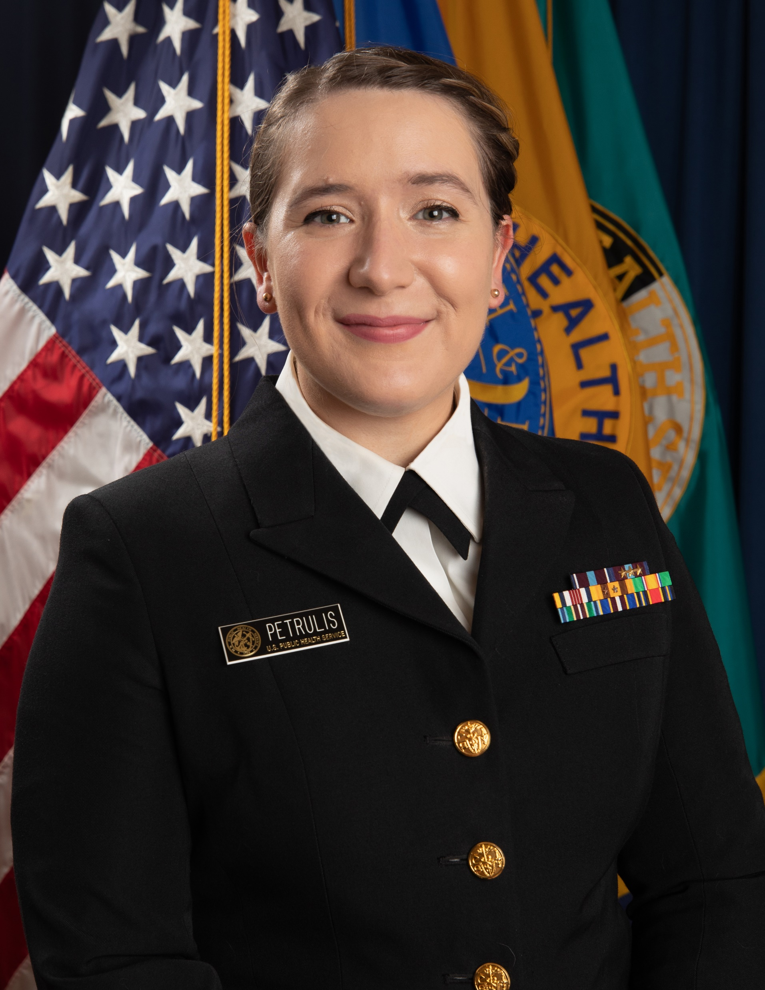
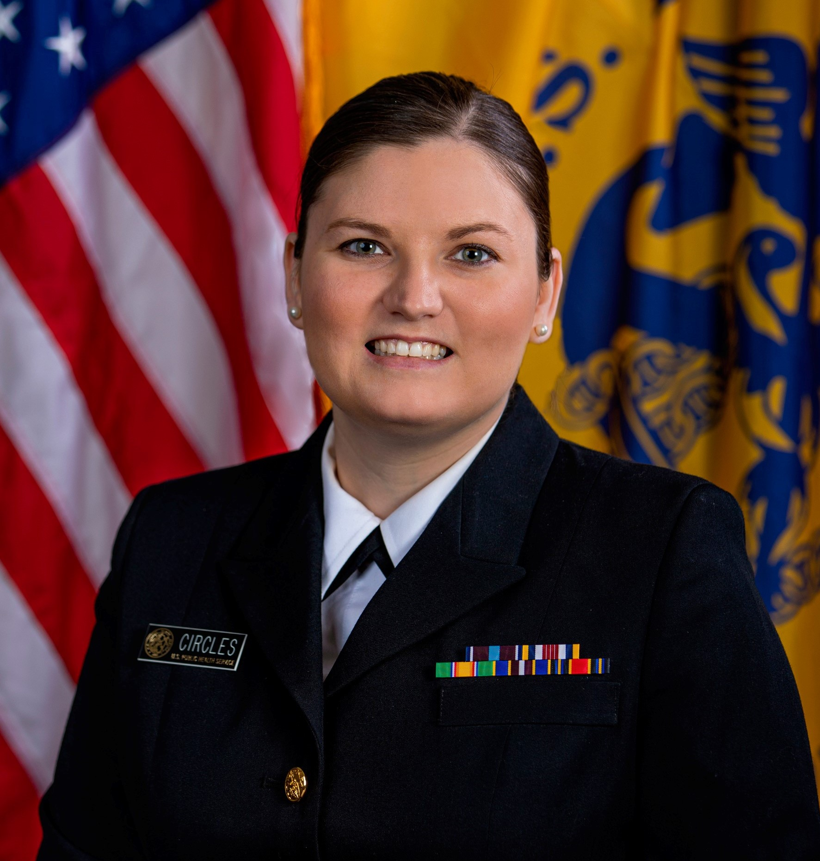
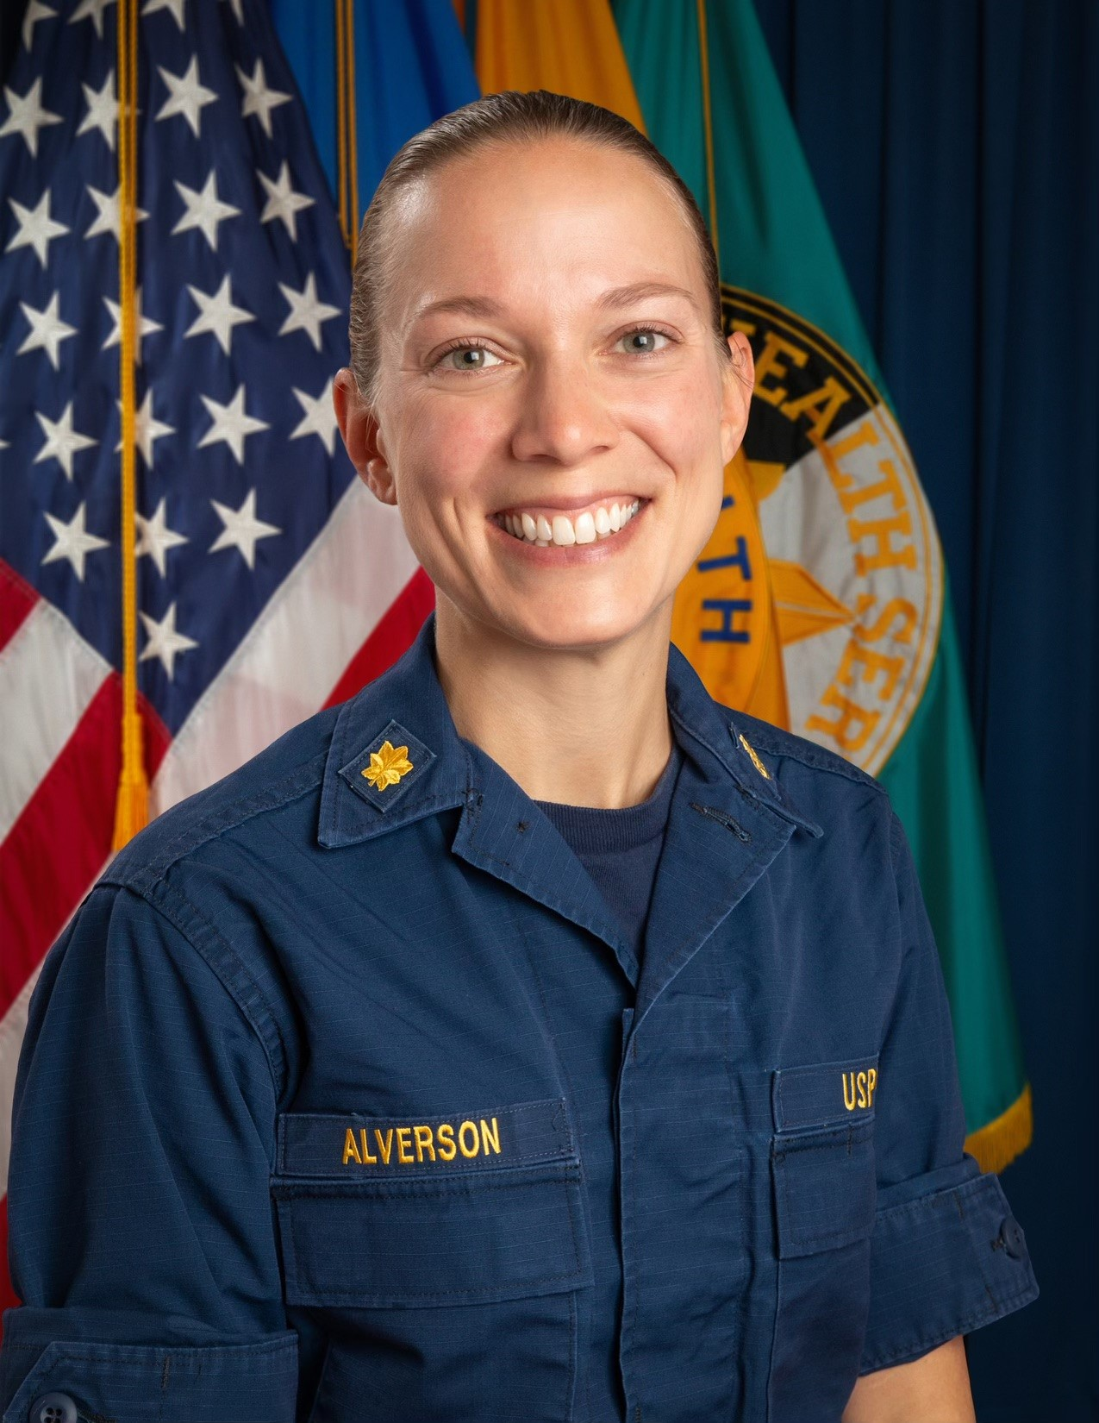
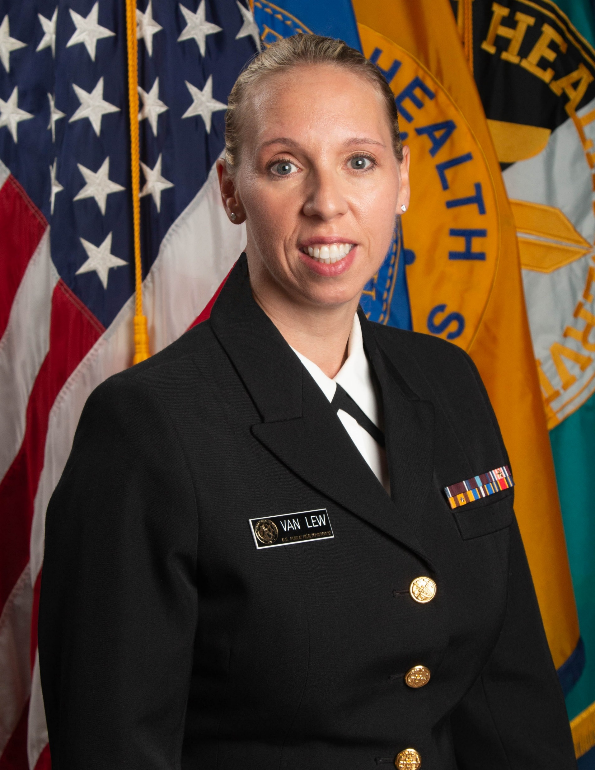
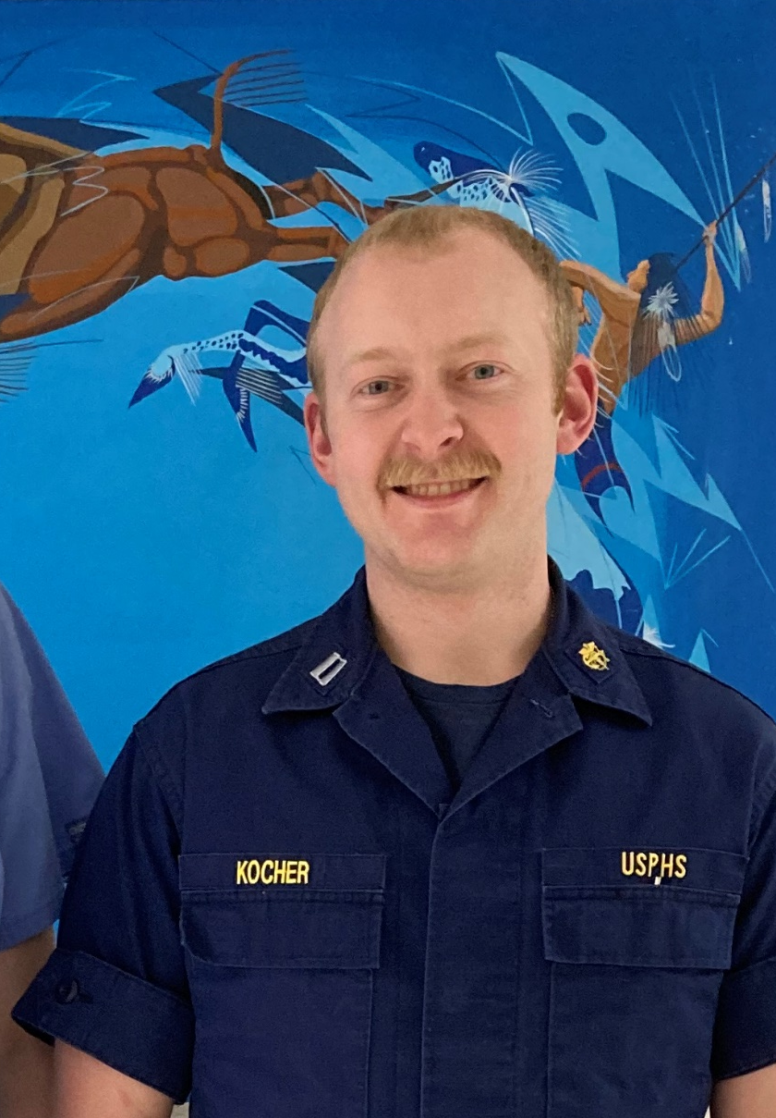

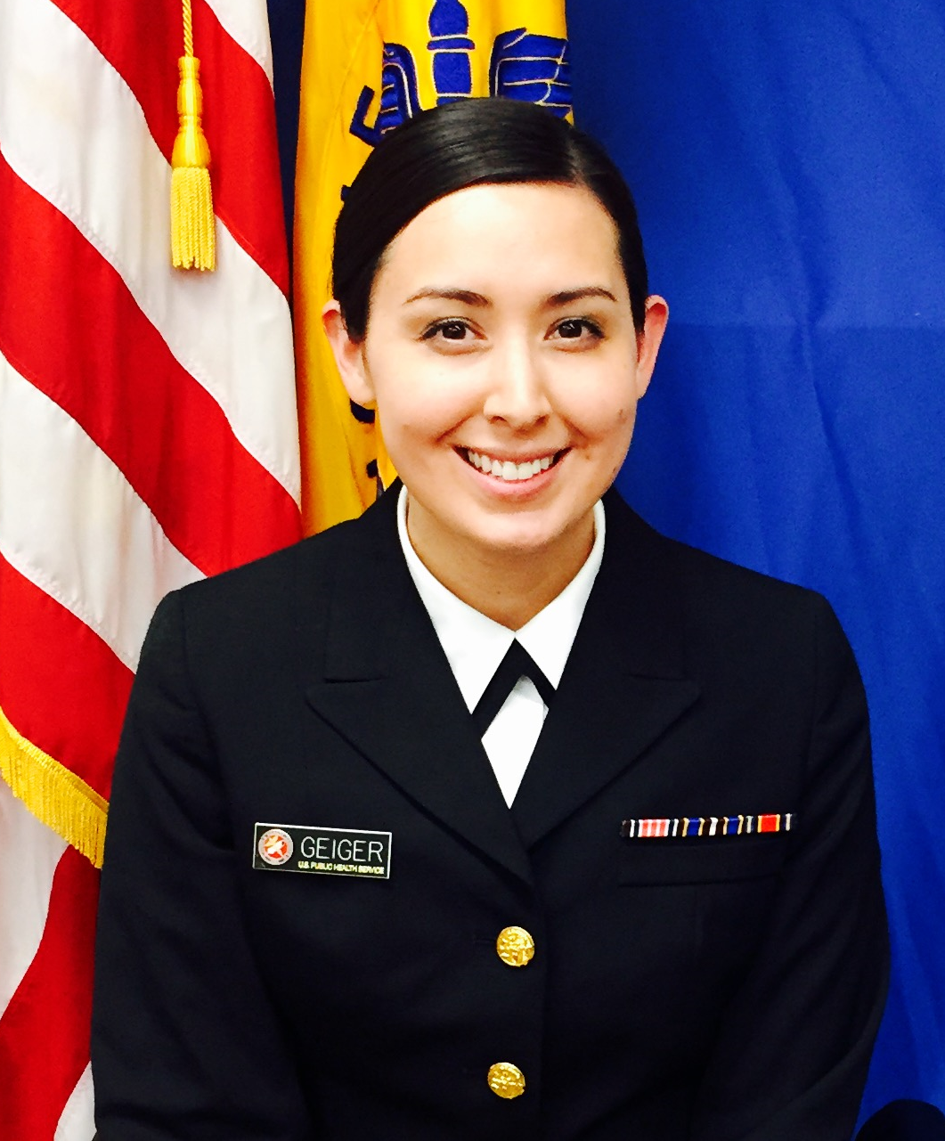
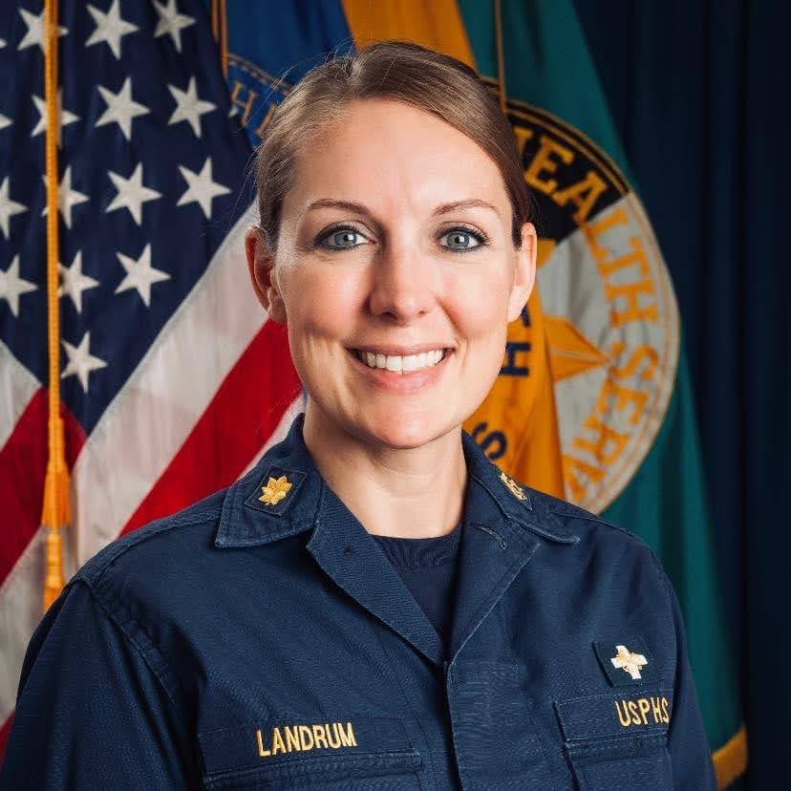
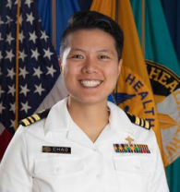

National Pharmacy Council – Ad Hoc Syndemic Committee
Not pictured:
Jonathan Enchinton
Heather Huentelman
Linda Mick

Slide 4
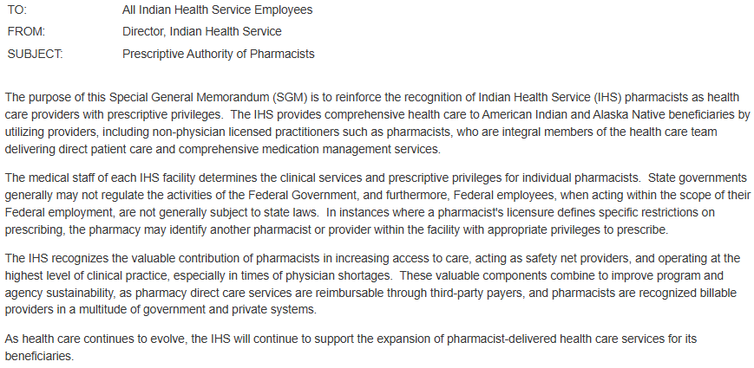
IHS Special General Memorandum (SGM) 24-09 - Issued Dec 20, 2024

Slide 5
Engaging Pharmacists in Syndemic Work
A Call to Action
Pharmacists are uniquely positioned to implement scalable interventions, frequently interact with patients, and drive measurable outcomes in reducing infection rates and improving quality of life.
Clinical and pharmacy leadership within the Indian Health Service endorses and supports this initiative.
Communications include a CALL TO ACTION for pharmacists to increase engagement in syndemic work to combat the intersecting epidemics of HIV/HCV/STIs.

Slide 6
Engaging Pharmacists in Syndemic Work
Adaptable Tools
The toolkit is packed with adaptable example policies and protocols, wrap-around documents, training resources, and implementation pearls.
All policies, protocols, note templates, and laboratory bundles are intended to be locally modified to fit the unique needs of each facility.
All resources are available online on the IHS STI webpage, in the “For Providers” section under “Clinical Pharmacy.”
Please join us in this urgent endeavor by adopting and promoting the use of the Pharmacy-Led Syndemic Toolkit.
Your leadership is pivotal in this fight.

Slide 7
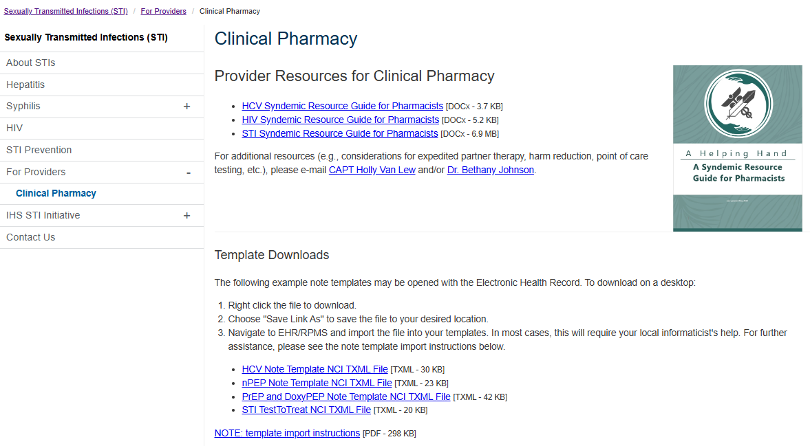
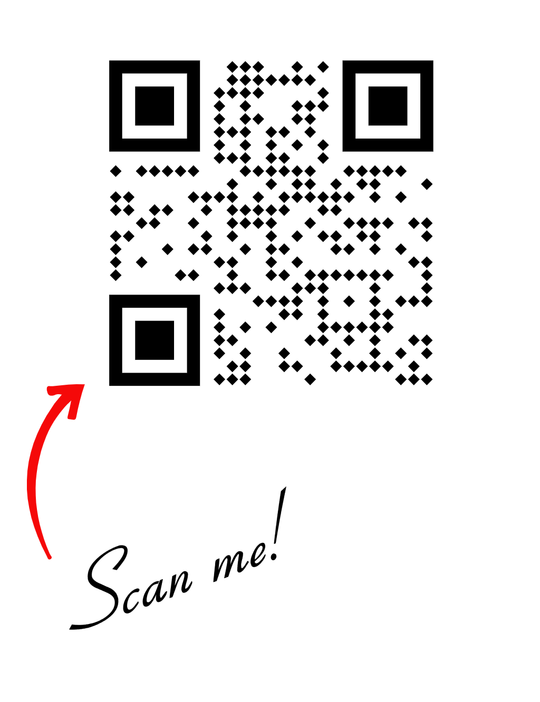
Virtual Tour of Online Resources
Notes:
Clinical Pharmacy | For Providers

Slide 8
Virtual Tour of Online Resources
A walk through of the toolkit
Engaging Pharmacists in Syndemic Work
Process Mapping
Frequently Asked Questions
Example Policy & Protocols
Example Note Templates – Text Based & File for Import into EHR
Training and Competencies
Notes:
Clinical Pharmacy | For Providers

Slide 9





Virtual Tour of Online Resources
A walk through of the toolkit

Slide 10
Note Templates
Two adaptable versions are available, created in collaboration with the National Council of Informatics.
Text-based template that can be used to build a note template
Importable template that can be populated and connected to local data sources
Clinics will need to collaborate with their local informaticist or clinical applications coordinator to customize and create or import templates.

Slide 11

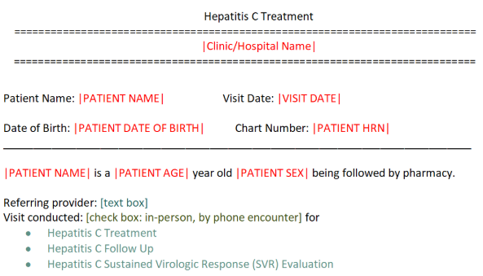
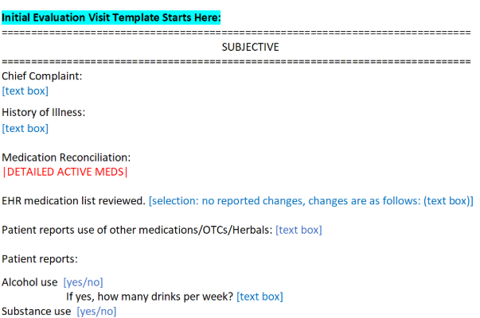
Note Templates

Slide 12
Virtual Tour of Online Resources

Slide 13
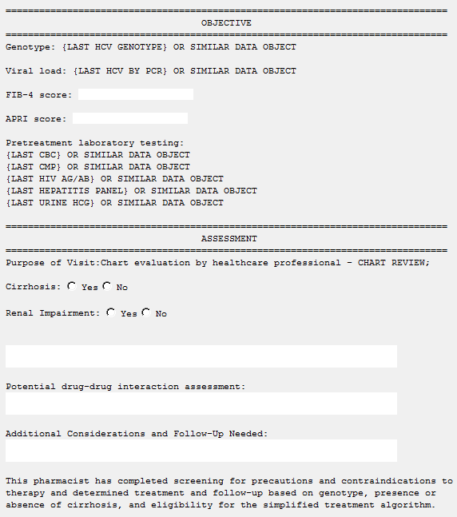
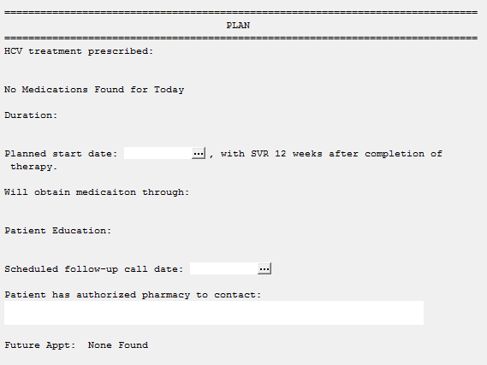
Note Templates

Slide 14
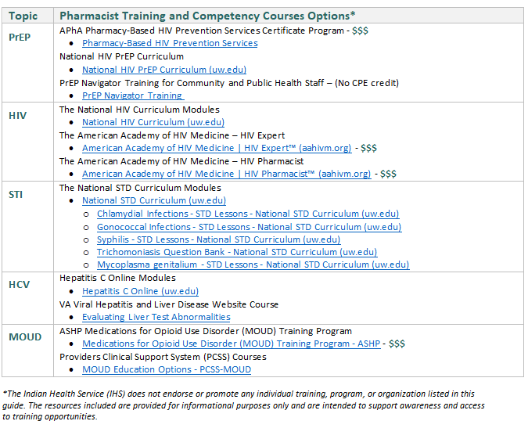
Training and Competency Resources

Slide 15
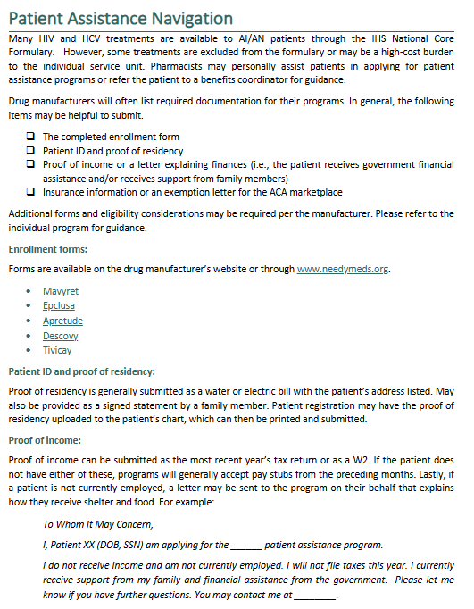
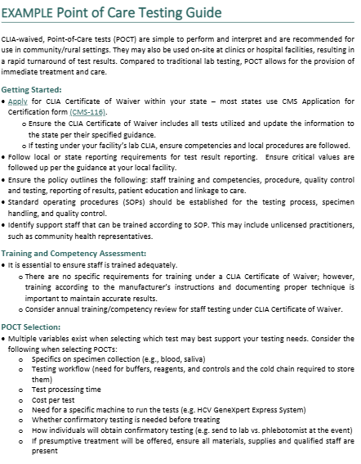
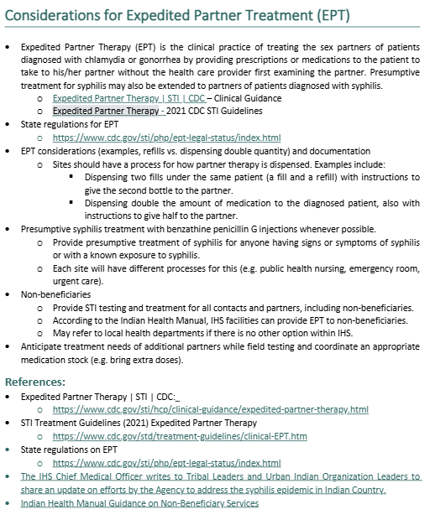
Resources Available
Notes:
Clinical Pharmacy | For Providers

Slide 16
Pharmacy Led Syndemic Committee - Next Steps

Slide 17
Defining Our Community of Practice
Goals
Sharing best practices and creating new knowledge to advance syndemic professional practices
Providing opportunities for mentorship and collaboration

Slide 18
Community of Practice Components
Bi-monthly Office Hours with a didactic portion offering CPE
Topics and presenters will vary and will address various aspects of syndemic work, share resources, highlight best practices, and spotlight activities at sites across the country.
Mentorship
Pharmacists who desire to implement syndemic services will be paired with one or more NPC Syndemic Committee Members as a mentor.
Mentors will provide technical assistance, including sharing resources, making recommendations, identifying gaps and needs, and working with mentees to implement pharmacy-based syndemic services.

Slide 19
Community of Practice Components
Technical assistance from the HIV/HCV/STI Branch
HIV/HCV/STI Branch will share guidance, resources, example policies, and subject matter experts for consultation.
Newsletter (in development)
Issues disseminated through listservs (Pharmacy, STI, HIV).
Content covering HIV/HCV/STIs, including guideline updates, best practices, spotlights on local programs, and upcoming events.
Please submit any program updates or projects that should be featured to holly.vanlew@ihs.gov or bethany.johnson@ihs.gov.

Slide 20
Support for Syndemic Services
Components
Training and competency resources
Syndemic-related pharmacist certification sponsorship
Patient incentives
Point-of-Care Test Program
Technical assistance
Mentorship request
For more information, please contact Bethany Johnson
(bethany.johnson@ihs.gov) or Holly Van Lew (holly.vanlew@ihs.gov).

Slide 21
Contact Us: CAPT Holly Van Lew, PharmD, BCPS, AAHIVP holly.vanlew@ihs.gov 240-475-2152 Dr. Bethany Johnson, PharmD, BCIDP bethany.johnson@ihs.gov 240-535-3014
Thank you for your attention!

