Slide 1
ECHO Diabetes Clinical Decision-Making for Insulin Pump Use Focus on Use in Type 2 Diabetes
January 8, 2026
Robin Johns RPh, CDCES
Carol Greenlee MD

Slide 2
Pre-question: Which one answer is correct?
Insulin Pump therapy with current AID systems
Requires more exact carb counting for meals & snacks than MDI (multiple daily injections)
Is too complex for people with type 2 diabetes to utilize
Often requires less insulin than MDI in people with large insulin requirements
Is not approved for use by people with type 2 diabetes

Slide 3
ADA 2026 Standards of Care
AID systems are the preferred insulin delivery system in individuals with type 1 diabetes and type 2 diabetes on multiple daily injections (MDI) and people with other forms of insulin-deficient diabetes.
They can be considered for use in people on basal insulin who are not reaching their targets.
Early initiation of AID therapy has been shown to be beneficial.
Recommendations
7.25a AID systems are the preferred insulin delivery method over MDI, CSII, and sensor-augmented pumps in
people with type 1 diabetes, A
adults with type 2 diabetes, A
children and adolescents with type 2 diabetes, E
those with other forms of insulin-deficient diabetes. B, C, D, E
Choice of an AID system should be made based on the individual’s circumstances, preferences, and needs. E
7.25b Consider AID systems for select people with type 2 diabetes treated with basal insulin not achieving individualized glycemic goals. B
Choice of an AID system should be made based on the individual’s circumstances, preferences, and needs. E
Notes:
https://diabetesjournals.org/care/article/49/Supplement_1/S150/163922/7-Diabetes-Technology-Standards-of-Care-in

Slide 4
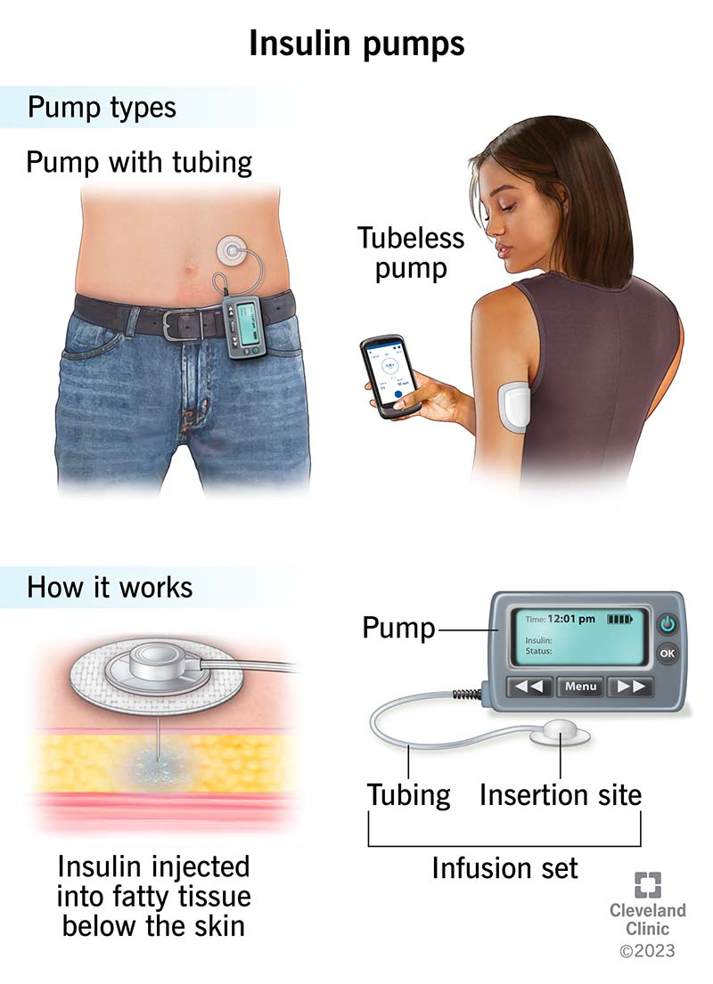
Insulin Pump Therapy
An insulin pump is a wearable medical device that supplies a continuous flow of rapid-acting insulin underneath the skin (Continuous Subcutaneous Insulin Infusion – CSII)
There are several brands of insulin pumps, but the two main categories are tubeless and tubed pumps
All pumps available in the United States today integrate with CGM (continuous glucose monitoring) technology and offer the ability to automatically adjust insulin delivery based on current glucose levels (Automated Insulin Delivery – AID (“Hybrid closed-loop”))

Slide 5

Tubed insulin pump
A tubed (tethered) insulin pump has a long, thin tube that connects the pump itself to a cannula under the skin
The pump is made of durable plastic and metal. It has a screen for viewing and selecting different settings and data. Along with the pump technology, it contains a cartridge (reservoir) of insulin. It may have a replaceable or rechargeable battery depending on the brand.
The maximum amount of insulin a reservoir can hold varies based on the pump type
The reservoir & infusion set must be changed every 2-3 days (now 7 days with MiniMed sets)
The reservoir must be changed if/when it runs out of insulin
New infusion sets, reservoirs and tubing are used every time. But the pump itself typically lasts for multiple years.
The tubing (which is several inches long) connects the reservoir of insulin in the pump to an infusion set on the skin.
The infusion set sticks to the skin with adhesive and has a smaller, flexible plastic tube (cannula) that goes underneath the skin.
The cannula is a few millimeters long and is inserted manually or with an injecting device.
The set has a needle that runs through the cannula so it can pierce the skin during insertion - the needle is removed so only the cannula remains.
The infusion set can be inserted on the upper arm, belly, hip, buttock or thigh
Usually, several types of infusion sets as options
While some tubed insulin pumps are waterproof, people typically disconnect them from the infusion site when they take a shower, bathe or swim and then reconnect the pump and tubing to the infusion site afterward. Some tubed pumps are just water resistant, not waterproof.
Tubed pump models: Tandem t:slim X2; Medtronic / MiniMed models; iLet Bionic Pancreas

Slide 6
Tubeless insulin pump
Tubeless insulin pumps (patch pumps) also use a flexible plastic tube (cannula) under the skin. But the insulin reservoir and the cannula are part of one “pod” that sits on the skin with an adhesive patch. There’s no external tubing.
The pump is operated wirelessly with a handheld controller.
Each pump — or pod — is used one time.
The pod needs to be changed every two to three days and must be changed if the reservoir runs out of insulin.
Before attaching the pod, the reservoir is filled with insulin
Then the adhesive is attached to the skin.
Next a button is pushed that releases a needle that’s threaded through the cannula in the pod. The needle retracts back into the pod, and the cannula remains under the skin. [only one option for cannula]
The pump can be worn on the upper arm, belly, hip, buttock or thigh.
Tubeless insulin pumps are waterproof (can bathe and swim with them on).
Omnipod 5

Slide 7
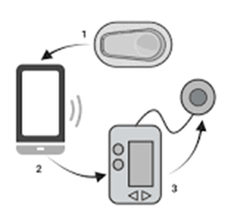
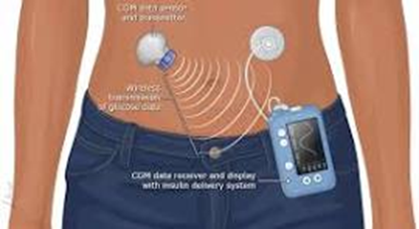
Automated Insulin Delivery (AID) systems Hybrid Closed Loop (HCL) systems
AID systems consist of mainly three components:
an insulin pump
a CGM system
an algorithm that determines insulin delivery (the “brain”)
the algorithm can be hosted in the pump body, in an insulin pod, or on a phone app.
All AID systems on the market today integrate with one or more CGM systems and adjust insulin delivery either by modulating the preprogrammed basal rates or by replacing the basal rates with microboluses or microdoses of insulin every 5 min.
The modulation of insulin delivery is done by increasing, decreasing, or pausing insulin based on
the CGM feedback
the predicted direction of the glucose levels (next 30-60 minutes)
the speed with which the glucose levels are changing

Slide 8
Algorithms Vary
All current AID systems provide automated correction doses, whether embedded in the microdose adjustments every 5 min or by providing additional correction boluses with doses that are dependent on the various types of algorithms, with variable frequency and threshold glucose based on the type of control algorithm.
Set basal rate, ICR & correction factor – algorithm learns insulin requirements
iLet uses only body weight to set up AID system
Current AID systems still require manual entry of carbohydrates for meal announcements or qualitative meal estimation (“usual”, “smaller than usual” “larger than usual”) announcements to calculate prandial doses.
some systems adjust better for missed meal “announcements” than others
Most AID systems can be used in manual mode (although this is generally not recommended, as the benefits of CGM modulation may be partially or totally lost)
Use of AID in manual mode may be necessary in some circumstances (e.g., sensor failure), therefore it is important to review and reassess manual-mode settings periodically (to be sure they align with actual insulin needs)

Slide 9

Non-Issues with CSII/AID systems in PWT2D
Ability to do math
Ability to carb count
Complexity
“Old” mindset – PWD needs to jump through all the hoops – “earn” the right to use CSII
“Of note, the treatment effect appeared to be similar among the patients who were receiving fixed doses of insulin and those who were counting carbohydrates for meal boluses before the trial and among the patients with higher as compared with lower numeracy scores at baseline.” A Randomized Trial of Automated Insulin Delivery in Type 2 Diabetes NEJM 2025
Notes:
https://pubmed.ncbi.nlm.nih.gov/40105270/

Slide 10
Existing Hoop for CSII/AID in PWT2D
ADA 2026 Standards of Care
There are no data that the presence or absence of C-peptide or islet autoantibodies is associated with responsiveness to continuous subcutaneous insulin infusion or AID therapy.
People with type 2 diabetes who continue to produce insulin have been shown to benefit from AID therapy .
The duration of diabetes is not related to outcomes with the use of technology.
Therefore, none of these measures should be used when determining suitability for continuous subcutaneous insulin infusion or AID therapy.
Unfortunately, currently Medicare & most state Medicaid still requires a low c-peptide value for the tube pumps (DME) - the tubeless pump is pharmacy benefit and does not require low c-peptide

Slide 11
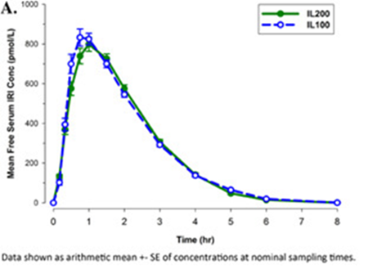
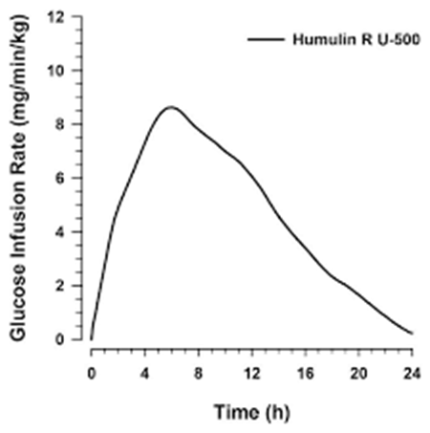
Issues with CSII/AID in PWT2D
Volume of insulin needed (units/day) vs reservoir capacity (200 -300 units)
Need to change reservoir /pod more often if large insulin doses
Often need less insulin with pump vs MDI but this varies
For safety usually reduce TDI by 25% for initial start of AID system
Add basal injection to CSII
Use of concentrated insulin (Humalog U200, Humulin U500)
AID systems not set for these/off label use
Lispro (Humalog )U200 (only available in pens) – pharmacokinetics & pharmacodynamics identical to U100 lispro insulin : https://www.frontiersin.org/journals/endocrinology/articles/10.3389/fendo.2025.1692589/full
U500 pharmacokinetic and pharmacodynamic profile differ significantly from U100 - U500 human insulin has an action time of 18.1-21.5 hours, the action time for U100 is 4–6 hours
Case reports on use in AID systems

Slide 12
Insulin Pumps with AID Systems
Omnipod 5 (tube-free) (Pharmacy benefit – no c-peptide level required to qualify)
iPhone or Android smartphone app or use of the Controller
Pairs with Dexcom & Freestyle Libre Plus sensors
Can adjust insulin action time in AID mode (allows AID system to begin correcting high BG earlier)
200-unit reservoir
MiniMed 780G system
SmartGuard & Meal Detection technology (most forgiving of missed meal announcements)
New sensors – Instinct (by Abbott) (15 day) & Simplera Sync as well as Guardian 4 sensor
Can adjust insulin action time in AID mode
300-unit reservoir
Tandem T:slim X2
Control-IQ technology
Tandem Mobi pump or t:slim X2 pump
Insulin action time fixed at 5 hours in AID mode
300-unit reservoir
iLet Bionic Pancreas
Based on weight alone
Requires meal announcements with usual, smaller or larger than usual (least forgiving)
300-unit reservoir

Slide 13
Kudva YC, Raghinaru D, Lum JW, et al.; 2IQP Study Group. A randomized trial of automated insulin delivery in type 2 diabetes. N Engl J Med 2025;392:1801–1812
Abstract: In this 13-week, multicenter trial, adults with insulin-treated type 2 diabetes were randomly assigned in a 2:1 ratio to receive AID (Tandem t:slim X2) or to continue their pretrial insulin-delivery method (control group);
Both groups received continuous glucose monitoring (CGM).
The primary outcome was the glycated hemoglobin level at 13 weeks.
Results: A total of 319 patients underwent randomization. Glycated hemoglobin levels decreased by 0.9 percentage points (from 8.2±1.4% at baseline to 7.3±0.9% at week 13) in the AID group and by 0.3 percentage points (from 8.1±1.2% to 7.7±1.1%) in the control group (mean adjusted difference, -0.6 percentage points; 95% confidence interval.
The mean percentage of time that patients were in the target glucose range of 70 to 180 mg per deciliter increased from 48±24% to 64±16% in the AID group and from 51±21% to 52±21% in the control group (3.4 hours per day longer with AID than with CGM alone).
Conclusions: In this 13-week, randomized, controlled trial involving adults with insulin-treated type 2 diabetes, AID was associated with a greater reduction in glycated hemoglobin levels than CGM alone.
Notes:
https://pubmed.ncbi.nlm.nih.gov/40105270/

Slide 14
Kudva YC, Raghinaru D, Lum JW, et al.; 2IQP Study Group. A randomized trial of automated insulin delivery in type 2 diabetes. N Engl J Med 2025;392:1801–1812
Among the patients with a baseline glycated hemoglobin level of 9.0% or higher, the mean glycated hemoglobin level was reduced from
10.3% to 7.9% in the AID group
9.7% to 8.6% in the control group
(mean difference, −1.0 percentage point; 95% CI, −1.5 to −0.5).
Among the patients who were receiving GLP-1 receptor agonists at baseline, the mean change in the glycated hemoglobin level was
−0.8±0.9% in the AID group (85 patients)
−0.3±0.8% in the control group (53 patients).
Among the patients who were receiving SGLT2 inhibitors at baseline, the mean change in the glycated hemoglobin level was
−0.8±0.9% in the AID group (72 patients)
−0.2±0.7% in the control group (41 patients).
Among users of both GLP-1 receptor agonists and SGLT2 inhibitors, the mean change in the glycated hemoglobin level was
−0.8±1.0% in the AID group (43 patients)
−0.1±0.7% in the control group (24 patients)
Notes:
https://pubmed.ncbi.nlm.nih.gov/40105270/

Slide 15
Kudva YC, Raghinaru D, Lum JW, et al.; 2IQP Study Group. A randomized trial of automated insulin delivery in type 2 diabetes. N Engl J Med 2025;392:1801–1812
The mean total insulin dose changed from
95±47 units per day at baseline to 87±46 units per day at 13 weeks in the AID group
102±50 units per day to 104±56 units per day, respectively, in the control group.
The mean change from baseline in weight was
2.4±4.4 kg in the AID group
0.9±3.3 kg in the control group
The use of the AID system led to no new safety signals unique to a population with type 2 diabetes.
Device-related adverse events were mainly due to infusion-set failures.
The results of this trial suggest that previous experience with an insulin pump or in-depth training in carbohydrate-counting methods are not prerequisites to the successful and safe use of AID to improve glycemia in patients with type 2 diabetes.
Notes:
https://pubmed.ncbi.nlm.nih.gov/40105270/

Slide 16
Diabetes Research & Clinical Practice. Volume 174108735April 2021 Improved glycemic control in 3,592 adults with type 2 diabetes mellitus initiating a tubeless insulin management system
Results
Change (mean ± SD) in HbA1c was
−1.3 ± 1.7% overall
−1.4 ± 1.7% for prior MDI users
−0.9 ± 1.5% for prior CSII users
The percentage of patients with
HbA1c ≥9% decreased (49% to 19%)
HbA1c <7% increased (10% to 22%) (p<0.0001).
Reductions in
TDD (overall, −33 ± 52U, p<0.0001)
Hypoglycemic Events (HE) per week (overall, −0.5 ± 2.0, p<0.0001),
Conclusions: Omnipod System use was associated with statistically and clinically meaningful reductions in HbA1c, TDD, and HE compared to prior treatments in T2DM.

Slide 17
Pasquel FJ, Davis GM, Huffman DM, et al.; Omnipod 5 SECURE-T2D Consortium. Automated insulin delivery in adults with type 2 diabetes: a nonrandomized clinical trial. JAMA Netw Open Feb 2025
Abstract - Objective: To evaluate the association of AID with hemoglobin A1c (HbA1c) levels in a diverse cohort of adults with type 2 diabetes. [Secure T2D]
Intervention: Participants used the Omnipod 5 AID System for 13 weeks following the 14-day standard therapy phase.
Following AID use,
HbA1c levels decreased from a mean (SD) of 8.2% (1.3) at baseline to 7.4% (0.9) at 13 weeks (mean difference, -0.8).
Improvement was seen across various subgroups (age, sex, race and ethnicity, insurance), and notably with or without use of GLP-1RAs or SGLT-2is and regardless of pretrial mealtime insulin regimen.
Time in target glucose range (70-180 mg/dL) increased from a mean (SD) of 45% (25) to 66% (17) (mean difference, 20).
Percentage of time in hypoglycemic ranges of less than 54 mg/dL and less than 70 mg/dL was noninferior compared with standard therapy. There was 1 episode of severe hypoglycemia and none of diabetic ketoacidosis or hyperosmolar hyperglycemic syndrome.
Conclusions and relevance: In this nonrandomized clinical trial, HbA1c levels were lower in a diverse cohort of adults with type 2 diabetes following AID initiation, suggesting that AID may be a beneficial and safe option for people with type 2 diabetes using insulin.
Notes:
https://pubmed.ncbi.nlm.nih.gov/39951268/

Slide 18
Pasquel FJ, Davis GM, Huffman DM, et al.; Omnipod 5 SECURE-T2D Consortium. Automated insulin delivery in adults with type 2 diabetes: a nonrandomized clinical trial. JAMA Netw Open Feb 2025
Participants had various techniques for insulin dosing at mealtimes, including carbohydrate counting or a more simplified meal bolus technique (i.e., small, medium, and large, fixed-dose, or correction-only).
Reduction in A1c similar for all premeal insulin techniques with use of AID system
Those with baseline HbA1c of 9.0% or greater had a decrease of −2.1 (95%CI, −2.3 to −1.9) percentage points,
those with baseline HbA1c level of less than 7.0% saw no change (0.0 [95%CI, −0.3 to 0.2] percentage points
A reduction in HbA1c level was observed in both GLP-1RA users and nonusers:
HbA1c decreased from a mean of 8.1% at baseline to 7.3% at end of treatment in GLP-1RA users (-0.9% points)
HbA1c decreased from a mean (SD) 8.4% to 7.5% for GLP-1RA nonusers (-0.8% points)
A similar pattern was observed for SGLT-2i users and nonusers.
Notes:
https://pubmed.ncbi.nlm.nih.gov/39951268/

Slide 19
Pasquel FJ, Davis GM, Huffman DM, et al.; Omnipod 5 SECURE-T2D Consortium. Automated insulin delivery in adults with type 2 diabetes: a nonrandomized clinical trial. JAMA Netw Open Feb 2025
Body mass index (BMI) changed from a mean of 34.9 at baseline to 35.1 at 13 weeks corresponding to a body weight increase of 0.8 kg
Total daily insulin requirements decreased from mean (SD) of 0.80 (0.46) U/kg/d at baseline to 0.57 (0.29) U/kg/d with AID (change, −0.23 U/kg/d)
At baseline, 94 participants (31%) used 100 U/d of insulin or more, which decreased to 31 (10%) at 13 weeks. After adjustment for
Adjusting for baseline HbA1c, a similar change in HbA1c level was observed among subgroups based on sex, age, socioeconomic status, pretrial mealtime insulin regimen, noninsulin glucose-lowering medication use, C-peptide level, and previous CGM use.
There were no serious adverse device effects. Overall, 73 device issues were reported during the treatment phase.
A total of 58%of these were related to the Pod, 21% related to the controller or personal smartphone, 12%related to the CGM sensor, and 10% related to the CGM transmitter
Notes:
https://pubmed.ncbi.nlm.nih.gov/39951268/

Slide 20
Key Points
People with T2D who require treatment with insulin benefit from use of Insulin pump therapy with AID systems regardless of c-peptide level, type of premeal insulin technique or use of GLP1 RA/SGLT2i medications
Benefits include greater TIR, lower risk of exercise-induce hypoglycemia and psychosocial benefits (e.g., reduced diabetes distress)
The main limitation is reservoir capacity for those with large insulin requirements due to more frequent changes of pods/infusion sets/reservoirs – options to help mitigate frequent changes include
Use of injected basal dose along with pump
Use of Lispro U200 (off label) in the pump
Potential use of U500 insulin but more research needed on how to safely use with the AID algorithms
Different AID systems offer different benefits & limitations – allow for individual considerations
Education & ongoing support are important for effective use and safety

Slide 21
Post-question: Which one answer is correct?
Insulin Pump therapy with current AID systems
Requires more exact carb counting for meals & snacks than MDI (multiple daily injections)
Is too complex for people with type 2 diabetes to utilize
Often requires less insulin than MDI in people with large insulin requirements
Is not approved for use by people with type 2 diabetes

Slide 22
Extra Slides

Slide 23
Medicare C-peptide Criteria Details
Standard (No Renal Issues): Fasting C-peptide must be ≤110% of the lab's lower limit of normal (LLN).
E.g., if normal range 0.5-2.0 – then 110% LLN = 0.55
With Renal Insufficiency: For patients with Creatinine Clearance (CrCl) ≤50 mL/min, the fasting C-peptide must be ≤200% of the lab's LLN.
For normal range 0.5-2.0, 200% LLN = 1.0
Concurrent Test: A fasting blood sugar drawn at the same time must be ≤225 mg/dL.
Alternative: A positive beta-cell autoantibody test (indicating Type 1 diabetes) can substitute for C-peptide levels.

Slide 24
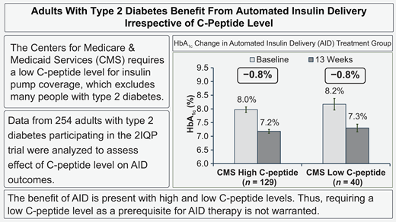
Adults With Type 2 Diabetes Benefit From Automated Insulin Delivery Irrespective of C-Peptide Level. Diabetes Care September 15 2025. Irl B. Hirsch; Yogish C. Kudva; et al

Slide 25
955-P: Effective Use of U-200 Insulin in OmniPod 5, Medtronic 780G, and Tandem X2 Systems June 2024 Diabetes 73 (Supplement_1)
Objectives: Commercially available insulin pumps are approved for U-100 insulin. Patients with high insulin dose requirements need to change infusion sets every 1-2 days, creating inconvenience and increasing costs. We evaluated the safety and feasibility of using U-200 insulin in hybrid closed-loop systems.
Methods: We reviewed clinical data and insulin pump uploads from three patients using U-200 insulin in their pumps, each diagnosed with a different type of diabetes: Type 1, Type 2, and post-pancreatitis. Each patient used a different hybrid closed-loop system in automated mode: OmniPod 5, Medtronic 780G, and Tandem X2. Insulin doses were reduced by 50% when programming the pump settings for U-200, with minor individual variations.
Results: Using U-200 insulin extended the infusion set wear from 1-2 days to 3 days.
For the patient using
the Medtronic 780G, Time in Range (TIR) improved by 57% in the month after transitioning to U-200 insulin. The Glucose Management Indicator (GMI) decreased from 9.6% to 7.4%, with SmartGuard mode active 73% of the time.
the Tandem X2, TIR increased by 33% over a month, and GMI improved from 8.7% to 7.5%, with the patient in Control IQ mode 94% of the time
the OmniPod 5 showed a 6% improvement in TIR and was in automated mode 100% of the time, with GMI improving from 6.7% to 6.5%.
There was no increase in time spent in hypoglycemia with U-200 insulin. All three patients reported enhanced quality of life and increased satisfaction with their pump therapy.
Conclusion: The use of U-200 insulin in hybrid closed-loop system algorithms was safe and effective, offering a viable option for automated insulin delivery systems (AIDS) in patients with high insulin needs.
This approach could also broaden the application of AIDS to different types of diabetes, as evidenced by our patients. This is the first reported case series to date. Further studies are necessary to establish standardized recommendations for using concentrated insulins in AIDS.

Slide 26
Practical considerations for using concentrated U200 insulin in automated insulin delivery systems Front. Endocrinol., 27 October 2025. Volume 16 - 2025
The use of automated insulin delivery systems (AID) is standard of care for people with type 1 diabetes. However, the limited capacity of insulin pump cartridges, which can hold 1.6-3.0mL or the equivalent of 160–300 units of U100 insulin, can be a barrier to AID use for individuals with high total daily insulin (TDI) requirements.
With the rising prevalence of obesity, expansion of AID use to type 2 diabetes, and trends towards smaller cartridge volumes to decrease the size of devices, practical solutions to reduce barriers to AID use for those with high TDI requirements are needed.
U200 concentrated rapid-acting insulin (U200) has a similar pharmacokinetic and pharmacodynamic profile to U100 insulin, provides the same dose of U100 insulin in half of the volume, and has been used off-label to facilitate AID use for those with high TDI needs.
In this perspective piece we provide practical considerations for clinical implementation of U200 use in AID systems, including identification of candidates, unique considerations in filling pumps with U200 insulin, guidance on programming appropriate AID settings for the different algorithms, concepts to address in patient education, and recommendations for standardized documentation in the electronic health record.

Slide 27
Practical considerations for using concentrated U200 insulin in automated insulin delivery systems Front. Endocrinol., 27 October 2025. Volume 16 - 2025
Use of U200 concentrated rapid-acting insulin (U200) in AID (U200-AID) could facilitate uptake of AID in this population.
U200 has a comparable pharmacokinetic and pharmacodynamic profile to U100 and provides the same insulin dose in half the volume, effectively doubling the capacity of insulin pump cartridges
Frontiers | Practical considerations for using concentrated U200 insulin in automated insulin delivery systems

Slide 28
J Endocr Soc. 2023 Oct 5;7(Suppl 1):bvad114.873. doi: 10.1210/jendso/bvad114.873 FRI654 Concentrated Regular U-500 Insulin In An Automated Insulin Delivery System: A Case Report. John Aurora Jr, Aruna Saraswat . PMCID: PMC10554185 - Abstract
Background: Concentrated regular U-500 (U-500R) insulin is commonly used in patients with T2DM who are highly insulin-resistant, requiring more than 200 units of insulin per day. Utilizing U-500R reduces the number of daily injections, decreases injection volume, and improves cost effectiveness. There have been clinical trials using U-500R for continuous subcutaneous insulin infusion (CSII), particularly in Omnipod which has been shown to improve glycemic control and patient satisfaction without an increase in hypoglycemia (1). In addition, U-500R administration via multiple daily injections (MDI) and an investigational U-500R CSII, have been compared and demonstrated improved glycemic control with both modalities, but an increase in nocturnal hypoglycemia with CSII (2). Automated insulin delivery (AID) systems, or hybrid closed loop systems, have not formally been studied in patients with T2DM using U-500R.
We present a case of a patient with T2DM with high insulin resistance using U-500R with Omnipod 5 AID system.
Clinical Case: A 54-year-old female with T2DM with high insulin resistance was initially on Omnipod Dash with U-100 insulin lispro with baseline A1c 12.1%. She was transitioned to Omnipod 5 in 2022, and over 4 months A1c improved to 8.8%, GMI 8.8%, TIR 38%, TAR 62%, TBR 0%, CV 35.9%, and automated mode 97%. However, her total daily dose was 134 units leading to pod changes every 1.5 days.
She expressed interest in switching to U-500R to reduce pod changes while utilizing her current CSII technology. We switched to U-500R, continued automated mode, increased her 24-hour BG target from 120 mg/dL to 130 mg/dL to reduce hypoglycemia risk, and increased her active insulin time from 3 to 6 hours to reflect U-500R kinetics.
After 4 weeks, her GMI improved to 8.0%, TIR 47%, TAR 52%, TBR 1%, CV 45.9%, and automated mode 94%. Although nocturnal BG readings were normal, ranging from 70-130 mg/dL, she was having nightly symptoms of relative hypoglycemia. We then adjusted her BG target overnight to 150 mg/dL, which kept BG between 80-130 mg/dL with resolution of her symptoms.
Conclusion: U-500R proved to be safe and effective with Omnipod 5 AID. Despite setting a higher BG target, the algorithm continuously kept BG well below this, particularly overnight. However, the safety mechanisms incorporated with the CSII suspended insulin delivery for predicted hypoglycemia. Further research will be required to adapt the automated dosing algorithm to U-500R to reduce the risk of nocturnal hypoglycemia.
Notes:
Aurora J Jr, Saraswat A. FRI654 Concentrated Regular U-500 Insulin In An Automated Insulin Delivery System: A Case Report. J Endocr Soc. 2023 Oct 5;7(Suppl 1):bvad114.873. doi: 10.1210/jendso/bvad114.873. PMCID: PMC10554185.

Slide 29
Case of U500 insulin use in AID system
Mini Case Challenges With Leading Experts in Diabetes: Where Does Automated Insulin Delivery Fit in Type 2 Diabetes?

Slide 30
Endocr Soc. 2025 Oct 22;9(Suppl 1):bvaf149.972. doi: 10.1210/jendso/bvaf149.972 MON-610 Use of Highly Concentrated U500 Insulin with Omnipod 5 in automated mode Palak Kiritbhai Patel, Aneeqa Saif, Pamela Rose Schroeder, Paul Alexander Sack . PMCID: PMC12543808. Abstract
Introduction: Concentrated regular U-500 insulin (U-500R) is typically prescribed for patients with Type 2 diabetes mellitus (T2DM) who are very insulin-resistant requiring more than 200 units of insulin per day. U-500R can reduce the number of daily injections, lower the volume of injections, and enhance cost-effectiveness. Clinical trials have demonstrated improvements in glycemic control without an increased risk of hypoglycemia with the use of U-500R for continuous subcutaneous insulin infusion (CSII). However, automated insulin delivery (AID) systems, including hybrid closed-loop systems, have not yet been formally studied in T2DM patients using U-500R.
Case: We present the case of a 39-year-old female with very insulin resistant T2DM who was initially treated with insulin lispro U100, using 100 units/day via the pump, which resulted in frequent pod changes every 1 to 1.5 days. In addition to the insulin she received from her pump, she also required ∼140 units of subcutaneous Basaglar daily.
Her U100 lispro insulin, used via the pump, was switched to U-500R while continuing to use the automated mode and her Basaglar was discontinued. We maintained a 24-hour blood glucose target of 110 mg/dL and increased her active insulin time from 3 hours to 6 hours to better reflect the kinetics of U-500R.
After four weeks, her average glucose level was 164 mg/dL. The distribution of her blood glucose (BG) readings was 1% <54 mg/dL, 1% < 70 mg/dL, 61% 70-180 mg/dL, 29% >180 mg/dL, and 8% > 250 mg/dL. The pump remained in auto mode 100% of the time. She was getting ∼38 units x 5 per day, or a total of 190 units. Of her total insulin usage, 59% was basal insulin and 41% was bolus insulin. Her insulin pod now lasts for 3 days. The HgA1C improved to 7.3 from 8.8 after two-month use of U500R in the Omnipod 5 AID system. She did not report any overt symptoms of hypoglycemia throughout this period, despite setting the BG target at the lowest possible level of 110. The rare episodes of hypoglycemia seemed to be mostly overnight.
Conclusion: U-500R proved to be safe and effective with Omnipod 5 AID. Further research is required to adapt the automated dosing algorithm to U-500R to reduce the risk of nocturnal hypoglycemia.

Slide 31
Safety and Effectiveness of MiniMedTM 780G Advanced Hybrid Closed-Loop Insulin Intensification in Adults with Insulin-Requiring Type 2 Diabetes Diabetes Technology & Therapeutics Vol. 27, No. 5
Abstract - Background: Early feasibility studies have demonstrated safe and effective automated insulin delivery use in individuals with suboptimally controlled type 2 diabetes (T2D). The present study investigated MiniMed™ 780G advanced hybrid closed-loop (AHCL) therapy safety and effectiveness in adults with insulin-requiring T2D.
Materials and Methods: This 13-site, single-arm, open-label study included 95 adults (mean ± standard deviation [SD] age of 60.3 ± 10.8 years and T2D duration of 18.6 ± 8.6 years) using basal-bolus insulin therapy.
Results: HbA1c was reduced from 7.9% ± 1.0% at baseline to 7.2 ± 0.7% (P < 0.001). The %TIR estimate was 80.9% (95% confidence interval: 78.4%, 83.1%), and the significance criteria for both the primary and secondary effectiveness end points were met (P < 0.001). While total daily insulin dose was increased from run-in to the end of the study (77.4 ± 38.5 U vs. 91.8 ± 49.3 U, P < 0.0001), announced carbohydrates were unchanged, and the number of daily user-initiated boluses was reduced (3.9 ± 1.9 vs. 3.2 ± 1.8, P < 0.0001).
There was no significant change in participant weight or body mass index, no severe hypoglycemia, DKA, or HHS, and no serious or unanticipated adverse device effects.
Conclusions: These findings show that MiniMed 780G AHCL use provides safe insulin intensification in type 2 diabetes and significantly improves mean HbA1c and %TIR.
Notes:
https://www.liebertpub.com/doi/10.1089/dia.2024.0586

Slide 32
Endocrine Practice Volume 16, Issue 5p778-784September-October, 2010 A Prospective Trial of U500 Insulin Delivered by Omnipod in Patients With Type 2 Diabetes Mellitus and Severe Insulin Resistance Wendy S. Lane, MD mountaindiabetes@msn.com ∙ Stephen L. Weinrib, MD, FACE ∙ Jonathan M. Rappaport, MD ∙ Therese Przestrzelski, RN, BSN
ABSTRACT
Objective
To test the effectiveness and safety of U500 regular insulin delivered by continuous subcutaneous insulin infusion (CSII) via the Omnipod insulin delivery system in patients with uncontrolled type 2 diabetes mellitus and severe insulin resistance.
Methods
In this prospective, 1-year, proof-of-concept trial, patients with insulin-requiring type 2 diabetes who had a hemoglobin A1c level of 7.0% or higher and severe insulin resistance (average insulin requirement, 1.74 units of insulin per kilogram each day; range, 1.4 to 2.64 units of insulin per kilogram [average insulin dose, 196.4 units daily]) were identified at routine office visits at Mountain Diabetes and Endocrine Center in Asheville, North Carolina, between December 2007 and August 2008. All patients had been on intensive insulin therapy with or without oral agents for more than 3 months. All patients were switched from baseline failed therapy to U500 regular insulin by continuous subcutaneous insulin infusion via Omnipod. Effectiveness was assessed by hemoglobin A1c measurement and 72-hour continuous glucose monitoring at baseline and at weeks 13, 26, and, 52 and by treatment satisfaction assessed by the Insulin Delivery Rating System Questionnaire at baseline and at week 52 while on U500 via Omnipod.
Results
Twenty-one adults were enrolled (mean age, 54 years; mean duration of diabetes, 4 years; mean body mass index, 39.4 kg/m2; mean insulin requirement, 1.7 U/ kg per day; and mean hemoglobin A1c, 8.6%) whose previous treatment with U100 insulin regimens had failed. Twenty patients completed the study. Treatment with U500 insulin via Omnipod significantly reduced hemoglobin A1c by 1.23% (P<.001) and significantly increased the percentage of time spent in the blood glucose target range (70- 180 mg/dL) by 70.75% as assessed by continuous glucose monitoring (P<.001) without a significant increase in hypoglycemia. Patients were satisfied with treatment with U500 insulin via Omnipod, and 14 patients elected to remain on treatment at study completion.
Conclusions
U500 insulin delivered subcutaneously continuously via Omnipod is a safe and effective method of insulin delivery in the very insulin-resistant type 2 diabetic population. (Endocr Pract. 2010;16:778-784)

Slide 33
Diabetes Obes Metab. 2020 Jan 26;22(3):434–441. doi: 10.1111/dom.13947 Human regular U‐500 insulin via continuous subcutaneous insulin infusion versus multiple daily injections in adults with type 2 diabetes: The VIVID study George Grunberger 1,✉, Anuj Bhargava 2, Trang Ly 3, Howard Zisser 4, Liza L Ilag 5, James Malone 5, Ludi Fan 5, Shuyu Zhang 5, Jennal Johnson 5
Aim: To compare the safety and efficacy of U500‐R delivered by a novel, specifically designed U500‐R insulin pump with U‐500R delivered by multiple daily injections (MDI).
Methods: The phase 3 VIVID study randomized people with type 2 diabetes to U‐500R by continuous subcutaneous insulin infusion (CSII) or MDI. Participants (aged 18–85 years) had HbA1c ≥7.5% and ≤12.0% and a total daily dose of insulin >200 and ≤600 U/day. After a 2‐week transition to three times daily injections of U‐500R, participants were treated for 24 weeks with U‐500R by CSII or MDI. Treatment arms were compared using mixed model repeated measures analysis.
Results
The study randomized 420 participants (CSII: 209, MDI: 211) with 365 completers. Mean changes from baseline were: HbA1c, −1.27% (−13.9 mmol/mol) with CSII and −0.85% (−9.3 mmol/mol) with MDI (difference − 0.42% [−4.6 mmol/mol], P <0.001); fasting plasma glucose, −33.9 mg/dL (−1.9 mmol/L) with CSII and 1.7 mg/dL (0.09 mmol/L) with MDI (difference − 35.6 mg/dL [−2.0 mmol/L], P <0.001); total daily dose, 2.8 U with CSII and 51.3 U with MDI (P < 0.001). Weight changes and rates of documented symptomatic and severe hypoglycaemia were similar between groups; the CSII group had a higher rate of nocturnal hypoglycaemia.
Conclusions
In type 2 diabetes requiring high doses of insulin, both methods of U‐500R delivery lowered HbA1c. However, the CSII group attained greater HbA1c reduction with significantly less insulin. Individualized dose titration will be important to balance glycaemic control with hypoglycaemia risk.
Human regular U‐500 insulin via continuous subcutaneous insulin infusion versus multiple daily injections in adults with type 2 diabetes: The VIVID study - PMC
Notes:
Human regular U‐500 insulin via continuous subcutaneous insulin infusion versus multiple daily injections in adults with type 2 diabetes: The VIVID study - PMC

