Slide 1

Syncope
Do I go to a cath lab, a trauma center, or back to bed?
Bart Grabman, MD University of New Mexico EMS Fellow December 18, 2025

Slide 2
I have no disclosures or conflicts of interest related to this presentation

Slide 3
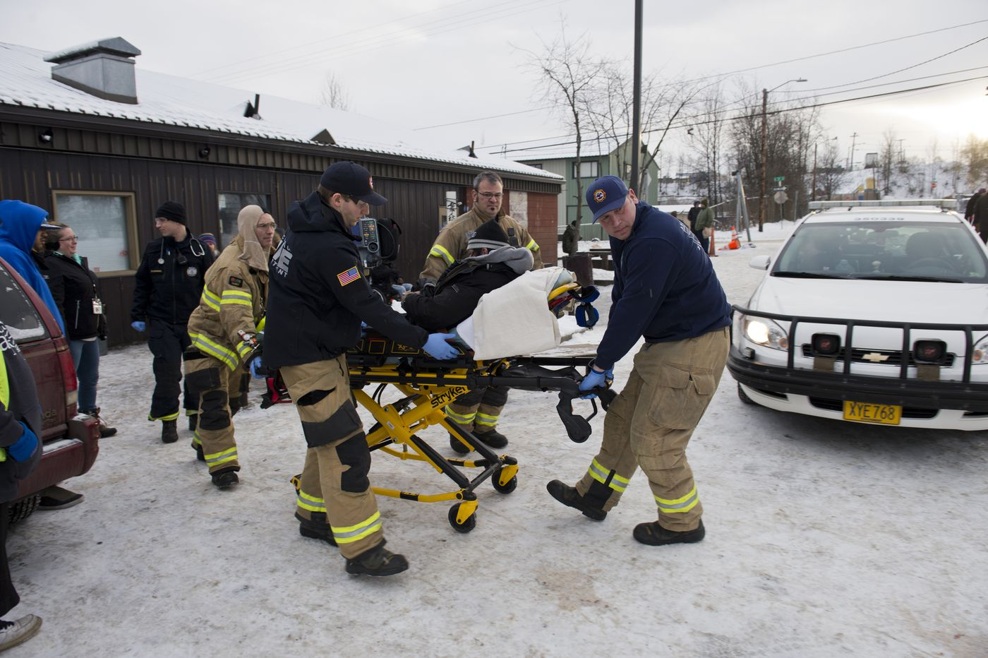



Slide 4

Notes:
Imagine this is your initial dispatch audio. Consider what things you would be worried about or thinking about prior to arrival at the patient.

Slide 5

Hyperventilation/Hypocarbia
Seizure??
Pulmonary Embolism
Psychiatric?
Stroke?
Aneurysm rupture?
Vasovagal
Cardiac?
Dehydration?
Trying to avoid going to jail???
OD??
Diabetic Issue
Ruptured Ectopic?
Notes:
These are all the things I would think about as a potential cause of syncope.

Slide 6
Syncope:
A symptom of an underlying cause
Extremely common
Up to 2% of EMS calls
Up to 20% of people will experience syncope
Notes:
I think of a diagnosis of ‘syncope’ to be a very generic term that could describe anything on a spectrum from a severe, life-threatening condition, to something totally benign that doesn’t require anything other than some reassurance for a patient. However, as you know, it’s often impossible to distinguish these things, and most patients land somewhere in the middle of that spectrum.
Generally, when I approach these patients, I think about syncope as a symptom of an underlying cause – and our job is to determine what the underlying cause may be.

Slide 7

Causes of Syncope:
Vasovagal: 21%
Cardiac: 9% Orthostatic (Dehydration): 9%
Medication Side-Effect: 7%
Seizure: 5%
Stroke/TIA: 4%
Unknown: 37%
Soteriades ES, Evans JC, Larson MG, et al. Incidence and prognosis of syncope. N Engl J Med. 2002;347(12):878-885
Notes:
There was a very large, well-done study, that followed and evaluated thousands of patients over many years, that described the causes of syncope.
Not surprisingly, vasovagal syncope was considered the most common cause. I was surprised to read that, after vasovagal, the most common cause is cardiac. Think things like sudden VTach, a long QT syndrome, symptomatic bradycardia or SVT. Right behind was orthostatic, followed by medication side-effects and then seizures. The least common case was stroke. Anecdotally, this makes sense to me – the vast majority of stroke patients I see don’t present with syncope, but usually weakness or aphasia, except in massive strokes. Even then, these patients usually don’t collapse suddenly. Finally, in over 1/3rd of patients, we couldn’t identify a cause.

Slide 8
But Did They Die?
Cardiac Syncope: 2x as likely to die (and almost 3x to die from a cardiac event)
Neurologic: 1.5x as likely to die (and 3x to die from a stroke)
Vasovagal: Does NOT increase risk of death
Notes:
I always think – what is the clinical importance of this? That is, will this information about their syncope change my testing? Will it change their prognosis? Will my recommendations change? As an example, do you really need that blood sugar on the guy that just got stabbed? Well, maybe if he got agitated because he was hypoglycemic, which led him to behave inappropriately and get into a bar fight… but probably not. But what we’ve found is that the cause of syncope actually does matter in some cases.

Slide 9

Sudden Syncope
ANY symptoms prior to collapse? ALWAYS scares me
Notes:
The other things I consider are how the syncope presents.
Is this sudden syncope, or was there a prodrome? That is, did the patient feel any preceding symptoms prior to collapsing? That may include a headache, palpitations, feeling warm or flushed, or nauseated. Perhaps they had some fatigue or weakness throughout the day. In my mind, the presentation of someone who experiences sudden syncope, with no preceding symptoms, is always a true emergency. I have two videos of public officials – watch to see how their episodes of syncope vary. The first video shows this woman with apparent sudden syncope – that is, she didn’t reach out to brace herself. She didn’t seem to have any seizure, or outward signs of anything abnormal before suddenly collapsing to the ground.

Slide 10

Notes:
Compare that to this video. This is the former Governor Mark Dayton of Minnesota. He clearly has some preceding symptoms prior to collapse, and seems to be struggling to speak, and appears weak. You can tell he stops to take a drink of water, then is slurring his speech before suddenly collapsing to the ground.
To me, these two videos highlight important differences in the potential cause of syncope. Obviously, we don’t often have a clear description of the circumstances that led to collapse, and rarely have a video to watch, so we have to base our evaluation on the limited information we have.

Slide 11
Sudden Syncope
Acute MI / Sudden Cardiac Death / Arrythmia
Massive Pulmonary Embolism
Massive Stroke
Ruptured Ectopic Pregnancy or AAA rupture
Notes:
That being said, if someone has a true sudden syncope – that is, they report no symptoms before collapse and were feeling completely fine before suddenly collapsing, it makes me worried. There aren’t many things that would cause this – and true sudden syncope is quite rare – but it always makes me consider these potential causes.

Slide 12
Work-up?
Vitals
EKG (Serial EKGs?)
Glucose
Stroke Exam?
Lung sounds and Exam
Notes:
In terms of cardiac causes, there are the obvious ones we always think about. Things like ventricular tachycardia should be relatively straight-forward. For the medics, you know the treatment of choice should be an antiarrythmic, which may vary depending on your protocols, but could be amiodarone or lidocaine. You know that they may need cardioversion, or defibrillation. And you know that, ultimately, this patient needs to be transported to a cardiac-capable facility for further evaluation, including echocardiogram, repeat EKGs, and cardiac intervention, including identifying why they’re in VTach. As we learned earlier, this patient is more likely to die from their syncope.

Slide 13
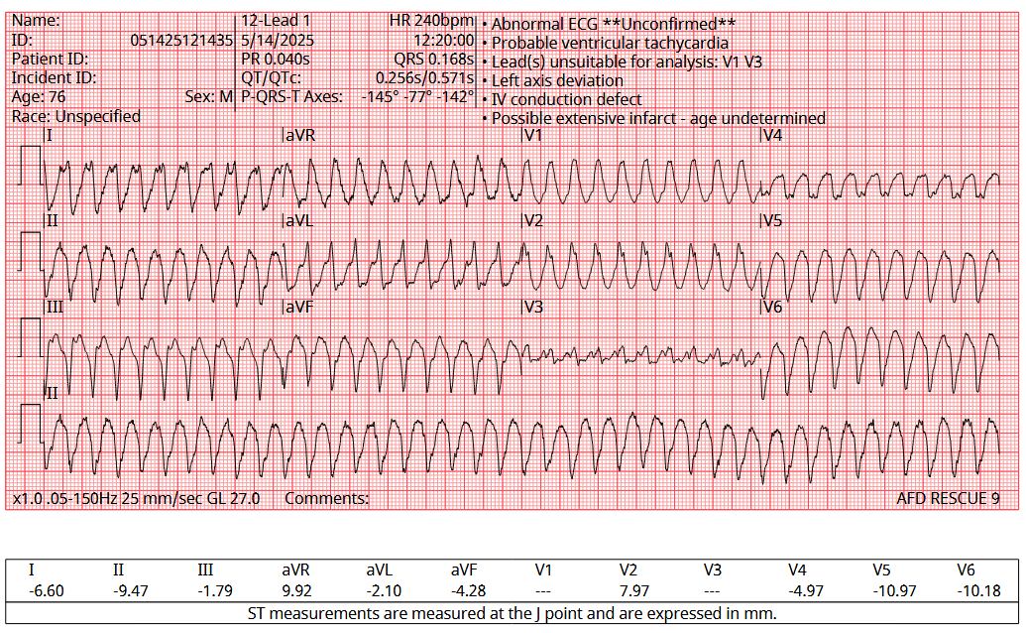
Cardiac Causes
Notes:
In terms of cardiac causes, there are the obvious ones we always think about. Things like ventricular tachycardia should be relatively straight-forward. For the medics, you know the treatment of choice should be an antiarrythmic, which may vary depending on your protocols, but could be amiodarone or lidocaine. You know that they may need cardioversion, or defibrillation. And you know that, ultimately, this patient needs to be transported to a cardiac-capable facility for further evaluation, including echocardiogram, repeat EKGs, and cardiac intervention, including identifying why they’re in VTach. As we learned earlier, this patient is more likely to die from their syncope.
So, lets run through some more EKGs with important, and sometimes more subtle findings.

Slide 14
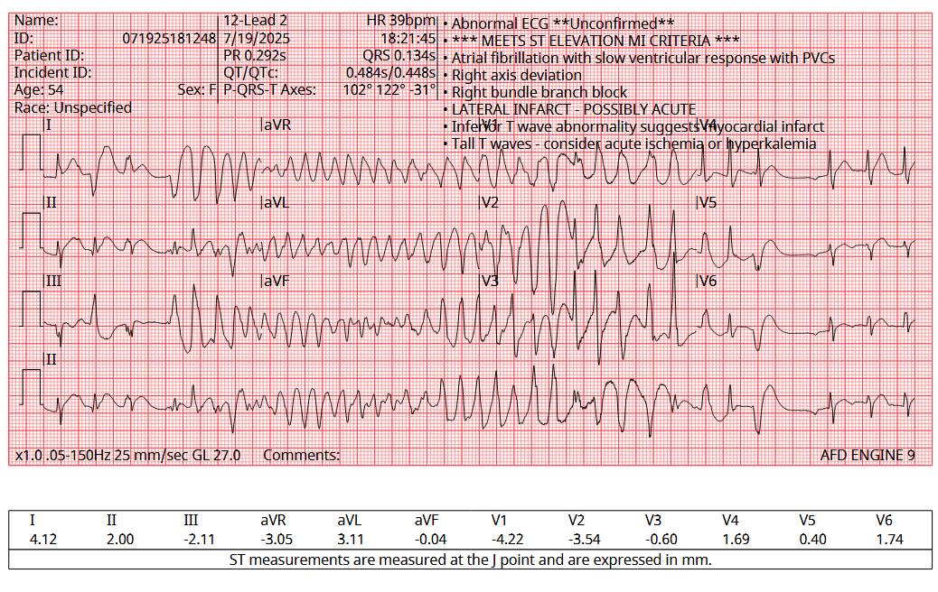
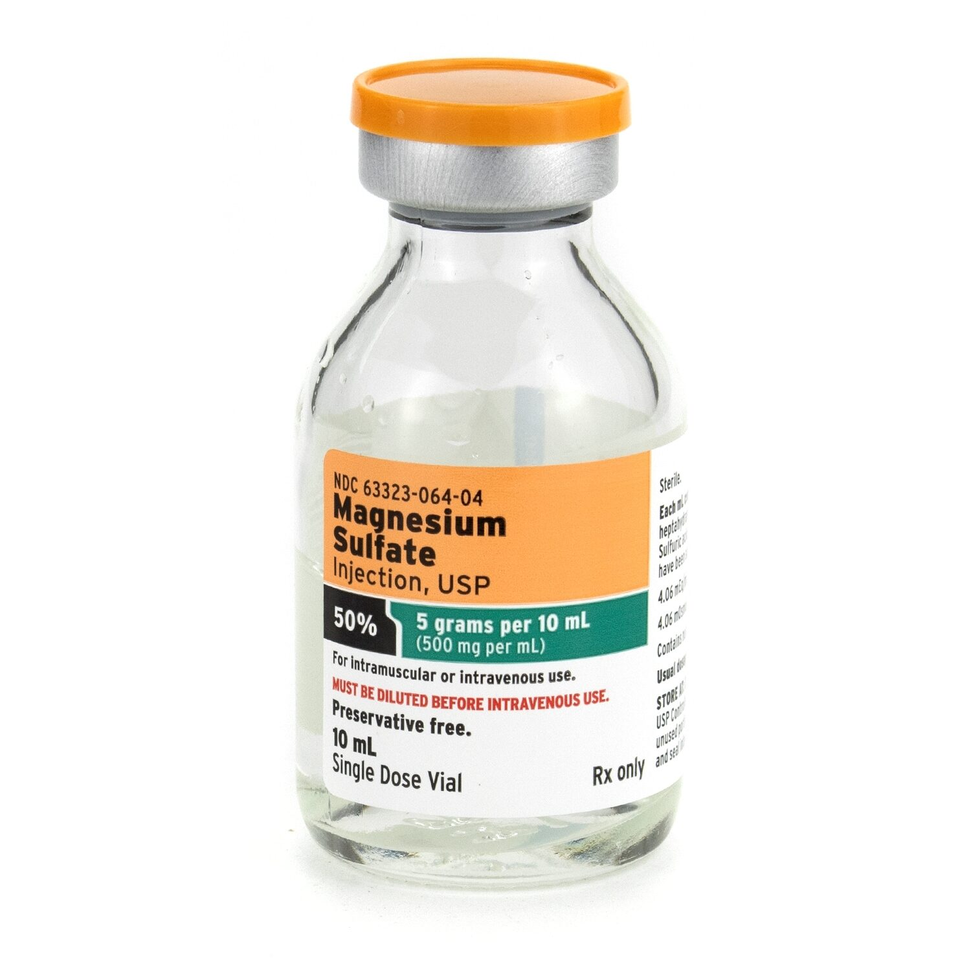

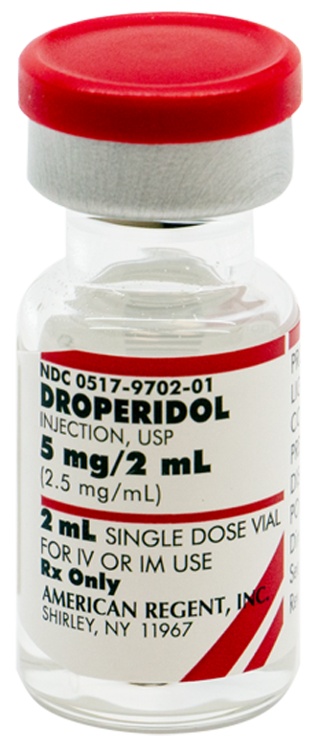
Notes:
This one is torsades. This is a scary, relatively rare rhythm, but requires different management and treatment than your typical VT. As you know, torsades is a type of polymorphic VT, generally resulting from an R-on-T phenomenon where a prolonged QT interval causes repolarization at the relative refractory period, causing disorganized depolarization of cardiac myocytes. Usually this is caused a long QT interval and be worsened by certain medications – the ones that we carry and give frequently include most antiemetics, Droperidol or Haloperidol. Other medications that may worsen this are certain types of antibiotics, some medications for neurological issues like Parkinson’s Disease, and lots of drugs for chemotherapy. Methadone is also a common cause.
These medications are fine to give… if you want to kill your patient. Treated with magnesium, and that help change the calcium flow in the cardiac myocytes and stabilize that cardiac myocte.

Slide 15
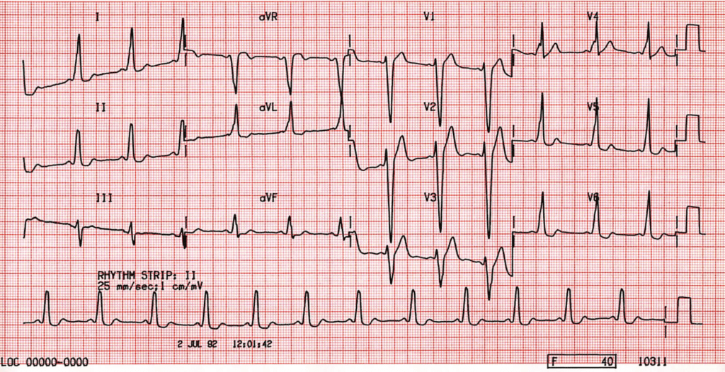
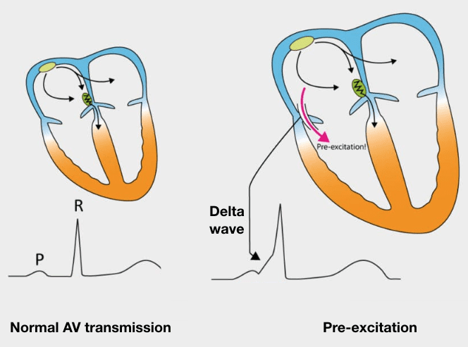
https://litfl.com/pre-excitation-syndromes-ecg-library/
Notes:
This is Wolf-Parkinson-White (WPW). You can see based on the wide QRS and presence of a delta wave, often best seen in the precordial leads. In patients who experience syncope and have delta waves on EKG, you should be highly suspicious of WPW, which can progress to sudden tachyarrythmias and unstable tachycardias. If the electrical circuit goes unchecked through the accessory pathway, this can lead to an unstable, rapid tachycardia that appears similar to Afib with RVR on EKG, but still with the presence of subtle delta waves.

Slide 16
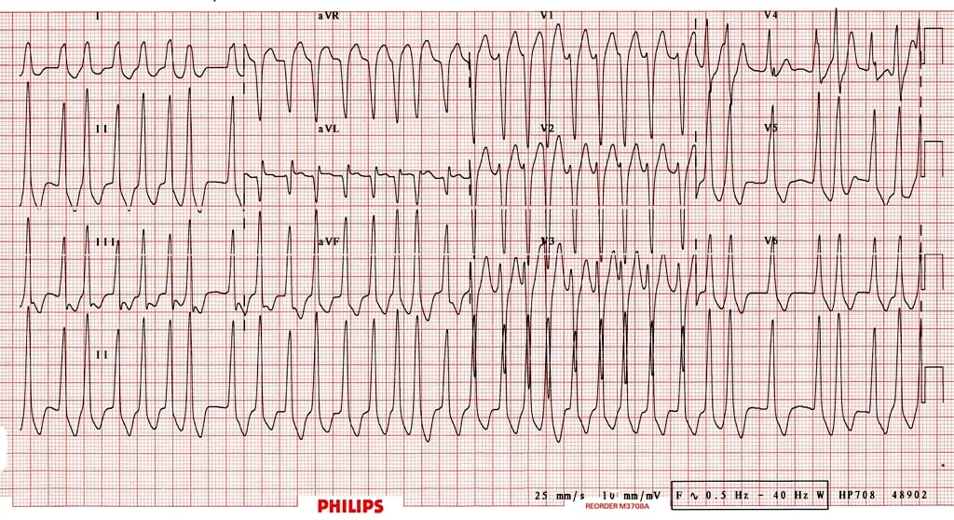
https://litfl.com/atrial-fibrillation-in-pre-excitation/
Notes:
The important difference here is the wide QRS and subtle Delta waves. If you see this, do not give adenosine, as this could lead to rapid progression to VF. Instead, some agencies may carry procainamide. Procainamide is preferred, as it has no blocking effect at the AV node and targets the accessory pathway.

Slide 17

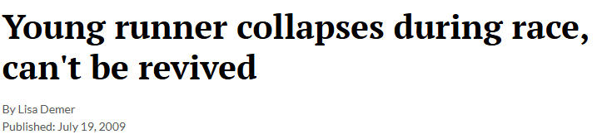
Always concerning if true syncope
Syncope/Collapse in Athletes
https://www.adn.com/alaska-news/article/young-runner-collapses-during-race-cant-be-revived/2009/07/19/
Notes:
One other important cause, especially in young people with syncope, is congenital cardiac issues, including long QT syndrome, and hypertrophic cardiomyopathy.

Slide 18
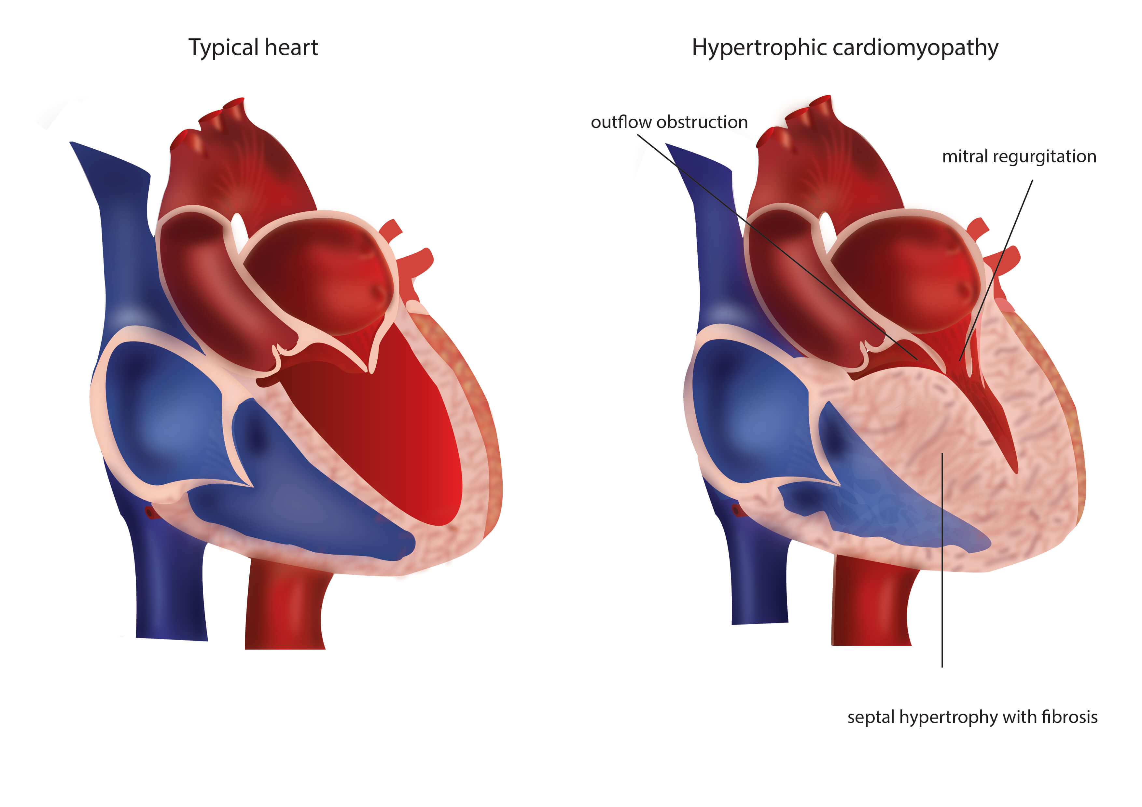
https://www.progenics.com.au/diseases/hypertrophic-cardiomyopathy
Notes:
HCM is the most common cause of cardiac death in young athletes, and these patients often collapse in public during high-intensity exercise or competition. Because of this thickened septum, in states of dehydration and rapid heart beat, there is less filling of the left ventricle, which can lead to the mitral valve to “block” the outflow. This may cause severe palpitations, severe respiratory distress, and collapse with sudden cardiac death.

Slide 19
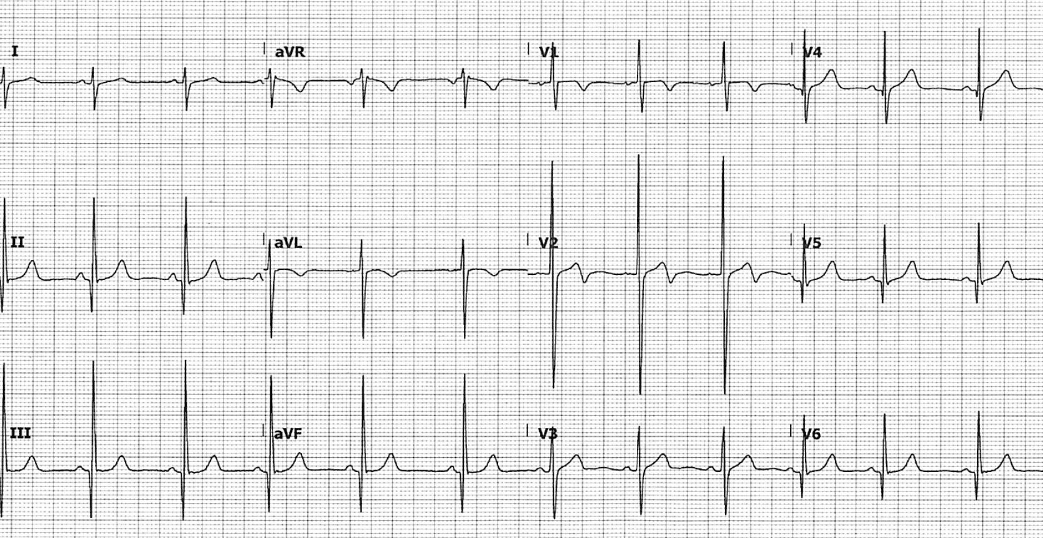
https://litfl.com/wp-content/uploads/2021/04/HCM-ECG.png
Notes:
In HCM, EKGs will often display very tall, but narrow, QRS complexes with Q-waves. This reflects the enlarged septum and may be a precursor to sudden cardiac death. The Q-waves in a young, otherwise healthy, individual do not indicate prior infarct. These patients should not be allowed to return to competition until cleared by a doctor. If hypotensive or still symptomatic when you arrive, consider a fluid bolus to help improve the left-ventricular volume and stroke volume.
If in arrest on your arrival, do your standard ACLS but prioritize additional IV fluids.

Slide 20
Vasovagal Syncope
Usually benign, with preceding symptoms:
Dizziness Lightheaded
Maybe nausea
Sweating/warmth
Notes:
OK, so lets switch gears a bit. Vasovagal syncope is common, and fortunately pretty benign. If you correct the underlying issue and remove the physical stressors or the cause, they usually do fine and generally just need to be observed for a period of time – I still recommend this be done with some bloodwork and monitoring in an emergency department, but if it’s a clear case of vasovagal syncope and they otherwise look fine, I have no problem with letting these patients decline transport.
Symptoms are often similar, with dizziness, lightheadedness, sweating/feeling of warmth, or nausea being common, and a rapid return to baseline.

Slide 21
Vasovagal Syncope
Exposure to stress, pain, or emotional response is common Autonomic dysfunction that leads to vagal stimulation
Bradycardia and hypotension common (initially)
Notes:
Essentially, in response to some kind of strssors – whether it’s pain, being surprised, seeing blood drawn or a traumatic event, some amount of irregular autonomic dysfunction may occur which leads to stimulation of the vagal nerve and a parasympathetic response. As a result of this parasympathetic stimulation, there may be transient bradycardia and hypotension. As you know, the parasympathetic stimulation may lead to dilation of the blood vessels … which may cause dizziness, sweatiness, and a sensation of warmth prior to collapsing. You should still do the same assessment for these patients as potential cardiac patients, but they often will get better quickly – potentially before your arrival on scene.

Slide 22
Orthostatic Syncope
Check Vitals
SBP drops >20 mmHg, or
DBP drops >10 mmHg With symptoms
Notes:
Orthostatic syncope can be more concerning than vasovagal, but is usually easier to identify, since patients don’t rapidly improve (usually) and will still feel dizzy or lightheaded on your arrival.
The formal definition is a drop in SBP >20mmHg or DBP >10 mmHg when moving to an upright position, but really, if someone gets super dizzy and stays dizzy while standing up, that’s usually good enough to make a presumptive diagnosis or orthostatic hypotension.
This can often be caused by dehydration, medications, and, more rarely, nerve disorders.

Slide 23
Orthostatic Syncope
Symptoms should develop within 3 minutes of standing
Check medications!
Treat underlying cause (if known), +/- fluids
Notes:
Essentially, as a patient stands, their autonomic nervous system should respond with increased stimulation of cardiac activity and potentially vasoconstriction to increase the blood flow to counter gravity and the position changes. If the body can’t compensate rapidly (as should happen in a healthy patient), this will result in decreased bloodflow to the brain, and, thus, syncope.
It is incredibly important to check the medication list – things like beta blockers or other cardiac meds may mean a patient’s heart cannot appropriately compensate for these changes. If that’s the case, it usually means they need to change medications (or stop taking them!). These patients should be strongly encouraged to go to the hospital – and they usually want to, since they’ll feel miserable if they stand.

Slide 24
Strokes
I know you know what to do.
Last Known Normal?
<4.5 hours? Maybe thrombolytics.
<24 hours? Maybe thrombectomy.
Notes:
I trust that you know what to do for strokes, but I’ll give you a little more information on why we care so much about the information that we ask for once you arrive to the hospital.
For stroke care, these is robust evidence around timing of the last known normal – and the reason it matters so much is that the medications we give – whether TNK to TPA, which are thrombolytics and will (hopefully) help break up the clot and improve long-term outcomes, but can lead to increased risk of hemorrhage with no benefit it given after a certain timeframe.
If they present early and the CT scans show a clot, and they meet all the other criteria, they can get thrombolytics and potentially get whats called a mechanical thrombectomy. That involves threading a catheter into the blood vessels in the brain and sucking the clot out. Research has shown that this may potentially be safe if performed within 24 hours of symptom onset.

Slide 25
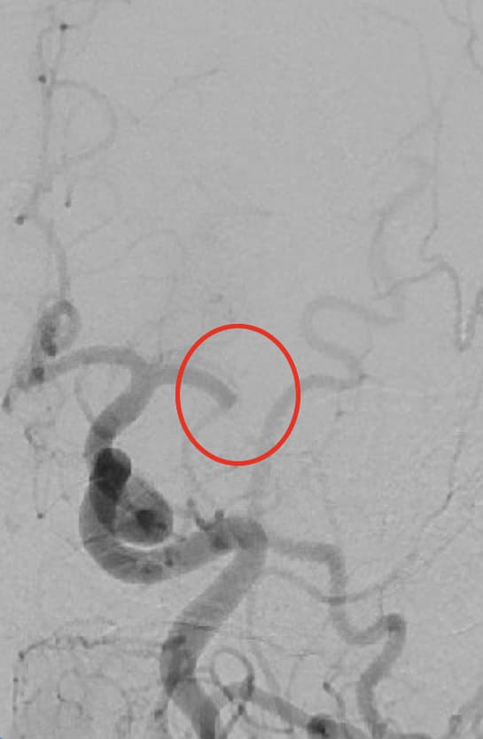
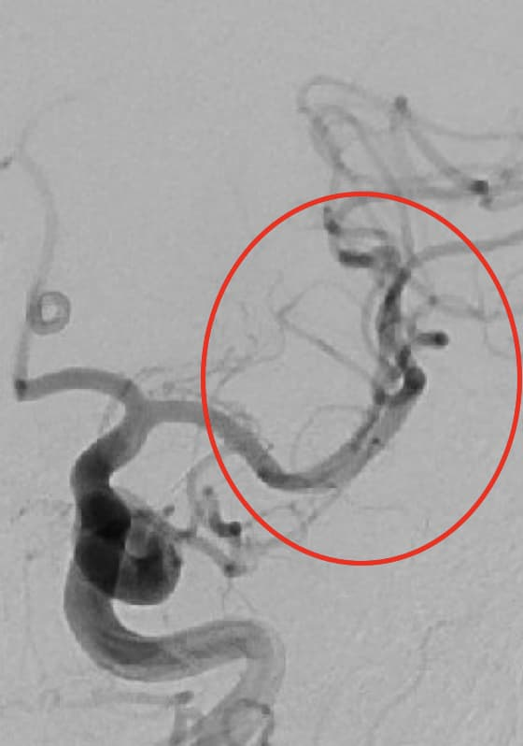
https://nortonhealthcareprovider.com/news/stroke-summary-mechanical-thrombectomy-helps-marathoner-47-recover-from-stroke/
Notes:
And here’s an example. One of the main blood vessels, called the left middle cerebral artery, was completely blocked, right after the branch point (on the photo on the left). After sucking out the clot, you can see improved blood flow to this side of the brain. This is an invasive procedure only performed in certain hospitals, usually by a neurologist or neurosurgeon with special training – but if we don’t know the timeframe of onset of symptoms, this may not be an option.

Slide 26
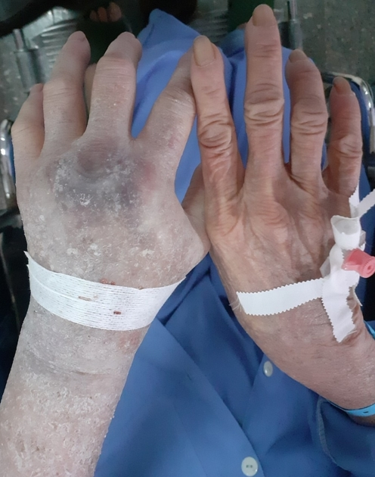
Get an IV…
But it NEEDS to be in the AC
Ideally 18g
Notes:
The reason we need the IV is to get the CT scan. When I was a medic, I didn’t understand or appreciate why this mattered. The reason it needs to be an 18g in a larger vessel is that we inject IV contrast through the IV to get the CT scan. We may need to give around 100cc of contrast rapidly to get good, reliable views of the brain. This contrast can be quite damaging to skin and other surrounding tissues – and in smaller blood vessels, or with smaller catheters, it’s more likely to leak or burst the blood vessel.
This photo is an example of contrast damage from extravasation into the patient’s left hand from an IV in the hand.

Slide 27
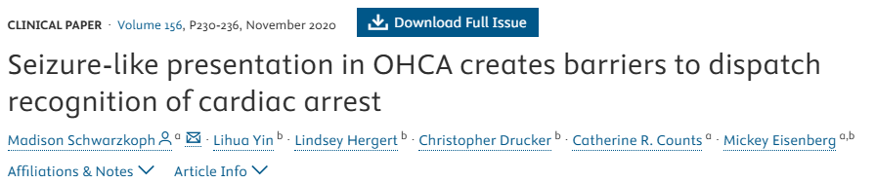
Seizures
Not all shaking is seizures
4% of patients who “seized” were dead
Seizures should have a postictal period
Notes:
Seizures are (hopefully) self-limited, and easier to identify, but patients without seizures can have “shaking” or “seizure-like activity” from hypoperfusion to the brain. In fact, one of my friends published this paper looking how bystanders described patients who were ultimately found to be in cardiac arrest when the called 911. Around 4% were initially described as “shaking,” “seizing,” or “convulsing,” and many were appropriately dispatched as seizures initially. And, this can happen any time there is hypoperfusion to the brain.
In general, seizures should have a postictal period that improves with time – and remember that patients that seize can be from an underlying neurological disorder, like epilepsy, as well as electrolyte abnormalities, masses or tumors, and certain medications can increase the likelihood of seizures.

Slide 28
Seizures
Oral trauma
Urinary incontinence
Highly specific Not very sensitive (If they have them, they probably seized… but if they don’t have them, they still may have seized)
Notes:
Oral trauma and urinary incontinence can be helpful in identifying a patient who had a seizure – but only about 25% of patients actually have these. These findings are highly specific for seizures – meaning if you see them, you can say with good certainty that they had a seizure, as long as the story fits. But they’re not sensitive, which means that there are lots of people that have seizures that do not bite their tongue or pee on themselves.

Slide 29
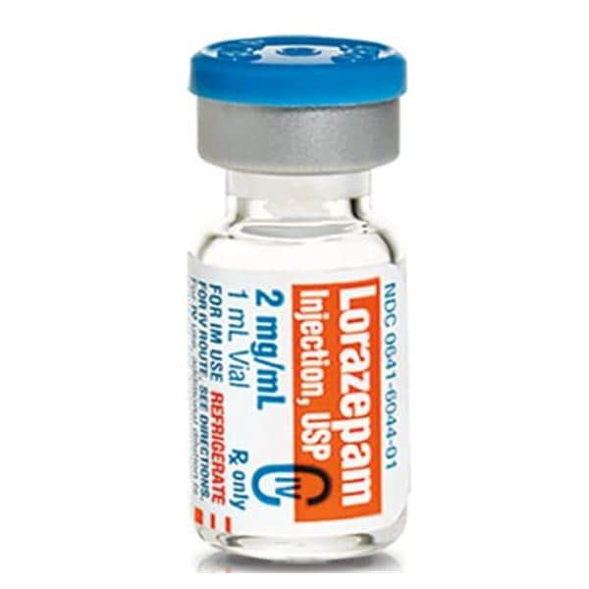
Seizures
Notes:
If you arrive and they are still seizing, you should be concerned – imagine how long it takes for someone to call 911. then how long it takes you to be dispatched, and how long it takes to get on scene. If they’re still seizing, it’s time to treat. First line treatment in the field is benzodiazepines. You may have midazolam, or lorazepam, or something similar. In general, I like Midazolam in the pre-hospital setting, but use what you have. If that doesn’t work, your next option should be more benzodiazepines. Finally, if that doesn’t work, give more benzodiazepines. Make sure you protect that airway, and if they end up with a prolonged seizure, you should consider airway support – in systems that allow for rapid sequence intubation, this may be appropriate, depending on where you are, transport times, and what your medical director allows.

Slide 30
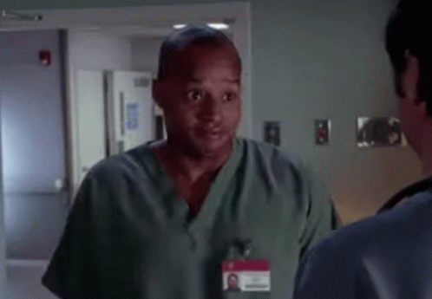
Unknown Causes?

Slide 31
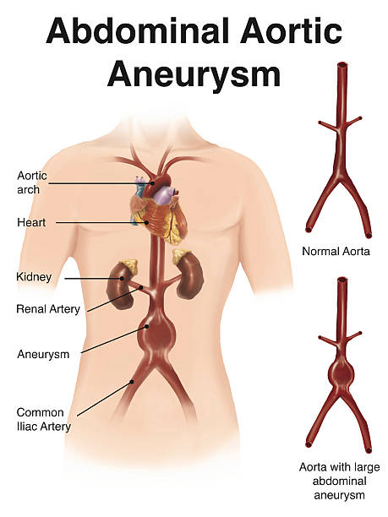
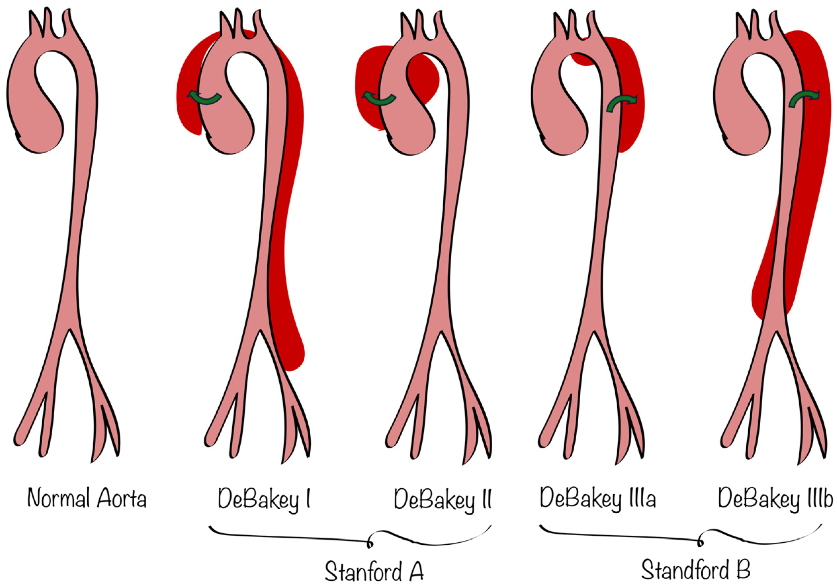
Notes:
Finally, here’s a diagram of different types of aortic dissections. While the exact types don’t really matter in the prehospital setting, it is important to know that this exists, and that it can mimic some other causes of syncope. On the far left is a diagram of a normal aorta. From the very top left, this represents the ascending aorta to the blood vessels of the head and upper body, and then the descending aorta down to the branch point of the iliac arteries. In the second picture (second from the left), this represents an aortic dissection where blood (bright red) is around the blood vessel, probably from a tear in the wall of the aorta that has spread all the way from the asending aorta to the descending aorta. In severe cases of aortic dissection, the dissection can spread more proximally to the aortic valve of the heart. If this happens, it can dissect into the coronary arteries and completely stop blood flow to the myocardium. This is a somewhat rare – but very important – cause of STEMI. If you see ST elevation on an EKG in a patient with severe or “tearing” chest pain and hypertension, I would be very concerned about an aortic dissection. In these cases, it may be reasonable to withhold aspirin, since that can actually increase the risk of bleeding and make this dissection worse. If you’re unsure, call your medical control.
Eremia, I.-A.; Popa, M.-I.-G.; Anghel, C.-A.; Stroe, T.-A.; Eremia, E.-A.; Marinescu, A.N.; Nica, R.I.; Nica, S. Outcomes of Surgical Versus Conservative Management in Stanford Type a Aortic Dissection: A Single-Center Retrospective Study. Life 2025, 15, 462. https://doi.org/10.3390/life15030462
https://www.stonybrookmedicine.edu/patientcare/surgery/vascular/abdominal-aortic-aneurysms

Slide 32
Take-Aways
Syncope is scary for patients … but 21% are vasovagal
Syncope isn’t usually scary for us … but patients are more likely to die after syncope
Always do your same work-up

Slide 33

Take-Aways
Syncope in kids and athletes need special attention / evaluation
Kalgin Koch July 19, 2009
Ryan Shay
November 3, 2007
Notes:
Finally, remember that true syncope in pediatric patients and in athletes are always concerning.
I say true syncope, because that doesn’t include someone who “collapses” after a track meet and lies down on the ground gasping for breath – but if they are truly unconscious and collapse, that is highly concerning. My former teammate, Kalgin, died from presumed hypertrophic cardiomyopathy in 2009. Ryan Shay, who was a professional runner, died during the US Olympic Trials in 2007 while running the marathon from hypertrophic cardiomyopathy. There are many examples of young, healthy athletes dying – so hopefully you have a better framework and understanding of how to respond to these patients (and others!) in the future.

Slide 34

Scan for CE Credit
E-mail for Questions
Bart Grabman, MD BGrabman@salud.unm.edu

