Slide 1
Management of Rib Fractures in the Trauma Patient
Justine Broecker, MD

Slide 2
No disclosures

Slide 3
Outline
Intro
Dx
Prognosis/Risk stratification
Pain Management
Surgical Management

Slide 4
Intro
Affecting 1 million adults annually in the US, account for 6% of trauma admissions (15000)
Blunt trauma: MVC, falls, other
Usually fractures rib 4-10, superior and pediatric rib fractures indicate significant force
>60% of child abuse cases will have associated healed healed rib fracture

Slide 5
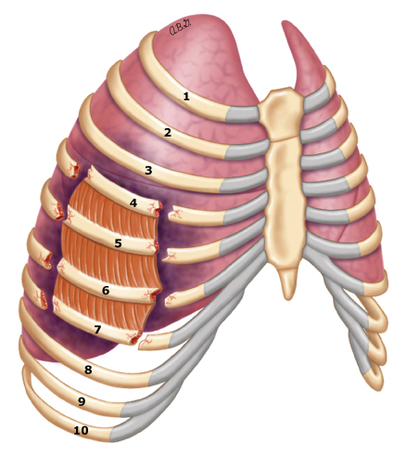
Diagnosis
CXR
CT
Flail chest: fractures of three or more ribs in two more more places, floating segment that loses mechanical continuity with remainder of chest wall, paradoxical chest wall motion
Chest abbreviated injury scale (AIS)
Nature of chest wall injury | AIS score
Single rib fractured | 1
Two ribs fractured (unilateral or bilateral) | 2
≥3 ribs fractured (unilateral or bilateral) | 3
Unilateral flail chest with 3 to 5 ribs fractured | 3
Unilateral flail chest with ≥5 ribs fractured | 4
Bilateral flail chest | 5

Slide 6
Associated Injuries
90% of rib fxr associated injuries
Intrathoracic: pneumothorax, hemothorax, pulmonary contusion
Sternal fracture
Intrabdominal: solid organ injury
Head injury
Upper extremity injury

Slide 7
Prognosis and Risk Factors
Flail chest: 58% required mechanical ventilation, pneumonia 21%, ARDS 14%
All rib fractures
  Pneumonia 6%, but higher (~30%) in patients >65
  Respiratory failure
  Retained hemothorax
  Empyema
  Long term data lacking in terms of chronic pain
  Mortality (<10% simple fractures, 10-20+% elder patients)
ICU admission scores
  Chest trauma score: age, pulmonary contusions, # of rib fractures and if bilateral (>4 associated respiratory failure)
  Ribscore: >6 fractures, bilateral, flail chest, >3 severely displaced, first rib, >1 in three areas, (>4 associated with respiratory failure)

Slide 8
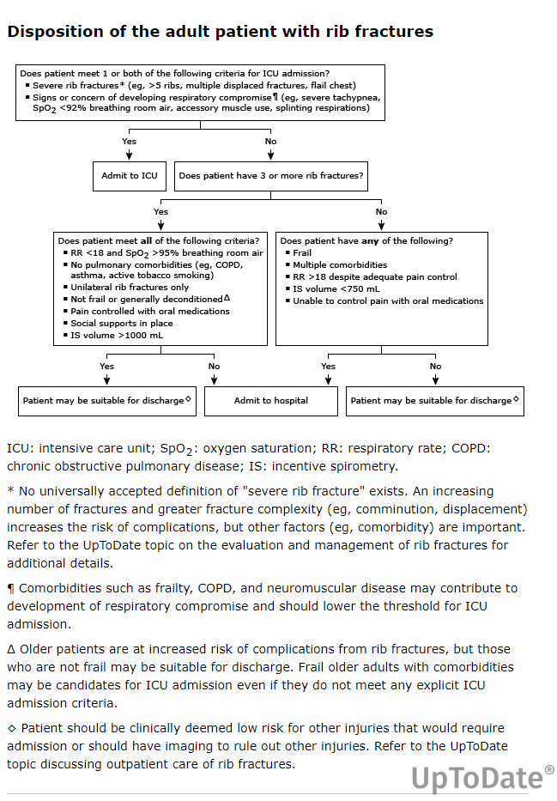
Management: dispo
Tranfer to level I: 2 rib fractures or bilateral with pulm contusion (Resources for Optimal Care of the Injured Patient: 2006, Committee on Trauma, American College of Surgeons)

Slide 9
Nonoperative Management
Multimodal pain control
Pulmonary toilet
ICU admission/monitoring

Slide 10
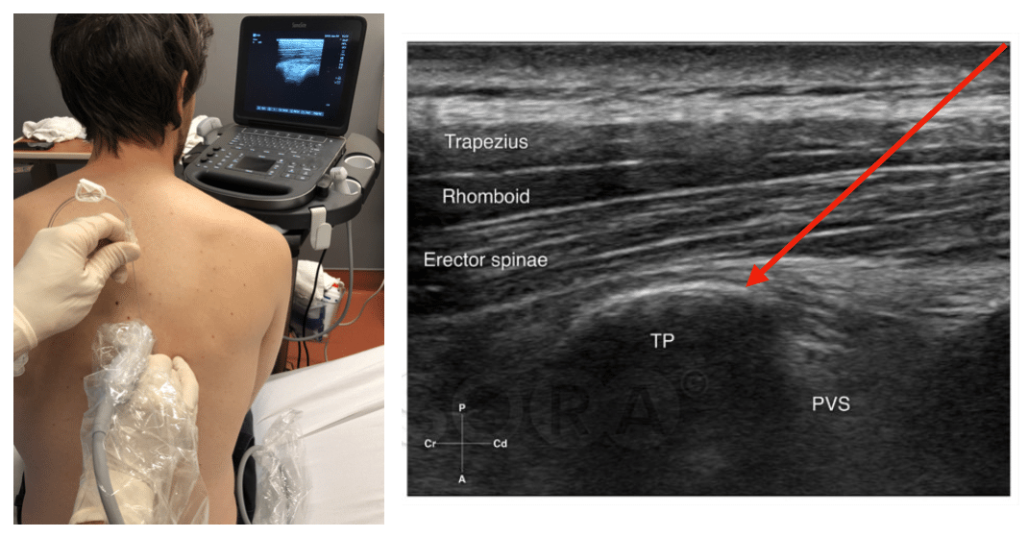
Regional blocks
Epidural
Paraverebral catheter
Intercostal nerve blocks
Erector spinae block
Serratus anterior plane block

Slide 11
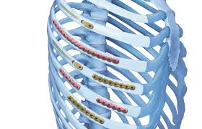
Evidence pro/con rib plating
Surgical management: plates, screws, wires or specialized devices to stabilize broken ribs
Limited evidence, hard to predict who will benefit, timing challenging, risks to surgery and rib fixation (significant pain), differing protocols
Indications: significant chest wall deformity, refractory to conservative pain management, cause of impending respiratory failure
Contraindications: instability, other injuries, pulmonary contusions, posterior fxr
Timing: 24-72 hours
Outcomes:
  Flail chest: reduce pulmonary complications, facilitates ventilator weaning, mortality benefit
  Non-flail rib fractures: more limited and mixed in terms of whether reduces pain/mortality/respiratory failure/LOS or improves quality of life especially in older patients

Slide 12
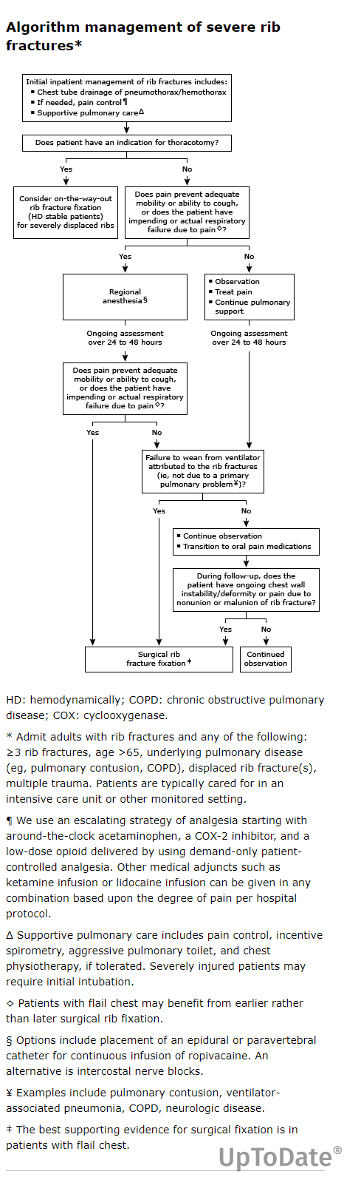
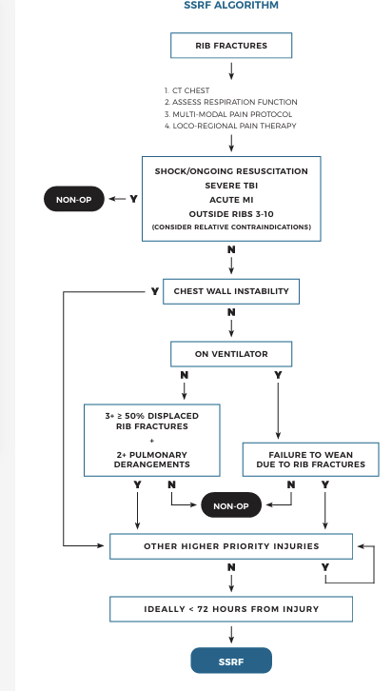
Management: surgery

Slide 13
References
Easter A. Management of patients with multiple rib fractures. Am J Crit Care 2001; 10:320.
Sammy IA, Chatha H, Lecky F, et al. Are first rib fractures a marker for other life-threatening injuries in patients with major trauma? A cohort study of patients on the UK Trauma Audit and Research Network database. Emerg Med J 2017; 34:205.
Livingston DH, Shogan B, John P, Lavery RF. CT diagnosis of Rib fractures and the prediction of acute respiratory failure. J Trauma 2008; 64:905.
Brasel KJ, Moore EE, Albrecht RA, et al. Western Trauma Association Critical Decisions in Trauma: Management of rib fractures. J Trauma Acute Care Surg 2017; 82:200.
Surdhar I, Jelic T. The erector spinae plane block for acute pain management in emergency department patients with rib fractures. CJEM 2022; 24:50.
Majercik S, Cannon Q, Granger SR, et al. Long-term patient outcomes after surgical stabilization of rib fractures. Am J Surg 2014; 208:88.
Chest wall injury society guideline for SSRF indications, contraindications, and timing. Chest Wall Injury Society. https://cwisociety.org/wp-content/uploads/2020/05/CWIS-SSRF-Guideline-01102020.pdf (Accessed on October 28, 2024).
Simon B, Ebert J, Bokhari F, et al. Management of pulmonary contusion and flail chest: an Eastern Association for the Surgery of Trauma practice management guideline. J Trauma Acute Care Surg 2012; 73:S351.
Chest Wall Injury Society Guideline 2020
ACS Best Practice Guideline Nov 2025

Slide 14
Thank you!

