Slide 1
Hypothermia and cold injuries
UNM EMS Consortium
Mateo Garcia

Slide 2
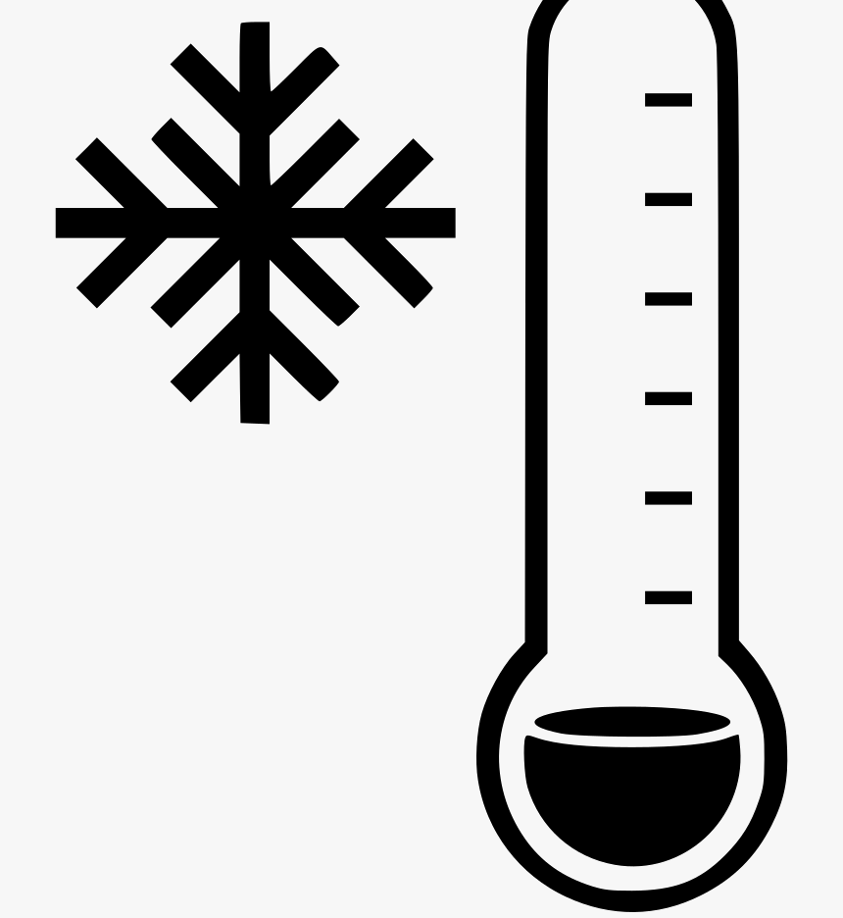
Hypothermia Definition
Unintentional drop in core body temp below 35 ℃
What are the different classifications of hypothermia?
Mild: 32 - 35 ℃
Moderate: 28 – 32 ℃
Severe: <28 ℃
Notes:
From CDC numbers

Slide 3
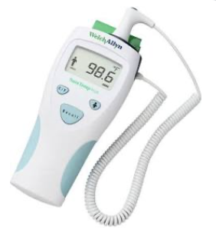
Hypothermia
Body temperature of < 35°C (95°F)
Can you become hypothermic in warmer weather…say 50°C?
What about water that is 60°-70F°?
Notes:
Windshield factor

Slide 4
What does hypothermia look like?
Stage | Clinical Symptoms | Temp | Treatment
HT class I | Conscious, shivering | 35-32°C | Passive external
HT class II | Impaired conscious, not shivering | 32-28°C | Active external, minimally invasive
HT class III | Unconscious with VS | 28-24°C | As above + airway, invasive only if cardiac instability
HT class IV | No vital signs | <24°C | CPR (3 rounds epi +/- defib), ECMO/CPB, if no ECMO thoracic/peritoneal lavage

Slide 5
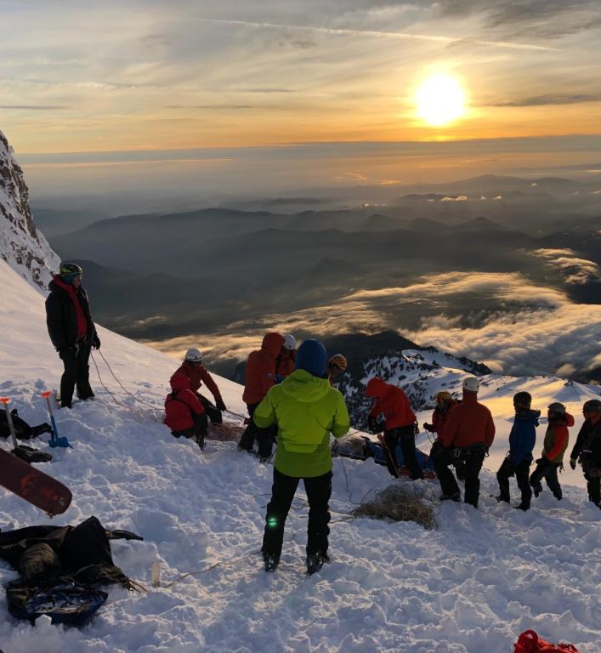
“The Swiss System”
Mild hypothermia (32 – 35 ℃) = shivering + no AMS
Moderate hypothermia (28 – 32 ℃) = no shivering, AMS
Severe hypothermia (24 – 28 ℃) = unconsciousness
Very severe (13.7 – 24 ℃) = apparent death
Fatal (<13.7 ℃)
Notes:
Not cut and dry, the physiologic response to hypothermia varies significantly but this is a helpful fallback
Designed for use by prehospital providers by the International Commission for Mountain Emergency Medicine in 2003
Pic: https://www.columbian.com/news/2020/may/25/climbers-swarm-mount-hood-despite-coronavirus-and-poor-conditions-rescue-team-leader-sounds-alarm/

Slide 6
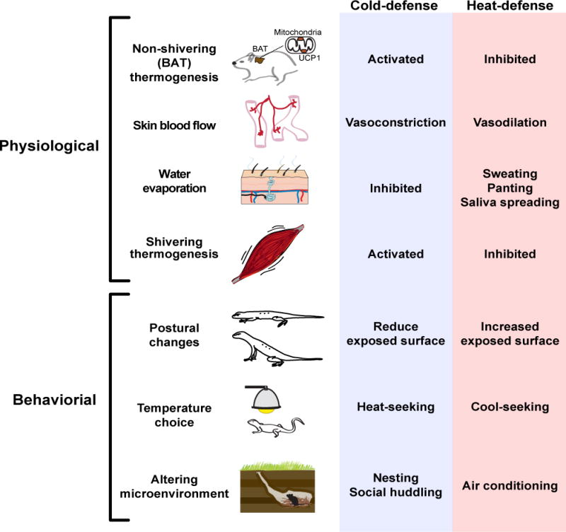
Response to cold stress
Notes:
Tan CL, Knight ZA. Regulation of Body Temperature by the Nervous System. Neuron. 2018 Apr;98(1):31-48. DOI: 10.1016/j.neuron.2018.02.022. PMID: 29621489; PMCID: PMC6034117.

Slide 7
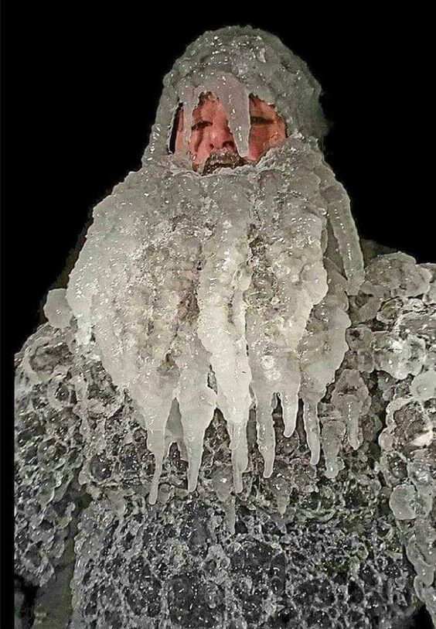
Who is at risk? Demographics
Extremes of age (elderly, infants)
Ethanol use
Lack of shelter (homeless persons)
Exposure (winter sports)
Underlying illness
Severe trauma

Slide 8
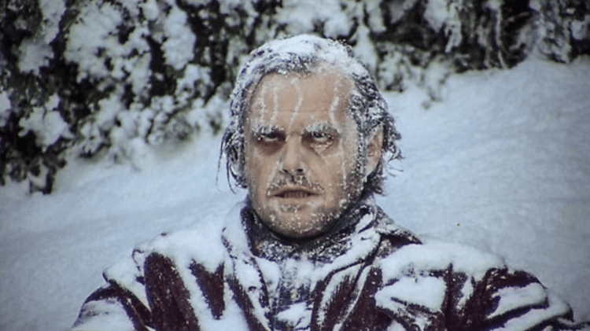
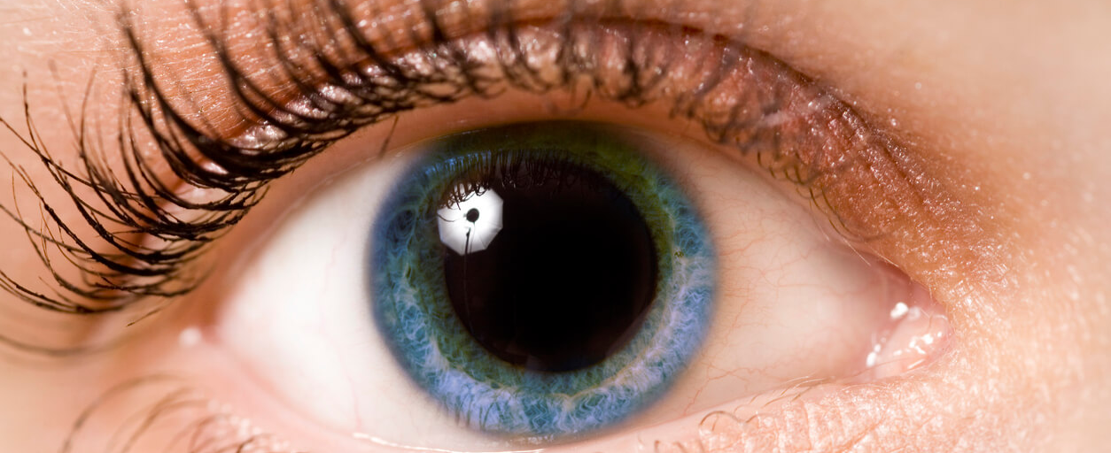
Physical Exam Considerations
ABCs v H&P
Pulse Oximetry
Tympanic probe
Pupils
Dilated with temp <27 ℃
Fixed and dilated <22 ℃
Notes:
Esophagus probe preferred (assess cardiac temp, no temp lag)
make sure that it is not placed proximally which can cause Inappropriate readings due to heated/humidified O2
Rectal/Bladder probes can have interference from lavage if ongoing
Tympanic thermometer: Walpoth BH, Galdikas J, Leupi F, Muehlemann W, Schlaepfer P, Althaus U. Assessment of hypothermia with a new "tympanic" thermometer. J Clin Monit. 1994 Mar;10(2):91-6. doi: 10.1007/BF02886820. PMID: 8207458.

Slide 9
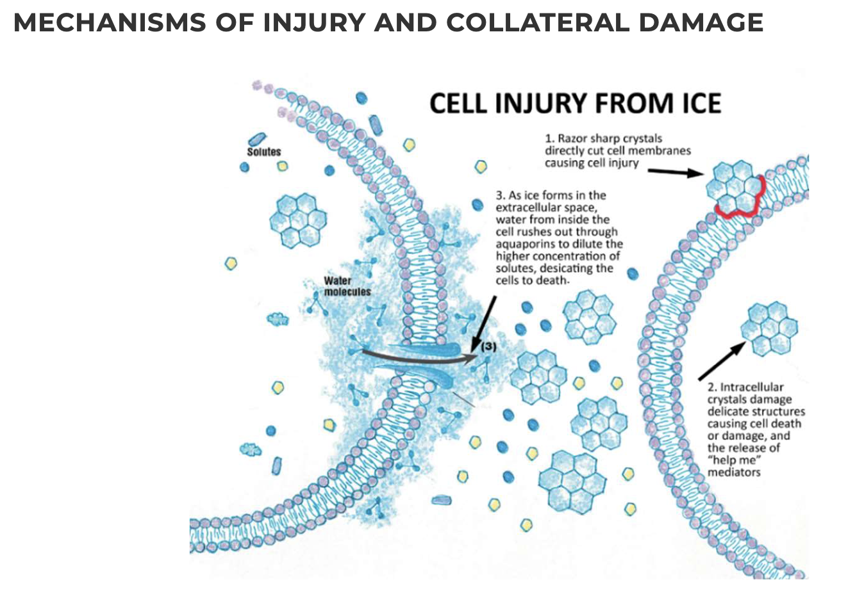
Assessment and vitals
HR: May be profoundly bradycardic.
BP: Normotensive to hypotensive.
RR: normal to slow respirations
Temperature: low
Imperative to check a blood sugar.

Slide 10
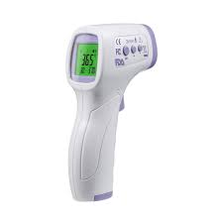
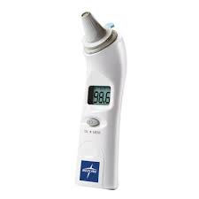
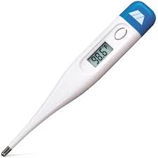
So what thermometer should we use!?
For EMS and prehospital providers, core temperature is not timely nor available
External temp – for trends and use until a core temp can be obtained

Slide 11

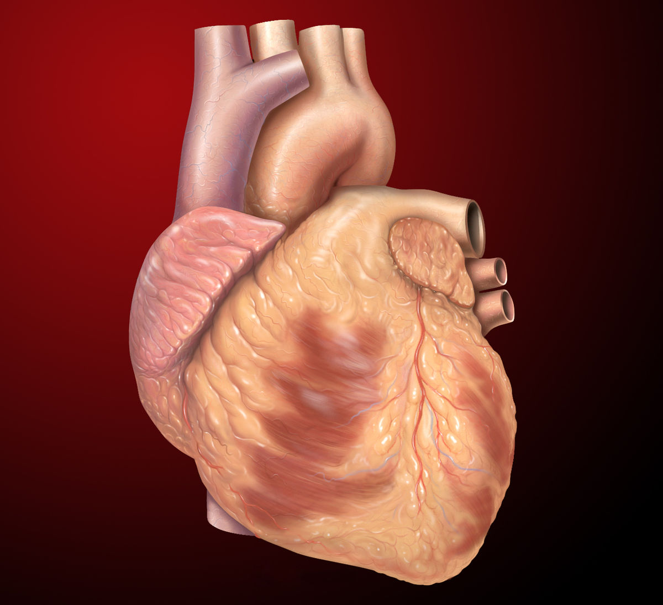
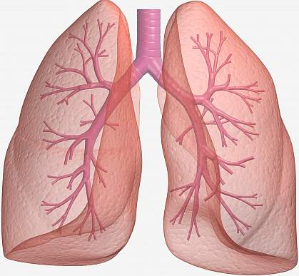
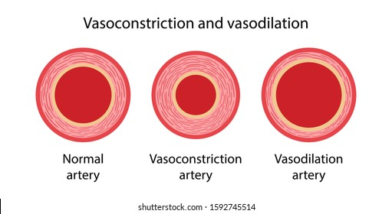
External signs of hypothermia - Mild
Catecholamine surge
Elevated HR, BP, RR
Shivering

Slide 12
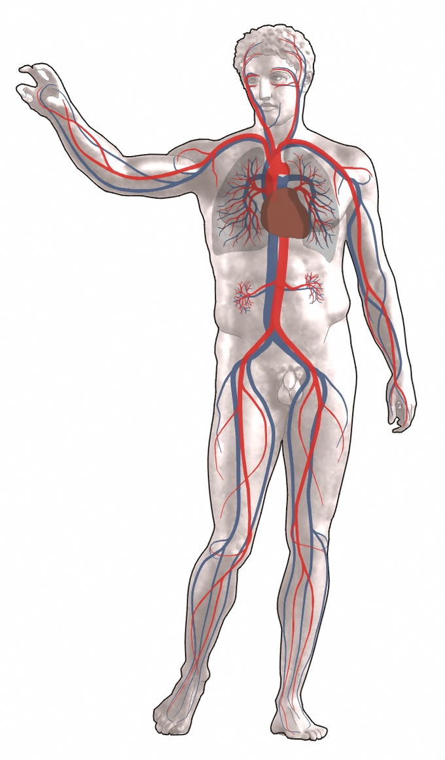
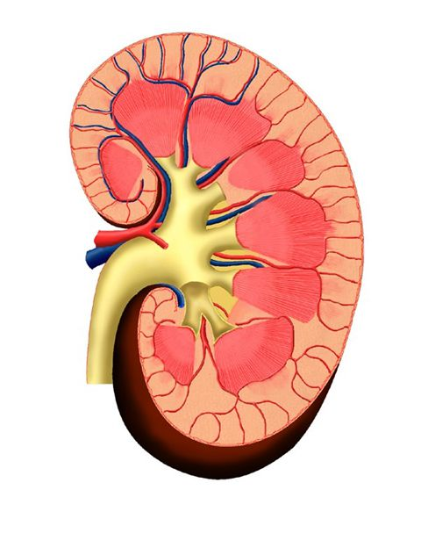
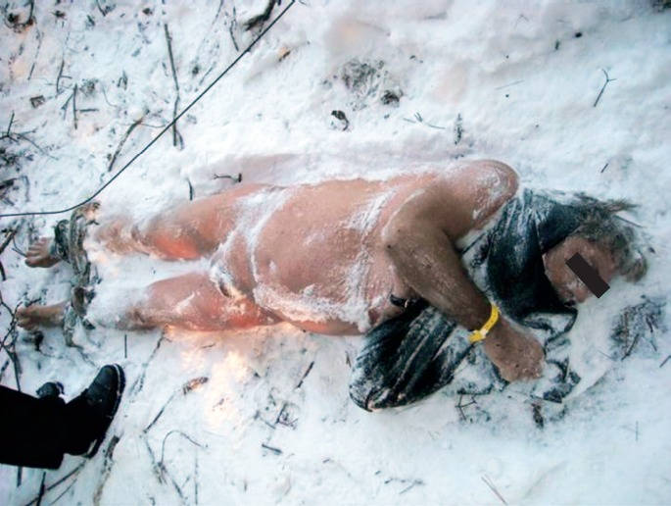
External Signs of Hypothermia - Moderate
Decreased catecholamine surge
Cold diuresis
AMS
“Paradoxical undressing”
Notes:
AMS – paradoxical undressing
Increased BF to the kidneys and decreased ADH secretion = cold diuresis
Paradoxical Undressing picture:
Rolf CM, Gallagher KE. Hypothermic Death in the Arctic State. Academic Forensic Pathology. 2018 Mar;8(1):64-82. DOI: 10.23907/2018.005. PMID: 31240026; PMCID: PMC6474461.

Slide 13
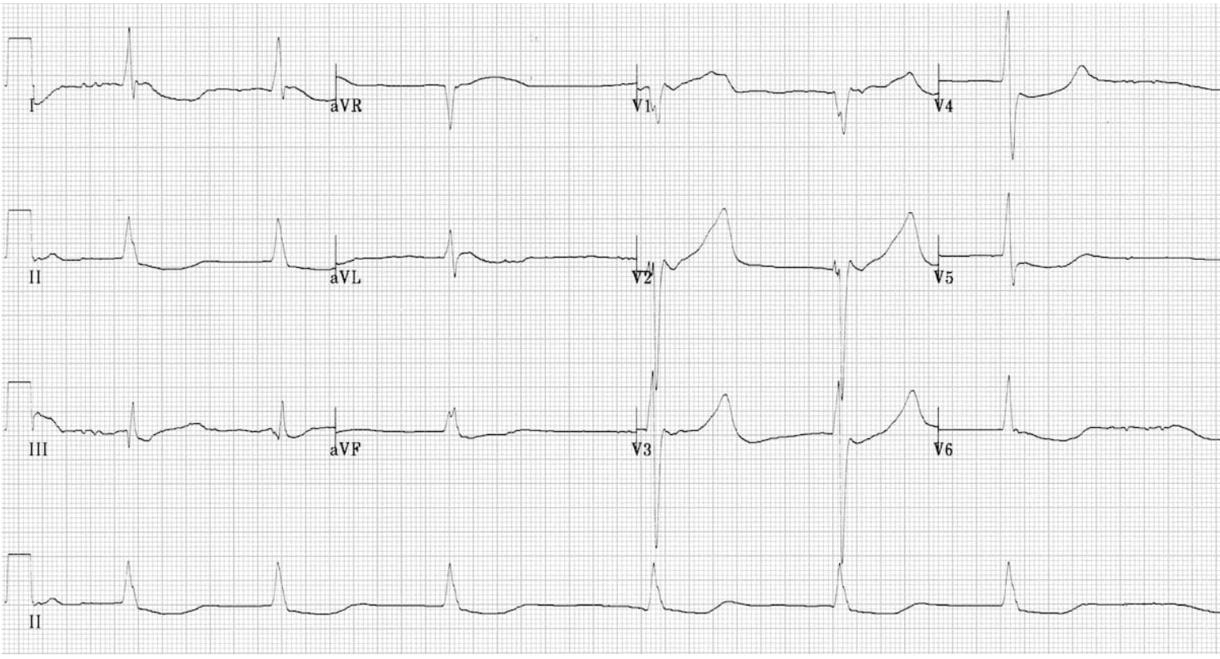
External Signs of Hypothermia - Severe
Severe CNS depression
Dysrhythmias common
Notes:
Severe AMS might require intubation for airway protection
V and A junctional dysrhythmias
Junctional bradycardia – no P waves, no significant widening of QRS
https://litfl.com/hypothermia-ecg-library/

Slide 14
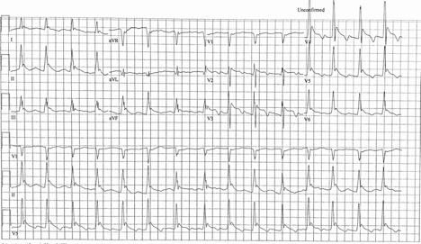
Classic EKG Findings

Slide 15
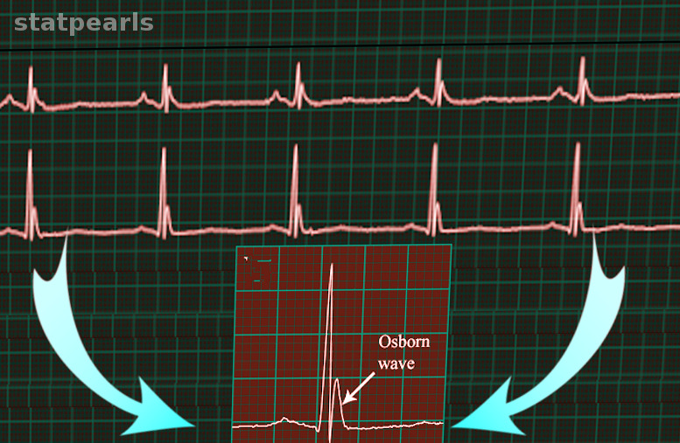
Osborn Waves

Slide 16
Soft Tissue Cold injuries Overview
Assessment and Management
Frostnip
Frostbite
Superficial/partial
Deep

Slide 17
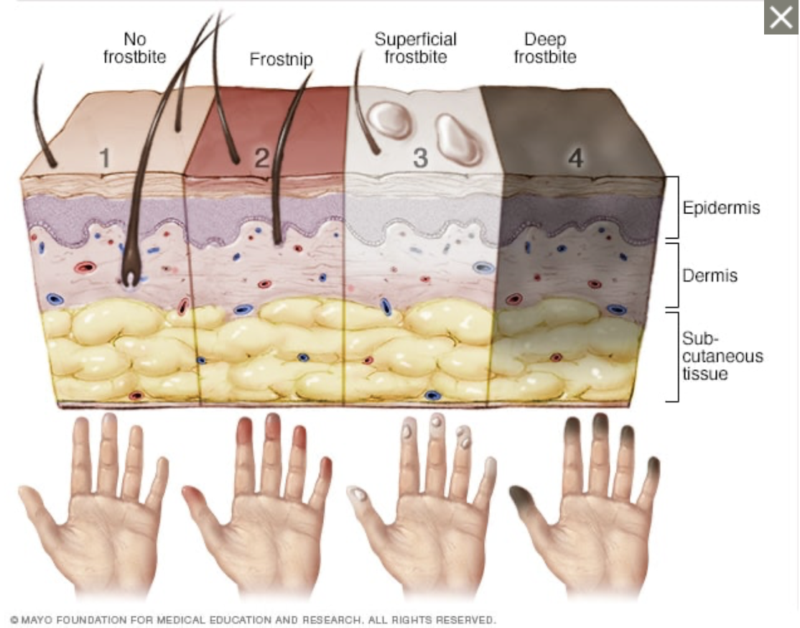
Notes:
Frostnip - mild form of frostbite. cold exposure leads to numbness, skin warms = may feel pain and tingling. No permanent damage
Superficial frostbite. Pale skin. The skin may begin to feel warm — a sign of serious skin involvement. If you treat frostbite with rewarming at this stage, the surface of the skin may appear mottled. And you may notice stinging, burning and swelling. A fluid-filled blister may appear 12 to 36 hours after rewarming the skin.
Deep (severe) frostbite. As frostbite progresses, it affects all layers of the skin as well as the tissues that lie below. The skin turns white or blue-gray and you lose all sensation of cold, pain or discomfort in the area. Joints or muscles may stop working. Large blisters form 24 to 48 hours after rewarming. The tissue turns black and hard as it dies.

Slide 18
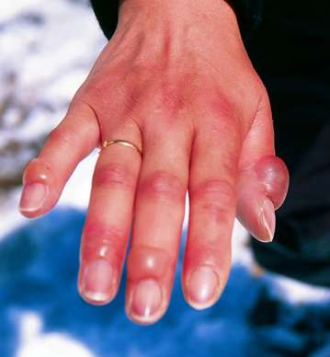
Frost Nip
Paleness or erythema with or without blisters
Pts complain of paresthesias, numbness or discoloration
Blistering and peeling are common
Notes:
Similar presentation to superficial burns
Most often affects nose, ears, hands and feet
Hemorrhagic blisters might indicate underlying injury, can leave them for hospital management

Slide 19
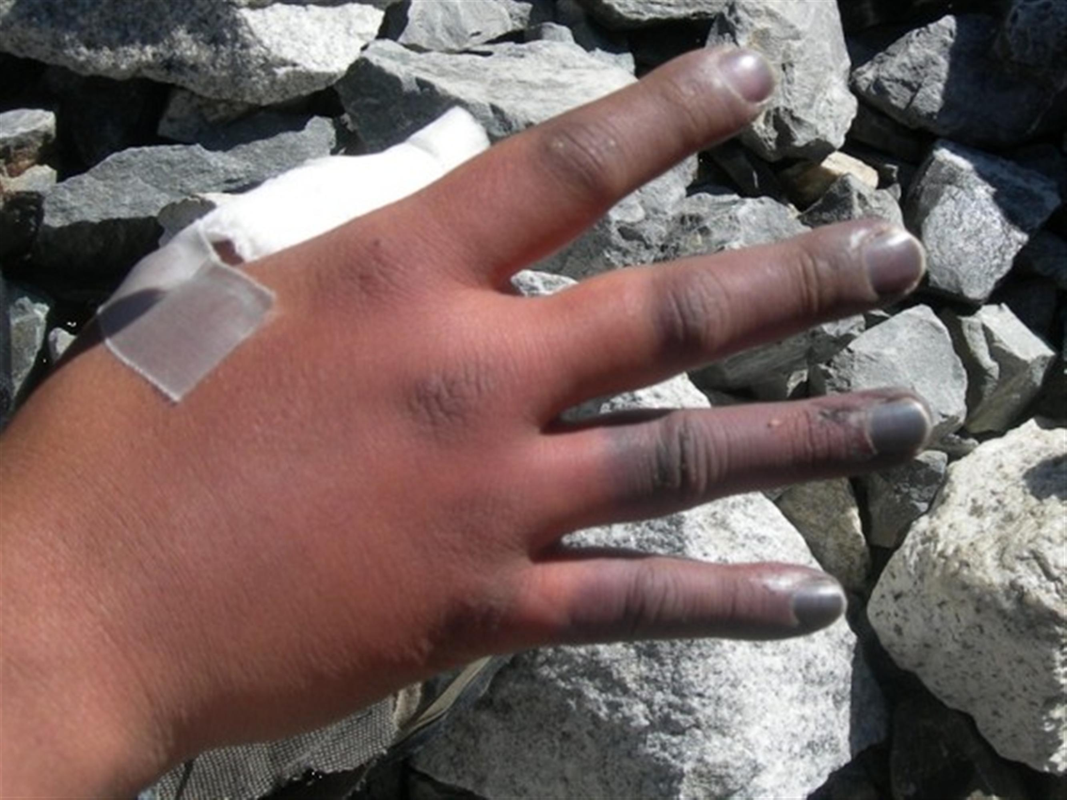
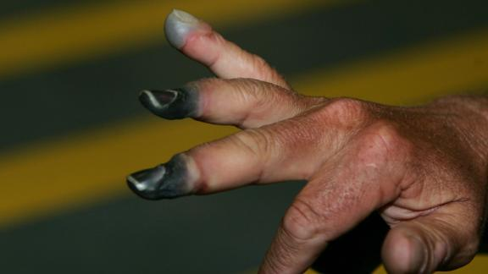
Frost Bite
Pathophysiology
Pre-freeze
Freeze-thaw
Vascular stasis
Late ischemic
Can lead to permanent injury or amputation
Notes:
Top superficial
Bottom deep
Initially pain, hardening, paresthesia, and numbness that progresses to hemorrhagic vesicle formation
Superficial – nonblanching with cold skin, rewarming can lead to flushing, pain and edema with blister formation
Deep – involves muscles, tendons and NV structures; can become frozen, firm, numb, blue/gray or mottled without change with rewarming

Slide 20
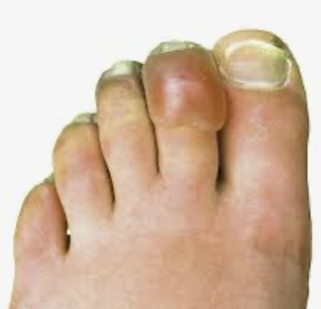
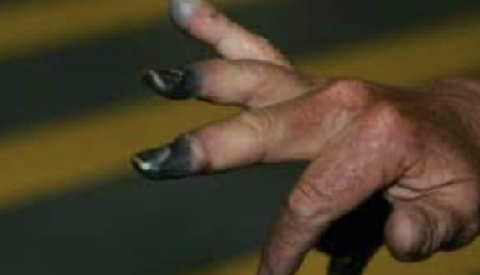
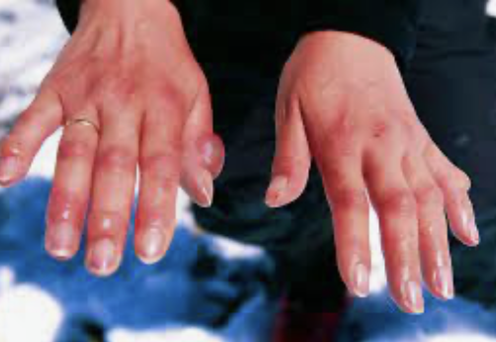
Frostbite
If frostbite present do not rub tissue - rewarm in warm water bath.
Stop further cold exposure.
If unable to keep re-warmed tissue warm then let stay cold until able to receive definitive care
If possible try to minimize use of affected extremity.

Slide 21
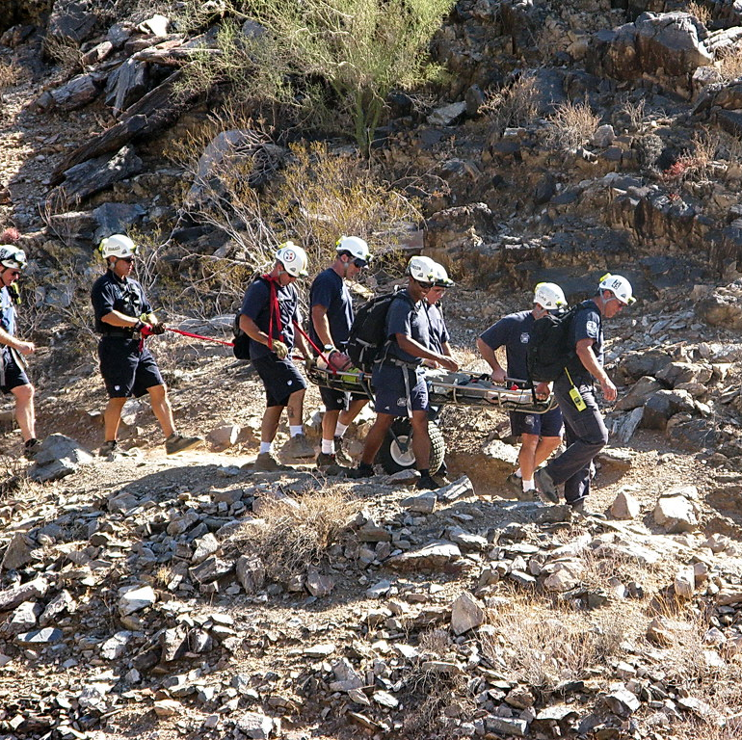
Initial therapy for hypothermia
What are some field measures that can be initiated?
Exposure – remove cold and wet clothing
Package for warmth
Warm, humidified O2
Active warming if moderate or severe*
Airway management for severe/comatose
Special considerations
Trauma
Sepsis/infection
High risk groups

Slide 22
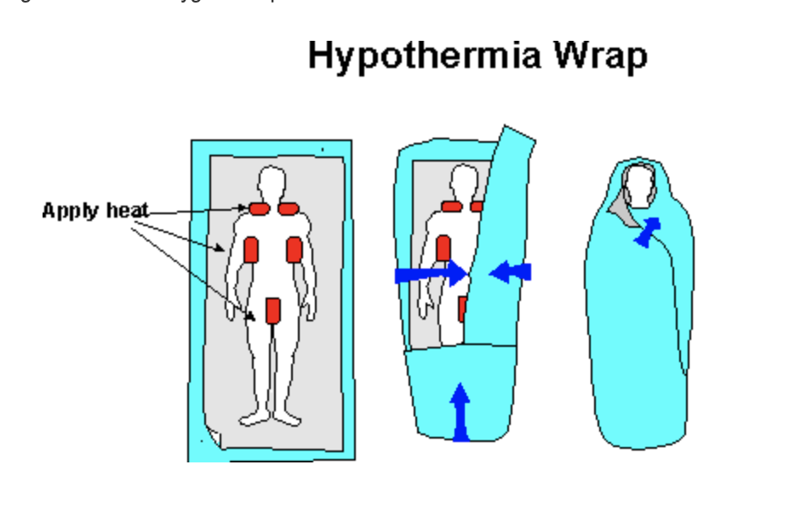
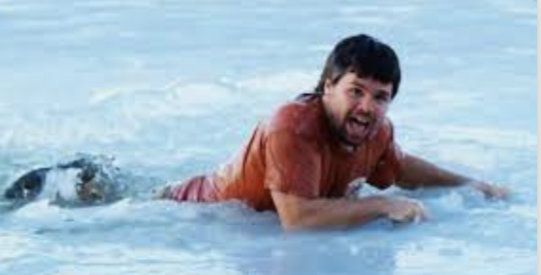
Prehospital management
Remove patient from the cold environment—handle gently.
Rough handling may precipitate V- Fib (a-fib is most common dysrhythmia)
Remove wet clothing
External rewarming - warm/dry blankets, radiant heat, warm packs.
Notes:
IV/IO - Warm crystalloid fluids of 20 mL/kg, if available, in 500 mL increments up to a total of 2L

Slide 23
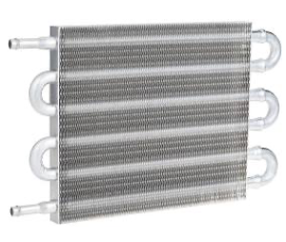
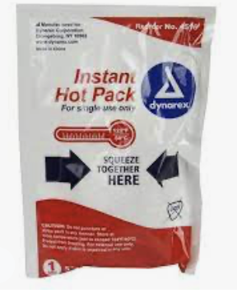
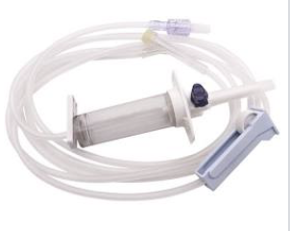
Warm IV fluids in pre hospital setting.
IV/IO - Warm crystalloid fluids of 20 mL/kg, if available, in 500 mL increments up to a total of 2L

Slide 24
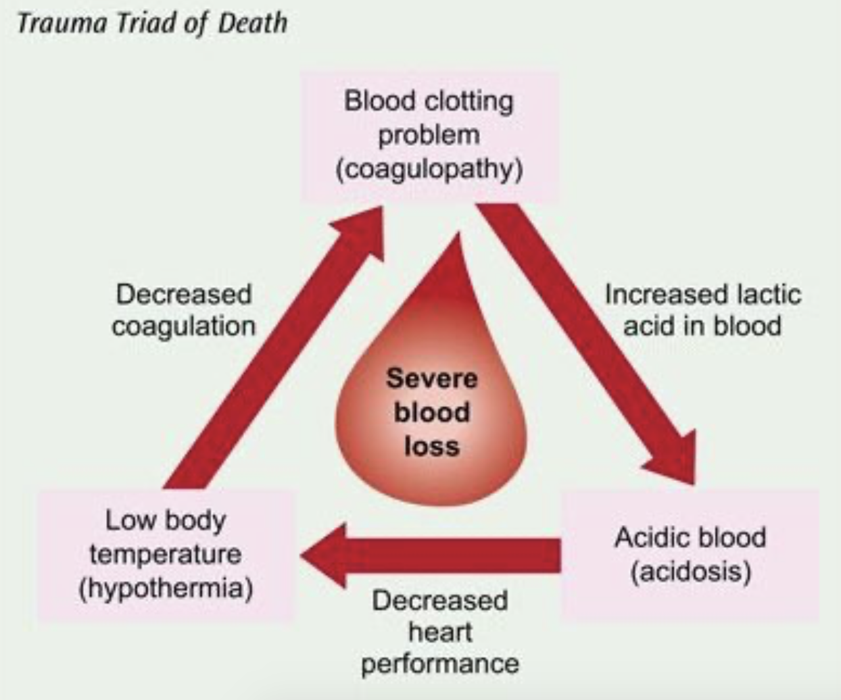
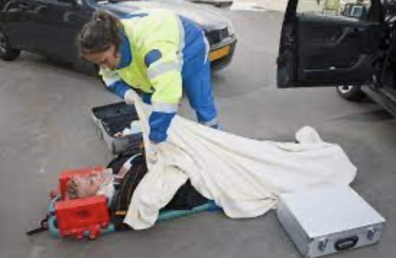
Trauma and hypothermia
Trauma patients at high risk of hypothermia .
Triad of death
Keep warm and dry.

Slide 25
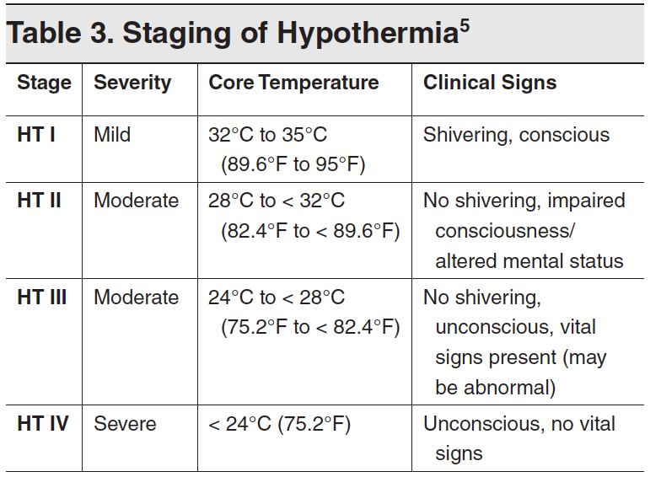
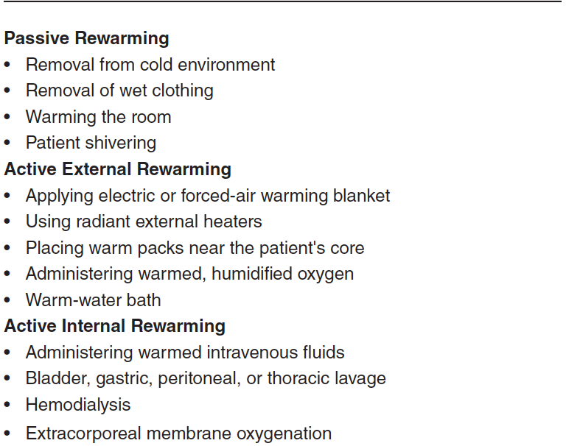
Rewarming
Guided by the stage of hypothermia:
Notes:
HT II and III should go to hospital with ICU/PICU (preferentially with ECMO)
HT I – passive external
HT II - passive external, internal and minimally invasive internal
HT III-IV – Everything
Not cut and dry rules, generalized rules. Consider HD stability in your choice

Slide 26
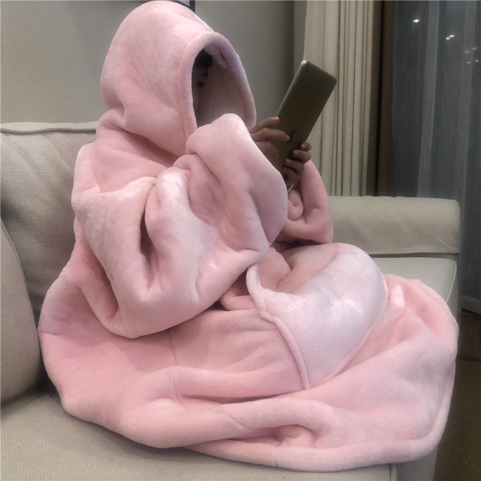
Passive rewarming
Packaging patient
Utilize intact shiver response
Rewarm at 0.5-2.0 ℃ /hr.

Slide 27
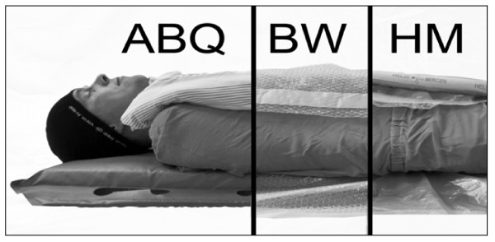
Insulation/packing Pre-hospital
Notes:
ABQ – Ambulance blankets/quilts
BW – Bubble wrap
HM (Hibler’s Method) of packaging – vapor tight layer and dry insulating layer
Hibler’s method: least heat loss (skin temp)
Citation: Thomassen Ø, Færevik H, Østerås Ø, et al. Comparison of three different prehospital wrapping methods for preventing hypothermia--a crossover study in humans. Scand J Trauma Resusc Emerg Med. 2011;19:41. Published 2011 Jun 23. doi:10.1186/1757-7241-19-41
patient packaging should include a sealed impermeable vapour barrier [114, 117] (if the patient is wet) excluding the face [118, 119], an external heat source, dry insulation (the thicker, the better), and a wind barrier that also reflects heat [114].

Slide 28
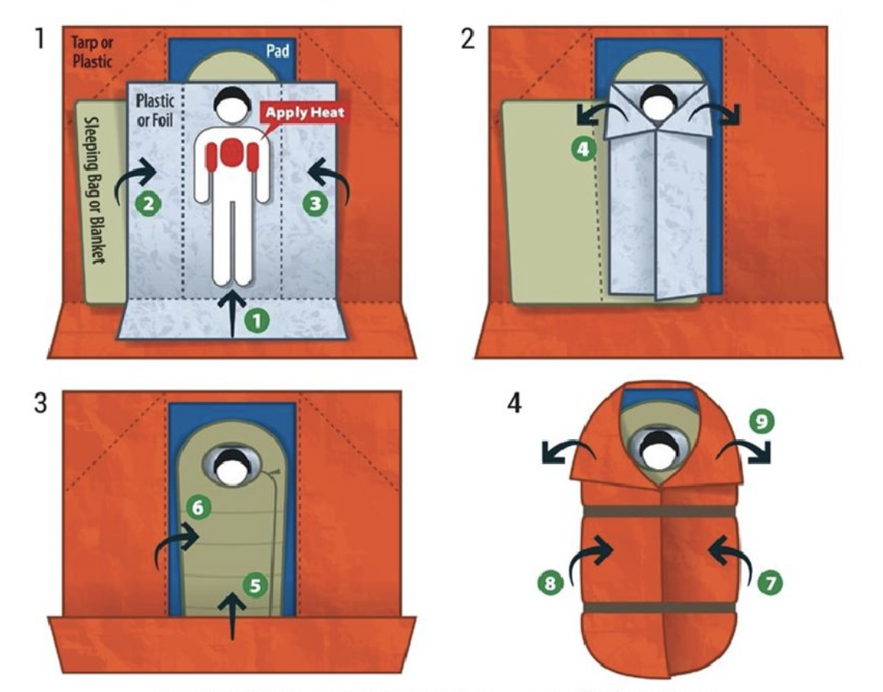
Insulation/packing Pre-hospital

Slide 29
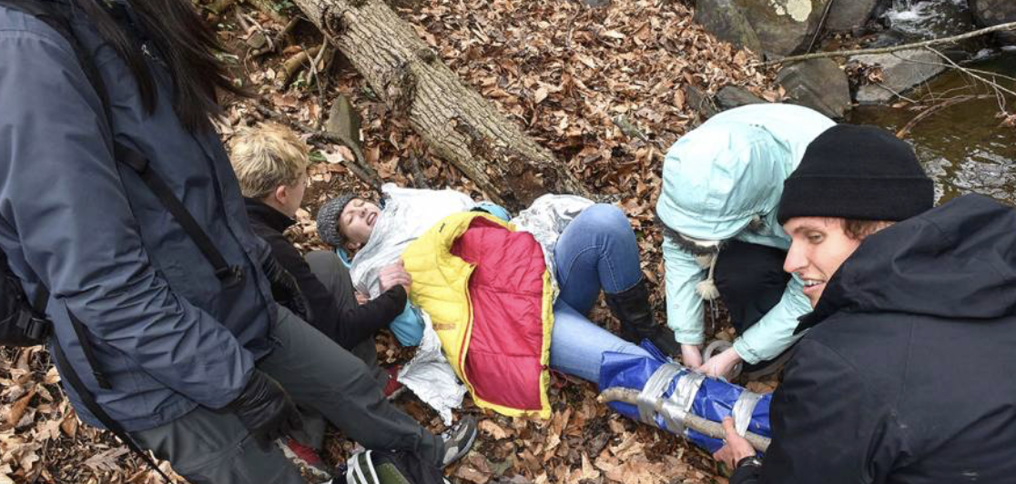

Slide 30
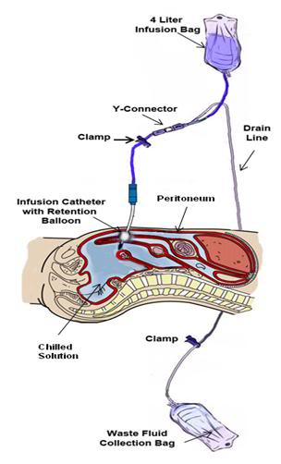
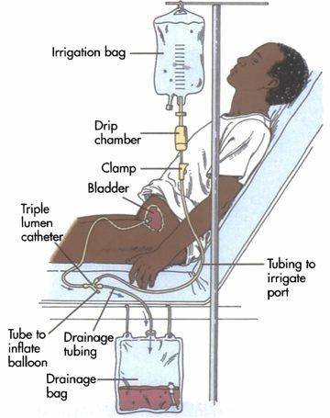
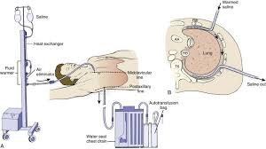
Hospital Rewarming: Lavage
Thoracic
Peritoneal
Bladder
Notes:
Thoracic – 3-6C/hr
Peritoneal – 2-4C/hr
Bladder – No significant core change found

Slide 31
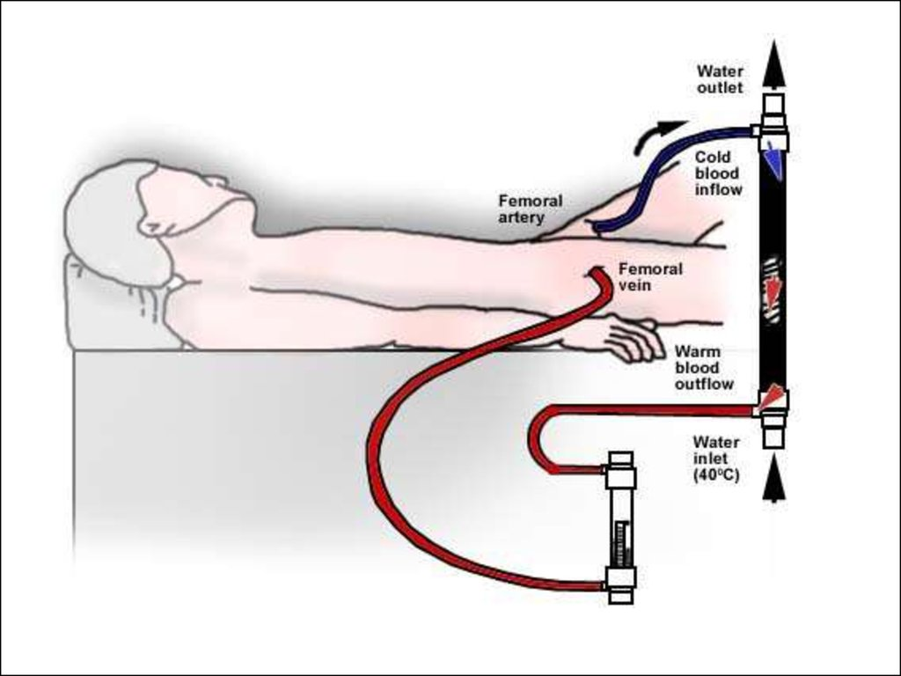
Extracorporeal Mechanical Oxygenation (ECMO)
A-V ECMO is the gold standard if it available
Most rapid rewarming method
Not available everywhere
Invasive
Expensive
Notes:
Another form of active internal rewarming
Rewarms 7-10C/hr

Slide 32
Clinical Scenario
EMS is called to a nearby park where an unidentified middle-aged woman was found on the ground near a park bench. She has no palpable pulse, and there is an unknown downtime. On exam, her pupils are fixed and dilated, and her body feels cold to the touch.
Should you start of withhold CPR?
For a frozen heart, what are the indications for defibrillation?
ACLS – Other considerations for Rx administration
Notes:
Futile – obvious lethal injury, stiff/frozen chest, avalanche burial >35min from rescue with airway impacted with snow
Give 1 round of Epi until 30C, then continue per protocol to avoid toxic accumulation
Defib – – if indicated, single shock at full power
some case reports of success at ~24C although previous convention was to not shock below 30C
Repeat shocks when >30C
ACLS – Epi considerations (American vs European)

Slide 33
When to initiate CPR in Hypothermic Patients
Best chance of full recovery – witnessed arrest in previously well patient
Most survivors found in Vfib or PEA arrest
Reasons not to start CPR:
Death prior to hypothermia
K+ >12
Any un-survivable condition (i.e. trauma, packed airway)
Frozen chest Wall
Core temp <14 ℃
Notes:
Note that most of these values were based on previous survival, not set in stone
Brain O2 consumption: decreases ~6% per 1C to 16% at 15C = increased success for neurological recovery from CPR
Cerebral metabolic suppression during hypothermic circulatory arrest in humans.McCullough JN, Zhang N, Reich DL, Juvonen TS, Klein JJ, Spielvogel D, Ergin MA, Griepp RB
Ann Thorac Surg. 1999 Jun; 67(6):1895-9; discussion 1919-21.
According to European Resus council (2016) – “At 18 °C the brain tolerates CA for up to 10 times longer than at 37 °C ”

Slide 34
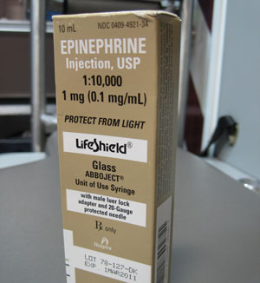
HT Modifications in ACLS
Epinephrine
Administered to patients <30 ℃
Defibrillation
1 dose at maximal charge
Notes:
1x dose for Epi
Defibrillation - if not responsive to shock, can repeat if indicated once >30C

Slide 35
Prehospital Management of cold injuries
How should the limb be rewarmed initially?
Remove cold/wet clothing, cover cold injuries with dry sheet
Place frostbitten limb on a warm body part
Rewarming with body temperature water (37-39 ℃) for 30 min to 1 hour with chlorhexidine or iodine
Frostbite – NSAIDS for pain relief, gradual rewarming
Notes:
Dressings – topical moisturizers/antibiotic ointment and splinting
Broad spectrum Abx for deep tissue layers
Murphy JV, Banwell PE, Roberts AH, et al. Frostbite: pathogenesis and treatment. J Trauma. 2000;48(1):171-178. (Review)

Slide 36
Summary
HT is a result of failure of the body’s intrinsic warming mechanism
Without shivering, the body will not rewarm in moderate hypothermia
Prompt ABC and rewarming in hospital is life saving
Initiate ACLS with modified Epi, shock delivery and adjusted CPR considerations
Cold injuries should be rewarmed in room temperature water gradually
NSAIDs should be used to pain control and clotting from cold injuries

Slide 37

What Questions do you have?

