Slide 1

From Itchy to Epi
Whitney Barrett MD
Notes:
Introduction:
EM physician
University of New Mexico
Instructor at the UNM EMS Academy

Slide 2

Wake up
When I say “allergic reaction” what do you think of?
What things immediately come to mind?
-- Tell a friend (or make a friend and then tell them)
Notes:
Before going too much further actually go get your pencil and paper and we will get things started
Keep your answers handy. We will come back to these

Slide 3
Objectives (things I hope you take away)
Understand what happens in the body that produces an allergic reaction- (Pathophysiology)
Identify things that commonly cause allergic reactions (allergens)
Describe the approach to the history and assessment of a patient with a possible allergic or immune reaction
Identify the differences between a mild, moderate and severe (anaphylactic) allergic reactions
Describe the treatment for an anaphylactic (severe) reaction
Notes:
Now that you know to expect some in-lecture assignments, lets review what we will cover today

Slide 4
Practical application
Distinguish
Distinguish allergic from anaphylactic
Treat
Treat anaphylaxis
Describe
Describe symptoms that identify allergic and anaphylactic reactions

Slide 5
Why does this topic matter?

Slide 6

Its one of the reasons you went into this…
Anaphylaxis is a TIME sensitive and LIFE-THREATENING condition
Early identification is critical
With the right interventions, you can save somebody’s life
Notes:
Anaphylaxis is a severe allergic reaction. It is:

Slide 7
What and why
What is an allergic reaction and why does it happen?
Notes:
Or if we are going to use medical words for this- what is the pathophysiology of an allergic reaction

Slide 8
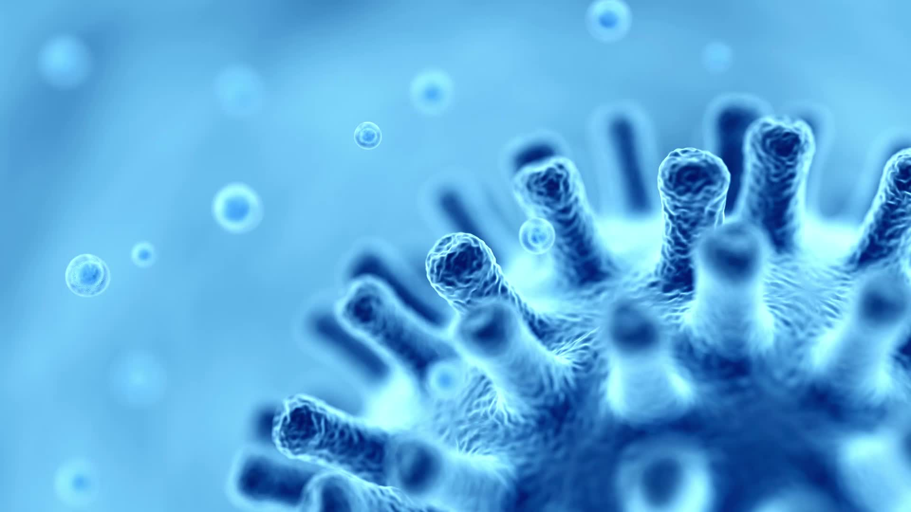
Definitions
Antigen- those things your body identifies as a threat (virus, bacteria, pollen, foreign substance)
Immune system- the collection of specialized cells and chemicals that fight things (antigens) your body identifies as a threat
Allergen- an antigen that causes a specific type of response (allergic response) by the immune system
Notes:
Lets cover a couple words that you will hear as we move forward

Slide 9
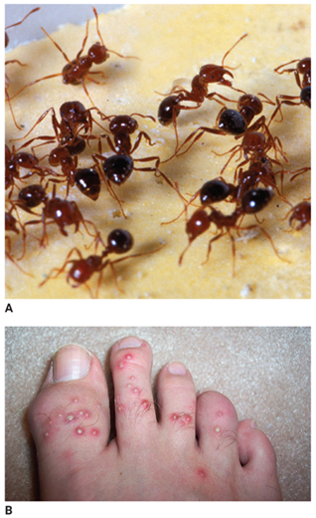
Allergens
Common classes of allergens
Food
Insects
Medications
Plants
Chemicals
Frequently we don’t Identify what cause reactions
Treat grouping of symptoms!
Notes:
We always want to know and patients always want to know what it was that caused their symptoms. Sometimes this is possible and it is always good to ask the patient about some specifics but remember that we might not always be able to identify the offending agent. In reality, it doesn’t really matter what the allergen was, the most important thing is that you can recognize and treat the allergic reaction.
As you are talking to you patient; however, it can be helpful to guide them to reflect on the most common items that cause allergic reactions. Things like food…

Slide 10
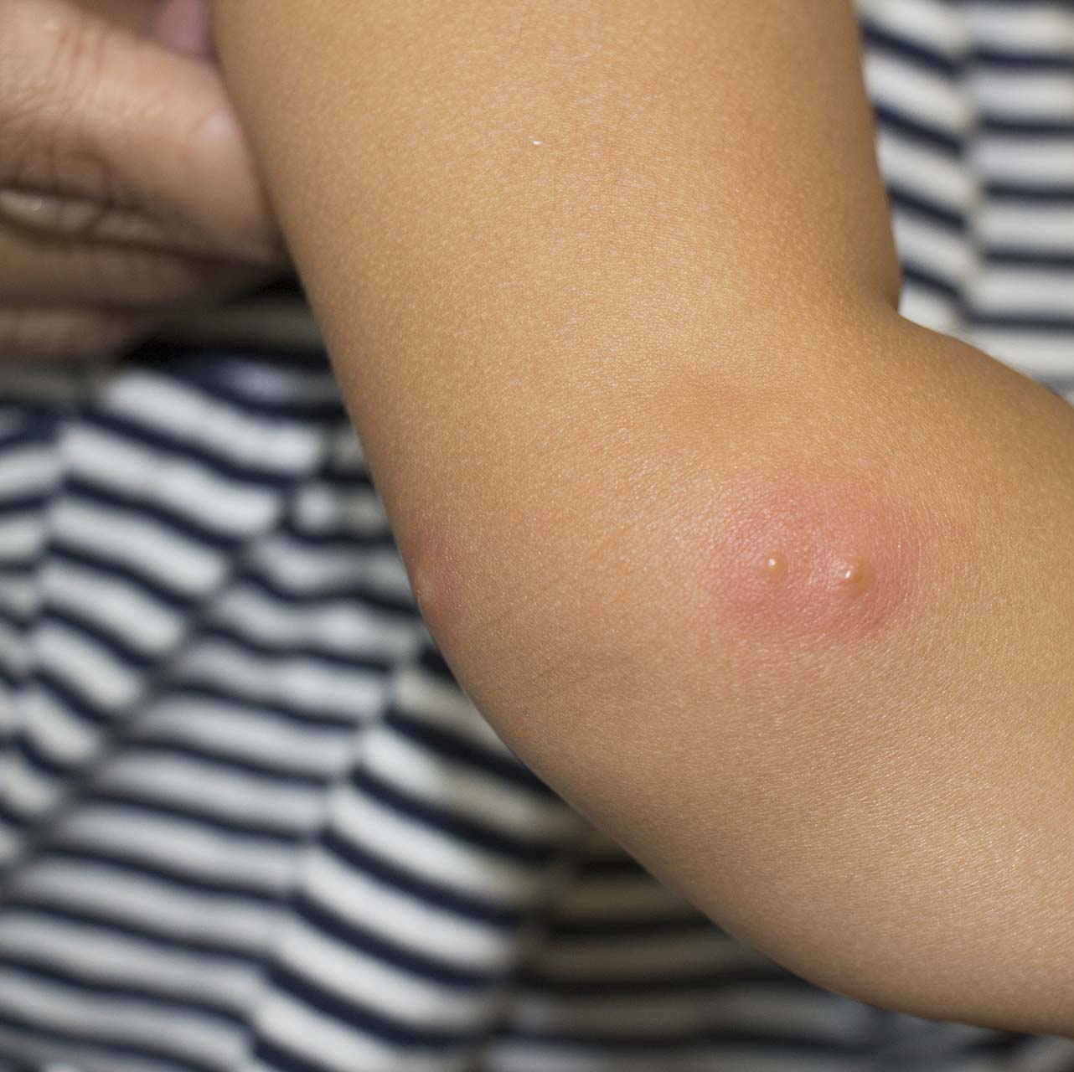
Normal response- bee sting example
Antigen- Bee venom introduced
Immune system
Sends special cells to “contain” the venom (antigen)
The blood vessels near the sting become more leaky to let the special cells go back and forth
With time (days) the venom is gone and immune system returns to normal
What we see
Swollen and red
Itchy
Key: LOCALIZED reaction
Notes:
Lets think about an example you might be familiar with
Say you get stung by a bee. Your immune system normally has a programed response to this
The venom is the antigen- what your body recognizes as foreign.
All this is happening with your immune system but what you see on yourself is:

Slide 11
Allergic reaction
An allergic reaction is an exaggerated immune response to any substance.
Pollen!
Caused by the body’s immune system
Mast cells
Releases chemicals to combat stimulus
Includes histamines and leukotrienes
Notes:
Your body over-reacts and releases special chemicals to fight what is simply an antigen
This overreaction is primarily mediated by histamine and leukotrienes

Slide 12

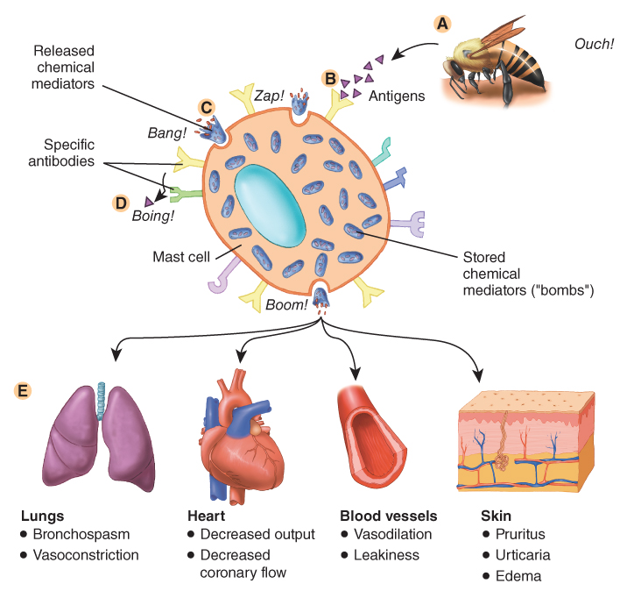
Allergic reaction
Venom=antigen/allergen
Mast cells recognize allergen and react!
Histamine and leukotrienes (special chemicals) are released
© Jones & Bartlett Learning.
Notes:
In an allergic reaction you have antibodies and mast cells that get involved
The Antibodies cause the mast cells to recognize the antigen as particularly bad
The result is that the mast cells release special chemicals

Slide 13

Allergic reaction
Histamine has special effects on different body organs
Bronchoconstriction
Tachycardia
Vasodilation + mucus production
Urticaria (rash)
Nausea/vomiting (not pictured)
The amount of effect can be variable
Patients can have mild to severe reactions
Notes:
Histamine is a powerful chemical that has effects on lots of different parts of the body especially the lungs, the cardiovascular system, the skin and the GI tract (think about parts where you have smooth muscle)
Depending on the person and amount of histamine, the full effects can vary from mild to severe

Slide 14

Pause
Based on what you now know about how allergic reactions happen…
What symptoms do you imagine a person with an allergic reaction could have?
HINT: what body systems histamine affects? what exam findings would you expect? What might vital sign changes might occur? What would the patient complain of?
Share with a friend
Notes:
I’ll give you some time here. You might even want to go back a couple slides to review those affected body systems. Once you have done that, think about vital signs- HR, BP, Respirations you might expect. What about the symptoms the patient would tell you they have

Slide 15

What signs and symptoms did you anticipate?
Notes:
Remember these happen on a spectrum but lets look at some of these in more detail. We will break these down into things your patient might complain of- their symptoms. And then the signs of or things you find on exam of allergic reaction. Both are important as sometimes you might not be able to communicate with your patient.

Slide 16
Body systems involved
Skin /Mucus Membranes
Lungs/airway
Cardiovascular
Gastrointestinal
Notes:
Remember those categories that we talked about before that are particularly sensitive to histamine? These are the classic 4 systems we refer to related to allergic reaction and anaphylaxis

Slide 17

Symptoms and Exam
Spectrum of allergic reaction symptoms
Notes:
So we have covered why allergic reactions happen (pathophysiology), what the most common offending agents are (allergens), now lets dig into the things your patient might complain of or findings you might discover on exam.

Slide 18
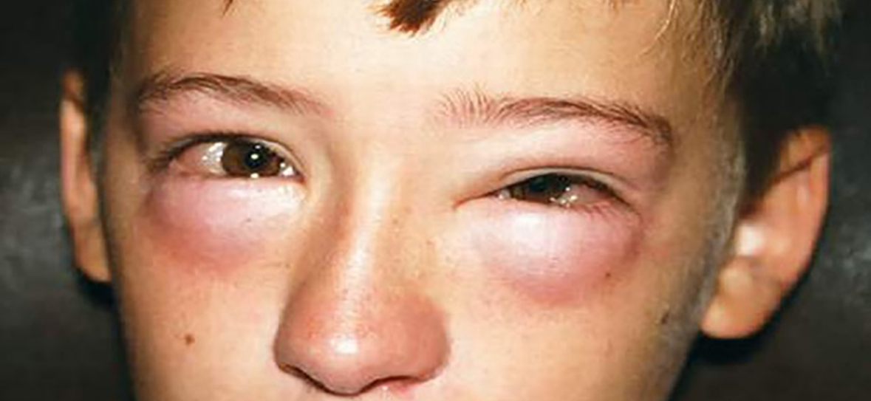
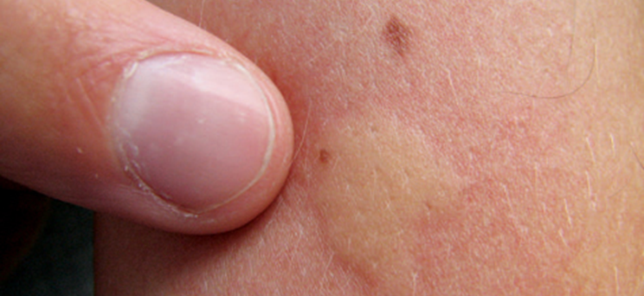
Things you might see
Patient describes:
Itching
Redness
Hot
Skin + Mucus membrane findings!
Rash/hives
Swelling
Watery eyes
Notes:
We talked about the fact the skin is one of the places histamine has a big affect. You might have had an allergic rash before. Patients will describe: On exam you will expect to see urticaria

Slide 19
Things you might hear
Patient says:
Its hard to breathe
My throat feels weird
My throat is tight
My breathing is noisy
Pulmonary/Airway exam
Stridor
Wheezing
Swollen oropharynx
Notes:
The lungs and pulmonary system is one of the most concerning areas histamine takes its affect. Your patient might describe symptoms like:
On exam you should listen closely for

Slide 20
Other stuff!
Gastrointestinal symptoms
Nausea
Vomiting
Abdominal cramping
Patient throws up on you
Notes:
The GI symptoms associated with allergic reaction are often missed or forgotten about. They don’t tend to be as dominate but they definitely count on the spectrum of allergic reactions. Most commonly patients might mention or respond about nausea or abdominal cramping if asked- these don’t tend to be the most dominate features of allergic reaction. They tend to care more that they would like to scratch their skin off its so itchy.

Slide 21
Vital sign abnormalities
Cardiovascular effects
Tachycardia (fast heart rate)
Hypotension (low blood pressure)
More pulmonary effects
Tachypnea (fast breathing)
Hypoxia (low oxygen levels)
Notes:
Finally, vital signs are vital right? Histamine will have affect on the cardiovascular and pulmonary systems with resulting abnormal vital signs. Look for things like tachycardia and hypotension- a combination that should always grab your attention! As well as tachypnea or hypoxia. A complete set of vitals and repeat sets of vitals to establish a trend is really important when managing patients with allergic reactions.

Slide 22
Allergic reaction
Patients can have symptoms of allergic reaction from any of these categories
Skin
Airway/pulmonary
Cardiovascular
Gastrointestinal
What makes an allergic reaction Anaphylaxis?

Slide 23
Anaphylaxis/Severe allergic reaction
Development of symptoms within minutes hours of exposure
PLUS one of the following
Skin/mucosal symptoms AND
Respiratory compromise
Decrease in blood pressure or evidence of end organ dysfunction (syncope etc)
2/4 body systems involved: skin, GI, cardiovascular, respiratory
Decreased BP/hypotension
Adults: SBP <90
Peds: SBP <70+2xAge in years

Slide 24

Anaphylaxis =multiple or life-threatening symptoms
Multiple systems involved. Many of them life threatening!
Airway obstruction/ Respiratory distress
Hypotension

Slide 25

Hypotension: onset minutes to hours
Hypotension in the setting of an exposure
Adult: SBP <90
Kids: SBP <70+ 2x age in years
Ex: 5-year-old would be hypotensive if SBP< 80 (70 + 2 (5))

Slide 26
Treatment
Notes:
We are getting close to the end. What you really want to know, after you identify the problems is how to fix them!

Slide 27
Never forget the basics
Scene safety!
Personal protection especially if there is some exposure
ABC’s
Severe allergic reaction =anaphylaxis
Patients can have compromised airways, breathing or circulation
Always address immediate risks first
If its not obvious right away, gather more information
Notes:
By this point I know you know this stuff but lets pause and review a little here. With anaphylaxis, a patient can have compromised airway, breathing or circulation. Be sure to always address immediate life threats first. Also remember that if on primary assessment the patient is concerning but isn’t forcing you into specific interventions, you can and should work on gathering more information. You don’t always need to and shouldn’t always make your management decisions right away.

Slide 28
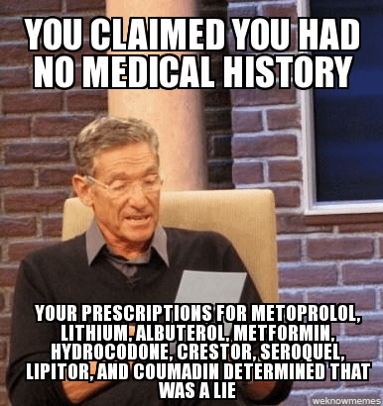
You should still do a history and exam…
After intervention for immediate life threats
A
B
C

Slide 29

Mild or Moderate symptoms- One system. Not severe
Supportive care**
Consider medications
Monitor for any changes in symptoms
Notes:
For patients with mild to moderate symptoms, the treatment is supportive and anticipatory. Make them as comfortable as possible, start making your way to the hospital. Don’t ever neglect those vitals and reassessment incase anything changes.

Slide 30
Treatment for Mild to Moderate allergic reaction
Diphenhydramine (Benadryl) - Yes!
Steroids (dexamethasone or solumedrol) - maybe
Benadryl and steroids are NOT the treatment for anaphylaxis

Slide 31
Treatment- Anaphylaxis
Oxygen administration based on:
Airway patency
Work of breathing
Abnormal lung sounds
Oxygen saturation
Medication:
Epinephrine 1:1000 also known as epinephrine 1mg/1mL
Benadryl- probably- second line
Albuterol- maybe
Steroids…
Notes:
Oxygen or respiratory support and epinephrine are the mainstays of anaphylaxis treatment. Let your patient guide you for placement of oxygen. The epinephrine dose for an adult is .3 mg of 1mg/1mL concentration of epinephrine IM.

Slide 32

Epinephrine
Make sure you know your local protocols and guidelines and only act within those
Epinephrine
Mimics the sympathetic (fight-or-flight) response
Causes the blood vessels to constrict
Reverses vasodilation and hypotension
Increases cardiac contractility and relieves bronchospasm
Rapidly reverses the effects of anaphylaxis
Notes:
What is epinephrine? You’ve probably heard about it before. We use it for lots of things and it exists in the body as a neurotransmitter too.

Slide 33
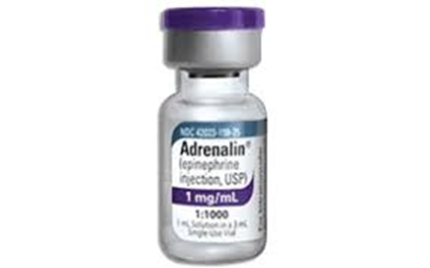
Epinephrine
Concentration: 1mg/1mL
Dose
Adult: 0.3 mg= 0.3mL
Peds: 0.15 mg= 0.15 mL up to 20 kg
Route: IntraMuscular
Lateral thigh

Slide 34

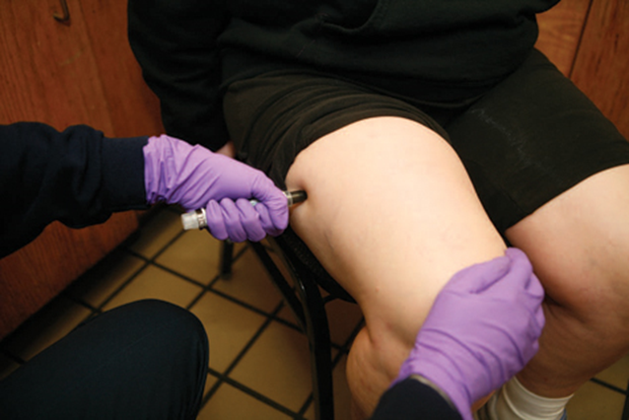
Epinephrine Administration
These are expensive
You can help a patient administer their own
If your agency carries these, you can administer them
Follow instructions on autoinjector
Notes:
Most of the national registry talks about epinephrine administered with an epi-pen. Here are examples of some available on the market and that your patient might have. You can always help them administer their own epineprhirine

Slide 35

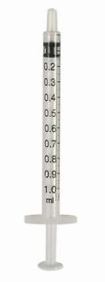
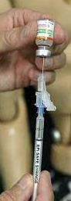
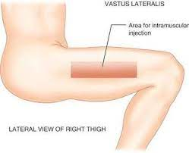
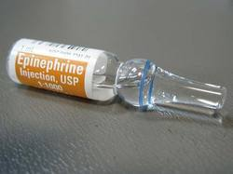
Epinephrine- syringe administration
Notes:
If you are drawing up epinephrine, be sure you are using the mechanism and systems designed by your agency. There should be a syringe that is clearly marked or actually prevents overfilling.

Slide 36
Potential side effects of epinephrine
Cardiovascular
High blood pressure
Increased pulse rate
Cardiac arrhythmias
Gastrointestinal
Nausea
Vomiting
Other
Dizziness
Headache
Anxiety
Chest pain

Slide 37
Remember
Mild/Moderate allergic reactions DON’T need epinephrine
Anaphylaxis is any of the following
Hypotension associated with allergen exposure
Respiratory distress
At least 2 out of 4 body systems involved
What is the dose of epinephrine for an adult?
Notes:
Let these couple things stick with you! Don’t forget to take any questions you have generated over the lecture to your instructors to clarify all of this.

Slide 38
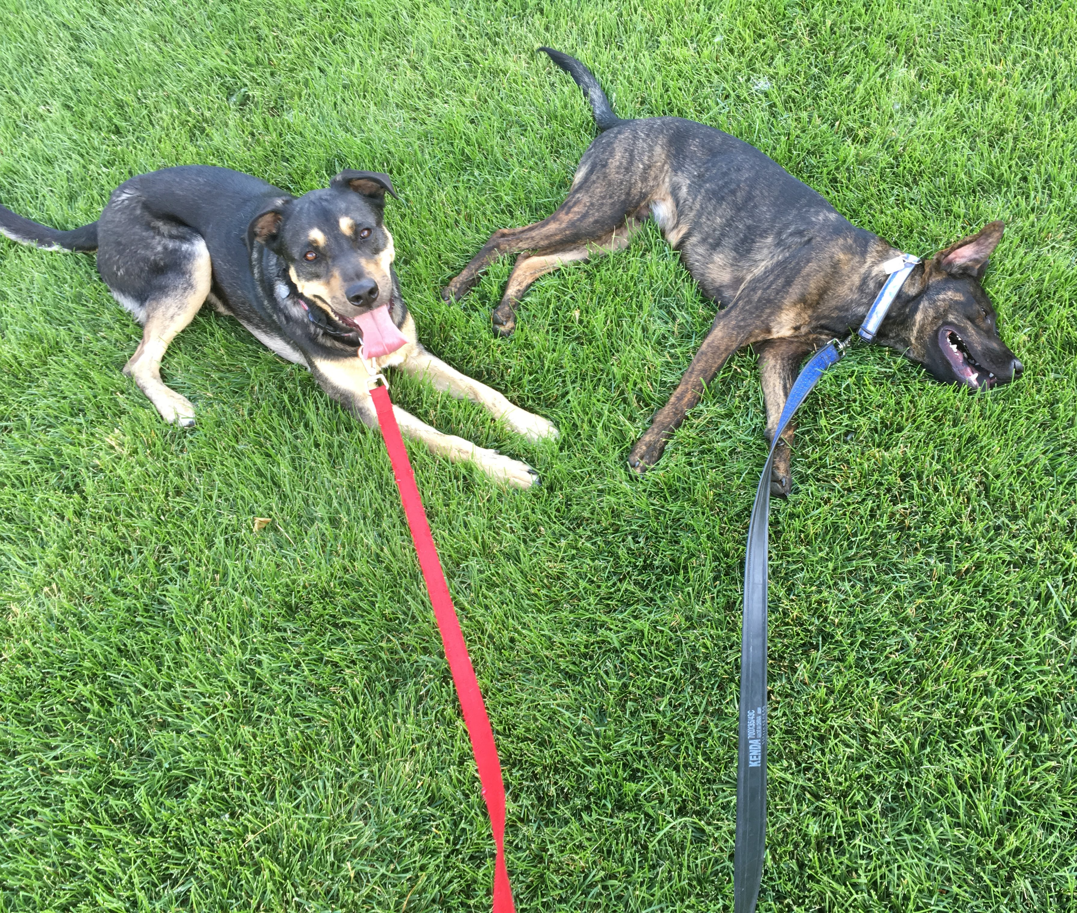
Examples

Slide 39
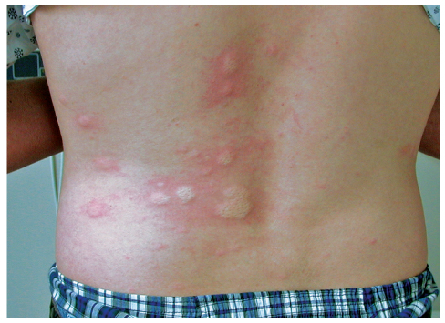
16 yo male just was stung by a bee on his back while riding his bike.
ABC’s are intact
Vital signs are all normal
He only reports his back is itchy
This is what his back looks like
Mild? Moderate? Severe?
Notes:
Lets look at some examples of cases and you can practice deciding if the reaction is mild, moderate or severe. Our first example is this patient- Don’t hesitate to pause and think about the case before we discuss the answer

Slide 40
Mild
Treatment?
Supportive
+/-Benadryl

Slide 41
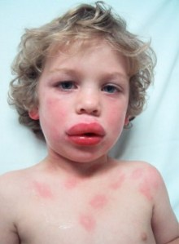
Mild - single system symptoms
Generalized erythema (flushing)
Urticaria
Periorbital edema or angioedema
Just nausea
Cough or runny nose
blog.sea2skyservices.com
Notes:
Remember this is all on a continuum, RARELY obviously one or obviously the other: The patient with an allergic reaction will first notice a sensation of warmth or tingling of the face, mouth, upper chest, and/or the site of the exposure. Pruritus (itching) is the most common symptom, along with generalized flushing and urticaria. This exposure can lead to respiratory distress, cough, tightness of the chest, dyspnea, and wheezing. Hypotension may be observed with the patient complaining of light-headedness and syncope. Gastrointestinal manifestations will follow. The patient may complain of cramps and abdominal pain, nausea, vomiting, and diarrhea. The patient may also have a sense of impending doom.

Slide 42
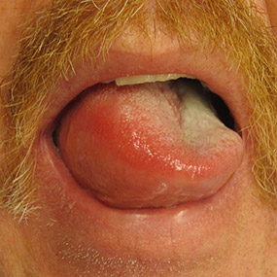
Single system or life threatening?
Technically, this is swelling of a mucus membrane (tongue)
It is also part of the airway
Why does it look weird?

Slide 43
Anaphylaxis =multiple or life threatening symptoms
Multiple systems involved. Many of them life threatening!
Airway obstruction /Respiratory distress
Hypotension

Slide 44
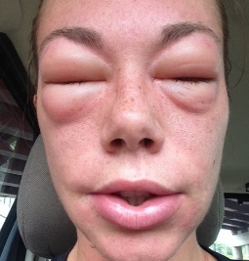
32 yo female just started on an antibiotic
First dose was 2 hours ago
Reports itchy skin and swelling as you see here.
She denies any other symptoms at this time
Vitals are normal
Mild? Moderate? Severe?

Slide 45

Moderate
Single system, not life threatening but more extensive symptoms and findings
What if she develops wheezing on exam during transport?
➔ Severe
Notes:
If you said moderate, your are spot on. There is only one system involved- the skin, but the symptoms seem to be more extensive than a little itching. You will need to pay close attention to this patient as you take care of them. What about if symptoms progress and then she develops wheezing? If you said that now she is considered a severe reaction- which is anaphylaxis- you are correct

Slide 46
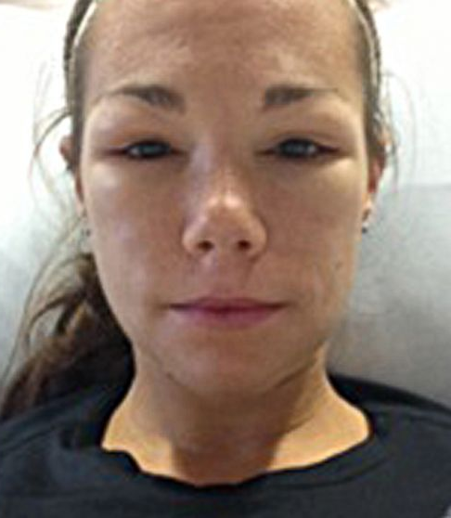
After treatment
What did you treat her with?
Epinephrine 0.3mg IM
Benadryl 25 mg IV

Slide 47
Reassessment
Giving epinephrine isn’t a one-time decision

Slide 48
Reassessment
Repeat the primary assessment, reassess the patient’s vital signs, and repeat the focused physical exam.
Watch for changes.
If your patient’s symptoms change and now they are severe or seem like anaphylaxis
Treat as anaphylaxis
You can give another dose!
Notes:
Lecture Outline
E. Reassessment
1. En route to the hospital, repeat the primary assessment, reassess the patient’s vital signs, and repeat a focused physical examination of the affected body systems.
a. If the patient is unstable, reassess every 5 minutes; if the patient is stable, reassess every 15 minutes.
b. Watch for signs of shock and treat immediately if present.

Slide 49
What if…
It doesn’t work or symptoms continue?
Pause to make sure you think this is anaphylaxis
Give another dose
.3mg IM epinephrine (1mg/1mL concentration)
It’s a child?
Half the dose
.15 mg IM epinephrine (1mg/1mL concentration)
They go into cardiac/respiratory arrest
Transition to usual cardiac arrest care
Notes:
So this is all fine until it doesn’t go as expected or there is a wrinkle
What would you do if the symptoms continue to progress?
What about if it isn’t an adult?
What if they go into cardiac arrest?

Slide 50
I gave epi a couple times and nothing changed
What could it be if its NOT anaphylaxis

Slide 51
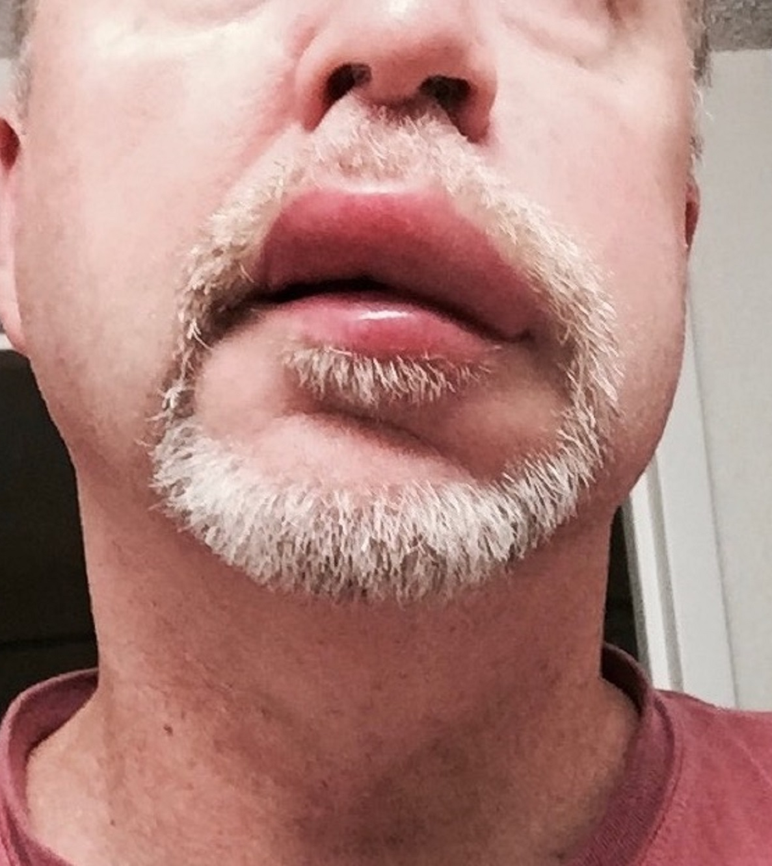
Differential Diagnosis
Angioedema
Acquired (Medication)
Hereditary
Mast Cell Activation Syndrome
Infection
For the most part if it seems like anaphylaxis, treat it like that to start

Slide 52

Take home points
Allergic reactions occur on a spectrum. Severe=Anaphylaxis
Anaphylaxis is identified by:
Life threatening symptoms (hypotension, respiratory distress) OR
Symptoms from at least 2/4 body systems (cardiovascular, pulmonary, skin, GI)
Epinephrine dosing is:
0.3mg IM for adults
0.15 mg IM for children
Notes:
You made it! Here are the take homepoints!

Slide 53

Questions?

