Slide 1
Optimizing Healthcare for Patients Returning to the Community after Incarceration
Eliza Hutchinson, MD
Assistant Professor of Family Medicine, University of Michigan
Director of Addiction Services, Packard Health
Adam Grant
Executive Director, A Brighter Way
June 5, 2025

Slide 2

Intros
Eliza Hutchinson, MD
Assistant Professor of Family Medicine, University of Michigan
Director of Addiction Services, Packard Health
Adam Grant
Executive Director, A Brighter Way

Slide 3
Objectives
Describe the unique health risks related to incarceration exposure
Develop clinical skills to optimize engagement and care delivery for formerly incarcerated individuals
Identify community resources, emerging models of care, and advocacy opportunities to improve the health of justice-involved individuals

Slide 4
Roadmap
Mass incarceration in the US
Healthcare in carceral settings
Health risks during reentry period
Clinical considerations
Clinic systems changes
Advocacy opportunities

Slide 5
We hope you will leave today’s session feeling:
A sense of urgency, inspiration, and empowerment in engaging intentionally with formerly incarcerated individuals and advocating for efforts to address health disparities in the justice-involved population.

Slide 6
Why have this conversation?
“I don’t interact with many patients who have been incarcerated”

Slide 7
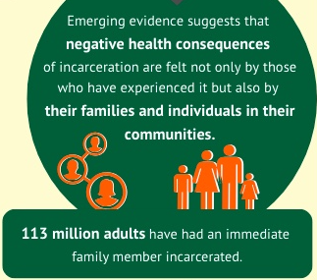
Why have this conversation?
Mass incarceration affects all our communities
Justice-involved individuals are already in our clinical settings
Urgent and neglected community health need
Addressing healthy equity and health disparities
Every member of the healthcare team can help
NIHCM
40% of patients in an urban primary care practice have a history of incarceration
MacKenzie et al, 2021

Slide 8
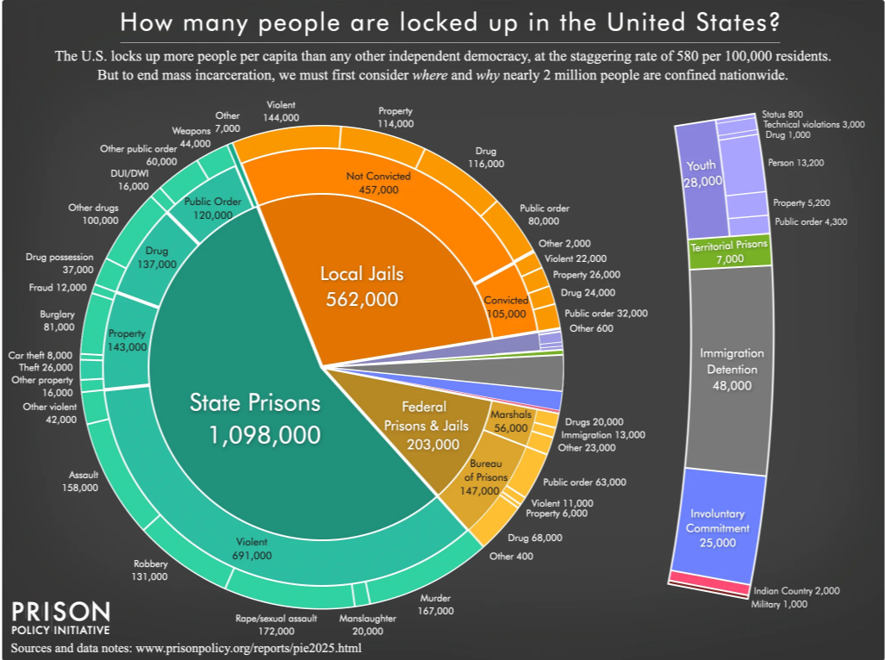
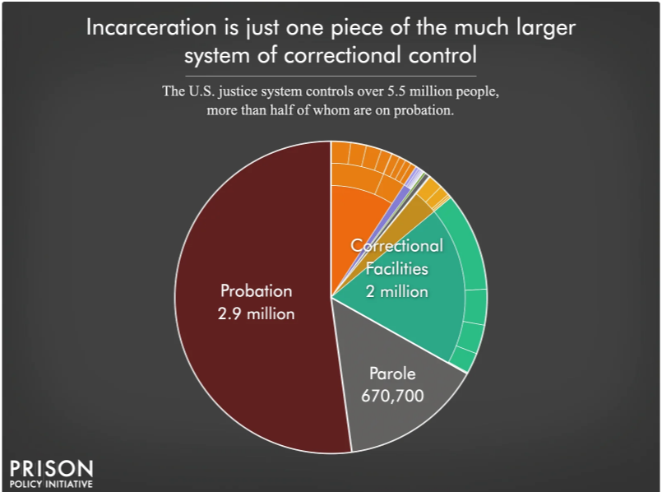
Incarceration by the numbers

Slide 9
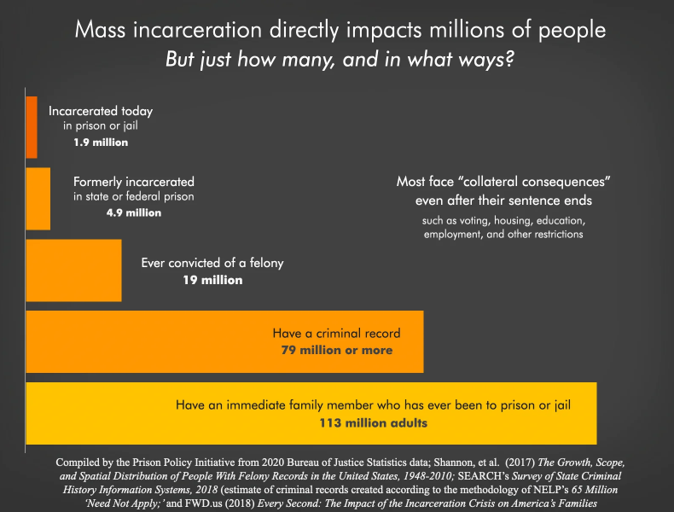
Current incarceration is only part of the picture
1 in 3 US adults has a criminal record
1 in 20 US adults has been incarcerated
Source: Prison Policy Initiative, Bureau of Justice Statistics

Slide 10
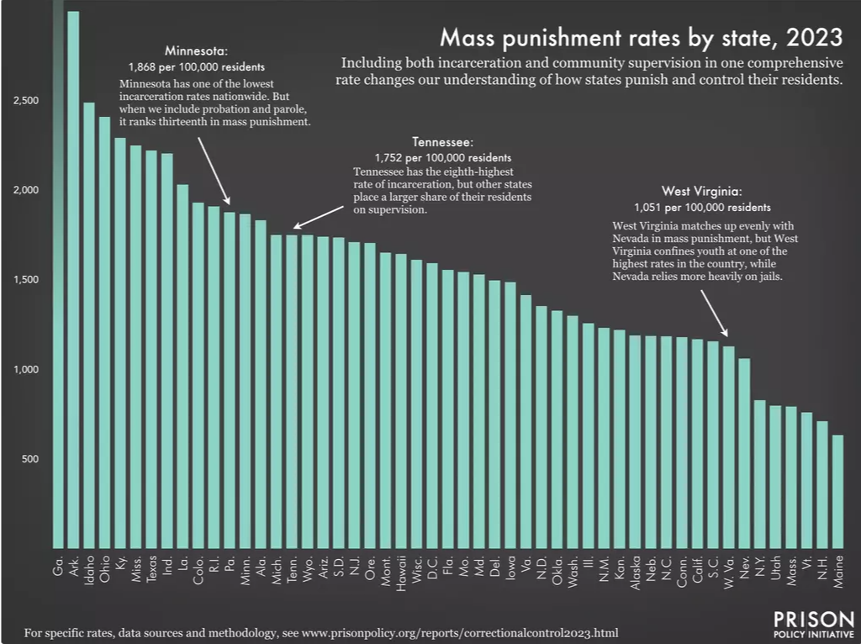
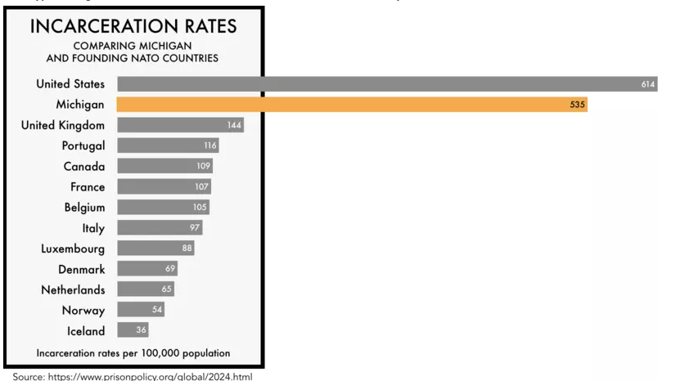
Mass punishment in Michigan
Source: Prison Policy Initiative

Slide 11
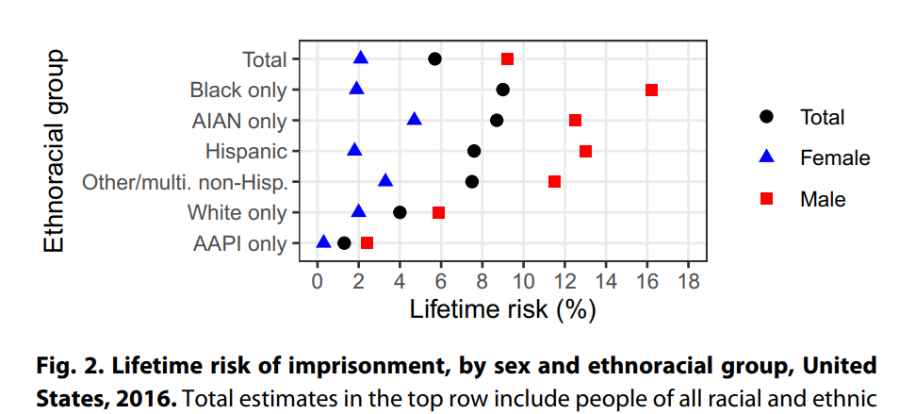
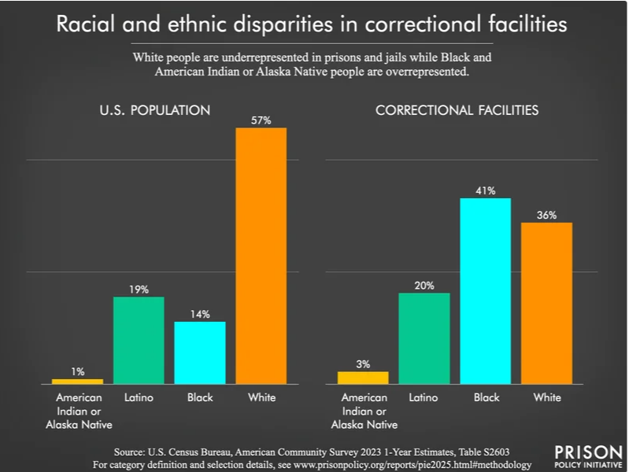
Prominent racial disparities in carceral settings
Roehrkasse & Wildeman, 2022
1 in 3
Black American men will be incarcerated
Bureau of Justice Statistics
Source: Prison Policy Initiative

Slide 12
Myth or Fact?
The majority of individuals are incarcerated for committing violent acts

Slide 13
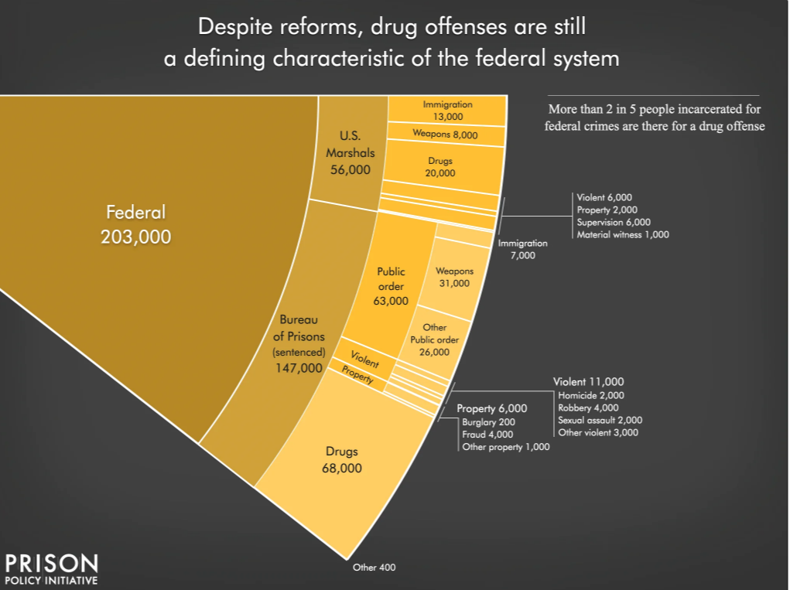
Myth or Fact?
A very small proportion are incarcerated for violent acts. Incarceration for drug-related offenses is far more common.

Slide 14
Myth or Fact?
The majority of incarcerated individuals have a substance use disorder (SUD).

Slide 15
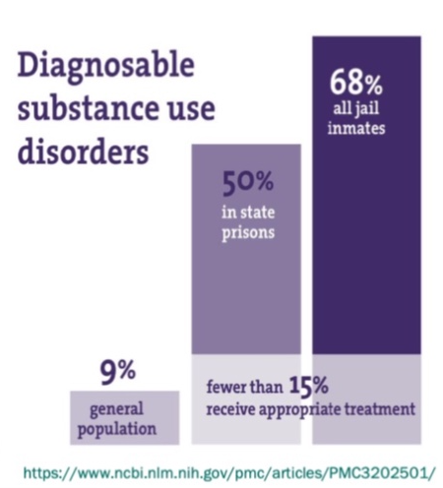
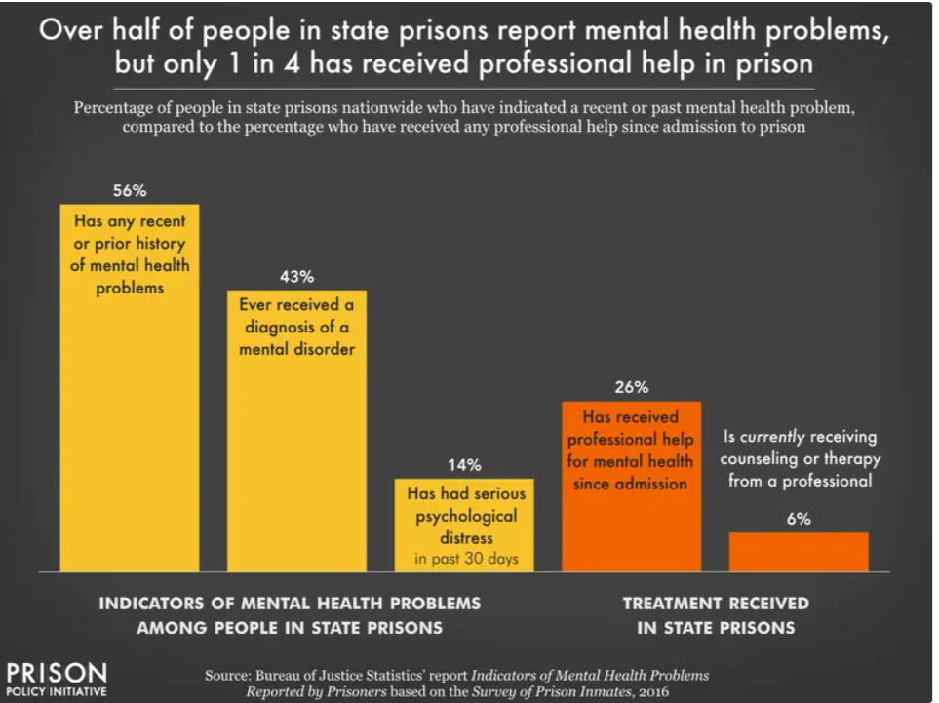
Myth or Fact?
The majority of incarcerated individuals have SUD and mental health conditions.

Slide 16
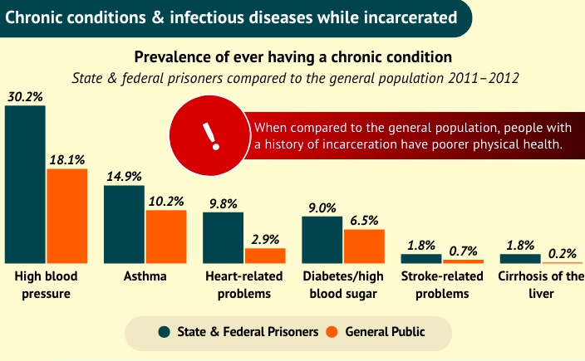
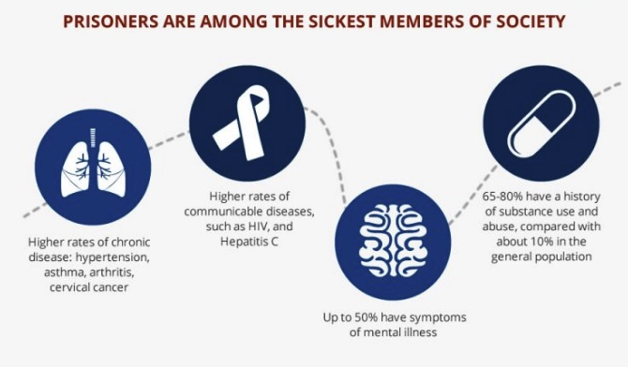
High prevalence of chronic disease in carceral settings
NIHCM
https://www.careinnovations.org/resources/innovation-spotlight-transitions-clinic-network/

Slide 17
How does incarceration worsen health?
Burden of health conditions at entry
Trauma during incarceration
Solitary confinement
Lack of access to harm reduction resources
Infectious disease spread/crowding
Diet/nutrition
Healthcare during incarceration (privatized)

Slide 18
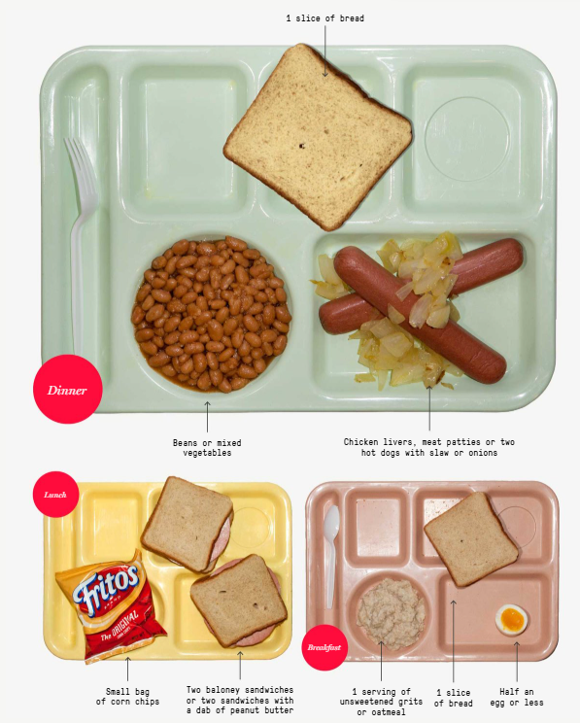
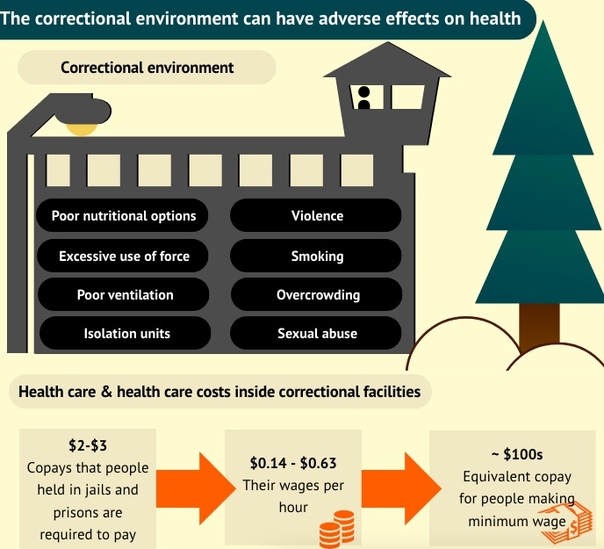
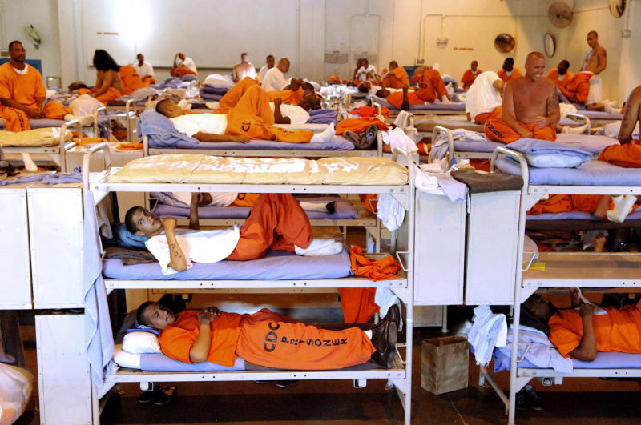
Adam: A typical day in prison
http://images.gawker.com/18ebk4rp5njymjpg/c_scale,fl_progressive,q_80,w_800.jpg
The Marshall Project
NIHCM

Slide 19
Limitations of healthcare in carceral settings
Privatization (incentive to spend less on care)
Inmate Exclusion Act
Lack of regulatory oversight or agreed-upon standards of care
Co-pays for medical care
“You stop requesting the medical help because you know that it’s not what you would get if you were home.”
“Every dental technician in there is nicknamed “Bloody Mary.” That’s not by chance…They don’t want to numb you up…You can’t get partials until you’ve lost at least 3 teeth, and they have to be in a row”

Slide 20
Adam: A typical day during reentry
Housing
Insurance reactivation
Trauma
Behavioral health
conditions
Repairing relationships
Triggers for
substance use
Transportation
Employment
Identification
Legal fees
Complex systems
Mistrust
Parole/Probation
Medical care
Chronic illness

Slide 21
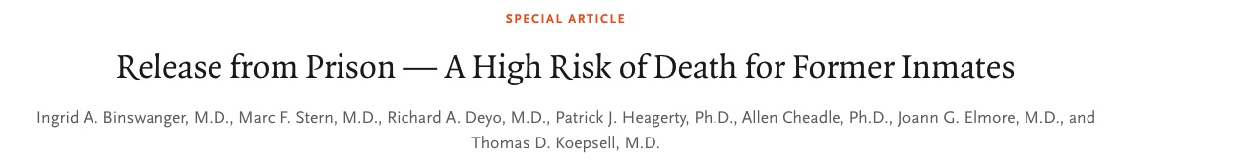
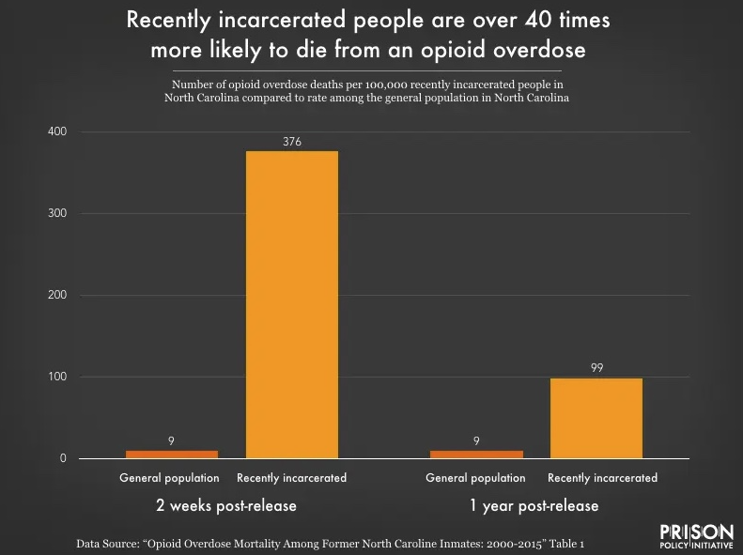
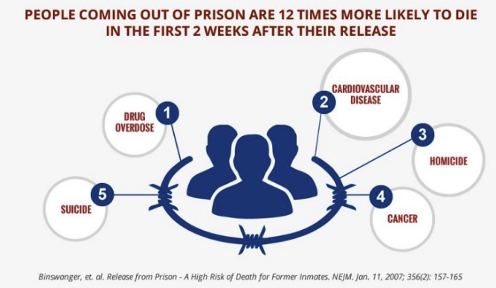

Slide 22
Myth or Fact?
There is not much that I, as a healthcare provider in the community, can do about these health disparities.

Slide 23
Myth or Fact?
There is not much that I, as a healthcare provider in the community, can do about these health disparities.

Slide 24
What can we do as healthcare providers?
Clinical/direct patient care
Systems of care and community resource partnership
Advocacy

Slide 25
What can we do as healthcare providers?
Clinical/direct patient care
Systems of care and community resource partnership
Advocacy

Slide 26

Keep in mind…
Build trust
Intersecting stigmatized identities (race, SUD, mental illness, housing instability, justice involvement)
Culture of incarceration
History of negative experience with carceral health systems
“Most people coming home are so traumatized from their health care experience inside, that they just try and avoid it as much as they can.”
Few providers have a shared identity with returning citizens or training on their unique needs. Some demonstrate discomfort during interactions. Time constraints further limit the ability to provide the holistic care needed.

Slide 27

Taking a history – do
Ensure physical comfort
Ask permission to ask questions
Explain why you are asking questions
Explain what you are NOT asking (details of charges)
Use clear language
Use person-first language
Share what you are documenting
Take incarceration history as you would a substance use disorder history

Slide 28

Taking a history – don’t
Ask about incarceration history on written intake forms
Ask details of criminal charges – knowledge of crime leads to lower quality of care (Pierre, et al 2022)
Press for information that a patient is reluctant to share
Use stigmatizing language (inmate, offender, ex-con, felon)
Include detail of incarceration history in EHR documentation
“They feel like they were stigmatized against, and so they don't feel comfortable going to those settings, seeking out medical care.”

Slide 29
How can we ask about incarceration exposure?
Many of my patients have had experience with incarceration, personally or in their family, and this can affect their health. Have you or anyone in your family had experience with incarceration?
In my experience, people who have been incarcerated often live with lasting impacts from that experience, such as discrimination from housing, mental health effects. Have you or anyone in your family be impacted by incarceration?
Without telling me any details about your charges, would you share with me the sorts of things that lead to incarceration for you? For example, some people find that they always end up in jail when they relapse on a substance, or because of an activity that gets their basic needs met. Does anything like that happen for you?
Can you tell me more about the times you have spent living in the community? What worked for you then to help stay out of jail?

Slide 30
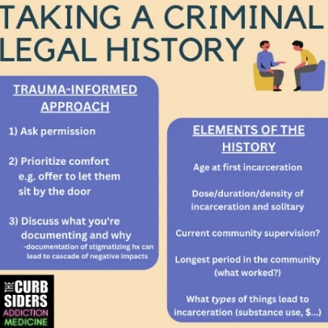
Taking a history of justice involvement

Slide 31

Words DO matter: documentation considerations
Implicit bias, stigma transmission (Goddu, et al 2018)
Be thoughtful and selective – record only relevant details (ex date of release if recent; key related social needs that the team will address)
Do NOT document details of charges if you learn them
Share with patient what you are and are not documenting

Slide 32
Screening and treatment after incarceration
No established guidelines. Follow typical guidelines for general population.
Remember most prevalent conditions, especially immediately post-release

Slide 33
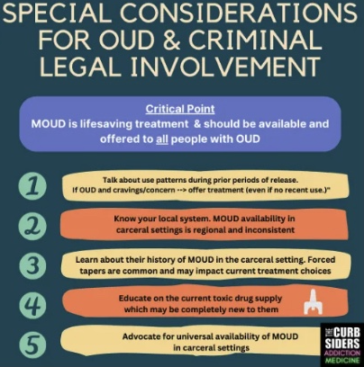
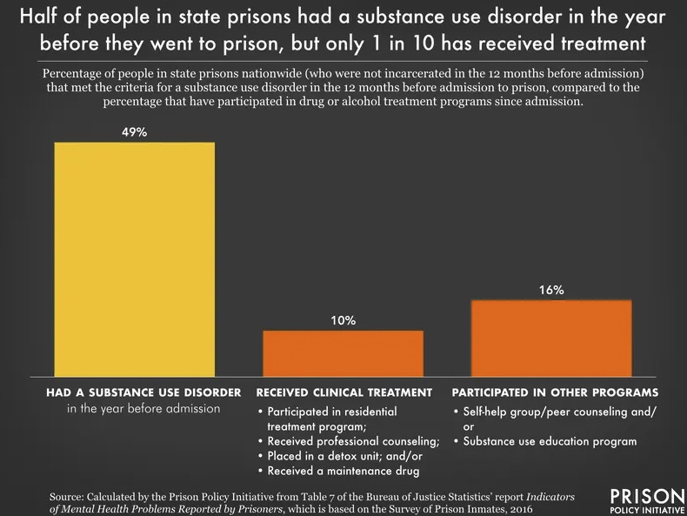
Save lives with MOUD, particularly during reentry!
Buprenorphine
reduces mortality by
61%
(Green, et al 2018)

Slide 34
Myth or Fact?
Justice-involved individuals have poor health outcomes because they tend not to follow up or follow medical advice.

Slide 35
Myth or Fact?
Justice-involved individuals often have neglected health conditions due to problematic systems of care. Due to competing demands (housing, employment, parole obligations), they may struggle with follow up. This is not different from other patients facing socioeconomic difficulties.

Slide 36
What can we do as healthcare providers?
Clinical/direct patient care
Systems of care and community resource partnership
Staff education, language
Multidisciplinary teamwork (especially behavioral health, peers, community health workers)
Peer support in clinic and/or in the community
Advocacy

Slide 37
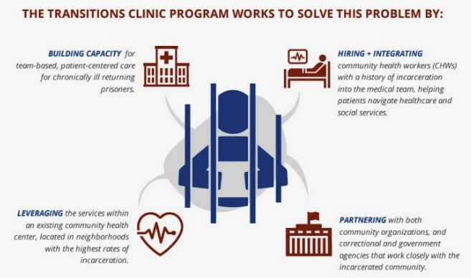

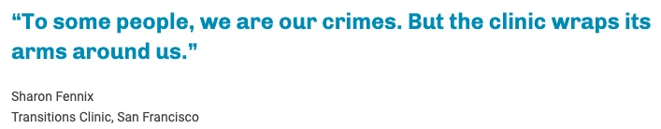
Innovative care model: Transitions Clinic Network

Slide 38

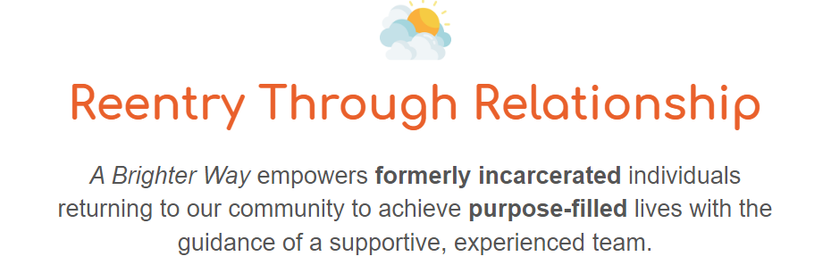
Adam: Community peer support

Slide 39
What can we do as healthcare providers?
Clinical/direct patient care
Systems of care and community resource partnership
Advocacy

Slide 40

Advocating for your justice-involved patient
Parole/Probation officers
Offer to provide letter of support (reassuring patient no information disclosed without their permission)
Currently incarcerated patient
Understand institutional restraint policies; advocate for removal as possible
If law enforcement present → advocate collaboratively for as much patient privacy as possible

Slide 41
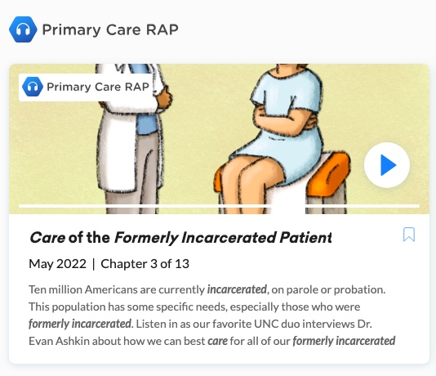

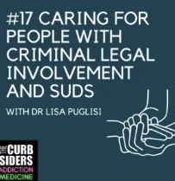


Where can I learn more?

Slide 42
Key take aways
Mass incarceration affects all our communities; every member of the healthcare team can make a difference!
You’ll never know if you don’t ask; be thoughtful in how you ask about incarceration and how you document
Think of incarceration exposure (particularly recent) as a serious health risk

Slide 43
References
Ashkin E, Baca-Atlas M, Zeitler M, Frayha N, et al. “Care of the Formerly Incarcerated Patient”. Primary Care Reviews and Perspectives podcast. May 2022.
Binswanger I, Stern MF, Deyo RA, et al. Release from prison – a high risk of death for former inmates. N Engl J Med. Jan 11;356(2):157-65.
Brinkley-Rubinstein L, Sivaraman J, Rosen DL, et al. Association of Restrictive Housing During Incarceration With Mortality After Release. JAMA Netw Open. 2019;2(10):e1912516. Published 2019 Oct 2. PMID: 31584680
Cohen SM, Puglisi L, Leyde S, Chan, CA. “#17 Caring for People with Criminal Legal Involvement and SUDs with Dr. Lisa Puglisi”. The Curbsiders Addiction Medicine Podcast. https://thecurbsiders.com/episode-list August 10, 2023.
Constantine R, Andel R, Petrila J, et al. (2010). Characteristics and Experiences of Adults with a Serious Mental Illness Who Were Involved in the Criminal Justice System. Psychiatric Services. 61(5):451-457.
Goddu AP, O’Conor KJ, Lanzkron S, et al. Do Words Matter? Stigmatizing Language and the Transmission of Bias in the Medical Record. J Gen Intern Med. 2018;33(5):685-691.
Green TC, Clarke J, Brinkley-Rubinstein L, et al. Post Incarceration Fatal Overdoses After Implementing Medications for Addiction Treatment in a Statewide Correctional System. JAMA Psychiatry. 2018;75(4):405-407. PMID: 29450443
Harvey TD, Busch SH, Lin H-J, et al. Cost savings of a primary care program for individuals recently released from prison: a propensity-matched study. BMC Health Services Research. 2022;22(585).
MacKenzie O, Goldman J, Chin M, et al. Association of Individual and Family History of Correctional Control With Health Outcomes of Patients in Primary Care Center. JAMA Netw Open. 2021:4(11):e2133384
Pierre K, Rahmanian KP, Rooks BJ, Solberg LB. Self-reported physician attitudes and behaviours toward incarcerated patients. J Med Ethics. 2022;48(5):338-342.
Roehrkasse AF & Wildeman C. Lifetime risk of imprisonment in the United States remains high and starkly unequal. Sci. Adv. 2022;8.
Wang EA, Hong CS, Shavit S, Sanders R, Kessell E, Kushel MB. Engaging individuals recently released from prison into primary care: a randomized trial. Am J Public Health. 2012;102(9):e22-e29. PMID: 22813476
Wang EA, Lin HJ, Aminawung JA, et al. Propensity-matched study of enhanced primary care on contact with the criminal justice system among individuals recently released from prison to New Haven. BMJ Open. 2019;9(5):e028097. Published 2019 May 2. PMID: 31048315

