Slide 1




Intersection of Acquired Brain Injury and Dementia
June 12, 2025
Sarah Foidel, PP-OTD, OTR/L, FAOTA
Director School of Occupational Therapy
Pacific University| sfoidel@pacificu.edu
Notes:
My names David Stephens, my mothers family are settlers from Sweden, Norway, Holland, Scotland, and Denmark and my father’s family is Haida from the Cumshewa and Skedans clans, and also are settlers from Wales, Ireland and Scotland. I’m a Nurse and serve the 43 federally recognized tribes of the NWTEC and all of Indian Country thru the NPAIHBs Indian Country ECHO program

Slide 2
About Your Speaker
Occupational Therapist (26 years)
Associate Professor and Director of Pacific’s School of Occupational Therapy
GWEP Partner
ECHO Faculty lead x 5 years
Mom, friend, board game player, hiker, and plant enthusiast.
Owner Functional Pathways LLC
Author and Researcher
Notes:
Here are our learning objectives for today's presentation.

Slide 3
Objectives
Increase understanding of Acquired Brain Injury (ABI) diagnosis and symptoms
Examine and recognize the intersection between brain injury and dementia
Through case study examples, increase ability to identify person-centered interventions
Notes:
Here are our learning objectives for today's presentation.

Slide 4
Acquired is non- progressive Acquired is non-developmental Traumatic implies external force Common Causes: MVA, Falls, Sports Injuries, Military Explosions Acquired Injury includes: CVA, TBI, Anoxic Event, Brain Tumor
Terminology: Acquired (ABI) versus Traumatic (TBI)

Slide 5
CDC Facts- Overview ABI
Falls are the leading cause of TBI (48%)
Almost half (49%) of TBI-related ED visits among children 0 to 17 years were caused by falls.
Four in five (81%) TBI-related ED visits in older adults aged 65 years and older were caused by falls
Being struck by or against an object was the second leading cause (17%)
28% TBI-related ED visits in children less than 17 years of age or less were caused by being struck by or against an object.
Falls and motor vehicle crashes were the first and second leading causes of all TBI-related hospitalizations (52% and 20%, respectively).
Intentional self-harm was the first leading cause of TBI-related deaths (33%)
Retrieved 2019: https://www.cdc.gov/traumaticbraininjury/get_the_facts.html

Slide 6
Risk Factors
Men 3x more likely to die from TBI
Rates were highest for persons 65 years and older.
Leading cause of death:
Falls for persons 65 years or older
MVA crashes adults ages 5-24 years
Assaults children ages 0-4.
Among non-fatal TBI-related injuries for 2006–2010:
Hospitalization rates were highest among persons aged 65 plus
ED visits were highest for children aged 0-4 years
Retrieved from http://www.cdc.gov/traumaticbraininjury 2014 Facts

Slide 7
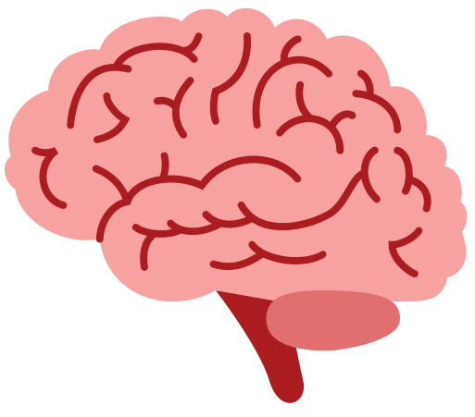
Pathology - Categories of TBI
Causes
Types
Closed head injury
MVA
Falls
Sports Accidents
Open head injury/ Penetration
Gunshot
Knife
Accidents
Concussion
Mild
Moderate
Severe

Slide 8
Measures severity of brain injury symptoms (consciousness and arousal) The scores range from 3 to 15 3 = extremely critical 15 = talking, alert, and oriented
Assessment: Glasgow Coma Scale
Severe
Moderate
Concussion
Mild

Slide 9
No Response/ Generalized response – I/II Localized response- III Confused-agitated- IV Confused-inappropriate- V Confused-appropriate- VI Automatic-appropriate- VII Purposeful and appropriate w/SBA- VIII Purposeful appropriate w/SBA on request-IX Purposeful & appropriate at Mod I- X
Assessment: Ranchos Levels

Slide 10
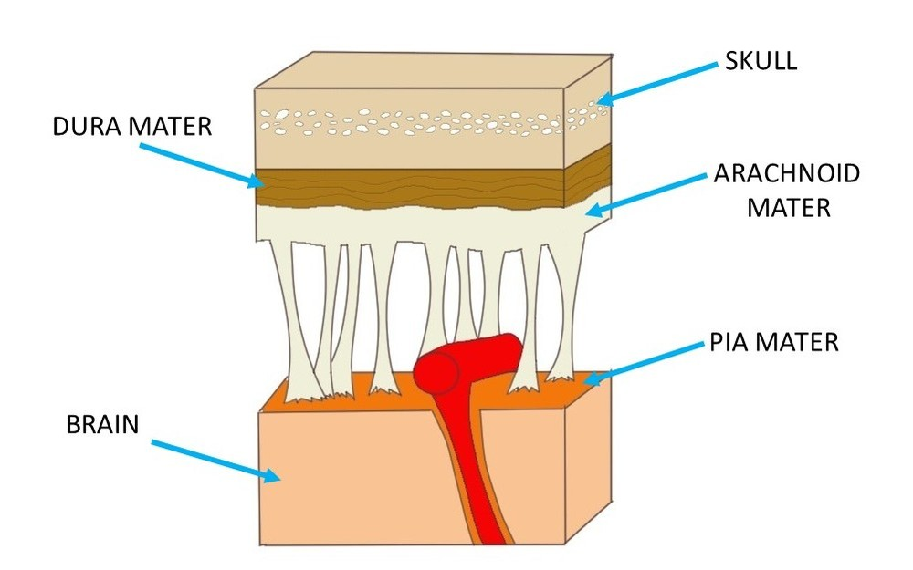
Pathology
The brain is composed of about 15 to 20 billion neurons plus other support cells.
The brain is essentially floating, supported in fluid within the skull.
The brain tissue is soft and therefore can be compressed, pulled, and stretched.

Slide 11
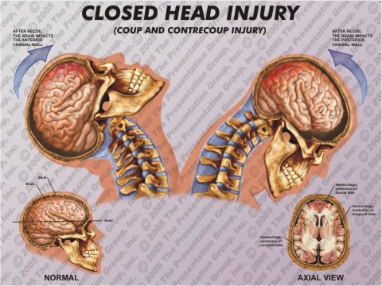
http://www.presentationgroup.com

Slide 12

DSM-5 Neurocognitive Disorders(NCD)
Delirium
Mild NCD
Major NCD
(NCD Not Otherwise Specified)

Slide 13
DSM 5 Criteria: Neurocognitive Disorder
Change from DSM IV
Minor versus Major
Sub Classification is by Etiology
The defining characteristics of NCD:
core deficits are in cognition
one or more domains impacted
not developmental
deficits represent a decline from baseline
requires concern & clinical evaluation
decrease in everyday activities is key

Slide 14

Sub classification by Etiology
Alzheimer’s disease
Lewy body disease
Frontotemporal dementia
Vascular neurocognitive impairment
Traumatic brain injury
HIV
Huntington’s disease
Other causes
http://www.psychiatry.org/mental-health/understanding-mental-disorders
(American Psychiatric Association, 2013)

Slide 15
Chronic Traumatic Encephalopathy-CTE
Condition that occurs in repetitive closed head injuries
Progressive attention, orientation, lack of insight, judgment, memory impairment and mood impairment.
Frequent dizziness and headaches symptoms, such as lack of insight, poor judgment
Common eventual development of Parkinsonism- blunted affect, shuffling slow gait
extensive tau neurofibrillary tangles on autopsy
http://www.cbsnews.com/pictures/nfl-football-players-with-cte/6/
McKee, A. C., Cantu, R. C., Nowinski, C. J., Hedley-Whyte, E. T., Gavett, B. E., Budson, A. E., ... & Stern, R. A. (2009). Chronic traumatic encephalopathy in athletes: progressive tauopathy following repetitive head injury. Journal of neuropathology and experimental neurology, 68(7), 709.

Slide 16

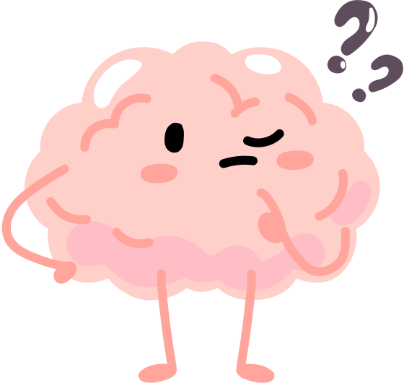
Overlap of Dementia and ABI
Notes:
NC: Here's a few program areas that we're currently planning to launch.

Slide 17
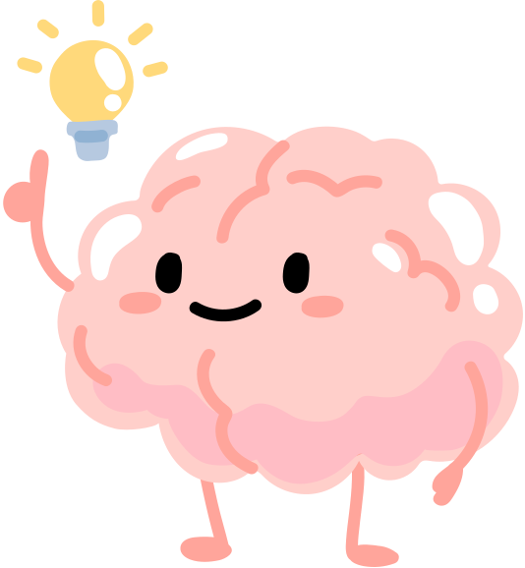
Increased Risk
Traumatic Brain Injury
Schizophrenia
Intellectual Development Disorders
Substance Use
Stroke/ Vascular Damage

Slide 18
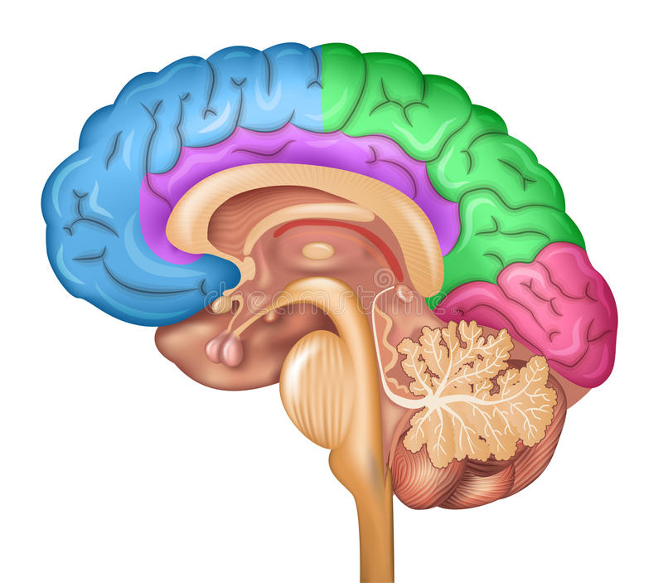
Functional Areas of the Brain
Frontal Lobe
Parietal Lobe
Temporal
Occipital
Insular
Limbic connections
Movement symptoms

Slide 19
Person Centered Care = Understanding Function
Abilities
Motivation
Environment

Slide 20
Traumatic Brain Injury
Personality change
Visual
Motor
Decision Making
Attention
Language
Sudden Onset
Front/ Back Phenomenon
Non- Progressive
Higher Risk for Dementia
Socially Inappropriate
Poor problem solving
Low Frustration Tolerance
Difficulty Following Directions
Non- Compliant

Slide 21
Alzheimer's Dementia
Short Term memory
Visual Spatial
Executive Function
Slow and progressive
Social skills remain
Poor Decision Making
Poor Visual Spatial Skills
Repeats stories
Gets Lost
Clumsy
High risk for anxiety/depression symptoms

Slide 22
Stroke or Vascular Event
Varied by location
Focal versus Global
Sudden Onset for Stroke
Gradual for Diffuse for Vascular
Difficulty with moving part of the body
Difficulty with Speech
Emotional and Cognitive Changes

Slide 23
Strength-Based Care Planning
Concerning Behavior | Intervention |  | Identified Resident Strength | Intervention
Asks repetitive questions due to short term memory loss | Provide notes and reminders for memory. Also educate caregivers. |  | Enjoys reminiscence due to strong social skills and long term memory | Provide opportunities group activities with social modelling and limited STM demands
Urinates (labeled as incontinence) on fake plants in the lobby | Briefs, redirection to bathroom, possibly clothes that are difficult to take off |  | Continence, seeking the use of the restroom, potential for increased ADL independence | Toileting schedule, well marked bathrooms, keep bathroom doors open, try a commode
3,7,8

Slide 24
Example of a Strength-Based Functional Care Plan
Behavioral Challenge | Strength | Interventions | Targeted Outcomes
Frequent Falls (at night) | Mobility, Attention and visual skills | Toileting schedule, frequent daily exercise, motion sensitive lighting, signs to remind to use call bell | Continence, increased sleep at night, maintained mobility, no injury from falls
Physically aggressive with toileting at night | Good attention skills, good social skills, good mobility, skin is in good condition | Daily mobility, positive sleep hygiene, depends at night with only changing in the am with bed bath | Skin remains in good condition, Mobility is maintained, full night of rest
3,7,8

Slide 25
Case Study and Discussion
Margo is a 68 year old with a history a head injury at age at 22 from a motor vehicle accident. It was rated as moderate and Margo had rehabilitation from OT, PT, and Speech for motor, sensory, and cognitive changes. Margo continued to live with planning and problem solving challenges, mild balance changes, and sensitivity to loud noises and bright lights.
Margo was able to complete an associates degree and has worked as an administrative assistant and a waitress for 40 years. She raised three children who live locally. Her husband passed away 2 years ago.
She lives independently in a single level home with 4 cats. Her daughter is a nurse and helps with medication set up and minimum housekeeping.
Current challenges: Driving (keeps hitting curbs, neighbors garbage cans), forgetful of appointments and medication schedule, calls family frequently for help, and recently had a fall breaking her wrist.

Slide 26
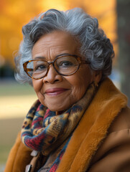
Lets Help Margo!
Where is Margo struggling?
What could be happening to cause changes?
Where does Margo need support?
Referral ideas?
Environmental changes?
ACTION ITEM: Care Plan for Strengths for Success

Slide 27

Thank You
Visit: IndianCountryECHO.org
Sarah Foidel OTD, PP-OTR/L, FAOTA
Occupational Therapist/ Director School of OT
Pacific University
sfoidel@pacificu.edu
Full reference list available/ Images all free for use
Notes:
Please visit our website to sign-up to join one of our many ECHO sessions. Thank you!

