Slide 1


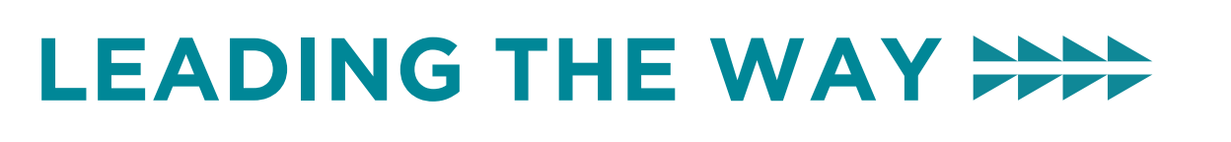
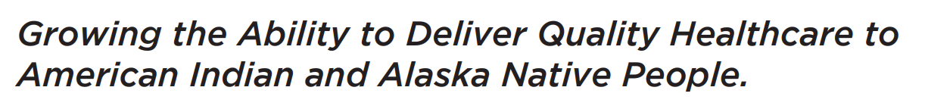
How can good nutrition help persons living with dementia?
August 14, 2025
Elizabeth Eckstrom, MD, MPH| Professor | OHSU| eckstrom@ohsu.edu

Slide 2

Objectives
Recognize modifiable lifestyle factors to prevent dementia
Understand the components of a Mediterranean-style diet that are so important for the brain
Gain confidence in
counseling older patients
to improve nutrition
Getty images
Notes:
Here are our learning objectives for today's presentation.

Slide 3
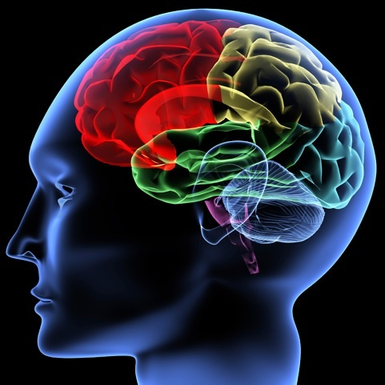
Brain Changes with Aging
Normal Aging
Slowed processing speed
Poorer word recall
Difficulty with multitasking
Cognitive Impairment
Inability to make new memories
Decreased planning, reasoning, abstraction, language
Changes in personality/emotions
Notes:
This group is likely aware of what is normal and abnormal with aging, but just a quick review….

Slide 4
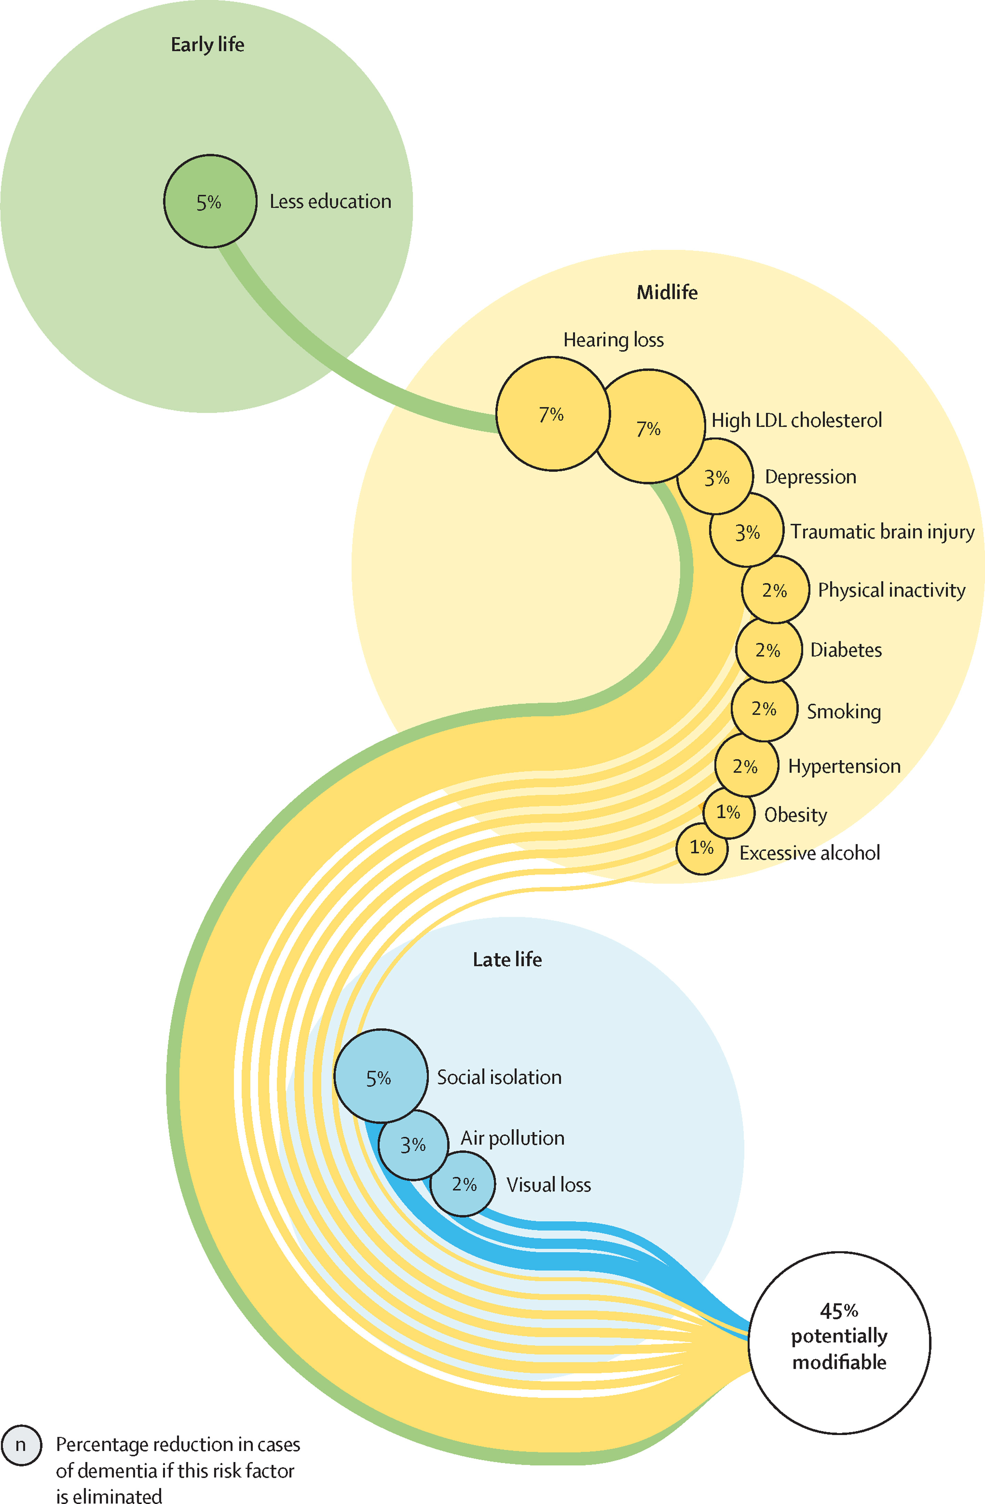
At least 45% of risk for dementia is preventable- and it helps to keep doing these things even after you have a diagnosis of dementia

Slide 5
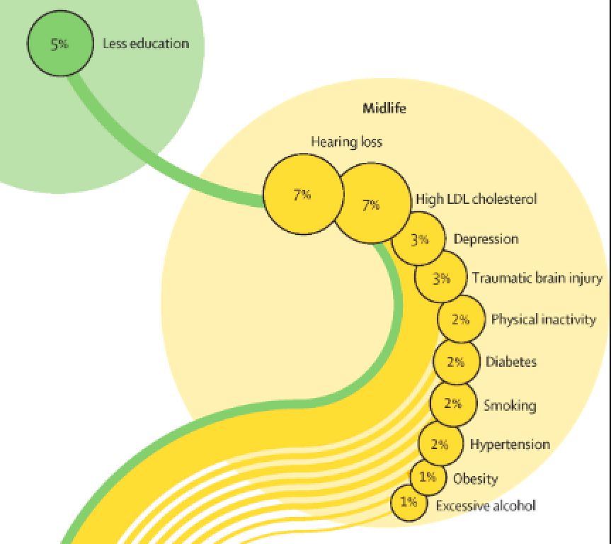
Managing risks for people with dementia

Slide 6
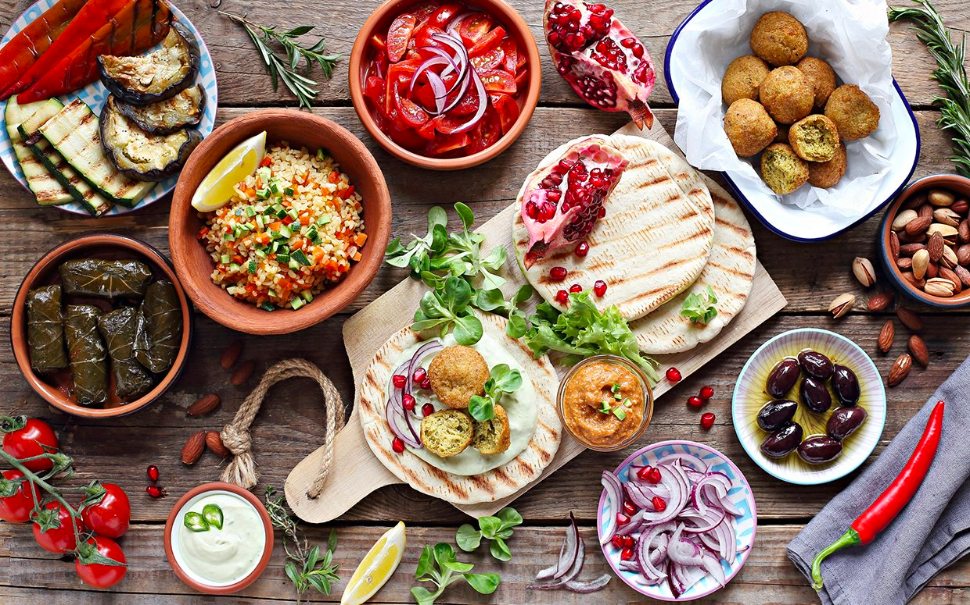
What did you have for dinner last night?
Was it a Mediterranean-style meal?

Slide 7
Mediterranean Diet

Slide 8
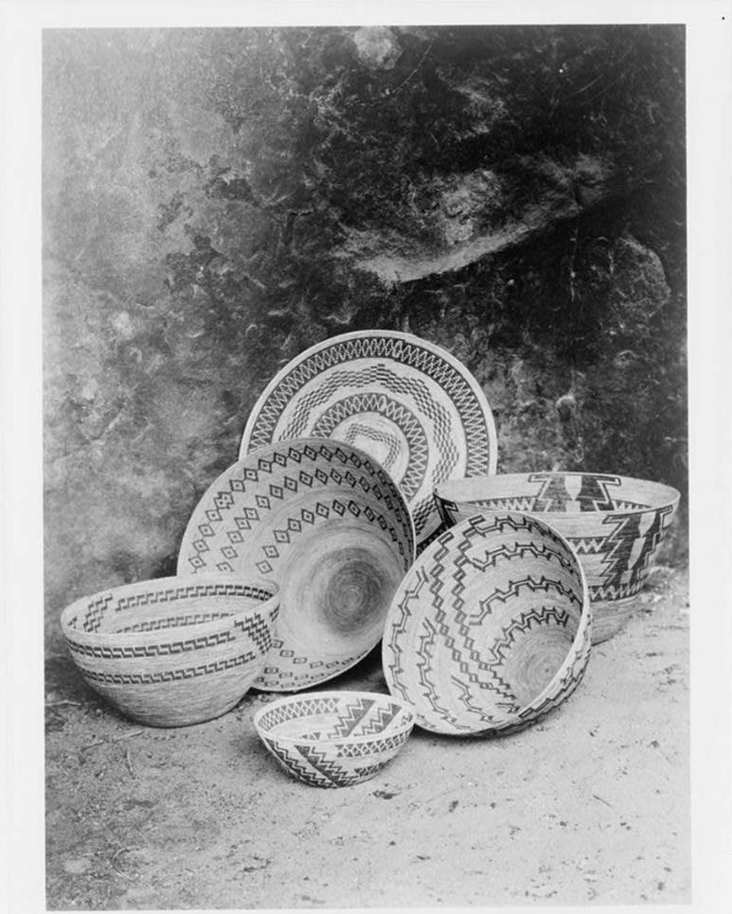
Why Mediterranean diet?
Reduces
Heart disease and stroke
Cancer deaths
Dementia
Diabetes medications
Frailty
Pain for those with arthritis
Increases
Quality of life for those with arthritis
Psychological resilience
Edward S. Curtis photograph

Slide 9

Mediterranean diet considered the
“Poor Man’s Diet”
Grew from the very poor areas of Naples and Sicily
Largely based on foods people grew themselves- tomatoes, greens, lentils, olive oil
Warmer climates with 2-3 crops possible per year
Couldn’t afford meat- so not part of the diet!
Most places near ocean, so fishing was part of the culture
Getty images

Slide 10

Traditional Pacific NW Native American foods that perfectly reflect the Mediterranean diet
Getty
images
Salmon!
Berries- huckleberries, salmon berries, blackberries
Hazelnuts
Wapato (similar to potatoes, skip the large white potatoes and eat yams, orange or purple)
Squash, beans, corn

Slide 11
What are some effects of a Western-style diet
on brain function?
High pro-inflammatory dietary scores - higher intake of red meat, processed meat, and fried food, and lower intake of whole grains- linked with cognitive impairment
An inflammatory nutrient pattern (low intake of calcium, antioxidant vitamins,omega-3 and high intake of cholesterol) is inversely associated with brain volume and cognitive function
McGrattan et al, 2019

Slide 12
The Gut Microbiome
The aging process alters the microbiome composition (dysbiosis) and leads to chronic low-grade inflammation
Dysbiosis implicated in pathogenesis of AD
Gut-derived bacteria and toxins can compromise the integrity of the BBB and contribute to early neuroinflammatory changes and AD by priming microglia and impairing amyloid clearance
Almost 60% of variation in the gut microbiome is attributable to diet so modifying the gut microbiome through diet could reduce inflammation associated with AD
McGrattan et al, 2019
Notes:
The aging process results in alterations to the microbiome composition (dysbiosis) and contributes to development of chronic low-grade inflammation
Dysbiosis implicated in the pathogenesis of AD by initiating and prolonging neuroinflammatory processes. Gut-derived bacteria and toxins can compromise the integrity of the BBB and contribute to early neuroinflammatory changes and AD by priming microglia and impairing amyloid clearance
Almost 60% of variation in the gut microbiome is attributable to diet; therefore, modulating the gut microbiome through dietary means could be an effective approach to reduce inflammation associated with AD

Slide 13
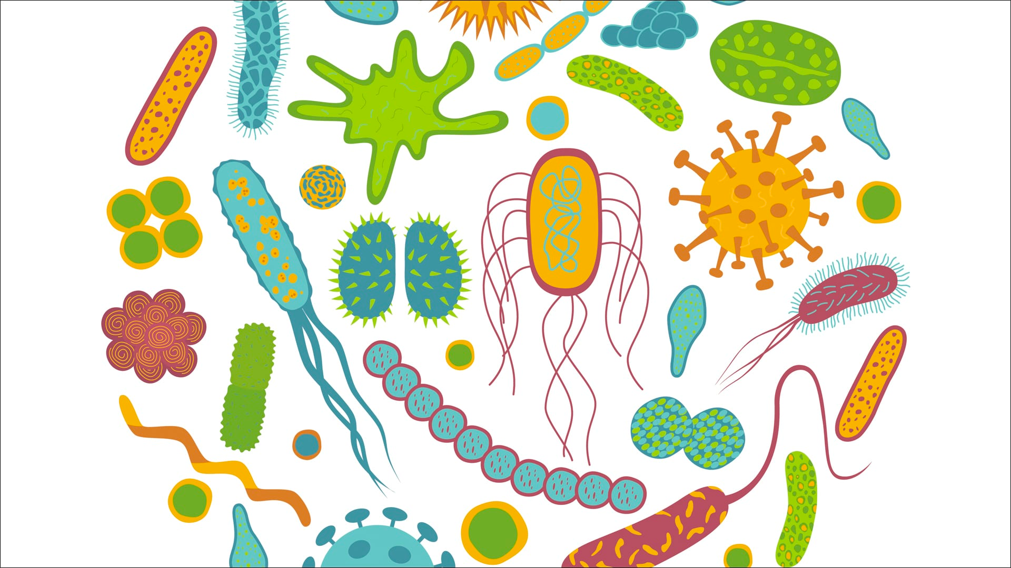
Gut Microbiome and
the Mediterranean diet
Notes:
Our gut bacteria (“microbiome”) play a huge role in health. There is a “gut-brain” pathway that means our gut microbiome influences brain activity- anxiety, depression, even dementia
Our microbiome has a “mid-life crisis” that may make us more vulnerable to inflammation and other negative aging factors. PREBIOTICS such as garlic may help lessen this midlife crisis
The Mediterranean diet alters our gut microbiome favorably within just 2-3 weeks!

Slide 14
Why plants and fish are so valuable…
Antioxidants from fruit and vegetables suppress neuroinflammatory processes and neuronal apoptosis
Plant-derived flavonoids downregulate the transcription factor activity to prevent neuroinflammation
Long chain omega-3 fatty acids from fish attenuate the expression of pro-inflammatory cytokines in microglia and help to resolve inflammation in the brain
Healthy high calorie plants and fish (nuts, avocado, salmon, seeds, etc) help maintain normal BMI- which is critical
McGrattan et al, 2019
Notes:
Antioxidants from fruit and vegetables suppress neuroinflammatory processes and neuronal apoptosis by inhibiting free radicals and cytokine production in activated microglia cells
Plant-derived flavonoids play a role in preventing neuroinflammation by down regulating transcription factor activity
Long chain omega-3 fatty acids from fish attenuate the expression of pro-inflammatory cytokines in microglia and help to resolve inflammation in the brain
Help maintain normal BMI- which is critical

Slide 15

What about protein?
For every 5% of calories that come from plant protein instead of carbs, there is a 26% lower risk of developing dementia
Low protein intake associated with lower verbal memory
Higher protein intake positively correlated with non-verbal learning, verbal memory, and reduced risk of MCI or dementia
Yeh, et al
Edward S. Curtis photo
Notes:
every 5% of calories that came from animal protein instead of carbohydrates, there was an 11% lower risk for developing dementia. And for every 5% of calories that came from plant protein instead of carbohydrates, there was a 26% lower risk for developing dementia

Slide 16

The Blue Zones
Moderate, regular physical activity as part of daily life
Plant-based diet
Moderate calorie intake
Life purpose
Engagement in family life
Engagement in social life
Stress reduction
Limited alcohol consumption, especially wine
Engagement in spirituality or religion

Slide 17
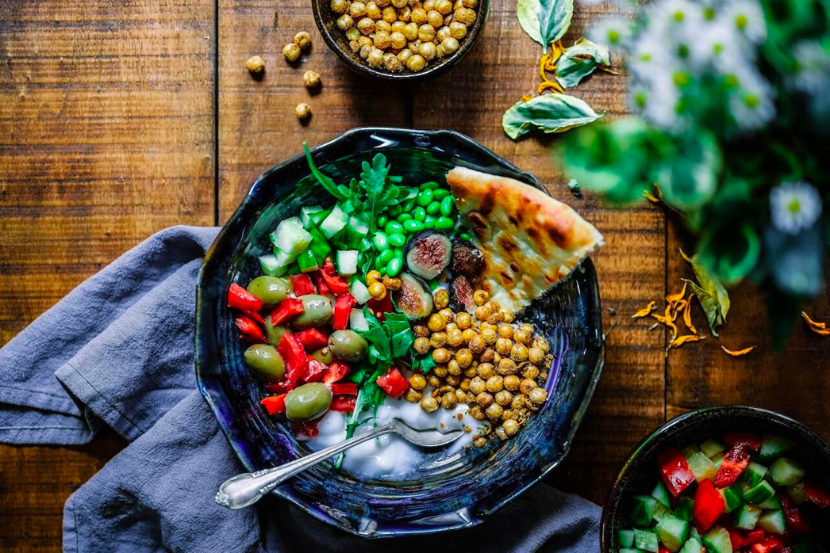
“If people truly live a healthy lifestyle, 90% should be able to avoid Alzheimer Disease within their normal lifespan.”
“An optimal diet can reduce risk of Alzheimer Disease by more than 50%”
Dr. Dean and Dr. Ayesha Sherzai,
Alzheimer’s Prevention Program at Loma Linda University Medical Center

Slide 18
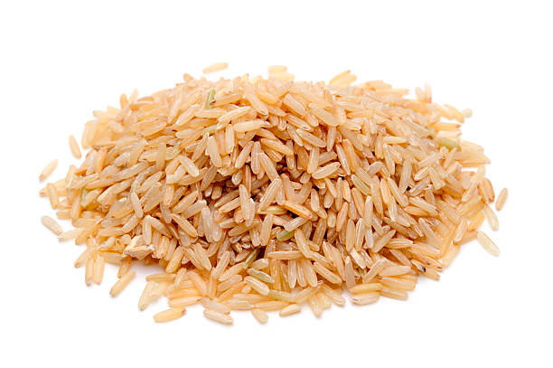
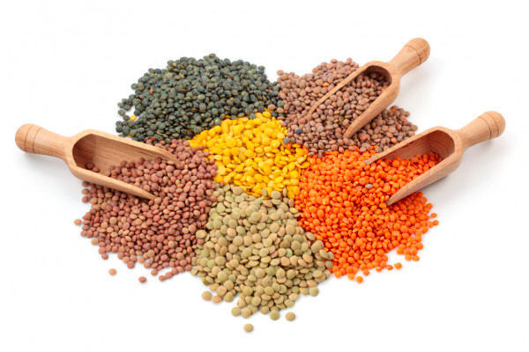

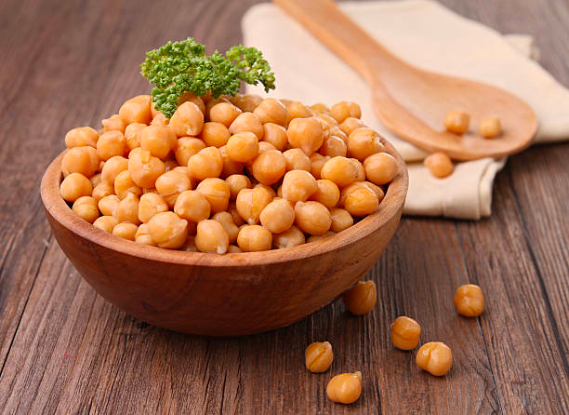
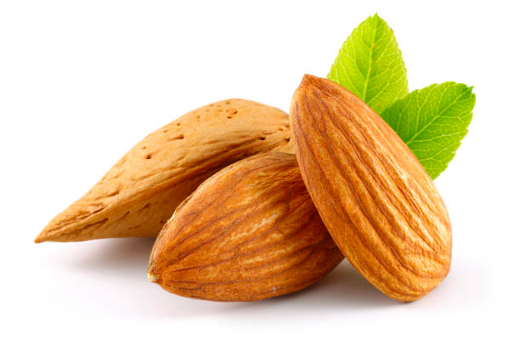
Protein- reduces Sarcopenia and Frailty
Eat at least 1 gm protein per kilogram weight. So if you weigh 130 pounds (60 kg), eat 60 gms protein daily
Try to get 70% of protein from plant-based sources, so 40 gm protein should be from vegetable sources and just 20 gm from animal sources.
3 oz tuna=
24 gms
½ c brown rice=
3 gms
½ cup lentils=
9 gms
½ c chickpeas=
8 gms
2 oz almonds=
12 gms
Notes:
Research shows good protein intake reduces sarcopenia, or loss of muscle mass, and frailty in older adults. Many older adults don’t get enough protein in their diet and this increases the risk of becoming frail and dependent. I recommend at least one gram protein per kilogram weight. So if you weigh 130 pounds (60 kg), eat 60 gms protein daily
Try to get 70% of protein from plant based sources, so 40 gm protein should be from vegetable sources and just 20 gm from animal sources. Lentils, chickpeas, brown rice, almonds are great sources of plant based protein, and tuna or salmon are great animal based sources of protein. For people with dementia, avoiding loss of muscle mass helps maintain independence in walking and other key activities of daily living, so reduces burden on caregivers and improves well being.

Slide 19
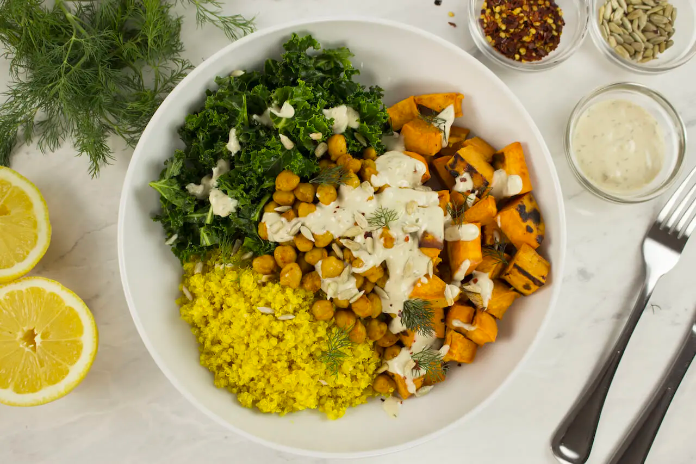
Mediterranean Brain Bowl Recipe*
https://www.bluezones.com/recipe/mediterranean-grain-bowl/
*Beans and greens are THE best foods to protect
the brain from dementia
Notes:
With ingredients like kale, sweet potatoes, chickpeas, turmeric, sunflower seeds and quinoa, this recipe is a great example of a plant based, high protein dish that helps protect the brain. Greens can even blunt the effect of terrible foods like bacon and donuts. Beans are a great source of clean protein and complex carbohydrates, and the resistant starches regulate blood sugar and the fiber can help reduce cholesterol – two very important functions for brain health.

Slide 20

Summary
Start NOW to reduce risk of dementia- and don’t stop healthy practices after you have a dementia diagnosis
A Mediterranean-style, mostly plant-based diet markedly reduces risk of dementia, and improves quality of life for those who have dementia
Simple garden vegetables, whole grains, lentils, salmon, healthy oils form the basis of the diet- and the diet can be tailored to local practices and available foods

Slide 21
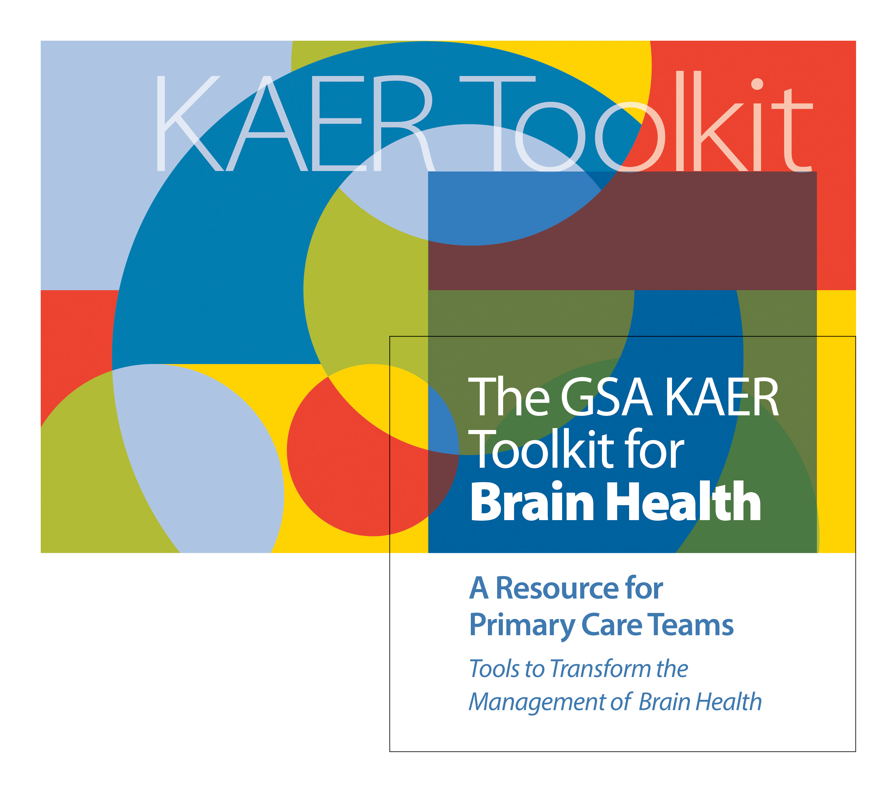

Slide 22


Questions?
Getty images
Visit: IndianCountryECHO.org
Elizabeth Eckstrom, MD, MPH
Professor
Oregon Health & Science University/Oregon GWEP
eckstrom@ohsu.edu
Notes:
Please visit our website to sign-up to join one of our many ECHO sessions. Thank you!

