Slide 1
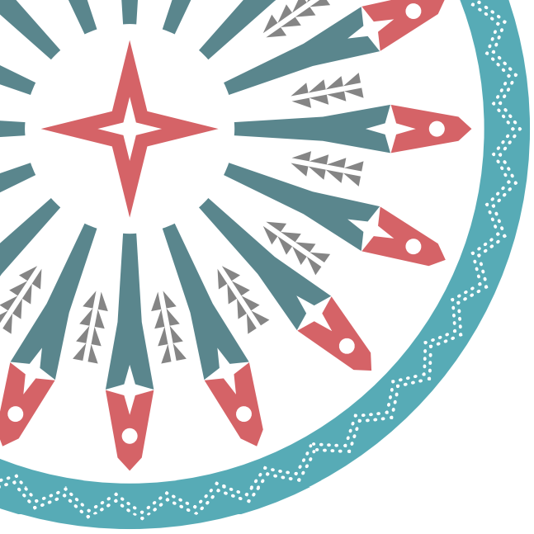

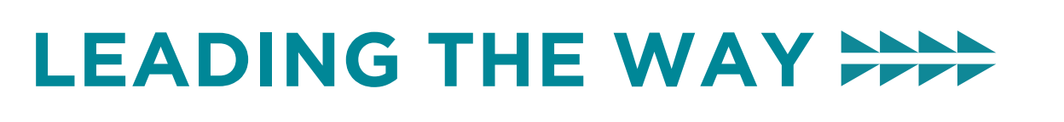
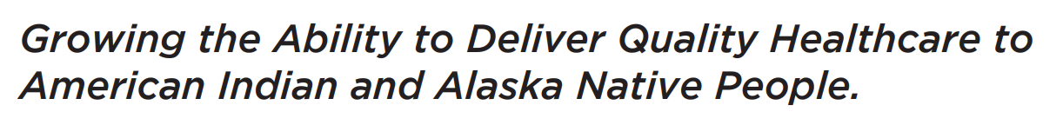
Cannabis & Dementia: Cause? Treatment?
What do we know?
11 Sept 2025
Maureen C. Nash, MD, MS
Clinical Psychiatric Director
Native American Rehabilitation Association of the NW
docmcnash@gmail.com
Notes:
My names David Stephens, my mothers family are settlers from Sweden, Norway, Holland, Scotland, and Denmark and my father’s family is Haida from the Cumshewa and Skedans clans, and also are settlers from Wales, Ireland and Scotland. I’m a Nurse and serve the 43 federally recognized tribes of the NWTEC and all of Indian Country thru the NPAIHBs Indian Country ECHO program

Slide 2
Objectives
By the end of this presentation, attendees will be able to describe:
What is dementia and why do we care about cannabis?
List 3 brain impacts of cannabis
List 2 or more brain risks of cannabis use
Notes:
Here are our learning objectives for today's presentation.

Slide 3

What we are covering today
What is Dementia anyway?
Cannabis and the Brain
Cannabis causing Cognitive Impairment?
Cannabis for “Dementia” Treatment?
Notes:
NC: Here's a few program areas that we're currently planning to launch.

Slide 4

What is Dementia anyway?
World Health Organization used to use a simple definition:
Cognitive deficits in 2 or more of: memory, attention, learning, use of or understanding language, orientation, visual-spatial areas or decision in making/problem solving
Behavior: Delusions, hallucinations, agitation/aggression, dysphoria/depression, anxiety, euphoria/elation, apathy/indifference, disinhibition, irritability/mood liability, aberrant motor behavior, night-time behavior disturbance, appetite/eating abnormalities
Loss of previous level of functioning in Independent Activities of daily living or activities of daily living
Notes:
Here are our learning objectives for today's presentation.

Slide 5
What are the evidence based
medical uses for Cannabis?
There is clear evidence supporting the utility of CBD to treat epilepsy. For other health conditions reviewed, evidence was often mixed and/or there was a general lack of well-powered randomized, placebo-controlled studies to draw definitive conclusions.
CANNABIS IS NOT FDA APPROVED FOR ANYTHING.
Some states allow “medical” cannabis use as they may define that
Sholler DJ, Schoene L, Spindle TR. Therapeutic Efficacy of Cannabidiol (CBD): A Review of the Evidence from Clinical Trials and Human Laboratory Studies. Curr Addict Rep. 2020 Sep;7(3):405-412. doi: 10.1007/s40429-020-00326-8. Epub 2020 Jul 25. PMID: 33585159; PMCID: PMC7880228.
Notes:
Here are our learning objectives for today's presentation.

Slide 6
NA/AN may be on 2 separate sides on the question of cannabis
Background: Most adults report beliefs that cannabis has at least one benefit (e.g., stress relief, chronic pain management); however, the benefits are not well established. Beliefs about cannabis benefits are associated with the initiation of use, whereas beliefs about the risks of cannabis are protective factors against its use.
This exploratory study examined beliefs about perceived benefits (i.e., stress relief, pain management) of cannabis, how beliefs vary as a function of use, and associations between health worry and benefits of cannabis among AIAN adults.
Participants (n = 182) were on average 41.4 (SD = 16.3) years old, 63.9% female, and identified as AIAN. Those who used cannabis in the past year were more likely to agree that cannabis relieves stress and less likely to believe that those who use cannabis should be very worried about their health. Participants who agreed that those who use cannabis should be worried about their health were less likely to report beliefs that cannabis relieves stress or helps with chronic pain.
Conclusions: Our study confirms the role of health-related perceptions and worry about cannabis products with cannabis use among this population that may be at risk for higher cannabis use.
Fleszar-Pavlović, S. E., Alegria, K. E., Vasquez, J. J., & Epperson, A. E. (2023). Past Cannabis Use, Health-Related Worry, and Beliefs About Perceived Benefits of Cannabis Among American Indians/Alaska Natives. Journal of Racial & Ethnic Health Disparities, 10(6), 2844–2850. https://doi.org/10.1007/s40615-022-01461-w
Notes:
Here are our learning objectives for today's presentation.

Slide 7
What do we know about AI/AN populations and dementia?
American Indian and Alaska Native (AI/AN) peoples are disproportionately impacted by substance use disorders (SUDs) and health consequences compared to others in US.
AI/AN peoples experience significant health disparities and disease burden that are exacerbated by settler-colonial traumas expressed through prejudice, stigma, discrimination, and systemic and structural inequities.
One such compounding disease for AI/AN peoples that is expected to increase but little is known is Alzheimer's disease and related dementias (ADRD).
AI/AN approaches for understanding and treating disease have long been rooted in culture, context, and worldview. Thus, culturally based prevention, service, and caregiving are critical to optimal outcomes, and investigating cultural beliefs regarding ADRD can provide insights into linkages of chronic stressors, disease, prevention and treatment, and the role of substance misuse
Crouch MC, et al. Dementia, Substance Misuse, and Social Determinants of Health: American Indian and Alaska Native Peoples' Prevention, Service, and Care. Chronic Stress (Thousand Oaks). 2023 Jan 18;7:24705470221149479. doi: 10.1177/24705470221149479. PMID: 36699807; PMCID: PMC9869198.
Notes:
Here are our learning objectives for today's presentation.

Slide 8
Cannabis Use and Study Trends in US
There has been an increase in cannabis use in older adults for both recreational and medical purposes over the past two decades (Rao & Roche). However, most studies examining the association between cannabis use and cognitive function do not include older adults (Stypulkowski & Thayer).
Studies involving younger adults have shown acute cognitive dysfunction during cannabis intoxication, with impairment in attention, learning, working memory, processing speed, and aspects of executive functioning (Crean et al. ; Kroon et al).
Long-term cannabis use is also associated with memory impairment (Schoeler & Bhattacharyya ).
Notes:
Here are our learning objectives for today's presentation.

Slide 9
Endocannabinoid Brain Changes
Pre-clinical studies suggest that there are age-related changes in the endocannabinoid system of the brain and that cannabinoids may benefit cognition in older animals (Piyanova et al.).
Low-dose administration of cannabinoid delta-9-tetrahydrocannabinol (THC) to older mice shows increased hippocampal spine density, increased synaptic connectivity, and enhanced cognitive performance, while THC administration in younger animals is known to worsen cognitive performance and has no effect on spine density (Bilkei-Gorzo et al.).
Notes:
Here are our learning objectives for today's presentation.

Slide 10
Tiny study comparing 2 groups
24 participants aged 65 and over with a history of heavy cannabis
Vs
26 participants with no lifetime cannabis use.
Heavy use was defined as more than 20 days a month, starting before the age of 20.
This pattern of use showed greater impairment in paired association learning, verbal memory, processing speed, and executive function (Burggren et al.).
Notes:
Here are our learning objectives for today's presentation.

Slide 11
Example of Problematic Study
The association between cannabis use and functional decline has not been studied widely in older people.
Retrospective question about subjective experience people aged 45 and above, examining the association between levels of cannabis use over the previous 12 months vs those who reported no cannabis use compared to cannabis users. Study numbers were not reported (Dowling, [11]).
Participants were recruited from publicizing the study in the national media and via existing older adult cohorts, but with no information on refusal rates.
Participants with an established diagnosis of dementia were not included. Ethical approval was obtained from the London Bridge NHS Research Ethics Committee (Ref: 13/LO/1578). A longitudinal design was used, with annual assessment.
Notes:
Here are our learning objectives for today's presentation.

Slide 12
Example of a Problematic Study
Examining the use of cannabidiol and delta-9-tetrahydrocannabinol-based medicine among individuals diagnosed with dementia living within residential aged care facilities: Results of a double-blind randomised crossover trial 2023
Example of a study that got published.
PwD studied. Only 21 prts in this study and their own estimates indicated they needed 50-150 people to be able to reach conclusions.
?Maybe one of numerous behavioral sx due to dementia improved.
Notes:
Here are our learning objectives for today's presentation.

Slide 13
Example of well done study: Long-Term Cannabis Use: Cognitive Reserves and Hippocampal Volume in Midlife
This prospective study followed a population-representative birth cohort for 45 years
Able to evaluate long-term cannabis users for cognitive deficits and hippocampal volume in midlife.
The longitudinal design enabled a comparison of a person’s midlife cognitive abilities to their childhood cognitive abilities before cannabis initiation. The study also enabled a test of the role of hippocampal gray matter volume in mediating associations between long-term cannabis use and cognitive deficits. Six findings stand out.
https://doi.org/10.1176/appi.ajp.2021.21060664
Notes:
Here are our learning objectives for today's presentation.

Slide 14
Findings:
1) long-term cannabis users exhibited IQ decline and poorer learning and processing speed in midlife relative to their childhood IQ.
People who knew them well described them as having memory and attention problems. These associations were not explained by prospectively assessed persistent tobacco, alcohol, and other illicit drug dependence or by childhood socioeconomic status, low childhood self-control, and family substance dependence history. Associations were also not explained by recent cannabis use. Findings were consistent across two cannabis exposures (persistence of cannabis dependence, persistence of regular use) and in tests comparing long-term cannabis users to five comparison groups (cannabis nonusers, tobacco users, alcohol users, recreational cannabis users, and cannabis quitters). (Table S11 in the online supplement summarizes findings across tests of dose-response associations and group comparisons.) This suggests that cannabis-related IQ decline, poorer learning and processing speed, and informant-reported memory and attention problems are not artifacts of analytic approach or of measured confounders, but rather are more likely to be consequences of long-term use. Cognitive childhood-to-adulthood changes such as those we observed have been shown to predict steeper cognitive decline from ages 70 to 82, and to do so better than adult cognitive level (39).
2) long-term cannabis users showed significantly larger IQ decline, poorer learning and memory, and poorer processing speed than long-term tobacco or alcohol users. Thus, some cognitive deficits were more pronounced for long-term cannabis users than for long-term tobacco or alcohol users, contrary to some claims
Notes:
Here are our learning objectives for today's presentation.

Slide 15
Findings:
3) cognitive functioning among midlife recreational cannabis users was similar to representative cohort norms. This suggests that infrequent, non–problem recreational cannabis use in midlife is unlikely to compromise cognitive functioning. Our results highlight the importance of not conflating long-term and recreational cannabis users in future studies.
4) cannabis quitters showed subtle cognitive deficits that may explain inconsistent findings on the benefits of cessation .
5) long-term cannabis users showed smaller bilateral volume in total hippocampus and five of 12 structurally and functionally distinct subregions compared with nonusers, consistent with case-control studies .
6) although persistence of cannabis use showed dose-response associations with cognitive deficits and, to a lesser extent, smaller hippocampal volume in the representative sample, smaller hippocampal volume did not statistically mediate associations between persistence of cannabis use and cognitive deficits.
  Smaller hippocampal volume has been suggested as a possible mediator of cannabis-related cognitive deficits , because the hippocampus is rich in type 1 cannabinoid (CB1) receptors and is involved in learning and memory. However, smaller hippocampal volume may be a reductionistic explanation for cannabis-related cognitive deficits. For example, in addition to the hippocampus, other CB1-rich brain regions, including those involved in reward and motivation, may play a role. Further, neurobiological mechanisms likely extend beyond gray matter volume differences to include differences in structural and functional connectivity . Finally, social mechanisms could also play a role.
Notes:
Here are our learning objectives for today's presentation.

Slide 16
Well done study: ED/inpatient visit due to CBD predicts later dementia
Key Points: Question: Are individuals who have an acute care encounter (an emergency department visit or hospitalization) due to cannabis use at increased risk of being diagnosed with dementia?
Findings: In this cohort study of 6 million individuals aged 45 years or older with no history of dementia, those with acute care due to cannabis use were at 1.5-fold (absolute risk, 5.0% vs 3.6%) and 3.9-fold (absolute risk, 5.0% vs 1.3%) increased risk of a new dementia diagnosis within 5 years compared with individuals with an all-cause acute care encounter and the general population, respectively. Meaning: Individuals with cannabis use severe enough to require emergency department or hospital care may be at increased risk of being diagnosed with dementia.
Risk of Dementia in Individuals With Emergency Department Visits or Hospitalizations Due to Cannabis.
JAMA neurology, 2025. Myran, DT; et al.
Notes:
Here are our learning objectives for today's presentation.

Slide 17
Welldone Study: RCT of THC for
Neuropsychiatric Sx of Dementia
Objective: To study the efficacy and safety of low-dose oral tetrahydrocannabinol (THC) in the treatment of dementia-related neuropsychiatric symptoms (NPS).
Methods: This is a randomized, double-blind, placebo-controlled study. Patients with dementia and clinically relevant NPS were randomly assigned to receive THC 1.5 mg or matched placebo (1:1) 3 times daily for 3 weeks. Primary outcome was change in Neuropsychiatric Inventory (NPI), assessed at baseline and after 14 and 21 days. Analyses were based on intention-to-treat.
Results: Twenty-four patients received THC and 26 received placebo. NPS were reduced during both treatment conditions. The difference in reduction from baseline between THC and placebo was not significant (mean difference NPItotal: 3.2, 95% confidence interval [CI] -3.6 to 10.0), nor were changes in scores for agitation (Cohen-Mansfield Agitation Inventory 4.6, 95% CI -3.0 to 12.2), quality of life (Quality of Life-Alzheimer's Disease -0.5, 95% CI -2.6 to 1.6), or activities of daily living (Barthel Index 0.6, 95% CI -0.8 to 1.9). The number of patients experiencing mild or moderate adverse events was similar (THC, n = 16; placebo, n = 14, p = 0.36). No effects on vital signs, weight, or episodic memory were observed.
Conclusions: Oral THC of 4.5 mg daily showed no benefit in NPS, but was well-tolerated, which adds valuable knowledge to the scarce evidence on THC in dementia. The benign adverse event profile of this dosage allows study of whether higher doses are efficacious and equally well-tolerated.
Classification Of Evidence: This study provides Class I evidence that for patients with dementia-related NPS, low-dose THC does not significantly reduce NPS at 21 days, though it is well-tolerated.
van den Elsen, Geke A H et al. “Tetrahydrocannabinol for neuropsychiatric symptoms in dementia: A randomized controlled trial.” Neurology vol. 84,23 (2015): 2338-46. doi:10.1212/WNL.0000000000001675
Notes:
Here are our learning objectives for today's presentation.

Slide 18
References
Timler A et al. Examining the use of cannabidiol and delta-9-tetrahydrocannabinol-based medicine among individuals diagnosed with dementia living within residential aged care facilities: Results of a double-blind randomised crossover trial . 2023. https://doi.org/10.1111/ajag.13224
Meier MH et al. Long-Term Cannabis Use and Cognitive Reserves and Hippocampal Volume in Midlife. 2022. AJP. 179(5). https://doi.org/10.1176/appi.ajp.2021.21060664
Myran DT; et al Risk of Dementia in Individuals With Emergency Department Visits or Hospitalizations Due to Cannabis. JAMA neurology, 2025.
van den Elsen, GAH, et al. (2015). Tetrahydrocannabinol for neuropsychiatric symptoms in dementia: A randomized controlled trial. Neurology, 84(23), 2338–2346. https://doi.org/10.1212/WNL.0000000000001675

Slide 19

Thank you for attending!
Visit: IndianCountryECHO.org
Maureen C. Nash, MD, MS
Clinical Psychiatric Director
Native American Rehabilitation Association of the NW
docmcnash@gmail.com
Notes:
Please visit our website to sign-up to join one of our many ECHO sessions. Thank you!

