Slide 1
ID Clinical Update
Jonathan Vilasier Iralu, MD, MACP, FIDSA
Indian Health Service Chief Clinical Consultant for Infectious Diseases
7/17/2025
Indian Health Service

Slide 2
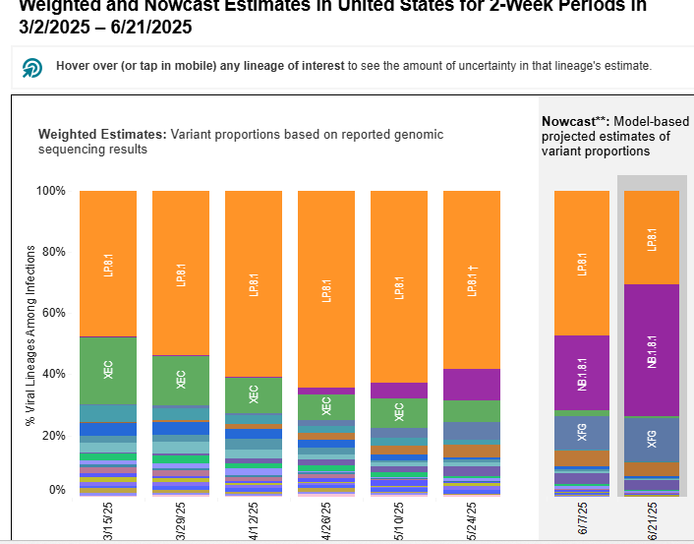
COVID-19 Update
NB .8.1 is replacing LP.8.1.1 as the dominant variant
Has a growth advantage.
No reports difference in severity,
May evade immune response
Paxlovid should work (no new PI mutations)
https://covid.cdc.gov/covid-data-tracker/#variants-genomic-surveillance
https://cdn.who.int/media/docs/default-source/documents/epp/tracking-sars-cov-2/23052025_nb.1.8.1_ire.pdf

Slide 3
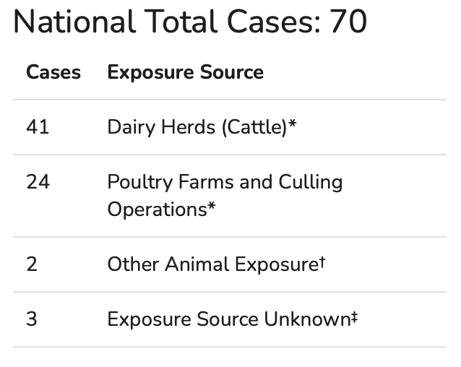
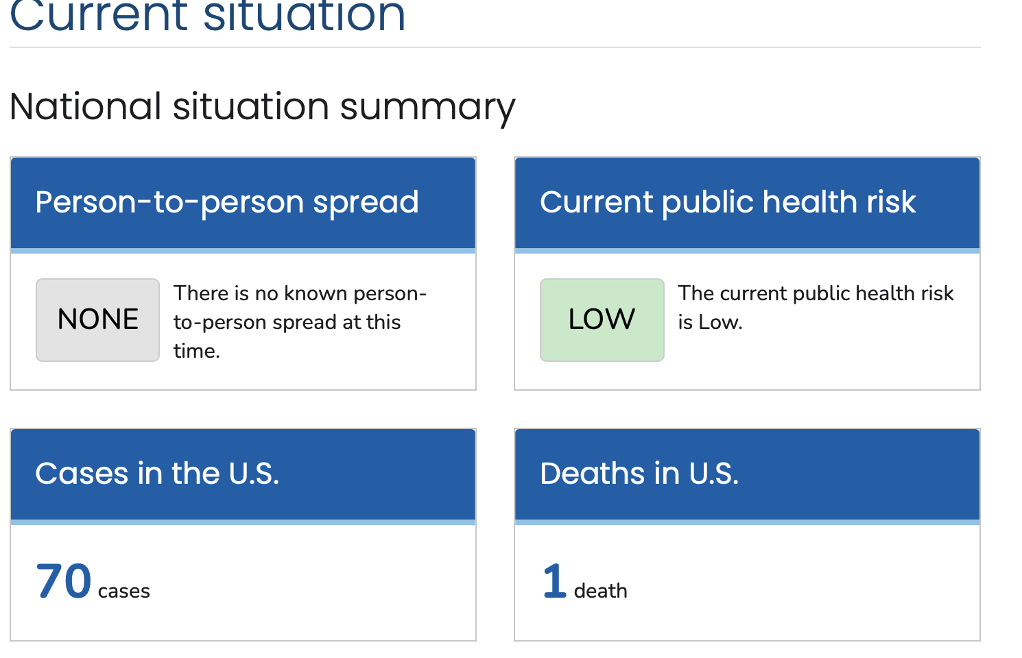
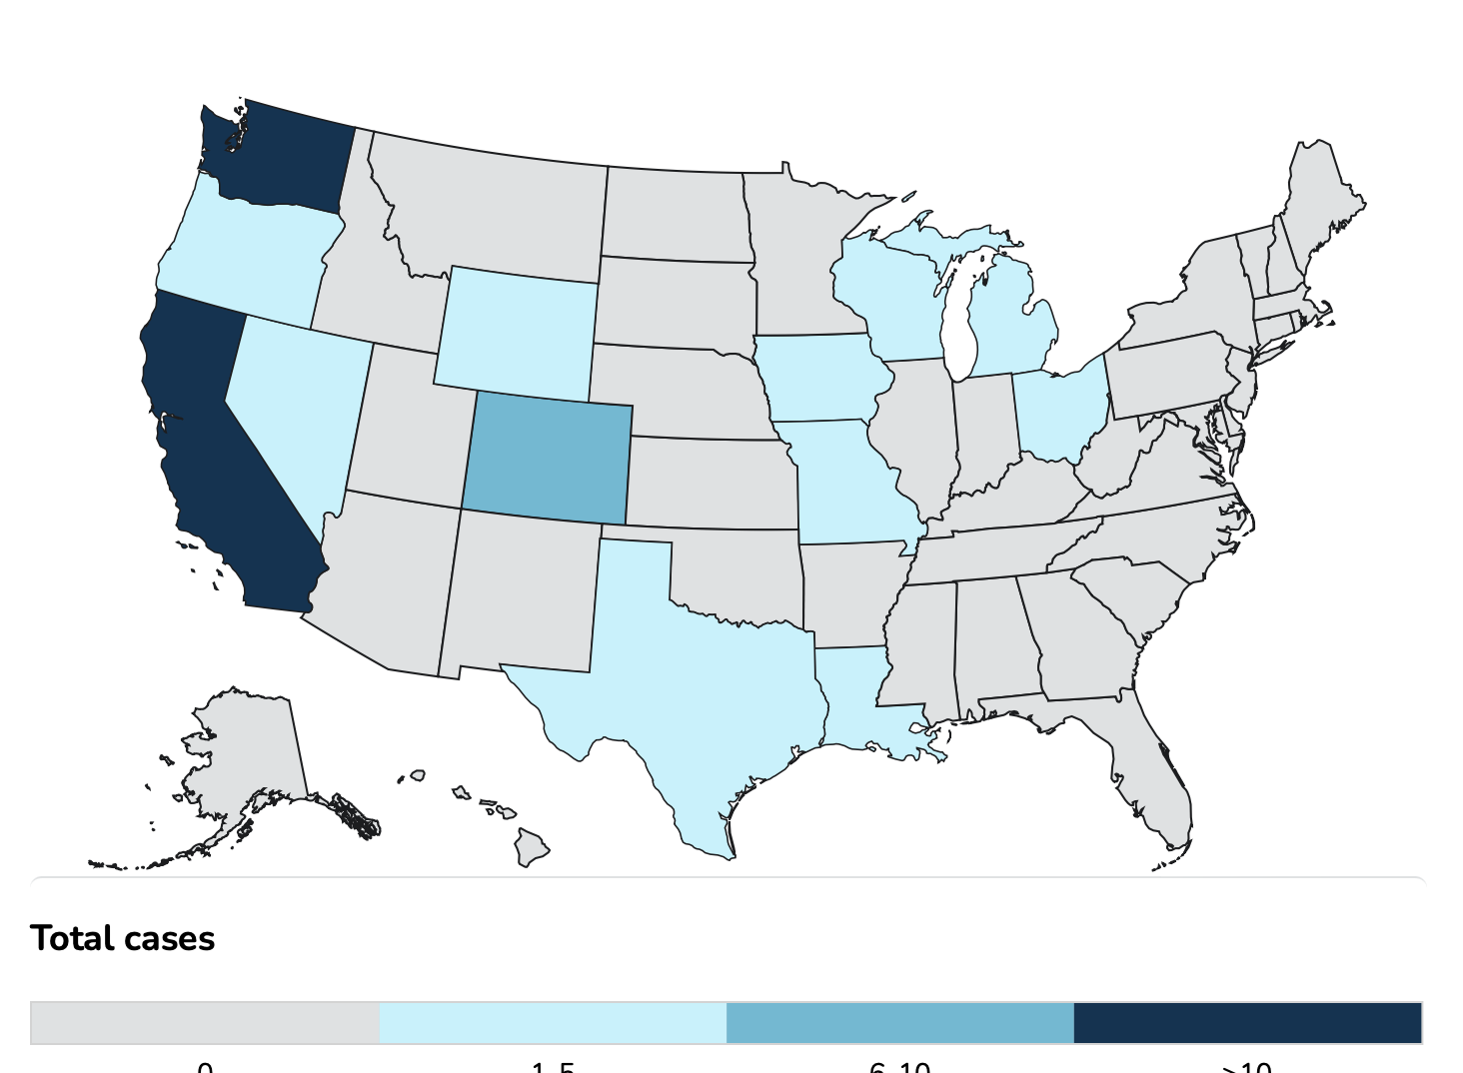
Avian Influenza Update
https://www.cdc.gov/bird-flu/situation-summary/index.html

Slide 4
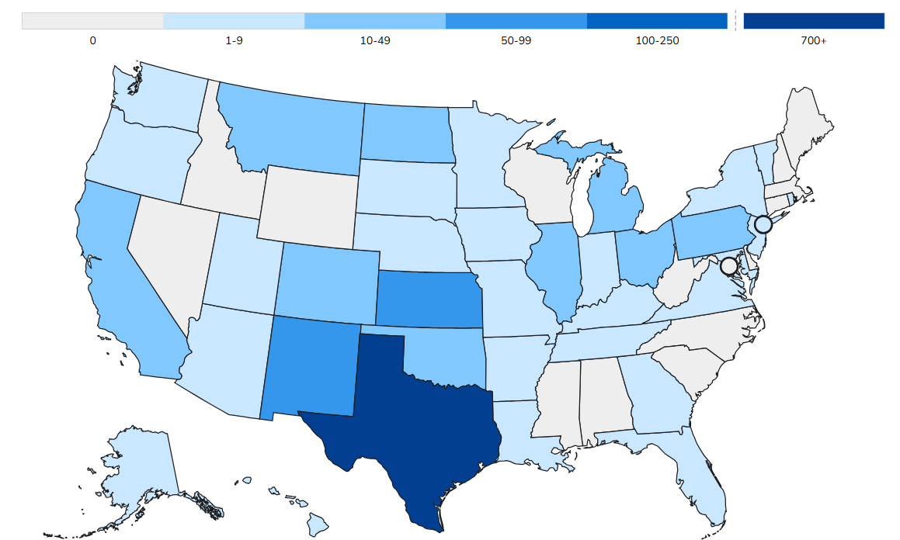
Measles Update
https://www.cdc.gov/measles/data-research/index.html
U.S. Cases in 2025 Total cases: 1288
Measles Cases 2025
Age Under 5 years: 368 (29%) 5-19 years: 469 (36%) 20+ years: 439 (34%) Age unknown: 12 (1%)
Vaccination Status Unvaccinated or Unknown: 92% One MMR dose: 4% Two MMR doses: 4% Hospitalization rate: 13% Deaths 3

Slide 5
CDC resources
Provider clinical assessment algorithm:
  https://www.cdc.gov/measles/downloads/Toolkit-Measles-Clinical-Provider-Flowsheet.pptx
Adult Measles vaccination:
  https://www.cdc.gov/measles/downloads/adult-mmr-algorithm-508.pdf

Slide 6
Evaluating a patient presenting with rash when there is no local measles transmission¹
START HERE
Needs ALL 3:
Fever²
Generalized, maculopapular rash
No vesicular lesions / vesicles³
No
Measles unlikely. If vesicular rash, consider varicella or alternative cause of rash.
Yes
Epidemiologic risk for measles in the 21 days before rash?
ANY of the following:
International travel in last 21 days
Domestic travel in last 21 days to an area with known measles transmission
Known exposure to measles
Measles clinical criteria?⁴
Fever² and rash
AND
Cough, runny nose, OR conjunctivitis
Measles unlikely.
If measles still suspected, contact state or local health department for guidance.
No
No
Yes
Received MMR vaccine in the last 21 days?
Yes
Likely a reaction to MMR vaccination⁵
Yes
No
Suspect measles.
Immediately contact local or state health department to discuss testing options.
See Testing Recommendations.
No
Prior measles vaccination?
Age ≤6 years: 1 dose MMR*
Age >6 years: 2+ doses MMR
Yes
Measles uncommon among people with age-appropriate vaccination. Measles can occur among vaccinated people, but generally during intense exposure (e.g., daycare or household exposure).
If measles suspected based on clinical presentation or severity of illness, contact state or local health department for guidance.
*or other measles-containing vaccine

Slide 7
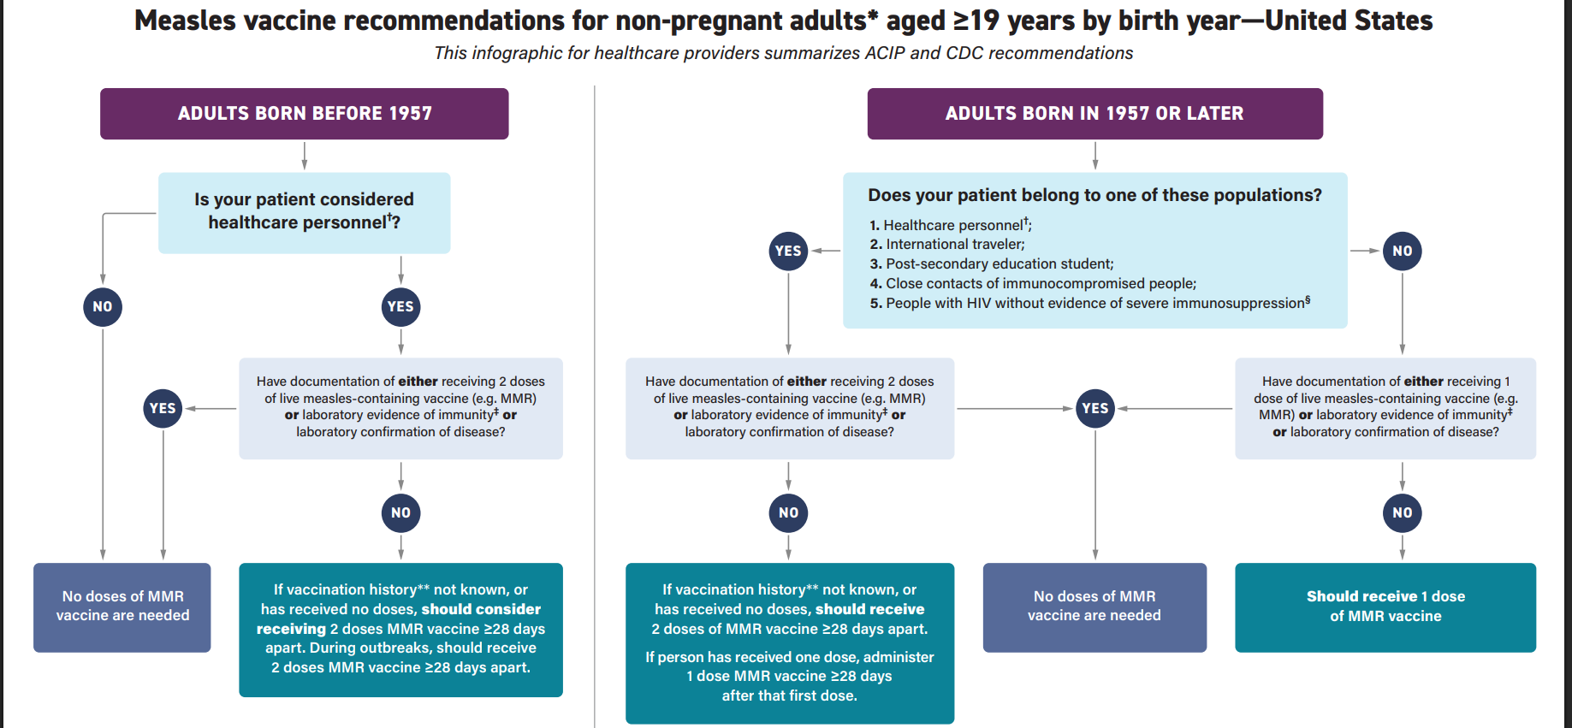
CDC Adult MMR algorithm

Slide 8
Lenacapavir PrEP
Approved in 12/2022 by FDA for HIV treatment (multidrug resistant)
Approved Jun 18, 2025 by FDA for PrEP (Purpose trials)
Multistage HIV-1 capsid inhibitor:
  Block capsid assembly, virus assembly and release, and nuclear transport
Dosage: 927 mg SQ every 6 months Side effects:
  Injection site reactions and nausea
Drug interactions: Rifampin, carbamazepine, amiodarone, statin, opiates
Cost per year: $28,218!
https://www.prepwatch.org/products/lenacapavir-for-prep/

