Slide 1
ECHO Diabetes
MASLD Management –
Medications & Monitoring
June 12, 2025
Carol Greenlee MD

Slide 2
Pre-Question – which one answer is most correct
If a PWT2D has or is at risk for MASLD, potential liver benefit is most likely from:
Increasing the dose of metformin
Addition of vitamin E 800 mg
Adding a GLP1 RA or Dual GLP1 + GIP RA medication
Adding a SGLT2i medication

Slide 3
Lifestyle Management Recap – Key Points
Lifestyle interventions are the foundation to preventing & reversing MASLD/MASH & its complications. These include
  Reducing calorie intake – weight loss (sustained 5-10%)
  Healthy diet composition & patterns
    Avoid SSB, added sugars/HFCS, saturated fats , red & processed meats, ultraprocessed foods
    Include fruits & vegetables, fiber, healthy fats/oils, fish & lean protein, nuts & seeds
    More home cooked meals, less “fast food”
  Avoid alcohol consumption & smoking
  Reduce sedentary time & increase physical activity/exercise as much as possible
“Successful lifestyle modification is highly effective across all stages of liver disease, including compensated cirrhosis.”
Notes:
https://pmc.ncbi.nlm.nih.gov/articles/PMC11058902/#Sec6

Slide 4
MASLD Benefits from Weekend Warrior PA Pattern
Weekend warrior and the risk of specific disease: a meta-epidemiology study. BMC Public Health 25, 1414 (2025)
  Conclusion: The WW PA pattern is associated with significant health benefits, including reduced risks of mortality, cardiovascular diseases, and metabolic syndrome. This pattern may be a viable alternative for individuals unable to engage in daily physical activity.
  Also shows benefit for GI disorders (including MASLD): At the threshold ≥ 150 minutes, compared with sedentary participants, hazard ratios for any digestive disease were
    0.83 for weekend warriors
    0.79 for active regulars
  “…people should try to get into the habit of doing regular activity; it’s more sustainable. But a good alternative, according to this research, is that packing all of that in over the weekend seems to confer benefit.
  So, all is not lost.”
Notes:
Fu, K., Wang, J., Pan, H. et al. Weekend warrior and the risk of specific disease: a meta-epidemiology study. BMC Public Health 25, 1414 (2025). https://doi.org/10.1186/s12889-025-22667-7

Slide 5
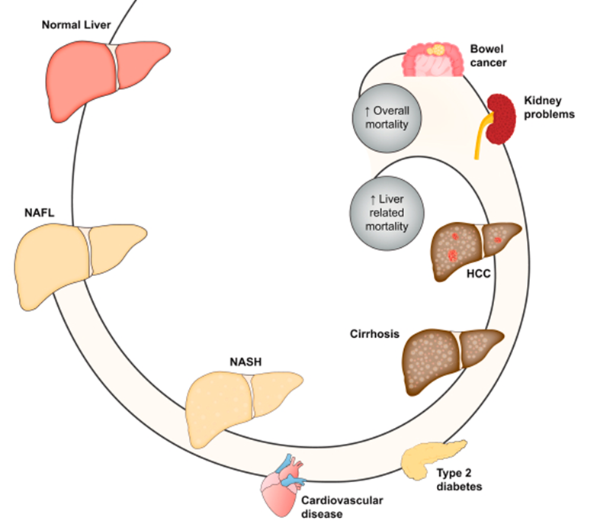
Key Points to Consider as Goals of Management
Main cause of death in people with MASLD is
  CVD
  Non-hepatic cancer
  Liver related (ESLD/ HCC)
T2D, Prediabetes & Obesity are major risk factors for MASH & cirrhosis
  Further weight gain increases risk of advanced fibrosis
  Diabetes increases the risk of HCC (hepatocellular carcinoma) 3X above those without diabetes
We want to prevent CVD, cancers, CKD as well as prevent progression to MASH, worsening fibrosis/cirrhosis & HCC
IR
MASLD
Increased IR
MASH

Slide 6
Suggested Multidisciplinary Team Composition
MASLD & MASH with F0-F1(low risk MASH)
  Primary Care team (physicians, APPs, PharmDs, etc.)
    Possible Endocrinology/Diabetes Care specialists
  RDNs
  CDCES
  Behavioral Health
  Exercise specialists/ Exercise program team
  Obesity Management team
  Bariatric/ Metabolic Surgery per ADA SoC
MASLD/MASH with F2-F3 (“at-risk fibrosis”)
  As above
  Add on Hepatology or GI care team
  Possible Endocrinology/Diabetes Care specialists
Cirrhosis (F4)
  Same as for F2-3 fibrosis
  Consider referrals to
    Transplant team for decompensated cirrhosis
    Social support team
Primary Care, RDNs, CDCES, BH
at all levels

Slide 7
Management of MASLD - Agenda
Recommendations & Reasons
Lifestyle
  Weight loss - Reduced calories
  Diet composition (liver fat, lipotoxicity, inflammation, etc.)
  Increased physical activity / exercise / reduced sedentary time
  Alcohol avoidance
  Smoking cessation
Medications
  For Diabetes – weight loss, CVD/renal risk reduction, Steatosis or MASH benefits
  For Obesity – CVD risk reduction, improvement in MASH parameters/fibrosis
  Statins – CVD risk reduction, do NOT need to stop
  For advanced fibrosis F2-F3 – one agent FDA approved – Resmetirom
Monitoring & Messaging

Slide 8
The Impact of Diabetes Management on MASLD
Diabetes-related Hyperglycemia (effects still being studied/clarified)
  can alter the way the liver processes and stores lipids, contributing to fat accumulation and inflammation - lipotoxicity
  can lead to the formation of AGEs (advanced glycosylation end-products), which can damage liver cells and contribute to fibrosis
  can increase oxidative stress and inflammation in the liver, further damaging liver cells and accelerating fibrosis.
  can increase the risk of HCC
“The longer someone has T2D, the greater the chance they will develop or experience progression of MASLD, highlighting the importance of diabetes management in preventing liver complications”
“Glycemic control and cirrhosis management tend to be synergistic, so improving one often helps with the other”
Notes:
https://pmc.ncbi.nlm.nih.gov/articles/PMC11524742/#sec21
https://touchendocrinology.com/diabetes/journal-articles/metabolic-dysfunction-associated-steatotic-liver-disease-and-type-2-diabetes-a-deadly-synergy/
Boursier J, Anty R, Carette C, et al. AFEF and SFD. Management of diabetes mellitus in patients with cirrhosis:An overview and joint statement. Diabetes Metab. 2021;47:

Slide 9
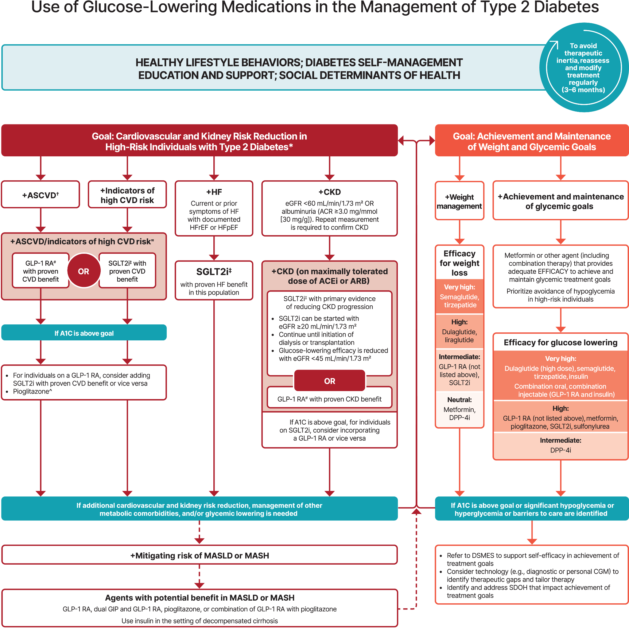

Date of Download: 4/19/2025
Notes:
From: 9. Pharmacologic Approaches to Glycemic Treatment: Standards of Care in Diabetes—2025 Diabetes Care. 2024;48(Supplement_1):S181-S206. doi:10.2337/dc25-S009

Slide 10
Glycemic Treatment
Standards of Care in Diabetes 2025
9.15 In adults with type 2 diabetes, metabolic dysfunction–associated steatotic liver disease (MASLD), and overweight or obesity, consider using a GLP-1 RA or a dual glucose-dependent insulinotropic polypeptide (GIP) and GLP-1 RA with potential benefits in metabolic dysfunction–associated steatohepatitis (MASH) for glycemic management and as an adjunctive to healthy interventions for weight loss. B
9.16a In adults with type 2 diabetes and biopsy-proven MASH or those at high risk for liver fibrosis (based on noninvasive tests), pioglitazone, a GLP-1 RA, or a dual GIP and GLP-1 RA is preferred for glycemic management due to potential beneficial effects on MASH. B
9.16b Combination therapy with pioglitazone plus a GLP-1 RA can be considered for the treatment of hyperglycemia in adults with type 2 diabetes with biopsy-proven MASH or those at high risk of liver fibrosis (identified with noninvasive tests) due to potential beneficial effects on MASH. B
Notes:
Pharmacologic Approaches to Glycemic Treatment: Standards of Care in Diabetes—2025 | Diabetes Care | American Diabetes Association

Slide 11
Management of MASLD/MASH
ADA 2025 Standards of Care
4.26 In adults with type 2 diabetes, MASLD, and overweight or obesity, consider using a glucagon-like peptide 1 (GLP-1) receptor agonist (RA) or a dual glucose-dependent insulinotropic polypeptide (GIP) and GLP-1 RA for the treatment of obesity with potential benefits in MASH as an adjunctive therapy to lifestyle interventions for weight loss. B
4.27a In adults with type 2 diabetes and biopsy-proven MASH or those at high risk for liver fibrosis (based on noninvasive tests), pioglitazone, a GLP-1 RA, or a dual GIP and GLP-1 RA is preferred for glycemic management because of potential beneficial effects on MASH. B
4.27b Combination therapy with pioglitazone plus GLP-1 RA can be considered for the treatment of hyperglycemia in adults with type 2 diabetes with biopsy-proven MASH or those at high risk of liver fibrosis (identified with noninvasive tests) because of potential beneficial effects on MASH.B

Slide 12
Reasoning for Recommendations
ADA 2025 Standards of Care
Optimizing the pharmacological management of hyperglycemia and obesity in people with type 2 diabetes with medications that also help improve MASH could serve the dual purpose of addressing these comorbidities while treating the liver disease
  The recommendation to treat hyperglycemia with GLP-1 RAs and/or pioglitazone in people with type 2 diabetes and MASLD is based on consistent histological benefit for steatohepatitis and to slow fibrosis progression in several phase 2 RCTs with GLP-1 RAs and with pioglitazone compared with no benefit with metformin or other glucose-lowering medications in MASH
    Combined pioglitazone and GLP-1RA treatment is associated with a greater decrease in hepatic steatosis as compared with pioglitazone alone in people with T2D
They may also decrease CVD, which is the number one cause of death in people with type 2 diabetes and MASLD
[Increasing evidence for GLP1 RA agents reducing ORC (obesity related cancers)]
Notes:
https://diabetesjournals.org/care/article/doi/10.2337/dci24-0094/160536/Metabolic-Dysfunction-Associated-Steatotic-Liver --

Slide 13
GLP1 RA Effects on MASLD
GLP-1 RAs are effective at inducing weight loss and ameliorating elevated plasma aminotransferases and steatosis.
There are a few phase 2 RCTs of GLP-1 RAs in individuals with MASH proven by biopsy.
  A small RCT reported that liraglutide improved some features of MASH and may delay fibrosis progression .
  Subcutaneous semaglutide treatment in 320 people with MASH (62% having type 2 diabetes) led to
    resolution of steatohepatitis without worsening of fibrosis in 59% of individuals at the higher dose (equivalent to 2.4 mg/week semaglutide) compared with 17% in the placebo group (P < 0.001).
    no significant effect on the stage of liver fibrosis but, over 72 weeks, slowed the progression of liver fibrosis (4.9% with the GLP-1 RA at the highest dose compared with 18.8% on placebo).
Patients in all groups (including PBO) received counseling on nutrition and exercise

Slide 14
Tirzepatide Effects on MASLD
Phase 2 paired-biopsy study of 190 adults with overweight or obesity with MASH (50–60% of whom had type 2 diabetes)
Resolution of steatohepatitis without worsening of fibrosis
Improvement of at least one fibrosis stage without worsening of MASH
Tirzepatide doses of
  5 mg/day – 44% of participants
  10 mg/day- 56%
  15 mg/day - 62%
  placebo – 10% of participants
Tirzepatide doses of
  5 mg/day – 55% of participants
  10 mg/day- 51%
  15 mg/day - 61%
  placebo – 30% of participants
Notes:
2025 ADA SoC

Slide 15
Phase 3 Trial of Semaglutide in Metabolic Dysfunction – Associated Steatohepatitis NEJM April 30, 2025
Semaglutide, a glucagon-like peptide-1 receptor agonist, is a candidate for the treatment of metabolic dysfunction–associated steatohepatitis (MASH).
In this ongoing phase 3, multicenter, randomized, double-blind, placebo-controlled trial, we assigned 1197 patients with biopsy-defined MASH and fibrosis stage 2 or 3 in a 2:1 ratio to receive once-weekly subcutaneous semaglutide at a dose of 2.4 mg or placebo for 240 weeks.
  Age – average 55
  BMI – average 35
  Type 2 diabetes - ~ 55%
  Fibrosis stage — stage 2 ~ 31% and stage 3 ~ 69%
  Median score on Fibrosis-4 Index: 1.58 (1.12–2.24)
  Enhanced liver fibrosis score - 9.95±0.94
  Liver stiffness — 12.8±6.6 kPa
The results of a planned interim analysis conducted at week 72 involving the first 800 patients are reported here (part 1)
Notes:
Phase 3 Trial of Semaglutide in Metabolic Dysfunction–Associated Steatohepatitis | New England Journal of Medicine

Slide 16



Resolution of steatohepatitis without worsening of fibrosis
Reduction in liver fibrosis without worsening of steatohepatitis
Sema – 62.9%
PBO – 34.3%
Sema – 36.8%
PBO – 22.4%
CONCLUSIONS: In patients with MASH and moderate or advanced liver fibrosis, once-weekly semaglutide at a dose of 2.4 mg improved liver histologic results.

Slide 17
Adding Pioglitazone for Glycemic & MASLD benefits
ADA 2025 Standards of Care
Pioglitazone improves IR→ improves glucose and lipid metabolism and reverses steatohepatitis in people with prediabetes or type 2 diabetes and even in individuals without diabetes.
Fibrosis also improved in some trials.
  A meta-analysis concluded that pioglitazone treatment results in resolution of MASH and may improve fibrosis.
    These studies are based on phase 2 clinical trials and await further phase 3 evidence.
  Pioglitazone is attractive because it offer potential benefit compared with lack of histological benefit (or clinical trial data) from other oral glucose-lowering therapies in MASLD.
In the context of treating hyperglycemia in people with type 2 diabetes with MASLD, where the low cost of pioglitazone and any liver improvement would be an added benefit to glycemic management, these plans would be potentially cost-effective for the treatment of MASLD
Notes:
ADA

Slide 18
Pioglitazone even at low dosage improves NAFLD in type 2 diabetes: clinical and pathophysiological insights from a subgroup of the TOSCA.IT randomised trial. Diabetes Res Clin Pract. 2021 Aug:178
Abstract
Aims: Non-Alcoholic Fatty Liver Disease (NAFLD) and type 2 diabetes (T2D) share pathophysiological mechanisms and possible therapeutic strategies. We evaluated the effects of 1-year treatment with pioglitazone or sulphonylureas on indirect indices of NAFLD in people with T2D and the role of insulin-resistance and glucotoxicity in determining these effects.
Methods: Patients with T2D (n = 195) aged 50-75 years, poorly controlled with metformin 2 g/day, were randomly allocated to add-on pioglitazone (n = 98) or sulphonylureas (n = 97) within the TOSCA.IT trial. Plasma insulin, glucose, and liver enzymes were measured at baseline and after 1-year. Indirect indices of NAFLD (Liver Fat Equation [LFE], Hepatic Steatosis Index [HSI], and Index of NASH [ION]), and insulin resistance (HOMA-IR, Visceral Adiposity Index [VAI] and adipose tissue Insulin Resistance [ADIPO-IR]) were calculated.
Results:
  Indices of NAFLD improved after pioglitazone, but not after sulphonylureas;
  Indices of insulin resistance decreased after pioglitazone, but not after sulphonylureas
  Changes in NAFLD indices were similar with different doses of pioglitazone (15, 30, or 45 mg/day), and were independent of blood glucose control.
Conclusions: One-year treatment with pioglitazone even at low dosage significantly improved
  liver steatosis and inflammation
  systemic and adipose tissue insulin resistance in patients with T2D
Notes:
Diabetes Res Clin Pract. 2021 Aug:178:108984. doi: 10.1016/j.diabres.2021.108984. Epub 2021 Jul 24.
Pioglitazone even at low dosage improves NAFLD in type 2 diabetes: clinical and pathophysiological insights from a subgroup of the TOSCA.IT randomised trial. Giuseppe Della Pepa 1, Marco Russo 2, Marilena Vitale 1, Fabrizia Carli 3, Claudia Vetrani 1, Maria Masulli 1, Gabriele Riccardi 1, Olga Vaccaro 4, Amalia Gastaldelli 5, Angela A Rivellese 6, Lutgarda Bozzetto 1

Slide 19
Cautions with Pioglitazone
Pioglitazone can cause dose-dependent weight gain
  15 mg/day, mean weight gain of 1–2%
  45 mg/day, mean weight gain of 3–5%
  can be blunted or reversed if combined with SGLT2 inhibitors or GLP-1 RAs
  [start with 15 mg daily, increase to 30 mg if needed for glycemic control]
Pioglitazone
  may increase fracture risk (especially postmenopausal women)
  may promote heart failure in individuals with preexisting congestive heart failure
  may increase the risk of bladder cancer, although this remains controversial
  [may reduce prostate cancer] - TBD

Slide 20
Combination of glucagon-like peptide 1 receptor agonist and thiazolidinedione for mortality and cardiovascular outcomes in patients with type 2 diabetes JAMA Network Open. Published online March 31, 2025
The study authors concluded, “This study found that GLP-1RA plus thiazolidinedione combination therapy was associated with a significant reduction in all-cause mortality and CV mortality.”
Patients receiving GLP-1RA and thiazolidinedione dual therapy, compared to those who did not receive either, had significantly lower risk of
  all-cause mortality (adjusted hazard ratio [AHR], 0.20; 95% CI, 0.19-0.21; P < .001),
  cardiovascular mortality (AHR, 0.20; 95% CI, 0.18-0.23; P < .001)
Suggests a potential synergistic effect on mortality
This study showed that GLP-1RAs could mitigate the risk of HF associated with thiazolidinedione use.
Notes:
Li J-X, Hsu T-J, Lin H-J, et al. Combination of glucagon-like peptide 1 receptor agonist and thiazolidinedione for mortality and cardiovascular outcomes in patients with type 2 diabetes. JAMA Network Open. Published online March 31, 2025. doi:10.1001/jamanetworkopen.2025.2577

Slide 21
ADA 2025 Standards of Care
4.30a In adults with type 2 diabetes and MASLD, use of glucose-lowering therapies other than pioglitazone or GLP-1 RAs may be continued as clinically indicated, but these therapies lack evidence of benefit in MASH. B
4.30b Insulin therapy is the preferred agent for the treatment of hyperglycemia in adults with type 2 diabetes with decompensated cirrhosis. C
SGLT2 inhibitors and insulin reduce hepatic steatosis, but their effects on steatohepatitis remain unknown (study just released showing improvement in MASH & fibrosis with Farxiga)
Other agents have either failed to improve steatohepatitis in paired-biopsy studies (metformin) or have no RCTs with liver histological end points (i.e., sulfonylureas, glitinides, dipeptidyl peptidase 4 inhibitors, or acarbose)
GLP-1 RAs are safe in individuals with compensated cirrhosis –
Insulin is the preferred glucose-lowering agent for the treatment of hyperglycemia in adults with type 2 diabetes with decompensated cirrhosis given the lack of robust evidence about the safety and efficacy of oral agents and GLP-1 RAs and dual GIP and GLP-1 Ras (sarcopenia is an issue)

Slide 22
Vitamin E not recommended for T2D
Vitamin E may be beneficial for the treatment of MASH in people without diabetes.
However, in people with type 2 diabetes, vitamin E monotherapy was found to be ineffective in a small RCT, and it did not seem to enhance pioglitazone’s efficacy when used in combination, as reported in an earlier trial in this population.
Risks of high dose vitamin E
  increased risk of bleeding and stroke
  potential link to prostate cancer and increased mortality

Slide 23
Recommendations regarding Resmetirom
ADA 2025 SoC
4.28 For consideration of treatment with a thyroid hormone receptor-β agonist [resmetirom (brand name – Rezdiffra)] in adults with type 2 diabetes or prediabetes with MASLD with moderate (F2) or advanced (F3) liver fibrosis on liver histology, or by a validated imaging-based or blood-based test, refer to a gastroenterologist or hepatologist with expertise in MASLD management. A
4.29 Treatment initiation and monitoring should be individualized and within the context of an interprofessional team that includes a gastroenterologist or hepatologist, consideration of individual preferences, and a careful shared-decision cost-benefit discussion. B
~$47,000 / year

Slide 24
Resmetirom – Phase 3 RCT
MASH resolved without worsening of fibrosis
Fibrosis improved by at least 1 stage with no worsening of MASH
80 mg daily - 25.9%
100 mg daily – 29.9%
Placebo – 9.7%
80 mg daily - 24.2%
100 mg daily - 25.9%
Placebo - 14.2%
Diarrhea and nausea were more frequent with resmetirom than with placebo, but resmetirom was well tolerated overall.
The optimal duration of treatment is uncertain
As of October 2024, resmetirom was available only through specialty pharmacies. This and its high cost will likely limit access. (Cost for Rezdiffra set at $47,400 annually)
Given its mechanism of action, careful surveillance for early endocrine disease related to thyroid, gonadal, or bone disease may be needed.

Slide 25
Don’t Stop the Statin !!
ADA 2025 Standards of Care
4.31a Adults with type 2 diabetes and MASLD are at increased cardiovascular risk; therefore, comprehensive management of cardiovascular risk factors is recommended. B
4.31b Statin therapy is safe in adults with type 2 diabetes and compensated cirrhosis from MASLD and should be initiated or continued for cardiovascular risk reduction as clinically indicated. B
  In people with decompensated cirrhosis, statin therapy should be used with caution, and close monitoring is needed, given limited safety and efficacy data. B
Some studies even suggest that statin use in people with chronic liver disease may reduce episodes of hepatic decompensation and/or overall mortality

Slide 26
Metabolic Surgery
ADA 2025 Standards of Care
4.32a Consider metabolic surgery in appropriate candidates as an option
  to treat MASH in adults with type 2 diabetes B and
  to improve cardiovascular outcomes. B
4.32b Metabolic surgery should be used with caution in adults with type 2 diabetes with compensated cirrhosis from MASLD B
  and is not recommended in decompensated cirrhosis. B
Metabolic surgery leading to sustained weight loss and improvement of type 2 diabetes can improve MASH and cardiometabolic health, altering the natural history of the disease. Meta-analyses report that
  70–80% of people have improvement in hepatic steatosis
  50–75% of people have improvement in inflammation & hepatocyte ballooning (necrosis)
  30–40% of people have improvement in fibrosis
  It may also reduce the risk of HCC

Slide 27
Survival and Cost-Effectiveness of Bariatric Surgery Among Patients With Obesity and Cirrhosis.
JAMA Surg. Published online April 02, 2025. Bansal S, Bader A, Mahmud N, Kaplan DE.
This VA study found that bariatric surgery improves survival and is cost-effective for patients with obesity and compensated cirrhosis.
  The study compared bariatric surgery to a lifestyle modification program and found that bariatric surgery was associated with
    a 72% lower risk of developing serious liver complications and
    an 80% lower risk of progressing to decompensated cirrhosis
https://jamanetwork.com/journals/jamasurgery/article-abstract/2832074
Notes:
https://jamanetwork.com/journals/jamasurgery/article-abstract/2832074

Slide 28
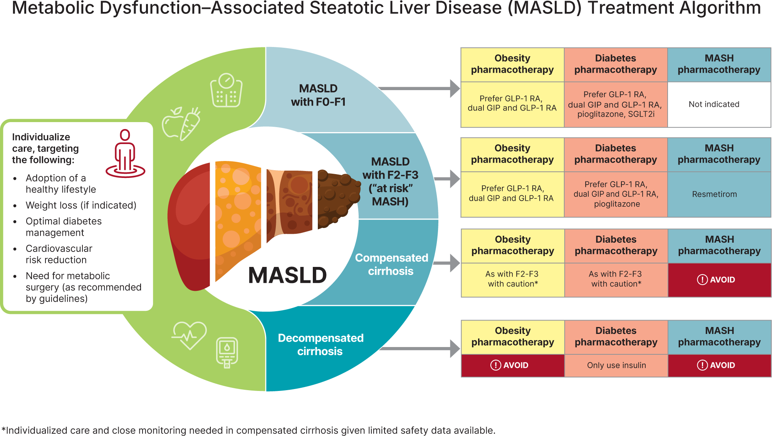
From: 4. Comprehensive Medical Evaluation and Assessment of Comorbidities: Standards of Care in Diabetes—2025
Diabetes Care. 2024;48(Supplement_1):S59-S85. doi:10.2337/dc25-S004
Metabolic dysfunction–associated steatotic liver disease (MASLD) treatment algorithm. F0-F1, no to minimal fibrosis; F2-F3, moderate fibrosis; F4, cirrhosis; GIP, glucose-dependent insulinotropic polypeptide; GLP-1 RA, glucagon-like peptide 1 receptor agonist; MASH, metabolic dysfunction–associated steatohepatitis; SGLT2i, sodium–glucose cotransporter 2 inhibitor.
Date of Download: 4/14/2025
Copyright © 2025 American Diabetes Association. All rights reserved.

Slide 29
Monitoring
Individual patient self-monitoring
  Setting SMART (specific, measurable, achievable, relevant, timely) goals for weight loss, dietary composition and/or physical activity [& medication taking]
    An example of a SMART exercise goal could be to swim 10 lengths, twice a week at the local pool for the next month.
    Another example of a SMART dietary goal could be to stop buying sugar-sweetened beverages for the next four weeks
  Tools
    Scale – weight
    Waist circumference
    CGM – glycemia targets & effects of lifestyle
    Apps – calorie and/or activity trackers
    Clinicians can review data from devices – e.g., step counts, etc.

Slide 30
How should patients with MASLD be monitored?
Most guidelines suggest that : “Patients with MASLD and no significant fibrosis (based on a low-risk FIB-4 score [<1.3] or VCTE [Fibroscan] <7-8 kPa) can be followed by their primary care physician with a repeated FIB-4 every 2 to 3 years”.
  management is usually focused on optimization of body weight, diabetes management, and underlying risk factors
  however
FIB4 has the potential to underestimate fibrosis severity in those with T2D
  Clinically significant fibrosis may be present in some adults with type 2 diabetes and FIB-4 values between 1.0 and 1.3,especially when type 2 diabetes is associated with obesity and multiple cardiometabolic risk factors.
    E.g., In drug trials of people w/ stage F2 & F3 - ~50% had FIB4 score under 1.3 (1.0-1.3)
Notes:
Annals of Int Med – In The Clinic Jan 2025

Slide 31
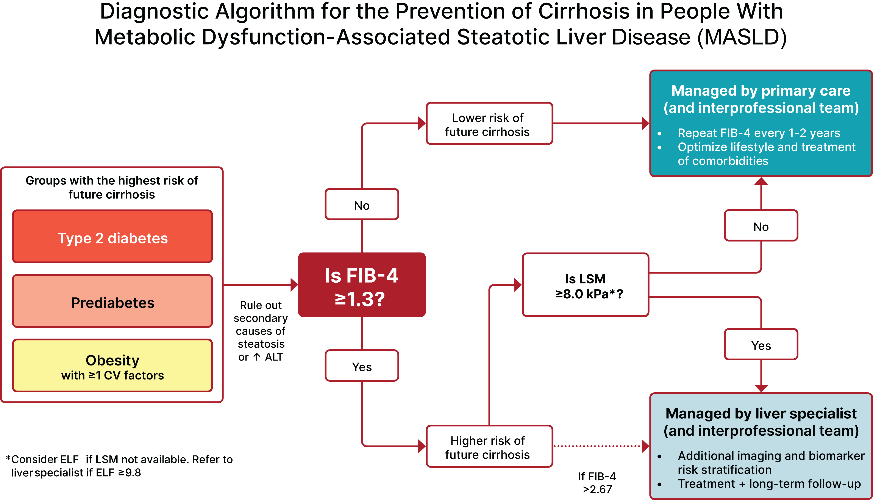
From: 4. Comprehensive Medical Evaluation and Assessment of Comorbidities: Standards of Care in Diabetes—2025
Diabetes Care. 2024;48(Supplement_1):S59-S85. doi:10.2337/dc25-S004
Date of Download: 3/11/2025
Copyright © 2025 American Diabetes Association. All rights reserved.

Slide 32
How should patients with T2D & MASLD be monitored?
The ADA Consensus paper on MASLD recommends that individuals (with T2D or prediabetes) with an initial FIB-4 score <1.3 be reassessed with repeat FIB-4 measurements in 1–2 years.
  Transient elastography (VCTE) may also be of benefit as part of risk assessment
    Many centers do VCTE (Fibroscan) in patients with T2D routinely if available
  Hopefully, most will have lower (improved) FIB4 index
Those whose FIB-4 score increases from <1.3 to >1.3 should be referred for transient elastography (VCTE/Fibroscan for LSM)
Given the potential for underestimation of fibrosis severity in individuals with T2D, those who progress from <1.0 to values between 1.0 and 1.3 may also be considered for secondary assessment with VCTE or an ELF test .
  Individuals with LSM >8.0 kPa or ELF > 9.8 should be referred to gastroenterology or hepatology specialists for additional diagnostic testing.
    The optimal ELF cutoff is evolving; management decisions should be individualized when the ELF score is between 9.2 and 9.7 based on clinical risk (i.e., testing may be needed more often in a high-risk individual with multiple cardiometabolic risk factors).
Notes:
https://diabetesjournals.org/care/article/doi/10.2337/dci24-0094/160536/Metabolic-Dysfunction-Associated-Steatotic-Liver

Slide 33
Apply Clinical Judgement
“It is now well established that adults with prediabetes or type 2 diabetes have the highest risk of developing MASLD.”
If the FIB4 score is >1.0 and <1.3 but patient with T2D has multiple risk factors – consider checking a secondary assessment test with VCTE or ELF test
  Approximately one in five people with type 2 diabetes have clinically significant fibrosis and are at high risk of developing cirrhosis from MASLD (i.e., has at-risk MASH)
  The risk of developing MASLD, MASH and fibrosis/cirrhosis has been independently associated with
    insulin resistance
    weight gain
    obesity
    cardiometabolic risk factors

Slide 34
How should patients with MASH be monitored?
Patients with indeterminate to high risk for fibrosis on FIB-4 &/or VCTE or ELF testing “should be referred to a specialist”
  Due to limited access to liver specialists – PC may need to help manage & monitor
  FIB-4 - not very sensitive to fibrosis change
    short-term improvement (6–12 months) in FIB-4 likely reflects changes in inflammation (i.e., plasma aminotransferases) rather than fibrosis.
  LSM (VCTE) – has been shown to reflect responses to therapeutic intervention
    Improvement (reduction in kPa) by >30% represents therapeutic response
    Worsening (increase in kPa) by >30% reflects disease progression.
Those with advanced fibrosis should be seen at least every 6 months to monitor for
  signs of liver decompensation (jaundice, ascites, hepatic encephalopathy)
    laboratory evaluation (CBC, INR, hepatic & renal panel)
  HCC screening (AFP & US)
Notes:
Annals of Int Med – In The Clinic Jan 2025

Slide 35
Monitoring - Screening for HCC
Recommendations for HCC screening in patients with MASH-associated cirrhosis (F4) are the same as those for cirrhosis of other etiologies
  semi-annual(every 6 months) ultrasound scans and alpha-fetoprotein (AFP) testing
Although patients with non-cirrhotic MASH can be at risk for HCC, their risk is below the screening threshold, so widespread screening cannot be recommended for this population.
  Certain patients with non-cirrhotic fibrosis should be assessed on a case-by-case basis due to an increased risk of HCC, including patients with:
    MASH and bridging fibrosis (on biopsy results)
    family history of HCC
    multiple cardiometabolic risk factors (especially T2D)
    continuous alcohol use
Notes:
Global Consensus Recommendations for Metabolic Dysfunction-Associated Steatotic Liver Disease and Steatohepatitis

Slide 36
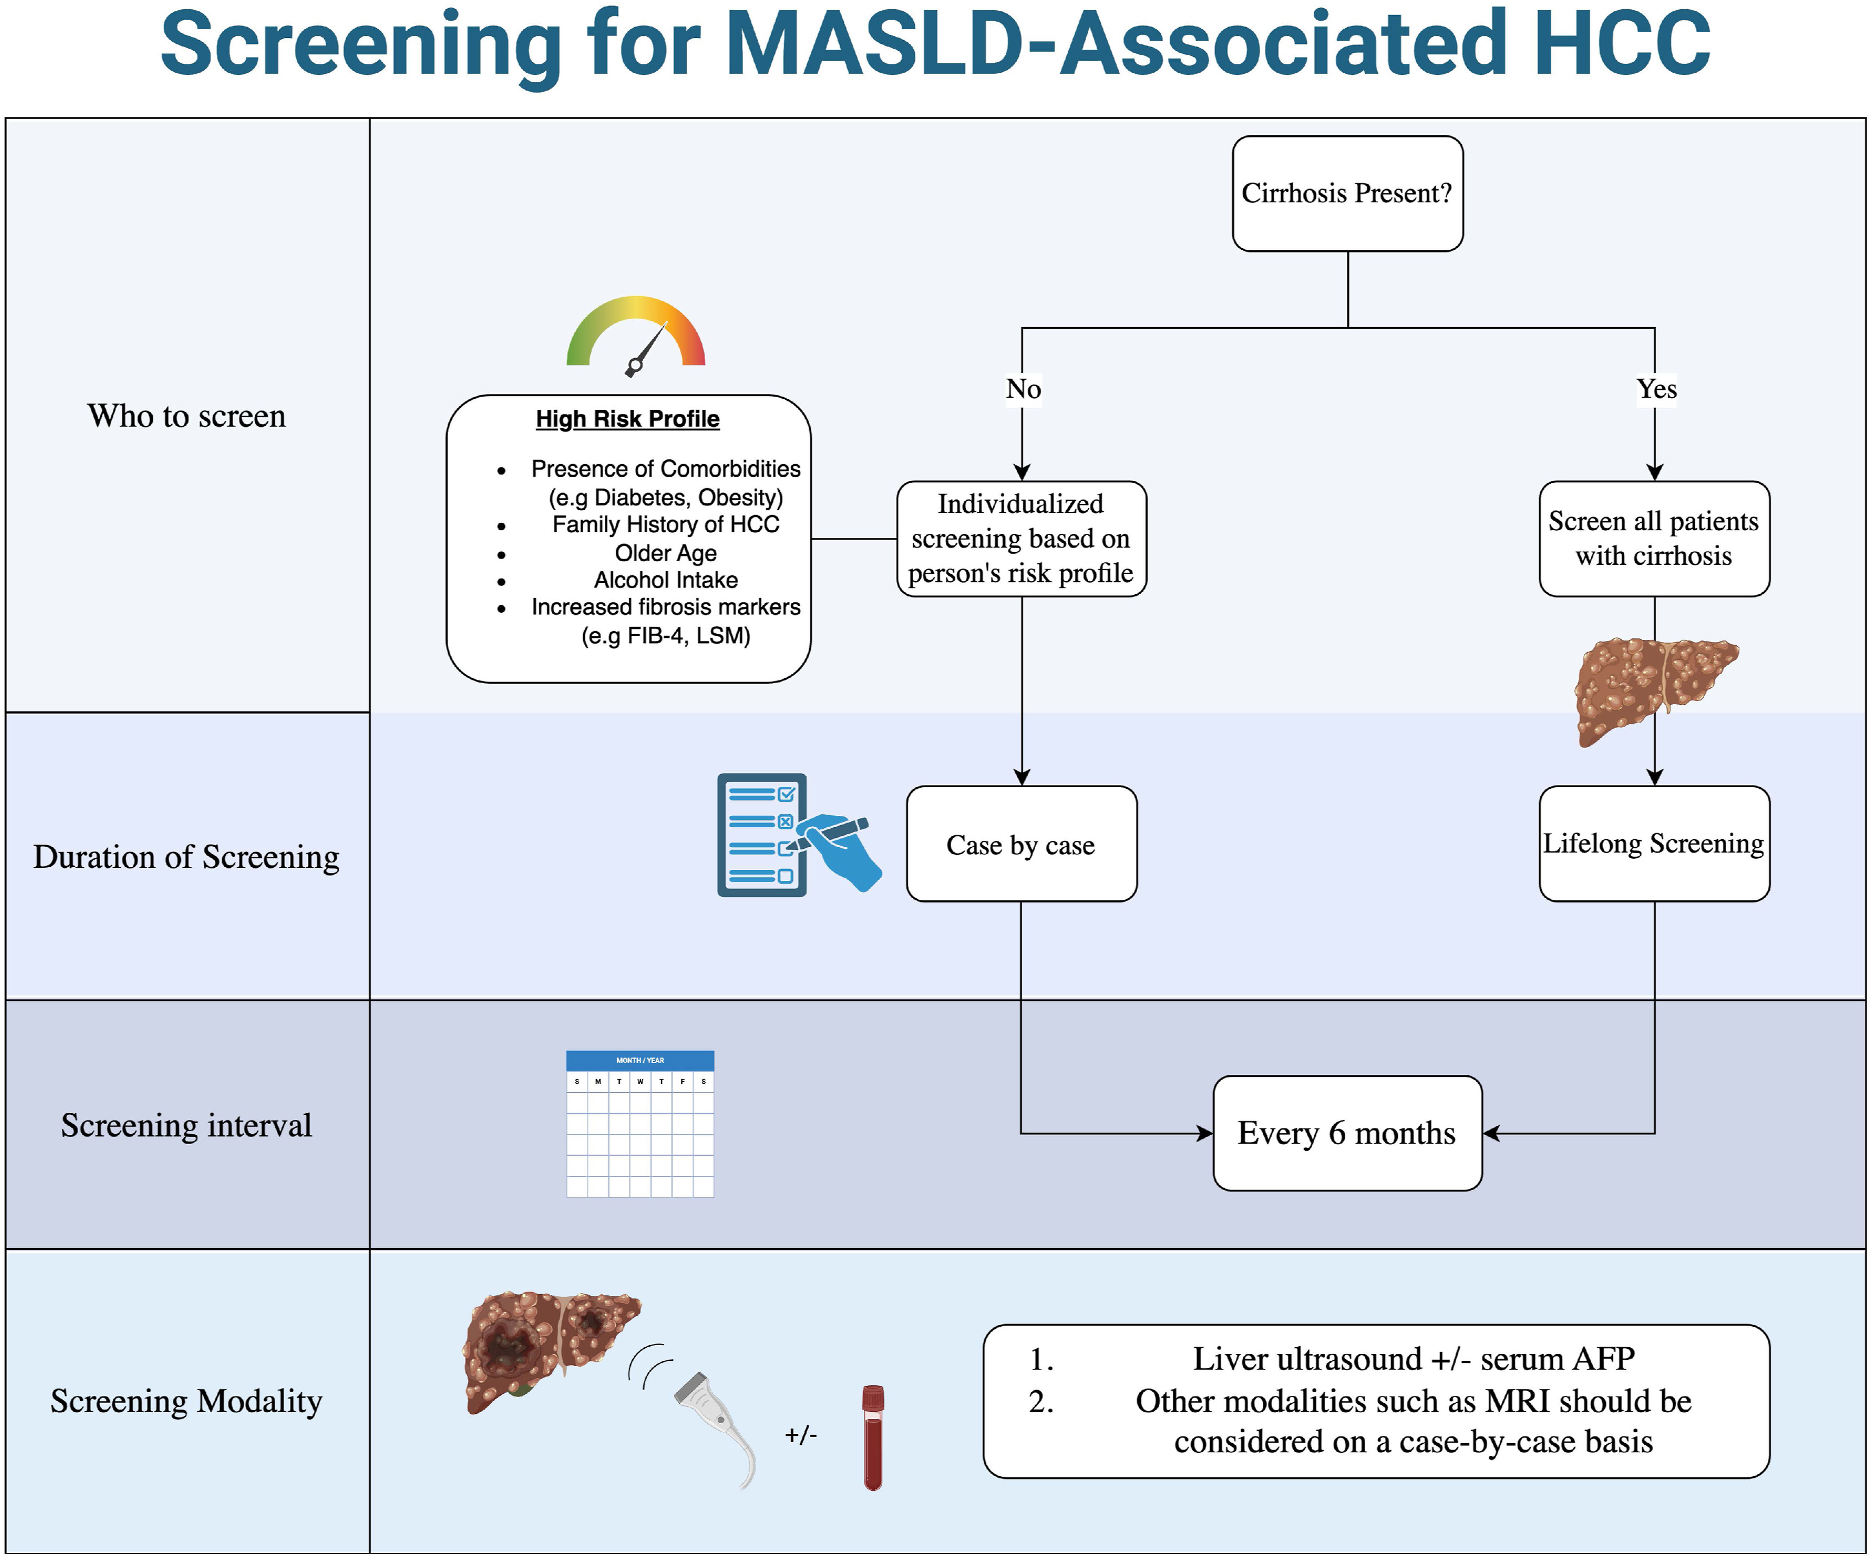
Notes:
https://www.gastrojournal.org/cms/10.1053/j.gastro.2025.02.044/asset/bb61fdf3-f8c7-462f-8f38-40bf0f5a8794/main.assets/gr4_lrg.jpg

Slide 37
Anticipate Updates/Revisions (Evolution) of Guidelines
Screening & Monitoring – better Non-Invasive Tests & better-defined cutoff values
Management
  Although only 1 pharmacologic agent has been approved by the U.S. Food and Drug Administration (FDA) for treatment of MASLD, several other pharmacologic therapies are in the pipeline
    Additional thyroid hormone receptor b-selective agonist medications
    FGF21 analogs
    P-PAR agents
    Incretin therapies
      Recent phase 3 study with semaglutide
      New dual & triple agents - E.g., Survodutide is a dual GLP-1 and glucagon RA that is in development, and a phase 2 paired-biopsy trial recently reported benefit in MASH
    SGLT2 inhibitors (?)

Slide 38
Effect of dapagliflozin on metabolic dysfunction-associated steatohepatitis: multicentre, double blind, randomised, placebo-controlled trial. BMJ 2025; 389 (Published 04 June 2025)
Study from China
The dapagliflozin trial included younger patients who were predominantly male and of Asian descent, with a lower body mass index (BMI), a lower prevalence of type 2 diabetes, and less fibrosis than participants in the resmetirom and semaglutide trials.
MASH resolution without worsening of fibrosis occurred in 23% of those on dapagliflozin and 8% of those on placebo (RR 2.91, 95% CI 1.22-6.97, P=0.01)
Fibrosis improvement by at least one stage without worsening of MASH was reported in 45% versus 20%, respectively (RR 2.25, 95% CI 1.35-3.75, P=0.001).

Slide 39
Summary – Key Points for Medication Management
In patients at risk for or determined to have MASLD, GLP1 or Dual RA medications are preferred for glycemic management & as an adjunctive to lifestyle for weight loss since they also benefit (reduce) liver risk as well as CVD risk
  Safe to use in patients w/ compensated cirrhosis & appear to improve outcomes
  No data for use w/ decompensated cirrhosis (want to avoid weight loss/sarcopenia)
For patients at risk for or with MASH, use of [low dose]pioglitazone for glycemic management can reduce liver risk & CVD risk
  Combination with GLP1 RA agents is safe & appears to improve mortality benefits & mitigates HF risk
Do not stop statins – statins benefit CVD risk & appear to reduce liver risk
Use of Resmetirom requires referral to hepatology [GLP1 based agents may be superior – phase 3 trials pending (lower cost & reduce multiple risks)]
Metabolic surgery w/sustained weight loss can improve MASH & c- cirrhosis
FIB4 can underestimate fibrosis risk in people with T2D & Prediabetes
  consider adding second screening test in individuals with FIB4 index in 1.0 to <1.3 range

Slide 40
Post-Question – which one answer is most correct
If a PWT2D has or is at risk for MASLD, potential liver benefit is most likely from:
Increasing the dose of metformin
Addition of vitamin E
Adding a GLP1 RA or Dual GLP1 + GIP RA medication
Adding a SGLT2i medication
Currently, GLP1 agents & pioglitazone are indicated for management of co-morbidities (glycemia, weight, CVD risk) – and at same time likely to benefit liver
In future, GLP1 RA containing meds may be indicated for treating MASH & fibrosis

Slide 41

Questions, Comments, Clarification
What are your barriers &/or concerns regarding addressing MASLD in your patients with type 2 diabetes or prediabetes?

Slide 42
Extra Slides

Slide 43
Continuation of metformin use after a diagnosis of cirrhosis significantly improves survival of patients with diabetes. Hepatology. 2014 Dec;60(6):2008-16.
Abstract: The risks and benefits of metformin use in patients with cirrhosis with diabetes are debated. Although data on a protective effect of metformin against liver cancer development have been reported, metformin is frequently discontinued once cirrhosis is diagnosed because of concerns about an increased risk of adverse effects of metformin in patients with liver impairment.
This study investigated whether continuation of metformin after cirrhosis diagnosis improves survival of patients with diabetes. Diabetic patients diagnosed with cirrhosis between 2000 and 2010 who were on metformin at the time of cirrhosis diagnosis were identified (n = 250). Data were retrospectively abstracted from the medical record. Survival of patients who continued versus discontinued metformin after cirrhosis diagnosis was compared using the log-rank test. Hazard ratio (HR) and 95% confidence interval (CI) were calculated using Cox's proportional hazards analysis. Overall, 172 patients continued metformin whereas 78 discontinued metformin.
Results: Patients who continued metformin had a significantly longer median survival than those who discontinued metformin (11.8 vs. 5.6 years overall, P < 0.0001; 11.8 vs. 6.0 years for Child A patients, P = 0.006; and 7.7 vs. 3.5 years for Child B/C patients, P = 0.04, respectively).
  After adjusting for other variables, continuation of metformin remained an independent predictor of better survival, with an HR of 0.43 (95% CI: 0.24-0.78; P = 0.005).
No patients developed metformin-associated lactic acidosis during follow-up.
Conclusion: Continuation of metformin after cirrhosis diagnosis reduced the risk of death by 57%. Metformin should therefore be continued in diabetic patients with cirrhosis if there is no specific contraindication.
Notes:
Zhang X, Harmsen WS, Mettler TA, Kim WR, Roberts RO, Therneau TM, Roberts LR, Chaiteerakij R. Continuation of metformin use after a diagnosis of cirrhosis significantly improves survival of patients with diabetes. Hepatology. 2014 Dec;60(6):2008-16.

Slide 44
Kaplan DE, Serper M, John BV, et al. Veterans Outcomes and Cost Associated with Liver disease Study Group. Effects of metformin exposure on survival in a large national cohort of patients with diabetes and cirrhosis. Clin Gastroenterol Hepatol. 2021;19:2148–2160.

Slide 45
Dual metformin and glucagon-like peptide-1 receptor agonist therapy reduces mortality and hepatic complications in cirrhotic patients with diabetes mellitus
Annals of Gastroenterology, 2023•pmc.ncbi.nlm.nih.gov
Background: Type 2 diabetes (T2DM) can accelerate the progression of cirrhosis.
Methods: We compared the effectiveness of dual metformin and glucagon-like peptide-1 receptor agonists (GLP1-RA) vs. metformin treatment alone in reducing mortality and hepatic complications in cirrhotic patients with T2DM.
  We evaluated propensity score-matched cohorts of T2DM and cirrhosis patients treated with metformin or dual metformin and GLP1-RA therapy. Data were obtained from the TriNetX Research Network. Our outcomes were all-cause mortality, composite risk of hepatic decompensation, and hepatocellular carcinoma (HCC).
Results Compared to patients on metformin alone, dual metformin and GLP1-RA therapy users had a lower risk for both
  death (hazard ratio [HR] 0.61, 95% confidence interval [CI] 0.42-0.89; P=0.011) and
  hepatic decompensation (HR 0.65, 95%CI 0.46-0.93; P=0.02) over 5 years.
  Patients on dual therapy had a lower risk for HCC (HR 0.44, 95%CI 0.26-0.74; P=0.001) compared to mono-metformin therapy patients.
Conclusion: In our multicenter retrospective study, dual therapy was associated with better mortality and morbidity in cirrhosis patients with T2DM compared to those on metformin alone.
Notes:
https://pmc.ncbi.nlm.nih.gov/articles/PMC10433257/#sec1-1

Slide 46
Pioglitazone & MASH Studies Summary
Thiazolidinediones (such as pioglitazone) are peroxisome proliferator-activated receptor agonists that are approved as third-line treatment for T2D and also show promise in the treatment of MASLD.
A meta-analysis of 8 RCTs of thiazolidinedione treatment in patients with MASH included 5 studies with pioglitazone. This meta-analysis confirmed that, compared with placebo, treatment with pioglitazone resulted in significantly higher likelihood of MASH resolution (odds ratio [OR], 3.65; P < 0.001) and liver fibrosis improvement (OR, 1.77; P ¼ 0.009) (50).
A more recent meta-analysis of 4 double- blind RCTs on the effect of pioglitazone in patients with prediabetes or T2D and MASLD reported improvement in steatosis and resolution of steatohepatitis (OR, 1.78; P ¼ 0.03) but not fibrosis. Potential adverse effects of pioglitazone are increased risk for dose-dependent weight gain (1% to 2% at 15 mg/d and 3% to 5% at 45 mg/d).
The improvements in steatosis and steatohepatitis were not seen with rosiglitazone.
Notes:
Dynamed Plus & ADA 2025 SoC

Slide 47
Resmetirom
Resmetirom is a thyroid hormone receptor-β agonist approved by the FDA for the treatment of adults with MASLD with moderate (F2) or advanced (F3) liver fibrosis on liver histology or a validated imaging- or blood-based test.
  In a phase 3 RCT, resmetirom for 52 weeks in 966 adults at the highest dose of 100 mg (or placebo) met the primary end point of MASH resolution without worsening of fibrosis in 29.9% of participants compared with 9.7% on placebo (P < 0.001) (283). Fibrosis improved in up to 25.9% and 14.2%, respectively (P < 0.001).
  Nausea, vomiting, and diarrhea occurred more often with resmetirom. The gastrointestinal side effects are dose dependent and improve with continued treatment.
  Resmetirom decreased free thyroxine (T4) levels by ∼20% and increased sex hormone-binding protein levels two- to threefold. Although a recent review of the data concluded that there is little concern about these changes, long-term postmarketing data must be collected .
  Guidance by the American Association for the Study of Liver Diseases (AASLD) about optimal individual identification for treatment, safety, and long-term monitoring has recently been published . This is especially relevant because hypothyroidism and hypogonadism are more prevalent in people with MASLD than in the general population, and clinicians should monitor all individuals with MASLD for symptoms of endocrine deficiency and manage according to clinical practice guidelines.
Per its label, candidates for resmetirom treatment are those with MASLD and moderate (F2) to advanced (F3) liver fibrosis but not with cirrhosis or other active liver disease (i.e., alcohol-related liver disease, autoimmune hepatitis, or primary biliary cholangitis) or unmanaged hypothyroidism or hyperthyroidism.
Given complexities associated with selection of an individual for therapy, drug cost, and treatment monitoring, therapy should be individualized and initiated by a hepatologist or gastroenterologist with expertise in MASH within an interprofessional team.
Notes:
ADA SoC 2025

Slide 48
Statin Use and Risk of Hepatocellular Carcinoma and Liver Fibrosis in Chronic Liver Disease | Hepatobiliary Disease | JAMA Internal Medicine | JAMA Network
Conclusions: This cohort study found that statin use, particularly lipophilic statin use and longer duration of therapy, was associated with reduced HCC risk and slower fibrosis progression in patients with CLD and intermediate to high fibrosis risk.
  These findings underscore the potential of statins as chemopreventive agents against HCC through their role in mitigating fibrosis progression.
  Lipophilic statins include atorvastatin, simvastatin, lovastatin, fluvastatin, cerivastatin and pitavastatin
  Hydrophilic statins include rosuvastatin and pravastatin.

Slide 49
Renin-angiotensin-aldosterone system inhibitor use improves clinical outcomes in patients with metabolic dysfunction–associated steatotic liver diseases: Target trial emulation using real-world data
Conclusions: ACEi/ARB use in patients with metabolic dysfunction–associated steatotic liver diseases was associated with a reduced risk of mortality, major adverse liver outcomes, and major adverse cardiac events compared with CCB use.
  Use of an ACE inhibitor or ARB was associated with a significantly decreased risk of
    mortality (hazard ratio [HR], 0.59; 95% CI, 0.51 to 0.68),
    major adverse liver outcomes (HR, 0.70; 95% CI, 0.61 to 0.80), including
    ascites (HR, 0.78; 95% CI, 0.63 to 0.98) and
    hepatic encephalopathy (HR, 0.67; 95% CI, 0.57 to 0.78), and
    major adverse cardiovascular events (HR, 0.82; 95% CI, 0.76 to 0.90),
    but not incident cancer (HR, 0.97; 95% CI, 0.86 to 1.10).
  A large prospective study is needed for external validation.
Notes:
Hepatology

Slide 50
Metformin in cancer prevention and therapy.
Ann Transl Med. 2014 Jun;2(6):57
The use of metformin was repeatedly associated with the decreased risk of the occurrence of various types of cancers, especially of pancreas and colon and hepatocellular carcinoma.
This observation was also confirmed by the results of numerous meta-analyses.
Notes:
Kasznicki J, Sliwinska A, Drzewoski J. Metformin in cancer prevention and therapy. Ann Transl Med. 2014 Jun;2(6):57

Slide 51
GLP-1 agonists halve risk of obesity-related cancers
A study published in The Lancet's eClinicalMedicine showed that GLP-1 receptor agonists liraglutide and exenatide nearly halved the risk of obesity-related cancers (ORC) and offered protection comparable to bariatric surgery, despite less weight loss. Experts call the findings transformational, pointing to the anti-inflammatory effects of these drugs and urging large-scale trials to explore their potential in cancer prevention.
ORC, defined as any of the following diagnoses: multiple myeloma, meningioma, adenocarcinoma of esophagus; stomach, colorectal, liver or bile duct, gallbladder, pancreas, corpus uteri, ovary, renal-cell kidney, thyroid, and postmenopausal breast cancer.
Notes:
presented at this year's European Congress on Obesity (ECO) in Malaga, Spain (11-14 May) and published in the journal eClinicalMedicine

Slide 52
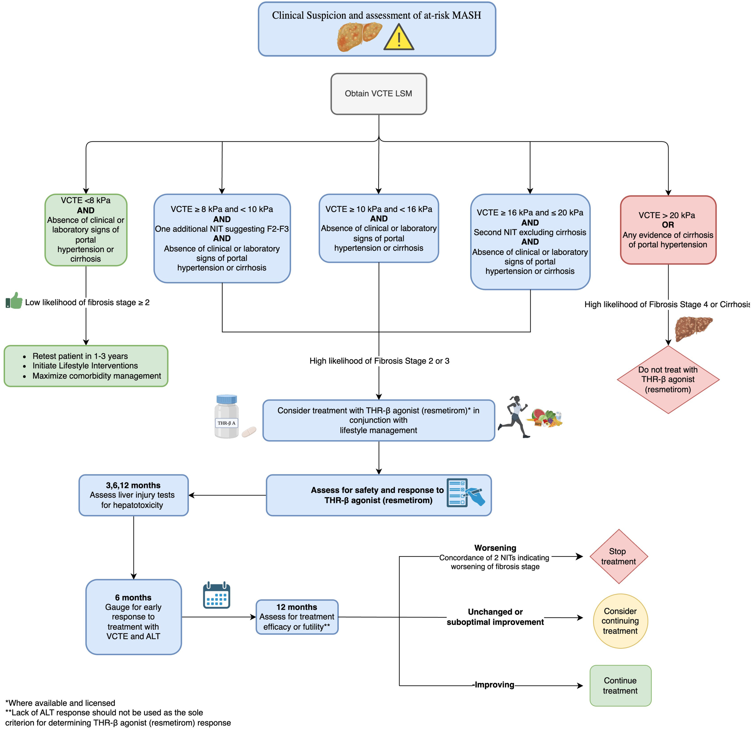

Slide 53
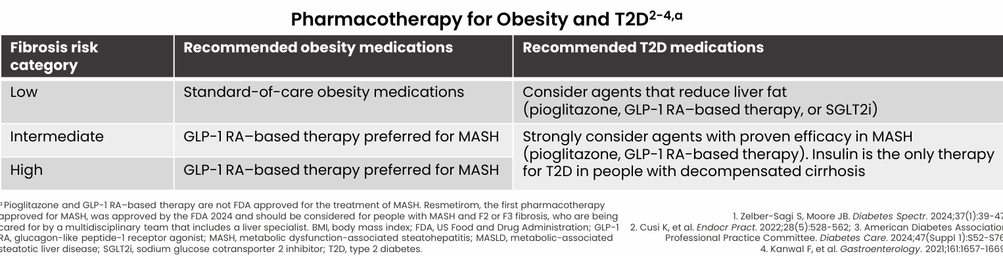

Slide 54
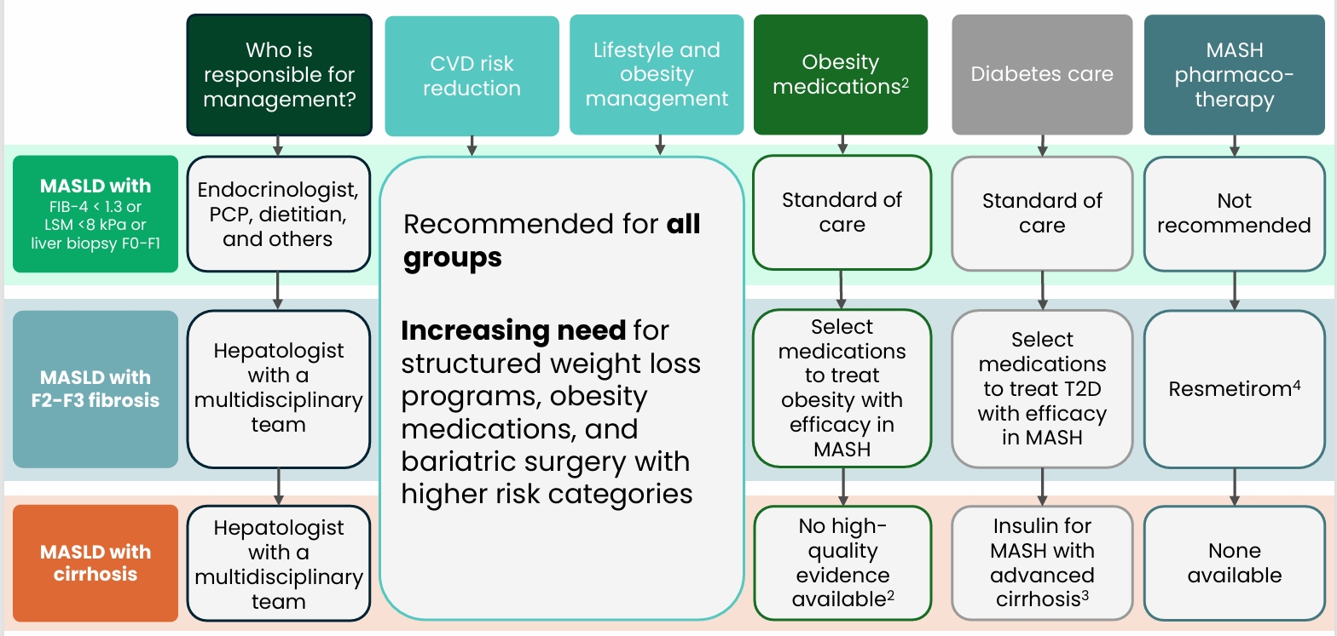
Approaches to MASLD & MASH
Endocrine Society & Institute for Medical and Nursing Education

Slide 55
ADA 2025 Standards of Care – Management of MASLD
4.25 Adults with type 2 diabetes or prediabetes, particularly with overweight or obesity, who have metabolic dysfunction–associated steatotic liver disease (MASLD) should be recommended lifestyle changes using an interprofessional approach that promotes weight loss, ideally within a structured nutrition plan and physical activity program for cardiometabolic benefits B and histological improvement. C
4.26 In adults with type 2 diabetes, MASLD, and overweight or obesity, consider using a glucagon-like peptide 1 (GLP-1) receptor agonist (RA) or a dual glucose-dependent insulinotropic polypeptide (GIP) and GLP-1 RA for the treatment of obesity with potential benefits in MASH as an adjunctive therapy to lifestyle interventions for weight loss. B
4.27a In adults with type 2 diabetes and biopsy-proven MASH or those at high risk for liver fibrosis (based on noninvasive tests), pioglitazone, a GLP-1 RA, or a dual GIP and GLP-1 RA is preferred for glycemic management because of potential beneficial effects on MASH. B
4.27b Combination therapy with pioglitazone plus GLP-1 RA can be considered for the treatment of hyperglycemia in adults with type 2 diabetes with biopsy-proven MASH or those at high risk of liver fibrosis (identified with noninvasive tests) because of potential beneficial effects on MASH.B
4.28 For consideration of treatment with a thyroid hormone receptor-β agonist in adults with type 2 diabetes or prediabetes with MASLD with moderate (F2) or advanced (F3) liver fibrosis on liver histology, or by a validated imaging-based or blood-based test, refer to a gastroenterologist or hepatologist with expertise in MASLD management. A
4.29 Treatment initiation and monitoring should be individualized and within the context of an interprofessional team that includes a gastroenterologist or hepatologist, consideration of individual preferences, and a careful shared-decision cost-benefit discussion. B
4.30a In adults with type 2 diabetes and MASLD, use of glucose-lowering therapies other than pioglitazone or GLP-1 RAs may be continued as clinically indicated, but these therapies lack evidence of benefit in MASH. B
4.30b Insulin therapy is the preferred agent for the treatment of hyperglycemia in adults with type 2 diabetes with decompensated cirrhosis. C
4.31a Adults with type 2 diabetes and MASLD are at increased cardiovascular risk; therefore, comprehensive management of cardiovascular risk factors is recommended. B
4.31b Statin therapy is safe in adults with type 2 diabetes and compensated cirrhosis from MASLD and should be initiated or continued for cardiovascular risk reduction as clinically indicated. B In people with decompensated cirrhosis, statin therapy should be used with caution, and close monitoring is needed, given limited safety and efficacy data. B
4.32a Consider metabolic surgery in appropriate candidates as an option to treat MASH in adults with type 2 diabetes B and to improve cardiovascular outcomes. B
4.32b Metabolic surgery should be used with caution in adults with type 2 diabetes with compensated cirrhosis from MASLD B and is not recommended in decompensated cirrhosis. B
Notes:
https://diabetesjournals.org/care/article/48/Supplement_1/S59/157568/4-Comprehensive-Medical-Evaluation-and-Assessment

Slide 56
Issues with FIB4
The FIB-4 test is used to detect fibrosis in fatty liver disease but has limited accuracy in predicting liver stiffness, resulting in high rates of false positives and negatives.
The FIB-4 index may not be effective in accurately detecting advanced liver fibrosis in individuals with diabetes and fatty liver disease.
The FIB-4 index may not reliably detect individuals with liver stiffness measurements of 8 kPa or higher, potentially leading to false negative results in about 20% of cases https://eurjmedres.biomedcentral.com/articles/10.1186/s40001-024-02032-x#:~:text=The%20FIB%2D4%20test%20is,of%20false%20positives%20and%20negatives.

Slide 57
Diabetes Medications & MASLD
Glucagon-like peptide-1 receptor agonists
Semaglutide, dulaglutide, liraglutide (1.8 mg/day), exenatide and lixisenatide have been shown to be effective in reducing steatohepatitis, compared with controls and glucagon-like peptide-1 (GLP-1) receptor agonists has the additional benefit of aiding weight loss
Thiazolidinediones
Pioglitazone, a thiazolidinedione, has also been demonstrated in placebo-controlled biopsy studies in patients with diabetes to be an effective long-term treatment to reduce steatosis and inflammation in MASLD.61Expand Reference Care should be taken in patients at risk of heart failure and pioglitazone is also associated with weight gain.62Expand Reference
Sodium-glucose cotransporter-2 inhibitors
Sodium-glucose cotransporter-2 inhibitors (SGLT-2i) have not been studied in paired biopsy studies in MASLD, however multiple placebo or active-controlled studies, utilizing reduction in serum liver enzyme levels or liver fat content on imaging as end points, have been undertaken. A meta-analysis of these studies (in which 90% of the patients had T2D) demonstrated SGLT-2i were effective at reducing liver enzymes (ALT and gamma-glutamyltransferase [GGT]) and liver fat content measured with magnetic resonance imaging (MRI), suggesting they may have utility in treating steatohepatitis associated with MASLD.63Expand Reference
Conversely metformin, sulphonylureas, dipeptidyl peptidase-4 (DPP4) inhibitors and insulin have not been demonstrated to have additional benefit in the treatment of MASLD beyond improvement in diabetes control and should not be preferred treatments for patients with T2D and MASLD if the above treatments could be used in the first instance

