Slide 1

Let’s talk about fentanyl- myths, facts, rumors, and more
Is what you think you know helping or harming the community and the people you serve?
Blue Valentine, CHW
NPAIHB ECHO 05/20/25
Image from https://www.newslaundry.com/podcast/lets-talk-about

Slide 2
Purpose
The intent of this presentation is to address some questions from providers and community members about fentanyl.
Disclaimer: information and the illicit drug supply is evolving quickly, and we are doing our best to stay on top of the most current information that is based in science.
People who use drugs are the experts in their own experience, and we can partner with them to reduce harm and help them understand their experience, with no expectation of abstinence.

Slide 3

Agenda
Overdose risk from touching fentanyl
Fentanyl test strips
“Naloxone-resistant” fentanyl
Fentanyl laced cannabis
Overdoses from smoking illicit drugs
Vaping illicit drugs
Overdoses from vaping illicit drugs
Image from: https://www.dreamstime.com/illustration/bigfoot-coffee.html

Slide 4

Fentanyl
Fentanyl gets a lot of press coverage and is the most well-known contaminant in the illicit drug supply.
It is important to know that there are many non-fentanyl contaminants in the supply that can be dangerous, including nitazines, xylazine, and benzodiazepines.
This presentation is centered around fentanyl, but not exclusive to fentanyl.
Image from: https://tenor.com/search/jan-brady-marsha-marsha-marsha-gifs

Slide 5
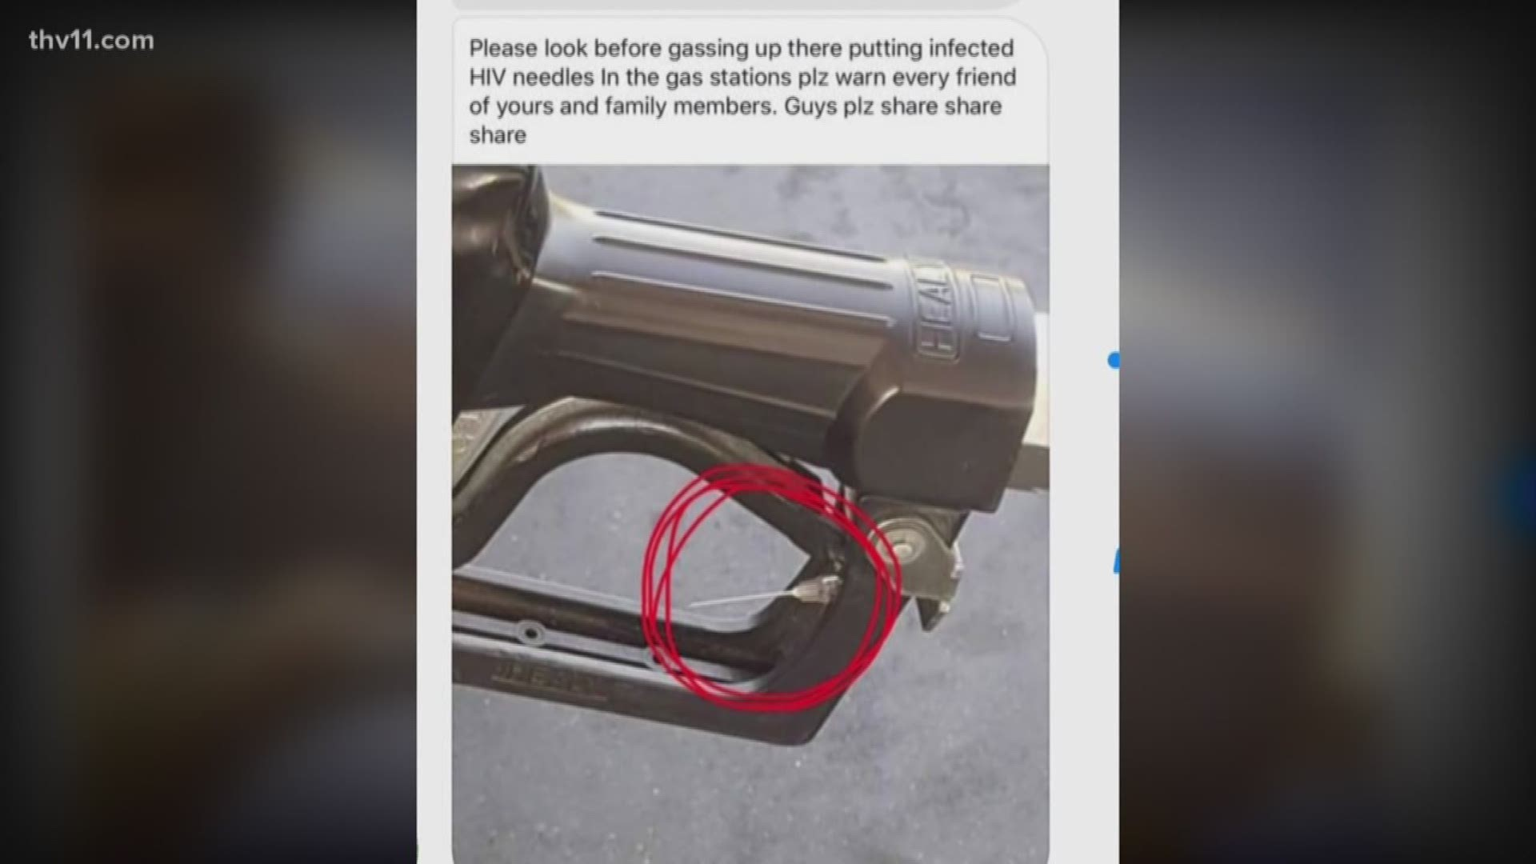
About myths
Often times, myths are created from a lack of information.
A myth may have a “grain of truth”.
A lack of information coupled with fear can create and fuel myths.
Unfortunately, fear is used as a tool to teach facts or lessons.
Image from https://www.thv11.com/article/news/local/verify/verify-are-people-hiding-needles-in-gas-pumps/91-581853980

Slide 6

Categorizing scenarios (or buckets)
Not possible; no risk
Potential, but not likely; little risk
Possible; some risk
Likely; high risk
Image from https://www.shutterstock.com/image-photo/colorful-buckets-row-isolated-on-white-329203394

Slide 7
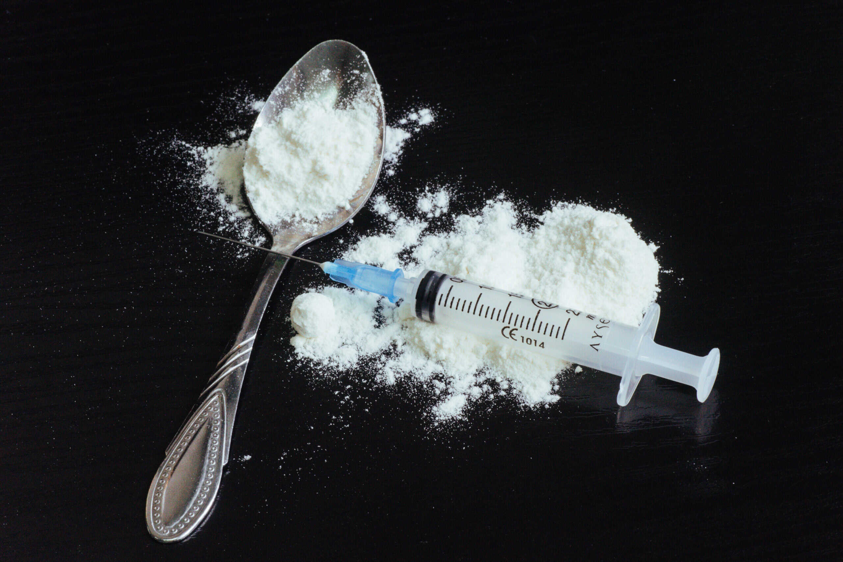
Overdose risk from touching fentanyl
Image from https://www.guardianrecovery.com/addiction-treatment/heroin-abuse-addiction/what-is-a-heroin-spoon/

Slide 8
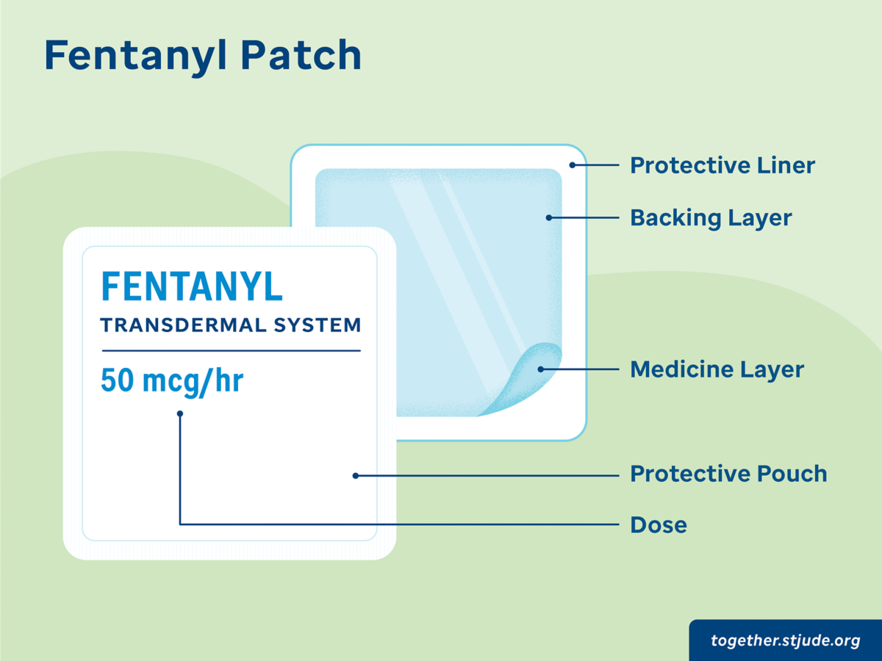
Overdose risk from touching fentanyl
Someone can not easily overdose by touching something that has fentanyl on it.
Fentanyl cannot penetrate the skin on its own. It needs moisture.
Fentanyl patches are specially formulated to aid in absorption and relieve pain.
To overdose from touching fentanyl patches, the entire surface of both palms would need to be covered in patches for 14 minutes.
Information from: https://www.wcnc.com/article/news/verify/fentanyl-drug-deadly-verify-viral-social-media/275-bbb5fa3b-30d0-44ec-86ec-a334184ab524 and https://www.acmt.net/wp-content/uploads/2023/01/Fentanyl_PPE_Emergency_Responders_.pdf
Image from: https://together.stjude.org/en-us/diagnosis-treatment/medication-management/fentanyl-patches.html

Slide 9

Touching fentanyl does not lead to intoxication or overdose
If our clients could use fentanyl by simply touching it, they would not have to worry about finding a vein in order to get high.
Nobody is using fentanyl by simply touching it, because it doesn’t work that way.
Information from common sense, think about it.
Image from https://www.syfy.com/movies/et-the-extra-terrestrial

Slide 10
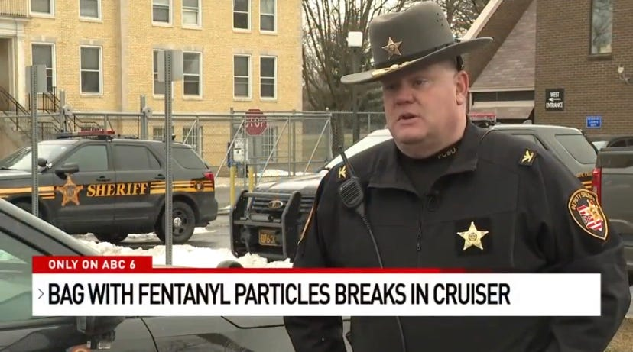
Overdose risk to first responders
The position of the American College of Medical Toxicology (ACMT) and American Academy of Clinical Toxicology (AACT), is as follows:
Fentanyl and its analogs are potent opioid receptor agonists, but the risk of clinically significant exposure to emergency responders is extremely low.
To date, we have not seen reports of emergency responders developing signs or symptoms consistent with opioid toxicity from incidental contact with opioids. Incidental dermal absorption is unlikely to cause opioid toxicity.
Information from https://www.ncbi.nlm.nih.gov/pmc/articles/PMC5711758/
Image from https://www.columbusmonthly.com/story/entertainment/human-interest/2022/02/03/dispatches-overdose-crisis-fentanyl-exposure-overdose-myth/6648270001/

Slide 11
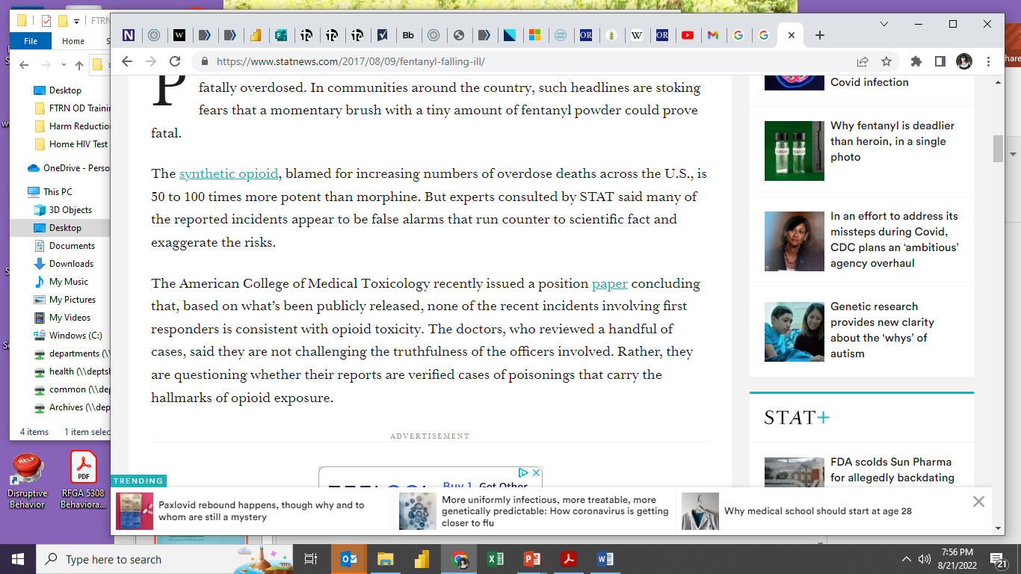
Overdose risk to first responders
A CPR mask can provide a barrier to help protect you, if you are worried about overdosing from performing CPR or rescue breaths to a person that is overdosing.
Image from https://www.statnews.com/2017/08/09/fentanyl-falling-ill/

Slide 12
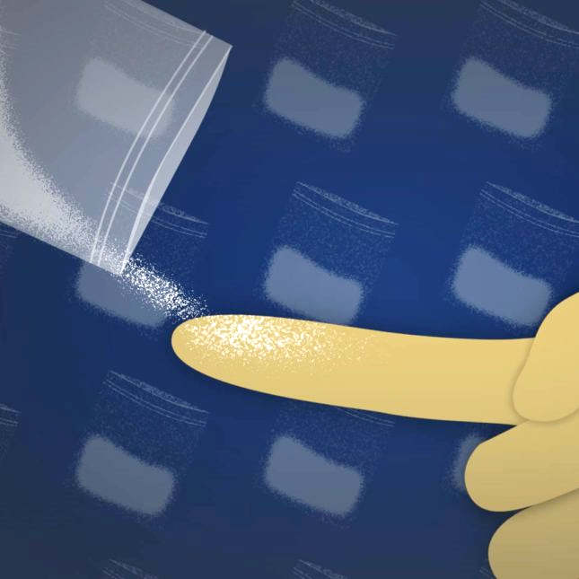
Overdose risk from touching fentanyl
Make sure fentanyl does not get into your mouth, nose, or eyes because then it can be dangerous.
Nitrile or latex gloves are an effective barrier.
Wash hands with mild soap and water following potential contact to remove fentanyl from the skin.
Hand sanitizer or other cleaning agents may increase skin absorption and should be avoided.
Information from: https://www.cdph.ca.gov/Programs/CCDPHP/sapb/CDPH%20Document%20Library/Responding-to-a-Fentanyl-Overdose.pdf and https://www.statnews.com/2017/08/09/fentanyl-falling-ill/
Image from: https://www.statnews.com/2017/08/09/fentanyl-falling-ill/

Slide 13
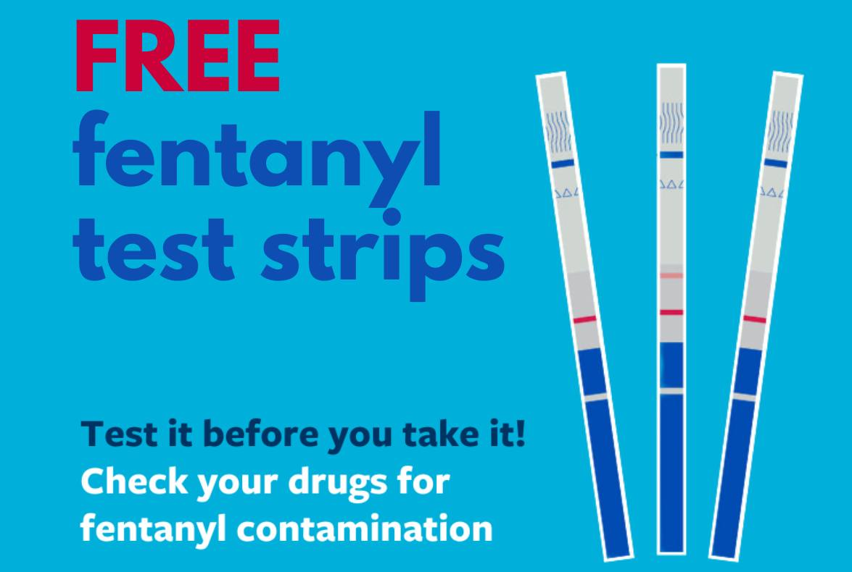
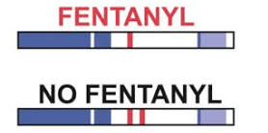
Fentanyl test strips (FTS)
Images from: https://www.facebook.com/photo/?fbid=859331906243446&set=a.307496668093642 and https://drugfree.org/fentanyl-test-strips/

Slide 14
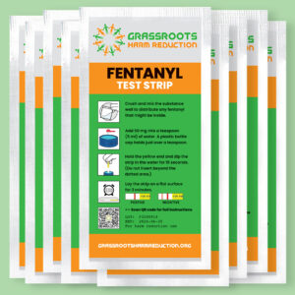
Fentanyl test strips can’t tell you for sure if a substance has fentanyl in it or if it is safe.
FTS can detect a handful of the most common types (analogs) of fentanyl.
There are more than 1400 different types of fentanyl.
Oregon has had overdose deaths from types of fentanyl not detected by test strips (such as cyclopropyl fentanyl).
Information from https://en.wikipedia.org/wiki/List_of_fentanyl_analogues and https://www.btnx.com/HarmReduction
and https://www.ice.gov/news/releases/lake-oswego-man-sentenced-federal-prison-distributing-fentanyl-china-leading-overdose
Image from: https://grassrootsharmreduction.org/

Slide 15
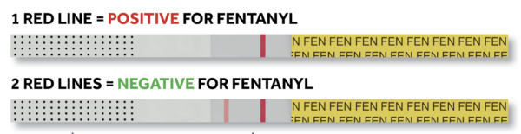
Fentanyl test strips can’t tell you for sure if a substance has fentanyl in it or if it is safe.
False positives can occur.
False negatives can occur.
BTNX brand tests require residue of meth and MDMA to be diluted in order to avoid a false positive.
User error can occur reading the results since 2 lines are a negative result.
Image from: https://dancesafe.org/fentanyl/

Slide 16
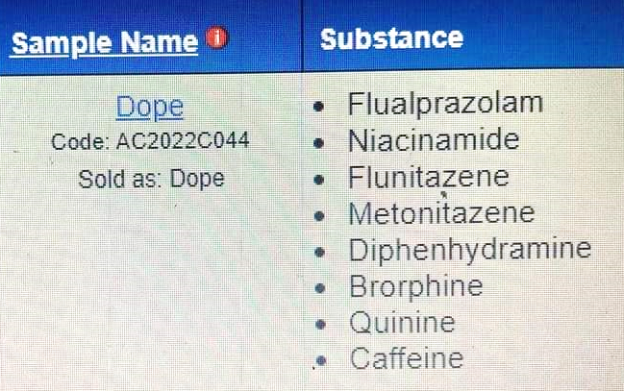
Fentanyl test strips can’t tell you for sure if a substance has fentanyl in it or if it is safe.
FTS will show a false positive result if diphenhydramine (Benadryl) is in the substance tested.
Benadryl is often added to opioids (heroin, fentanyl) sold on the street (unregulated).
Other contaminants may also create a false positive result
Information from https://www.cdph.ca.gov/Programs/CID/DOA/CDPH%20Document%20Library/Fact_Sheet_Fentanyl_Testing_Approved_ADA.pdf
https://www.aacc.org/-/media/Files/Divisions/TDM-TOX/AACC-TDM-CT-Newsletter_Summer_2020_final.pdf?la=en&hash=9AA897EBC6DE9E132FEEB5F070BB8AE45250843F#:~:text=At%203%20h%2C%206%20h,of%20high%20levels%20of%20diphenhydramine. Image from https://www.facebook.com/joltharmreductionpeoria/

Slide 17
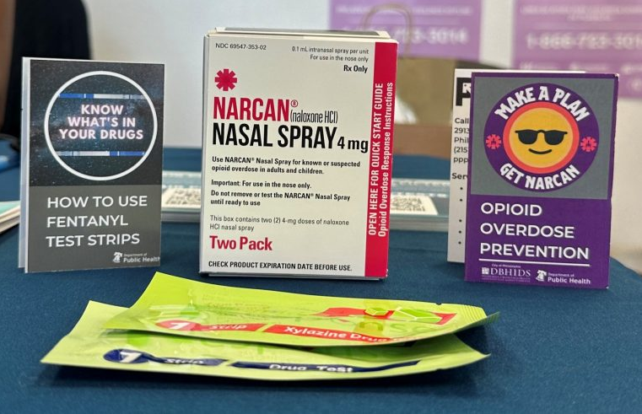
Fentanyl test strips can be a great tool for engagement
FTS can be a great tool to help organizations get connected to people who are using drugs.
People seeking FTS should also be given harm reduction education and naloxone
FTS can open the door to discussions on safer drug use
FTS can help people think about safety when using drugs
Image from: https://www.phila.gov/2023-09-06-pick-up-harm-reduction-supplies-at-a-resource-hub/

Slide 18
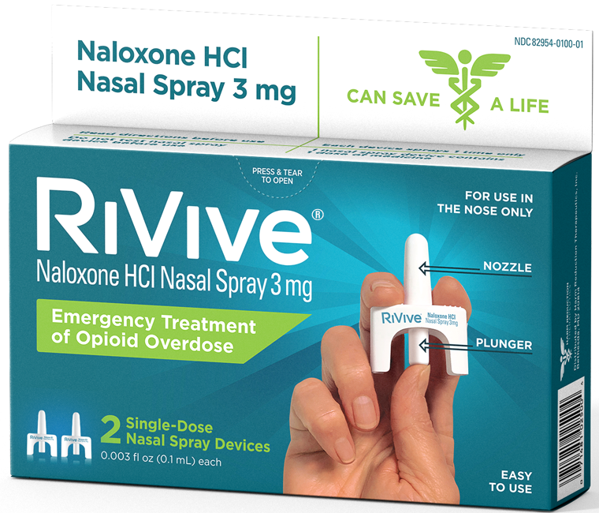
Naloxone-resistant fentanyl
Image from: https://www.harmreductiontherapeutics.org/

Slide 19
Fentanyl is not resistant to naloxone
Fentanyl itself is not resistant to naloxone, but fentanyl can cause vocal cord closure, which can lead to death.
Fentanyl will respond to naloxone if someone is overdosing, because it is an opioid.
High doses of the synthetic opioid fentanyl can cause rapid and sustained vocal cord closure (VCC) leading to airway obstruction that prevents overdose victims from breathing. This airway effect is not caused by morphine-derived opiates (e.g. heroin), is distinct from respiratory depression, resistant to naloxone, and can be lethal.
Fentanyl can induce chest wall rigidity, or wooden chest syndrome (WCS). Fentanyl induced skeletal muscle rigidity can cause ventilator failure.
Information from https://pubmed.ncbi.nlm.nih.gov/34492557/ and https://www.ncbi.nlm.nih.gov/pmc/articles/PMC8312149/#:~:text=Fentanyl%2Dinduced%20chest%20wall%20rigidity%2C%20otherwise%20known%20as%20wooden%20chest,with%20sedatives%20for%20intubated%20patients

Slide 20
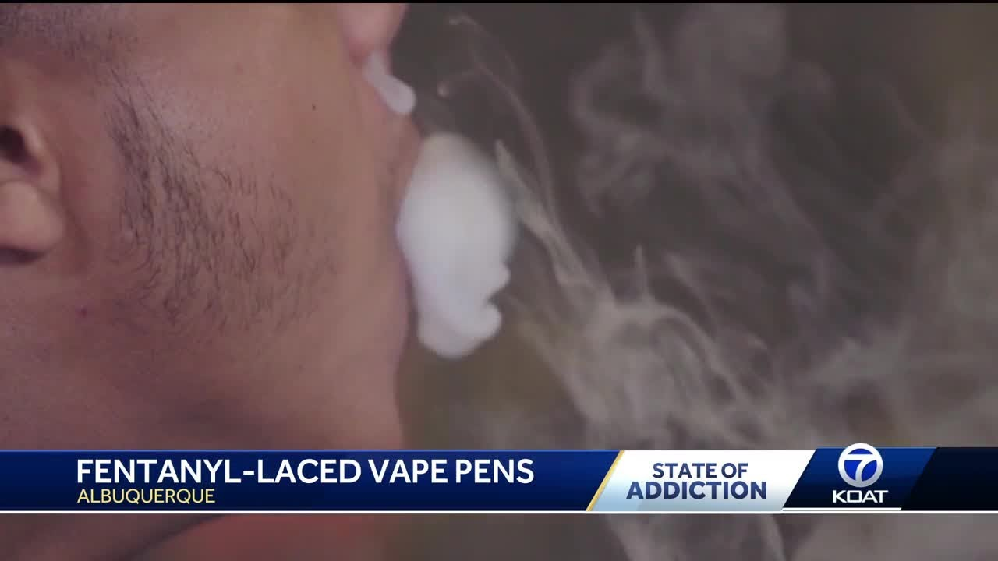
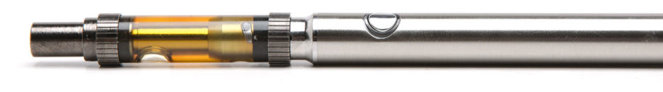
Fentanyl-laced cannabis
Images from: https://www.youtube.com/watch?v=4vwcGJULpq0 and https://weedmaps.com/learn/dictionary/vape-pen

Slide 21
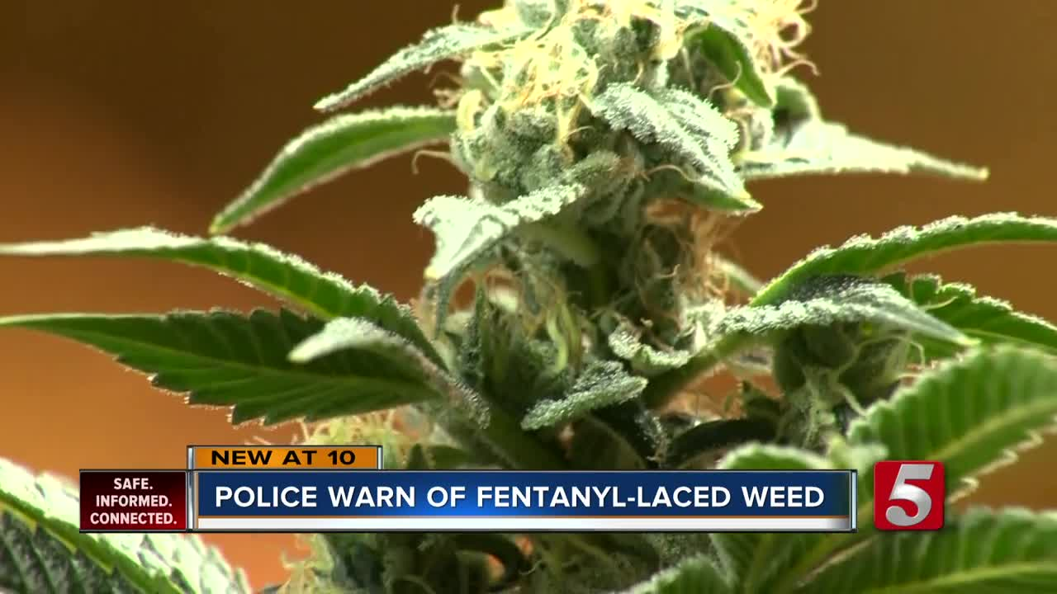
Fentanyl-laced cannabis (flower, vape)
In the case of cannabis flower, smoking involves loading the material into a pipe or roll paper, lighting it on fire, and inhaling the smoke. Burning fentanyl with a direct flame destroys it, so even if someone smoked cannabis contaminated with fentanyl, the fentanyl would not be active in the smoke.
In the case of vaping cannabis, fentanyl’s boiling point is 466 ⁰ C, or about 871⁰ F. The hottest temperature settings on cannabis oil vape pens are 210-220⁰ C (or 410-428⁰F).
Information from https://filtermag.org/fentanyl-marijuana-myth/amp/ Image from https://www.newschannel5.com/news/police-warn-of-marijuana-laced-with-fentanyl

Slide 22
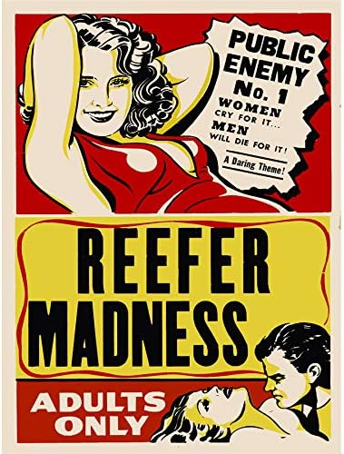
Fentanyl-laced cannabis (flower, vape) TL:DR
Traditional cannabis oil vapes do not get hot enough to vape cannabis with fentanyl.
Using a direct flame to smoke cannabis with fentanyl will destroy the fentanyl because it is too hot.
Information from https://filtermag.org/fentanyl-marijuana-myth/amp/ mage from https://www.amazon.se/-/en/UFCVWBC1384_VC/dp/B07JX6NSFF

Slide 23
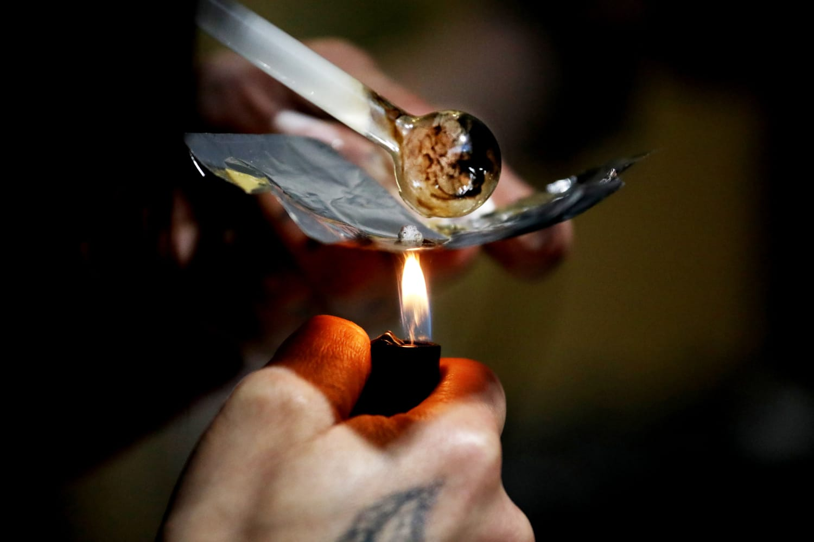
Overdoses from smoking illicit drugs
Image from: https://www.nbcnews.com/health/health-news/feared-illicit-fentanyl-now-drug-choice-many-opioids-users-rcna40418

Slide 24
Overdoses from smoking illicit drugs
From January–June 2020 to July–December 2022, the percentage of overdose deaths with evidence of injection decreased 29.1%, from 22.7% to 16.1%.
From January–June 2020 to July–December 2022, the percentage of overdose deaths with evidence of smoking increased 73.7%, from 13.3% to 23.1%.
The number of deaths with evidence of smoking increased 109.1%, from 2,794 to 5,843.
By 2022, smoking was the most commonly documented route of use in overdose deaths.
Trends were similar in all U.S. regions.
Info from: https://pubmed.ncbi.nlm.nih.gov/38358969/

Slide 25
Overdoses from smoking illicit drugs: TLDR
The percentage of overdose deaths related to injection are decreasing.
The percentage of overdose deaths related to smoking (not vaping) are increasing.
Info from: https://pubmed.ncbi.nlm.nih.gov/38358969/

Slide 26
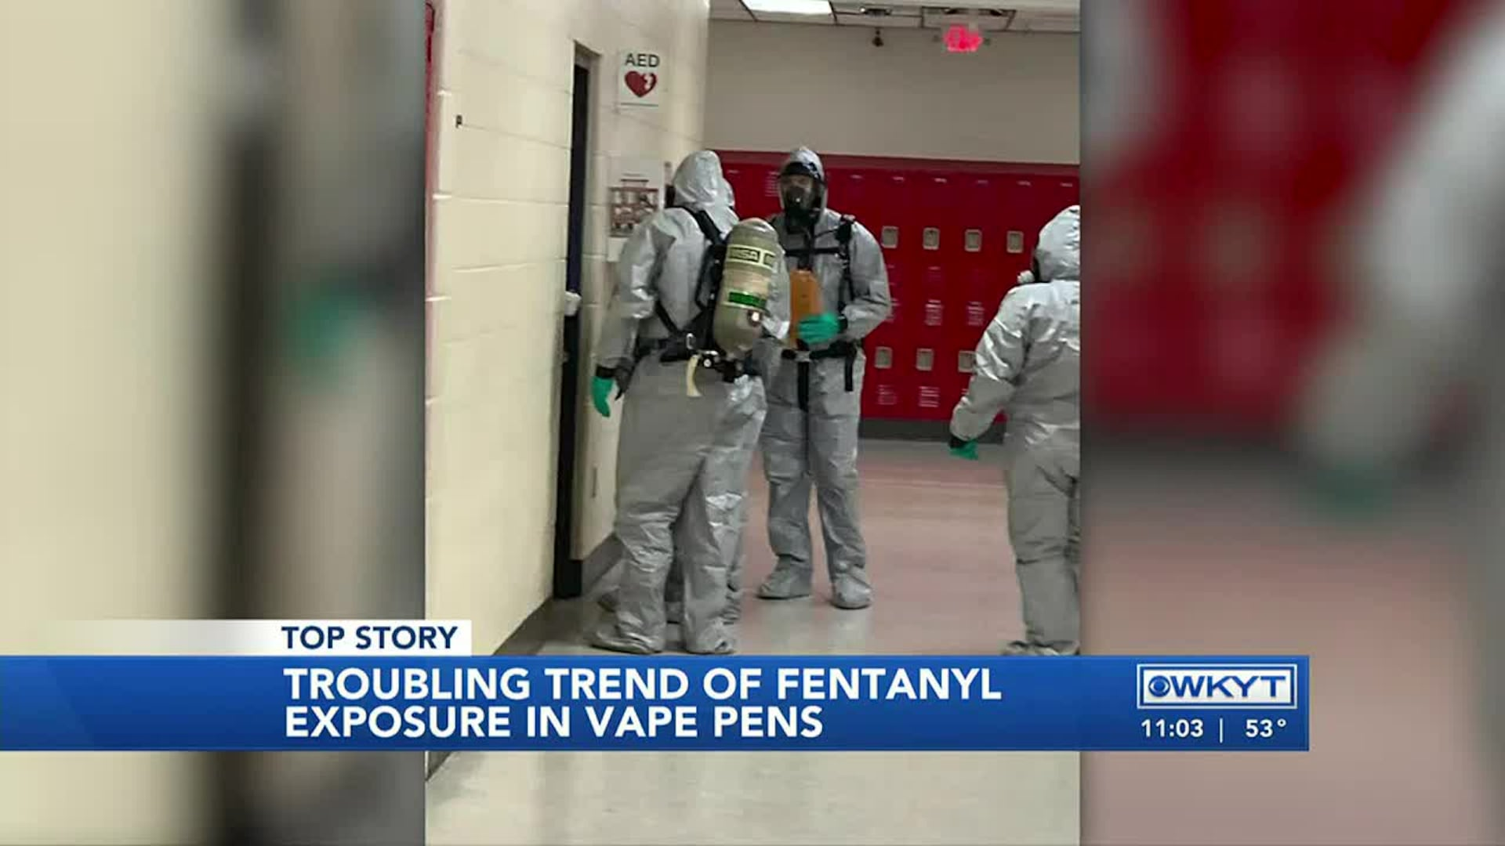
Vaping illicit drugs
Image from: https://www.wkyt.com/2021/12/03/fentanyl-laced-vape-pens-among-teens-concern-after-tennessee-high-school-incident/

Slide 27
Vaping illicit drugs
Traditional cannabis or nicotine vape pens may not work (or work well) for vaping opioids or stimulants.
Newer technology has created a market for vape pens with varying temperatures and mechanisms for heating drugs.
Vape pens that are sold to smoke cannabis wax, shatter, and dabs (concentrates) have temperatures that can be different from traditional cannabis vapes used to smoke cannabis oil or resin.
Nicotine vapes can be modified for smoking other substances.

Slide 28
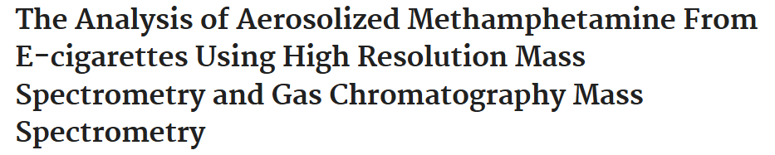
Research on vaping illicit drugs
The use of electronic cigarettes (e-cigs) has expanded from a nicotine delivery system to a general
drug delivery system. The internet is rife with websites, blogs and forums informing users how
to modify e-cigs to deliver illicit drugs while maintaining optimal drug delivery of their device.
The goal of this study was to qualitatively identify the presence of methamphetamine in the
aerosol produced by an e-cig and to quantitatively assess the effect voltage on the concentration
of aerosolized methamphetamine.
Image and info from : https://pubmed.ncbi.nlm.nih.gov/31504663/

Slide 29
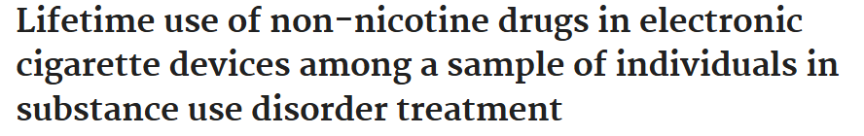
Research on vaping illicit drugs
Methods: In 2019, we surveyed 553 individuals from 18 residential SUD treatment programs in California, USA. Individuals reporting any lifetime use of an e-cigarette containing nicotine (n = 279) were asked about ever use of drugs other than nicotine in their e-cigarette. Those who reported use of non-nicotine drugs in their e-cigarette also reported what psychoactive drugs were used. Results: Among all the participants, 25 % (n = 139) . reported ever engaging in other substance use in e-cigarettes (OSUE). The most common drugs used in vaping devices were marijuana/THC/hash, (70.5 %, n = 98) and amphetamines/methamphetamine (51.1 %, n = 71).
Image and info from : https://pubmed.ncbi.nlm.nih.gov/36341309/

Slide 30
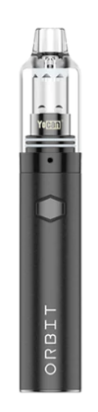

Vaping illicit drugs
Vape pens like these have different voltages and variable temperatures which make them more ideal for vaping illicit drugs, when compared to a traditional nicotine or cannabis oil vape pen.
Images from: https://tools420.com/yocan-orbit-review/#Yocan_Orbit_Specs and https://www.upends.com/blogs/articles/meth-vape-pen-a-2021-review-of-the-meth-vaporizer

Slide 31
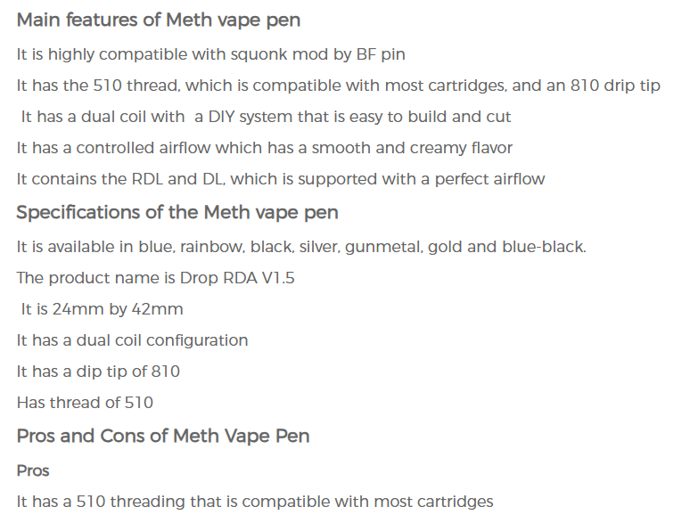
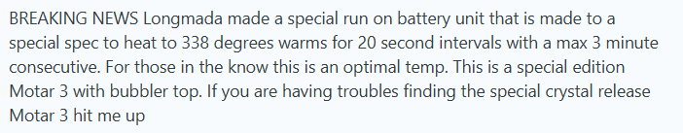
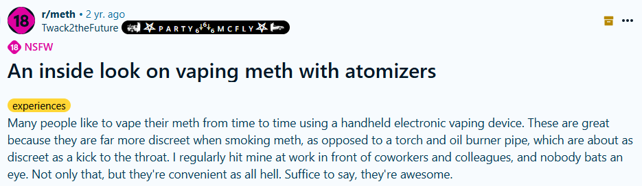
Vaping illicit drugs- online forums

Slide 32
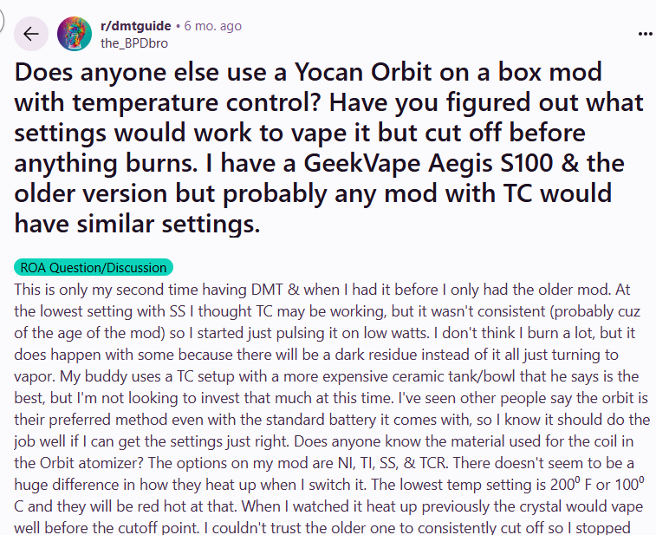
Vaping illicit drugs- online forums

Slide 33
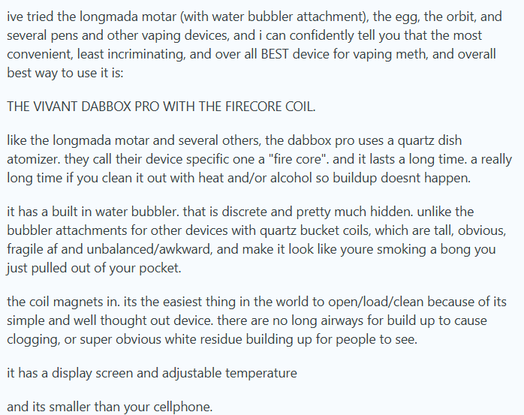
Vaping fentanyl (or meth)- online forums

Slide 34
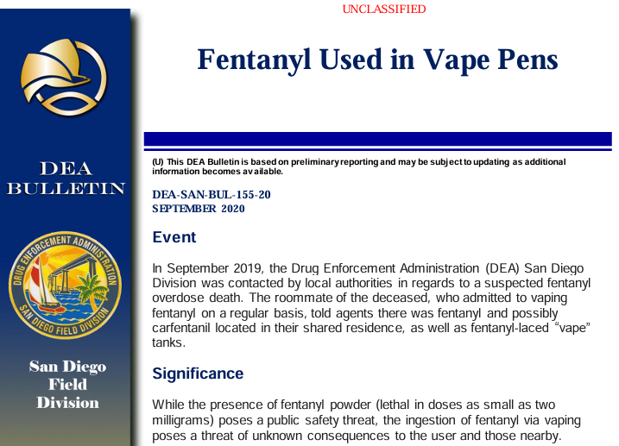
Overdose from vaping illicit drugs – San Diego
In this instance, the people who vaped illicit drugs were doing so intentionally.
Image and info from :https://www.dea.gov/documents/2020/2020-09/2020-09-14/fentanyl-used-vape-pens

Slide 35

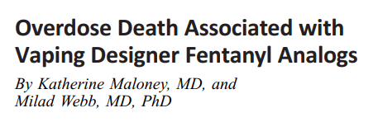
Overdose from vaping illicit drugs – San Diego
In this case, the vape contained nicotine, butyrylfentanyl, and valerylfentanyl.
Toxicology found fentanyl, butyrylfentanyl, valerylfentanyl, ꟗ -hydroxyfentanyl, cocaine, buprenorphine, and sertraline in the person’s system.
The person also had a known history of injection drug use and had a syringe in his pocket when he was found.
Image and info from :https://myadlm.org/science-and-research/clinical-and-forensic-toxicology-news/archives/2019/december-2019

Slide 36
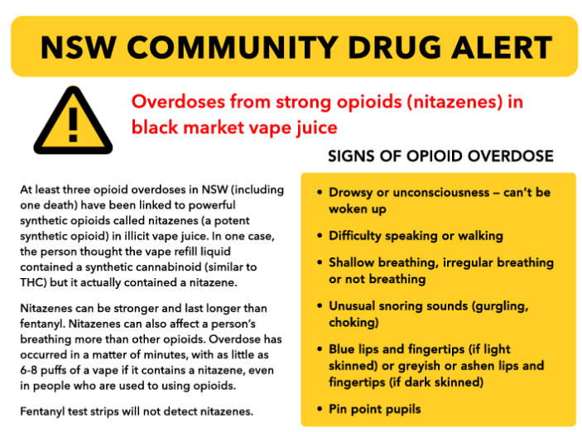
Overdoses from vaping illicit drugs – NSW
In this instance, the people who vaped illicit drugs were doing so unintentionally.
Image from: https://nuaa.org.au/s/Nitazene-Vape.pdf

Slide 37
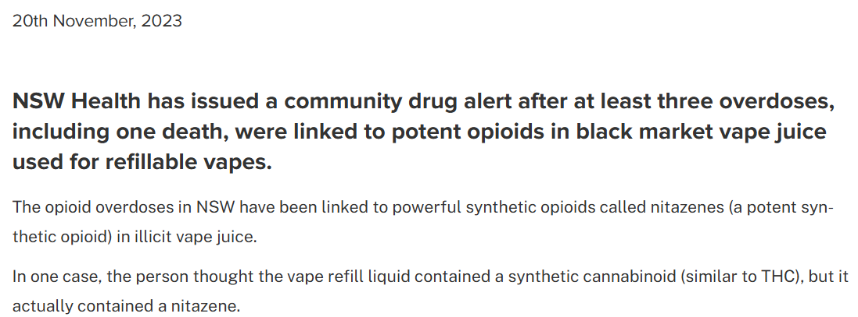
Overdoses from vaping illicit drugs – NSW
Image and info from: https://pathology.health.nsw.gov.au/articles/overdoses-linked-to-illicit-vape-juice/

Slide 38
Overdoses from vaping illicit drugs
Harm reduction practices can include only buying regulated nicotine vape juice (or e-liquid) and cannabis concentrates and not using anyone else’s vapes to avoid accidental ingestion of illicit drugs.
While this does not yet appear to be common, it is important to remember that it can and does happen.
Many harm reductionists have been told this is not possible, and they will tell others it is also not possible. It is important to keep an open mind and remember that people who use drugs are the experts in their own lives.
Info from: https://pathology.health.nsw.gov.au/articles/overdoses-linked-to-illicit-vape-juice/ and https://www.dea.gov/documents/2020/2020-09/2020-09-14/fentanyl-used-vape-pens

Slide 39
Overdoses from vaping illicit drugs- recap
In 2023, New South Wales, Australia had 3 confirmed overdoses and one death from black market vape juice containing nitazines.
The DEA has confirmed one overdose death in the US from vaping fentanyl.
While not common, overdose deaths from intentional or unintentional vaping of illicit drugs is possible.
Info from: https://pathology.health.nsw.gov.au/articles/overdoses-linked-to-illicit-vape-juice/ and https://www.dea.gov/documents/2020/2020-09/2020-09-14/fentanyl-used-vape-pens

Slide 40

Recap- main points
You can’t overdose from touching fentanyl, but care should still be taken anytime there is potential exposure.
It is safe to help someone that is overdosing.
Fentanyl test strips should not be used as a standalone tool due to possible false positives and false negatives, and because they do not let a person know everything that is in a substance.
No opioids are resistant to naloxone, but complications can occur with fentanyl and/or polysubstance overdoses.
Image from: https://humanedge.org.uk/15-myths-about-mentoring-debunkednbsp/

Slide 41
Recap- main points
There are not any documented cases of cannabis flower being laced with fentanyl, and direct flame would destroy the fentanyl.
Using a direct flame to smoke fentanyl will destroy the fentanyl because it is too hot. This means cannabis flower-laced fentanyl would not cause an overdose.
Traditional cannabis vapes do not get hot enough to vape fentanyl.
We are seeing an increase in overdose deaths from smoking illicit drugs.
Image from: https://humanedge.org.uk/15-myths-about-mentoring-debunkednbsp/

Slide 42
Recap- main points
Black market vapes for nicotine and cannabis can be dangerous for many reasons.
Very few overdoses have been confirmed from vaping opioids or stimulants.
It is possible to vape meth or fentanyl, but it appears to be very uncommon.
There are now vapes that are used for and sold as tools to smoke illicit drugs.
Image from: https://humanedge.org.uk/15-myths-about-mentoring-debunkednbsp/

Slide 43
Questions?
Blue Valentine, CHW
Blue.Valentine@BentonCountyOR.gov
(541) 243-4394

Slide 44
References
https://www.statnews.com/2017/08/09/fentanyl-falling-ill/
https://www.wcnc.com/article/news/verify/fentanyl-drug-deadly-verify-viral-social-media/275-bbb5fa3b-30d0-44ec-86ec-a334184ab524
https://filtermag.org/fentanyl-marijuana-myth/amp/
https://www.ncbi.nlm.nih.gov/pmc/articles/PMC5711758/
https://en.wikipedia.org/wiki/List_of_fentanyl_analogues (not a complete list)
https://www.ice.gov/news/releases/lake-oswego-man-sentenced-federal-prison-distributing-fentanyl-china-leading-overdose
https://www.aacc.org/-/media/Files/Divisions/TDM-TOX/AACC-TDM-CT-Newsletter_Summer_2020_final.pdf?la=en&hash=9AA897EBC6DE9E132FEEB5F070BB8AE45250843F#:~:text=At%203%20h%2C%206%20h,of%20high%20levels%20of%20diphenhydramine.
https://dancesafe.org/wp-content/uploads/2019/02/2019-fent-strips.pdf
https://pubmed.ncbi.nlm.nih.gov/34492557/
https://www.ncbi.nlm.nih.gov/pmc/articles/PMC8312149/#:~:text=Fentanyl%2Dinduced%20chest%20wall%20rigidity%2C%20otherwise%20known%20as%20wooden%20chest,with%20sedatives%20for%20intubated%20patients
https://pathology.health.nsw.gov.au/articles/overdoses-linked-to-illicit-vape-juice/

Slide 45
References
https://pathology.health.nsw.gov.au/articles/overdoses-linked-to-illicit-vape-juice/
https://nuaa.org.au/s/Nitazene-Vape.pdf
https://tools420.com/yocan-orbit-review/#Yocan_Orbit_Specs
https://pubmed.ncbi.nlm.nih.gov/30245461/
https://www.ojp.gov/pdffiles1/nij/grants/251788.pdf
https://pubmed.ncbi.nlm.nih.gov/27277119/
https://pubmed.ncbi.nlm.nih.gov/36341309/
https://pubmed.ncbi.nlm.nih.gov/31504663/
https://www.dea.gov/documents/2020/2020-09/2020-09-14/fentanyl-used-vape-pens
https://myadlm.org/science-and-research/clinical-and-forensic-toxicology-news/archives/2019/december-2019

Slide 46
Forums on vapes for/vaping illicit drugs
https://www.bluelight.org/community/threads/vaping-meth-2014.731118/
https://www.reddit.com/r/meth/comments/113ib7e/an_inside_look_on_vaping_meth_with_atomizers/?share_id=wfUIXW_NGhkjgxxhD8wvm&utm_content=2&utm_medium=android_app&utm_name=androidcss&utm_source=share&utm_term=10
https://www.upends.com/blogs/articles/meth-vape-pen-a-2021-review-of-the-meth-vaporizer
https://www.reddit.com/r/yocanvape/comments/vmhkn4/yocan_orbit_how_to_use/
https://www.reddit.com/r/meth/comments/113ib7e/an_inside_look_on_vaping_meth_with_atomizers/?share_id=wfUIXW_NGhkjgxxhD8wvm&utm_content=2&utm_medium=android_app&utm_name=androidcss&utm_source=share&utm_term=10
https://www.reddit.com/r/dmtguide/comments/1g03kxe/does_anyone_else_use_a_yocan_orbit_on_a_box_mod/

Slide 47
Vaping / smoking temperatures- technical info
pg 66:
Also, it has been reported that the temperatures reached from “chasing the dragon” with heroin were between 200 ºC and 300 ºC, which is much lower than the tobacco cigarette studies. (750 °C - manufactured cigarettes)
pg 75:
The temperature under cigarette smoldering conditions was hypothesized to be high relative to “chasing the dragon”. The temperatures recorded ranged from 214.1 - 441.6 °C, with most trials being between 250 °C and 300 °C (failed trials omitted).
pg 81:
With this, the authors concluded that higher temperatures of 750 °C resulted in extensive degradation of not only the parent fentanyl compound itself, but also of the propionanilide and PEP.
pg 85:
This indicates that fentanyl itself is not stable below 350 ˚C as found in literature and hence is not likely suitable for volatilization for inhalation administration
From: Nishikawa, Rona Kiyomi, "Detection and characterization of pyromarkers of smoked drugs of abuse" (2012). Graduate Theses, Dissertations, and Problem Reports. 4904.
https://researchrepository.wvu.edu/etd/4904

