Slide 1
Methadone for OUD: Updates and Ongoing Barriers to Care
Jessica Gregg MD PhD

Slide 2
What is methadone?

Slide 3
Methadone is an opioid.
Opioid: synthetic or semisynthetic substance that mimics opiates.
Opiate: natural substance derived from….

Slide 4


Slide 5

Notes:
The milky fluid that seeps from cuts in the unripe poppy seed pod has, since ancient times, been scraped off and air-dried to produce what is known as opium.

Slide 6
→opium, morphine, codeine, heroin
→used for various purposes for thousands of years
→ in the 1800s, emerged as a popular cure-all in the US

Slide 7
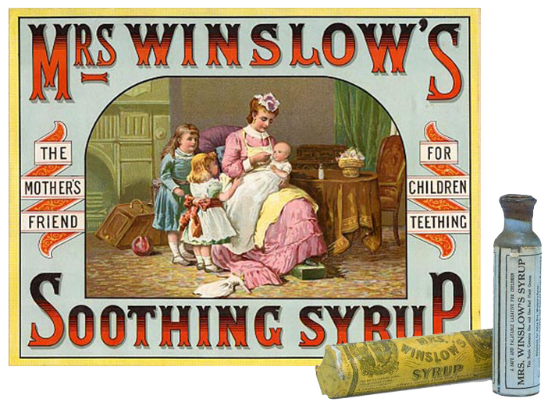

Slide 8
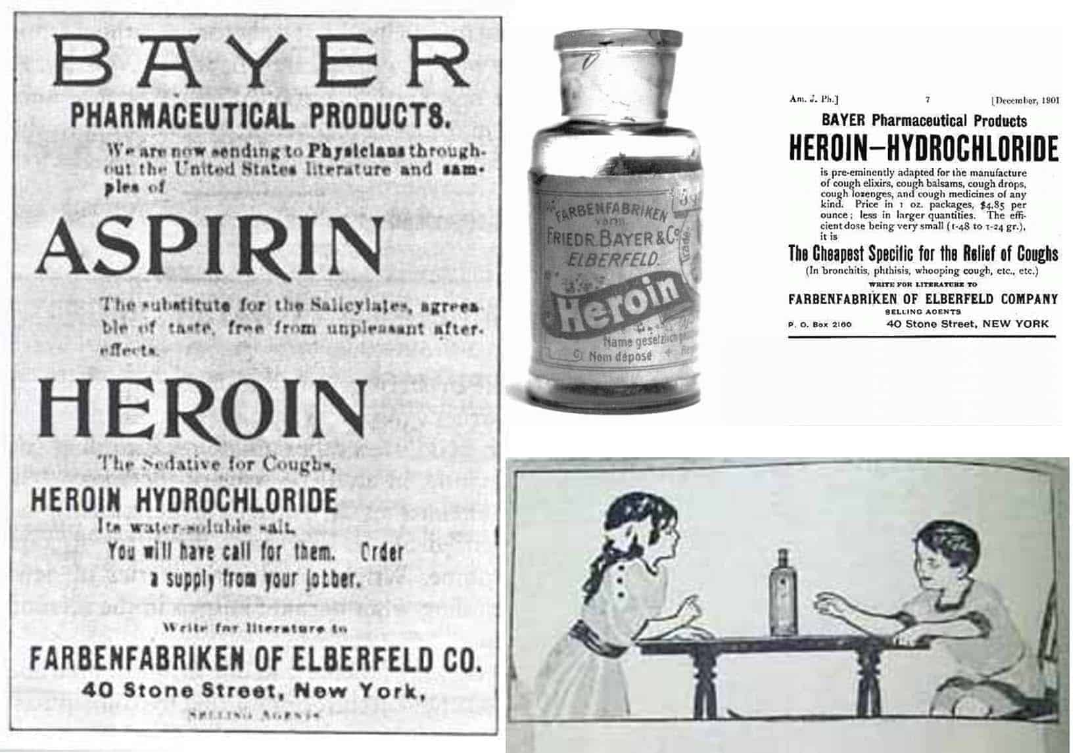
Notes:
Heroin synthesized in 1874 as tx for bronchitis, asthma, tuberculosis, morphine and opium addiction

Slide 9
1914: Harrison Narcotics Act
Regulated the consumption and availability of opiates.
"The purpose of this bill—and we are all in sympathy with it—is to prevent the use of opium in the United States, destructive as it is to human happiness and human life."
1914 Congress passed the Harrison Narcotics Act
Regulate the consumption and availability of opiates.
Notes:
In 1914, congress passed the Harrison Narcotics Act of 1914, which was an act regulating consumption and availability of opium stated that a doctor could prescribe opioids ”in the course of his professional practice only”, addiction not a medical concern, so no opioids to treat addiction

Slide 10
A doctor would still be allowed to prescribe opiates but …. “in the course of his professional practice only”
Substance use disorders not considered part of the medical domain
Doctors were not allowed to prescribe opiates to treat opioid use disorder

Slide 11

Notes:
Fast forward 60 years

Slide 12

Notes:
Approximately 10% to 25% of American military personnel stationed in Southeast Asia using heroin.

Slide 13
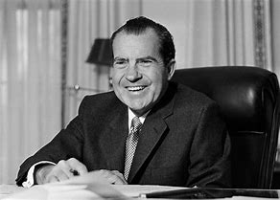
Notes:
President Richard Nixon feared the return of American soldiers would worsen the nation's heroin problem. War on drugs

Slide 14
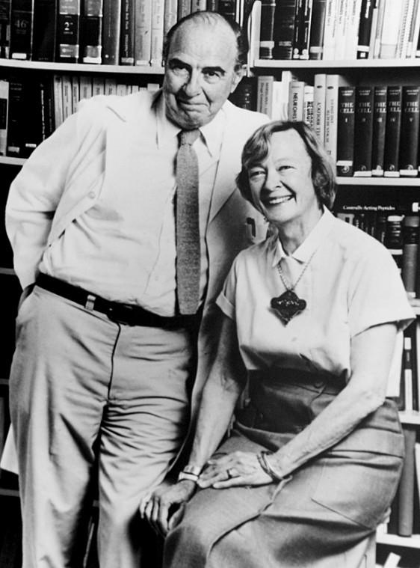
Vincent Dole & Marie Nycewinder
Researchers at the Rockefeller center
Found that research participants used less heroin when they took the opioid methadone
Nixon was happy

Slide 15
1970 – FDA approves methadone for “detoxification”
– Methadone is approved as maintenance treatment
- Opioid Treatment Programs (OTPs) are created to dispense methadone (medical providers still unable to prescribe it for OUD)

Slide 16
HIGHLY REGULATED!!!!
Attend clinic daily for a minimum of 3 months.
After 90 days, may take home one dose if:
attending groups
participating in educational, vocational, or homemaking activities
employment, education, or homemaking responsibilities are hindered by daily attendance may take home an extra dose.
Not using
No criminal activity
Stable home environment
Safe storage
Counselor feels this will be beneficial to the patient
Notes:
Extremely strict regulations

Slide 17
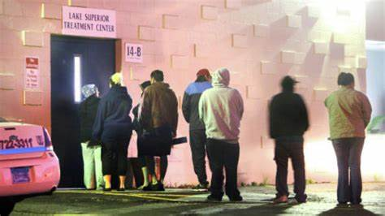
Notes:
Lines and other kinds of trouble – whether or not someone is looking for it. Set up to create stigma and once get take home doses just want to disappear

Slide 18

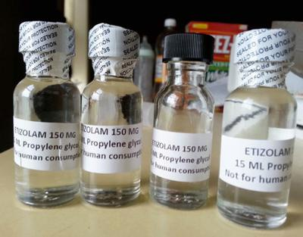

Slide 19
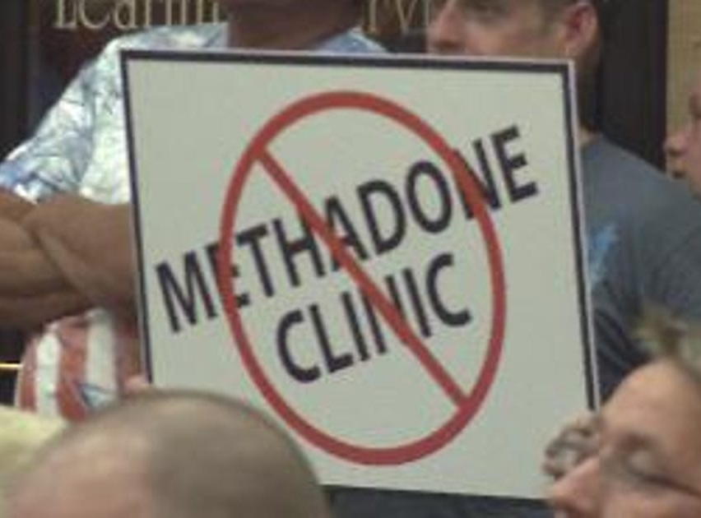

Slide 20


Slide 21
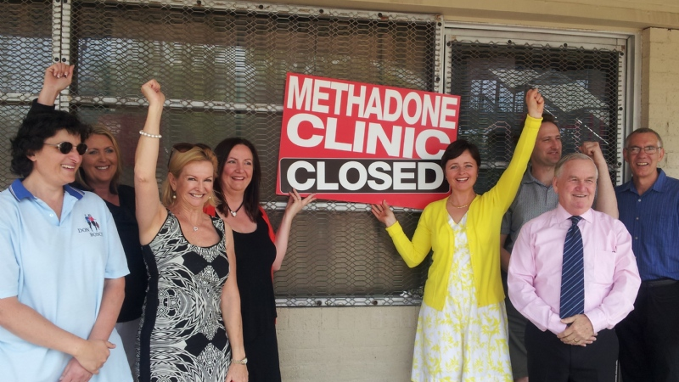

Slide 22
Fewer than 20% of US Counties have an OTP

Slide 23
Only 4% of OTP are in rural areas.
Residents of rural areas must drive hours to access the medication
A huge deal for Indian Country
Lister JJ, Weaver A, Journal of Health Care for the Poor and Underserved 2020; 31(3): 1291-1307.DOI link, PMid:33416695

Slide 24
Methadone: efficacy
Cochrane review 2009
  Patients taking methadone are significantly less likely to have positive urine drug screen
  Decreased new infections with Hep C/HIV
  Decreased criminality
  Decreased deaths
Notes:
Don’t see the people driving these results.

Slide 25
Mortality risk during and after methadone treatment
Mortality Risk during and after opioid substitution treatment: systematic review and meta-analysis of cohort studies. Sordo, et al. BMJ 2017.
Notes:
During methadone treatment, both all cause and overdose mortality were substantially and significantly lower than during periods of treatment disengagement

Slide 26
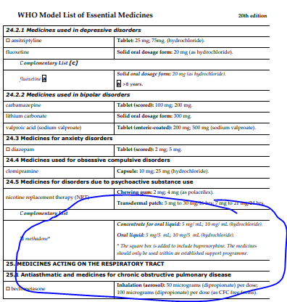
Notes:
This is despite such strong evidence for its effectiveness in treating opioid use disorder that WHO considers it one of “essential medications”.

Slide 27
How Does it Work?

Slide 28
Notes:
Three different mechanisms

Slide 29
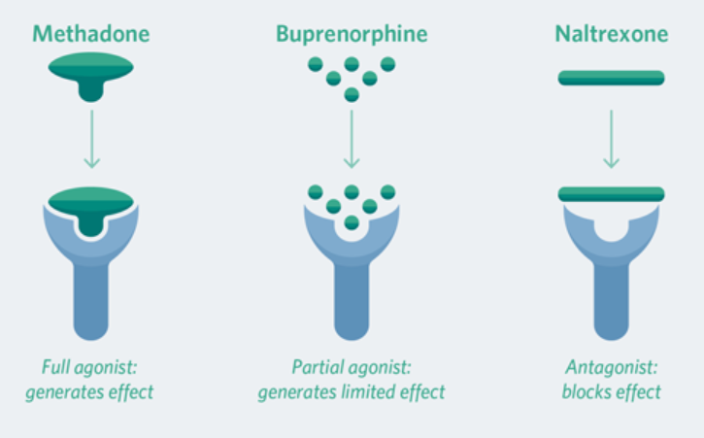
Notes:
Naltrexone binds super tightly

Slide 30
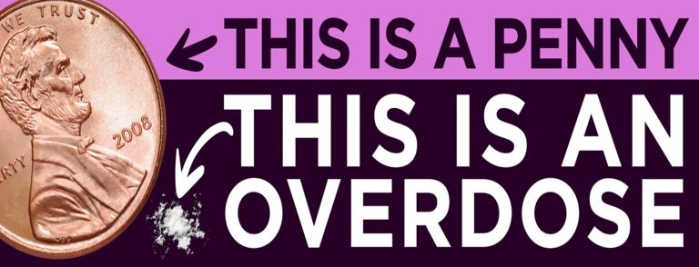
The introduction of fentanyl into the illicit drug supply makes full agonists more important than ever

Slide 31
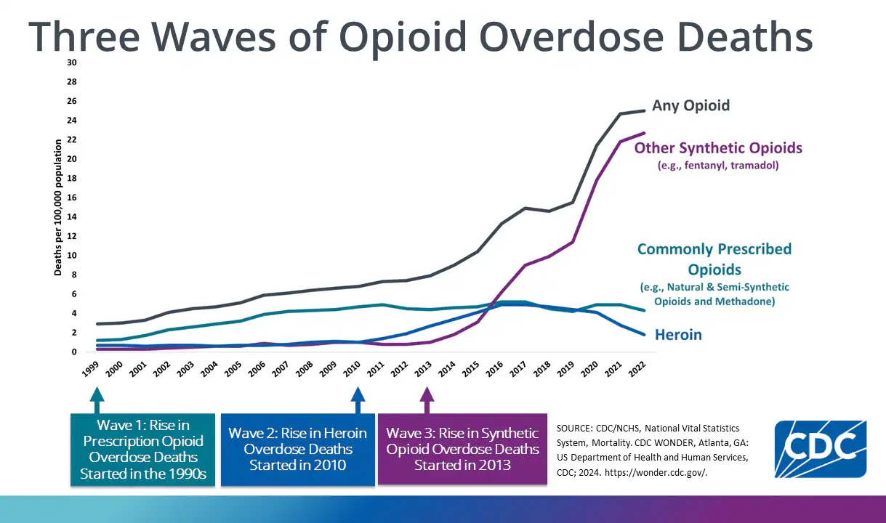

Slide 32
But methadone is complicated

Slide 33
Half life
15 to 60 hours
People have variable metabolism
Half-life can be affected by other medications like antibiotics, anti-seizure medications, etc.

Slide 34
Notes:
Full agonist, slow onset, ½ life about 24 hours
Methadone is stored extensively in the liver and secondarily in other body tissues. Its elimination half-life averages 24 to 36 hours at steady state,. Because of this long half-life, achieving steady-state serum methadone levels—in which drug elimination is in balance with the amount of drug remaining in the body— requires 4 to 5 days on average, although it can take much longer in some individuals.

Slide 35
Notes:
Until steady state, dose remains same but effect is greater every day.

Slide 36
It is easy to overdose
Start low(ish), go slow
Federal regulation: maximum first dose = 30mg
Maximum total dose on first day = 40mg
Blocking dose (for heroin) > 60mg
Notes:
I

Slide 37
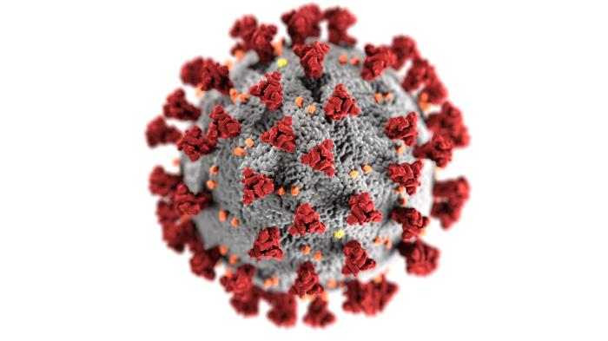

Slide 38
OTP lobbies were often crowded, with long lines.
To allow physical distancing, SAMHSA issued an emergency exemption to the OTP regulations in March 2020
States were allowed to request blanket permission for stable OTP patients to receive 28 days of take-home doses and up to 14 days of take-home doses for patients who were less stable but thought to be able to handle the self-administration of methadone safely.
The definition of “stable or “less stable” to the discretion of the OTP medical staff.
Telehealth counseling, rather than in-person, was allowed

Slide 39

The result?
Rates of diversion did not increase
Overdoses did not increase
Patients reported increased attendance to other important aspects of their lives, such as jobs, school, and family.
Jones CM, et al. JAMA Psychiatry. 2022

Slide 40
Result?
In April 2024, The Substance Abuse and Mental Health Services Administration (SAMHSA) updated the rules to take into account both data from COVID changes and the impact of fentanyl

Slide 41
Extended Take-Home Doses: SAMHSA increased the number of take-home doses allowed for patients early in treatment. Within the first 14 days, patients can receive up to seven days of medication at home.
Higher Initial Methadone Doses: Initial methadone dosing increased from 30 mg to 50 mg.
Urine Drug Screen Adjustments: The Final Rule now specifies that the presence of drugs detected on urine drug screening does not necessarily limit take-home medications unless their use increases the risk of an overdose.

Slide 42
Whether these flexibilities are adopted is up to each state, clinic, and tribe

Slide 43
Conclusion
Methadone is life-saving
Access is limited
It is improving, but still terrible
Consider lobbying your state, clinic, or tribe to adopt the flexibilities
It is important to understand the lengths patients must go to to get this life-saving medication

