Slide 1
Trauma Informed Care (TIC) for Trauma Patients at the IHS
Justine Broecker, MD
UCSF HEAL Fellow

Slide 2
Patient JC
35 yo M suffers multiple gsw
Taken to ED via EMS and with police
Blood pressure on arrival systolic 70s, lethargic somewhat agitated but awake
ATLS: A, B intact, C three torso gsw wounds
Transient responder, taken to OR
Also happening in the trauma bay: a provider jokes that he was probably “minding his own business.” documented as “combative.” recognized by one of the providers as a “frequent flyer” to the Emergency Department
Requires massive transfusion, ex-lap, injury to right iliac vein, small and large bowel
12 days later extubated and awake, on rounds won’t remove covers from head so chief resident says “this guy is so combative” as removes covers from head
Notes:
Obtained from a colleague’s presentation about TIC

Slide 3
What could be done differently?
Notes:
So, especially with regards to trauma informed care, what do we think could have been differently in terms of how the providers reacted to and treated the patient?
Great those are great responses and today we are going to talk about how to potentially manage this situation and patient in a more compassionate manner using the trauma informed care model

Slide 4
Objectives
To define trauma informed care (TIC)
To discuss the importance of TIC for trauma and native patients
To discuss implementation of TIC

Slide 5
What is Trauma Informed Care (TIC)?
https://www.youtube.com/watch?v=fWken5DsJcw

Slide 6
TIC
Understand the impact of trauma: TIC acknowledges that trauma can affect a person's emotions, relationships, and development.
Prevent re-traumatization: TIC aims to avoid re-experiencing the thoughts, feelings, or sensations of a traumatic event.
Create a safe and welcoming environment: TIC prioritizes physical, psychological, and emotional safety.
Build trust: TIC aims to build trust through transparency and sensitivity to people's needs.
Empower people: TIC provides opportunities for choice and collaboration.
Consider cultural differences: TIC is responsive to racial, ethnic, and cultural differences.

Slide 7
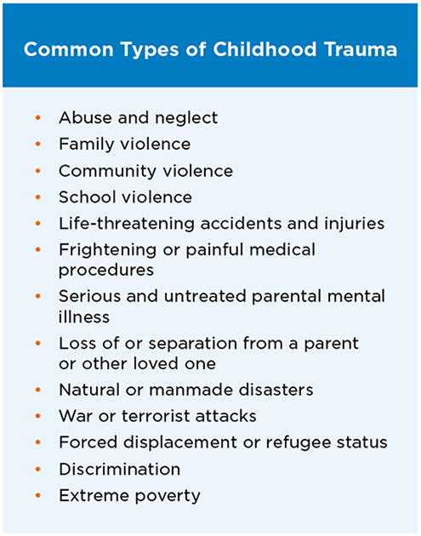
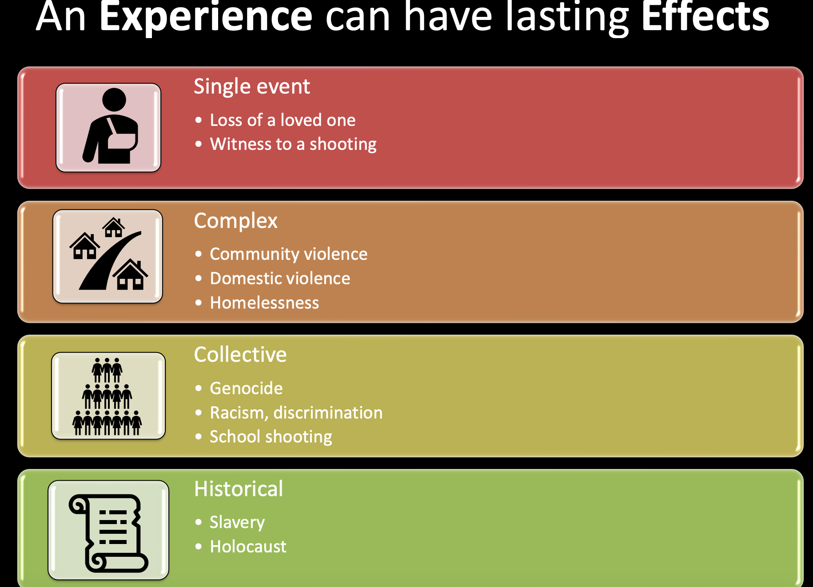
What is trauma?
A very difficult or unpleasant experience that causes someone to have mental or emotional struggles over time

Slide 8
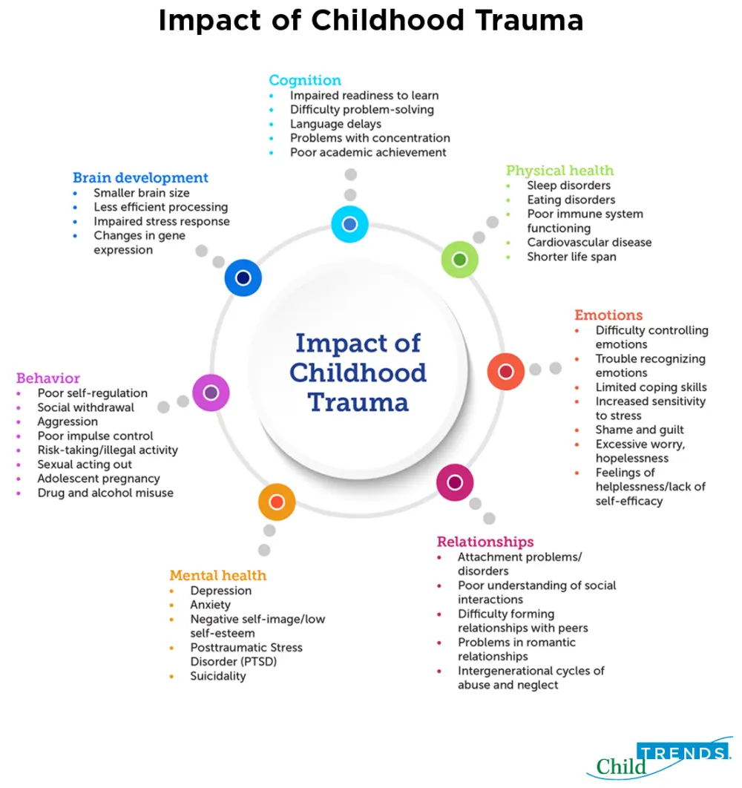
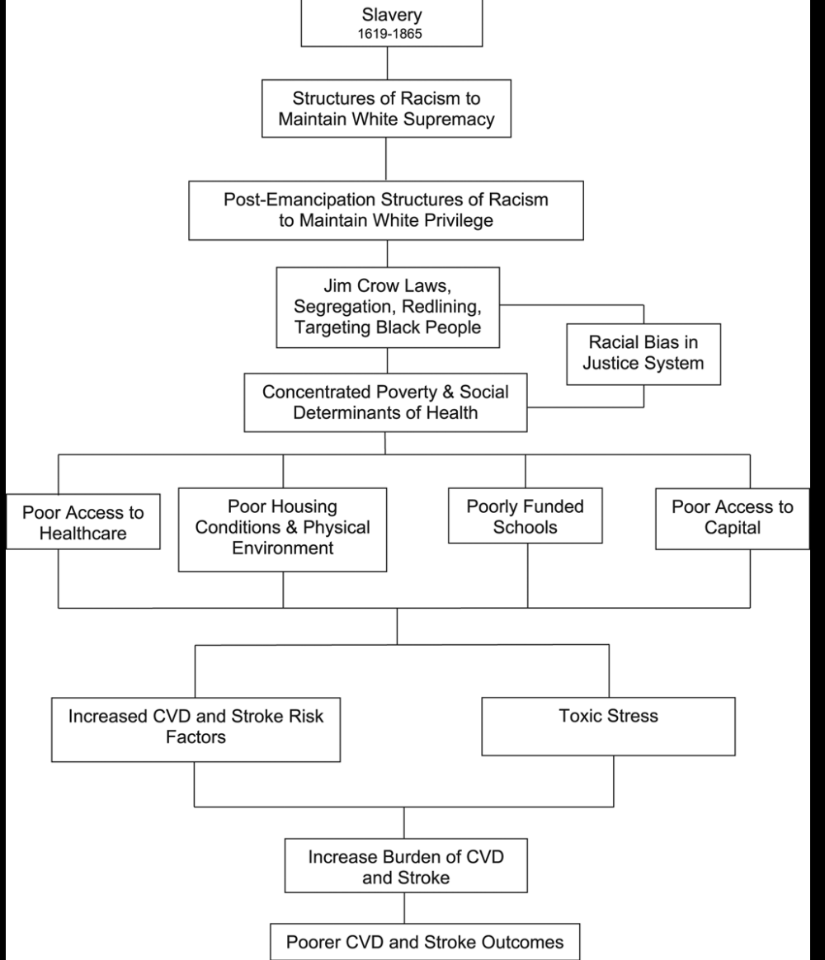
Impact of Trauma

Slide 9
Social Determinants of Health
Conditions in the environments where people are born, live, learn, work, play, worship and age that affect a wide range of health, functioning and quality of life outcomes and risks --Centers for Disease Control and Prevention

Slide 10
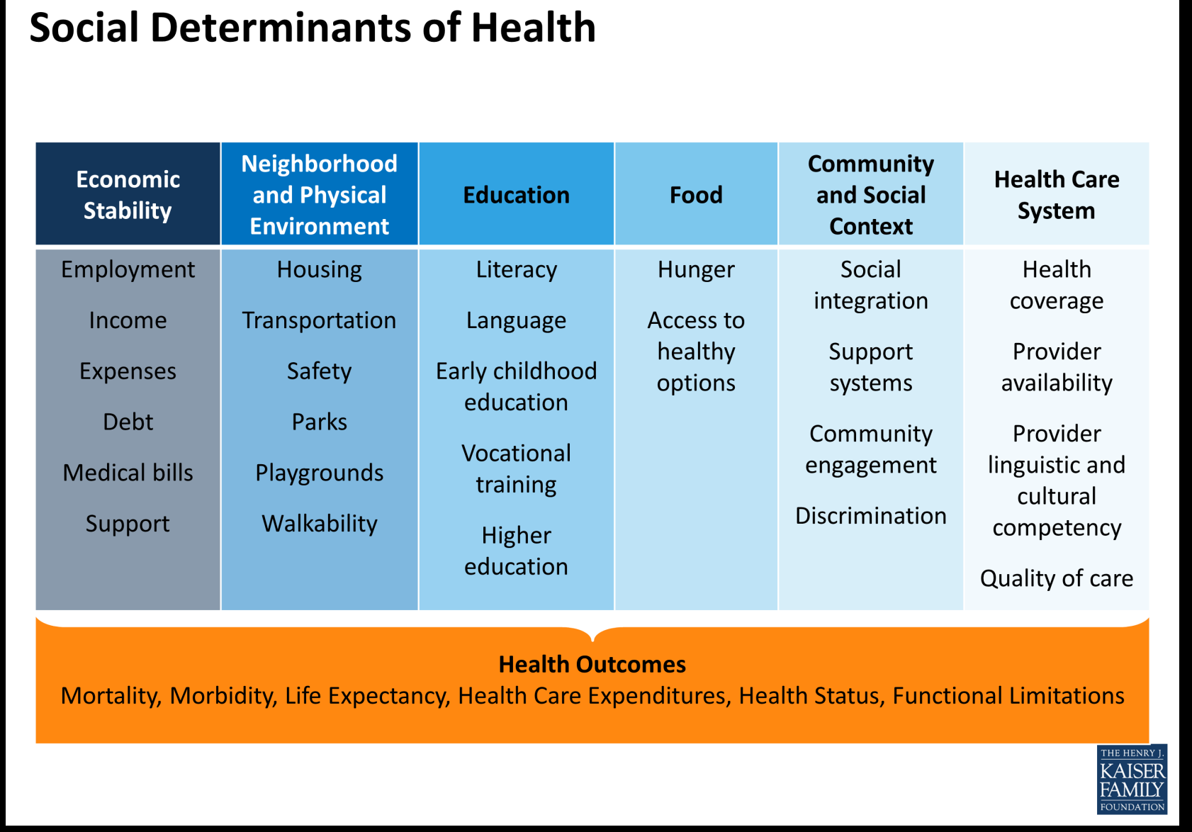
SDH

Slide 11
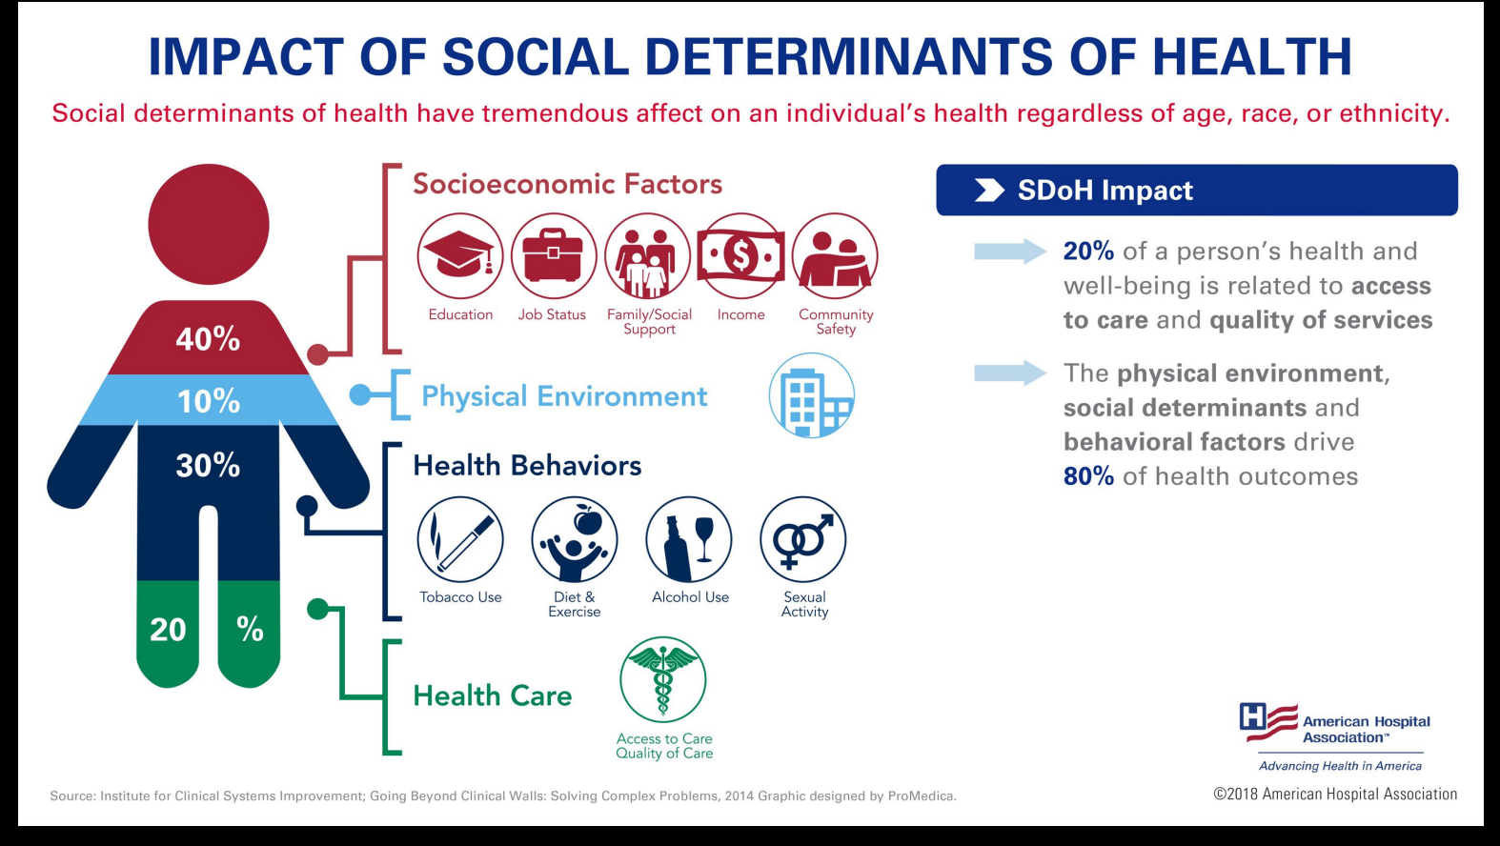
Impact of SDH

Slide 12

Adverse childhood and community experiences (ACEs)

Slide 13
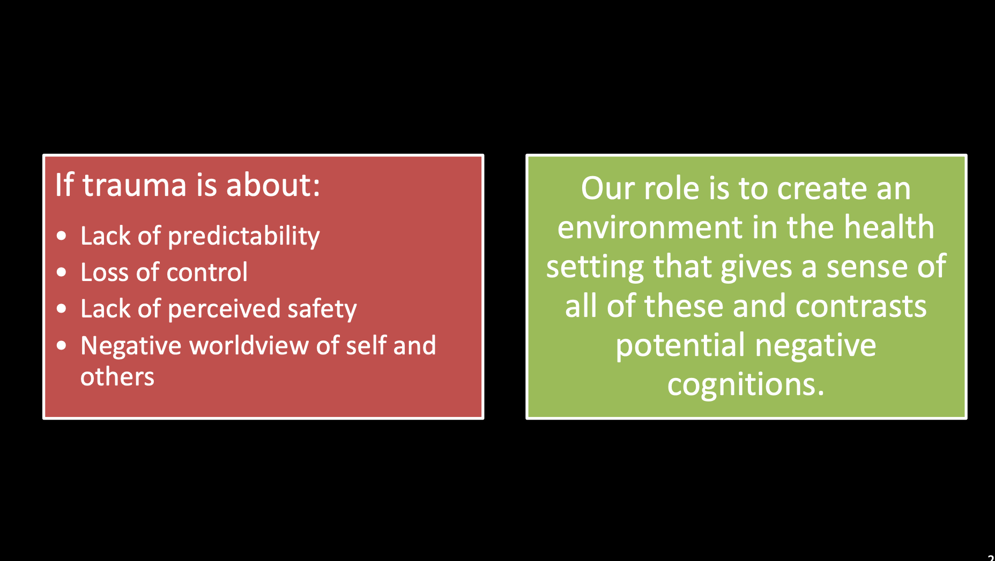
Goal of TIC
Notes:
So the goal of TIC is to utilize an understanding of the causes and manifestations of trauma that we just disussed that result in lack of predictability, loss of control etc
And our goal is to

Slide 14
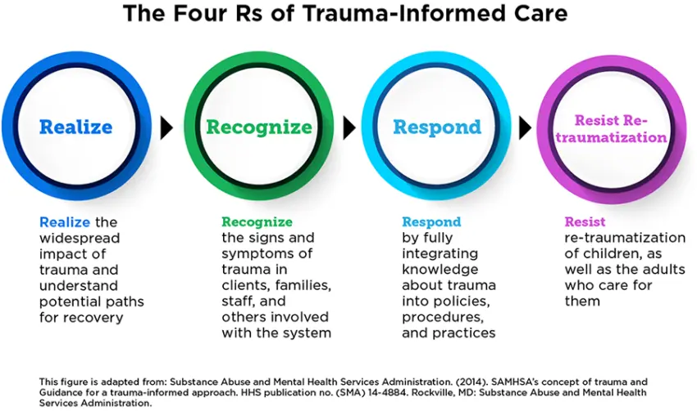
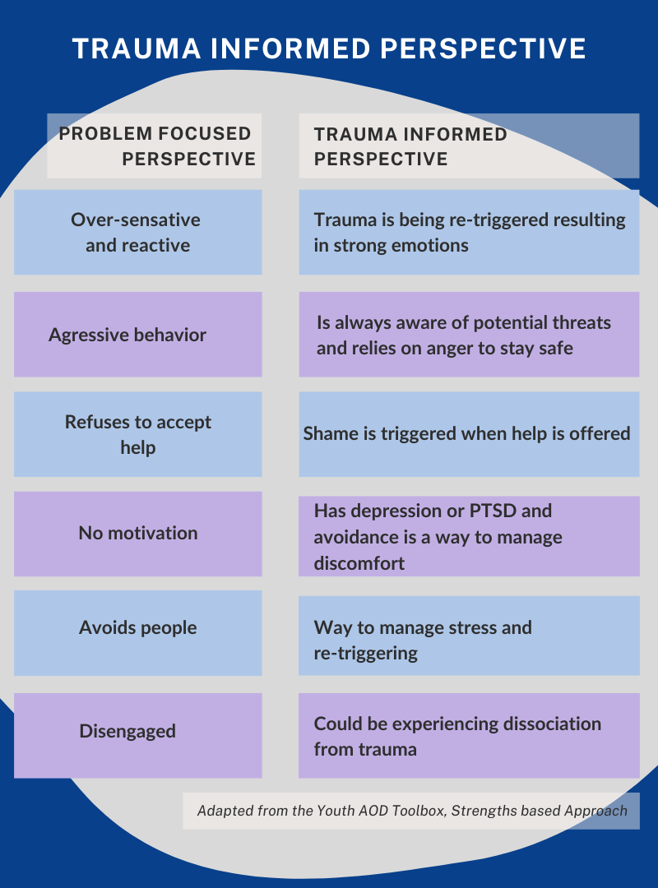
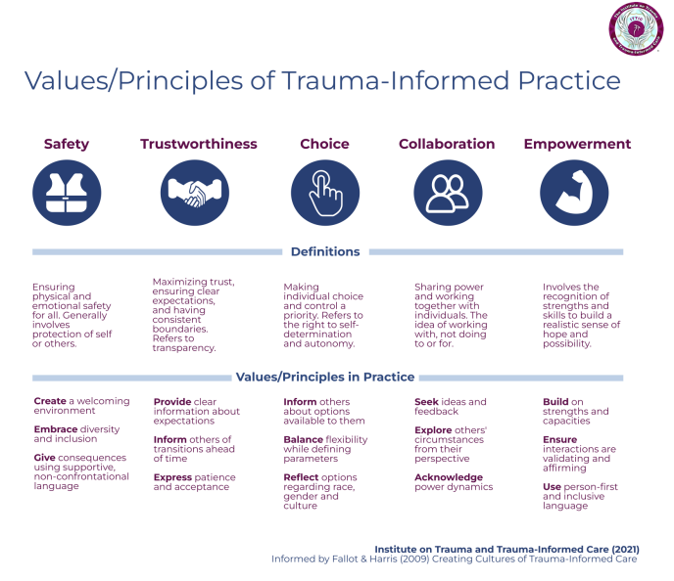
What’s wrong with you >> What happened to you?
Notes:
Importance of screening
Core principles: safety, trustworthiness, peer support, collaboration, awareness, empowerment and choice
Importance of social work to address social determinants of health

Slide 15
Healthcare System Retraumatization
PTSD may make healthcare system into triggering event
Example: pelvic exam on sexual abuse survivor, child forced to cooperate may make hospital itself triggering
Consequences: worsen syx related to trauma/stress (PTSD) and worse outcomes for patients, decrease trust in health care system, lack of adherence to recommended healthcare
Importance of consent, open honest communication, building trust
Notes:
So in the TIC model it is very important that the health care system not retraumatize patients who already suffer from existing trauma
The healthcare system itself may be traumatizing for instance a child who has been forced to cooperate in the past may be triggered every time he returns to the healthcare setting
But also we should be mindful of how things we do may trigger patients to remember events outside the hospital such as performing a pelvic exam on a sexual abuse survivor
The consequences of retraumatizing vulnterable patients are significant:
Instead its important that we empower patients with informed consent, open honest communication, building trust

Slide 16
TIC and Documentation
• Consider how documentation follows a patient
• Just the facts
• Interpretation of behavior
  “Noncompliant”
  • "refusal of care" or signs of “Trauma”?
  • "oppositional" or isolated?
  • "aggressive" or fearful?
  • "defiant" or depressed?
  • “combative” or “anxious”
  Entry and exit wounds for GSW
• Documentation can impact acceptance to rehabilitation facilities and can perpetuate stereotype
Notes:
The documentation we perform also can be important to providing trauma informed care

Slide 17
Benefits of TIC
Patient Experience:
  Promotes autonomy, decreases helplessness
  Improves patient engagement, treatment adherence and health outcomes
  Prevent further harm and reduce re-traumatization
Provider Experience:
  Decreases frustration
  Improves empathic communication
  Raises awareness of biases
  Improves job satisfaction and reduces burnout

Slide 18
Trauma Informed Care in Trauma Patients
Trauma patients often have hx of trauma, ACEs and/or SDH challenges
Trauma itself is traumatizing, patients are vulnerable
communication during primary/secondary survey may promote patient comfort, trauma informed history and physical, procedures, discharge
Notes:
Providing trauma informed care to our trauma patients is extremely important

Slide 19
Importance of Trauma Informed Care in Injured Trauma Patients
TIC Interventions have been shown to improve trauma patient comfort/satisfaction as well as follow-up and adherence
TIC Interventions also improve trauma providers’ job satisfaction
More investigation is needed to translate TIC interventions to outcomes such as rates of reinjury/recidivism and mortality

Slide 20
TIC In practice
In 2012, the US Attorney General National Task Force on Children Exposed to Violence called for all EDs to provide TIC, and for all clinicians interacting with patients experiencing trauma to be trained in TIC.
Despite this, trauma providers’ knowledge and practice of TIC limited by time constraints and need for more training

Slide 21
TIC in Native Patients
Unique historical trauma: congressional genocidal policies, boarding school history, forced sterilization at the IHS
Creates mistrust in US government/IHS, engagement with IHS may be triggering, potential lack of adherence to recommended healthcare services
Importance of culture to healing, cultural competency/humility among providers
Notes:
Our native patients also face unique challenges that should be considered in a trauma informed care model

Slide 22
TIC Training Avenues
IHS
ATLS 11th edition
Most online CME
Future directions: More discussion/hands on trainings

Slide 23
References
Dicker R. “Trauma Informed Care.” OHSU Grand Rouns. Accessed March 5, 2025.
Bruce M, et al. “Trauma Providers’ Knowledge, Views and Practice of Trauma-Informed Care.” Journal of Trauma Nursing 25(2):p 131-138, 2018.
Xia W, et al. “Current practices and challenges in applicatin of TIC for accidentally injured patients.” Nursing Open. December 6 2023.
Brown et al. “Trauma-informed care interventions in emergency medicine: a systematic review.” West J Emerg Med. 2022 Apr 13;23(3):334-344.
Ashworth et al. “TIC best practices for improving patient care in the emergency department.” International Journal of Emergency Medicine 2023, 16(39).
Fischer KR, et al. “TIC for Violently Injured Patients in the ED.” Annals of Emergency Medicine. 2019, 73(2):193-202.

Slide 24

Thank you!

