Slide 1




Decision-Making Capacity and Consent for Persons Living with Dementia
March 13, 2025
Adi Shafir, MD
Assistant Professor – Palliative Care and Geriatrics
OHSU, Portland OR
Oregon Geriatrics Workforce Enhancement Program
shafira@ohsu.edu

Slide 2
Objectives
Define capacity and learn how to perform a clinical capacity assessment
Recognize how dementia can impact capacity over time
Distinguish steps of surrogate decision making

Slide 3
Outline
What is informed consent and why is decision making capacity important?
How to evaluate capacity
Changes to capacity with dementia diagnosis
Surrogate decision maker standards

Slide 4
Check in – True or False
All patients with dementia lack capacity to make their own medical decision
Capacity is the same regardless of the decision at hand
Capacity can change over the course of an hour, day, or week
Notes:
False
False
True

Slide 5
Outline
What is informed consent and why is decision making capacity important?
How to evaluate capacity
Changes to capacity with dementia diagnosis
Surrogate decision maker standards

Slide 6
Informed Consent
Must be obtained prior to any treatment or procedure in medical setting
Based on concepts of autonomy – the patient must agree to the treatment and think it is right for them

Slide 7
Disclosure of information
Patients must be given information that is relevant to making an informed decision about their treatment
  Details of the patient’s condition
  Details and purpose of the proposed treatment
  Risks and benefits of the proposed treatment and of alternative treatments, including the option of no treatment at all
Ideally information is given in discrete chunks with decision aid or written materials available
Appelbaum PS. Clinical practice. Assessment of patients’ competence to consent to treatment. N Engl J Med. 2007;357(18):1834-1840.

Slide 8
Informed consent
Criteria for valid informed consent
  A physician must convey the details of the treatment or procedure, including the risks, benefits, and alternatives of the proposed treatment or procedure in an understandable manner
  The patient must voluntarily agree to the treatment or procedure
  The patient must have intact decisional capacity
Lim T, Marin DB. The assessment of decisional capacity. Neurol Clin. 2011;29(1):115-126, viii.

Slide 9
Outline
What is informed consent and why is decision making capacity important?
How to evaluate capacity
Changes to capacity with dementia diagnosis
Surrogate decision maker standards

Slide 10
Who determines capacity?
Decisional capacity status is determined by a clinical assessment
We do a poor job of assessing capacity
  One study - 35% of residents who were identified by a structured capacity instrument to lack capacity had incorrect physician assessment
  Especially poor in Alzheimer’s disease
    Clinicians with extensive experience in capacity assessments had an agreement rate of 98% for healthy control subjects
    56% judgment agreement for patients with mild or moderate Alzheimer dementia
Lim T, Marin DB. The assessment of decisional capacity. Neurol Clin. 2011;29(1):115-126, viii.
Notes:
6 In a large (N100) study with an excellent criterion standard for capacity status, Etchells et al.42 found a standardized MMSE comparable to a specific assessment instrument in its ability to identify incapacity; they noted that the most useful range of scores were 16 or below for predicting incapacity, and 24 or above for predicting capacity. In another study with excellent criterion validation of capacity status, Molloy et al.58 found the MMSE to be even superior to instruments specifically designed to assess the capacity to make either specific or general advance directives; in their study group, whose mean MMSE was 21.58.6, they found the optimal cutoff score was 20.

Slide 11
Case
JH - 82-year-old man with Alzheimer’s dementia, type 2 diabetes, peripheral vascular disease hospitalized with ischemic foot wound
Conservative management with IV antibiotics and wound care not sufficient – infection spreading
Surgery is recommending a below the knee amputation

Slide 12
Four elements of capacity
Ability to Communicate a Choice
Ability to Understand Relevant Information
Ability to Appreciate the Nature of the Situation and the Possible Consequences
Ability to Manipulate Information Rationally
Lim T, Marin DB. The assessment of decisional capacity. Neurol Clin. 2011;29(1):115-126, viii.

Slide 13
Ability to Communicate a Choice
Least strict or difficult of the 4 components of capacity
Patient able to make a decision and to express his or her choice
If not able to make a decision, then do not fulfill this standard
If comatose or in a vegetative state – not able to express choice
Lim T, Marin DB. The assessment of decisional capacity. Neurol Clin. 2011;29(1):115-126, viii.

Slide 14
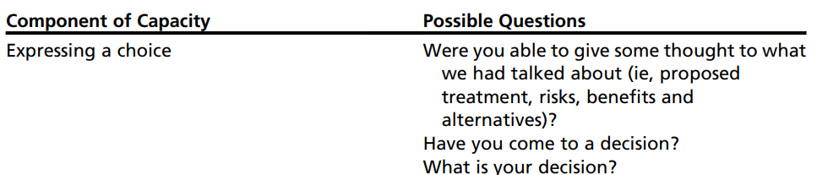
Communicating a choice
Possible questions
  Were you able to give some thought to what we talked about?
  Have you come to a decision?
  What is your decision?
Lim T, Marin DB. The assessment of decisional capacity. Neurol Clin. 2011;29(1):115-126, viii.

Slide 15
Case - JH
JH states he would not want an amputation
States “I’ll be fine – my leg will get better”

Slide 16
Ability to Understand Relevant Information
Has to understand the information that is presented regarding their treatment
Patient can demonstrate by paraphrasing what has been told to them regarding the diagnosis, the recommended treatment, benefits, risks, and alternatives to the treatment
Understanding the information doesn’t mean they can apply the information to themselves
Lim T, Marin DB. The assessment of decisional capacity. Neurol Clin. 2011;29(1):115-126, viii.

Slide 17
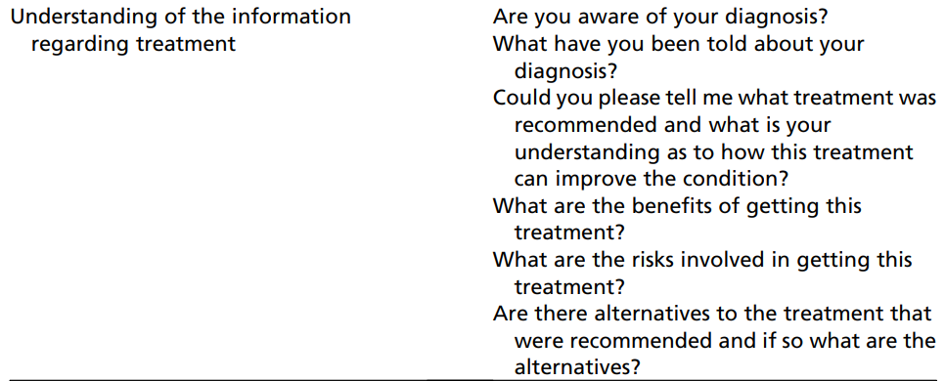
Understand relevant information
Lim T, Marin DB. The assessment of decisional capacity. Neurol Clin. 2011;29(1):115-126, viii.

Slide 18
Case - JH
When asked about his diagnosis, states he has an infected foot
Is able to state that surgery has recommended an amputation
Doesn’t believe there are any benefits to the procedure
States the downsides are “I won’t have my damn leg”

Slide 19
Ability to Appreciate the Nature of the Situation and the Possible Consequences
The patient’s ability to relate the information to his or her circumstance
Includes having insight into and acceptance of the illness
Refusing treatment, however, does not necessarily indicate that a patient doesn’t have capacity
Demonstrate understanding of the consequence of their decision
Lim T, Marin DB. The assessment of decisional capacity. Neurol Clin. 2011;29(1):115-126, viii.

Slide 20
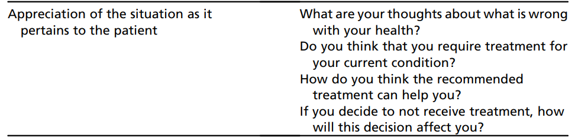
Appreciation of the situation
Lim T, Marin DB. The assessment of decisional capacity. Neurol Clin. 2011;29(1):115-126, viii.

Slide 21
Case - JH
States his leg will get better if he takes antibiotics by mouth for a few more days
Thinks the recommended treatment will just make his life worse since he won’t be able to walk easily
States if he doesn’t get the amputation his leg will recover eventually on it’s own

Slide 22
Ability to Manipulate Information Rationally
This component focuses on the thought process applied by the patient to arrive at their decision
The ability to rationally manipulate information is intricately related to one’s understanding and appreciation of the information
Patients can demonstrate understanding and appreciate consequences, but may not follow a logical thought process to arrive at the decision
Lim T, Marin DB. The assessment of decisional capacity. Neurol Clin. 2011;29(1):115-126, viii.

Slide 23
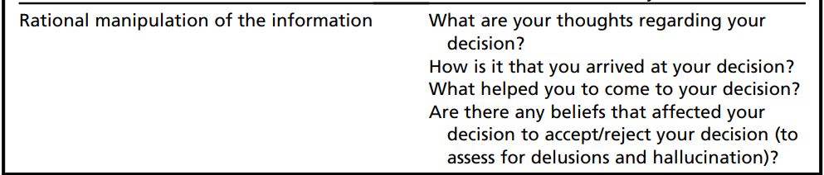
Rational manipulation of information
Lim T, Marin DB. The assessment of decisional capacity. Neurol Clin. 2011;29(1):115-126, viii.

Slide 24
Case - JH
States he has arrived at his decision because “the doctors don’t know what they’re talking about”
It is important to him to be able to walk easily, keep mowing his lawn

Slide 25
Case - JH
Does JH have capacity to make this decision?
Why or why not?

Slide 26
Capacity is decision specific
Capacity is specific to a situation and decision
Can apply the criteria based on how serious the decision is
If something is effective, carries minimal risk, and there are no alternatives – then less “strict” capacity required
Someone can have capacity to answer some questions/scenarios but not others
Lim T, Marin DB. The assessment of decisional capacity. Neurol Clin. 2011;29(1):115-126, viii.
Notes:
Scenario 1: proposed treatment is effective, carries minimal risk, and there are few or no alternatives
May be sufficient for the patient to be “aware of what is going on” and express a choice
Scenario 2: : (a) the proposed treatment carries a greater than minimal risk; (b) the proposed treatment has less definitive benefit; and (c) there are alternatives to the proposed treatment
Patient must also exhibit an understanding of the proposed treatment, the risk, benefits, and alternatives to the treatment

Slide 27
Capacity on a sliding scale
Capacity
Gravity of decision

Slide 28
Case - Margie
78-year-old woman with Lewy Body Dementia
Primary care wants to start a new medication for high blood pressure
Old medication was causing leg swelling so hoping to discontinue
What would you assess?

Slide 29
Case - Margie
1 year later, Margie has a fall at home and breaks her hip
Partial hip replacement surgery is recommended to reduce pain, improve weight bearing and walking, but will require rehab stay
Margie is worried about rehab stay, wants to remain in her home
She keeps forgetting about hip and getting out of bed in hospital and then falling due to pain/instability
What do you think about capacity?
Would you involve surrogate decision maker?

Slide 30
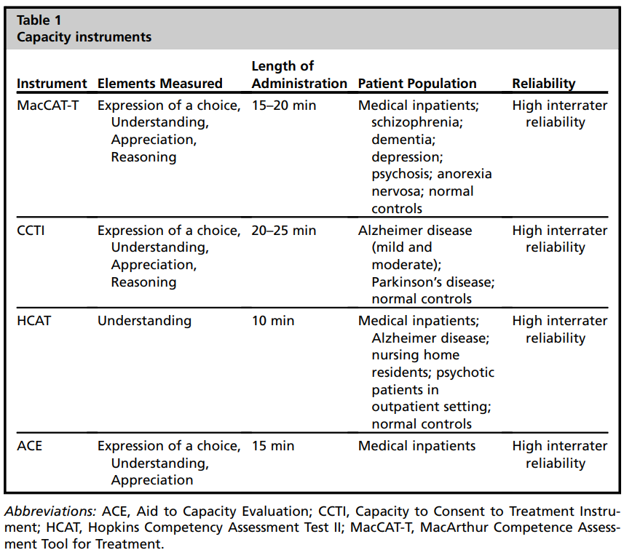
MacArthur Competence Assessment Tool for Treatment
Capacity to Consent to Treatment Instrument
Hopkins Competency Assessment Test II
Aid to Capacity Evaluation

Slide 31
Outline
What is informed consent and why is decision making capacity important?
How to evaluate capacity
Changes to capacity with dementia diagnosis
Surrogate decision maker standards

Slide 32
Impact of dementia on capacity
Dementia – progressive cognitive and functional impairment
Most patients will eventually become unable to make medical, legal, and financial decisions independently
Early stages – decision making capacity retained
  Anticipatory planning crucial for to preserve autonomy over future decisions and reduce future strains on caregivers
Moderate stages - many patients who lack formal decisional capacity
  May still be able to participate meaningfully in decision-making
Chiong W, Tsou AY, Simmons Z, Bonnie RJ, Russell JA, Ethics, Law, and Humanities Committee (a joint committee of the American Academy of Neurology, American Neurological Association, and Child Neurology Society). Ethical considerations in dementia diagnosis and care: aan position statement. Neurology. 2021;97(2):80-89.

Slide 33
Frequency of capacity impairment
Nursing home population (regardless of diagnosis)
  Decisional impairment ranged from 44-69%
One study showed all of their mild-to-moderate AD patients (mean MMSE: 19.4) performed poorly on the “understanding” legal standard
28% to 83% had adequate decisional abilities on the other relevant legal standards of “appreciation,” “reasoning,” or “choice.”
Kim SYH, Karlawish JHT, Caine ED. Current state of research on decision-making competence of cognitively impaired elderly persons. Am J Geriatr Psychiatry. 2002;10(2):151-165.

Slide 34
Cognitive fluctuations
Cognition can fluctuate in dementia – good days and bad days
More common in Dementia with Lewy Body
Try to avoid “bad days”, times of day that are worse for confusion
Trachsel M, Hermann H, Biller-Andorno N. Cognitive fluctuations as a challenge for the assessment of decision-making capacity in patients with dementia. Am J Alzheimers Dis Other Demen. 2015;30(4):360-363.

Slide 35
Implications for dementia care
Don’t assume lack of decision-making capacity – may be preserved in mild to moderate dementia
Maximize autonomy by allowing decisions on less difficult decisions
Involve surrogates for more challenging decisions
Cognitive testing (MMSE) can provide an approximate cutoff but isn’t the same as capacity assessment

Slide 36
Outline
What is informed consent and why is decision making capacity important?
How to evaluate capacity
Changes to capacity with dementia diagnosis
Surrogate decision maker standards

Slide 37
Surrogate decision makers
Early identification of a surrogate-decision maker is important for patients with cognitive impairment who still have capacity
If a patient lacks the capacity to appoint someone a lengthy legal process of appointing a guardianship and/or conservatorship may be necessary
If available, patient’s nuclear family serves as a surrogate decision-maker

Slide 38
Hierarchy of surrogate decision making
Known wishes
- Via informal conversations or advance directive)
Substituted judgement
- Based on previously held values and preferences
Best interest approach
- What surrogate thinks is best
If no known wishes, then
If values and preferences are unknown
Notes:
A key central assumption in applying known wishes or a substituted judgment surrogate decision for a person with dementia is the presumption that these wishes, values, and preferences are stable over time and still relevant to the decision at hand

Slide 39
Summary
Informed consent requires decision-making capacity
Capacity assessment involves communicating choice, understanding, appreciation, and manipulation of information
Capacity is specific to a decision
Capacity is impaired in dementia but may still be preserved in earlier stages

Slide 40

Visit: IndianCountryECHO.org
Adi Shafir, MD
Assistant Professor, Palliative Care and Geriatrics
OHSU, Portland, OR
shafira@ohsu.edu
Notes:
Please visit our website to sign-up to join one of our many ECHO sessions. Thank you!

